Slide 1
Introduction to Muon Collider Concept and US Efforts
Sergo Jindariani (Fermilab)
Muon-Ion Collider Workshop
December 2023
With material from the US Muon Collider R&D Coordination Group
IMCC, MAP, Muon Collider Forum, etc

Slide 2
A bit of history
1960s: First mention of Muon Colliders in the literature
1990s-2010: Design studies through US institutional collaborations
2011-2016: Muon Accelerator Program was approved by DOE
  Focused on a proton-driver solution; studied 125 GeV and 1.5, 3 and 6 TeV colliders
2021: Muon Colliders become part of the EU Accel. R&D Roadmap
    International Muon Collider Collaboration (IMCC) formed, CERN host for now
2022: US Snowmass study reveal strong interest on Muon Colliders
  Muon Collider Forum Report: a vision from the US perspective
  Supported the National Collider R&D Initiative
March 2023: Formation of the US Muon Collider R&D coordination group
  Provide input to the P5 panel on US-based Muon Collider research
December 2023: P5 Report released, with strong support for Muon Collider R&D

Slide 3
Colliding Muons
More in Karri’s talk
Muons are much heavier than electrons → no synchrotron radiation issues, can accelerate to high energies
Muons are elementary particles – the whole energy is available for probing new physics
Unlike for proton collisions, there is no QCD background
Muons are difficult to produce
Muons decay (in 2 microseconds at rest!)
  All beam manipulations must be done fast
  Particles from muon decays deposit significant energy in the accelerator components and physics detectors
  Neutrino induced radiation effects need to be mitigated

Slide 4
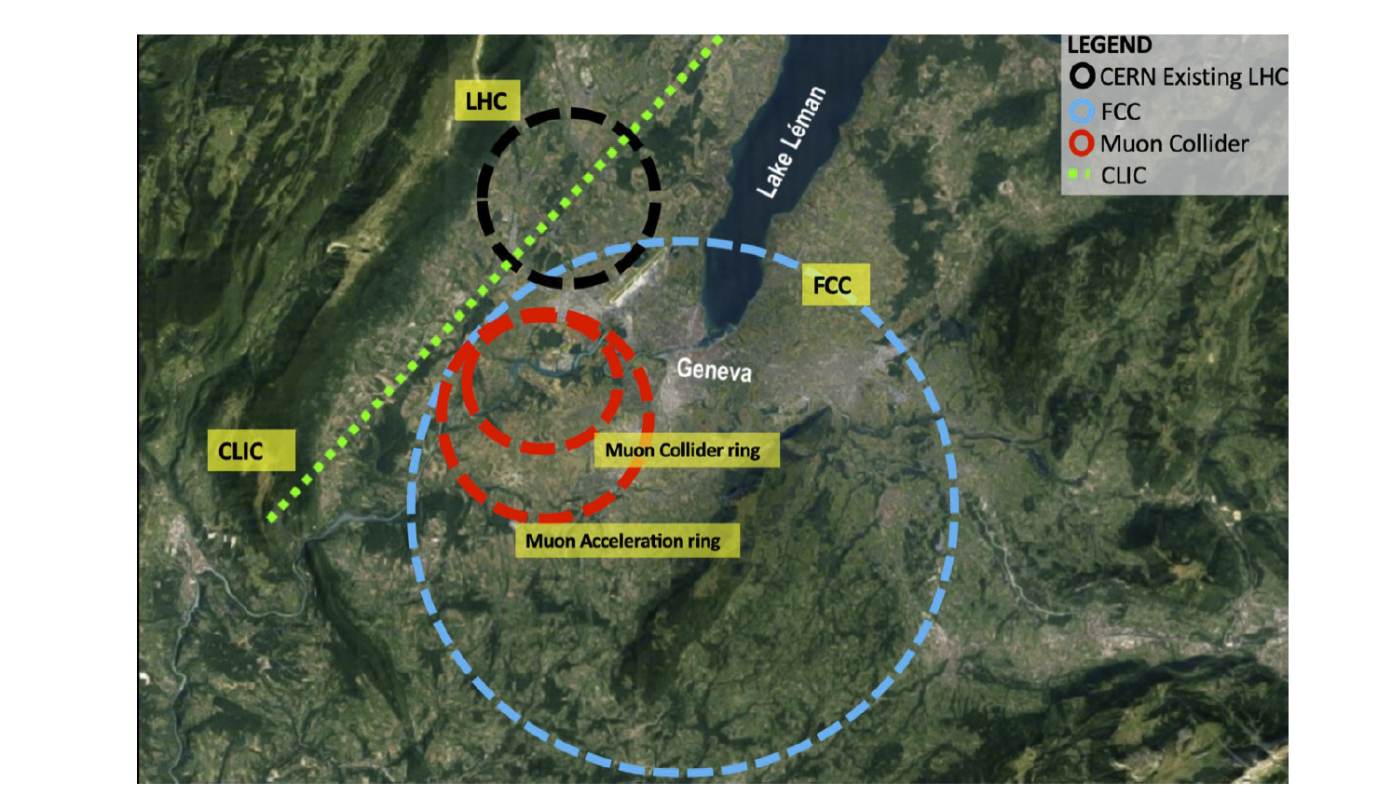
Compactness
D.Schulte et al
A Muon Collider is a precision probe of fundamental interactions, in a smaller footprint as compared to electron or proton colliders

Slide 5
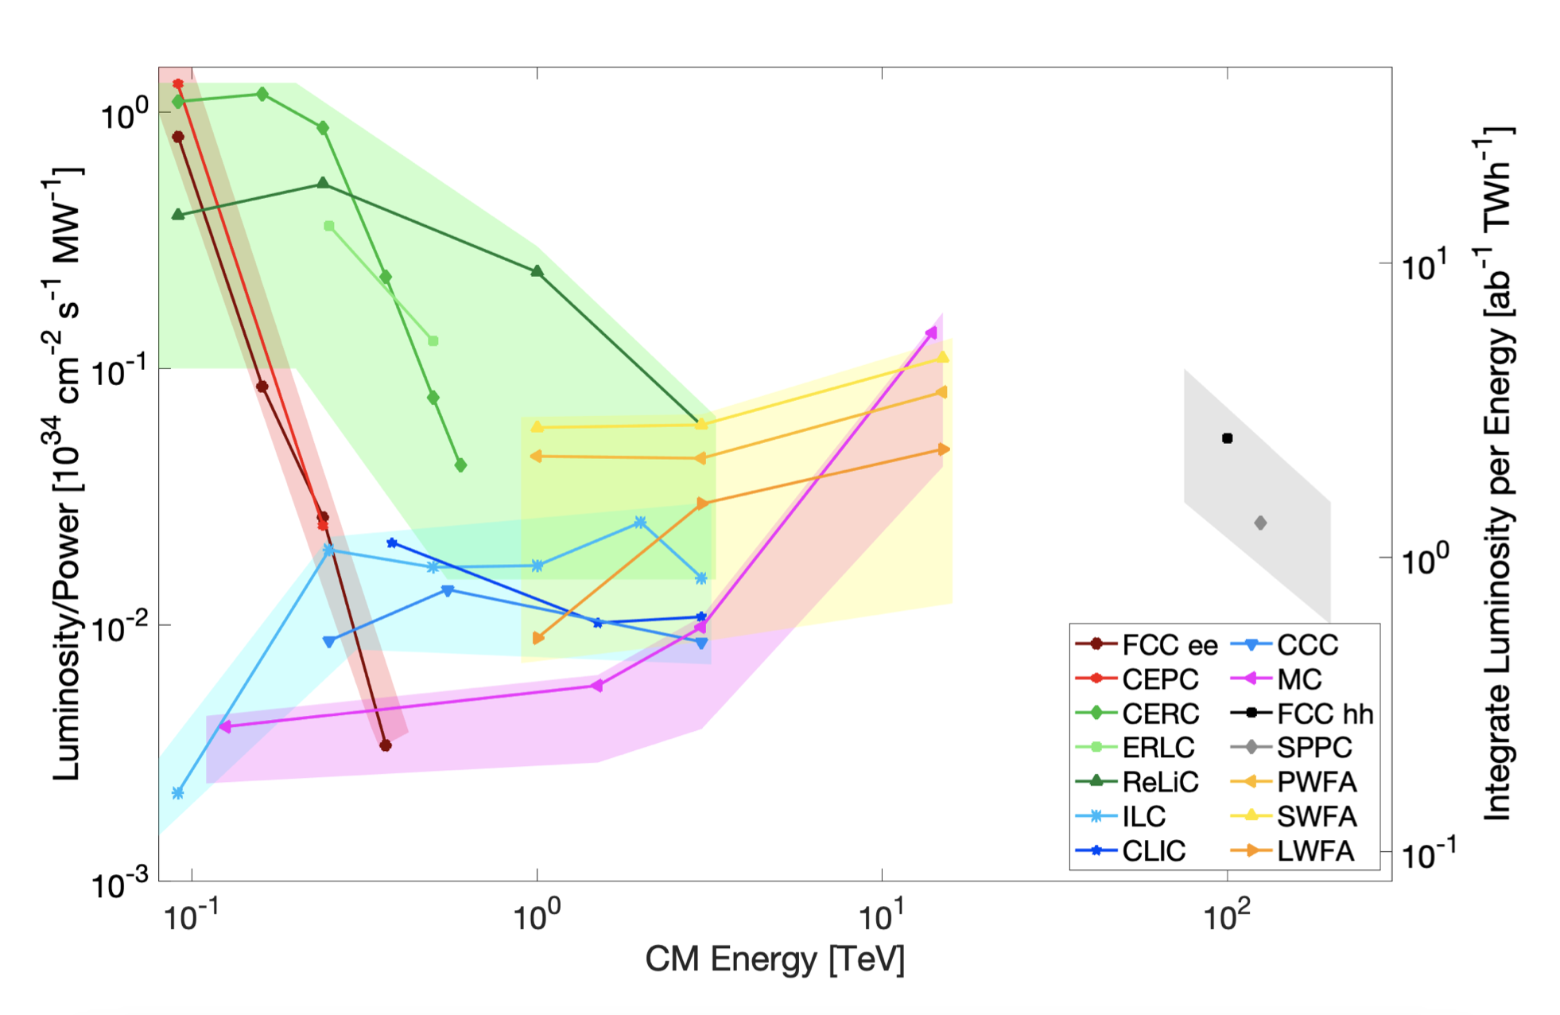
Energy Efficiency
More details: Snowmass’21 ITF report

Slide 6
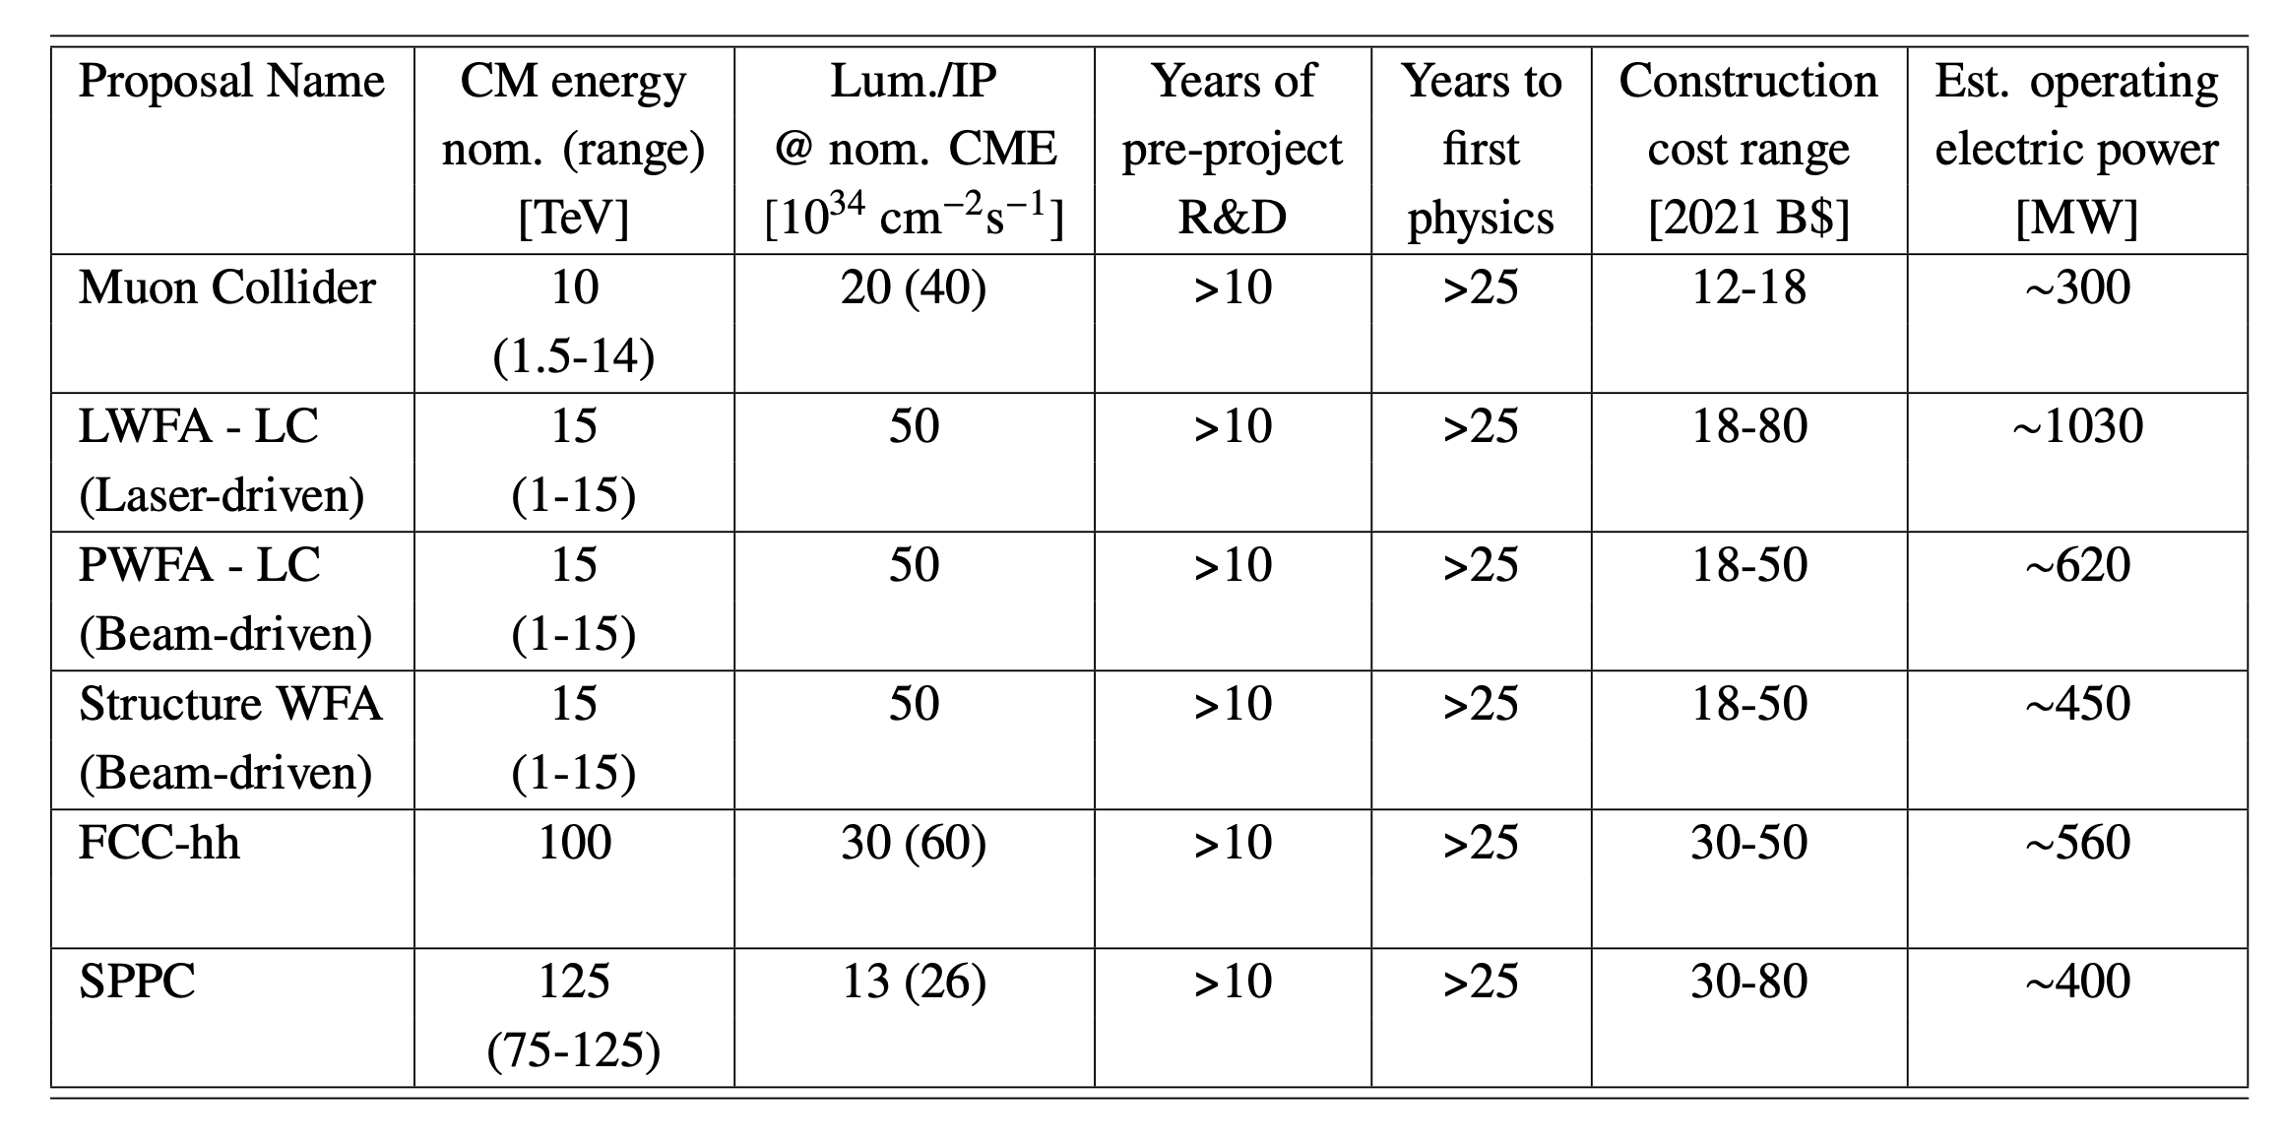
Cost: ~10 TeV pCM scale
More details: Snowmass’21 ITF report

Slide 7
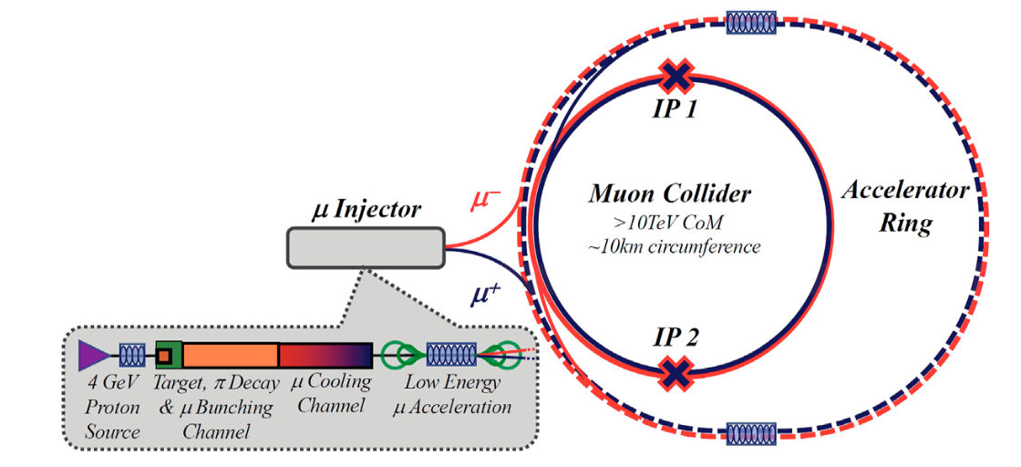
The Machine Concept
The goal is to get to 10 TeV center-of-mass energy
Staging at 3 TeV is the current baseline (other options possible)
Staging in luminosity instead of energy is also possible
Only two bunches circulating at a time
Proton Driver based muon collider

Slide 8
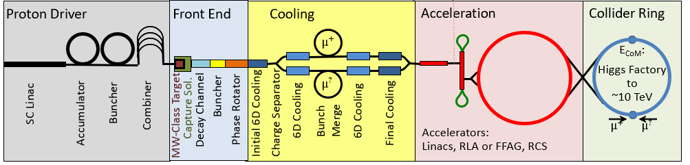
The Machine Stages
Muon production target
Ionization cooling to reduce 6D emittance
Collider ring for counter propagating muons
MW-scale proton driver
Capture 200 MeV bunches
Acceleration to TeV scale energy

Slide 9
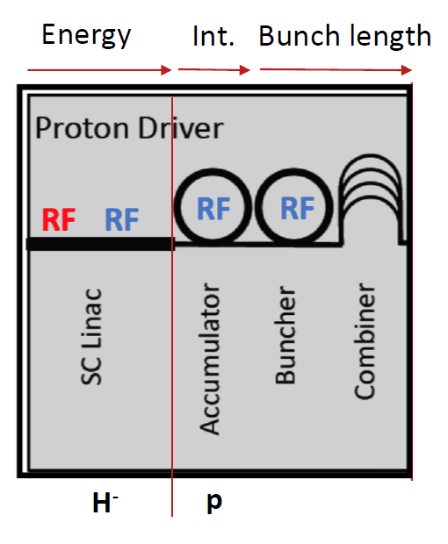
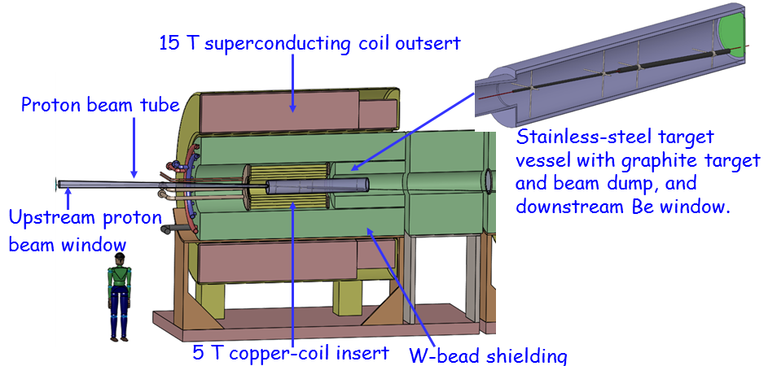
Proton Driver and Target Requirements
More in Katsuya’s talk
  Target materials that produce high muon yield & are tolerant to MW beams
  Strong solenoidal magnet (15-20T) to maximize capture, with large aperture (2+ m) to allow shielding
Best performance: 1-4 MW proton beam @ 5-20 GeV, compressed to 1-3 ns bunches at a 5-10 Hz frequency

Slide 10
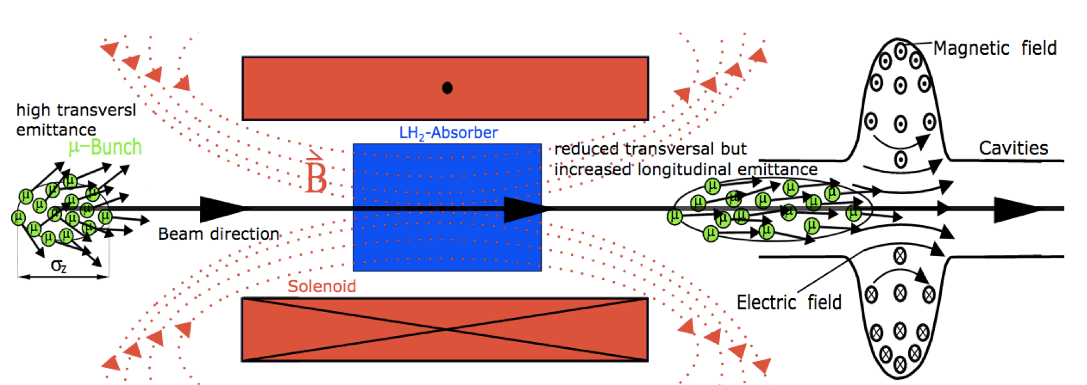
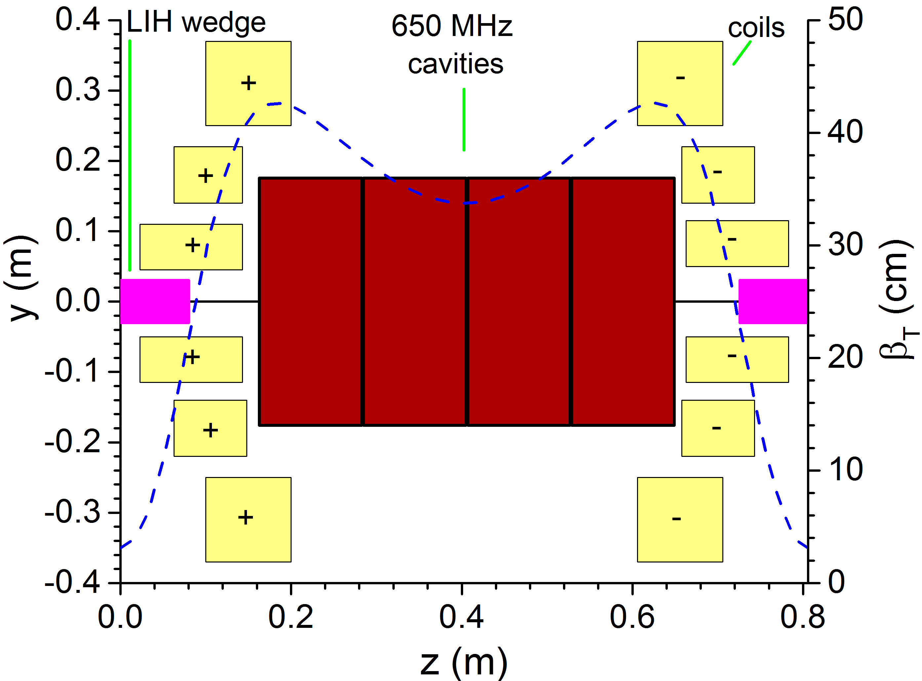
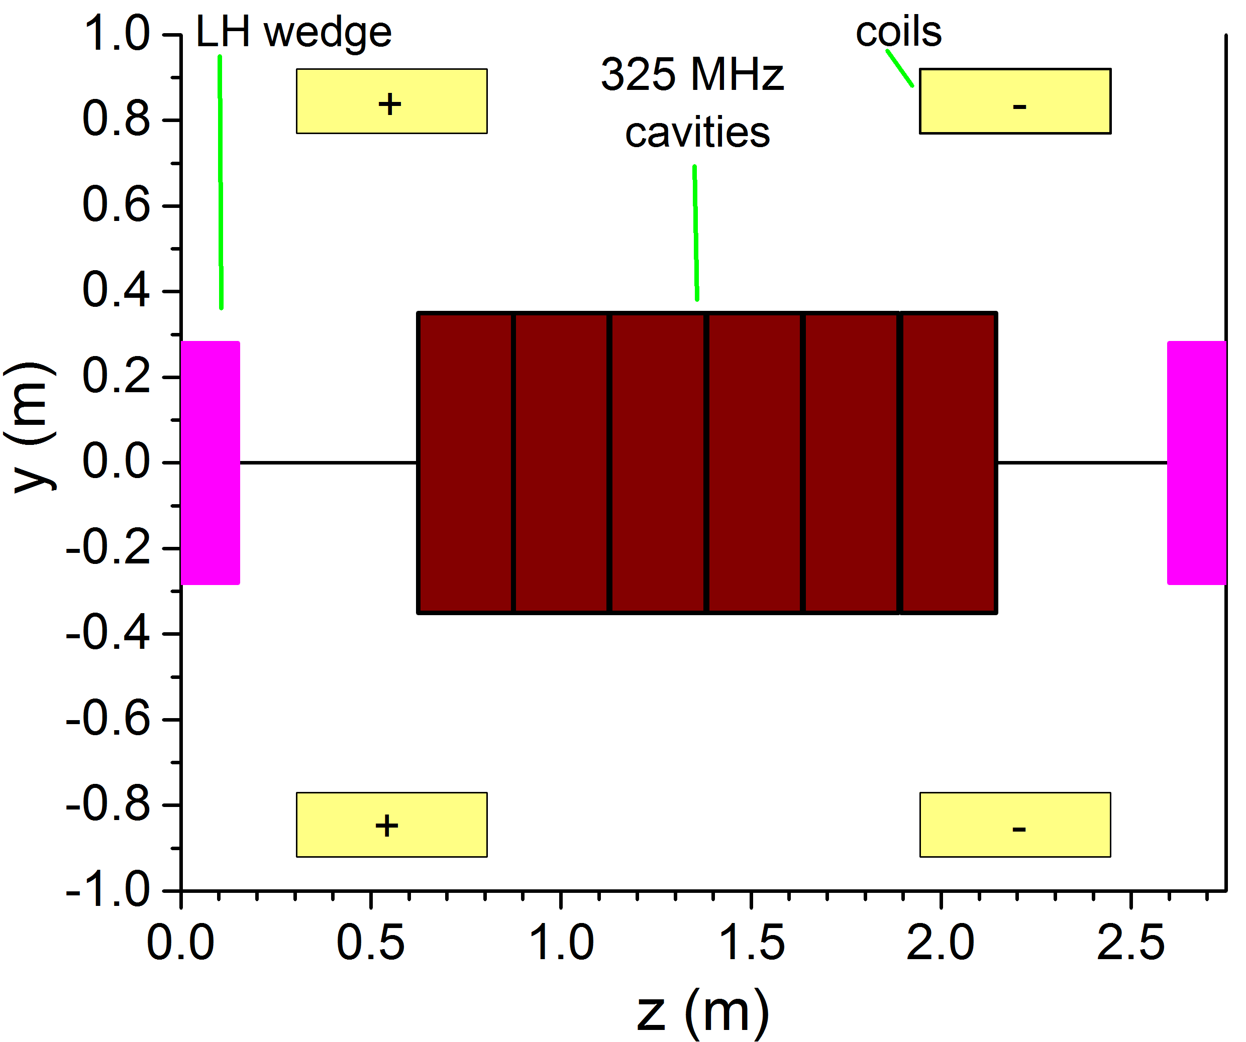
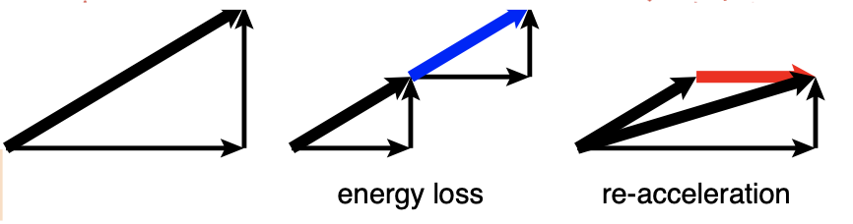
Ionization Cooling
More in Katsuya’s talk
Early cell (“easy”) – 2T peak
Late cell ( “hard”) – 14 T peak
  Large bore solenoidal magnets: From 2 T (500 mm IR), to 20+ T (50 mm IR)
  Normal conducting rf that can provide high-gradients within a multi-T fields
  Absorbers that can tolerate large muon intensities
  Integration: Solenoids coupled to each other, near high power rf & absorbers

Slide 11
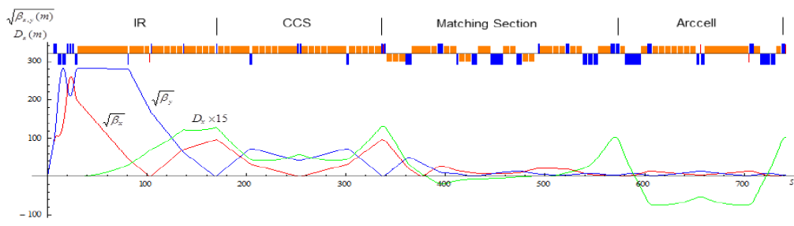

Accelerator and Collider Rings
More in Diktys’s talk
IR region (high-B quads)
bend region (high-B dipoles)
DC field
Pulsed from ${−B}_{w}$ to ${+B}_{w}$
  Dipoles with strong field (12-16 T for 10 TeV) and large aperture (~150 mm) to allow for shielding
  Quadrupoles with strong fields for the IR (15-20 T for 10 TeV)
  Mitigation system for the neutrino flux from muon decays
  Rapid Cycling Synchrotron accelerators
  Fast ramping magnets (<0.5 ms) accompanied with 8-10 T DC magnet
  Energy sources with good power management for pulsed magnets

Slide 12
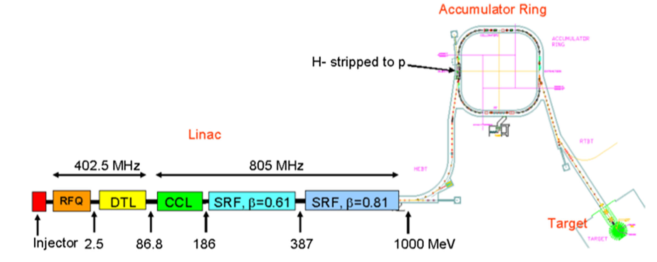
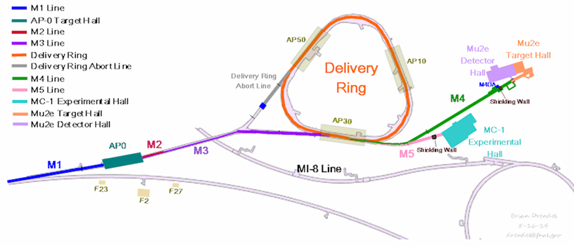
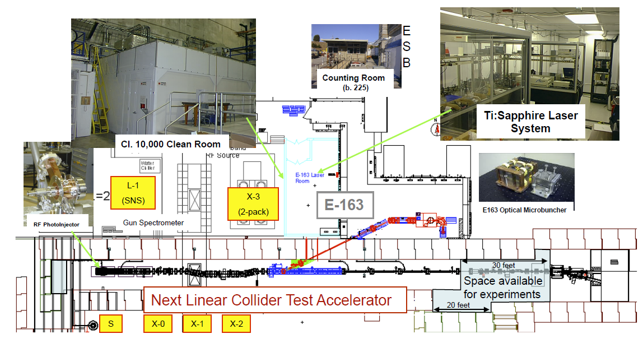
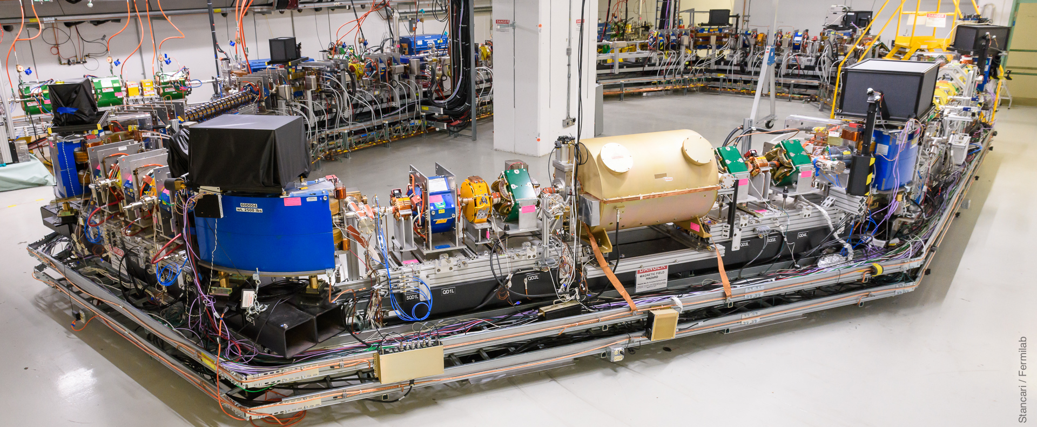
Possibilities within the US
More in Diktys’s talk
Several existing US based facilities can aid the MuC R&D program: they expressed interest and are currently explored
Muon Campus @ Fermilab
SNS linac @ Oak Ridge
Cooling demo
Proton driver tests
NLCTA @ SLAC
FAST/ IOTA @ Fermilab
Proton driver tests
NC rf tests

Slide 13
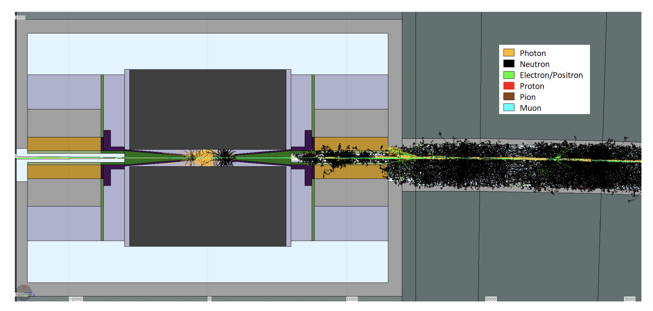
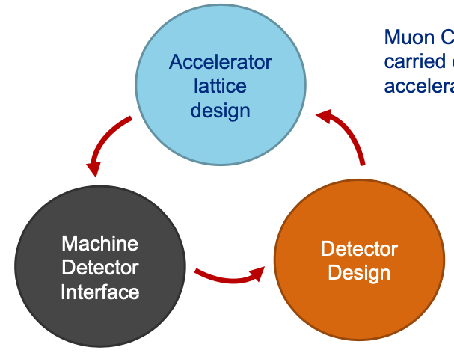
Beam Induced Background
More in Donatella’s talk
Beam background is one of the unique features/challenges of Muon Colliders
Main Source of Beam Induced Background (BIB) are showers produced by electrons originating in beam muon decays
The challenge is to separate collision particles from the BIB
Detector environment and occupancy can be harsh

Slide 14
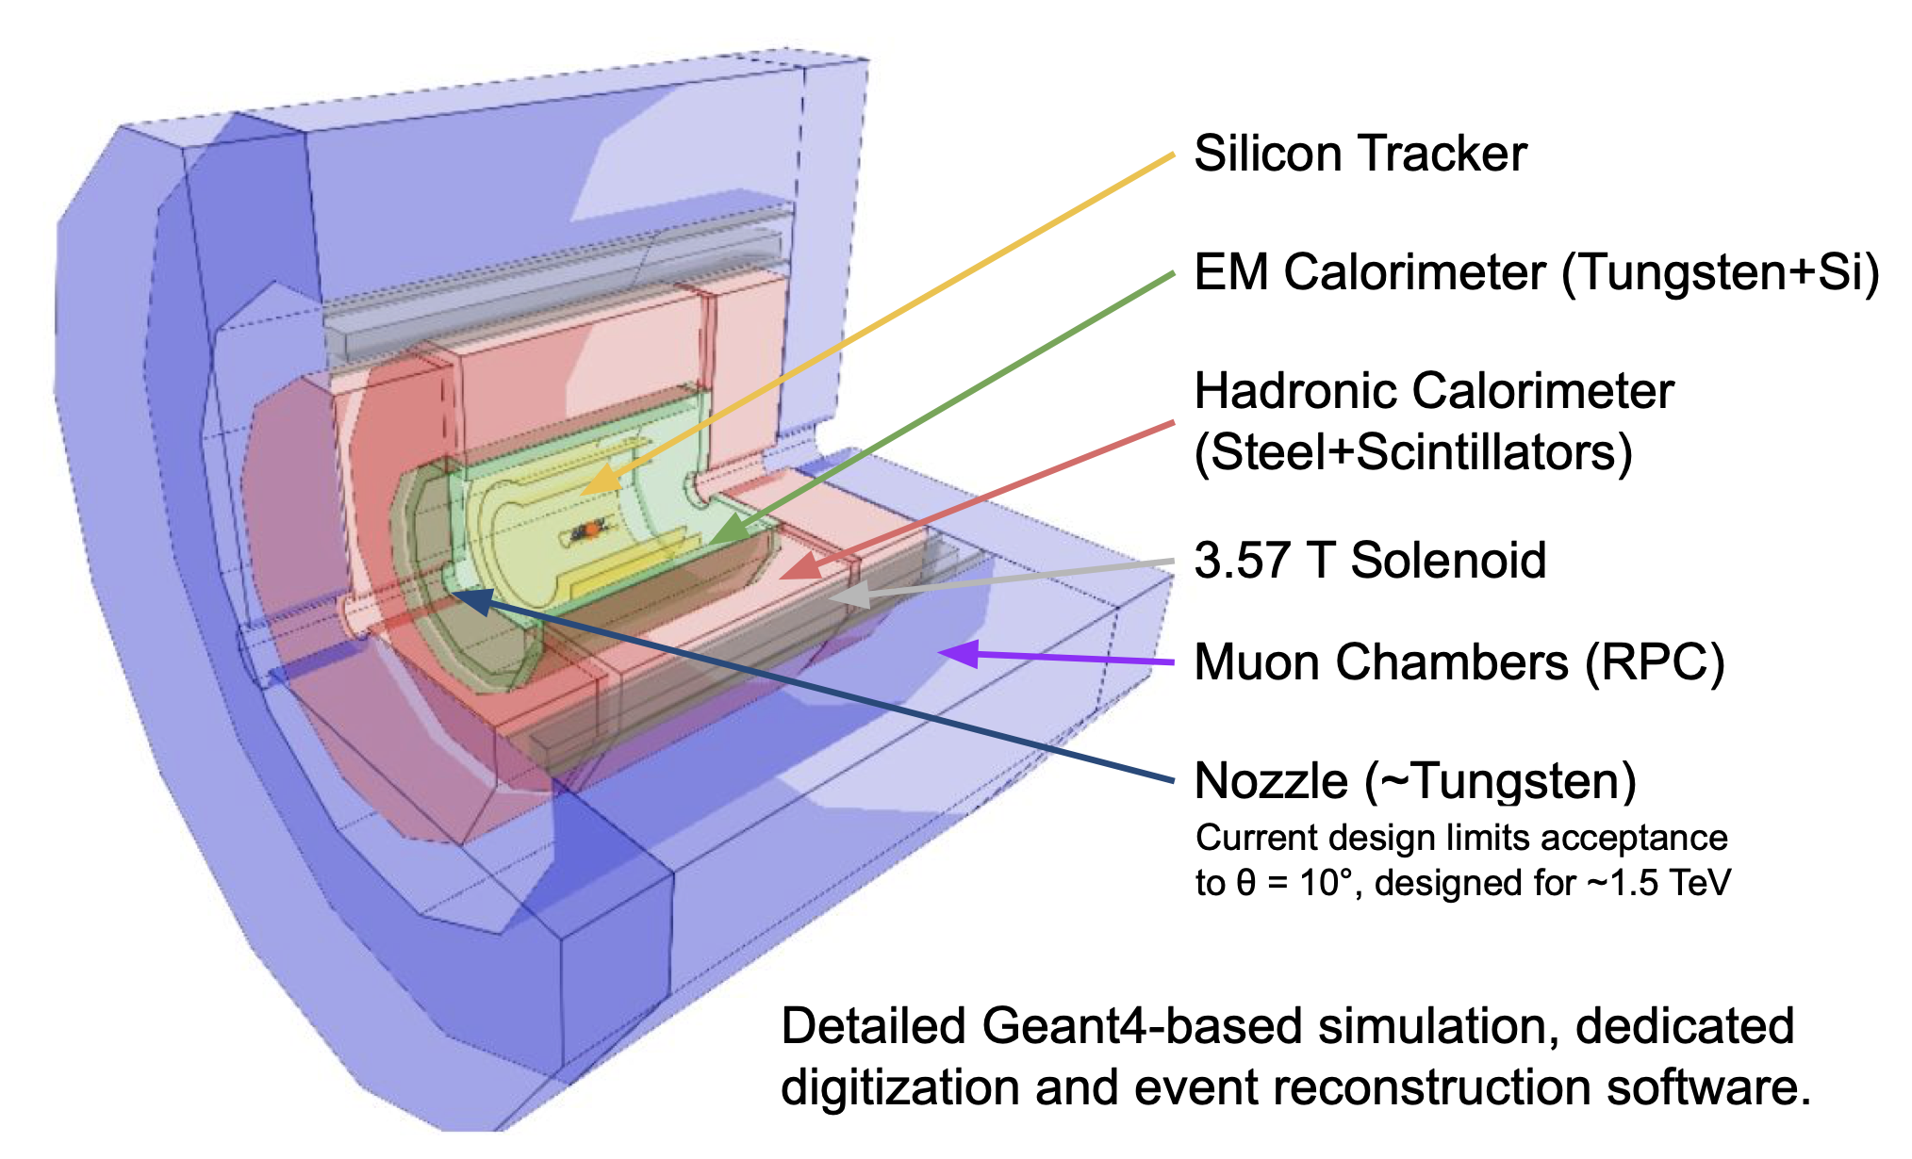
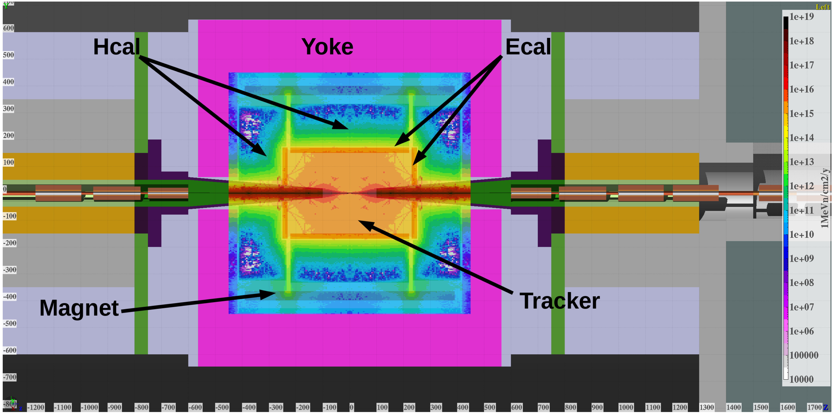
3 TeV Detector Concept
More in Donatella’s talk
antimuon
muon

Slide 15
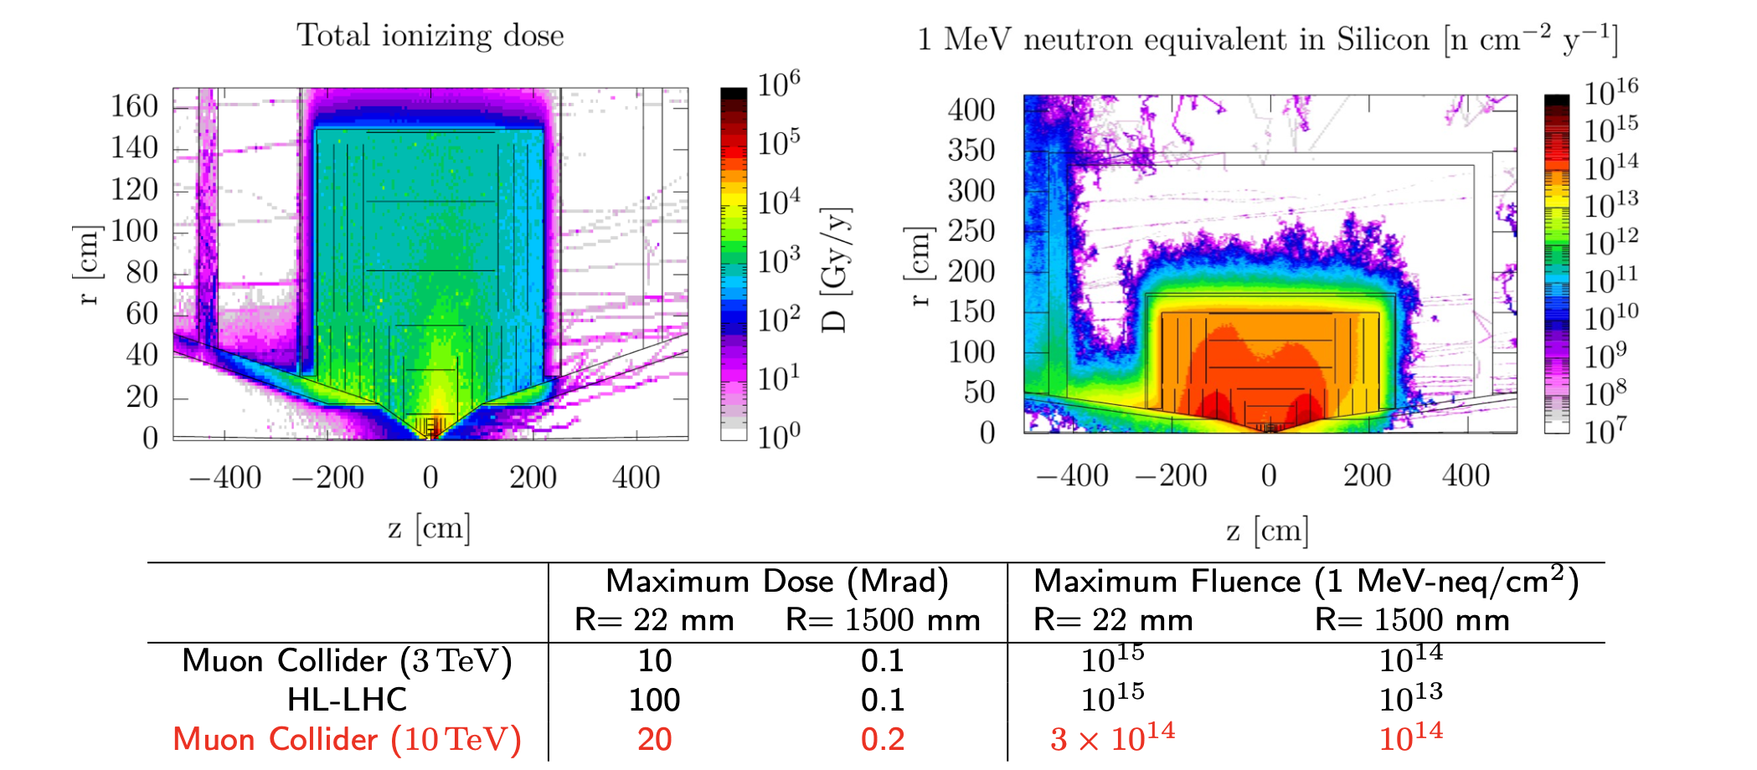
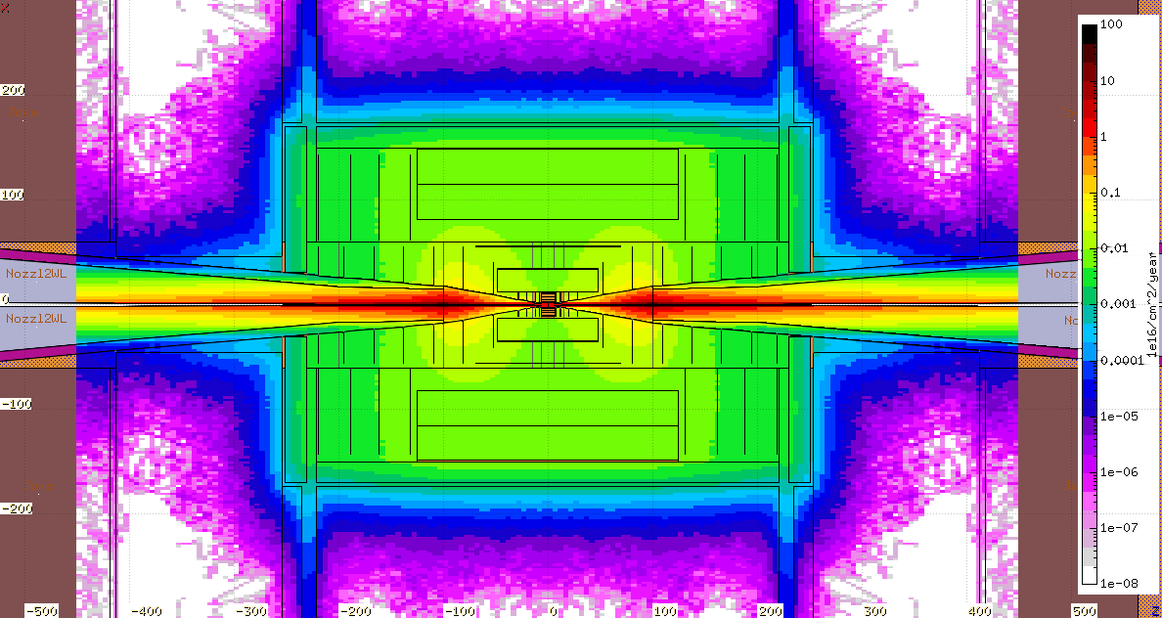
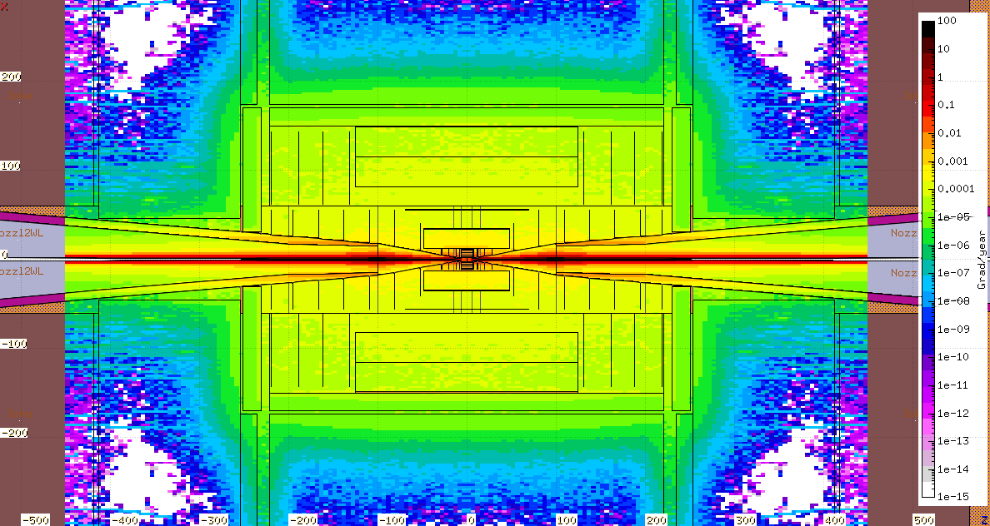
Radiation Environment
Total Ionizing Dose for one year of operation (200 days)
1-MeV-neq fluence for one year of operation (200 days)

Slide 16
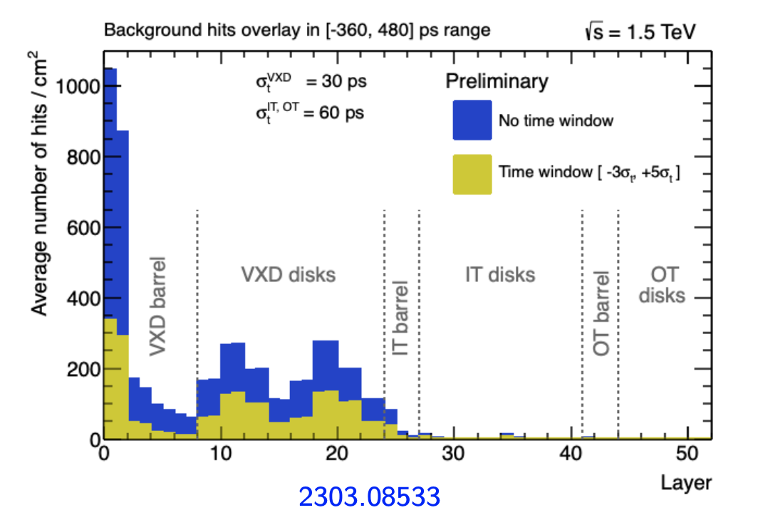
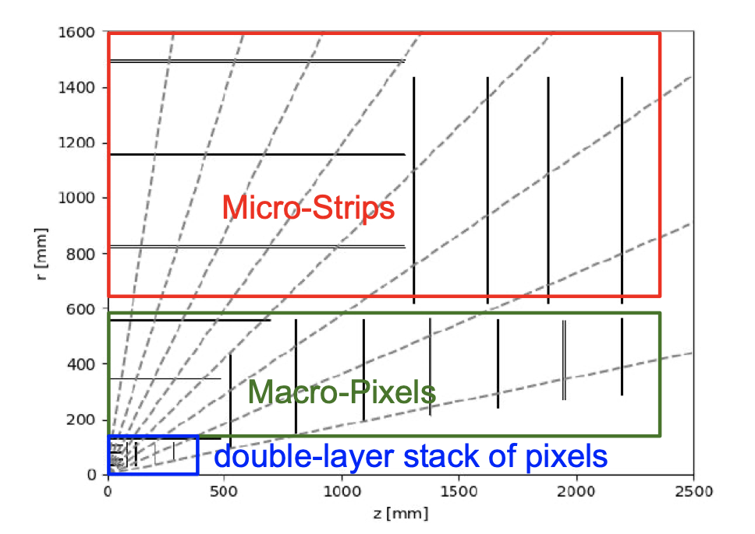
Tracking Detectors
Large occupancy in the inner layers of the vertex detector
Hits partially out-of-time with respect to the bunch crossing
Not pointing to the interaction region
Potential technologies: hybrid pixels, LGADs, MAPs

Slide 17
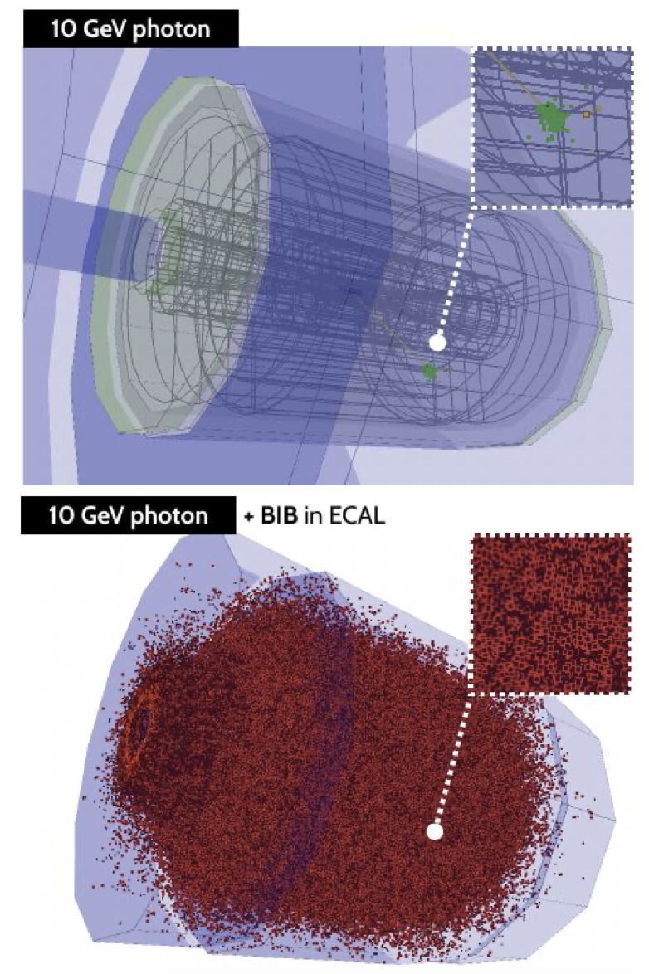
Calorimeters
Mostly low-E photons and neutrons
300 particles/cm² and <E> ~ 1 MeV/photon
Severe for the front of the EM calorimeter but steeply falling going deeper
Timing and depth segmentation help a lot!
Current baseline – SiW,
strong interest in studying crystal based finely- segmented calorimeters ( with and w/o DRO)

Slide 18
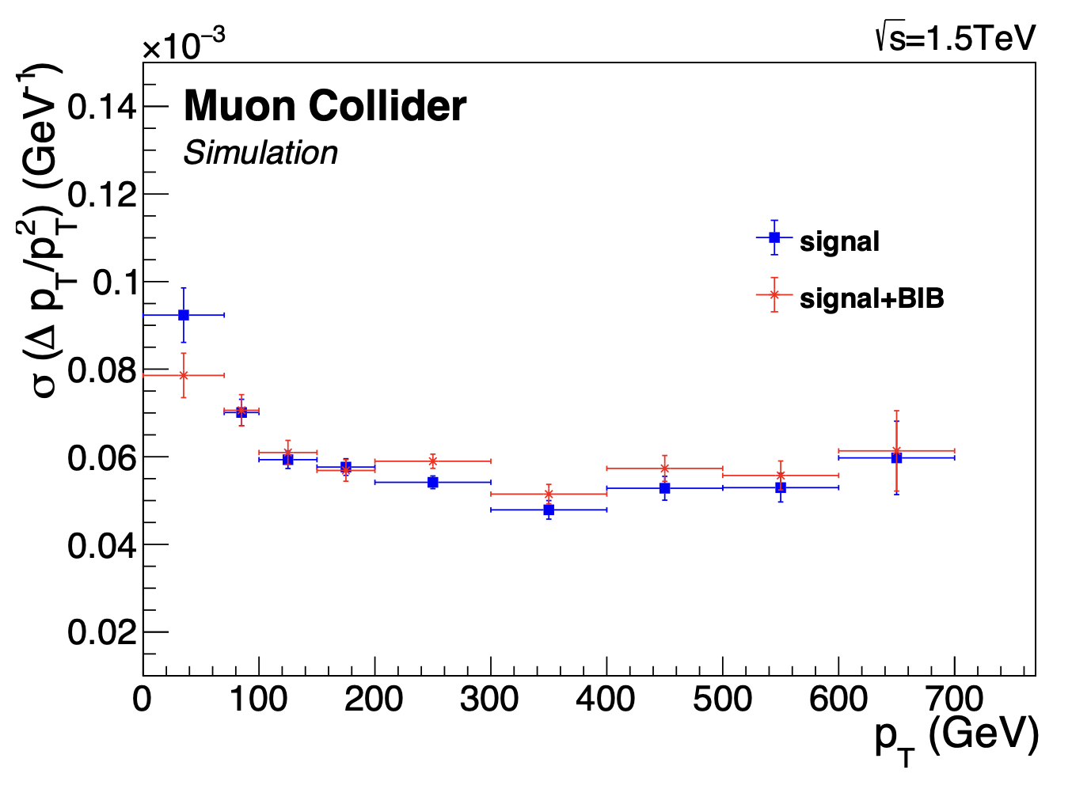
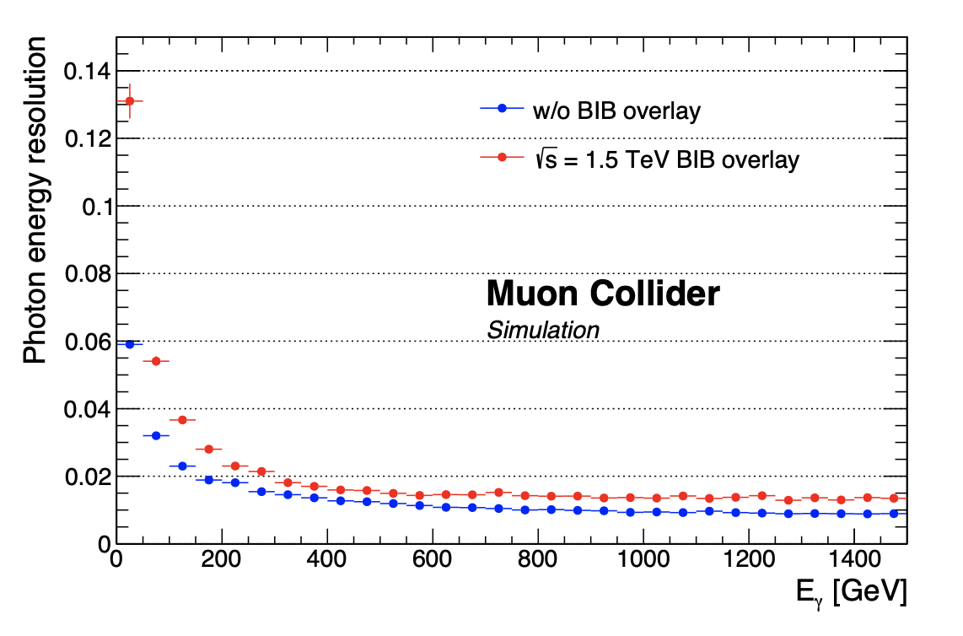
Performance in Simulation
Track relative momentum resolution
BIB effects are small
Few % Electron/Photon Energy Resolution

Slide 19
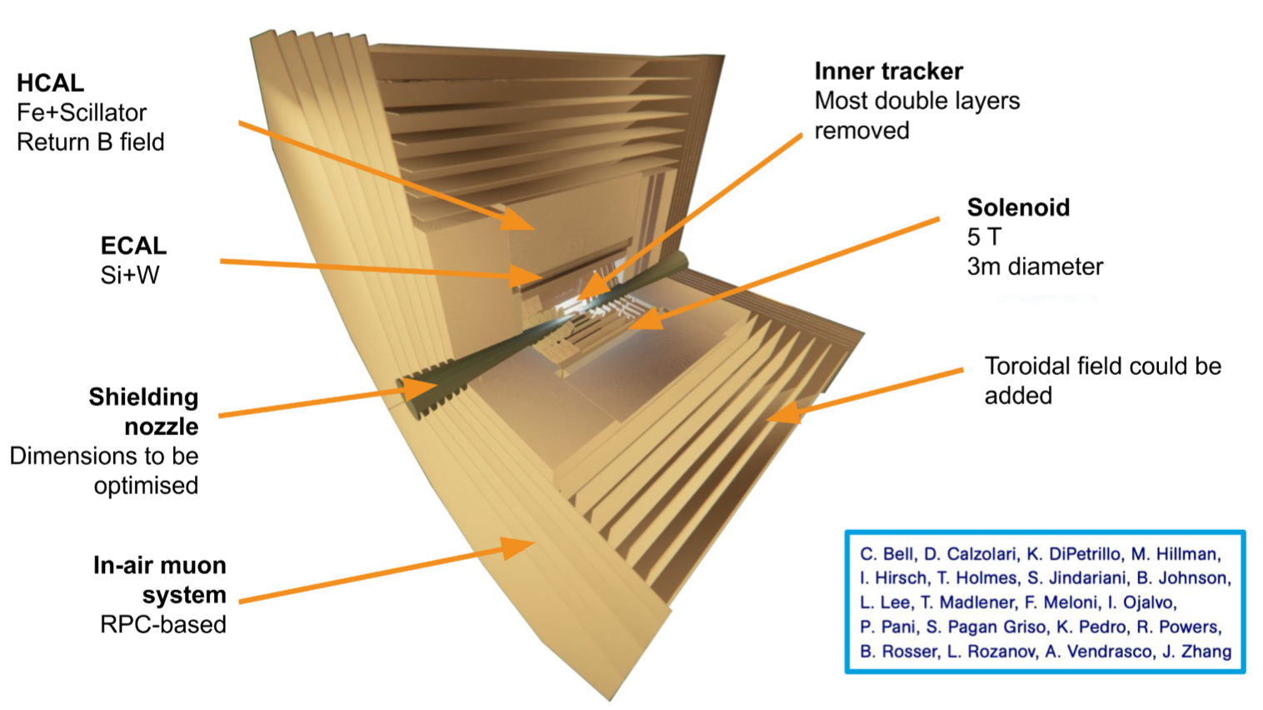
Steps towards 10 TeV
Preliminary results look promising (see CPAD’2023)
Removed most double layers
Increased solenoidal field to 5T
Moved calorimeters outside of the magnet
Increased calorimeter depth

Slide 20
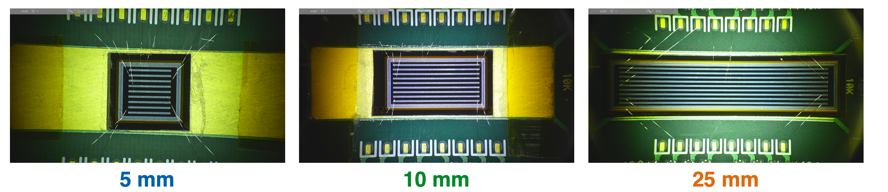
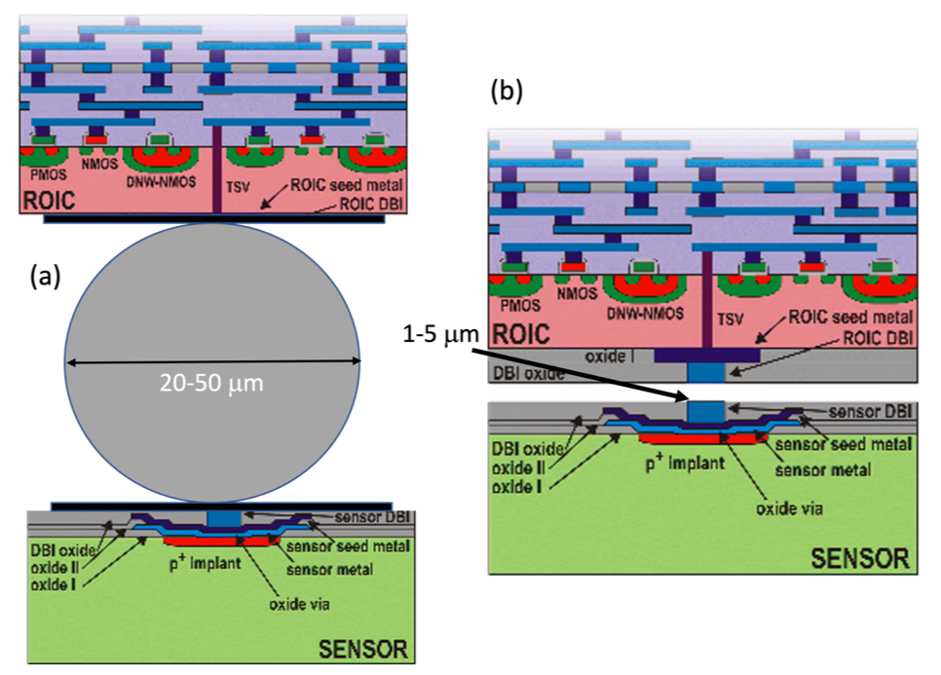
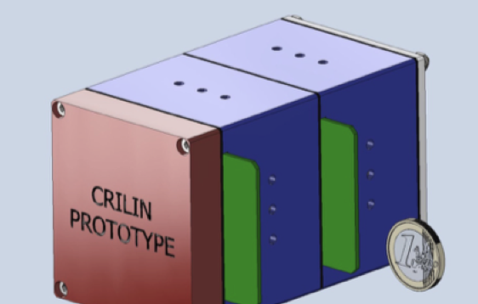
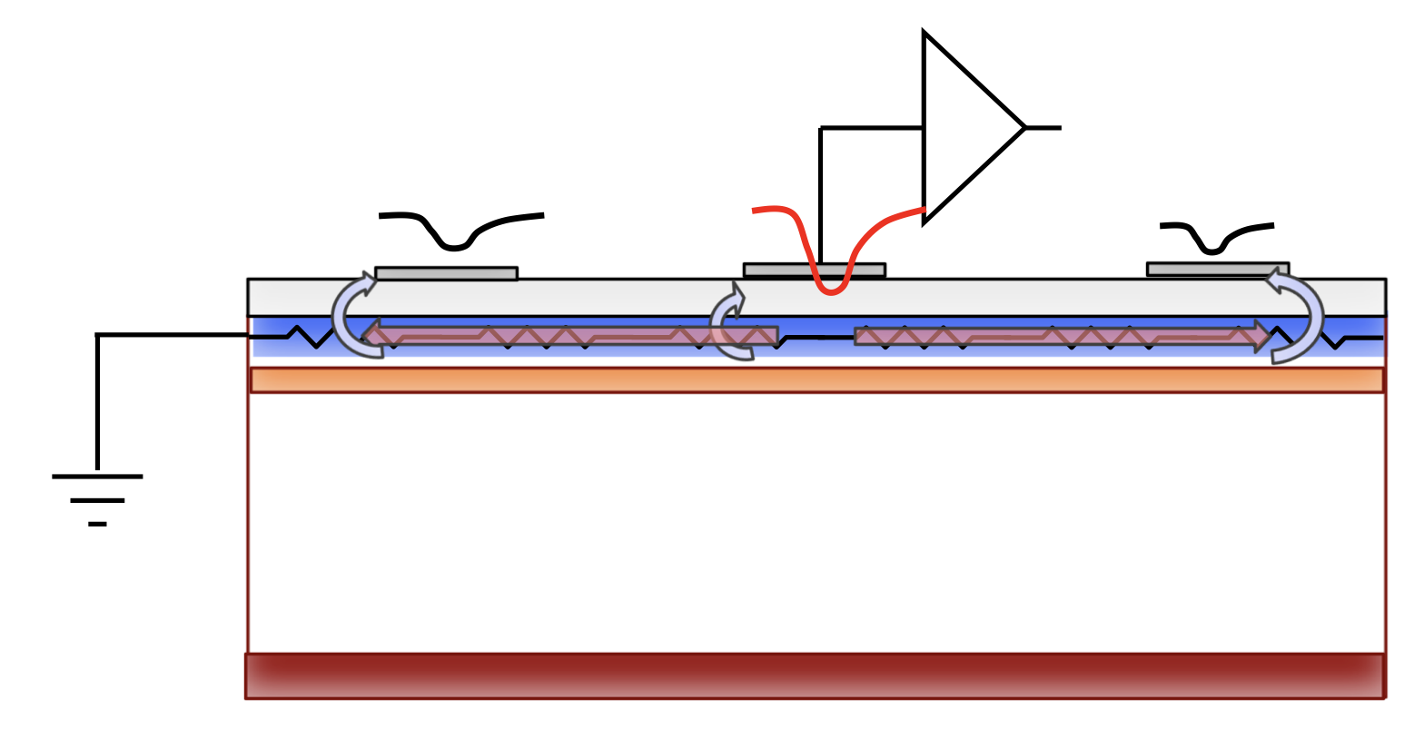
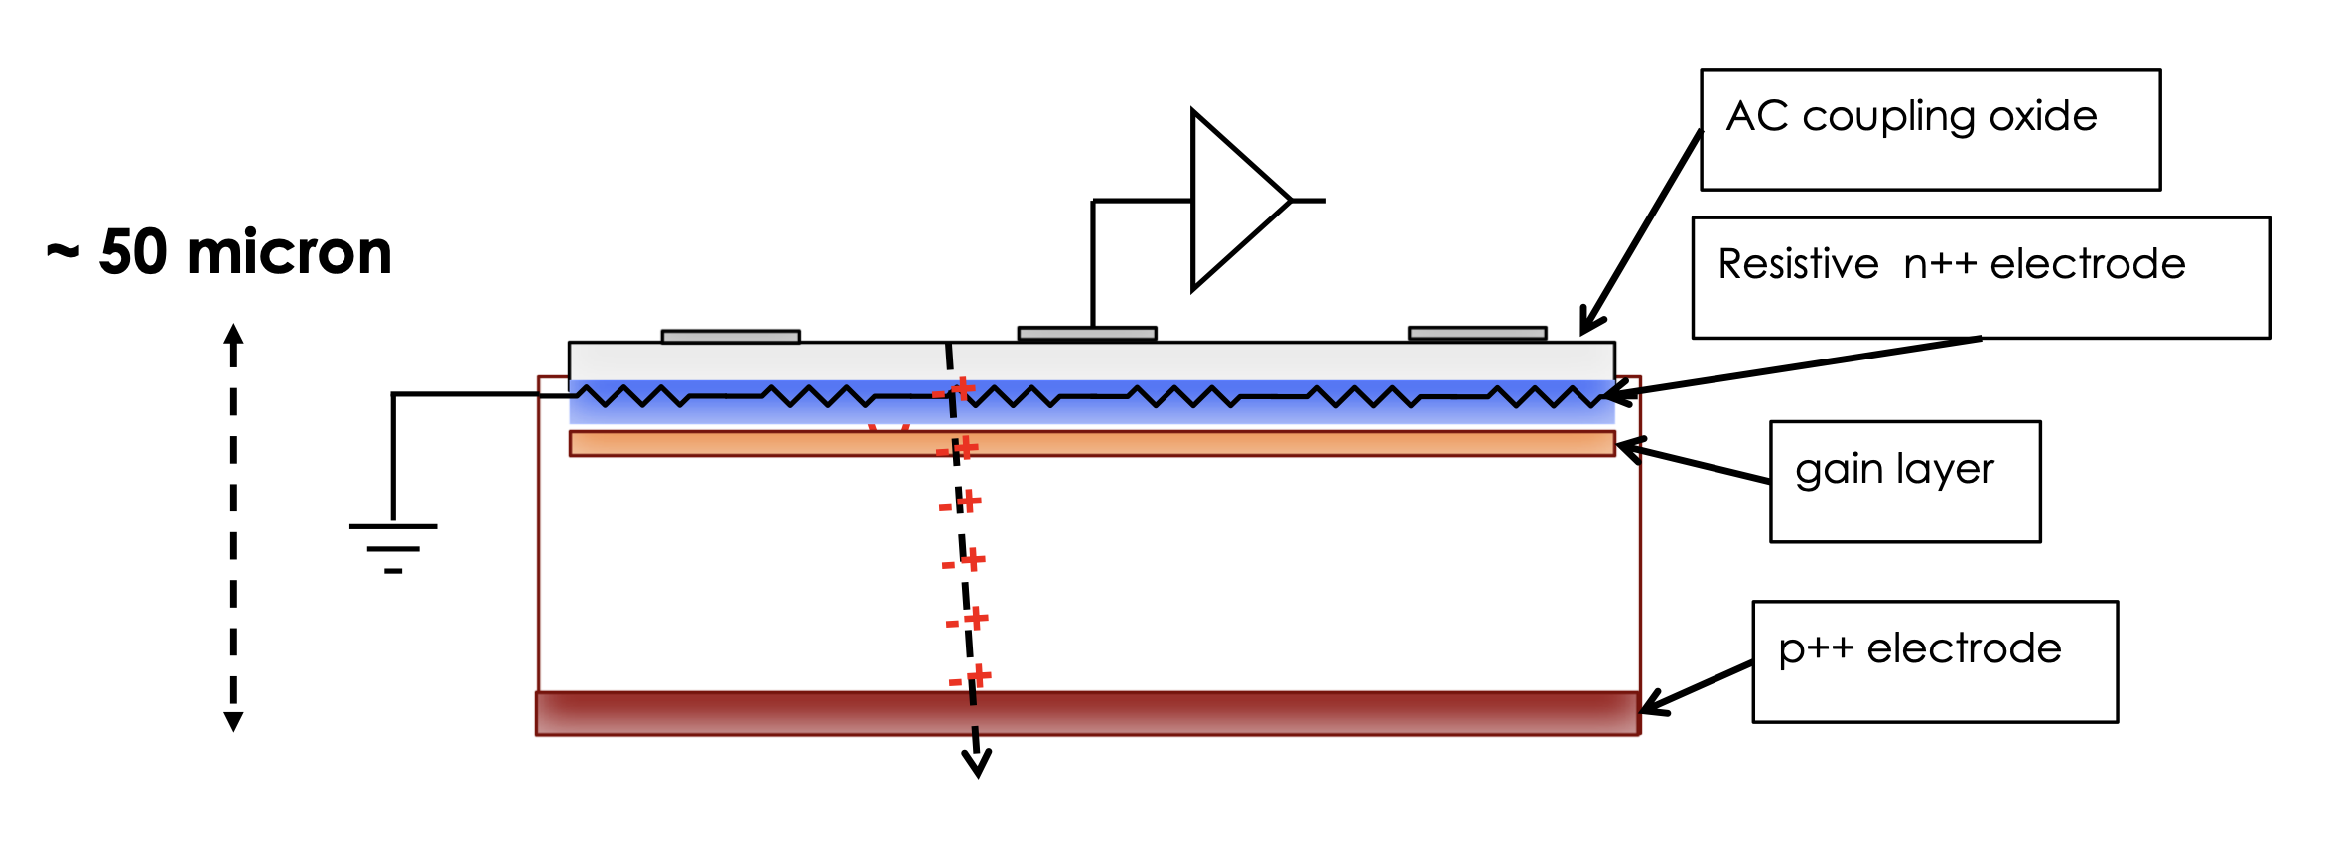
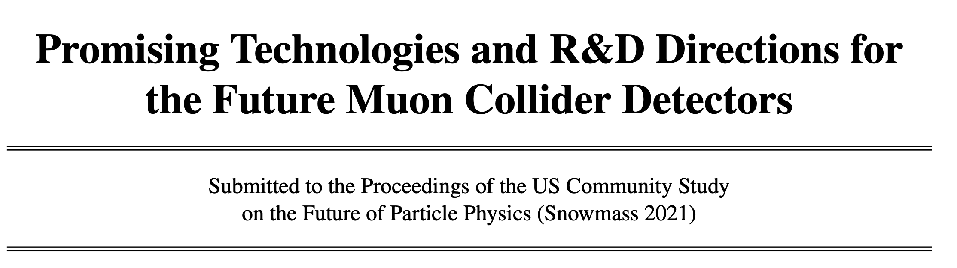
R&D Activities in US and Europe:
4D Trackers:
  Design, Sensors, Data Transmission, Power, Mechanics
  3D Integration, ASIC, Intelligent Sensors/Modules
Calorimeters:
  Different technologies, design, reconstruction (with AI/ML)
  Integration of precision timing
Muons:
  Qualification of new gases, fast timing,…
TDAQ:
  Architecture studies
  Real-time reconstruction, novel readout technologies
MDI+Forward:
  MDI Design, Forward Muon Tagger
  Luminosity Monitor
Detector magnet!
arXiv: 2203.07224
Significant synergies with HL-LHC and EIC, e+e-, and pp detectors

Slide 21
Software and Simulations
Realistic simulation of the BIB is crucial for quantifying the detector performance
Complex event features due to beam-induced background
The design, optimization, performance estimation and physics case of a muon collider are expected to require moderate dedicated computational resources.
  Core software frameworks and analysis tools. Focus on multi-threading; synergies with other future accelerators projects and HL-LHC
  BIB and shielding simulations (FLUKA, MARS, GEANT) are CPU/disk-intensive. Need accuracy and efficiency. Ideal case for in-development GPU simulation engines
  Detector layout design and technology evaluation require iterations.
  Digitization and reconstruction algorithms require detailed studies and production of large samples for realistic physics projections. Balance full/fast simulations.

Slide 22
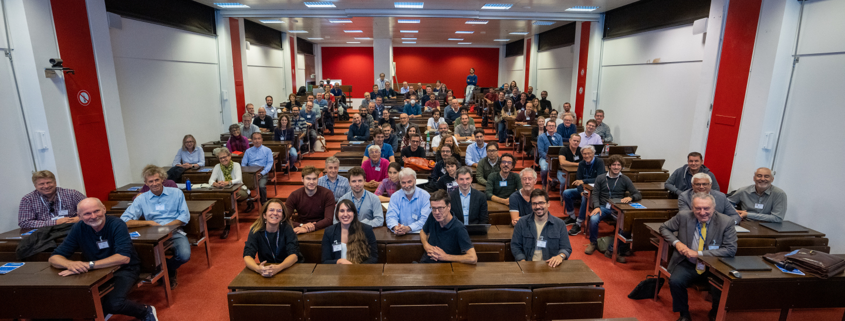
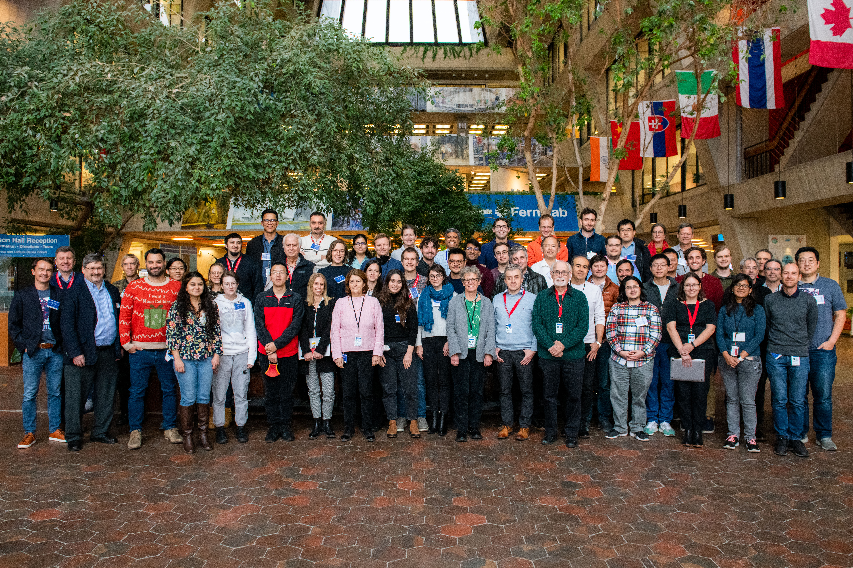
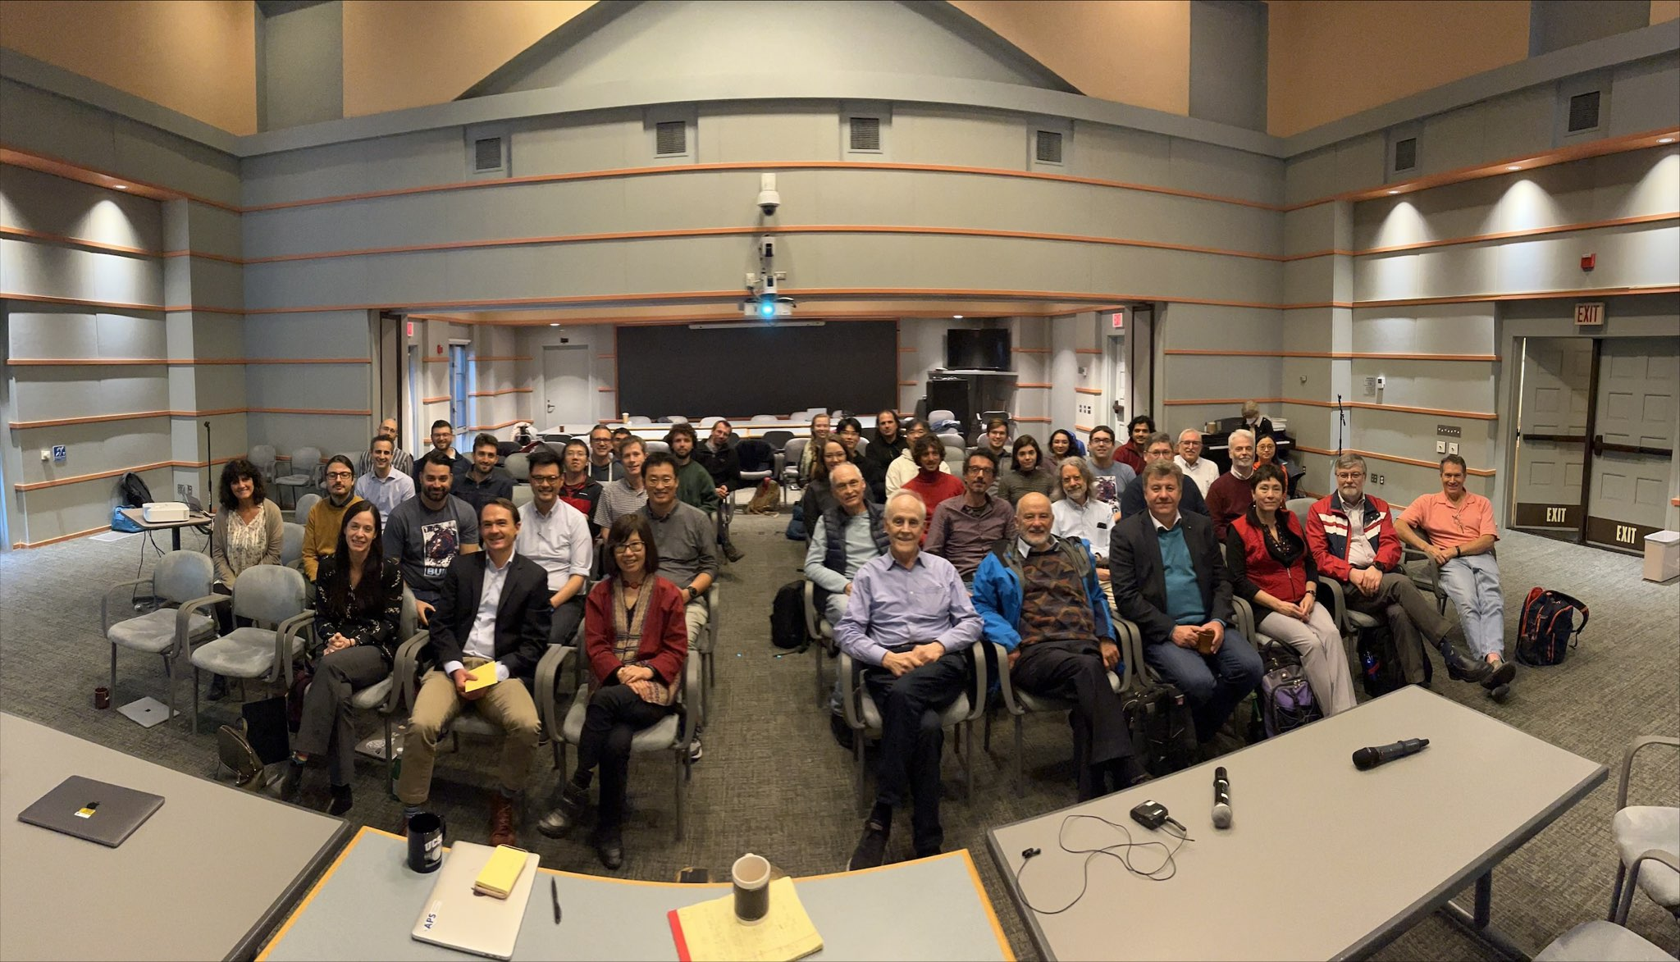
Muon Collider during Snowmass
IMCC Meeting, CERN, Oct 2022
  AF+EF+TF Cross-frontier Muon Collider Forum :
    Regular meetings with 50-100 participants in each, workshops
    40+ dedicated White Papers
    Final report with ~180 authors, 50+% from Early Career arXiv:2209.01318
  Conclusion of the Forum: No fundamental showstoppers identified, but many engineering challenges exist, requiring a significant R&D investment and development cycle
MuC Physics and Detector Workshop, Fermilab, Dec 2022
KITP Workshop, Santa Barbara, March 2023

Slide 23

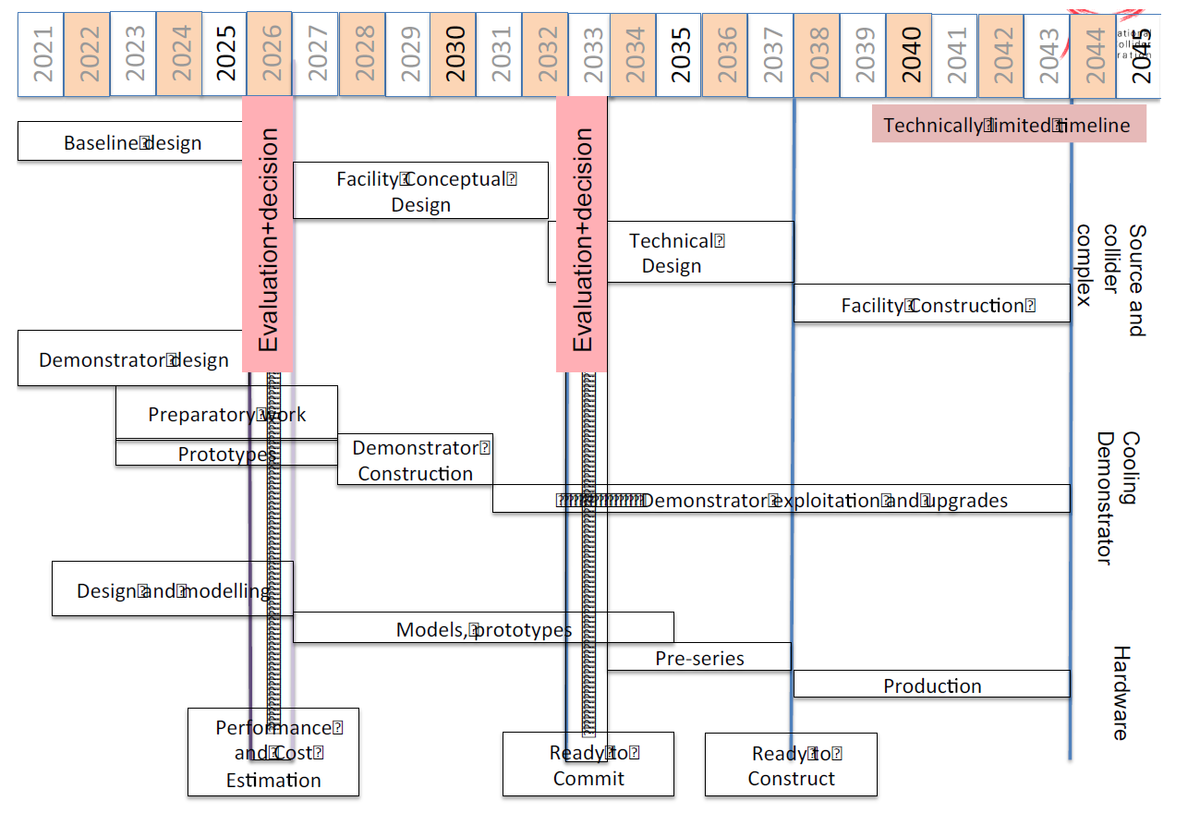
International Muon Collider Collaboration
AS OF TODAY: (1) Initial baseline set of parameters defined, (2) Interim design report is in preparation
IMCC formed in 2021; CERN is currently the host lab
50+ partner institutions, 30+ signed formal agreement
Close collaboration between IMCC and US during Snowmass
Several US institutions started to join, many more expressed interest
IMCC has ~1/2 of the FTEs to achieve goals under “aspirational scenario”
Technically limited timeline

Slide 24
Snowmass Energy Frontier Priorities
1) “The EF supports continued strong US participation in the success of the LHC, and the HL-LHC”
2) “The EF supports a fast start for construction of an e+ e− Higgs factory (linear or circular),”
3) “and a significant R&D program for multi-TeV colliders (hadron and muon)”
“The US EF community has also expressed renewed interest and ambition to bring back energy-frontier collider physics to the US soil while maintaining its international collaborative partnerships and obligations

Slide 25
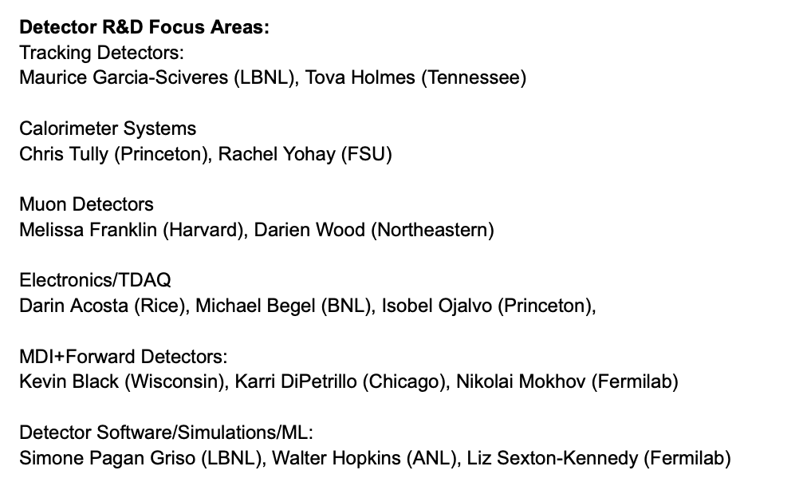
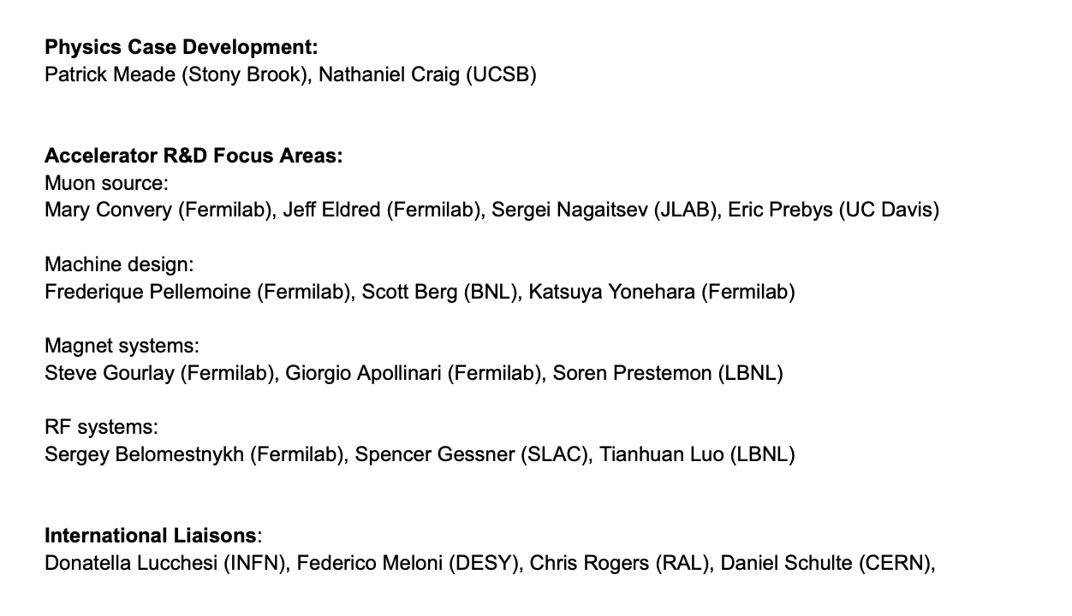
US Muon Collider R&D Coordination Group
In March, R&D Coordination Group was assembled to provide input to P5
Focus on key elements of 10 TeV accelerator and detector design
Develop R&D plan, activities, budget and deliverables
Chairs: Sergo Jindariani, Diktys Stratakis (FNAL), Sridhara Dasu (Wisconsin)
+ communication with DOE, CPAD, ECFA

Slide 26
Preliminary US Muon Collider R&D timeline
Y0
Y7
Y17
R&D Phase
Demo Phase
Accelerator Design
Design Work/Component+Technology R&D
Demonstrator Construction and Operation
System Design and Optimization
Final Facility TDR+ Cost
Detector/MDI Design +
Component/Technology R&D
Prototyping
Technical Readiness to Construct
Detector Design
Reference Design for the Final Facility +
TDR and Cost for the Demo Phase
Physics Studies
Physics Studies
Physics
Simulation and Computing Infrastructure
Simulation and Computing Infrastructure
A 10-page R&D summary document submitted to P5 (link). Includes R&D plan, timeline, FTE and M&S needs

Slide 27
P5 – Key Messages
More in Mark’s talk
Realization of a future collider will require resources at a global scale and will be built through a world-wide collaborative effort where decisions will be taken collectively from the outset by the partners. This differs from current and past international projects in particle physics, where individual laboratories started projects that were later joined by other laboratories. The proposed program aligns with the long-term ambition of hosting a major international collider facility in the US, leading the global effort to understand the fundamental nature of the universe.
…
In particular, a muon collider presents an attractive option both for technological innovation and for bringing energy frontier colliders back to the US. The footprint of a 10 TeV pCM muon collider is almost exactly the size of the Fermilab campus. A muon collider would rely on a powerful multi-megawatt proton driver delivering very intense and short beam pulses to a target, resulting in the production of pions, which in turn decay into muons. This cloud of muons needs to be captured and cooled before the bulk of the muons have decayed. Once cooled into a beam, fast acceleration is required to further suppress decay losses.
…
Although we do not know if a muon collider is ultimately feasible, the road toward it leads from current Fermilab strengths and capabilities to a series of proton beam improvements and neutrino beam facilities, each producing world-class science while performing critical R&D towards a muon collider. At the end of the path is an unparalleled global facility on US soil. This is our Muon Shot.

Slide 28
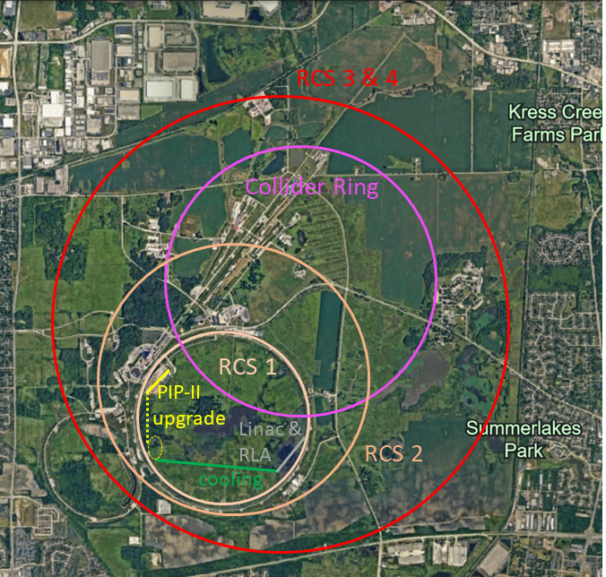
Muon Collider at Fermilab?
Initial concept for 10 TeV machine
Proton source
  PIP-II -> Post-ACE driver -> Target
Ionization cooling channel
Acceleration (4 stages)
  Linac + RLA → 173 GeV
  RCS #1 → 450 GeV (Tevatron size)
  RCS #2 → 1.7 TeV (col. ring size)
  RCS #3, 4 → 5 TeV (site fillers)
Collider ring, 10.5 km long
  Can it fit in the same tunnel as RCS #2 (?)
Aiming for a reference design in ~ 5-7 years

Slide 29
P5 – Key Messages
More in Mark’s talk
Instrumentation
Increase the annual budget for generic Detector R&D by at least $20 million in 2023 dollars. This should be supplemented by additional funds for the collider R&D program
The detector R&D program should continue to leverage national initiatives such as QIS, microelectronics, and AI/ML.
General Accelerator R&D
Increase annual funding to the General Accelerator R&D program by $10M per year in 2023 dollars to ensure US leadership in key areas.
Support generic accelerator R&D with the construction of small scale test facilities. Initiate construction of larger test facilities based on project review, and informed by the collider R&D program.
Collider R&D
To enable targeted R&D before specific collider projects are established in the US, an investment in collider detector R&D funding at the level of $20M per year and collider accelerator R&D at the level of $35M per year in 2023 dollars is warranted.

Slide 30
Summary
Muon Collider is an exciting future collider option. A machine that can provide both precision and energy reach for future discoveries.
Requires major developments in accelerator and detector design, reconstruction, simulation and computing
Large synergies with muon-ion collider, neutrino, CLFV, Beam dump, DIS, etc
P5 report opens the door for a strong R&D program in the US
Next steps:
    Understand funding mechanisms
    Organization of US efforts
    Refine the R&D program in both accelerator and detector

Slide 31
Backup

Slide 32
Is there a gap?
We need more energy and more precision!
10 TeV
What if New Physics is here???
TeV
LHC Searches
Electroweak Scale
LHC Higgs

Slide 33
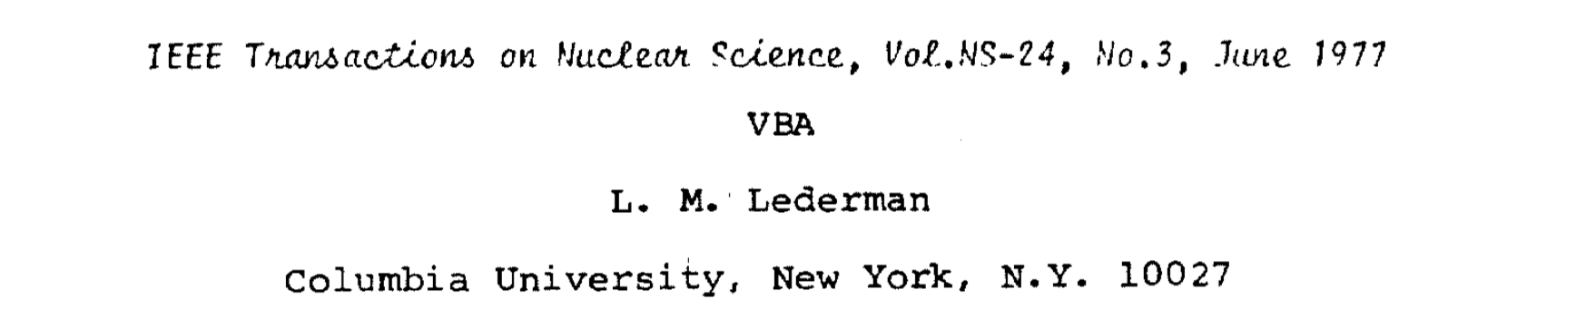
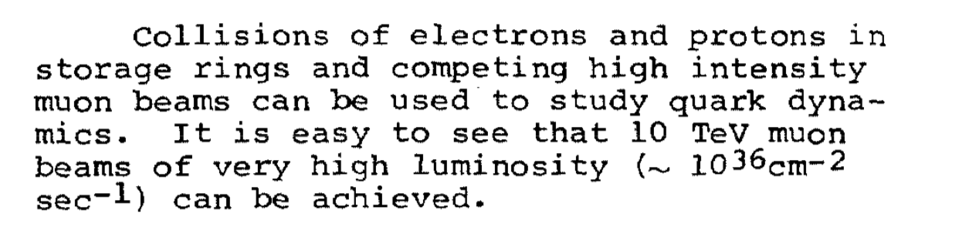
We need a shift of paradigm!
proton
proton
muon
muon

Slide 34
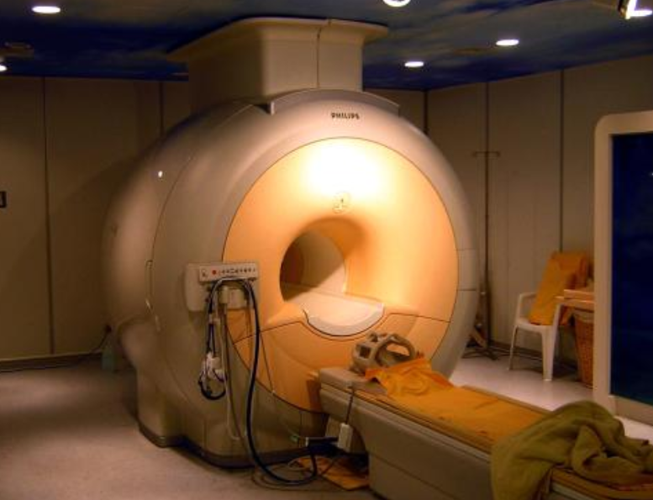
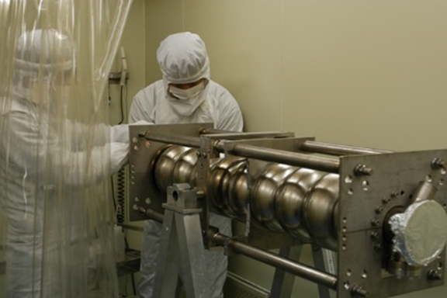
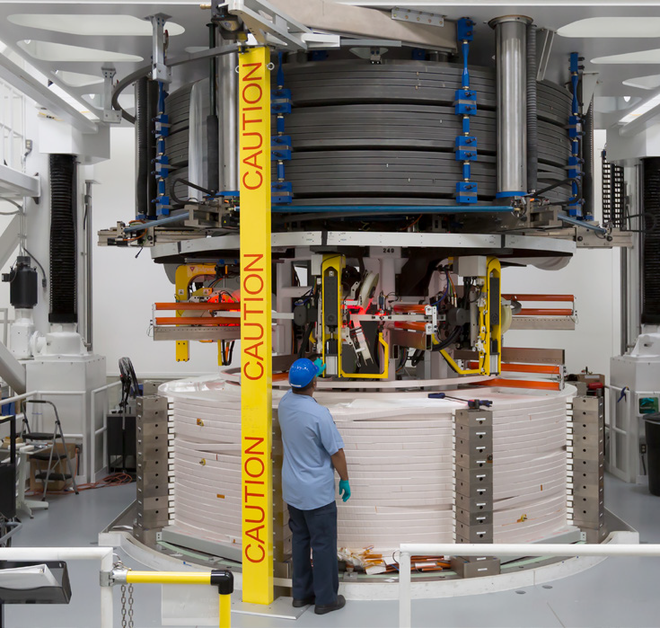
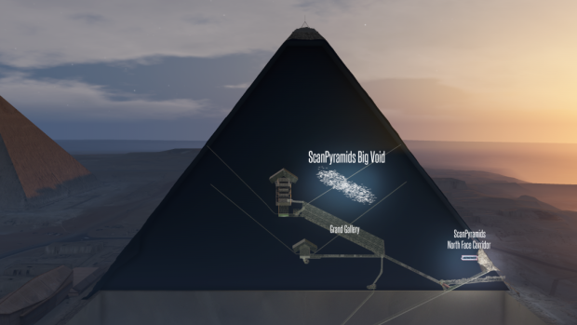
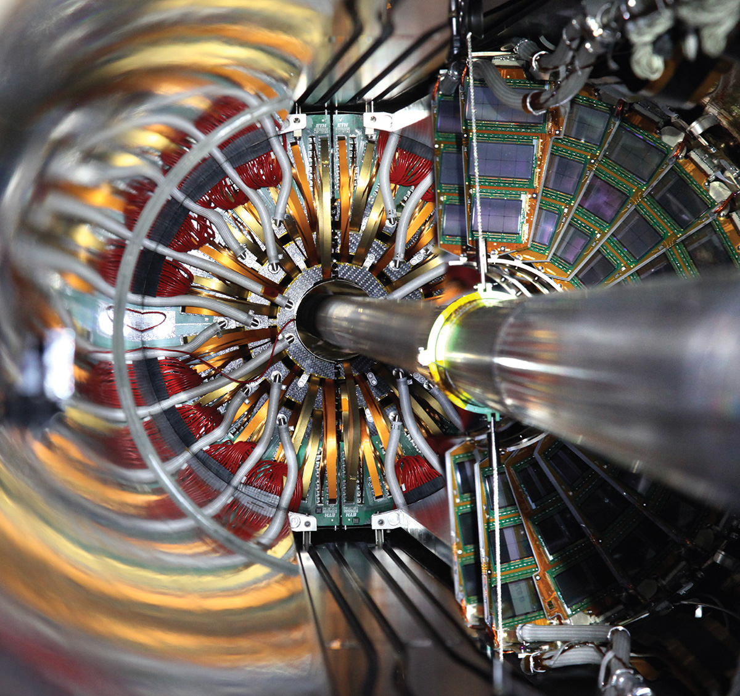
Many spinoffs
Magnets – medical imaging, nuclear fusion
RF cavities - light sources for studies of material properties
Muon beams – large scale object imaging
Muon spectroscopy – material studies
Detectors – rad hard sensors, silicon photonics, high speed serial links
Algorithms

Slide 35
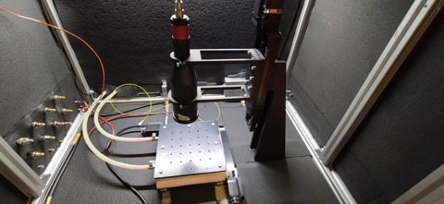





Unique Challenges and Opportunities
Strong interest amongst Early Career – build a diverse community of future US particle physics leadership!
Unique training ground for future generations of accelerator and particle physicists
Cutting edge technology + highly impactful research = Draw the best talent

Slide 36

Snowmass Muon Collider Timeline
Caution: this is a Technically Limited, highly optimistic timeline
The actual construction start time is subject to:
  Successful outcome of the proposed extensive R&D program
  Availability of funding + resources, host laboratory, and international agreements
Development will take a long time – need to start now!

Slide 37


Fastsim vs Fullsim
Events selection and analysis techniques have not been fully synchronized across fullsim and fastsim analyses. Nevertheless, it is encouraging to see that qualitatively the results agree
Higgs → bb cross-section:
FastSim: 0.73% vs Fullsim: 0.75%
Very good agreement in 2-track final state
1-track better in fastsim due to higher acceptance

Slide 38

And this is how it would look at Hanford

Slide 39
US Muon Collider R&D timeline
2023
2030
2040
R&D Phase
Demo Phase
Accelerator Design
Design Work/Component+Technology R&D
Demonstrator Construction and Operation
System Design and Optimization
Final Facility TDR+ Cost
Detector/MDI Design +
Component/Technology R&D
Prototyping
Technical Readiness to Construct
Detector Design
Reference Design for the Final Facility +
TDR and Cost for the Demo Phase
Physics Studies
Physics Studies
Physics
Simulation and Computing Infrastructure
Simulation and Computing Infrastructure

Slide 40
And how it would look at Hanford?

Slide 41

90 years of Accelerators
Charm quark (1974)
Tau lepton (1975)
bottom quark (1977)
Gluon (1978/79)
W,Z bosons (1983)
Top quark (1995)
Tau neutrino (2000)
Higgs boson (2012)

Slide 42
Future Detector Needs
Detectors at future colliders have more stringent requirements than at HL-LHC and require significant R&D
Electron Colliders:
  High granularity and low mass trackers
  High Granularity Calorimeters
Hadron Colliders
  High Granularity Trackers and Calorimeters
  Rad hard sensors and FE electronics
  Electronics, trigger systems, high speed links
Muon Collider
  High granularity and Fast timing requirements
  Moderate radiation tolerance
  Lots of synergies with e+e- and pp
Fermilab group’s Detector R&D efforts are well aligned with these needs

Slide 43

Magnet Technology
HTS demo at Fermilab
Record SC 32 T @ NHMFL
Cooling: Designs consider B-fields of 30-40 T
  commercial MRI 29 T magnets.
  Record 32 T achieved at NHMFL.
  A funded proposal to design purely SC 40 T magnet in place
Acceleration: Fast cycling magnets with 1000 T/s
Demonstrated record ramp rate of 300 T/s with HTS – upgrades for higher fields proposed
Collider Ring: Large 16 T arc dipoles
Plans in 4-5 years to demonstrate 12-15 T dipoles

Slide 44

Costs

Slide 45

Costs

Slide 46
R&D Timeline
More details: https://arxiv.org/abs/2201.07895

Slide 47

LEMMA Scheme
Produce muons at threshold → no cooling needed
Excellent idea but studies show that a very large positron bunch charge is needed to get to desired luminosity → need a game changing invention

Slide 48


Higgs Physics
Self-coupling: at 3 TeV better than LHC. At 10 TeV similar or better than FCC-hh.
λ4 is 50% at 14 TeV
Order of magnitude in Higgs precision wrt HL-LHC and can directly probe
the scale implied in same machine!

Slide 49


Physics BSM
At 10 TeV rivals FCC-hh. Unmatched at 30 TeV
Covers simplest WIMP candidates
hard or impossible
with next gen DM direct detection

Slide 50


Physics BSM
New singlet extension
Compositeness

Slide 51


Slide 52
Muon Collider Synergies
Facility/Experiment | Physics Goals | Synergy
nuStorm | Short baseline neutrino program, including searches for sterile neutrino and cross section measurements | 100kW proton source, muon production and collection, storage ring operation
Neutrino Factory (e.g. nuMax) | Better CP, mixing angles, mass splitting, non-standard interactions | MW class proton source, muon production and collection, 6D partial cooling and muon acceleration (up to ~5 GeV)
Dark Sector searches | Searches for particles from Dark Sectors produced in fixed target experiments using high intensity proton beam | MW class high-intensity proton beams
Charged Lepton Flavor Violation (e.g. AMF) | Searches for rare lepton flavor violating proceses (mu2e, mu2eg, mu3e, etc) | MW class proton source, muon production and collection, storage ring
Beam dump experiments | Searches for exotic particles (dark photons, Lmu-Ltau, etc) in muon beam dump experiments | 100kW – MW proton source, muon production and collection, partial cooling and acceleration
Neutrinos from collider beam muon decays | DIS in neutrino-nucleus interactions, better nuclear PDF, atmospheric neutrinos FASERν like experiment with smaller flux uncertainties | Everything up to multi-TeV energy collider beams
Muon Ion Collider | A broad program addressing many fundamental questions in nuclear and particle physics | Everything up to multi-TeV energy collider beams

Slide 53
Useful References
  Useful references for this Effort:
    Muon Smasher’s Guide: Link
    IMCC Facility overview white paper: Link
    IMCC Simulated Performance white paper: Link
    IMCC Promising Detector Technologies white paper: Link
    Muon Collider Forum Report: Link

Slide 54
Muon Collider Challenges and Progress
Challenge | Progress | Future work
Multi MW proton sources with short bunches | Multi-MW proton sources have been and are being produced for spallation neutron sources and neutrino sources (SNS, ESS, J-PARC, Fermilab) | Refine design parameters, including proton acceleration to 5-10 GeV. Accumulation and compression of bunches.
Multi MW targets | Neutrino targets have matured to 1+MW. RADIATE studies of novel target materials and designs aim at 2.4MW. | Develop target design for 2 MW and short muon collider bunches. Produce a prototype in 2030s.
Production solenoid | ITER Nb3Sn central solenoid with similar specifications and rad levels produced | Study cryogenically stabilized superconducting cables and validate magnet cooling design. Investigate possibility of HTS cables.
Cooling channel solenoids | Solenoid with 30+T field now exists at NHMFL. Plans to design 40+T solenoids in place. | Extend designs to the specs of the 6D cooling channel, fabrication for the demo experiment
Ionization cooling | MICE transverse cooling results published. Longitudinal cooling via emittance exchange demonstrated at g-2. | Optimize with higher fields and gradients. Demonstrate 6D cooling with re-acceleration and focusing
RF in magnetic field | Operation of up to 50 MV/m cavity in magnetic field demonstrated, results published | Design to the specs of the 6D demo, experiment; fabrication

Slide 55
Muon Collider Challenges and Progress
Challenge | Progress | Future work
Fast Ramping Magnets | Demonstrated with 290 T/s up to 0.5T peak field at FNAL. Ramps up to 5000 T/s demonstrated with small magnets. | Design and demonstration work to achieve higher ramp rates (up to 1000 T/s) and peak fields of ~2T with large magnets
Very Rapid Cycling Synchrotron Dynamics | Lattice design in place for a 3 TeV accelerator ring | Develop lattice design for a 5 TeV accelerator ring
Neutrino Flux Effects | Mitigation strategies based on placing the collider ring at 200m and introducing beam wobble has been shown to achieve necessary reduction up to 10-14 TeV | Study mechanical feasibility, stability and robustness of the mover's system and impact on the accelerator and the beams
Detector shielding and rates | Demonstrated to be manageable in simulation with next generation detector technologies | Further develop and optimize 3 and 10 TeV detector concepts and MDI. Perform detector technology R&D and demonstration.
Open aperture storage ring magnets | 12-15T Nb3Sn magnets have been demonstrated | Design and develop larger aperture magnets 12-16T dipoles and HTS quads
Low-beta IR collider design and dynamic aperture | Lattice design in place for a 3 TeV collider with optics and magnet parameters within existing technology limits | Develop lattice design for a 10 TeV collider

Slide 56
Fermilab ACE and Muon Collider
ACE is a step in right direction (power increase at 120 GeV requires power increase at 8 GeV – as muon collider needs).
ACE infrastructure is compatible with the Muon Collider R&D needs (though needs to be expanded)
ACE will provide an excellent platform for Muon Collider accelerator and detector R&D
ACE Booster replacement is to be designed such that it is compatible with the Muon Collider Facility needs (also, will need to be expanded)

Slide 57


Booster Replacement Scenarios
  Initial scenarios under explorations included cases where available 8 GeV power is in 1-2 MW range
  Exact parameters still to be defined, including input from the upcoming ACE physics workshops

Slide 58
Muon Collider Physics
Self-coupling: at 3 TeV better than LHC. At 10 TeV similar or better than FCC-hh.
Covers simplest WIMP candidates
hard or impossible
with next gen DM direct detection
Order of magnitude in Higgs precision wrt HL-LHC and can directly probe
the scale implied in same machine!
Unprecedented reach for strongly motivated BSM scenarios

Slide 59

Radiation Levels
1-MeV-neq fluence for one year of operation (200 days)
Total Ionizing Dose for one year of operation (200 days)
Muon Collider 10 TeV
tbc
O(0.1)
tbc
O(10¹⁴)

Slide 60

Mitigation Strategy
  Disperse the neutrino flux by periodically deforming the collider ring arcs vertically
  Use either magnetic field or mechanical movers
  Goal to be similar to LHC: i.e. negligible (100 x lower than legal requirements)
Annual off-site legal limits: 1000 µSv/year
Our goal: <10 µSv/year
Airline flight: 3 µSv/hour

