Slide 1
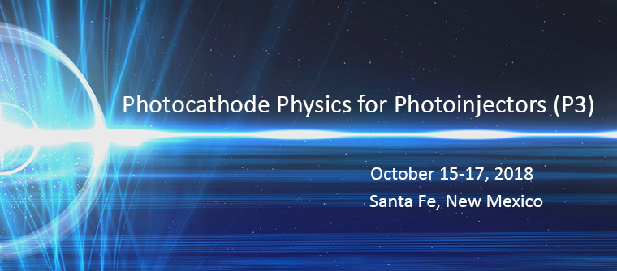
Hilton Buffalo Thunder Resort

Slide 2
Workshop Conclusion
Local Committee
Organizing Committee
Lucy Maestas
Shannon Perez
John Lewellen
Vitaly Pavlenko
Nathan Moody
Ivan Bazarov (Cornell University)
Luca Cultrera (Cornell University)
David Dowell (SLAC National Accelerator Laboratory)
Daniele Filippetto (Lawrence Berkeley National Laboratory)
Fay Hannon (Thomas Jefferson National Accelerator Facility)
Carlos Hernandez Garcia (Thomas Jefferson National Accelerator Facility)
Kevin Jensen (Naval Research Laboratory)
Siddharth Karkare (Arizona State University)
John Lewellen (Los Alamos National Laboratory)
Nathan Moody (Los Alamos National Laboratory)
Pietro Musumeci (UCLA)
Howard Padmore (Lawrence Berkeley National Laboratory)
John Smedley (Brookhaven National Laboratory
Theo Vecchione (SLAC National Accelerator Laboratory)
Notes:
I’ve been asked to give highlights of the ongoing and future A&E R&D. A comprehensive view of all R&D would extend well beyond the time allotted so I give an overview that is organized to show the framework we utilize when planning for the future.

Slide 3
Workshop Action Items
Deliverable: Draft a digestible, compact R&D Roadmap
  POC: Nathan and Theo first draft (Kathy Karkay volunteered to help); editor model; executive summary available for PMs
  ROI argument / rationale for cathode research across application areas; use DOE report template (send links around)
Deliverable: New review paper updating status and priorities of photocathode R&D
  POC: Jared M.; Siddharth K., Theo V.
  Engage wide participation
  Email: p3_2018_participants@lanl.gov
Workshop discussion: Understanding and responding to challenges in photocathode funding
  Edit shared document: https://docs.google.com/document/d/15IyoL_47Z2N3Uq9LVxuUSu-2e0PmSDh5mT4pFYwoGbw/edit?usp=sharing
Engage senior program managers to study their photocathodes needs and program risks
  POC: Bruce Dunham (suggested)
  Organize delegations to periodically visit DOE and the relevant program managers
Drive toward standardized architectures and components to leverage the limited funds (e.g., common puck, transfer, etc.). In practice this has been difficult, but worth pursuing.
  Coordinate test of BNL (John Smedley) cathodes at SLAC to fast-track a high-impact demonstration
  Repository of common-puck designs (Eric M.)

Slide 4
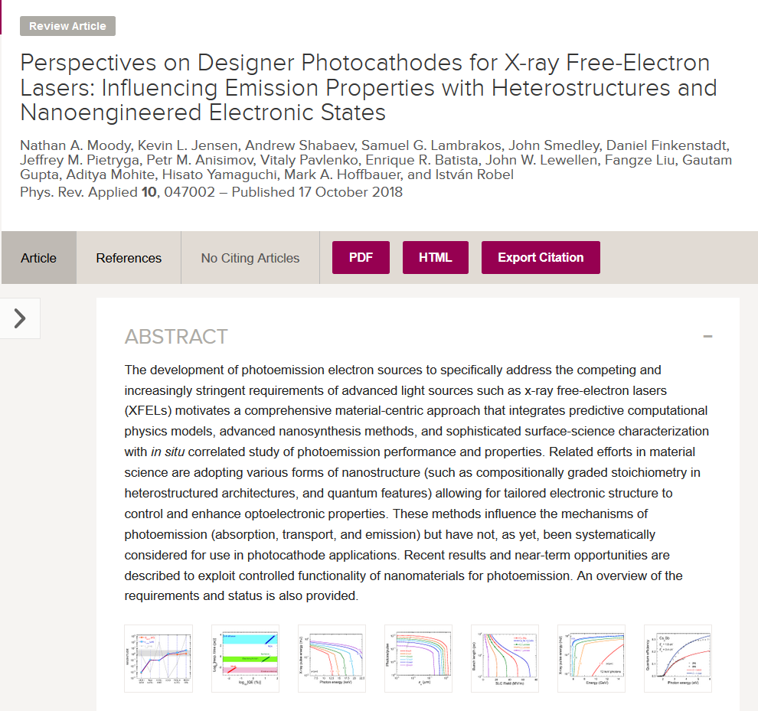
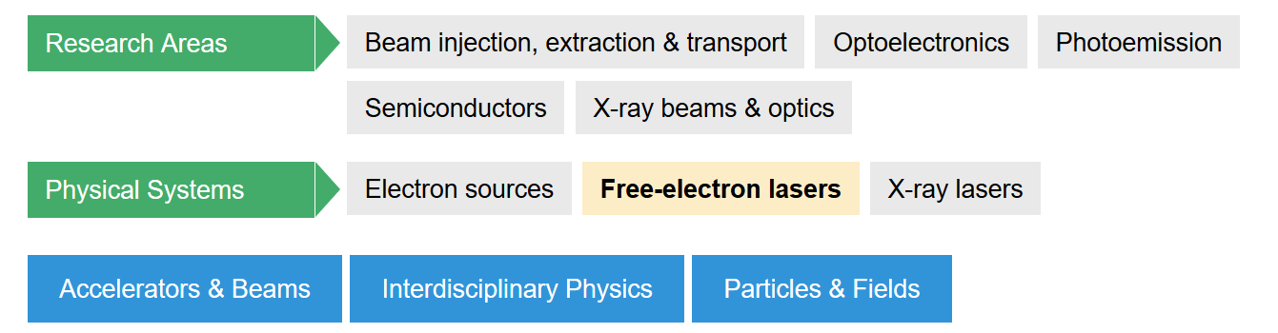
New review paper published today
https://doi.org/10.1103/PhysRevApplied.10.047002

Slide 5


Handoff for P3 2020
Successful 2020 proposal:
  SLAC National Accelerator Laboratory and Arizona State University
  Chair: Theodore Vecchione tvecchio@slac.stanford.edu
  Co-chair: Siddharth Karkare karkare@asu.edu
Coming in 2020:
  Changes to workshop format and organization to

