Slide 1
Computational Screening for New Photocathode Materials
Joshua T. Paul, Alice Galdi, Siddharth Karkare, Howard Padmore, Ivan Bazarov, Richard G. Hennig

Slide 2
Motivation
Common photocathode materials: GaAs, InGaAs,
CsTe, CsI,
SbCs, Sb-K-Cs, Na-K-Sb
New photocathodes are typically identify based on trial and error efforts on what photocathodes already exist

Slide 3
Motivation
Computational resources have the ability to improve the search for photocathode materials
  Materials databases (MaterialsProject, AFlowLib, OQMD)
  Density functional theory (DFT)
  High-throughput techniques
  Supercomputers (HiPerGator, XSEDE)
  Materials science software (Pymatgen, MPInterfaces)

Slide 4
Computational Path to Find Photocathodes
Screen MaterialsProject database
Identify surface states
Match candidates to commercial substrates
Calculate effective mass
Estimate MTE
Software Complete
Validating
Validating
Calculating
Software Complete

Slide 5
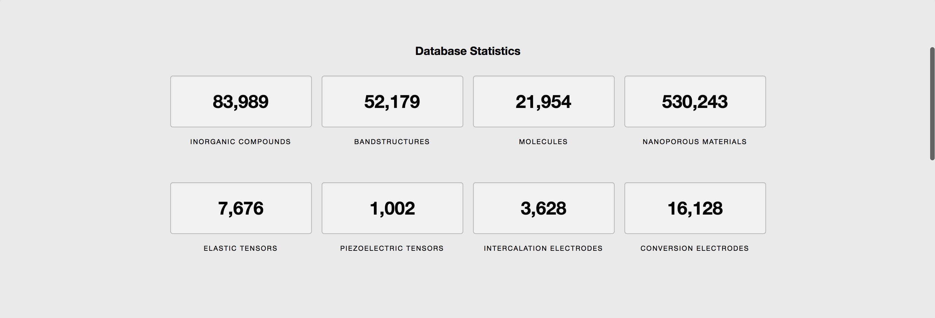
MaterialsProject Database
Using materials databases, we can search for photocathodes never before considered
Jain, PRL 115 036402 (2015)

Slide 6

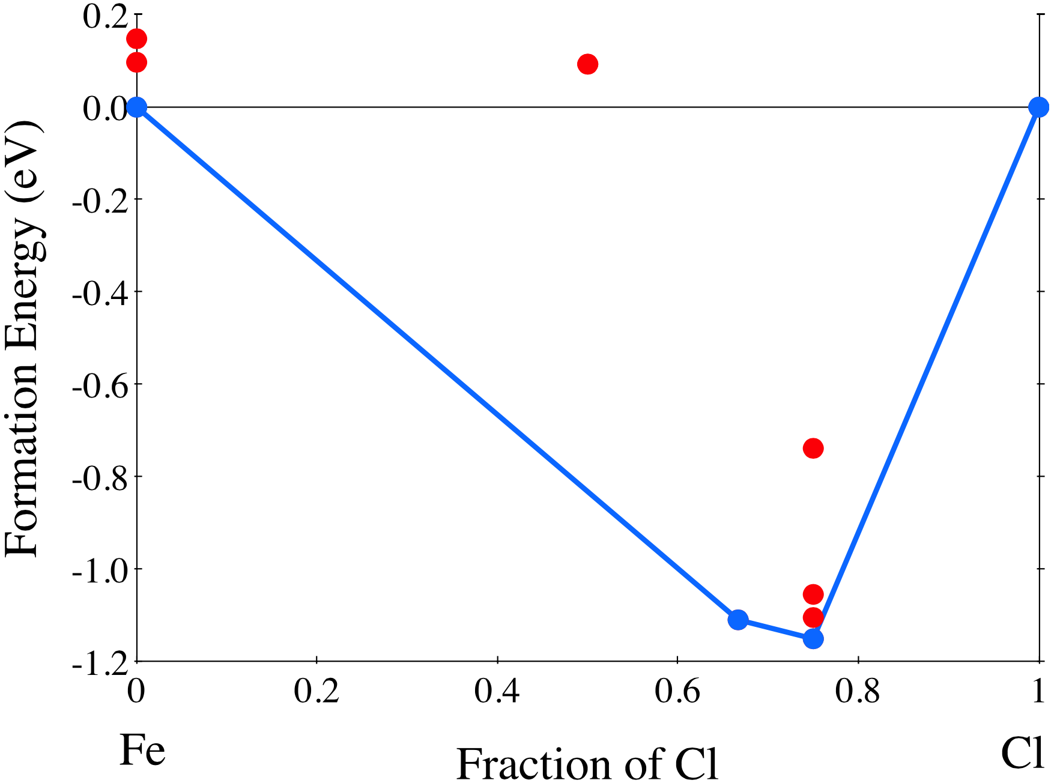
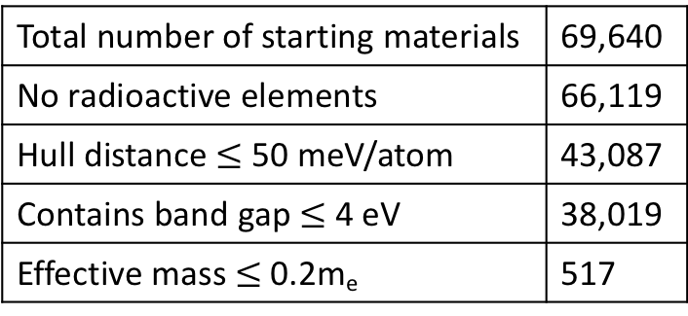
Initial Screening Criteria
Need to reduce the number of materials considered for calculations to a more reasonable number
Total number of starting materials | 69,640
No radioactive elements | 66,119
Hull distance $≤$ 50 meV/atom | 43,087
Contains band gap $≤$ 4 eV | 38,019
Effective mass $≤$ 0.2m_{e} | 517
Hull distance: Sun et al. Sci. Adv. 2016; 2, 11, e1600225

Slide 7
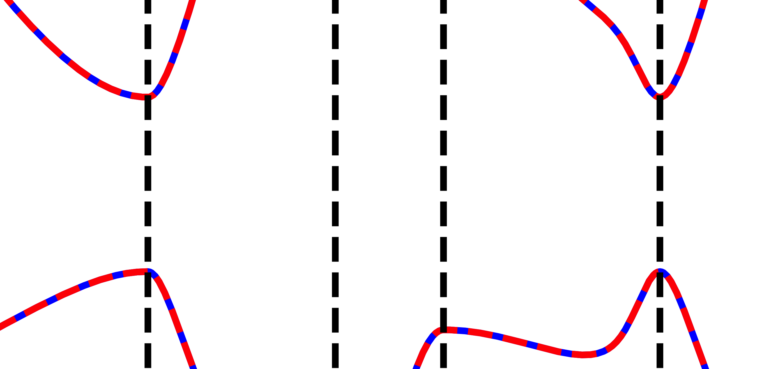
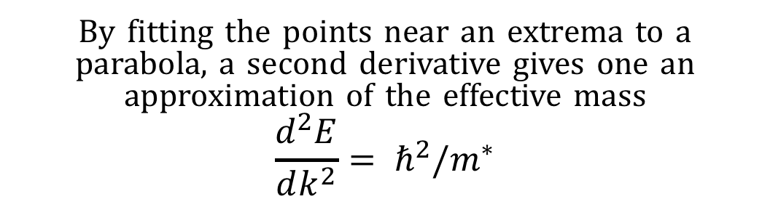
Approximating the Effective Mass
By fitting the points near an extrema to a parabola, a second derivative gives one an approximation of the effective mass
$$\frac{d^{2}E}{dk^{2}}= ℏ^{2}/m^{∗}$$
Performed for select systems in Kim et al. PHYS. REV. B. 80, 035203

Slide 8
Approximating the Effective Mass: Convergence
The default k-point density in MaterialsProject is sufficient for their purposes, but fairly low for fitting to equations. Thus, we re-calculate the effective mass using higher density meshes.
Potentially low m* materials
GaAs | BaLiAs | GeSe
Cs₃BiN | Na₃As | NaZnAs

Slide 9
Approximating the Effective Mass: Convergence
Using MaterialsProject data to estimate m* is insufficient for screening, but it does allow for narrowing the scope of the investigation

Slide 10
Estimating MTE: Probability of Optical Excitation
When calculating dielectric response in VASP, the optical excitation probability is calculated. This can be explicitly written out to obtain the strength of transition from one band to another at a given k-point
M. Gajdoš, PHYS. REV. B 73, 045112 (2006)

Slide 11
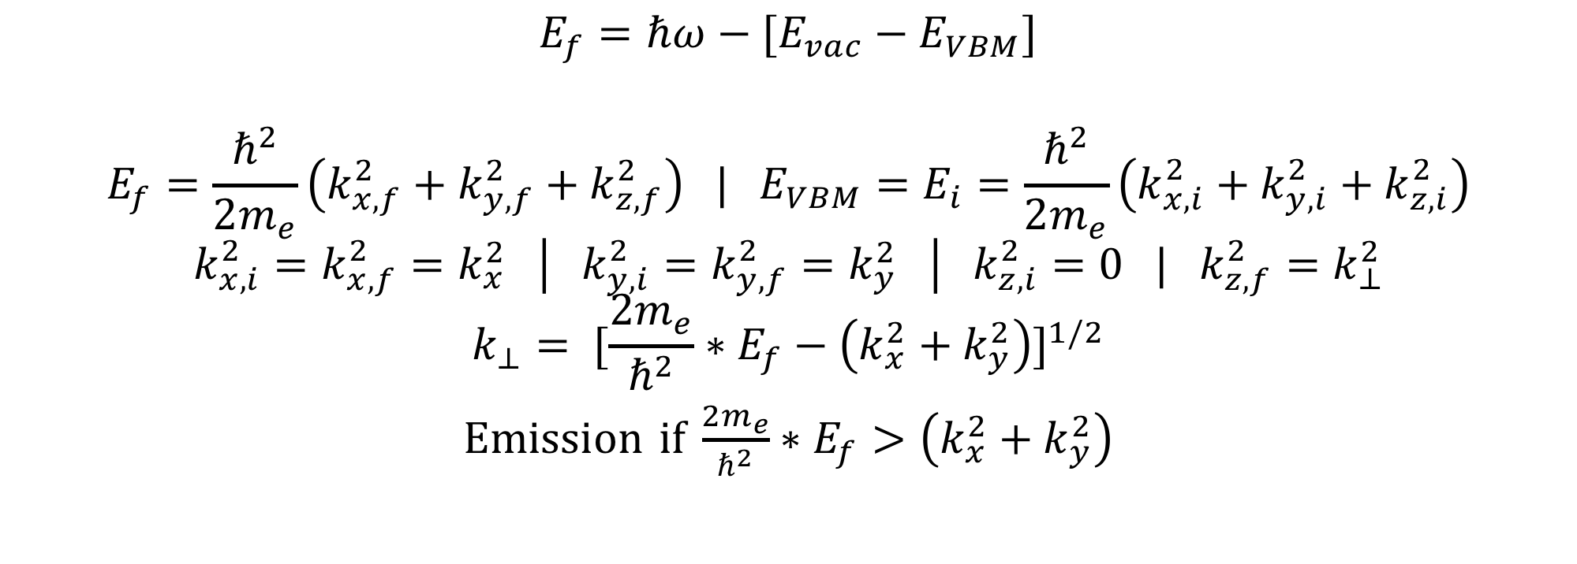
Estimating MTE: Relevant Optical Transitions
$$E_{f}=ℏω−[E_{vac}−E_{VBM}]$$
$$E_{f}=\frac{ℏ^{2}}{2m_{e}}\left(k_{x,f}^{2}+k_{y,f}^{2}+k_{z,f}^{2}\right) | E_{VBM}=E_{i}=\frac{ℏ^{2}}{2m_{e}}\left(k_{x,i}^{2}+k_{y,i}^{2}+k_{z,i}^{2}\right)$$
$$k_{x,i}^{2}=k_{x,f}^{2}=k_{x}^{2} \left| k_{y,i}^{2}=k_{y,f}^{2}=k_{y}^{2} \right| k_{z,i}^{2}=0 | k_{z,f}^{2}=k_{⊥}^{2}$$
$$k_{⊥}= {[\frac{2m_{e}}{ℏ^{2}}∗E_{f}−\left(k_{x}^{2}+k_{y}^{2}\right)]}^{1/2}$$
Emission if $\frac{2m_{e}}{ℏ^{2}}∗E_{f}>\left(k_{x}^{2}+k_{y}^{2}\right)$
For a more detailed derivation, refer to Karakare et al., PHYS. REV. B 95, 075439 (2017)

Slide 12
Estimating MTE: Relevant Optical Transitions
(100)
(010)
(001)

Slide 13
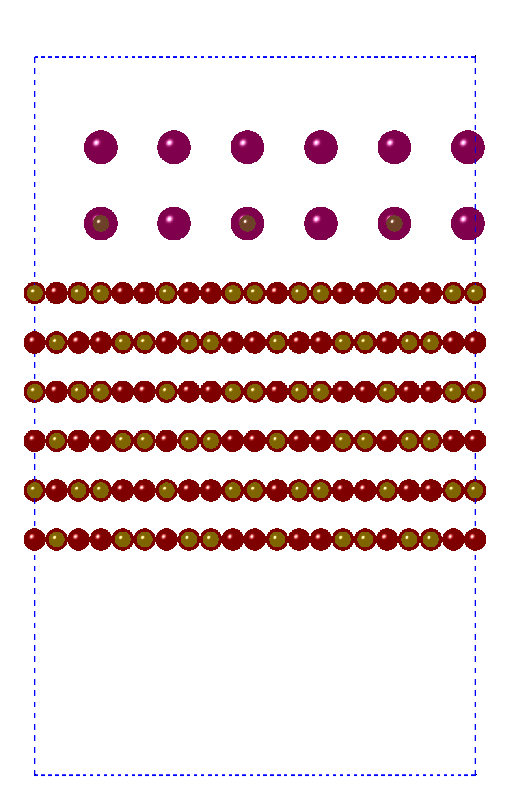
Matching Photocathodes to Substrates
Using MPInterfaces software package, we can epitaxially match potential photocathodes to other materials
With our database of commercial substrates, we can match the screened photocathodes to easily obtained substrates to optimize growth conditions
Cs3Sb on (100) MgO

Slide 14
Summary
Using a computational approach, we can identify photocathodes that have not been considered before
Effective masses can be estimated from band curvatures, which is currently being validated for over 500 materials
Using transition rates and focusing on relevant transitions for emission, we can approximate MTE for emission
Using MPInterfaces, we can epitaxially match candidate photocathodes to a variety of commercially available materials to help optimize growth conditions

Slide 15
Acknowledgments
Center for Bright Beams and the National Science Foundation for funding this project
The HiPerGator supercomputer, where these calculations are being performed
The MaterialsProject database for providing the initial database of structures

