Slide 1
Observations of the laser-induced emission from the diamond field emitter tips
Evgenya I. Simakov, Heather Andrews, Dongsung Kim, Kimberley Nichols, Vitaly Pavlenko
Los Alamos National Laboratory
Kenneth Leedle, Dylan Black
Stanford University
Juahang Shao, Argonne National Laboratory
Sergey Antipov, Euclid Techlabs
October 17, 2018
Notes:
1

Slide 2
Outline
Diamond field emitter arrays (DFEAs)
Fabrication of DFEAs
Field emission and conditioning
Laser-induced emission
Conclusion and plans

Slide 3
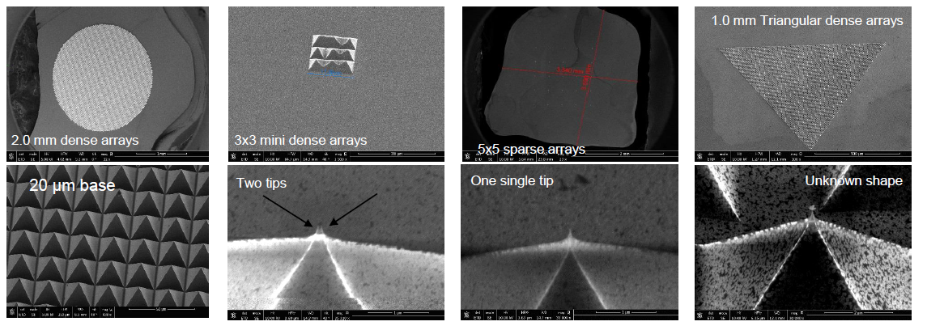
Diamond field emitter array cathodes
  μm-size pyramids with nm-size tips.
  High thermal conductivity.
  Perform in poor and good vacuum.
  Current in field emission > 1 A/mm².

Slide 4
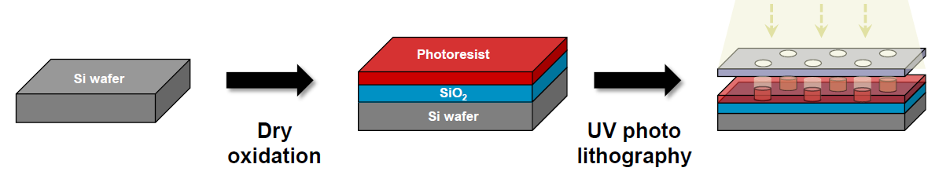
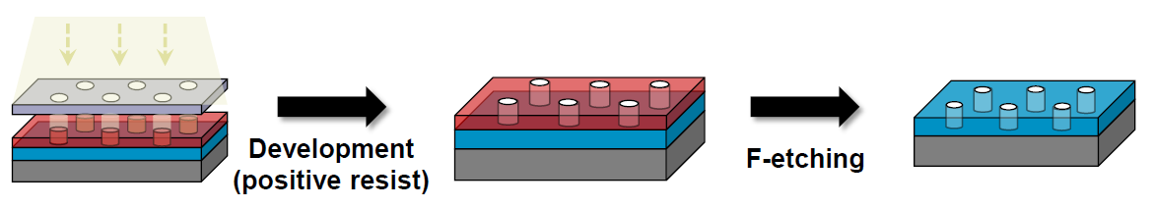
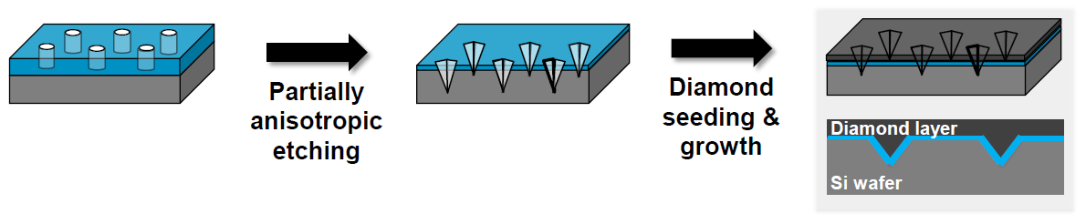
Fabrication

Slide 5
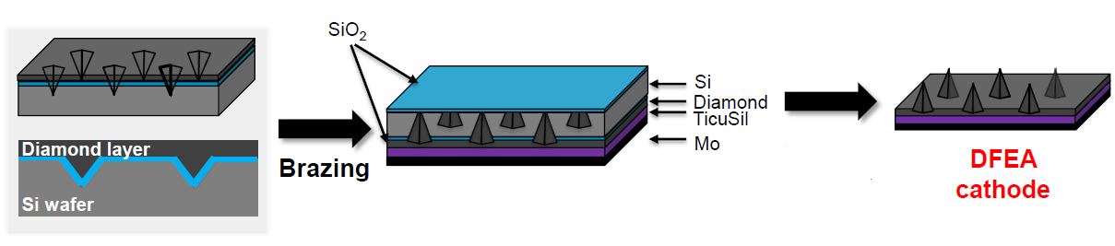
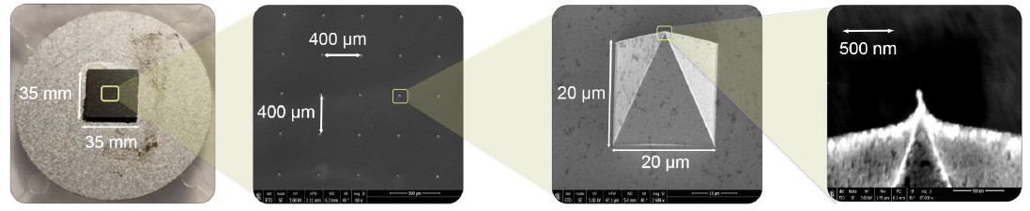
Fabrication – cont.
Etching

Slide 6
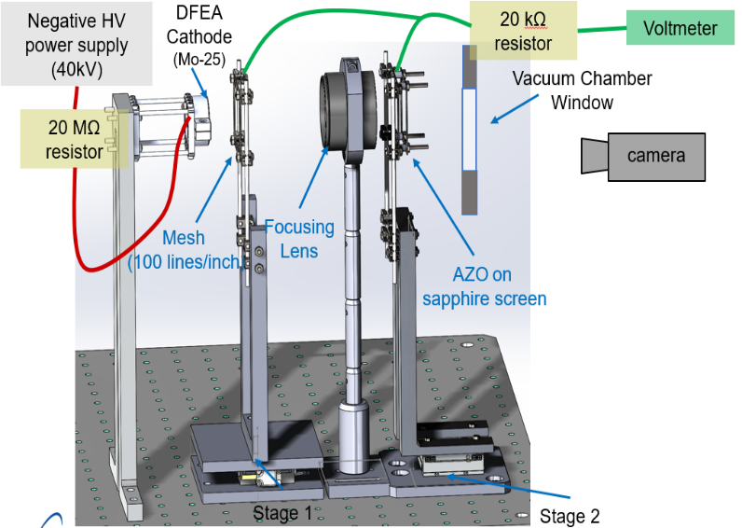
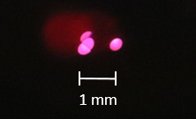
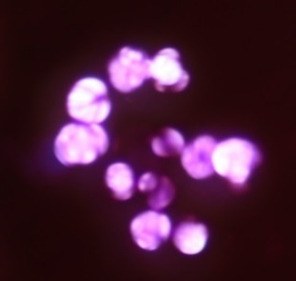
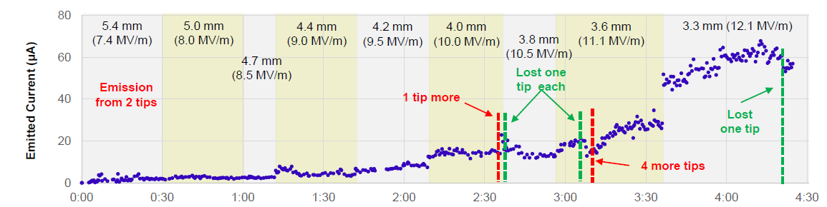
Field emission experiment

Slide 7
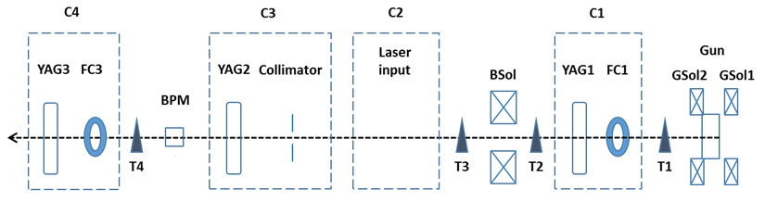
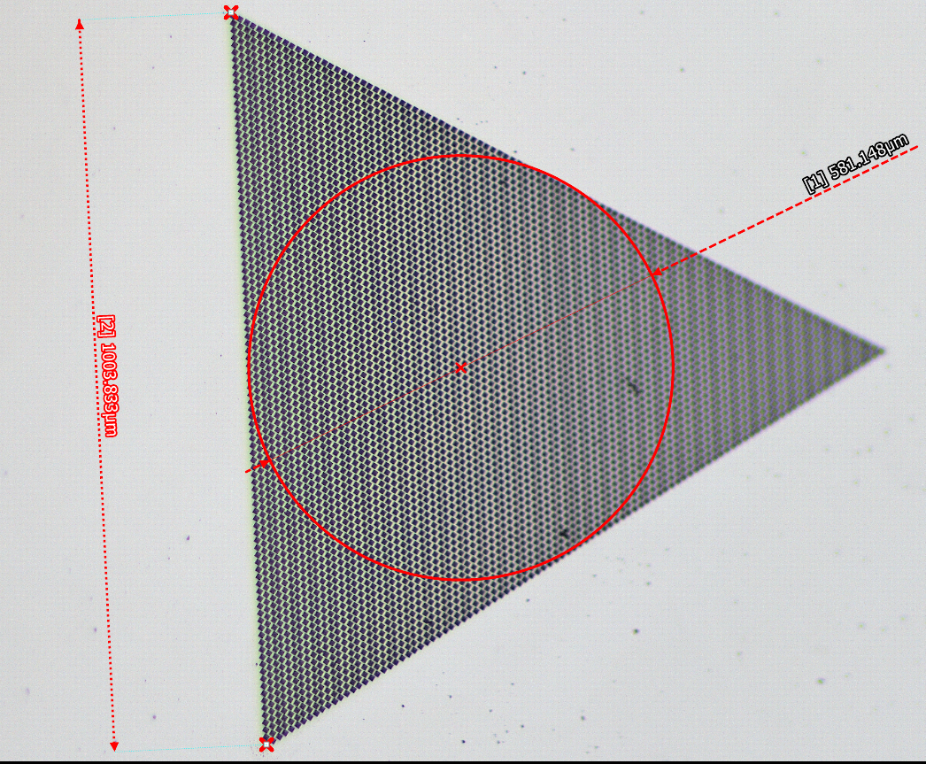
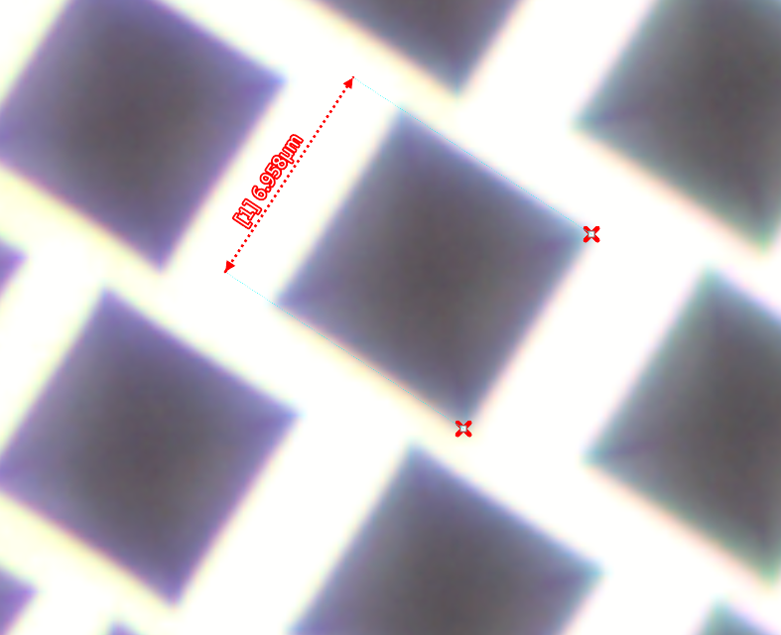
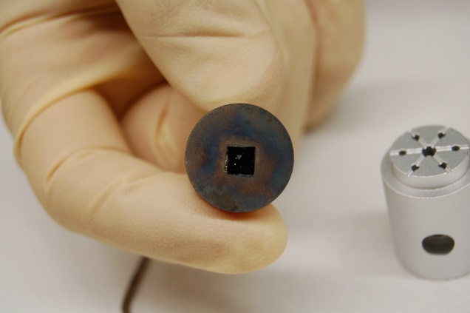
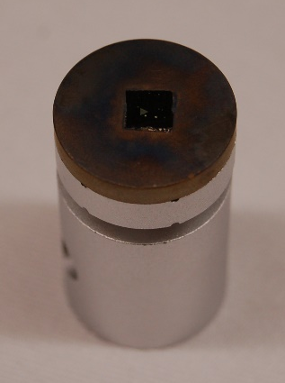
Field emission in rf gun studies at AWA (ACT beamline)

Slide 8
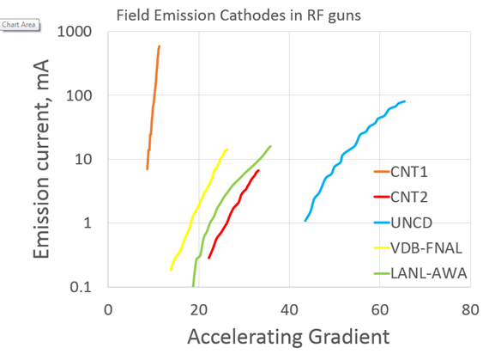
Up to 30 nC electron bunches generated in RF gun
5000 tips in LANL sample vs.
10⁶ tips in VDB-FNAL sample
Breakdown occurred on both days of testing at 36 MV/m. Significant charge decrease after BD.

Slide 9
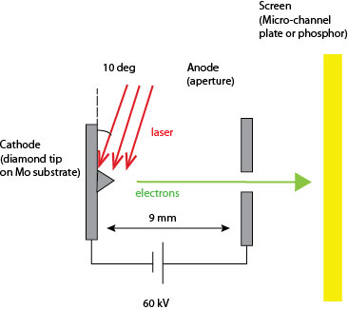
Setup of the laser emission experiment
Notes:
9

Slide 10
Parameters of the experiment
Cathode | Mo-16, 5x5, spacing 400 µm, base 22 µm
Laser’s wavelength | 256 nm, 512 nm, 1024 nm, 2.02 µm
Bias | 57 kV
AK distance | 9.5 mm
Anode’s thickness | 1 mm
Anode aperture’s diameter | 700 microns
Laser’s incidence angle | 10 deg
Cathode-to-screen distance | 40 cm
Laser’s pulse duration | 260 fs
Laser’s spot size | 40 micron at 1024 nm
Notes:
10

Slide 11
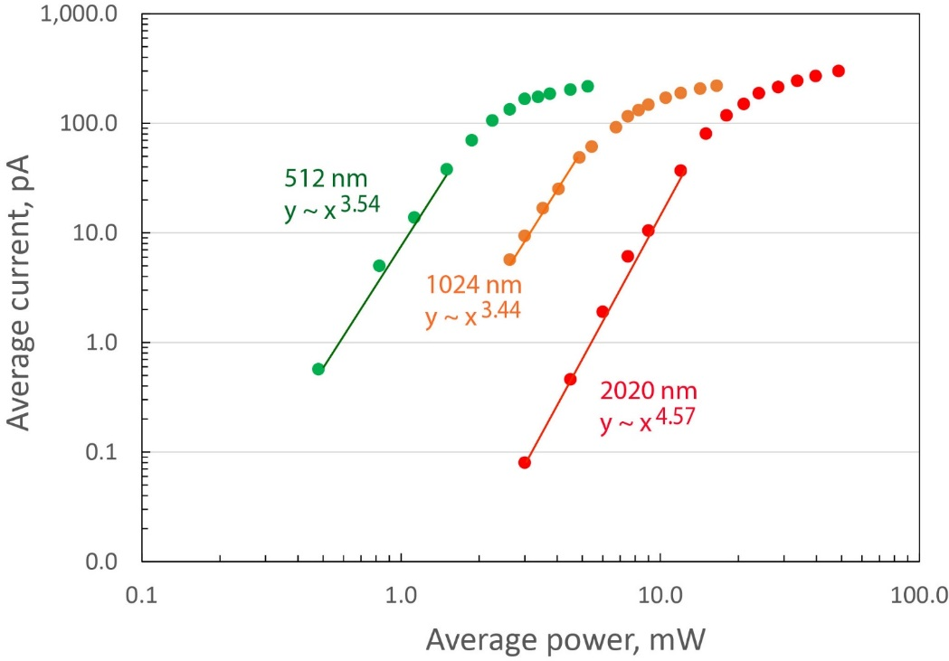
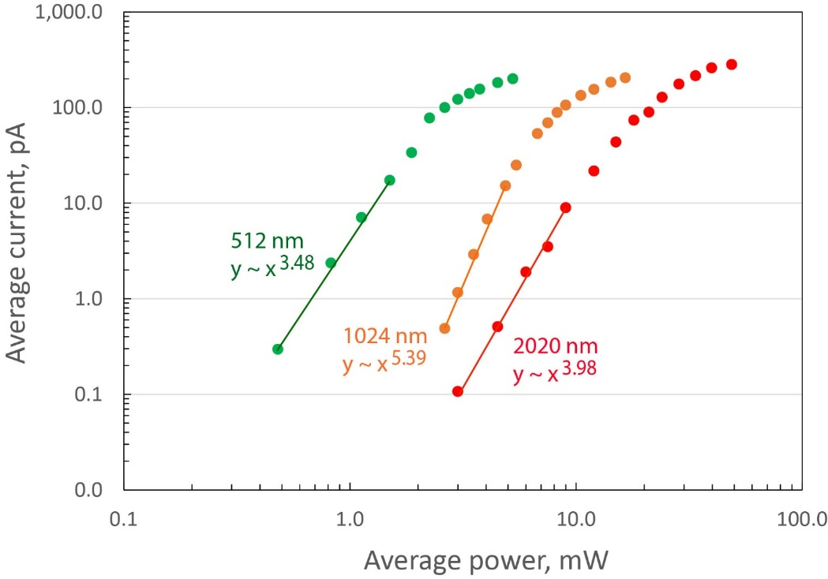
Emission at 512 nm, 1024 nm, and 2020 nm
The TM polarization
The TE polarization

Slide 12
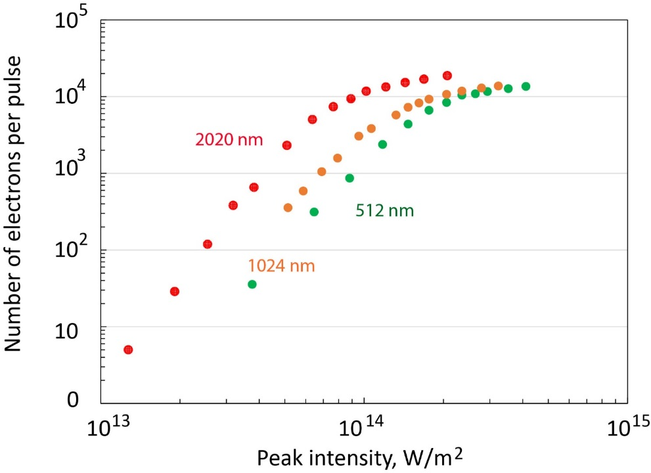
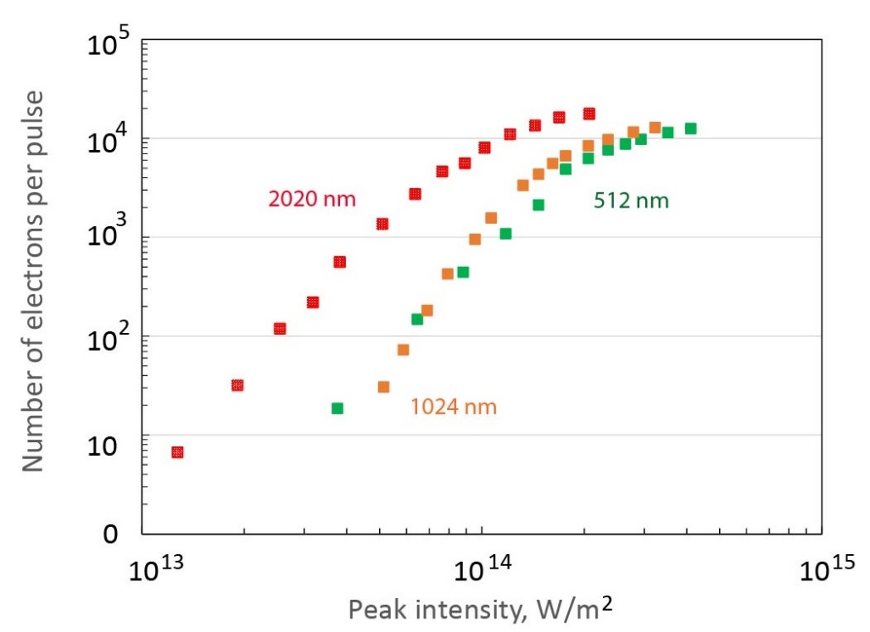
Number of electrons vs power density
The TM polarization
The TE polarization

Slide 13
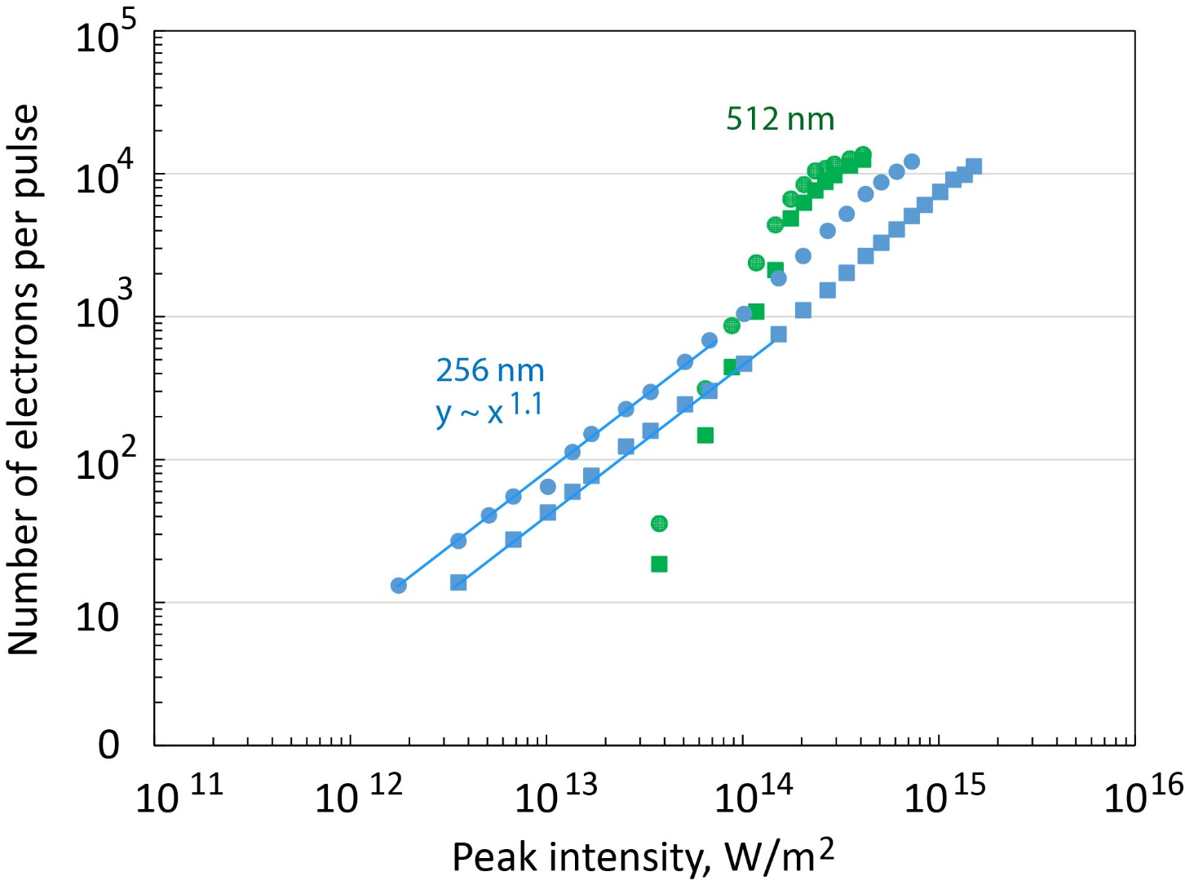
Field emission vs photoemission

Slide 14
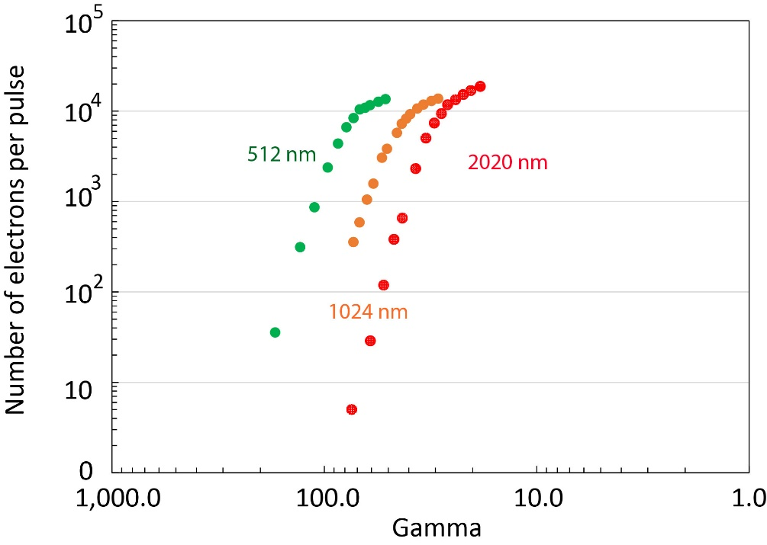
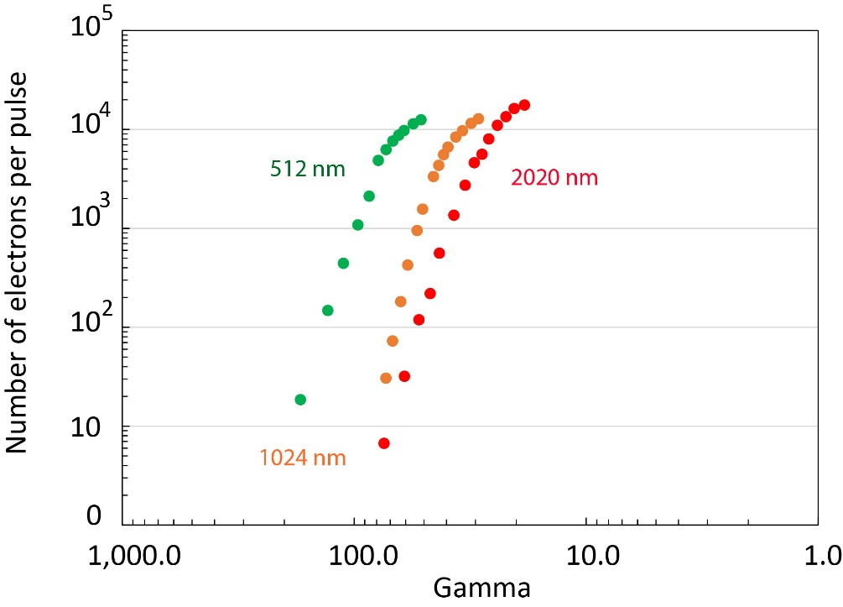
Number of electrons vs Keldysh parameter
The TM polarization
The TE polarization
Field enhancement ~100 at the tip would explain the field emission.
If current saturation is due to the space charge, then the area of emission is ~1 μm².

Slide 15
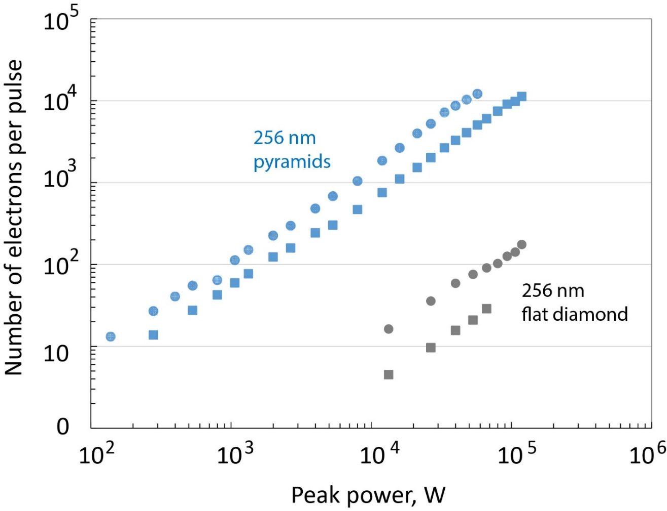
Photoemission is not localized to pyramids

Slide 16
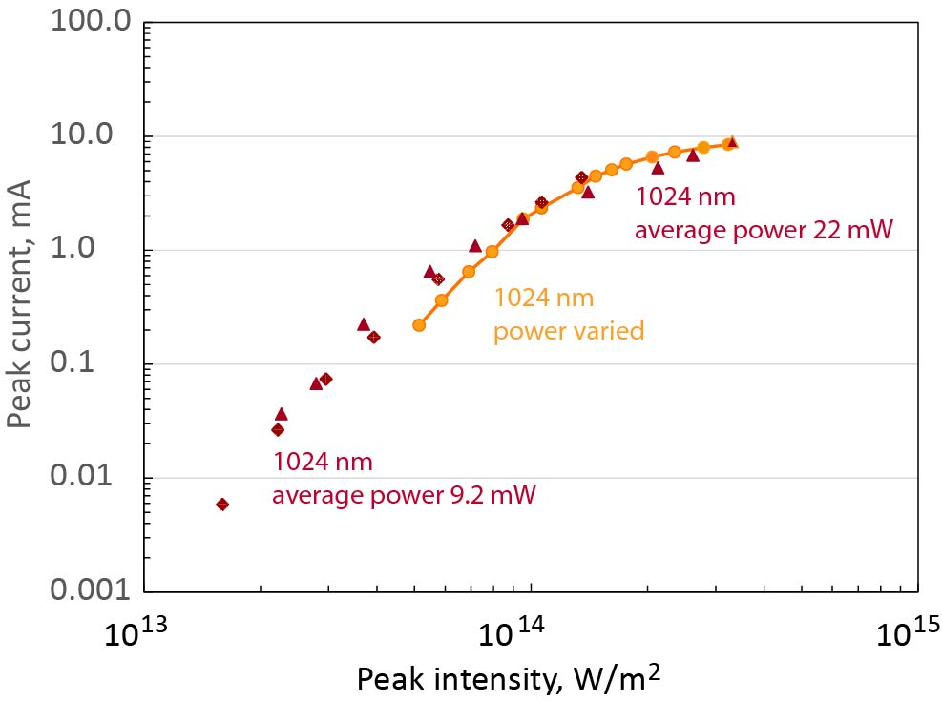
No thermal effects observed in a short pulse

Slide 17
Conclusions
Lots of interesting data on DFEA cathodes at LANL.
We fabricate DFEA samples and are happy to share them with collaborators.
DC field emission test stand operational at LANL.
Collaboration with AWA is established to test DFEAs in an RF gun.
We are commissioning a new test stand for the laser-induced emission studies:
  Laser system: Coherent Monaco 1035-80, 80 μJ/pulse at 1035 nm, 50 MHz repetition rate, pulsewidths 300 fs to 10 ps.

