Slide 1
Towards adaptive, automated growth of photocathodes
Vitaly Pavlenko, Alexander Scheinker, Mark A. Hoffbauer, Fangze Liu, and Nathan A. Moody
Los Alamos National Laboratory
Photocathode Physics for Photoinjectors (P3) 2018
October 16th, 2018

Slide 2
Definitions
Photocathodes = Alkali Antimonide Photocathodes
  Cs₃Sb = Single parameter system
  K₂CsSb = Two-parameter system
Growth = Co-evaporation at a low substrate temperature
  Co-evaporation = True co-evaporation
  Low = Temperature at which cathode is stable
Automated = Feedback-based process control
Towards = Ultimate goal is stoichiometric single crystal
Slide 2
Notes:
2

Slide 3
Benefits of Automation
Reproducibility: you always get the same thing
Accuracy & Flexibility: you can specify exactly what you want
Cost: you can do something more important instead
Slide 3
Notes:
3

Slide 4
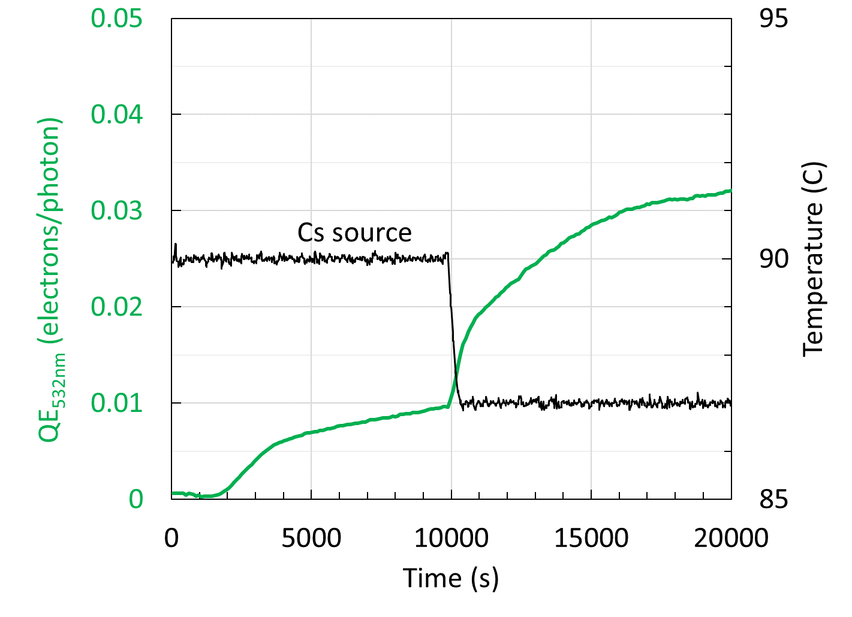
How Important is Flux Control?
Intuitive adjustment
Slide 4
Notes:
4

Slide 5
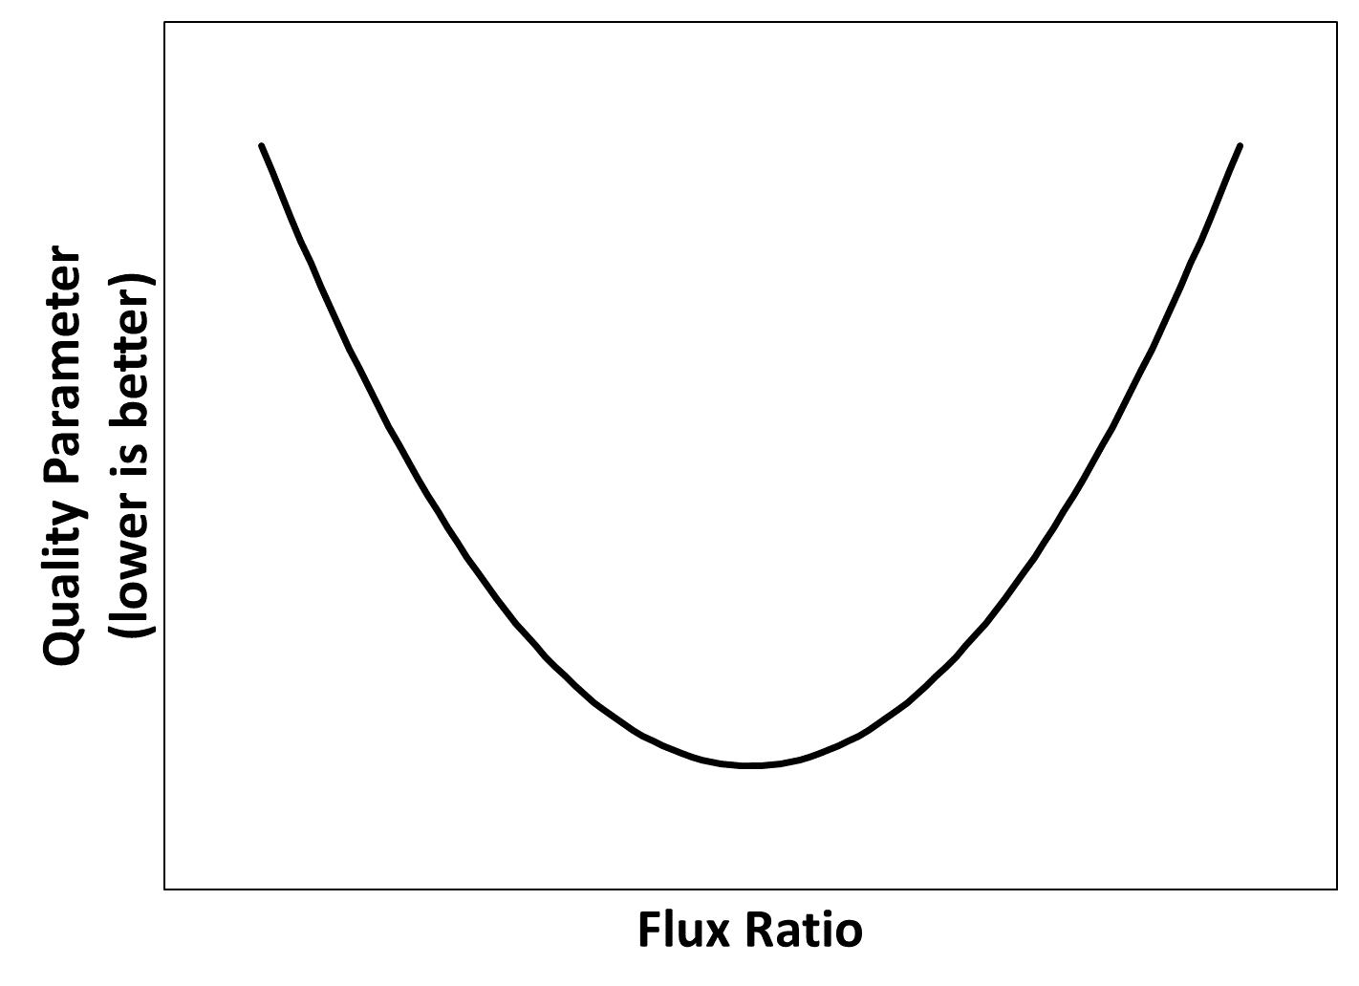
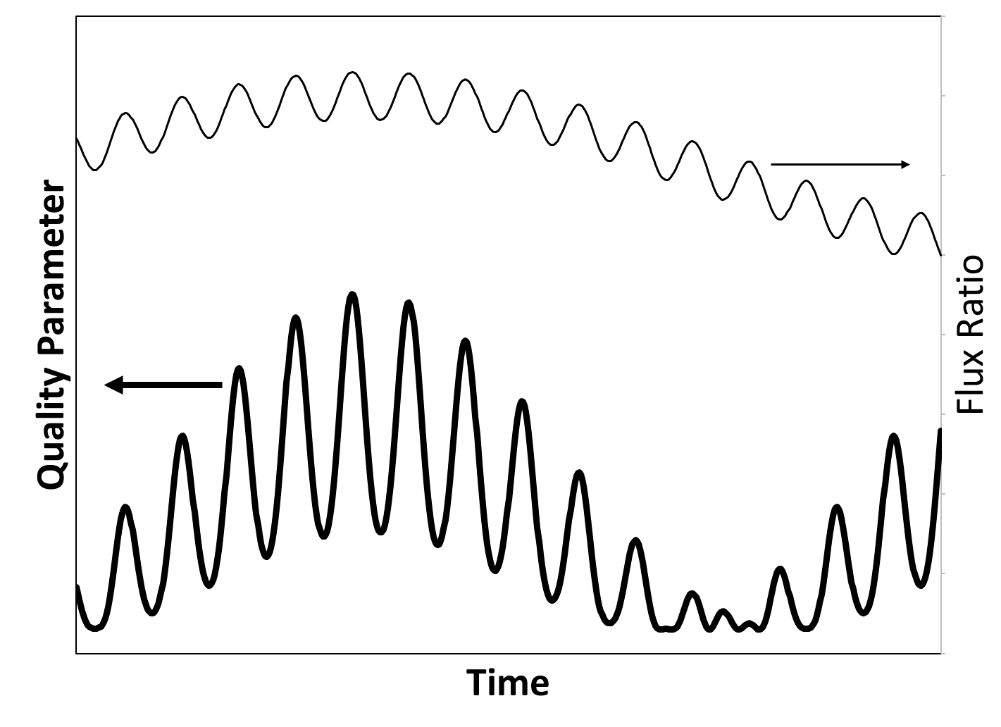
Rudimentary Model for Single Parameter System
Assumption: Extremum
Consequences:
(local) minimum
Oscillations vanish at extremum
Frequency doubles at extremum
Phase shift by π at extremum
Slide 5
Notes:
5

Slide 6
Choice of Thickness-Independent Quality Parameter
Physically significant parameter, lower is better
1.8
Cs₃Sb
≥50 nm thick
QE_{405nm}/QE_{532nm}
5.2
Engineering parameter, lower is better
Non-stoichiometric Cs₃Sb
<50 nm thick
Data from:
L. Cultrera et al., Applied Physics Letters, 99, 152110, 2011.
E_{threshold}(eV)
2.0
2.2
Slide 6
Notes:
6

Slide 7
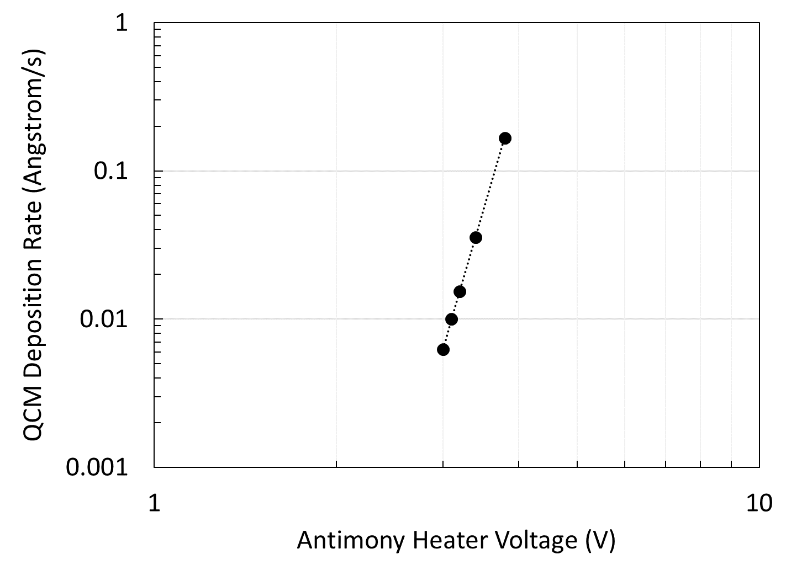
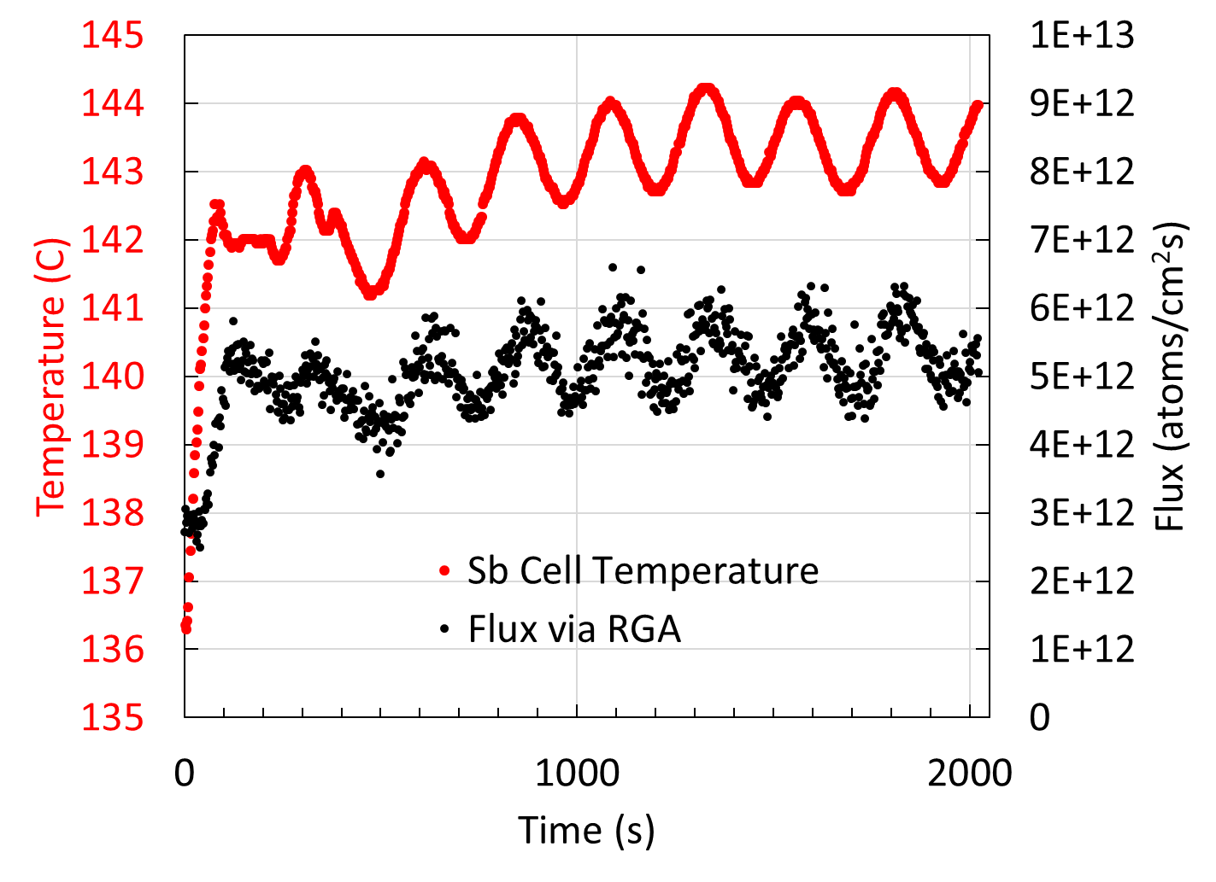
Flux Control and Calibration
Slide 7
Notes:
7

Slide 8
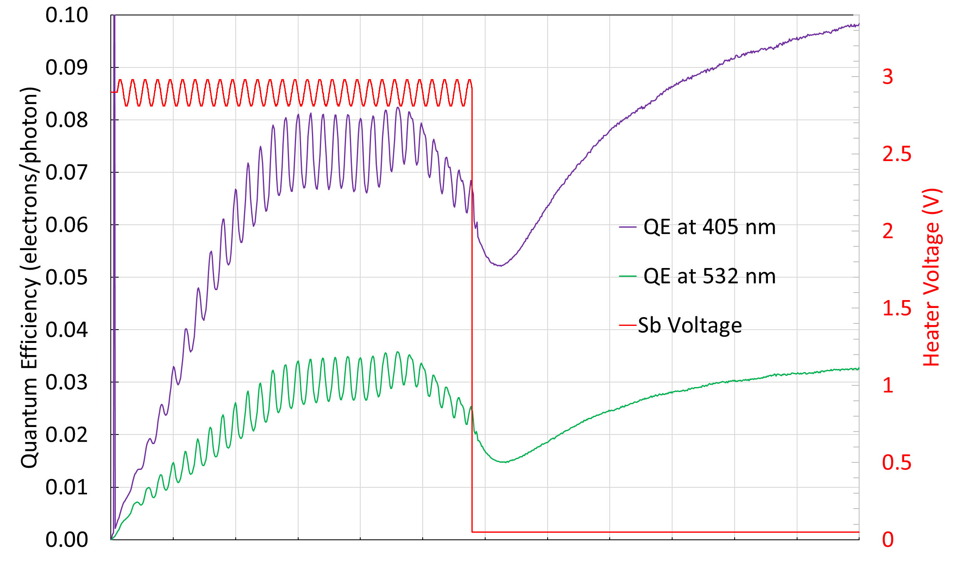
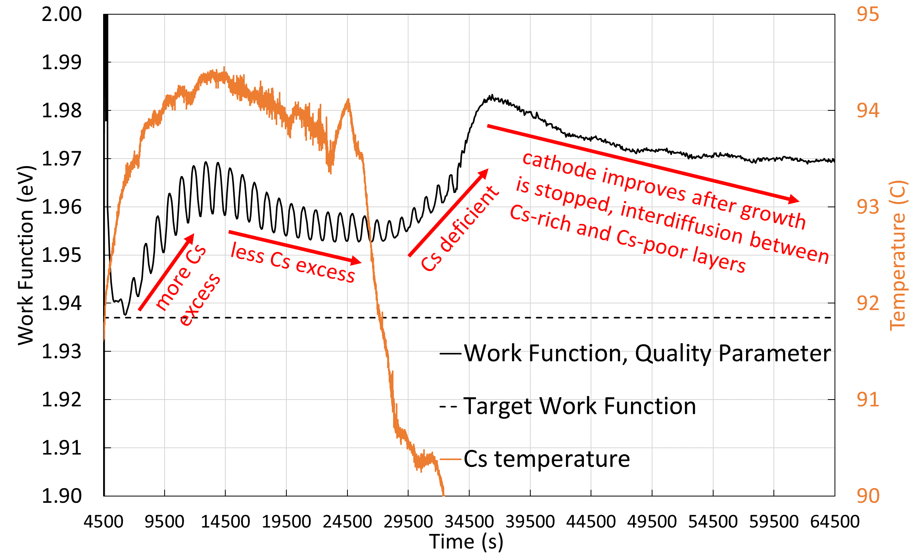
Towards Automated Growth
Observations:
+ (local) minimum
+/- Oscillations vanish at extremum
- Frequency doubles at extremum
- Phase shift by π at extremum
GOAL
Slide 8
Notes:
8

Slide 9
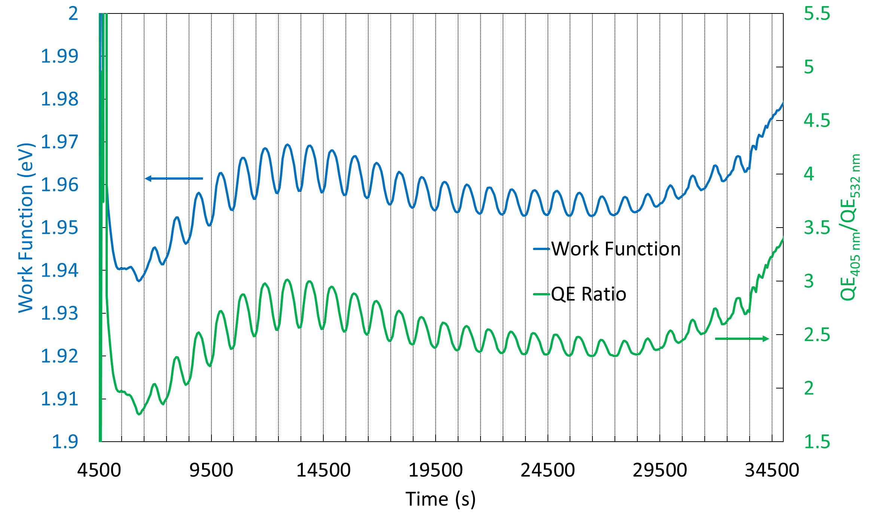
Choice of Thickness-Independent Quality Parameter: Experiment
Advantages
QE Ratio
Easy to implement
No ambiguity
Work Function
Physically significant
Potentially universal metric
Slide 9
Notes:
9

Slide 10
Conclusions / Future Plans
Precise flux control is critical for low substrate temperature co-evaporation of alkali antimonides
Thickness-independent real-time quality parameter can be based on photoemissive properties
Response of the growing cathode system to flux ratio modulation indicates potential for feedback-based control methods
Next step: integration of adaptive control algorithm into growth procedure
Slide 10
Notes:
10

