Slide 1
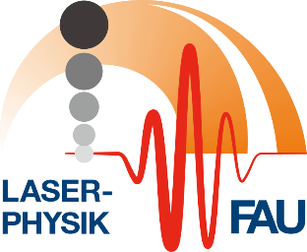
Generation of attosecond electron pulses by inelastic ponderomotive scattering at an optical traveling wave
M. Kozák^{1,2}, T. Eckstein¹, N. Schönenberger¹, and P. Hommelhoff¹
Photocathode Physics for Photoinjectors (P3)
17.10.2018
¹ Department of Physics, Friedrich-Alexander-Universität Erlangen-Nürnberg (FAU), Staudtstrasse 1, 91058 Erlangen, Germany, EU
² Faculty of Mathematics and Physics, Charles University, Ke Karlovu 3, 12116 Prague 2, Czech Republic, EU

Slide 2
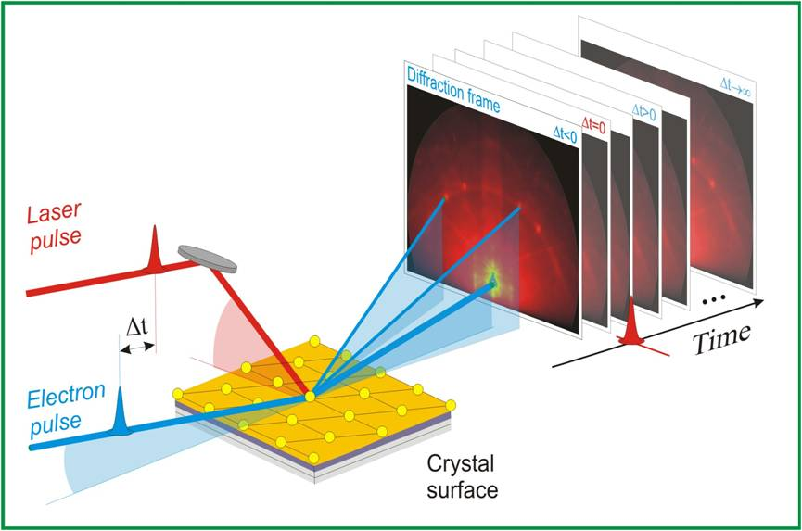
Motivation
Pulsed electron beams for imaging with both high temporal and high spatial resolution
de Broglie wavelength:
Temporal resolution limited due to dispersion of electrons in vacuum
Solution: Control of momentum of electrons accelerated to 1-300 keV (typical energies in electron microscopy) using short laser pulses → Generation of electron pulses with attosecond durations
S. Chen, et al., PNAS 102, 8854 (2005).
P. Baum, Chem. Phys. 423, 55 (2013), PNAS 107, 19714 (2010).

Slide 3
Motivation
Imaging of the electron wavepacket dynamics, ultrafast response of electronic polarization to the field of light (nonlinear effects, resonant effects, scattering, etc.)
Phase-resolved imaging of optical near-fields – nanophotonics,nanoplasmonics
E. Goulielmakis, et al., Nature 466, 739 (2010).
B. Barwick, et al., Nature 462, 902 (2009).

Slide 4
Motivation
Coherent phonon dynamics, ultrafast energy transfer between electrons and phonons
Electron sources for novel laser-driven electron accelerators
M. Hase, et al., Nat. Photonics 6, 243 (2012).
J. Breuer, P. Hommelhoff, PRL 111, 134803 (2013).

Slide 5
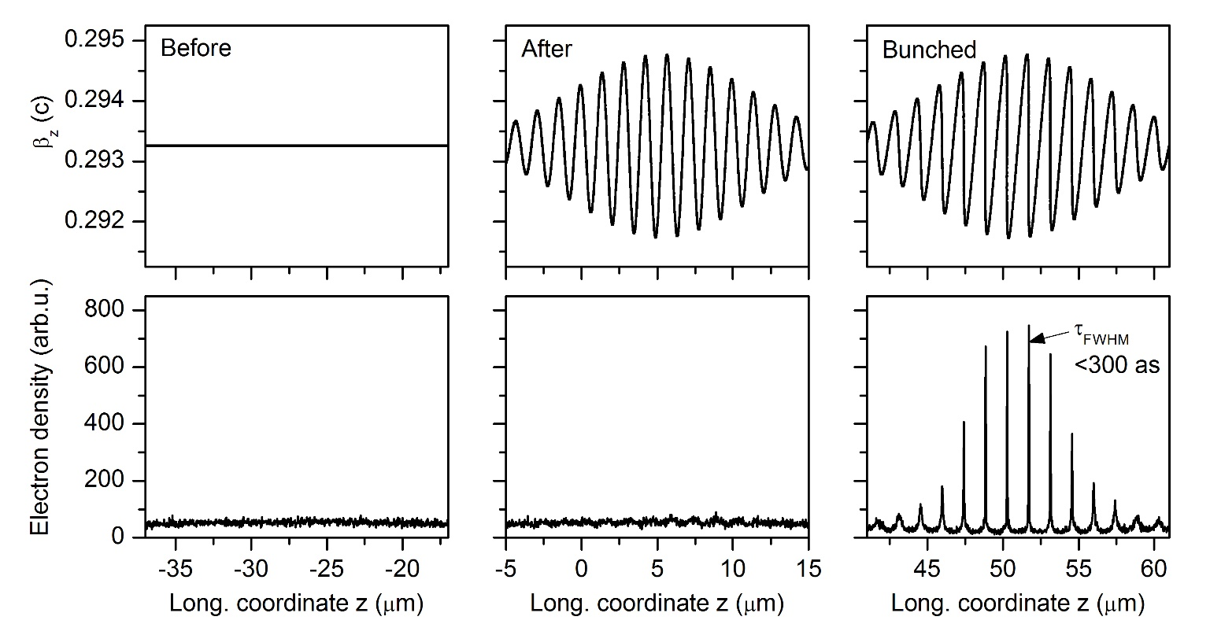
General concept of attosecond electron pulse train generation
Similar to nonlinear compression of optical pulses:
Spectral broadening – introducing a time-correlated phase modulation in the form of a linear chirp to part of the electron distribution
Compression by dispersive propagation – dispersion of electrons in vacuum is close to linear for small relative energy modulation

Slide 6
General concept of attosecond electron pulse train generation
Similar to nonlinear compression of optical pulses:
Spectral broadening – introducing a time-correlated phase modulation in the form of a linear chirp to part of the electron distribution
Compression by dispersive propagation – dispersion of electrons in vacuum is close to linear for small relative energy modulation

Slide 7
Interaction of electrons with optical near-fields
Interaction between free electrons and electromagnetic field of light in vacuum is not possible due to different dispersion relations for electrons and photons:
S. T. Park et al., New J. Phys. 12, 123028 (2010).
Electron energy spectrum after the interaction is modulated – absorption/emission of n photons
Wavefunction, Hamiltonian:
F. J. García de Abajo et al., Nano Lett. 10, 1859 (2010).
Notes:
Optimal photon energy matches the potential barrier/workfunction of material (for one photon emission in materials as copper, diamond, tungsten or silicon, wavelength range 260-610 nm)

Slide 8
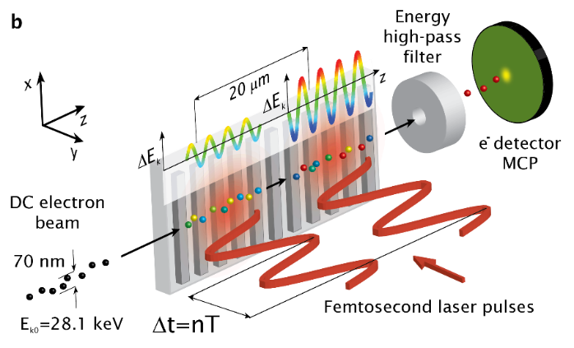
Sub-cycle energy modulation
Ramsey-type control
Y. Morimoto, P. Baum, Nat. Phys. 14, 252 (2018).
M. Kozák, et al., Nat. Commun. 8, 14342 (2017).
K. E. Echternkamp, et al., Nat. Phys. 12, 1000 (2016).
K. E. Priebe, et al., Nat. Photonics 11, 793 (2017).

Slide 9
Free-space electron energy modulation
Two counter-propagating laser fields at different frequencies
Analogy to the Kapitza-Dirac effect
Ponderomotive force:
P. Baum, A. H. Zewail, PNAS 104, 18409 (2007).
D. L. Freimund, et al., Nature 413, 142143 (2001).

Slide 10
Free-space electron energy modulation
Two counter-propagating laser fields at different frequencies
Two laser fields at different
frequencies intersected under
some particular angles
Ponderomotive force:
P. Baum, A. H. Zewail, PNAS 104, 18409 (2007).

Slide 11
Modulation of energy/longitudinal momentum
Energy and momentum conservation for two crossed laser beams at different frequencies

Slide 12
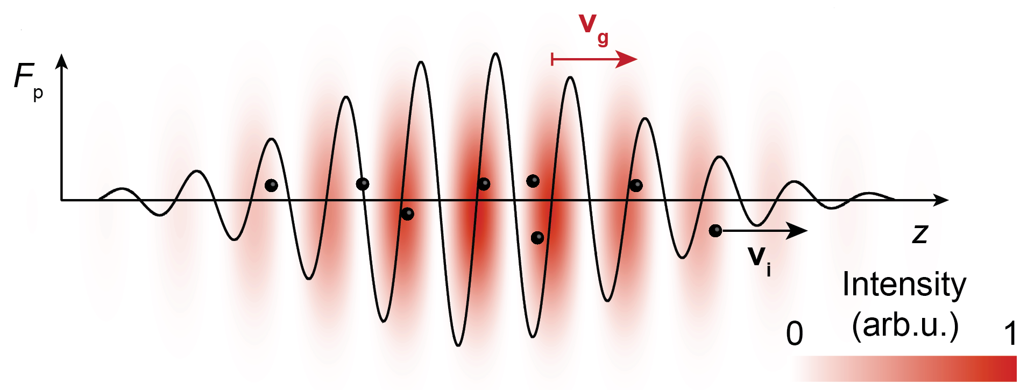
Modulation of energy/longitudinal momentum
Energy and momentum conservation for two crossed laser beams at different frequencies
Standing wave created in the electron´s rest frame
M. Kozák, T. Eckstein, N. Schönenberger, and P. Hommelhoff, Inelastic ponderomotive scattering of electrons at a high-intensity optical travelling wave in vacuum, Nature Physics 14, 121 (2018).

Slide 13
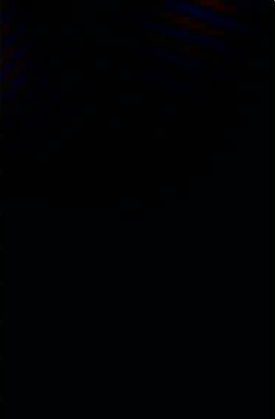
Interaction between electrons and ponderomotive potential of a „slow“ optical travelling wave

Slide 14
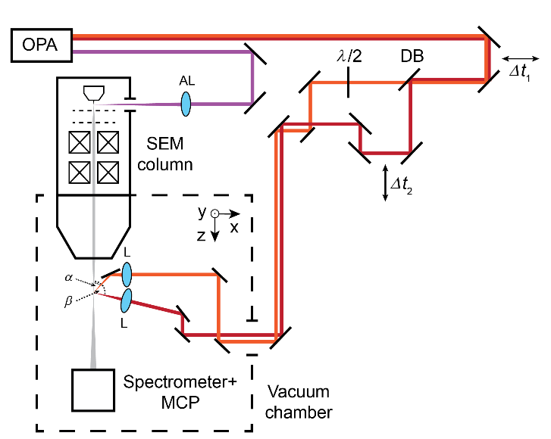
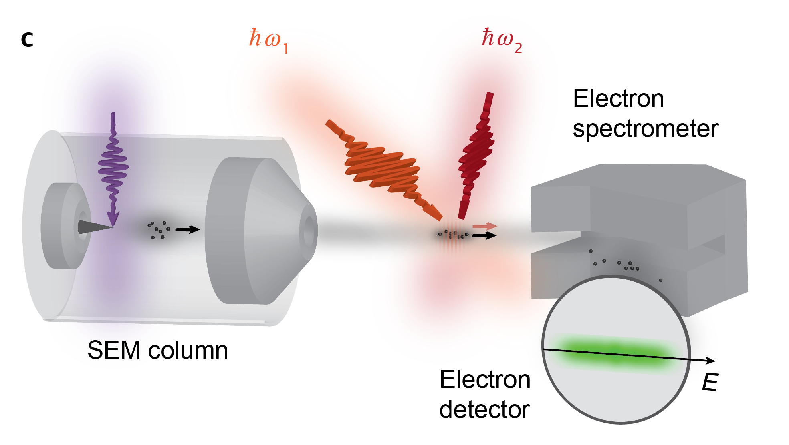
Experimental demonstration of the longitudinal Kapitza-Dirac effect - setup
Electron source - laser-triggered SEM, Schottky tip cathode
Laser – Ti:sapphire regenerative amplifier, optical parametric amplifier
M. Kozák, et al., Nature Physics 14, 121 (2018).

Slide 15
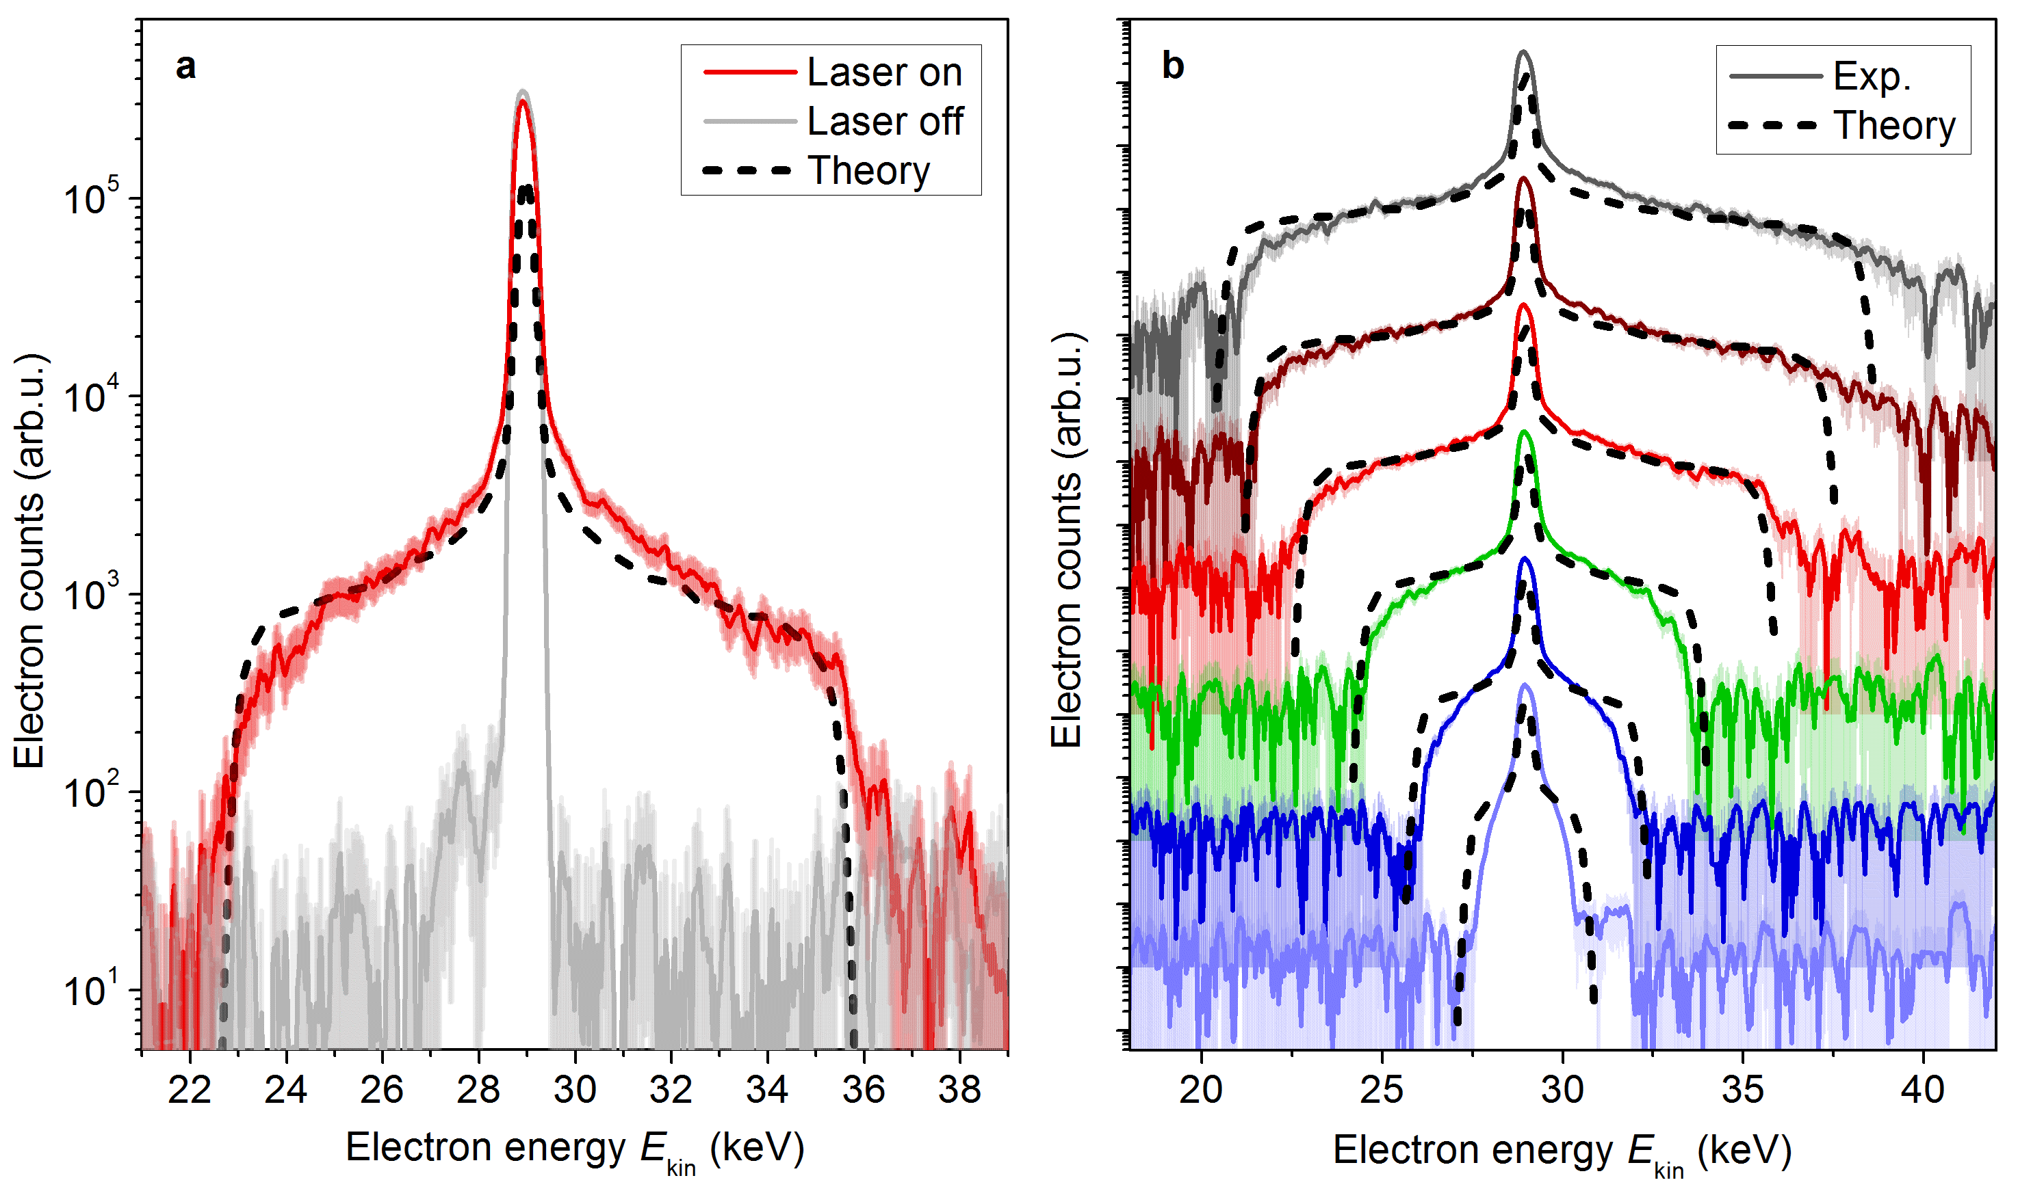
Experimental demonstration of the longitudinal Kapitza-Dirac effect – measured results
Electron spectra with and without the laser pulses, intensity dependence
Theory - numerical solution of the classical
relativistic equation of
motion with Lorentz force:
128 μJ
111 μJ
85 μJ
59 μJ
38 μJ
19 μJ
M. Kozák, et al., Nature Physics 14, 121 (2018).

Slide 16
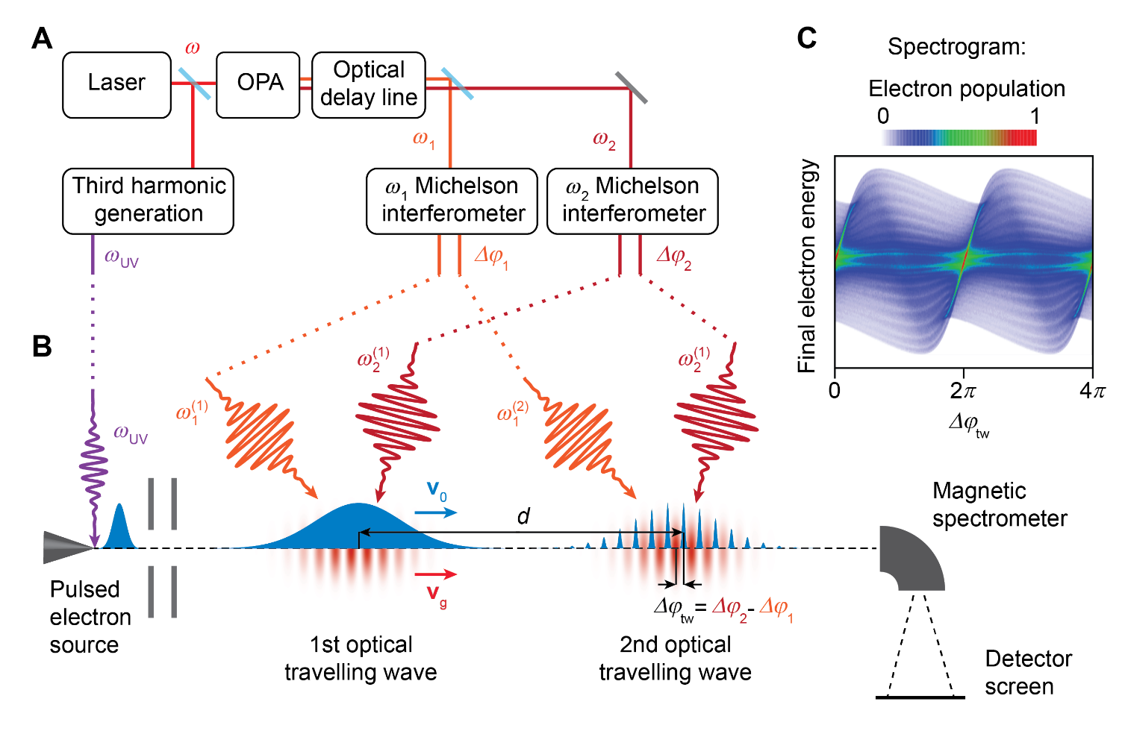
Generation and detection of attosecond electron electron pulse trains
Sinusoidal modulation of electron energy/longitudinal momentum – ballistic formation of attosecond bunches
Detection via a second phase-locked interaction
M. Kozák, et al., Phys. Rev. Lett. 120, 103203 (2018).

Slide 17
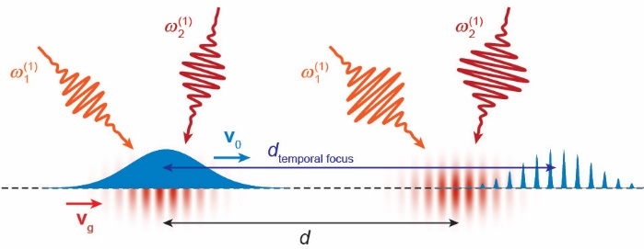
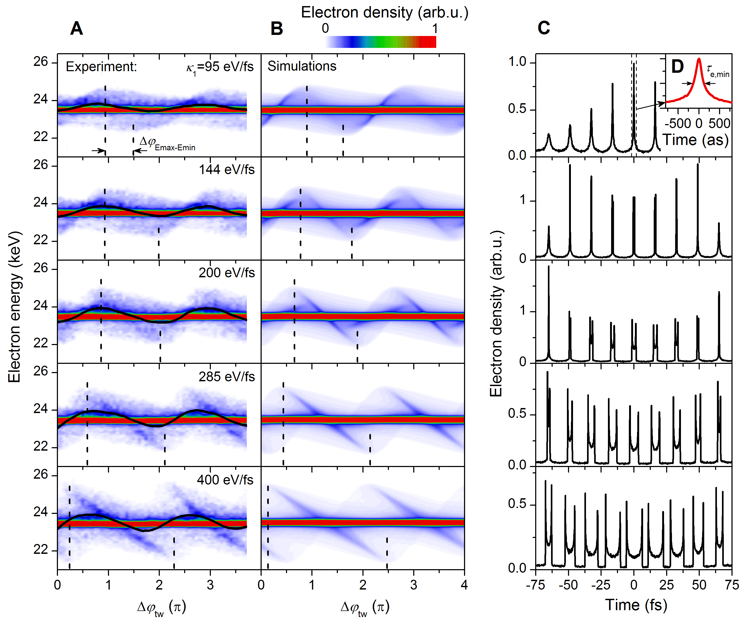
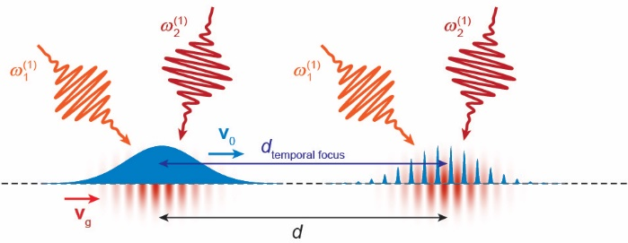
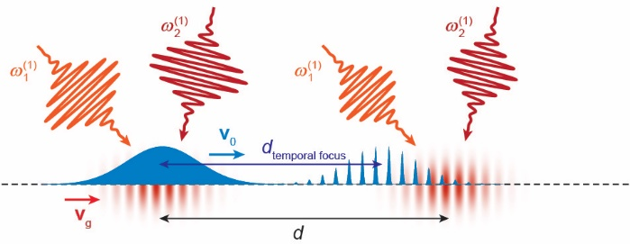
Generation and detection of attosecond electron electron pulse trains
Measured spectrograms clearly reveal phase oscillation
The shape of the spectrograms contains information about the state of the electrons in the longitudinal phase space
M. Kozák, N. Schönenberger, P. Hommelhoff, Ponderomotive generation and detection of attosecond free-electron pulse trains, Phys. Rev. Lett. 120, 103203 (2018).

Slide 18
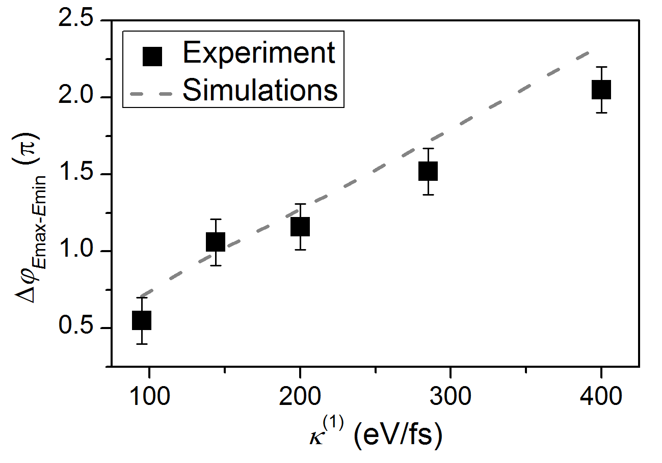
Generation and detection of attosecond electron electron pulse trains
Measured spectrograms clearly reveal phase oscillation
The shape of the spectrograms contains information about the state of the electrons in the longitudinal phase space
Phase shift between energy minima and maxima (dashed lines) in the spectrograms.
M. Kozák, N. Schönenberger, P. Hommelhoff, Ponderomotive generation and detection of attosecond free-electron pulse trains, Phys. Rev. Lett. 120, 103203 (2018).

Slide 19
Conclusions & outlook
New powerful technique for periodic energy modulation of the electrons by their interaction with ponderomotive potential of an optical travelling wave produced by two laser pulses at different frequencies in vacuum was developed and demonstrated
Strong energy modulation of up to 50% of the initial electron energy observed
High acceleration gradient of G_{p}=2.2±0.2 GeV/m reached in the sub-relativistic field regime

Slide 20
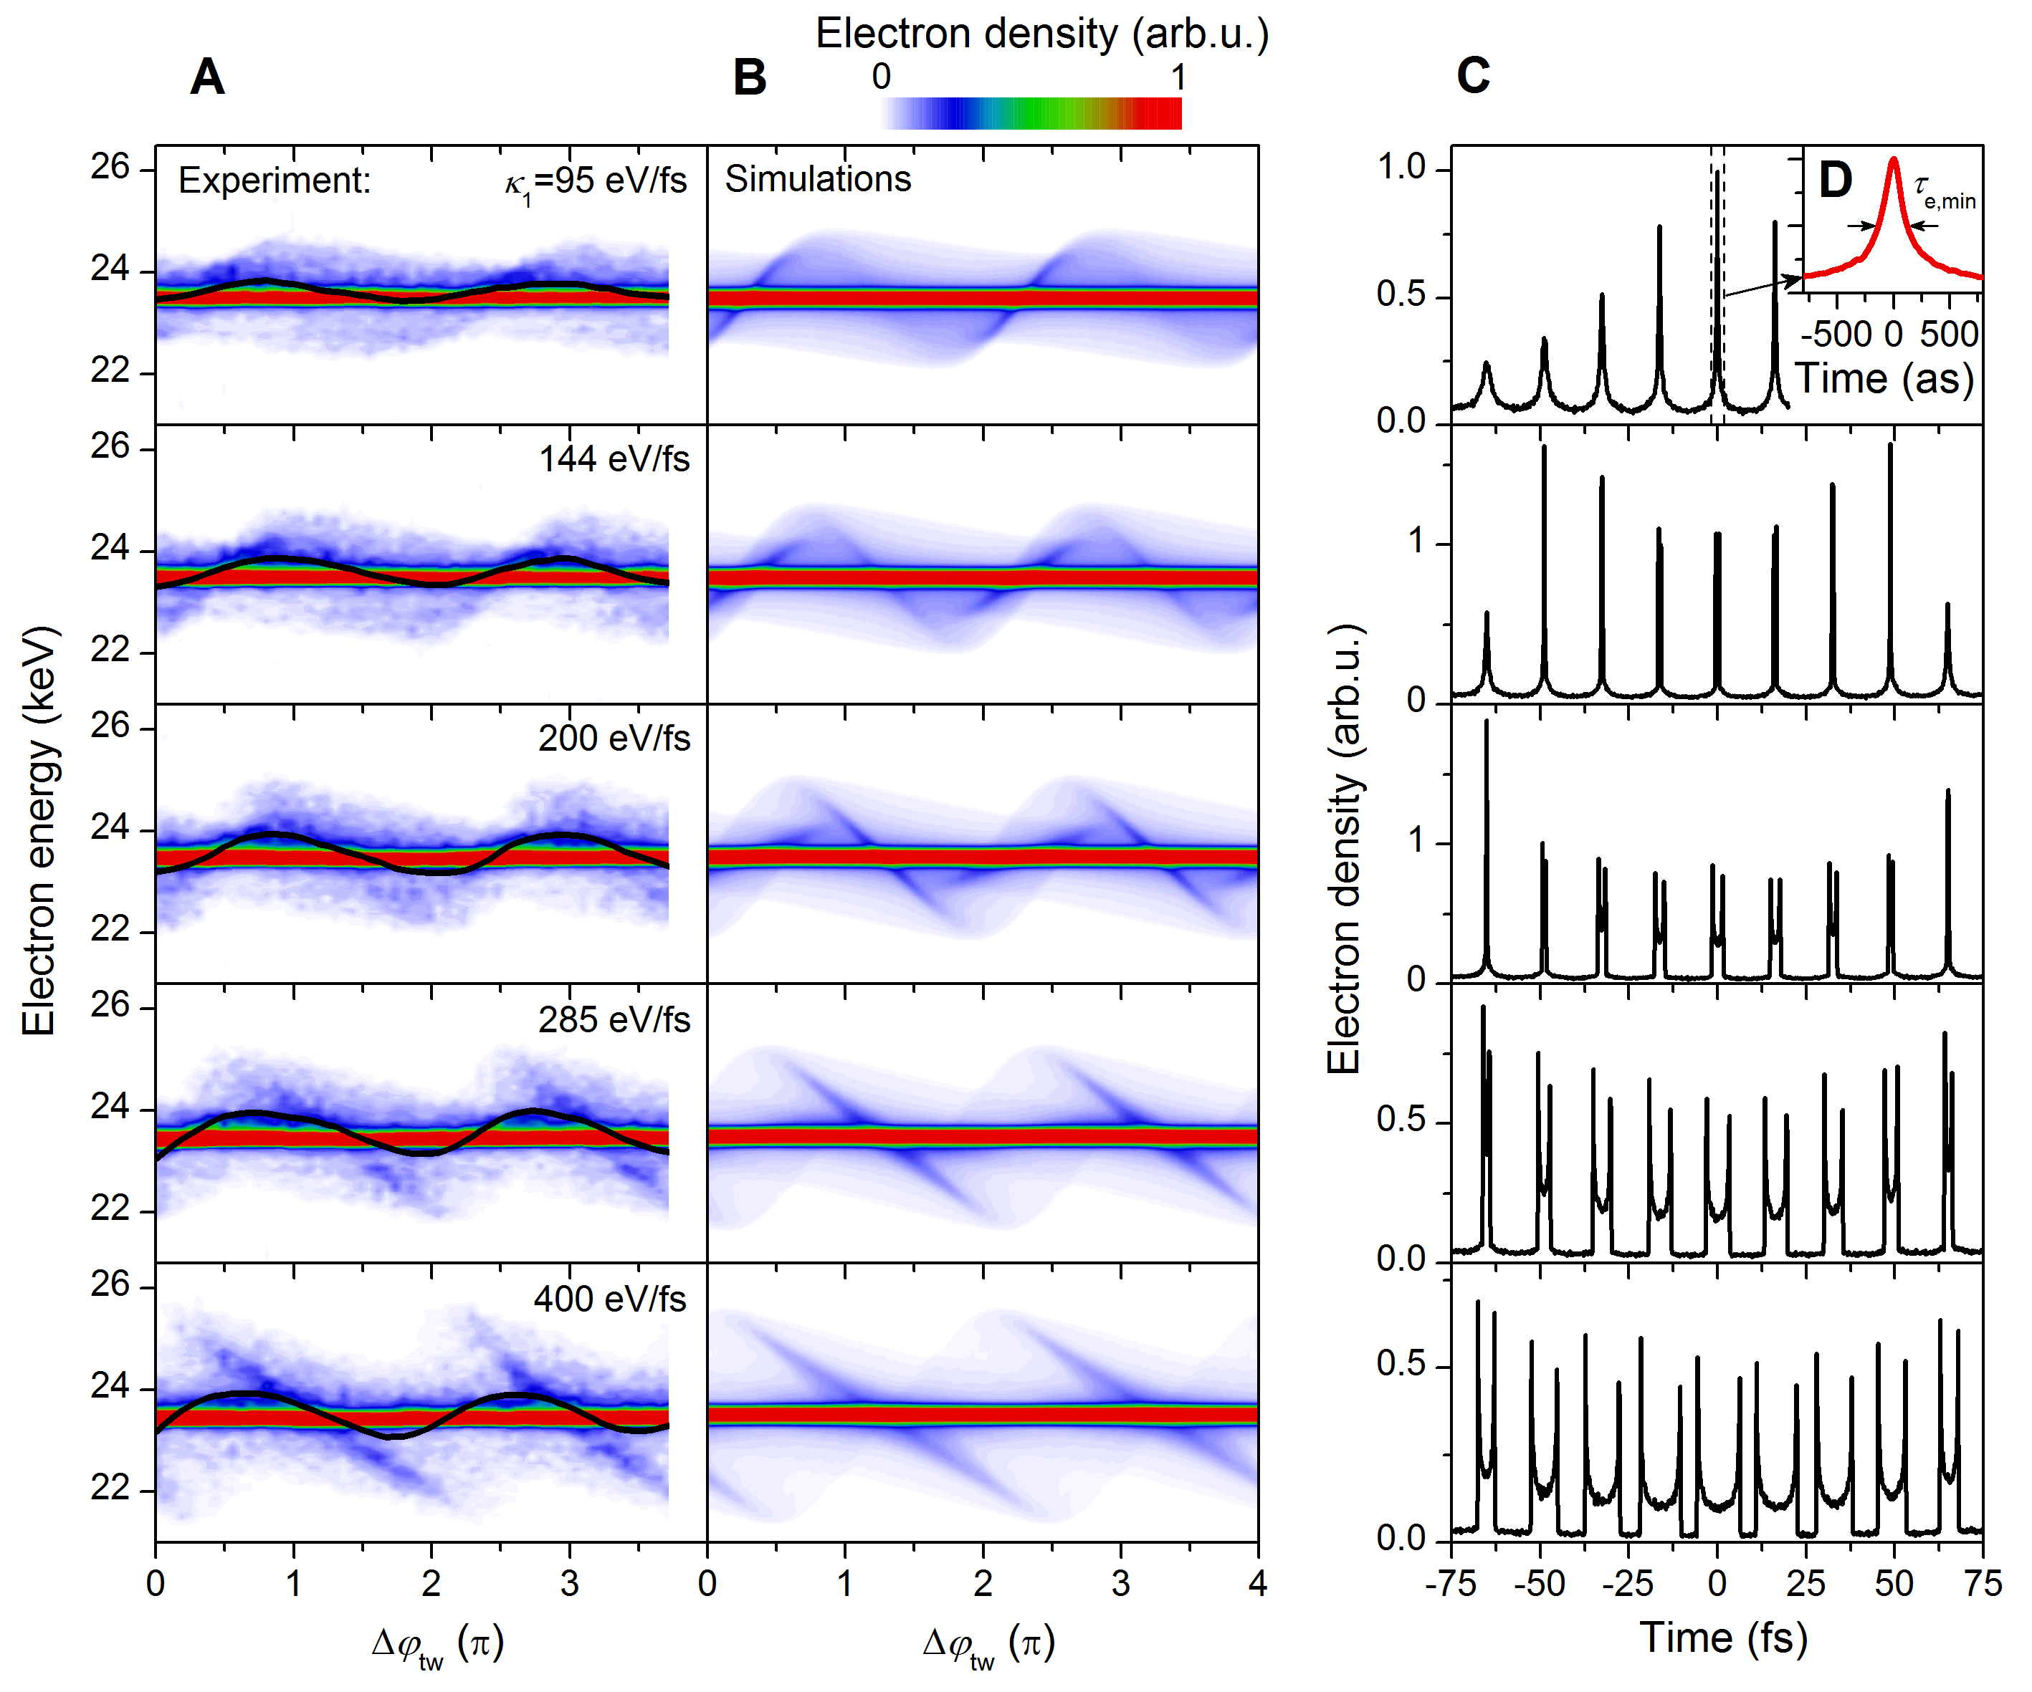
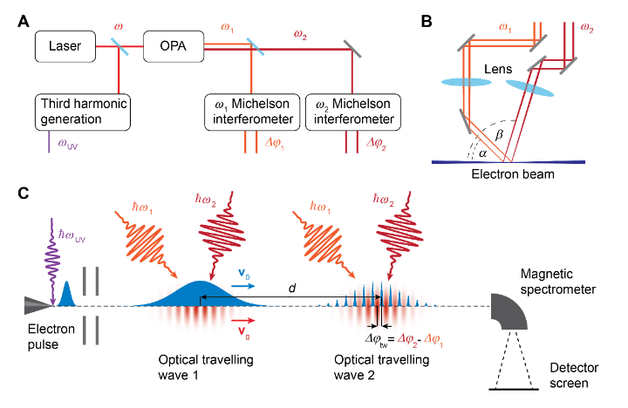
Conclusions & outlook
New powerful technique for periodic energy modulation of the electrons by their interaction with ponderomotive potential of an optical travelling wave produced by two laser pulses at different frequencies in vacuum was developed and demonstrated
Attosecond electron pulse train generation and detection was experimentally demonstrated
Duration of individual pulses below 300 as
Attosecond pulse trains are available for ultrafast imaging experiments

Slide 21

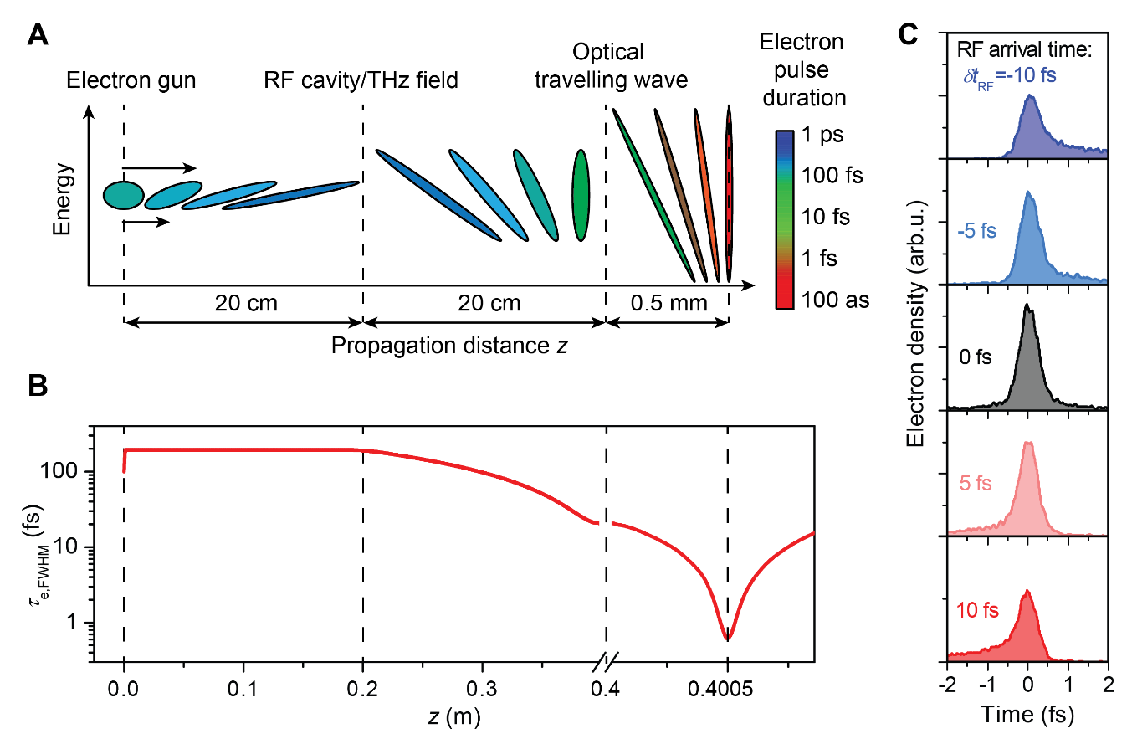
Conclusions & outlook
Generation of isolated attosecond electron pulses
M. Kozák, et al., Phys. Rev. Lett. 120, 103203 (2018).

Slide 22
Conclusions & outlook
Ponderomotive acceleration possible using chirped pulses
M. Kozák, J. Phys. B: At. Mol. Opt. Phys. 48, 195601 (2015).

Slide 23
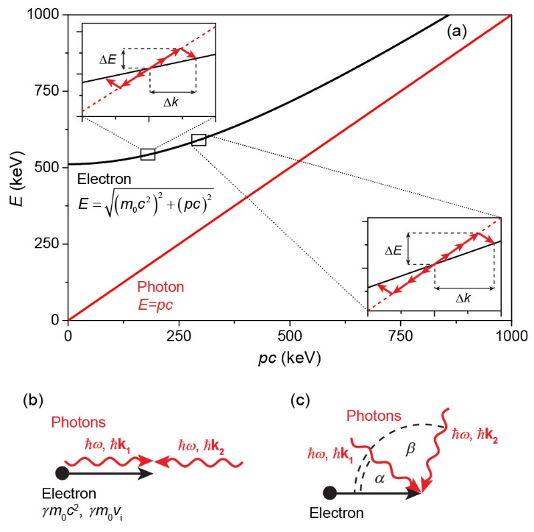
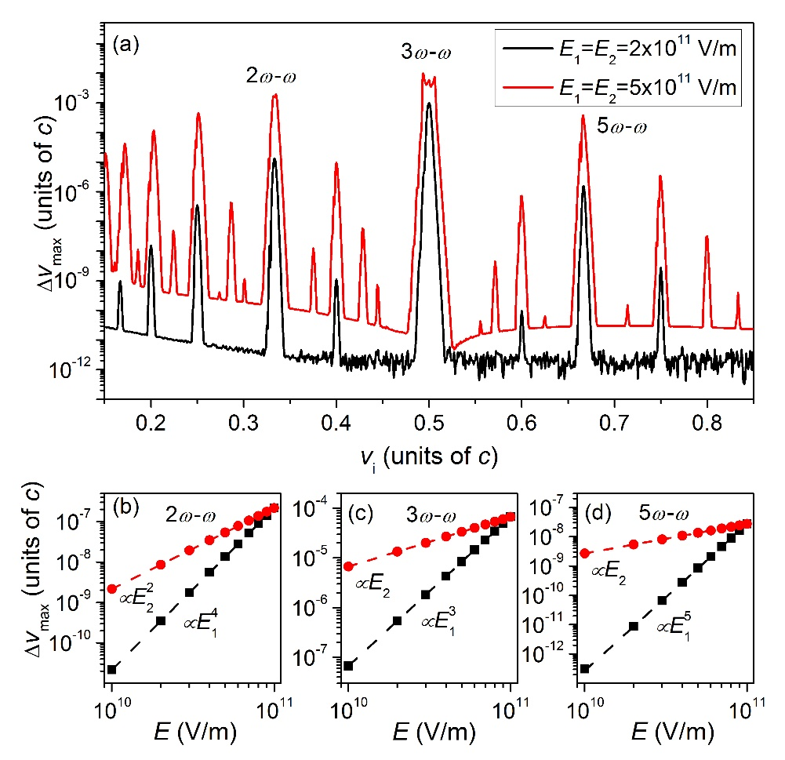
Conclusions & outlook
Higher-order nonlinear scattering of electrons at an optical standing wave
M. Kozák, Nonlinear inelastic scattering of electrons at an optical standing wave, Phys. Rev. A 98, 013407 (2018).

Slide 24
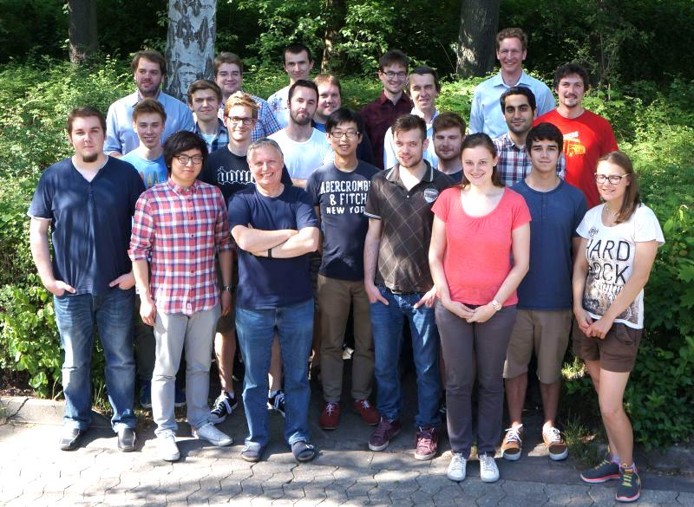



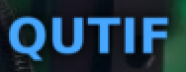








FAUs Lehrstuhl für Laserphysik
Peter Hommelhoff
Philip Dienstbier
Timo Eckstein
Christian Heide
Takuya Higuchi
Martin Hundhausen
Johannes Illmer
Ang Li
Joshua McNeur
Stefan Meier
Timo Paschen
Jürgen Ristein
Constanze Sturm
Alexander Tafel
Norbert Schönenberger
Philipp Weber
Peyman Yousefi
Robert Zimmermann
Open
positions!
Partners/
collaborations:
QEM collaboration
ACHIP collaboration
D. Bykov, P. Russell, MPL
R. L. Byer + coll., Stanford / SLAC
I. Hartl, F. Kärtner, R. Aßmann, DESY
R. Holzwarth, MenloSystems
Chr. Lemell, J. Burgdörfer, TU Vienna
M. Kling, F. Krausz, LMU/MPQ
G. G. Paulus, Jena
J. Rosenzweig, P. Musumeci, UCLA
M. Stockman, Georgia State
Former members:
M. Förster A. Aghajani-Talesh J. Breuer P. Dombi D. Ehberger M. Eisele R. Fröhlich J. Hammer S. Heinrich J. Hoffrogge H. Kaupp M. Krüger A. Liehl L. Maisenbacher F. Najafi H. Ramadas T. Sattler Ella Schmidt M. Schenk L. Seitz J.-P. Stein H. Strzalka Y.-H. M. Tan S. Thomas Di Zhang

Slide 25
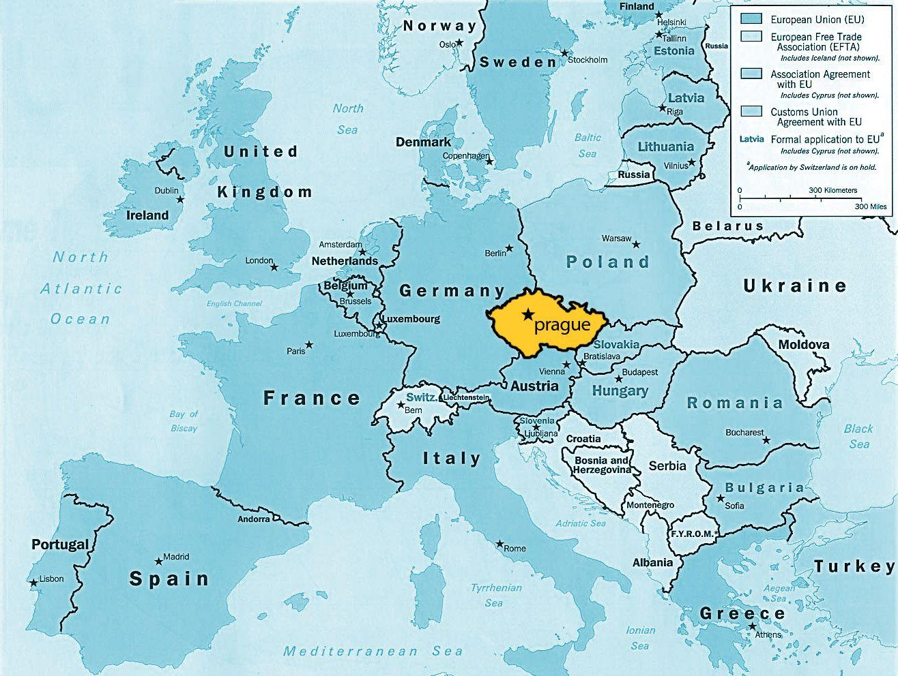

Starting new group at Charles University in Prague
Research topics:
Attosecond imaging with pulsed electron beams
Attosecond physics in solids
Open PhD and Postdoc positions!!!
Contact e-mail: kozak@karlov.mff.cuni.cz
Prague, Czech republic

Slide 26
Thank you for your attention!!!
Relevant publications:
M. Kozák, T. Eckstein, N. Schönenberger, and P. Hommelhoff, Inelastic ponderomotive scattering of electrons at a high-intensity optical travelling wave in vacuum, Nature Physics 14, 121 (2018).
M. Kozák, N. Schönenberger, P. Hommelhoff, Ponderomotive generation and detection of attosecond free-electron pulse trains, Phys. Rev. Lett. 120, 103203 (2018).

Slide 27
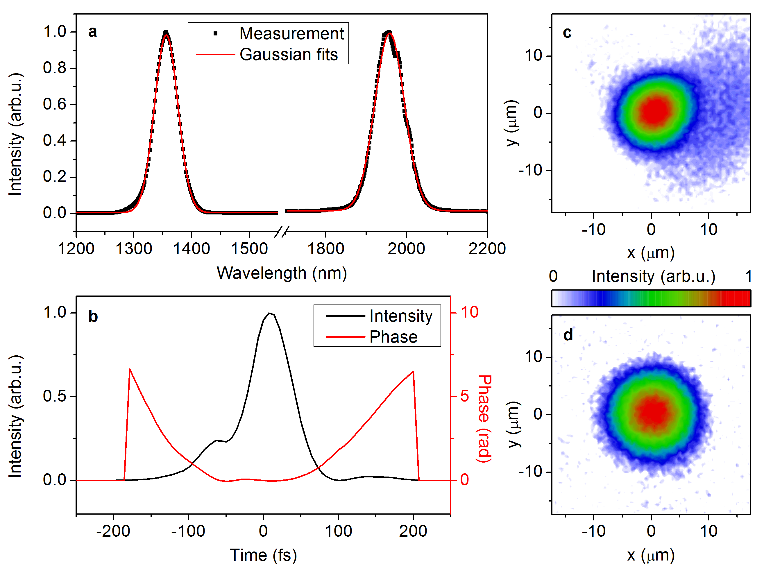
Experimental demonstration of the longitudinal Kapitza-Dirac effect – setup characterization
Laser spectra measured by infrared spectrometer, pulse duration of the OPA output measured by FROG, beam profiles measured by an imaging setup with a CCD camera
Subrelativistic field regime

Slide 28
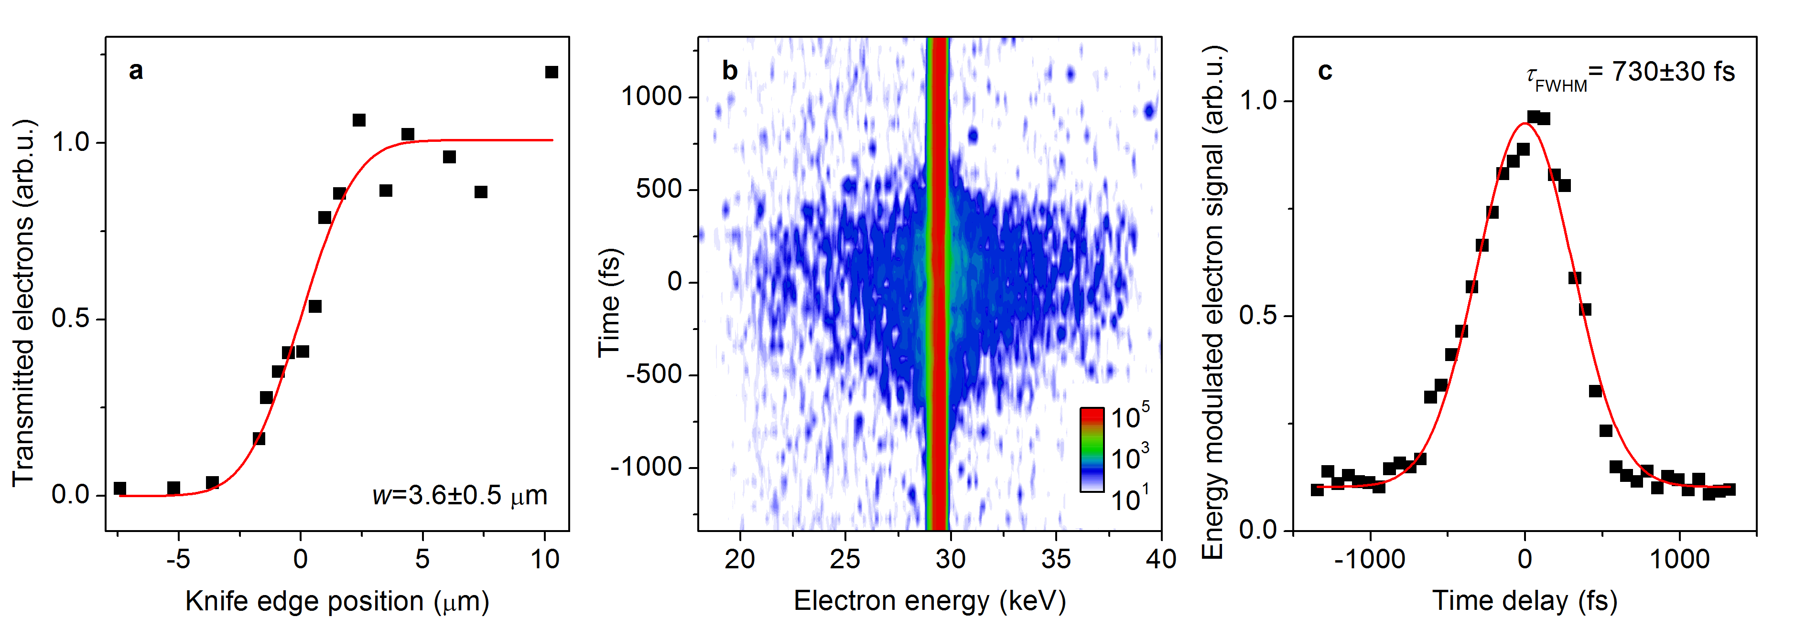
Experimental demonstration of the longitudinal Kapitza-Dirac effect – setup characterization
Electron beam spatial and temporal characterization

Slide 29
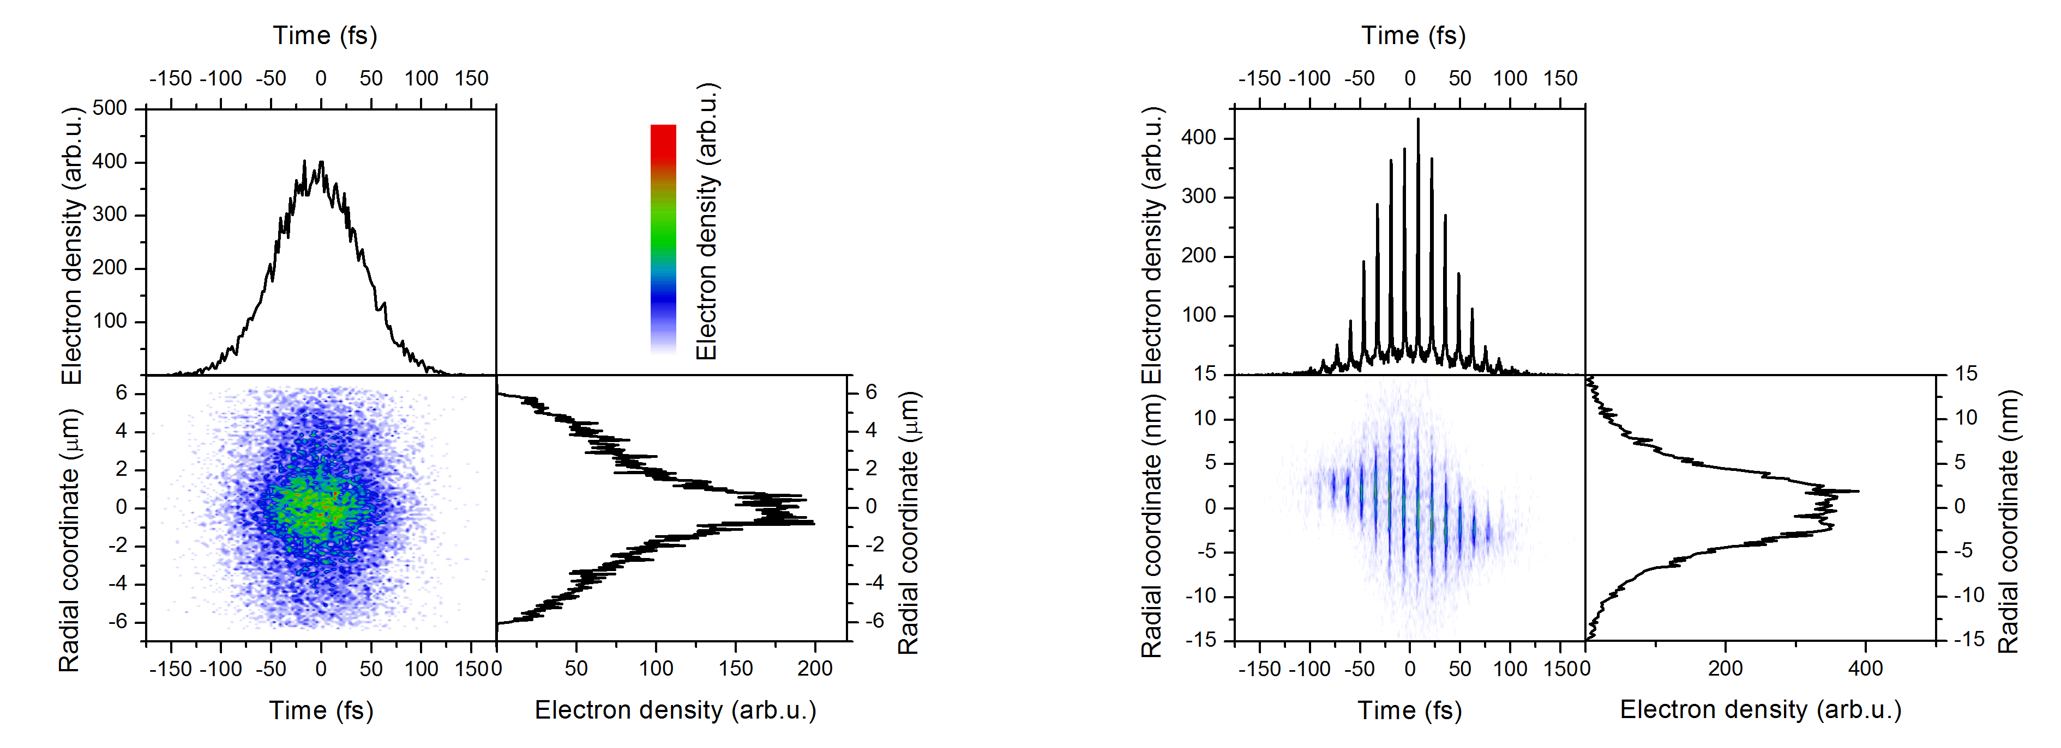
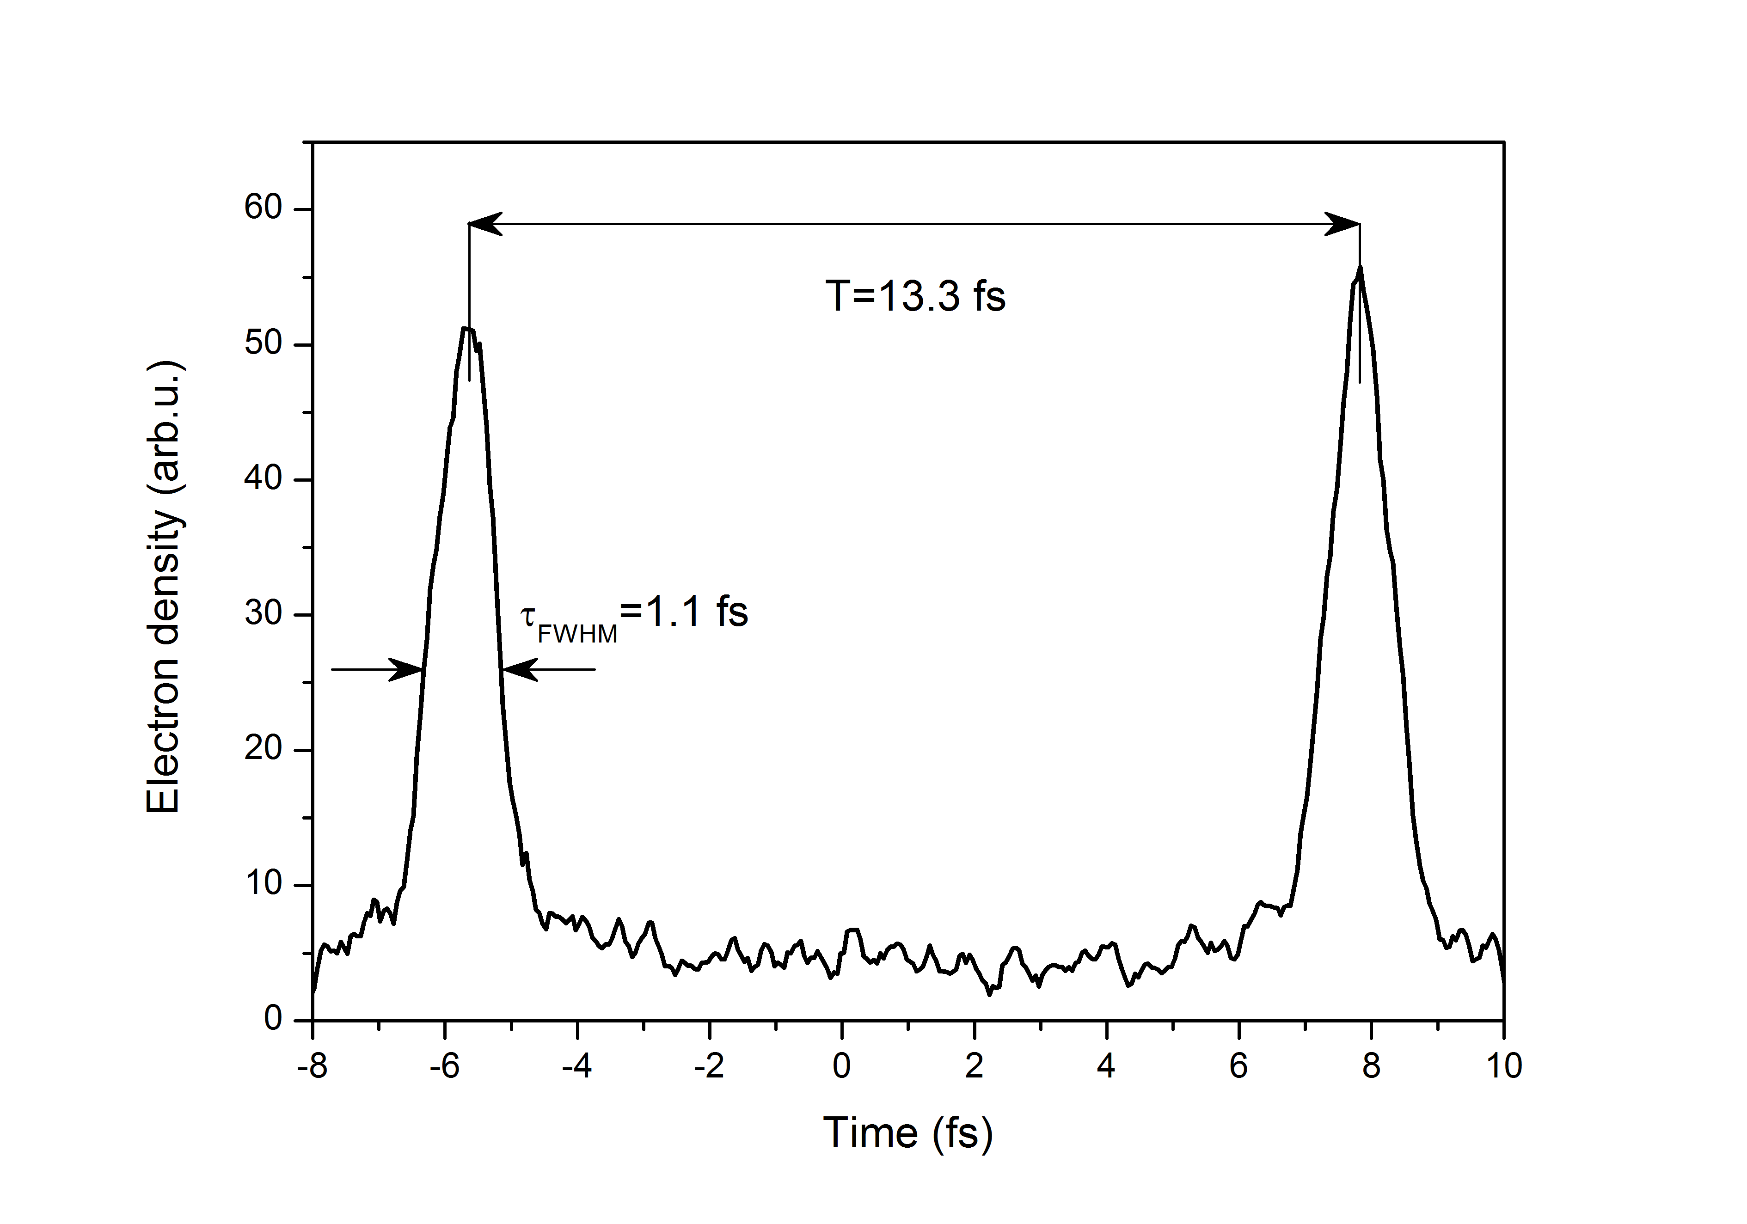
Practical considerations – simulation results
Necessary energy modulation for temporal focus at 3 mm drift distance ∼10 eV → laser pulse energy of the order of 100 nJ-1 μJ
Repetition rate of the experiment → 100 kHz-1 MHz
Compression of focused electron beam:
Laser parameters:
3 mm

Slide 30
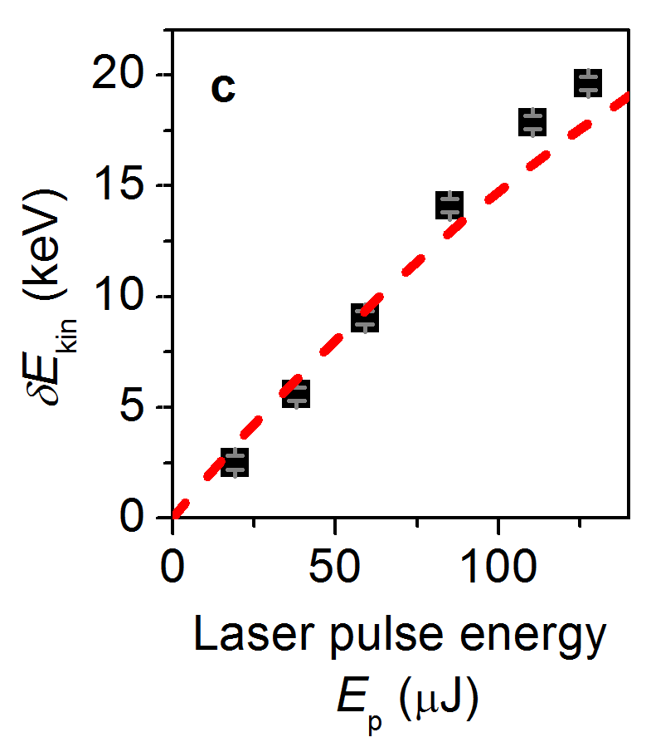
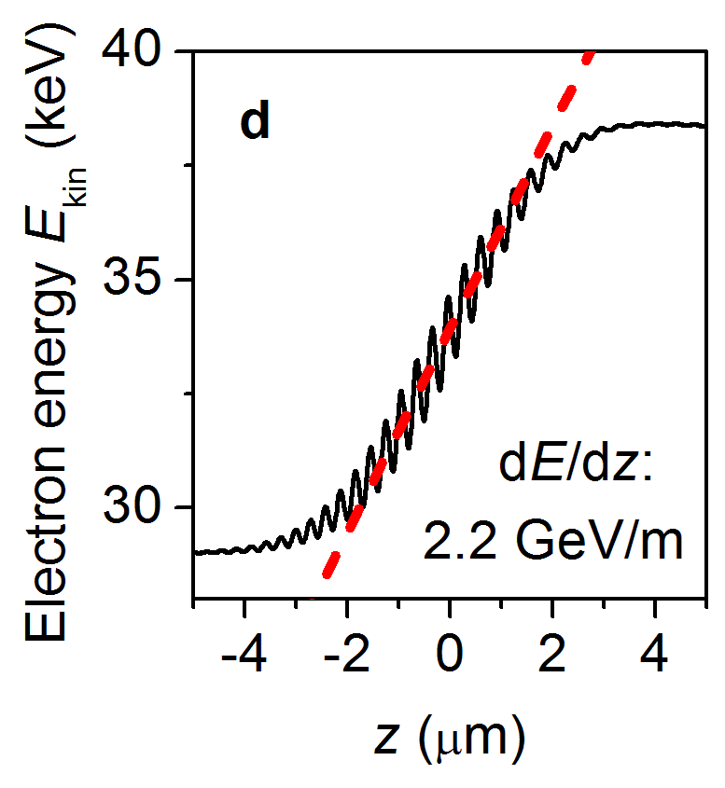
Experimental demonstration of the longitudinal Kapitza-Dirac effect – measured results
Maximum acceleration gradient
G_{p}=dE_{kin}/dz=2.2±0.2 GeV/m
Energy spread vs. Intensity
Comparison with optical near-fields:
Maximum observed gradient for near-fields at 30 keV: G_{p}=200 MeV/m
Transverse spatial acceptance of ∼100 nm vs ∼5 μm
Transverse forces (phase shifted with respect to the accelerating/decelerating forces) acting on electrons in the case of near-fields
M. Kozák, et al., Nature Physics 14, 121 (2018).

Slide 31
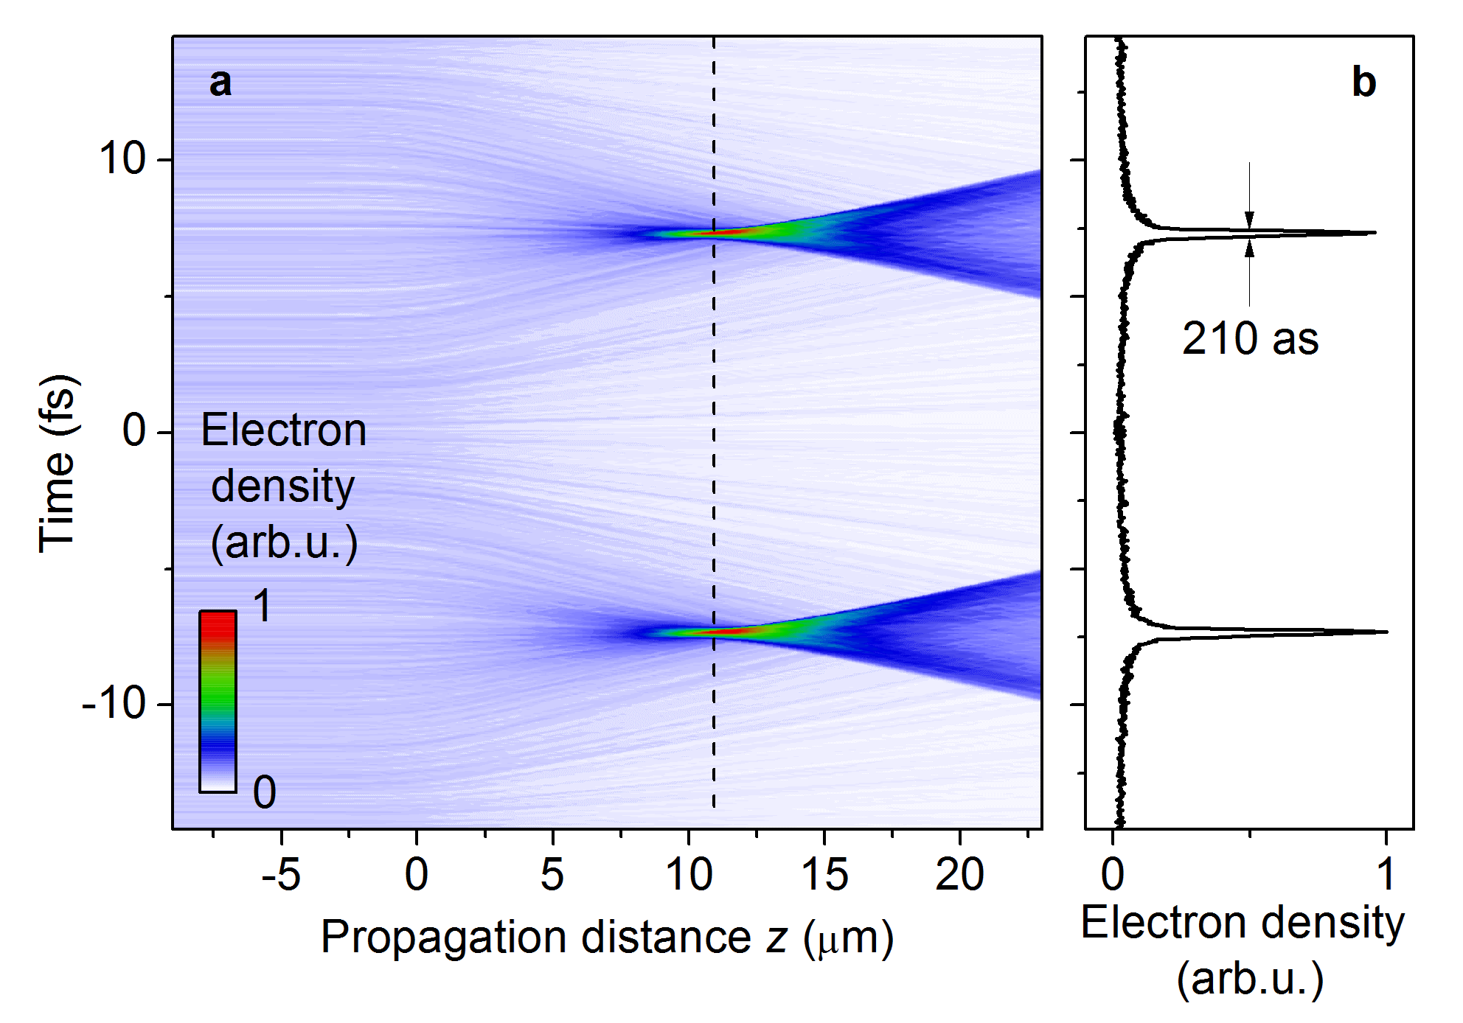
Attosecond electron bunching
Sinusoidal modulation of electron energy/longitudinal momentum – ballistic formation of attosecond bunches
M. Kozák, et al., Nature Physics 14, 121 (2018).

Slide 32
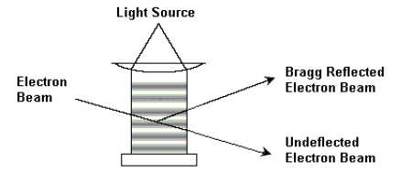
Particle-wave dualism in quantum mechanics
Difraction of matter waves at a periodic optical grating??
(Kapitza and Dirac, 1933)
Scattering at a ponderomotive
potential of a standing wave:
www-personal.umich.edu/~dmanna/

Slide 33
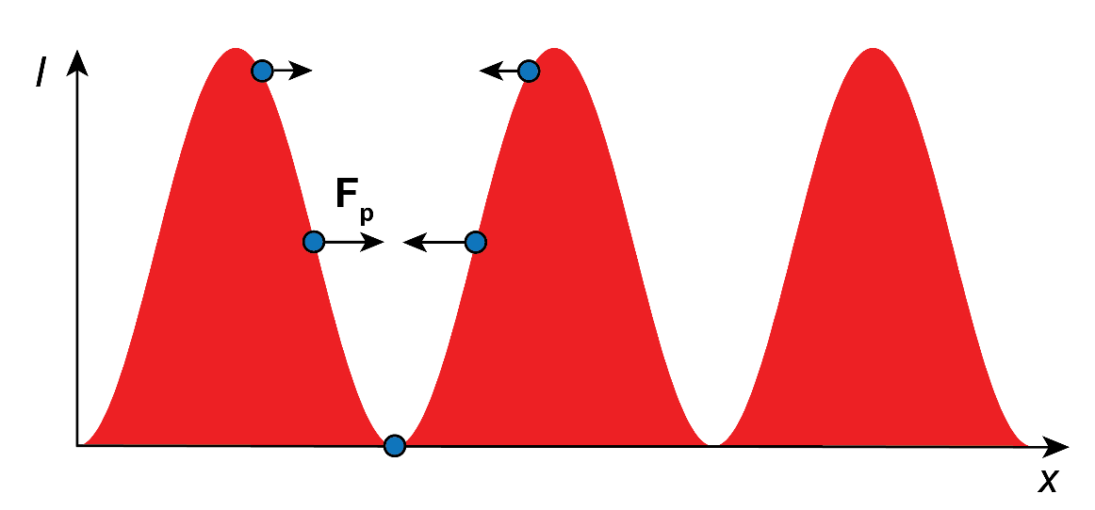
Ponderomotive force
Classical motion of a charged particle in the non-uniform oscillating electromagnetic field
First order perturbation theory
Averaging over an integer number of optical periods

Slide 34
Particle-wave duality in quantum mechanics
Difraction of matter waves at a periodic optical grating??
(Kapitza and Dirac, 1933)
Energy and momentum conservation
Stimulated Compton
scattering
www-personal.umich.edu/~dmanna/
H. Batelaan, et al., Journal of Physics: Conference Series 701 (2016) 012007

Slide 35
Particle-wave duality in quantum mechanics
Difraction of matter waves at a periodic optical grating??
(Kapitza and Dirac, 1933)
First observed for atoms where the interaction can be resonantly enhanced
www-personal.umich.edu/~dmanna/

Slide 36
Particle-wave duality in quantum mechanics
Difraction of matter waves at a periodic optical grating??
(Kapitza and Dirac, 1933)
First observed for atoms where the interaction can be resonantly enhanced
Succesful experiment with electrons showing quantization of momentum transfer
www-personal.umich.edu/~dmanna/

Slide 37
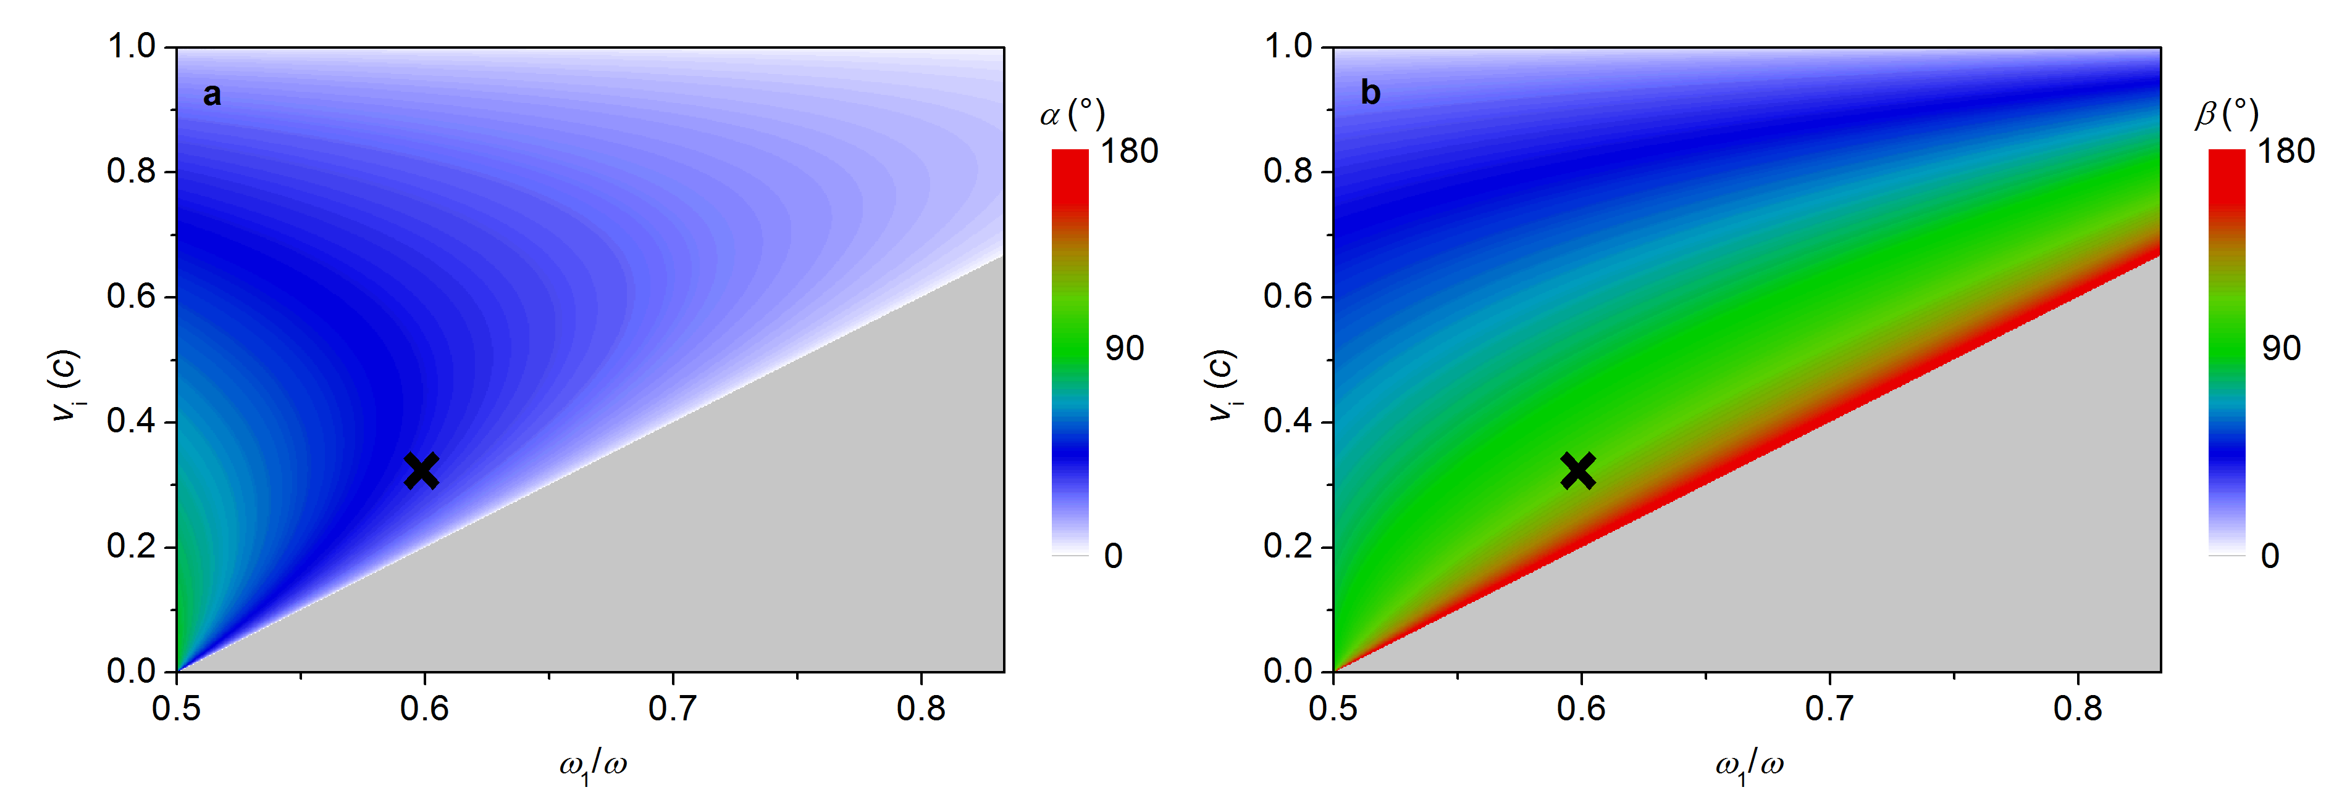
Modulation of energy/longitudinal momentum
Energy and momentum conservation for two crossed laser beams at different frequencies
For ω= ω₁ + ω₂ (optical parametric generation), the conditions for angles α and β as a function of frequency ω₁ and electron initial velocity v_{i}:

