Slide 1

Photocathode research at
UCLA Pegasus Laboratory
P. Musumeci
UCLA Department of Physics and Astronomy
P3 workshop
October 15-17th 2018, Santa Fe, NM

Slide 2






Acknowledgements
UCLA Pegasus Laboratory group
X. Shen, J. Giner Navarro. Postdocs.
E. Pyrez, E. Curry, D. Cesar, E. Cropp, P. Denham Graduate students.
C. Pennington, N. Burger, R. Hessami G. Calmasini, A. Urbanowicz. Undergraduates.
Collaborators: R. K. Li, J. Maxson, D. Alesini, G. Andonian, F. Carbone, D. Filippetto, J. Luiten, S. Karkare, J. B. Rosenzweig, J. Spence
Funding sources
  DOE Accelerator Stewardship DE-SC0009914.
  NSF Accel Science PHY-1734215
  This work was supported by the U.S. National Science Foundation under award PHY-1549132, the Center for Bright Beams.

Slide 3
Outline
Load-lock chamber for high gradient S-band RF gun
Symplectic camels and magnetized beams
DC gun test stand for photocathodes
  Laser heating
  Pump-probe reflectivity
  Cold gun and new NSF MRI with University of Colorado: HyRes

Slide 4
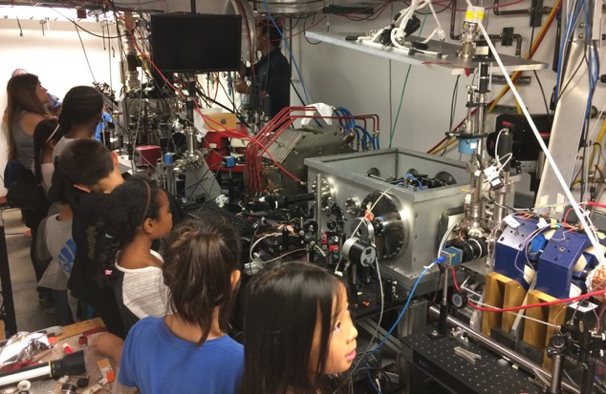
High peak brightness low charge beam research at UCLA Pegasus Laboratory
3-14 MeV student-run university-size accelerator beamline optimized for sub-pC beams
Ultralow charge beams with high peak brightness or phase space density:
  DLA: few fs acceleration bucket, sub-micron aperture
  High resolution ultrafast electron diffraction
  Single shot imaging / UEM
  THz acceleration / amplification
E. Curry et al. Meter-scale THz-driven acceleration of a relativistic electron beam. Phys. Rev. Lett. 120, 094801 (2018)
D. Cesar et al., Onset of non-linear effects in high gradient dielectric laser accelerator. Communications Physics 1, 46 (2018)
D. Cesar, et al., Demonstration of single-shot picosecond time-resolved MeV electron imaging using a compact permanent magnet quadrupole based lens. Phys. Rev. Lett., 117, 024801 (2016)
J Maxson, et al., Direct measurement of sub-10 fs relativistic electron beams with ultralow emittance. Phys. Rev. Lett., 118 154802 (2017)
Gun
Sol
Linac
Dipole
Sol
Spectrometer
Quads
Deflector
6 m
Notes:
One of the few/only MeV high brightness beamlines in a university. Much different environment than National Laboratory
Education and outreach (here is me trying to explain to 4th graders what is it that we do).
Focus on low charge high brightness beam research.
Don’t have time to show highlights here, just point you to the list of recent publications from the laboratory

Slide 5
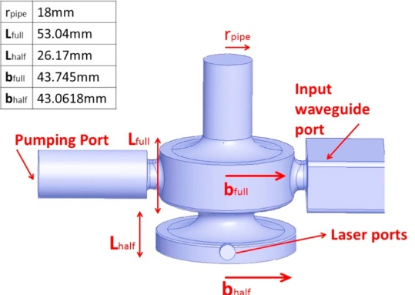
Current Pegasus beam performances
5 nm transverse emittance, 20 fC, ~10 um spot on cathode
Various emittance diagnostics techniques being developed
  Single-shot 4D transverse emittance diagnostics based on TEM grid
  Electron microscope-based setup for single-shot 4D trace space reconstruction
  Knife-edge beam-matrix reconstruction (with LBNL, D. Filippetto and F. Ji).
1.4 cell gun with braze-less design to maximize launch phase/field
High power RF system upgrade. Solid state modulator and 7.5 MW klystron
Notes:
Current performances

Slide 6
How to further improve brightness: advanced photocathodes in high gradient RF guns
Many open questions:
  Vacuum and life-time
  Effect of roughness at high field
  Brightness scaling
Developed a 1.4 cell photoinjector load–lock system compatible with “APEX-style vacuum suitcase” to deliver substrate-grown photocathodes from the preparation chamber into the injector without breaking vacuum.
Cathodes being considered for testing:
  High QE semiconductors. Alkali-antimonide photocathodes.
  Single crystal cathodes / atomically clean metals.
Notes:
Photocathode research.

Slide 7
UCLA gun Load-Lock chamber
Tested spring-less RF contact for cathode back-plane in a preliminary setup.
Full system ready to be attached to the gun
NEG pumping being installed
Aiming at 10⁻¹⁰ vacuum in loadlock region
Gun vacuum more of an issue, but all diagnostics work single-shot
Cathodes from LBNL/ASU (end of 2018)

Slide 8
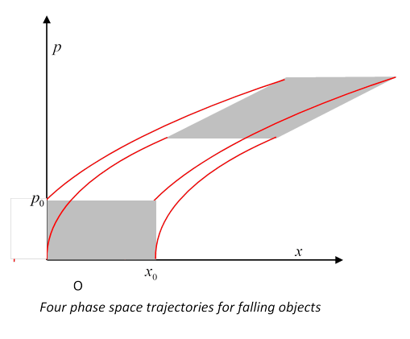
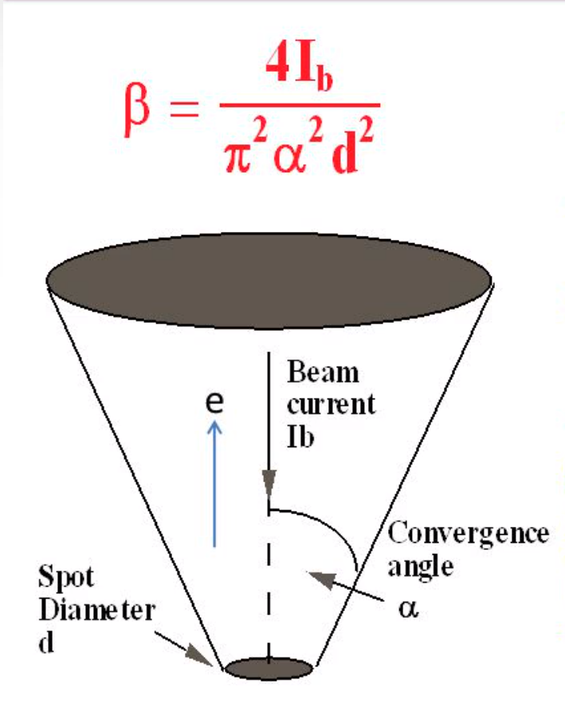
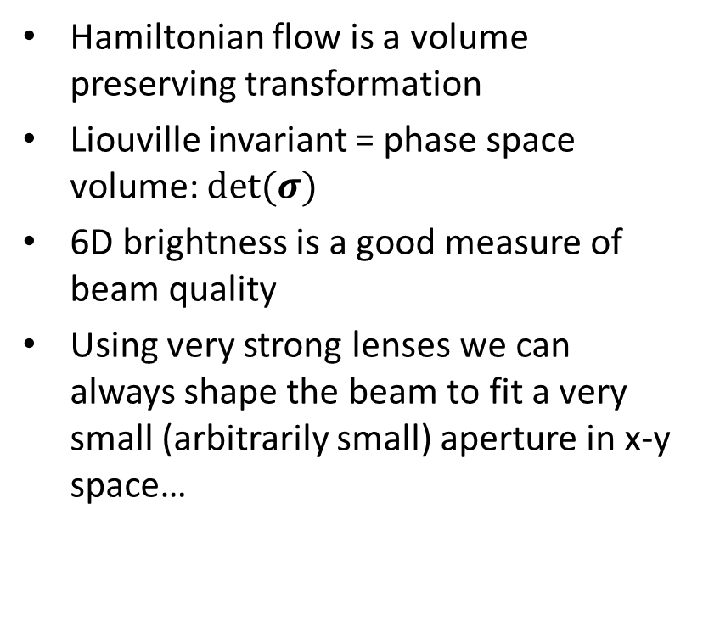
Some general considerations on
6D brightness and Liouville theorem
Hamiltonian flow is a volume preserving transformation
Liouville invariant = phase space volume: $det⁡(σ)$
6D brightness is a good measure of beam quality
Using very strong lenses we can always shape the beam to fit a very small (arbitrarily small) aperture in x-y space…
Notes:
Let me talk about something which when I found out this summer completely blew my mind. We were working on these 4D phase space reconstruction diagnostics and studying beam correlations. Skew quadrupoles and so on.

Slide 9
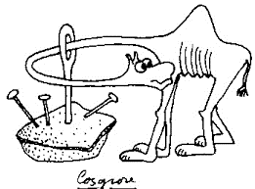

Symplectic camels and the non squeezing theorem (Gromov, 1985)
…but we can’t fit an arbitrary small aperture in x-px space !!!
Liouville volume is not the only invariant in symplectic transformations.
‘Lagrangian’ invariants : $Tr(\left(Jσ\right)n)$
  In 2D (4D phase space) $\det\left(σ\right)=ε_{1}^{2}ε_{2}^{2}$ $Tr\left(\left(Jσ\right)2\right) ∝ε_{1}^{2}{+ε}_{2}^{2}$
B. Carlsten, PRSTAB, 14, 050706 (2011): eigenemittances

Slide 10
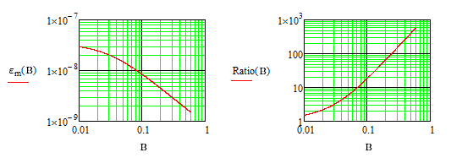
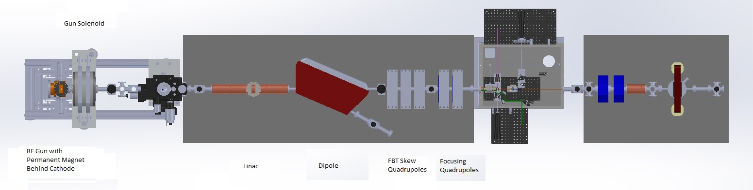


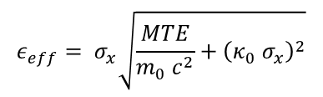

Consequences of Gromov theorem for beam physics:
Flat beam transforms and emittance exchange beamlines
A beam with a smaller eigenemittance can always be transformed into a round beam (by adding correlation/angular momentum)
At the same time it can fit into a smaller phase space hole than a round beam with the same 4D emittance.
Critical for some applications (DLA, microscopy, etc.) !
Magnetized beam + Skew quadrupole beamline implemented at Pegasus
Permanent magnet to tune B on cathode
Simulations predict 2 nm x 200 nm emittances and 1.5 um x 10 um spot sizes at DLA entrance
$$ε_{eff}= σ_{x}\sqrt{\frac{MTE}{m_{0} c^{2}}+{\left(κ_{0} σ_{x}\right)}^{2}}$$
$$ε_{±}= ε_{eff}±L$$
$$ε_{−}≅\frac{MTE}{{ e}_{0}B c}$$
$$ε_{−}\left(nm\right)=\frac{0.033∗MTE\left(meV\right)}{B(kG)}$$

Slide 11
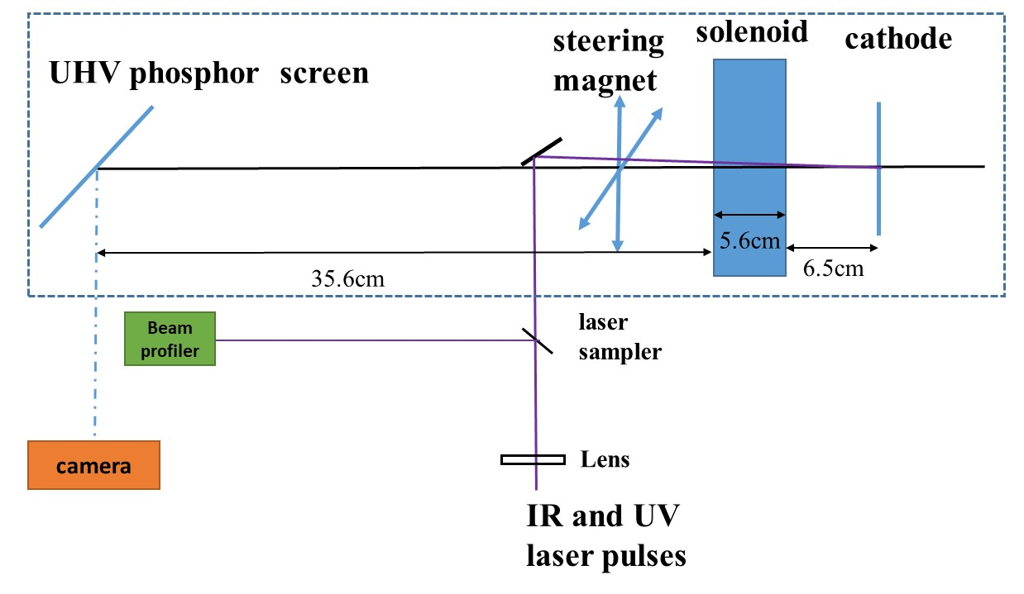
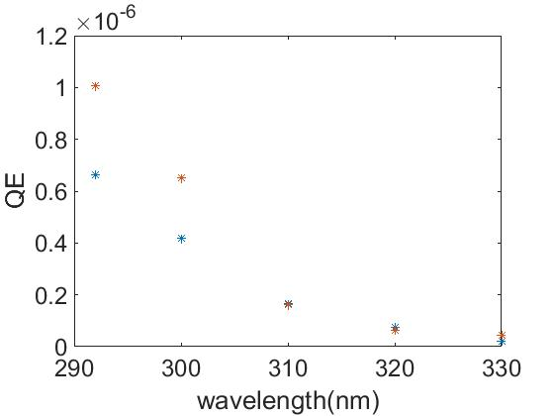
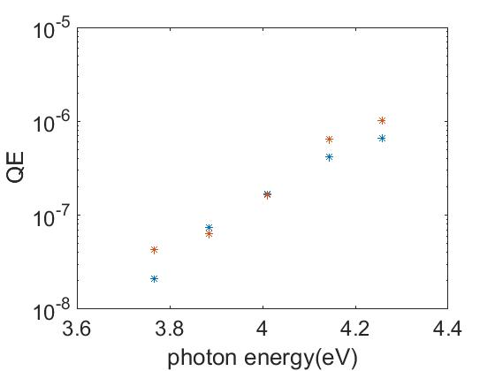
DC gun test stand
30 kV test stand for cathode studies
Easy-to-exchange cathode plugs
Solenoid scan for emittance measurements
OPA for tunable UV
  QE and emittance vs. wavelength
@0.048 mJ/cm2
*The fluence marked is peak fluence.
@ 0.032 mJ/cm2
@ 0.058 mJ/cm2
@ 0.040 mJ/cm2
@ 0.066 mJ/cm2
@ 0.036 mJ/cm2
@ 0.075 mJ/cm2
@ 0.040 mJ/cm2

Slide 12
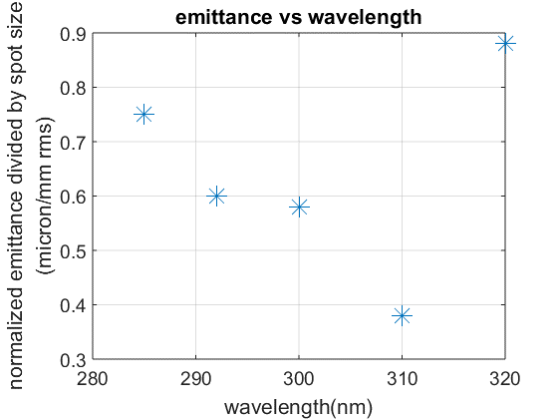
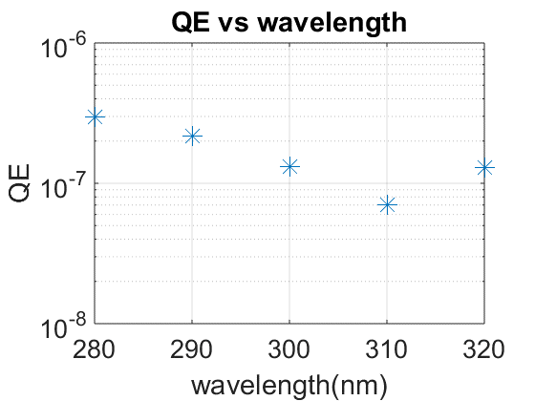
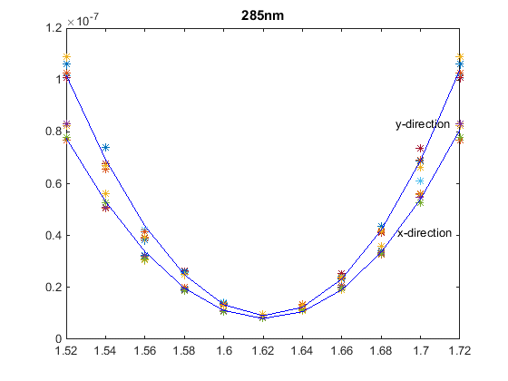
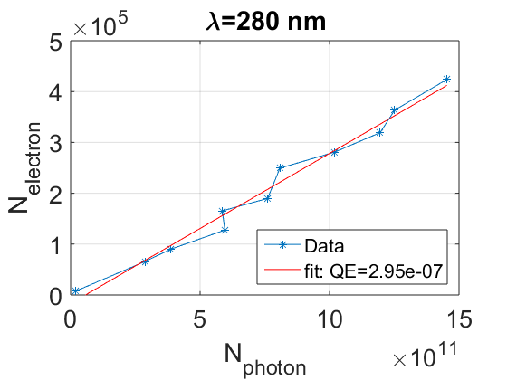
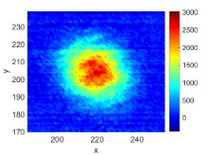
Emittance and QE measurements at high fluence (mJ/cm^2 incident)
After replacing cathode plug, not reproduced
Measurements to be validated using single-crystal plug
285 nm
Normalized emittance/ spot size(0.75 um/mm rms)

Slide 13
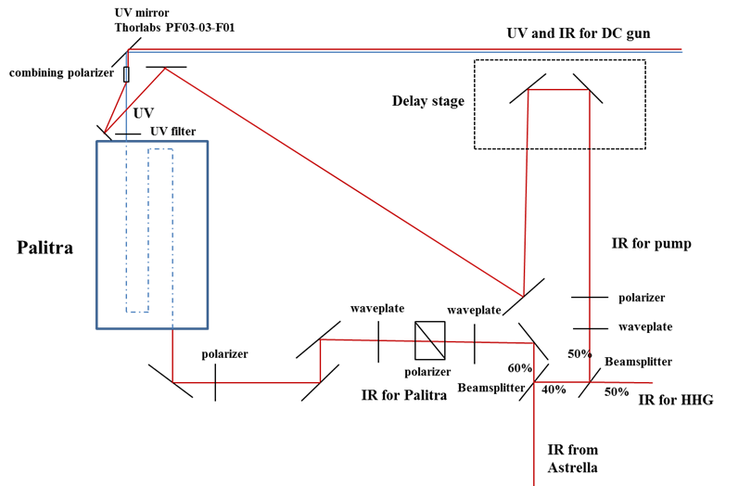
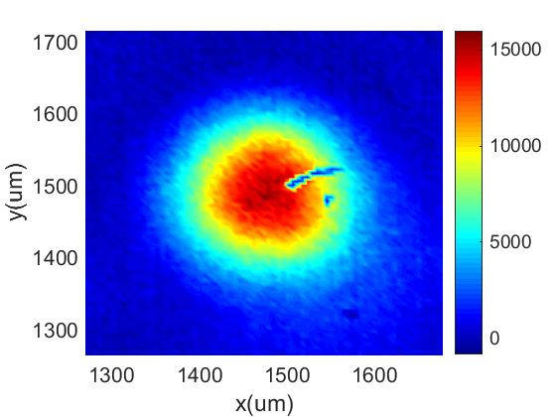
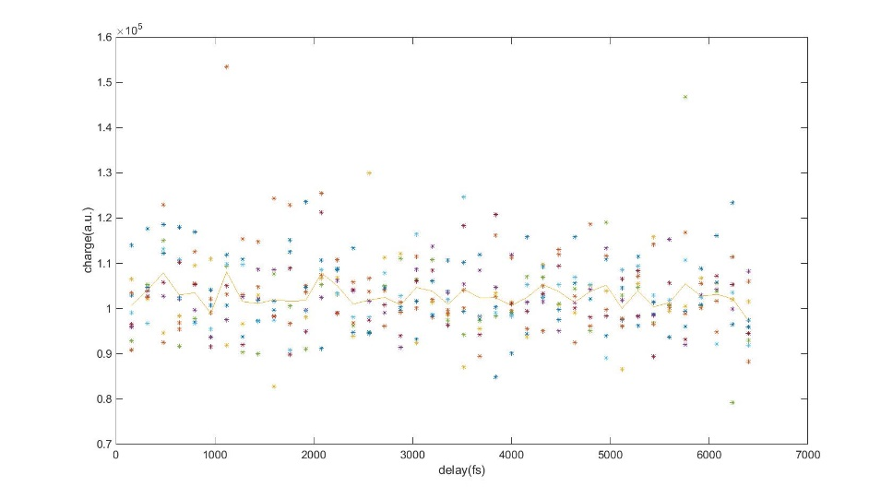
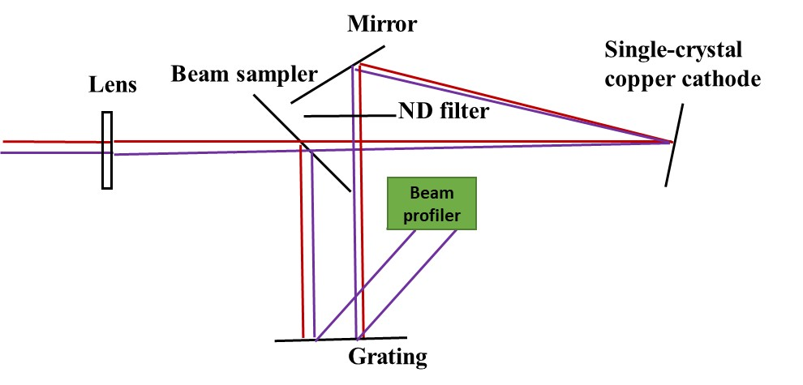
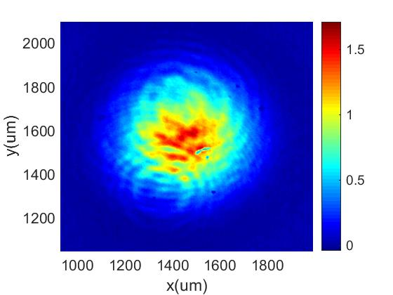
Laser heating for metal cathodes
800 nm pump and tunable UV probe
Measuring charge yield vs. time-delay
No signal yet
Strong 800 nm emission at the fluences where laser heating should be observed. Hard to disentangle
Emittance measurements require deflector
Pump-probe reflectivity setup being implemented.
UV spot virtual cathode
IR spot virtual cathode

Slide 14
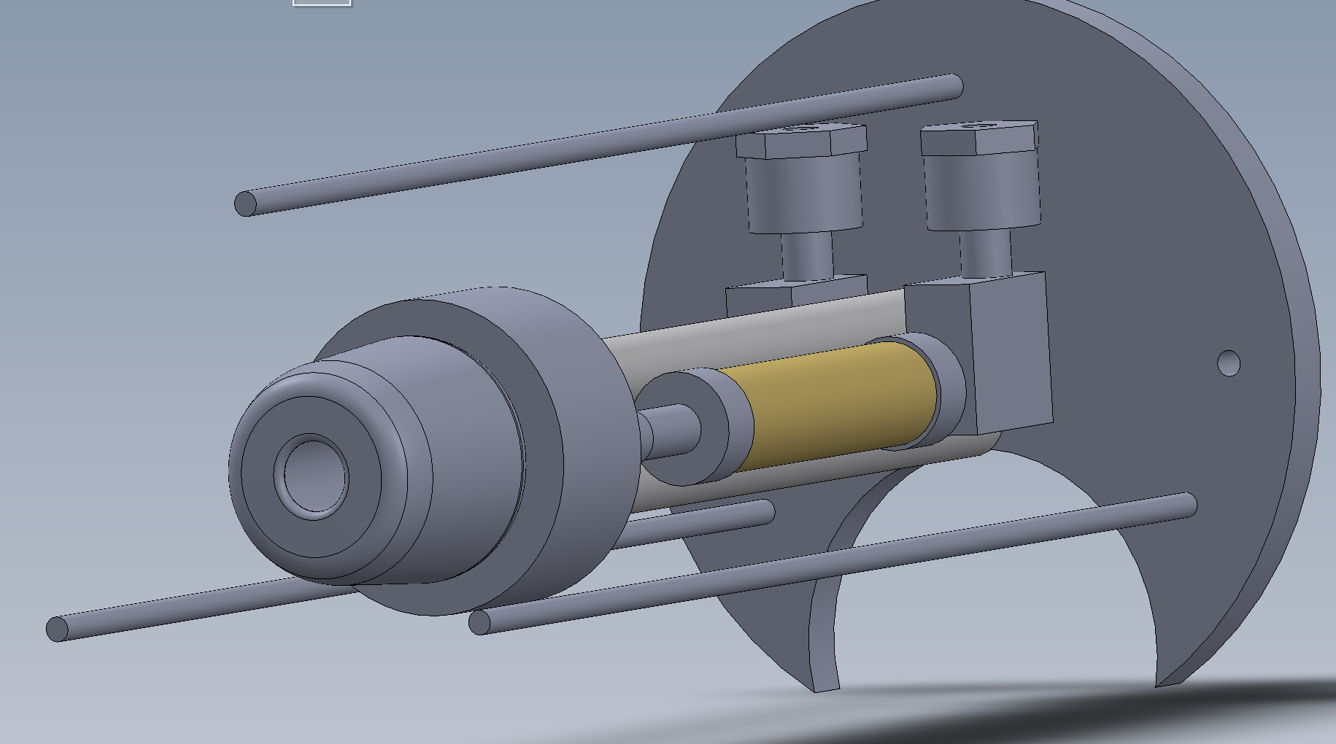
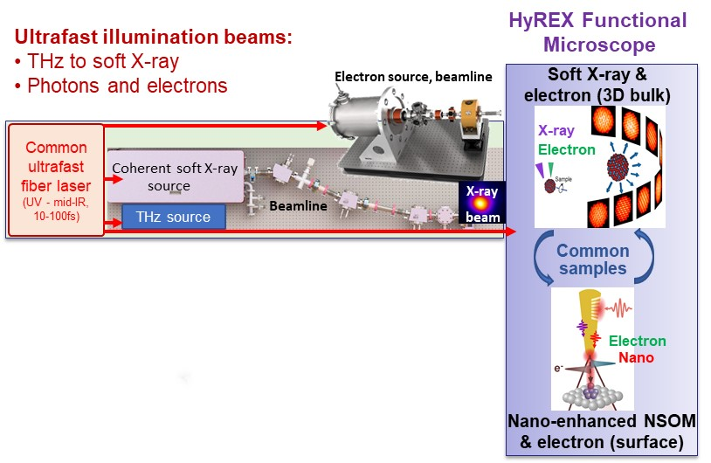
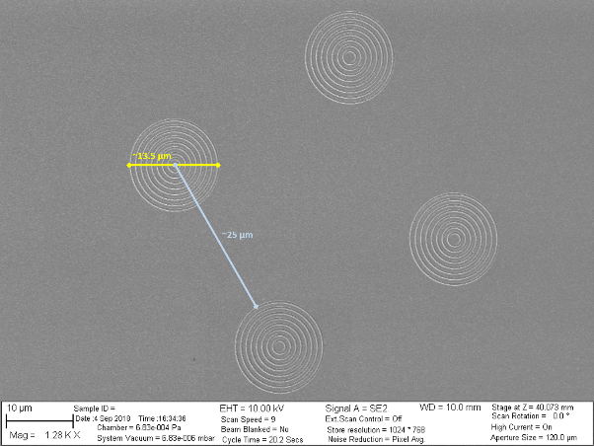
Other UCLA DC gun developments
Plasmonic cathode studies (with D. Filippetto et al. LBNL)
High brightness beamline for new NSF MRI with Colorado putting together HHG and UED
Cold (liquid nitrogen) gun being tested for metal cold cathode yield and emittance measurements

Slide 15
Conclusions
Beam Brightness and Photocathode Physics relevant for all Pegasus beamline applications : DLA, THz, UED and UEM
Load-lock for high gradient S-band injector coming soon !
Magnetized beams have unique advantages (small emittance linearly benefits from improvements in MTE)
DC gun test stand(s) + tunable UV source to investigate laser heating / plasmonic photocathodes / cold metal cathode sources

