Slide 1
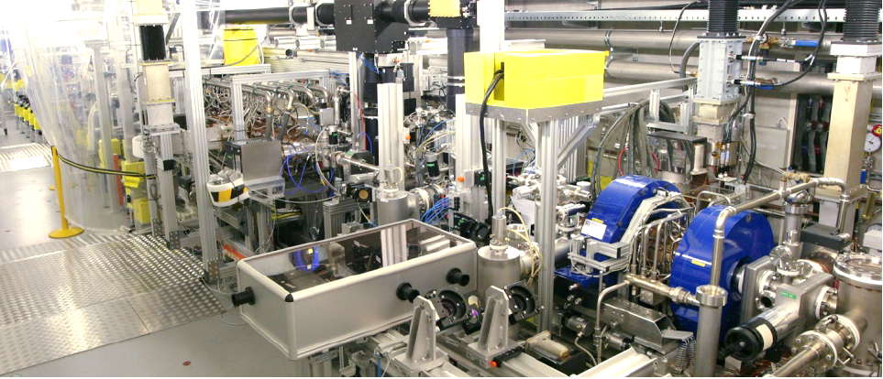



Space-Charge Dominated Photoemission in the Photocathode RF Gun at PITZ
Ye Chen and Mikhail Krasilnikov for the DESY-PITZ team
The 5th Photocathode Physics for Photoinjectors (P3) Conference
Santa Fe, New Mexico USA, October 15-17, 2018
Photo Injector Test facility at DESY in Zeuthen
Acknowledgements to
D. H. Dowell, SLAC, C. Hernandez-Garcia, J-lab, R. Ganter, PSI, C. Hessler, CERN
F. Brinker, M. Dohlus, K. Floettmann, W. Hillert, S. Lederer, S. Schreiber, DESY
P. Michelato, L. Monaco, C. Pagani, D. Sertore, INFN, H. Chen, Y.-Ch. Du, W.-H. Huang, Ch.-X. Tang, Q.-L. Tian, L.-X. Yan, Tsinghua University
A. Arnold, J. Teichert, R. Xiang, HZDR, H. De Gersem, E. Gjonaj, T. Weiland, TEMF
for kind support and useful discussions on photocathode and photoemission

Slide 2
Outline
SCDPE: Space-Charge Dominated PhotoEmission
PITZ facility
Observation & characterization of SCDPE
Summary

Slide 3
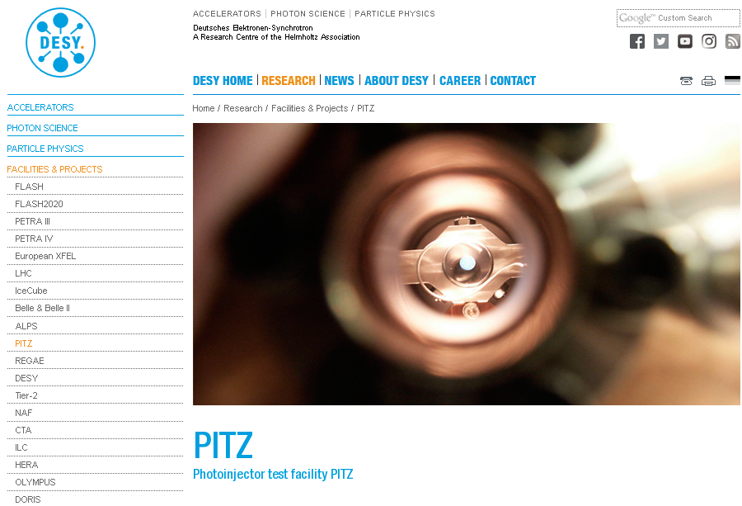
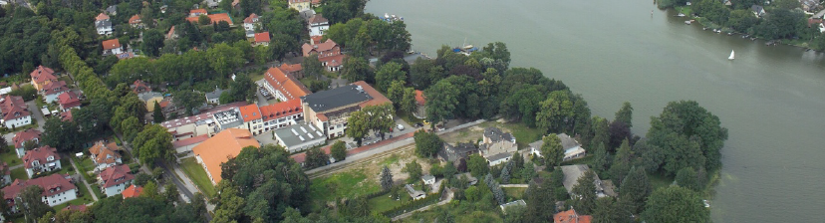
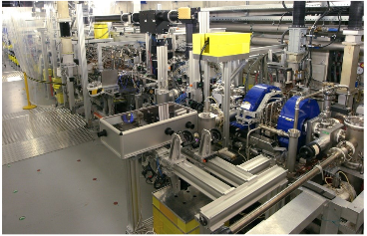
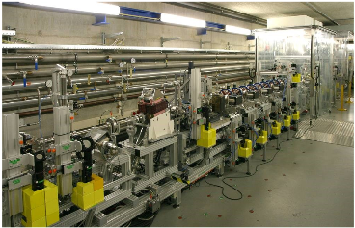
The PITZ Facility
DESY Zeuthen Campus nearby Berlin
http://www.desy.de/
PITZ
Zeuthener See

Slide 4
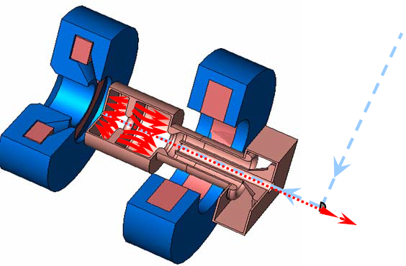
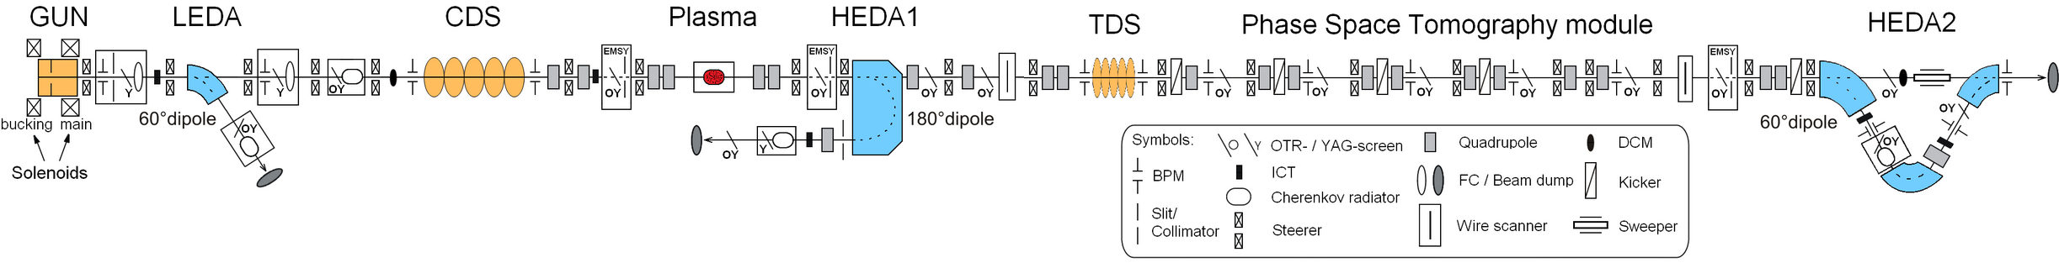
Development, test and optimization of high brightness electron sources
for SC linac driven FELs + applications
The DESY-PITZ guns are in use at the European X-ray Free Electron Laser (European-XFEL) and the Free electron LASer in Hamburg (FLASH).
RF Gun
L-band (1.3 GHz) 1.6-cell copper cavity
Ecath ≥ 60 MV/m → 7 MeV/c e-beams
650 µs ×10 Hz → up to 45 kW av. RF power
Cs₂Te PC (QE~5-15%) → up to 5 nC/bunch
Solenoids for emittance compensation
LLRF control for amp and phase stability
<7MeV
<25MeV
UV
PITZ Beam Line 3.0
Laser
→ Details: https://pitz.desy.de/

Slide 5
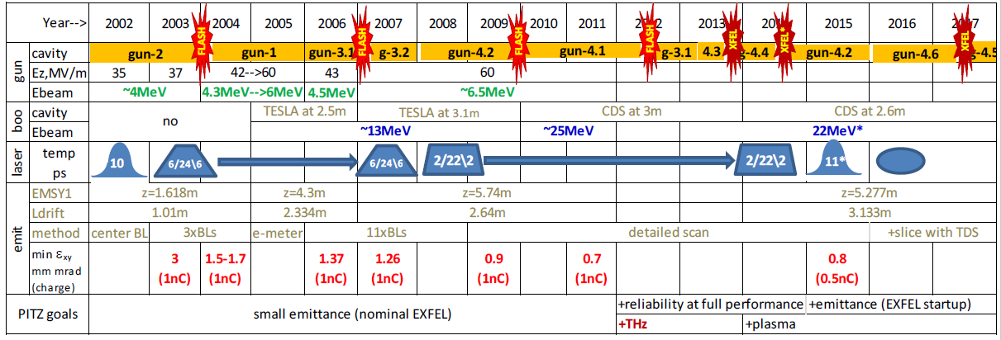
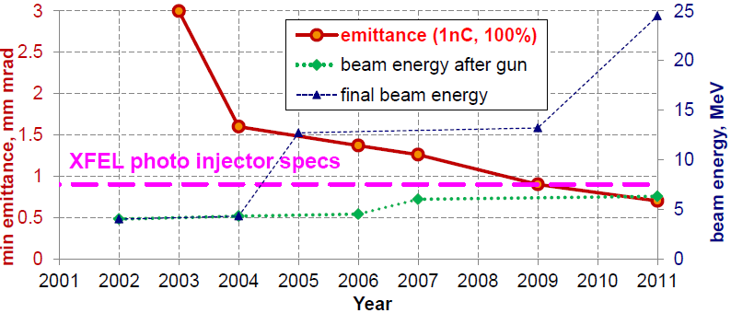
PITZ evolution 2002-2017
→Photocathode and cathode laser
Highlights of the Evolution:
→Increasing the brightness (decreasing the emittance)
→Improving gun stability and reliability
→Extending beam diagnostics
→Use high brightness beam capability

Slide 6
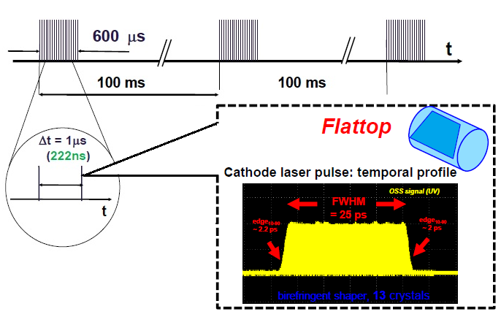
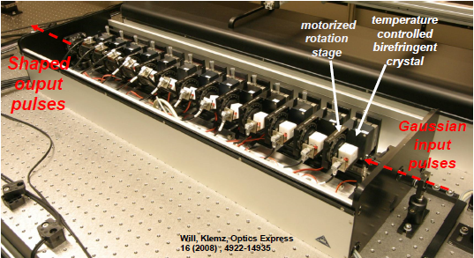

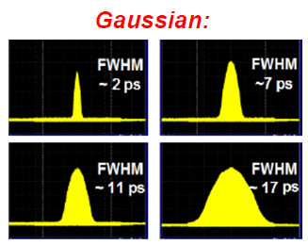

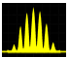
Flexible Photocathode Laser pulse shaping system
Pulse Train Time Structure
PITZ and EXFEL run bunch trains with up to 600 (2700) laser pulses
MBI Pulse Shaper
Towards ultimately low emittance beams
→ 3D ellipsoidal pulses (under development)
Proof of principle demonstrated with IAP (JINR) system at PITZ (2016-2017)
Comparison with simulated e⁻ beam shapes (500pC): similarity in shape
Comb
Gaussian laser
Flattop laser
Ellipsoidal laser
@EMSY1
@PST.Scr1
→Details in J. Good et al., Proc. 38th FEL Conf., WEP006 (2017)
First Measurement

Slide 7
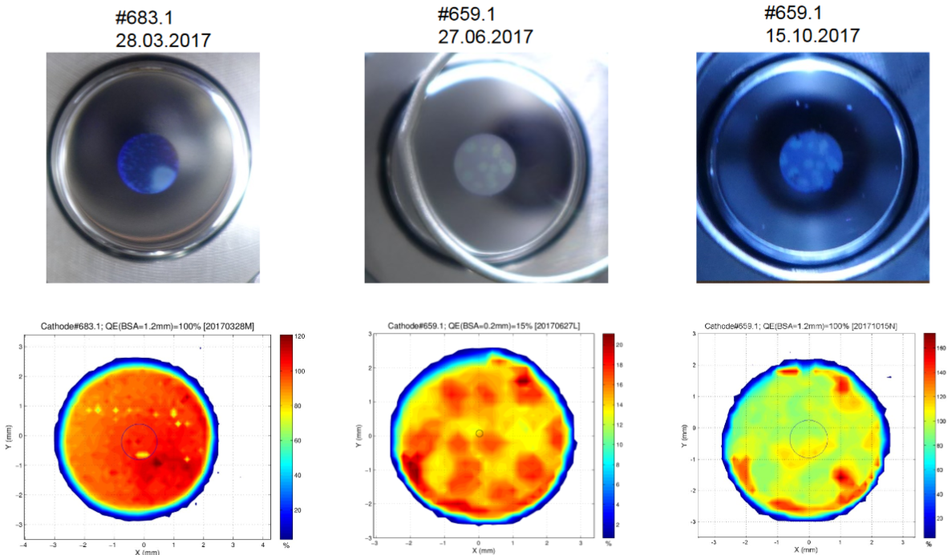
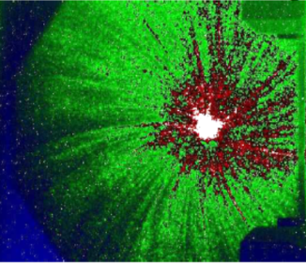
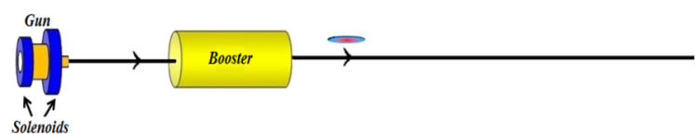
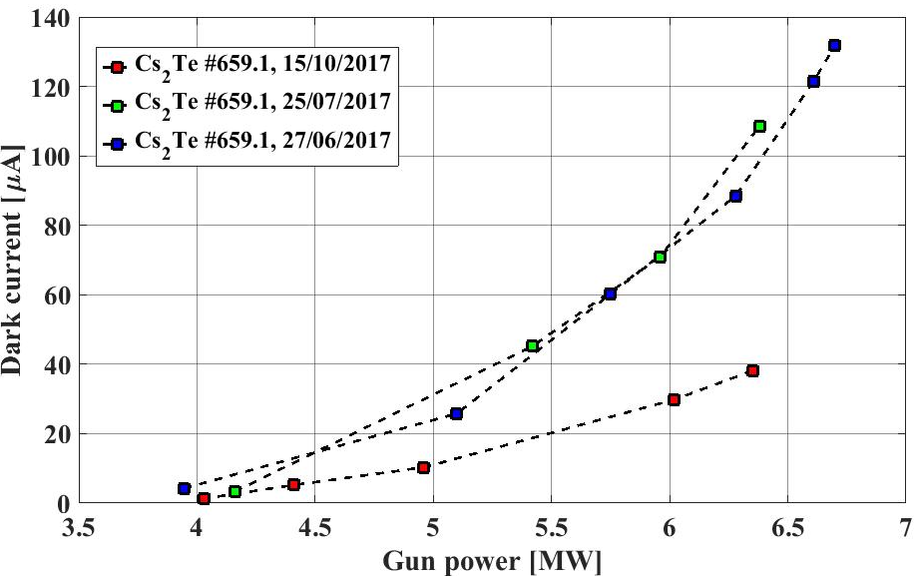
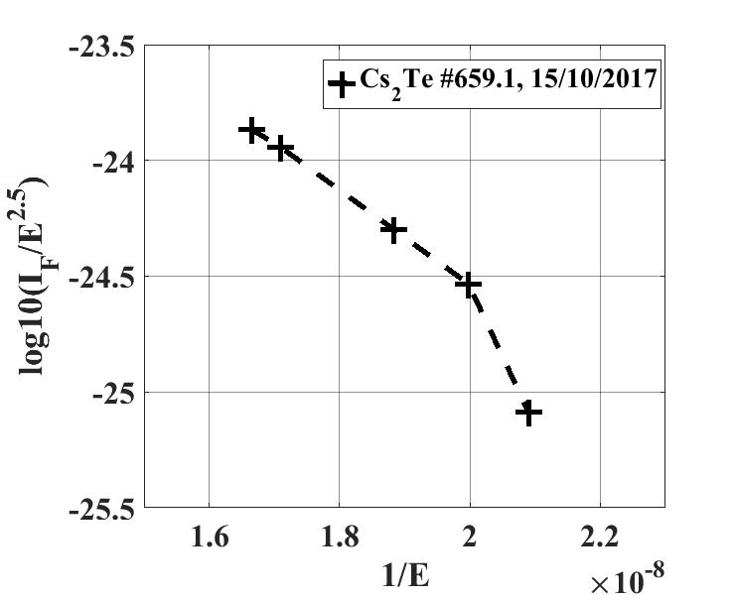
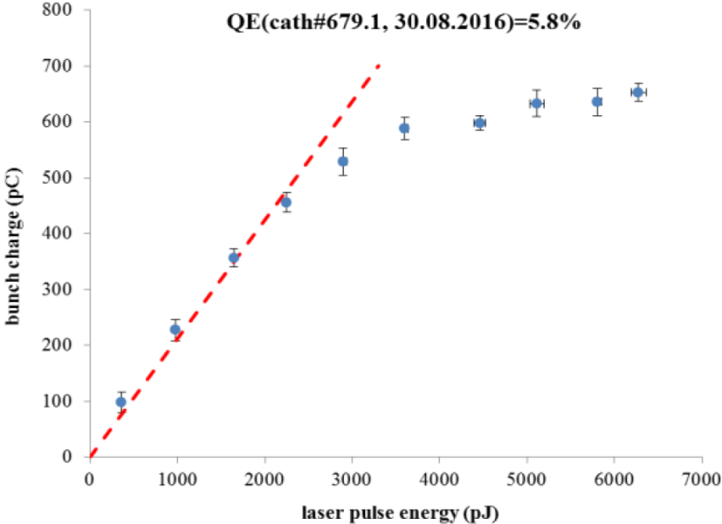
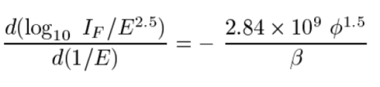
Photocathode in the gun: Cs₂Te
Visual inspection
Cs₂Te produced at DESY and INFN-LASA
QE: 5~15% @ 257 nm
Up to 5 nC/single bunch possible
Vacuum level in the gun: ~10⁻⁹ mbar
For nominal operation (~6.5MW×650µs) dark current < 100µA (for different guns)
Dark current measurement
Faraday cup
insertable
YAG Screen
Dark current
on Screen
QE map
~0.8m
Max. dark current vs. RF power during gun conditioning
~ 1 month
~ 4 months
 ≈ 92
QE measurement
I_{F}: current [A], E: field [V/m]

Slide 8
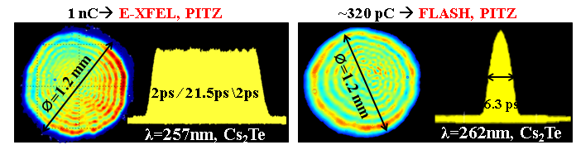
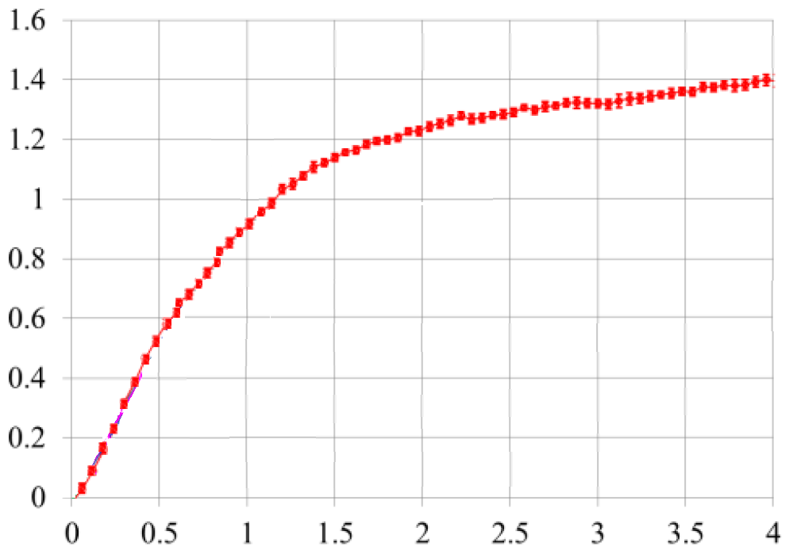
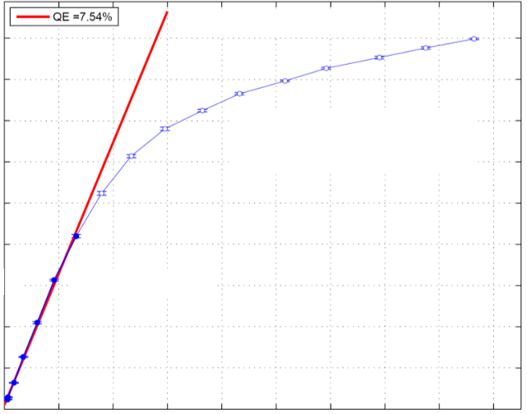

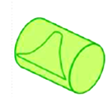

Operation: Working Points at European-XFEL, FLASH & PITZ
1nC → European XFEL, PITZ ~320pC → FLASH, PITZ
→At European-XFEL and
FLASH working points, the
beam extraction at cathode
strongly influenced by space-
charge effects
→Best emittance measured at
the working points, e.g. for
1nC beam at European-XFEL
RF@~6.5MW×650µs | RF@~4.8MW×600µs
1.6
1.4
1.2
1.0
experiment
0.45
0.40
0.35
0.30
0.25
experiment
$$ε_{x,n}≈0.72 mm mrad$$
$$ε_{y,n}≈0.60 mm mrad$$
$$\sqrt{ε_{x,n}ε_{y,n}}≈\text{0.66 }\text{mm} \text{mrad}$$
0.8
0.6
0.4
0.2
0
Q [nC], emitted bunch charge
320pC
1nC
0.20
0.15
0.10
0.05
0.00
0 0.5 1.0 1.5 2.0 2.5 3.0 3.5 4.0
0 0.02 0.04 0.06 0.08
Qbunch [nC]
Laser pulse energy [µJ]
Representative cathode drive laser intensity

Slide 9

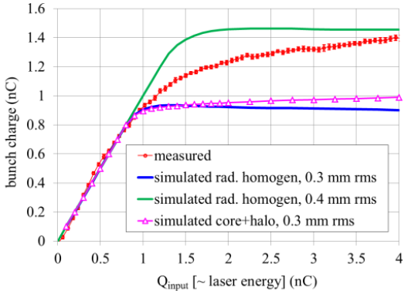
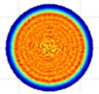
Operation: Discrepancies of Emitted Charge in simulation vs. measurement
1nC → European XFEL, PITZ ~320pC → FLASH, PITZ
Charge vs. Laser Energy
simulated
σ_{rms}=0.4mm
Uniform
measured
E-XFEL
case
σ_{rms}≈0.3mm
C+H
σ_{rms}=0.3mm
RF@~6.5MW×650µs | RF@~4.8MW×600µs
Uniform
1.6
1.4
1.2
1.0
experiment
0.45
0.40
0.35
0.30
0.25
experiment
0.8
0.6
0.4
0.2
0
Q [nC], emitted bunch charge
320pC
Core(C)+Halo(H) model:
fits for Gaussian temporal
distribution (see backup slide)
but not for flattop case
1nC
0.20
0.15
0.10
0.05
0.00
0 0.5 1.0 1.5 2.0 2.5 3.0 3.5 4.0
0 0.02 0.04 0.06 0.08
NIM A 871, 97-104 (2017)
Qbunch [nC]
Laser pulse energy [µJ]
Representative cathode drive laser intensity

Slide 10
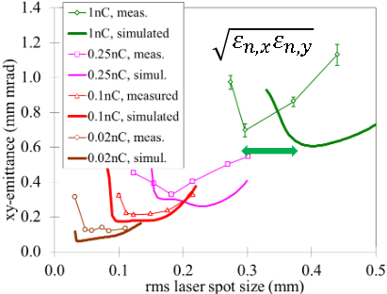
Operation: Discrepancies of Emittance in simulation vs. measurement
1nC → European XFEL, PITZ ~320pC → FLASH, PITZ
Emittance vs. Cathode Laser Spot Size
1nC
RF@~6.5MW×650µs | RF@~4.8MW×600µs
1.6
1.4
1.2
1.0
250pC
Stronger
effects
experiment
0.45
0.40
0.35
0.30
0.25
experiment
100pC
20pC
0.8
0.6
0.4
0.2
0
Q [nC], emitted bunch charge
Lager discrepancies for stronger space-charge dominated e-beams
Problems may (partially) originate from photocathode already?
320pC
1nC
0.20
0.15
0.10
0.05
0.00
0 0.5 1.0 1.5 2.0 2.5 3.0 3.5 4.0
0 0.02 0.04 0.06 0.08
PRST-AB 15, 100701 (2012)
Qbunch [nC]
Laser pulse energy [µJ]
Representative cathode drive laser intensity

Slide 11
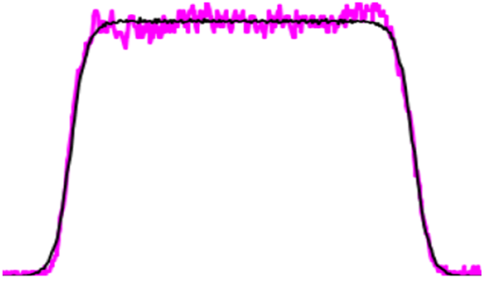
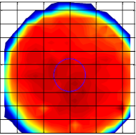


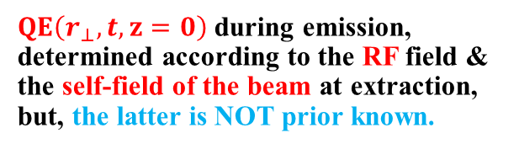
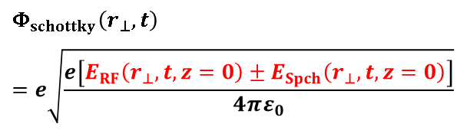


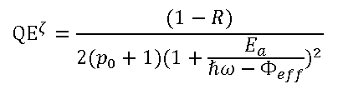


Modeling: Some Treatments in simulations
Treatment 1 → Generating more "realistic" photoemission distribution according to cathode laser (and QE map)
Treatment 2 → Bridging beam dynamics in vacuum with simplified effective cathode QE
Treatment 3 → modeling field(RF + space-charge) effects during emission through well-known Schottky effect
for metals:
for semiconductors:
Temporal laser profile
$${QE}^{\text{∗}}=\frac{α{(ℏω−Φ_{eff})}^{2}}{8Φ_{eff}(E_{F}+Φ_{eff})}$$
$${QE}^{ζ}=\frac{(1−R)}{2(p_{0}+1){(1+\frac{E_{a}}{ℏω−Φ_{eff}})}^{2}}$$
$$Φ_{schottky}\left(r_{⊥},t\right)$$
$$=e\sqrt{\frac{e\left[E_{RF}\left(r_{⊥},t,z=0\right)±E_{Spch}\left(r_{⊥},t,z=0\right)\right]}{4πε_{0}}}$$
y
$$Φ_{eff}=Φ_{0}{±Φ}_{schottky}+…$$
$Φ_{eff}$: effective cathode work function
$Φ_{0}$ : intrinsic work function
$Φ_{schottky}$: Schottky term
$ℏω$: photon energy
$E_{F}$: Fermi energy
$α$: characteristic parameter
$$Φ_{eff}=E_{g}{+E_{a}±Φ}_{schottky}+…$$
$E_{a}$: electron affinity
$p_{0}$: characteristic parameter
$R$: reflection coefficient
$E_{g}$: band gap
intensity
x
QE
Map, f₂
Laser
Spot Map, f₁
$QE\left(r_{⊥},t,z=0\right)$ during emission, determined according to the RF field & the self-field of the beam at extraction, but, the latter is NOT prior known.
time
$$∗$$
f₂)
Convolution
(f₁
(r, t)
*D. Dowell et al., PRST-AB 12 074201 (2009)
$ζ$K. Jensen et al., J. Appl. Phys104, 044907 (2008)

Slide 12
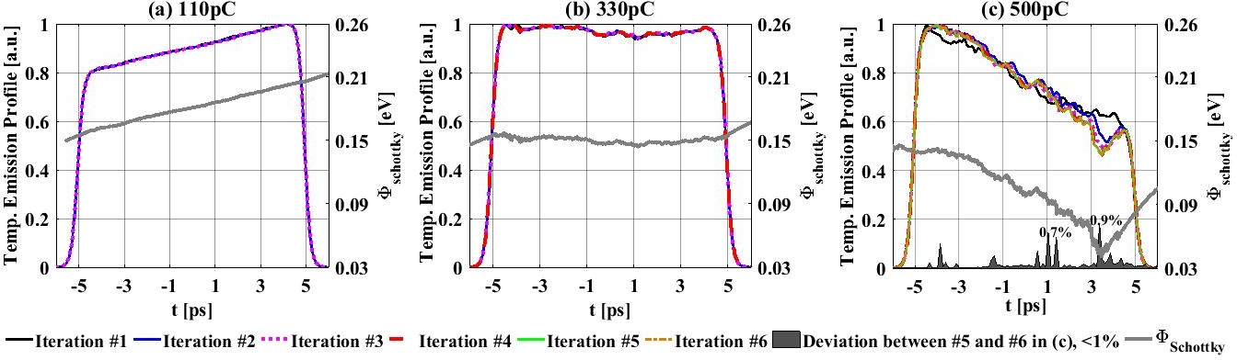
Modeling: Some Treatments in simulations
Treatment 1 → Generating more "realistic" photoemission distribution according to cathode laser (and QE map)
Treatment 2 → Bridging beam dynamics in vacuum with simplified effective cathode QE
Treatment 3 → modeling field(RF + space-charge) effects during emission through well-known Schottky effect
for metals:
for semiconductors:
Temporal laser profile
$${QE}^{\text{∗}}=\frac{α{(ℏω−Φ_{eff})}^{2}}{8Φ_{eff}(E_{F}+Φ_{eff})}$$
$${QE}^{ζ}=\frac{(1−R)}{2(p_{0}+1){(1+\frac{E_{a}}{ℏω−Φ_{eff}})}^{2}}$$
$$Φ_{schottky}\left(r_{⊥},t\right)$$
$$=e\sqrt{\frac{e\left[E_{RF}\left(r_{⊥},t,z=0\right)±E_{Spch}\left(r_{⊥},t,z=0\right)\right]}{4πε_{0}}}$$
y
$$Φ_{eff}=Φ_{0}{±Φ}_{schottky}+…$$
$Φ_{eff}$: effective cathode work function
$Φ_{0}$ : intrinsic work function
$Φ_{schottky}$: Schottky term
$ℏω$: photon energy
$E_{F}$: Fermi energy
$α$: characteristic parameter
$$Φ_{eff}=E_{g}{+E_{a}±Φ}_{schottky}+…$$
$E_{a}$: electron affinity
$p_{0}$: characteristic parameter
$R$: reflection coefficient
$E_{g}$: band gap
intensity
x
QE
Map, f₂
Laser
Spot Map, f₁
$QE\left(r_{⊥},t,z=0\right)$ during emission, determined according to the RF field & the self-field of the beam at extraction, but, the latter is NOT prior known.
time
$$∗$$
f₂)
Convolution
(f₁
(r, t)
Treatment 4 → determining temporal emission profile based on a space-charge iteration approach (See poster for details)
Can self-consistently determine temporal emission profile according to local fields at cathode surface
For very high space-charge densities numerical convergence tricky
→ Another relevant work: photoemission modeling based on a 3D Lienard-Wiechert approach [see details in NIM A 889, 129-137 (2018)]
*D. Dowell et al., PRST-AB 12 074201 (2009)
$ζ$K. Jensen et al., J. Appl. Phys104, 044907 (2008)

Slide 13
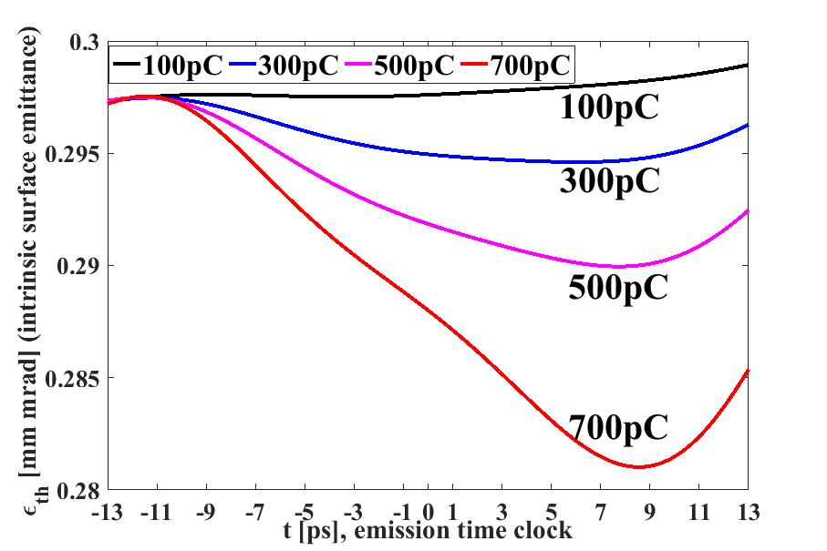
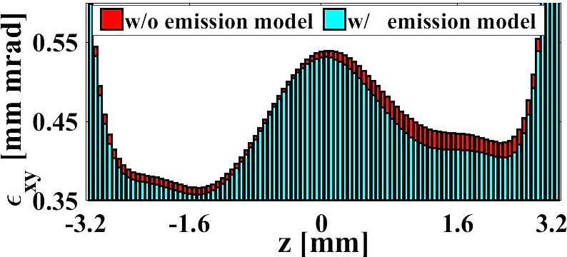
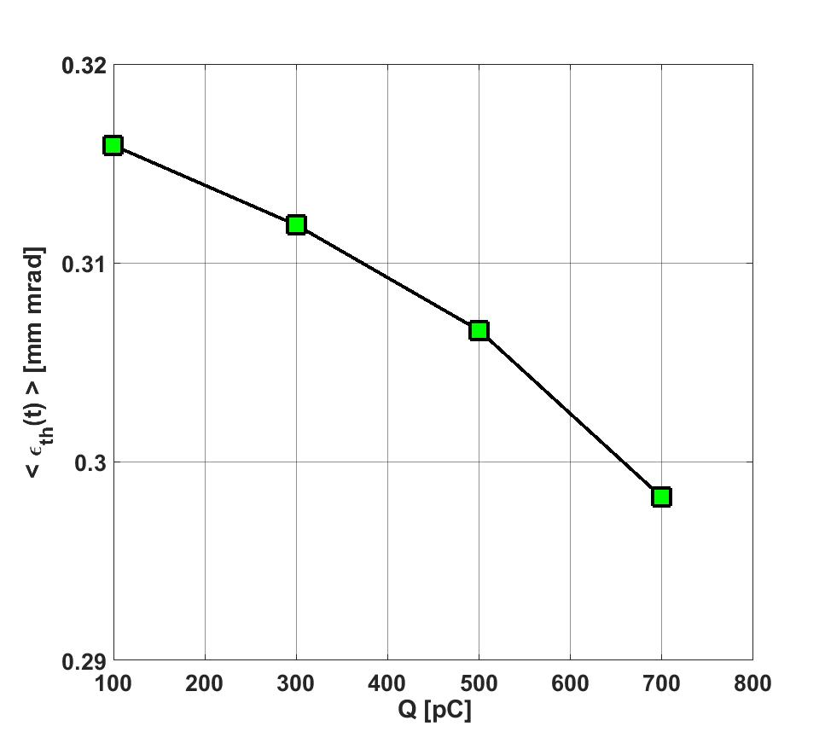
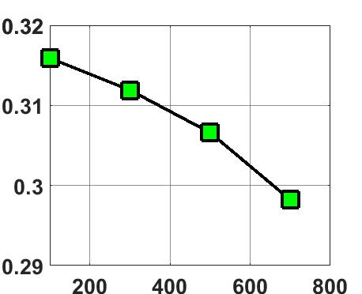


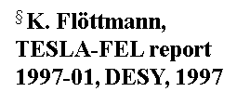

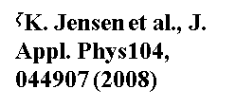
Modeling (Cont'd): Space-Charge Cooling Effect
QE and intrinsic emittance:
Simulation setup
$${QE}^{ζ}=A_{fit} {(1+\frac{E_{a}}{ℏω−Φ_{eff}})}^{2}$$
$${ε_{th}}^{§}=r_{rms}\sqrt{\frac{2E_{kin}}{3mc^{2}}}$$
$ζ$K. Jensen et al., J. Appl. Phys104, 044907 (2008)
Dump
$$E_{kin}=ℏω−[E_{g}+E_{a}±Φ_{schottky}\left(r_{⊥},t\right)]$$
$§$K. Flöttmann, TESLA-FEL report 1997-01, DESY, 1997
Emittance @~5.277m
$$Φ_{schottky}\left(r_{⊥},t\right)∝\sqrt{E_{RF}\left(r_{⊥},t,z=0\right)±E_{Spch}\left(r_{⊥},t,z=0\right)}$$
At cathode
Downstream at 5.277m
Space-charge fields cooling down cathode surface through an increased cathode work function
500pC
Time-dependent photoemission effects influence downstream slice emittance
For higher charges the effect will be stronger
  Simulations in progress

Slide 14
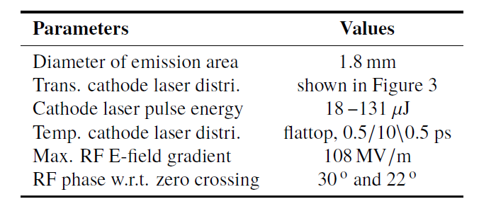
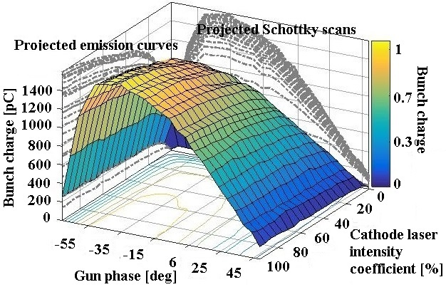
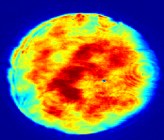
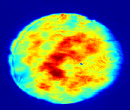
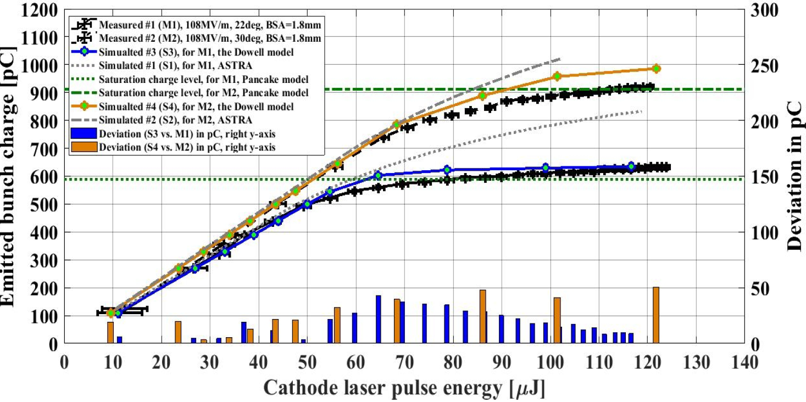
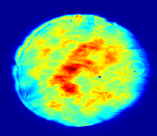
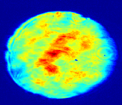


Modeling (Cont'd): "Emission Curve"
Characteristic emission measurements
Machine parameters
→"Emission curve" (Q vs. E_{las})
→"Schottky scan" (Q vs. _{gun})
In collaboration with Tsinghua University (H. Chen, Y.-Ch. Du, Ch.-X. Tang, et al.)
Emission curves measured for a copper cathode in an S-band NC RF gun
(Proceedings of LINACʹ18 , THPO116)
129.5µJ
113.3µJ
93.1µJ
Conventional
Improved
pancake
76.5µJ
Measured
Conventional
Improved
Measured trans. laser distributions used for simulations at different laser pulse energies
Improved agreements with measurements
49.7µJ
Measured
pancake
18.3µJ

Slide 15


Observation and analysis of a photocathode effect
Spiky photo-emitted electron bunch trains (Q-train) from a fresh Cs₂Te photocathode
Observation at FLASH (S. Lederer & S. Schreiber)
Charge measured at gun exit
Cathode drive UV laser
∆Q ~10%
→
Cathode #73.3
in fresh state
~tens of µs
1 MHz repetition rate
A flat energy distribution of the laser pulse train produces a "spike" at the head of the electron bunch train emitted from a fresh cathode
The spike depends on laser energy density and accelerating field on cathode
The spike "vanishes" over long operation time (year)
S. Lederer, et al., European Workshop on Photocathodes for Particle Accelerator Applications (EWPAA), Daresbury, 2016
S. Lederer, S. Schreiber, et al., FEL’15

Slide 16

Observation and analysis of a photocathode effect
Spiky photo-emitted electron bunch trains (Q-train) from a fresh Cs₂Te photocathode
Observation at FLASH (S. Lederer & S. Schreiber)
two laser operation to explore the effect
Charge measured at gun exit
Cathode drive UV laser
Laser 2
Laser 1
∆Q ~10%
→
Cathode #73.3
in fresh state
~tens of µs
1 MHz repetition rate
A flat energy distribution of the laser pulse train produces a "spike" at the head of the electron bunch train emitted from a fresh cathode
The spike depends on laser energy density and accelerating field on cathode
The spike "vanishes" over long operation time (year)
delay
→L1 only (red) as reference
→Q-train effect "restarted" as delay time increases
S. Lederer, et al., European Workshop on Photocathodes for Particle Accelerator Applications (EWPAA), Daresbury, 2016
S. Lederer, S. Schreiber, et al., FEL’15

Slide 17

Observation and analysis of a photocathode effect
Spiky photo-emitted electron bunch trains (Q-train) from a fresh Cs₂Te photocathode
Observation at FLASH (S. Lederer & S. Schreiber)
Charge measured at gun exit
Cathode drive UV laser
∆Q ~10%
→
Cathode #73.3
in fresh state
~tens of µs
average
1 MHz repetition rate
A flat energy distribution of the laser pulse train produces a "spike" at the head of the electron bunch train emitted from a fresh cathode
The spike depends on laser energy density and accelerating field on cathode
The spike "vanishes" over long operation time (year)
→long-term average QE not really changing
S. Lederer, et al., European Workshop on Photocathodes for Particle Accelerator Applications (EWPAA), Daresbury, 2016
S. Lederer, et al., EWPAA, Helmholtz-Zentrum Berlin, Germany, 2017

Slide 18




Observation and analysis of a photocathode effect
Spiky photo-emitted electron bunch trains (Q-train) from a fresh Cs₂Te photocathode
Observation at FLASH (S. Lederer & S. Schreiber)
One hypothesis
Charge measured at gun exit
→temporal variation of cathode band bending potential
Cathode drive UV laser
Vac. level from bulk
e⁻
∆Q ~10%
Extracted photoelectrons recombine with the holes (e.g., from defects) at the surface state dynamically changing the band bending level, and therefore, the cathode work function, QE[$Φ_{w}$(t)] → Q(t)
dE_{band}
→
Cathode #73.3
in fresh state
Surface
states
~tens of µs
p-type semiconductor
1 MHz repetition rate
A flat energy distribution of the laser pulse train produces a "spike" at the head of the electron bunch train emitted from a fresh cathode
The spike depends on laser energy density and accelerating field on cathode
The spike "vanishes" over long operation time (year)
→  0.4 eV change of bending potential (green) over ~90µs may result in spiky Q-train effect (red)
Photoemission model
$$QE∝A_{fit} {(1+\frac{E_{a}}{ℏω−\text{Φ}\text{w}})}^{2}$$
$$\text{}\text{w}=E_{g}+E_{a}+{dE}_{band}±\sqrt{\frac{q^{3}E}{4πϵ_{0}}}$$
simulation
Microscopic modeling of dE_{band}(t) needed
measurement
Experimental studies reveal cathode effects

Slide 19


Summary
PITZ Group 2015
The PITZ facility is used to characterize and study space-charge dominated photoemission
  →Important for clarifying discrepancies between measurement and simulation at the working points of European XFEL and FLASH
  →Essential for
    Understanding slice emittance formation at cathode (including "green" photocathodes R&D for CW upgrade of European-XFEL)
    Advanced (e.g. ellipsoidal) cathode laser pulse shaping (benefiting high charge beams or CW guns)
Space-charge iteration approach used to take into accounts space-charge contributions onto photoemission through well-known Schottky effect
  → Emission curve simulated with improved agreement to measurement
  → Space-charge can COOL the intrinsic (surface) emittance
Microseconds level "Q-train" effect observed at FLASH and analyzed at PITZ: spiky photo-emitted electron bunch trains from a fresh Cs₂Te photocathode may originate from the change of band bending potential
Outlook: more detailed PE modeling
  Modeling of possible field penetrating effects (e.g. on
  electron mobility)
  →Open for new joint work!
PITZ Collaboration Meeting 2018

Slide 20


Backup Slide on "Core + Halo" model
measurement
simulation
"Core + Halo" model
→Temp. Gaussian case fairly explained
  →Trans. emission profile does play a role

Slide 21




Development of Green cathodes on INFN LASA plug design
Aim: → better beam quality, → simplified photo cathode laser. ➔ especially needed for CW operation
Goal: grow reliable “green” cathodes (K-Cs-Sb compound) on INFN plugs and test them in the PITZ RF-Gun (high cathode gradient + fairly high duty cycle)
  First sequential deposition on test sample in week 47/2017 (“proof of principle”)
    Sb 10 nm
    K until max QE
    Cs until max QE
    Repeated on 1 Dec 2017
  Long term measurement
    Total extracted charge over more than 3 months
    QE versus time
      Base system pressure: low 10⁻¹⁰ mbar
      QE decrease depends on
      light power density (fatigue effect?)
    → still reasonable QE
  Next: Design new source layout in view
  of co-evaporation in the near future
View into the prep chamber
(full light spectrum)
        broad band LED
        power density ($\frac{1}{8}mW/cm²$)
        Laser Driven Light Source
        power density ($\sim 21mW/cm²$)
No light
F. Stephan, 18th Advanced Accelerator Concepts Workshop (AACʹ18)

