Slide 1
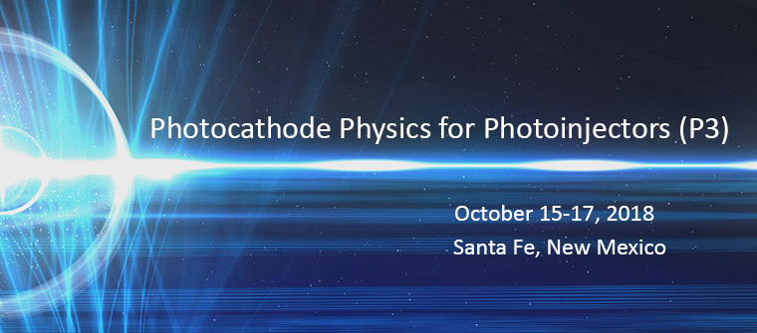



Spin polarized low energy electron microscopy:
3D vector-magnetometry
and workfunction mapping
Andreas Schmid, LBNL

Slide 2
P3
acceleration
photocathode
electron beam
light

Slide 3
Spin polarized low energy electron microscopy
Sample
electron beam
Deceleration

Slide 4
Spin polarized low energy electron microscopy
image screen
accelerate reflected e⁻
dipole
beam
splitter
Sample
decelerate primary beam
photocathode

Slide 5
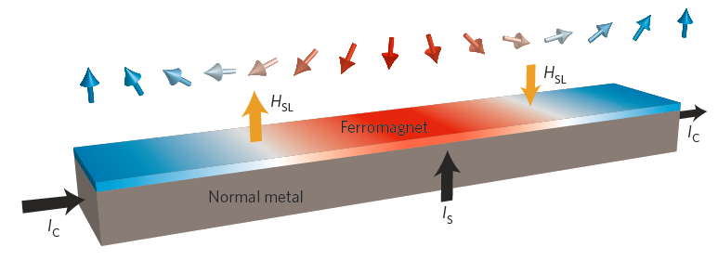
Electrically driven domain-wall motion
A. Brataas Nat. Nanotech. 8, 485 (2013)
Pt/Co/Ni/Co/Pt
CoFe/Pt or Ta
K.-S. Ryu, Nature Nanotech. 8, 527 (2013)
S. Emori, Nature Mater. 12, 611 (2013)
Propagation of domain wall using spin-orbit torque:
Very high velocity [Thiaville, A. et al. Europhys. Lett. 100, 57002 (2012)]
Suppressed critical current [Tretiakov, O. A. et al. Phys. Rev. Lett. 105, 157201 (2010)]
Chirality-dependent direction of motion [Khvalkovskiy, A. V. et al. Phys. Rev. B 87, 020402(R) (2013)]

Slide 6
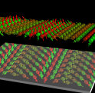
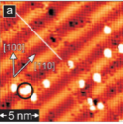
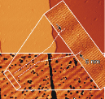

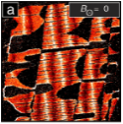
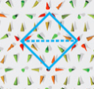
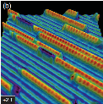
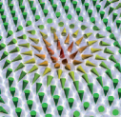
Magnets with broken inversion symmetry:
image, understand, control chiral magnetism
Spirals,
Skyrmions,
Chiral domain walls, …
STM, TEM, Moke, etc.
Bode, et al. Nature 447, 190 (2007)
Ferriani et al. PRL 101, 027201 (2008)
Meckler et al. PRL 103, 157201 (2009)
Sessi, et al. PRL 103, 167201 (2009)
Muhlbauer et al., Science 323, 915 (2009)
Yu et al., Nature 465, 901 (2010)
Yu et. al., Nature Mat. 10, 106 (2011)
Heinze, et al. Nat Phys. 7, 713 (2011)
Yoshida et al. PRL 108, 087205 (2012)
Menzel et al. PRL 108, 197204 (2012)
Seki, et. al., Science 336, 198 (2012)
Bauer et al., PRL 110, 177207 (2013)
Romming et al. Science 341, 636 (2013)
Ryu, et al. Nat. Nanotech. 8, 527 (2013)
…

Slide 7
Spin polarized low energy electron microscopy image of Fe/Ni thin film
Pixel brightness
=
x-component of magnetization vector.
Field of view: 10 μm diameter in images in this talk, unless mentioned.
M_{X}
3ML Fe
2ML Ni
Cu (001)

Slide 8
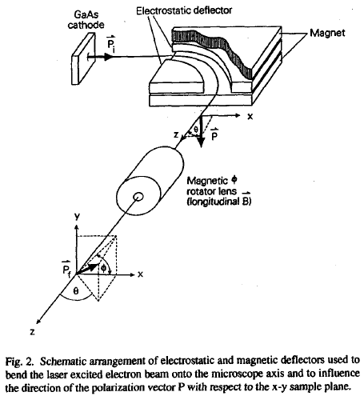
SPLEEM: imaging 3D magnetization vector
“A compact electron-spin-polarization manipulator”
T. Duden, E. Bauer, Rev. Sci. Inst. 66, 2861 (1995)
M_{X}

Slide 9
3 SPLEEM images,
3 cartesian components of magnetization
M_{X} M_{Y} M_{Z}

Slide 10
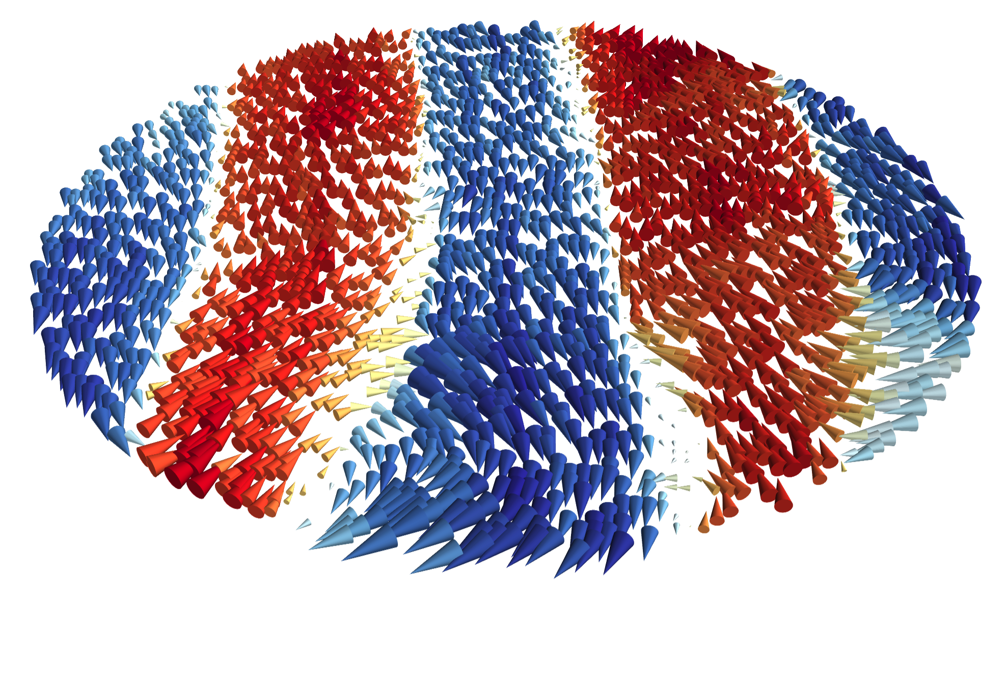
SPLEEM: 3D vector-map of magnetization

Slide 11
SPLEEM: 3D vector-map of magnetization
Directly identify right-handed and left-handed spin textures

Slide 12
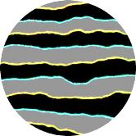
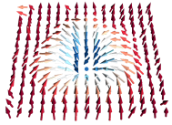
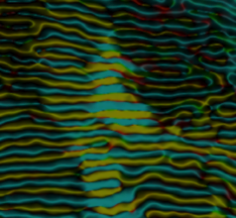
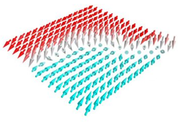
Magnets with broken inversion symmetry:
image, understand, control chiral magnetism
Spirals,
Skyrmions,
Chiral domain walls, …
SPLEEM
G. Chen et al. PRL 110, 177204 (2013)
G. Chen et al. Nat. Comm. 4, 2671 (2013)
G. Chen et al. APL 106, 062402 (2015)
G. Chen et al. APL 106, 242404 (2015)
G. Chen et al. Adv. Mater. 27, 5738 (2015)
G. Chen et al. Nat. Comm. 6, 6598 (2015)
G. Chen et al. Nat. Comm. 8, 15302 (2017)
H. Yang et al. Nature Mat. 17, 605 (2018)
…

Slide 13
Work function mapping:
(i) Hall thrusters
(ii) Thermionic power generation

Slide 14

Hall thrusters: electrically powered rocket engines
Tyson C Back, AKS, Steven B Fairchild, John J Boeckl, Marc Cahay, Floor Derkink, Chen Gong, Ali Sayir

Slide 15
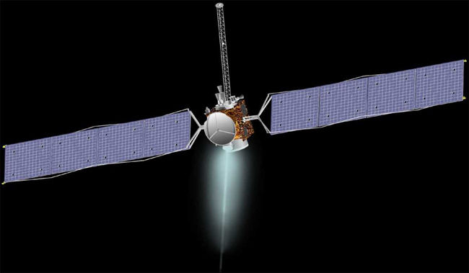
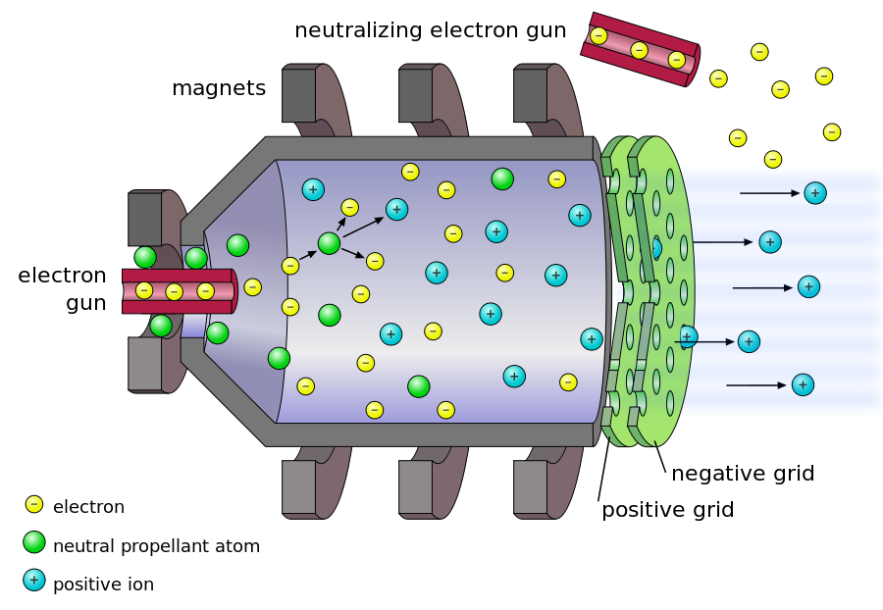
Solar powered rocket engine.
NASA probe “Dawn” (now visiting Ceres)
Xe ion beam: High efficiency because exhaust velocity is high.

Slide 16
Solar powered rocket engine.
NASA probe “Dawn” (now visiting Ceres)
Xe ion beam: High efficiency because exhaust velocity is high.
Propulsion system depends on
e-beam to neutralize the Xe+ beam.

Slide 17
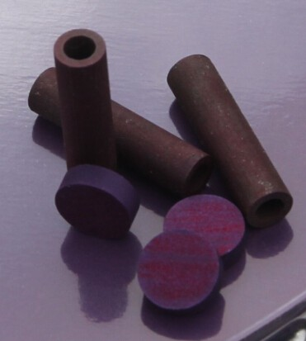
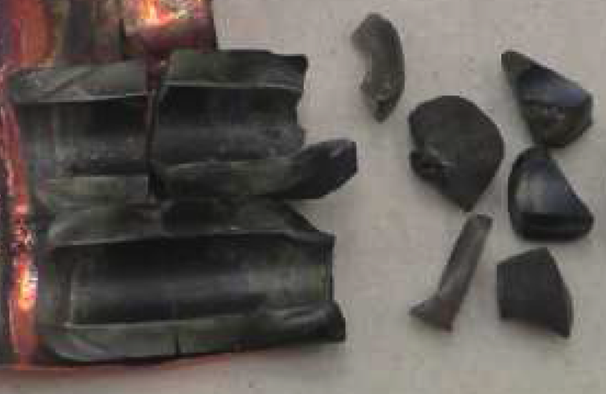
Cathode materials: poor fracture toughness
M.S. McDonald et al., IEPC-2017-253

Slide 18
High strength and low workfunction:
directionally solidified LaB₆-MeB₂ compounds
A. Taran et al., Functional Materials 20, 485 (2013)

Slide 19
LaB₆-VB₂: high strength, low workfunction
Functional imaging: heat sample, image thermionic emission
LaB₆-matrix:
dark
VB₂-nanorods:
bright
T. Back et al., Ultramicroscopy 183, 67 (2017)

Slide 20
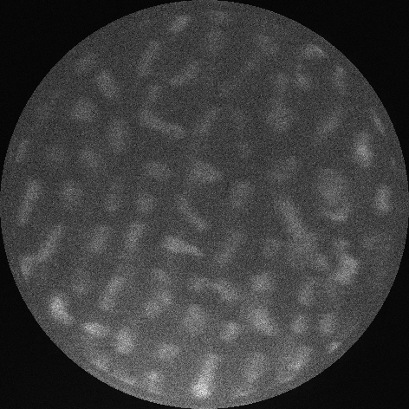
LaB₆-VB₂: high strength, low workfunction
Functional imaging: heat sample, image thermionic emission
LaB₆-matrix:
dark
VB₂-nanorods:
bright
T. Back et al., Ultramicroscopy 183, 67 (2017)

Slide 21
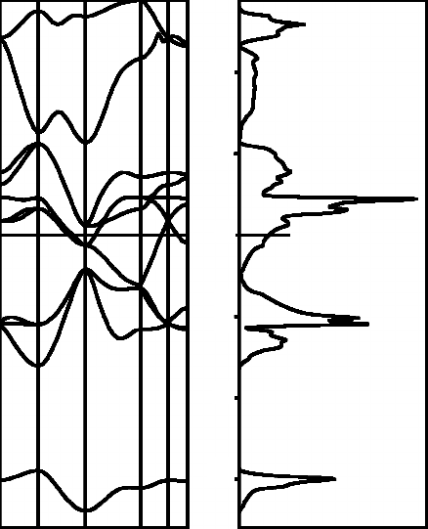
above work function: transmission/reflection ≈ DOS
10
5
0
-5
-10
-15
work
function
below work function: 100% reflection
E_{F}
Energy
Electric field between column and sample
Sample band structure and density of states

Slide 22
Imaging Workfunction
10
5
0
-5
-10
-15
work
function
E_{F}
Energy
Electric field between column and sample
Sample band structure and density of states

Slide 23
Work function measurements from energy dependence of electron reflectivity: LaB₆
Reflectivity [%]
Voltage between cathode & sample

Slide 24
Work function measurements from energy dependence of electron reflectivity: LaB₆
Φ_{sample} – Φ_{cathode} = 0.8 eV
Φ_{cathode} = 1.6 eV
=> Φ_{sample} = 2.4 eV
Reflectivity [%]
Voltage between cathode & sample

Slide 25
LEEM workfunction mapping: LaB₆-VB₂
1 μm
T. Back et al., Ultramicroscopy 183, 67 (2017)

Slide 26
LEEM workfunction mapping,
in-situ deposition onto LaB₆-VB₂
1 monolayer boron
1 monolayer lanthanum
1 monolayer vanadium
1 μm
T. Back et al., Ultramicroscopy 183, 67 (2017)

Slide 27
Directionally solidified LaB₆-VB₂:
High strength under extreme conditions
Workfunction can be significantly lower than LaB₆ host compound

Slide 28

Work function mapping:
(ii) Electrical power generation
Andre Cauduro, Lucas Hess, Frank Ogletree, Jared Schwede, AKS

Slide 29
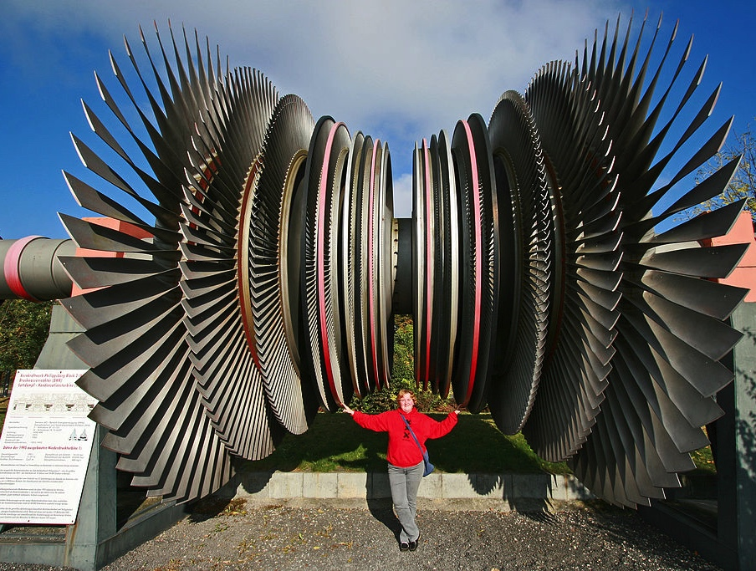
Acknowledgement
Dan Riley
en.wikipedia.org/wiki/Steam_turbine#mediaviewer/File:Turbine_Philippsburg-1.jpg

Slide 30
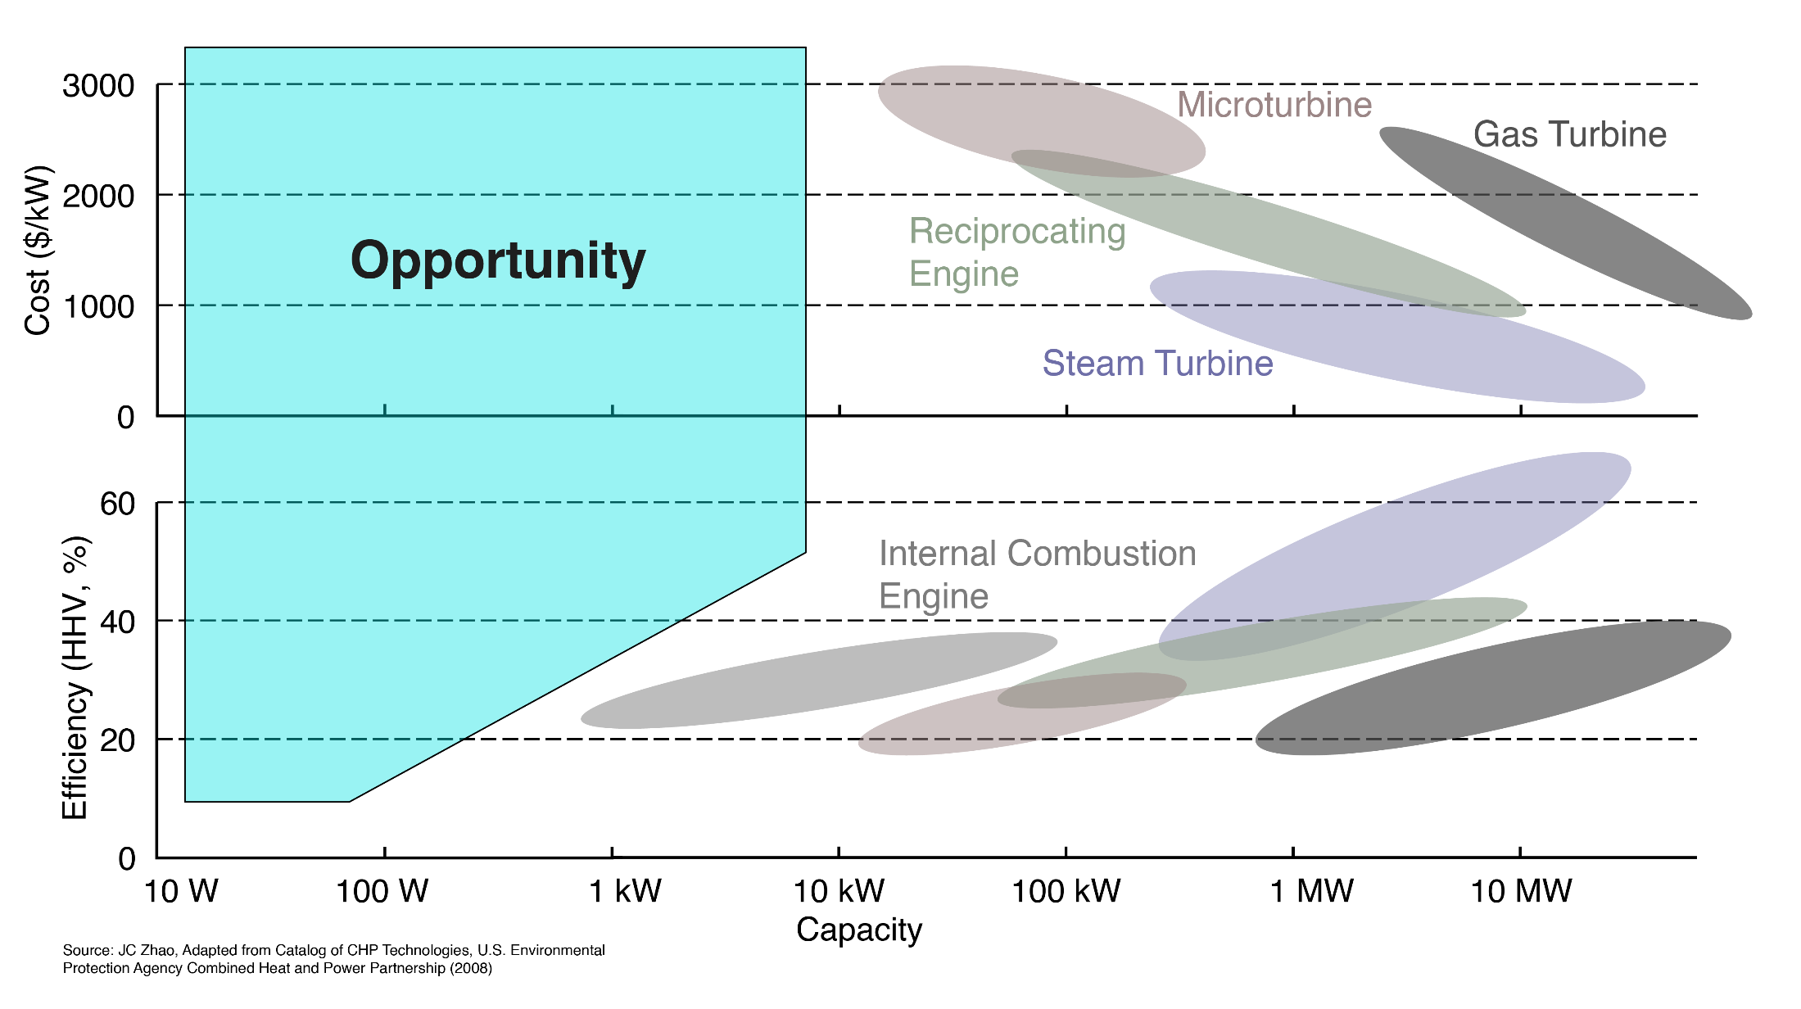
Power generation landscape

Slide 31


Energy
high work
function
low work
function
E_{F}

Slide 32
Energy
high work
function
low work
function
E_{F}
space charge

Slide 33
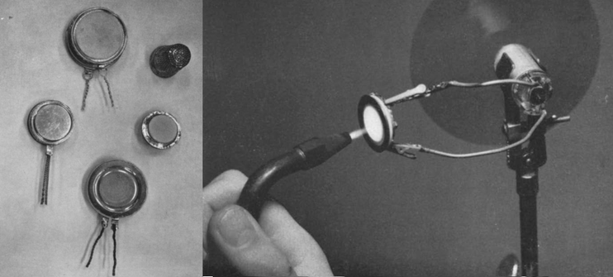
Thermionic energy conversion
GE Research, 1963 (PCE ~4.5%).

Slide 34
Efficiency potential, thermoelectrics and thermionics
WF =
WF =
WF =
Thermionics
Thermoelectrics
Jared W. Schwede, Spark Thermionics

Slide 35
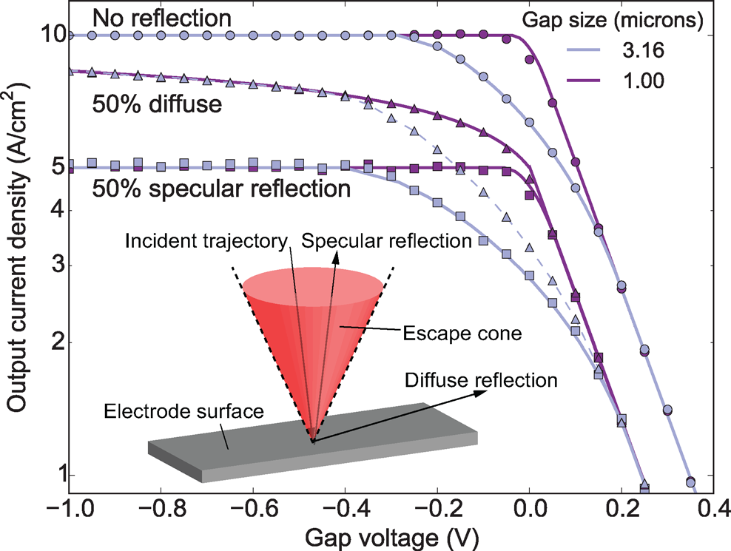
Optimizing thermionics anode for:
low workfunction
low reflectivity
I. T. Lim, S. A. Lambert, J.-L. Vay, J. W. Schwede, APL 112, 073906 (2018)

Slide 36
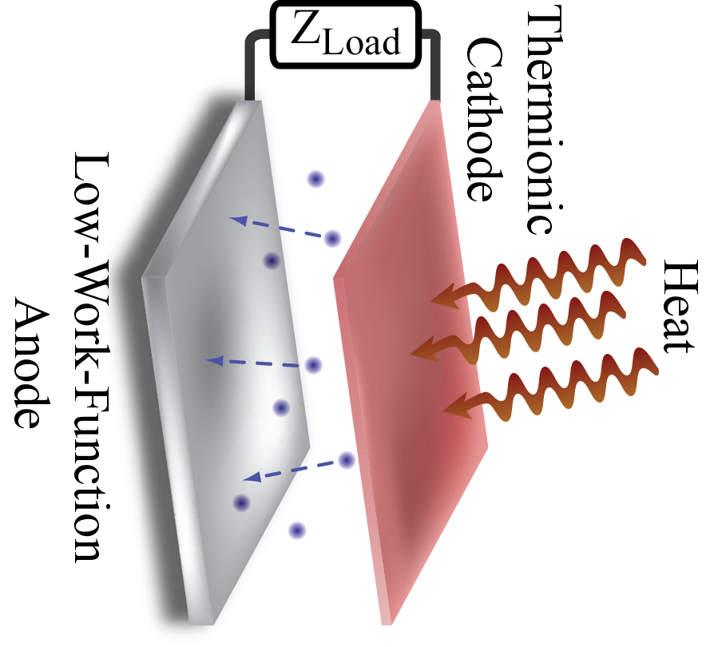
Thermionic converter: “black box”
Thermionic
cathode
Heat
Low workfunction
anode

Slide 37
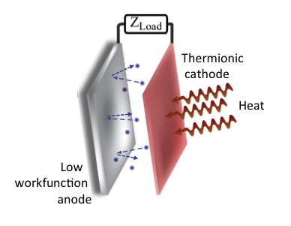
Opening the “black box”: Low energy electron microscopy as a model thermionic converter
image screen
accelerate reflected e⁻
dipole
beam
splitter
sample
decelerate primary beam
photocathode

Slide 38
In-situ cesium deposition on Cr(110)
Reflectivity
Φ (Cr₁₁₀)=4.9eV
Φ (Cs_{Min})=1.6eV
Φ (CsCr₁₁₀)=2.0eV
Cr [110]

Slide 39
Current absorption
60 % absorption

Slide 40
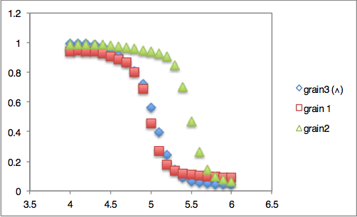
Polycrystalline anode materials (W)
BF-LEEM
IV-LEEM
2
1
Reflectivity
3
3μm
Landing Energy/eV
Different grains: different workfunction, different reflectivities

Slide 41
Polycrystalline anode materials (W)
BF-LEEM
IV-LEEM
2
1
Reflectivity
3
3μm
Landing Energy/eV
Different grains: different workfunction, different reflectivities

Slide 42
Polycrystalline anode materials (W)
BF-LEEM
IV-LEEM
2
1
Reflectivity
3
3μm
Landing Energy/eV
Different grains: different workfunction, different reflectivities
Hunch: what if we suppress grain growth?

Slide 43
Vapor deposition Cr on cold Si: ‘nanograined’ Cr anodes
Φ (Cr₁₁₀)=4.9eV
Cr(110)
Φ (Cs_{Min})=1.6eV
Φ (CsCr₁₁₀)=2.0eV
Cr [110]
Reflectivity
Φ (Cr_{Nano})=4.4eV
Cr(‘nano’)
Φ (Cs_{Min})=1.6eV
Φ (CsCr_{Nano})=1.8eV
Cr ‘nano’
A. Cauduro et al., to be published

Slide 44
Current absorption
60 % absorption
78 % absorption
As-deposited Cr films lead to enhanced current absorption
specular and diffuse reflection is quenched

Slide 45
Using LEEM for thermionics anodes development:
Identify low-workfunction systems
Identify low-reflectivity systems
 | Crystalline Cr [110] | Nanograined Cr/W | Nanograined Mo/Si
I_{Absorbed} % ª | 60 | 78 | 80
Φ_{cesiated} eV | 2.0 | 1.8 | 1.7
ª Integrated current absorption from 0-2 eV.

Slide 46
Using LEEM for anodes & cathodes discovery:
Quantitative characterization of low-workfunction
and/or low-reflectivity systems
In-situ thermionic emission imaging
Photoemission electron microscopy (just add light)
Workfunction mapping at high resolution
In-situ MBE sample growth
In-situ cesiation
In-situ negative electron affinity preparation

Slide 47



Thanks!
Tyson Back
Steven B. Fairchild
John J. Boeckl
Marc Cahay
Ali Sayir
Jared Schwede
Lucas Hess
Frank Ogletree
Gong Chen
Andre Cauduro
Roberto Lo Conte
McCallum Robertson
Floor Derkink

Slide 48
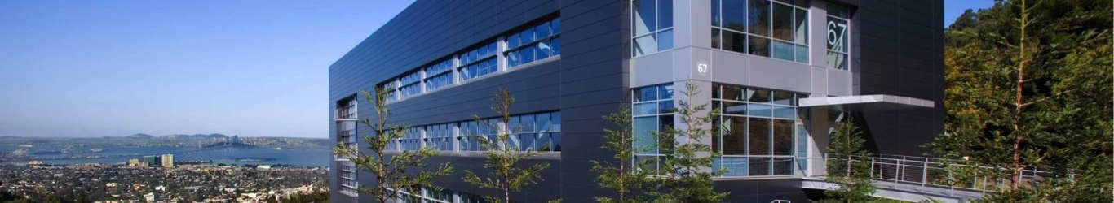

Research Made Possible By the Molecular Foundry
A knowledge-based user facility for nanoscale science at Lawrence Berkeley National Laboratory
Provides free access to multidisciplinary expertise and instrumentation
Proposal calls in March and September
foundry.lbl.gov

