Slide 1
Experimental evaluation and Monte Carlo simulation of thin GaAs photocathodes
Wei Liu¹
Matthew Poelker², Charlie Sinclair², Erdong Wang¹
¹Brookhaven National Laboratory
²Jefferson Lab
Photocathode Physics for Photoinjectors (P3) Workshop
October 15, 2018, Santa Fe, New Mexico

Slide 2
Outline
Motivation
Experimental results
Monte Carlo (MC) model
  Photoexcitation
  Electron transportation
  Emission
Compare MC model and experiment
Discussion/Summary

Slide 3
Motivation
Thin GaAs photocathodes can be used to provide higher electron spin polarization and shorter electron bunch length than thick GaAs
The measured QE was considerably higher than expected values
Use Monte Carlo simulation to explain the photoemission from thin GaAs photocathodes
Notes:
Why we do this work? Thin …….
So, some experiment for thin GaAs were performed at Jlab. But we found that the measured …

Slide 4
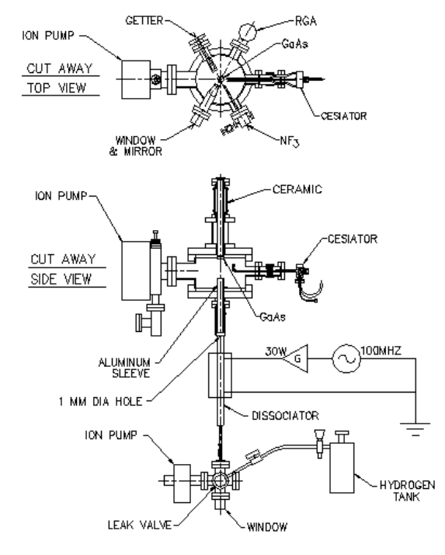
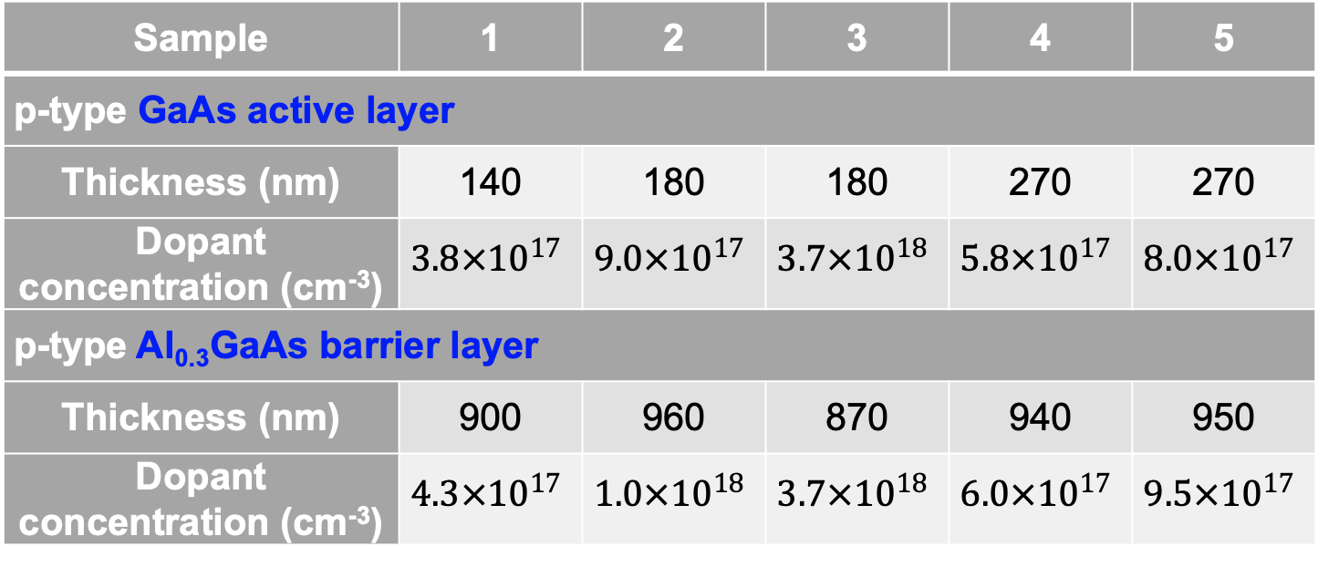
Experiment
Sample | 1 | 2 | 3 | 4 | 5
p-type GaAs active layer
Thickness (nm) | 140 | 180 | 180 | 270 | 270
Dopant concentration (cm⁻³) | $$3.8×{10}^{17}$$ | $$9.0×{10}^{17}$$ | $$3.7×{10}^{18}$$ | $$5.8×{10}^{17}$$ | $$8.0×{10}^{17}$$
p-type Al_{0.3}GaAs barrier layer
Thickness (nm) | 900 | 960 | 870 | 940 | 950
Dopant concentration (cm⁻³) | $$4.3×{10}^{17}$$ | $$1.0×{10}^{18}$$ | $$3.7×{10}^{18}$$ | $$6.0×{10}^{17}$$ | $$9.5×{10}^{17}$$
GaAs active layer was grown on the AlGaAs barrier layer, which was fabricated on the p-type GaAs substrate
Experiments were preformed at JLab
Samples were heated to 575 ºC for 2 hours and activated by Cs and NF₃
Notes:
For this study, we build 5 samples.

Slide 5
Experimental results
Thicker GaAs and higher dopant density sample provide the highest QE
QE was higher than we expected?
Experimental spectral response curves

Slide 6
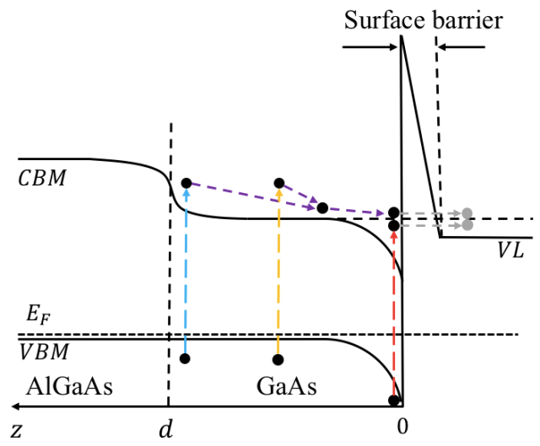
3-step photoemission in MC model
Photoexcitation
Transportation
Emission

Slide 7
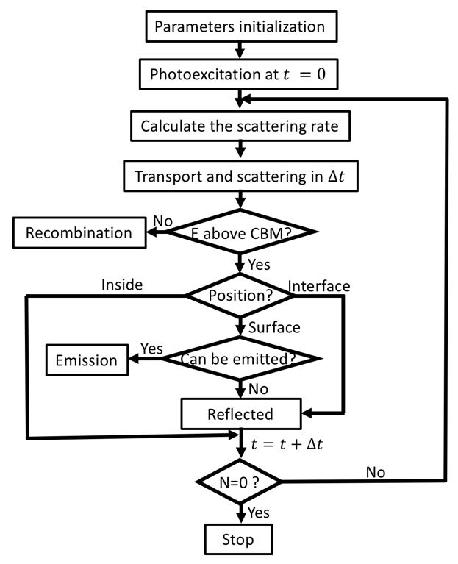
Flowchart of MC Model
Notes:
Execute photoexcitation to obtain electron distribution

Slide 8
Photoexcitation
Position distribution
Band structures
Energy distribution
﻿J.S. Blakemore, ﻿J. Appl. Phys. 53(10), R123 (1982)
Notes:
These plots were simulated for the GaAs sample with thickness of 270 nm and dopant concentration $8.0×{10}^{17} {cm}^{−3}$ when illuminated with 100,000 photons of energy 1.8 eV

Slide 9
Electron transportation-scattering rate
Impurity scattering
Carrier (hole) scattering
Phonon scattering
  Deformation potential
  Piezoelectric
  Nonpolar optical phonon (NOP)
  Polar optical phonon (POP)
  Intervalley

Slide 10

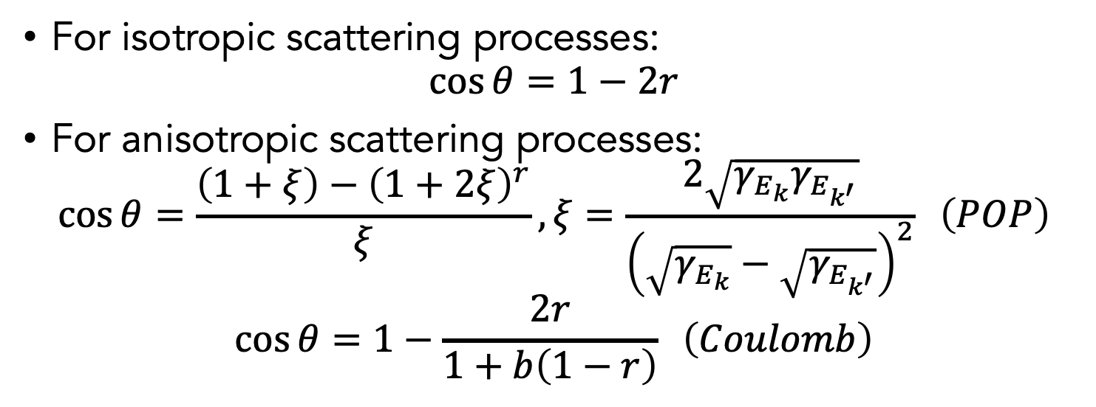
Electron transportation-scattering angle
$$θ$$
For isotropic scattering processes:
$$\cos{θ}=1−2r$$
For anisotropic scattering processes:
$$\cos{θ}=\frac{\left(1+ξ\right)−{\left(1+2ξ\right)}^{r}}{ξ}, ξ=\frac{2\sqrt{γ_{E_{k}}γ_{E_{k^{′}}}}}{{\left(\sqrt{γ_{E_{k}}}−\sqrt{γ_{E_{k^{′}}}}\right)}^{2}} \left(POP\right)$$
$$\cos{θ}=1−\frac{2r}{1+b\left(1−r\right)} \left(Coulomb\right)$$
C. Jacoboni and L. Reggiani, Rev. Mod. Phys. 55, 645 (1983)
D. Vasileska and S.M. Goodnick, https://nanohub.org/resources/9109

Slide 11
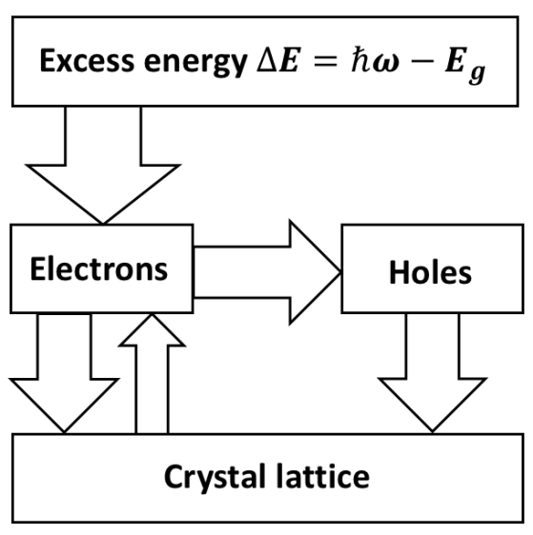
Electron transportation-energy flow
Electrons obtain energy from photon
Electrons exchange energy with holes and crystal lattice
Electron reach a steady-state distribution after a series of scattering
Notes:
the width of the arrows indicates the relative size of each energy-flow channel

Slide 12
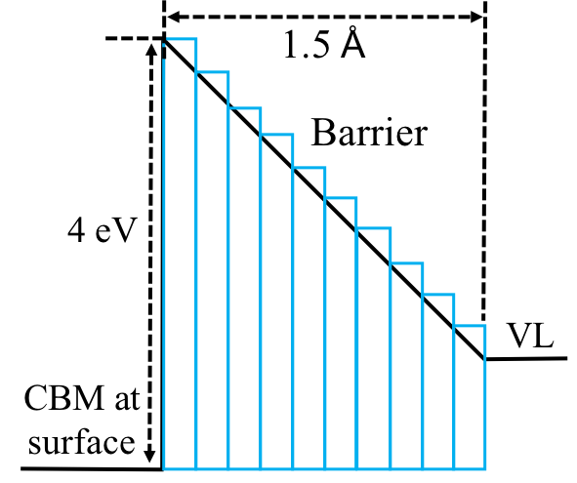
Emission
Surface electron has a probability to cross the surface barrier into vacuum
The transfer matrix (TM) method is used to calculated the transmission probability
Photocathode surface barrier
Calculated transmission probability

Slide 13
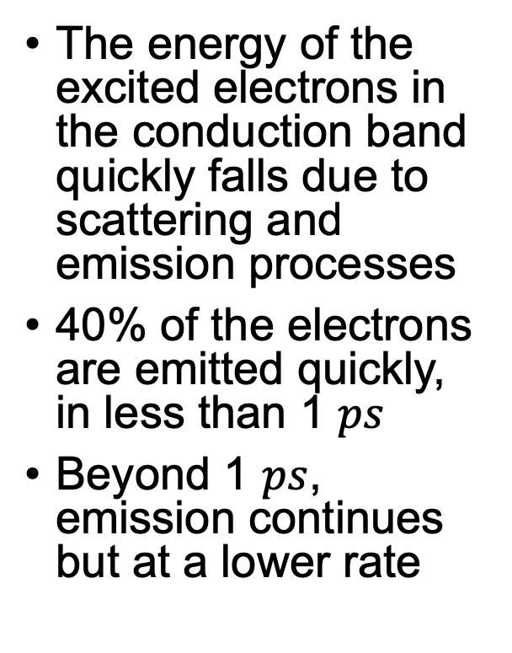
Time evolution of electron information
The energy of the excited electrons in the conduction band quickly falls due to scattering and emission processes
40% of the electrons are emitted quickly, in less than 1 $ps$
Beyond 1 $ps$, emission continues but at a lower rate

Slide 14
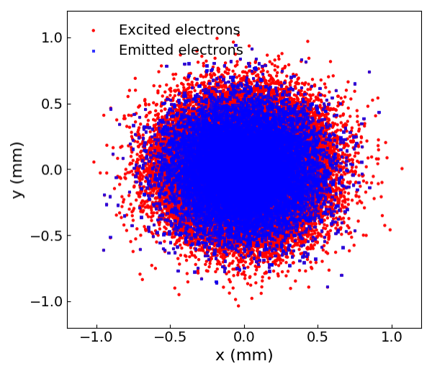
Two dimensional distribution

Slide 15
Compare MC model and experiment-thick bulk GaAs photocathode
Best fit is obtained for electron affinity of -0.04 eV
The MC model use electron affinity within -0.05 to -0.03 eV
Notes:
To assign a reasonable value to electron affinity, the MC model was used to predict QE as a function of photon energy (i.e., the QE spectral response) for thick bulk GaAs (thickness set to 10 $μm$), for which electron reflection at the buffer layer is not relevant.
The best match between the simulated and experimental results was obtained for electron affinity $−0.04$ eV.
Based on this result, for the thin GaAs photocathode samples, the MC model used electron affinity as a variable set to values within the range of -0.05 to -0.03 eV, to obtain the best fit between experimental and simulated results.

Slide 16
Compare MC model and experiment-thin GaAs photocathodes
The bandgap of AlGaAs is 1.8 eV
Only photoemission in GaAs is considered in the MC model
Reflections at the AlGaAs/GaAs interface enhanced the QE
with reflections at the AlGaAs/GaAs interface
without reflections at the interface

Slide 17
Temporal response
Thicker and higher dopant density samples provide longer electron bunches
Much shorter pulses are obtained when electron reflections at the AlGaAs/GaAs interface is ignored
with reflections at the AlGaAs/GaAs interface
without reflections at the interface
Notes:
The ‘‘pulse-response time’’ $τ_{90}$ is defined as the time interval in which 90% of the pulse charge is contained

Slide 18
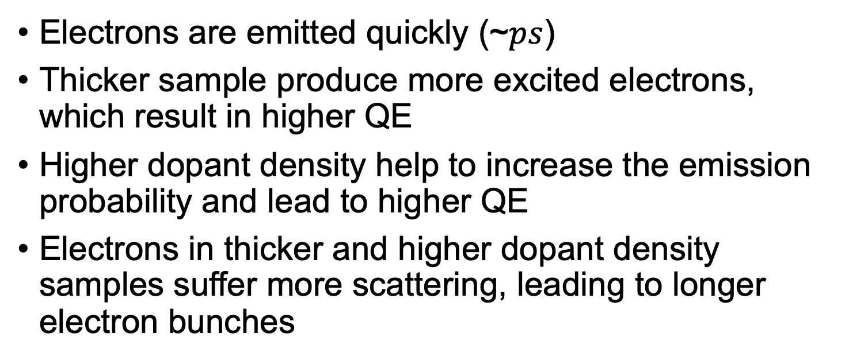
Discussion/Summary
Electrons are emitted quickly (~$ps$)
Thicker sample produce more excited electrons, which result in higher QE
Higher dopant density help to increase the emission probability and lead to higher QE
Electrons in thicker and higher dopant density samples suffer more scattering, leading to longer electron bunches
Reflections enhance the QE and prolong the electron bunches

Slide 19
Thank you for your attention !

