Slide 1
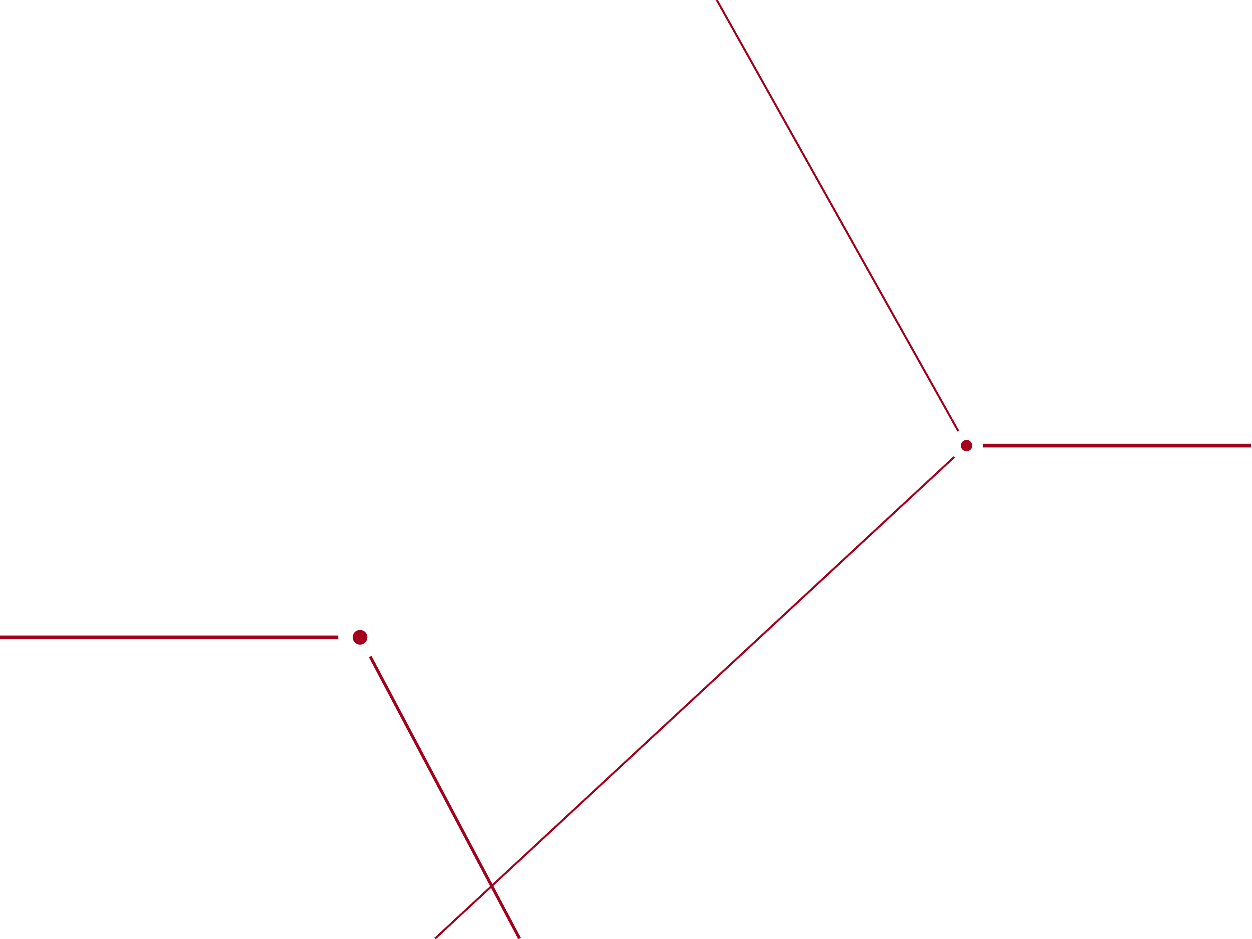
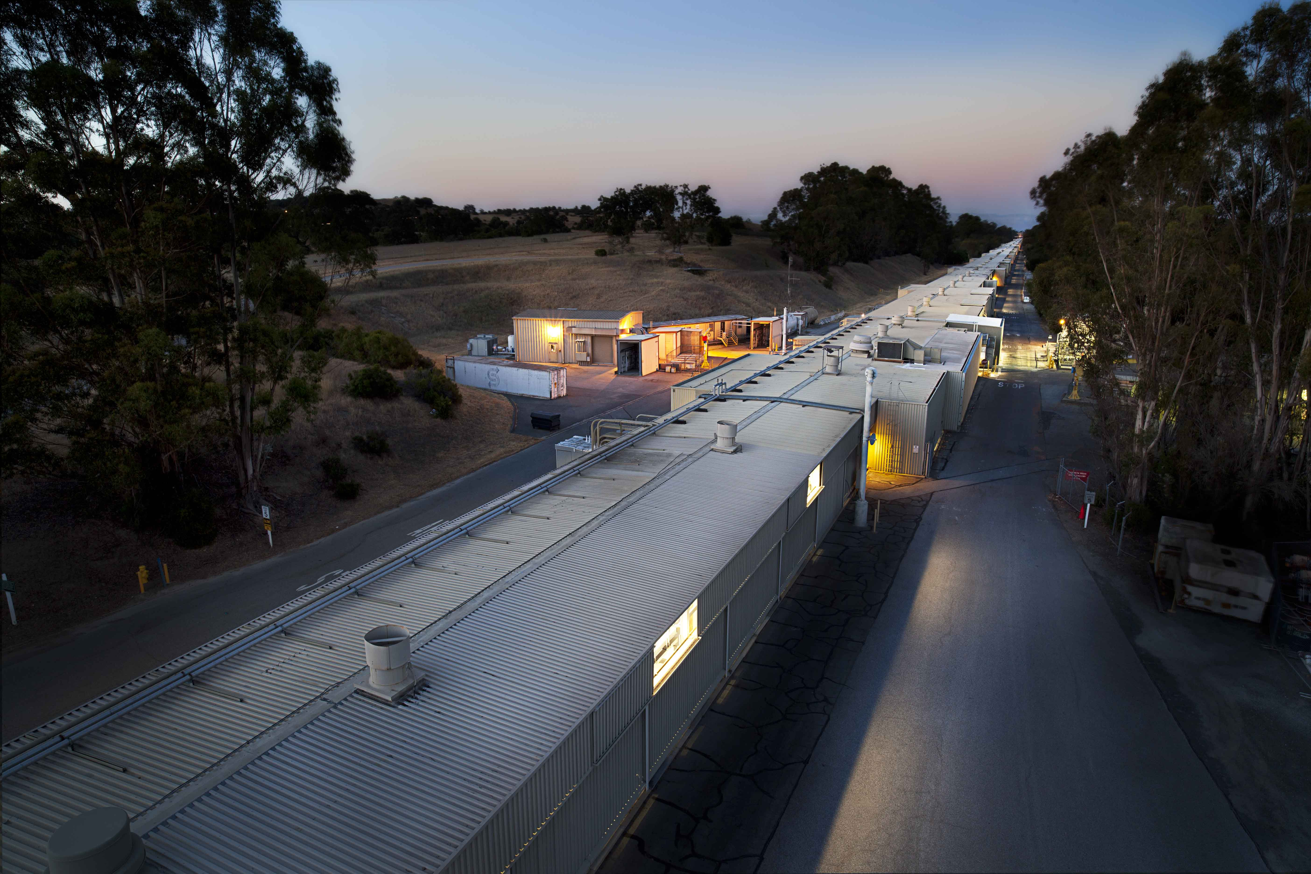

Requirements and Challenges of Photocathodes for Free Electron Laser Applications
DRAFT
Bruce Dunham
Oct 15, 2018

Slide 2
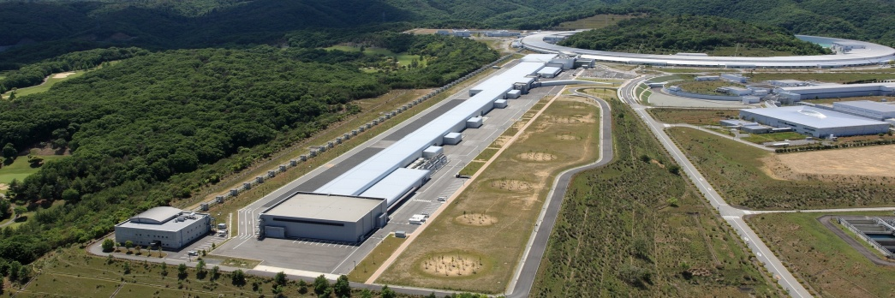


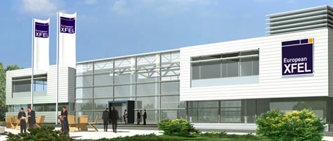
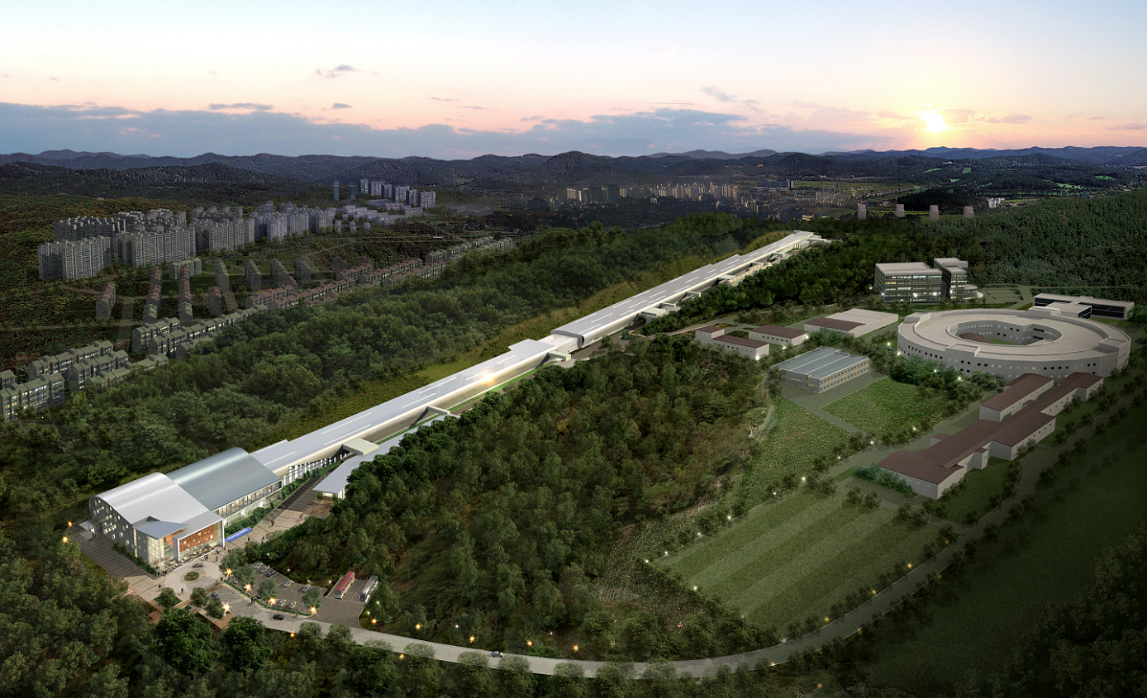
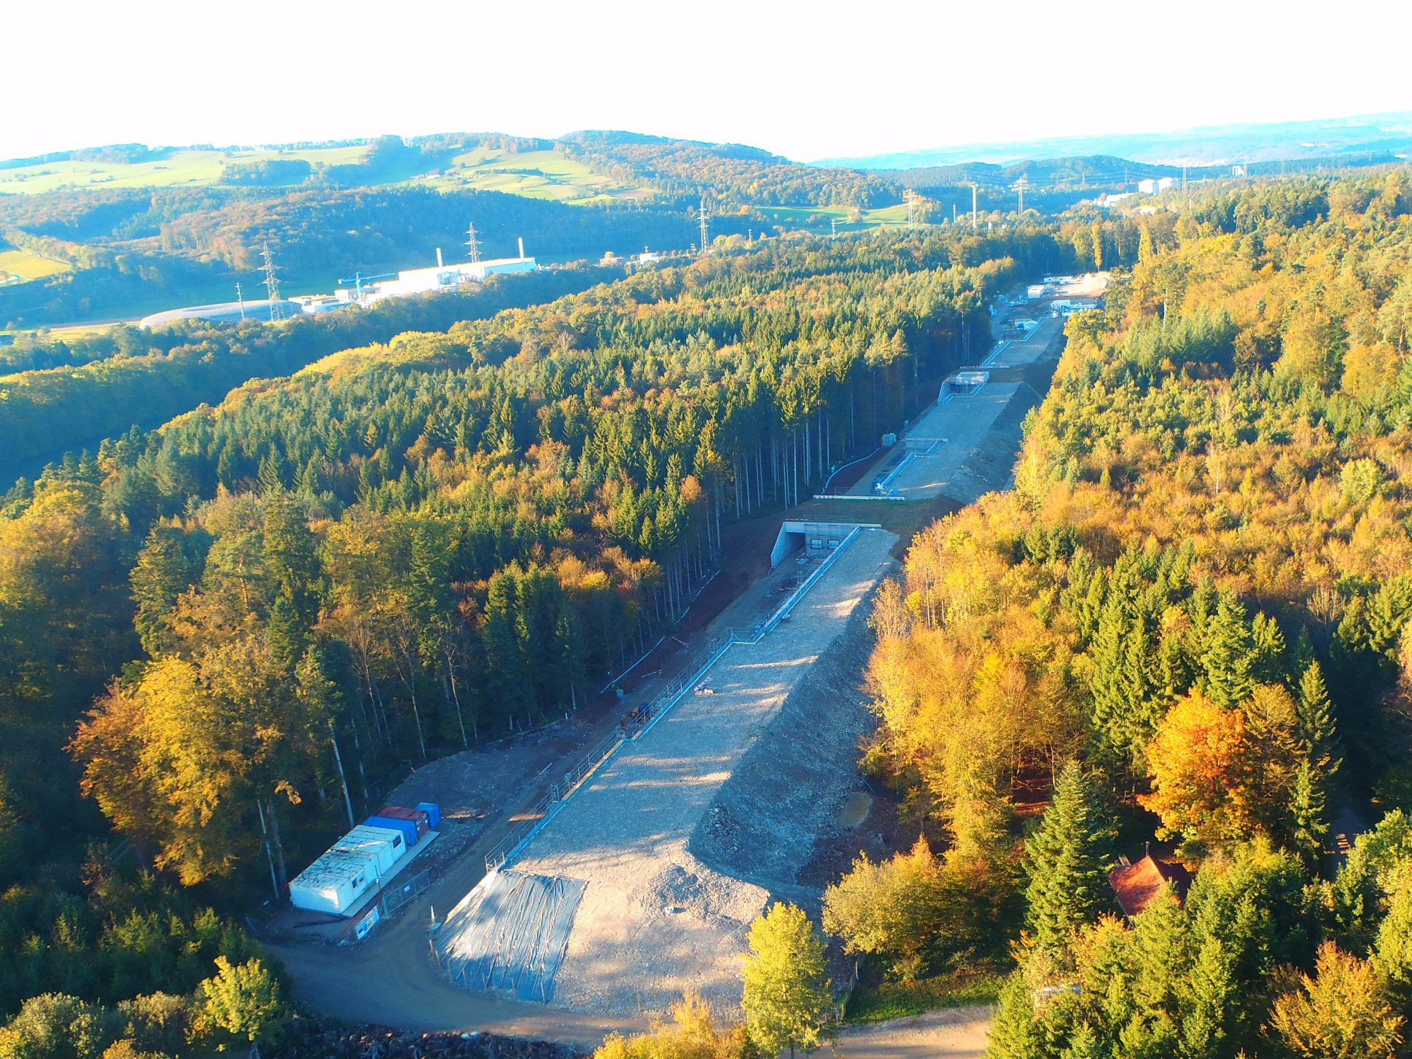


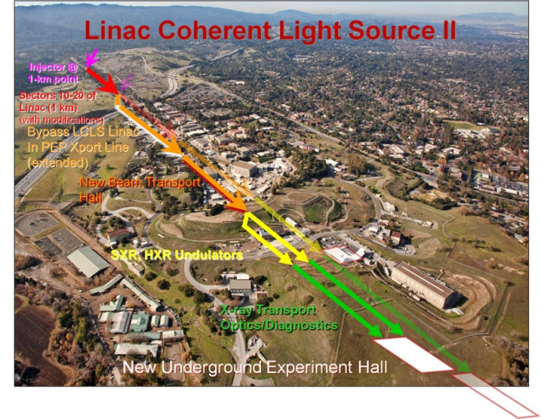
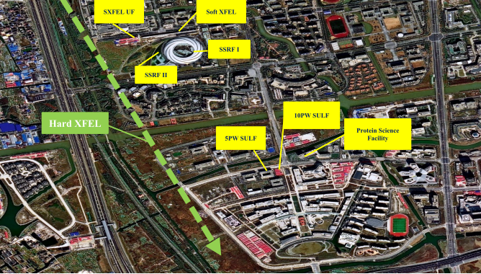


Hard X-ray FELs
SACLA 2011
8.5 GeV,
60Hz NC
European XFEL 2017
17.5 GeV, 2800 x 10 Hz SC
PAL XFEL2016
10 GeV
60Hz NC
SWISS FEL 2018
5.8 GeV
100 Hz NC
LCLS-II 2020
4 GeV
1 MHz SC
Shanghai SHINE 2025
8 GeV
1 MHz SC
LCLS-II-HE 2025
8 GeV
1 MHz SC
2
Notes:
SACLA thermionic
PAL copper
LCLS-II, CsTe
LCLS-I Copper
XFEL – CsTe
SwissFEL copper
Shanghai – CsTe

Slide 3
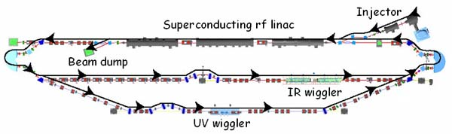
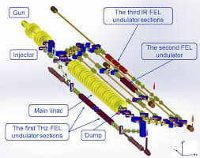
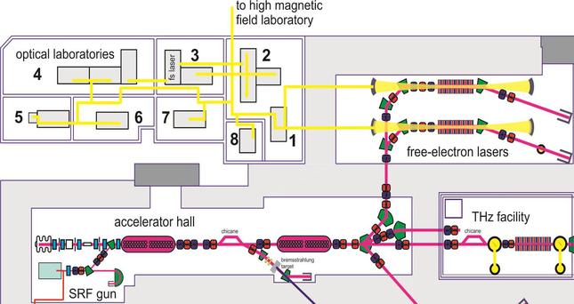
Other FELs
Jlab IR/UV FEL
88-135 MeV
74.85 MHz
Novosibirsk THz FEL
40 MeV
90 MHz
HZDR FEL
12-34 MeV
13 MHz
Notes:
Boeing FEL used CsKSb
Only metal, CsTe and thermionic cathodes in regular use – what are we doing wrong???
Industrial FEL, EUV
CHALLENGE!! How to justify all the work we have and want to do
QW GaAs only real advance in memory

Slide 4
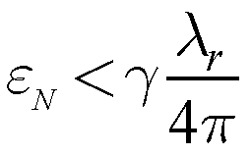
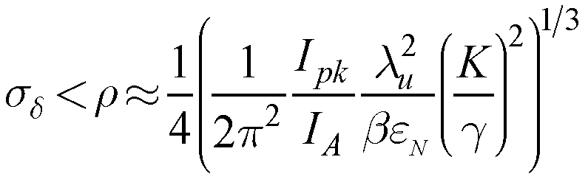
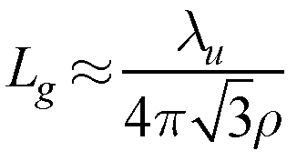
SASE FEL Electron Beam Requirements
ε_{Ν} < 0.5 µm at 1 Å, 15 GeV
relative energy spread:
<0.04% at I_{pk} = 3 kA, K ≈ 3, λ_{u} ≈ 3 cm, …
18L_{G} ≈ 60 m for ε_{Ν} ≈ 0.5 µm
P(z) = P₀ ∙ exp(z/L_{G})
Notes:
We must increase peak current, preserve emittance, and maintain small energy spread so that power grows exponentially with undulator distance, z,
P(z) = P₀ ∙ exp(z/L_{G})
FEL power reaches saturation at ~18L_{G}
SASE depends exponentially on e⁻ beam quality (to be exploited)

Slide 5
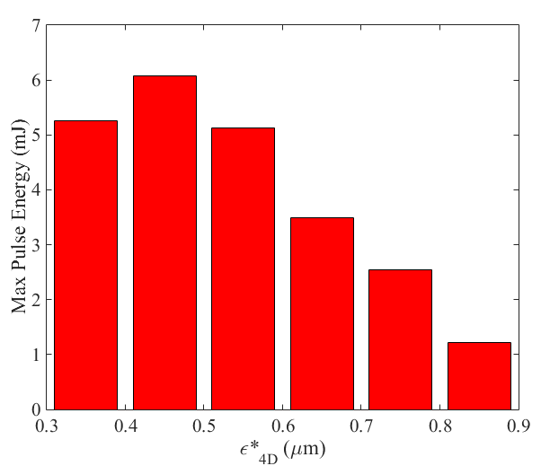
Example: FEL output vs. Injector emittance
LCLS peak FEL performance
LCLS hard X-ray (> 6.5 keV) energy loss data w/ nominal injector charge

Slide 6
Motivation for lower thermal emittance (LCLS-II-HE)
Emittance at Undulator
Photon Energy (keV)
LCLS-II Injector
The emittance at the injector will need to be at least 4X lower than we can generate now to reach 20 kV (< 0.1 um needed)
Electron Energy (GeV)

Slide 7
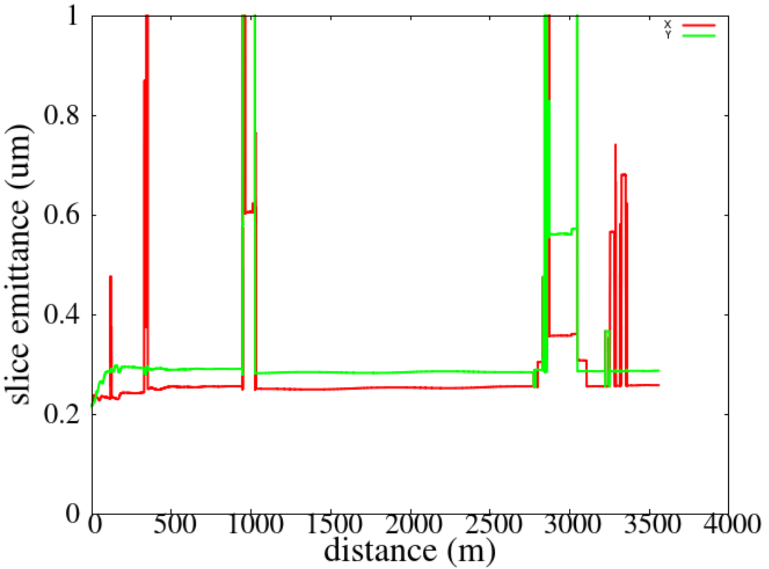
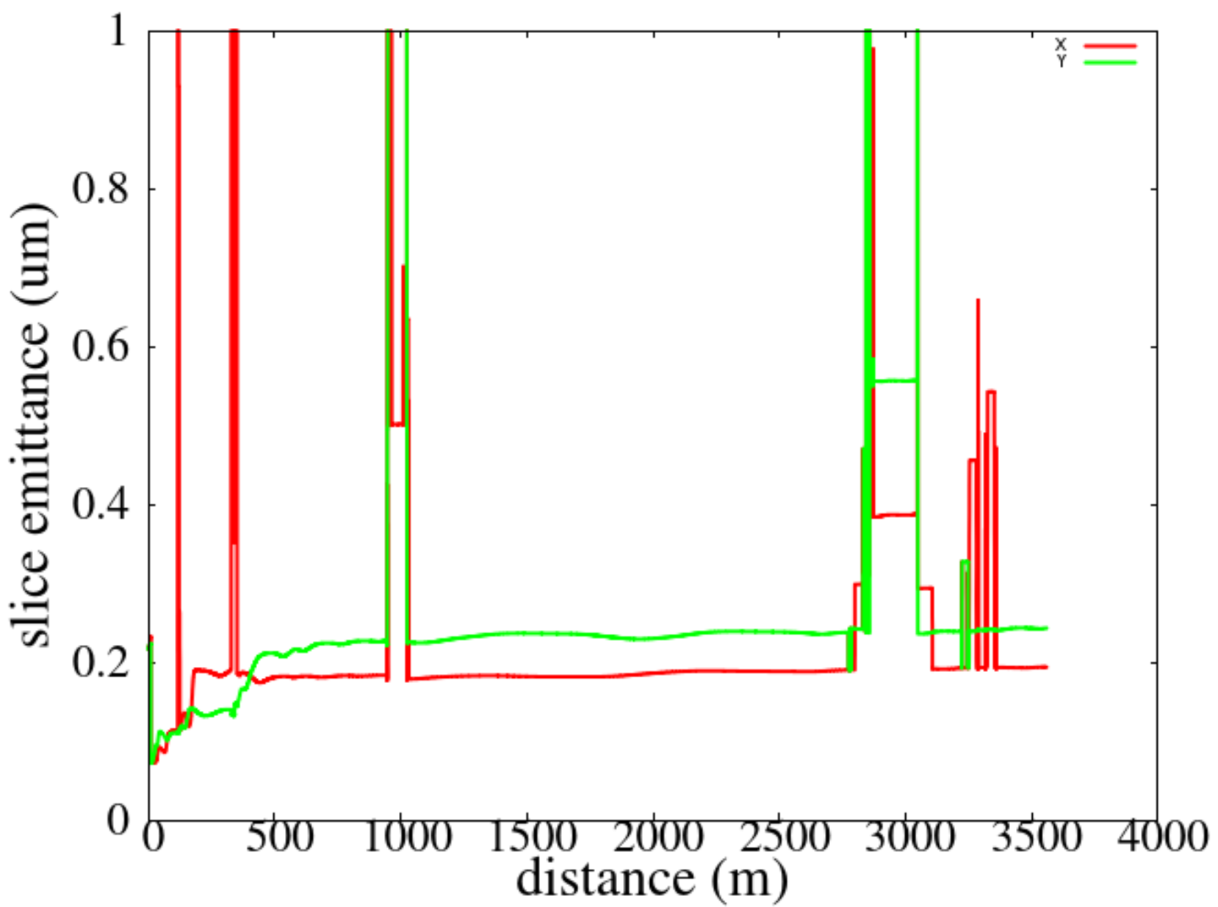
Beam transport limitations from 100 MeV → 8 GeV
Nominal Slice Emittance Evolution
High Brightness Slice Emittance Evolution
Slice ε: 0.22/0.22 → 0.26/0.30 um
Slice ε: 0.08/0.07 → 0.19/0.24 um
Better cathodes do not solve everything …

Slide 8

System Level Knobs for FEL Performance
How to achieve better emittance at the undulators?
  Injector and FEL optimizations
  Layout optimized for lower I_{peak}
  Controlling instabilities
  Emittance compensation
  Start-to-end simulations
  Laser shaping
  Cathodes with lower ε_{th} and improved laser shaping
  Wavelength dependence of ε_{th}
  Temperature dependence of ε_{th}
  Laser shaping
  Cathode heating, other effects
  Low Frequency Guns
  Longer initial pulse (lower I_{peak})
  Less RF curvature
  Gun gradient
  Gun energy
System Design and Optimization
Cathodes and Lasers
Gun Design
Notes:
U bunching instabilities driven by laser modulations

Slide 9
MTE Ranges available today
1 eV
emittance
Log-scale
Practically used MTE’s
1.4 um / mm-rms
Metals
  25-40 meV near threshold
  Very low QE<10⁻⁶.
Alkali-antimonides
  25-40 meV near threshold
  Low QE <10⁻⁴.
GaAs/(Cs,O)
  25-40 meV near threshold
  long response time
100 meV
0.44 um / mm-rms
10 meV
0.14 um / mm-rms
MTE limited by disorder induced heating (DIH)
1 meV
0.04 um / mm-rms

Slide 10
Average Current and Bunch Charge
Average currents for FELs are in the range of ~10 nA up to ~10 mA with bunch charges of ~10 pC up to ~500 pC
The rep rate is the biggest driver for average current, with ‘industrial’ applications at the high end. CW systems more in use.
The majority of machines are <100 uA and ~100 pC
  Much less demanding for cathodes (QE not a big concern)
  Opens up opportunities for: metals, near threshold emission, etc
  Cathode lifetime is less of a concern (2 week lifetime desired)
The relatively modest demands on current/bunch charge open up possibilities for big reductions in thermal emittance.

Slide 11
Example: Improvements for LCLS-II
CsTe is the baseline cathode for LCLS-II. An easy win for lower emittance:
change to a better cathode with visible/IR excitation
Initial simulations indicate that ~0.20 um (95%) can be obtained:
Na₂KSb
This cathode is desired because:
It can run ‘hot’, and the LBL gun operates at >50C
Has already demonstrated 65 mA with reasonable lifetime in a DC gun
Improved emittance control with laser shaping in the green/IR
Full characterization of a NaKSb photocathode in the APEX gun to prove out feasibility for LCLS-II/HE

Slide 12
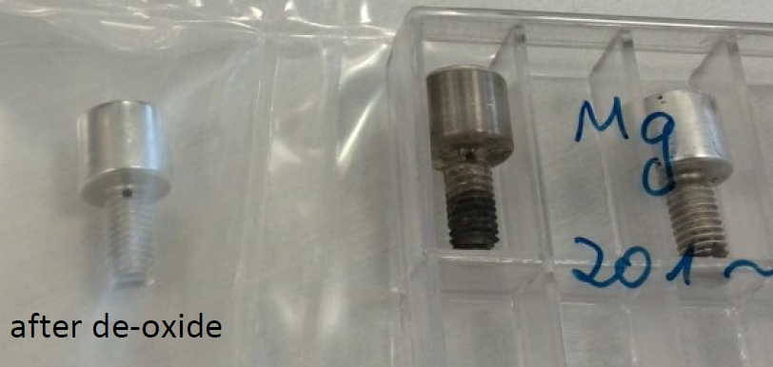
Example: Metal Cathodes
Magnesium has the highest QE of a (machinable) metal – 0.2% at 260 nm
Can be cleaned in-situ
Low dark current
Cathodes can be machined then cleaned and prepared to be particle-free
Bunch charges up to 300 pC and current of 30 uA have been demonstrated
One measurement (BNL) indicates that it has lower thermal emittance than predicted
Mg plugs for an SRF gun
J. Teichert ERL17 workshop
Theoretical understanding and full characterization of the thermal emittance and QE versus wavelength of Mg/Pb cathodes for use in an SRF gun, material properties, roughness, …

Slide 13
Example: SRF Gun with a lead cathode (DESY)
Pb is a superconductor
QE of ~0.05%
100 pC operation feasible
Vertical tests underway at DESY
Waiting for results from DESY

Slide 14
Properties of Alkali Photocathodes
Colder temperatures
Longer laser wavelengths
Na₂KSb
Cultrera et al, APL 108, 134105 (2016)
Cs₃Sb
QE drops near threshold and with decreasing temperature.
Not a big concern for most FELs
Operation at cold temperatures a good match for CW SRF guns
Need a better understanding of properties at < 80K
Notes:
These plots show some recent measurements on alkali cathodes. Each have emittance on the left axis and laser spot size on the bottom. The slope gives the thermal emittance per mm of laser spot size, our usual way to describe cathodes a low current. The left shows what happens as the laser wavelength is changed from green to infrared – the emittance drops > 2X. Cooling it down drops in even further.
Note that the QE drops for longer wavelengths, and for colder temperatures
The could be the first step in a staged approach to harder x-rays – a new cathode and laser.
R&D: full characterization over 4K-300K, operation in an SRF gun, dark current/multipacting, particle free growth and transport,surface roughness

Slide 15
Other Topics to Consider
Induced heating
Longitudinal non-linearities that reduce compression efficiency
Longitudinal non-linearities that drive instabilities
Optimizing laser shaping for emittance and/or FEL performance

Slide 16
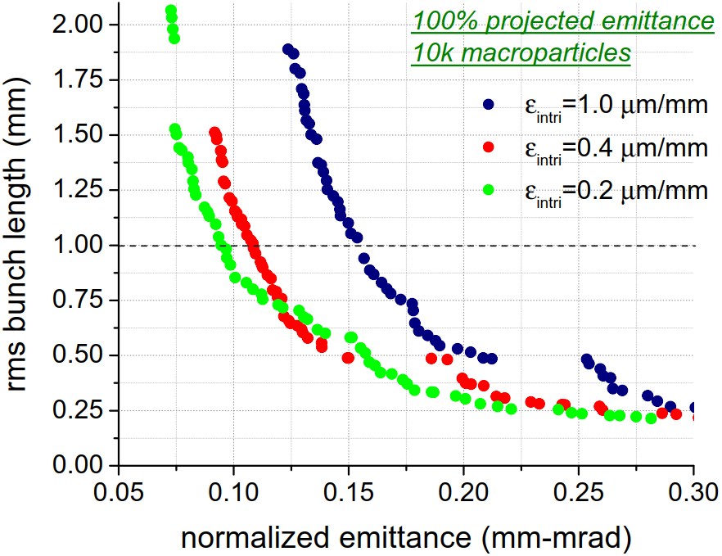
Final Example: Path forward for LCLS-II-HE and 20 keV
Comparison of WiFEL-type gun (40 MV/m) performances for different cathode ε_{intrinsic}
Intrinsic emittance (um/mm rms) | Total intrinsic emittance (um) | 100% emit. at z_{rms} = 1 mm (um) 200K MP
1.0 | 0.114 | 0.142 (0.116, 95%)
0.4 | 0.065 | 0.093 (0.075, 95%)
0.2 | 0.042 | 0.075 (0.061, 95%)
Lower intrinsic emittance allows improved beam brightness

Slide 17
Summary
Challenges
Requirements

