Slide 1
<10 meV MTE from Cu
- Siddharth Karkare (Department of Physics - ASU)
What does MTE depend on?
  Excess energy, roughness, band-structure
Demonstration of sub-10 meV MTE
  Can be obtained from Cu(100) surface cooled to 30 K
How to translate low MTE to high brightness?
  Defeat electron heating

Slide 2

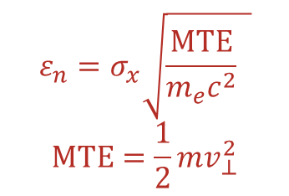

MTE, Brightness and Emittance
1000
Cathodes Used Today
$$B_{4D}∝\frac{N_{bunch}}{ε_{n}^{2}}$$
100
$$∝\frac{E_{z}}{MTE}$$
Brightness
MTE (meV)
$$ε_{n}=σ_{x}\sqrt{\frac{MTE}{m_{e}c^{2}} }$$
$$MTE=\frac{1}{2}mv_{⊥}^{2}$$
10
I. Bazarov et al., Phys. Rev. Lett. 102, 104801 (2009)
1

Slide 3
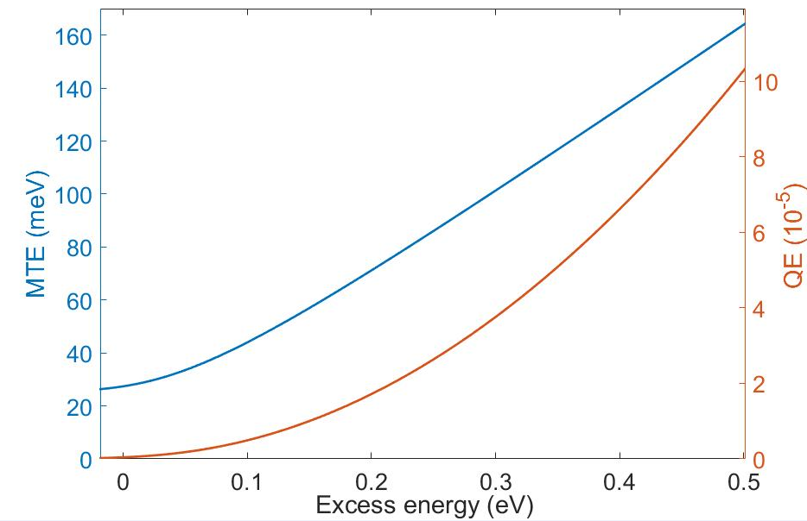


MTE limiting factors (1) – Excess energy
$$ℏω>W$$
$$ℏω=W$$
Vacuum level
Work
Function
W
Energy
Fermi level
Lower photon energy to the work function
Cool to low temperature
Limited by kT at threshold
Penalty for operation is low QE
J. Feng, S Karkare et al. APL 107, 134101 (2015)

Slide 4
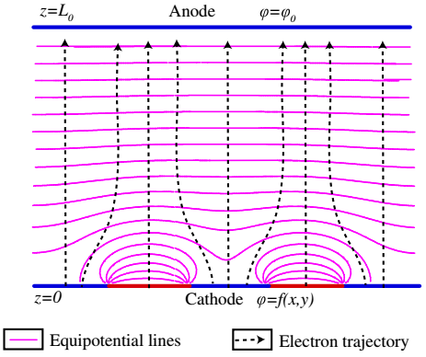




MTE limiting factors (2) -Surface non-uniformities
Physical Roughness
Chemical Roughness
$${MTE}_{field}=\frac{π^{2}a^{2}E_{0}e}{2λ}$$
$$MTE_{wf}=\frac{π^{2}h^{2}e}{4\sqrt{2}aE_{0}}$$
$$2a$$
$$λ$$
J. Feng, S. Karkare et al, J. Appl. Phys. 121, 044904 (2017)
S. Karkare and I. Bazarov, Phys. Rev Applied, 4, 024015 (2015)
G. Gevorkyan et al. Phys. Rev. ST- Accel and Beams, 21, 093401(2018)
Need single crystal ordered surfaces to minimize MTE

Slide 5
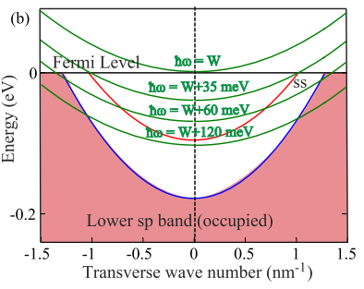
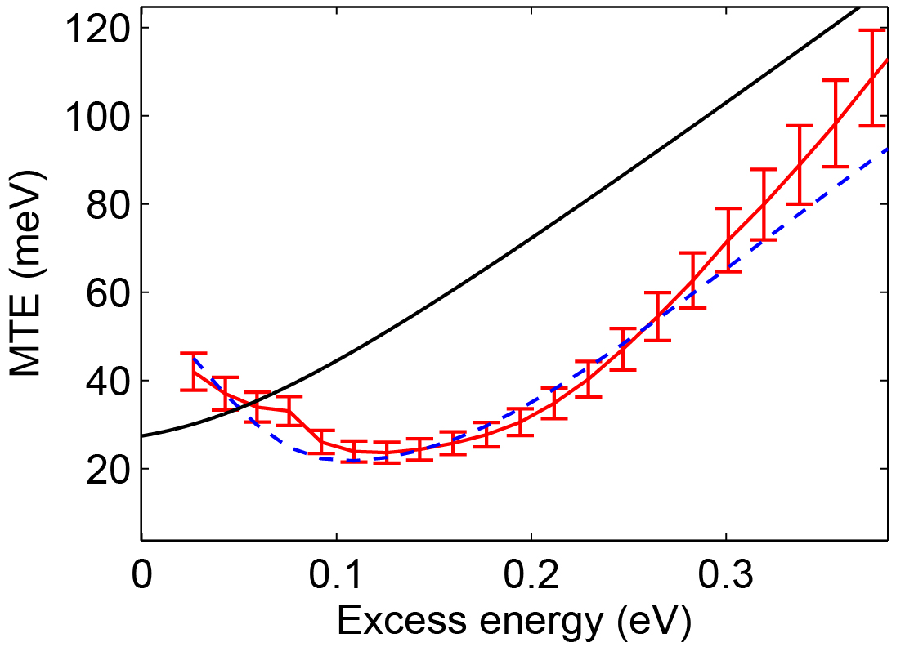
MTE limiting factors (3) – Band structure
Effect surface state of Ag(111)
S. Karkare et al. Phys. Rev. B 95, 075439 (2017)
S. Karkare et al. Phys. Rev. Lett. 118, 164802 (2017)

Slide 6
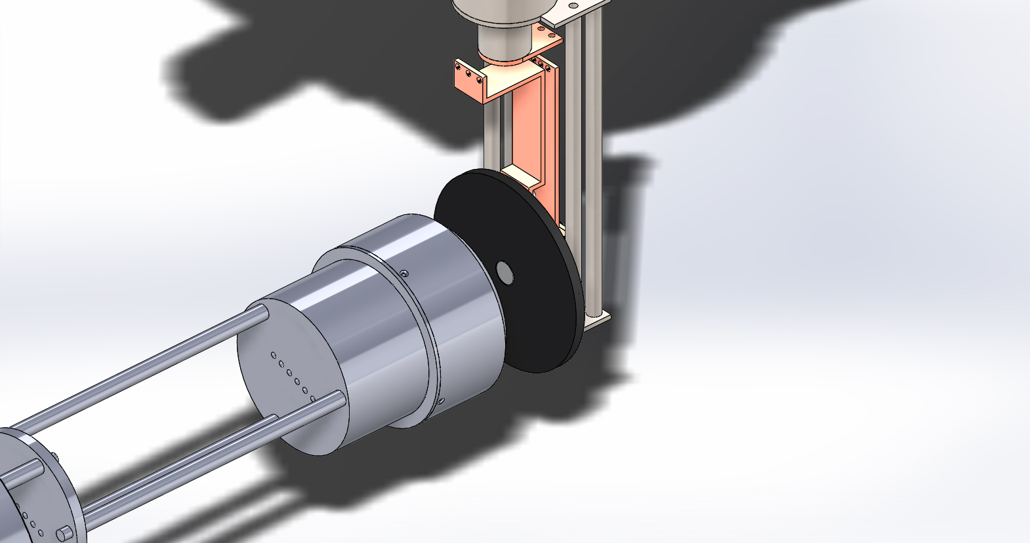
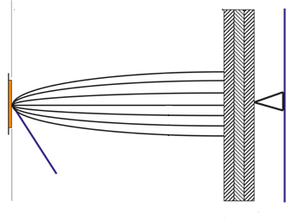


Measuring Low MTE
8 V
acceleration
4 V
acceleration
Cryostat
Sample
Delay Line
Detector
Electrons drift towards detector
MTE = 28 meV
4.5 eV at RT
X, Y Delay lines
Sample
(x, y, t) of electron hitting the MCP
Incident laser pulse (fs-ps)
MCP stack
MTE = 6 meV,
4.43 eV at 30 K
$$p_{x}=m_{e}\frac{x}{t}$$
$$p_{y}=m_{e}\frac{y}{t}$$
Electrostatic shield
Has sub-meV energy resolution!!!
Can obtain complete energy/momentum distribution

Slide 7
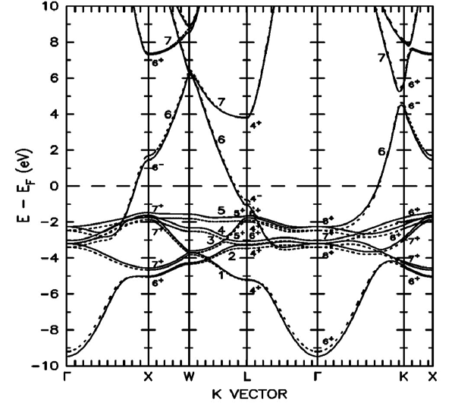
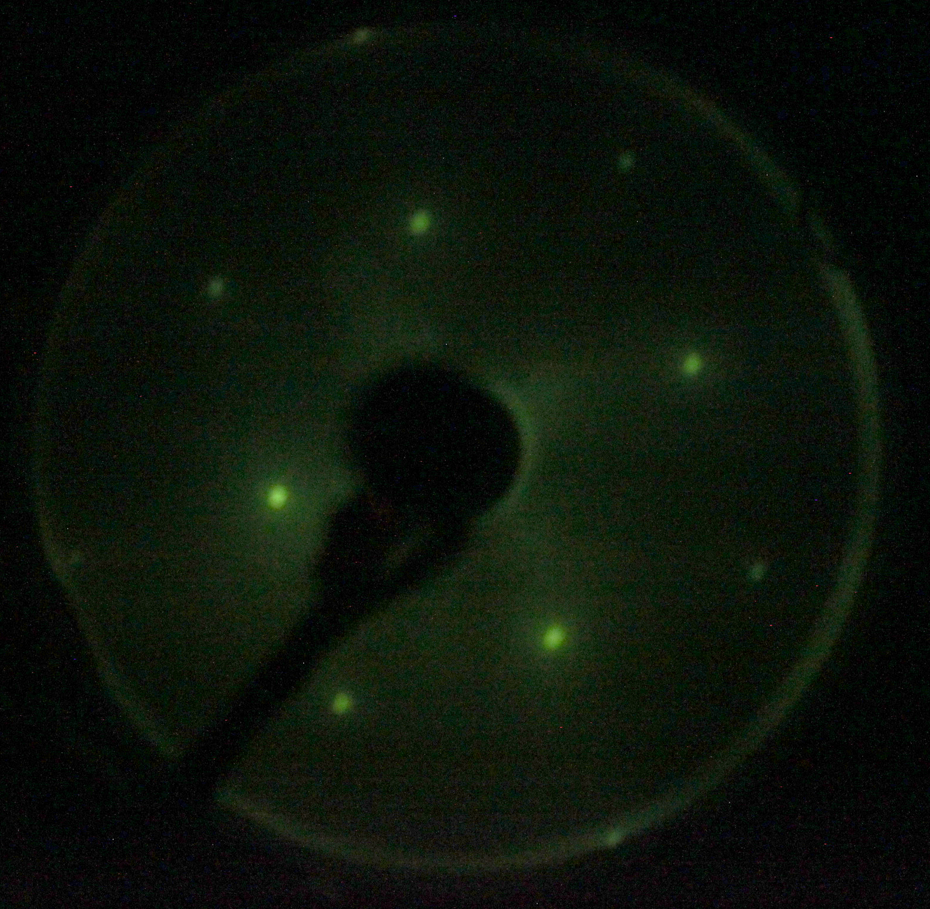
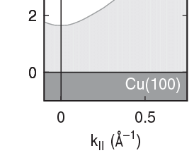
Cu(100) – Ideal for low MTE
Work function
X (100)
0 Transverse
momentum
direction
Projected band-structure
Atomically ordered flat surface
Photoemission threshold at ~4.5 eV – can be accessed by our laser
Cooled to LHe (30K)

Slide 8
Cu(100) – Smallest MTE measured
Room Temperature
30K
6 meV MTE measured from Cu(100)
Previous record was 22 meV from Cs₃Sb at 90K
6 meV!!
Work function reduced!!! – first measurement of work function of Cu(100) at LHe temp ??
Issue – Very low QE (~10⁻⁸) …
Still suitable for single electron/ bunch applications
For large charge densities – electron heating/multi-photon emission – Jai Kwan Bae’s talk
Andreas Schroeder’s talk on Wednesday for theory description

Slide 9
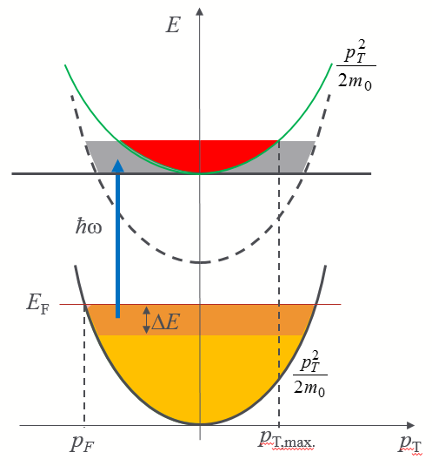
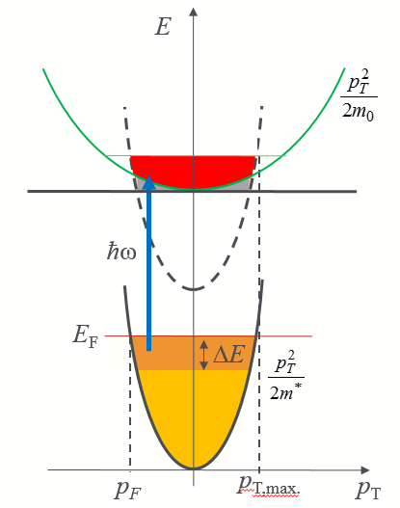
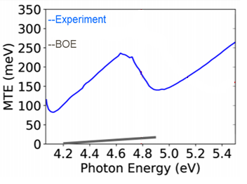
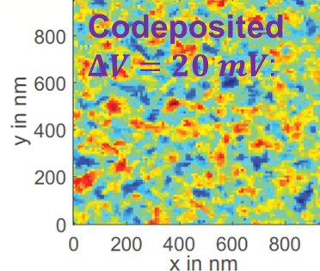
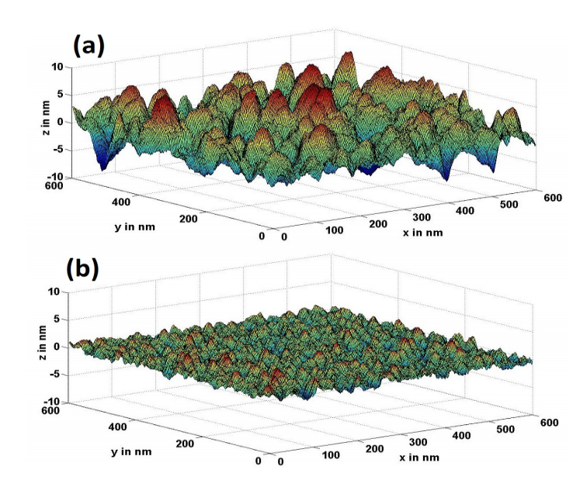
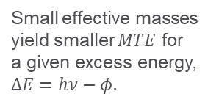
Beat Electron Heating – CBB efforts
Use single crystals with small effective masses
Use Low Electron Affinity semiconductor cathodes – Alkali-antimonides, GaAs(Cs/O)
Small effective masses yield smaller $MTE$ for a given excess energy, $ΔE=hν−φ.$
Electron heating is mitigated
Have higher QE even at threshold
However, roughness is an issue
Does not work for PbTe(111)!!!
Measurement
Kevin Nangoi’s talk on Wednesday
Predictions from band-structure
Will DeBenedetti’s talk in next session
Gevork Gevorkyan’s talk in next session
New low effective mass materials:
Joshua Paul’s talk this session
Chris Pierce’s talk next session
Howard Padmore’s talk tomorrow

Slide 10


Acknowledgements
LBNL
Howard Padmore
Siddharth Karkare (now at ASU)
UIC
Gowri Adhikari
Andreas Schroeder
NSF and DOE
for funding
Cornell
Jared Maxson

Slide 11

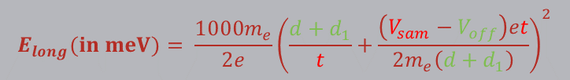

Basic setup and equations
x, y, t are recorded for each electron hitting the DLD
DLD
V=0
1.
$$E_{long}(in meV)= \frac{{1000m}_{e}}{2e}{\left(\frac{d+d_{1}}{t}+\frac{\left(V_{sam}−V_{off}\right)et}{2m_{e}\left(d+d_{1}\right)}\right)}^{2}$$
d+d₁
d
S
d₁
V_{shield}-V_{off1}
Shield
V_{sam}-V_{off}
Sample
2.
$$v_{x}=\frac{x}{t}$$
$$v_{y}=\frac{y}{t}$$
Red → known/can be varied and measured
Green → unknown but constant for one sample
MTE is calculated by averaging over all detected electrons

Slide 12




Obtaining Flat equipotential lines
Manipulator shifted w.r.t DLD
DLD
A
DLD
A
V=0
V=0
FLAT EQUIPOTENTIAL LINES
e⁻
e⁻
$$ℏω$$
$$ℏω$$
d₁
V_{shield}-V_{off1}
Shield
d₁
V_{shield}-V_{off1}
Shield
V_{sam}-V_{off}
Sample
V_{sam}-V_{off}
Sample
DLD
A
DLD
A’
A
V=0
V=0
CURVED EQUIPOTENTIAL LINES
e⁻
e⁻
$$ℏω$$
$$ℏω$$
V_{shield}-V_{off1}
d₁
V_{shield}-V_{off1}
Shield
d₁
Shield
V_{sam}-V_{off}
Sample
V_{sam}-V_{off}
Sample
If fields are not flat, the shield electrode acts like an non-linear electron lens and the electron spot on the DLD moves when the manipulator (sample+shield) position is changed w.r.t the DLD, keeping the incident laser spot fixed w.r.t DLD

