Slide 1
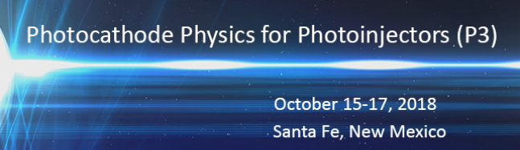


Prospects for uncertainty principle limited photoemission in electron microscopy
Jared Maxson
Cornell University
Department of Physics + CLASSE

Slide 2
Premise
In this conference: first measurements of few meV MTEs from a flat cathode.
What can photocathodes for photoinjectors offer the fields of traditional electron scattering: diffraction, microscopy, spectroscopy?
  (who already have nearly quantum limited source phase spaces…)
Can they be modified to compete with outperform field emission sources in traditional microscopes?
  Dream: Enable sub-angstrom resolution TEM that uses photoemission either CW or pulsed for “on demand time resolved”
  Dream: TEM quality beams in accelerator-based UED/UEM
Unique to photoemission: approaching longitudinal quantum limits with low MTEs
This talk: Not entirely an overview, not all original research, something in between. Hoping to stimulate discussion!

Slide 3
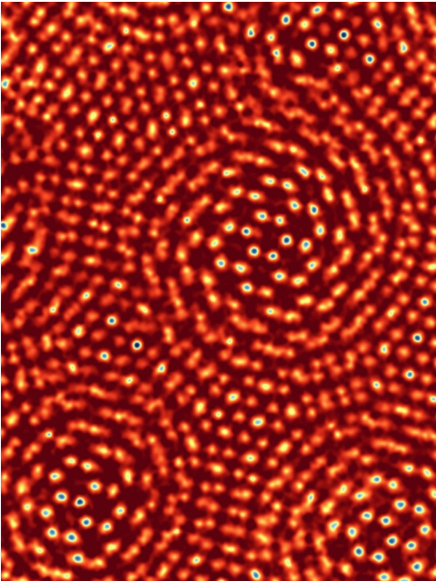

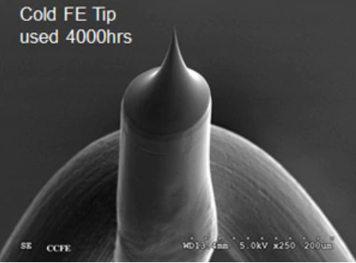
Traditional transmission electron microscopy
Advent of spherical aberration correctors (Cs) have yielded < 0.5 angstrom resolution images either in:
  scanning small probe beam (sub angstrom, STEM)
  direct imaging (wider parallel beam, TEM)
  World record resolution currently at 40 pm (Muller group →)
In one sense, traditional microscope design is a precision ~1m DC linac with extreme focal length (few mm) lenses.
Small, intense sources are critical:
Few -> 100 nm scale source sizes with 10s of nA to 10s of uA CW current!
Hitachi
Jiang et al., Nature 559, 343 (2018)

Slide 4
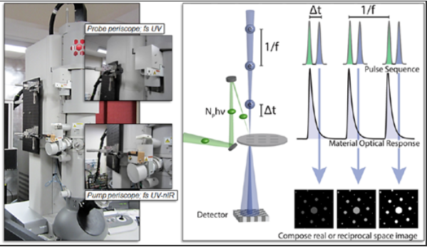
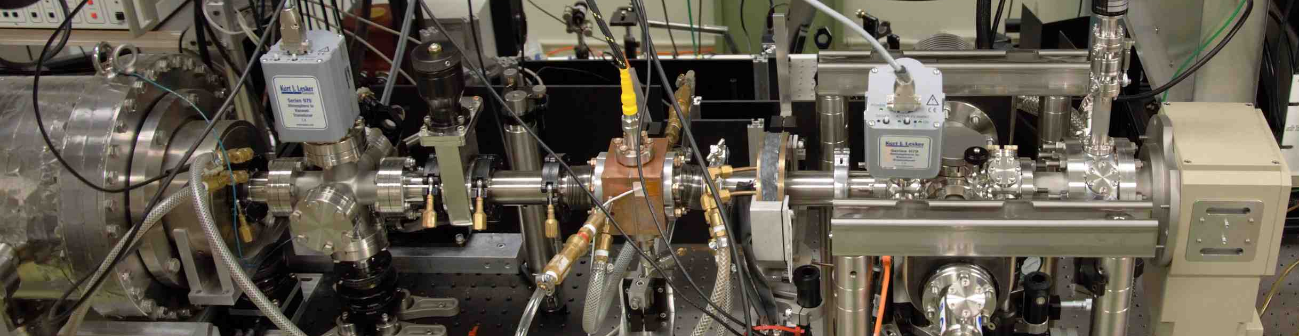
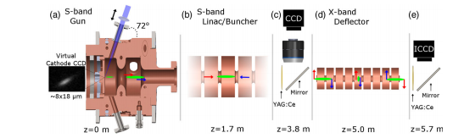
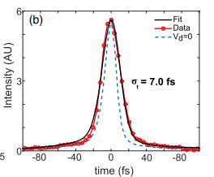
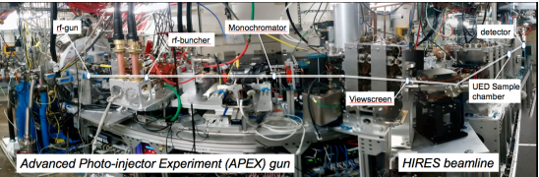
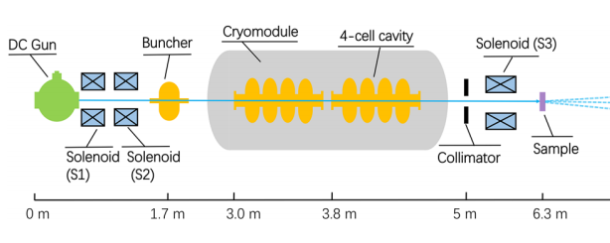
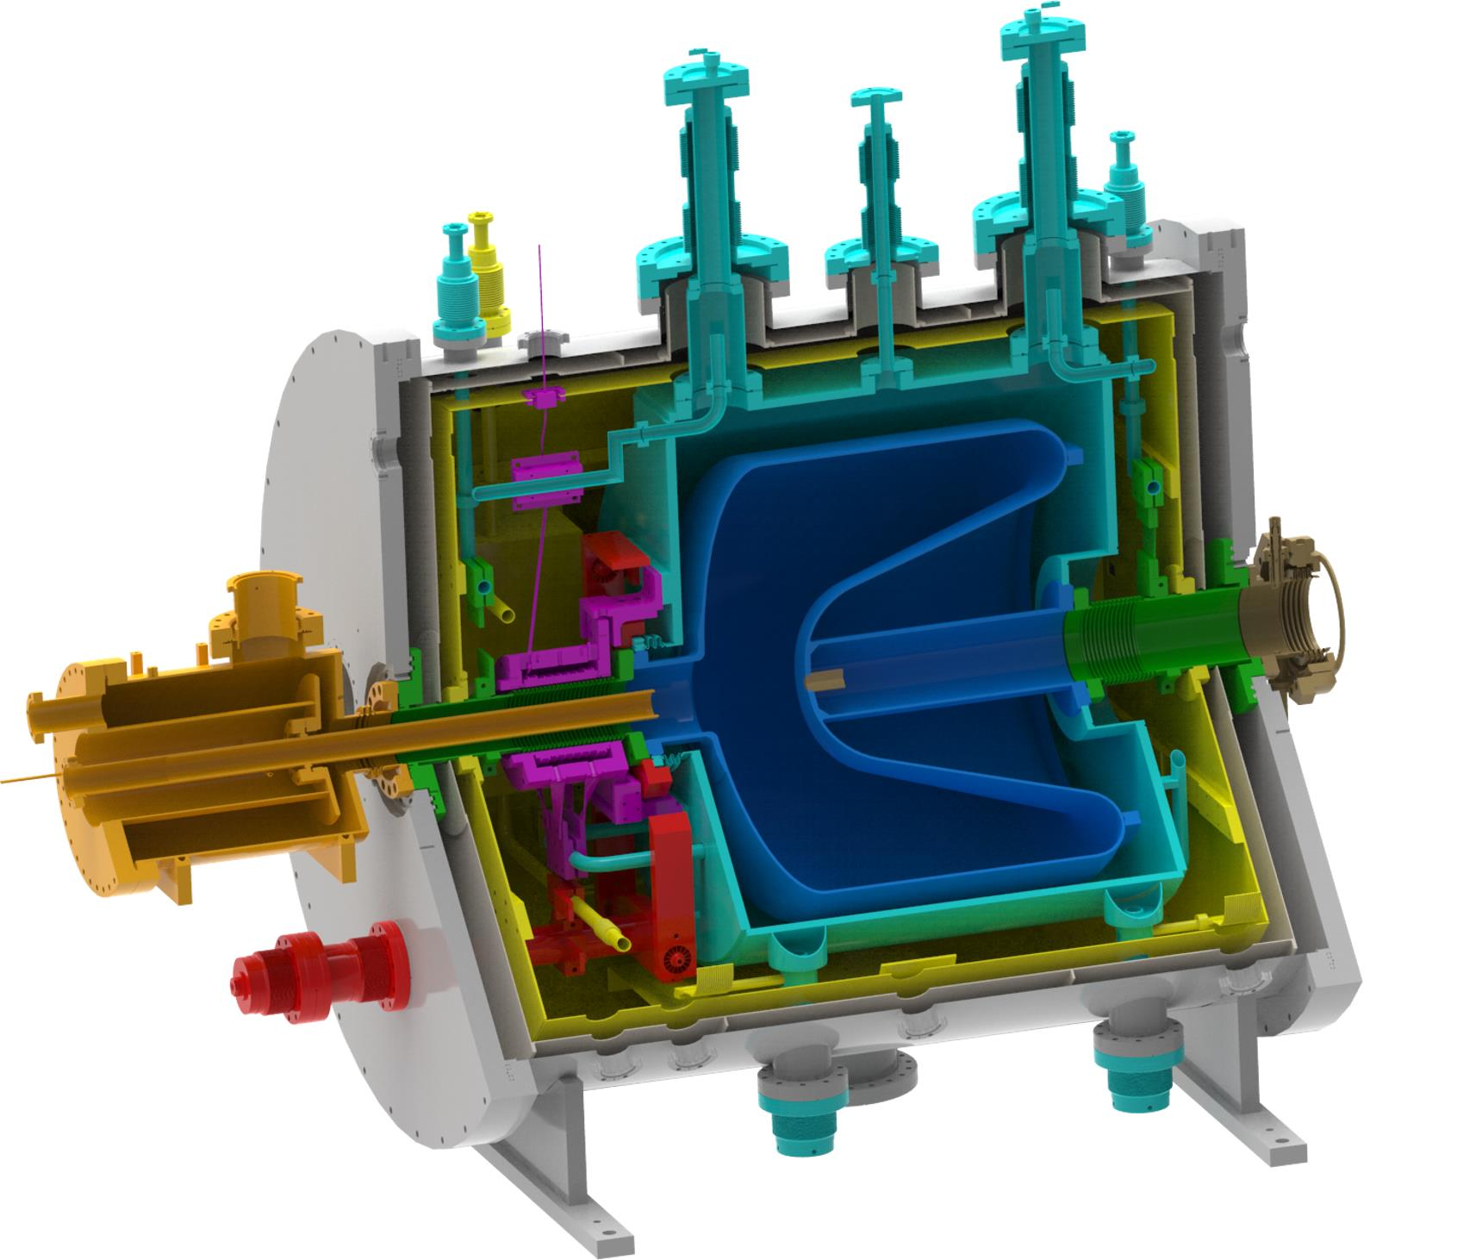

UED/UEM
What have photocathodes for photoinjectors offer the fields of electron scattering: diffraction, microscopy, spectroscopy?
  Extreme time resolution (sub-ps) via photoemission and pump-probe
DC guns and
Modified TEMs
Flannagan Group
Siwick group
High field pulsed FEL injectors
…and SLAC, BNL, multiple others in China, Germany
UCLA Pegasus
High rep rate FEL injectors
Chinese Academy of Engineering Physics
SLAC

Slide 5
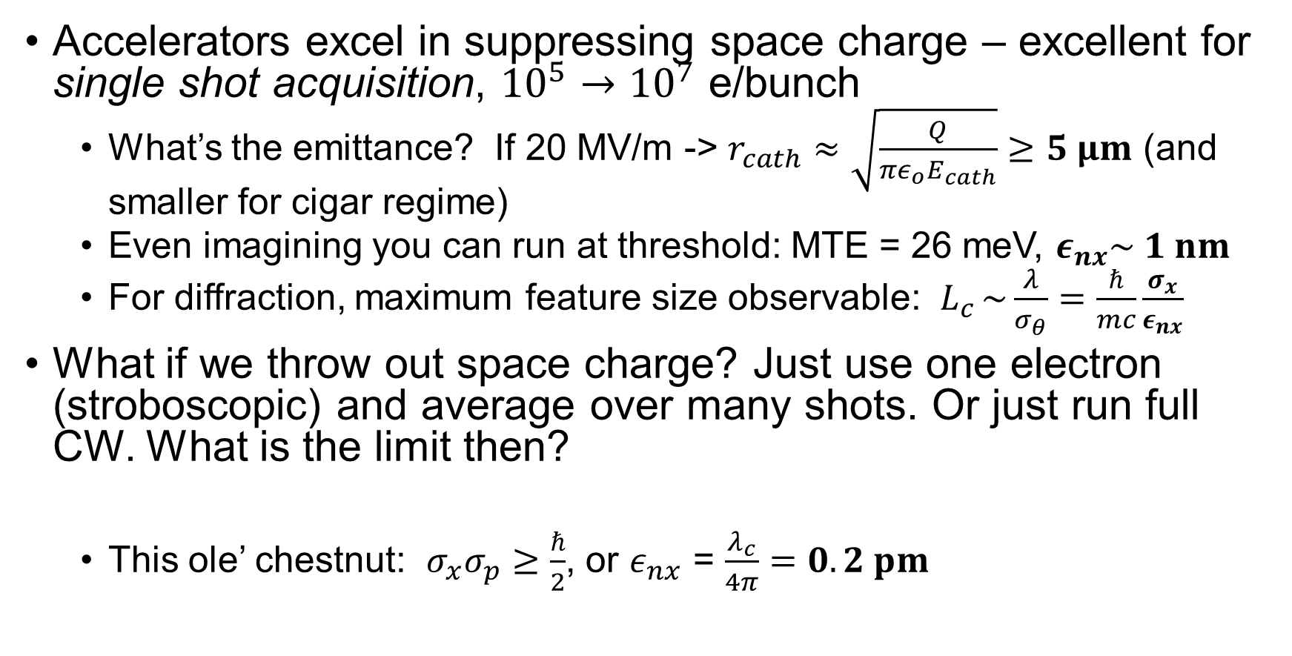
Emittance limits in Single Shot vs. Single electron/CW
Accelerators excel in suppressing space charge – excellent for single shot acquisition, ${10}^{5}→{10}^{7}$ e/bunch
  What’s the emittance? If 20 MV/m -> $r_{cath}≈\sqrt{\frac{Q}{{πε_{o}E}_{cath}}}≥5 μm$ (and smaller for cigar regime)
  Even imagining you can run at threshold: MTE = 26 meV, $ε_{nx}\sim 1 nm$
  For diffraction, maximum feature size observable: $L_{c }\sim \frac{λ}{σ_{θ}}=\frac{ℏ}{mc}\frac{σ_{x}}{ε_{nx}}$
What if we throw out space charge? Just use one electron (stroboscopic) and average over many shots. Or just run full CW. What is the limit then?
  This ole’ chestnut: $σ_{x}σ_{p}≥\frac{ℏ}{2}$, or $ε_{nx}$ = $\frac{λ_{c}}{4π}=0.2 pm$
Notes:
Lots of accelerators

Slide 6
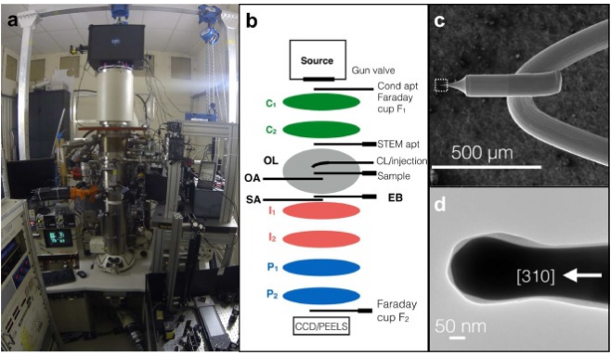
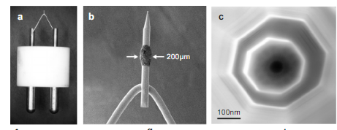
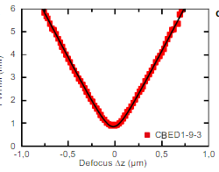
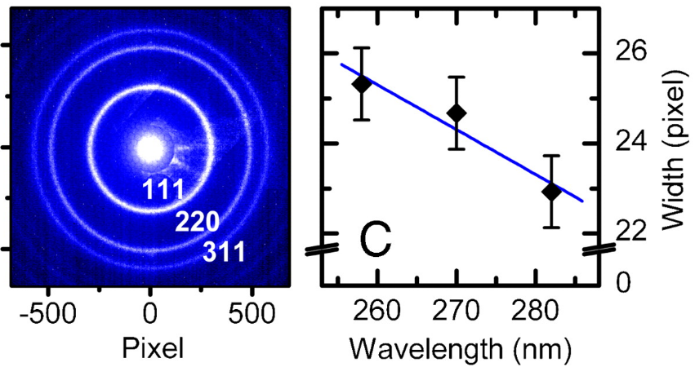
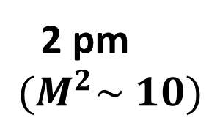
Small sources for stroboscopic scattering
The ultrafast stroboscopic microscopy community has been pushing for small sources for some time:
Ropers Group: Armin Feist, Ultramicroscopy, 176 (2017)
2 pm
$$(M^{2}\sim 10)$$
Université de Toulouse
F. Houdellier et al, Ultramicroscopy 186, 128-138 (2018)
5-10 pm
Baum Group
M. Aidelsburger et al., PNAS 46 (2010)

Slide 7
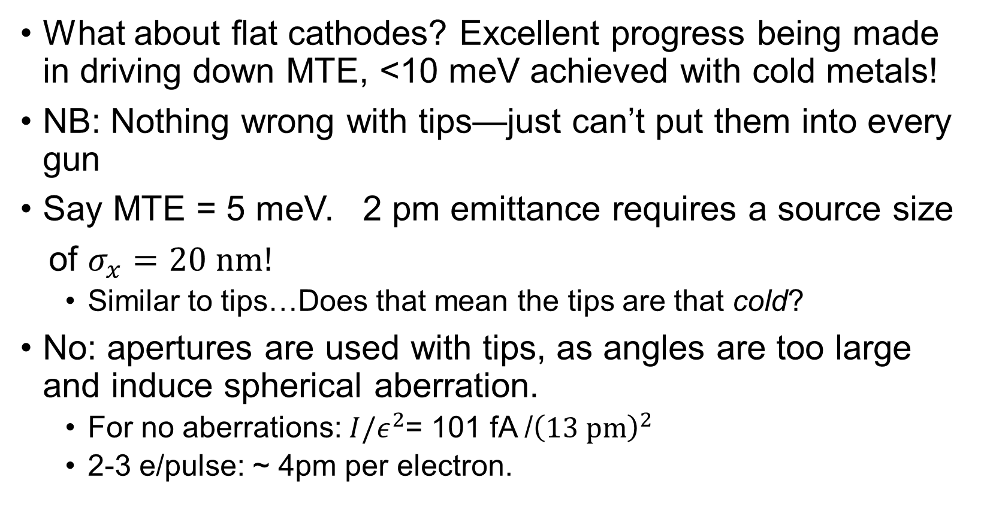
Perspectives for “flat” photocathodes
What about flat cathodes? Excellent progress being made in driving down MTE, <10 meV achieved with cold metals!
NB: Nothing wrong with tips—just can’t put them into every gun
Say MTE = 5 meV. 2 pm emittance requires a source size
of $σ_{x}=20 nm!$
  Similar to tips…Does that mean the tips are that cold?
No: apertures are used with tips, as angles are too large and induce spherical aberration.
  For no aberrations: $I/ε^{2}$= 101 fA /${\left(13 pm\right)}^{2}$
  2-3 e/pulse: ~ 4pm per electron.

Slide 8
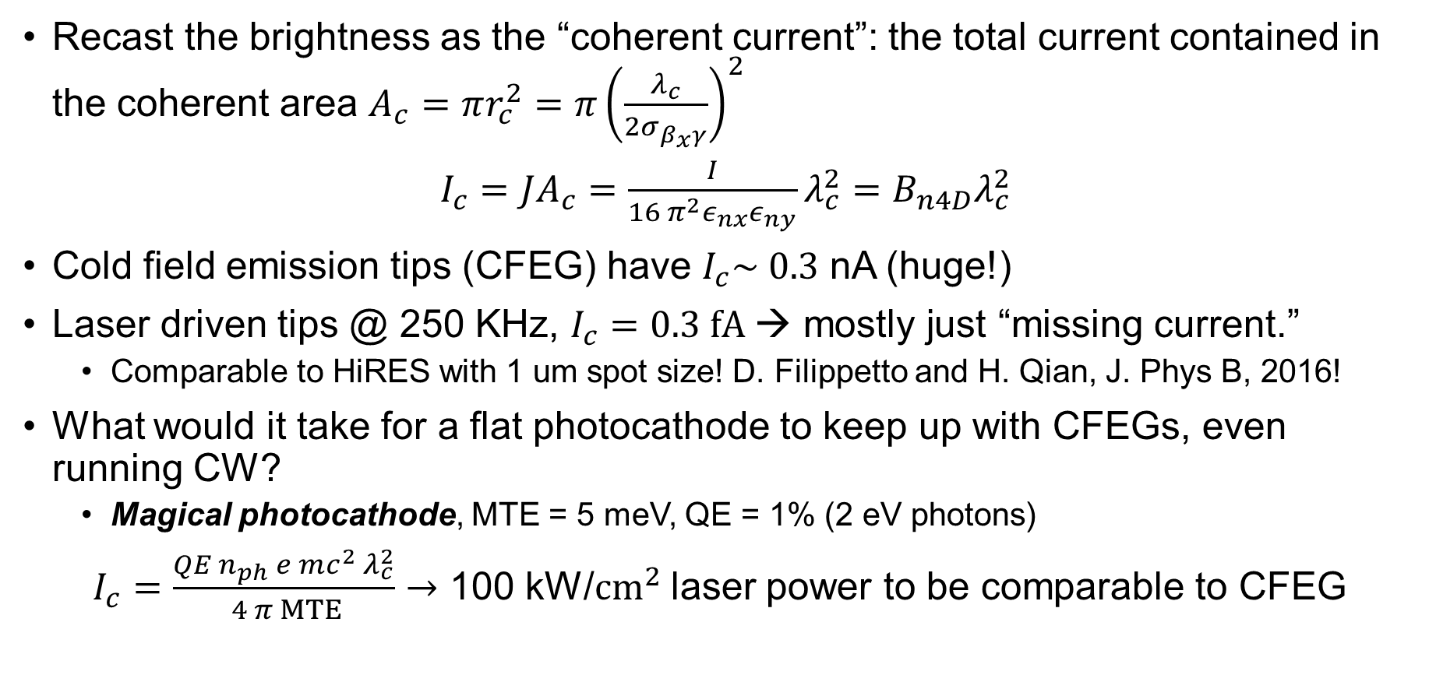

Comparison to FE tips
Recast the brightness as the “coherent current”: the total current contained in the coherent area $A_{c}=πr_{c}^{2}=π{\left(\frac{λ_{c}}{2σ_{β_{x}γ}}\right)}^{2}$
$I_{c}=JA_{c}=\frac{I}{16 π^{2}ε_{nx}ε_{ny}}λ_{c}^{2}=B_{n4D}λ_{c}^{2}$
Cold field emission tips (CFEG) have $I_{c}\sim 0.3$ nA (huge!)
Laser driven tips @ 250 KHz, $I_{c}=0.3 fA$→ mostly just “missing current.”
  Comparable to HiRES with 1 um spot size! D. Filippetto and H. Qian, J. Phys B, 2016!
What would it take for a flat photocathode to keep up with CFEGs, even running CW?
  Magical photocathode, MTE = 5 meV, QE = 1% (2 eV photons)
$I_{c}=\frac{QE n_{ph} e mc^{2} λ_{c}^{2}}{ 4 π MTE}→$ 100 kW/$cm^{2}$ laser power to be comparable to CFEG
$$p_{x}$$
x
(probably not feasible, but compares favorably with laser driven tips!)
Handling high peak and average power density is critical

Slide 9
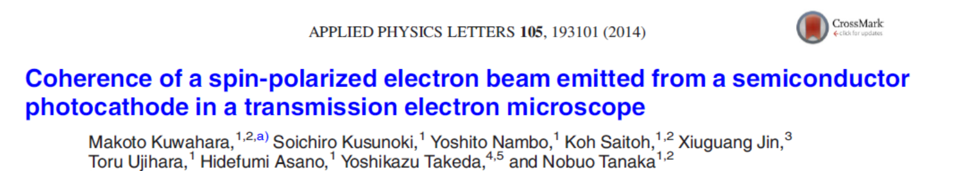
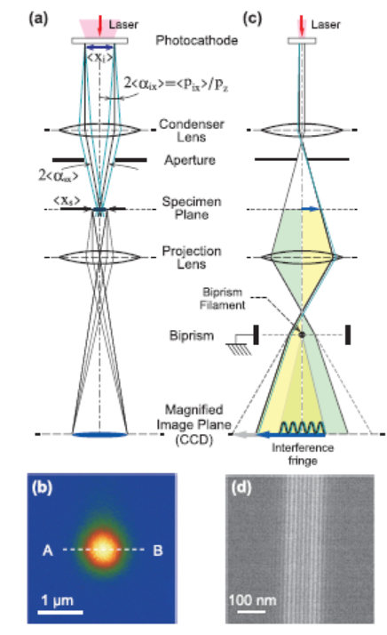
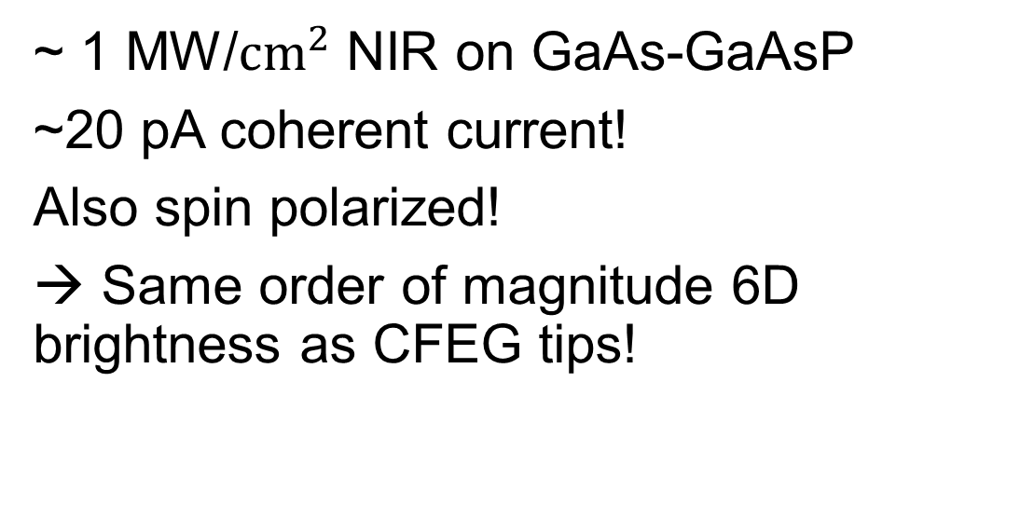
Interesting example
~ 1 MW/$cm^{2}$ NIR on GaAs-GaAsP
~20 pA coherent current!
Also spin polarized!
→ Same order of magnitude 6D brightness as CFEG tips!

Slide 10
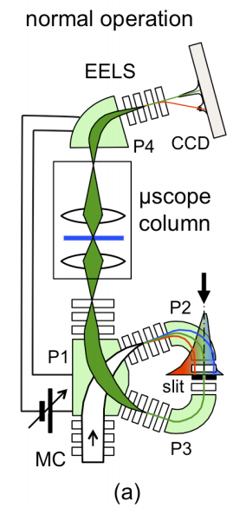
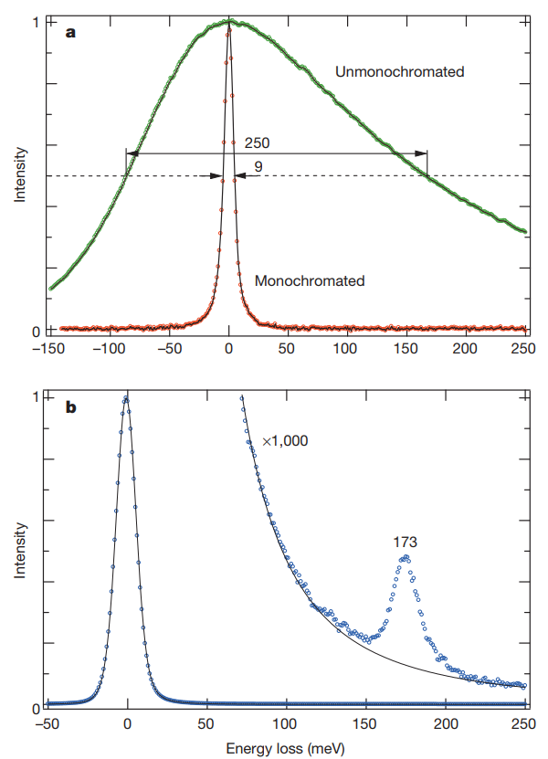
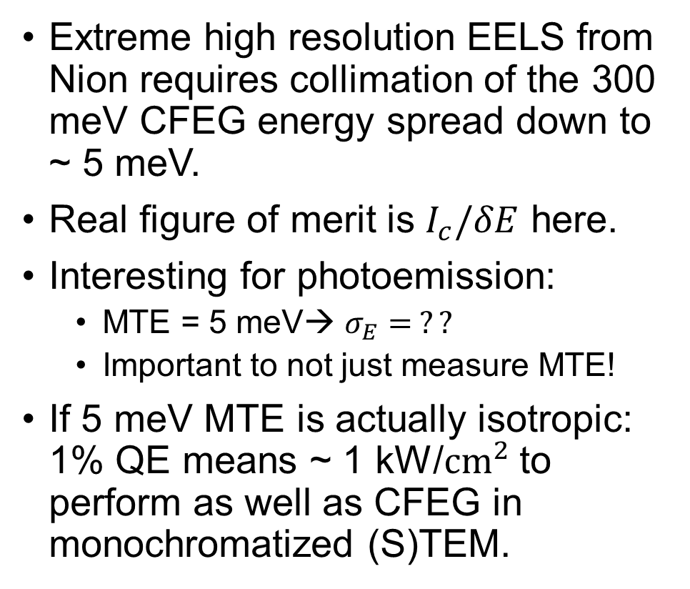
Not just transverse phase space…
Extreme high resolution EELS from Nion requires collimation of the 300 meV CFEG energy spread down to ~ 5 meV.
Real figure of merit is $I_{c}/δE$ here.
Interesting for photoemission:
  MTE = 5 meV→ $σ_{E}= ??$
  Important to not just measure MTE!
If 5 meV MTE is actually isotropic: 1% QE means ~ 1 kW/$cm^{2}$ to perform as well as CFEG in monochromatized (S)TEM.
O. Krivanek , Nature 514, 209 (2014)
Nion Monochromator

Slide 11
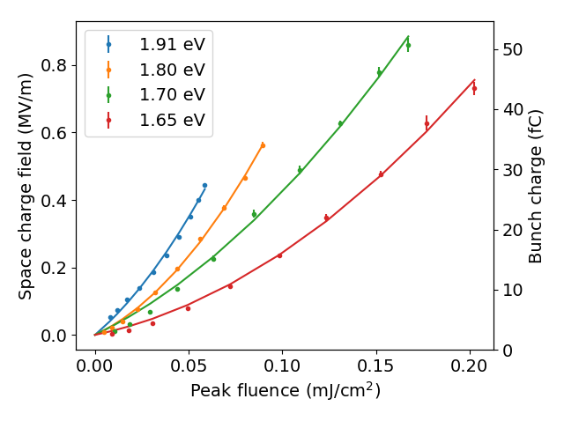
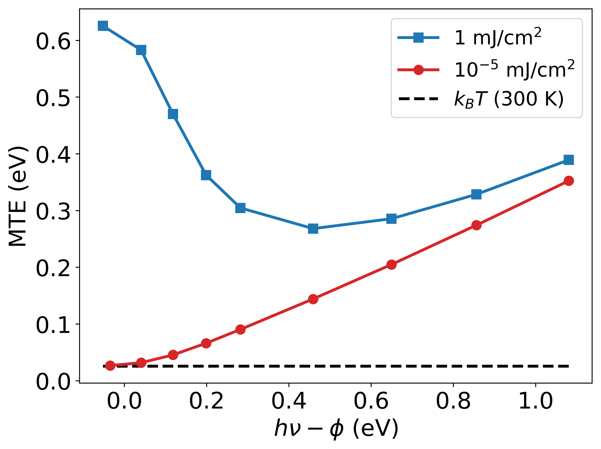
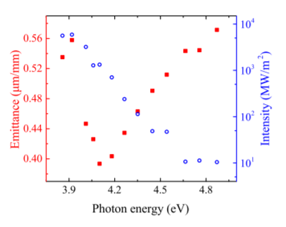
Nonlinear photoemission
Operation at threshold means that MTE and temp are linked!
Also, intense lasers (pulsed and CW…) can prompt nonlinear photoemission, growing excess energy…
Nonlinear emission from Antimonides
Nonlinear emission simulation in Cu
Increase in emittance observed
C. An et al., AIP Advances 8, 055225 (2018)

Slide 12
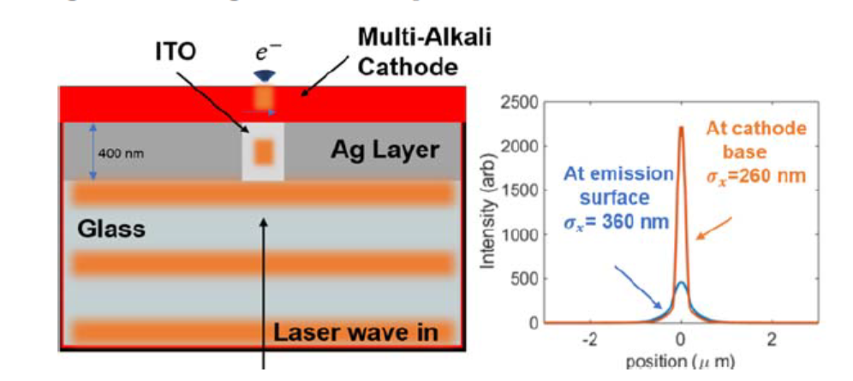
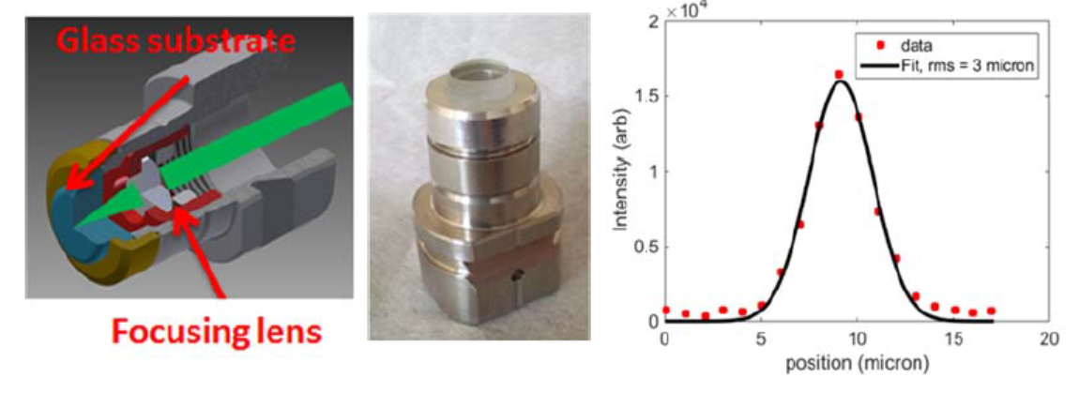

Small sources: options for accelerator guns
Small isn’t necessary (brightness is), but it helps—alleviates the collimation you’d need to do downstream.
Subwavelength apertures, pay penalty: P~$D^{−4}$,
  transmission through a 300 nm hole is 0.1 %. ~10 nJ/electron.
  MHz repetition rates—1 second acquisition time.
Plasmonic confinement a very attractive approach!

Slide 13
Flat cathodes in use can achieve similar brightness to photoemission nanotips—just a matter of the optics column.
Achieving comparable performance to field emission tips is a question of high power density handling—to me seems very possible!
However, where do we stand w.r.t the longitudinal phase space and the uncertainty principle?
  few meV energy spreads and short, fs drive laser pulses are relatively unexplored…
One quick case study

Slide 14
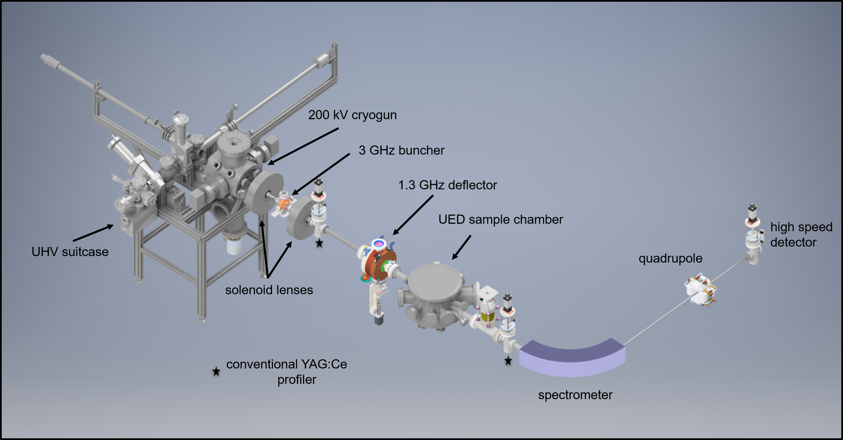

Quantum limits in the longitudinal phase space
With low energy spread and $σ_{t}\sim 100 fs$ laser pulses, simple beamlines yield very interesting results under longitudinal pulse length compression…
…a new UED/Photoemission test beamline under development at Cornell. See talk by W. Li.

Slide 15
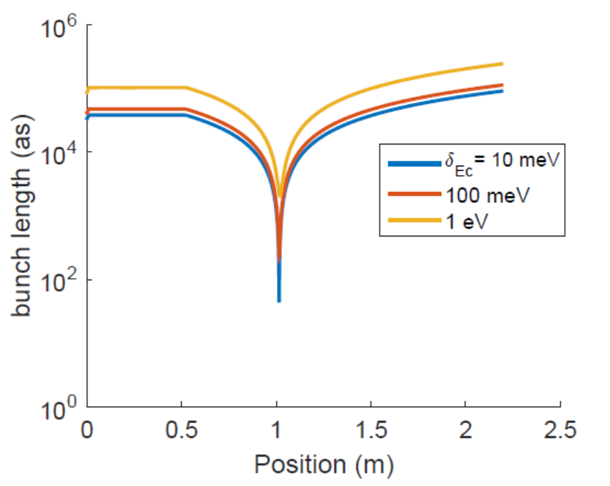
Quantum limits in the longitudinal phase space
In the zero space charge regime (single to few electrons per micron/pulse), vary initial energy spread from photocathode, look at the minimum pulse length after RF compression:
Single electron attosecond pulses
Due to extreme low longitudinal emittance!
In this regime, minimum bunch length is strongly determined by the initial energy spread.
In practice—limited by jitter to 10s of fs.
General Particle Tracer (no space charge)

Slide 16
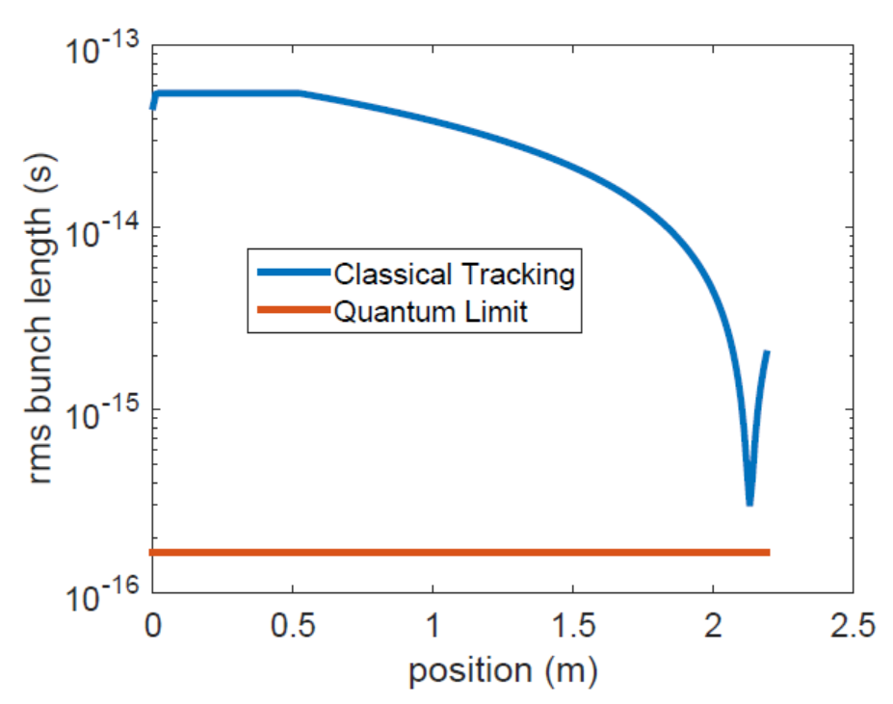
Quantum limits in the longitudinal phase space
Check the uncertainty principle limit (using energy spread induced by the buncher)
We are right there!

Slide 17
Thanks!
To you for listening!
To P. Musumeci, R. K. Li, D. Filippetto, S. Karkare and H. Padmore, I. Bazarov, L. Cultrera for pertinent discussions.
Cornell Bright Beams Lab:
  Matthew Andorf, Adam Bartnik, Ivan Bazarov, Robert Chirco, Luca Cultrera, Randell Doane, Cameron Duncan, Alice Galdi, Colwyn Gulliford, Hyeri Lee, Jared Maxson, Tobey Moore, Chad Pennington, Camille Xu
Funding: Cornell, and NSF award PHY 1549132, the Center for Bright Beams

