Slide 1
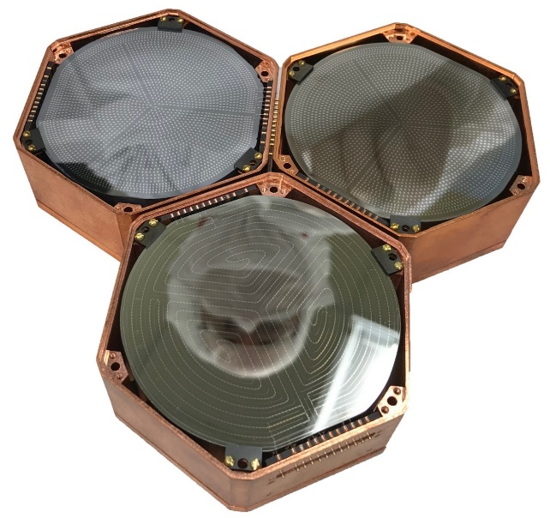
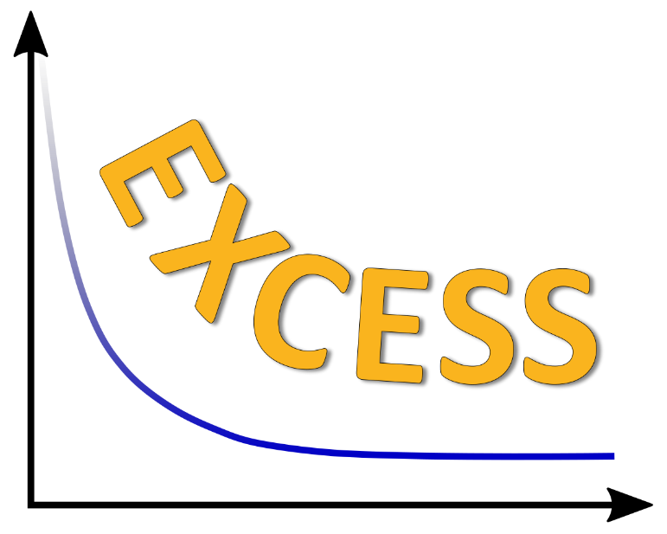
EXCESSive Challenges to Reactor CEνNS Detection
Rupak Mahapatra, Texas A&M

Slide 2
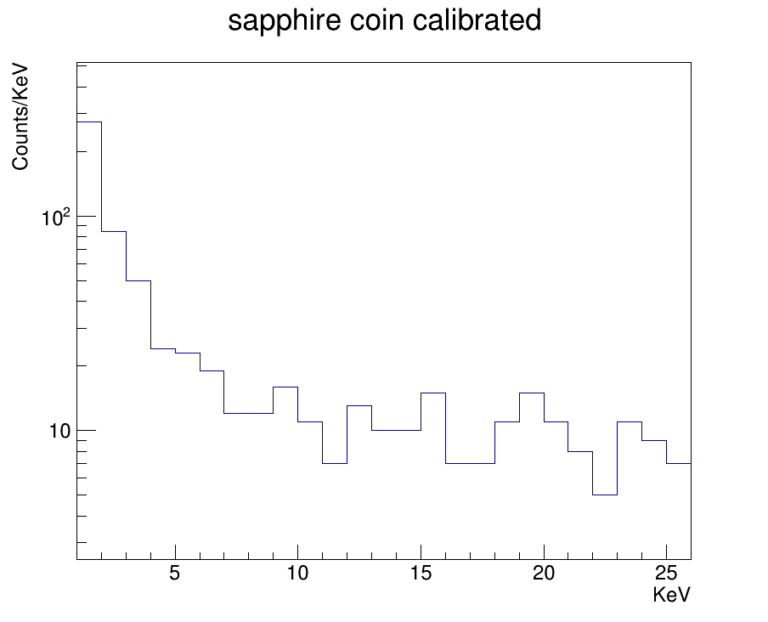
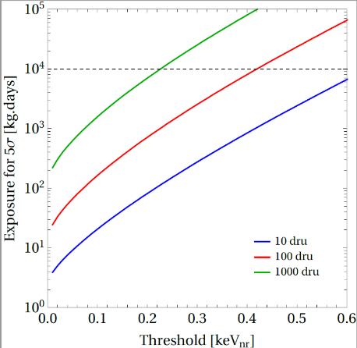
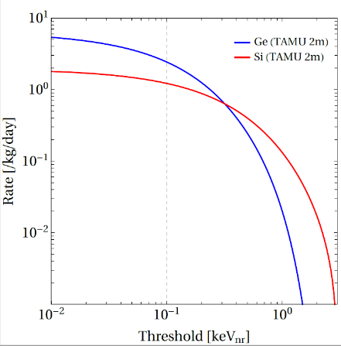
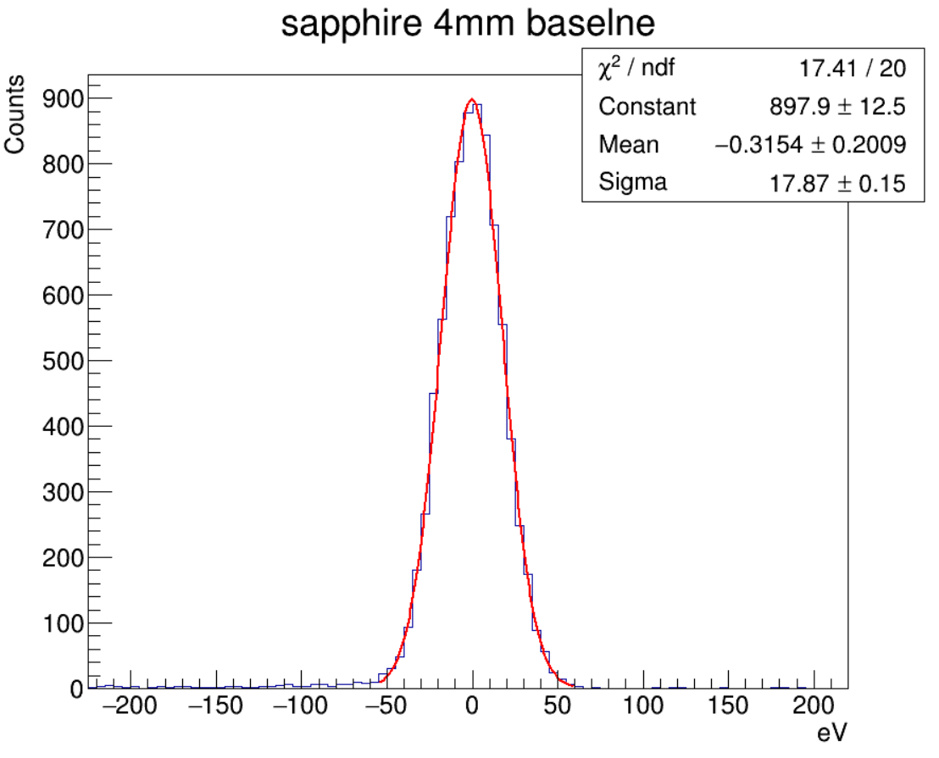
The Interplay Between Threshold and Background
MW Reactor at 2m - Scale for Power and 1/r²
Exponential background at low energies that is not due to noise, especially at surface!
100 gm MINER sapphire
Background
Integrate above E_{threshold}
Calibrated based on 13.9KeV line. Exact value is within 15-18 eV, based on peak

Slide 3

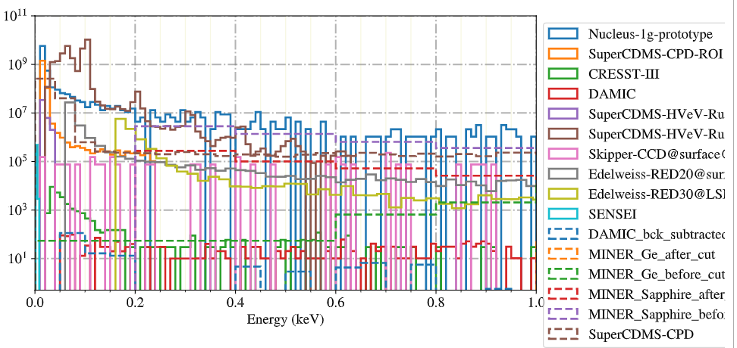
EXCESS Workshop – Speaking a Common Background Language
A collective effort of 10 rare event search collaborations to address observation of an exponentially rising low energy background with yet unknown origin.
All participating collaborations presented data about their observed excesses and details about the respective measurements. The provided data is publicly available on the workshop's data repository: https://github.com/fewagner/excess
Follow-up events about interpretations of the signals as well as further discussion about available data are in preparation. Broader community involvement required.
EXCESS workshop June 15-16
Reactor CEνNS is yet to be discovered!
Many low-threshold detectors are ready for the signal, but background an issue
Once measured, CEνNS can be a tool for reactor monitoring and safeguards
However, the synergy with Dark Matter is helping us reduce background and improve ER/NR rejection for discovery

Slide 4

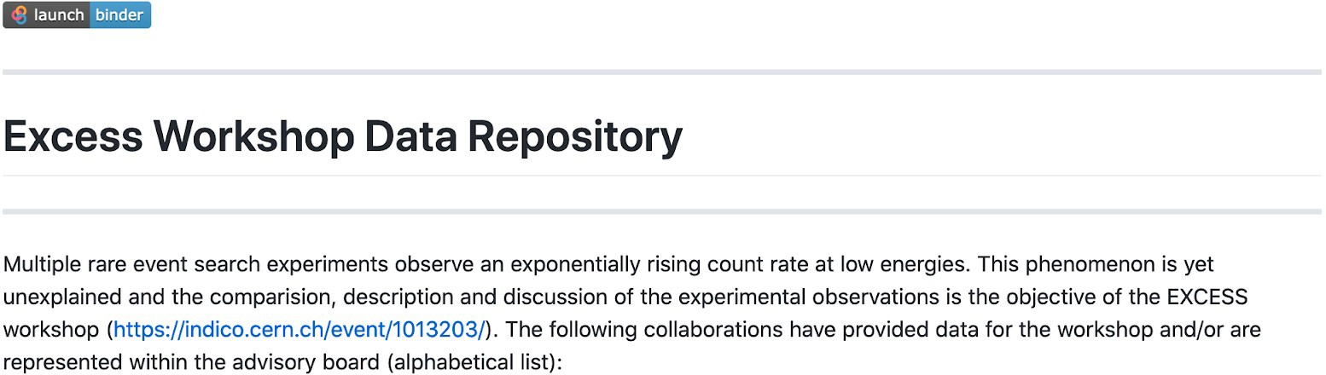
Common visualization of the energy spectra:
https://github.com/fewagner/excess (publicly available now)
15./16.6.2021
indico.cern.ch/event/1013203/ bit.ly/3vj8Zz2
Margarita Kaznacheeva
EXCESS workshop

Slide 5
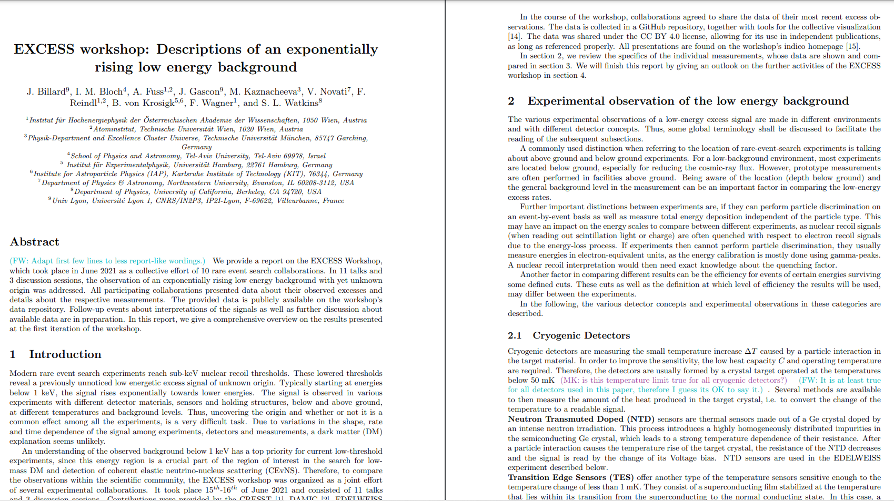
Summary from experiments will be on arXiv soon

Slide 6
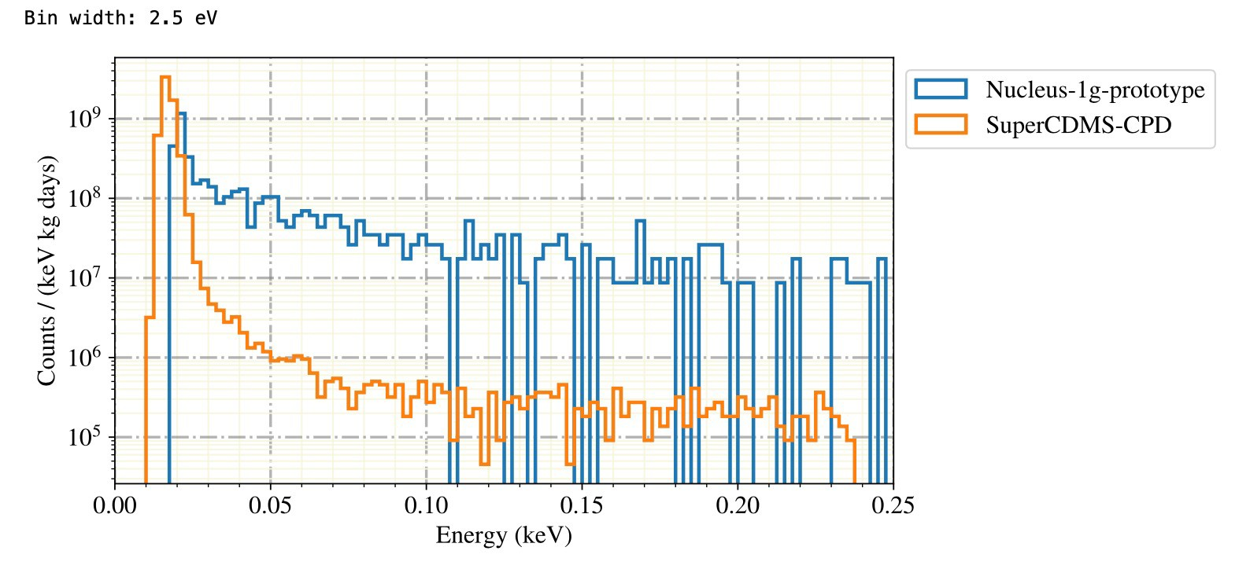

Key Considerations to unify and understand – What do we see?
Lowered sub-keV thresholds among DM/CEνNS experiments reveal a new signal of unknown origin. Typically starting at energies below 1 keV, the signal rises exponentially towards lower energies.
The signal is observed in various experiments with different detector materials, sensors and holding structures, below and above ground, at different temperatures and background levels.

Slide 7
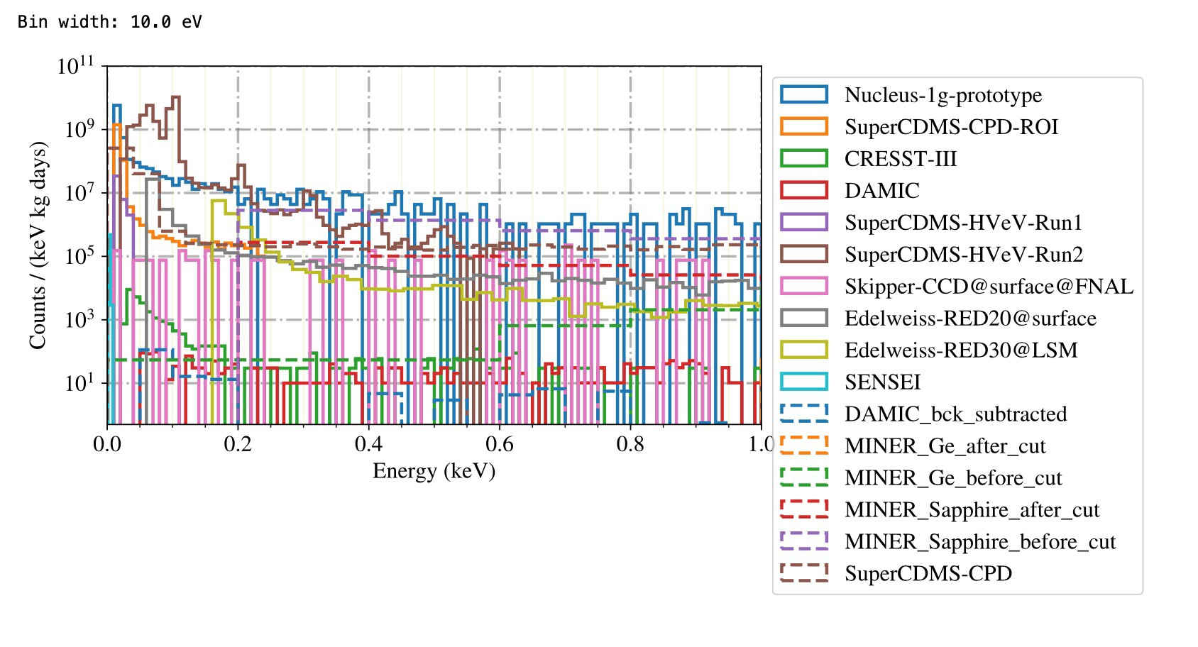
Key Considerations to unify and understand – What is it?
An understanding of the observed background below 1 keV has a top priority for current low-threshold experiments, since this energy region is a crucial part of the DM/CENNS ROI
Uncovering the origin and whether it is a common effect among all the experiments, is a difficult task. Needs further collaborative work
Due to variations in the shape, rate and time dependence of the signal among experiments, detectors and measurements, a dark matter (DM) explanation seems unlikely.
Future workshop to include theorists, phenomenologists, experimentalists to think of possible common systematics that could explain this excess

Slide 8
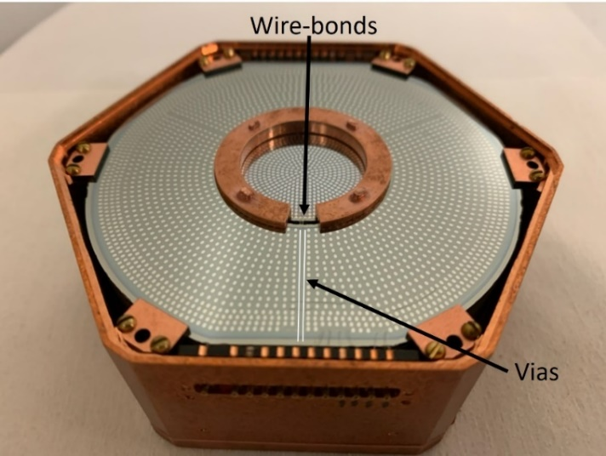
Many Targets, Clamps, Temperatures, Housings

Slide 9
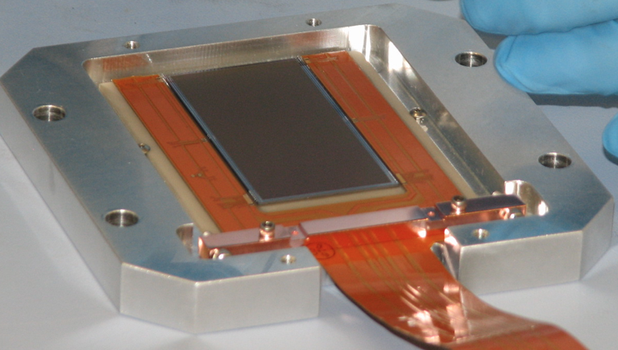
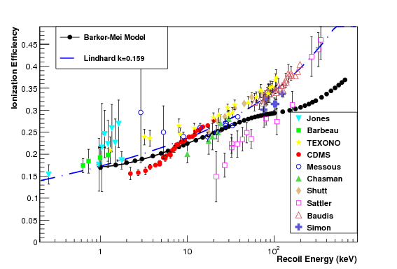
CEνNS Detector Technologies
Most Dark Matter detectors now in use for CEνNS – synergy in low threshold and background reduction techniques
Fundamentally, phonon detectors (with SQUIDs) can access lower recoil thresholds due to lower noise and no Lindhard
CCDs have shown very low noise and low-threshold too
Any detector (PPC, CCD) using charge will suffer from Lindhard
CONNIE CCD: ~gm mass with eVee sensitivity
Light (quenched) | Ionization (quenched) | Phonon(no quenching)
Lindhard=.1-.2 | .15 (Ge), .05 (Si) | No Quenching!
Req E_{th} =20 eV | 30eV(Ge),10(Si) | 200 eV
Resol. σ=4 eV | 5 eV (Ge), 2 (Si) | 40 eV
CRESST (10 gm) | CDMS(kg), CONNIE(gm) | CRESST, CDMS
CRESST/NUCLEUS: ~gm mass with few eVnr sensitivity
Si
Ge
MINER: ~gm-kg mass with 50 eVnr sensitivity

Slide 10
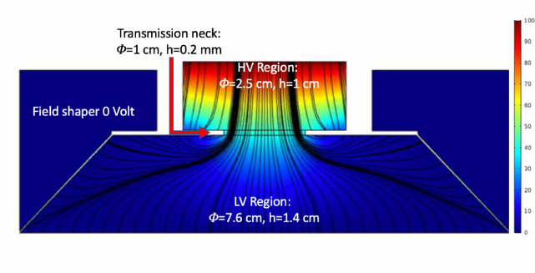
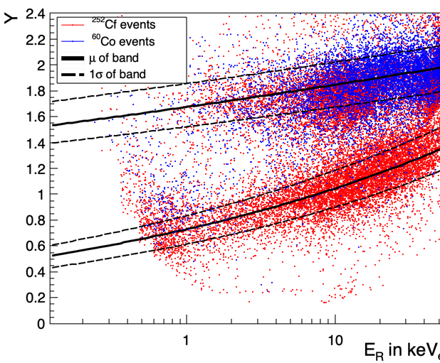
Nature of the Background? ER? NR? Unknown effects in crystals?
Further important distinctions between experiments are, if they can perform particle discrimination on an event-by-event basis as well as measure total energy deposition independent of the particle type.
This may have an impact on the energy scales to compare between different experiments, as nuclear recoil signals (when reading out scintillation light or charge) are often quenched with respect to electron recoil signals due to the energy-loss process.
If experiments then cannot perform particle discrimination, they usually measure energies in electron-equivalent units, as the energy calibration is mostly done using gamma-peaks. A nuclear recoil interpretation would then need exact knowledge about the quenching factor.
Another factor in comparing different results can be the efficiency for events of certain energies surviving some defined cuts. These cuts as well as the definition at which level of efficiency the results will be used, may differ between the experiments.

Slide 11
Common visualization of the energy spectra:
https://github.com/fewagner/excess (publicly available now)
15./16.6.2021
indico.cern.ch/event/1013203/ bit.ly/3vj8Zz2
Margarita Kaznacheeva
EXCESS workshop

Slide 12
Reactor CENNS Program is very active
Dark Matter detector technologies with stricter threshold and background requirements have allowed CENNS programs to flourish.
Background at surface (not underground like Dark Matter experiment) still an issue
Rapid progress in achieving sub-1000 DRU and sub-100eVnr requirements
Within the next couple of years CENNS will open up new frontiers in fundamental physics research and applied nuclear safeguards

