Slide 1



Searching for Boosted Dark Matter via Dark-Strahlung
Doojin Kim
The Mitchell Conference on Collider, Dark Matter, and Neutrino Physics
Texas A&M University, May $16$^{th}, $2019$
DK, Jong-Chul Park and Seodong Shin [arXiv:$1903.05087$]

Slide 2
Two-Component Boosted Dark Matter Scenarios
Dark sector
Stable particle A
Stable particle(s)
Stable particle B
Evidence via
gravitational interaction
&
Detection via
non-gravitational interaction
Standard Model particles

Slide 3
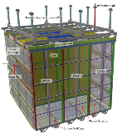
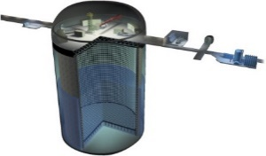
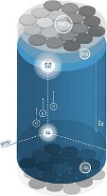
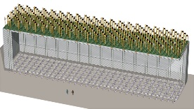
Detection of Boosted Dark Matter (BDM)
Dark matter
Dark matter
Dark matter
Surface detectors
Earth surface
Underground
DM detectors
Underground
large-volume detectors
Simply waiting for signals coming from the universe today
(Often) doing nontrivial model building to create boosted dark matter
(Typically) probing cosmological dark matter (nonrelativistic) through its boosted “partners”

Slide 4
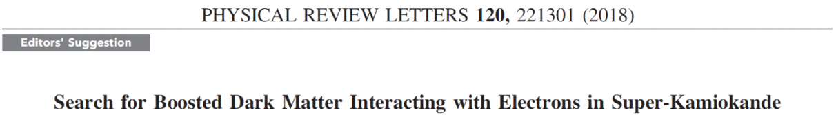
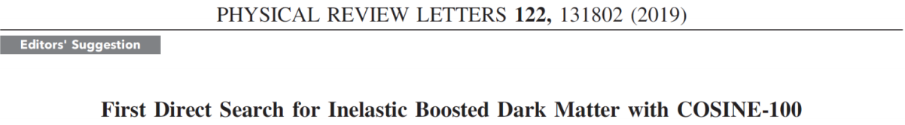
Elastic/Inelastic BDM Searches at SK/COSINE-100
Rising interest in boosted dark matter searches…
Initially, not one of the physics missions.
Opened to other (unplanned) physics opportunities, not restricted to primary physics goals.

Slide 5







Minimal BDM Scenario
$$χ_{0}$$
$$χ_{1}$$
$$χ_{1}$$
$$χ_{1}$$
$$χ_{0}$$
$$χ_{1}$$
…
…
•
$$X^{∗}$$
$$ε$$
$$e^{−}/p$$
Galactic halo
Earth
Example model: dark gauge boson + fermionic dark matter
(In principle,) electron and proton scattering channels are available.

Slide 6





Issue 1: Background
•
•
•
•
$$ν$$
$$ν$$
$$ν$$
•
…
…
•
•
•
$$ν$$
•
•
•
$$Z^{∗}$$
•
•
•
$$e^{−}/p$$
Atmosphere
Earth
Irreducible backgrounds from atmospheric-neutrino-induced events

Slide 7


Issue 2: Distinction from Neutrino Scenario
$$χ_{0}$$
$$ν$$
$$ν$$
$$ν$$
$$χ_{0}$$
$$\overline{ν}$$
…
…
•
$$Z^{∗}$$
$$e^{−}/p$$
Galactic halo
Earth
(Light) boosted dark matter behaves like a neutrino.
  Signature-wise, it is challenging to distinguish the BDM scenario from the neutrino one.

Slide 8





Avoiding Issue 1: Inelastic BDM Scenario
$$χ_{0}$$
$$χ_{1}$$
$$χ_{1}$$
$$χ_{1}$$
$$χ_{0}$$
$$χ_{1}$$
…
…
$$χ_{2}$$
•
•
$$ε$$
$$X^{∗}$$
$$X^{(∗)}$$
$$e^{−}$$
$$ε$$
$$e^{+}$$
$$e^{−}/p$$
Galactic halo
Earth
Inelastic DM $+$BDM $=$Inelastic BDM [DK, Park, Shin, PRL 119 (2016) 161801]
  Additional signature from the decay of heavier unstable dark-sector state (or excited state) $χ_{2}$
  at the expense of the model minimality.

Slide 9
Is it possible to have similar signatures in the minimal scenario?

Slide 10


Subleading Processes
$$χ_{0}$$
$$χ_{1}$$
$$χ_{1}$$
$$χ_{1}$$
$$χ_{0}$$
$$χ_{1}$$
…
…
$$χ_{1}^{∗}$$
$$χ_{2}$$
•
•
$$ε$$
$$X^{∗}$$
$$X$$
$$e^{−}$$
$$ε$$
$$e^{+}$$
$$e^{−}/p$$
Galactic halo
Earth
Dark-Strahlung (DS): initial-state/final-state dark gauge boson radiation [DK, Park, Shin, arXiv:1903.05087]
Cf.) Dark-strahlung at the LHC [Gupta, Primulando, Saraswat, JHEP 1509 079; Bai, Bourbeau, Lin, JHEP 1506 205; Kim, Lee, Park, Zhang, PRD 98 055027], Dark-trident (in beam-produced dark matter searches) [de Gouvea, Fox, Harnik, Kelly, Zhang, JHEP 1901 001]

Slide 11
Goals
√
The dark-strahlung channel is relatively background-free (Issue 1).
The existence of the dark-strahlung channel can be evidence to refute the hypothesis that the signals would be induced by neutrinos originating from the decay/pair-annihilation of cosmological dark matter (Issue 2).
Cosmogenic BDM searches can benefit from the dark-strahlung than beam-produced dark matter searches.

Slide 12
















Dark-Strahlung vs. Z-Strahlung
Electron scattering with dark radiation
For example, Z radiation
$$χ_{1}$$
$$ν$$
$$χ_{1}$$
$$ν$$
$$χ_{1}^{∗}$$
•
$$ν^{∗}$$
•
•
$$ε$$
•
$$X^{∗}$$
$$X$$
$$e^{−}$$
$$Z^{∗}$$
$$Z$$
•
$$e^{−}$$
$$ε$$
VS
•
$$e^{+}$$
$$e^{+}$$
$$e^{−}$$
$$e^{−}$$
Z-strahlung is highly suppressed in the SM, while dark-strahlung may be sizable (even comparable to the leading-order process depending on parameter choices). ⇒ Additional observations of BDM signals in the dark-strahlung channel might serve a “milestone” in the field of BDM.

Slide 13
Goals
√
The dark-strahlung channel is relatively background-free (Issue 1).
√
The existence of the dark-strahlung channel can be evidence to refute the hypothesis that the signals would be induced by neutrinos originating from the decay/pair-annihilation of cosmological dark matter (Issue 2).
Cosmogenic BDM searches can benefit from the dark-strahlung than beam-produced dark matter searches.

Slide 14
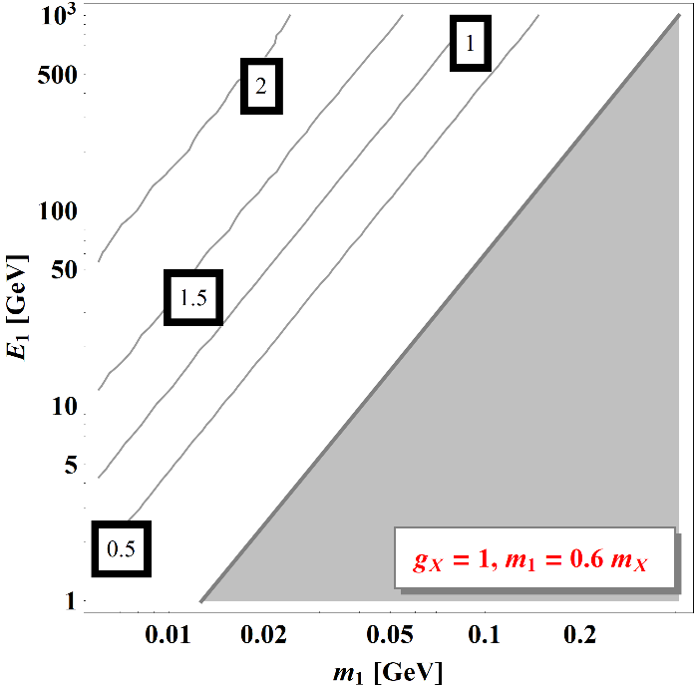
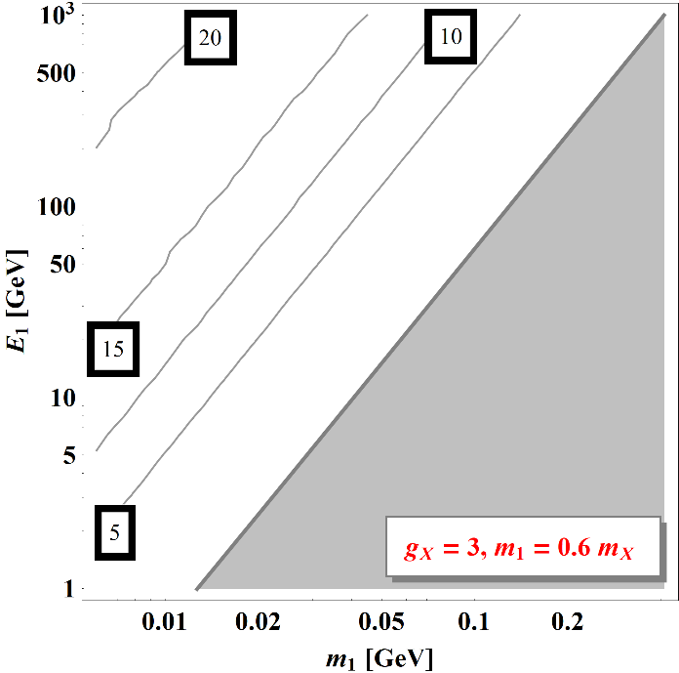
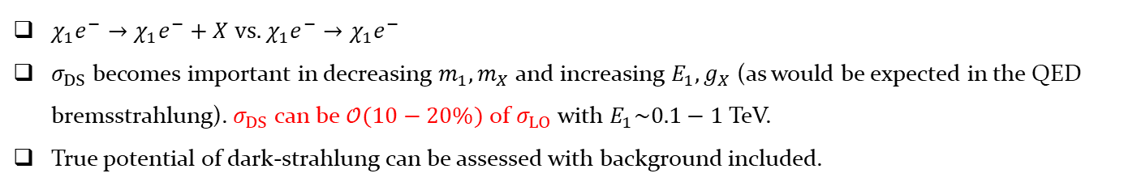
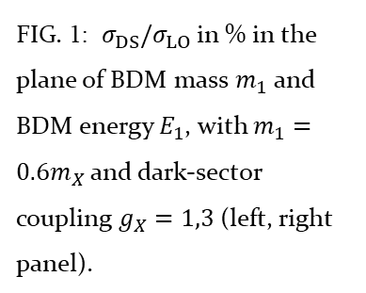
Simple Elastic Scattering vs. Dark-Strahlung
FIG. 1: $σ_{DS}/σ_{LO}$ in % in the plane of BDM mass $m_{1}$ and BDM energy $E_{1}$, with $m_{1}=0.6m_{X}$ and dark-sector coupling $g_{X}=1,3$ (left, right panel).
$χ_{1}e^{−}→χ_{1}e^{−}+X$ vs. $χ_{1}e^{−}→χ_{1}e^{−}$
$σ_{DS}$ becomes important in decreasing $m_{1}, m_{X}$ and increasing $E_{1}, g_{X}$ (as would be expected in the QED bremsstrahlung). $σ_{DS}$ can be $𝒪(10−20\%)$ of $σ_{LO}$ with $E_{1}\sim 0.1−1$ TeV.
True potential of dark-strahlung can be assessed with background included.

Slide 15
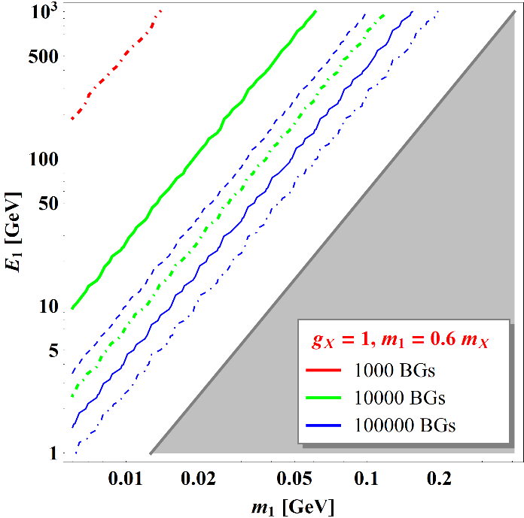
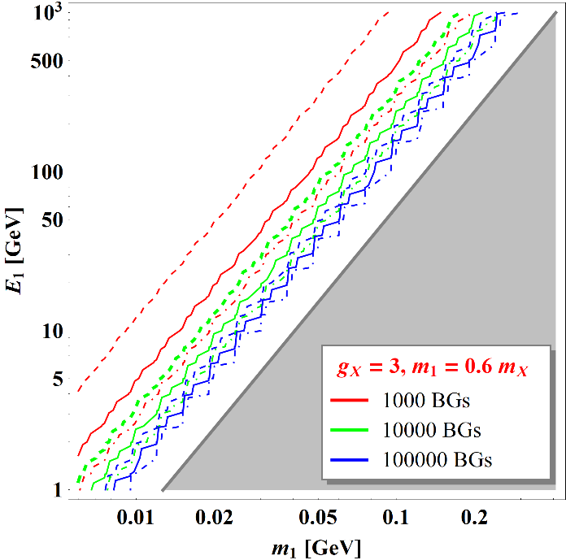
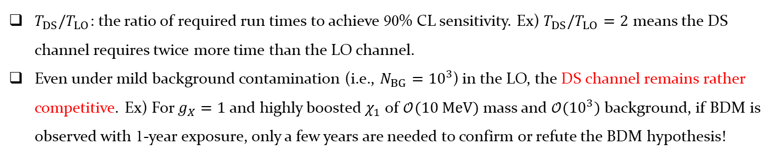
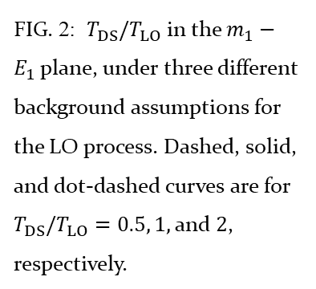
Comparison in the Presence of Backgrounds
FIG. 2: $T_{DS}/T_{LO}$ in the $m_{1}−E_{1}$ plane, under three different background assumptions for the LO process. Dashed, solid, and dot-dashed curves are for $T_{DS}/T_{LO}=0.5, 1,$and $2$, respectively.
$T_{DS}/T_{LO}$: the ratio of required run times to achieve 90% CL sensitivity. Ex) $T_{DS}/T_{LO}=2$ means the DS channel requires twice more time than the LO channel.
Even under mild background contamination (i.e., $N_{BG}={10}^{3}$) in the LO, the DS channel remains rather competitive. Ex) For $g_{X}=1$ and highly boosted $χ_{1}$ of $𝒪(10 MeV)$ mass and $𝒪({10}^{3})$ background, if BDM is observed with 1-year exposure, only a few years are needed to confirm or refute the BDM hypothesis!

Slide 16
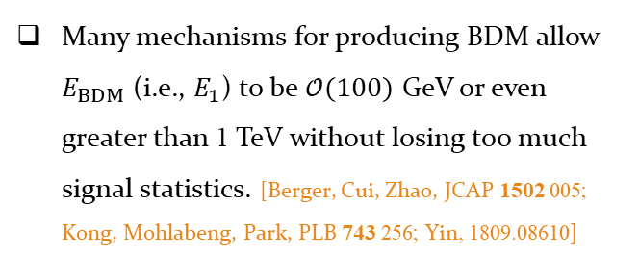
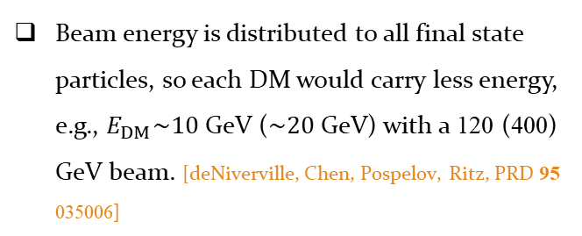
Cosmogenic BDM vs Beam-Produced DM
Beam-produced DM search
Cosmogenic BDM search
Beam energy is distributed to all final state particles, so each DM would carry less energy, e.g., $E_{DM}\sim 10$ GeV ($\sim 20$ GeV) with a 120 (400) GeV beam. [deNiverville, Chen, Pospelov, Ritz, PRD 95 035006]
Many mechanisms for producing BDM allow $E_{BDM}$ (i.e., $E_{1}$) to be $𝒪(100)$ GeV or even greater than 1 TeV without losing too much signal statistics. [Berger, Cui, Zhao, JCAP 1502 005; Kong, Mohlabeng, Park, PLB 743 256; Yin, 1809.08610]
Particle accelerator experiments are more capable of controlling potential backgrounds, e.g., on-/off-target beam data analyses in MiniBooNE.
Cosmic-frontier searches are easily plagued by cosmic-ray-induced backgrounds (including neutrino-induced backgrounds), in particular, at surface-based detectors.
Cosmogenic BDM searches may enjoy the full benefit from dark-strahlung!

Slide 17
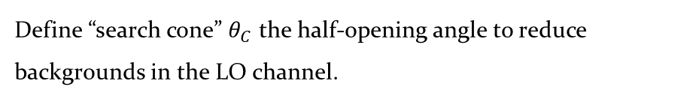
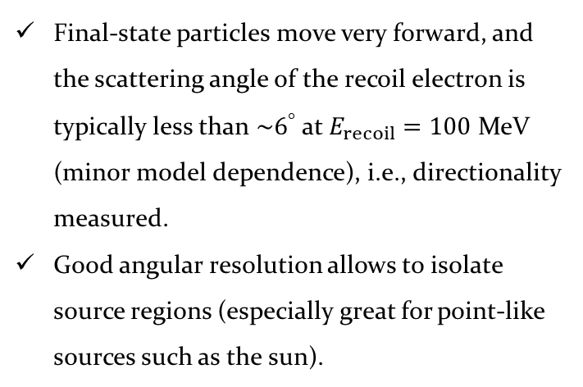
Angular Cut to Reduce Background
Boosted DM is incoming ultra-relativistically!
Source point
Final-state particles move very forward, and the scattering angle of the recoil electron is typically less than $\sim 6^{°}$ at $E_{recoil}=100$ MeV (minor model dependence), i.e., directionality measured.
Good angular resolution allows to isolate source regions (especially great for point-like sources such as the sun).
$$χ_{1}$$
$$e^{−}$$
$$χ_{1}$$
Define “search cone” $θ_{C}$ the half-opening angle to reduce backgrounds in the LO channel.

Slide 18
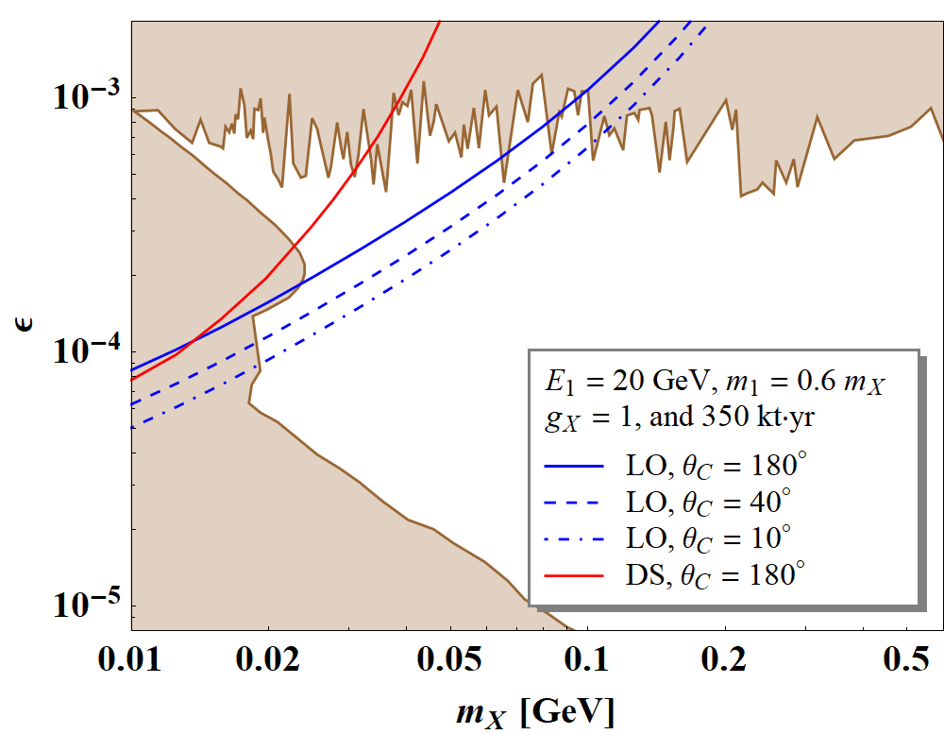
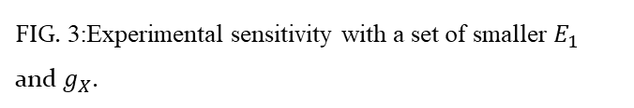
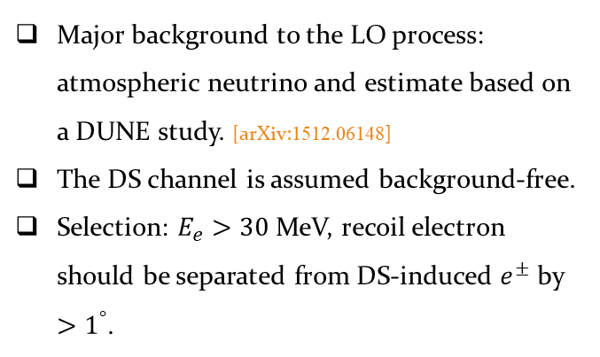
Experimental Sensitivities of DUNE
FIG. 3:Experimental sensitivity with a set of smaller $E_{1}$ and $g_{X}$.
Major background to the LO process: atmospheric neutrino and estimate based on a DUNE study. [arXiv:1512.06148]
The DS channel is assumed background-free.
Selection: $E_{e}>30$ MeV, recoil electron should be separated from DS-induced $e^{±}$ by $>1^{°}$.
The Dark-Strahlung channel can be complementary to the LO search channel even with realistic effects included.

Slide 19
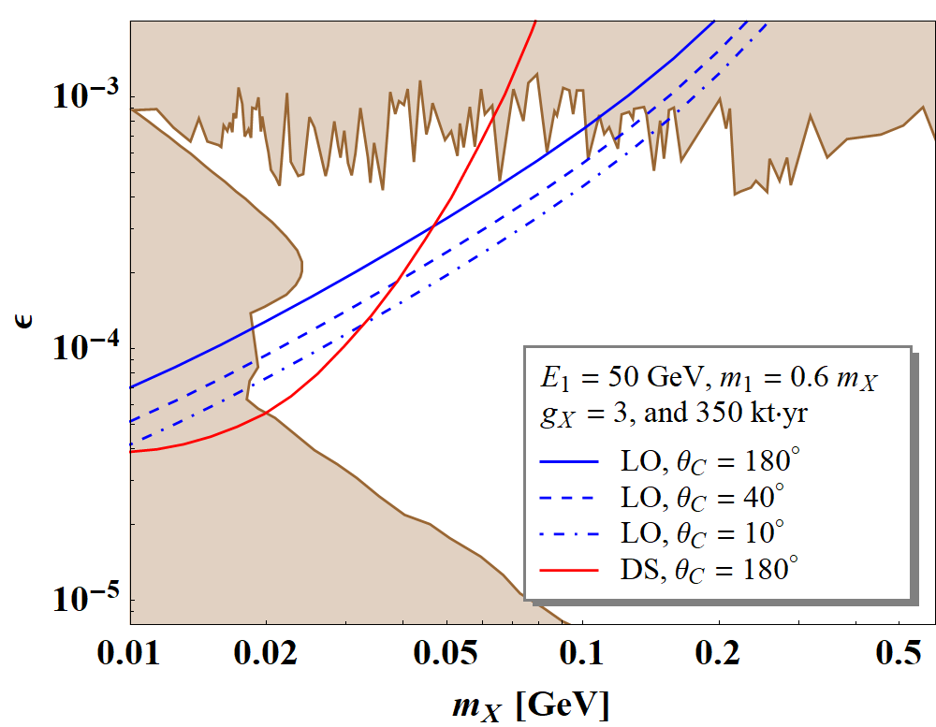
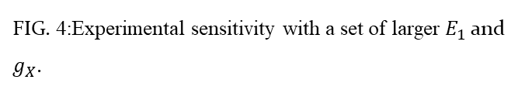
Experimental Sensitivities of DUNE
FIG. 4:Experimental sensitivity with a set of larger $E_{1}$ and $g_{X}$.
The same backgrounds and selection criteria are considered.
The Dark-Strahlung channel may allow us to explore a wider range of parameter space than the LO channel with a search cone does.

Slide 20
Goals
√
The dark-strahlung channel is relatively background-free (Issue 1).
√
The existence of the dark-strahlung channel can be evidence to refute the hypothesis that the signals would be induced by neutrinos originating from the decay/pair-annihilation of cosmological dark matter (Issue 2).
√
Cosmogenic BDM searches can benefit from the dark-strahlung than beam-produced dark matter searches.

Slide 21
Conclusions
Dark-strahlung can provide a new channel for boosted dark matter searches.
Due to the existence of additional signatures on top of target recoil, the associated signal search can be (nearly) background-free.
The existence of dark-strahlung may reject the “neutrino” hypothesis that the associated events are initiated by neutrinos from DM annihilation/decay.
Cosmogenic BDM searches can enjoy benefits from dark-strahlung more than beam-produced DM searches.
The channel with dark-strahlung can be complementary to or even surpassing the corresponding leading-order one.

Slide 22
Backup

Slide 23
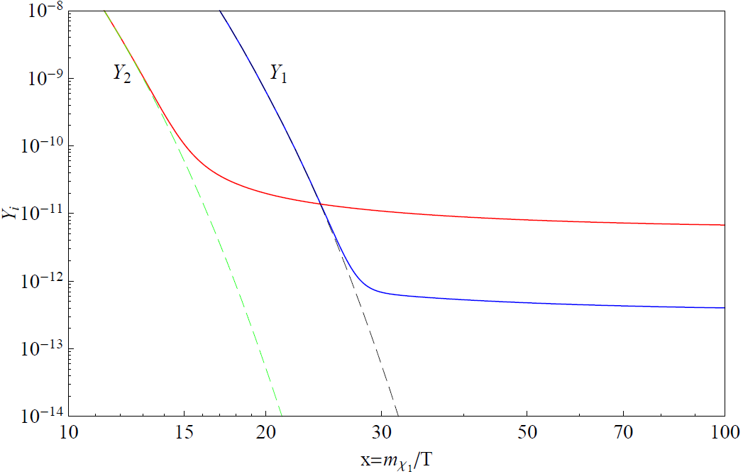








Two-component Boosted DM Scenario
A possible relativistic source: BDM scenario (cosmic frontier), stability of the two DM species ensured by separate symmetries, e.g., $Z_{2}⊗Z_{2}^{′}, U\left(1\right)⊗U{\left(1\right)}^{′}, etc.$
Dominant relic
$$χ_{0}$$
$$χ_{1}$$
SM
$$χ_{0}$$
$$χ_{1}$$
SM
Freeze-out first
Freeze-out later
Negligible, non-relativistic relic
$$Y_{1}$$
$$Y_{0}$$
$$Y_{1}$$
“Assisted” freeze-out mechanism
[Belanger, Park ($2011$)]

Slide 24


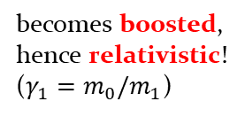




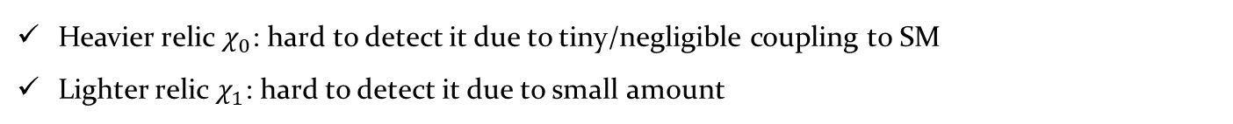
Motivation for BDM
$$χ_{0}$$
$$χ_{1}$$
SM
$$χ_{0}$$
$$χ_{1}$$
SM
Heavier relic $χ_{0}$: hard to detect it due to tiny/negligible coupling to SM
Lighter relic $χ_{1}$: hard to detect it due to small amount
$$χ_{0}$$
$$χ_{1}$$
$$χ_{1}$$
becomes boosted,
hence relativistic!
($γ_{1}=m_{0}/m_{1}$)
$$χ_{0}$$
$$χ_{1}$$
(Galactic Center in the present universe)
(Laboratory)
[Agashe, Cui, Necib, Thaler ($2014$)]

Slide 25
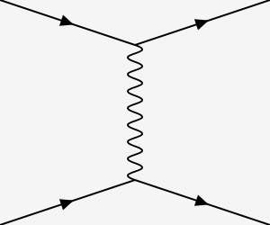













Expected Number of ν-Induced Background Events
Atm.-$ν$ may induce multi-track events (which could be backgrounds)
The dominant source
  $ν_{e}$-induced C.C. events
Other subdominant sources
  N.C. events: smaller cross section
  $ν_{τ}$-induced: too small flux, hence negligible
  $ν_{μ}$-induced C.C.: leaving an energetic (primary) muon (which can be tagged easily)
$$ν_{e^{±}}$$
$$e^{±}$$
$$e^{±}$$
$$W$$
$$ν$$
$$π^{±}$$
$$ν$$
$$ν$$
$$e^{±}$$
$$p/n$$
$$π^{±}$$
$$ν$$
e.g. $π^{±}→μ^{±}ν→e^{±}ννν$, $π^{±}→e^{±}ν$

Slide 26
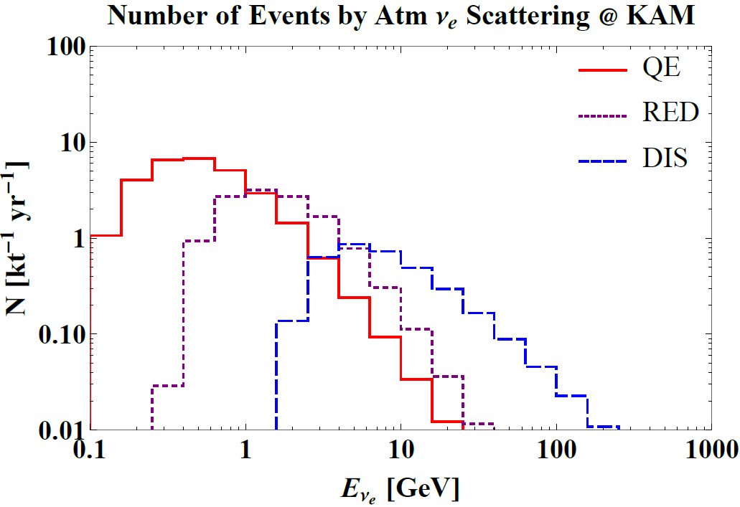
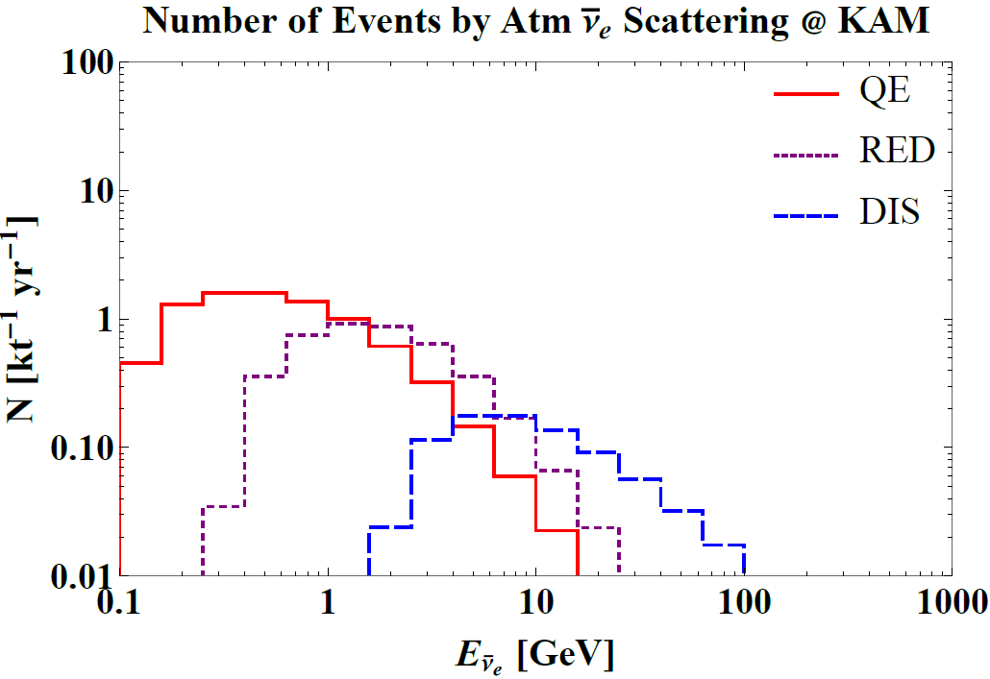
Expected Number of ν-Induced Background Events
$ν_{e}$-flux [SK Collaboration, 1502.03916] ⊗ $ν_{e}$-cross section [Formaggio, Zeller, 1305.7513]
RES
RES
Most DIS events result in messy final states, not mimicking signal events, while a majority of resonance events may create a few mesons in the final state [Formaggio, Zeller, 1305.7513].
  12.2 events/kt/yr are potentially relevant.
  (quality) track-based particle identification, timing information etc at LArTPC detectors can suppress such events significantly. → Zero BG is achievable!

Slide 27
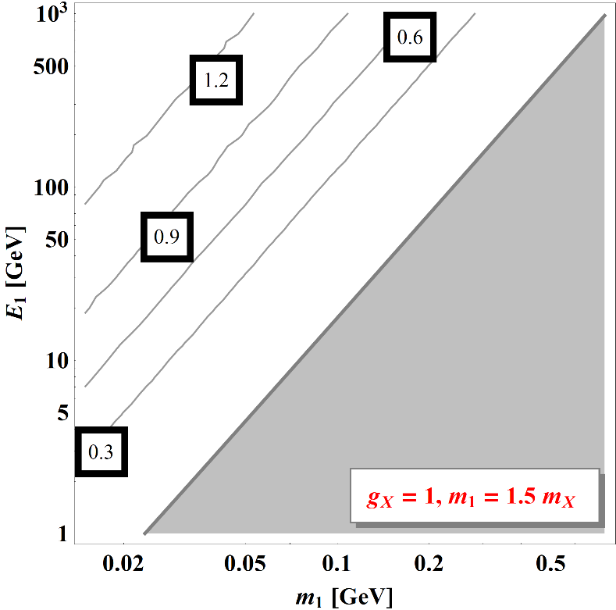
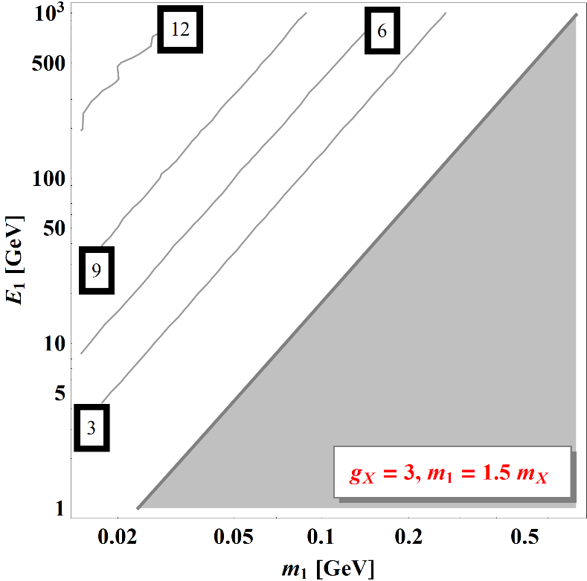
Simple Elastic Scattering vs. Dark-Strahlung

Slide 28
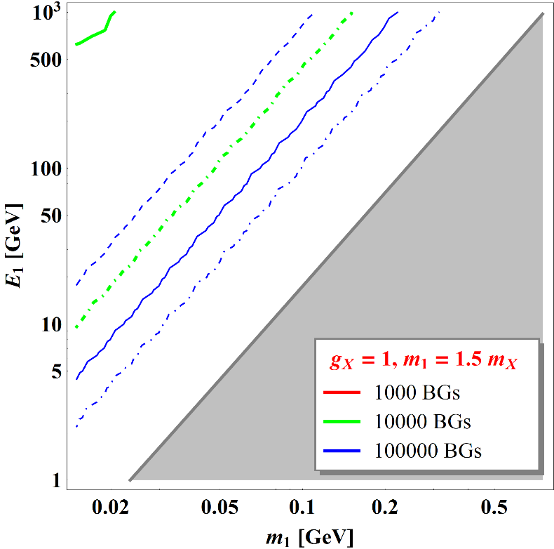
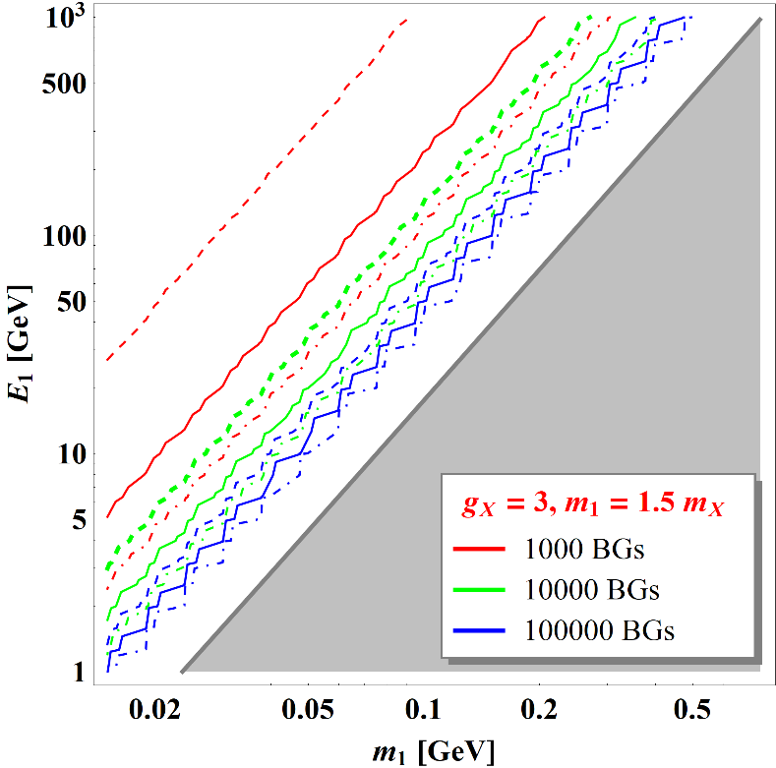
Comparison in the Presence of Backgrounds

Slide 29





Benchmark Model
Vector portal (e.g., dark photon scenario)
Fermionic DM
  Flavor-conserving interaction ⇒ elastic scattering
Dark matter pair-annihilation
$$ℒ_{int}∋−\frac{ε}{2}F_{μν}X^{μν}+g_{X}{\overline{χ}}_{1}γ^{μ}χ_{1}X_{μ}+h.c.+\frac{1}{Λ^{2}}{\overline{χ}}_{0}χ_{0}{\overline{χ}}_{1}χ_{1}$$
$$e^{−}$$
$$X$$
$$ε$$
$$e^{+}$$
$$g_{11}$$
$$χ_{1}$$
•
$$χ_{1}$$
$$X$$
$$χ_{0}$$
$$χ_{1}$$
$$χ_{0}$$
$$χ_{1}$$

Slide 30
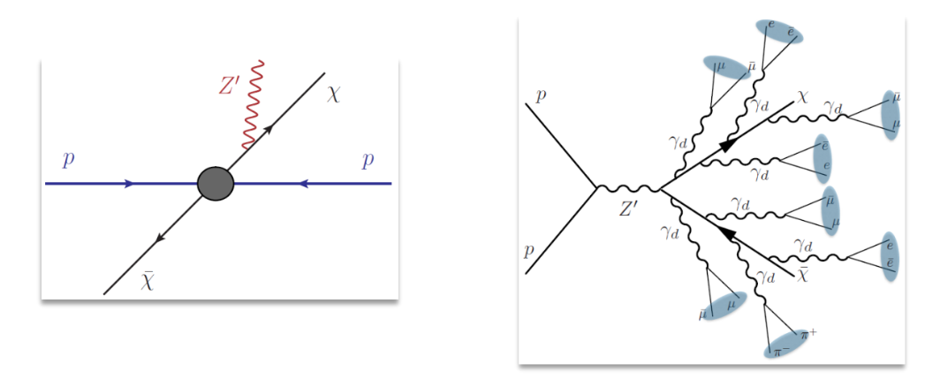
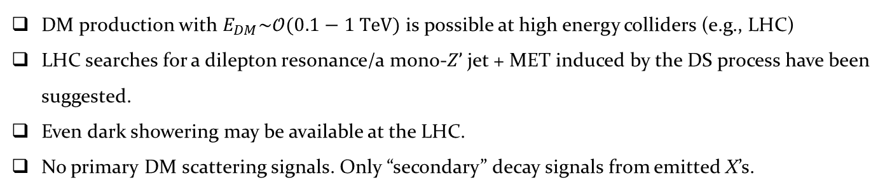
Dark-Strahlung at High Energy Colliders
DM production with $E_{DM}\sim 𝒪(0.1−1 TeV)$ is possible at high energy colliders (e.g., LHC)
LHC searches for a dilepton resonance/a mono-$Z’$jet + MET induced by the DS process have been suggested.
Even dark showering may be available at the LHC.
No primary DM scattering signals. Only “secondary” decay signals from emitted X’s.

