Slide 1

The λ6 Universe
2018-19
Dimitri V. Nanopoulos
Texas A&M University,
Academy of Athens, Greece

Slide 2
A Model Of EveryThing (MOET)
Flipped
Almost
⬇
⬇
⬇
Below the Planck Scale
Simple GUT models (SU(5), SO(10)) not obtained from weakly-coupled string
  They need adjoint Higgs, …
Flipped SU(5)×U(1) derived, has advantages
  Small (5-, 10-dimensional) Higgs representations
  Long-lived proton, neutrino masses, leptogenesis, …
Construct model of Starobinsky-like inflation within flipped SU(5)×U(1) framework
Ellis, Garcia, Nagata, Nanopoulos & Olive

Slide 3
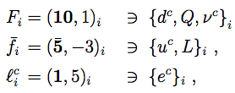
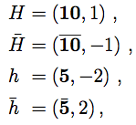



Flipped SU(5)×U(1) GUT Model
Ellis, Garcia, Nagata, Nanopoulos & Olive
Fields:
  Matter: Higgs:
  Singlets:
Superpotential:
No-scale Kähler potential:
D-terms:
Symmetry breaking:
Proton lifetime:

Slide 4



Neutrino Masses & Mixing
Consider 2 options:
(A) Inflaton decouples from neutrinos
  Inflaton decays to Higgs(inos): leptogenesis difficult
(B) Inflaton couples to neutrinos
Double seesaw mass matrix, 2 heavy states, couplings where
Constraints from neutrino data, easier leptogenesis

Slide 5




Neutrino Masses & Inflaton Coupling
Ellis, Garcia, Nagata, Nanopoulos & Olive
To avoid overproduction of dark matter via gravitinos if no later entropy
With entropy factor Δ, if inflaton couples to neutrinos:
Normal neutrino mass hierarchy preferred
Weak or strong reheating? Much much extra entropy?

Slide 6


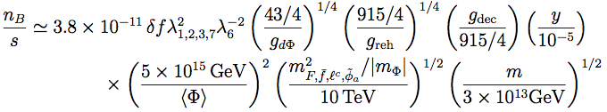
Entropy Release & Baryogenesis
Ellis, Garcia, Nagata, Nanopoulos & Olive
Entropy release
Relaxes gravitino production constraint, little effect on number of inflationary e-folds:
Standard leptogenesis if inflaton couples to neutrinos:

Slide 7
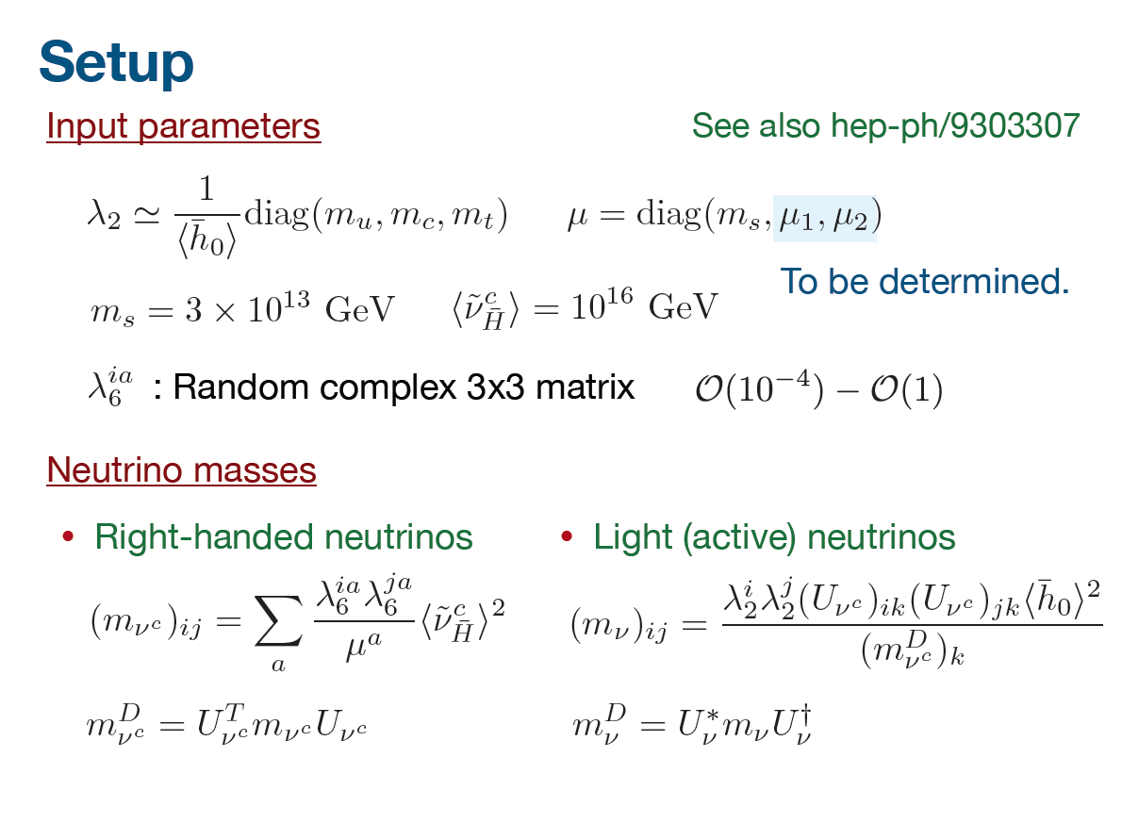

Slide 8
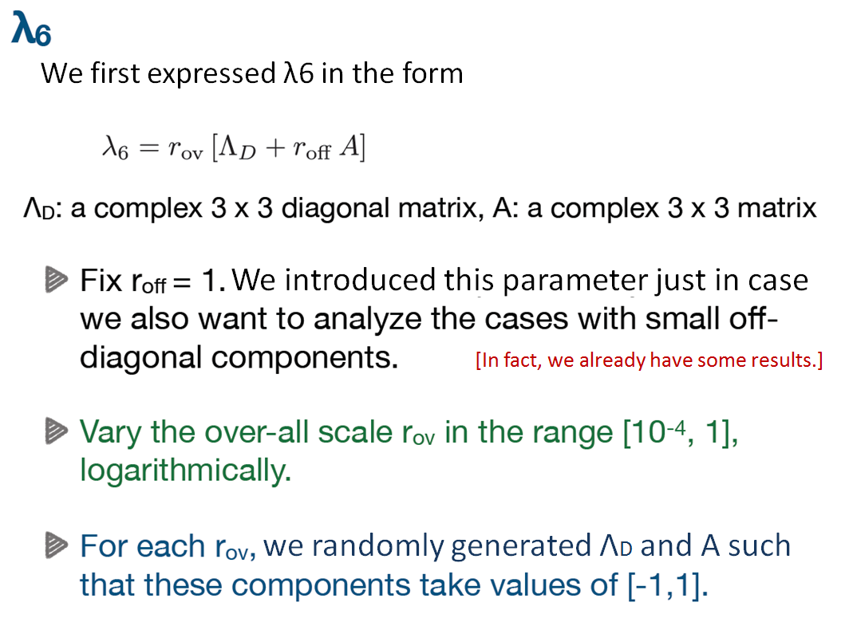

Slide 9
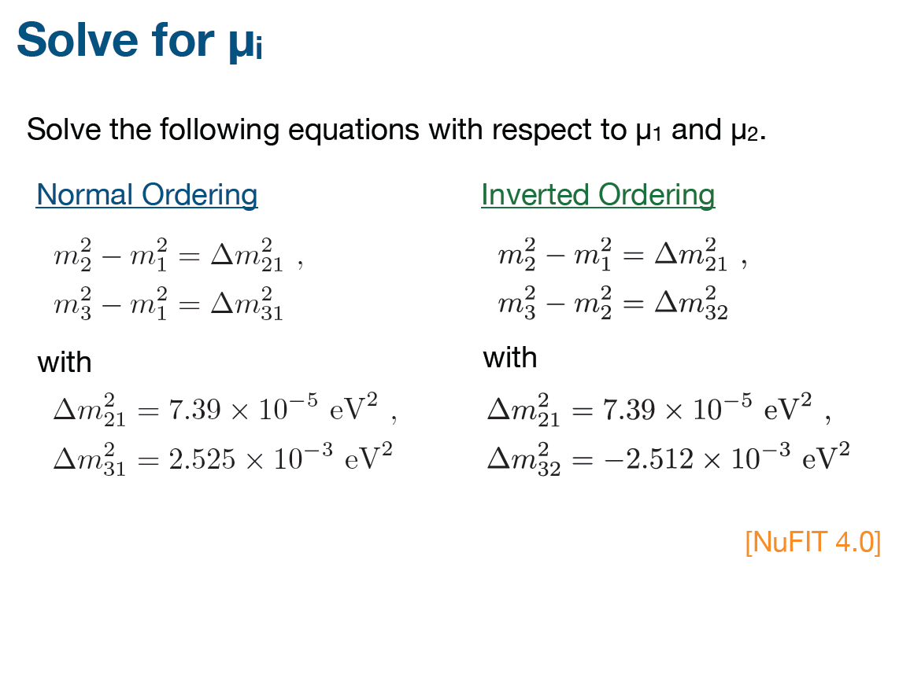

Slide 10
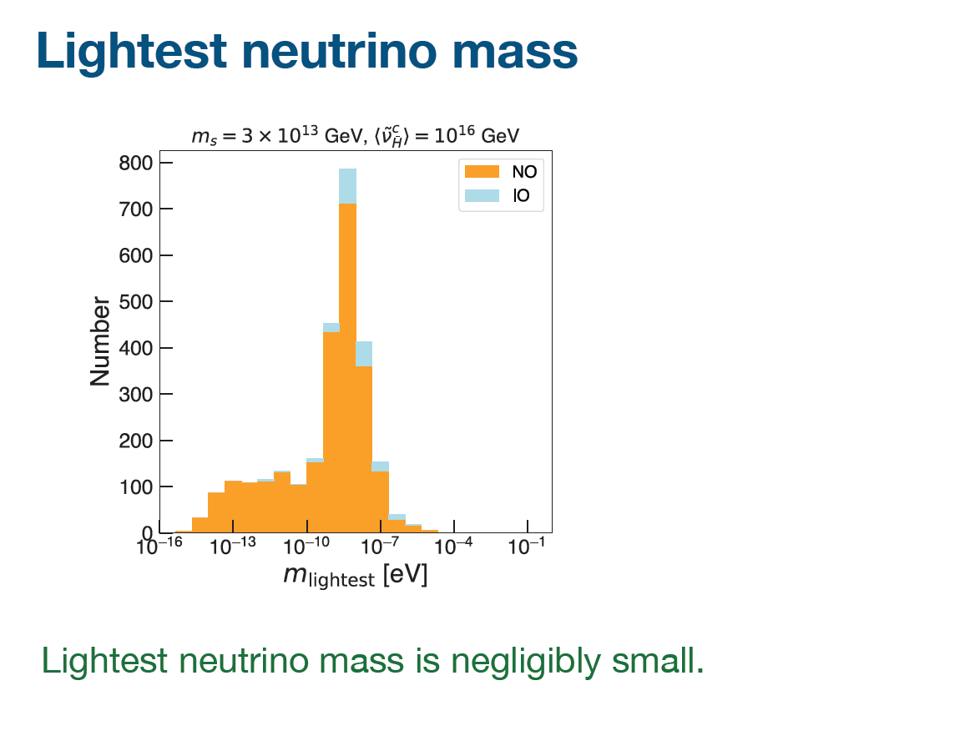

Slide 11
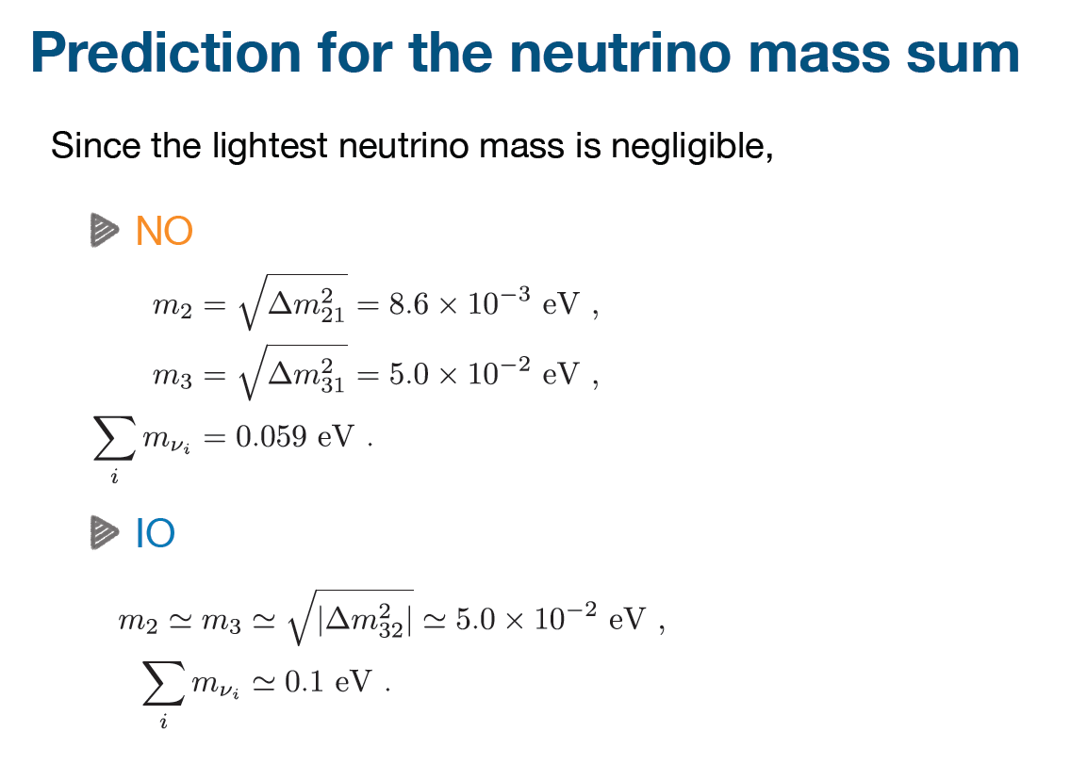

Slide 12
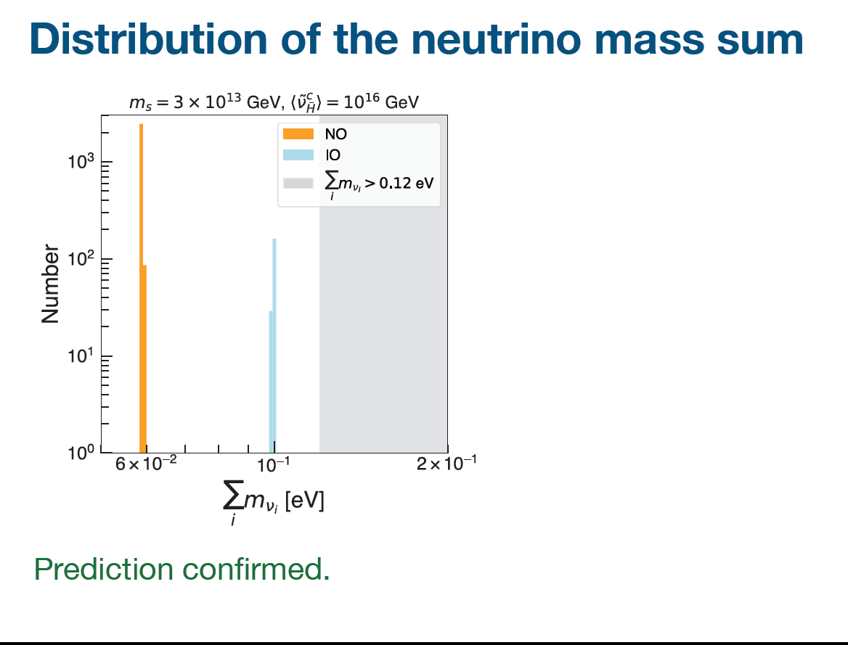

Slide 13
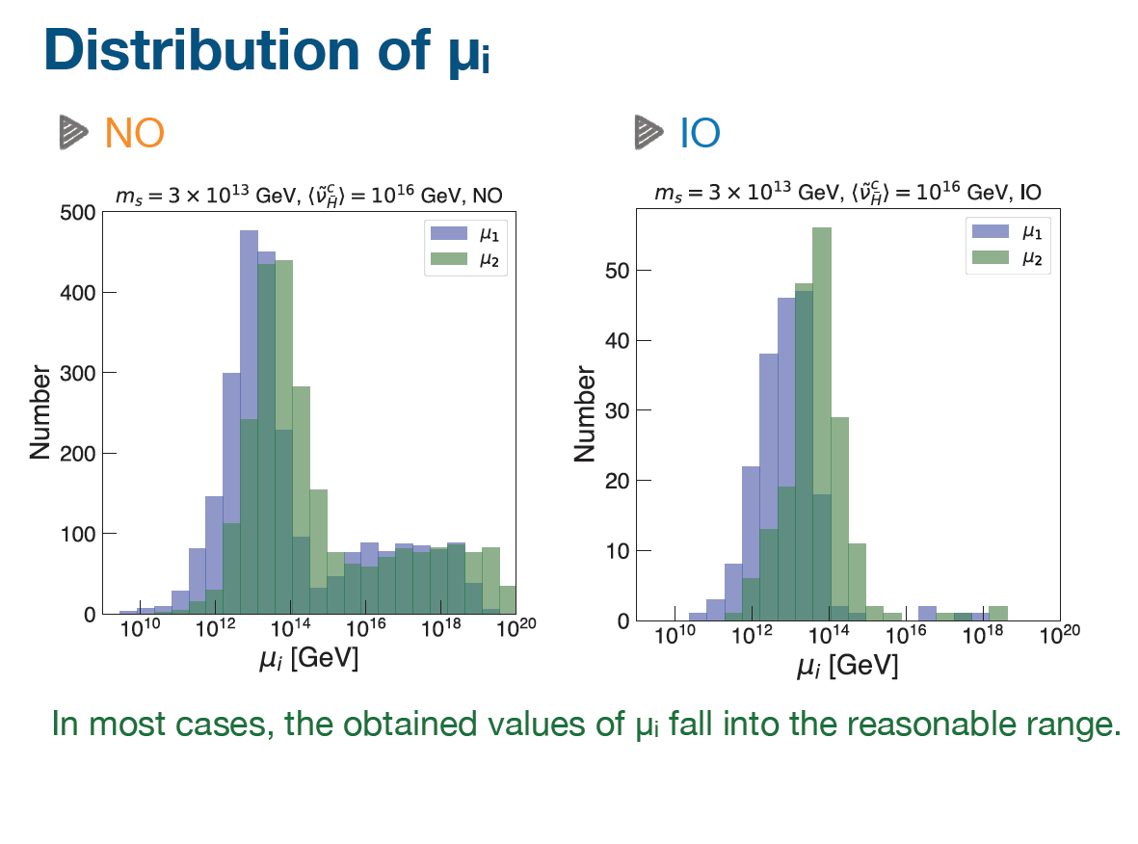

Slide 14
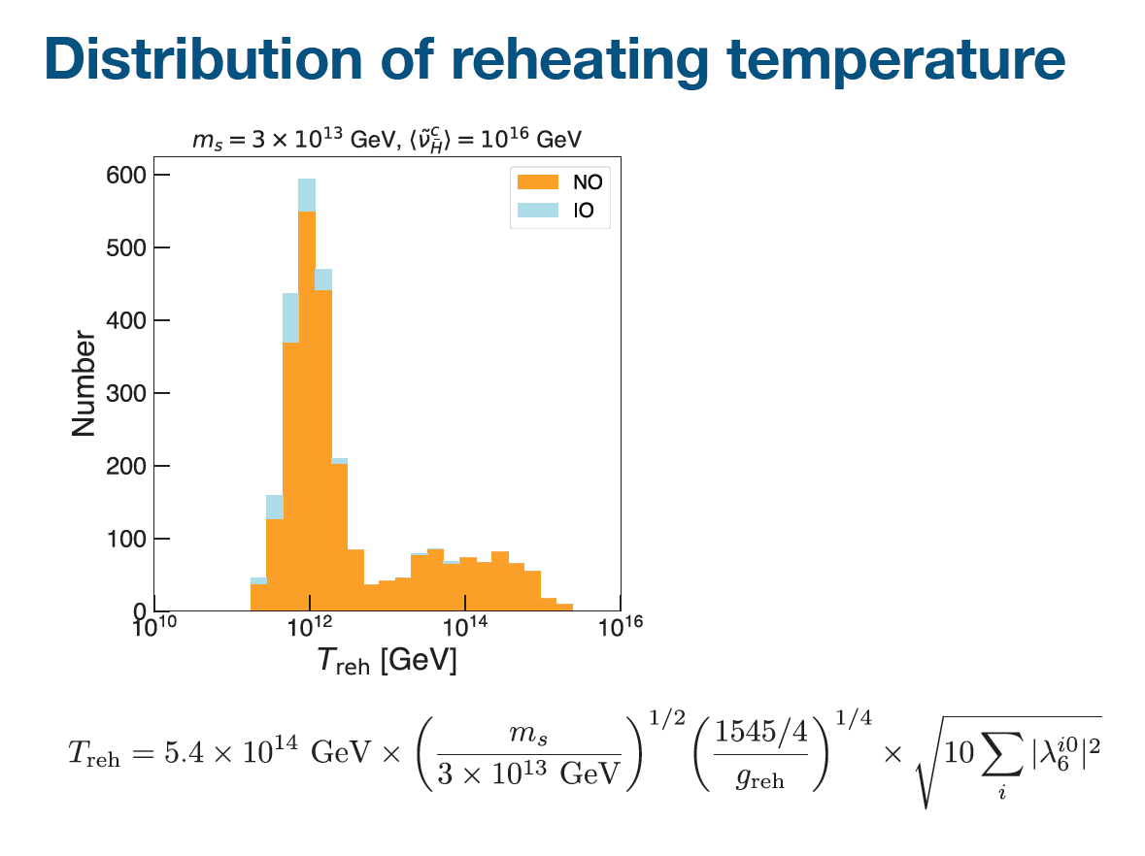

Slide 15
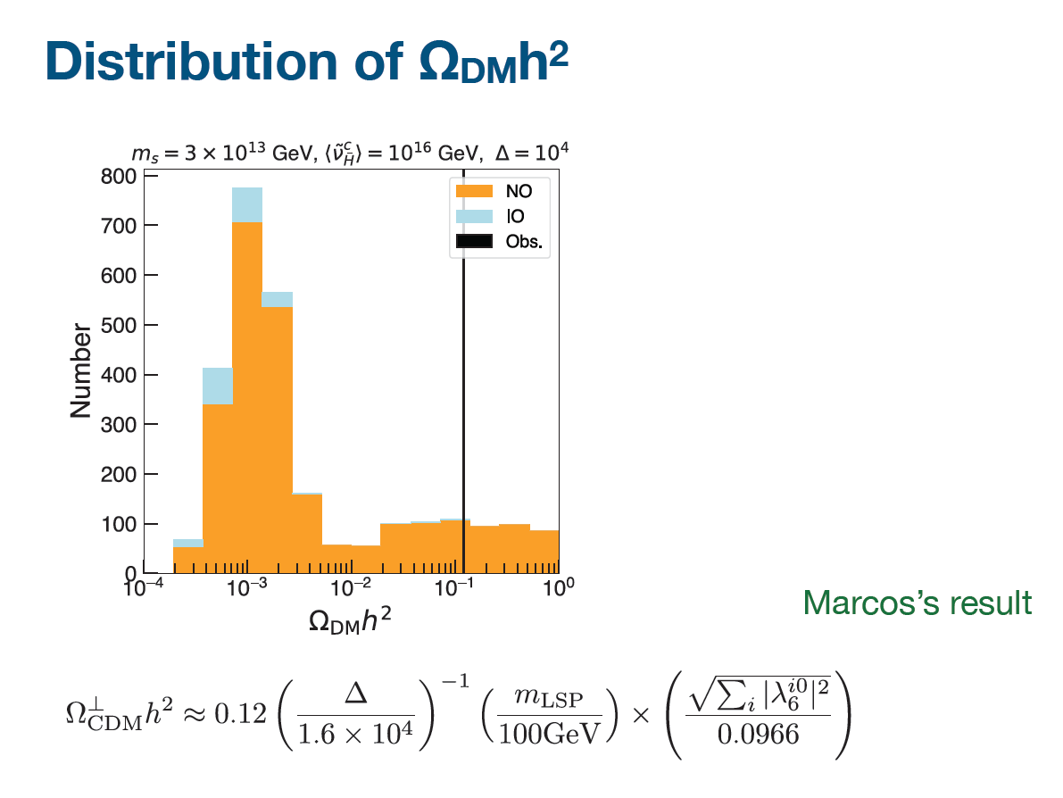

Slide 16
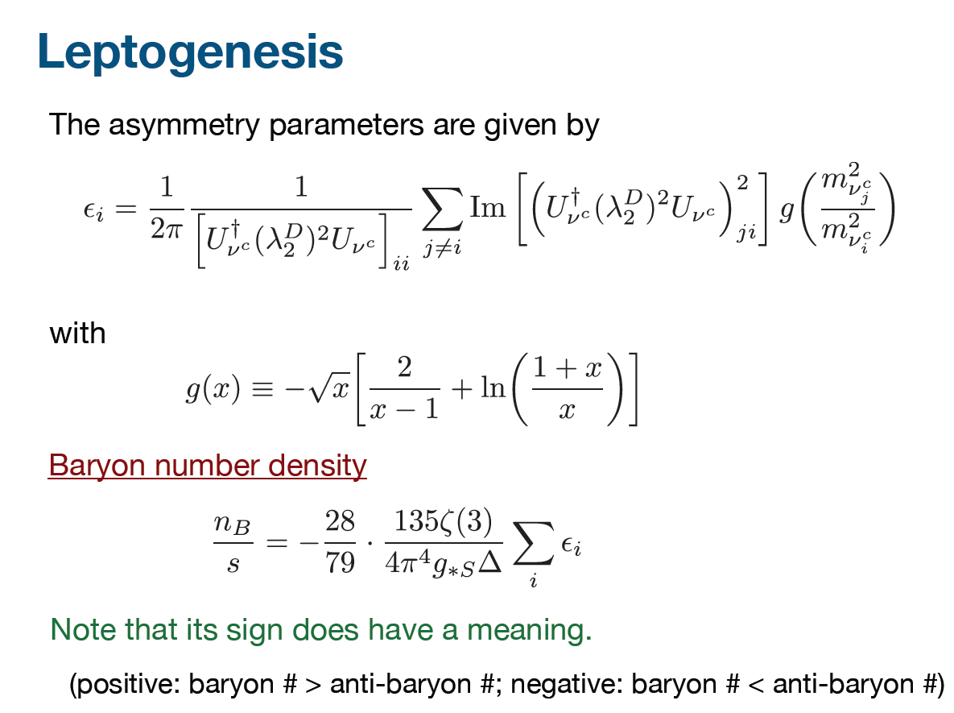

Slide 17
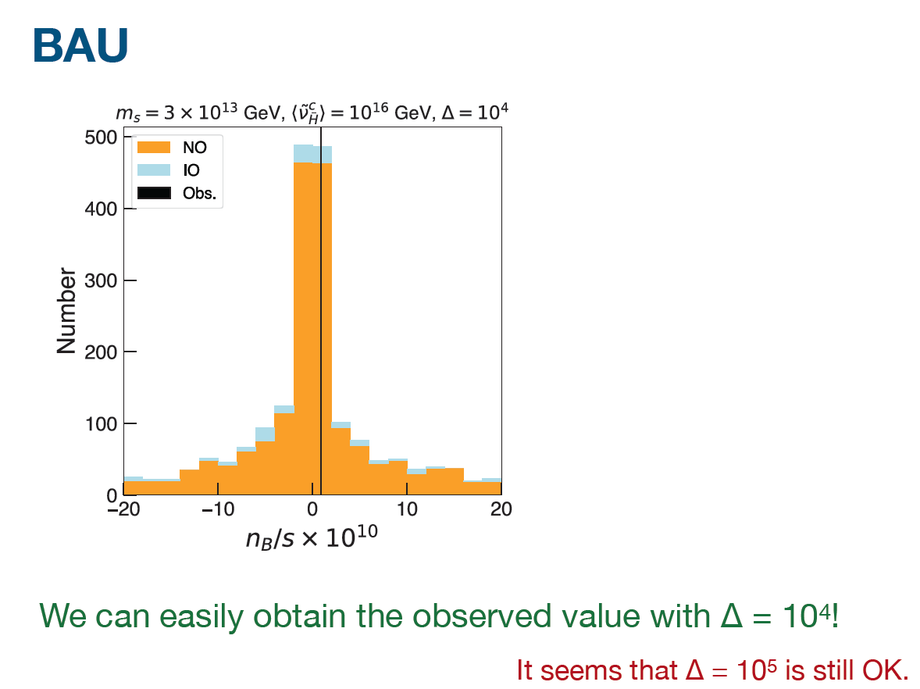
Ellis, Garcia, Nagata, Nanopoulos & Olive

Slide 18
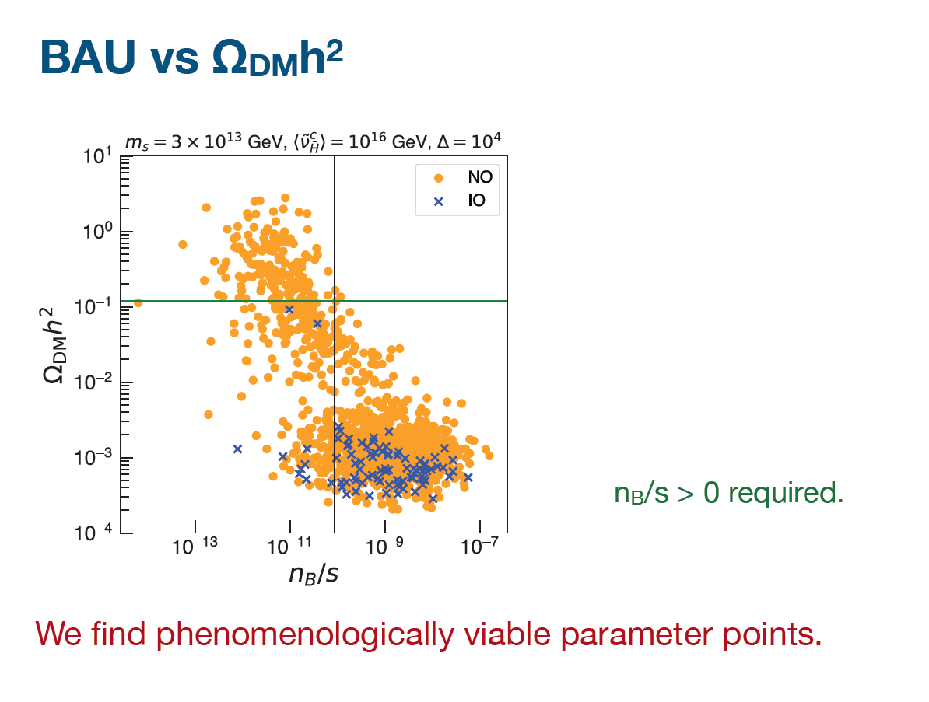
Ellis, Garcia, Nagata, Nanopoulos & Olive

Slide 19
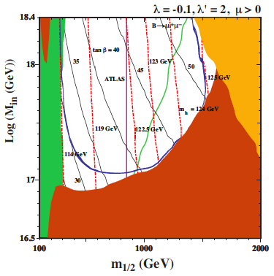
No-Scale Framework for Particle Physics & Dark Matter
Incorporating LHC constraints, Higgs mass, flavour, supersymmetric dark matter, Starobinsky-like inflation, leptogenesis, neutrino masses, …
Ellis, Nanopoulos & Olive
(~ gluino mass)

Slide 20
Flipped
Almost
A Model of Everything
⬇
⬇
⬇
Below the Planck Scale
Starobinsky-like inflation can be embedded within flipped SU(5)×U(1) model
Inflaton coupling to neutrinos preferred for baryogenesis – implications for neutrino masses
Prefer strong reheating after inflation for same reason
Example how inflation can connect string theory (no-scale supergravity, GUT derived from string) with particle physics accessible to experiment (neutrinos, dark matter, proton decay, LHC, …)
Ellis, Garcia, Nagata, Nanopoulos & Olive

Slide 21
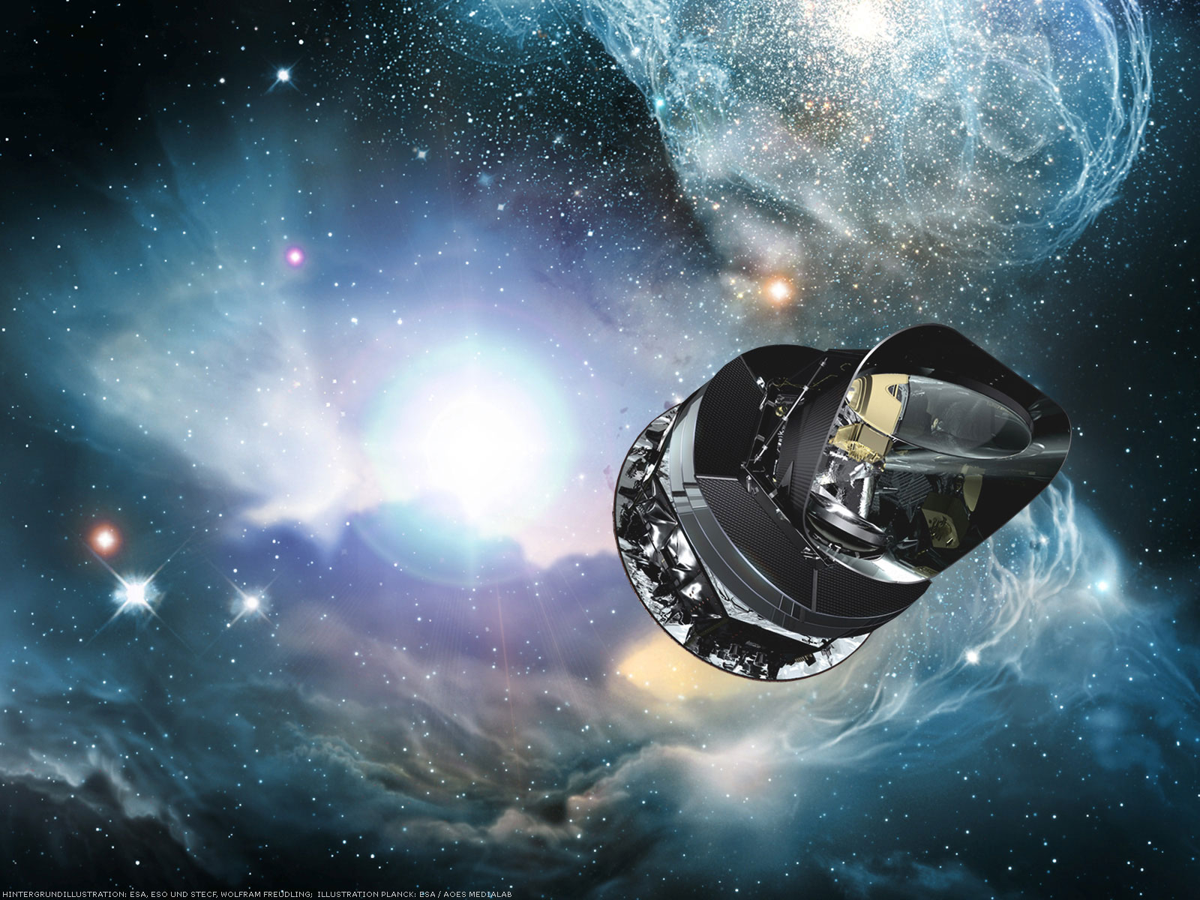
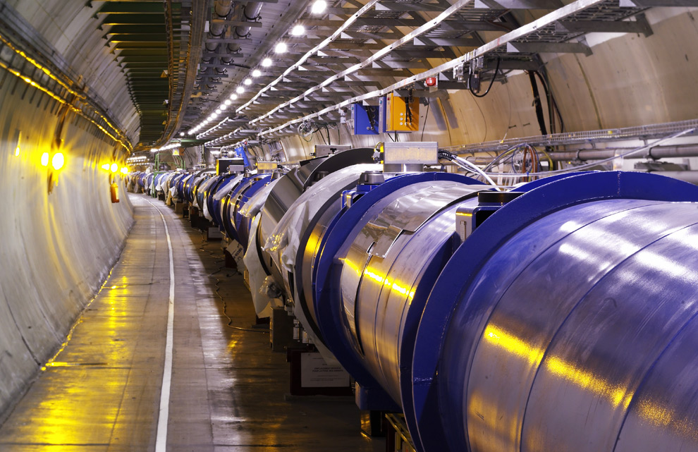
THANK YOU VERY MUCH

