Slide 1
Neutrino Masses and Mixings in a Realistic Intersecting D-brane World
Van E. Mayes
University of Houston – Clear Lake
May 2019
TexPoint fonts used in EMF.
Read the TexPoint manual before you delete this box.:

Slide 2

String Phenomenology
The goal is to construct the SM or SSM as an effective theory of
a string-based model, and try to test such models at future
experiments.

Slide 3
String Theory
It is currently the best candidate for a theory which unites gravity with
quantum mechanics.
Bosonic string theory: 26 dimensions.
Superstring theory: 10 dimensions.
The observed universe is 4-dimensional.
Calabi-Yau compactifications for extra 6 dimensions.
There are five different string theories: Type I, Type IIA, Type IIB, Heterotic $E_{8}×E_{8}$
and Heterotic $SO(32)$

Slide 4
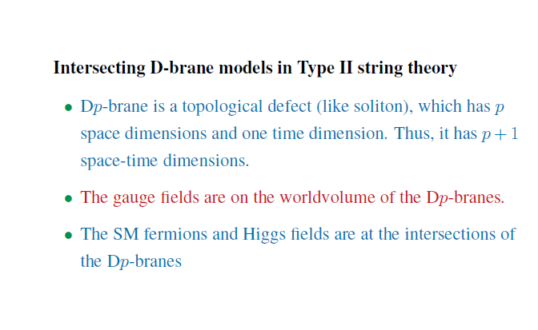

Slide 5
Dp-Branes
Open string end-points are fixed on p dimensional
hyperplanes. They obey Dirichlet boundary conditions.

Slide 6
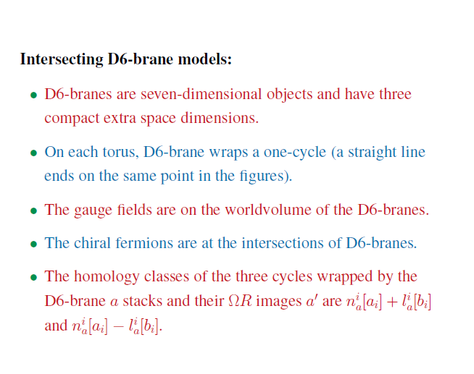

Slide 7
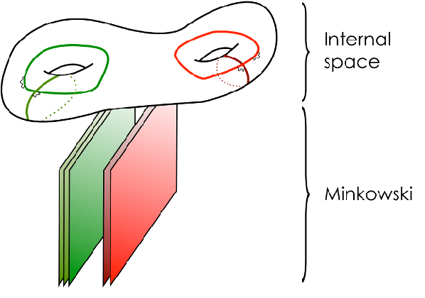

Slide 8
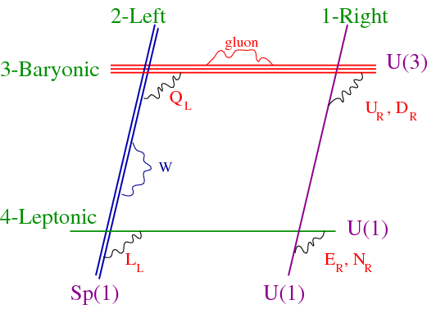

Slide 9
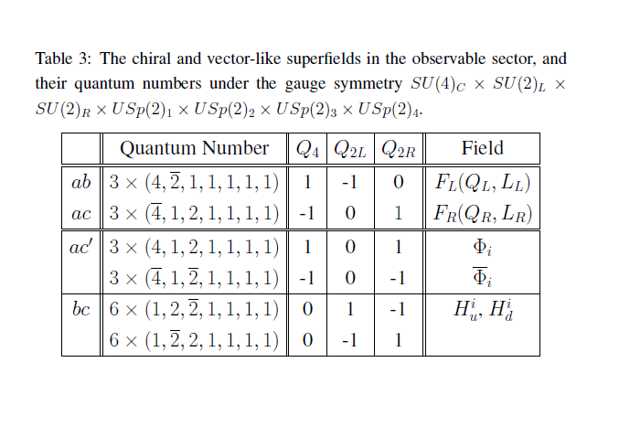
A Realistic Intersecting D-brane World

Slide 10
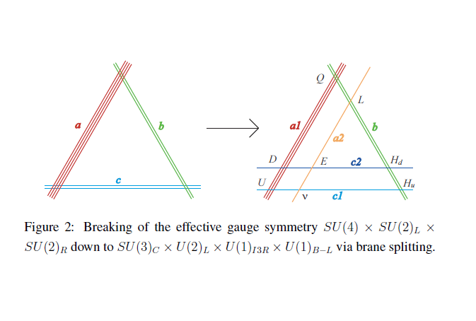

Slide 11
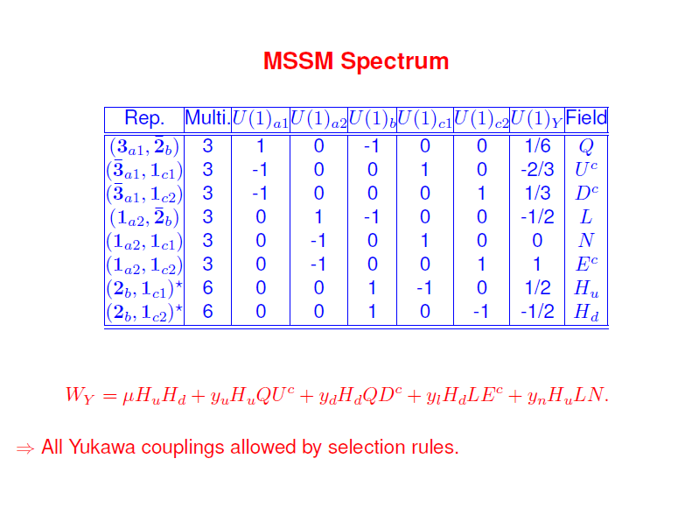

Slide 12
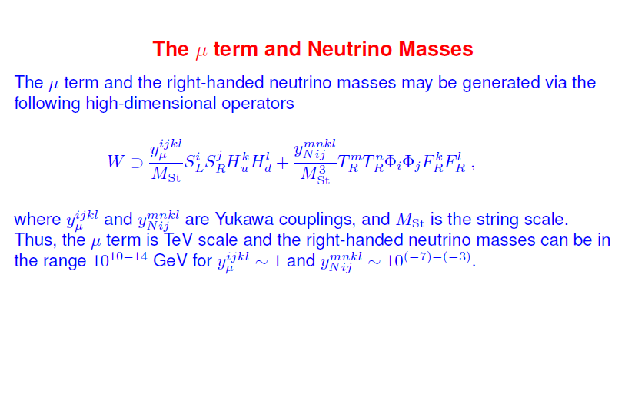

Slide 13
Summary of 2007-2008 Results:
A 3-generation SSM was constructed.
2. Gauge coupling unification is automatic.
3. The correct SM quark masses and the quark CKM mixing matrix were obtained.
4. The correct τ lepton mass was obtained. However, the electron mass was
roughly 5-7 times larger than the expected value, while the muon mass
was 50%-60% too small.
5. The correct electron and muon masses can be generated by dimension -5
operators.

Slide 14
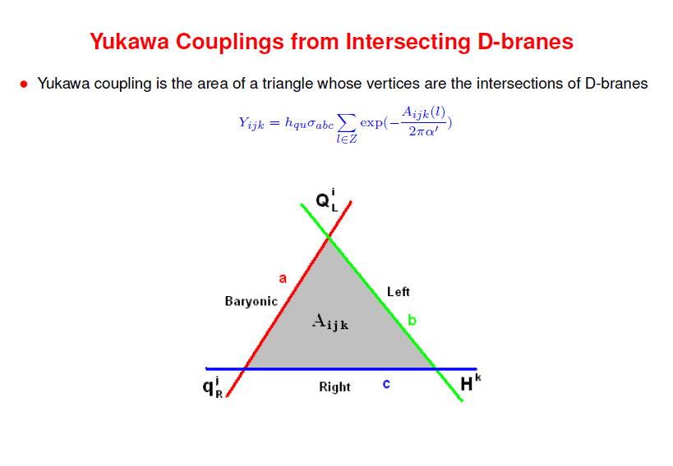
The Yukawa couplings are exponentially suppressed proportionally to the area bounded by the vertices of the triangles formed by a triplet of D-branes.

Slide 15
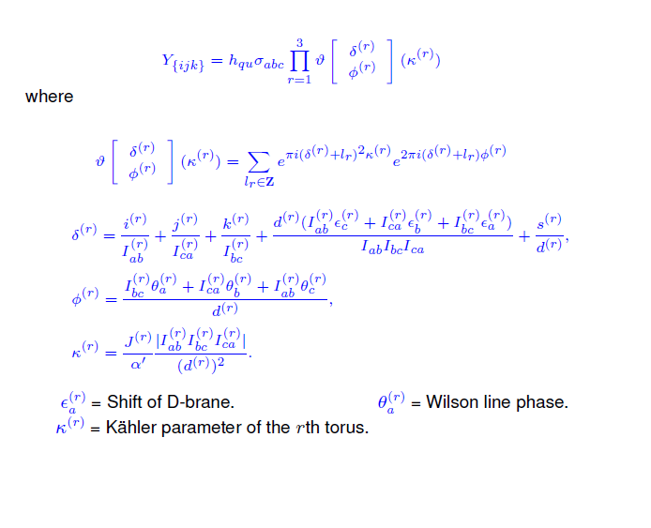
Parameterization of Yukawa Couplings

Slide 16
Choose
Then on the first two-torus:
where the Yukawa couplings are given by

Slide 17
B=C and D=F at ε = 0 and ½
B,C,D,F are small at ε = 0 and ½
A=1 and E=0 at ε = 0.
A=0 and E=1 at ε = ½.

Slide 18
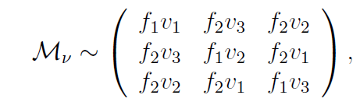
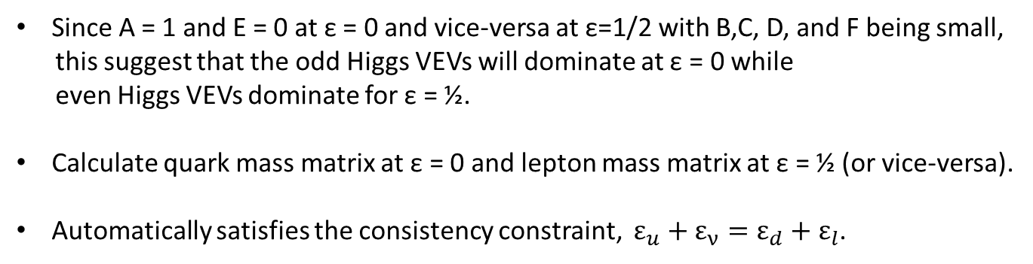
Flavor Symmetry In Yukawa Matrices
Δ(27) flavor symmetry
Each of the two matrices composing the mass matrix in the model have this form
when ε= 0 and ½ (B=C and D=F):
Since A = 1 and E = 0 at ε = 0 and vice-versa at ε=1/2 with B,C, D, and F being small,
this suggest that the odd Higgs VEVs will dominate at ε = 0 while
even Higgs VEVs dominate for ε = ½.
Calculate quark mass matrix at ε = 0 and lepton mass matrix at ε = ½ (or vice-versa).
Automatically satisfies the consistency constraint, $ε_{u}+ε_{ν}=ε_{d}+ε_{l}$.

Slide 19
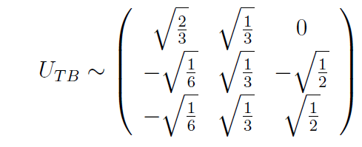
Near-tribimaximal Mixing
Δ(27) includes A4 as a sub-group.
A4 is known to lead directly to tribimaximal mixing.
A4
Neutrino Yukawa mass matrix in the model may naturally accommodate near-tribimaximal mixing.

Slide 20
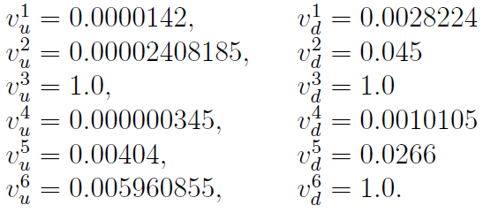
Model Parameters
VEVs chosen to fit quark and charged lepton mass matrices first.
VEVs for neutrino mass matrix chosen so that it is tribimaximal.
Kappa chosen in order to achieve correct CKM matrix

Slide 21
Quark Mass Matrices and CKM Mixing Matrix

Slide 22
Lepton Mass Matrices

Slide 23
Lepton Mixing Matrices

Slide 24
Type I Seesaw Mechanism
Choose:

Slide 25
Fitting Quark and Lepton Mass Matrices
It is possible to naturally accommodate the correct masses for
quarks and charged leptons.
Nearly the correct CKM matrix may be obtained.
It is possible to have a (Dirac) neutrino mass matrix which is consistent with
the u-type quark mass matrix and which also leads to near-tribimaximal mixing.
For an appropriately chosen right-handed neutrino mass matrix, the
correct neutrino mixing angles and mass-squared differences for
Majorana neutrino masses are naturally obtained after the seesaw mechanism.
An RGE analysis has been performed and the results remain valid at low energy.

Slide 26
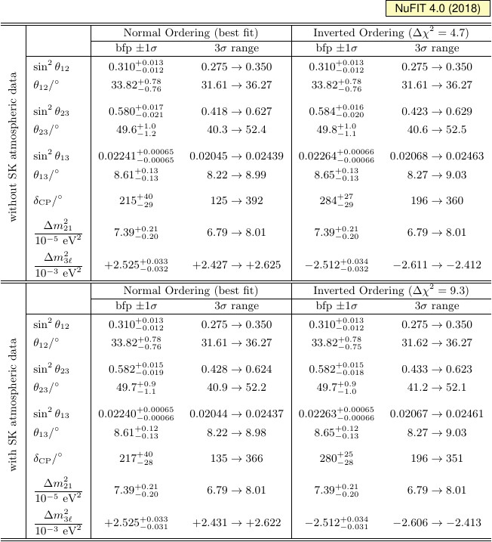
JHEP 1901 (2019) 106

Slide 27
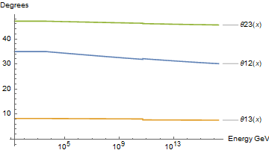
RGE Running of Neutrino Mixing Angles
Mixing angles are $θ_{12}={35.0}^{°}, θ_{23}={47.1}^{°},$and $θ_{13}={8.27}^{°}$.
REAP package introduced in S. Antusch, J. Kersten, M. Lindner, M. Ratz and M. A. Schmidt, JHEP 0503, 024 (2005) [arXiv:hep-ph/0501272] [ http://www1.physik.tu-muenchen.de/ rge/.]

Slide 28
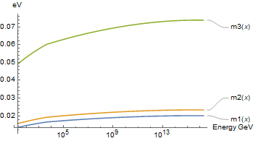
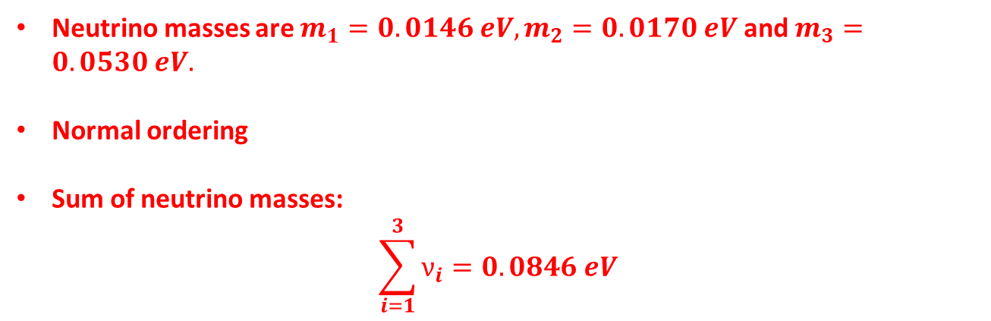
RGE Running of Neutrino Masses
Neutrino masses are $m_{1}=0.0146 eV, m_{2}=0.0170 eV$ and $m_{3}=0.0530 eV.$
Normal ordering
Sum of neutrino masses:
$$\sum_{i=1}^{3}{ν_{i}=0.0846 eV}$$

Slide 29
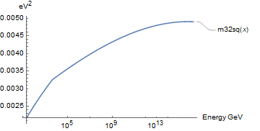
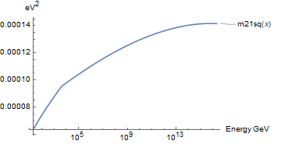



RGE Running of $∆m_{32}^{2}$ and $∆m_{21}^{2}$
$∆m_{32}^{2}=0.0252$ e$V^{2}$
$$∆m_{21}^{2}=0.0000739 eV^{2}$$

Slide 30
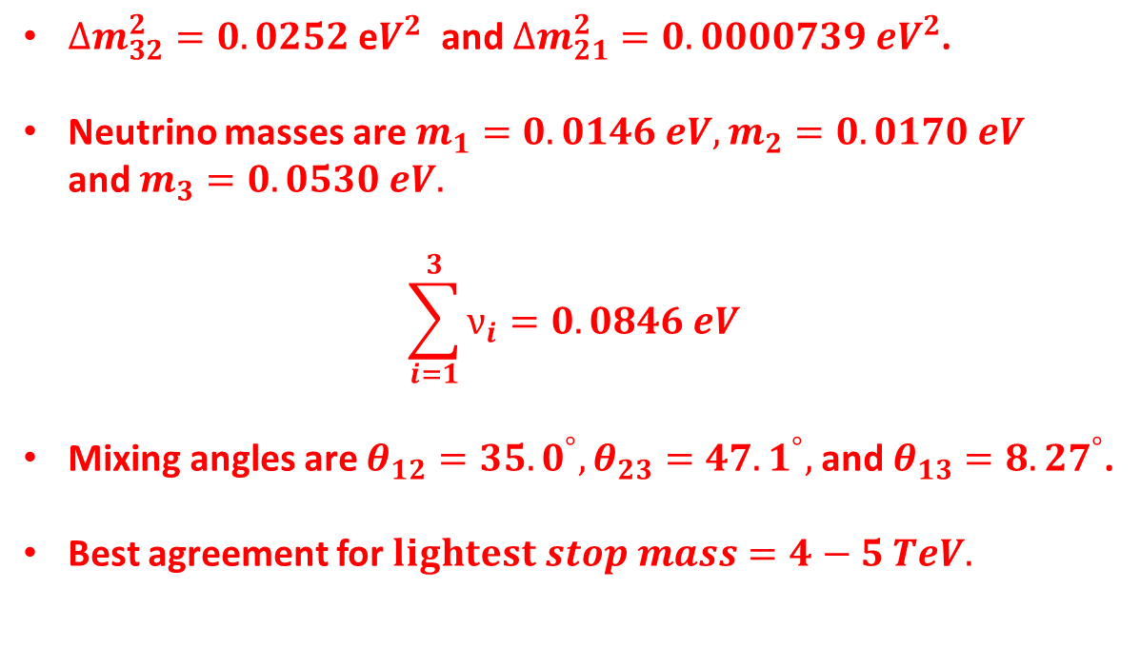
Summary of Results
$∆m_{32}^{2}=0.0252$ e$V^{2}$ and $∆m_{21}^{2}=0.0000739 eV^{2}$.
Neutrino masses are $m_{1}=0.0146 eV, m_{2}=0.0170 eV$
and $m_{3}=0.0530 eV.$
$$\sum_{i=1}^{3}{ν_{i}=0.0846 eV}$$
Mixing angles are $θ_{12}={35.0}^{°}, θ_{23}={47.1}^{°},$and $θ_{13}={8.27}^{°}$.
Best agreement for $lightest stop mass=4−5 TeV.$

