Slide 1
Dimitri Nanopoulos and the
Birth of Astroparticle Physics
On the occasion of Dimitri’s Retirement from TAMU
Remarks by
Bob Webb
Texas A&M University

Slide 2
Dimitri’s Biographic Info
Born in Athens in 1948.
Attended the University of Athens and graduated in 1971
Attended the University of Sussex where he was awarded his PhD in High Energy Physics in 1973.
Post doctoral fellowship, l’Ecole Normale Superieure, Paris, 1975-76.
Research Fellow, Harvard University, 1977-79.
CERN Staff Member, 1979-86.
Professor of Physics, University of Wisconsin, 1986-88.
Professor of Physics, Texas A&M University, 1989-2019.
Distinguished Professor of Physics 1992-2019.
Mitchell/HEEP Chair in High Energy Physics, 2002-2019.

Slide 3
More data…
More than 525 refereed publications, with an excess of 28,000 citations! (Placing him as the fourth most cited high energy physicist in 2001.)
Has presented more than 250 invited presentations over the years.
Founding Director of the Astroparticle Physics Group at the Houston Advanced Research Center (HARC).
Fellow of the APS (1988)
Member of the Academy of Athens’ Natural and Applied Sciences (1997).
President of the Greek National Council of Research and Technology (2005).
Greece’s representative to CERN and the European Space Agency.

Slide 4
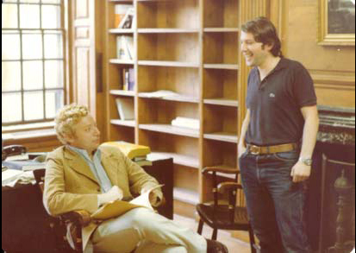

Slide 5
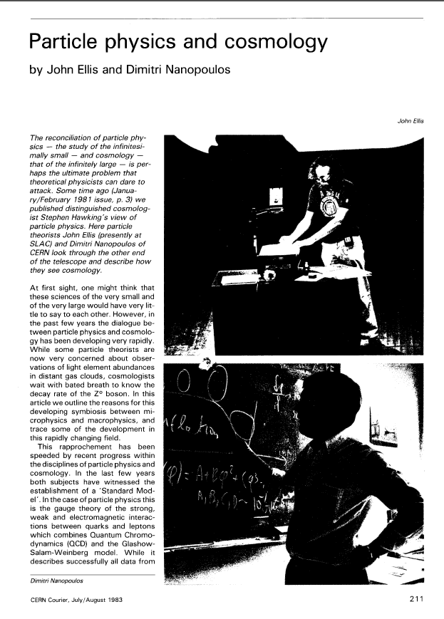
Early Work, circa late
70’s early 80’s
The dawning of the Age of Astroparticle Physics and the Search for GUTs

Slide 6
Is Flipped SU(5) the answer?

Slide 7
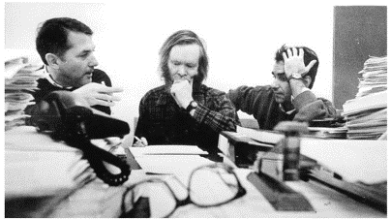
And the era of a long lasting collaboration!

Slide 8
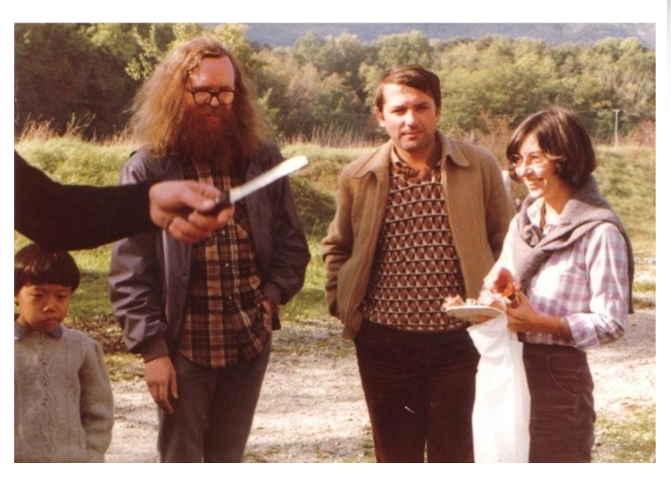

Slide 9
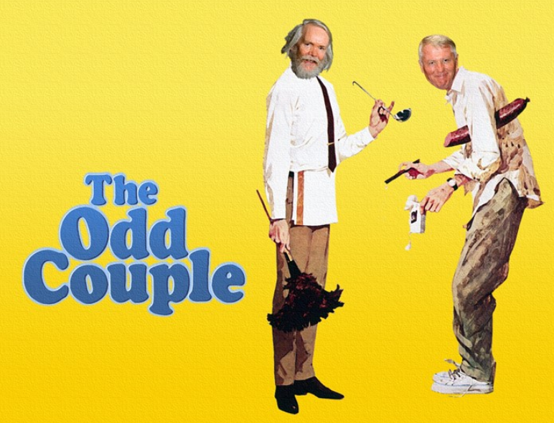


Slide 10
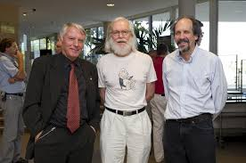

Slide 11
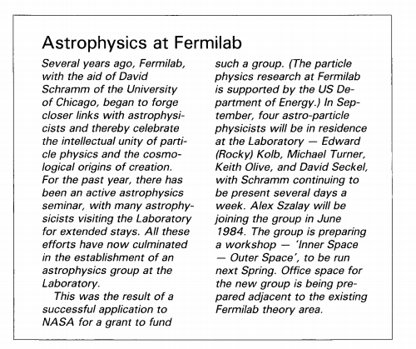
1984…

Slide 12
Dimitri becomes a Texan
High energy physics (HEP) program begins at TAMU in 1980.
We (TAMU HEP) soon realized that having some theory colleagues around to discuss the latest ideas and results with would be a benefit to all so the department established a Center for Theoretical Physics in ~1985.
Dimitri was one of the early hires into the Center in 1988.
Dimitri launches the Center for Astroparticle Physics at HARC in the Woodlands as the TAMU work on the SSC begins in earnest.

Slide 13
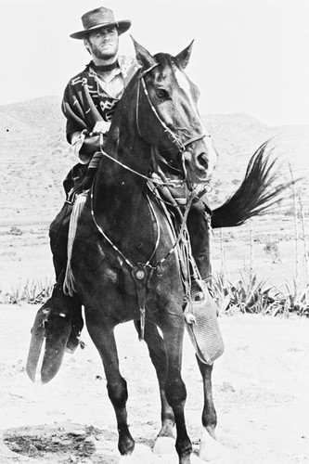

Slide 14
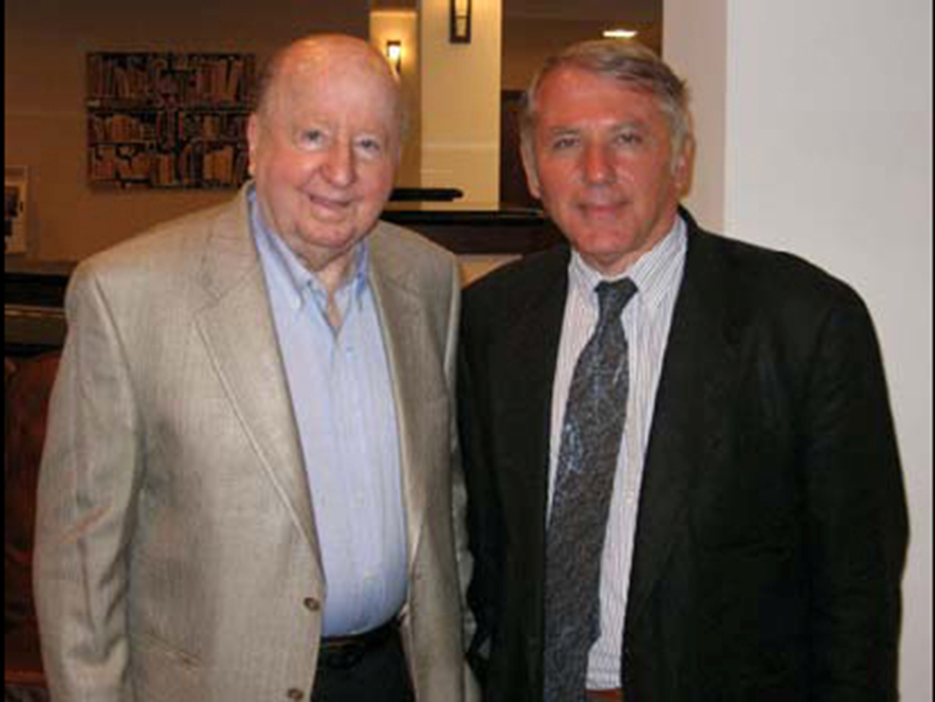
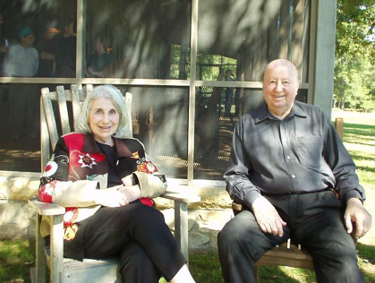

Slide 15
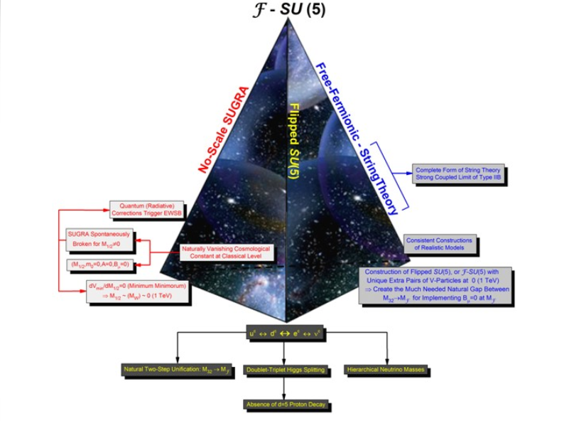
Search for the Grail continues

Slide 16
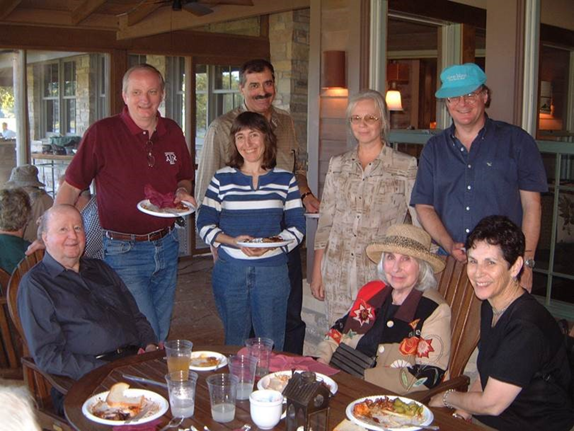
Astronomy and cosmology arrive in 2006

Slide 17
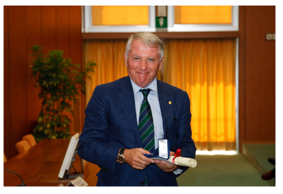
Honors and Awards
Recipient of the 2006 Onassis International Prize in honor of his achievements in the natural sciences.
Recipient of the 2009 Enrico Fermi Prize in recognition of his pioneering international work in the field of string theory.

Slide 18


