Slide 1

Welcome to Physics Dept,
U. Maryland!

Slide 2
This Workshop is sponsored by
Maryland Center for Fundamental Physics (MCFP)

Slide 3
Large-Momentum
Effective Field Theory
Xiangdong Ji
University of Maryland
April, 6, 2018
College Park

Slide 4
Outline
Parton physics and dilemma of theory
Parton physics as the fixed point of the momentum renormalization group
Large momentum effective field theory
Gluon spin and quark distributions
Conclusions

Slide 5
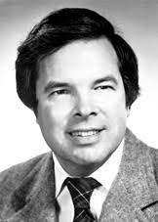
In 1974, Ken Wilson introduced a theory to solve QCD on Euclidean lattice, now called Lattice QCD

Slide 6
However, starting late 1980’s to 1990’s， Ken W. lead a new effort to solve QCD using light-cone quantization

Slide 7
Wilson was after parton physics!

Slide 8
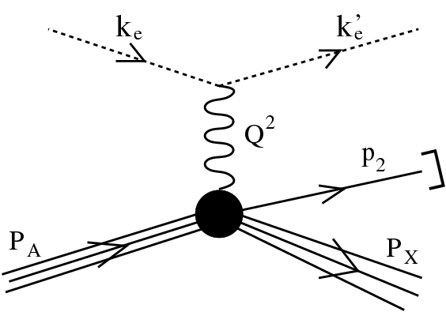
Deep-inelastic scattering (Jlab12 GeV, EIC)
Study quarks and gluons content of QCD bound states (nucleon and nucleus), thereby learning the fundamental structure of the basic constituent of matter.

Slide 9
Two vital theoretical concepts:
Scale separation and partons
Scale separation (factorization): Cross sections can be written as convolution of quark & gluon scattering cross section (scattering mechanism) and the gluon and quark distributions functions (structure physics), thanks to asymptotic freedom
Partons: the quark and gluon distributions can be understood as density distributions in the infinite momentum frame of the bound states.

Slide 10
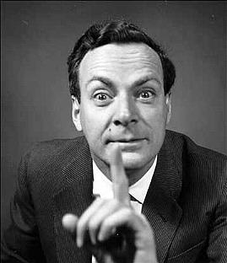
Feynman Language
Feynman has been known for his great physics intuition, by converting complicated physics to simple languages:
Feynman diagrams
Feynman parton model
Feynman path integral

Slide 11
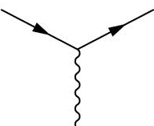
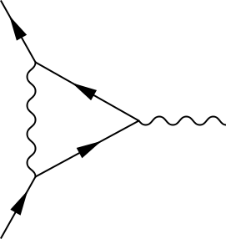
Need for partons
Consider electromagnetic form factor of a particle, its physical meaning is clear at the tree level,
Consider its one-loop correction,
its physics is not so clear…..

Slide 12
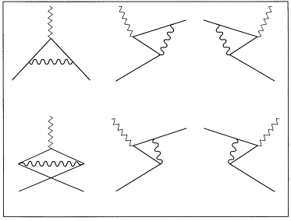
There are six diagrams in time-ordering
The sum is frame-independent (Lorentz invariant), but the individual contributions depend on the frame or the momentum of the particle

Slide 13
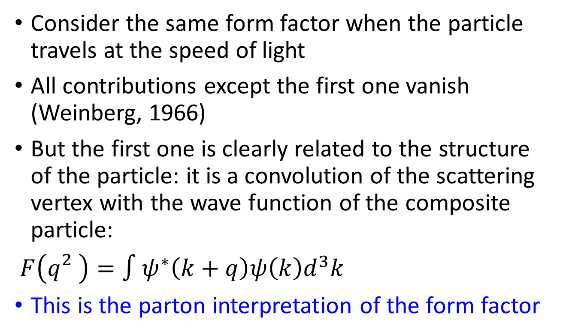
Infinite momentum frame
Consider the same form factor when the particle travels at the speed of light
All contributions except the first one vanish (Weinberg, 1966)
But the first one is clearly related to the structure of the particle: it is a convolution of the scattering vertex with the wave function of the composite particle:
$F\left(q_{}^{2}\right)=∫ψ^{∗}\left(k+q\right)ψ\left(k\right)d^{3}k$
This is the parton interpretation of the form factor

Slide 14
Quark and gluon parton distributions
The Feynman momentum is, in the Bjorken frame, fraction of the longitudinal momentum carried by quarks:
x = k^{z}/P^{z} , 0<x<1

Slide 15
IMF and Theoretical Difficulties
IMF is a physical abstraction.
It is difficult to calculate in the IMF because it involves boosting all particles to the infinite momenta and there is a lot of infinities around.
The most popular approach is to express partons as light-cone correlation function.

Slide 16
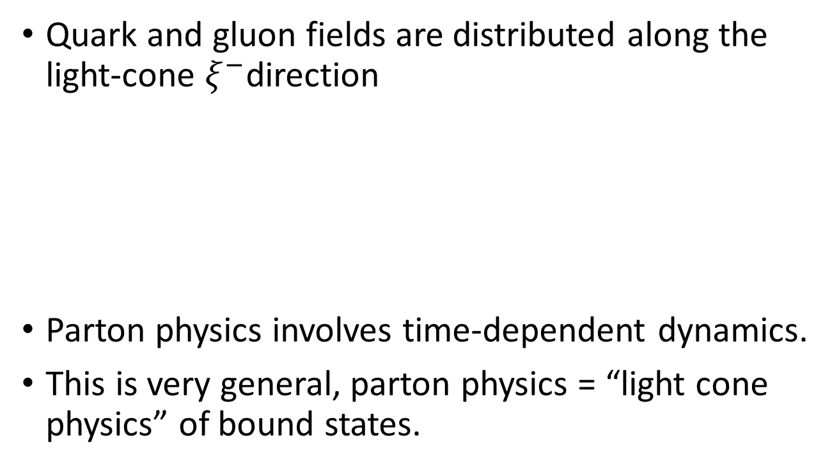
Partons as light-front correlations
Quark and gluon fields are distributed along the light-cone $ξ^{−}$direction
Parton physics involves time-dependent dynamics.
This is very general, parton physics = “light cone physics” of bound states.
𝜉⁰
𝜉⁻
𝜉⁺
𝜉³

Slide 17
How to deal with time-dependent correlations?
Monte Carlo calculations, like lattice QCD?
Direct Monte Carlo simulation is out of the question because of the sign problem (NP-complete problem, the ultimate sign problem!)
Ken Wilson and others in 1990’s have proposed to calculate parton physics using Hamiltonian formalism and light-cone quantization.

Slide 18
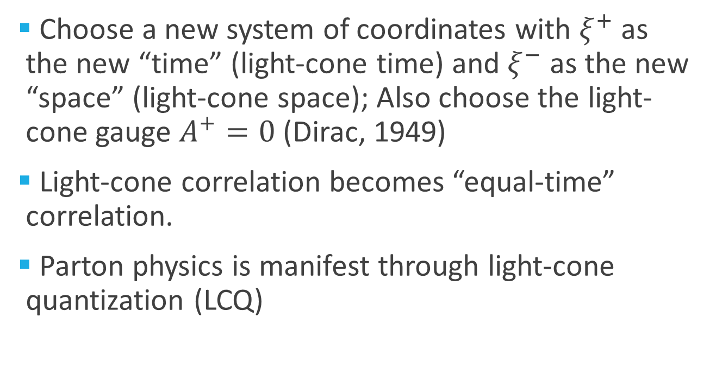
Light-front quantization
Choose a new system of coordinates with $ξ^{+}$ as the new “time” (light-cone time) and $ξ^{−}$ as the new “space” (light-cone space); Also choose the light-cone gauge $A^{+}=0$ (Dirac, 1949)
Light-cone correlation becomes “equal-time” correlation.
Parton physics is manifest through light-cone quantization (LCQ)

Slide 19
Status of Hamiltonian approach
Despite many years of efforts, light-front quantization has not yielded a systematic approach to calculating non-perturbative parton physics.
Not even an approximate calculation of parton distributions using QCD LF Hamiltonian has appeared.
Light-front quantization conferences have been held every other year!

Slide 20
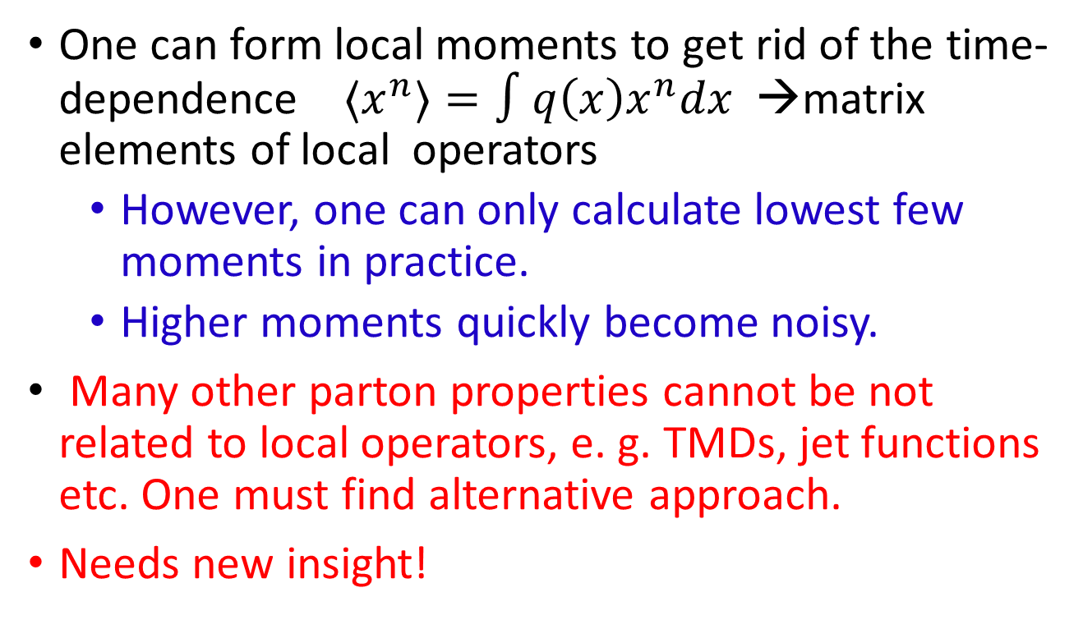
Parton physics on lattice?
One can form local moments to get rid of the time-dependence ${〈x}^{n}〉=∫q\left(x\right)x^{n}dx$ →matrix elements of local operators
  However, one can only calculate lowest few moments in practice.
  Higher moments quickly become noisy.
Many other parton properties cannot be not related to local operators, e. g. TMDs, jet functions etc. One must find alternative approach.
Needs new insight!
W. Detmold et al., EPJ 2001, PRD 2002;
D. Dolgov et al. (LHPC, TXL), PRD 2002.

Slide 21
Parton physics as fixed point of the momentum RG evolution
X. Ji, Sci.China Phys.Mech.Astron.
57 (2014) 1407-1412

Slide 22
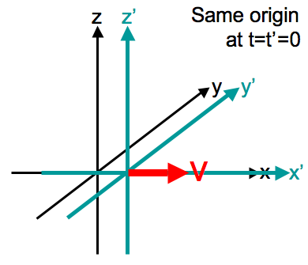
Center-of-Mass and Internal Motions : non-relativistic case
In non-relativistic systems, the COM motion is decoupled from the internal motion in the sense that the internal dynamics is independent of the COM momentum.
H = H_{com} + H_{int}
H_{int} is independent of P (COM momentum) and R (COM position)
Wave function of the H-atom is independent of its speed.
Galilei transformation

Slide 23
Center-of-Mass and Internal Motions : Relativistic case
In relativistic theory, the internal dynamics DOES depend on the total momentum of the system.
The internal wave function of a system is frame-dependent.
Wave functions in the different frame is related by Lorentz boost
|p˃ = U(Λ(p)) |p=0>, Λ is related to the boost K_{i}
Bound state properties do depend on the COM momentum p.

Slide 24
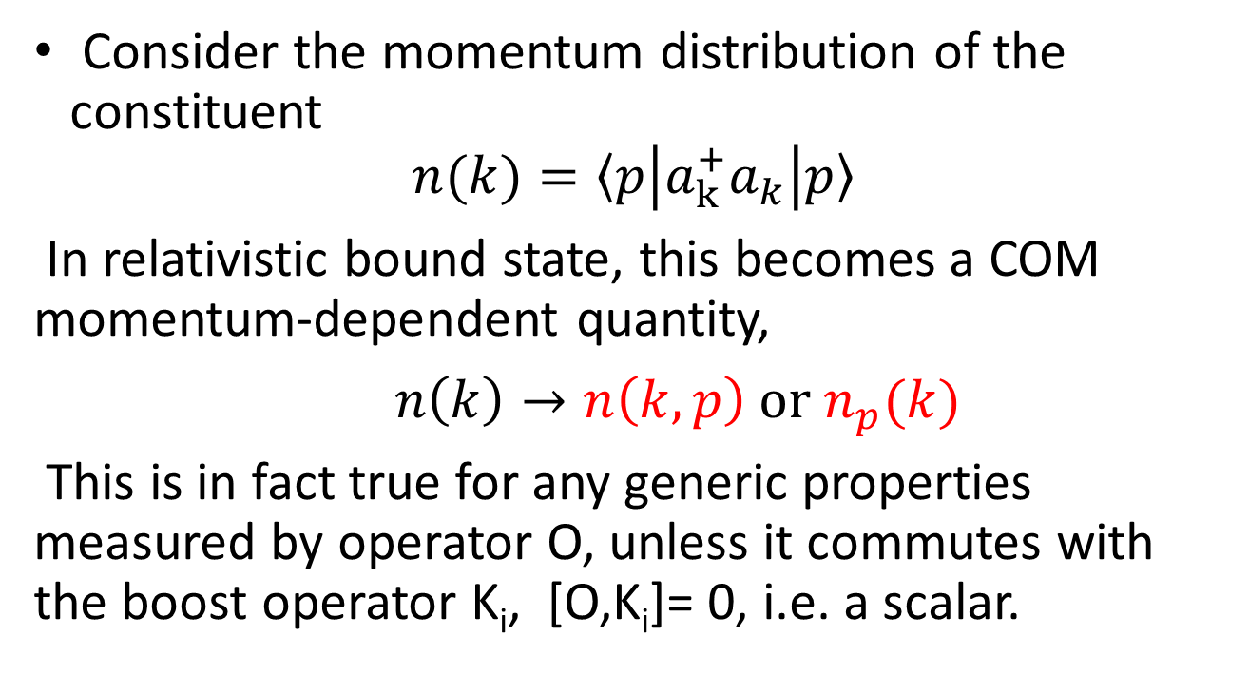
Momentum distribution of constituents
Consider the momentum distribution of the constituent
$$n(k)=〈p\left|a_{k}^{+}a_{k}\right|p〉$$
In relativistic bound state, this becomes a COM momentum-dependent quantity,
$n\left(k\right)→n\left(k,p\right) or n_{p}(k)$
This is in fact true for any generic properties measured by operator O, unless it commutes with the boost operator K_{i}, [O,K_{i}]= 0, i.e. a scalar.

Slide 25
Computing the momentum dependence
computing the momentum dependence of an observable O(p) is in principle possible through commutation relation,
[O, Ki] = ...
However, in relativistic theories, the boost operator K is highly non-trivial, it is interaction-dependent, just like the Hamiltonian.
Thus, computing the p-dependence of an observable is just as difficult as studying the dynamical evolution.

Slide 26
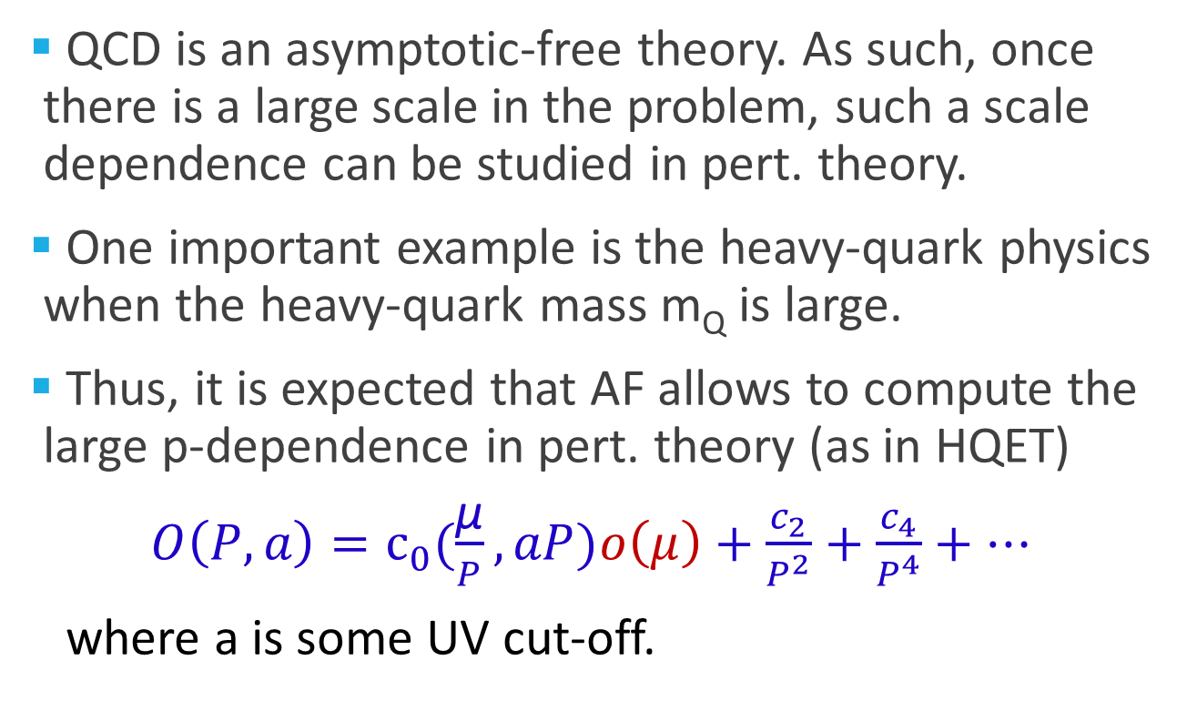
Asymptotic freedom (AF) and large momentum case
QCD is an asymptotic-free theory. As such, once there is a large scale in the problem, such a scale dependence can be studied in pert. theory.
One important example is the heavy-quark physics when the heavy-quark mass m_{Q} is large.
Thus, it is expected that AF allows to compute the large p-dependence in pert. theory (as in HQET)
$O\left(P,a\right)=c_{0}(\frac{\text{μ}}{P}, aP)o\left(μ\right)+\frac{c_{2}}{P^{2}}+\frac{c_{4}}{P^{4}}+…$
where a is some UV cut-off.

Slide 27
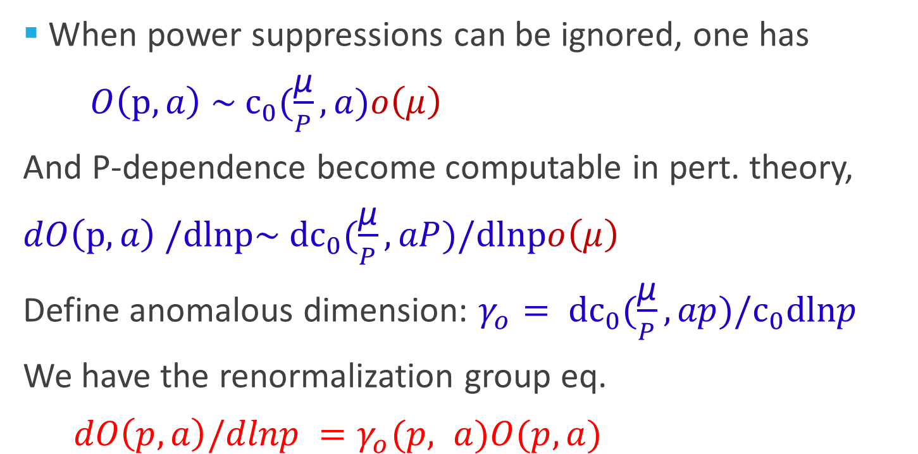
Renormalization group equation
When power suppressions can be ignored, one has
$O\left(p,a\right) \sim c_{0}(\frac{\text{μ}}{P}, a)o\left(μ\right)$
And P-dependence become computable in pert. theory,
$dO\left(p,a\right) /dlnp\sim dc_{0}(\frac{\text{μ}}{P}, aP)/dlnpo\left(μ\right)$
Define anomalous dimension: $γ_{o}= dc_{0}(\frac{\text{μ}}{P}, ap)/c_{0}dlnp$
We have the renormalization group eq.
$dO\left(p,a\right)/dlnp =γ_{o}(p, a)O(p, a)$

Slide 28
Fixed point and parton physics
The RG equation has a fixed point at P=∞
This is the infinite momentum limit in which the partons were first introduced by Feynman. Thus the parton physics corresponds to frame-dependent physical obervables at the fixed point of the frame transformations.
In principle, there is nothing new here. However, as far as I know, this is the first time when this notation has been expressed in QCD equations. More importantly, this teaches one how to calculate the parton physics in QCD！

Slide 29
Parton physics: a unique way to describe the hadron structure
The hadron structure is better represented by partons: parton amplitudes, parton correlations, parton distributions, etc
The great advantage is that partons separate the structure of hadrons from that of the vacuum in which all partons have + momentum zero.
All high-energy scattering data can be used to learn about parton physics

Slide 30
Large-momentum effective theory
X. Ji, Phys. Rev. Lett., 110 (2013) 262002
X. Ji, Sci.China Phys.Mech.Astron. 57 (2014) 1407-1412

Slide 31
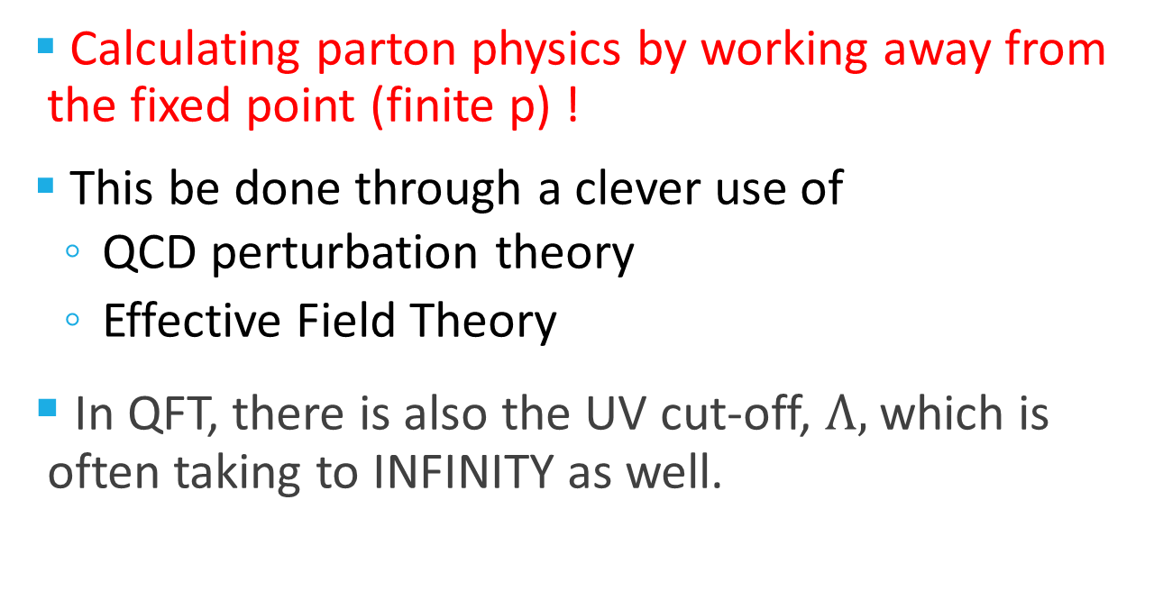
Main goal
Calculating parton physics by working away from the fixed point (finite p) !
This be done through a clever use of
  QCD perturbation theory
  Effective Field Theory
In QFT, there is also the UV cut-off, $Λ,$ which is often taking to INFINITY as well.

Slide 32
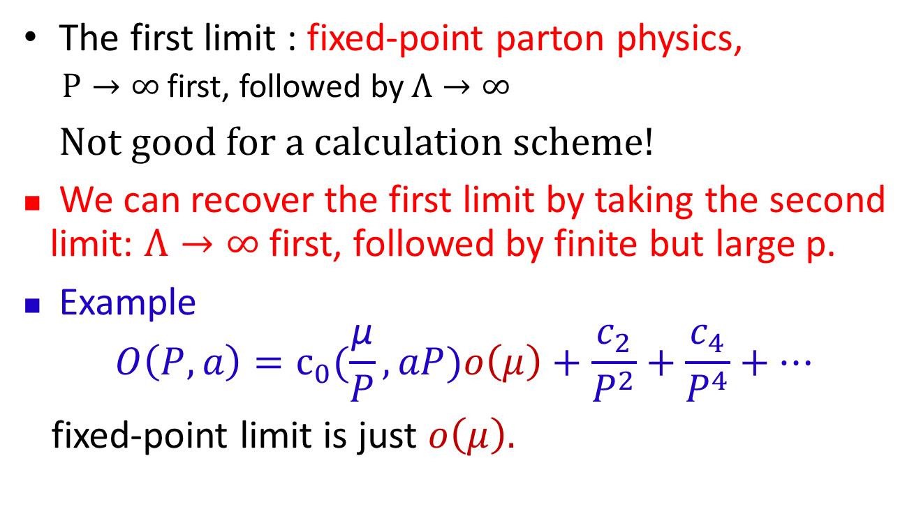
Two different limits
The first limit : fixed-point parton physics,
  $P→∞$first, followed by $Λ→∞$
Not good for a calculation scheme!
We can recover the first limit by taking the second limit: $Λ→∞$first, followed by finite but large p.
Example
$$O\left(P,a\right)=c_{0}(\frac{\text{μ}}{P}, aP)o\left(μ\right)+\frac{c_{2}}{P^{2}}+\frac{c_{4}}{P^{4}}+…$$
fixed-point limit is just $o\left(μ\right).$

Slide 33
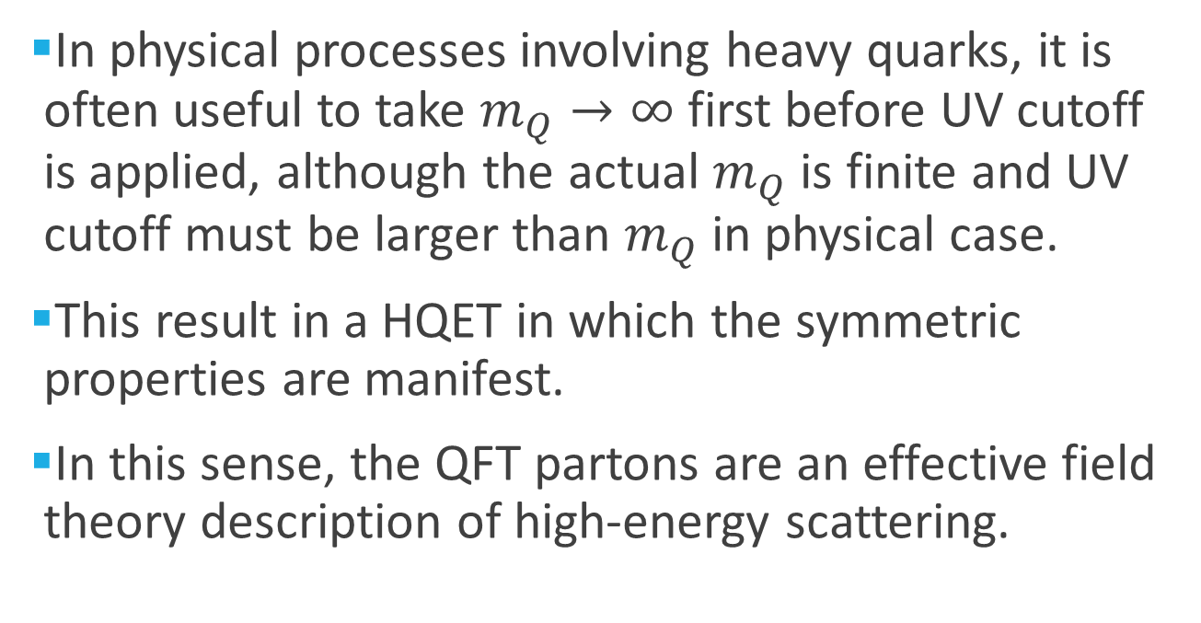
Analogy with HQET
In physical processes involving heavy quarks, it is often useful to take $m_{Q}→∞$ first before UV cutoff is applied, although the actual $m_{Q}$ is finite and UV cutoff must be larger than $m_{Q}$ in physical case.
This result in a HQET in which the symmetric properties are manifest.
In this sense, the QFT partons are an effective field theory description of high-energy scattering.

Slide 34
A Euclidean quasi-distribution
Consider space correlation in a large momentum P in the z-direction.
  Quark fields separated along the z-direction
  The gauge-link along the z-direction
  The matrix element depends on the momentum P.
𝜉⁰
⁰
^{Z}
𝜉³

Slide 35
The second limit
In taking the second limit, the Q-PDFs will have log dependence on the momentum of the nucleon.
Meanwhile, the parton density has support outside of 0<x<1.
However, it is closer to the physical reality because in high-energy scattering, the hadron does have FINITE momentum.

Slide 36
Taking the limit P-> ∞ first
After renormalizing all the UV divergences, one has the standard quark distribution!
  One can prove this using the standard OPE
  One can also see this by writing
  |P˃ = U(Λ(p)) |p=0>
  and applying the boost operator on the gauge link.
𝜉⁻
𝜉⁰
𝜉⁺
𝜉³

Slide 37
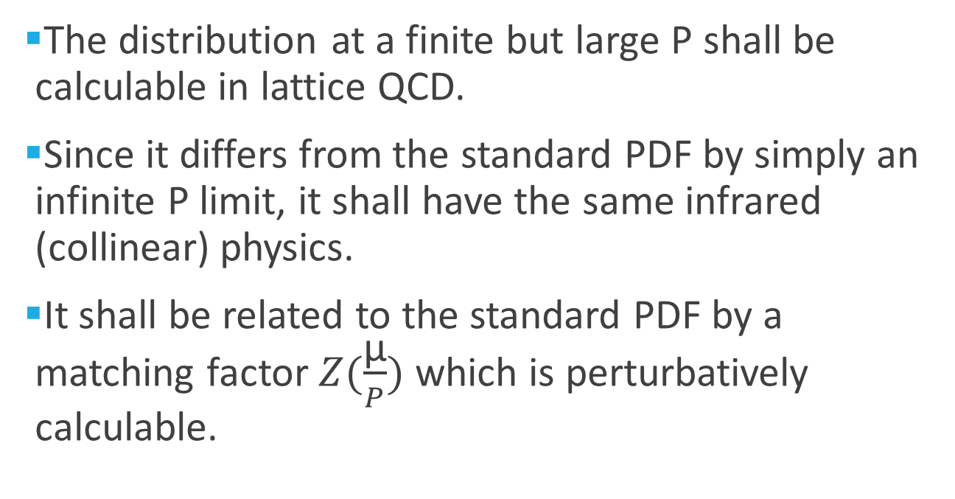
Finite but large P
The distribution at a finite but large P shall be calculable in lattice QCD.
Since it differs from the standard PDF by simply an infinite P limit, it shall have the same infrared (collinear) physics.
It shall be related to the standard PDF by a matching factor $Z(\frac{\text{μ}}{P})$ which is perturbatively calculable.

Slide 38
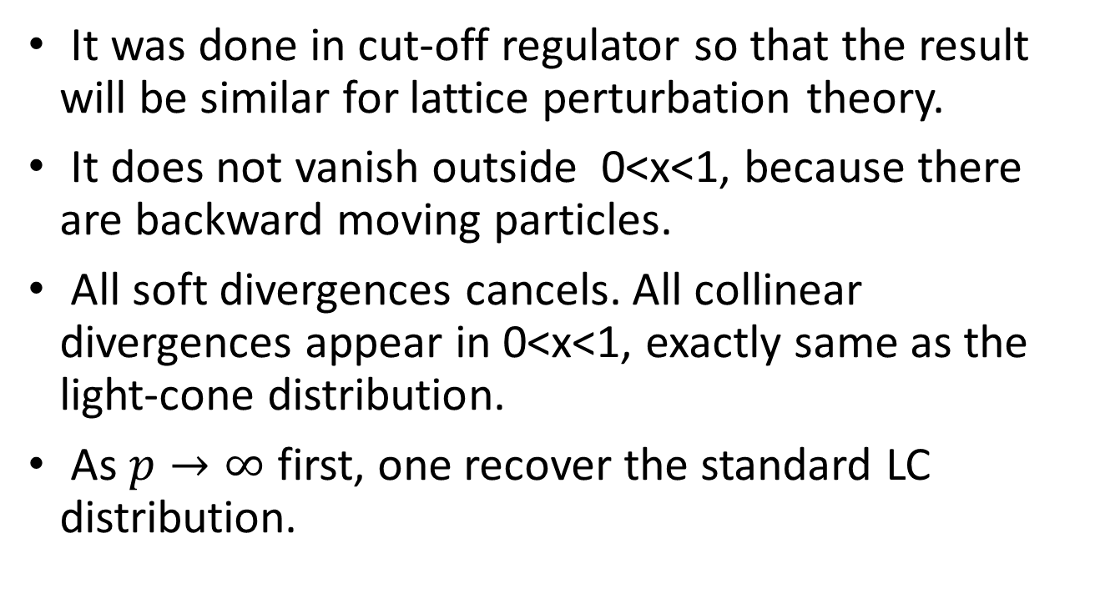
Properties
It was done in cut-off regulator so that the result will be similar for lattice perturbation theory.
It does not vanish outside 0<x<1, because there are backward moving particles.
All soft divergences cancels. All collinear divergences appear in 0<x<1, exactly same as the light-cone distribution.
As $p→∞$ first, one recover the standard LC distribution.

Slide 39

Factorization or matching at one-loop
Since the IR behavior of the quasi-distribution is the same as the LC one, one can write down easily a factorization to one-loop order.
Where the matching factor is perturbative.
Xiong, Ji, Zhang, Zhao, 2014

Slide 40
All order proof (Qiu and Ma)
Ma and Qiu, 2014, 2015
Consider A³= 0 gauge (no subtle spurious singularity in this case).
There are no soft-singularities in the quasi-distribution.
All collinear singularities are in ladder diagrams, happen when P large and gluons are collinear with the P. This singularity is the same as that of the light-distribution.

Slide 41
All-order renormalization and non-perturbative scheme
There has been a significant progress in understanding all order renormalization
and non-perturbative matching recently,
Ji, Zhang and Zhao, 2017;
Ishikawa, Ma, Qiu, Yoshida, 2016, 2017;
Green, Jansen and Steffens, 2017;
Constantinou and Panagopoulos, 2017;
Stewart and Zhao, 2017;
A. Constantinou et al. (ETMC), 2017, 2018;
H.-W. Lin et al. (LP3), 2017, 2018;

Slide 42
General recipe
LaMET is a theory designed to make ab initio computation of light-cone (light-front, parton) physics on a Euclidean lattice!
The recipe:
  Deconstructing (unboosting) the light-cone operator
  Lattice computation with large momentum
  Effective field theory interpretation

Slide 43
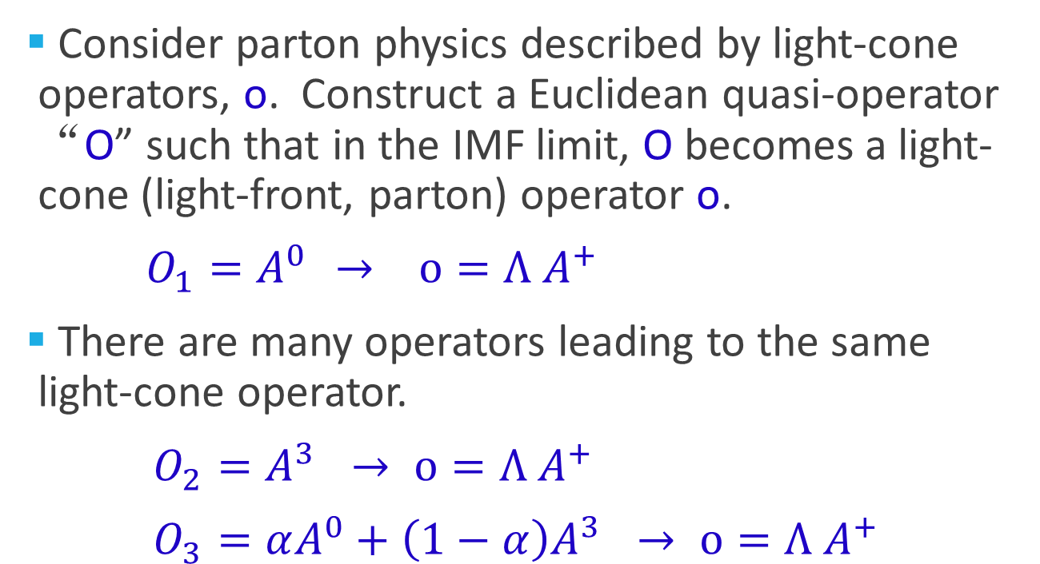
Step 1: Deconstructing the light-cone operators
Consider parton physics described by light-cone operators, o. Construct a Euclidean quasi-operator “O” such that in the IMF limit, O becomes a light-cone (light-front, parton) operator o.
${O_{1}=A}^{0 }→ o=Λ A^{+}$
There are many operators leading to the same light-cone operator.
${O_{2}=A}^{3 }→ o=Λ A^{+}$
${O_{3}=αA^{0}+\left(1−α\right)A}^{3 }→ o=Λ A^{+}$

Slide 44
Step 2: Lattice calculations
Compute the matrix element of Euclidean operator O on a lattice in a nucleon state with large momentum P.
The matrix element may depend on the momentum of the hadron P, O(P,a), and also on the details of the lattice actions (UV specifics).

Slide 45
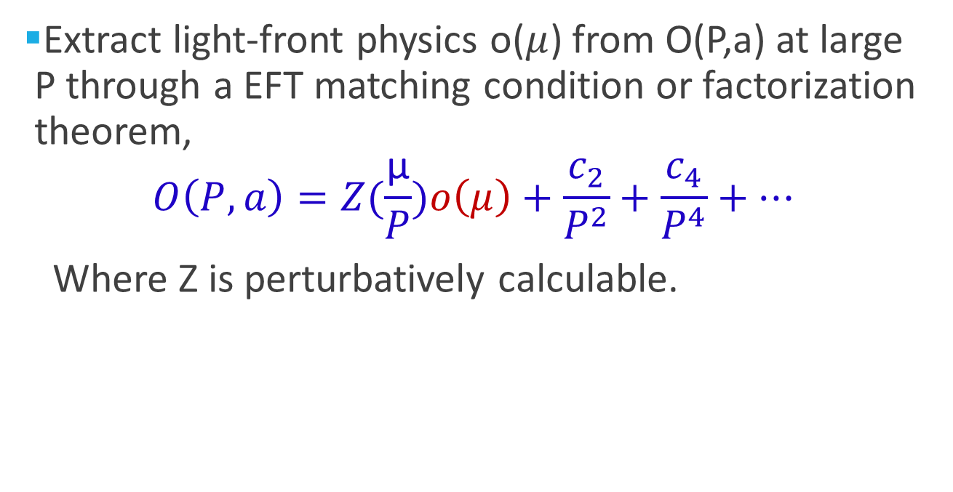
Step 3: Extracting the light-cone physics from the lattice ME
Extract light-front physics o($μ$) from O(P,a) at large P through a EFT matching condition or factorization theorem,
$$O\left(P,a\right)=Z(\frac{\text{μ}}{P})o\left(μ\right)+\frac{c_{2}}{P^{2}}+\frac{c_{4}}{P^{4}}+…$$
Where Z is perturbatively calculable.

Slide 46
Infrared factorization
Infrared physics of O(P,a) is entirely captured by the parton physics o(µ). In particular, it contains all the collinear divergence when P gets large.
Z contains all the lattice artifact (scheme dependence), but only depends on the UV physics, can be calculated in perturbation theory

Slide 47
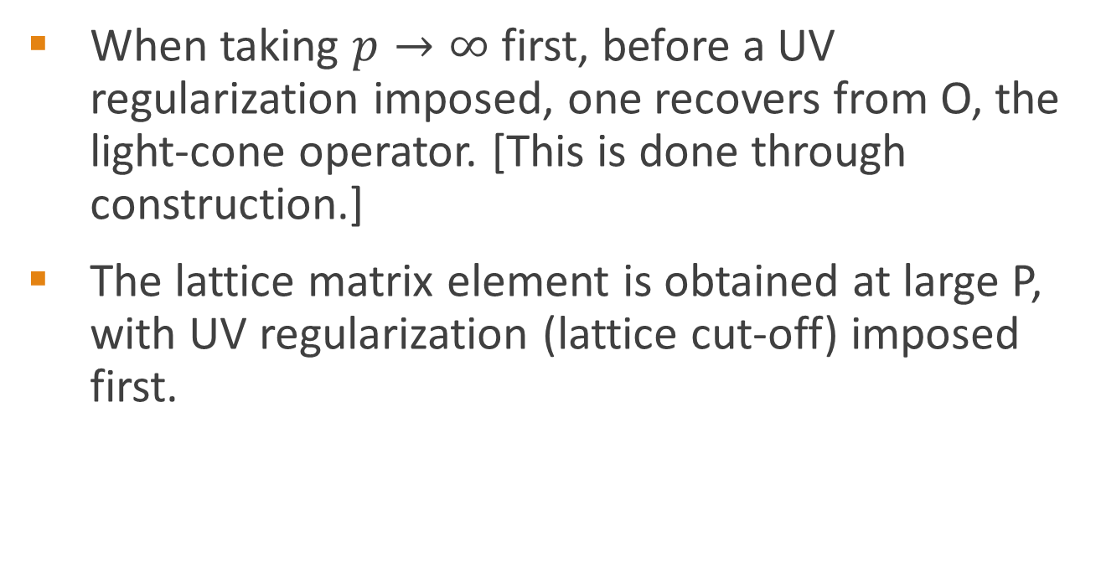
Why factorization exists?
When taking $p→∞$ first, before a UV regularization imposed, one recovers from O, the light-cone operator. [This is done through construction.]
The lattice matrix element is obtained at large P, with UV regularization (lattice cut-off) imposed first.

Slide 48
Universality class
Hatta, Ji, Zhao, 2014
Just like the same parton distribution can be extracted from different hard scattering processes, the same light-cone physics can be extracted from different lattice operators.
All operators that yield the same light-cone physics form a universality class.
Universality class allows one exploring different operator O so that a result at finite P can be as close to that at large P as possible.

Slide 49
Examples and remarks

Slide 50
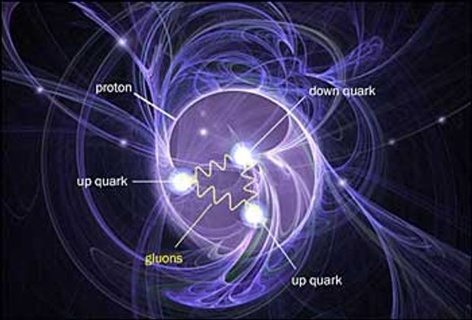
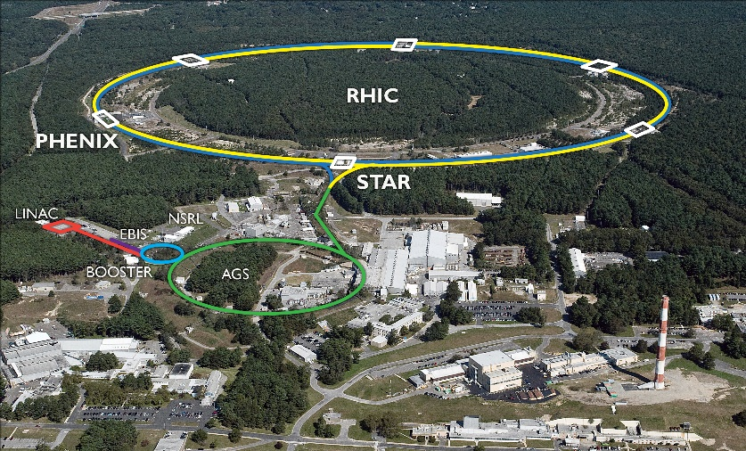
Gluon polarization
Believed to contribute significantly to the proton spin.
Measurable in polarized PP collision at RHIC (a physical observable)
However, there is no gauge-invariant local operator corresponds to this quantity. (nature of gauge theory!)

Slide 51
QCD factorization
In QCD factorization, one can show that the gluon polarization is a matrix element of non-local light-cone correlations.
No one knows how to calculate this for nearly 30 years!

Slide 52
LaMET calculations (Ji,Zhang,Zhao, PRL (2013))
In LaMET theory, one can start with the local operator in a physical gauge in the sense that the gauge condition shall allow transverse polarized gluons:
  Coulomb gauge
  Axial guage Az=0
  Temporal gauge A0 =0
Their matrix elements in the large momentum limit all go to ΔG.
Hatta, Ji, Zhao, 2014

Slide 53
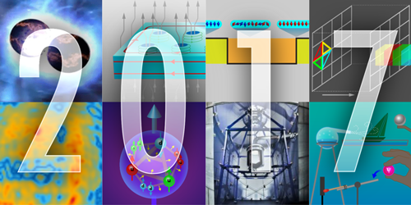
First calculation (Yang et al, PRL (2017))
Gluons Provide Half of the Proton’s Spin
The gluons that bind quarks together in nucleons provide a considerable chunk of the proton’s total spin. That was the conclusion reached by Yi-Bo Yang from the University of Kentucky, Lexington, and colleagues (see Viewpoint: Spinning Gluons in the Proton). By running state-of-the-art computer simulations of quark-gluon dynamics on a so-called spacetime lattice, the researchers found that 50% of the proton’s spin comes from its gluons. The result is in agreement with recent experiments and shows how such lattice simulations can now accurately predict an increasing number of particle properties. The simulations also indicate that, despite being substantial, the gluon spin contribution is too small to play a major part in “screening” the quark spin contribution—which according to experiments is only 30%—through a quantum effect called the axial anomaly. The remaining 20% of the proton spin is thought to come from the orbital angular momentum of quarks and gluons.

Slide 54
Quark distributions
For isospin non-singlet distributions, calculations are easier on lattice.
One can calculate the quasi-distributions and match to light-cone ones
Several groups:
  LP3 collaboration, H.W. Lin et al,
  ETMC collaboration, DESY et al group
  Regensburg
  …

Slide 56
C. Alexandrou et al., 2018

Slide 57
LP3 collaboration
J. W. Chen et al (LP3), 2018

Slide 58
Parton physics of nucleon and nuclei, from EIC
Light-cone wave function, ψ_{n}(x_{i}, k_{⊥i})
Distributions amplitudes, ψ_{n}(x_{i})
Parton distributions, f(x)
Transverse momentum dependent (TMD) parton distributions, f(x, k⊥)
Generalized parton distributions, F(x,𝜉,r⊥)
Wigner distributions, W(x, k⊥, r⊥)
Parton fragmentation functions…

Slide 59
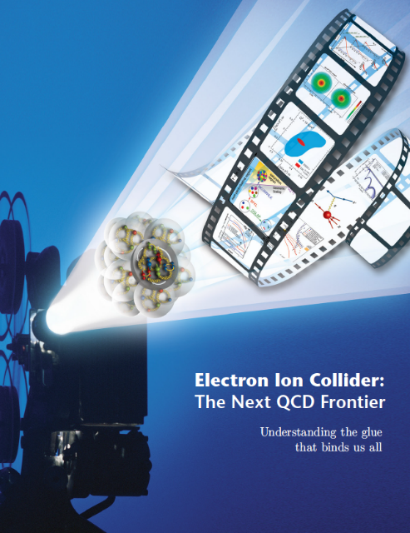
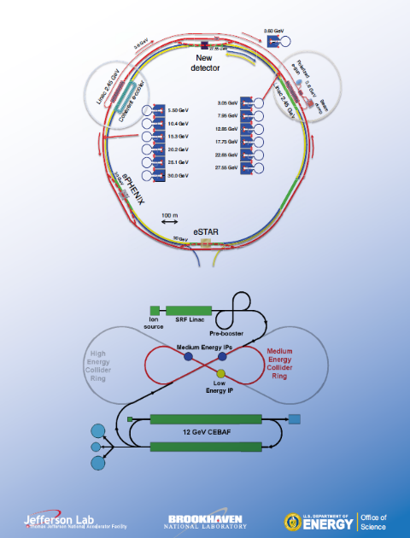
White Paper for the Electron-Ion Collider
December 2012
eRHIC (BNL)
ELIC (JLab)
Ed. A. Deshpande, Z.-E. Meziani, J. Qiu
arXiv:1212.1701

Slide 60
Conclusions: A lot to be done!
Right lattice configurations
Control of systematic errors
Transverse-momentum dependent distributions
Light-cone wave functions
Direct comparison of EIC data with lattice calculations without sum rules!

