Slide 1
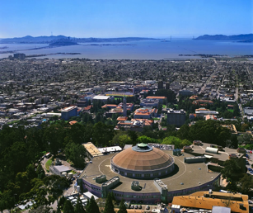
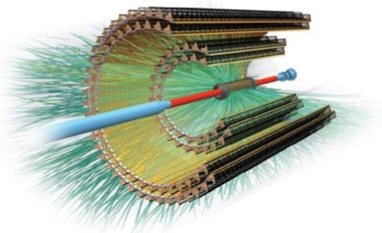
ALICE ITS Upgrade
Stefania Beolè
Università degli Studi di Torino & INFN
on behalf of the ALICE collaboration
HFWorkshop2017

Slide 2
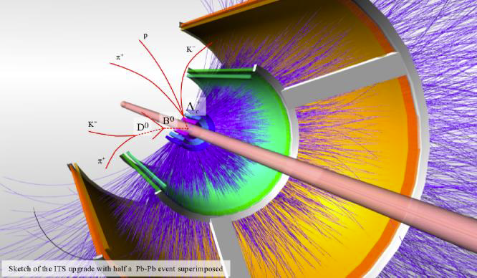
Motivation and choice of technology
Detector final layout
Selected topics from R&D and production strategy
First results from prototypes
Construction and integration schedule
Conclusions

Slide 3

Goals of the ALICE Upgrade
Physics Goal ➔high-precision measurements of QGP properties
  Open HF ( charm & beauty, mesons & baryons ), Quarkonia down to zero p_{T}
    thermalisation, hadronization, recombination, temperature evolution of the QGP
  Vector mesons and low-mass di-leptons
    chiral symmetry restoration, virtual thermal photons
  High-precision measurement of light (anti-)nuclei and hyper-nuclei
    nucleo synthesis, exotics
ALICE upgrade LoI:
March 2013

Slide 4

Main requirements for the new ITS
Main requirements for the new Inner Tracking System:
  High tracking efficiency and resolution at low p_{T} (60% @ 100 MeV/c)
    Increase granularity, reduce material thickness
  Excellent secondary vertex resolution (Λ_{c} : cτ~60 μm)
    Move closer to Interaction Point (IP), new beam pipe, smaller diameter
  High-statistics, un-triggered data sample ( >10 nb⁻¹ Pb-Pb)
    Increase readout rate, reduce data size (online data reduction)
ITS upgrade TDR:
March 2014

Slide 5
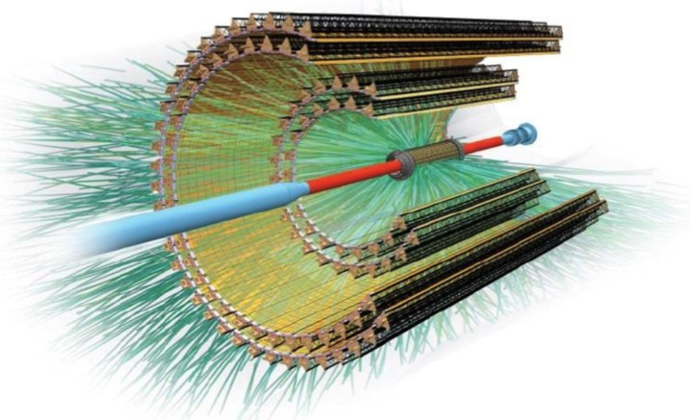
ITS Upgrade Design Objectives
Improve impact parameter resolution:
by a factor ~3 in rφ and ~5 in z at p_{T}=500MeV/c
get closer to IP: 39mm ➔ 23mm (innermost layer)
reduce material budget: ~1.14% X₀ ➔ ~0.3% X₀
(inner layers)
reduce pixel size: 50x425μm² ➔ O(30x30μm²)
Spatial resolution: currently 12 μm x 100 μm (SPD) 5 μm x 5 μm
Improve tracking efficiency and p_{T} resolution at low p_{T}
increase granularity: 6 layers ➔ 7 pixel layers
Withstand radiation load (10 years operation):
TID: ~ 270 krad, NIEL: ~1.7x10¹² 1MeV n_{eq}/ cm²
Fast insertion and removal
possibility to replace non-functioning detector staves during yearly shutdown
Exploit LHC luminosity increase ➔Fast readout
readout of Pb-Pb at up to 100 kHz (presently 1kHz) and 200kHz for pp

Slide 6
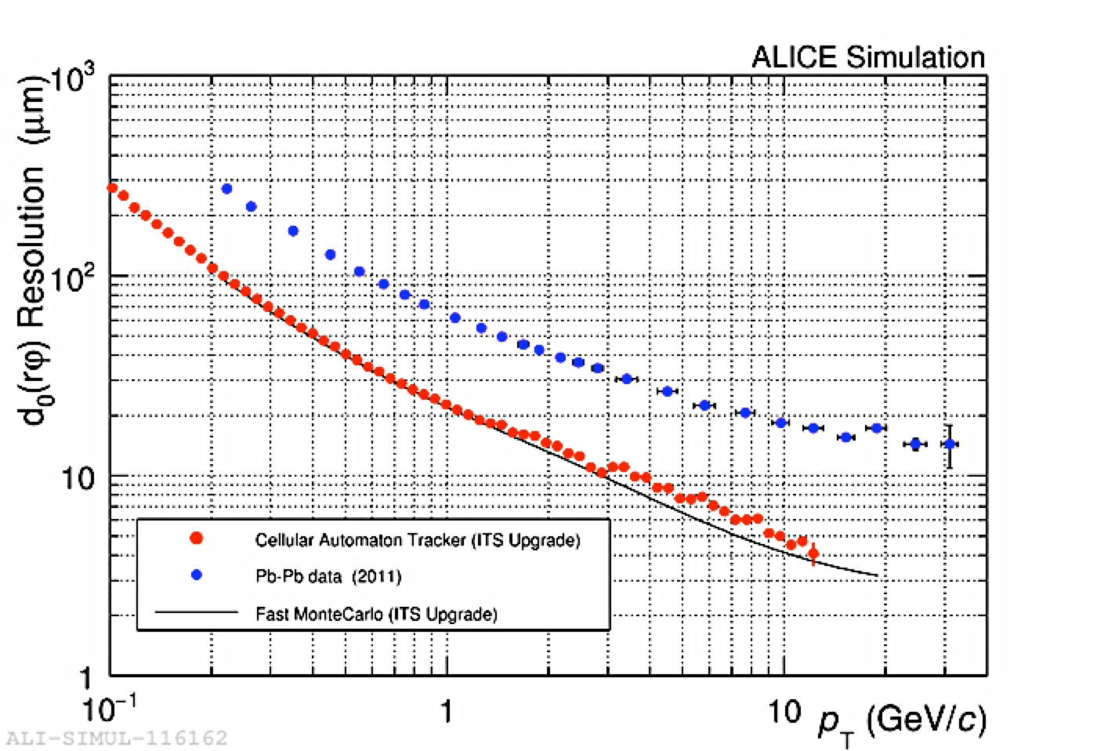
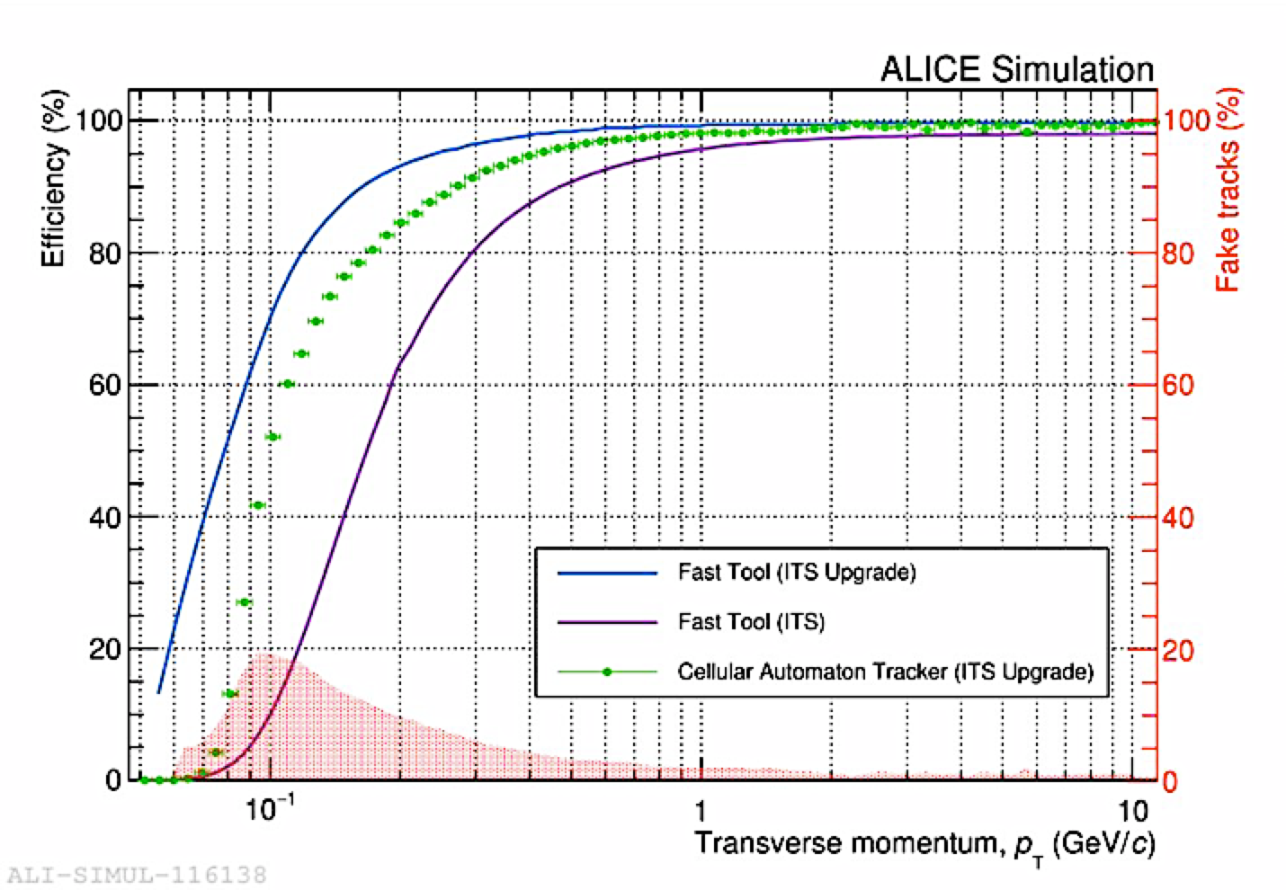
Performance of new ITS (MC simulations)
Cellular Automaton Tracker
Impact parameter resolution
Tracking efficiency (ITS standalone)
40 μm at p_{T}= 500 MeV/c
~60% at p_{T}= 100 MeV/c

Slide 7
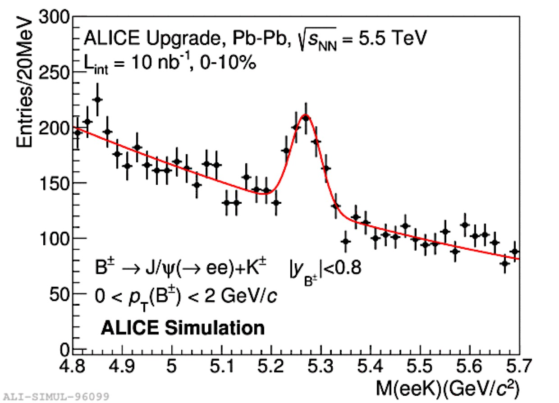
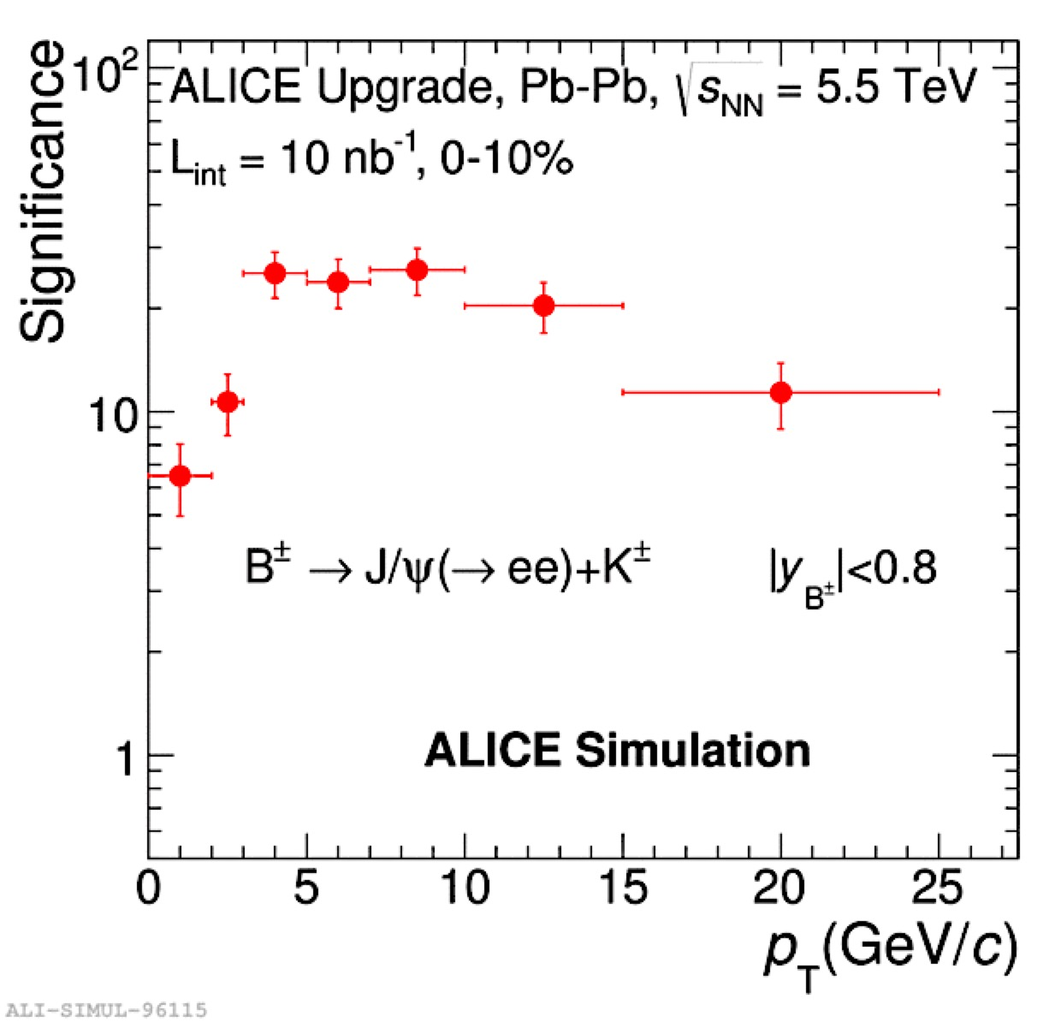
Physics performance with the new ITS (MonteCarlo)
B± not accessible with the present ITS
clean signal
at low p_{T}
Measure energy loss for b,
quantitative verification of ΔE_{c}>ΔE_{b}vs.p_{T}

Slide 8
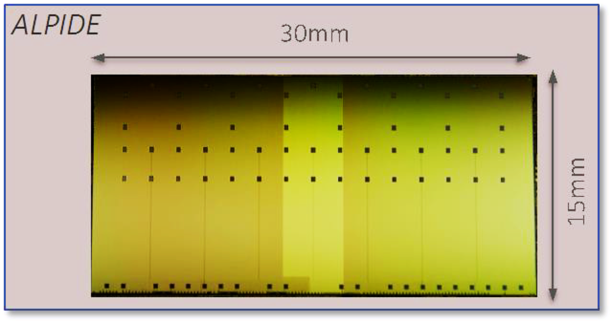
ALPIDE – Monolithic Pixel Detector
Key Features
In-pixel:
  amplification
  discrimination
  multi event buffer
In-matrix zero suppression
(priority encoding)
Ultra-low power (entire chip):
< 40mW/cm² (140mW full chip)
triggered acquisition (200 kHz Pb-Pb, 1 MHz pp) or continuous (integration time 1μs-> ∞)
High speed serial data output (HSO)
  OB: 400 Mbit/s
  IB: 600 Mbit/s or 1.2 Gbit/s
Inner Barrel:
50 μm thick
Outer Barrel:
100 μm thick
Pad-over-matrix
active area
periphery
Pixel size: 29x27μm²

Slide 9
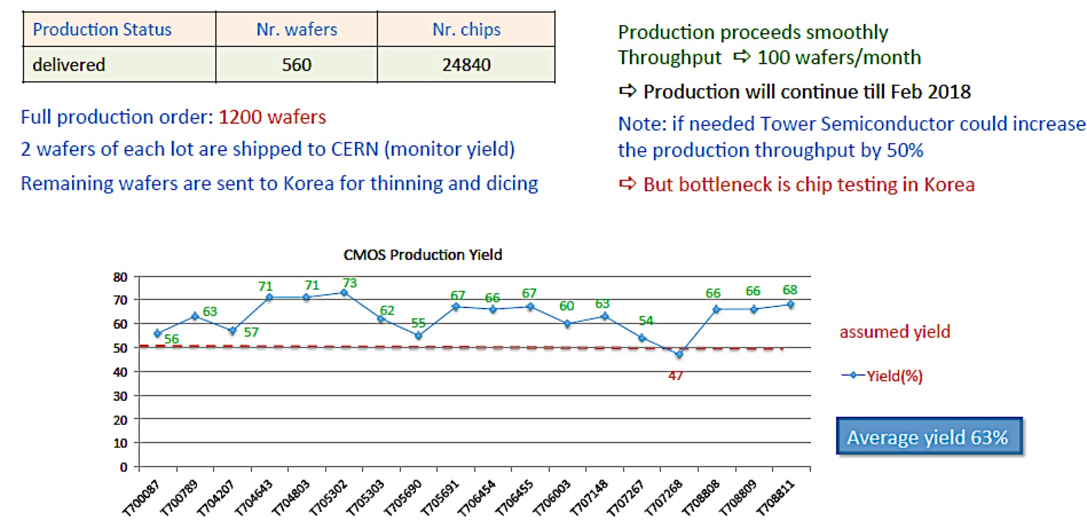
ALPIDE: series production

Slide 10
ALPIDE – Detection Efficiency and Fake-Hit Rate
Big operational margin with only 10 masked pixels (0.002%)
Chip-to-chip fluctuations negligible
Non-irradiated and NIEL/TID chips show similar performance
Sufficient operational margin after 10x lifetime NIEL dose
NIEL/TID
V_{BB}=-3V
non-irradiated
10x lifetime NIEL

Slide 11
ALPIDE – Resolution and cluster size
Chip-to-chip fluctuations negligible
Non-irradiated and TID/NIEL chips show similar performance
Resolution of about 5µm at a threshold of 200 electrons
Sufficient operational margin even after 10x lifetime NIEL dose
V_{BB}=-3V
5μm

Slide 12
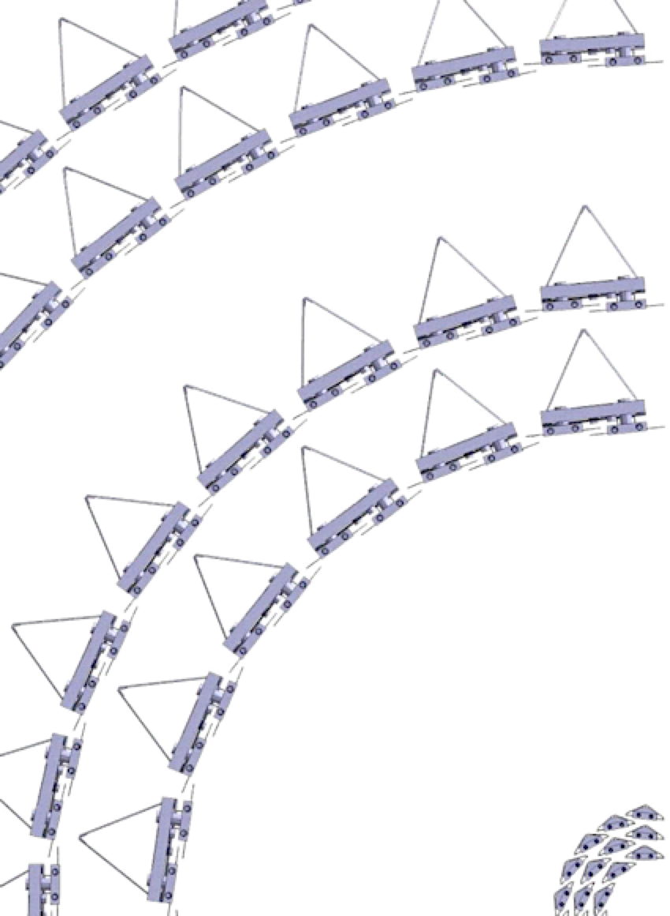
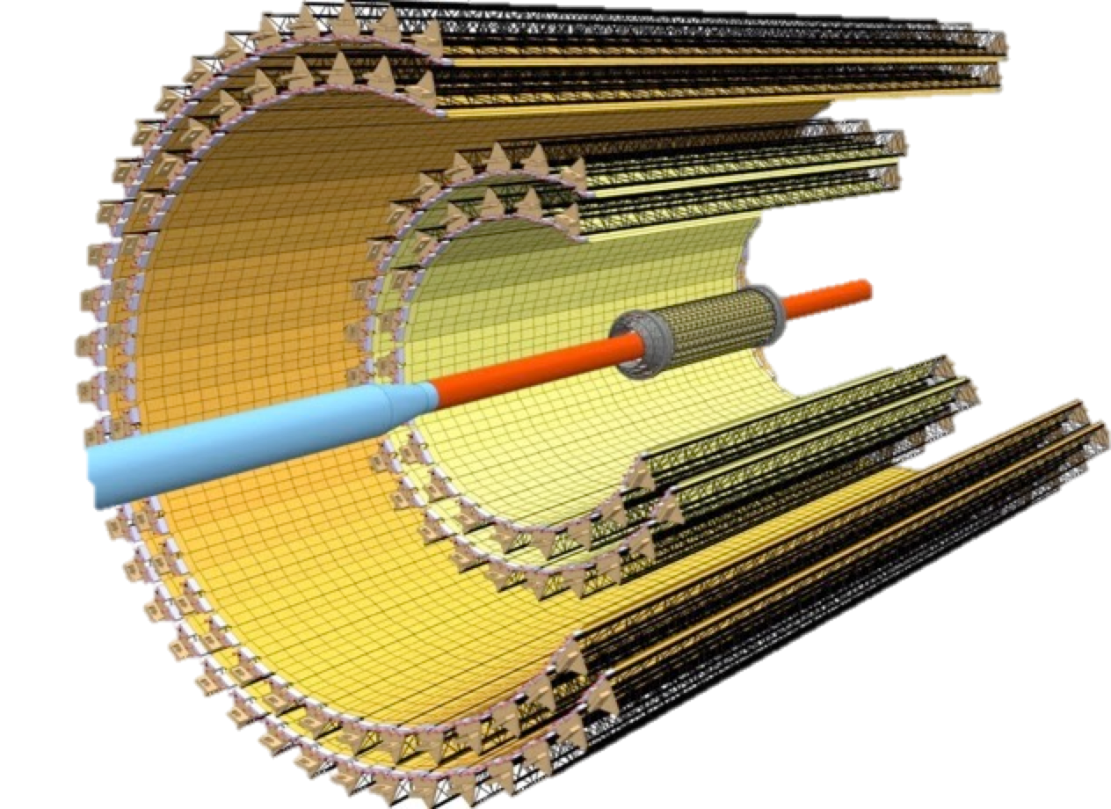

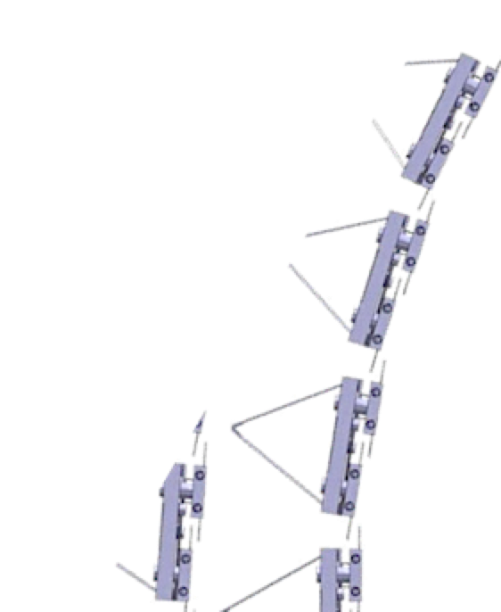
Layout of the new ITS
The ITS is constituted by
  7 layers; 3 (IL), 2 (ML), 2(OL)
  192 staves; 48 (IL), 54 (ML), 90 (OL)
Layer #
6
5
4
3
2
1
0
n. of Staves
48
42
30
24
20
16
12

Slide 13
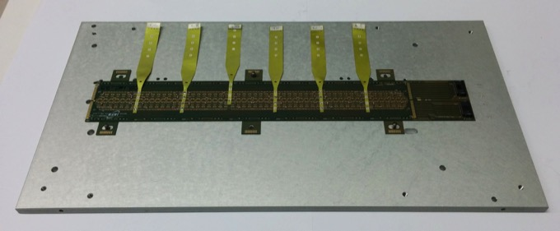
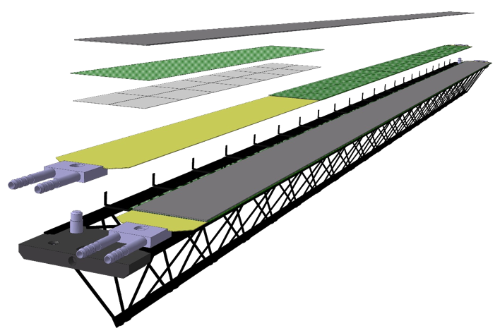
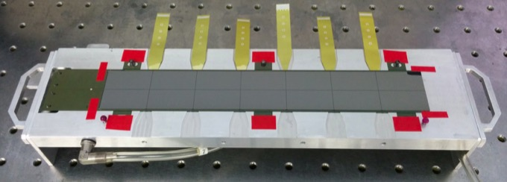
Detector HICs and staves– Outer Barrel
STAVE: HIC glued to the IB space frame & cold plate, such to provide HIC support, alignment, and thermal contact to the cold plate
HIC: Hybrid Integrated Circuit
HALF STAVE
POWER BUS
HIC
FPC
HIC: FPC SIDE
14 SENSORS
COLD
PLATE
SPACE FRAME
HIC: SENSOR SIDE

Slide 14
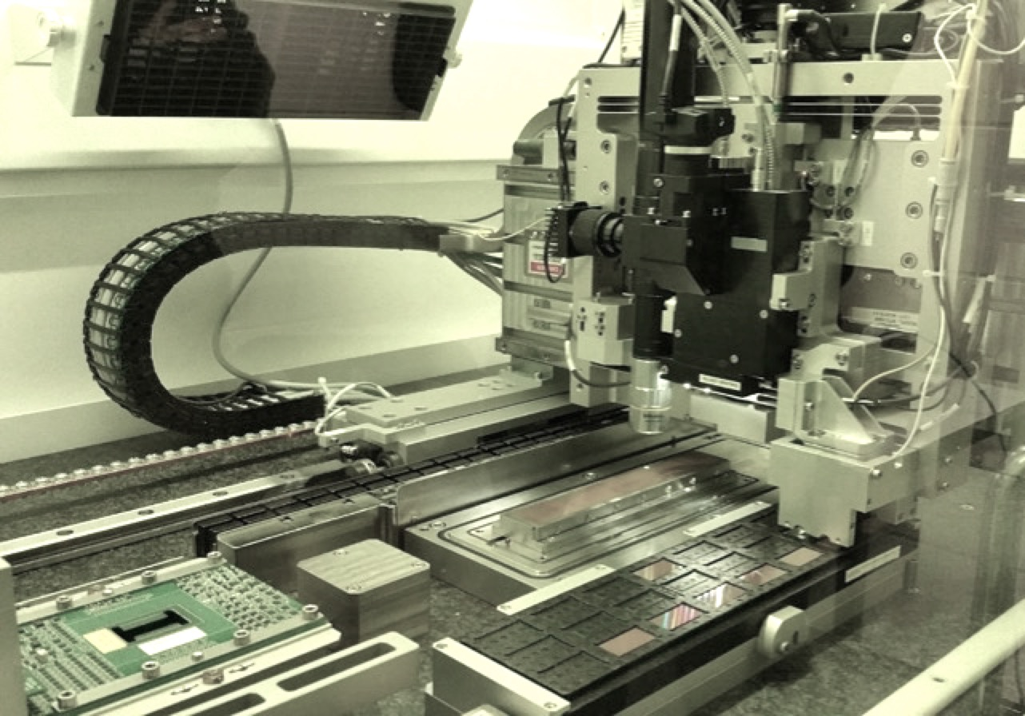
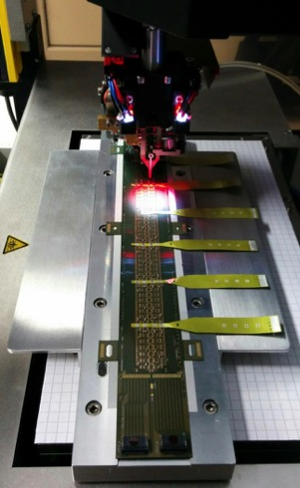
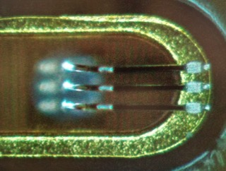
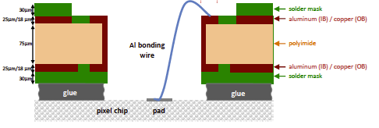
HIC Assembly (IB & OB)
Automated module assembly
(custom-made machine)
Electrical interconnection
(wire bonding)
Wire bond: chip (pad over logic) to FPC
Probe card
Chip tray
Assembly table

Slide 15
HIC: preparation for production
After HIC Production Readiness Review (April 2017)
IB HICs pre-production
  >30 functional HICs and 10 functional stave (overall yield = 90%)
OB HICs pre-production
  >50 functional HICs (overall yield ~ 90%)
Optimization of layouts and procedures:
  OB FPC layout: minor changes
    new design will allow for separation of analog and digital GND planes
    first production lot delivered end of October
  Chip to FPC gluing procedure
    optimization of the layout of the glue deposition mask
    change of glue (ABLESTIK45 -> ARALDITE 2011)
      Ablestik didn’t pass aging tests
      ARALDITE extensively used by ATLAS and CMS

Slide 16
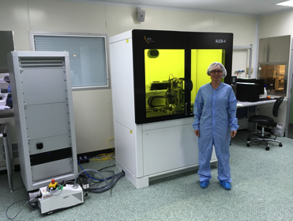
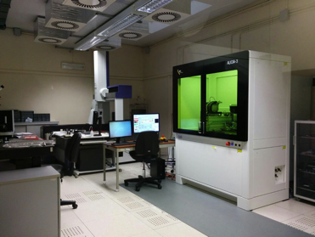
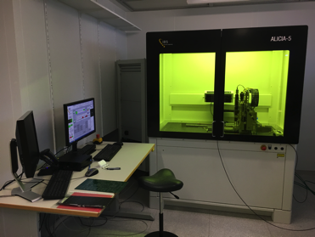
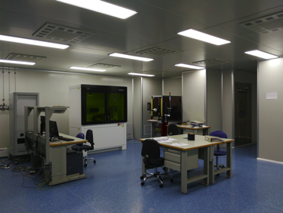
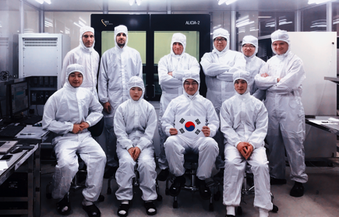
Outer Barrel (ML and OL) HICs production
Production takes place in 5 sites: Bari, Liverpool, Strasbourg, Pusan/Inha, Wuhan
Infrastructures are ready and final tooling is available in each site
BARI
LIVERPOOL
STRASBOURG
WUHAN
PUSAN/INHA
PRODUCTION STARTED IN OCTOBER 2017 AND WILL CONTINUE TILL AUG/SEP 2018

Slide 17
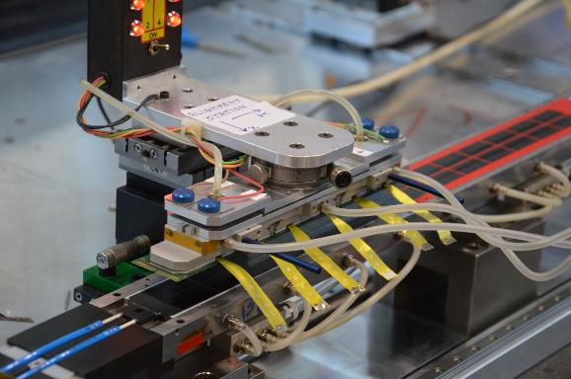
OB STAVE assembly: HIC alignment
HICs are placed on a carbon fiber cold plate which includes kapton pipes for cooling purpose
Micrometric stages allow for HIC positioning precision within 10-20μm
The procedure makes use also of custom made tools machined with a precision of 100μm along 1.5m
All the production steps are surveyed by means of CMM machines

Slide 18
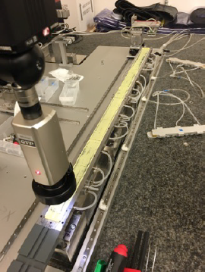
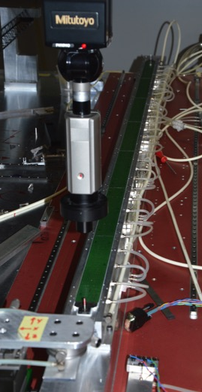
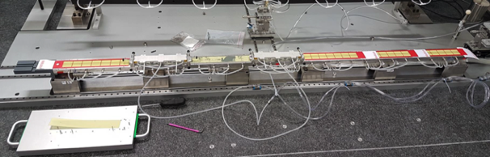
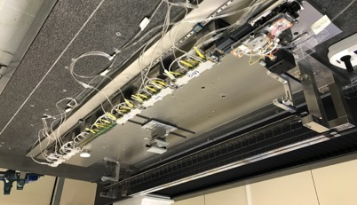
Outer Barrel Stave Production
Pre-series production allowed to validate the Assembly procedure: 2 dummy and 2 functional staves produced
All production sites ready to start stave assembly by Dec 2017
  Daresbury, LBL, LNF, NIKHEF, Torino
TORINO
NIKHEF
LNF
LBNL
Daresbury

Slide 19
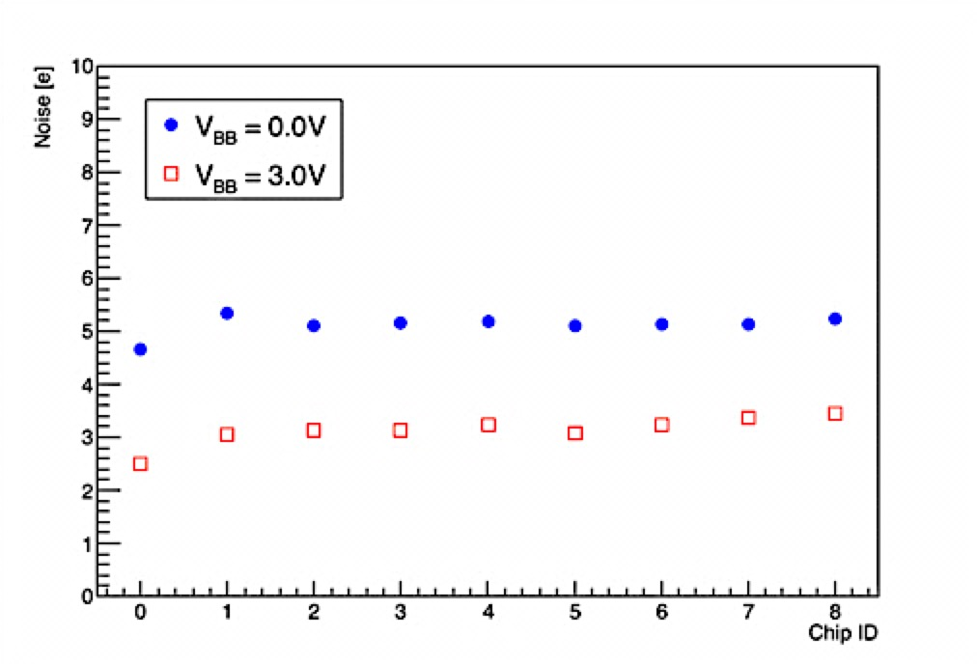
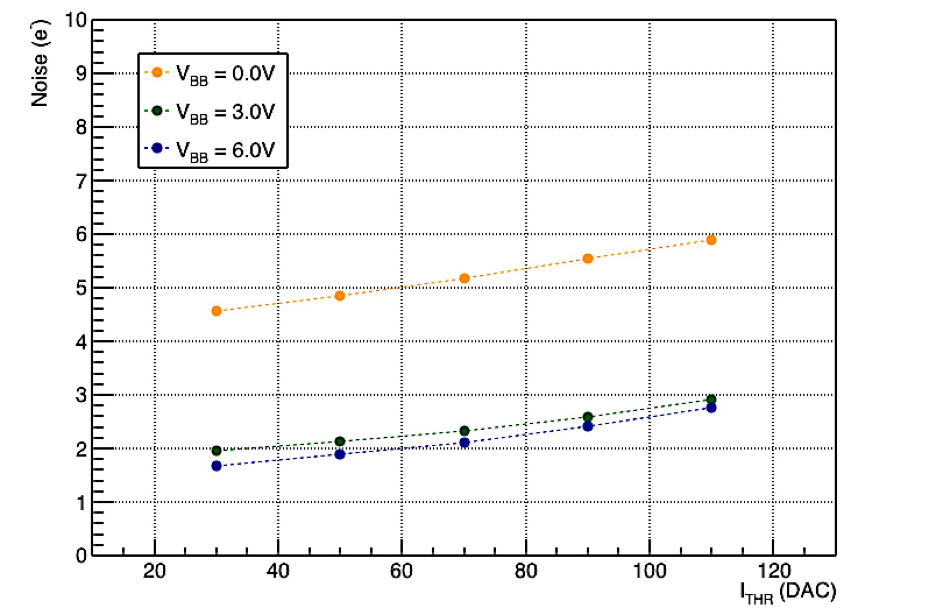
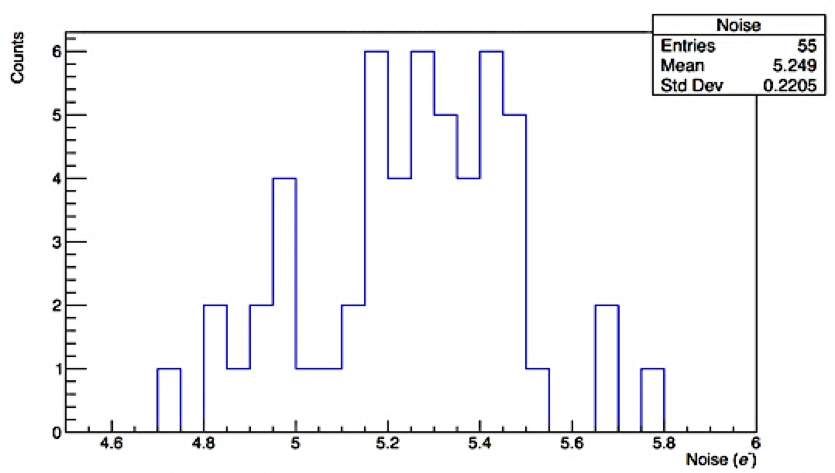
Test Results: HICs noise
Noise extracted from threshold scan (s-curve fit) for IB HICs:
Measured noise values ~5e⁻ without back bias, ~3e⁻ with 3V back bias
Noise independent on position of chip on HIC
Noise values in good agreement with values measured on single chip
From ALPIDE PRR (for comparison):
Noise of single ALPIDE chips
as a function of ITHR
Noise homogeneous over all tested HICs
(here: average noise values for the chips of 6 HICs)
Avg. noise of chips on HIC
as a function of chip position

Slide 20
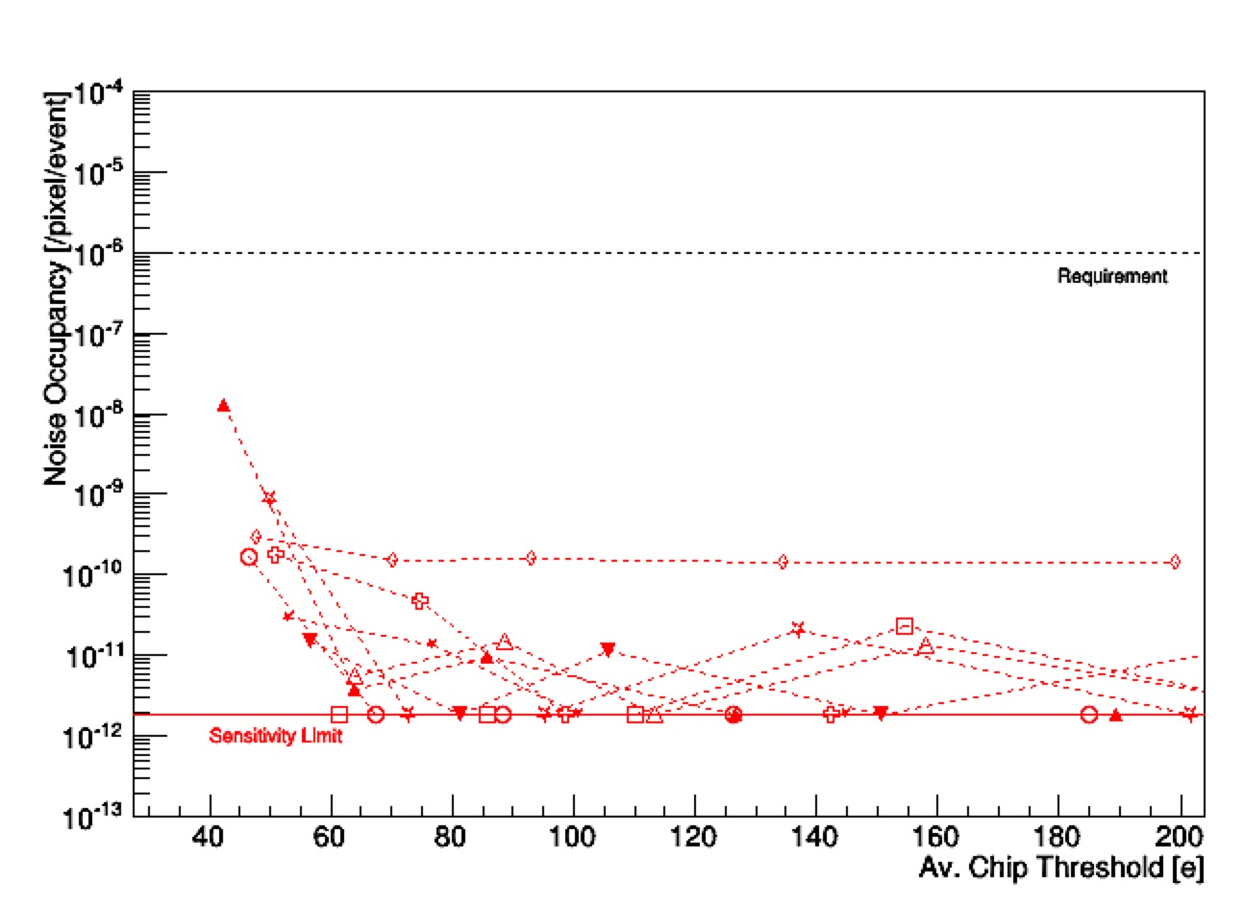
Test Results: IB HICs noise occupancy
Noise occupancy measured from data taking with random triggers:
with 5 pixels (i.e. 1/100000) masked as a function of threshold

Slide 21
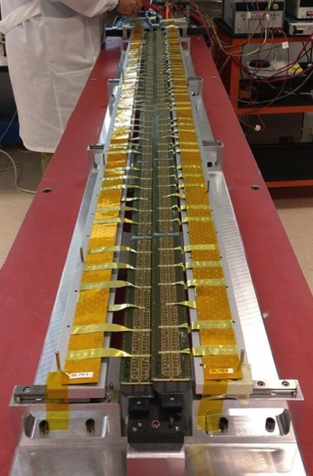
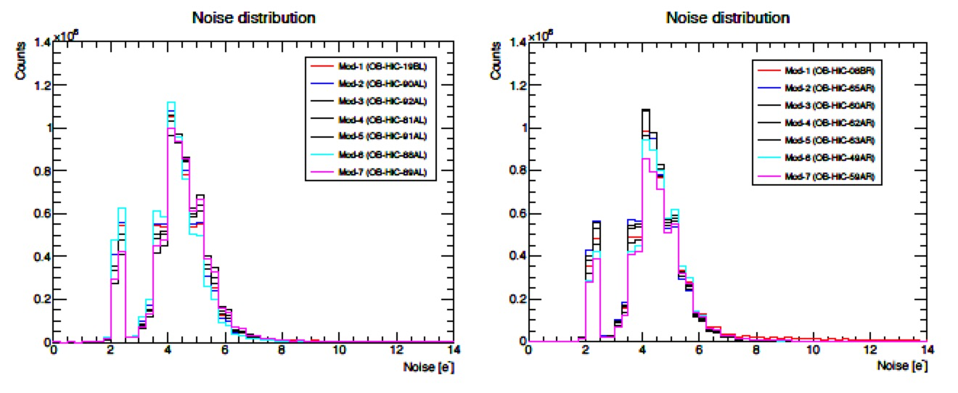
Test results: OB staves
Stave 1 tested in Torino:
  195/196 chips responding (102M pixels !!)
    1chip had few wire bonds damaged during assembly
    issue understood and new procedure developed
  results of tests, though preliminary, are very encouraging:
    noise distribution measured in threshold scan on all 195 chips operated concurrently
    Threshold scan tests both readout and analogue performance
    Noise and threshold values are comparable to single chip ones
NOISE~5e⁻
NOISE~5e⁻
preliminary
preliminary
HS1_L
V_{BB}=0V
HS1_R
V_{BB}=0V

Slide 22
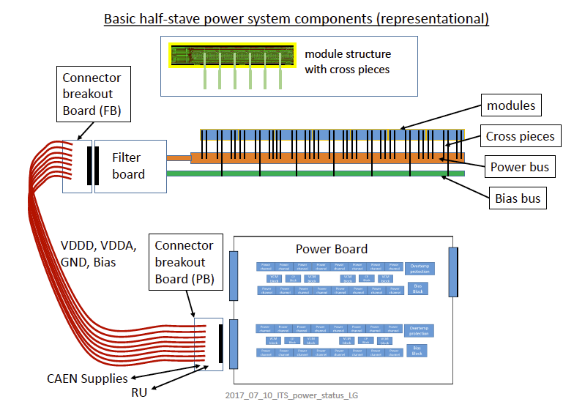

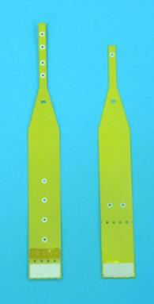
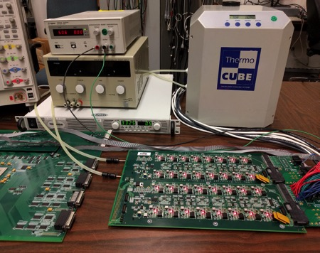
Powering system
POWER BUS – BIAS BUS
CROSS
CABLES
Development of the full chain required 2 years of R&D
Prototype version of Power Boards tested on HICs and Staves
Testing power board kits already shipped to all the HIC/STAVE production sites (Bari, CERN, Strasbourg, Pusan, Liverpool, LNF, Torino, Nikhef, Daresbury)
2 power board prototypes will be used for full board radiation testing
POWER BOARD

Slide 23
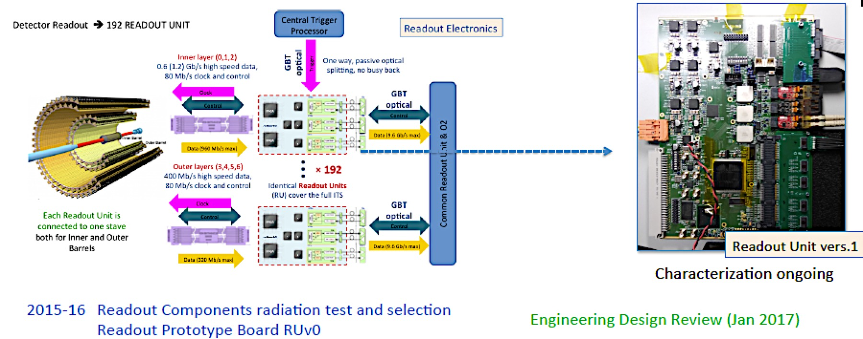
Read-out electronics

Slide 24
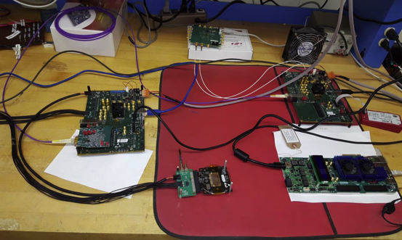
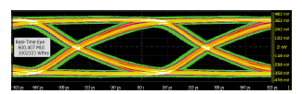
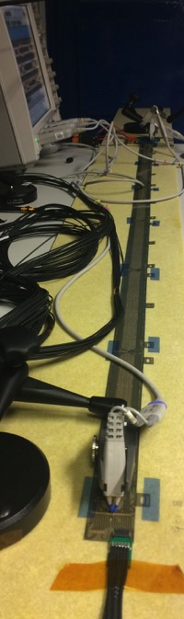
Read out electronics tests
single chip set-up
OB stave
set-up
ALPIDE will be the only electronics component around the interaction point, the off detector electronics will sit 5m away
RUv0
ALPIDE
EYE diagram of signal propagated over 5m-long cable
Communication between sensors (ALPIDE) and off-detector electronics via SAMTEC firefly cables
Distribution of CLK and slow-control at 40MHz
Data read-out:
  1.2 Gb/s (IB)
  0.4Gb/s (OB)
single chip (109 hours of integrity measurements)
  BER ≤ 9.8 10⁻¹⁵ with a Confidence Level (CL) of 99 %.
Inner Barrel Stave prototypes (250 h)
  BER ≤ 7.9 10⁻¹⁶ (CL 99 %)
Outer Barrel Stave prototypes (preliminary)
  BER ≤ 4.2 10⁻¹⁵ (CL 99 %)

Slide 25
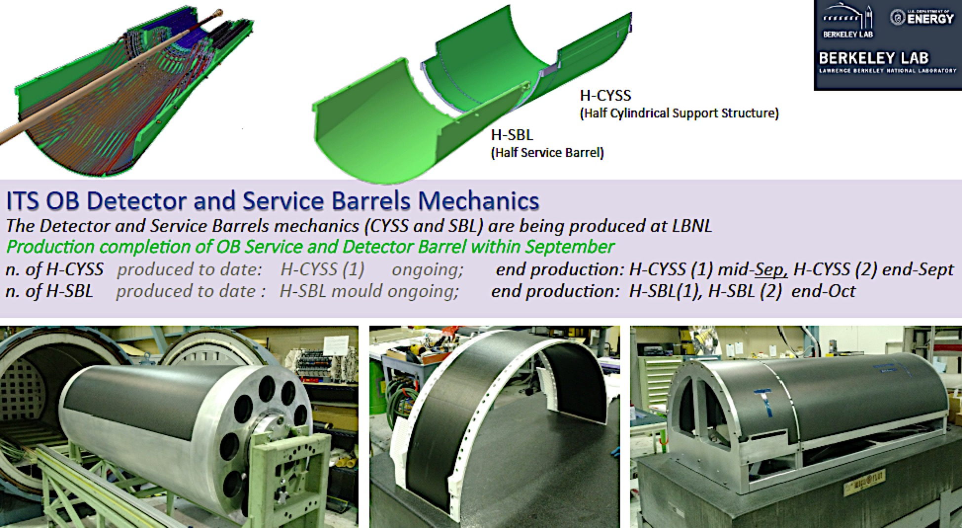
OB mechanics

Slide 26
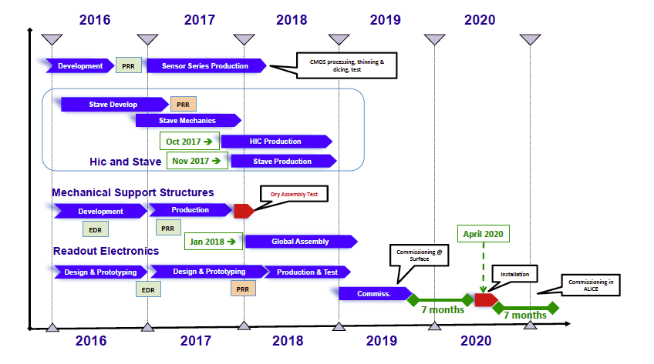
ITS Upgrade overall schedule

Slide 27
Conclusions
The ALICE ITS upgrade project has successfully completed the R&D phase
SENSOR:
  The ALPIDE sensor meets all the requirements
  The production of ALPIDE chips is progressing well (average yield ~63%)
HICs and STAVES:
  IB and OB HIC production has started (series production in all sites will start in November 2017)
  OB Stave pre-production is ongoing, series production will start in all sites in December 2017
MECHANICS:
  Fabrication of Cold Plates and Space Frame is finished
  Fabrication of large composite structures has started and is progressing well and on track
  dry assembly test will take place by December 2017
Development of Readout Electronics and Power Distribution Systems are generally progressing well and on track for the overall project schedule
The project is well on track for installation starting middle 2020

Slide 28
BACK UP SLIDES

Slide 29

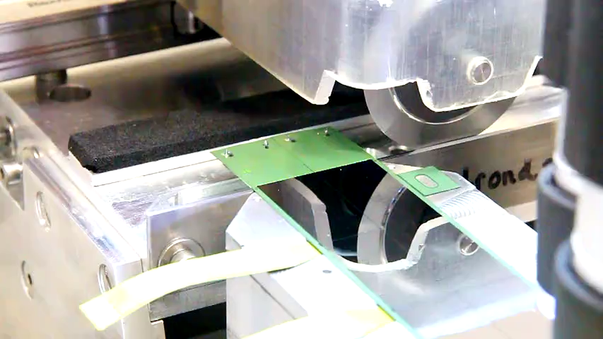
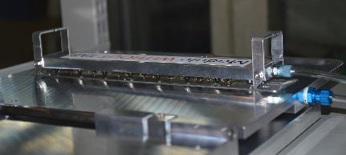
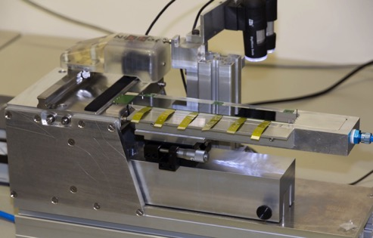
OB STAVE assembly: TAB CUT
TAB
TAB CUT PROCEDURE
1. Module gripper
2. TAB CUTTER
The FPC TAB, used for HIC test, must be cut before the HIC assembly on the CP
TAB CUTTER allows alignment of the HIC with a precision of 10 μm by means of video-cameras placed on the cut line.

Slide 30
ALPIDE– Technology and Pixel Layout
SUB
SUB
IRESET
AVDD
PIX_IN
VRESET
pwell
nwell
deep pwell
deep pwell
N_{A} ~ 10¹⁶
epitaxial layer
p substrate
N_{A} ~ 10¹³
Spacing
Diameter
N_{A} ~ 10¹⁸
CMOS Pixel Sensor - TowerJazz 0.18μm CMOS Imaging Process
  High-resistivity (> 1kΩ cm) p-type epitaxial layer (25μm) on p-type substrate
  Small n-well diode (2 μm diameter), ~100 times smaller than pixel => low capacitance (~fF)
  Reverse bias voltage (-6V < V_{BB} < 0V) to substrate (contact from the top) to increase depletion zone around NWELL collection diode
  Deep PWELL shields NWELL of PMOS transistors (full CMOS circuitry within pixel active area) )

Slide 31
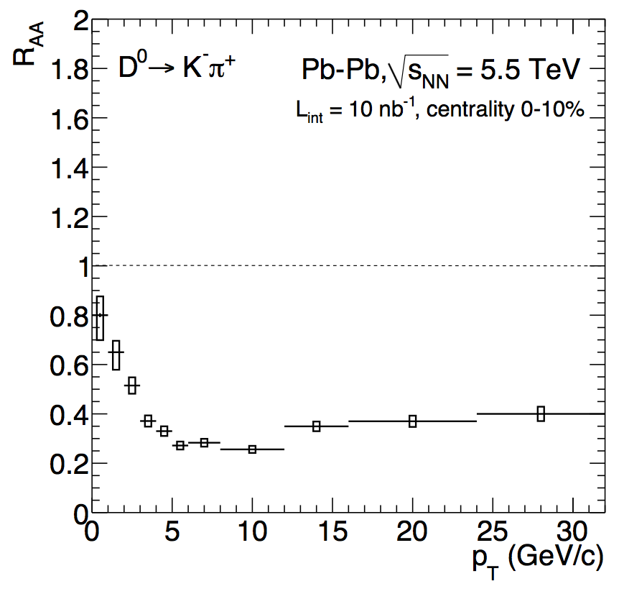
D mesons with ALICE
CERN-LHCC-2013-024
0-10%
ALICE Upgrade projection
D⁰
D_{s}
Average D⁰,D⁺,D^{*+}
Precise measurements down to p_{T}=0
Discriminate models to quantify microscopic interactions with the medium
Total charm cross section
  All charmed particles relevant (role of recombination for D_{s}, Λ_{c},..?)
  Reference for charmonium measurements
ALICE Upgrade projection
D_{s}⁺

Slide 32
B mesons with ALICE
CERN-LHCC-2013-024
CERN-LHCC-2015-001
BAMPS
TAMU
projection
projection
Non-prompt D⁰ (mid)
Non-prompt J/ψ (fwd)
B⁺→D⁰π⁺
Beauty via Dπ, J/ψK, non prompt D and J/ψ, combining measurements at mid and forward rapidity
Precise R_{AA} and v₂ can discriminate models at low p_{T}, where parton mass plays a role, constrain the b-quark diffusion coefficient and probes b-quark thermalisation

Slide 33
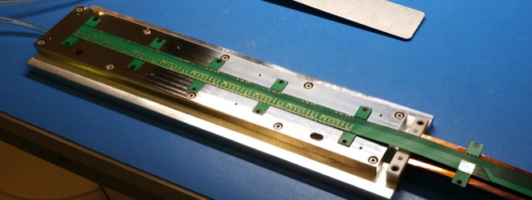



Inner Barrel HIC and stave production
Production of IB HICs and Staves is done at CERN
HIC and Stave assembly area
IB HIC
STAVE: HIC glued to the IB spaceframe & coldplate, such to provide HIC support, alignment, and thermal contact to the coldplate
IB STAVE: FPC SIDE
IB STAVE: SF SIDE
HIC and Stave wire bond area

Slide 34

IB mechanics

Slide 35

Review Milestones

Slide 36

Production Milestones

Slide 37

OB mechanics

Slide 38

HIC and Staves testing protocol and set-up
Powering Test
FIFO Test
(×3 DVDD)
Local Bus Test
Digital Scan (×3 DVDD)
Digital White Frame
Each scan has a dedicated analysis which creates a result, including a classification
  classes: green – orange – red
  Classification based on configurable cut values
For each test result parameters and attachments are written to the production database
Threshold Scan
(0V and 3V)
Threshold Tuning
(0V and 3V)
Threshold Scan
(0V and 3V)
Noise Occupancy
(0V and 3V)
Noise Occupancy
w Mask (0V and 3V)
HIC test flow
GUI interface to test set-up

Slide 39

Detector HICs and staves – Inner Barrel
HIC: Hybrid Integrated Circuit
IB HIC
Flexible PCB - FPC
9 sensors
STAVE: HIC glued to the IB spaceframe & coldplate, such to provide HIC support, alignment, and thermal contact to the coldplate
Cold Plate
IB STAVE: FPC SIDE
Space Frame
IB STAVE: SF SIDE

Slide 40


IB stave prototypes production
HIC Production procedure:
Chip automated inspection in ALICIA
Chip alignment on ALICIA assembly table
FPC clamping by vacuum on dedicated jig, alignment using dowel pins
Adhesive mask application on FPC and glue distribution
Mask removal, check of glue spots, application of shims (adhesive tape) on FPC wings
Flip FPC and overlap on chips using ruby balls for alignment
Curing on assembly table at room T for 12 h
Transfer on wire bonding jig
Visual inspection
Chips interconnection by wire-bonding
Transfer on HIC storage plate and electrical test

Slide 41
Stave Tests
The same functional characterisation has been performed for HICs and staves; no difference in
performance has been observed. Below: comparison for a HIC before and after mounting on a stave
Left: Comparison of noise per chip
Right: Correlation of thresholds

Slide 42

Thermal Cycling
Performed thermal cycling on several devices:
300 cycles 10 – 50 deg C (corresponding to 10 years of operation) plus “non-operative” cycles (10-60 deg C)
Tested devices: 7 HICs (5 complete) and 1 stave (expected to finish Mon, April 24)

Slide 43
Thermal Cycling: Comparison Before – After
Comparison of performance before an after thermal cycling (HIC 14)
Chip | Dead Pixels
 | Before | After
0 | 0 | 0
1 | 1 | 1
2 | 0 | 0
3 | 678 | 678
4 | 1701 | 1701
5 | 1022 | 1022
6 | 0 | 0
7 | 1022 | 1022
8 | 0 | 0

Slide 44




ITS Stave Mechanics, characterization status report
Preliminary Thermo-elastic Test of Stave 0 has been performed.
Y-displacement
CASE | CHILLER | POWER | C.room | Chiller | UPPER CP | LOWER CP
Baseline | OFF | OFF | 20 | 20 | 20 | 20
23 | ON | ON | 20 | 18 | 23 | 21
31 | OFF | ON | 20 | \ | 31 | 25
30 Water | ON | OFF | 20 | 30 | 27 | 27
40 Water | ON | OFF | 20 | 40 | 36 | 36
Lower coldplate
Upper coldplate (middle)
Y-Displacement
Upper coldplate (side)
Upper
Lower
CTE 4-8 µm/m/°C
[mm]

Slide 45

Test Beam set-up
Telescope 1
Telescope 2
Beam
(6GeV/c pions)
Two telescopes based on ALPIDE chips
Analysis method
  Extrapolation of a track from the 6 reference planes to the Device Under Test (DUT) in the centre
  Searching for a cluster in a square of 100x100µm²
  Measure
    detection efficiency (existence of cluster)
    cluster size
    position resolution (extrapolated vs. measured impinging point)
Corresponding laboratory measurement
  Fake-hit rate
  Threshold (S-curve scan)

Slide 46
Test Beam Measurements List
Operational margin
  Detection efficiency, fake-hit rate and position resolution as function of the charge threshold
Irradiation study
  Large operational margin sustained after the expected lifetime
Supply voltage study (1.62V, 1.8V, 1.98V)
  Same performance achievable also for +/-10% of the nominal supply voltage
Different operation modes (triggered, continuous integration)
  Both modes show similar performance
Temperature Dependence (15˚C, 20˚C, 25˚C, 30˚C, 35˚C)
  No significant dependence measured
Reverse substrate bias dependence (0V, -1V, -2V, -3V, -4V, -5V, -6V)
  Clear ordering with higher reverse-substrate bias leading to better performance
  -3V sufficient for substantial improvement

Slide 47
Irradiated chips
Name | TID Dose | NIEL Dose
W7-R5 | 206 krad (75%)* | 2.2x10¹² 1MeV n_{eq}/cm² (130%)*
W7-R17 | 205 krad (75%)* | 2.2x10¹² 1MeV n_{eq}/cm² (130%)*
W7-R38 | 462 krad (170%)* | 5.1x10¹² 1MeV n_{eq}/cm² (300%)*
W7-R41 | 509 krad (190%)* | 5.6x10¹² 1MeV n_{eq}/cm² (330%)*
W8-R5 | - | 1.7x10¹³ 1MeV n_{eq}/cm² (1000%)*
W8-R7 | - | 1.7x10¹³ 1MeV n_{eq}/cm² (1000%)*
* Percentage is relative to the lifetime dose

Slide 48
Operational modes
Triggering
  Strobe duration: O(100ns)
  Only possible for events detected by the trigger
  Short strobe duration assumed to lead to a smaller sensitivity to
    fake hits (not relevant for ALPIDE)
    beam-induced background
  Timing resolution defined by the peaking time of the front-end circuit
Continuous Integration
  Strobe active full time, closed only to switch to the next in-pixel hit buffer
  Can be used to acquire events which cannot be triggered on like Ultra-Peripheral Collisions (UPC) in Pb–Pb
  Measuring all background events
  → increased data throughput
  Timing resolution determined by strobe window
  Trade-off between strobe-window size and data band-width

Slide 49
Readout – global timing (triggered)
Trg. n
Trg. n+1
Trg. n+2
Ev. n-1
Ev. n
Ev. n+1
Ev. n+2
Ev. n+3
Ev. n+4
Ev. n+5
Ev. n+6
Time width within signals are recorded on trigger depends on the analog shaping time (≈ µs)
Time
Event rate = average number of interactions per second.
Background – almost constant over time, not dominant due to the short integration time.
Noise – pixel with a signal without being actually hit, not constant over integration time.
Trigger – due to analog latency at pixel level, when the trigger arrives the event signal is still present in the pixel, but not yet recorded in the pixel memory. All pixels with a signal over threshold during the strobe window (event, background, noise, etc. ) get stored in memory.

Slide 50
Readout – global timing (continuous)
Frame n-1
Frame n
Frame n+1
Frame n+2
Frame n+…
Ev. n-1
Ev. n
Ev. n+1
Ev. n+2
Ev. n+3
Ev. n+4
Ev. n+5
Ev. n+6
frame width is defined by the strobe window signal. Analog shaping time (≈ µs) makes it possible for the same signal to be recorded in two frame
Time
Event rate = average number of interactions per second. Poisson dictates pileup in frames.
Background – almost constant over time, relevant for the inner layers only.
Noise – pixel with a signal without being actually hit, not constant over integration time.
Frame – the frame coincides with the strobe window being on, during which every signal is recorded, hence the sensor records everything, as the time the strobe window shut close is negligible (some ns every cycle).

