Slide 1


Multi-messenger Approach to Ultra-light Bosons
Soumya Bonthu
Department of Physics,
Oklahoma State University
Particle Physics in Plains
University of Kansas
November 3, 2024
Based on I.K.Banerjee, SB, Ujjal Dey: Arxiv: 2406.13756

Slide 2
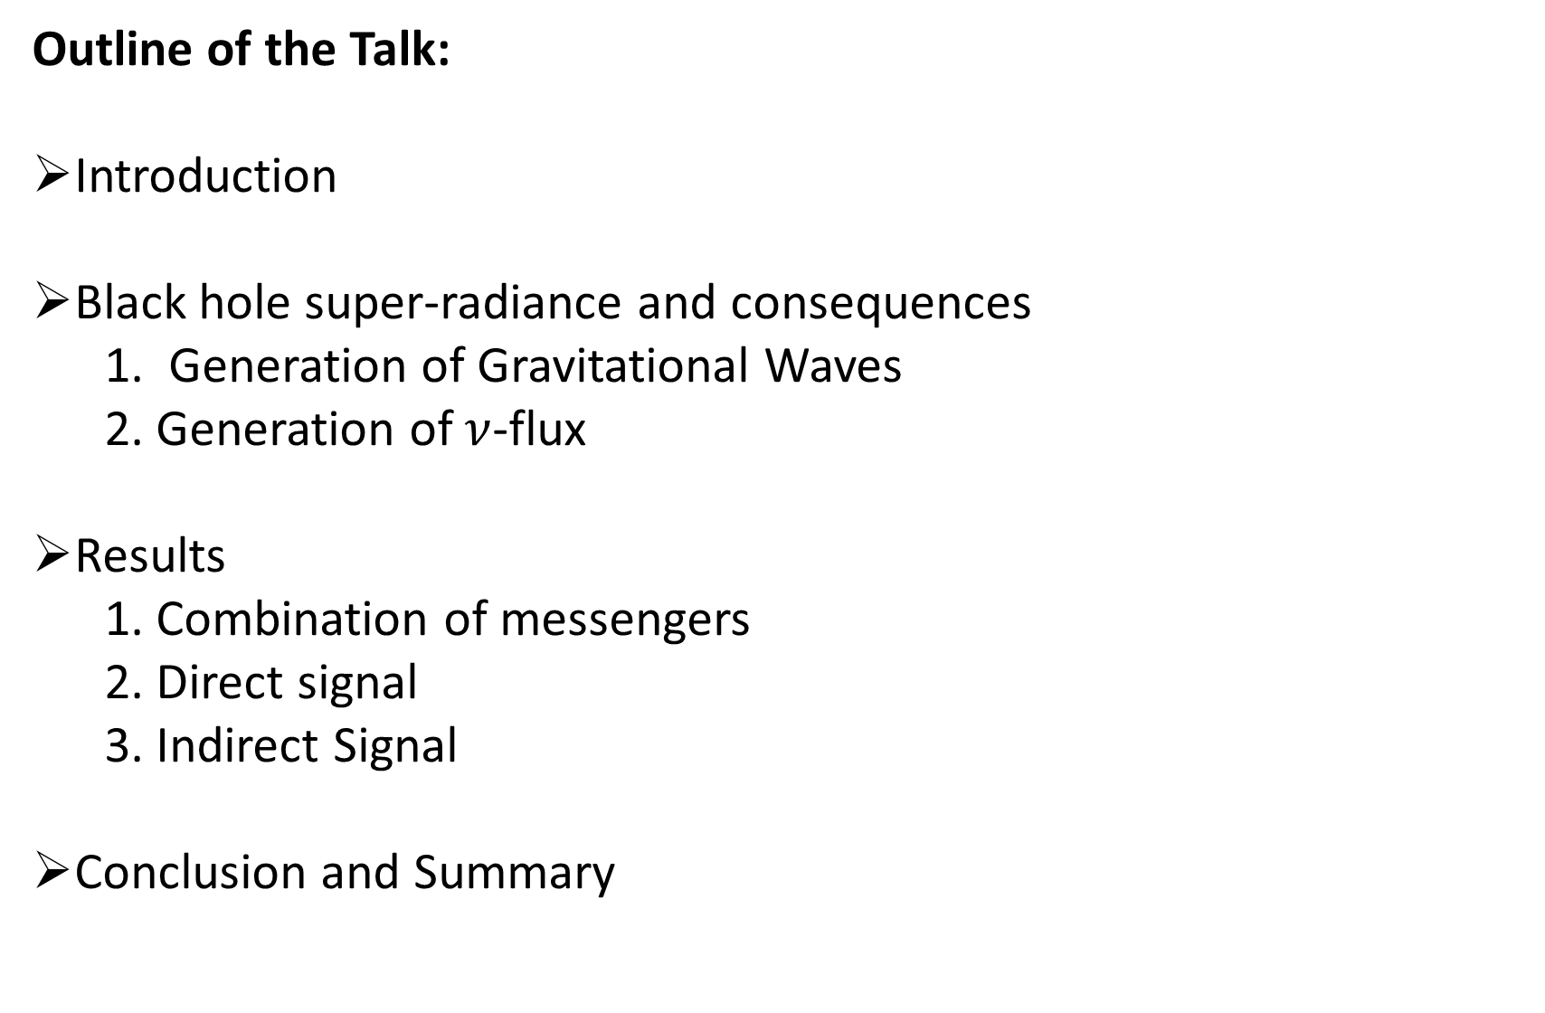
Outline of the Talk:
Introduction
Black hole super-radiance and consequences
1. Generation of Gravitational Waves
2. Generation of $ν$-flux
Results
1. Combination of messengers
2. Direct signal
3. Indirect Signal
Conclusion and Summary

Slide 3
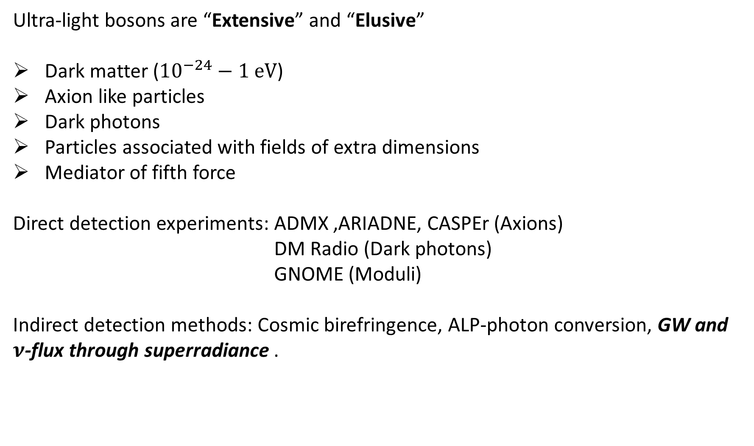
Ultra-light bosons are “Extensive” and “Elusive”
Dark matter (${10}^{−24}−1$eV)
Axion like particles
Dark photons
Particles associated with fields of extra dimensions
Mediator of fifth force
Direct detection experiments: ADMX ,ARIADNE, CASPEr (Axions)
DM Radio (Dark photons)
GNOME (Moduli)
Indirect detection methods: Cosmic birefringence, ALP-photon conversion, GW and $ν$-flux through superradiance .

Slide 4
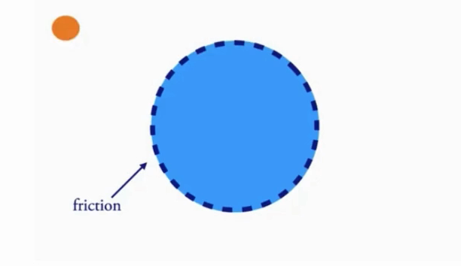

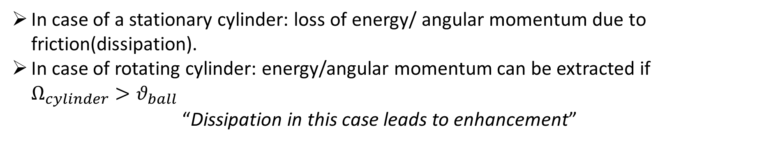
Mechanical analogue of Superradinace:
In case of a stationary cylinder: loss of energy/ angular momentum due to friction(dissipation).
In case of rotating cylinder: energy/angular momentum can be extracted if $Ω_{cylinder}>θ_{ball}$
“Dissipation in this case leads to enhancement”
Credit: Olivier Simon YT video

Slide 5
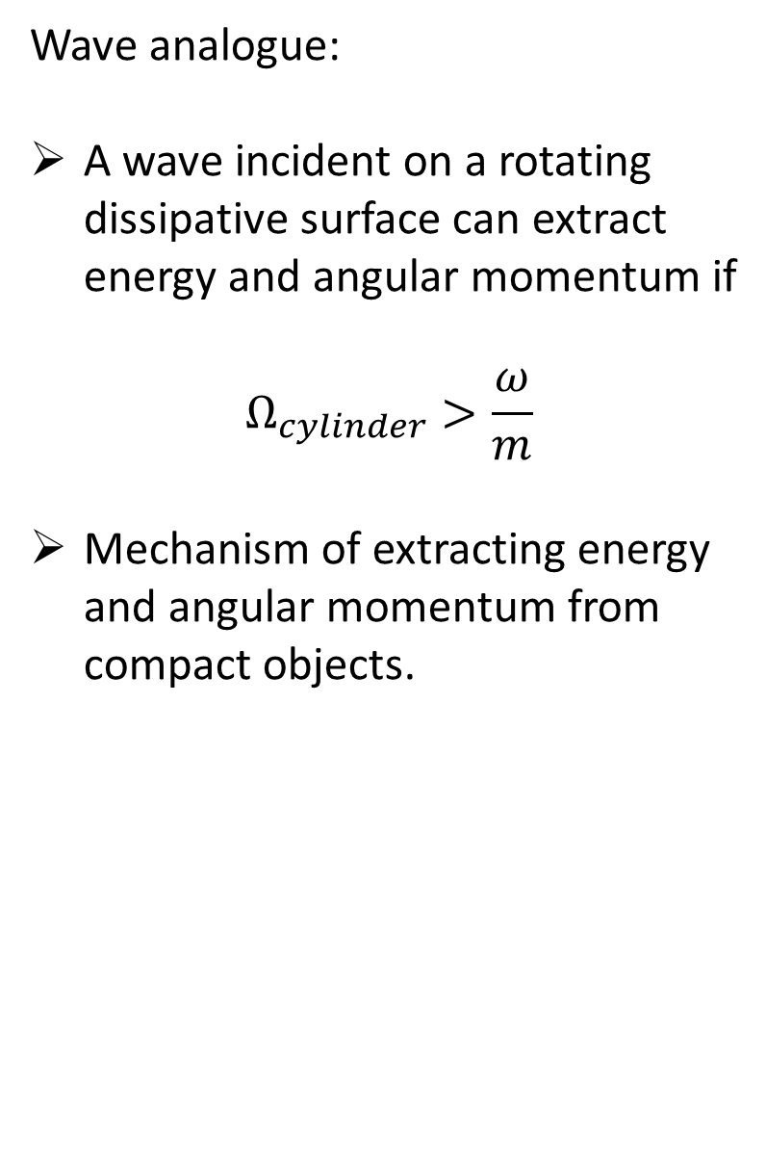
Wave analogue:
A wave incident on a rotating dissipative surface can extract energy and angular momentum if
$$Ω_{cylinder}>\frac{ω}{m}$$
Mechanism of extracting energy and angular momentum from compact objects.
Credit: Olivier Simon YT video

Slide 6
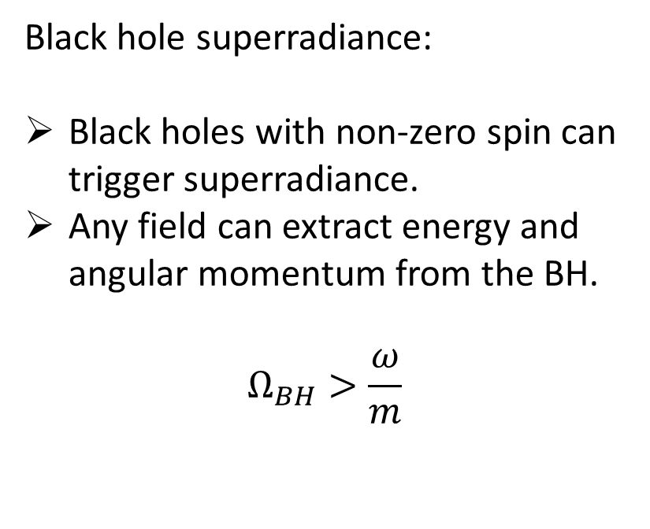
Black hole superradiance:
Black holes with non-zero spin can trigger superradiance.
Any field can extract energy and angular momentum from the BH.
$$Ω_{BH}>\frac{ω}{m}$$
Credit: Olivier Simon YT video

Slide 7
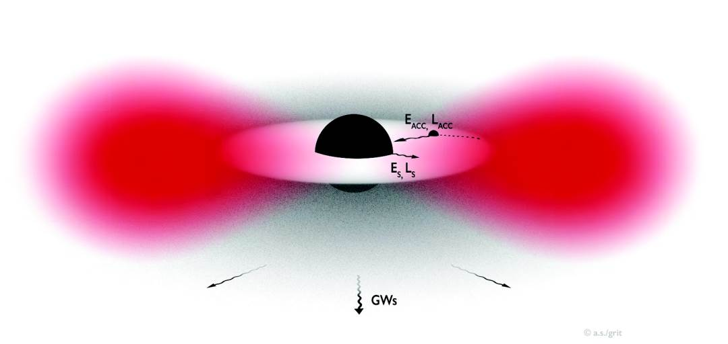
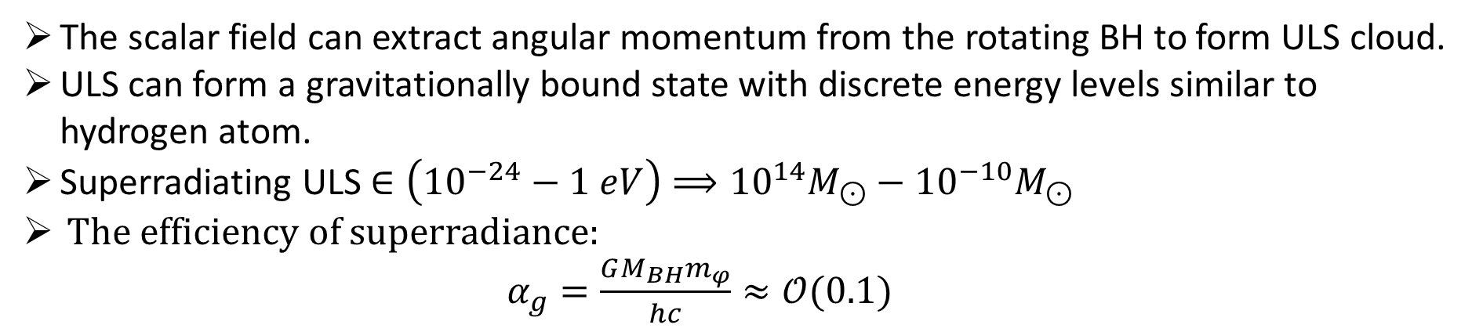
(Credit: arXiv:1501.06570v8)
The scalar field can extract angular momentum from the rotating BH to form ULS cloud.
ULS can form a gravitationally bound state with discrete energy levels similar to hydrogen atom.
Superradiating ULS $∈\left({10}^{−24}−1 eV\right)⟹{10}^{14}M_{⊙}−{10}^{−10}M_{⊙}$
The efficiency of superradiance:
$α_{g}=\frac{GM_{BH}m_{φ}}{hc}≈𝒪(0.1)$

Slide 8
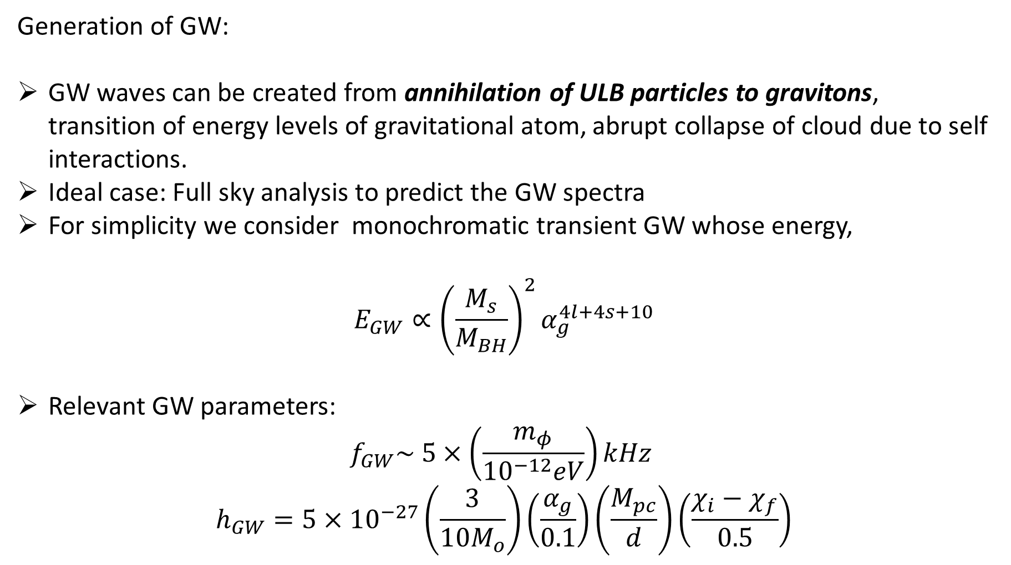
Generation of GW:
GW waves can be created from annihilation of ULB particles to gravitons, transition of energy levels of gravitational atom, abrupt collapse of cloud due to self interactions.
Ideal case: Full sky analysis to predict the GW spectra
For simplicity we consider monochromatic transient GW whose energy,
$$E_{GW}∝{\left(\frac{M_{s}}{M_{BH}}\right)}^{2}α_{g}^{4l+4s+10}$$
Relevant GW parameters:
$$f_{GW}\sim 5×\left(\frac{m_{φ}}{{10}^{−12}eV}\right)kHz$$
$$h_{GW}=5×{10}^{−27}\left(\frac{3}{10M_{o}}\right)\left(\frac{α_{g}}{0.1}\right)\left(\frac{M_{pc}}{d}\right)\left(\frac{χ_{i}−χ_{f}}{0.5}\right)$$

Slide 9
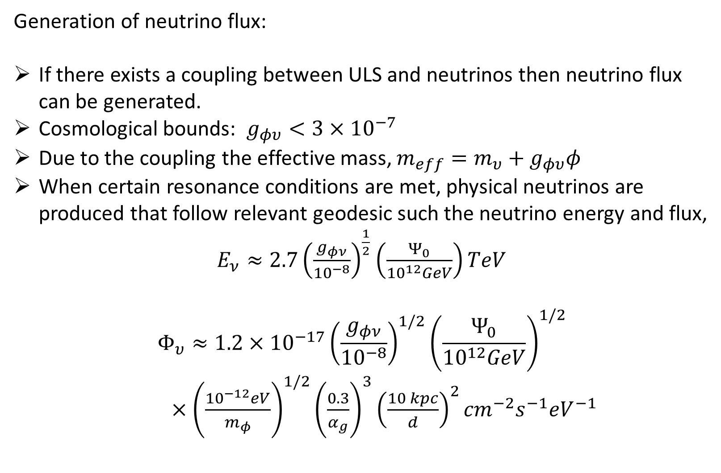
Generation of neutrino flux:
If there exists a coupling between ULS and neutrinos then neutrino flux can be generated.
Cosmological bounds: $g_{φυ}<3×{10}^{−7}$
Due to the coupling the effective mass, $m_{eff}=m_{υ}+g_{φυ}φ$
When certain resonance conditions are met, physical neutrinos are produced that follow relevant geodesic such the neutrino energy and flux,
$E_{ν}≈2.7{\left(\frac{g_{φν}}{{10}^{−8}}\right)}^{\frac{1}{2}}$ $\left(\frac{Ψ_{0}}{{10}^{12}GeV}\right)TeV$
$$Φ_{υ}≈1.2×{10}^{−17}{\left(\frac{g_{φν}}{{10}^{−8}}\right)}^{1/2}{\left(\frac{Ψ_{0}}{{10}^{12}GeV}\right)}^{1/2}$$
$×{\left(\frac{{10}^{−12}eV}{m_{φ}}\right)}^{1/2}{\left(\frac{0.3}{α_{g}}\right)}^{3}{\left(\frac{10 kpc}{d}\right)}^{2}{cm}^{−2}s^{−1}{eV}^{−1}$

Slide 10
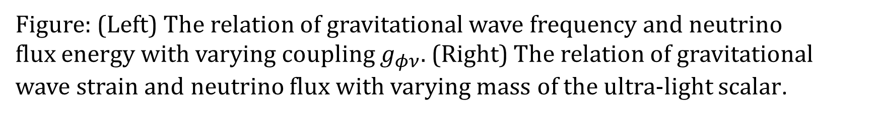

Results: Combination of messengers
Figure: (Left) The relation of gravitational wave frequency and neutrino
flux energy with varying coupling $g_{φν}$. (Right) The relation of gravitational wave strain and neutrino flux with varying mass of the ultra-light scalar.
$$α_{g}=0.25 , (χ_{i}−χ_{f})=0.5$$

Slide 11
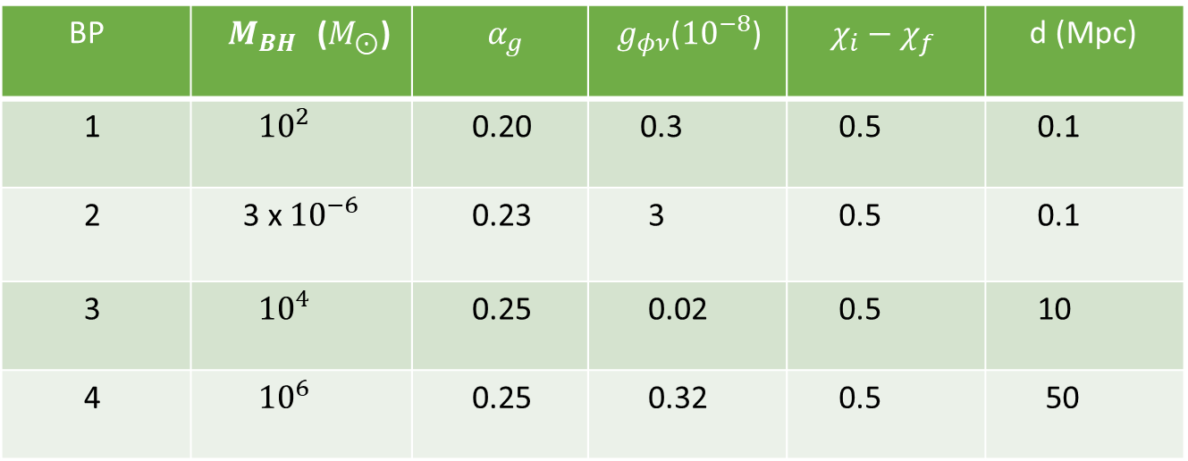
Benchmark Parameters:
BP | $M_{BH }$($M_{⊙}$) | $α_{g}$ | ${ g}_{φν}$(${10}^{−8}$) | $χ_{i}−χ_{f}$ | d (Mpc)
1 | ${10}^{2}$ | 0.20 | 0.3 | 0.5 | 0.1
2 | 3 x ${10}^{−6}$ | 0.23 | 3 | 0.5 | 0.1
3 | ${10}^{4}$ | 0.25 | 0.02 | 0.5 | 10
4 | ${10}^{6}$ | 0.25 | 0.32 | 0.5 | 50

Slide 12
Figure: GW and neutrino flux due to benchmark cases.

Slide 13
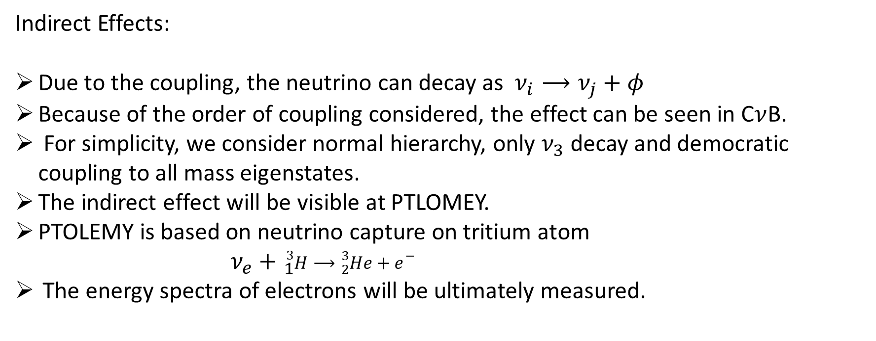
Indirect Effects:
Due to the coupling, the neutrino can decay as $ν_{i}⟶ν_{j}+φ$
Because of the order of coupling considered, the effect can be seen in C$ν$B.
For simplicity, we consider normal hierarchy, only $ν_{3}$ decay and democratic coupling to all mass eigenstates.
The indirect effect will be visible at PTLOMEY.
PTOLEMY is based on neutrino capture on tritium atom
$ν_{e}+{}_{1}^{3}{H⟶{}_{2}^{3}{He+e^{−}}}$
The energy spectra of electrons will be ultimately measured.

Slide 14
Figure: The prediction of differential energy spectra of electron due to the capture of the CNB neutrinos on tritium in PTOLEMY.
$$Δ=40 meV, m_{ν_{3}}=50 meV, m_{φ}={10}^{−3}meV,g_{φυ}=3×{10}^{−8}$$

Slide 15
Summary and Conclusion:

Slide 16
References:
R. Brito, V. Cardoso and P. Pani, Superradiance: New Frontiers in Black Hole Physics, Lect. Notes Phys. 906 (2015) pp.1 [1501.06570].
Y. Chen, X. Xue and V. Cardoso, Black Holes as Neutrino Factories, 2308.00741
K. Akita, G. Lambiase and M. Yamaguchi, Unstable cosmic neutrino capture, JHEP 02 (2022) 132 [2109.02900].

Slide 17
THANK
YOU

