Slide 1

Recycled Dark Matter
Thomas C. Gehrman
w/ Barmak Shams Es Haghi (UT Austin),
Kuver Sinha (Oklahoma), and
Tao Xu (Oklahoma)
arXiv: 2310.08526

Slide 2
Outline of Talk
Overall story of recycled dark matter
Trapped (Multicomponent Dark Sector)
PBH formation
UHDM produced from PBHs

Slide 3
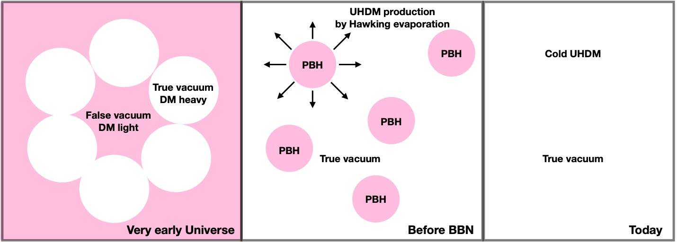
History of PBH Formation
χ φ, m_{χ/φ} = 0
χ φ SM
First order phase transition (FOPT) caused by symmetry breaking of a scalar φ
Multicomponent heavy dark sector (DS) is trapped because mass is too high to penetrate the bubble wall
Trapped Multicomponent Dark Sector becomes compressed until PBHs form
  Mininmum size of pocket therefore PBH mass due to annihilation of Dark matter leads to extended mass function being controlled by IR physics
Light PBHS Hawking evaporated recycled ultra heavy dark matter (UHDM) before BBN
Dark sector satisfies the observed dark matter relic abundance

Slide 4


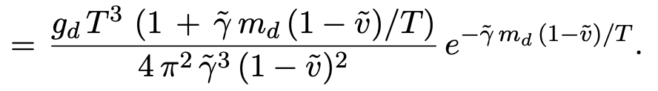
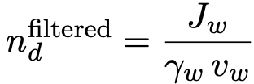

Trapped Dark Sector During FOPT
Location of our m_{d}/T
The probability of a DM particle penetrating through the moving bubble wall is given by J_{w.} The probability of being trapped in false vacuum is given by F^{trapped}
tildes are in the bubble wall rest frame. Quantities without tildes are in the global plasma rest frame
The greatest suppression to trapping is in the exponential which is controlled by dark matter mass and particle temperature

Slide 5

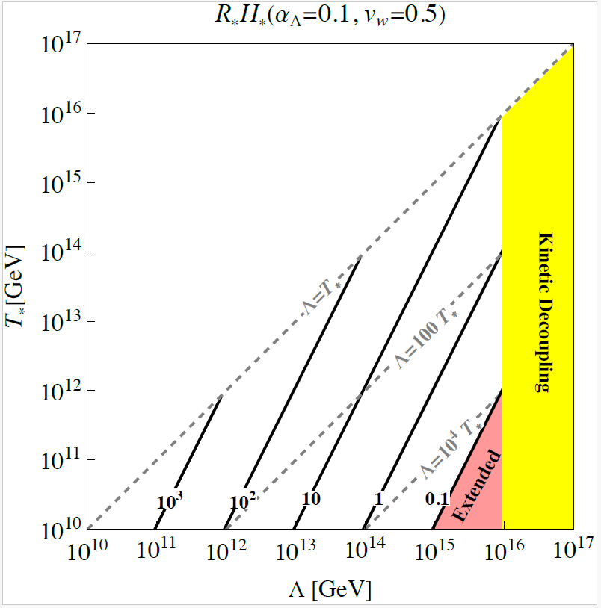
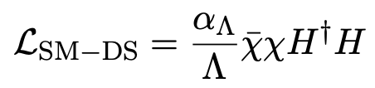


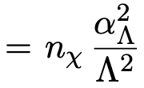

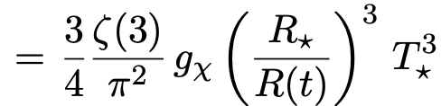

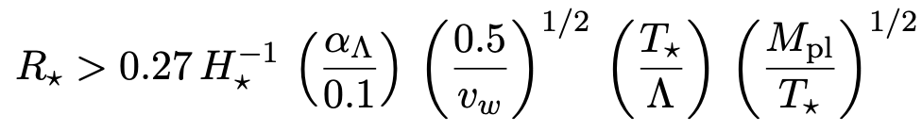
Thermal History
Lower bound to maintain kinetic equilibrium with SM
When T < Λ the cross section is a constant

Slide 6
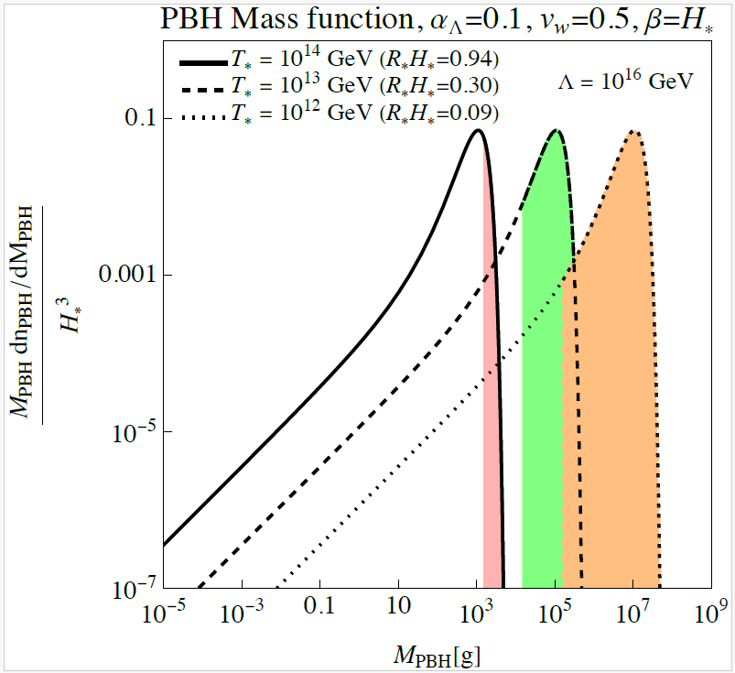
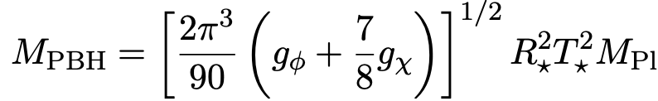
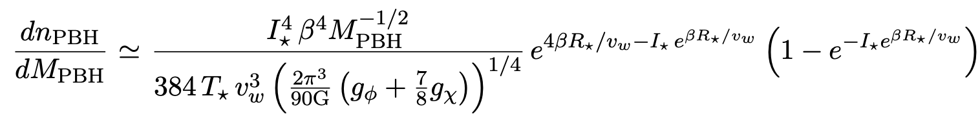

PBH Formation
Include lower bound due to annihilation in small pockets

Slide 7
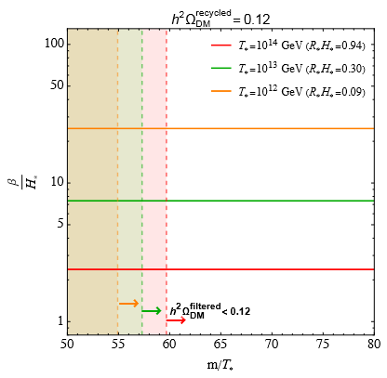
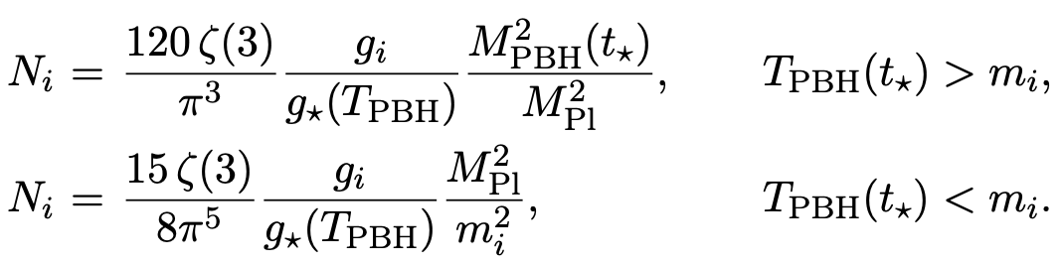


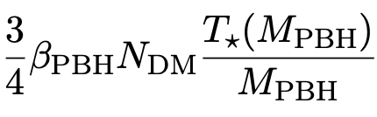
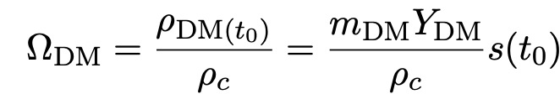


PBH Evaporation & DM Relic Abundance
Total number of DM = (Number of DM from PBHs) x (Total number of PBHs)

Slide 8
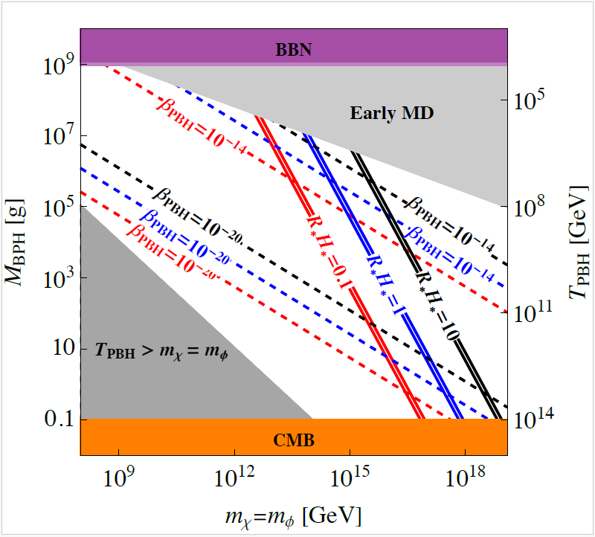
UHDM from PBHs Formed by a Trapped Dark Sector

Slide 9
Summary
Multicomponent DS is trapped during FOPT and collapses into PBH. The same UHDM is reproduced (Recycled) by Hawking evaporation of PBHs and matches observed relic abundance.
Annihilation of DM to SM particles controls the PBH mass function.
Recycling mechanism can be tested GWs in the MHz-GHz range
Recycled Dark Matter: arXiv: 2310.08526
T. Gehrman, B. Es Haghi, K. Sinha, T. Xao
PBH+Baryogensis+HFGWs: arXiv:2211.08431
PBH+DM+HFGWs: arXiv:2305.09194

Slide 10
Thank You!

Slide 11
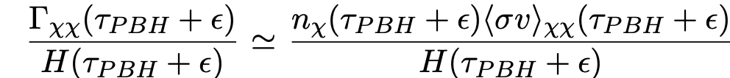
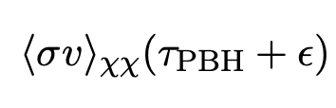




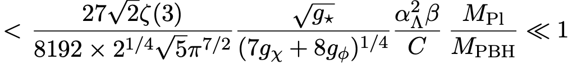
Annihilation of Dark Matter After Evaporation of PBHS
Issue may arise where annihilation of dark matter after PBH evaporation may lead to a lower relic abundance

Slide 12

The Need for a Multicomponent Dark Sector
Typical FOPT Scenario: One scalar φ is massless in the true vacuum and fermion gains its mass from the symmetry breaking of the scalar. Fermion is the dark matter candidate.
The annihilation of a fermion to a massless scalar leads to energy density leaving the pocket. This highly suppresses PBH formation and therefore inhibits recycling.
Recycling:

Slide 13
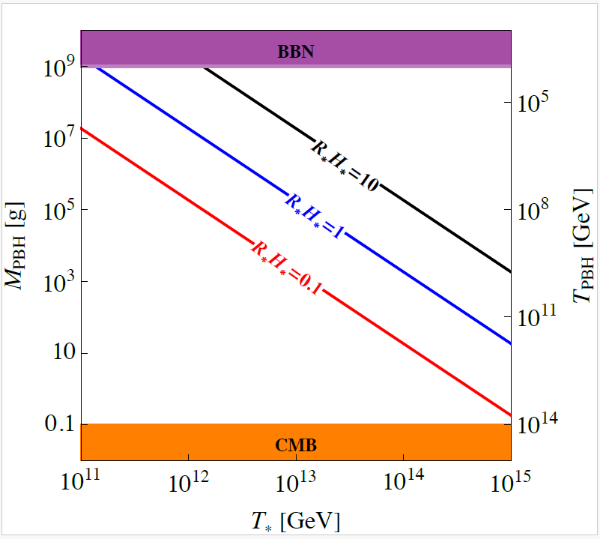

Possible Questions/ Extra Information
How do φ and χ affect PBH formation?
An attractive force caused by φ particles (Yukawa force) could enhance PBH formation by causing χ particles to collapse before the degeneracy pressure becomes important. However, we did not pressure the strength of this force in our work, but detailed calculation needs to be done.
Fermi Ball Scenario: A fermion asymmetry in the pocket leads to Fermi ball formation while the scalar is massless leading to a recycling scenario

Slide 14
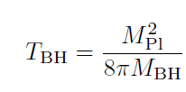
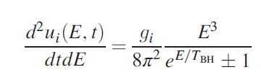

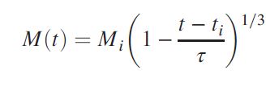

Black Hole Thermodynamics
D. Baumann, P. Steinhardt, and N. Turok 2007
arXiv:hep-th/0703250v1
P. Gondolo, P. Sandick, and B. Shams Es Haghi 2020
r_{s} ≡ Schwarzschild radius
T_{BH} ≡ Black Hole Temperature
M_{i} ≡ Initial Mass of Black Hole
Tau ≡ We take this to be the Evaporation time
t_{i} ≡ Formation time
u_{i} ≡ Energy density
M_{Pl} ≡ Reduced plank mass
M_{Pl} ≡ 1.220 890 x 10¹⁹ GeV

