Slide 1
Exploring High-Performance Computing Resources for Particle Physics: A Comprehensive Overview
Dr. Terrance Figy
Associate Professor
Department of Mathematics, Statistics, and Physics
Wichita State University
Particle Physics on the Plains
University of Kansas
October 14, 2023

Slide 2
Outline
Introduction
Regional HPC systems that are FREE
Pete Supercomputer, BeoCat, BeoShock
Advanced Cyberinfrastructure Coordination Ecosystem: Services & Support (ACCESS)
Open Science Grid (OSG)
National Research Platform (NRP)
Conclusions

Slide 3
Introduction
This talk is from the perspective of a lone wolf theoretical physicist.
Building a small research program is not easy. However, the National Science Foundation has made it a lot easier with supporting a number of projects in this region that have improved access to advanced cyber-infrastructure resources. Thanks!
It now easier than ever to obtain the needed to computational resources for FREE.
In this talk I will discuss research computing environments I have experience with.

Slide 4
Most problems in physics need computing resources and software tools.
Laptops can do quite a lot. However, to really push the boundaries you need more.
What do computational physicists need ?
  Plotting tools
  Coding tools, compilers
  A place to run their open-source software tools (CPUs and GPUs)
  Storage
Physics offers many use cases.

Slide 5

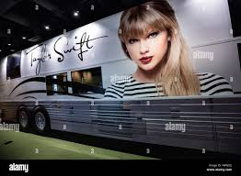


Regional HPC Systems that are FREE
Pete Supercomputer
WSU’s BeoShock
K-State’s BeoCat
It’s better I take you to the sign-up pages.
So, let the tour begin.

Slide 6
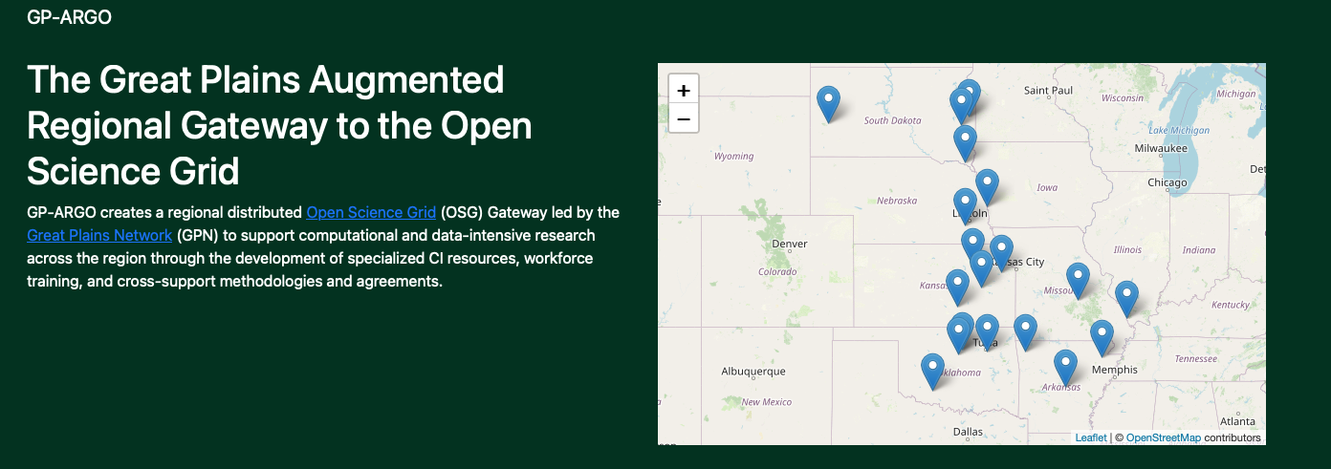
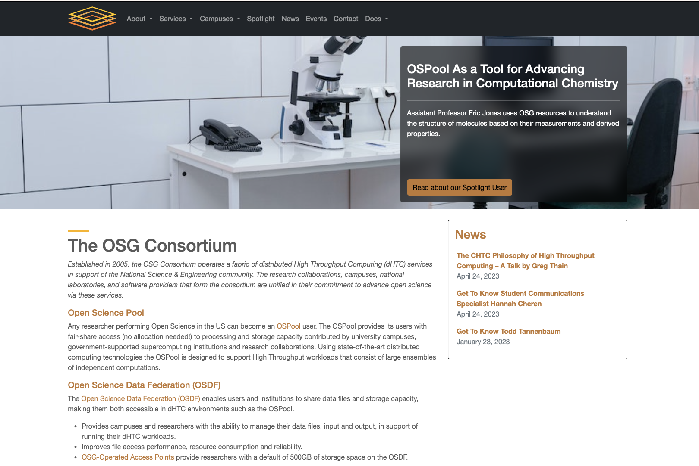
Open Science Grid
https://osg-htc.org

Slide 7
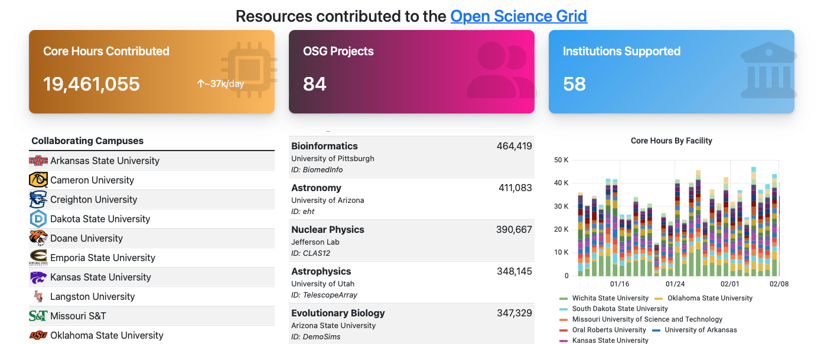
Open Science Grid and GP-ARGO

Slide 8
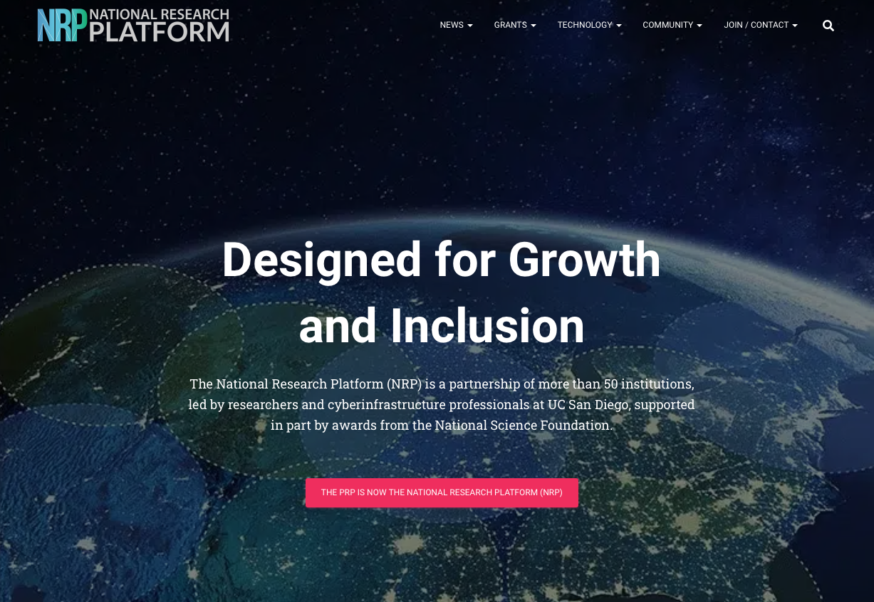
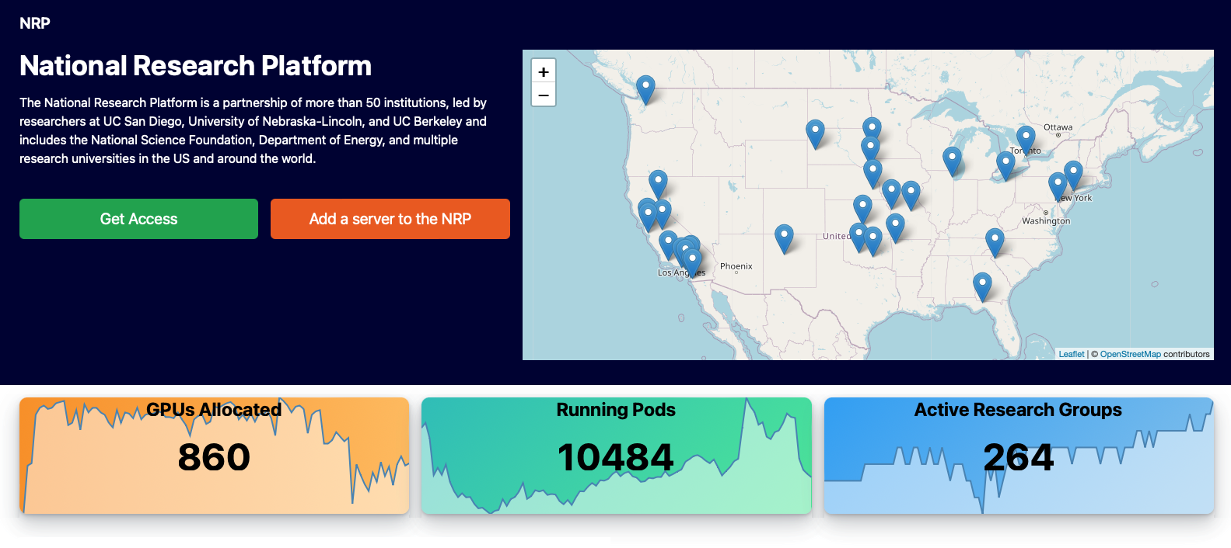
National Research Platform
JupyterHub Service
https://docs.pacificresearchplatform.org/userdocs/jupyter/jupyterhub-service/
https://nationalresearchplatform.org

Slide 9
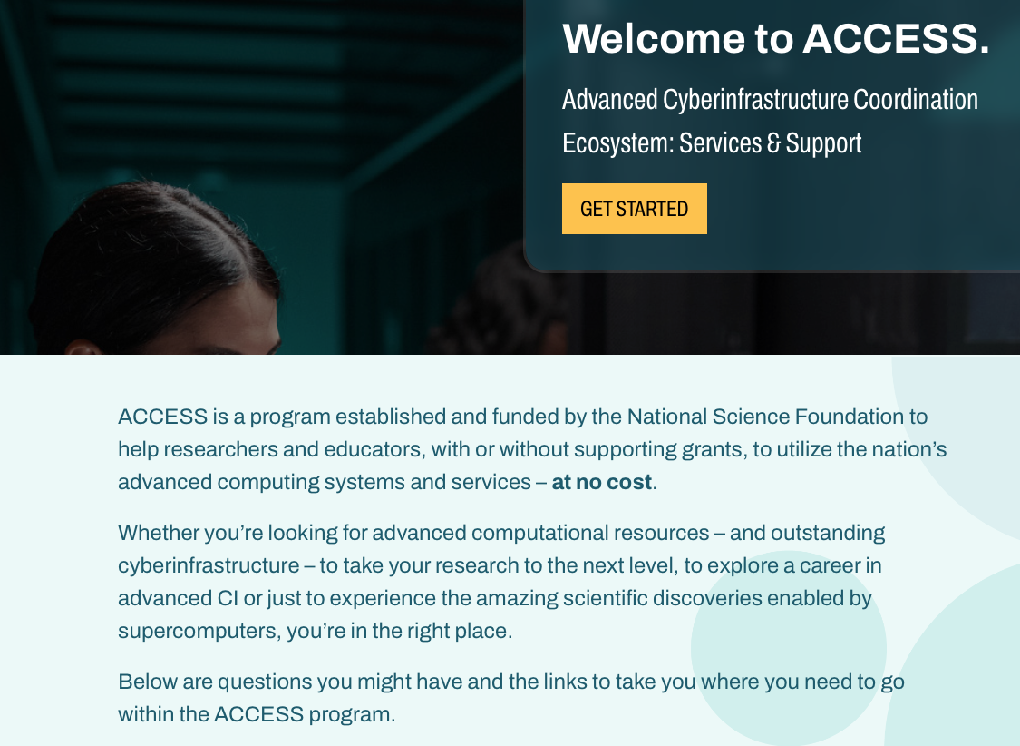
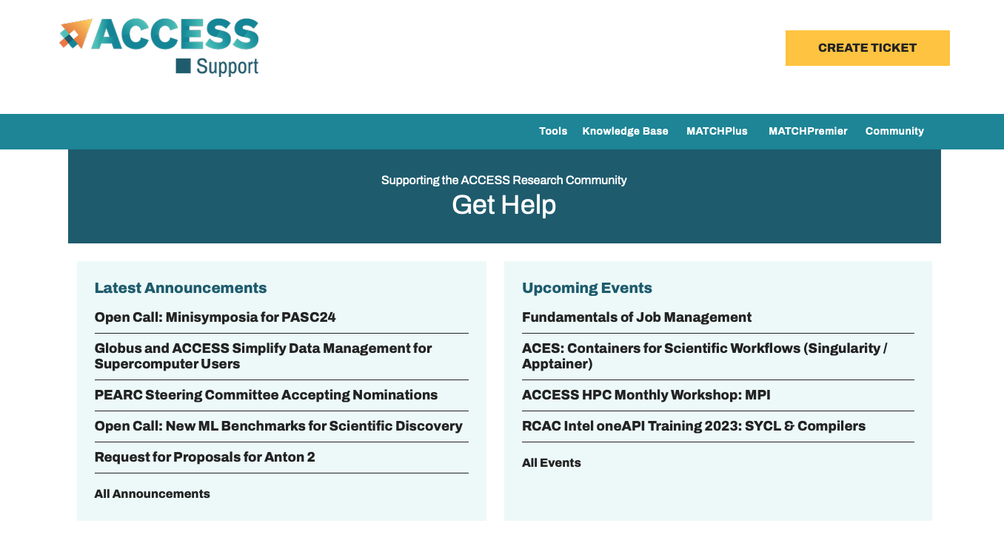
ACCESS and Getting Help
https://access-ci.org/about/
https://support.access-ci.org

Slide 10
Conclusions
Today I promoted a few computing resources that I have allowed me to get work done.
The impact of FREE computing has been transformational and is so valuable.

