Slide 1

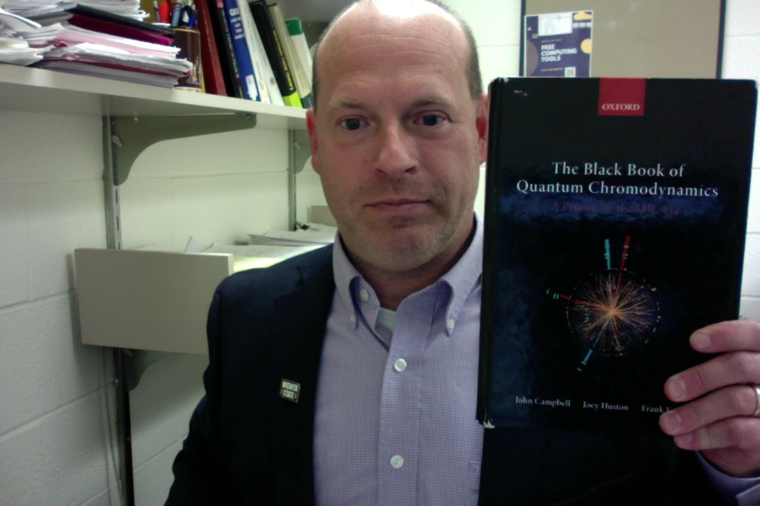
NLO Multijet Merging for Higgs Production Beyond the VBF Approximations, Part I
Dr. Terrance Figy
Associate Professor
Department of Mathematics, Statistics, and Physics
Wichita State University
Particles Physics on the Plains 2022 Part 2 October 22-23, 2022

Slide 2
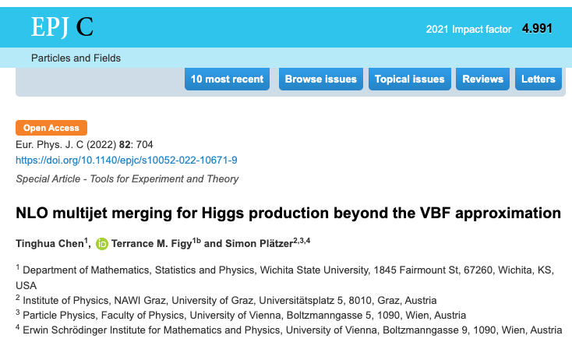
References and Thanks to Collaborators…
Collaborators: Simon Platzer, Peter Schichtel, Michael Rauch, Malin Sjodahl, Francisco Campanario, and Tinghua Chen.
https://arxiv.org/abs/2109.03730 (Published in 2022! )
https://arxiv.org/abs/1802.09955
https://arxiv.org/abs/1610.07922
https://arxiv.org/abs/1308.2932
https://arxiv.org/abs/0710.5621
In a full talk I would discuss the history of calculations.
Notes:
Yes, I like to talk about the same thing over and over.

Slide 3
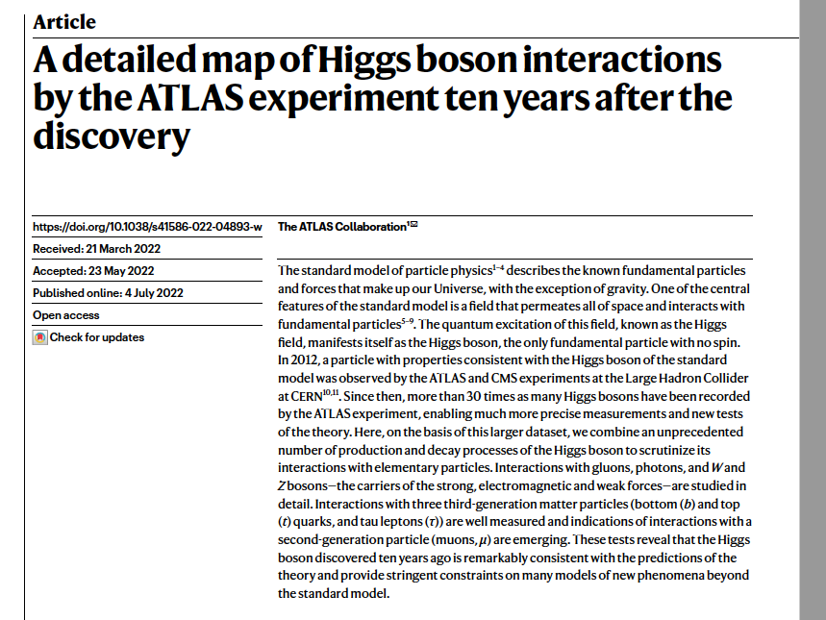
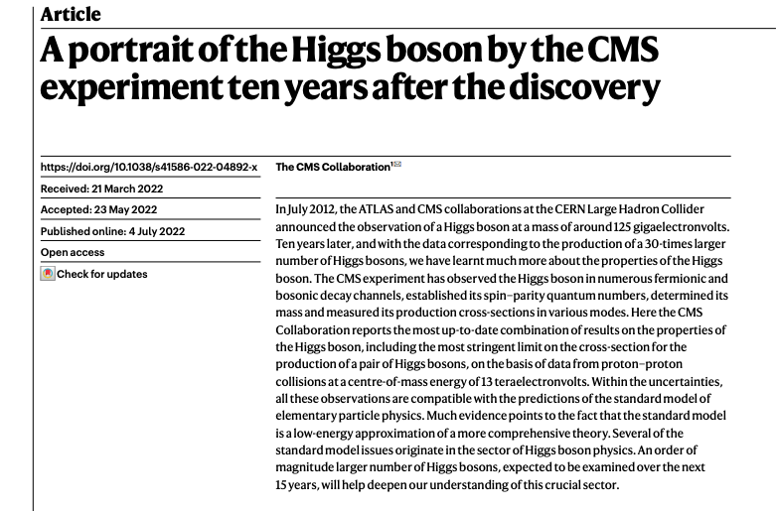
10 Years of the Higgs Boson
July 4, 2022 [https://www.nature.com/articles/s41586-022-04893-w, https://www.nature.com/articles/s41586-022-04892-x]

Slide 4
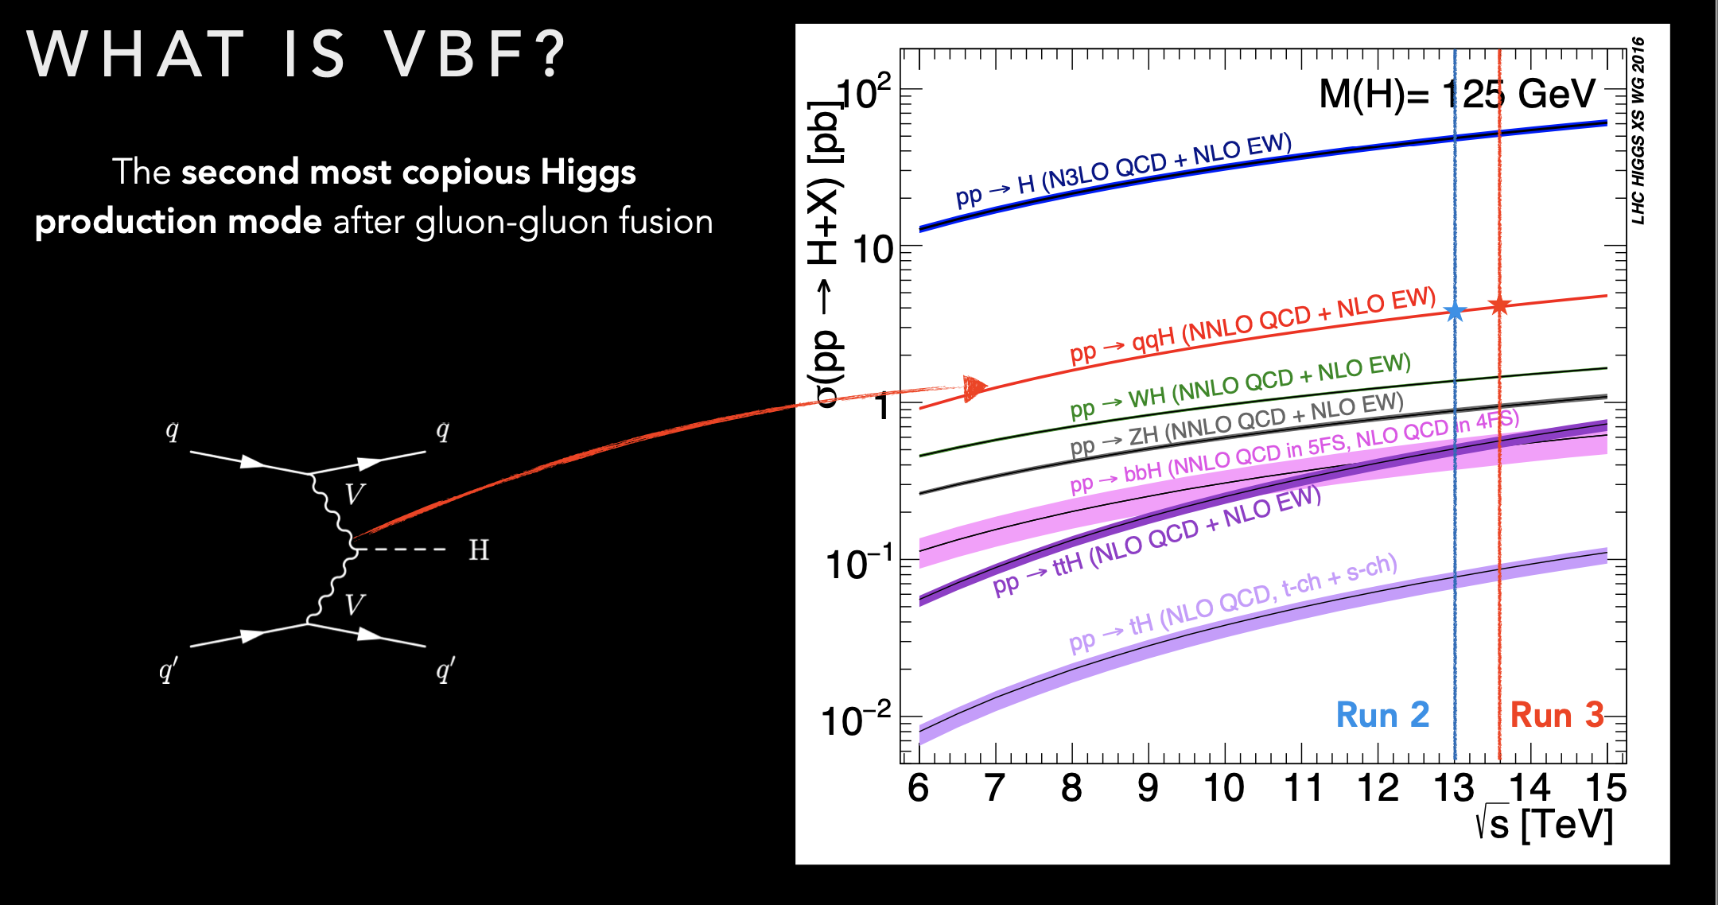

Slide 5
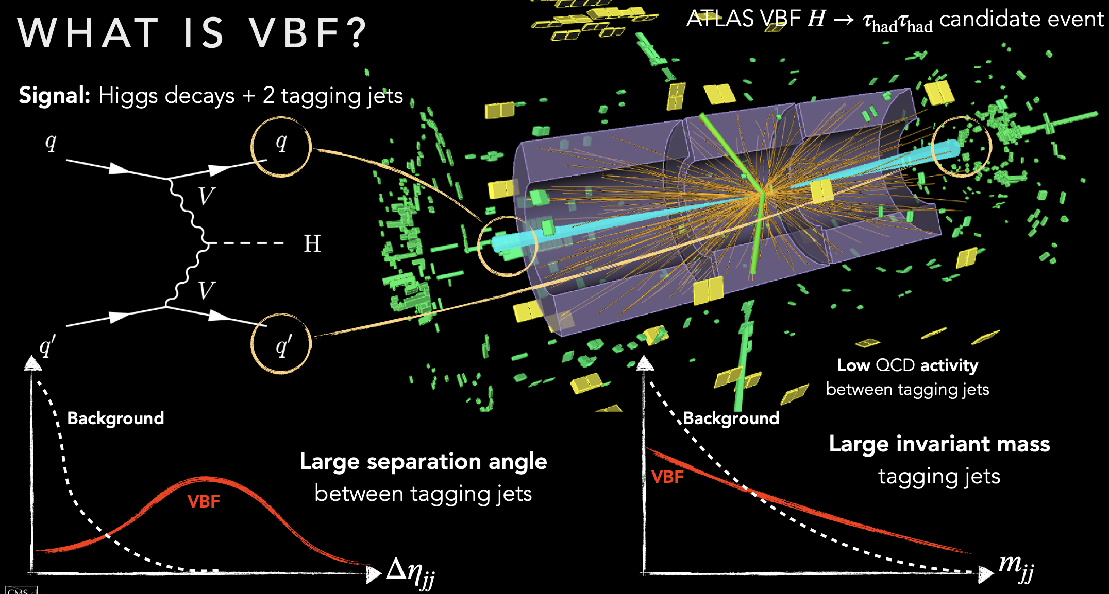

Slide 6
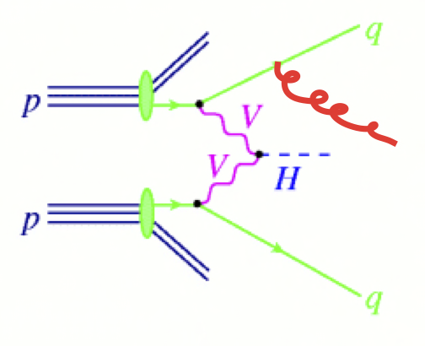
Vector Boson Fusion (+Jet)

Slide 7
Simulation Tools and Matrix Elements
Herwig 7 Event Generator (https://herwig.hepforge.org)
  General purpose event generator,
  parton showers, hadronization, MPI modeling
HJETS++ (https://hjets.hepforge.org)
  Add-on module to Herwig 7
VBFNLO (https://www.itp.kit.edu/vbfnlo)
  Interfaced to Herwig 7 via the Binoth One-Loop Accord

Slide 8
HJETS
F. Campario, T. M. Figy, S. Platzer, and M. Sjodahl, PRL 111, 211802
Matchbox [S. Platzer and S. Gieseke, arXiv:1109.6256]
  Catani-Seymour Dipole subtraction [hep-ph/9605323]
  Subtractive and POWHEG style matching to parton shower
  ColorFull [M. Sjodahl, arXiv:1211.2099, http://colorfull.hepforge.org]
Tensorial Reduction [F. Capanario, arXiv:1105.0920]
Scalar Loop Integrals: OneLOop [A. van Hameren arXiv:1007.4716 ]

Slide 9
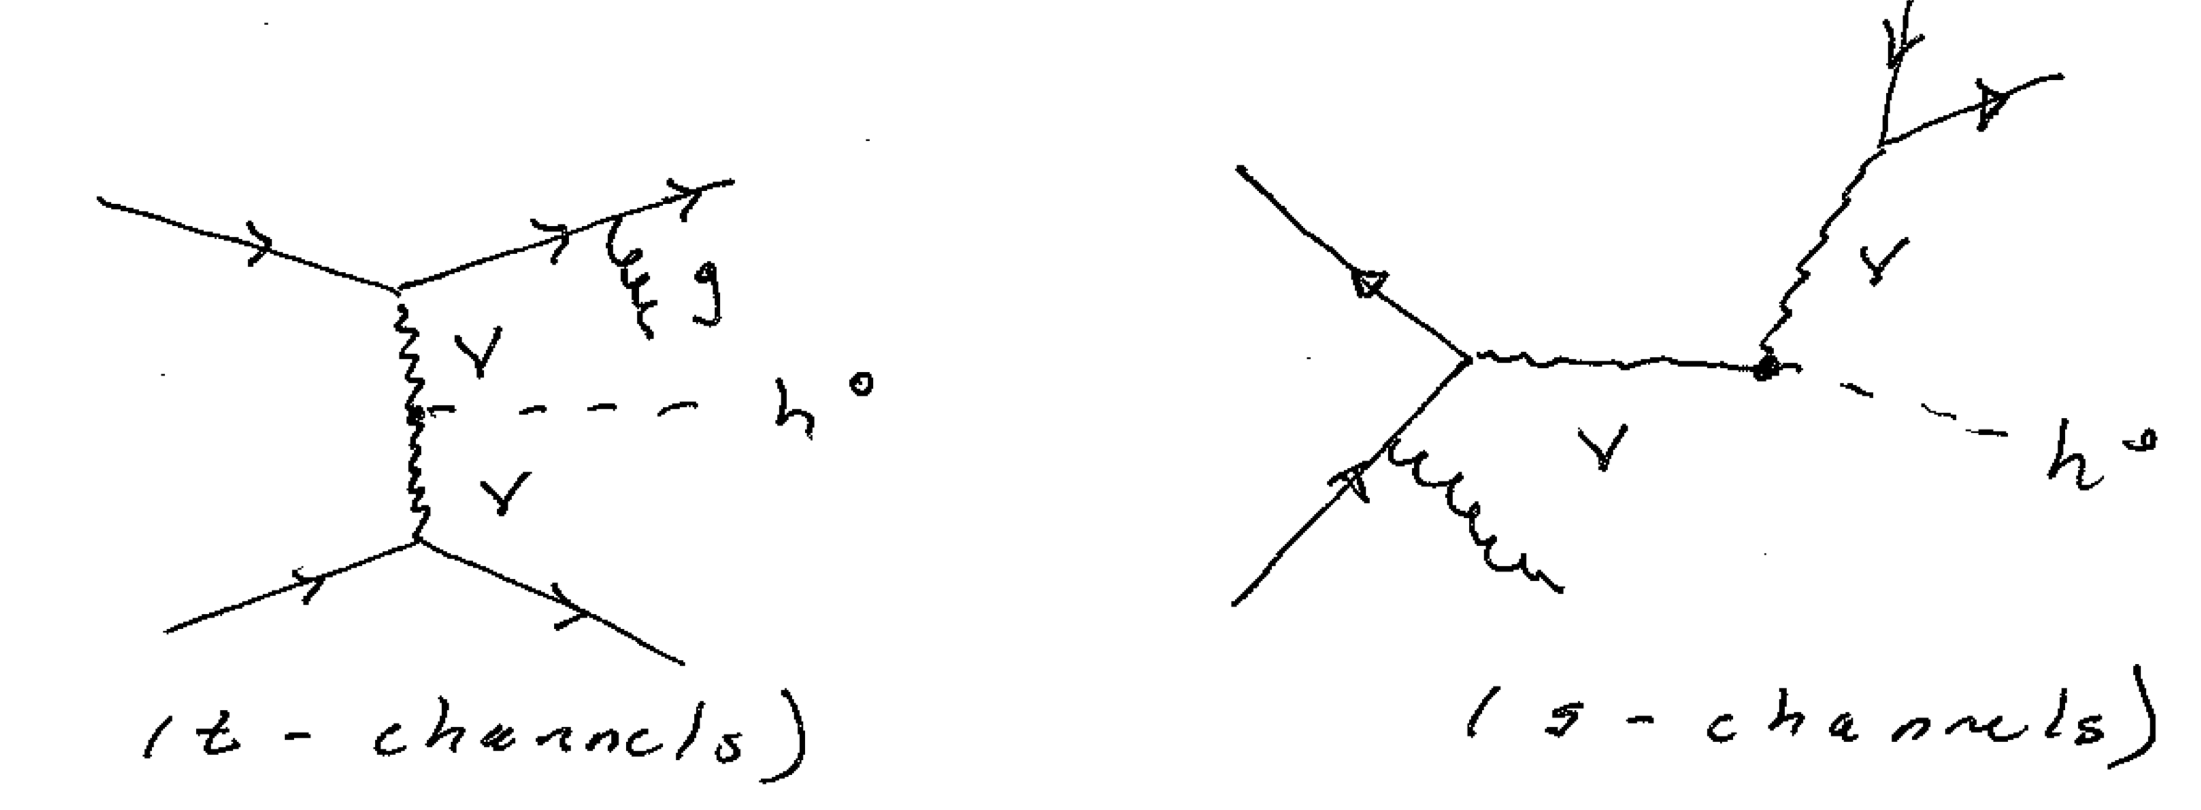
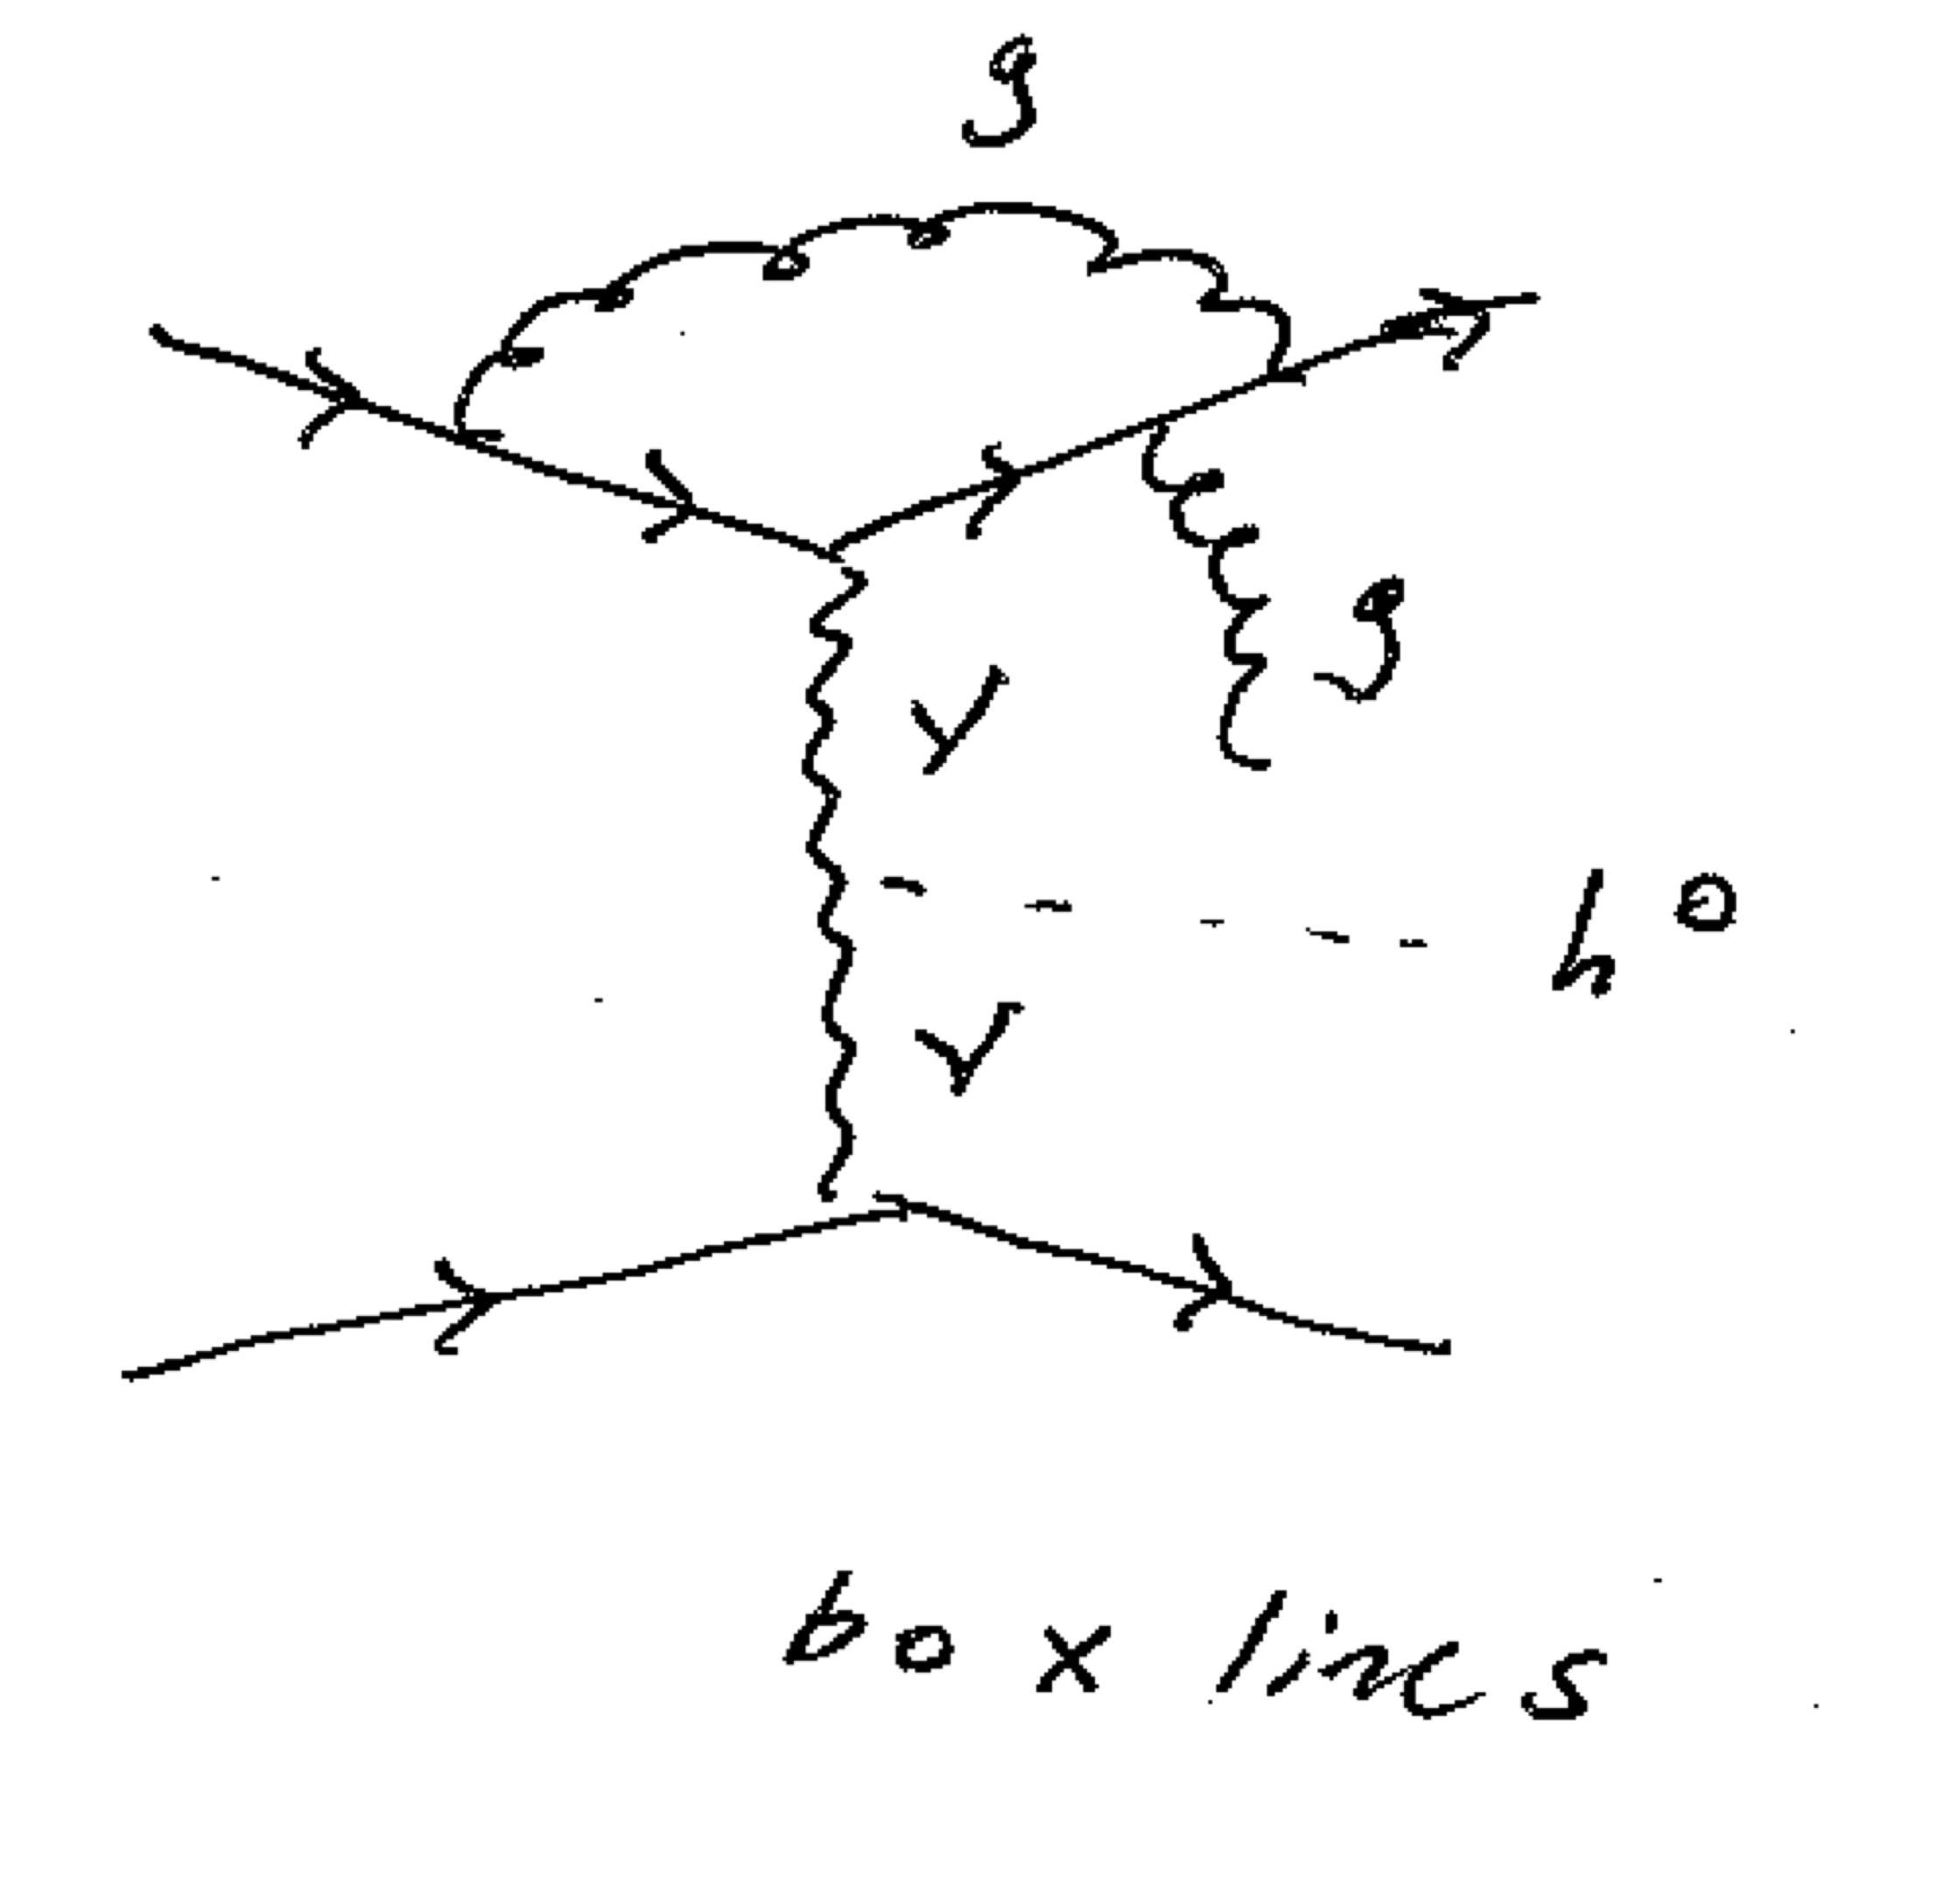
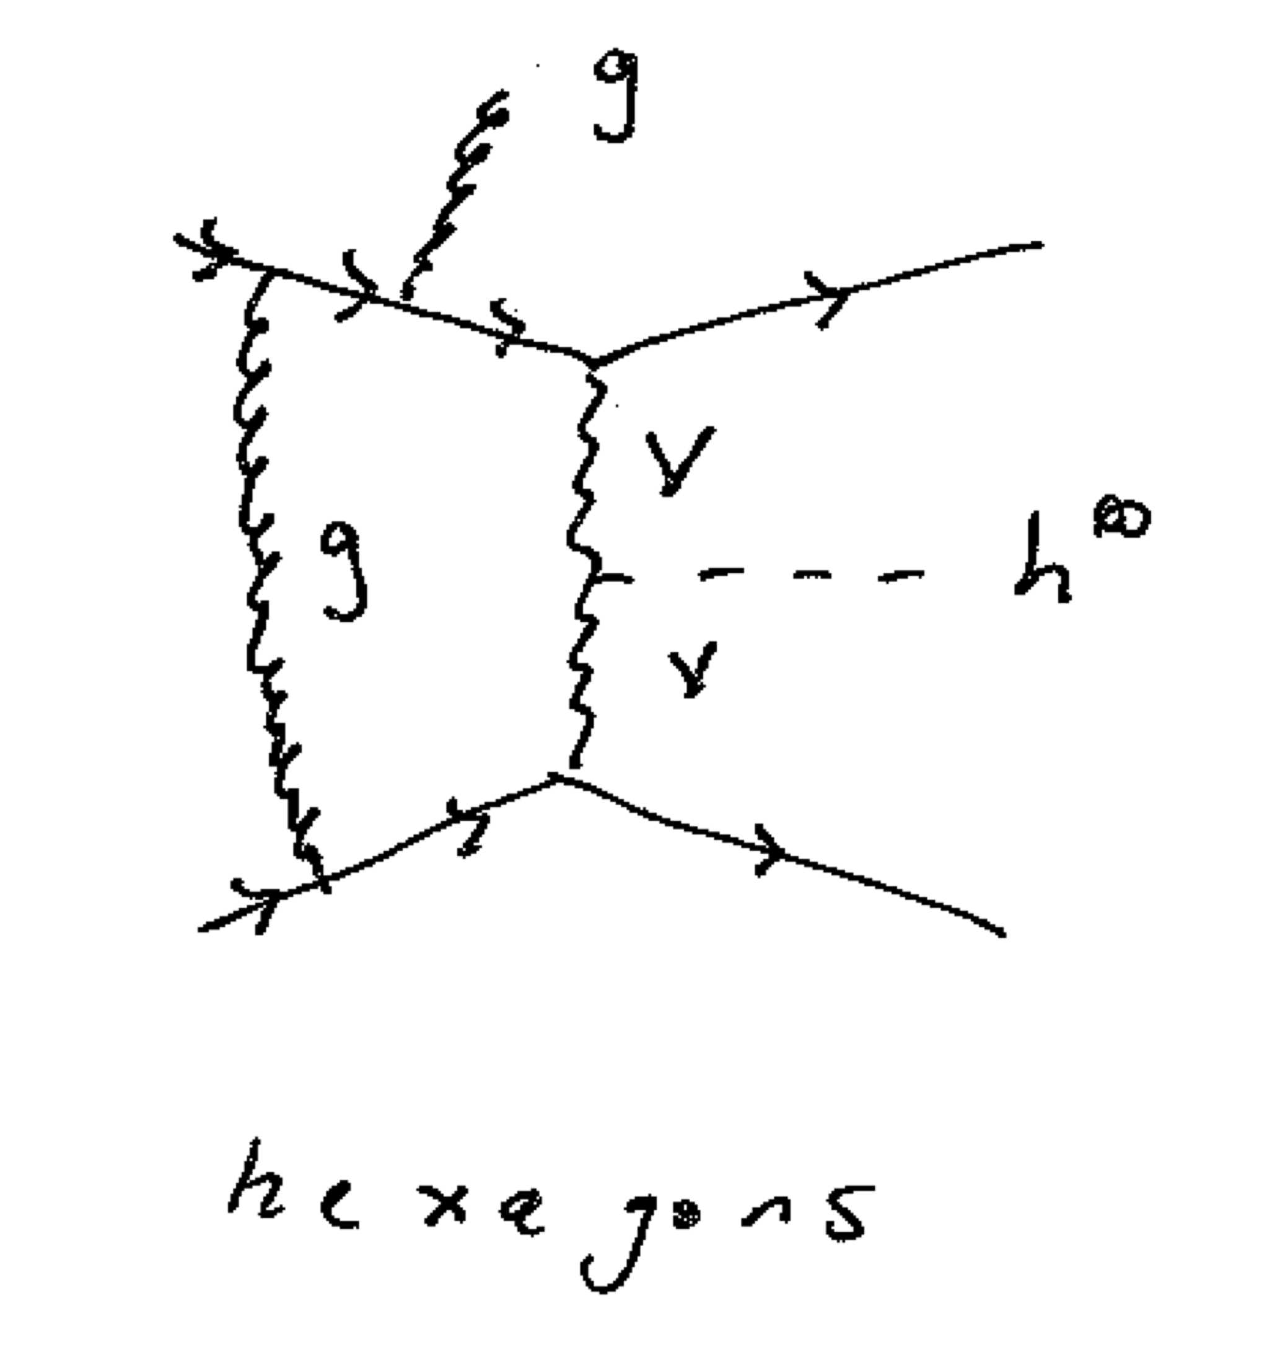
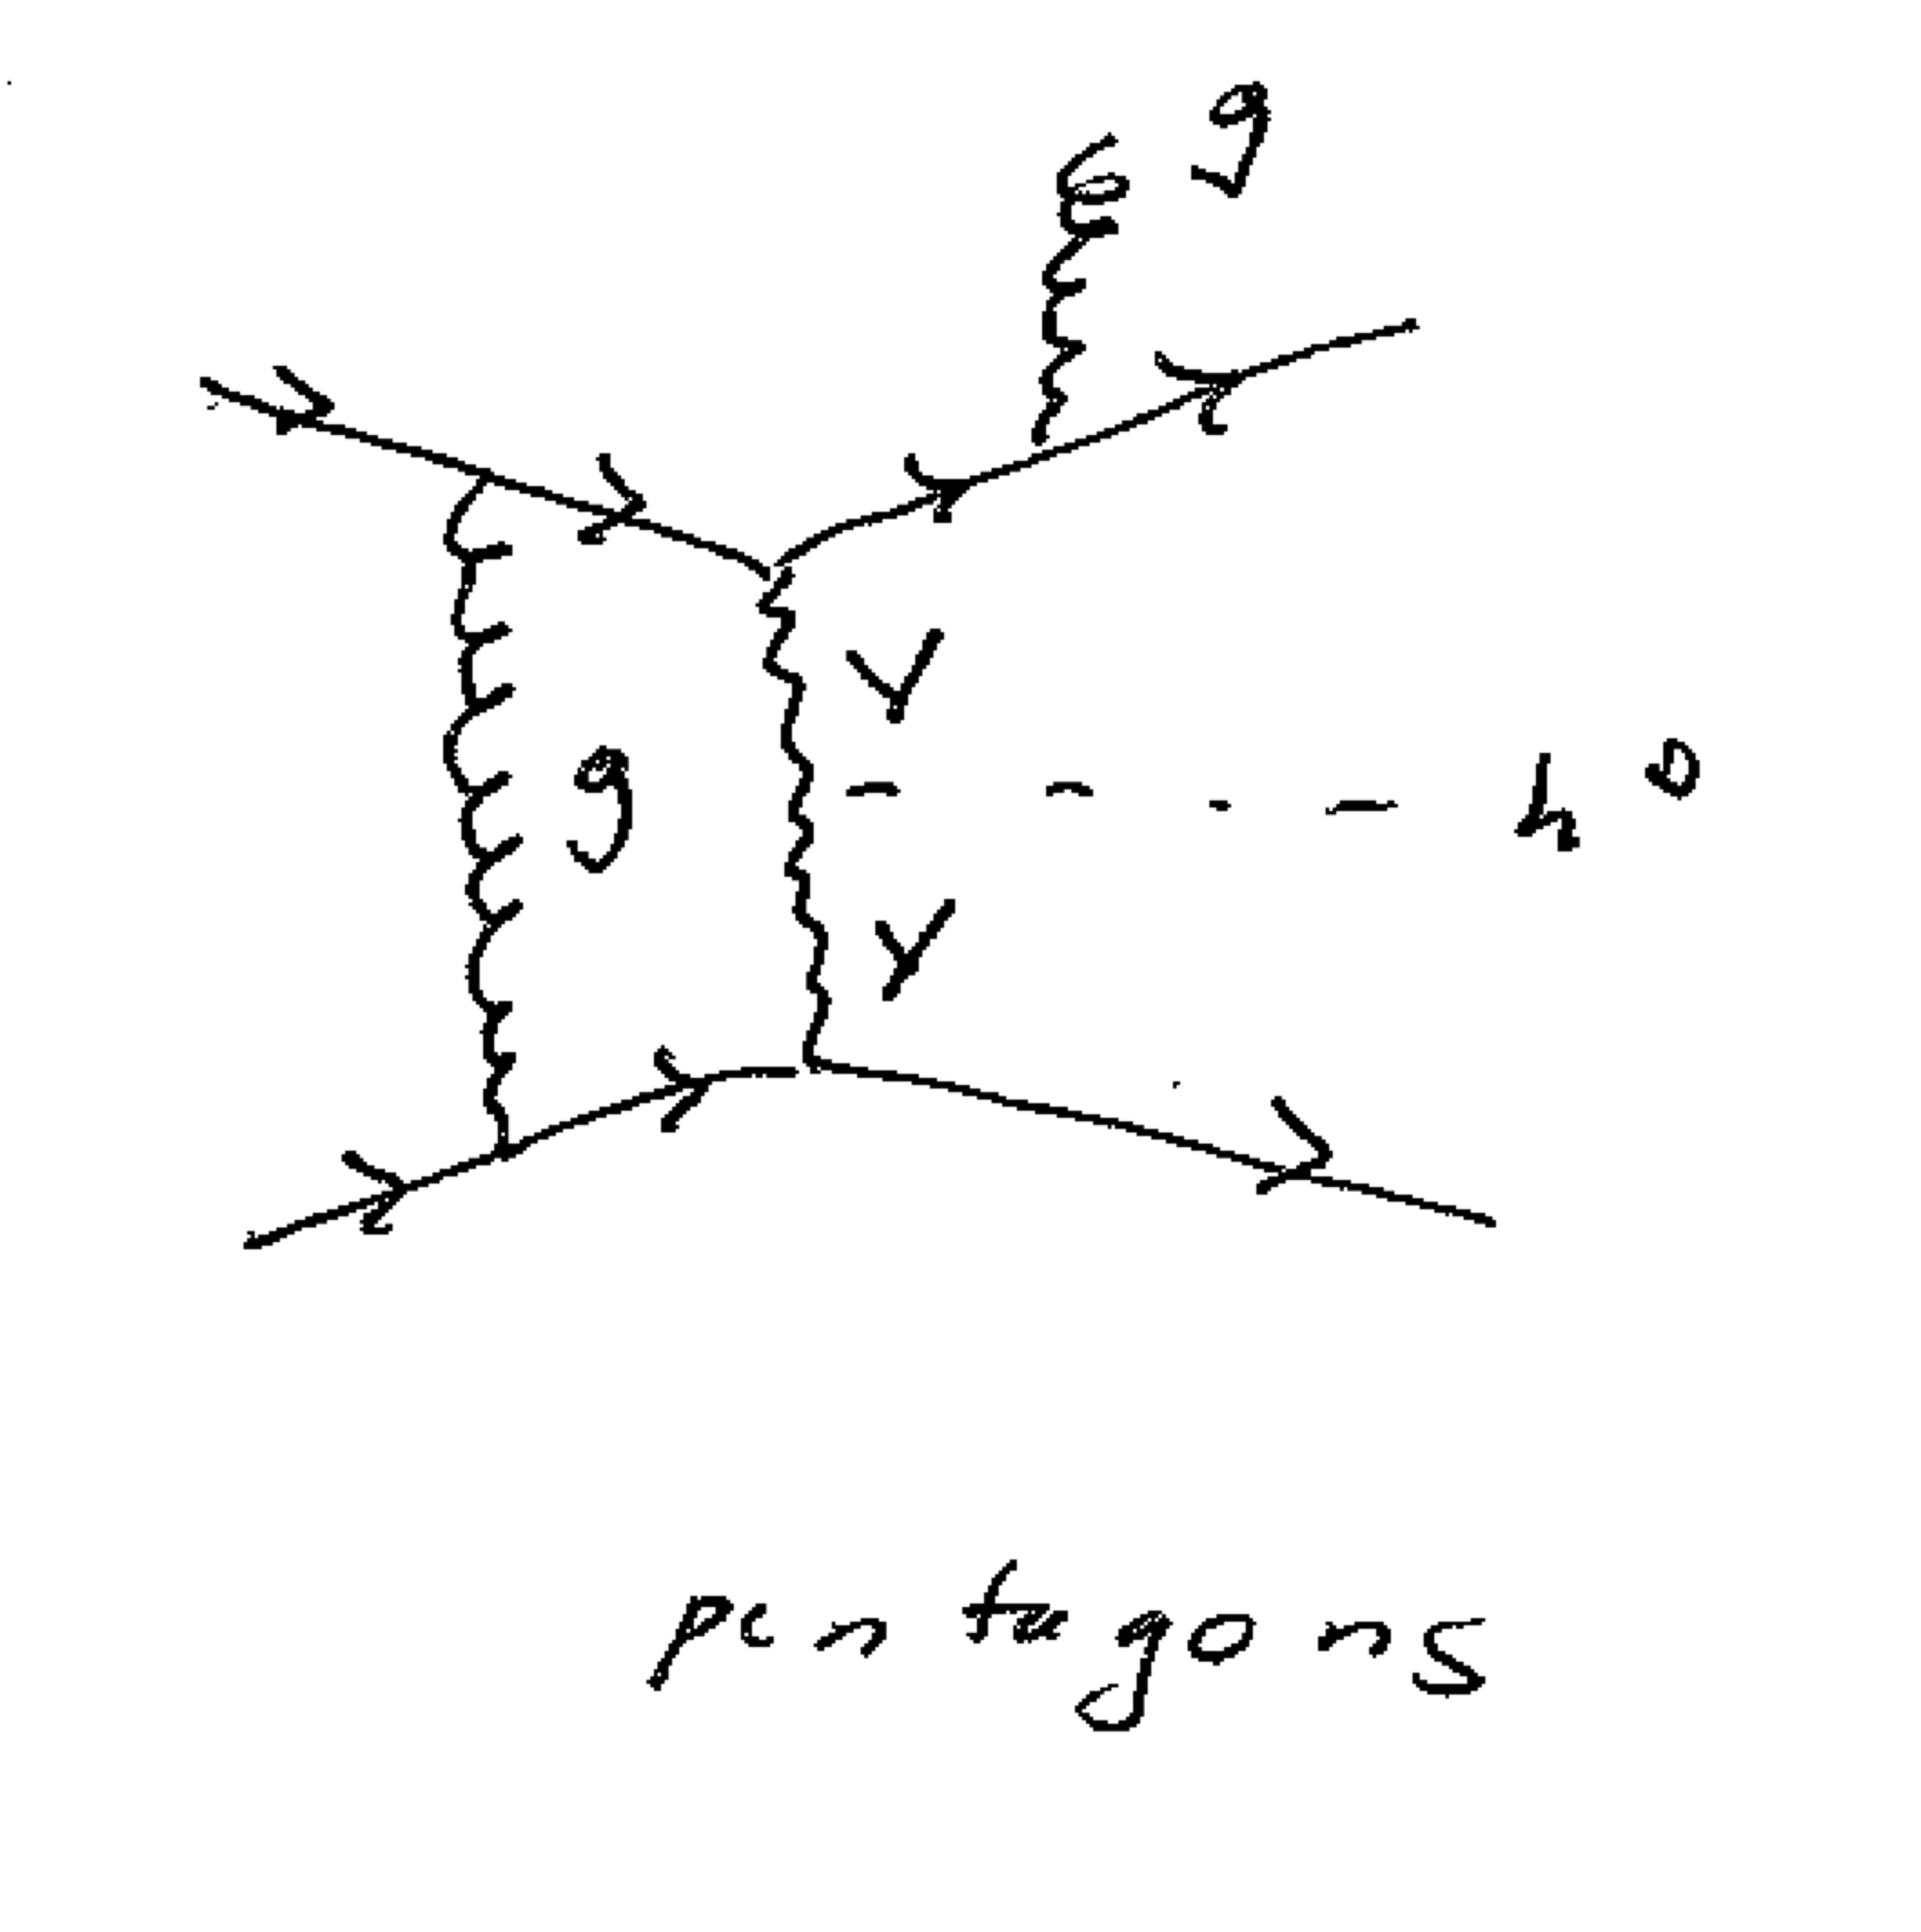
HJETS

Slide 10
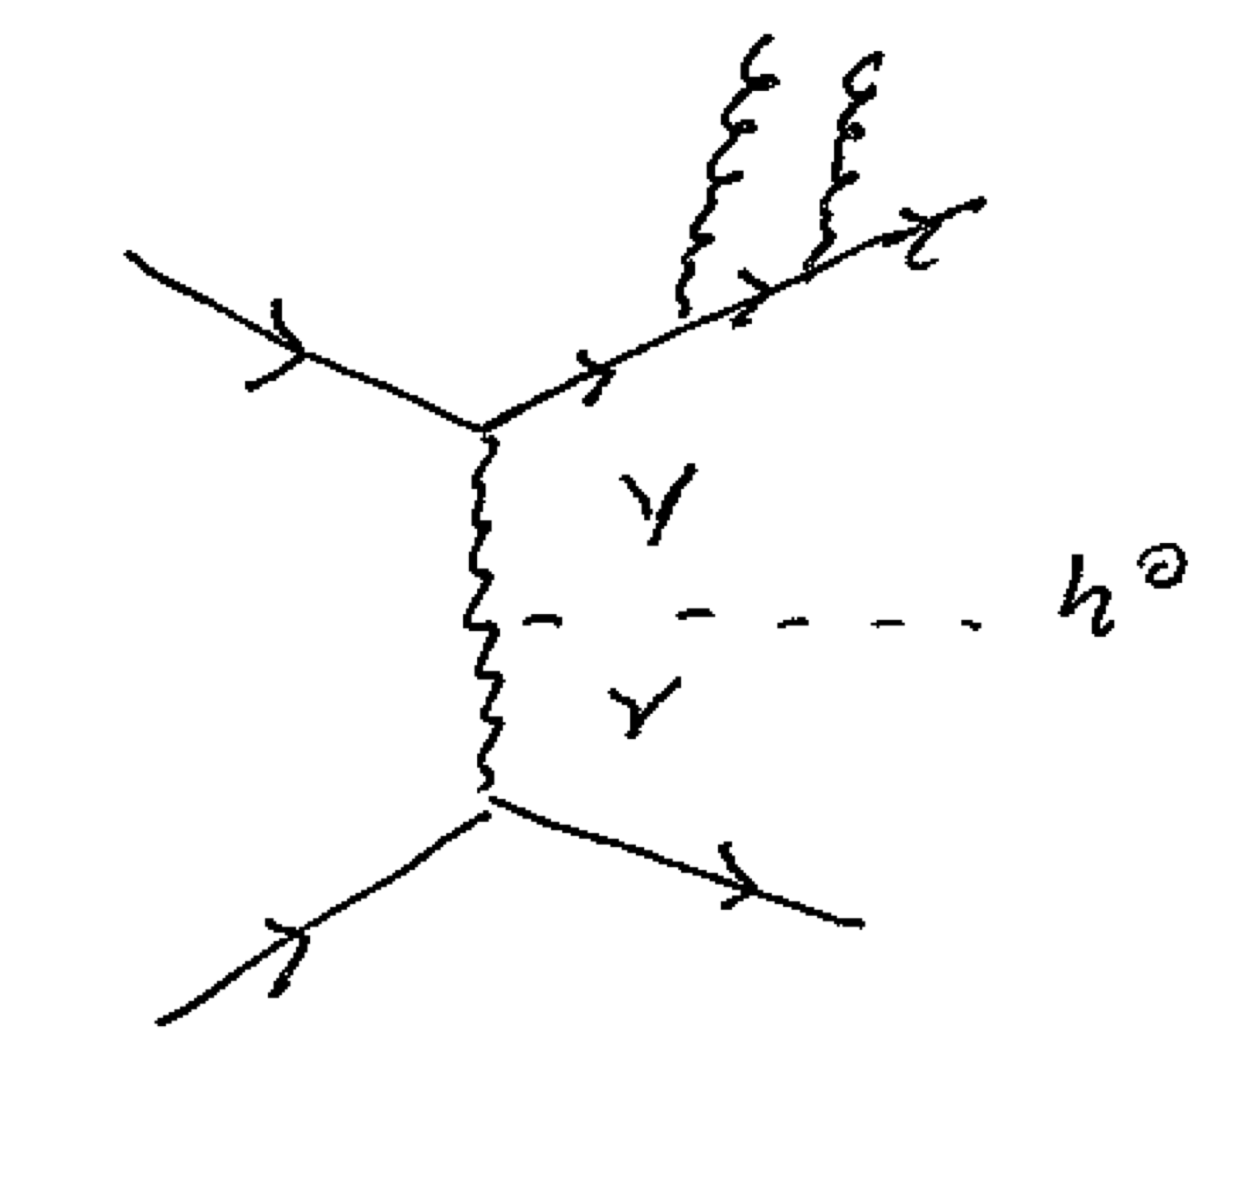
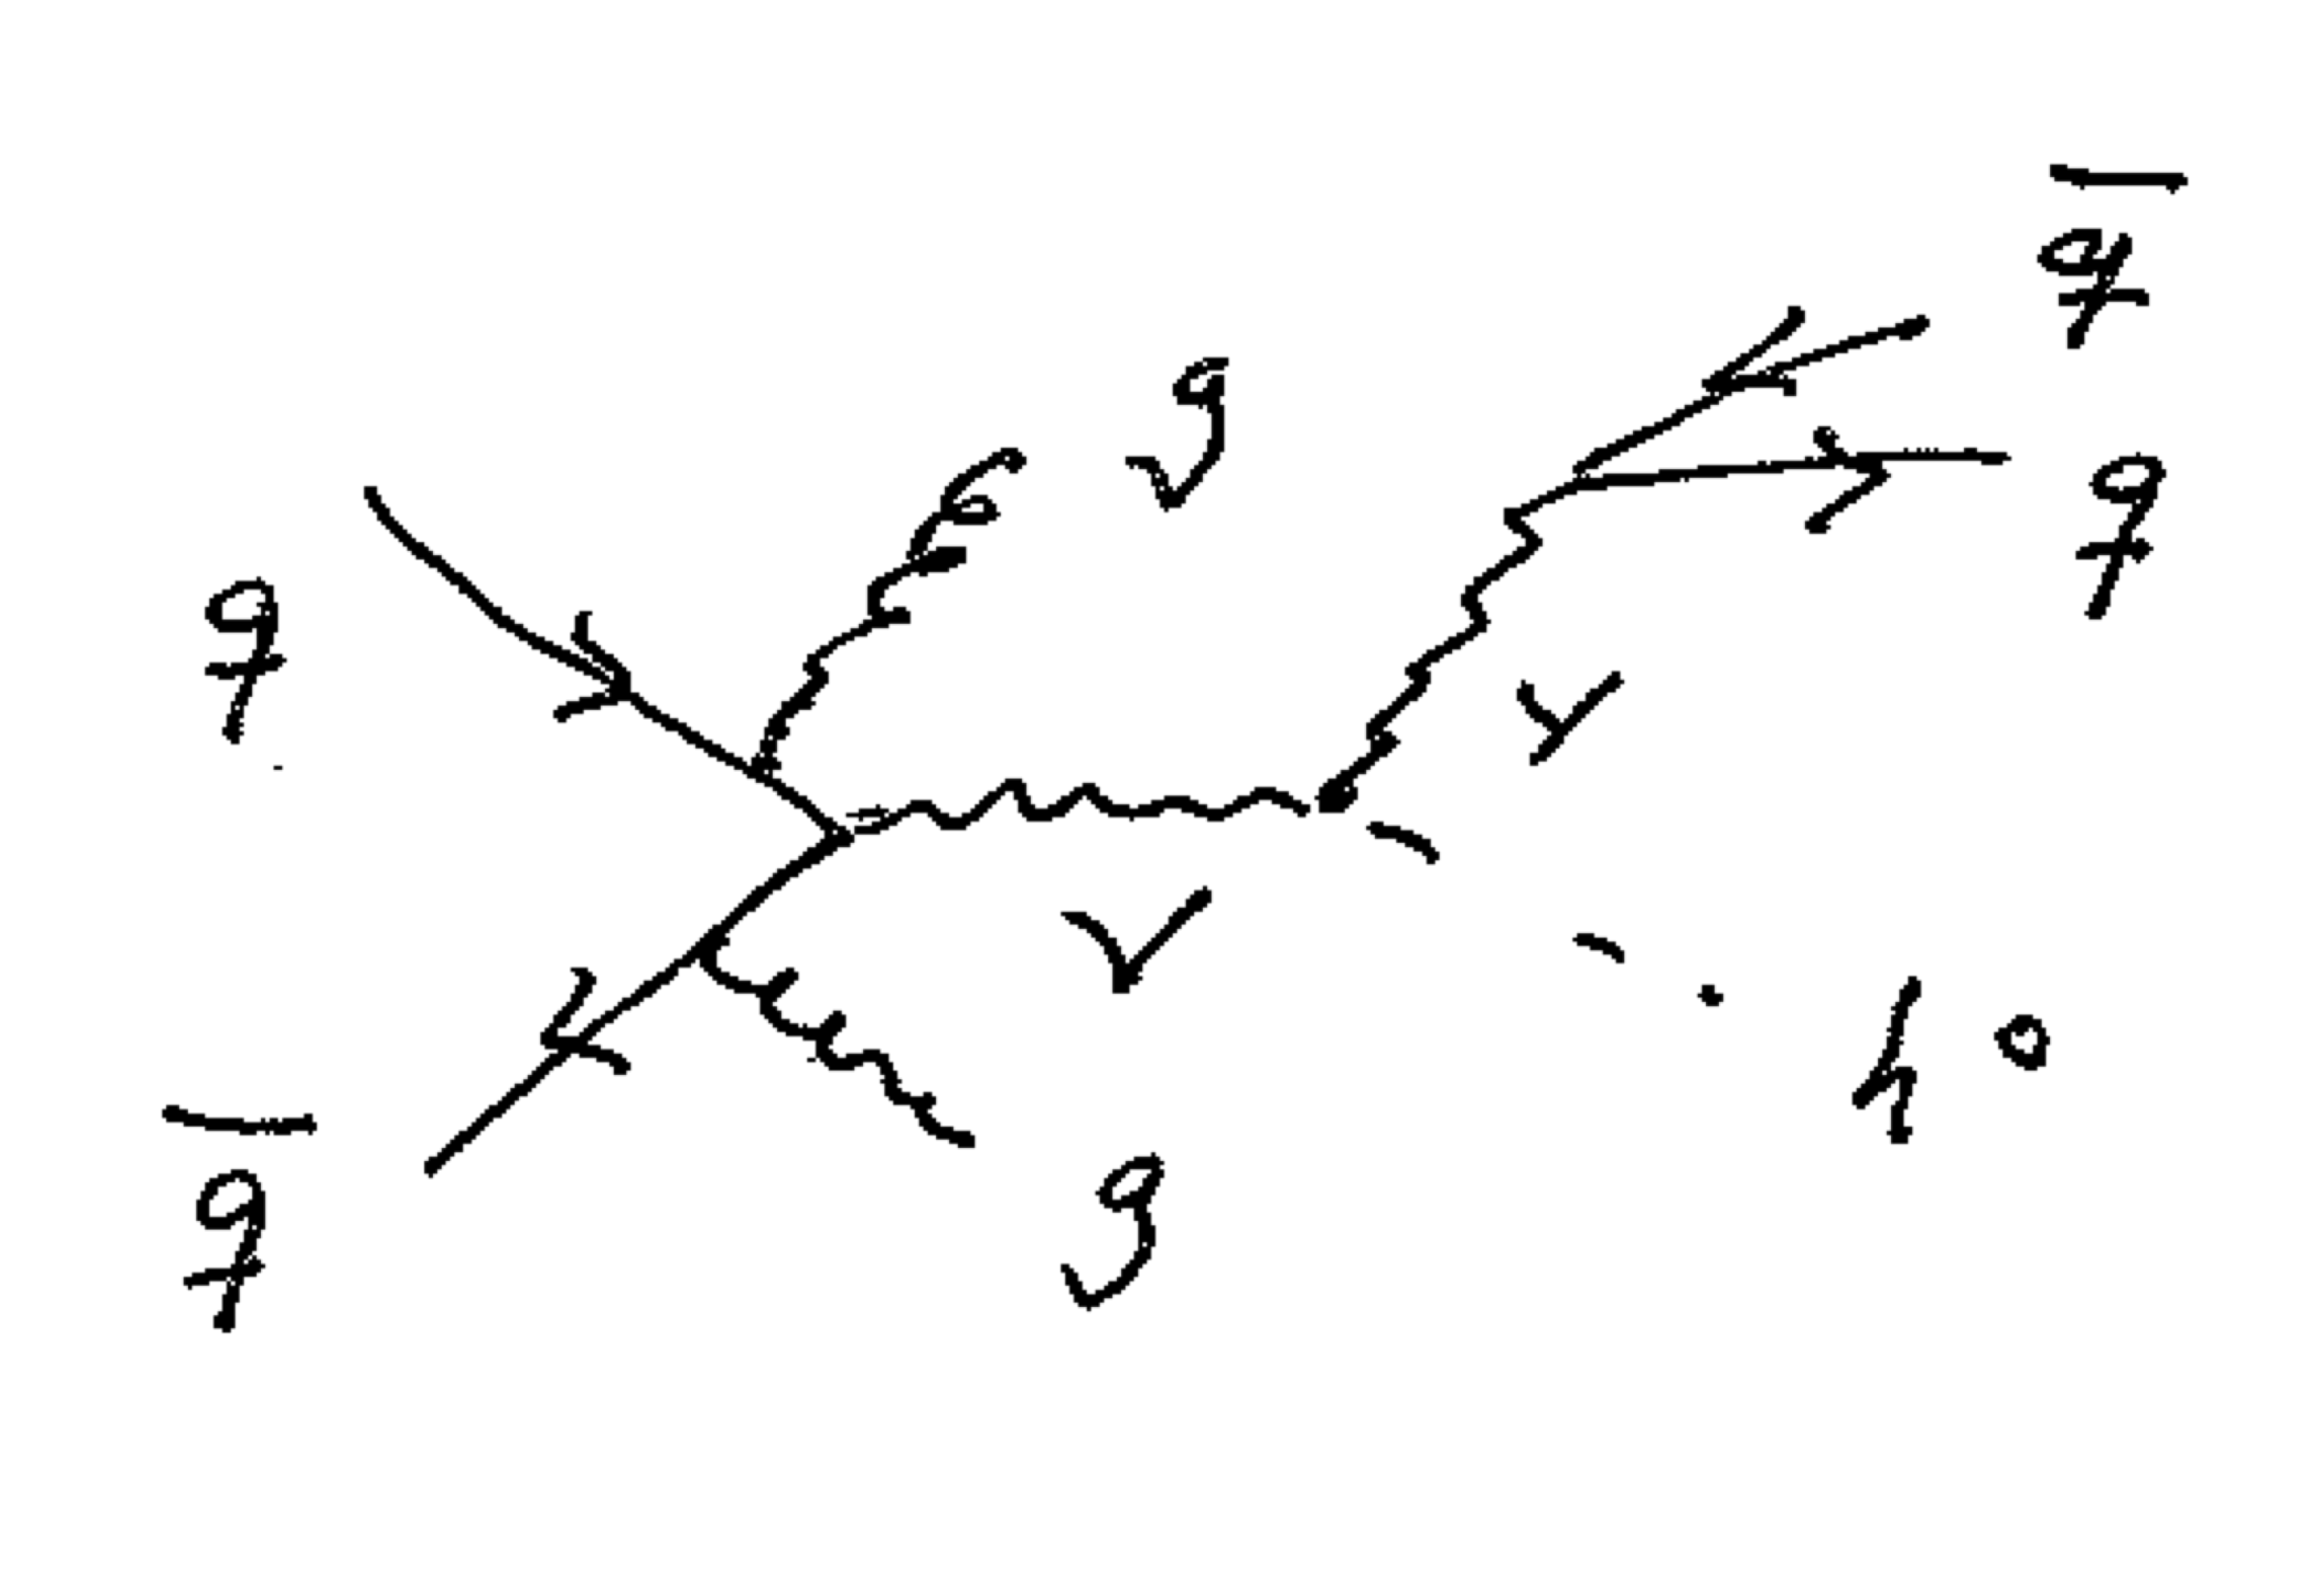
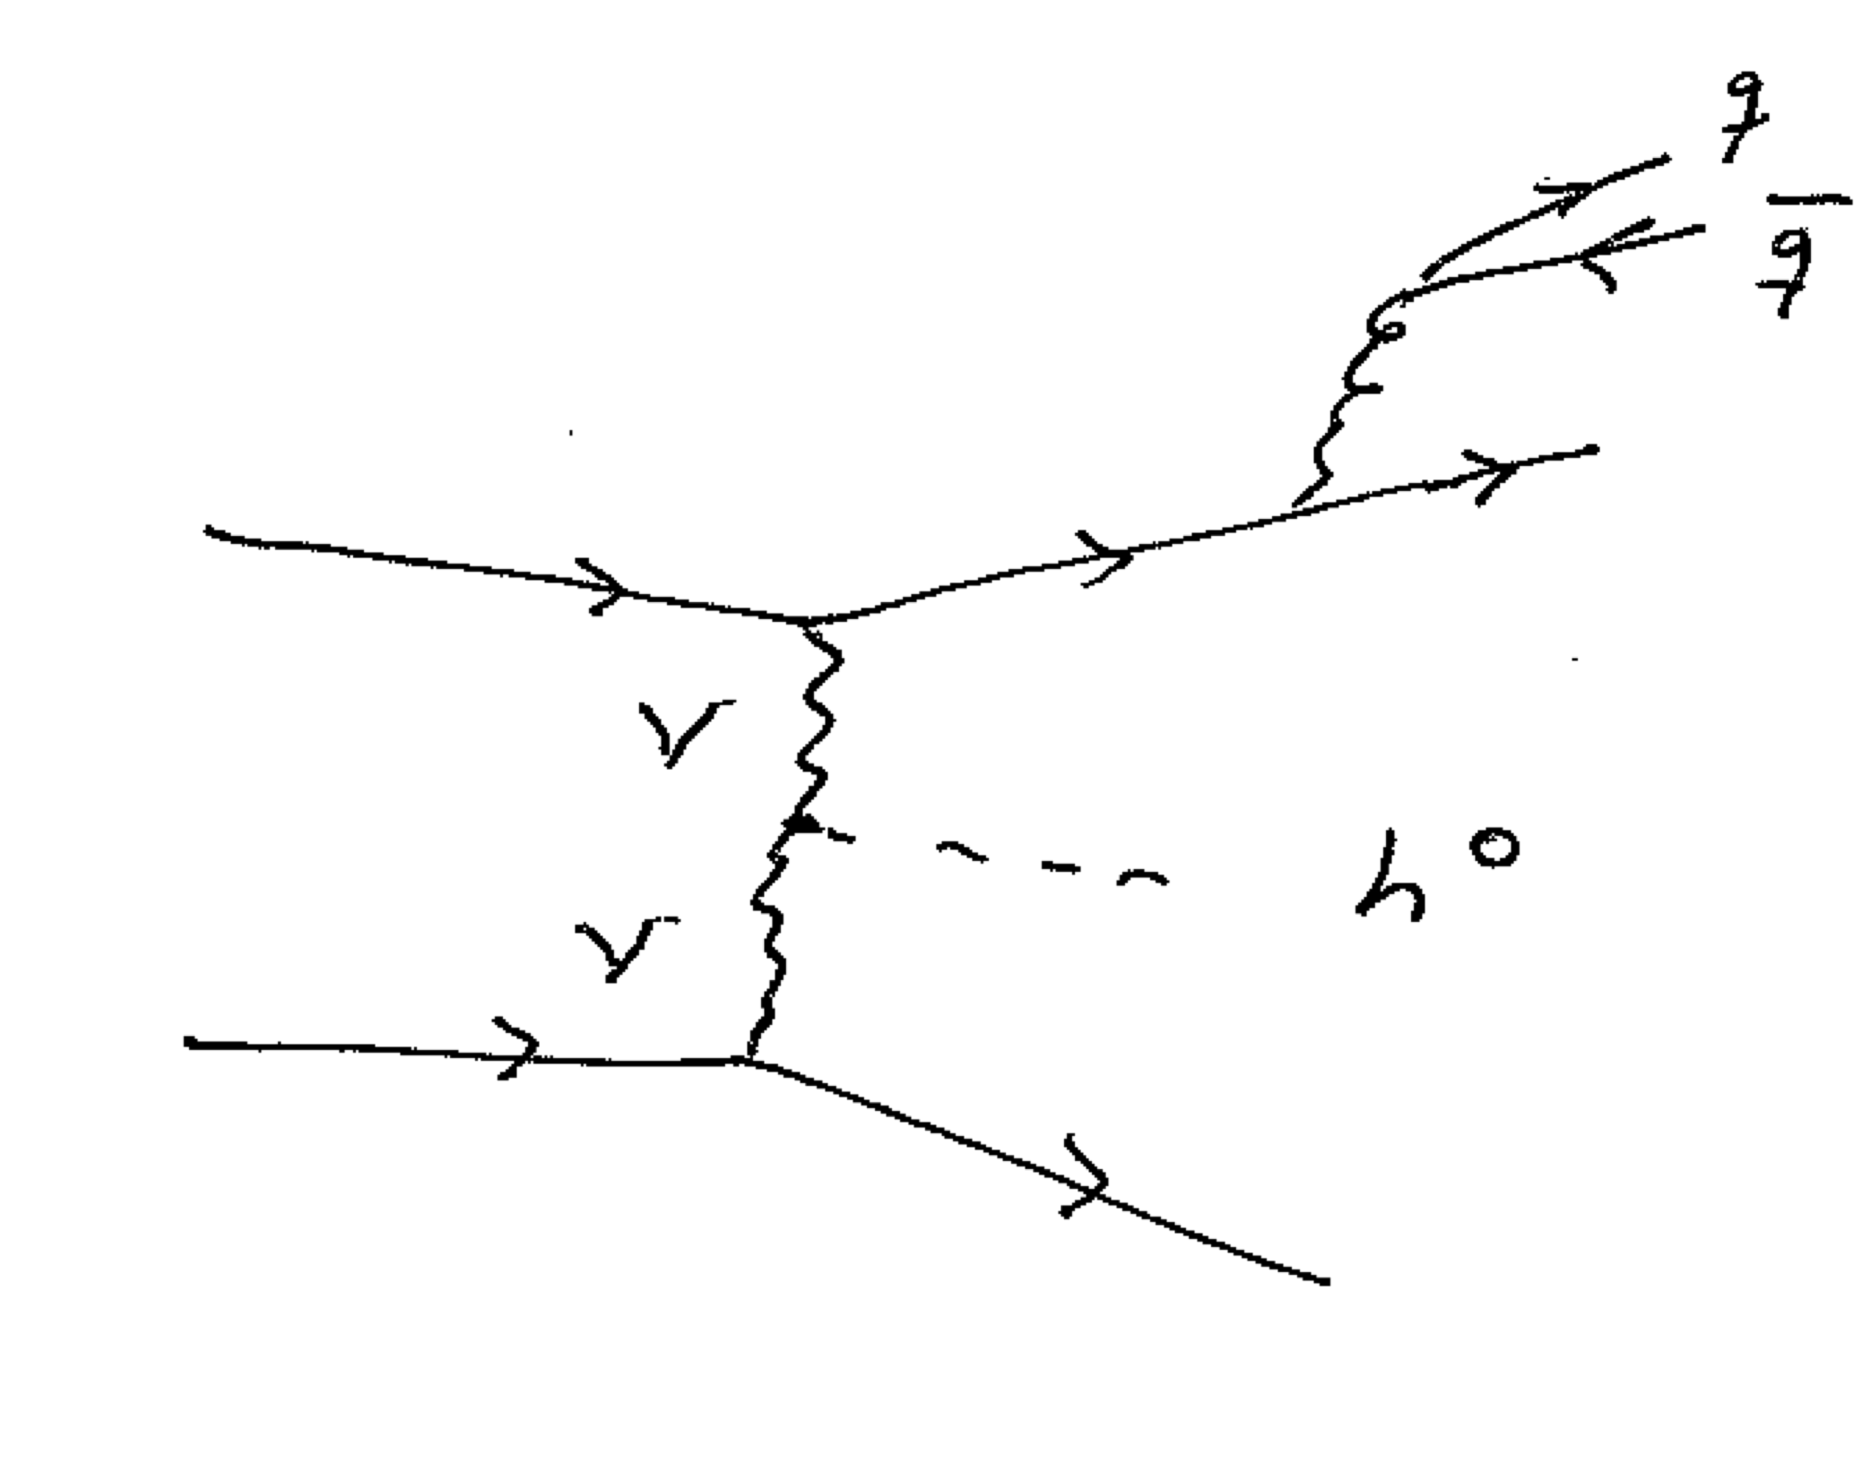
HJETS
Real Corrections

Slide 11
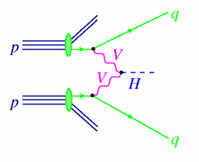
VBFNLO
Project Description
VBFNLO is a fully flexible parton level Monte Carlo program for the simulation of vector boson fusion, double and triple vector boson production in hadronic collisions at next to leading order in the strong coupling constant. VBFNLO includes Higgs and vector boson decays with full spin correlations and all off-shell effects. In addition, VBFNLO implements CP-even and CP-odd Higgs boson via gluon fusion, associated with two jets, at the leading order one loop level with the full top-quark and bottom-quark mass dependence in a generic two Higgs doublet model.
A variety of effects arising from beyond the Standard Model physics are implemented for selected processes. This includes anomalous couplings of Higgs and vector bosons and a Warped Higgsless extra dimension model. The program offers the possibility to generate Les Houches Accord event files for all processes available at leading order.
All implemented processes can be found here.
The list of people involved in VBFNLO is here.

Slide 12
Herwig 7

Slide 13
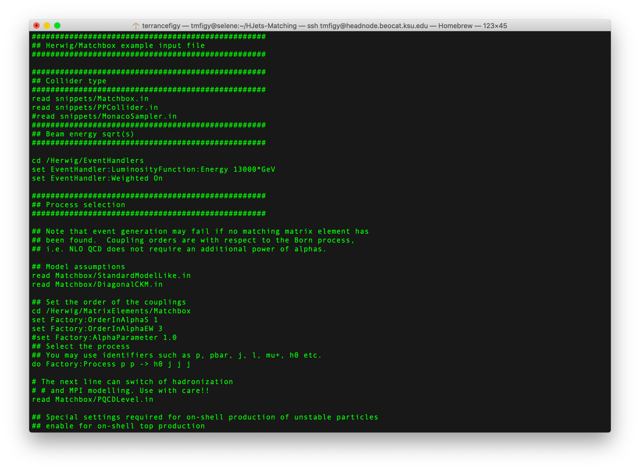
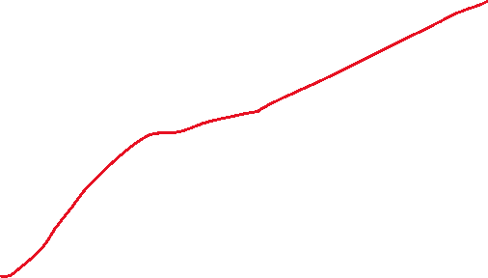

Slide 14
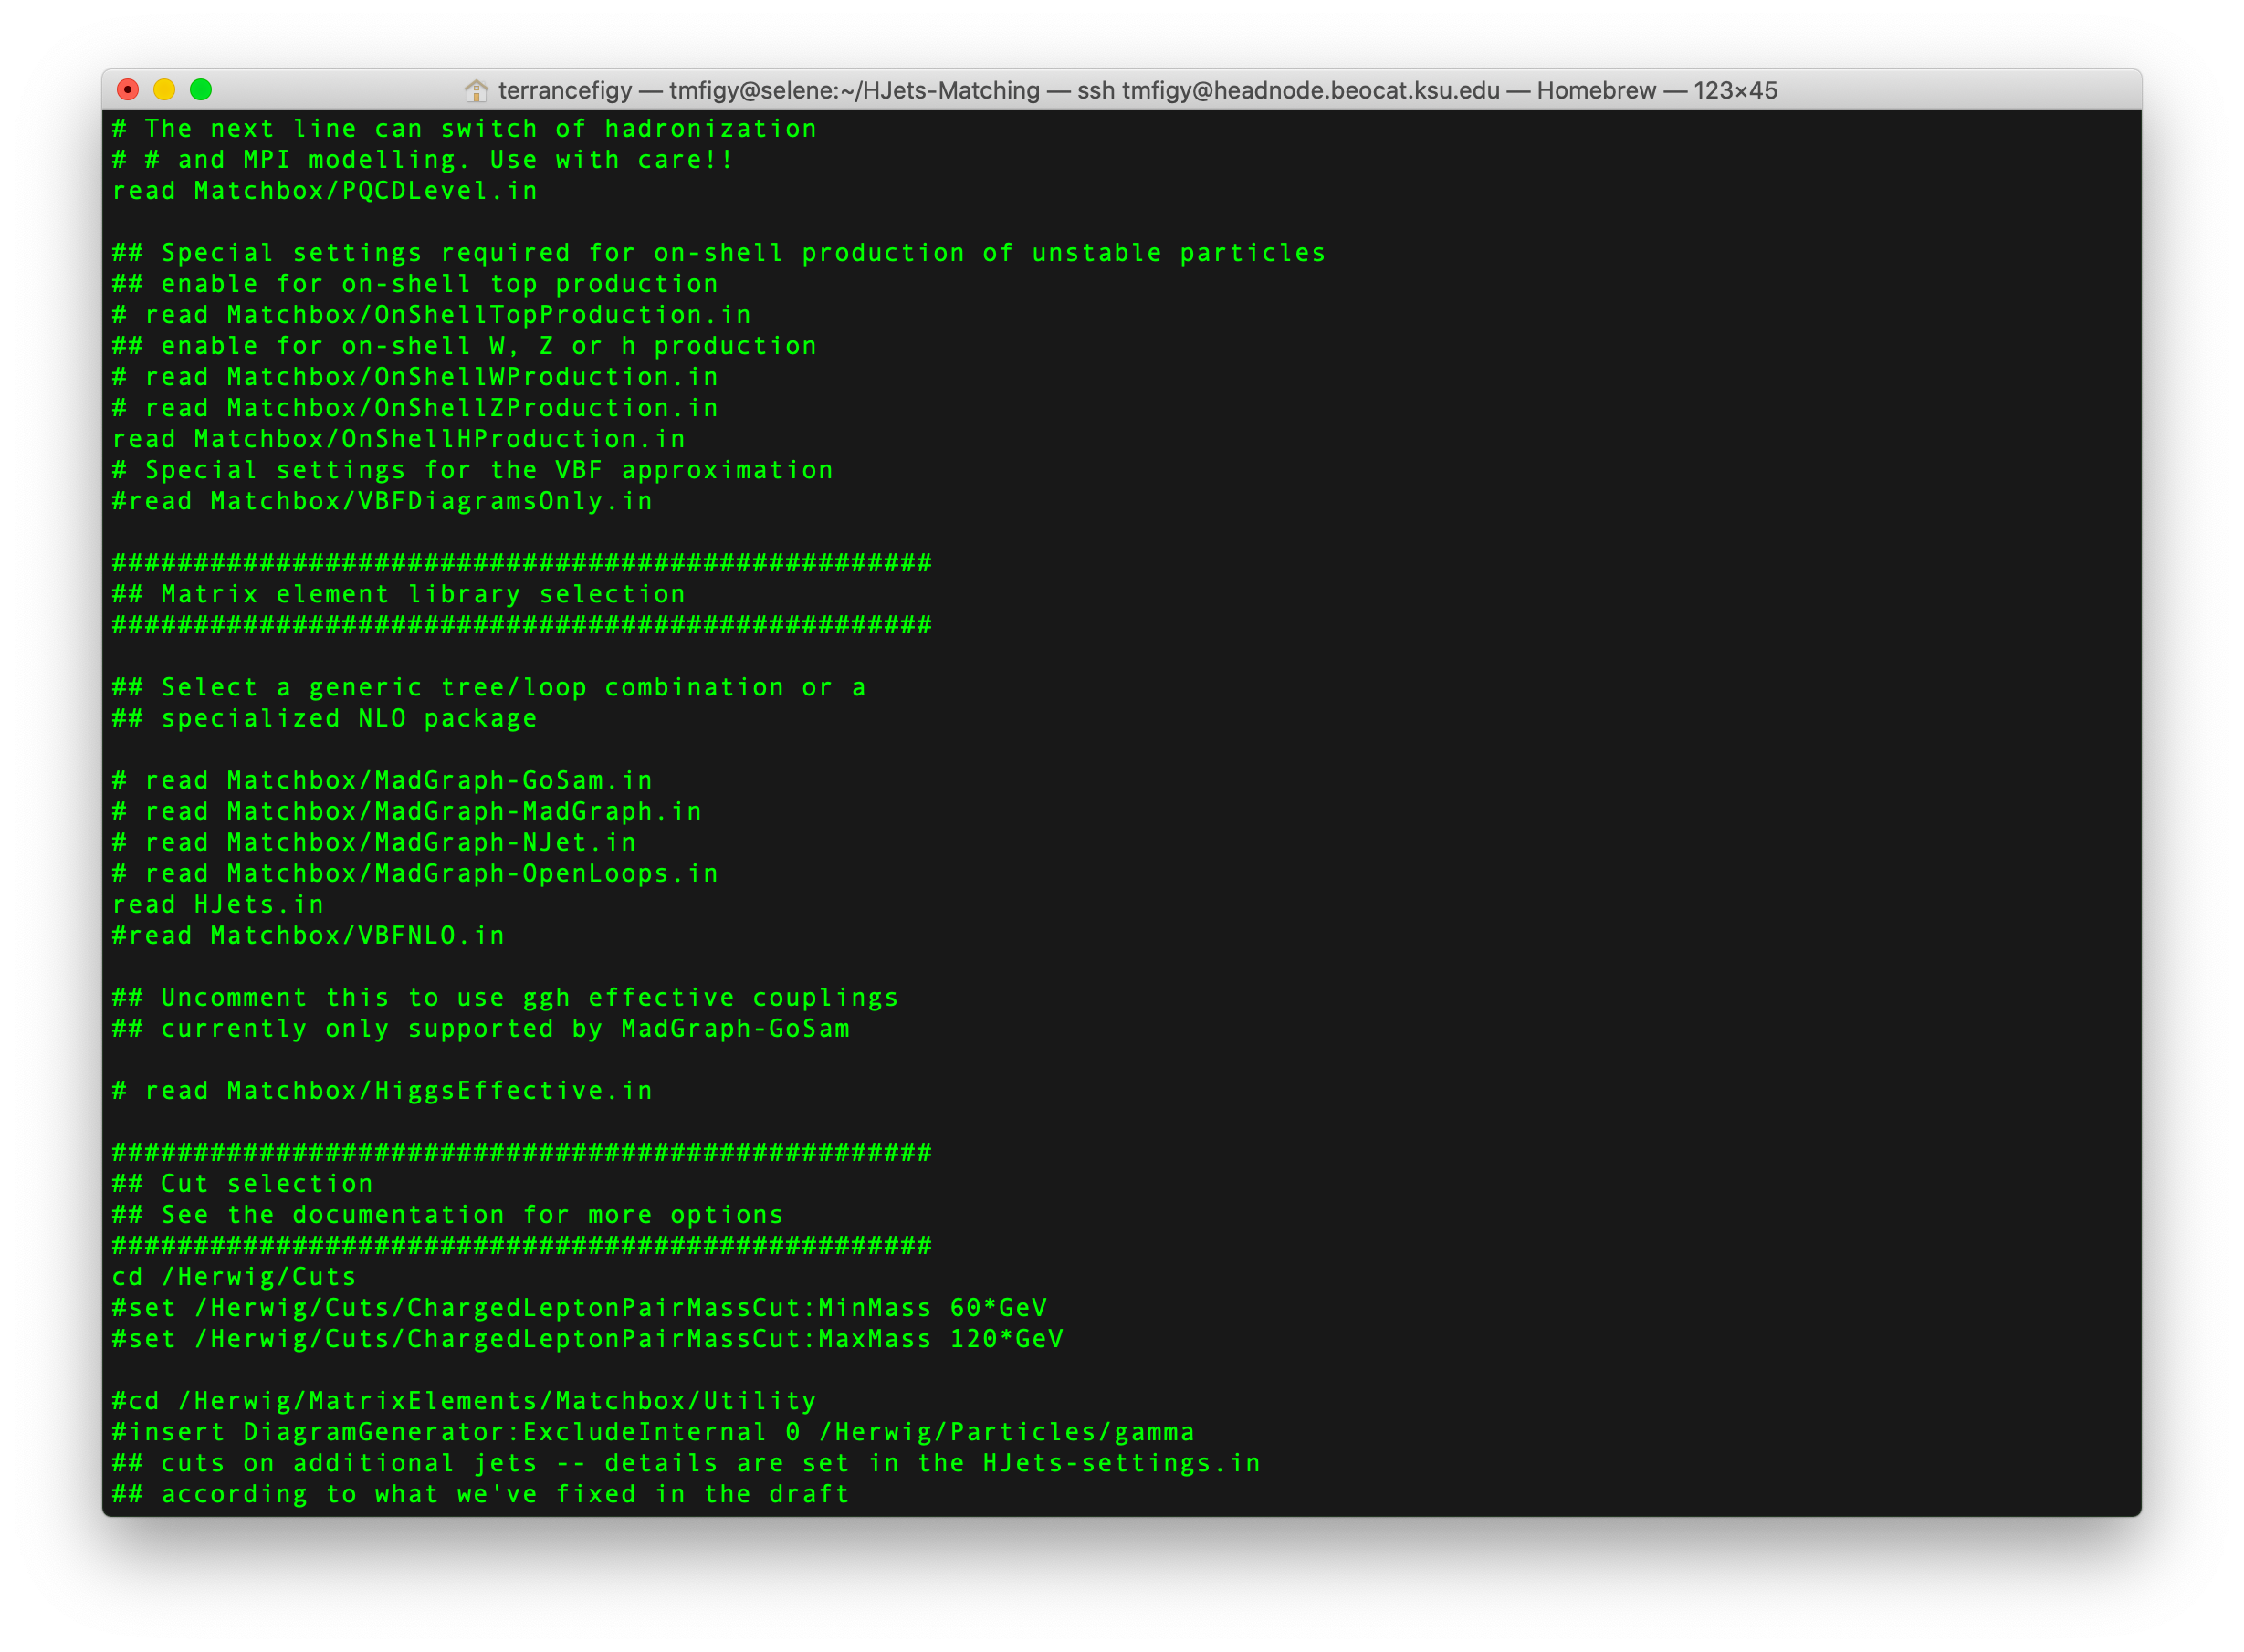

HJets
VBFNLO

Slide 15
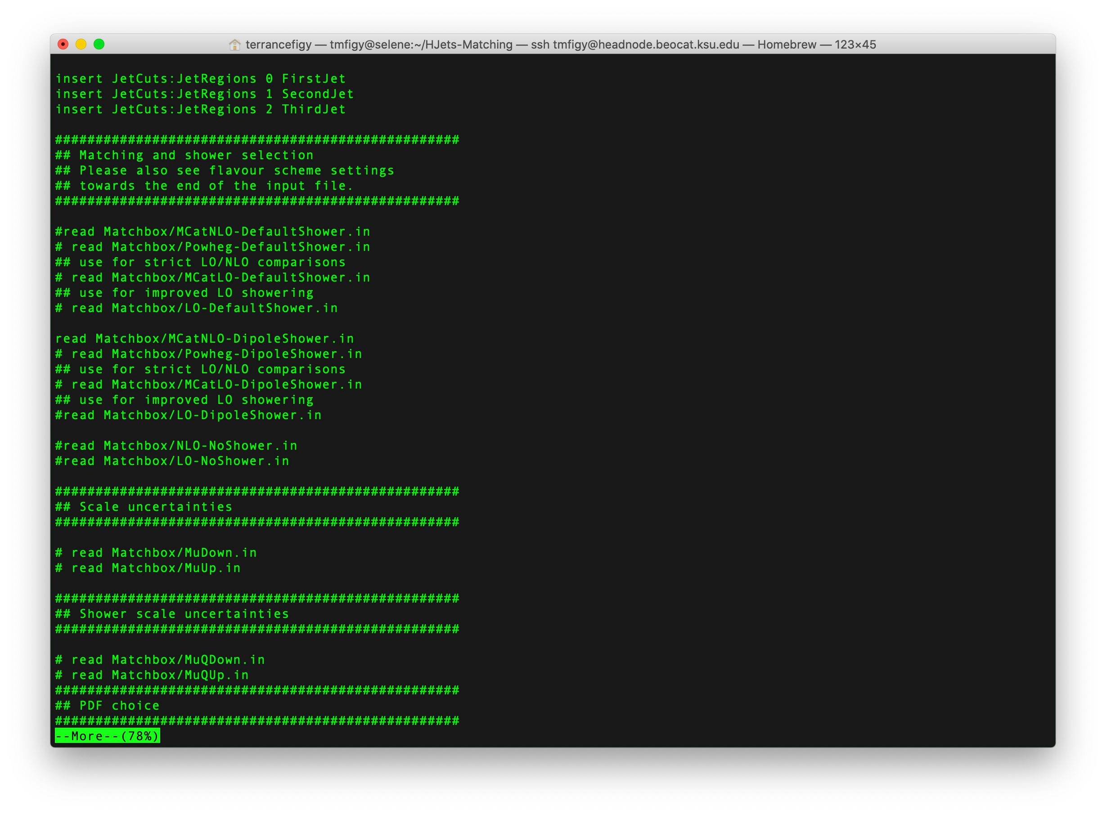


Various setup:
Fixed Order
NLO/LO matching
  Subtractive
  Powheg

Slide 16
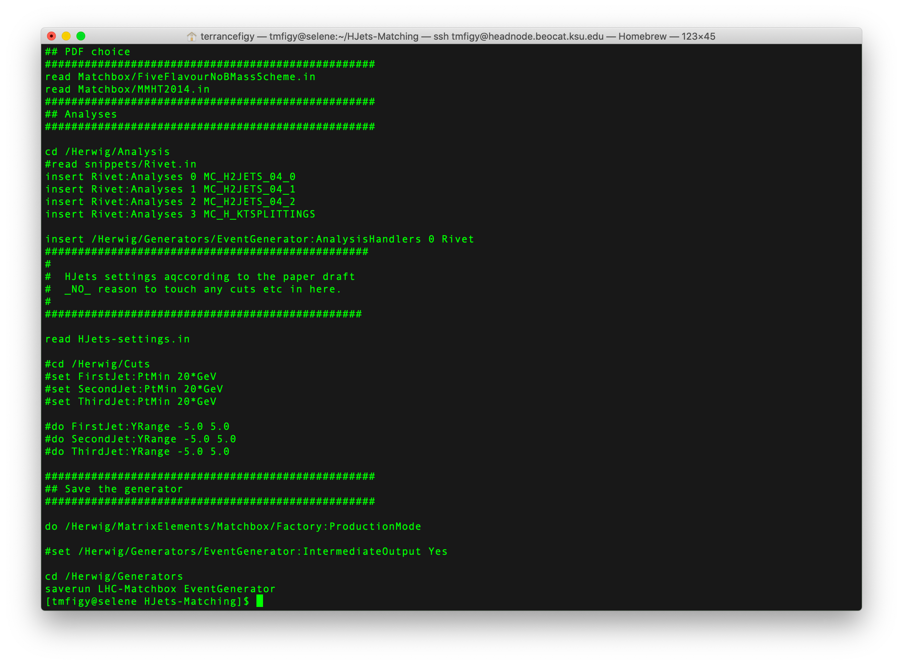

Rivet analysis for implementing
selection cuts and histogram.
Custom run setting can be read in.

Slide 17
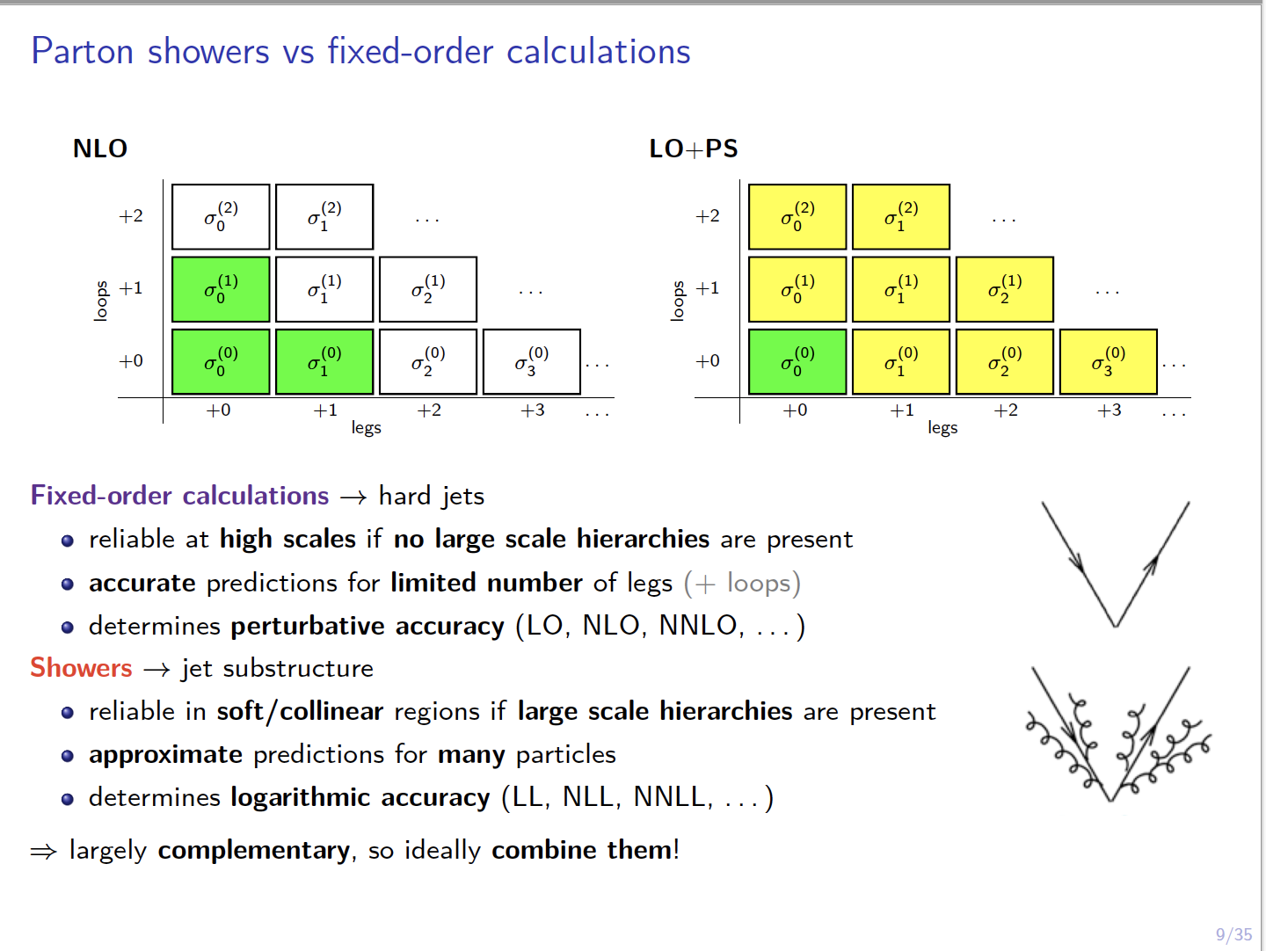
NLO Matching in Herwig 7
See https://arxiv.org/pdf/1605.07851.pdf
https://arxiv.org/pdf/1912.06509.pdf
https://arxiv.org/pdf/1109.6256.pdf

Slide 18
NLO Merging in Herwig 7

Slide 19
NLO Merging in Herwig 7
See https://arxiv.org/pdf/1705.06700.pdf
Dijet Production at the LHC

Slide 20
Input Parameters and Event Selection Cuts
CMS Energy of Collider and Beam Type: pp LHC (13 TeV)
PDF set (LHAPDF): PDF4LHC15_nnlo_100_pdfas
Factorization and renormalization scales: HT(jets)
Anti-Kt Jet clustering (R=0.4) using FastJet:
  At least two jets with pTjet > 25 GeV
Results include a dipole parton shower as implemented in Herwig 7. Matched results use a MC@NLO type matching. No hadronization or MPI have been included in the simulations.
For more details contact me via email.

Slide 21
Rapidity Gap and Invariant Mass
NLO+PS does a good job overall for 2 jet observables.

Slide 22
Inclusive Jet and Gap Jet Cross Section
Using HT(jets) for the scale.
Gap jets reside between yj1 and yj2.
Beyond 2 jets you need NLO 3 jet.

Slide 23
Gap Jet Activity
Gap Jets are quite soft.
Again, you need NLO for more than 2 jets

Slide 24
Transverse Momentum Spectrum (fixed scale: mh)

Slide 25
To Be Continue …
See Tinghua Chen’s talk now to see more kinematic distributions …

