Slide 1
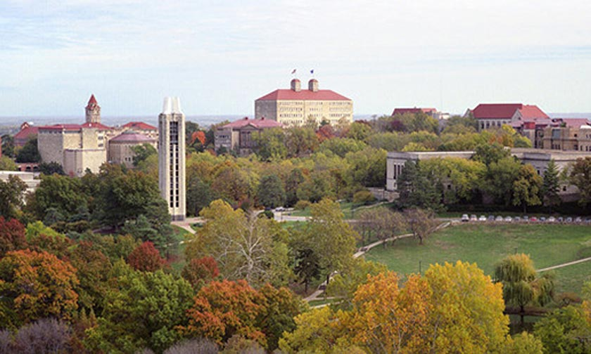
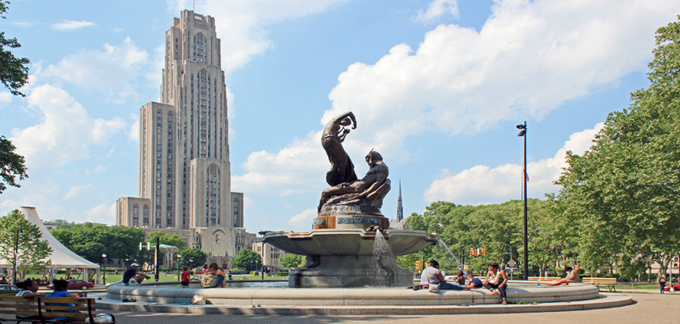
From Higgs to Charm
Tao Han
PITT PACC, University of Pittsburgh
Particle Physics on the Plains
April 2, 2022, University of Kansas
TH, X. Wang, arXiv:1704.00790; TH, B. Nachman, X. Wang, arXiv:1812.06992;
B. Carlson, TH, S.C.I. Leung, arXiv:2105.08738; TH, Y. Ma, et al. arXiv:2202.08273

Slide 2
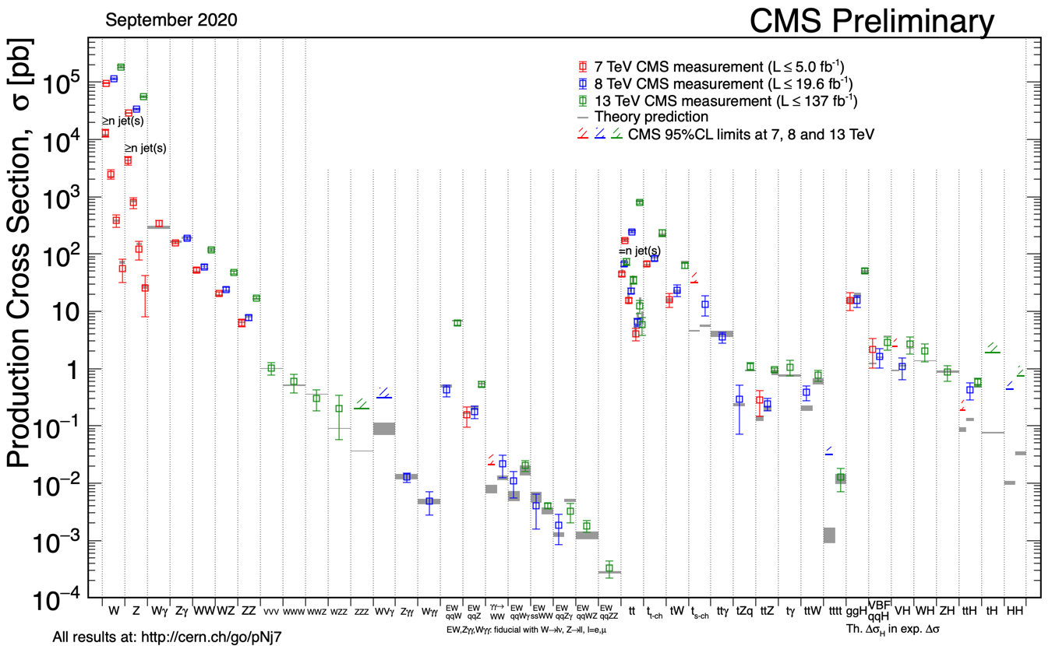

LHC Rocks & So Does The SM!
→
𝜎_{pp} ~ 10¹¹ pb
𝜎_{WW} ~ (10⁻¹³ nm)²
LHC: The energy frontier & precision frontier!

Slide 3
Higgs Boson Properties:
Korytov@NPHP21
Monumental achievements in theory & experiment!
Higgs boson brings in new fundamental questions…
A driver in precision & energy frontiers!
The next target: the Higgs boson to charm!

Slide 4
Charm-quark Yukawa Coupling
In the 𝛋-scheme for BSM:
Measuring coupling at the LHC is very difficult:
BR(h → cc)=2.9%
Formidable QCD backgrounds
c-tagging challenging
... …
The best hope:
subject to huge backgrounds 2-jets, cc; h → bb …
At LHC Run 2: 𝛋_{c} < 8.5
ATLAS-CONF-2021-021

Slide 5
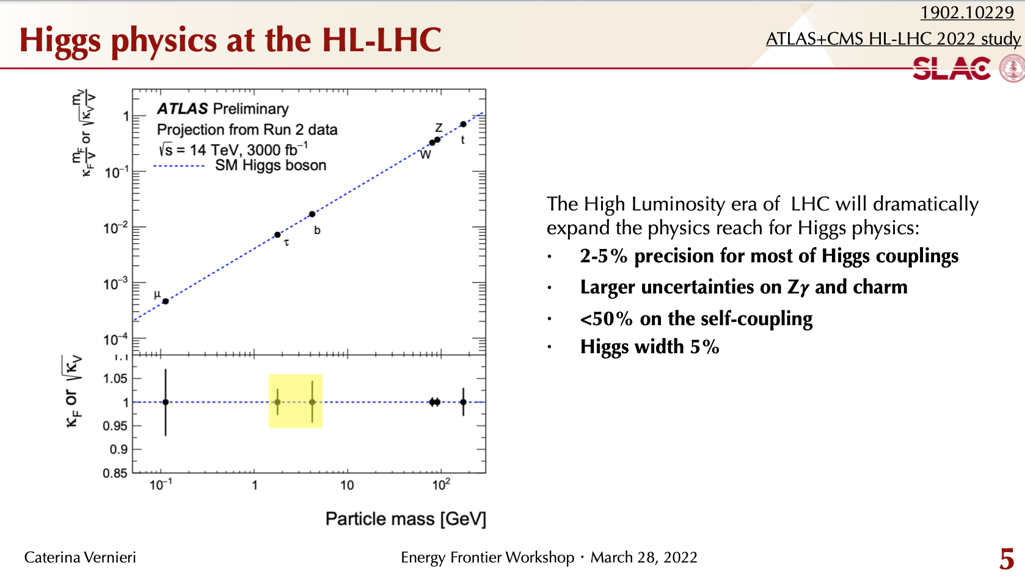
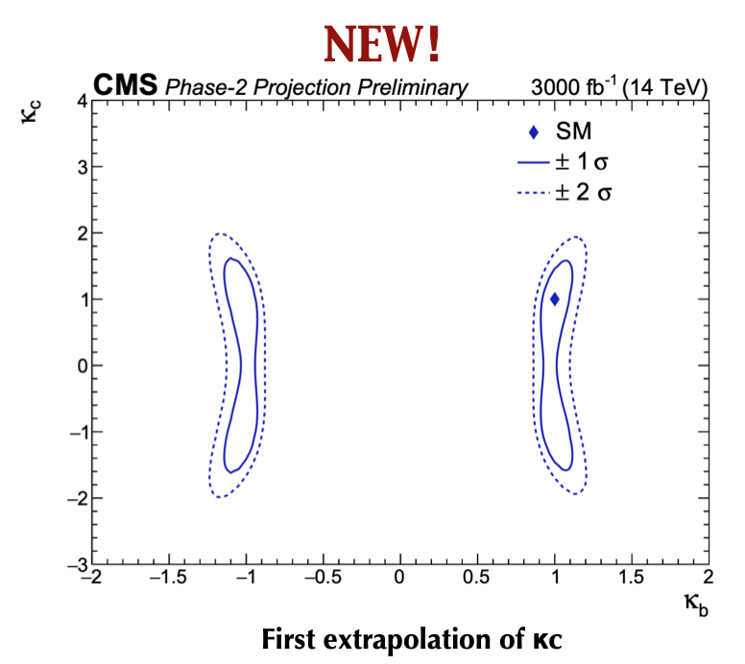
At HL-LHC with 3 ab⁻¹:

Slide 6
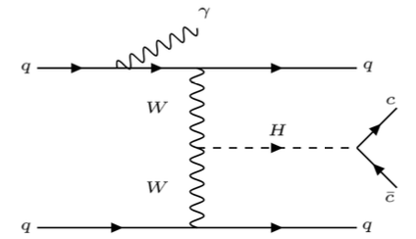
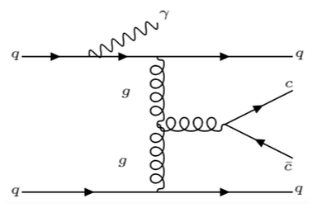
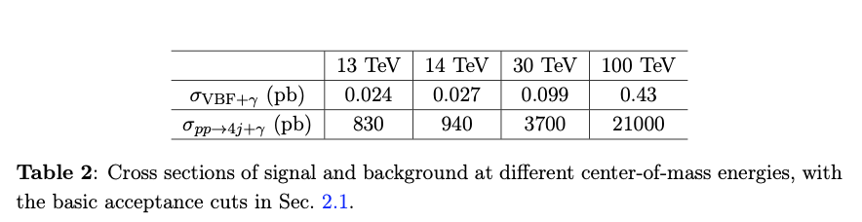


(1). Higgs to charm+𝛄 in VBF
Signal rate ~ 25,000/ab !
B. Carlson, TH, S.C.I. Leung, aXive:2105.08738

Slide 7
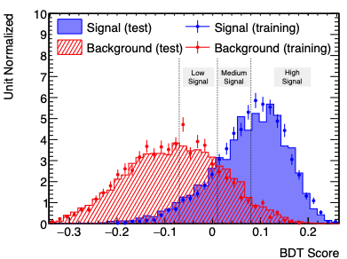
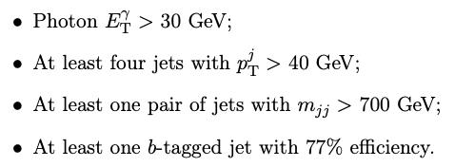
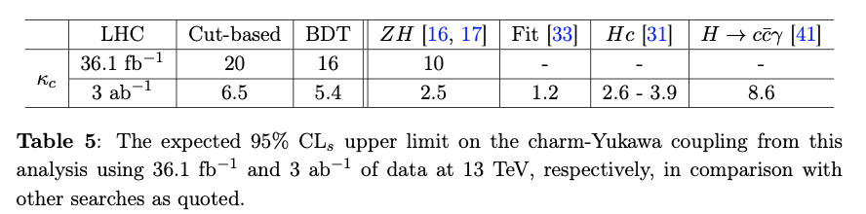
(1). Higgs to charm+𝛄 in VBF
Multi-variable BDT:
B. Carlson, TH, S.C.I. Leung, aXive:2105.08738

Slide 8

(2). Higgs radiative decay
TH and X. Wang, arXiv:1704.00790
We want an
additional 𝞬
to trigger on:
Not EW+ 𝛄,
insensitive to 𝛋_{c}

Slide 9
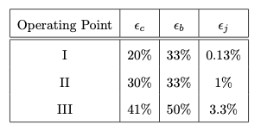
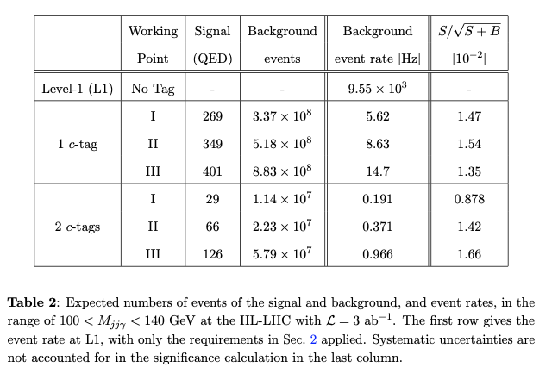
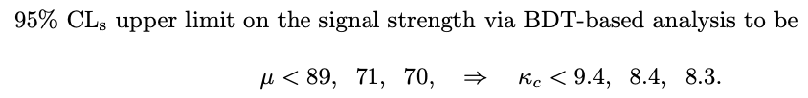
Results for
c-tagging efficiency;
b and jet mis-tagging rates
TH, B. Nachman, X. Wang, arXiv:1812.06992

Slide 10
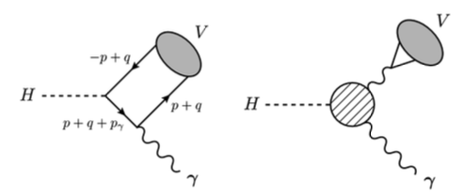
A remark on
Bodwin, Petriello et al. (2013, 2014, 2017); Konig, Neubert (2015)
J/𝛙 𝛄 is more than an order of magnitude smaller;
Further, the dominant contribution is from 𝛄*→ J/𝛙,
not from the direct hcc Yukawa:
≪
TH and X. Wang, arXiv:1704.00790

Slide 11
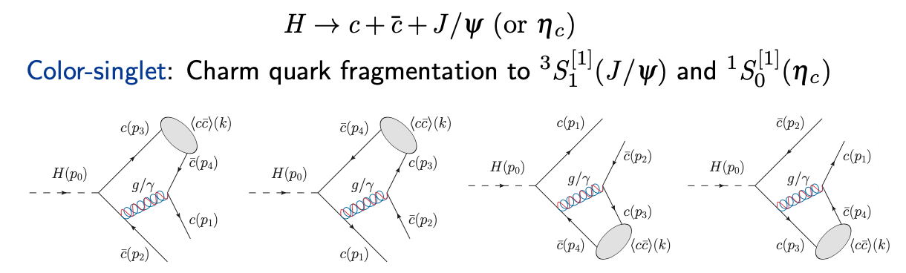
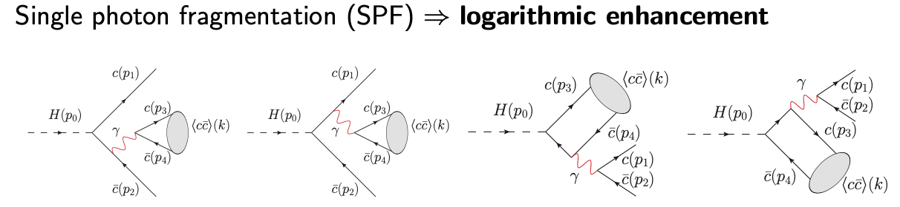
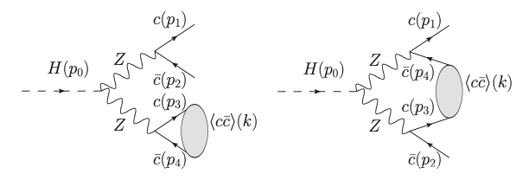
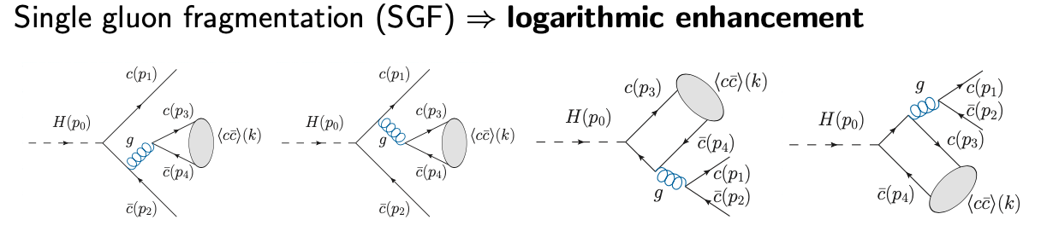
(3). Higgs decay to charmonia: c-fragmentation
EW contributions via HZZ:
Color-Octet contributions:

Slide 12
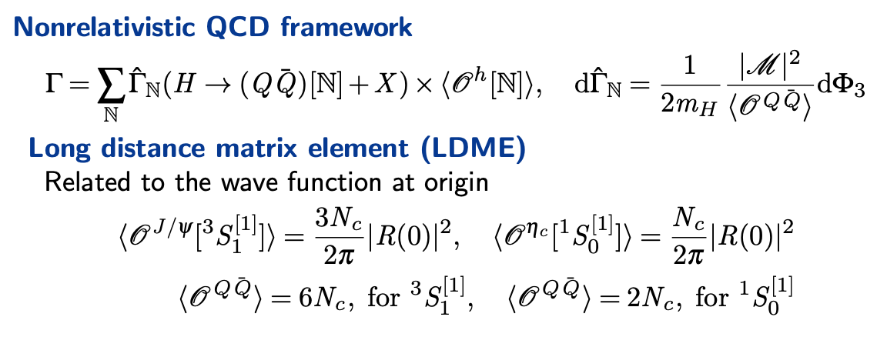
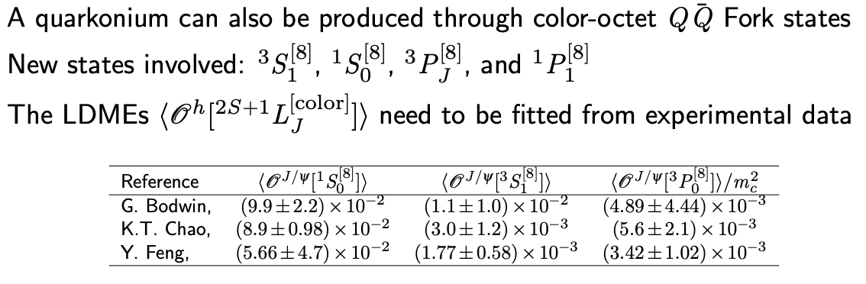
(3). Higgs decay to charmonia: c-fragmentation

Slide 13
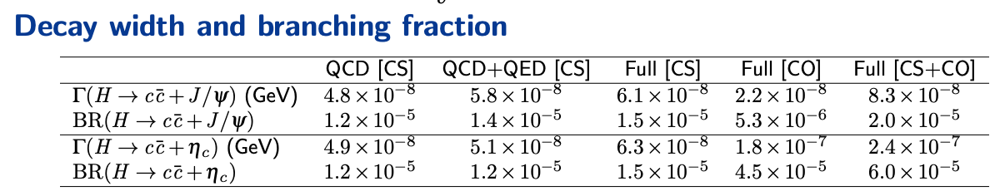
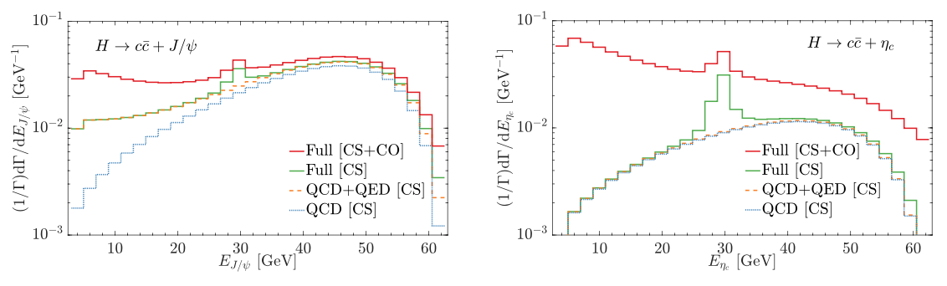
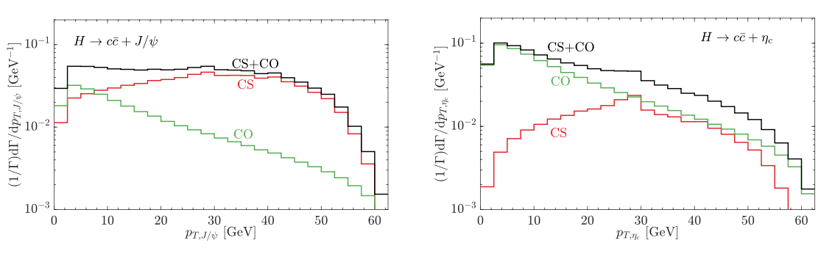
(3). Higgs decay to charmonia: c-fragmentation

Slide 14
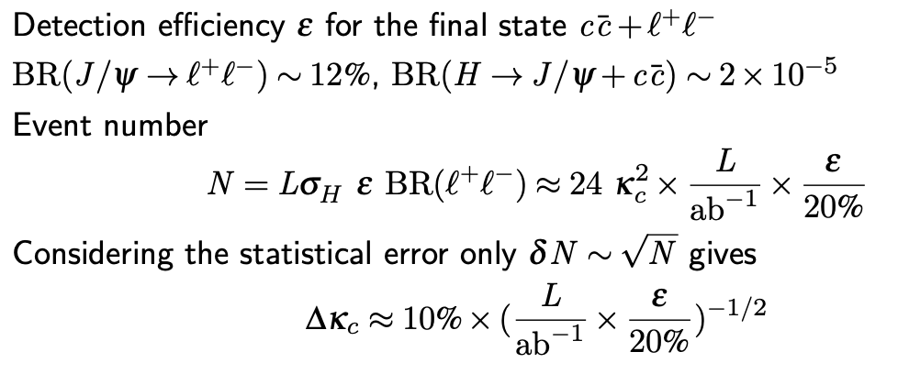

(3). Higgs decay to charmonia: c-fragmentation
~ 50M / ab⁻¹
for 3 ab⁻¹
For a quantitative estimate, need background studies:
Cross section of
at high p_{T} ~ 25 fb
Formidable backgrounds!

Slide 15
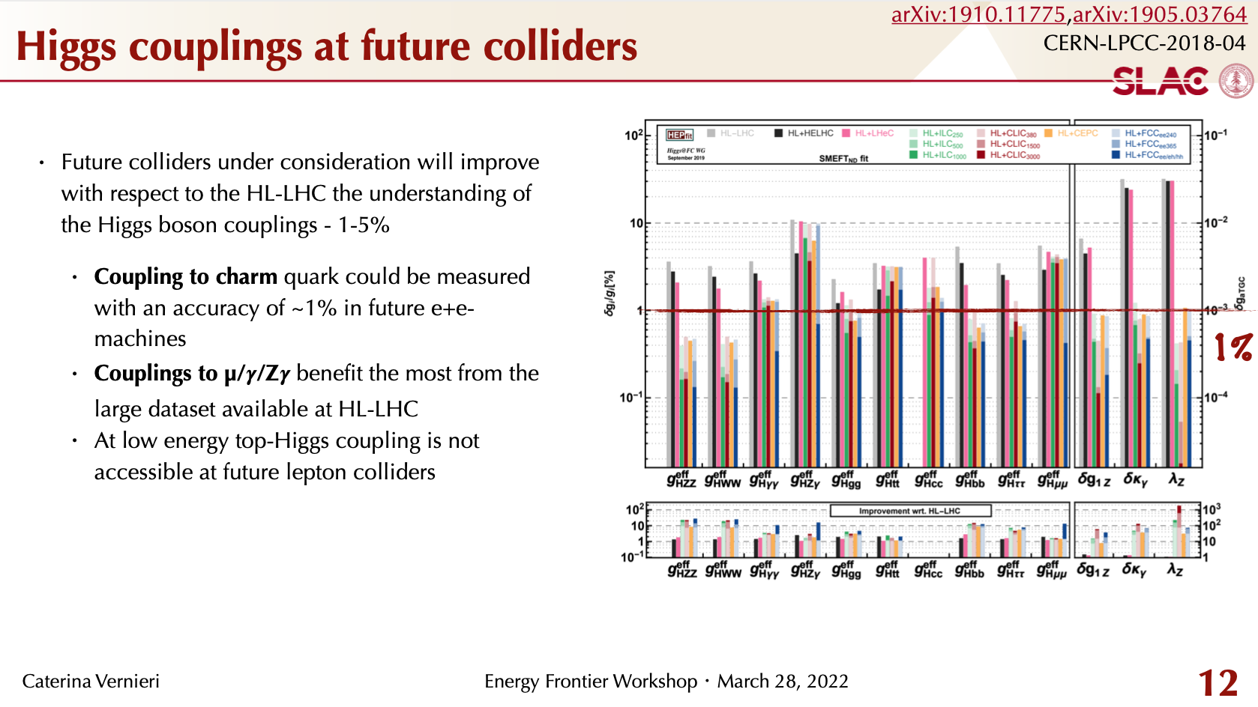
Summary on Hcc Coupling
𝛋_{c} sensitivity @ HL-LHC:
8.3
Vh: hc kinematics: Global fit:
2.5 3.0 1.5
Need to combine all !
charm+𝛄 in VBF : 5.4
: hopeful
Hard work needed, future is bright !

