Slide 1
Higgs Boson Production in Association of Three Jets via Gluon Fusion
Dr. Terrance Figy
Assistant Professor
Department of Mathematics, Statistics, and Physics
Wichita State University
Particles on the Plains
April 2, 2022

Slide 2
Rebuilding Research Programs after Covid-19
In this talk I will make a numerous excuses.
In this talk you learn about a research project started before Covid-19. You will hear complaints about artificial paradigms. If you are offended tell me.
In this talk I will give the young scientists some good advice:
“Physics isn't the most important thing. Love is.”
― Richard P. Feynman
Catch-22: In order to feed a family and advance I need to ignore my family.

Slide 3
How do we support the struggling scientists?
We much have compassion.
We must communicate clearly what is needed.
We must stand our ground. Maybe form a union if need be.
Finally, for those non-scientists, please, stop assuming we sit around and do nothing.
I am concerned that COVID-19 and the attacks on democracy are setting us back in terms of scientific discovery and innovation.
Please, check in on the struggling scientists. They may be sitting next to you.

Slide 4
Why is the Higgs Boson So Interesting to Dr. Figy?
The reason I’m interested in particle physics is to a help me understand what the table is made of.
I find the Higgs Boson interesting because it is a “real world” problem.
The problem of understanding the fundamental interactions and particles is the most “real world” problem you can study.
Studying the Higgs boson allows me to use a very BIG computer and do some programming.
I’m a scientist and prefer to find ways to move the science I’m passionate about forward.

Slide 5
References and Collaborators
Higgs boson CP-properties of the gluonic contributions in Higgs plus three jet production via gluon fusion at the LHC
CP-violating Higgs boson production in association with three jets via gluon fusion
Collaborators: Francisco Campanario and Michael Kubocz

Slide 6




CP-violating Higgs Boson

Slide 7
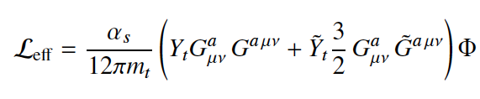

CP-violating Higgs

Slide 8
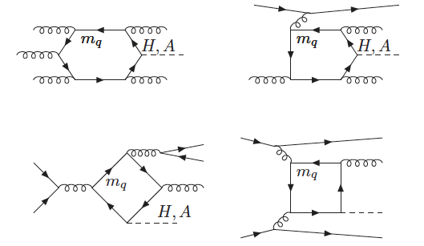

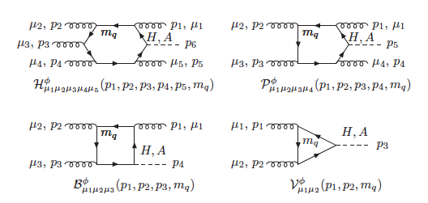
Feynman Diagrams (Yes, we still use them.)

Slide 9




Numerical Results
MMHT2014nlo68lo parton distributions functions
Kt-jet with p=-1
alphaS(Mz) =0.130
Collider Energies: 13 TeV
27 TeV

Slide 10
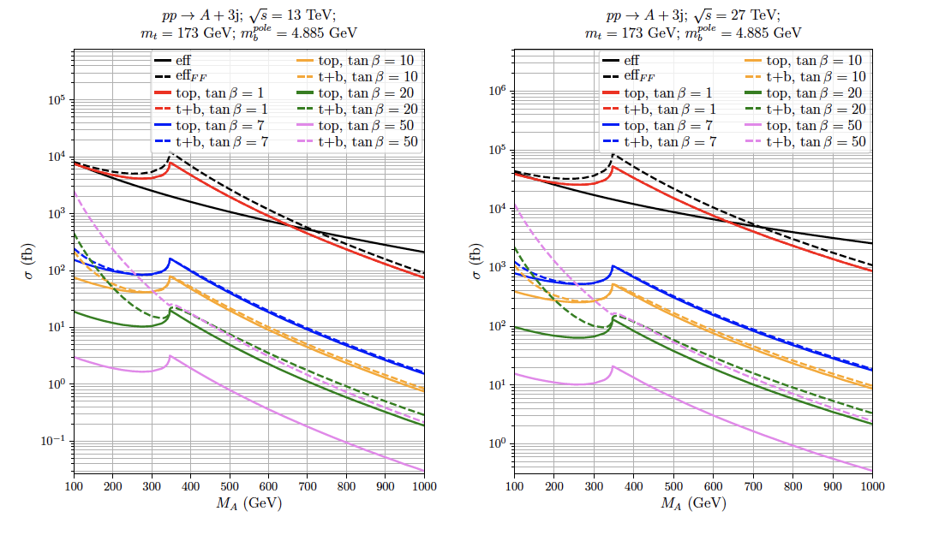
Numerical Results (Pure CP-odd)

Slide 11
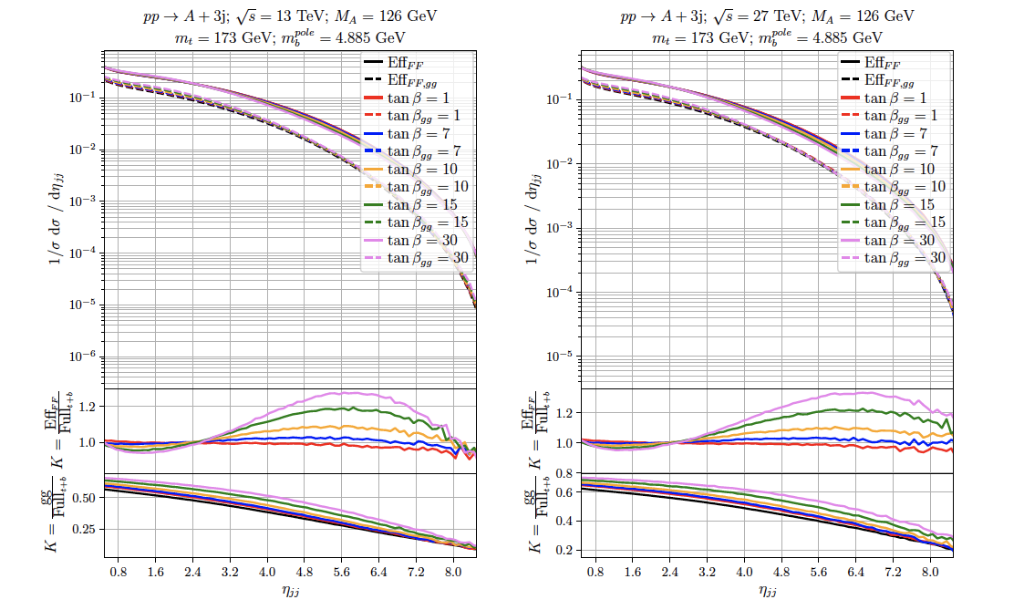
Numerical Results (Pure CP-odd)

Slide 12
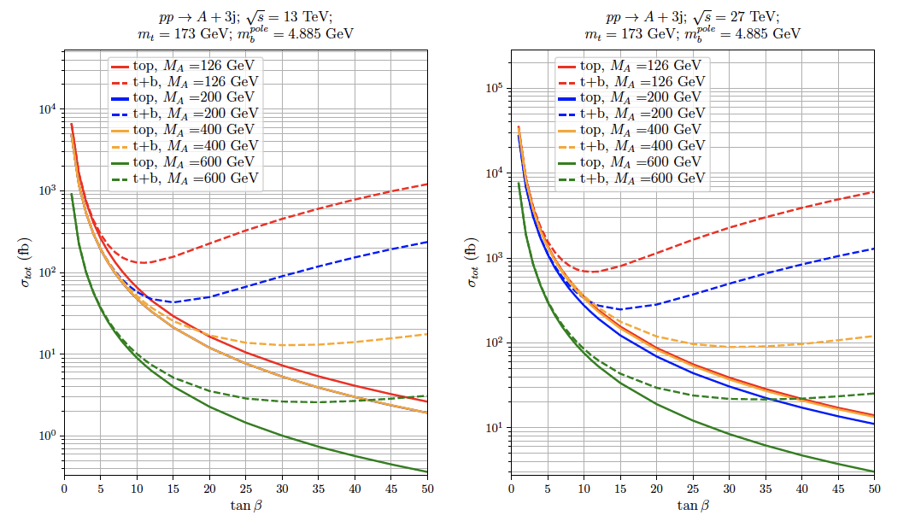
Numerical Results (Pure CP-odd)

Slide 13
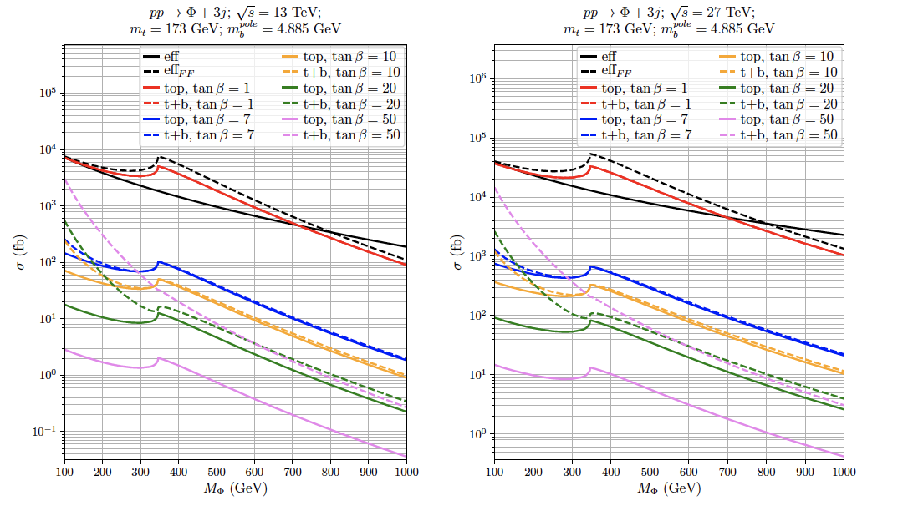
Numerical Results (CP-violating)

Slide 14
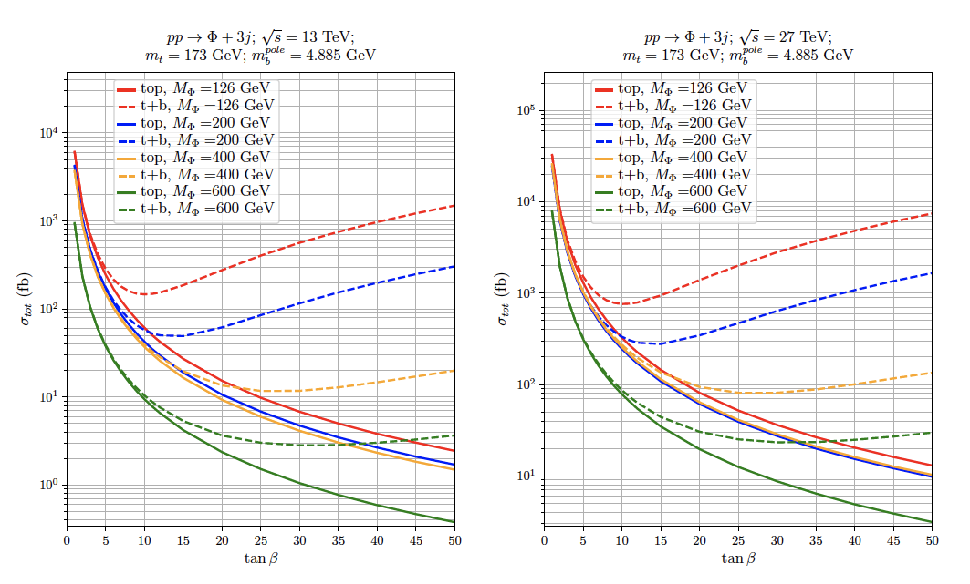
Numerical Results (CP-violating)

Slide 15
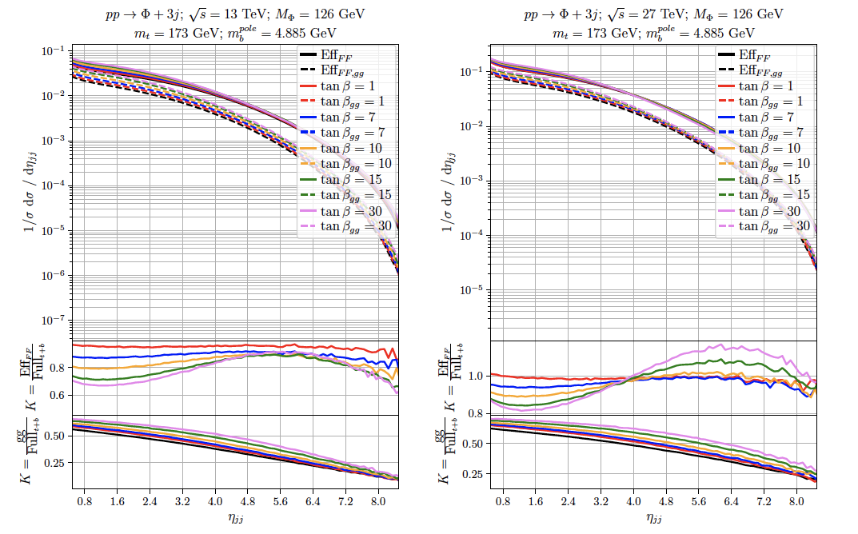
Numerical Results (CP-violating)

Slide 16
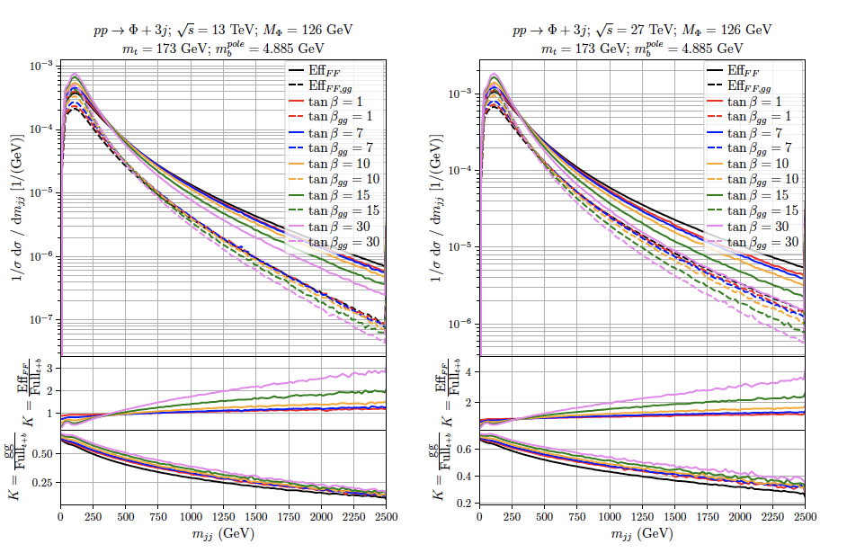
Numerical Results (CP-violating)

Slide 17
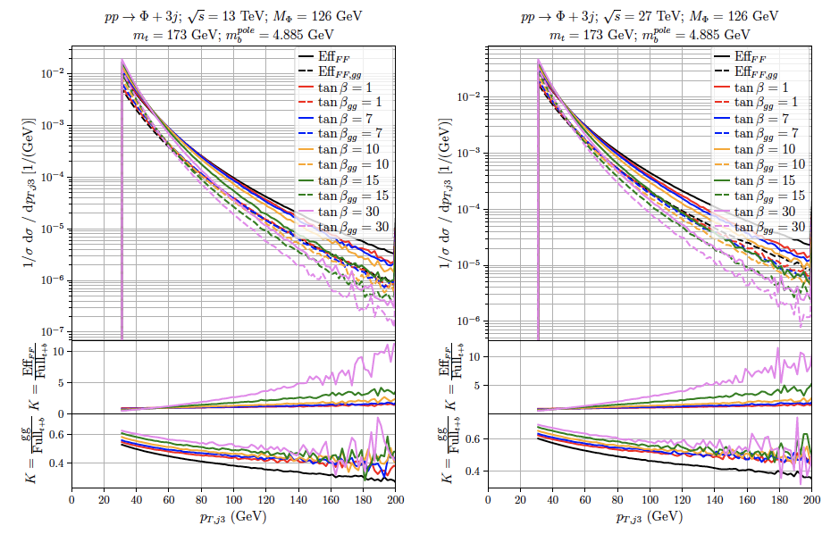
Numerical Results (CP-violating)

Slide 18











Closing Remarks

