Slide 1
RHIC Experiments in Transition at Brookhaven National Laboratory
Outline: ● Today to 2022
Edouard Kistenev
Brookhaven National Laboratory
PHENIX Experiment

Slide 2
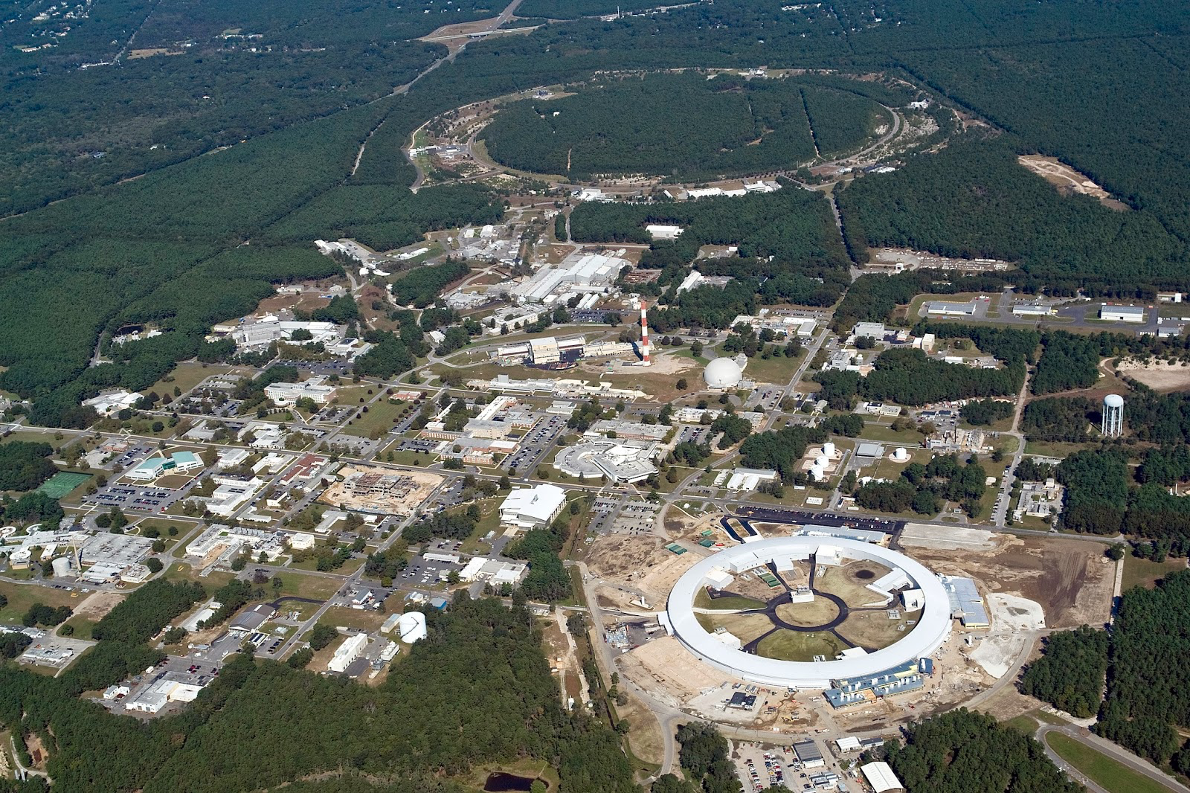
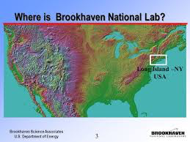
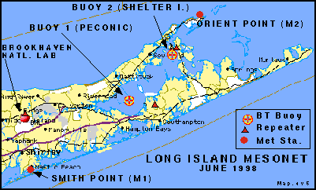
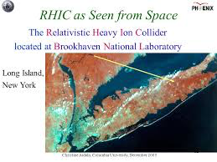
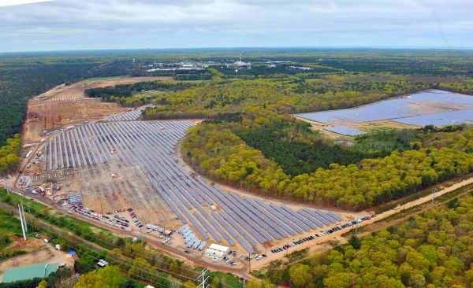
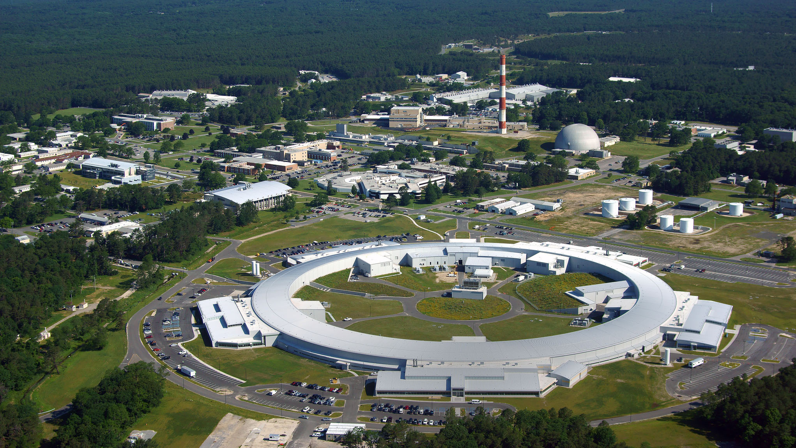
Brookhaven National Laboratory in Transition

Slide 3

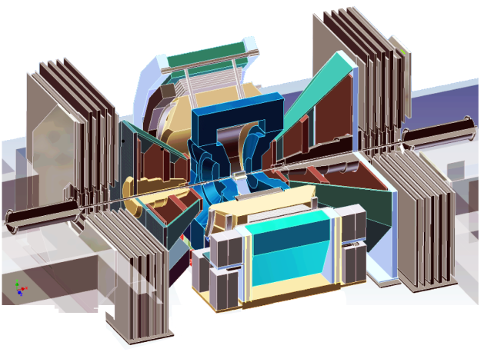
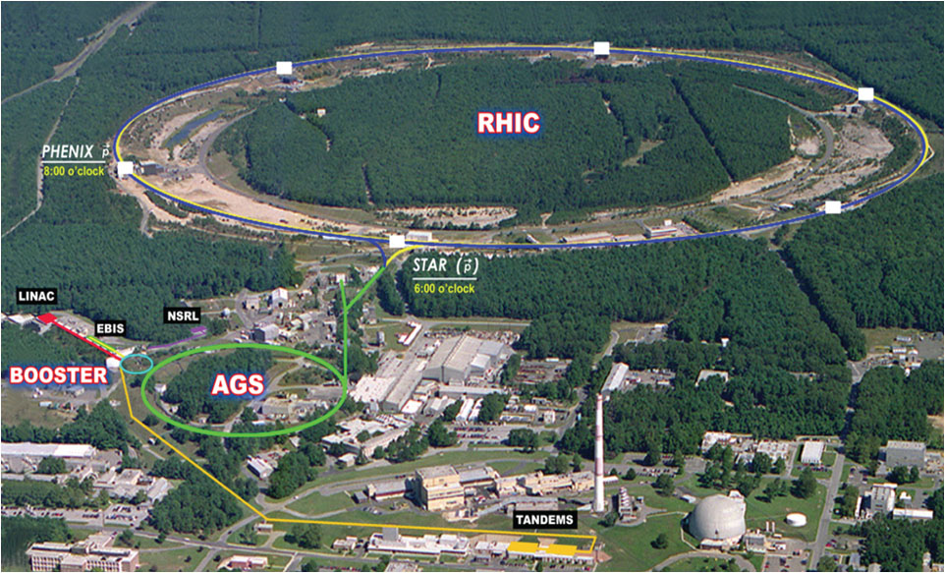

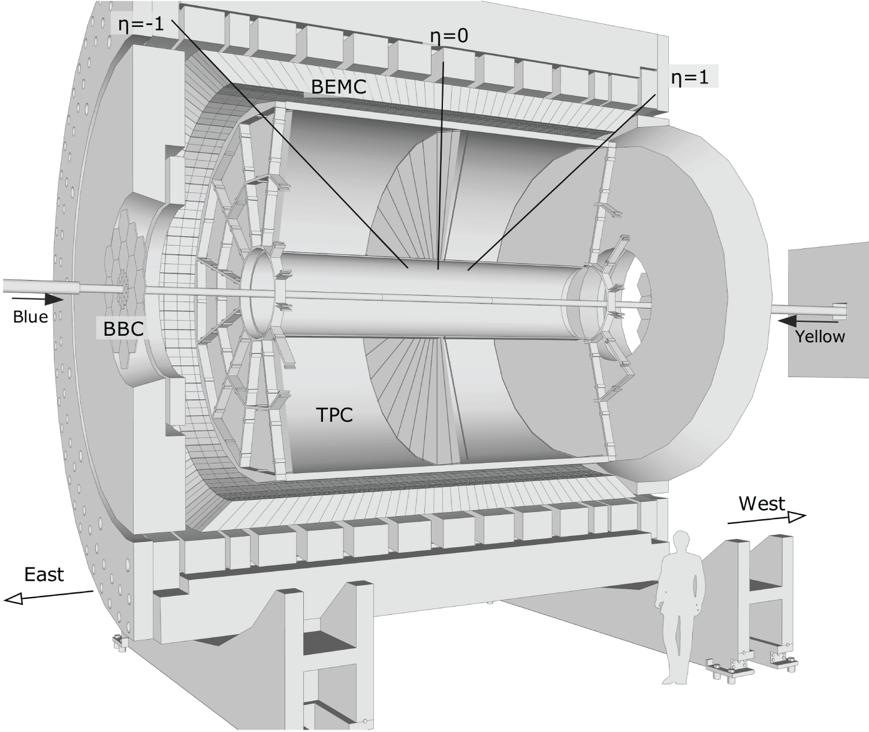
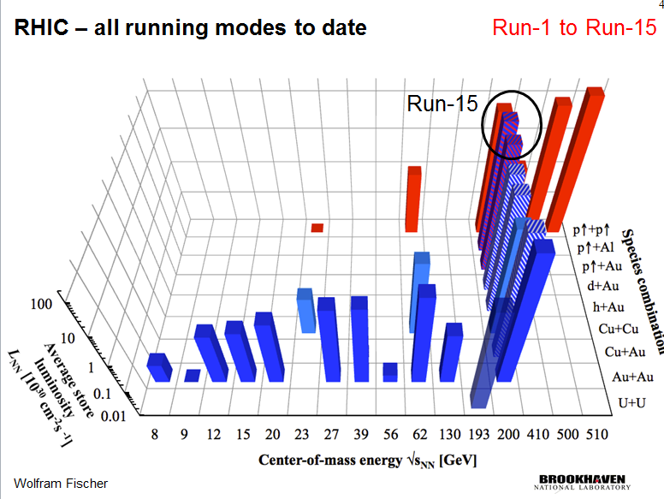
Relativistic Heavy Ion Collider
Bird’s eye view
Φ 1.2km

Slide 4
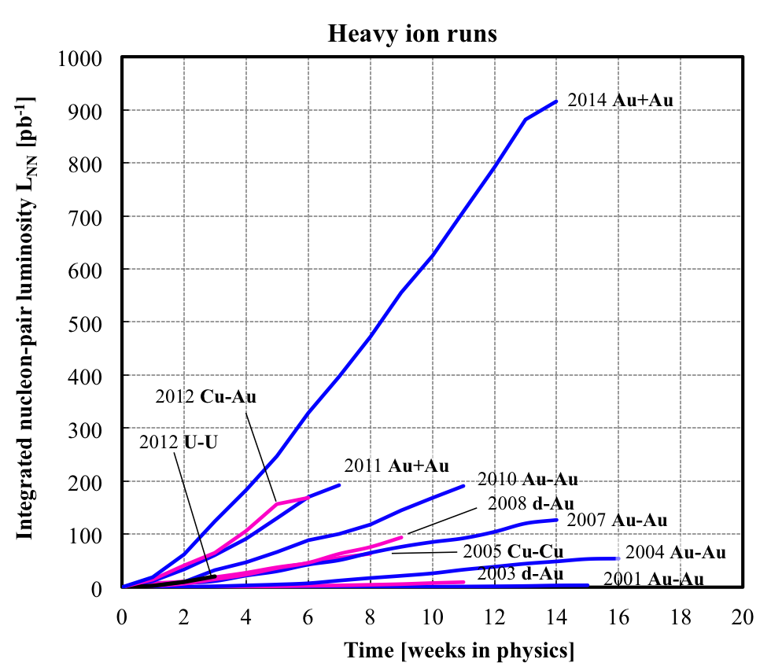
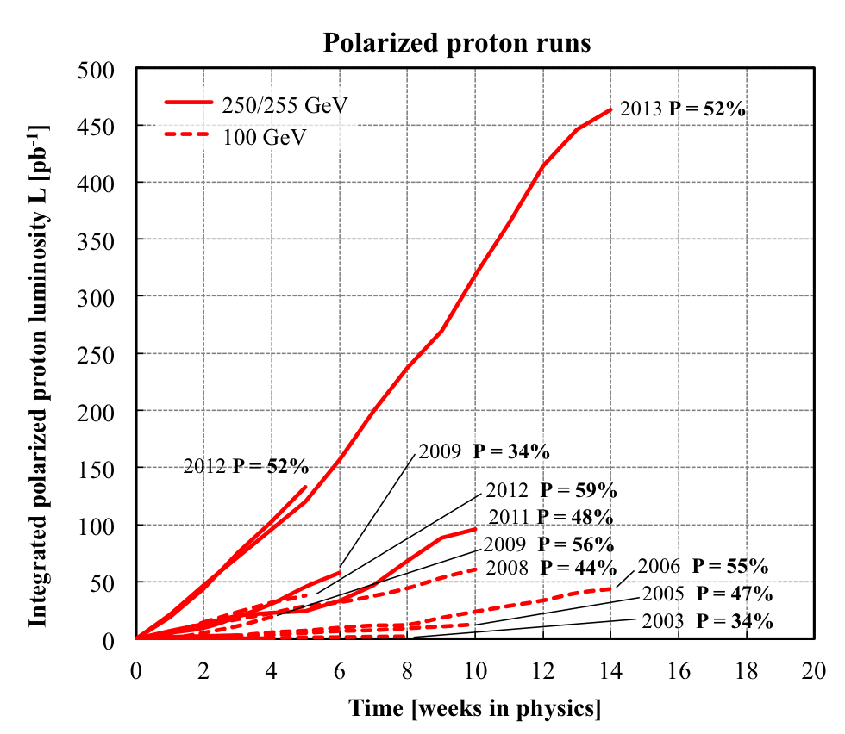

Slide 5
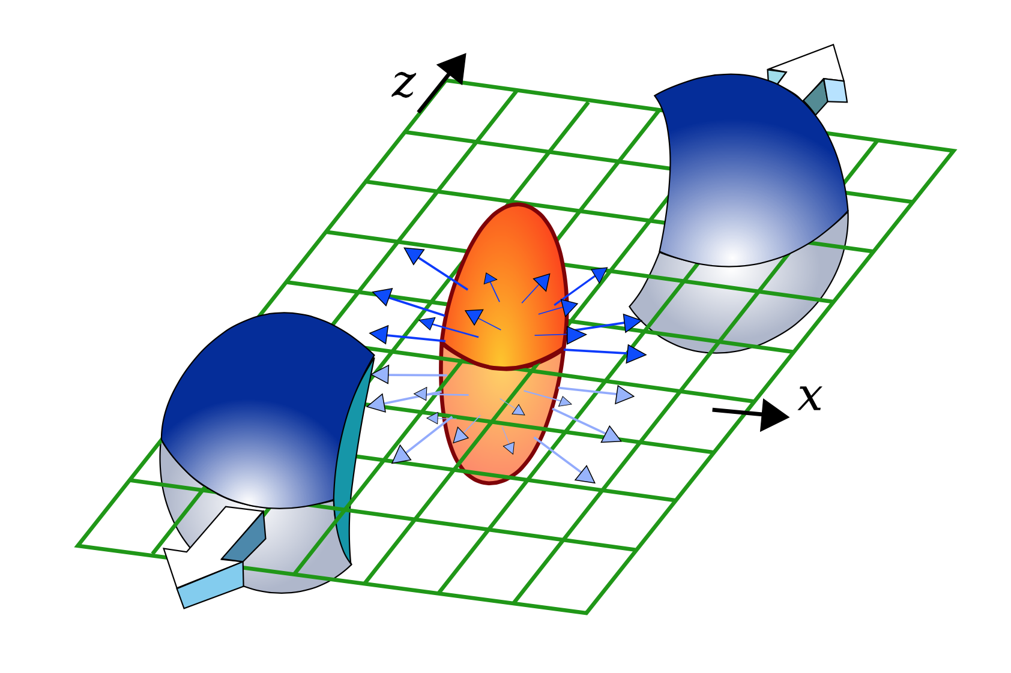
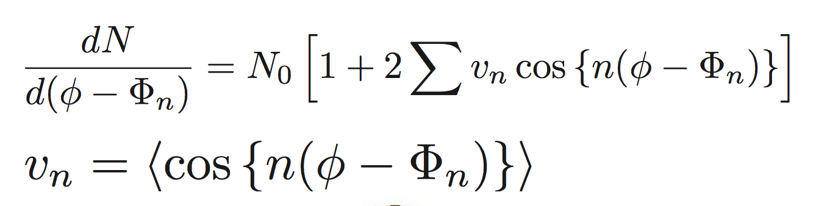
An experimentalist view of Heavy Ion Collisions
  The collective nature of the the collision created medium converts initial state azimuthal asymmetry into a strong signal in the final state particle emission pattern
  dn/dφ ~ 1 + 2 v₂(p_{T}) cos (2 φ)
  V3 and higher tells of fluctuations
Notes:
Elliptic flow describes the azimuthal momentum space anisotropy of particle emission from non-central heavy-ion collisions in the plane transverse to the beam direction, and is defined as the second harmonic coefficient of the azimuthal Fourier decomposition of the momentum distribution.^{[4]} Elliptic flow is a fundamental observable since it directly reflects the initial spatial anisotropy, of the nuclear overlap region in the transverse plane, directly translated into to the observed momentum distribution of identified particles. Since the spatial anisotropy is largest at the beginning of the evolution, elliptic flow is especially sensitive to the early stages of system evolution.^{[5]} A measurement of elliptic flow thus provides access to the fundamental thermalization time scale and many more things in the early stages of a relativistic heavy-ion collision.^{[4]}

Slide 6
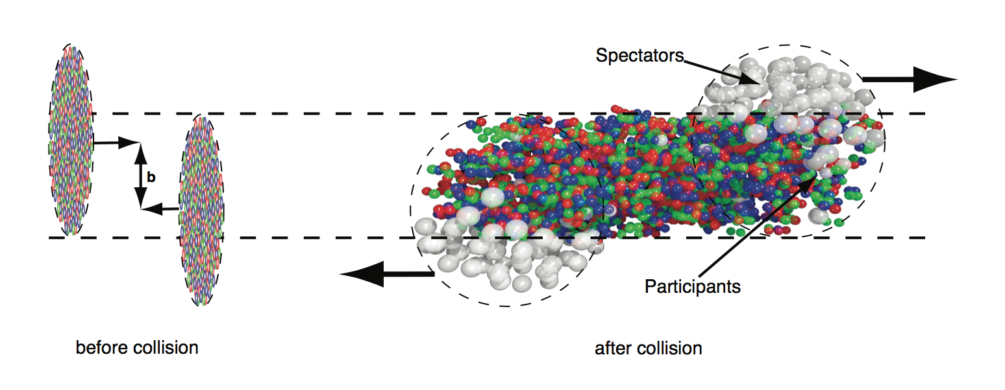
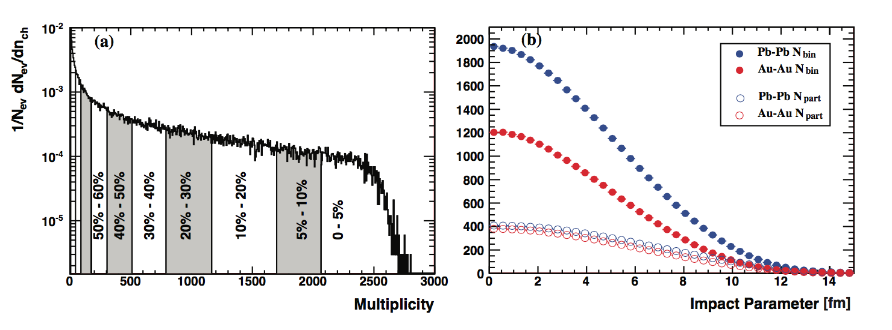
LHC
RHIC

Slide 7
QGP program near Tc
Detailed inspection of QGP near T_{c} using probes over a broad range of scales
  Jet and Di-jet
  γ-jet correlations
  Heavy flavor jets
  Separated ϒ(1s), ϒ(2s), ϒ(3s)

Slide 8

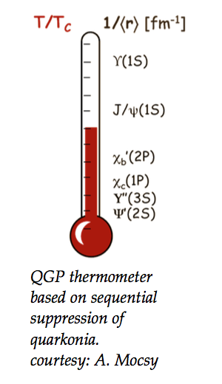
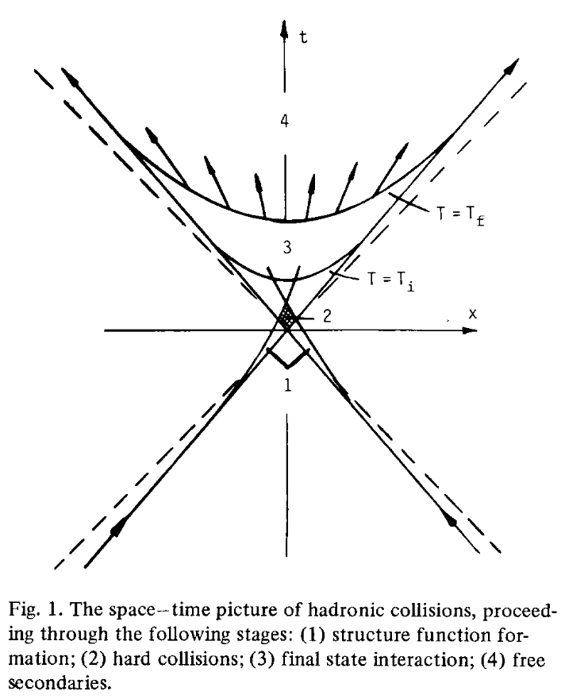

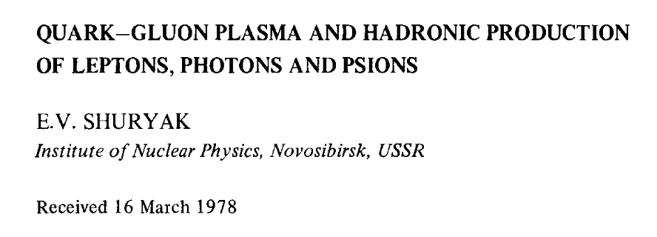
J/ψ production and differential suppression the ?????
Open charm
particles
“sequential
Melting”
plasma
partons
Color screening of the cc potential by the surrounding color charges
_
_
cc pair ~
J/ψ pre-resonant state

Slide 9
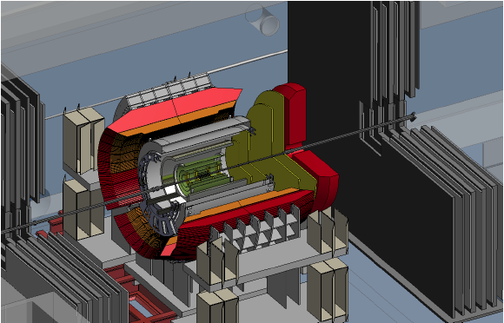
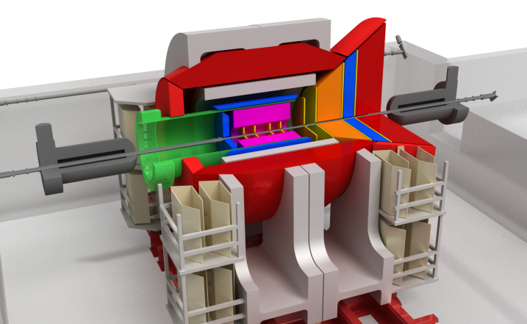
Evolution of the Experiment (PHENIX)
Documented: http://www.phenix.bnl.gov/plans.html
Current PHENIX
sPHENIX (+fsPHENIX)
An EIC detector
15y+ operation
100+M$ investment
Broad spectrum of physics (QGP, Hadron Physics, DM)
150+ published papers to date
Last run in this form 2016
Comprehensive central upgrade based on BaBar magnet
Rich jet and beauty quarkonia physics program
→ nature of QGP
fsPHENIX : forward tracking, e&h calorimetry and muon ID → Spin, CNM
Path of PHENIX upgrade leads to a capable EIC detector
Large coverage of tracking, calorimetry and PID
Open for new collaboration/new ideas
arXiv:1501.06197 [nucl-ex]
arXiv:1402.1209 [nucl-ex]
~2000
2017→2020
~2025
Time
RHIC: A+A, spin-polarized p+p, spin-polarized p+A
EIC: e+p, e+A

Slide 10
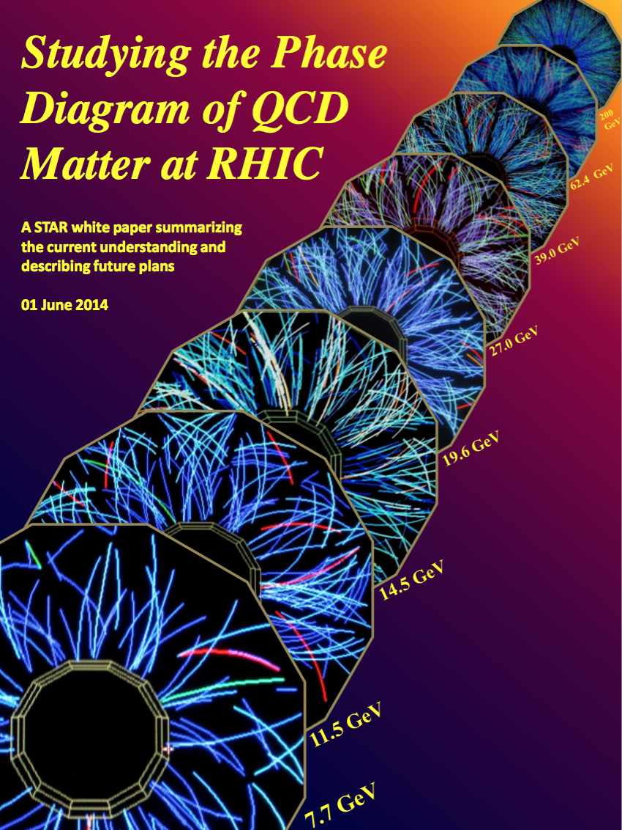
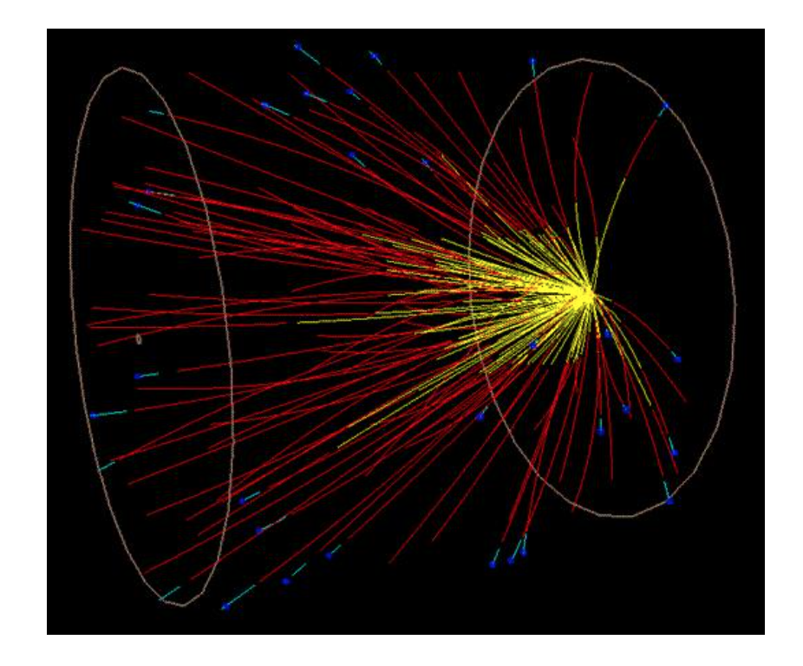
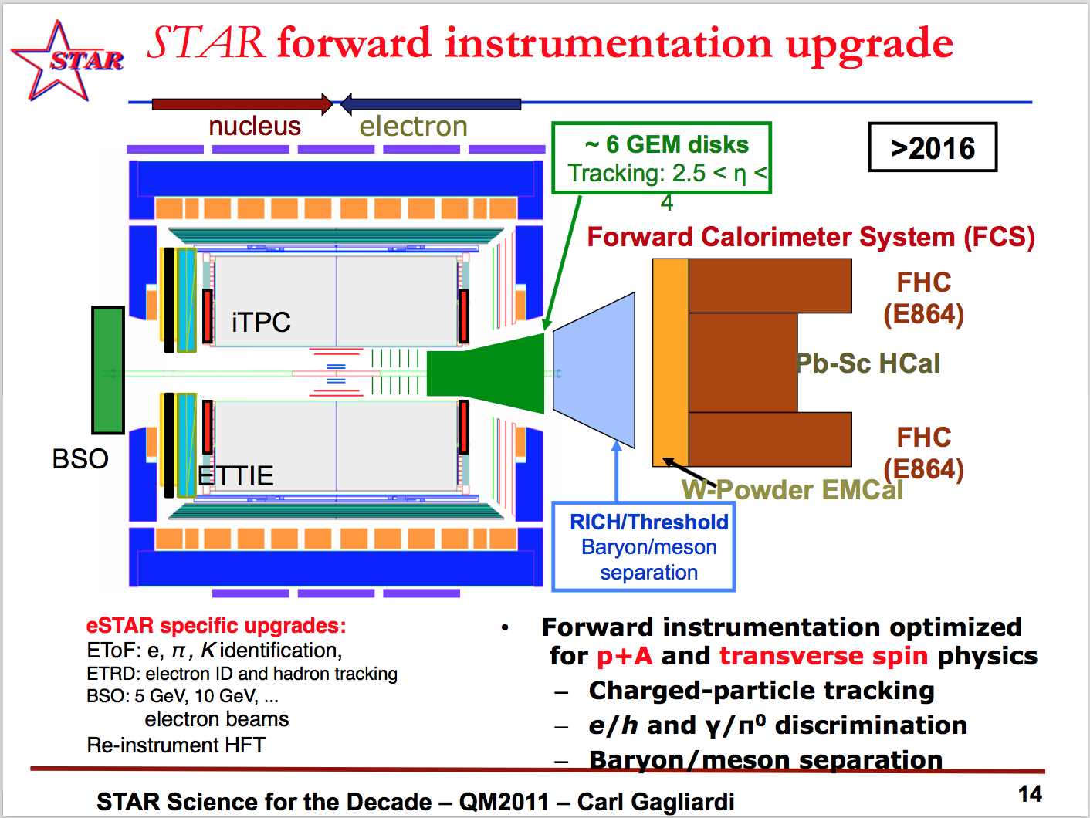
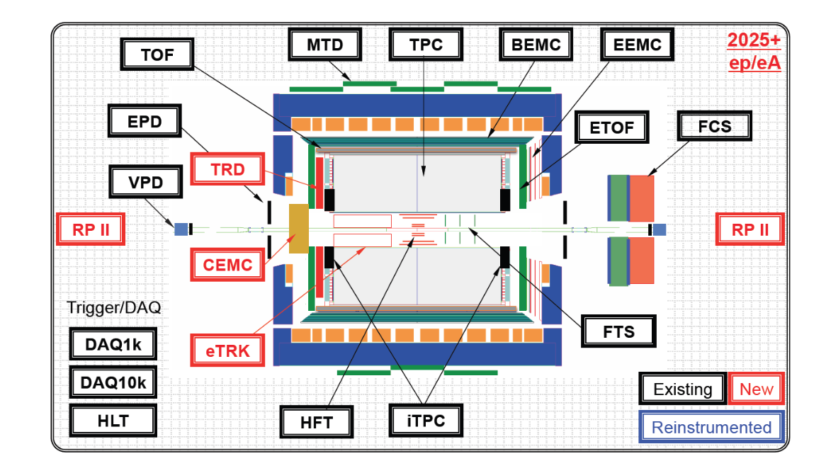
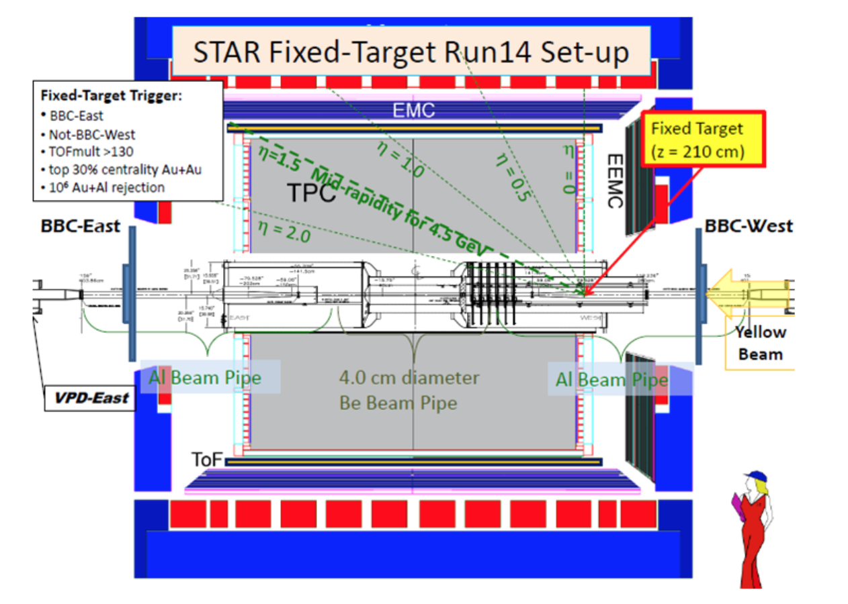
STAR
IN THE NEXT DECADE

Slide 11
sPHENIX experiment (already in construction stage …. illegal )
Beam Line and Pixel Tracker→
5.3 m
Silicon Strip Tracker→
EM Calorimeter ↘
Inner Hadron Calorimeter →
BaBar Magnet↗
Outer Hadron Calorimeter →
Detailed CAD model
Beam view

Slide 12
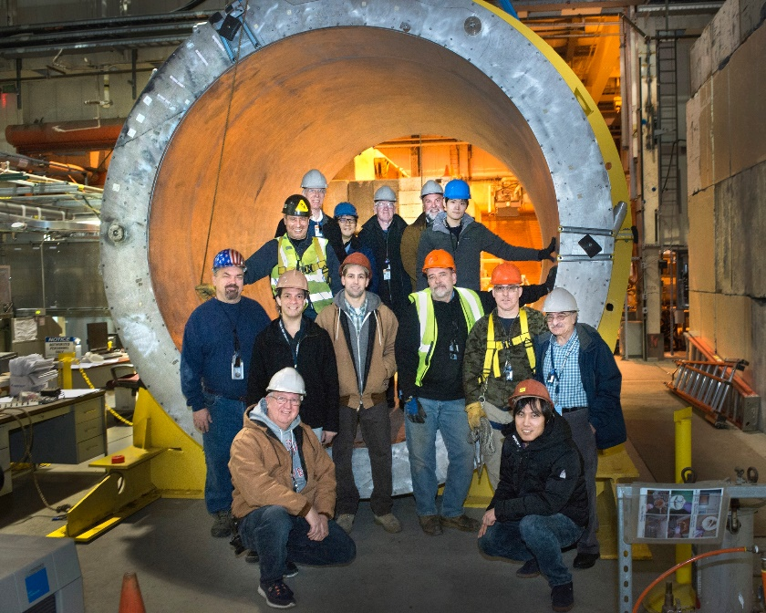
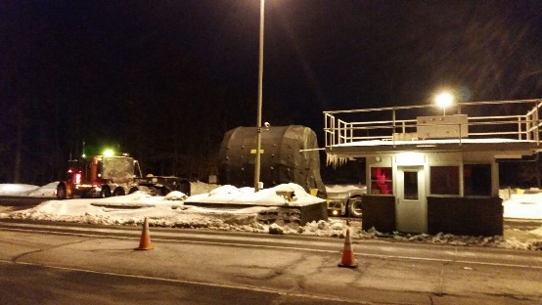
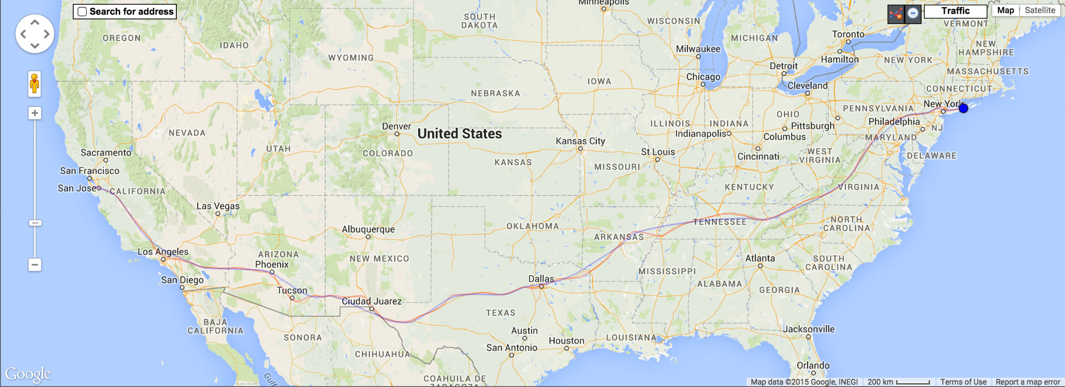
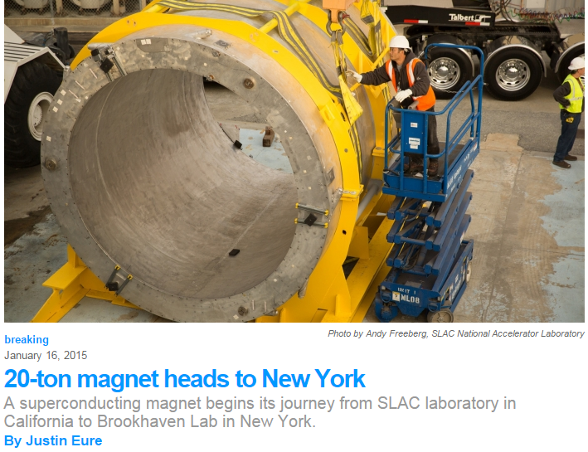
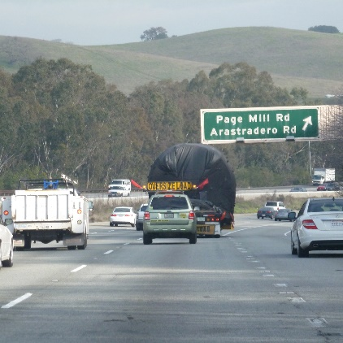
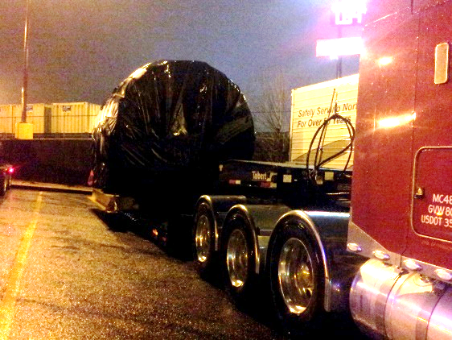
Move BaBar Magnet
BNL Gate
Feb 3, 2015
Jan 16 -> Feb 3 2015
SLAC
Jan 16, 2015
Magnet Testing Area, BNL
I-280, CA
In the News
Near Oak Ridge, TN

Slide 13
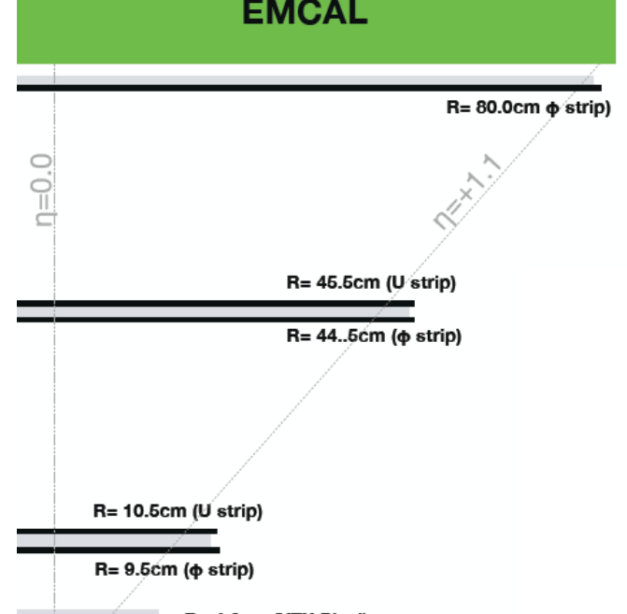
Tracking : Reconfigure existing Silicon Tracker
Restacking PHENIX Pixel Tracker
Also in study: a TPC for outer layer tracking
Side view
Beam View
60μm, 2%X₀
B₀ = 1.5T
60μm, 1%X₀×2
60μm, 1.4%X₀×2
50μm, 1.3%X₀×2

Slide 14
Tracking : Performance in Geant4
Invariant mass for e⁺e⁻ pairs
Single track performance
Single track simulation in Geant4
Inv. Mass
Also full detector HIJING simulation in Geant4
Eff. = 92% at 1 GeV/c and 97% at high p_{T}.

Slide 15
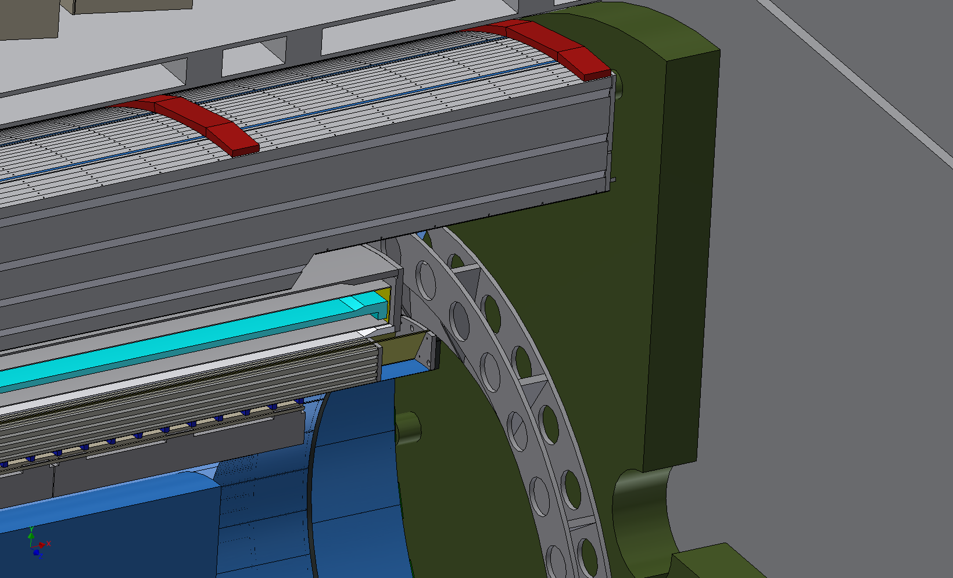
Backbone: New Jet and EM Id Calorimetry
OUTER HCAL
MAGNET
SUPPORT RING
EMCAL
INNER HCAL

Slide 16
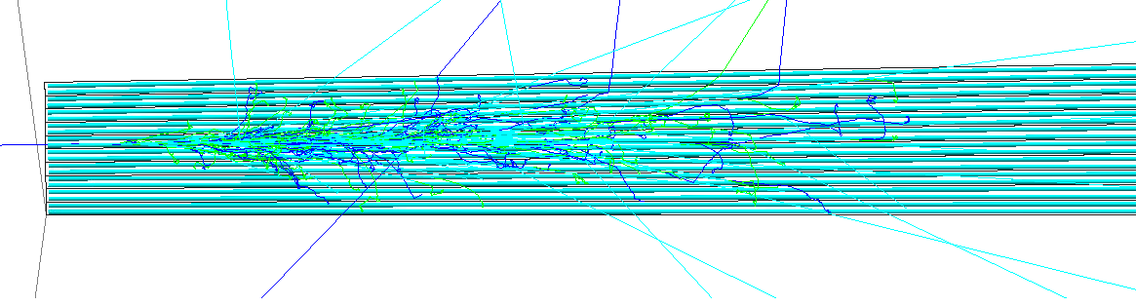
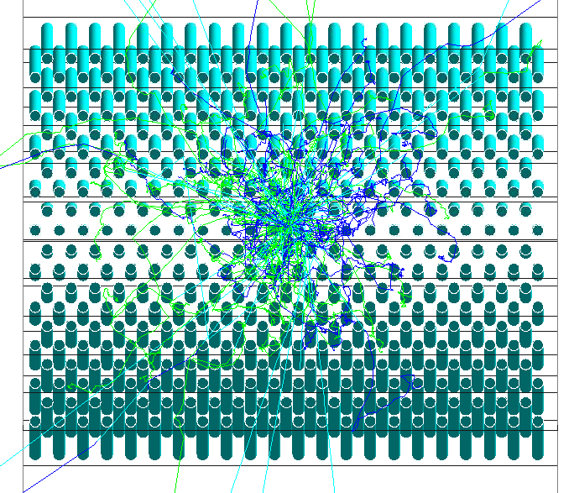
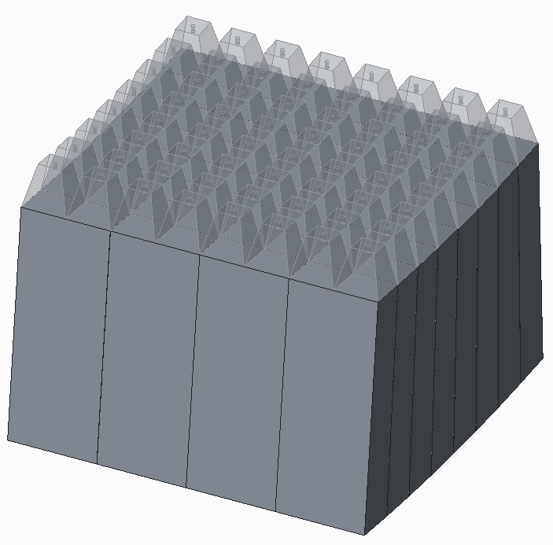
Electron ID: EM Calorimeter
Electron ID using a compact EMCal with assistance from inner Hcal (|η|<1)
Scintillation fiber-W powder sampling calorimeter (SPACAL), dE/E ~ 12%/√E
10GeV, e+
Side view
2 cm
Tapered to form full cylinder
Azimuthally projective fibers
Particle view
1 cm
10GeV e
Fibers :
diameter of 0.5mm
Spacing of 1mm

Slide 17
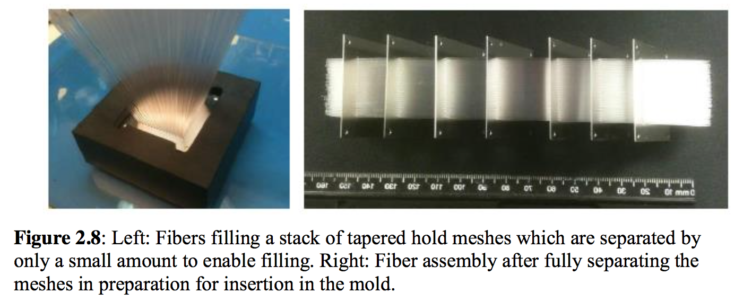
Dealing with technological challenges

Slide 18
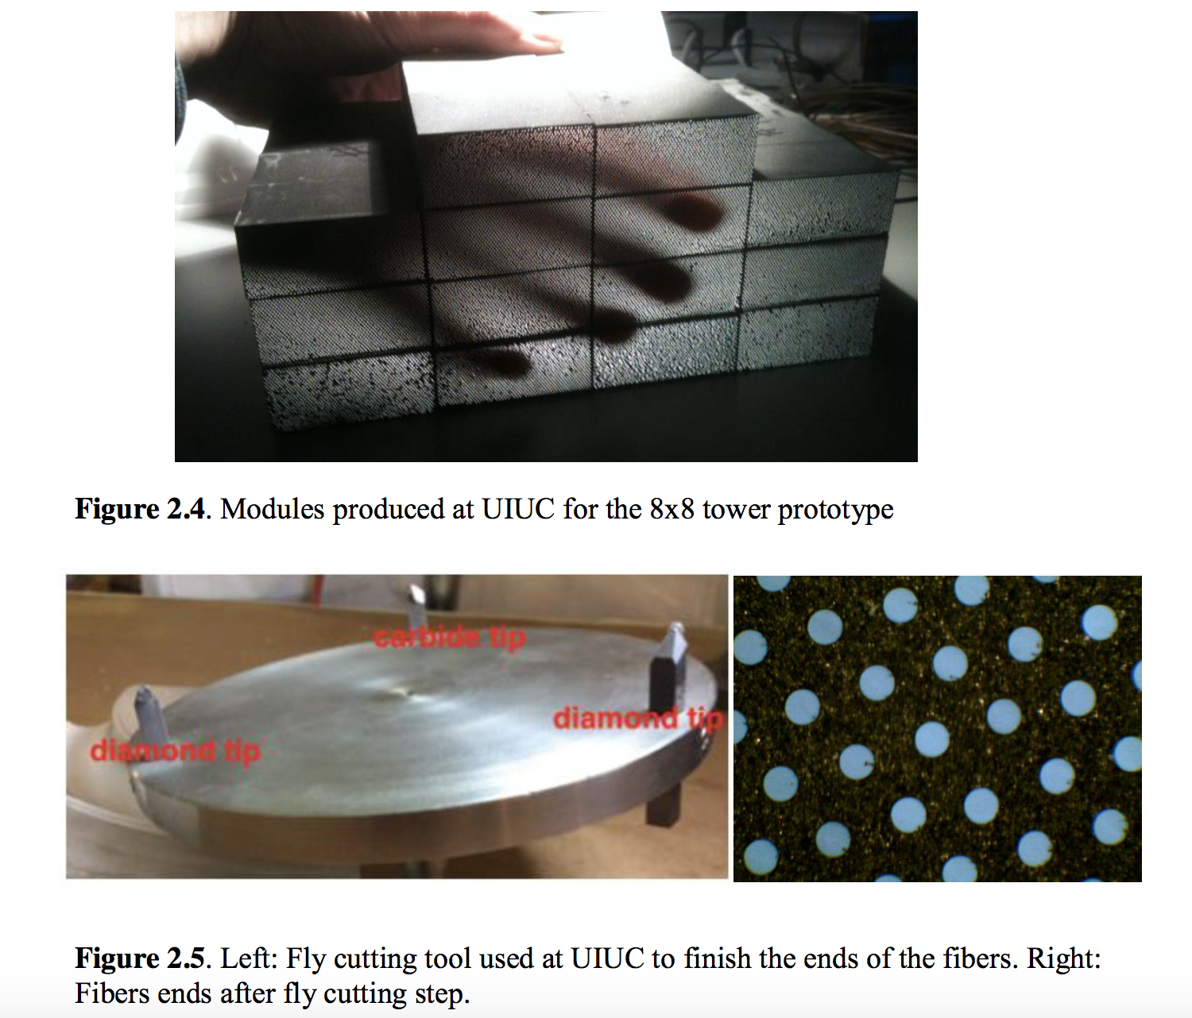
Bricksmanship in modern physics

Slide 19
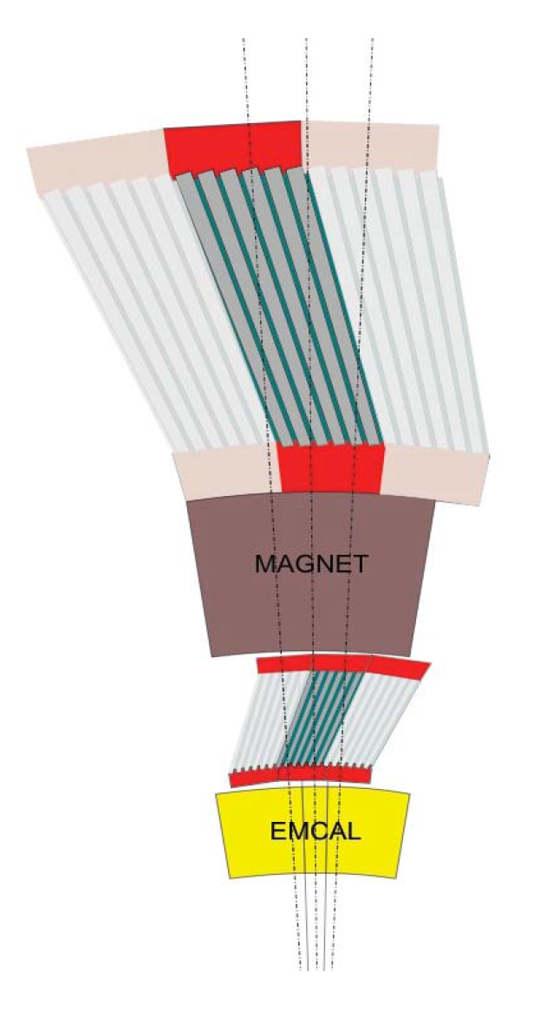
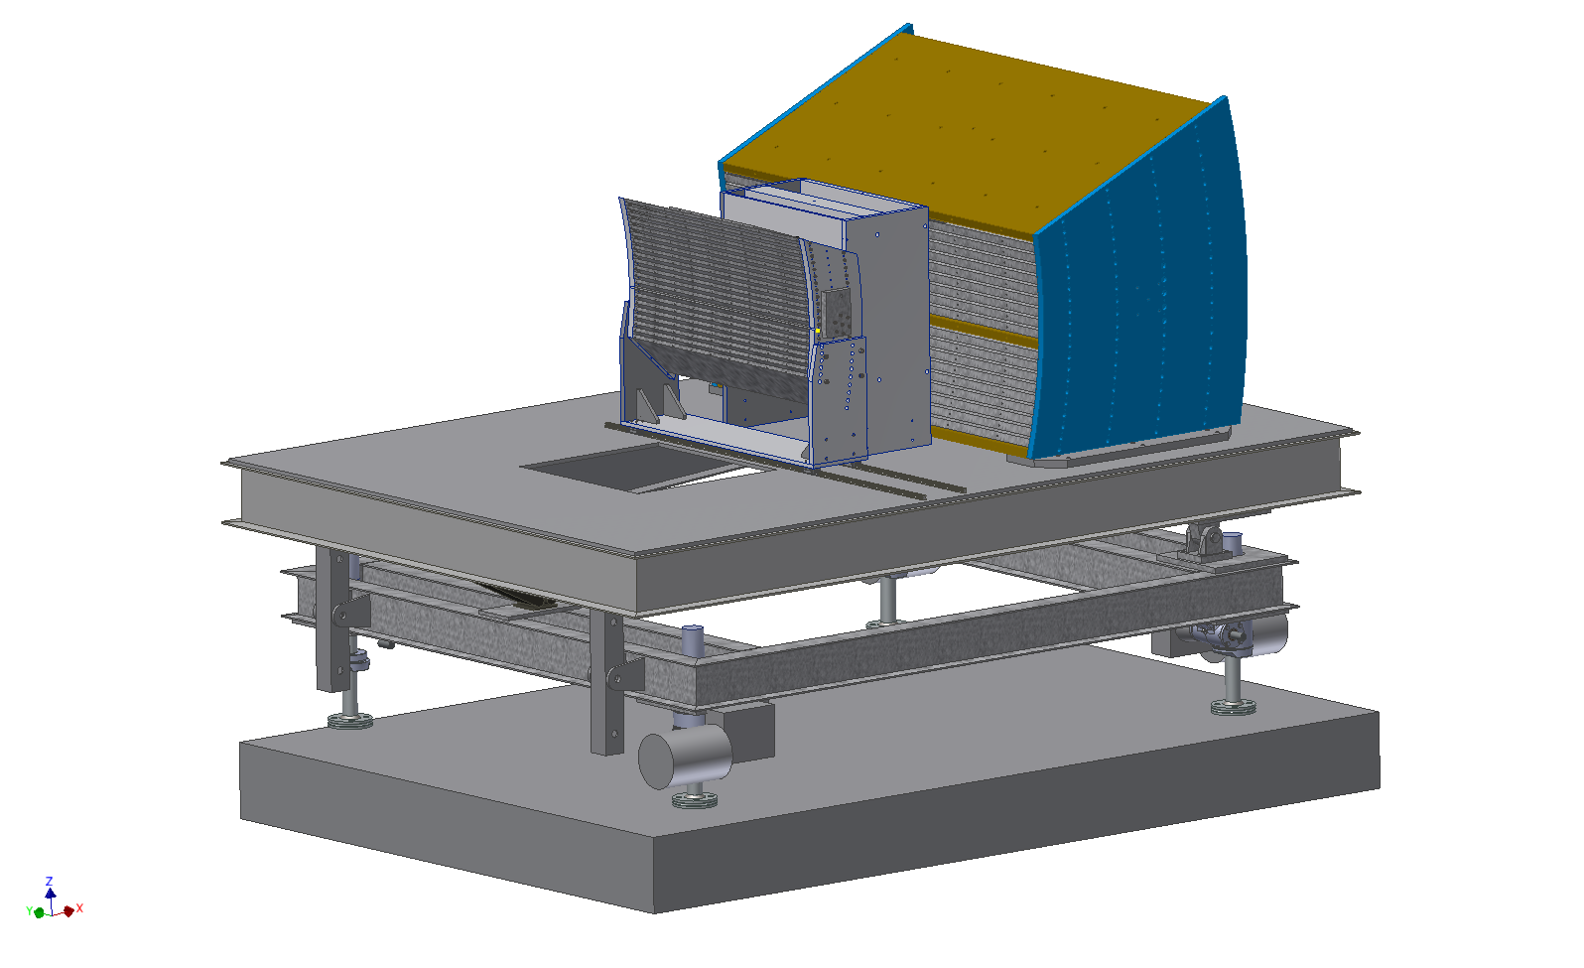
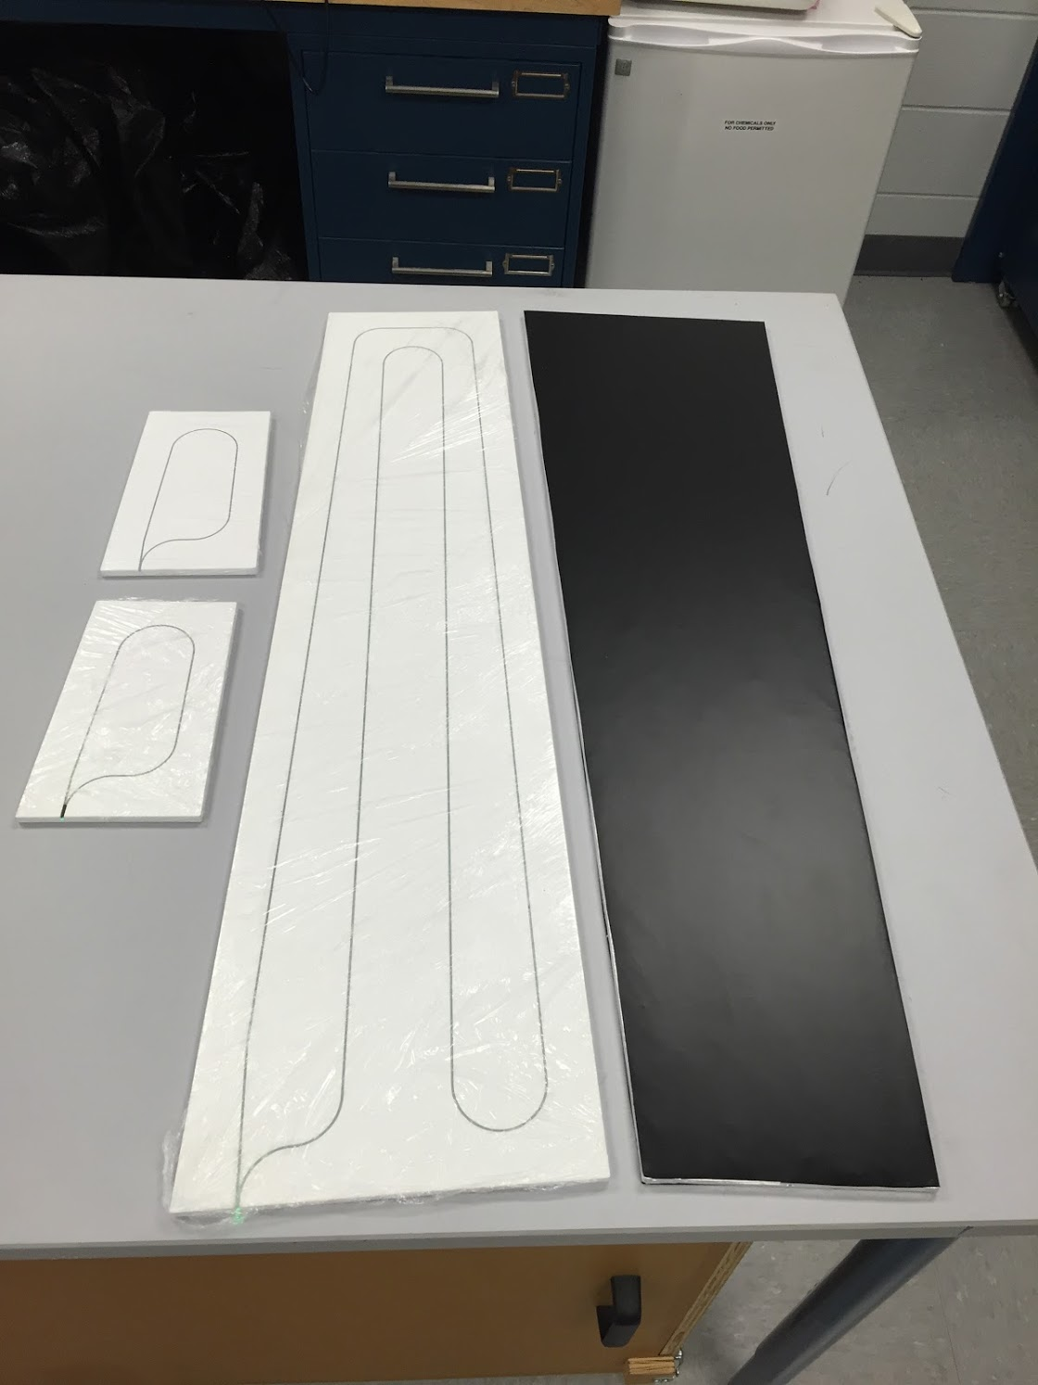
Hadron Calorimeter
Novel design using tilted iron plates doubling as
field return
Active medium – scintillators in the gaps between
plates
Optical readout (WLS fibers and SiPM’s);
PoP Prototype tested in FermiLab in 2014
System prototype is in assembly stage. Beam test in
April 2016 at FNAL
HCOuter
HCInner
Solenoid

Slide 20
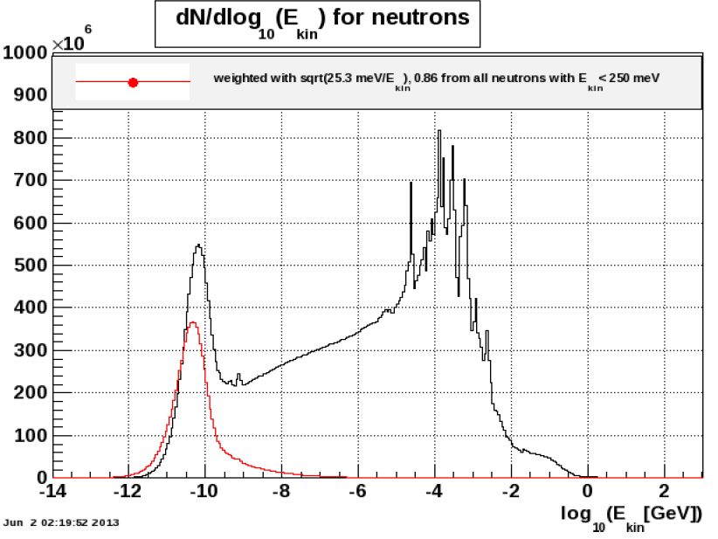
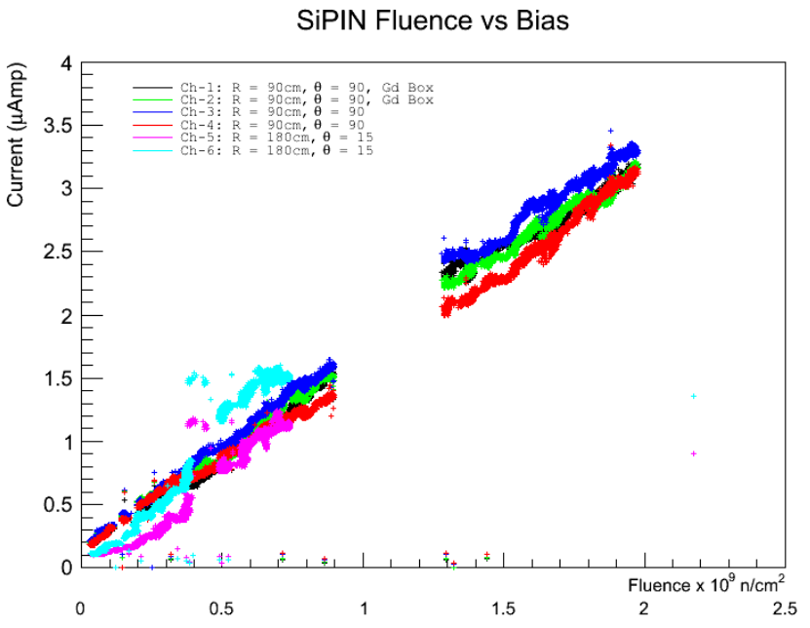
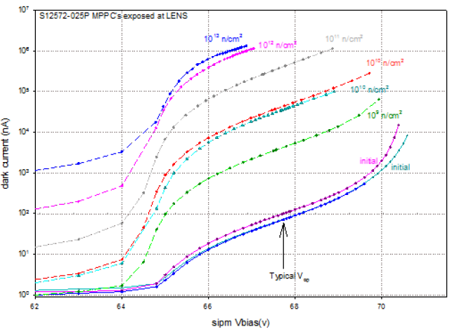
Radiation Damage in SiPMs
Estimated neutron flux in the STAR IR
Damage is caused mainly by neutrons (E ~ MeV)
Measure thermal neutron flux in RHIC IR and estimate MeV equivalent neutrons using MC
Estimates in STAR for 2013 run (L=526 pb⁻¹):
R= 3-8 cm, |Z| < 10 cm : Φ_{eq} ~ 8x10¹⁰ n/cm²
R= 100 cm, Z = 675 cm : Φ_{eq} ~ 2.2x10¹⁰ n/cm²
Neutron measurements at the Indiana University LENS Facility
Y. Fisak et.al. NIM A756 (2014) 68-72
Measured neutron flux in the PHENIX IR
Shielded against thermal neutrons
2 x 10⁹ n/cm²

Slide 21
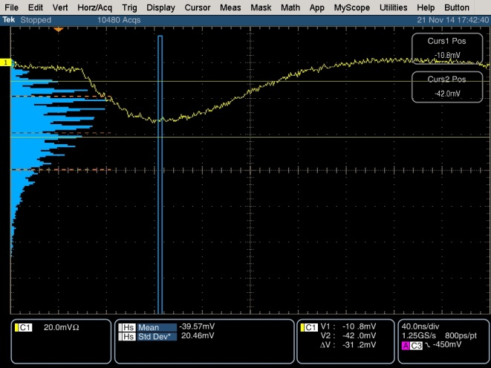
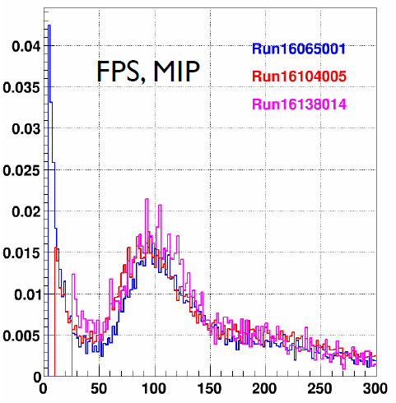
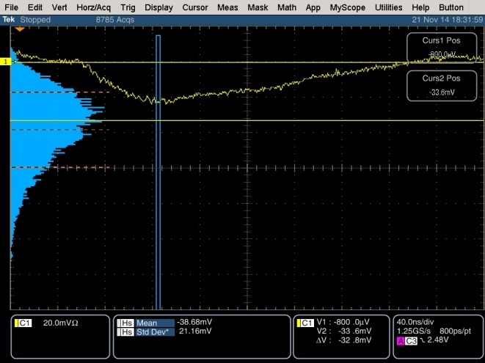
Radiation Damage in SiPMs
Hamamatsu S12572-025P
Primary effect seems to be increase in noise and not loss of PDE
MIP peak for STAR Forward Preshower detector during RHIC Run 15
Before irradiation
φ_{n} ~ 10⁹ n/cm²
After 0.3 x 10⁹ n/cm²
O. Tsai, EIC R&D Report, July 2015
Operationally we plan to keep V_{b} constant for currents up to ~ 1 mA
Will require cooling to maintain ~ 20° C

Slide 22
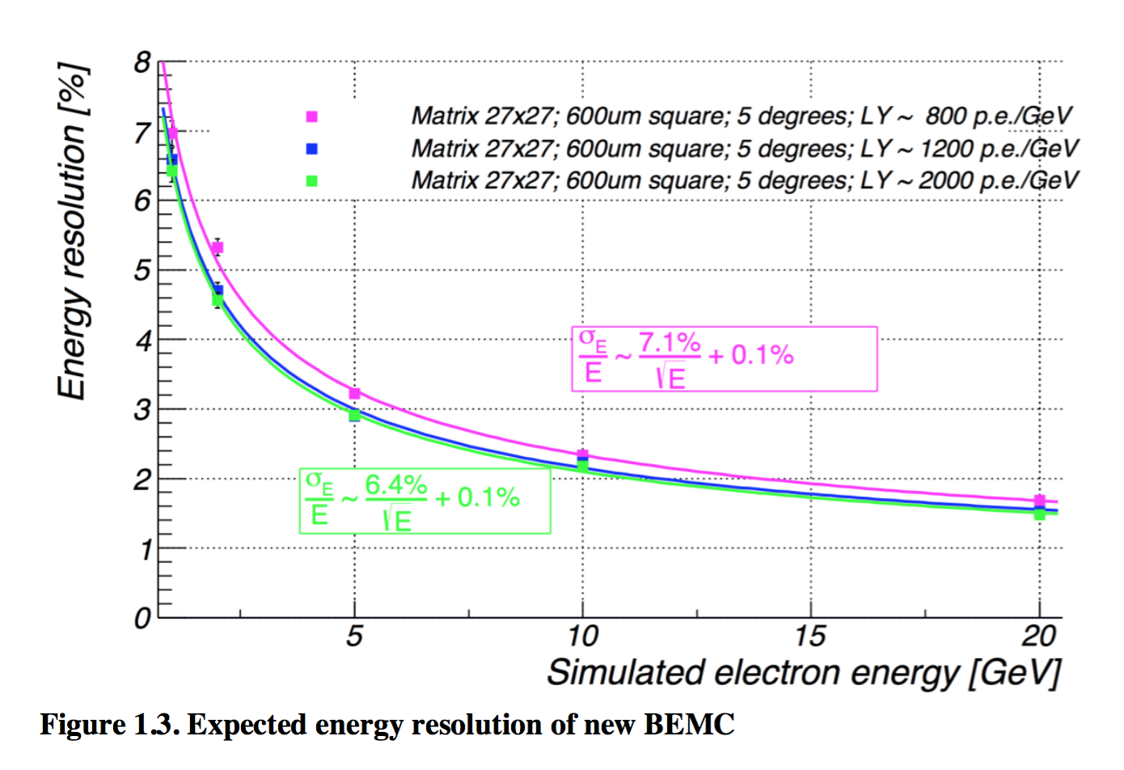
EM Calorimeter Energy resolution

Slide 23
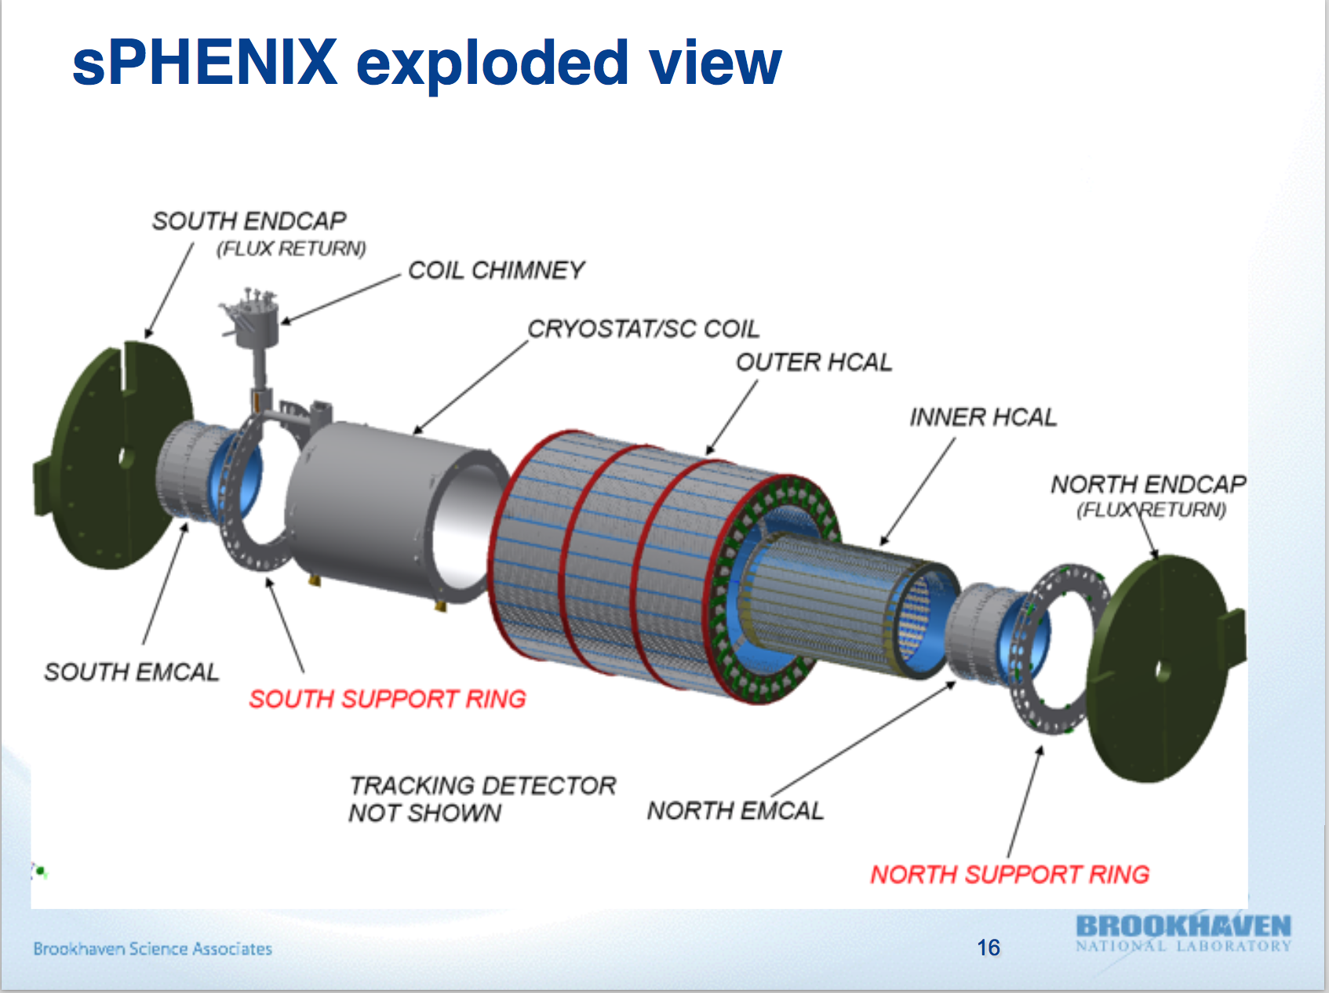

Slide 24
Use jets as probe of QGP in sPHENIX
Efficiency
Di-jets
Photon-jet
Notes:
Major sPHENIX subjects require both jets and photons (high pT) well measured so the balance of energy in hard collisin can be tested

Slide 25

B-quark jet tagging
Heavy quark provide very different
Sensitivity to collision and radiative energy
Loss in QGP from light quark/gluon
Probed by heavy quark jets at sPHENIX
Cut on N track off vertex
B-jet purity after DCA based tagging

Slide 26

Forward spectrometer of sPHENIX: fsPHENIX
Shared detector with future eRHIC program
and deliver an unique forward program with RHIC’s pp/pA collision
white paper submitted to BNL in Apr 2014: http://www.phenix.bnl.gov/plans.html
EIC detector GEM + H-Cal
→ Forward jet with charge sign tagging
→ A_{N} in hadron collisions
→ polarized Drell-Yan with muons
→ Forward-central correlations
+ central detector (sPHENIX)
+ reuse current forward silicon tracker & Muon ID detector
Single jet in GEANT4
p_{T} = 4.1 GeV/c, eta = 3
p/A
p↑
IP
GEMs
Hadron Calo.

Slide 27


fsPHENIX DY – challenging and very interesting
Statistics-kinematic coverage comparisons
Major challenge on background and potential improvement
JLab
Notes:
Also measure DY against large pT range from TMD-applied region to Twist-3

Slide 28

Challenge: Forward field design
Field calculation in COMSOL (SBU)
BaBar superconducting magnet
  Length: 385 cm
  Nominal field: 1.5T
  Designed for homogeneous B-field in central tracking
Field calculation and yoke tuning
  Field calculated and cross checked: POISSION, FEM, OPERA and COMSOL
For forward spectrometer
  Longer field volume for forward tracking
  Higher current density at end of the magnet -> better forward bending
  To work well with RICH needs field-shaping yoke: Forward & central Hcal + Steel lampshade
Track

Slide 29


High energy polarized EIC concepts
Highly polarized electron and nucleon beams
Ion beams from D-> U or Pb
Variable C.M. energy from 20 -> 100 GeV (150 upgradable)
High collision luminosity 10³³-10³⁴ cm⁻²s⁻¹
(HERA luminosity ~ 5x10³¹ cm⁻² s⁻¹ )
Possibility of more than one interaction regions
eRHIC @ BNL
MEIC @ JLab
250 GeV polarized proton
100 GeV/N heavy nuclei
15 GeV polarized electron
luminosity ≥ 10³³ cm⁻²s⁻¹
p 100 GeV/c
Support pol. D

Slide 30

Physics goals: nucleus as a laboratory for QCD
Outlined in EIC white paper, arXiv:1212.1701
The compelling questions:
  Where does the saturation of gluon densities set in?
  How does the nuclear environment affect the distribution of quarks and gluons and their interactions in nuclei?
Deliverable measurement using electron-ion collisions
  Probing saturation of gluon using diffractive process and correlation measurements
  Nuclear modification for hadron and heavy flavor production in DIS events; probe of nPDF
  Exclusive vector-meson production in eA
Leading detector requirement:
  ID of hadron and heavy flavor production
  Large calorimeter coverage to ID diffractive events
  Detection/rejection of break-up neutron production in eA collisions
γ*
h
e’
q
e

Slide 31


eRHIC era: sPHENIX based concept for an EIC Detector
-1<η<+1 (barrel) : sPHENIX + Compact-TPC + DIRC
-4<η<-1 (e-going) :
High resolution calorimeter + GEM trackers
+1<η<+4 (h-going) :
  1<η<4 : GEM tracker + Gas RICH
  1<η<2 : Aerogel RICH
  1<η<5 : EM Calorimeter + Hadron Calorimeter
ZDC and roman pots in Hadron Direction
η=+1
R (cm)
R (cm)
η=-1
HCal
HCal
Aerogel
EMCal
-1.2
z ≤ 4.5m
DIRC
EMCal & Preshower
RICH
Outgoing
hadron
beam
TPC
EMCal
η= 4
p/A
e⁻
BBC
GEMs
GEMs
Station1
GEM
Station2
GEM
Station3
GEM
Station4
z (cm)
ZDC
z≈12 m
Roman Pots
z≫10 m

Slide 32
Summary
RHIC program in this decade is about quantitatively studies of QGP near T_{C} using probes over a broad range of scales
Initial stage of this program – sPHENIX – just underwent successful DOE scientific review;
It got substantial bust from the shipment of BaBar magnet to BNL
Both sPHENIX and STAR are developing forward upgrades aimed towards transverse spin physics;
Both upgrade paths could lead to a capable EIC detector and broad ep/eA program
Plenty of opportunities for Universities and good students

Slide 33
Motto of experimentalist (violated daily)
As forthwith declared on this day,
Physics Experiment Electronics shall contain no:
Blueberry Pies
Raspberry Pi’s
Legos
Tamagotchis
Arduinos
Game Controllers
Garage Door Openers
Or any other such technologies deemed to be unworthy of the professional and reliable operation of a world-class physics detector.
The control devices that we are using are the type found in military, medical equipment and automobile engines. That’s why your car doesn’t just shut off in the middle of the Long Island Expressway. SB, 1/14/2016

