Slide 1
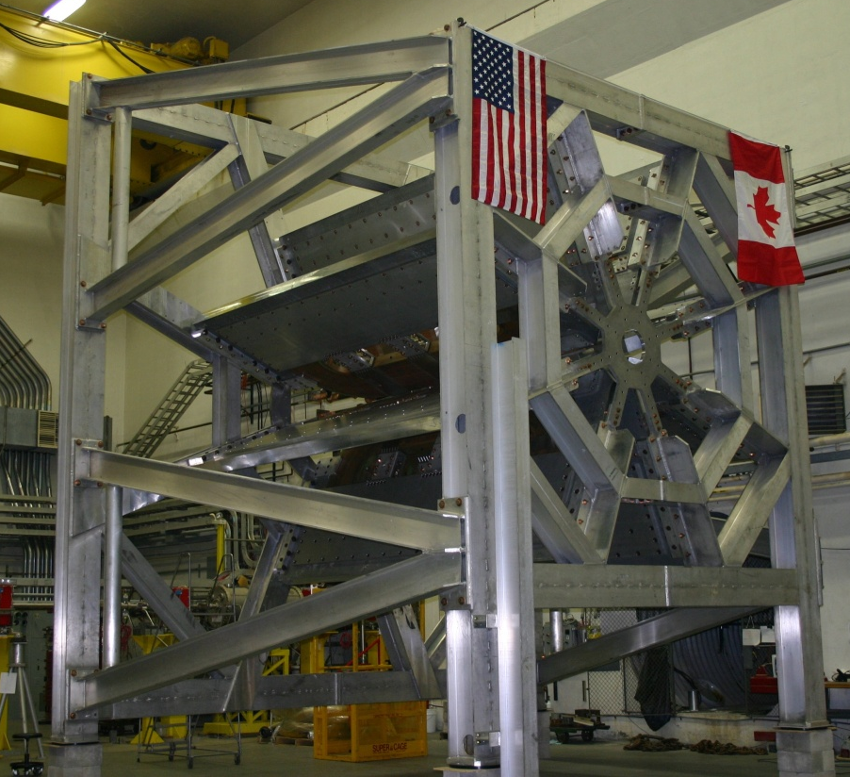


Latest Results from the Q-weak Experiment at Jefferson Lab
Dave Mack (TJNAF)
HEP2016
Valparaiso, Chile
January 12, 2016
DOE, NSF, NSERC
Q-weak home page: https://www.jlab.org/qweak/

Slide 2
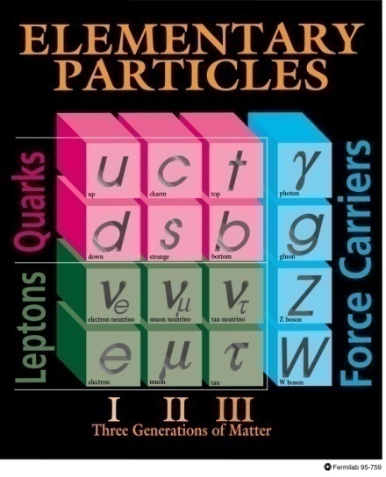

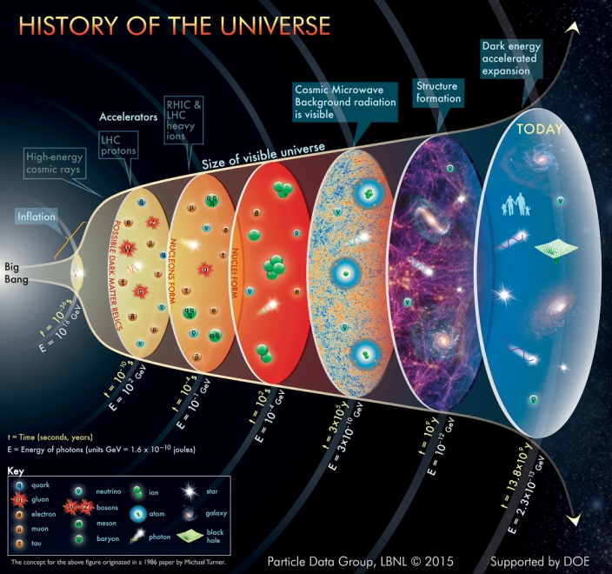
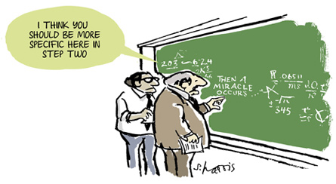
Physics Motivation
+gravity
+dark matter
+dark energy

Slide 3
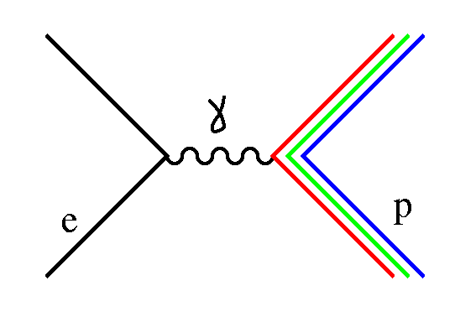
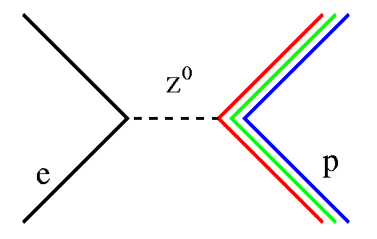
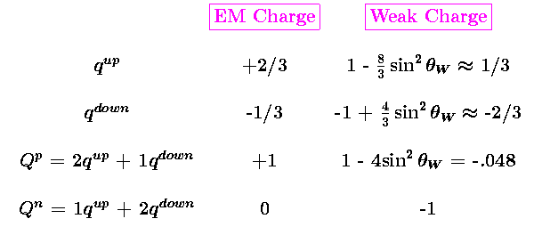
The Quark Weak Vector Charges
  Q_{w}^{p} is the neutral-weak analog of the proton’s electric charge
The roles of the proton and neutron are almost reversed:
ie, neutron weak charge is dominant, proton weak charge is almost zero.
This suppression of the proton weak charge in the SM makes any deviations relatively large. With an experimental accuracy of 4%, it is possible to make the best measurement of sin²θ_{W} at low energies
Notes:
A 4% measurement of a suppressed observable has a smaller absolute uncertainty.

Slide 4
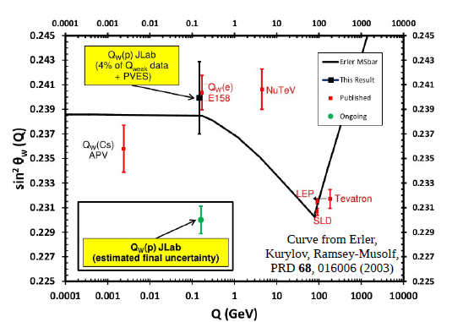
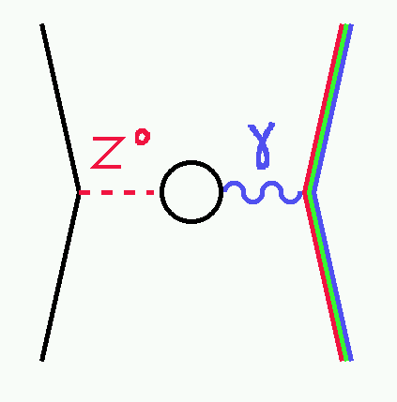
The Running of sin²θ_{W}
In the context of the SM, the running due to γ-Z mixing is calculable at lower energy scales to high precision.
But sin²θ_{W} is determined better at the Z pole than we can match. So what’s the point of Q-weak?
Comparing sin²θ_{W}(0) with sin²θ_{W} (M_{Z}) constrains the presence of non-SM shifts in the EW radiative corrections.
Since Q_{w}^{p} is a suppressed, weak scale observable, an experimental accuracy of 4% has multi-TeV scale sensitivity to new PV interactions between electrons and light quarks.

Slide 5
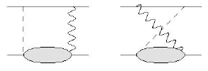
Interpretability and Electroweak Corrections
Although Q_{w}^{p} ~ 1-4sin²θ_{W}, there are substantial box diagram corrections.
WW box is relatively large, but precisely calculable.
γZ box contains long distance contributions, but the uncertainty makes a smaller contribution than Z pole data.
Z pole uncertainty
dominates
interpretability
Qweak(proton) can be calculated to ~1%,
well below our experimental sensitivity.

Slide 6
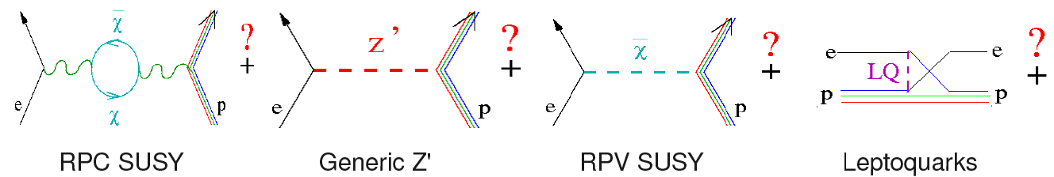
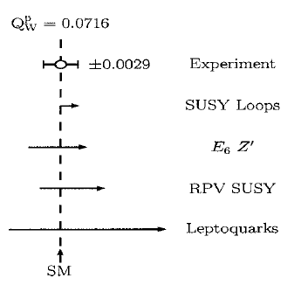
Q-weak’s Keyhole on New Physics
Our experiment is sensitive to new physics with PV couplings of electrons to light quarks.
In this 2003 study, our biggest sensitivity was to lepto-quarks.
The RPV SUSY limits got much tighter in 2013.
Erler and Su,
Prog. Part. Nucl. Phys. 71 (2013) 119-149.
Erler et al., Phys. Rev. D 68, 016006 (2003).

Slide 7
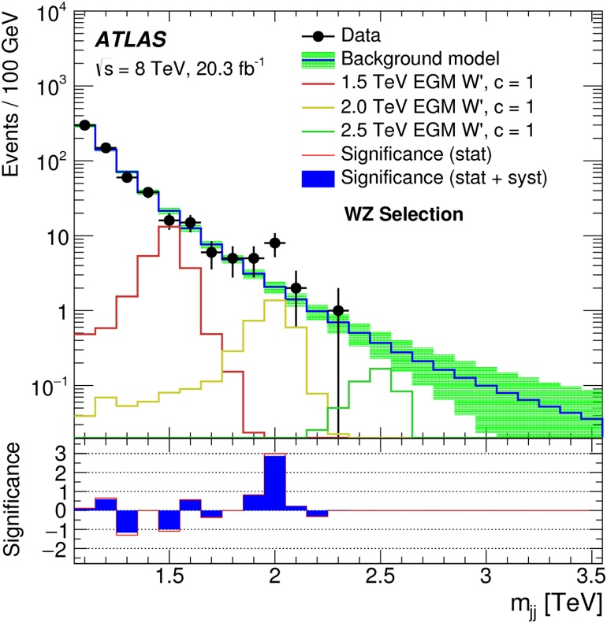
LHC W’ and Q-weak
In LHC Run 1 data, there was a possible signal rising out of the statistical mud in W’ → WZ near a mass of 2 TeV. There aren’t enough statistics yet in Run II to check it.
Q-weak is blind to a W’ since it would shift G_{f} and not cause sin²θ_{W} to run.
But W’ models always come with a Z’. A recent publication predicts a corresponding Z’ near 4 TeV.
Dobrescu and Liu,
PRL 115, 211802 (2015).
This is a very high mass. Unless the specific couplings happen to be several times larger than SM values, the Q-weak pull would be significantly less than 1σ.
I’ll be happy to be surprised though!
See Wed talk by H. Wahlberg this conference and references
https://indico.cern.ch/event/385771/timetable/#20160106.detailed

Slide 8
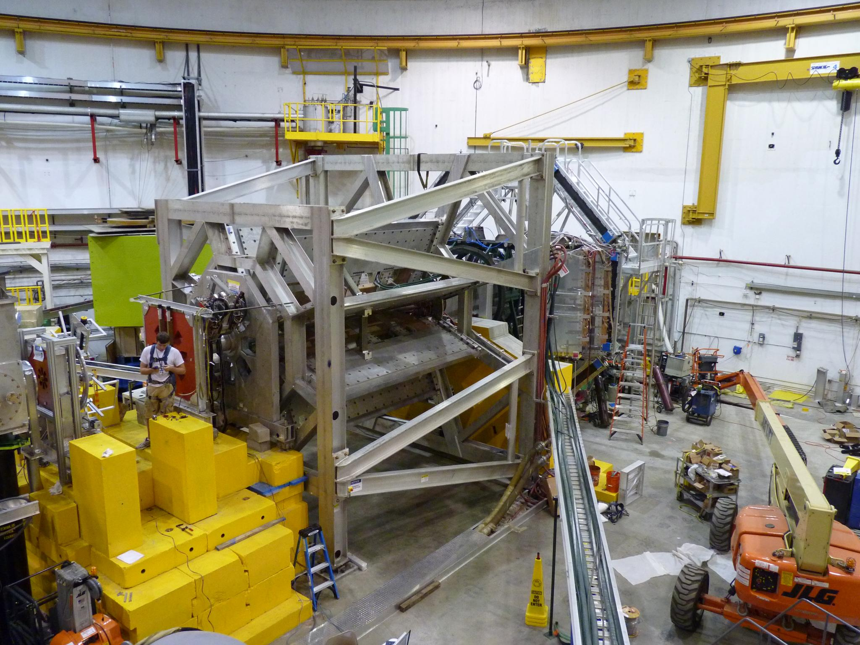
Determination of Q_{w}^{p} via
PV Electron Scattering

Slide 9
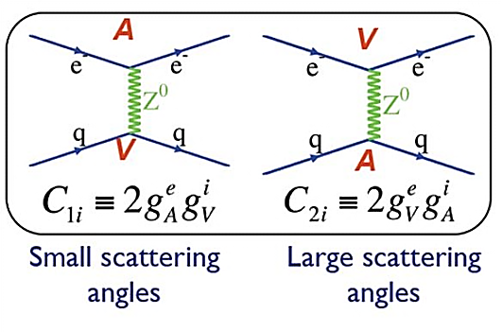

Accessing Q_{w}^{p} from PV Electron Scattering
Parity violation in electron scattering arises from V x A couplings of the Z.
We isolate the small EM x Weak
interference term, normalized to |EM|² ,
thru the PV asymmetry.
By varying the angle and momentum Xfer,
one can extract Qw^{p} and axial couplings, etc.
We wanted A(e) x V(q) to dominate.
In the limit of low momentum transfer and forward kinematics, the leading order term for elastic scattering contains the weak charge:
Roughly
-200 ppb
At our chosen kinematics, Q_{w}^{p} dominates the asymmetry (~2/3).

Slide 10
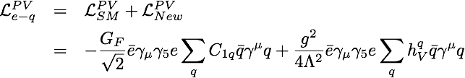

Energy Scale of a Q_{w}^{p} Measurement
The sensitivity to new physics Mass/Coupling ratio can be estimated by adding a new PV contact term to the electron-quark Lagrangian
(Erler et al. PRD 68, 016006 (2003)):
where Λ is the mass and g is the coupling.
A new physics “pull” on the proton weak charge, ΔQ_{w}^{p}, can then be related to the mass to coupling ratio:
Assuming ΔQ_{w}^{p} = 4% x Q_{w}^{p}, and g ~ 1, then Λ is TeV scale.
Sensitivity is “broad band”: one can be as sensitive to a 200 MeV new particle with small couplings as to a 20 TeV particle with large couplings.
Tough game: statistically, 2 TeV is 2⁴ = 16 times harder than 1 TeV.

Slide 11
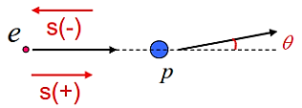
Methodology
We flip the longitudinal beam polarization up to 1000 times per second, with a brief pause for the beam polarization and intensity to stabilize. (That’s as fast as we can manage without excessive dead-time.)
With an electron scattered into each detector every nsec, the signal must be integrated.
(-200 ppb)
The experiment also requires:
  Noise from target density fluctuations and electronics must be << 1/√N.
  Minimal beam parameter changes on spin flip (ie, << wavelength of visible light)
  Corrections for remaining small false asymmetries that do occur on spin flip
  Precise measurements of Q², beam polarization, and backgrounds.

Slide 12
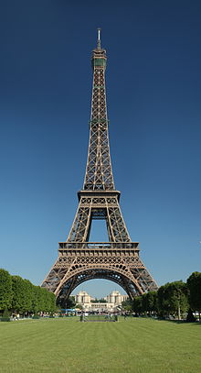
How Small is the 200 ppb Q-weak PV Signal?
current
- + - + - + -
helicity
6 μA
If this figure were to scale, the zero of the vertical axis would be 250 km below our feet.
time
It is like the thickness of a coat of paint on top of the 325m Eiffel Tower.
And we have to measure it
to a several percent accuracy!
Notes:
peak-to-peak noise band is about 6-8 times the rms noise.

Slide 13
Statistical Facts of Life of Measuring Very Small Asymmetries
How long would it take to measure a 200 ppb asymmetry to 1% if one were tracking particles at Rate = 10 MHz (eg, 10 detectors each with 1 MHz rate)?
ΔA = 1/√N
N = 1/ΔA² = 1/(0.01*200x10⁻⁹)² = 2.5x10¹⁷ events
That’s 0.25 billion billion events.
Time = N/Rate = 2.5x10¹⁰ sec
1 year = 3.2x10⁷ sec → 793 years
For ΔA < 10 ppb like Q-weak, experiments are not feasible in event- or tracking-mode.
The only choice is to design a low-background experiment and integrate.
For ΔA > 100 ppb, event mode can be used. Tracking helps suppress backgrounds, but the downside is that dead-time and randoms must be controlled.

Slide 14
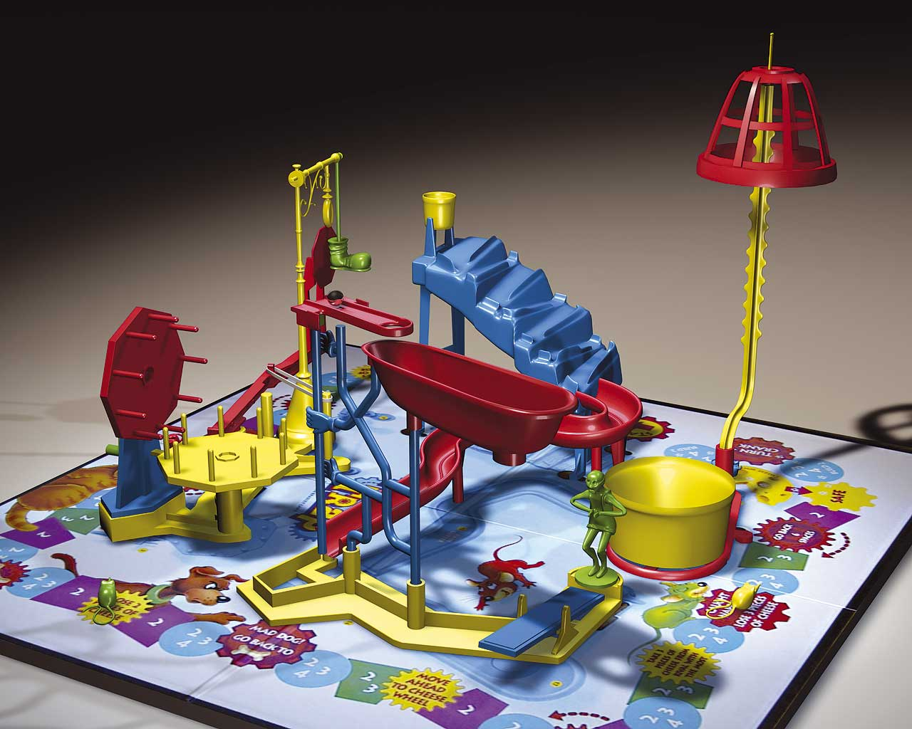
The Apparatus

Slide 15
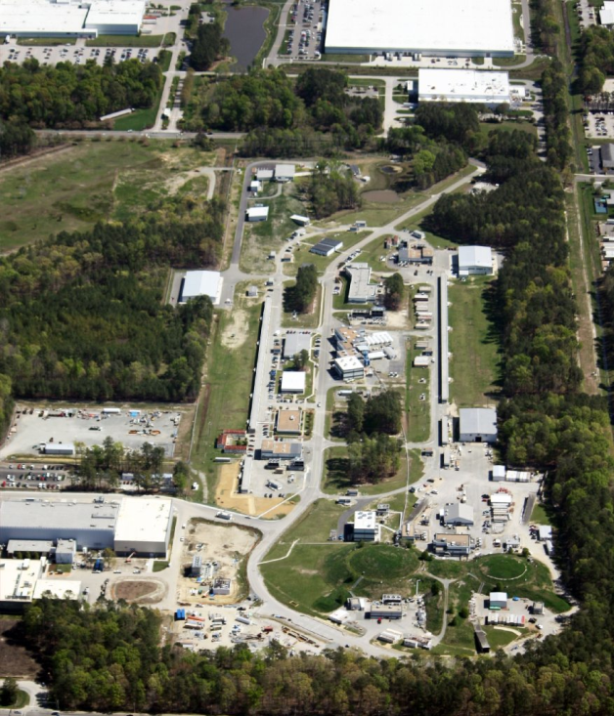
Bird’s-eye View of
Accelerator
Site
D
JLab Proposal
The Qweak Experiment:
“A Search for New Physics at the TeV Scale via a Measurement of the Proton's Weak Charge“,
December 10, 2007
http://qweak.jlab.org/doc-public/ShowDocument?docid=703
A
B
C

Slide 16
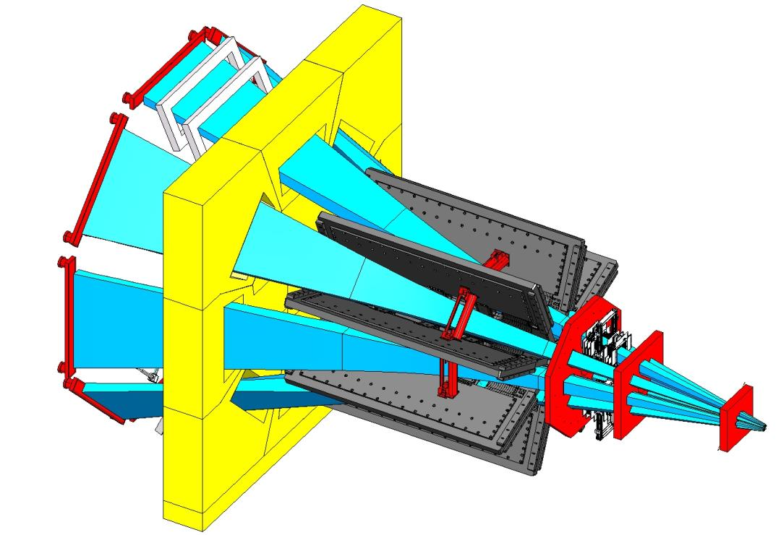
Q-weak Spectrometer
Must isolate elastic e+p events at small angles, with the largest acceptance possible, without tracking.
(A new particle traverses each detector approximately every nsec.)
Electromagnet since no ferromagnetic materials could be used.
Quartz Cherenkov bar
Qweak Toroidal Magnetic Spectrometer (QTor)
  E_{beam}= 1.16 GeV
Lum. = 1.7 x 10³⁹ cm⁻²s⁻¹
  θ = 6° - 12°
  Q² = 0.025 (GeV/c)²
Total Rate = 6.4 GHz
High density concrete shield wall
Collimators
Scattered electron beam

Slide 17
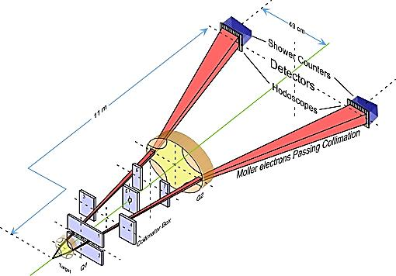
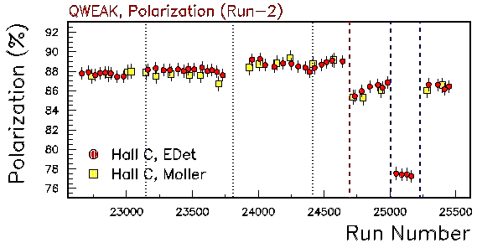
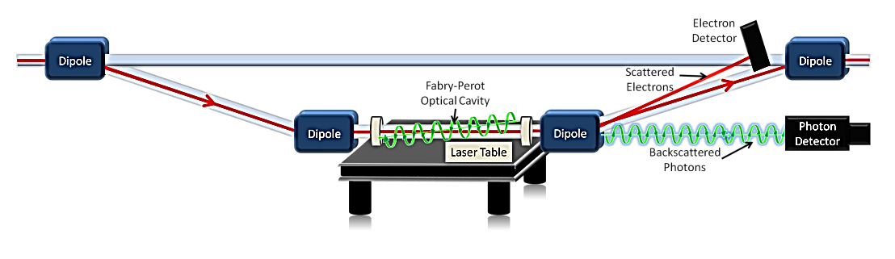
Precision Polarimetry
Qweak requires ΔP/P ≤ 1%
Two independent polarimeters
Existing <1% Hall C Møller polarimeter:
  Low beam currents, invasive
  Known analyzing power provided by polarized Fe foil in a 3.5 T field.
Møller Polarimeter
New Compton polarimeter (1%/h)
  High I_{beam}, non-invasive
  Known analyzing power provided by circularly-polarized laser
Preliminary
Compton
Moller
Compton Polarimeter

Slide 18
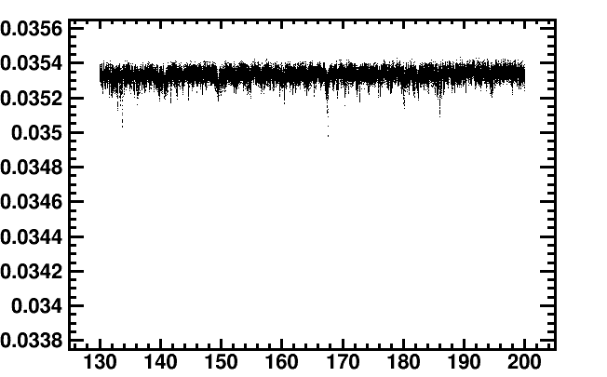

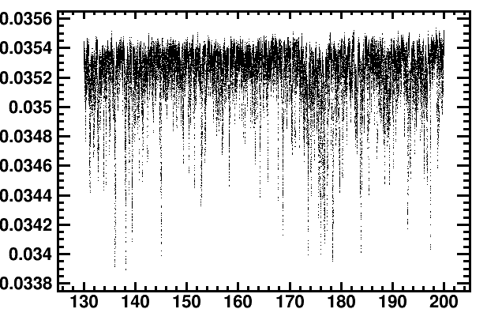

Target Bubble-ology
Changes in column density between + helicity and – helicity samples are a source of noise. The main source is bubble/vapor layer formation on the Al windows. Reversing helicity every 1 msec was critical to make
the fluctuations appear negligible.
The target under
nominal running
conditions.
The target during
a stress test.
Pump speed = 28.5 Hz
Main Detector
Yield
(V/μA)
sin gas
Pump speed = 12 Hz
con gas
Time (sec)

Slide 19
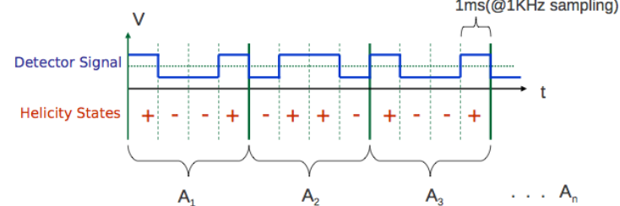
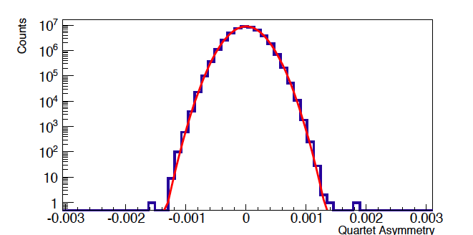
Signal Manipulation
Helicity flip every 1/960 sec
PMT anode current integrated
for each helicity state,
normalized to beam charge
Quartet asymmetries calculated
(cancels linear drifts)
Asymmetry width ~230 ppm at
180 μA is dominated by √N
Half-wave plate inserted or removed every 8 hours. (No possibility of electronic pick-up.)
Additive “blinding factor” applied.
Gaussian Fit (σ=230 ppm)
Data
(Quartet Asymmetries over several days)

Slide 20
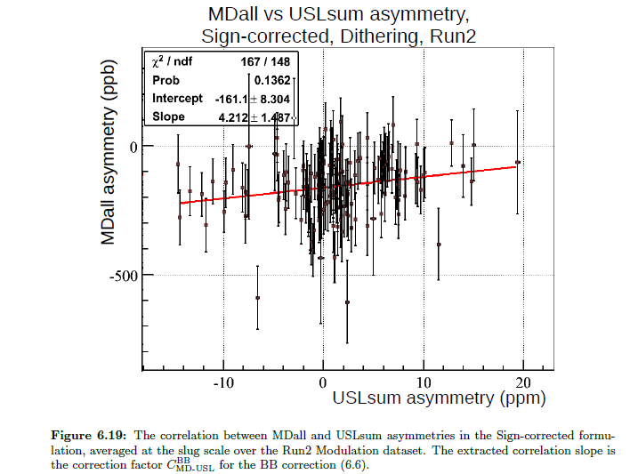

Beamline Background
A qualitatively new bkg in PV experiments at JLab. Regression with beam position monitor leaves a correlation. Perhaps a big asymmetry in a tiny (ppm level) halo or tail.
Some of it cancelled by Half Wave Plate change every 8 hours, but not all.
This “hidden variable” problem was strangled by removing residual correlations between the signal and background detectors after regressing for the usual position, angle, and energy changes.
E. Kargiantoulakis, U. of Virginia,
https://qweak.jlab.org/do-public/ShowDocument?docid=2276

Slide 21
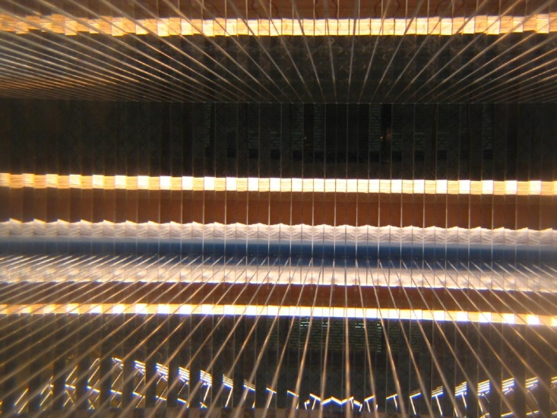
Status and
Latest Results

Slide 22
Status
The Qweak Experiment finished successfully
  2 years in situ, ~1 year of beam
Commissioning run analyzed
  ~ 4% of dataset
  Results presented here: 1st Determination of Q_{w}(p), C_{1u}, C_{1d}, & Q_{w}(n)
Remainder of experiment still being analyzed
  Expect final A_{pv} result to have ~5x better precision
  Final Q_{w}(p) uncertainty in the ballpark of “5%”

Slide 23
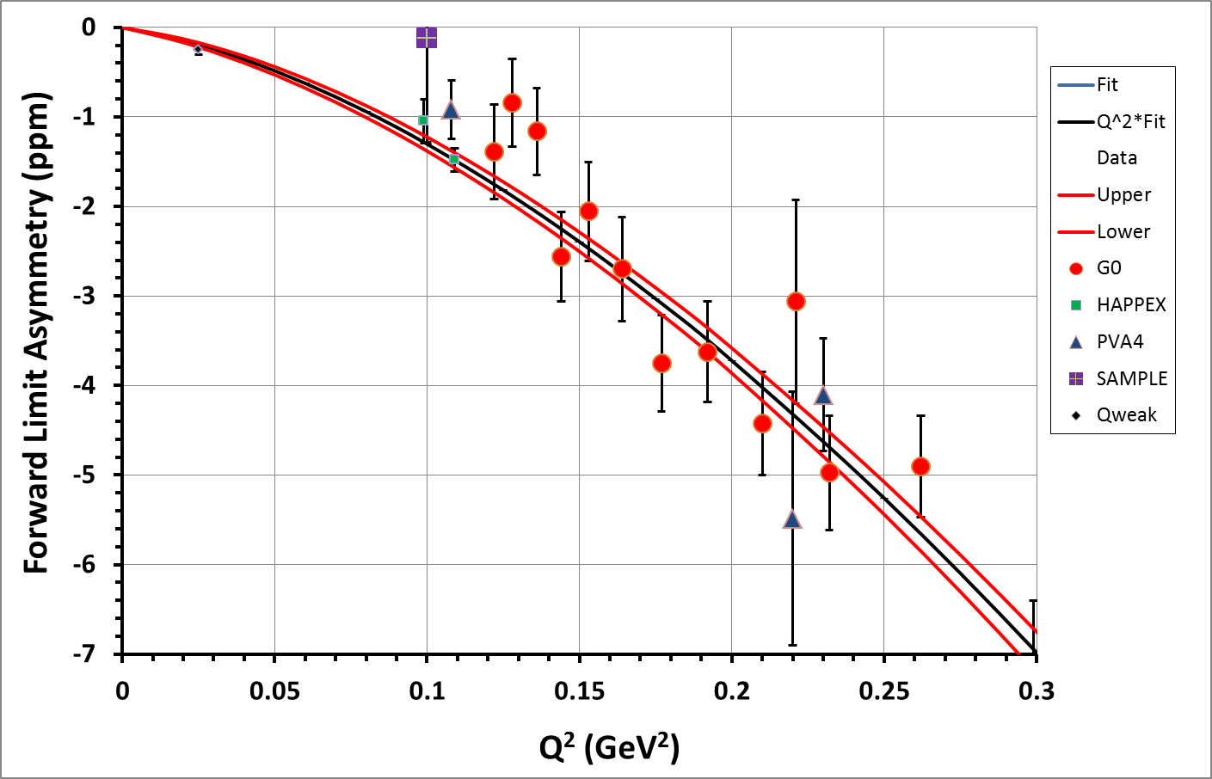
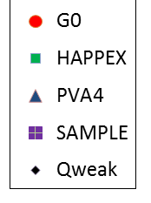
Fully Corrected Elastic e+p Asymmetry
(evolved to Ө = 0° at fixed Q²)
D. Androic et al., Phys. Rev. Lett. 111, 141803 (2013)
http://arxiv.org/abs/1307.5275v2
A_{PV} = -279 ± 35 (statistics) ± 31 (systematics) ppb
<Q²> = 0.0250 ± 0.0006 (GeV/c)²
<E> = 1.155 ± 0.003 GeV
This Experiment
(4% of our data)

Slide 24
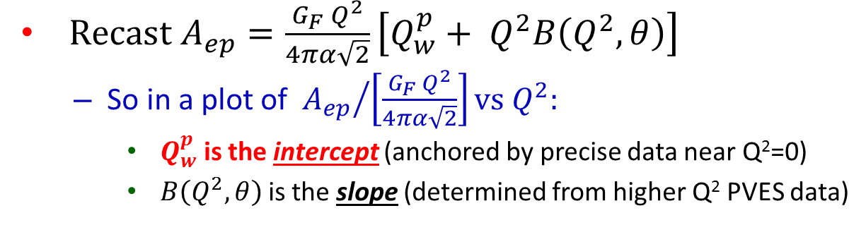
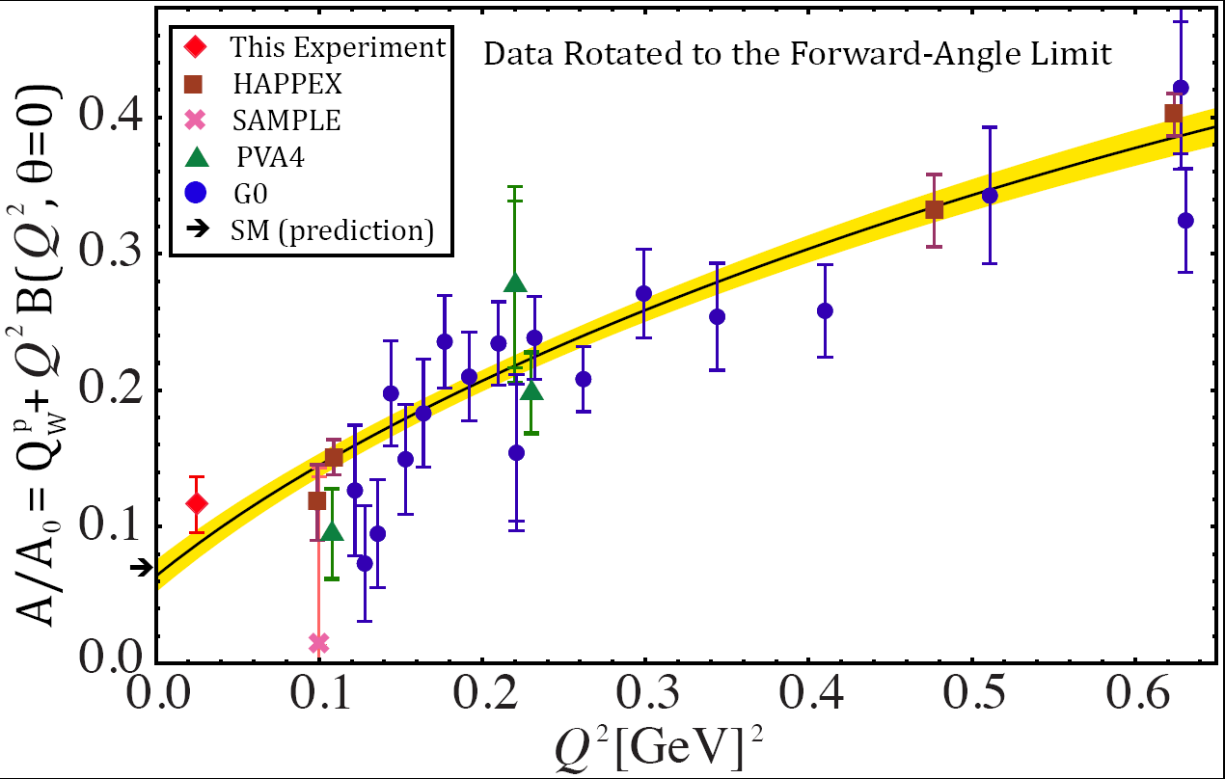
Global fit of PV Elastic Electron Scattering Data
Dividing out the leading Q² dependence makes it easier to
see all the experiments on one plot and interpret.
A = -279 ± 35 ± 31 ppb
Q_{W}(p) = 0.064 ± 0.012
(only 4% of all data collected)
SM value = 0.0710(7)

Slide 25
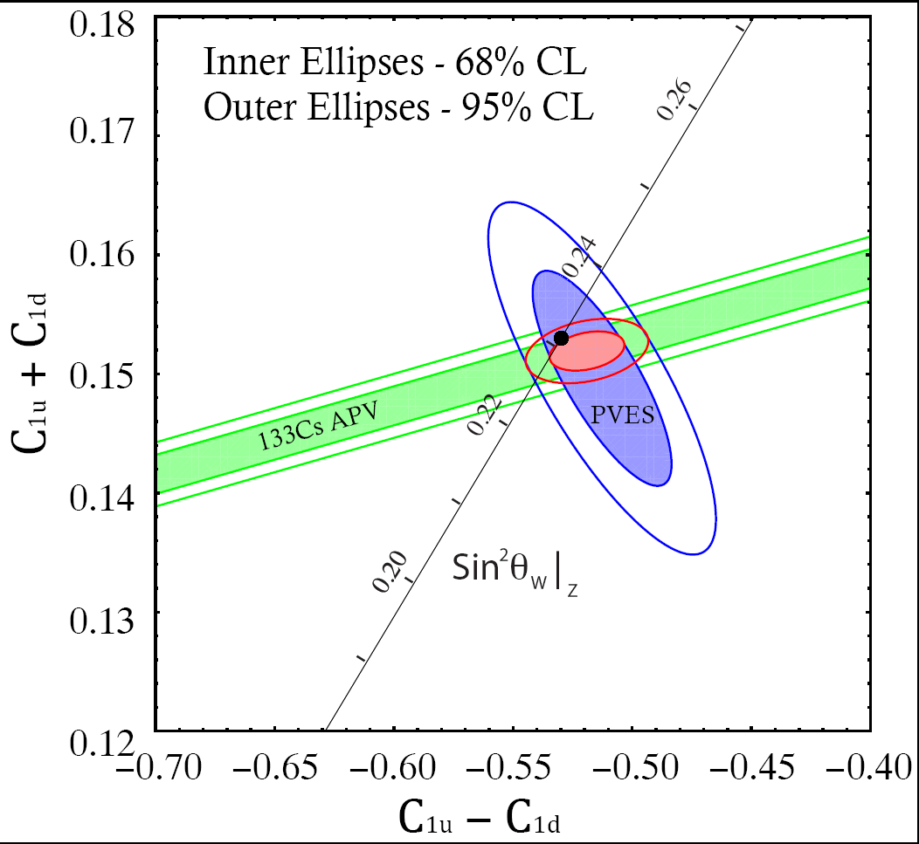
Combining PV Electron Scattering & Atomic PV
Q_{W}(p) = -2(2C_{1u} + C_{1d}) = 0.064 ± 0.012
(only 4% of data)
SM value = 0.0710(7)
APV + PVES
Combined Result
SM
C_{1u} = -0.184 ± 0.005
C_{1d} = 0.336 ± 0.005
(only 4% of data)
Q_{W}(n) = -2(C_{1u} + 2C_{1d}) = -0.975 ± 0.010
(only 4% of data)
SM value = -0.9890(7)

Slide 26
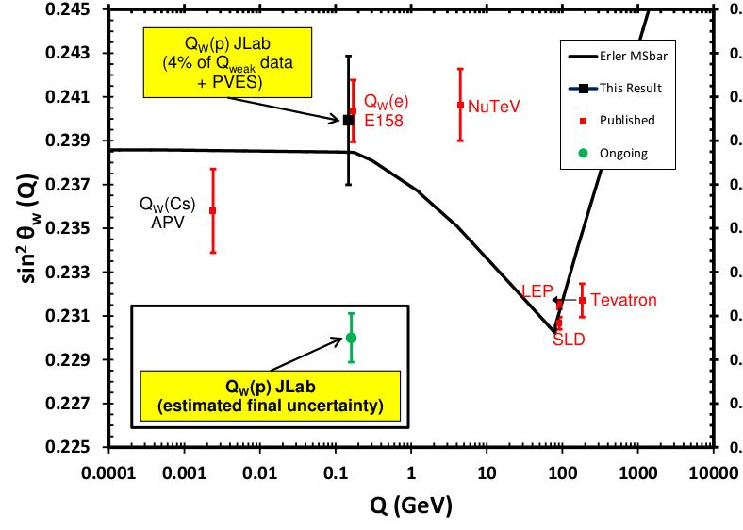
Weak Mixing Angle Result
Curve from
Erler, Kurylov, Ramsey-Musolf,
PRD68, 016006 (2003)

Slide 27
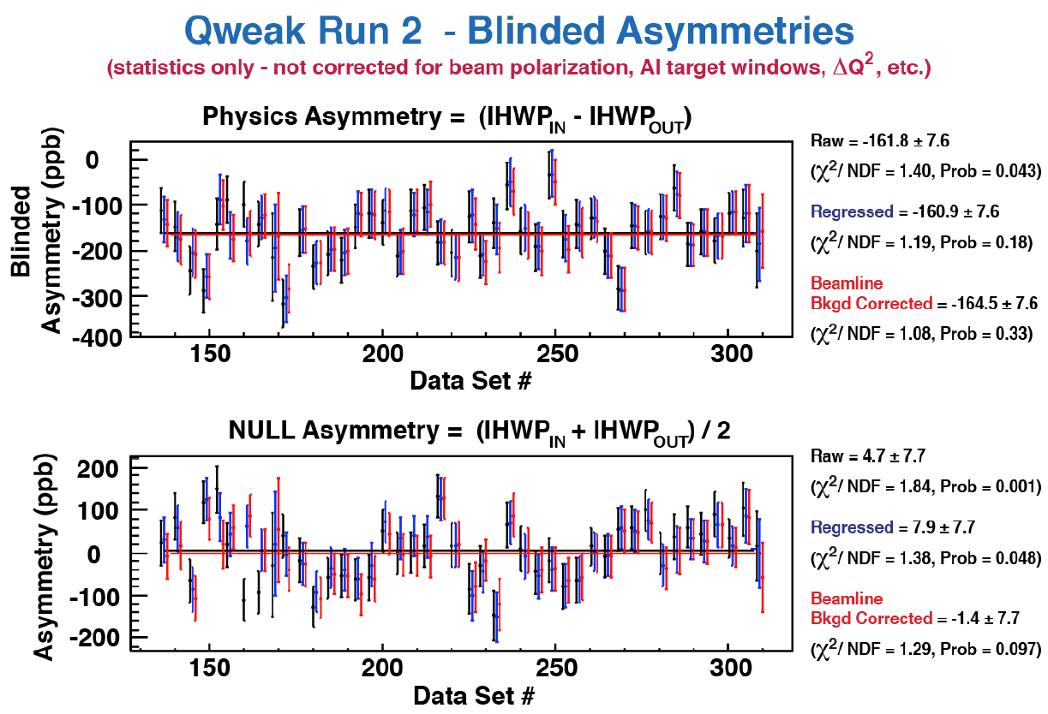
Quality of the Majority of Q-weak Data
Asymmetry - As expected, the probability of a fit to A_{pv} = constant improves with corrections to remove noise.
Null – This Null is consistent with zero, and the probability of a fit to Null = constant is okay.
James Dowd

Slide 28
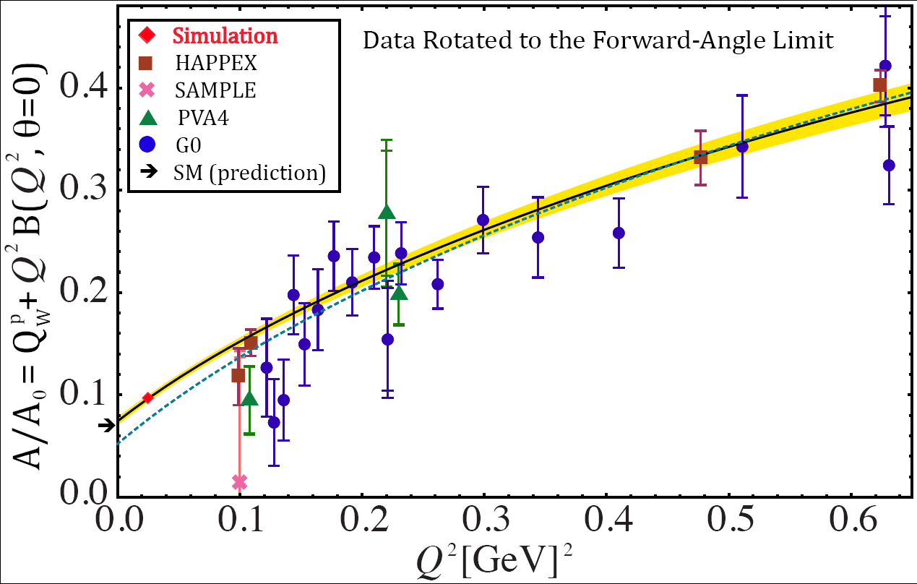
Potential Impact with Final Result
(Assuming SM Value)
Fit without this experiment (large error band not shown)

Slide 29
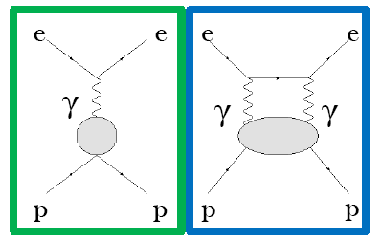
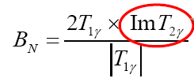
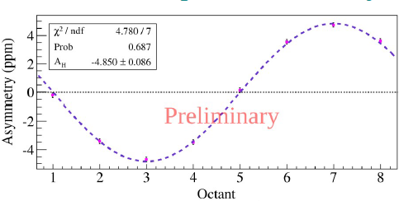
Transverse Asymmetry Measurement in e+p Elastic Scattering
B_{n} is a parity conserving, transverse asymmetry
due to 2γ exchange.
B_{n} with 100% transverse polarization is O(100) times larger than Apv with 100% longitudinal polarization.
We carefully measured it because it leads to a ppb-level correction in our PV data due to a few % P_{t} and small broken azimuthal asymmetries in our detector.
B Waidyawansa talk at PAVI14,
http://pavi14.syr.edu/Slides.html
Uncorrected asymmetry
Since B_{n} depends on the imaginary part of the 2γ exchange amplitude, our 1.16 GeV beam energy data provides an integral measurement of all excitations of the proton up to E_{cm} = 1.7 GeV.

Slide 30
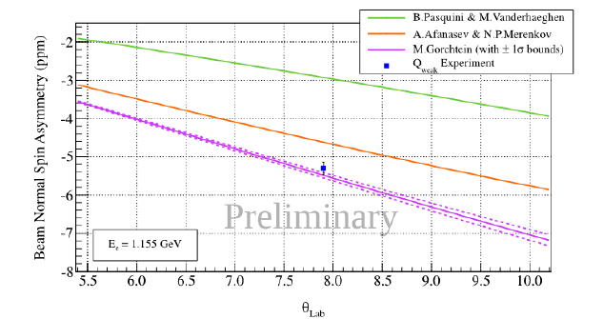
Elastic e+p Transverse Asymmetry Results
Our result is perhaps the most accurately measured e+p asymmetry at the GeV scale
(it’s a single spin asymmetry).
Green curve - A pioneering model which used only MAID single π amplitudes significantly under-predicted the data.
Red and Purple curves - Models which use photo-production data to constrain the forward Compton amplitude do reasonably well.
B_{n}
_{(ppm)}
Θ_{lab} (deg)
Intermediate states in the 2γ box diagram
like N + multi-π are important.

Slide 31
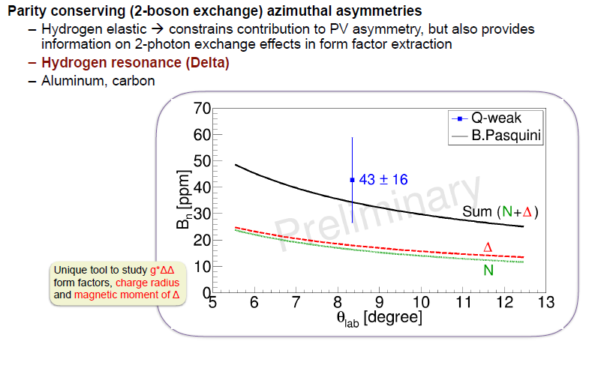
Inelastic e+p Transverse Asymmetry Results
The prediction of a very large asymmetry at forward angles is confirmed.

Slide 32
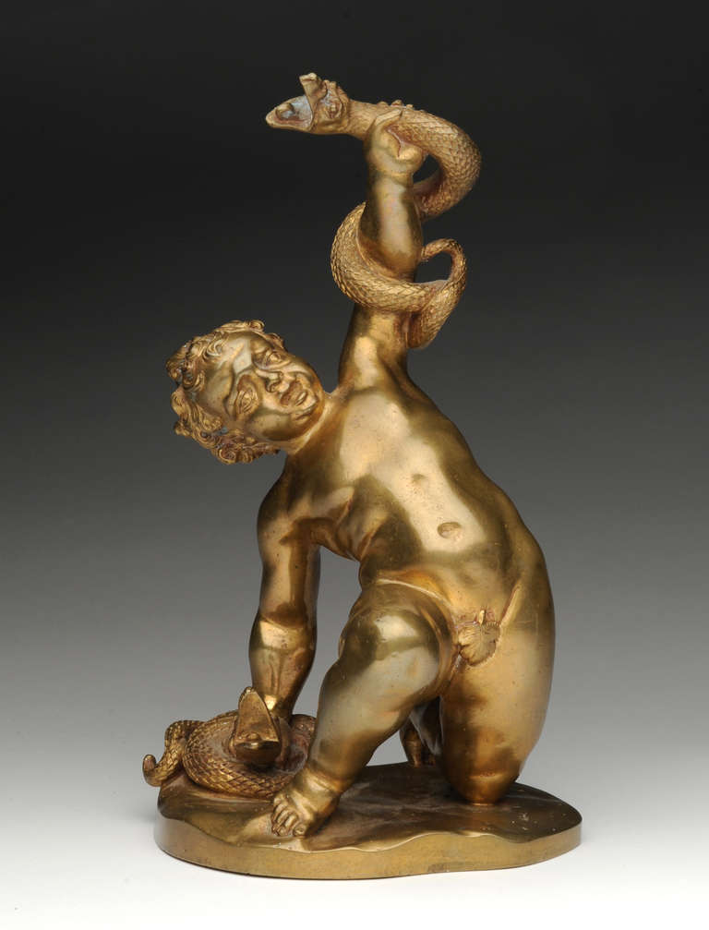
Progress Since HEP2012
We’re not done yet, but much progress since Jan 2012:
Completed our data taking (our Run II) in May 2012
Published low statistics Q_{w}^{p} result and global analysis in PRL Oct 2013
Essentially finalized two transverse asymmetry results (B_{n}),
one in the elastic e+p channel (~20x larger than Apv),
ii. one in e+p→e’ + Δ (~200x larger than Apv).
Discovered a qualitatively new bkg/noise in PV
experiments at JLab, the so-called Beamline Background.
Strangled in the recent PhD thesis of E. Kargiantoulakis (UVa).
Discovered a qualitatively new systematic (non-noise)
bkg and working on that.
10 more PhD’s awarded (15 to date)

Slide 33
Summary
The weak vector charge of the proton, Q_{w}^{p} , is 1-4sin²θ_{W} suppressed hence a good way to
i. measure sin²θ_{W} at low energies,
ii. search for new PV interactions between electrons and light quarks.
Elastic PV electron scattering at low momentum transfer allows us to determine the weak vector charge of the proton. We have
i. measured the smallest & most precise e+p PV asymmetry ever.
ii. determined Q_{W}(p) at low energies: 0.063 ± 0.012 (from only 4% of data)
iii. Find a result consistent with the SM with nontrivial sensitivity
λ/g = ½( √2 G_{F} ΔQ_{W})^{-1/2} = 1.1 TeV
Combining our result with Cs APV, we sharpen C1u, C1d, and hence Q_{w}^{n}.
Expect to report results with ~5 times smaller uncertainties
  Expected physics reach of ~ 2.3 TeV.

Slide 34
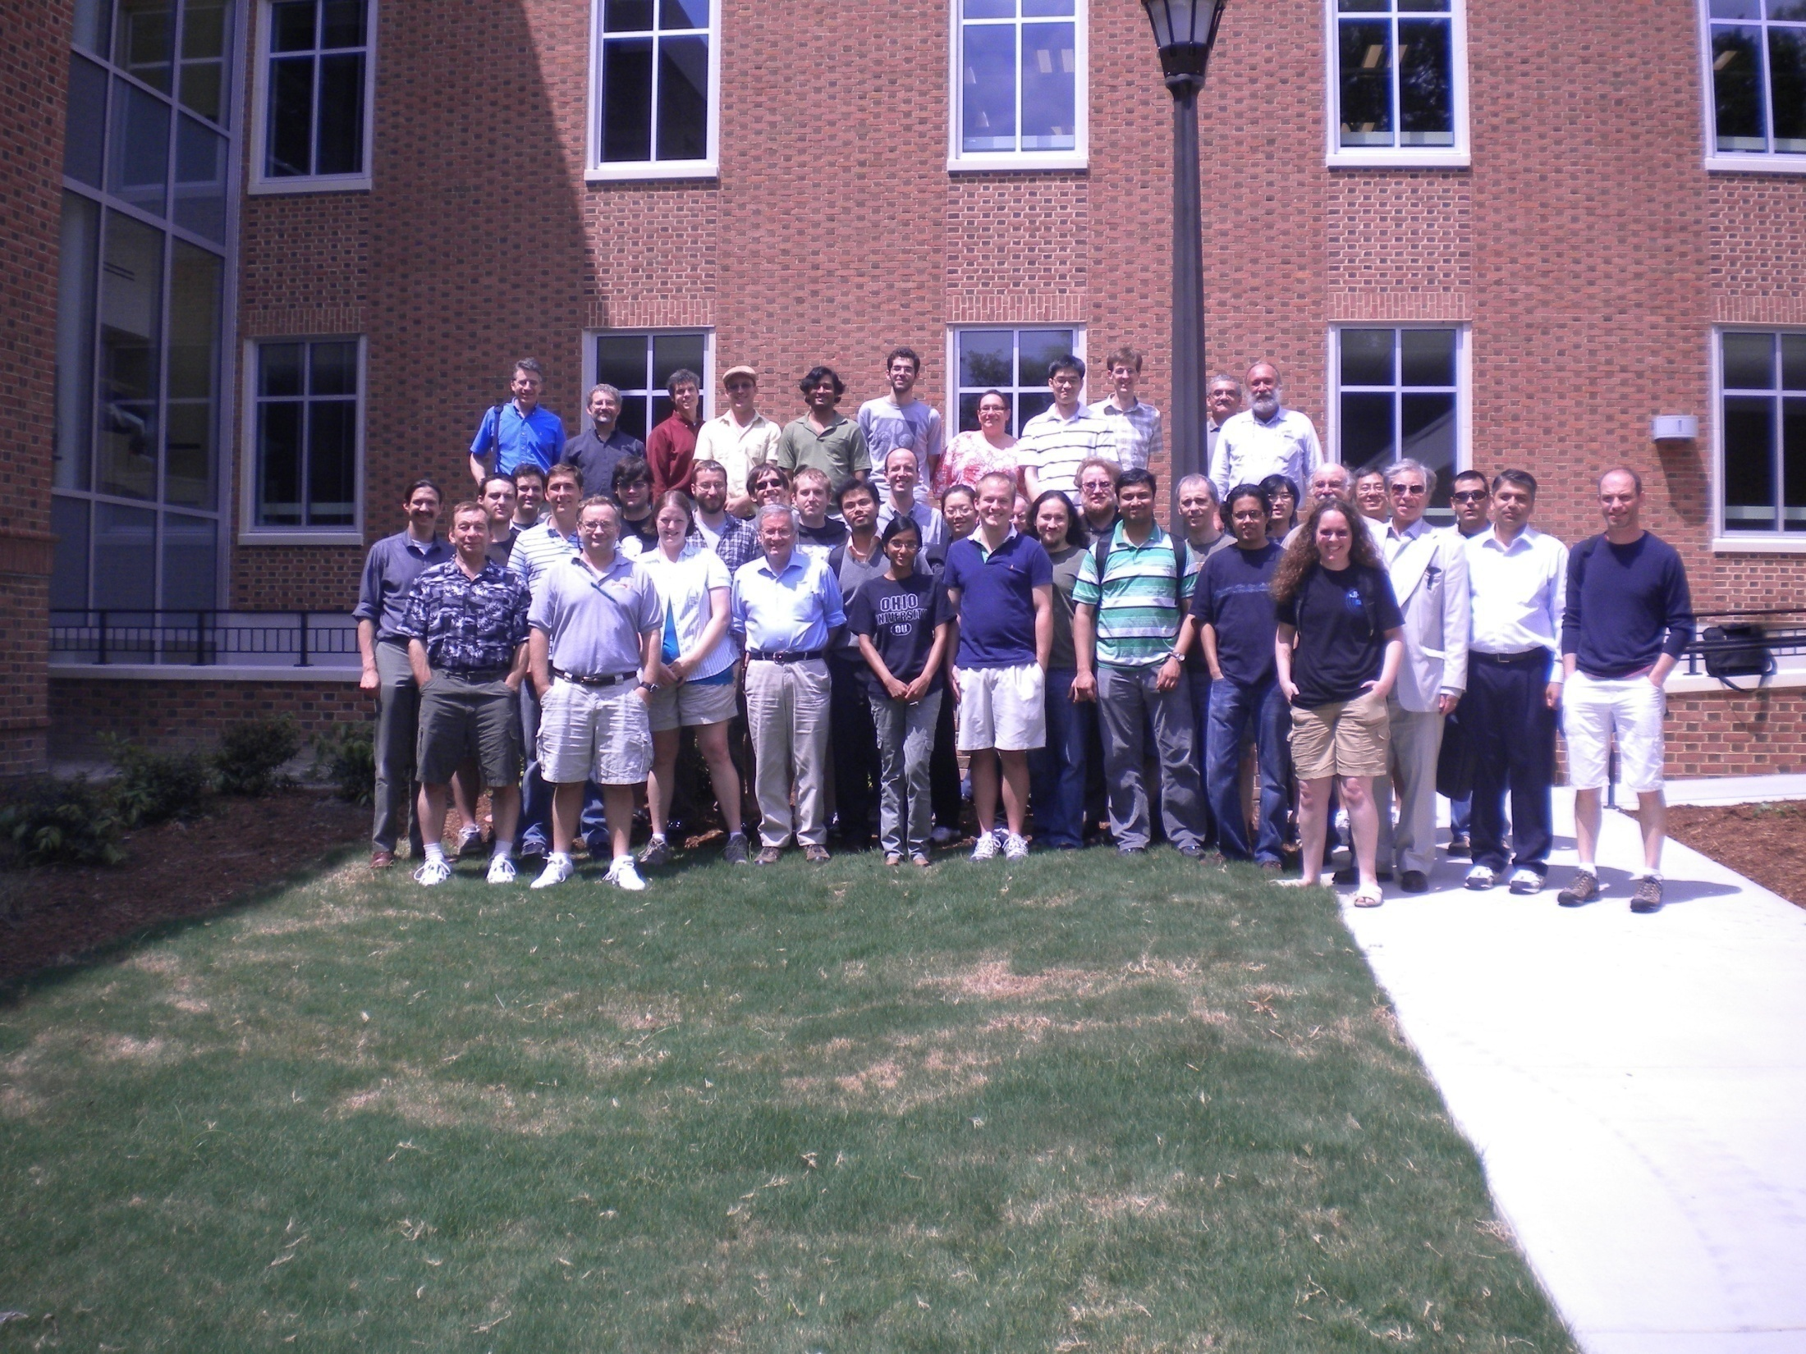
The Q-weak Collaboration
W&M meeting
A. Almasalha, D. Androic, D.S. Armstrong, A. Asaturyan, T. Averett, J. Balewski, R. Beminiwattha, J. Benesch, F. Benmokhtar, J. Birchall, R.D. Carlini¹ (Principal Investigator), G. Cates, J.C. Cornejo, S. Covrig, M. Dalton, C. A. Davis, W. Deconinck, J. Diefenbach, K. Dow, J. Dowd, J. Dunne, D. Dutta, R. Ent, J. Erler, W. Falk, J.M. Finn¹*, T.A. Forest, M. Furic, D. Gaskell, M. Gericke, J. Grames, K. Grimm, D. Higinbotham, M. Holtrop, J.R. Hoskins, E. Ihloff, K. Johnston, D. Jones, M. Jones, R. Jones, K. Joo, E. Kargiantoulakis, J. Kelsey, C. Keppel, M. Kohl, P. King, E. Korkmaz, S. Kowalski1, J. Leacock, J.P. Leckey, A. Lee, J.H. Lee, L. Lee, N. Luwani, S. MacEwan, D. Mack, J. Magee, R. Mahurin, J. Mammei, J. Martin, M. McHugh, D. Meekins, J. Mei, R. Michaels, A. Micherdzinska, A. Mkrtchyan, H. Mkrtchyan, N. Morgan, K.E. Myers, A. Narayan, Nuruzzaman, A.K. Opper, S.A. Page¹, J. Pan, K. Paschke, S.K. Phillips, M. Pitt, B.M. Poelker, J.F. Rajotte, W.D. Ramsay, M. Ramsey-Musolf, J. Roche, B. Sawatzky, T. Seva, R. Silwal, N. Simicevic, G. Smith², T. Smith, P. Solvignon, P. Souder, D. Spayde, A. Subedi, R. Subedi, R. Suleiman, E. Tsentalovich, V. Tvaskis, W.T.H. van Oers, B. Waidyawansa, P. Wang, S. Wells, S.A. Wood, S. Yang, R.D. Young, S. Zhamkochyan, D. Zou
¹Spokespersons *deceased ²Project Manager

Slide 35
Misc. Q_{w}^{p} References
Description | Reference
Q-weak home page | https://www.jlab.org/qweak/
New Physics Sensitivities (most notably lepto-quarks) | “Weak Charge of the Proton and New Physics”, Jens Erler et al. Phys. Rev. D 68, 016006 (2003). http://arxiv.org/abs/hep-ph/0302149
Proposal | The Qweak Experiment: “A Search for New Physics at the TeV Scale via a Measurement of the Proton's Weak Charge“, December 10, 2007 http://qweak.jlab.org/doc-public/ShowDocument?docid=703
High accuracy calculation of the running of the weak mixing angle | “Weak Mixing Angle at Low Energies”, J. Erler and M. J. Ramsey-Musolf, Phys. Rev. D 72 (2005) 073003 http://arxiv.org/abs/hep-ph/0409169
First Q-weak Result in PRL | “First Determination of the Weak Charge of the Proton”, D. Androic et al., Phys. Rev. Lett. 111, 141803 (2013) http://arxiv.org/abs/1307.5275v2
Updated RPV SUSY Sensitivities | Fig 10 in “The Weak Neutral Current”, Erler and Su, Prog. Part. Nucl. Phys. 71 (2013) 119-149, http://arxiv.org/abs/1303.5522
Dark Z’ | “Muon Anomaly and Dark Parity Violation”, H. Davoudiasl et al., PRL 109, 031802 (2012), http://arxiv.org/abs/1205.2709
W’ Model near 2 TeV | “W’ Boson near 2 TeV: Predictions for Run 2 Of the LHC”, Dobrescu and Liu, PRL 115, 211802 (2015). http://arxiv.org/abs/1506.06736

Slide 36

Extras

Slide 37
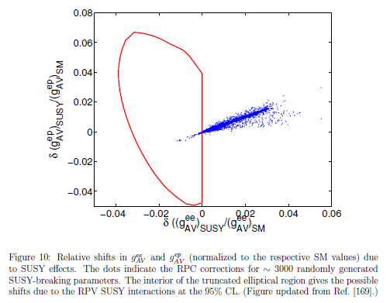
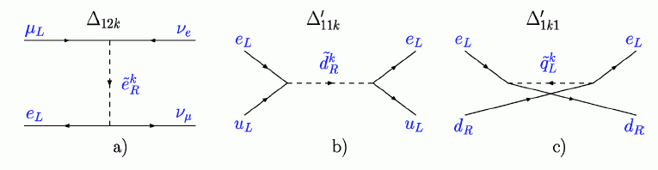
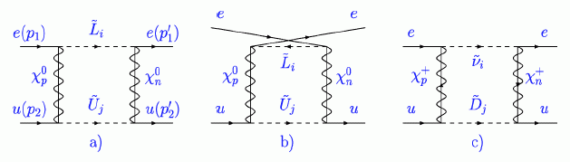
SUSY Sensitivities updated with plot from Erler and Su (2013)
R-parity Violating (tree-level) SUSY:
No obvious dark matter.
(“New” particles would decay to normal matter.)
R-parity Conserving
(loop-level) SUSY:
Dark matter may be the lightest SUSY particle.
(It got “stuck” carrying the R quantum number.)
“The Weak Neutral Current”, Erler and Su,
Prog. Part. Nucl. Phys. 71 (2013) 119-149,
http://arxiv.org/abs/1303.5522

Slide 38
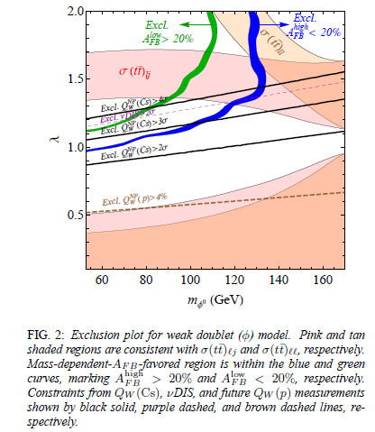
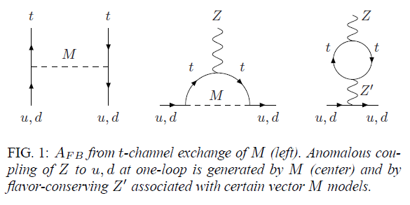
Low Energy PV and the Tevatron Top A_{FB} Anomaly
M. Gresham et al., arXiv:1203.1320v1 [hep-ph] 6 Mar 2012
Tevatron CF and D0 collaborations saw an excess in the t-tbar forward-backward asymmetry, A_{FB}.
(Precision measurements can also be made at the energy frontier!)
X
A possible explanation which avoided known constraints was
a new, not-too-massive, scalar or vector particle.
Sufficiently precise low energy PV experiments can constrain new physics models.

Slide 39

PRL 109, 031802 (2012)

Slide 40

Q-weak’s Keyhole on New Physics
Our experiment is sensitive to new physics with PV couplings of electrons to light quarks.
In this 2003 study, our biggest sensitivity was to lepto-quarks.
The RPV SUSY limits got much tighter in 2013.
Erler and Su,
Prog. Part. Nucl. Phys. 71 (2013) 119-149.
Erler et al., Phys. Rev. D 68, 016006 (2003).

Slide 41

Uncertainty Goals
2% on A_{z} ≈ 4% on Q_{w} ≈ 0.3% on sin²θ_{W}

Slide 42



Polarized Source
monthly
reversal
960 Hz
reversal
8 hour
reversal

Slide 43






Gamma-Z Box Correction
Z
γ
~7% correction
The □_{γZ} is the only E & Q² dependent EW correction.
  → Correct the PVES data for this E & Q² dependence.
x10⁻³
Calculations are primarily dispersion theory type
  error estimates can be firmed up with data!
E Dependence
Q² Dependence

Slide 44



Q-weak Spectrometer (detail)
Shield Hut
Qweak Toroidal Magnetic Spectrometer (QTor)
Trigger Scintillators
Horizontal Drift Chambers
Luminosity Monitors
Downstream Luminosity Monitors
Beam
Vertical Drift Chambers
Quartz Cherenkov bars
LH2 target
Collimators
Used only during low current tracking mode operation

Slide 45



LH₂ Cryotarget Design
I_{Beam} = 180 uA
L = 35 cm (4% X₀)
P_{beam} = 2.2 kW
A_{spot} = 4x4 mm²
V = 57 liters
T = 20.00 K
P ~ 220 kPa
World’s highest power and lowest noise cryogenic target ~3 kW
Centrifugal pump
(17 l/s, 7.6 kPa)
3 kW Heater
3 kW HX utilizing
4K & 14K He coolant
(m/s)
35 cm cell (beam interaction volume)
Fluid
velocity
Solid Tgts
beam
beam

Slide 46


Cell
LH2 Transverse Flow:
1.1 kg/s
15 L/s
3-7 m/s
13.9°
13.9°
Cell 35 cm long
Al entrance window ~0.1 mm thick, 22.2 mm Φ
Al exit window ~0.125 mm thick over 15 mm Φ,
0.635 mm thick over 173.5 mm
Scattered electron acceptance ±13.9°
Electron Beam
180 μA, 4x4 mm²

Slide 47


Jlab Exo-Skeletons
Manitoba radiator modules (physicist responsibility) were installed in a strong, stiff Jlab exo-skeleton suitable for carrying Pb shielding and pre-radiators (engineering and safety responsibility).
Each module carries 200 lbs (90 kg) of Pb bricks to provide limited shielding for PMTs. (Pre-radiators would double that.)

Slide 48
Collimation

