Slide 1
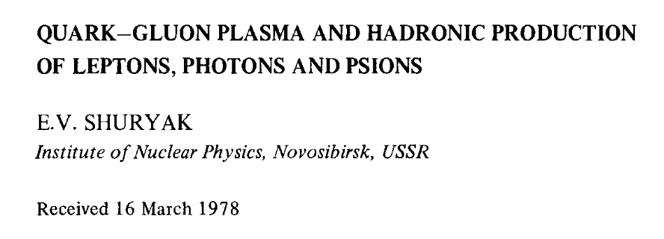
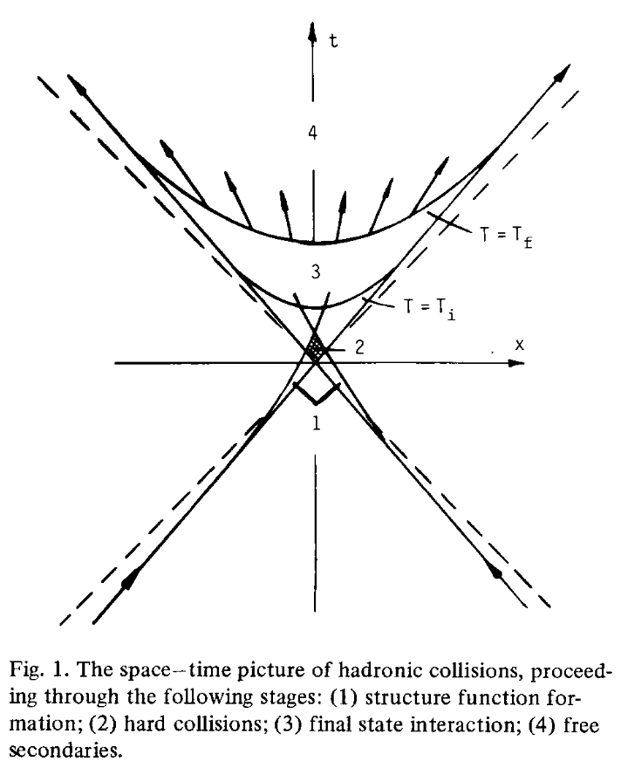
Probing QGP at RHIC with leptonic and quarkonia probes.
Edouard Kistenev
Brookhaven National Laboratory
I should like to argue in this paper, that a very important intermediate region exists, namely reactions taking place far from the collision point and not obeying the parton model, but at the same time treatable by perturbative QCD methods.
We are interested in the final state interaction region, limited by two lines: T(x, t) = Ti, the initial temperature at which the thermodynamical description becomes reasonable, and T(x, t) = Tf ~ m~, where the system breaks into secondaries [4,7].
The medium is assumed to be the quark-gluon plasma discussed in ref. [5] ,

Slide 2
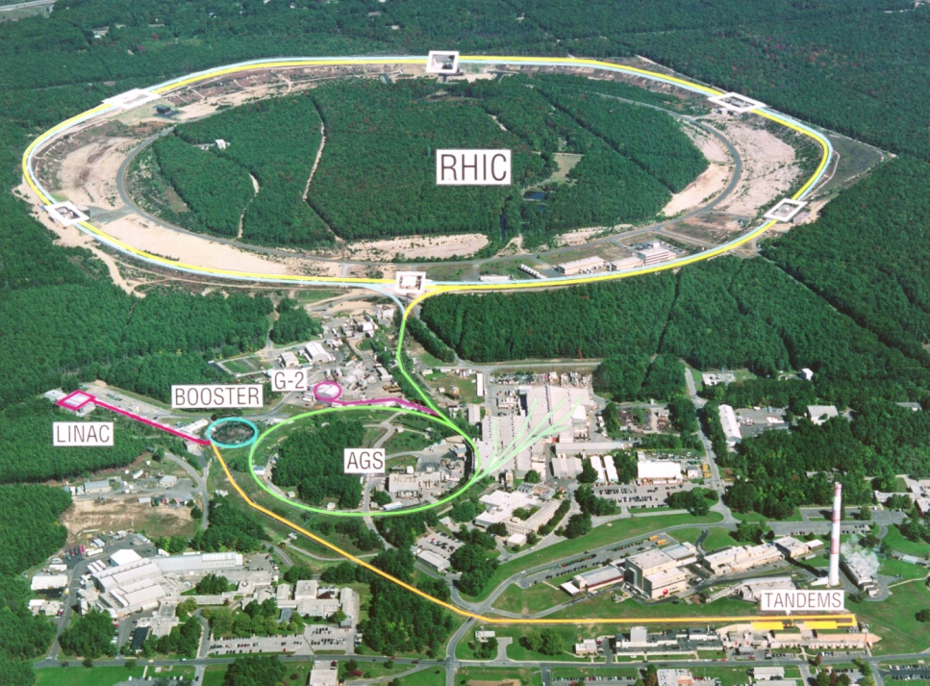
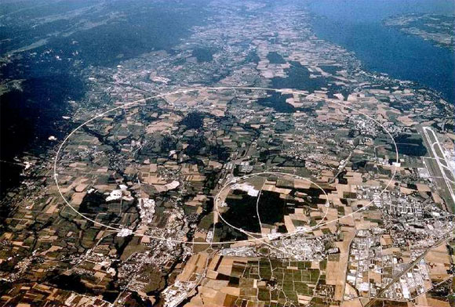
New Energy and Intensity Frontiers
2
RHIC → RHIC II
LHC
First collisions 2000
p+p, d+Au, Cu+Cu,
Cu+Au, Au+Au, U+U
√s_{NN} ~ 7 – 200 GeV
Polarized protons
First collisions 2010
p+p, Pb+Pb, p+Pb
√s_{NN} =2.76 TeV
(5.5 TeV in 2015-16)

Slide 3
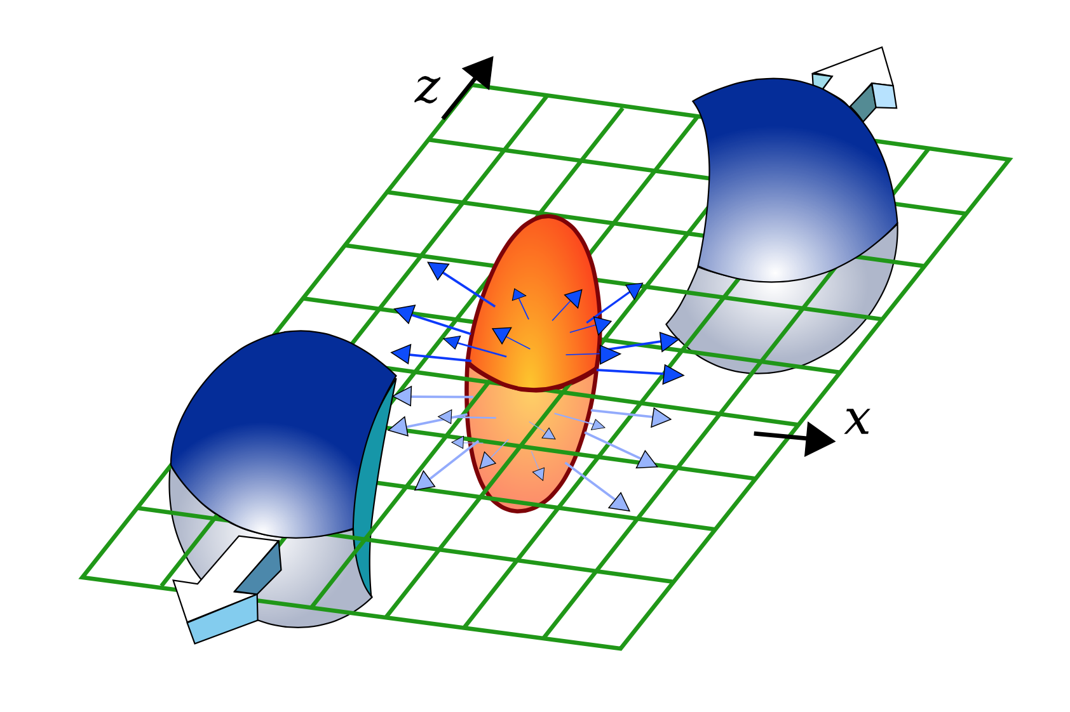
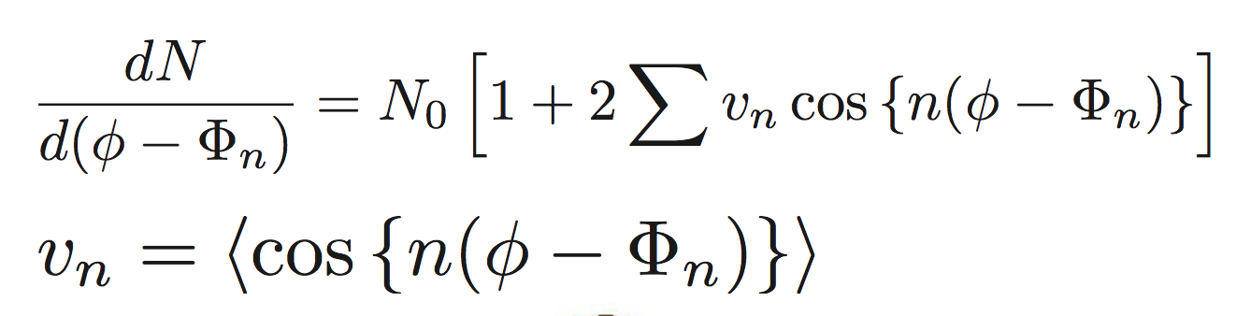
An experimentalist view of Heavy Ion Collisions
  The collective nature of the the collision created medium converts initial state azimuthal asymmetry into a strong signal in the final state particle emission pattern
  dn/dφ ~ 1 + 2 v₂(p_{T}) cos (2 φ)
  V3 and higher tells of fluctuations

Slide 4
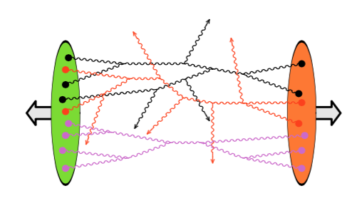
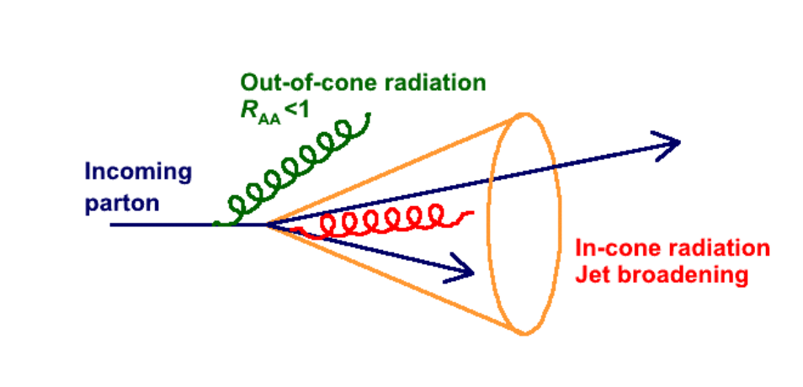
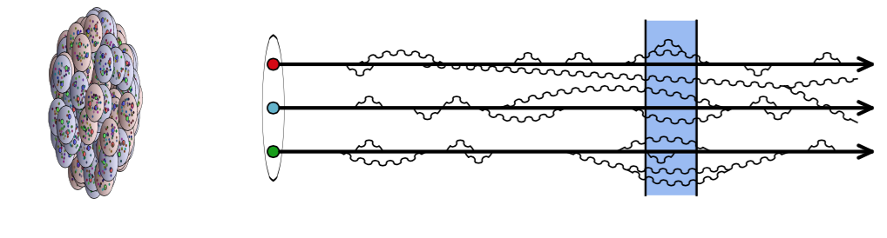
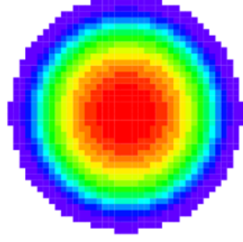
Space-Time Evolution in Heavy Ion Collisions
Collision lllllll
  Initial state?
  CGC?
Rapid equilibration
  How?
  Glasma?
  Role of B-field?
Anisotropicaly expanding sQGG
  Properties?
  T, η/s, q, D, … ?
  Quasiparticles ?
Hadronization to freeze-out nnn
  Coalescence? Chiral symmetry?
∧
?
?
?
sQGP
τ < 1fm/c
τ ≥ 10 fm/c
Photon emission
Di-leptons and quarkonia
Heavy flavors
Jets
Yields
Spectra
Suppression (with respect to scaled reference)
Energy loss and pattern
Observables:
Measurable:
Notes:
The results presented here can be put into context using a schematic space-time evolution of the system from the initial collision, to rapid equilibration, an expanding QGP, and finally hadronization and freeze- out. The creation of strongly coupled matter in small systems has opened up a new window to study the initial state and early time evolution of the collision. Heavy flavor energy loss allows to constrain our understanding of transport properties of the QGP. The dilepton continuum addresses the hadron properties in the later phase, which are related to chiral symmetry restoration. And direct photon emission allows to constrain our understanding of the full space time evolution.
FRANC ̧OIS GELIS : an effective theory –known as the Color Glass Condensate (CGC)– has been developed in order to organize the calculations of processes in the saturation regime. This effective theory approximates the description of the fast partons in the wavefunction of a hadron by exploiting the fact that their dynamics is slowed down by Lorentz time dilation, and provides a way to track the evolution with energy of the multigluon states that are relevant in the dense regime. This framework has been applied to a range of reactions at high energy: DIS, proton-nucleus collisions and nucleus-nucleus collisions. At leading order, these calculations correspond to a classical field description of the system. In nucleus-nucleus collisions, this classical field remains coherent for a brief amount of time after the collision, forming a state know as the Glasma. A central question in heavy ion collisions is to understand how these classical fields lose their coherence in order to form a plasma of quarks and gluons in local thermal equilibrium.

Slide 5
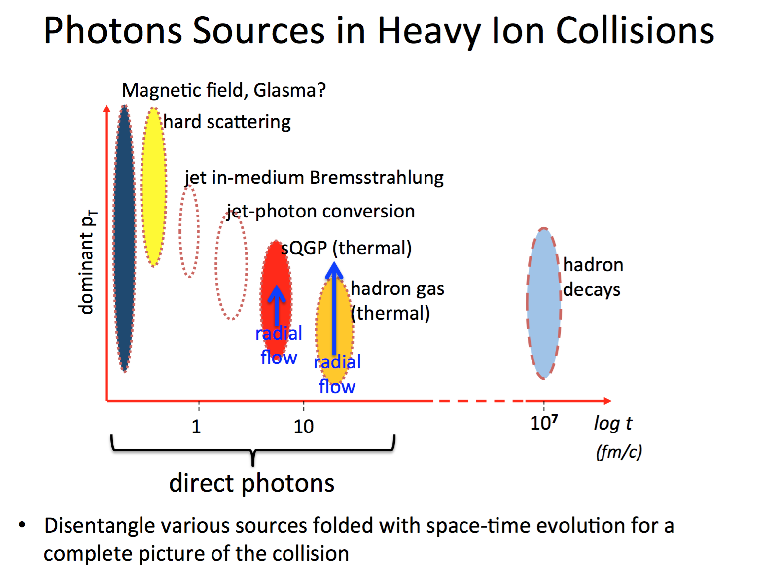
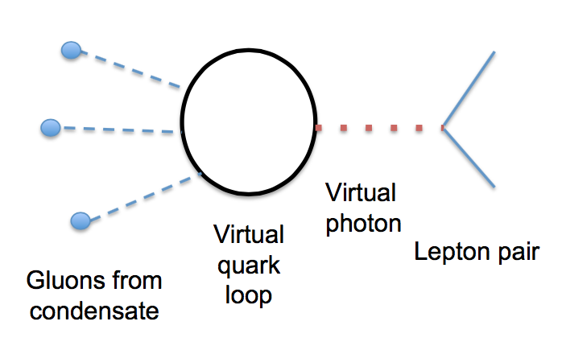
g
q
q
γ
π
π
ρ
γ
Early emission →High yield → high T
Late emission → Long in-medium time → Large Doppler shift

Slide 6
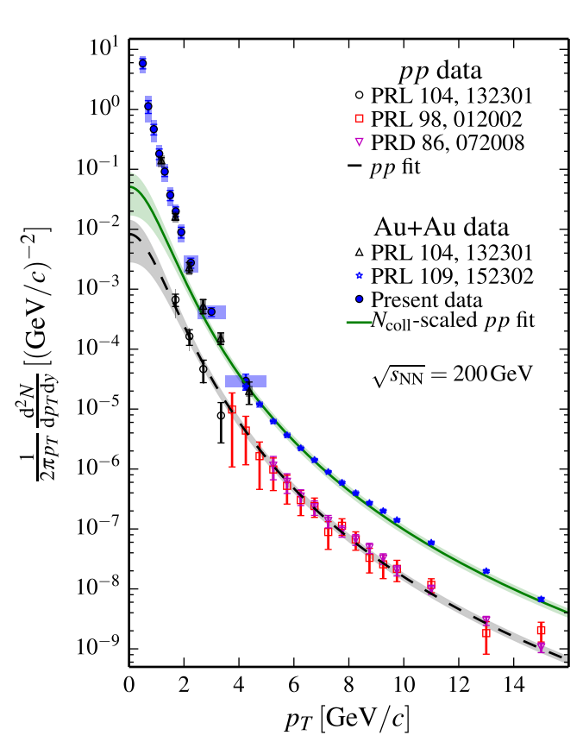
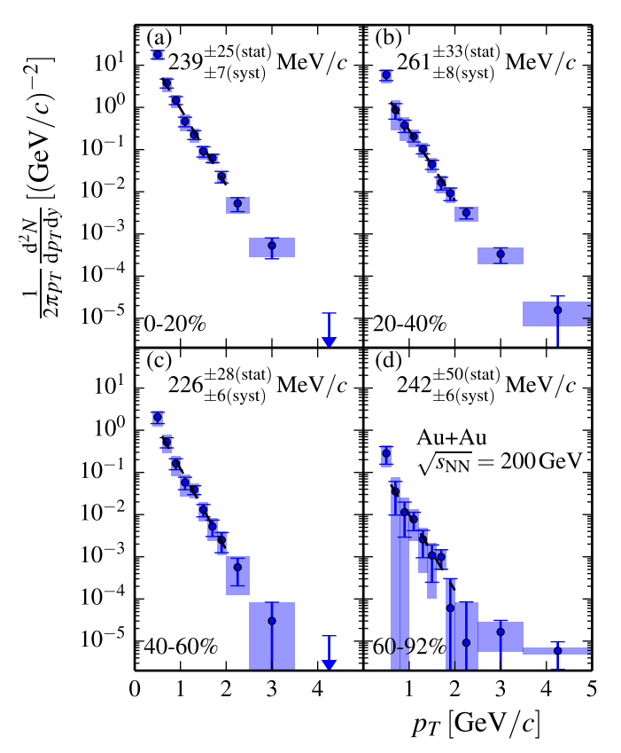

Direct Photon Emission from 200 GeV Au+Au
PHENIX: Phys. Rev. C 91 064904 (2015)
Prompt component subtracted
Large direct photon excess
yield with inv. slope T ~ 240 MeV

Slide 7
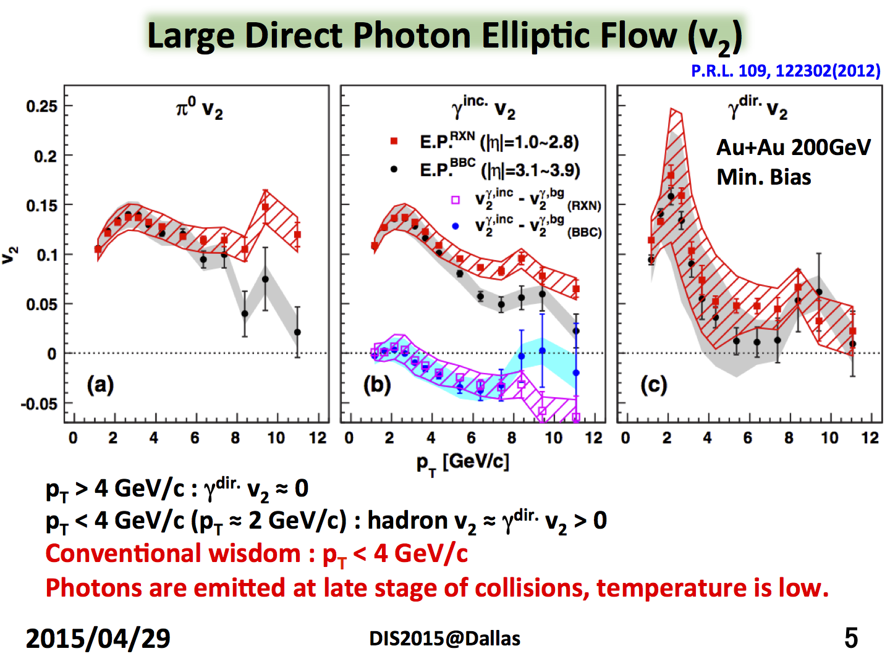
^{Sanshiro Mizuno}

Slide 8
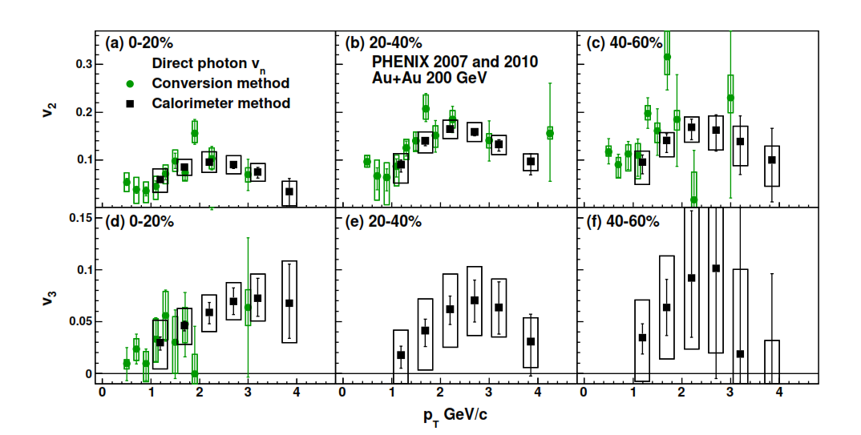
Direct Photons Flow confirmed
PHENIX: arXiv:1509.07758 (2015)
Large v₂ and v₃
Consistent with that measured for charged and πº_{’s}
8

Slide 9

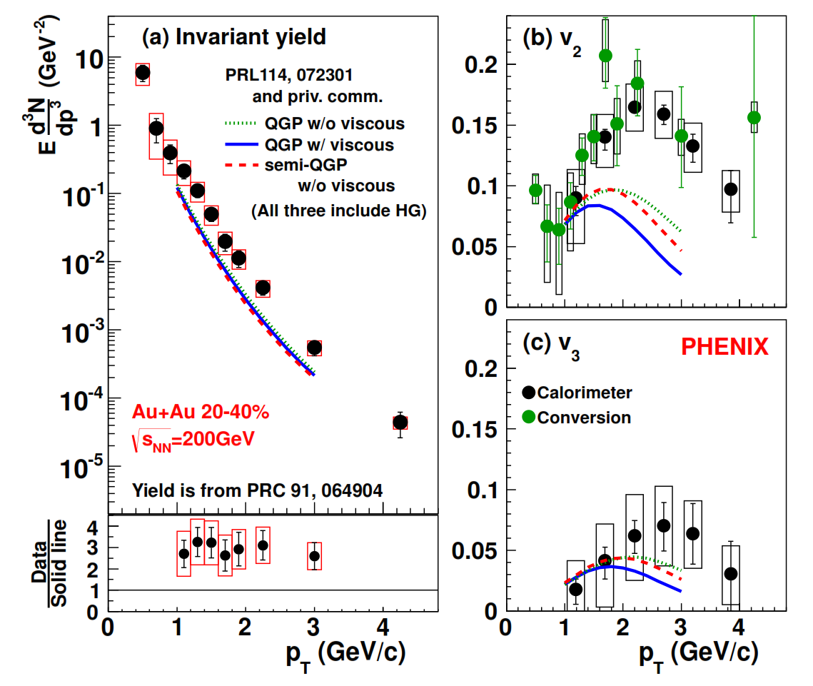
but not interpreted ….
Many model calculations and consideration*:
More traditional, large contribution from hadron gas
  Thermal rate in QGP & HG, with hydro (viscous/non viscous) or blastwave evolution
  Microscopic transport (PHSD)
New early contributions
  Non-equilibrium effects (glasma, etc.)
  Enhanced thermal emission in large B-fields
  Modified formation time and initial conditions
New effects at phase boundary
  Extended emission
  Emission at and after hadronization
Example: viscous hydro + thermal emission
Large yield and v_{n} challenge understanding of sources, emission rates and space-time evolution
*list not complete
Notes:
Over the past couple of years there have been many ideas proposed to address this apparent puzzle non can resolve the tension between yield and anisotropy. These approaches include early contributions from non equilibrium effects, enhanced thermal emission in large B fields, modifications of initial conditions or formation time. Or new effects at the phase boundary like an expanded emission or emission at hadroniza- tion. In summary, the large yield and large vn challenge or understanding of the sources, emission rates and space time evolution.

Slide 10
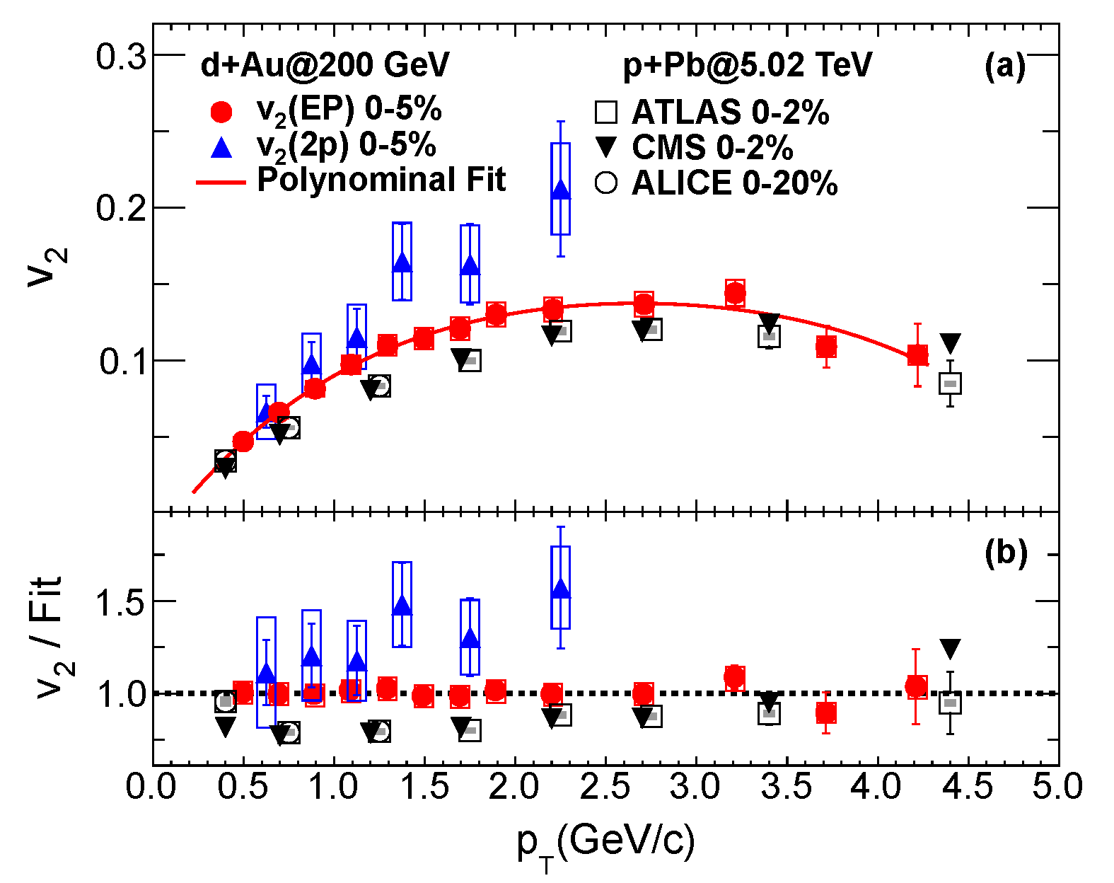
Expected and unexpected …
PRC87, 054907 (2013)
PHENIX, PRL114, 192301 (2015)
No modification in initial hard scattering and PDF compared to p+p at mid-rapidity but …
We didn’t anticipate “flow” in a small system like d+Au
-all charged
-EP – event plane
-2p – Au direction only

Slide 11
Single Photon’s summary:
An excess of yield above the Ncoll scaled p+p yield is observed at all centralities up to about 4GeV/c photon pT;
Prompt photon subtracted pT slope of the excess photons is close to ~240Mev and independent of centrality;
Excess yield scales as N^{1.4}
Photons from affected pT range flow with measured v2 and v3 close to that of π⁰’s;
Theoretical picture is incomplete at best. Large excess points to early emission, large flow points to late emission.

Slide 12
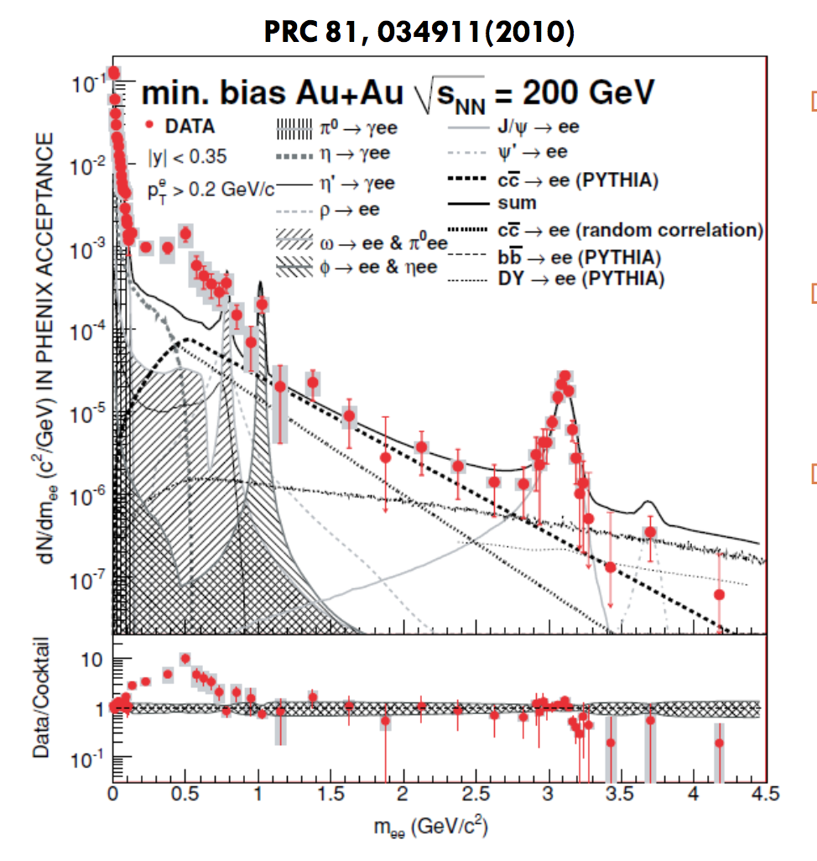
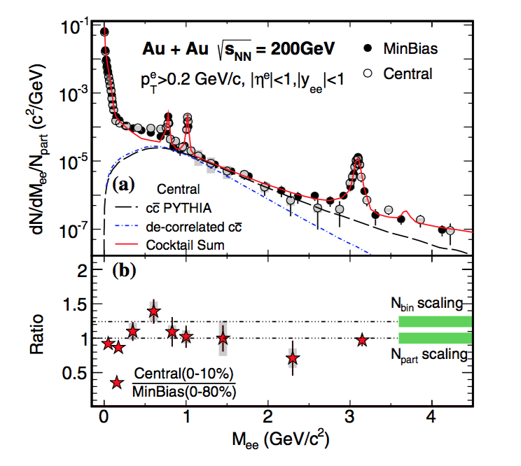
Low Mass e⁺e⁻ Pair Emission
PHENIX
STAR, PRL 113 022301 (2014)
Notes:
PHENIX data from 2004 showed a large enhancement of the low mass dilepton continuum [36], about a factor of 5 in minimum bias collisions, albeit with a very small signal-to-background (S/B) ratio resulting in large systematic errors. This enhancement was much larger than expected from theoretical models that did very well in describing dilepton data from the SPS.
Recently STAR has shown that they see a much smaller enhancement [37] than originally reported by PHENIX.

Slide 13
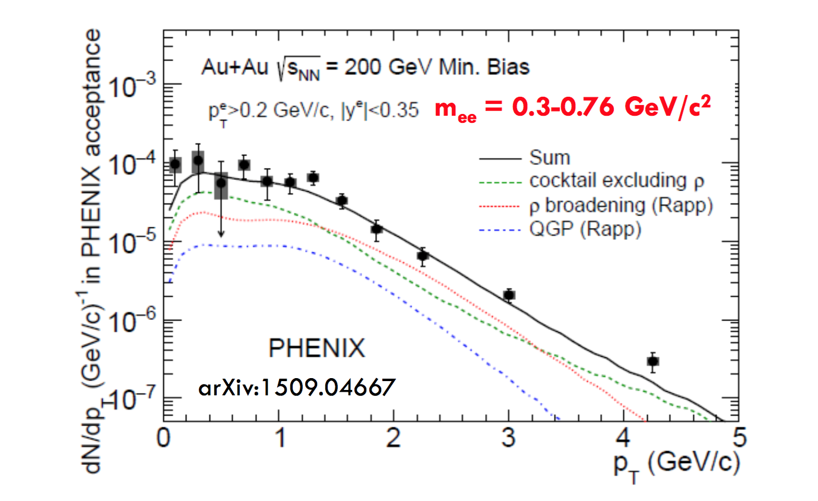
Resolution: PHENIX+HBD Data from 2010
Active rejection of conversion and Dalitz pairs;
Improved hadron rejection;
Improved analysis technique.

Slide 14
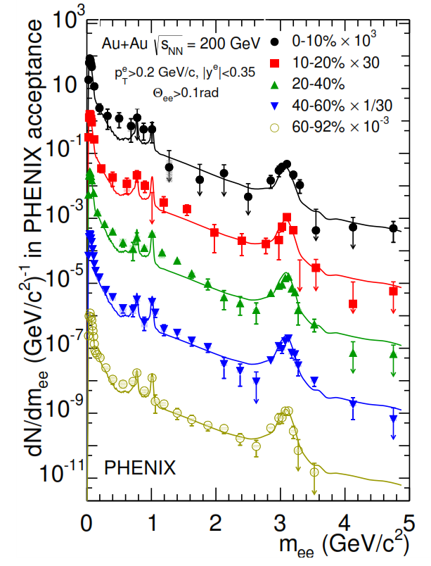
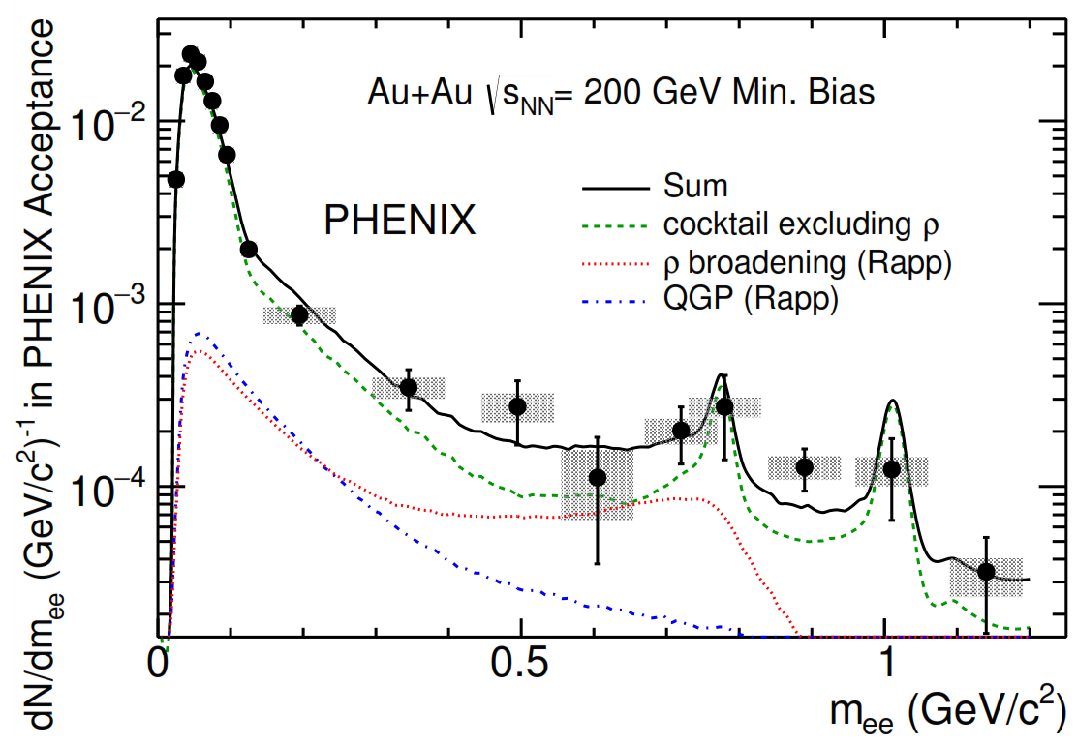
Moderate Enhancement in 200 GeV Au+Au
PHENIX: arXiv 1509.04667 (2015)
Moderate enhancement
  for 300 < m < 750 MeV factor*
  min.bias 2.3 ± 0.4 ± 0.4 ± 0.2
  central 3.2 ± 1.0 ± 0.7 ± 0.2
Smaller than previous result
Consistent with STAR data
Consistent with ρ broadening
Moderate enhancement consistent with ρ broadening
*binary scaled PYTHIA for c/b
Notes:
On the right hand side are the final results: shown is the yield of pairs in the phenix acceptance as a fct of mass for different
centrality selections. The data is compaired to the cocktail of expected sources. As you can see the peripheral data is described well by the
Cocktail while for the more central collisions an excess remains.
If one quantifies this excess in the mass range 300-750 one find a factor of 2.3 for minimum bias collisions and 3.2 for central collisions
(here we use PYTHIA to estimate the c/b contribution)
Smaller than previous result
Consistent with STAR data
And consistent with rho broadening – this is shown on the right hand plot, which give the pt spectrum of pairs in 300-750 mass range
Compared to the cocktail of expected sources and the model of broadening rho – good agreement is achieved.
In summary we see a moderate enhancement, consistent with rho broadening.

Slide 15
Di-electron summary
Small excess in di-electron pair production is a good news;
It is naturally explained by ρ-broadening in the matter which is now kind of “experimentally” proven;
It points towards “clustered” objects in “produced” matter ;
Could those objects be “quasiparticles” of Edward Shuryak ????

Slide 16

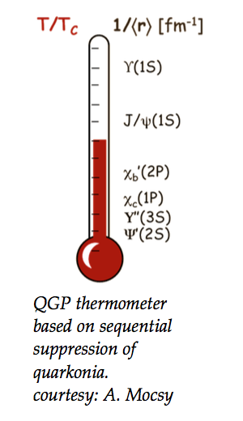
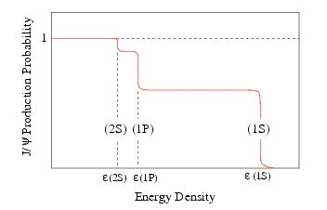

J/ψ production and differential suppression the ?????
Open charm
particles
“sequential
Melting”
Satz, J. Phys. G32, R25 (2006)
plasma
partons
Color screening of the cc potential by the surrounding color charges
_
_
cc pair ~
J/ψ pre-resonant state

Slide 17
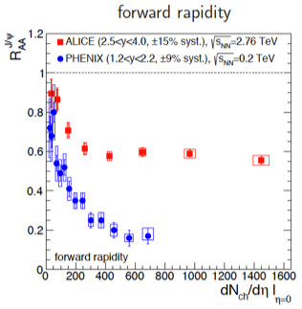
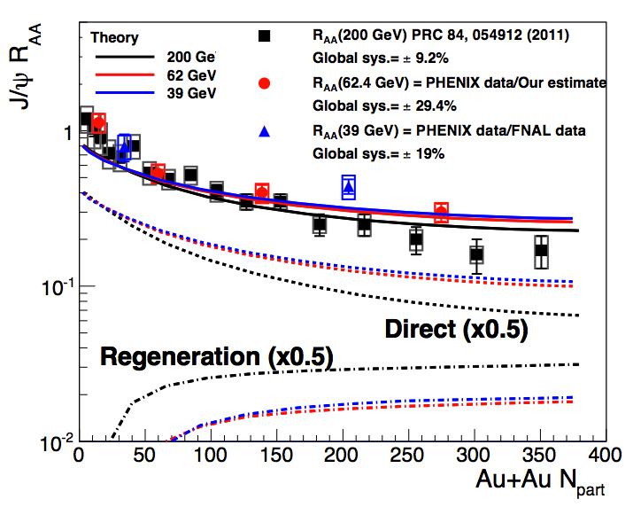
LHC and strong charm coalescence
At RHIC 39 GeV, 62 GeV, 200 GeV all show similar suppression
- perhaps strongest at 200 GeV
J/ψ suppression much stronger at 200 GeV than 2.76 TeV for similar energy density - strong coalescence
In the model (PRC82, (2010) 064905) this similarity is due to a balance between color screening and coalescence

Slide 18
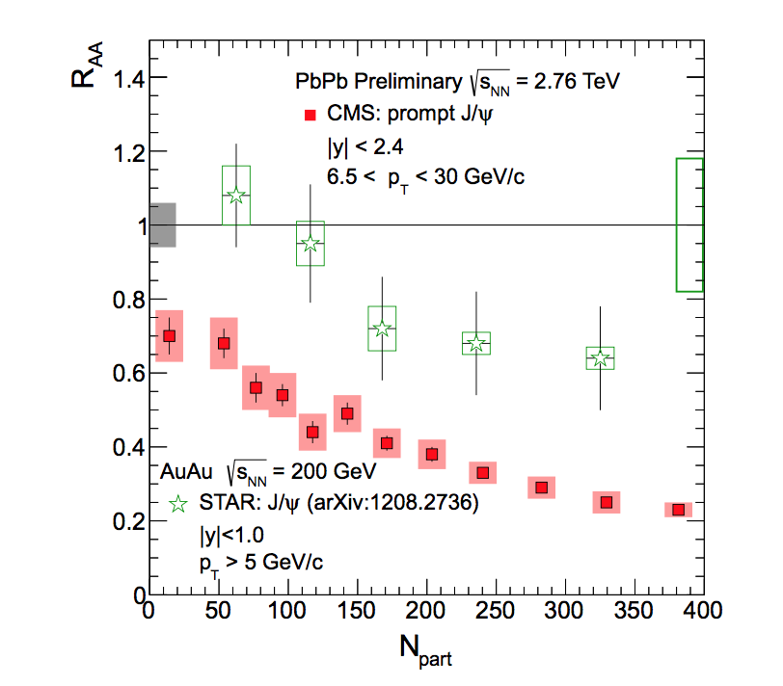
Questioning the RHIC-LHC differences
M. Murray / Nuclear Physics B (Proc. Suppl.) 233 (2012) 212–216
Notes:
It is among our purposes here to investigate the influence of such an emission on the kinematics of the J/ψ production in p(d)A and AA collisions. Indeed, for a given J/ψ momen- tum (thus for fixed y and P T ), the processes discussed above, i.e. g + g → c c ̄ → J / ψ ( + X ) a n d g + g → J / ψ + g , w i l l p r o c e e d o n t h e average from gluons with different Bjorken-x. Therefore, they will be affected by different shadowing corrections. From now on, we will refer to the former scenario as the intrinsic scheme, and to the latter as the extrinsic scheme. In the following, we shall consider them as distinct approaches.1

Slide 19
Can coalescence be proven experimentally
U+U measurements
U+U collisions allow us to go to higher energy density at RHIC
Central U+U collisions should have:
    15-20% higher energy density than Au+Au collisions
      stronger color screening
    Increased charm production from ~ 25% larger Ncoll values
      stronger coalescence
J/ψ production in U+U collisions allows us to explore how the trade-off between color screening and coalescence evolves as we increase energy density and charm production
In RHIC Run 12 PHENIX recorded
1.08 B minbias √sNN = 193 GeV U+U events

Slide 20
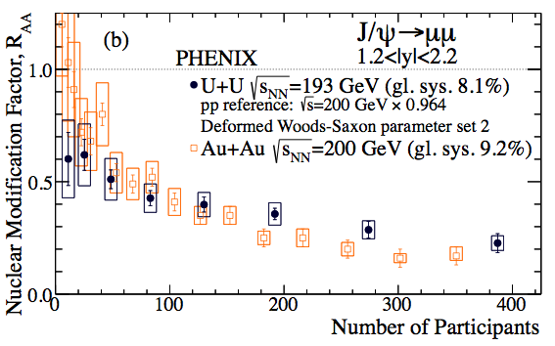
The U+U RAA
Start with the latest parameter set (2) to calculate RAA
The U+U RAA is somewhat larger than that for Au+Au at low centralities
  arXiv:1509.05380
Notes:
Next slide – ratio of dN/dY
Difference in suppression is not sufficient to hide the yield difference at small centralities giving the way to the statement of favoring enhanced recombination

Slide 21
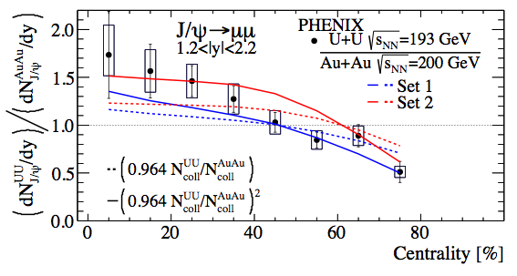
Make the experimental ratio of dN/dy values.
  Has the advantage that it does not rely on Ncoll
  However our expectation for its behavior is determined by Ncoll
  arXiv:1509.05380
Consistent with a picture in which the increase in charm coalescence becomes more important than the increased color screening when going from Au+Au to U+U

Slide 22
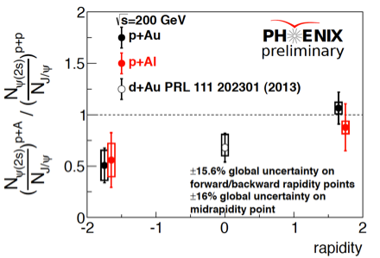
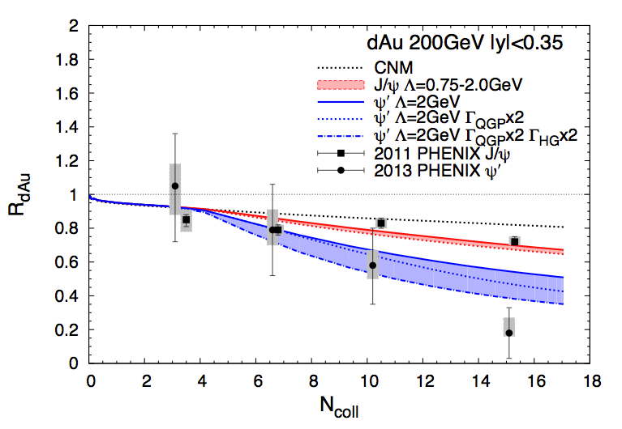
May small systems hold the key to answers
22
In pA/dA the breakup effects could be ignored (formation time arguments);
Data shows suppression at forward rapidity, no suppression at backward rapidity
Suppression is caused by interactions with produced particles and occurs after the charmonium leaves the target
Du & Rapp arXiv:1504.00670

Slide 23
Quarkonia summary
In AuAu and PbPb collisions over the whole RHIC-LHC energy range prompt J/Y follow common pattern of suppression when plotted against participant multiplicities;
Little or almost no suppression is visible in RHIC and LHC High pT J/Y data;
The suppression of comparable magnitude is also observed in forward direction in small systems (pAu, dAu, pAl) essentially excluding large breakup effects in nuclear matter;
What is left are color screening resulting in quarkonia melt in produced media and recombination which follows.

Slide 24
Can it be a sign of “… particles with M, pt as large as 4-5 GeV are mainly produced not via hard collisions, but at the plasma stage ….. “ (Edward Shuryak, 1978)
Global summary
After many years of theoretical and experimental efforts the Hot & Dense matter probing is still a challenge:
  We may reliably extract and decompose signals of prompt and “thermal” photons produced at a different stages of collisions but can’t reconcile the total yield and flow attributed to those photons;
  From the onset of the field our understanding of QGP strongly relied on explanation of disproportionally low yield of quarkonia (J/Y) in central HI collisions (compared to scaled pp-collisions. Today we have related data covering the energy range from SPS to RHIC to LHC. That data shows amazing consistency and energy independent behavior currently impossible to explain without assuming an almost miraculous balancing between quarkonia melting (or break-up by comoves) and regeneration in QGP.
The final consistentcy between data on di-leptons between experiments and theory is certainly a very good news. What is even better – rho broadening due to in the matter scattering is sufficient to explain observed excess over expectations.
Notes:
Dileptons are due to the qq ➔ μ+/μ- (e+e-) process, where q stands for u, d, s quarks;
Direct leptons have a similar origin
Direct photons due to gq-γq, gq-γq, qq~ γg (g stands for gluons) differ by the factor γ/μ+ ~600.

