Slide 1



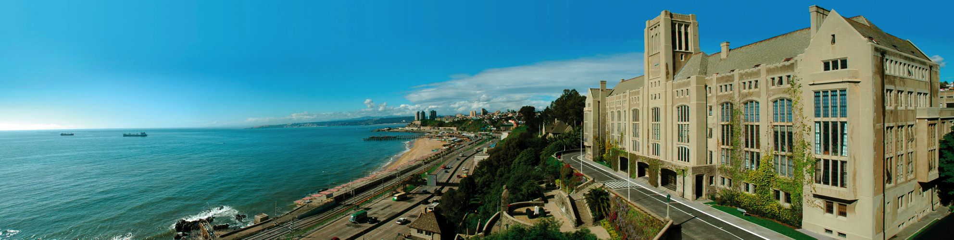
2009-2016
Jan 6th, 2016
Ex umbra in solem
www.cctval.usm.cl

Slide 2
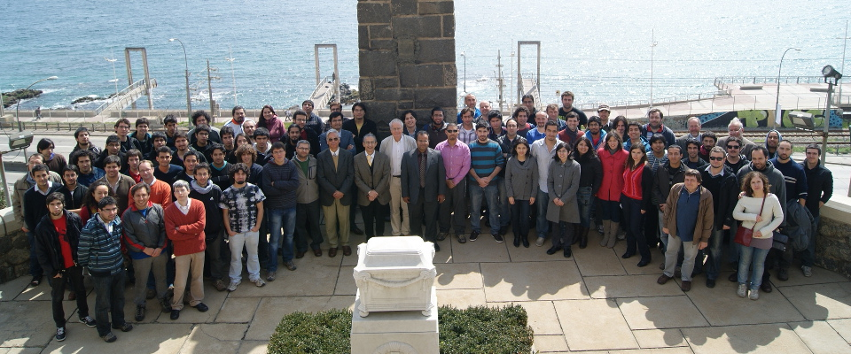
CCTVal
Particle Physics, Computer Science and Electronics.

Slide 3
Theoretical physics
Society
Experimental physics
Engineering / Technology / Industry
www.cctval.cl

Slide 4
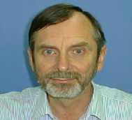
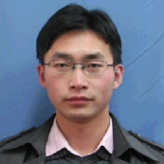
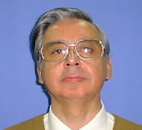
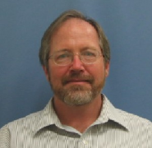
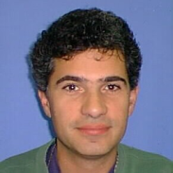
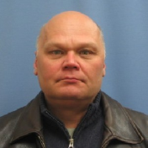
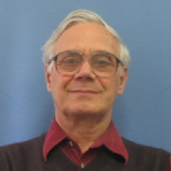
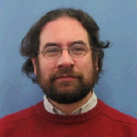
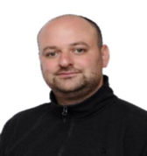
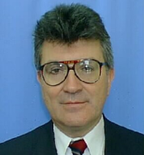
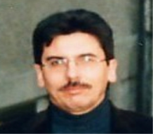
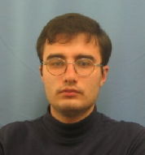
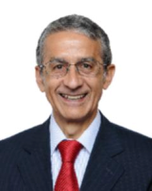
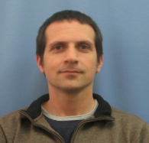
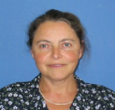
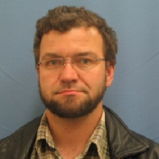
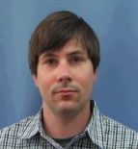
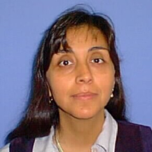
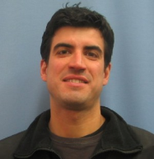
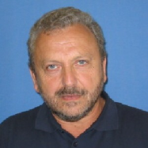
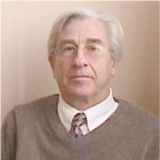
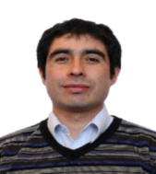
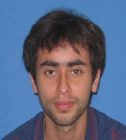
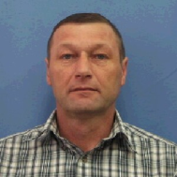
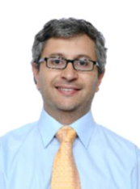
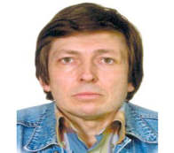
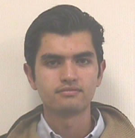
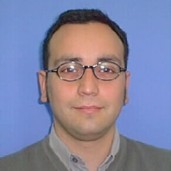
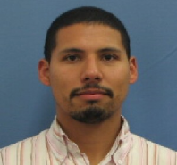
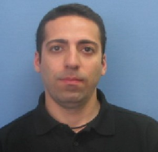
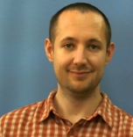
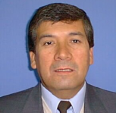
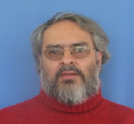
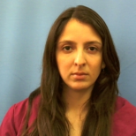
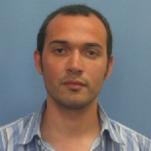
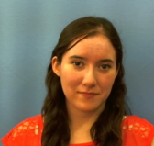
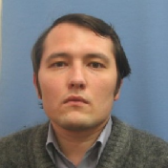
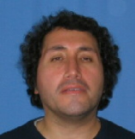
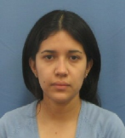
Who we are
The Center is composed by 5 main groups
12 Senior researchers (7 Chilean, 1 US , 4 Russian)
14 Young researchers (10 Chilean, 3 Russian and 1 Armenian)
18 Postdocs (11 Chilean, 2 US , 1 Russian, 1 Chinese, 1 Iranian,1 Venezuelan, 1 Moroccan)
3 Project managers (Engineers)
2 Technicians + 4 Administration

Slide 5
Research Activities
Particle detector
technology,
advanced sensors
1
2
Experimental particle
physics
Particle physics
theory and
phenomenology
3
4
Neutrino
physics
5
High performance
computing
Power electronics,
modeling, control
and signal processing
6
www.cctval.cl

Slide 6
Achievements (2009-2016)
Researchers 31 ( 35%)
Postdoctoral Fellows 18 ( 65% non Chilean)
ISI PUBLICATIONS 541
Citations 14.701 (Jan 2014)
Students > 100 (average)
Theses ( under-post graduated) 185
(Physics, Electronics, informatics, Mechanics, Industrial)
Participation in SC conferences 302
Scientific visit ( Labs/ Universities in the world) 122
Patents ( presented) 5
Contracts with industry/labs 10
External funding awarded 10 M USD
Equipment 1.2 M USD

Slide 7
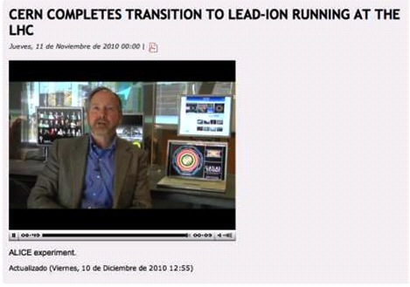

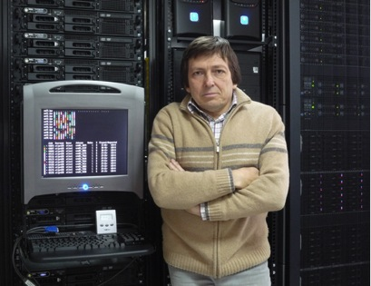
International collaborations
ATLAS participation
Higgs physics
Heavy ions (convenor: W. Brooks)
Student training
Ph.D. Electronics Thesis
Grid computing Thesis
CERN grid connection
TIER 2 Level
51 % of grid resources in
LatinAmerica

Slide 8
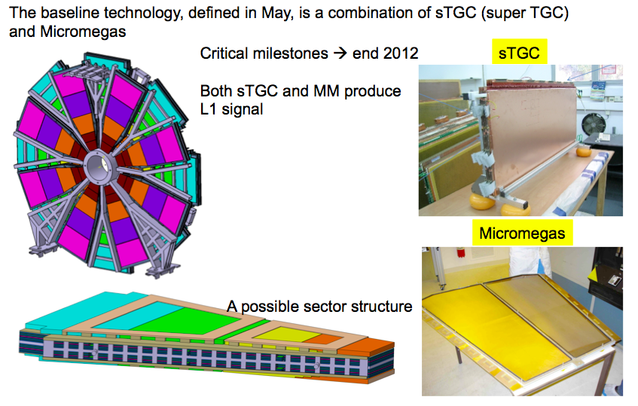

ATLAS Muon System Upgrade
The ATLAS muon system upgrade
Particle detector technology
USM production site (15% of new ATLAS muon spectrometer):
A clean room with 2 granite tables and a crane
Graphite spray machines: PRIMA and KUKA robot
2 m long winding machine and electrical test set up
Cosmic ray test facilities in UTFSM and PUC (Santiago)
Group from Electronics Department participates in programming of KUKA robot and PRIMA machine setup

Slide 9
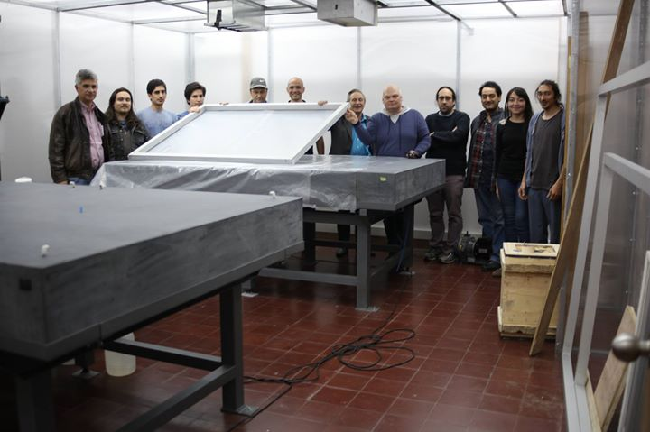
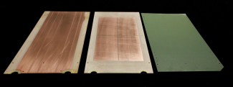
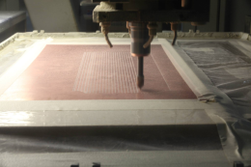
Atlas Upgrade
www.CERN.ch

Slide 10

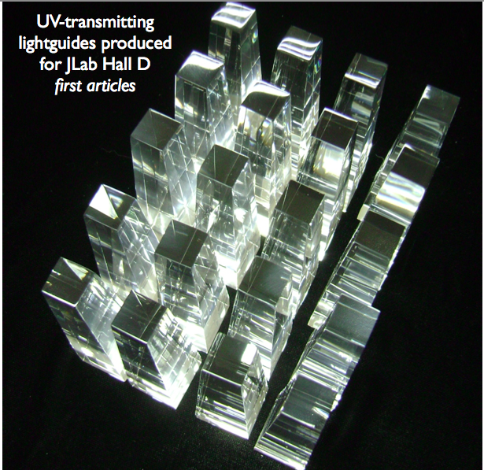
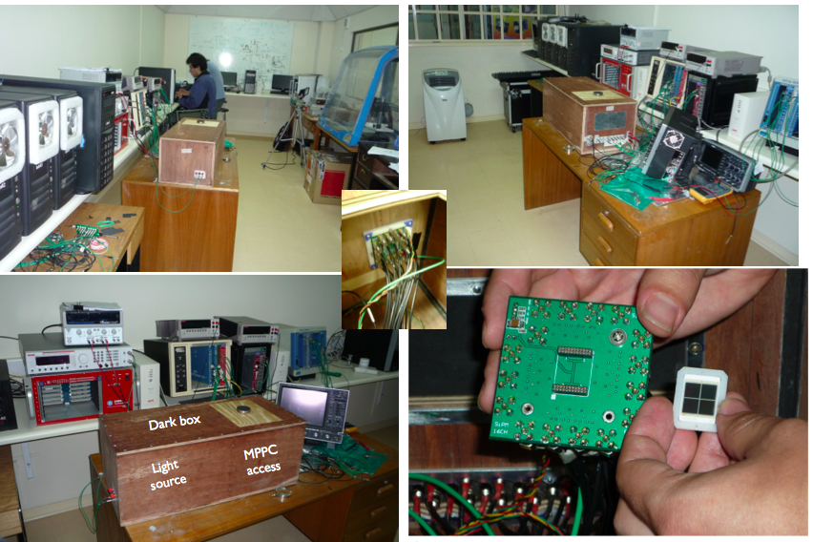
International collaborations
CLAS: Strong interactions
Student visits
GlueX: polarized photons
Fabrication of 4000 UV-transmitting lightguides, 10 different irregular trapezoidal geometries
$2 million contract budget
Complete characterization of 2800 16-cell MPPC/SiPMs for JLab Hall D

Slide 11
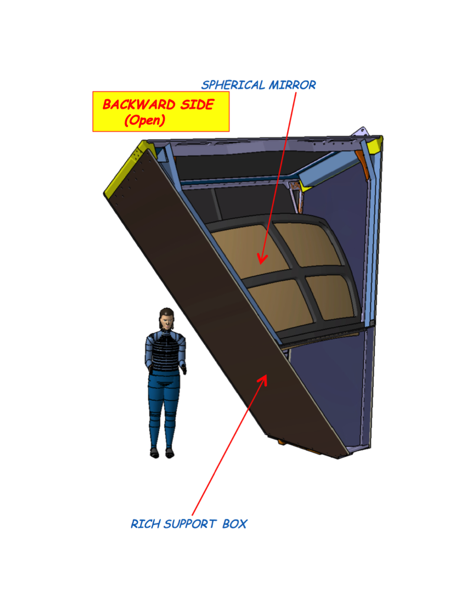
CLAS12 RICH Mirrors
Crucial detector for CLAS12 particle identification; needed for experiment E12-06-117 ; three USM spokespersons
USM will make front-surface ultralight mirrors using carbon fiber reinforced polymer (CRFP) layup on a polished steel mandrel
Technology applicable to solar energy, space science, microwave applications
www.cctval.cl

Slide 12



Advanced tsunami warning
Chilean and US Navy, Boston Univ.
High performance computing
Computing, electronics,….
Biomedical image processing
Hyperspectral imaging
PET
Computational astrophysics
Redshift determination
Molecular astrophysics
Big data and machine learning
Scientific computing
Databasing (CERN-ATLAS)
GRID
Event-Index
www.cctval.cl

Slide 13



ANDES deep underground Lab
Neutrino physics
- Projected deep underground Laboratory: ANDES
- Inside road tunnel under the Andes Mountains
- First U-Lab on the Southern Hemisphere
- World’s 3rd deepest (1750 m under rock)
- International Latin American laboratory
- Our group has the coordination in Chile

Slide 14
Applied Research
www.cctval.cl

Slide 15






Applied Research Projects
Copper Detector
Mining copper Sorting Equipment
Nuclear Densimeter
wireless probe for use in radio guided surgery
Radon Detector
Medical Image
solution
2012
2013
2014

Slide 16






Applied Research Projects
Low cost Pc-board ,
internet Cloud Platform for Industrial Equipment's ( case for Mining – Energy)
Mobile payment Latam platform
Automation solutions for Mining and Agriculture
micro sleep and a high level of fatigue ( mining truck workers)
2015

Slide 17
Will Brooks
Sergey Kuleshov
Hayk Hakobyan
Jonathan Miller
Ryan White
Ahmed El Alaoui
Fedor Prokoshin
Edson Carquin
Experiment
Physics
Claudio Dib
Boris Kopeliovic
Sergey Kovalenko
Eugeny Levin
Antonio Carcamo
Amir Rezaeian
Juan Carlos Helo
Irina Potashnikova
Alfonso Zerwekh
Maximiliano Rivera
Marat Siddikov
Sebastian Mendizabal
Oscar Castillo-Felisola
Ivan Schmidt
Theory

Slide 18
Thank you for coming

