Slide 1
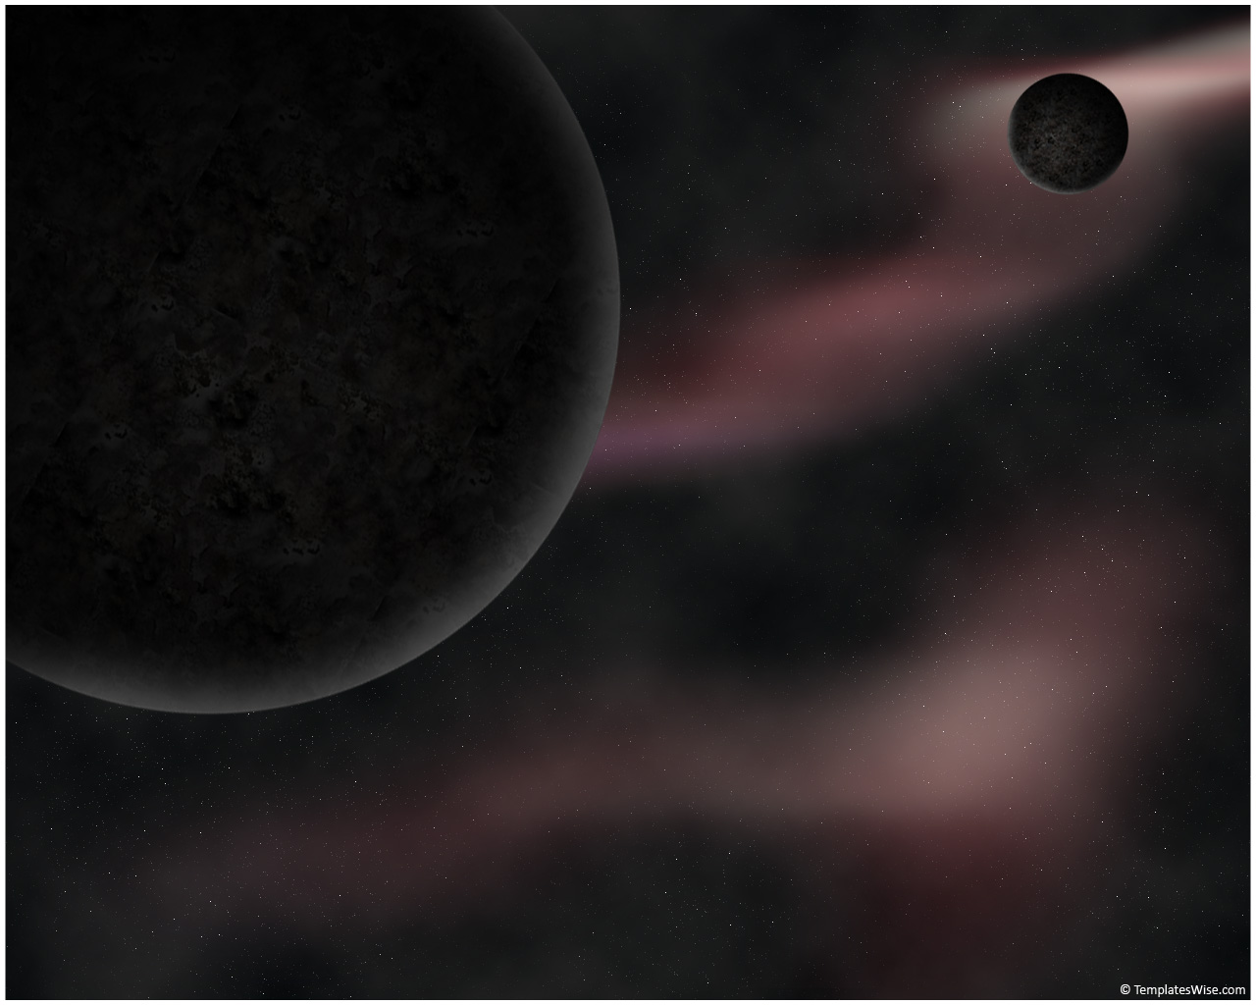
Recent Results and Future Plans for Dark Matter Searches with PICO
Tony Noble
Queen’s University
Notes:
FFK Conference Budapest Oct 12 – 16 2015

Slide 2
Outline
Recent Results and Future Plans for Dark Matter Searches with PICO
Motivation:
Introducing the SNOLAB facility
PICO superheated liquid technology
Results From PICO
Tony Noble
Queen’s University
Conclusions

Slide 3
Scientific Questions being addressed at SNOLAB
Neutrino properties
Double Beta Decay
Solar neutrinos
Geo neutrinos …
Dark matter
Processes in Supernova explosions?
Non particle physics applications: Engineering, Seismicity, Biology in extreme locations, Genetic studies in absence of cosmic rays….
…

Slide 4
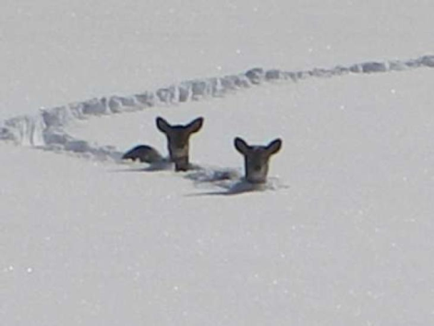
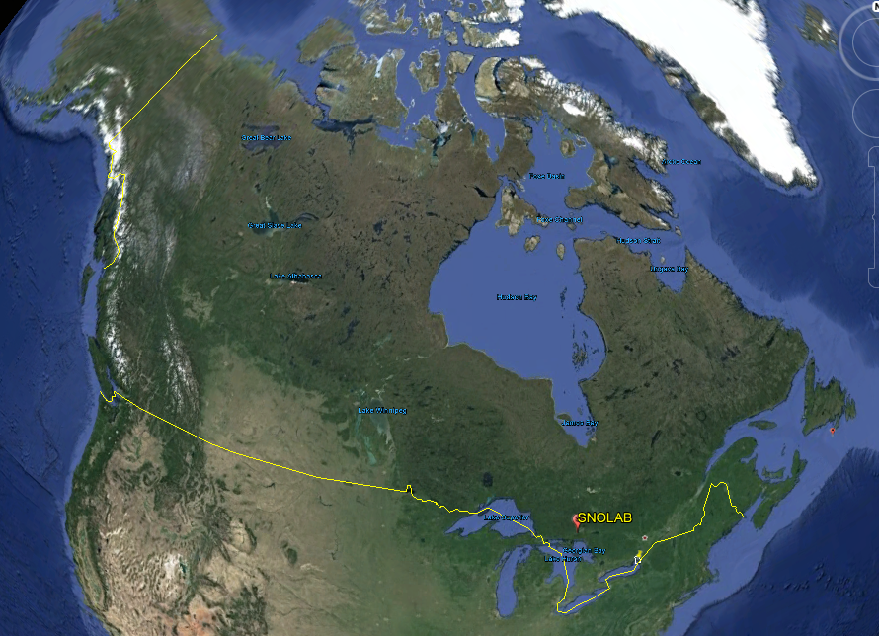
SNOLAB ….

Slide 5
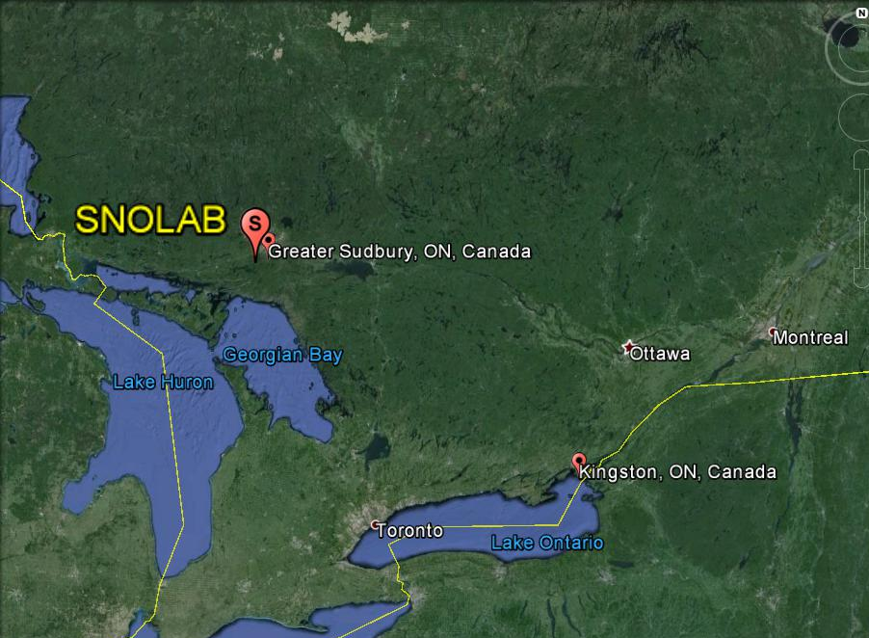
Located 2 km underground in a mine in Sudbury

Slide 6
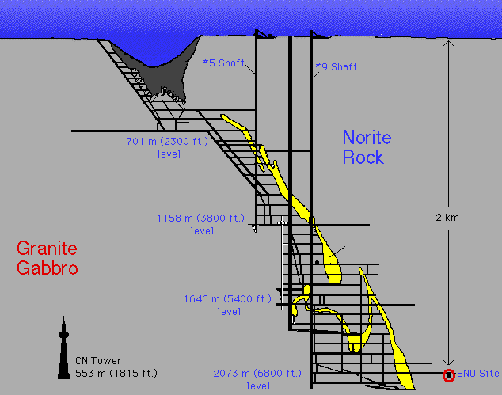
SNOLAB is Situated 2 km underground in a Vale mine in Sudbury.
2 km of rock stops the cosmic rays from reaching the detector and mimicking the rare signals we are looking for.
SNOLAB

Slide 7
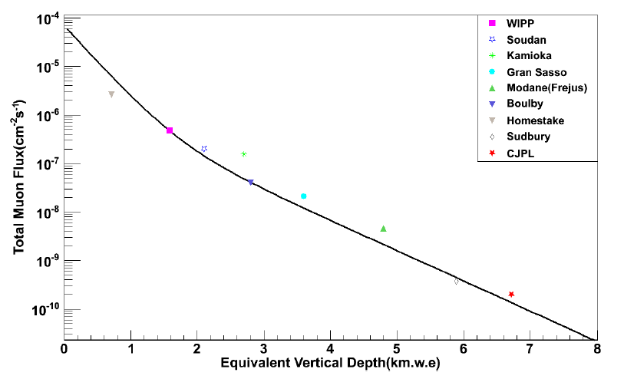
The Deepest Lab with International Program. Recently pipped by CJPL.
SNOLAB Muon Flux = 0.27/m²/day
SNOLAB
JinPing

Slide 8
SNOLAB Underground facilities
Cryopit
Cube
Hall
Utilities
Ladder
SNO

Slide 9
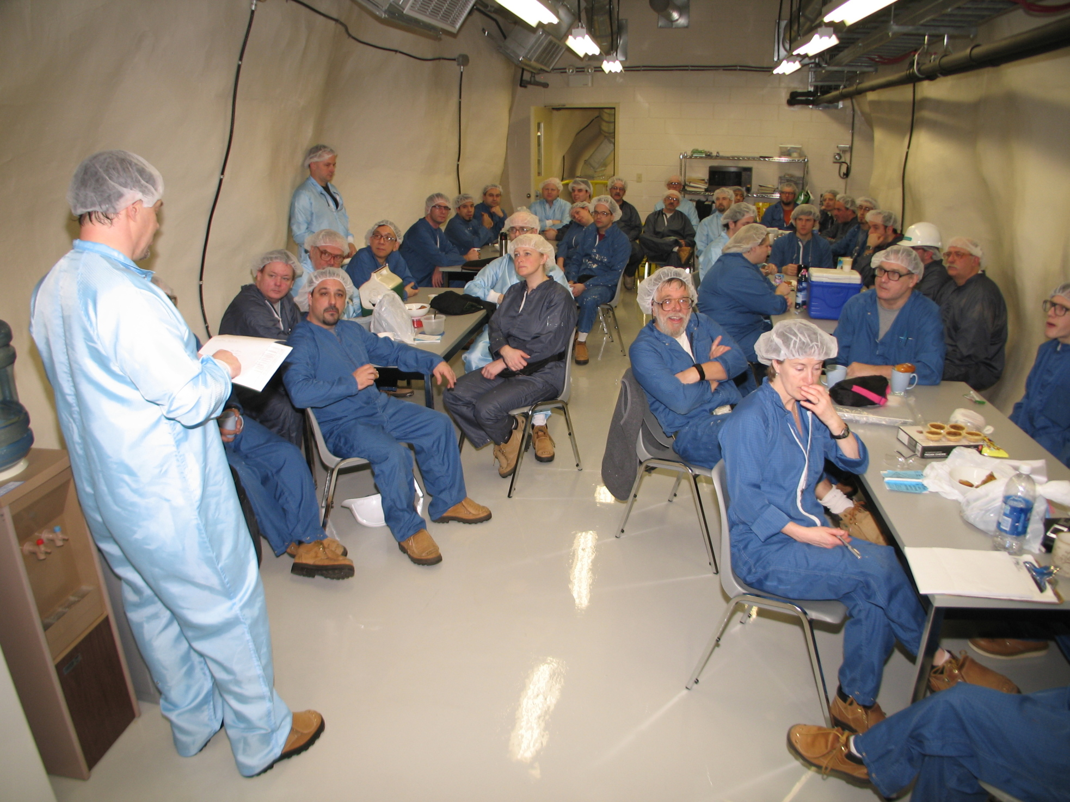

Slide 10
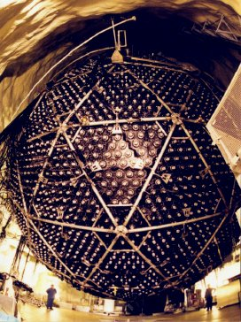
SNO during construction

Slide 11
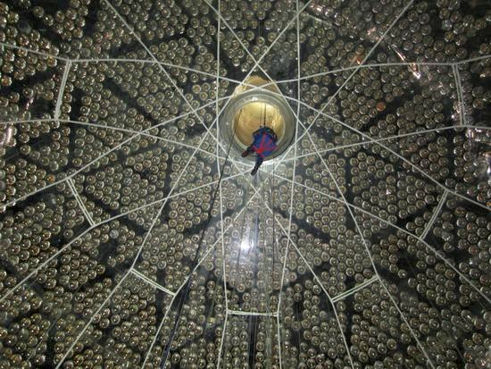
Lowering into the SNO+ detector at SNOLAB

Slide 12
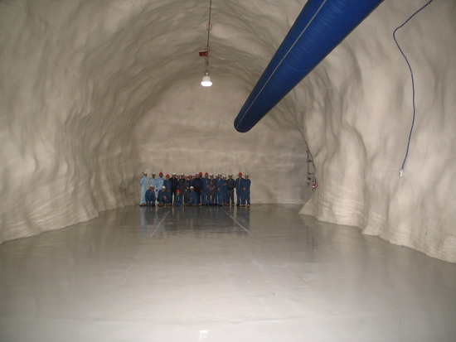
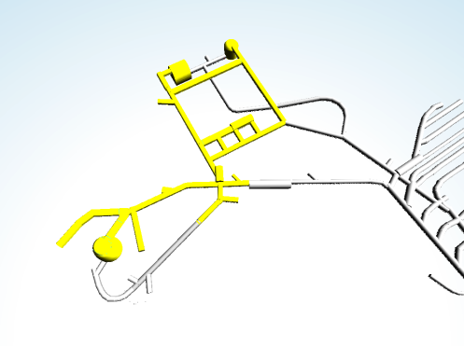
Ladder
Labs

Slide 13
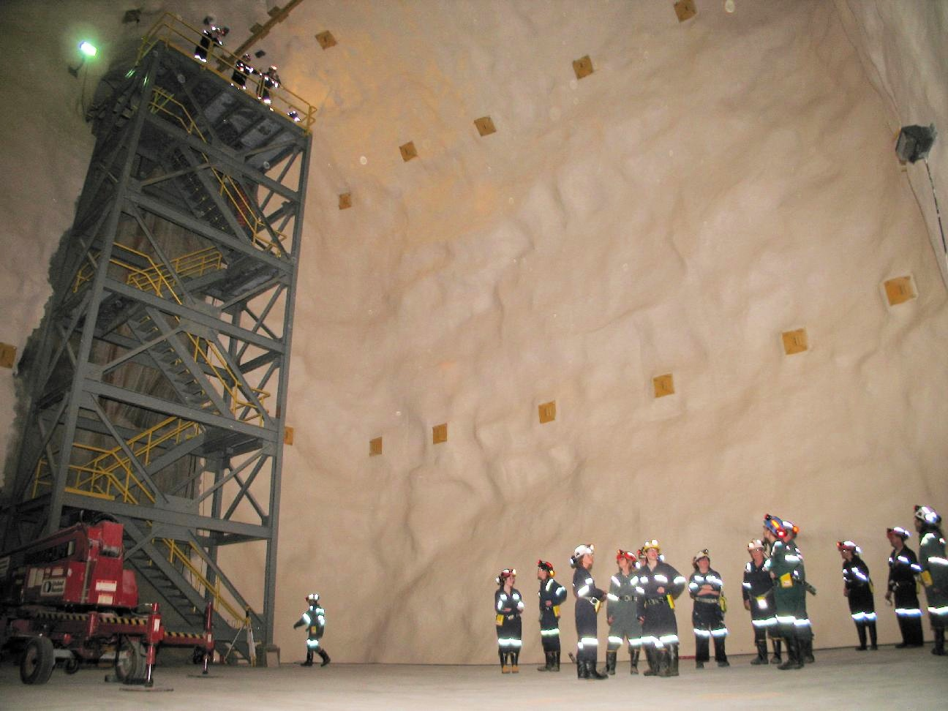
Cube
Hall

Slide 14
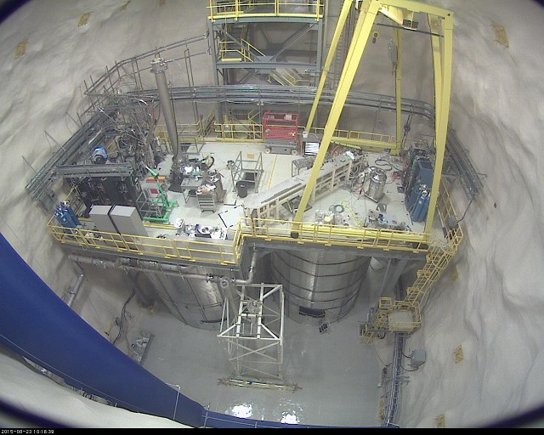

Slide 15
Dark Matter at SNOLAB
PICASSO 2.5kg Superheated Droplet C₄F₁₀ Completed Run
DEAP I 7kg Scintillation LAr ProtoType Completed
COUPP 2kg Superheated Bubble Ch. CF₃I Completed
COUPP 4kg Superheated Bubble Ch. CF₃I Completed
DAMIC CCD Si Operational
PICO 60 Superheated Bubble Ch C₃F₈ Operational
PICO 2L Superheated Bubble Ch C₃F₈ Operational
MiniClean 500 kg Scintillation LAr Under Construction
DEAP 3600 kg Scintillation LAr Under Construction
SuperCDMS CryogenicéSolidState Ge Si In Preparation

Slide 16
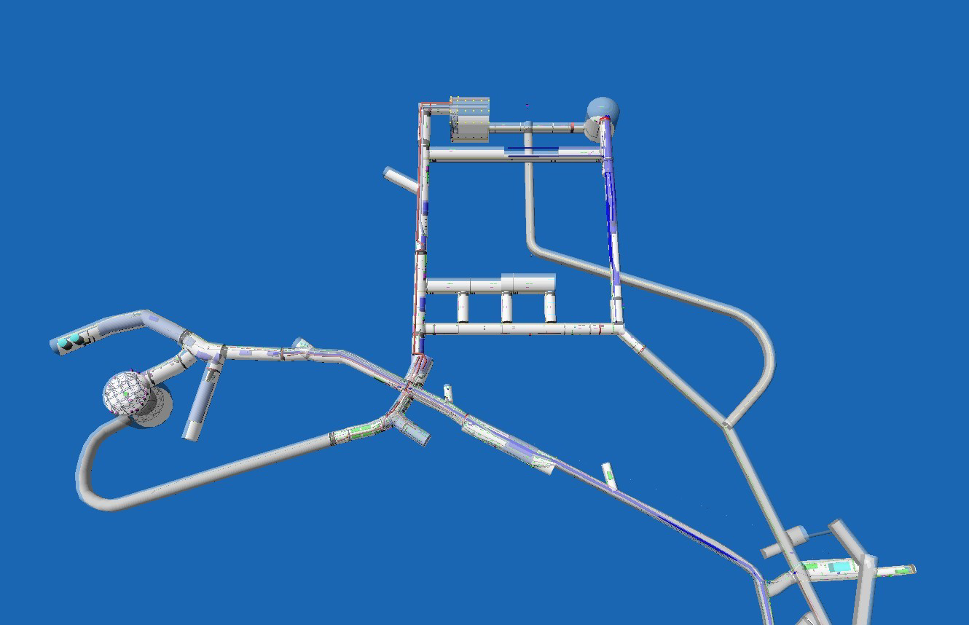
SNOLAB as of Oct 2015.
DEAP 3600
MiniClean
NEWS
nEXO ?
PICO 250L ? DEAP 50K ?
PICO 2L
Halo
DAMIC
PICO 60
SuperCDMS
SNO+

Slide 17
Direct Dark Matter Detection…The challenges:
    Must detect kinetic energy of recoiling nucleus in WIMP interaction. ~(1-100 keV).
    Very low event rate expected
    ~(1 event per tonne/year)
    Need to remove ~all sources of backgrounds that can mimic the signal

Slide 18
Multipronged approach world wide:
    Wide range of target materials
      Spin-independent and spin-dependent sensitivity
      Low, Medium and High mass WIMPs
    Different technologies
    Different backgrounds and systematics
For example, at SNOLAB alone:
DEAP Has sensitivity to SI sector and higher mass WIMPs
SuperCDMS Has sensitivity mainly to SI sector and low/medium masses
PICO Has sensitivity to low to high mass WIMPs in SD sector. Can exchange target fluids “easily”
NEWS Has sensitivity to very low mass dark matter in SI and SD
Together, these projects span a large swath of parameter space, with very different technologies and target materials.

Slide 19
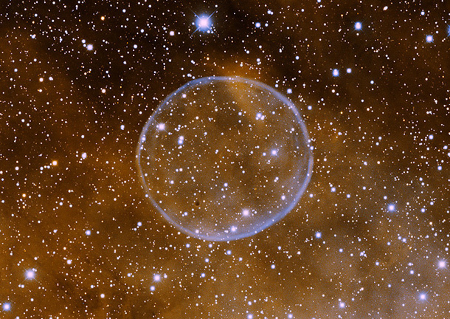
PICO
Dark Matter Search with Bubble Detectors @ SNOLAB

Slide 20
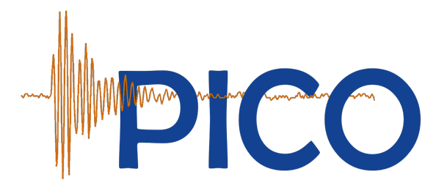


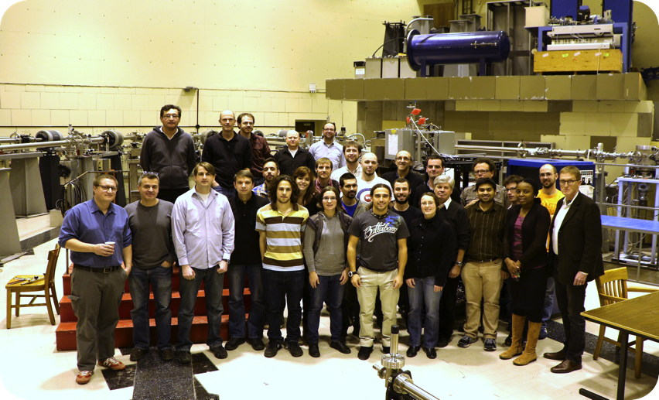















E. Vázquez-Jáuregui
I. Lawson
C. Amole, M. Besnier, G. Caria, G. Giroux, A. Kamaha, A. Noble
M. Ardid, M. Bou-Cabo, I. Felis
D.M. Asner, J. Hall
D. Baxter, C.E. Dahl, M. Jin,
J. Zhang
P. Bhattacharjee.
M. Das, S. Seth
S. Fallows, C. Krauss, P. Mitra
S.J. Brice, D. Broemmelsiek,
P.S. Cooper, M. Crisler, W.H. Lippincott, E. Ramberg, M.K. Ruschman, A. Sonnenschein
E. Behnke, H. Borsodi, O. Harris, A. LeClair, I. Levine, E. Mann, J. Wells
R. Neilson
K. Clark
R. Filgas, I. Stekl
F. Debris, M. Fines-Neuschild, C.M. Jackson, M. Lafrenière, M. Laurin, J.-P. Martin, A. Plante, N. Starinski, V. Zacek
J.I. Collar,
A.E. Robinson
J. Farine, F. Girard, A. Le Blanc, R. Podviyanuk, O. Scallon, U. Wichoski
D. Maurya, S. Priya

Slide 21
The Objectives of the PICO Collaboration:
(Merger of PICASSO & COUPP collaborations)
  To develop the bubble chamber technology with the ultimate goal of building a tonne scale detector.
  To fully explore the Spin-Dependent sector and have particular sensitivity to low mass WIMPS
  To reach this capability with a series of detectors of increasing mass and sophistication.
PICO 2L → PICO 60 → PICO “250 L”

Slide 22
The Principle of Operation for Bubble Chambers

Slide 23
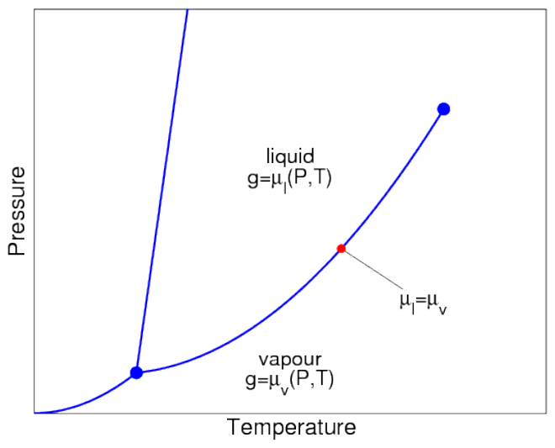
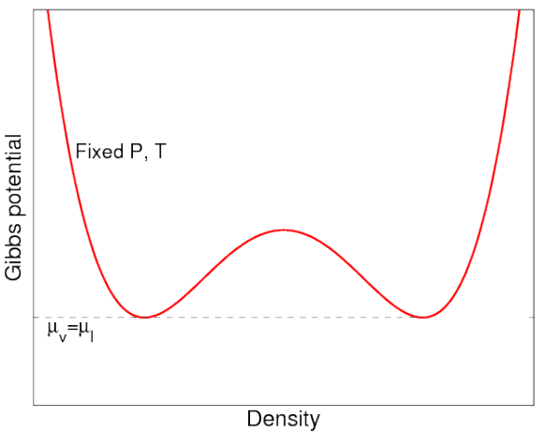
Bubble Chamber Operation
Phase diagram
Gibbs free energy
Vapour
Liquid
Gas Like
(entropy)
Liquid Like
(enthalpy)
When on the saturation curve, liquid and gas are in equilibrium. (Same pressure, temperature and chemical potential).
At equilibrium, the potential has two minima (one dominantly gas like and one liquid dominated)

Slide 24
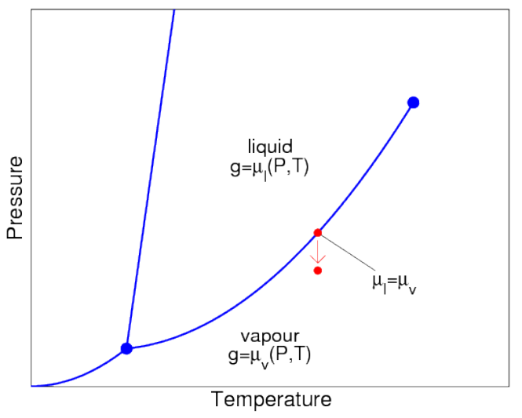
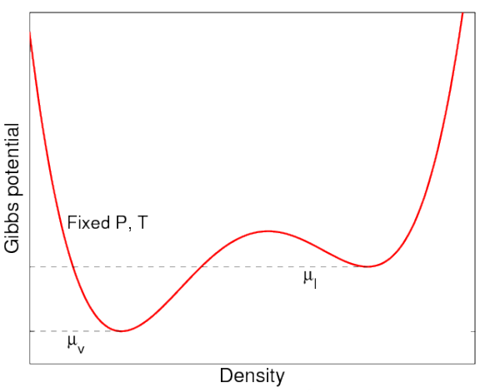
Bubble Chamber Operation
Phase diagram
Gibbs free energy
Superheated Liquid
Vapour
We now lower the pressure of the chamber carefully….starting from the pure liquid phase.
This distorts the potential, leading to a meta-stable superheated liquid state. Unless sufficient energy is added, it will stay in meta-stable state.

Slide 25
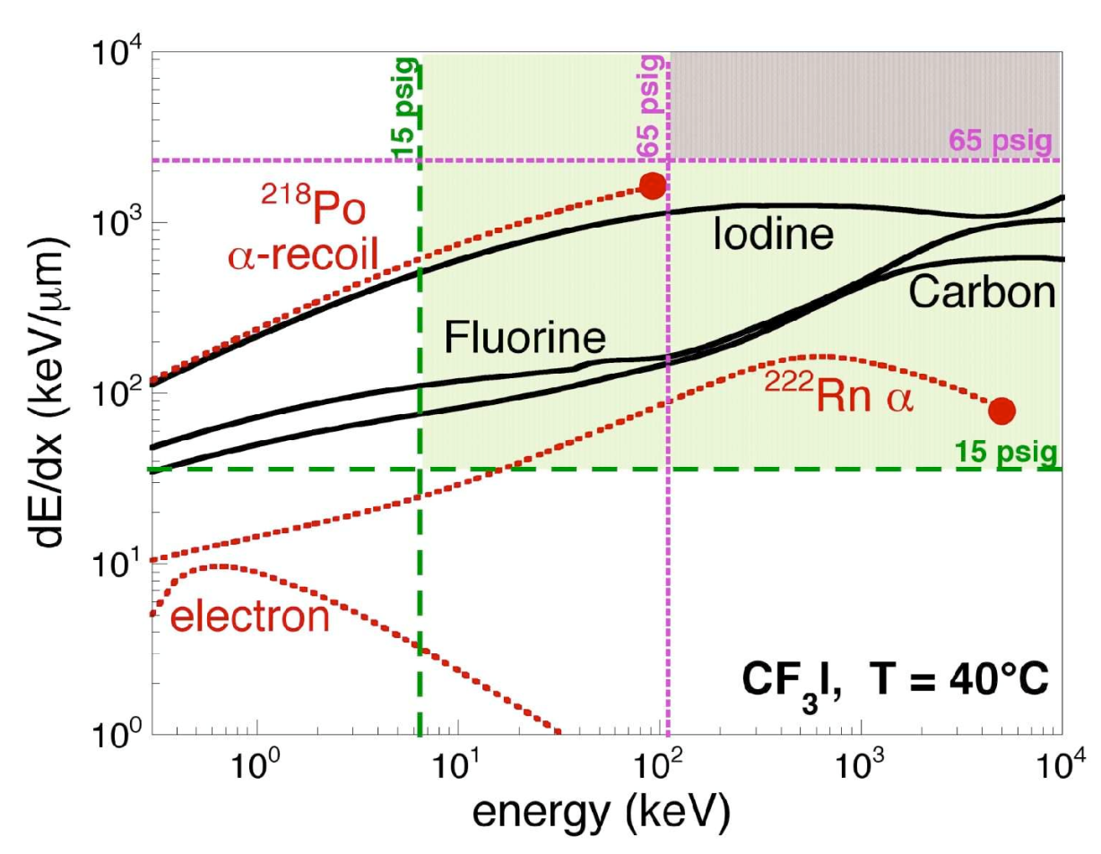
Bubble chambers as nuclear recoil detectors
Thermodynamic parameters are chosen for sensitivity to nuclear recoils but not electron recoils.
Better than 10⁻¹⁰ rejection of electron recoils (betas, gammas).
Alphas are (were) a concern because bubble chambers are threshold detectors.
Take away message:
Energy deposition depends on particle type. So can tune detector to be sensitive to certain types only. → Particle discrimination

Slide 26
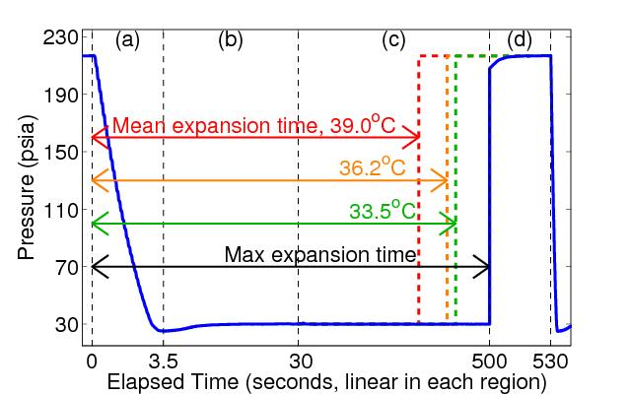
Principle of Operation: Bubble Chamber
Buffer fluid
(water)
Synthetic silica jar
Target fluid
(CF₃I/C₃F₈)
Hydraulic
fluid
to hydraulic controller
Lower the pressure to a superheated state.
See the bubble:
  Cameras trigger. record position, multiplicity
  Microphones record acoustic trace
  Fast pressure transducer recording.
Raise pressure to stop bubble growth (100ms), reset chamber (30sec)

Slide 27
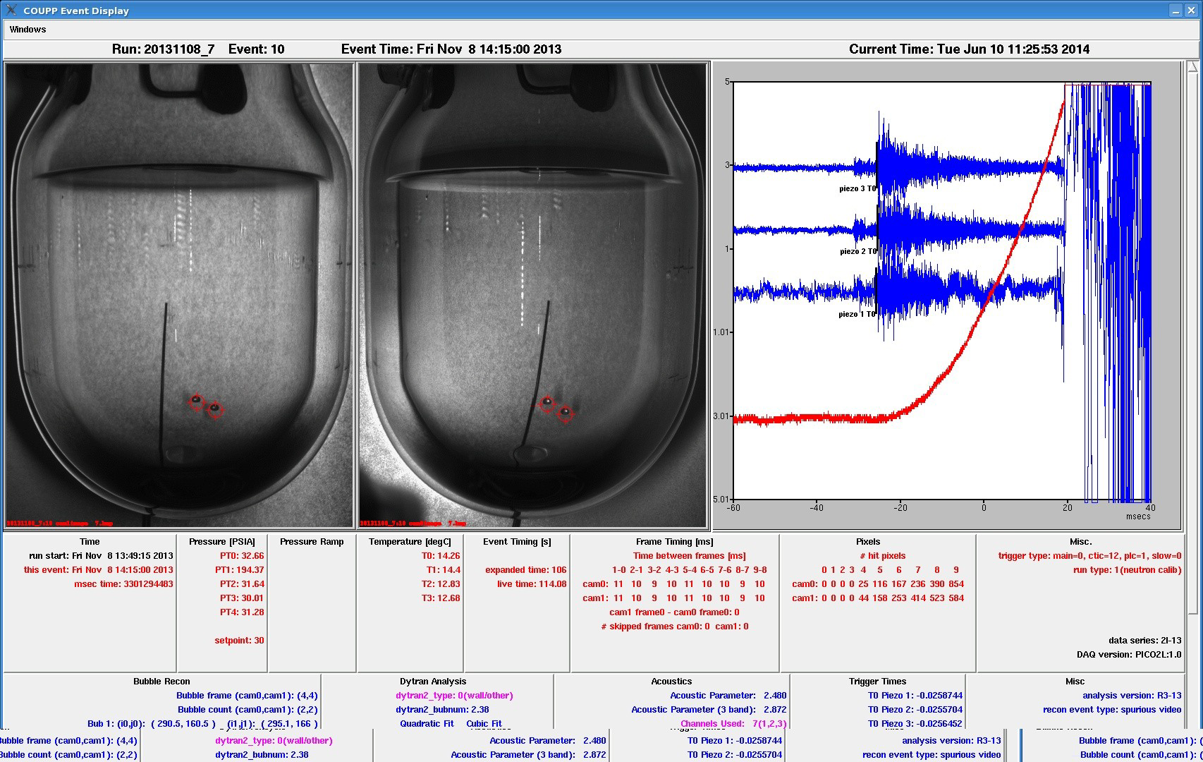
Acoustic Transducers
100fps stereo images
Fast Pressure Transducer
Screen Display during operations

Slide 28
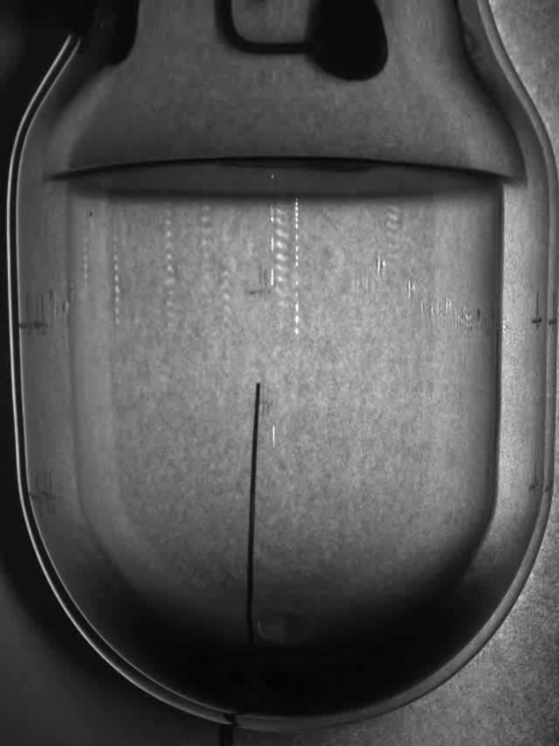
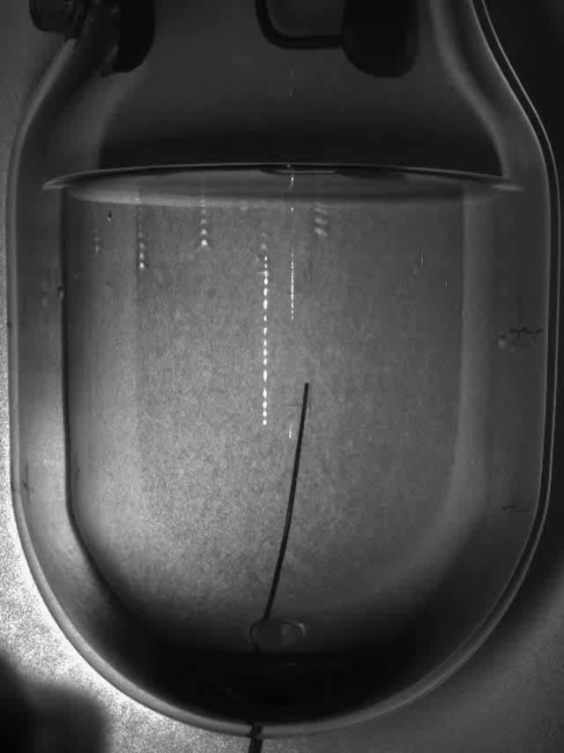
Two example events recorded
Single Bubble event
Neutron event

Slide 29
Background Mitigation Strategies

Slide 30
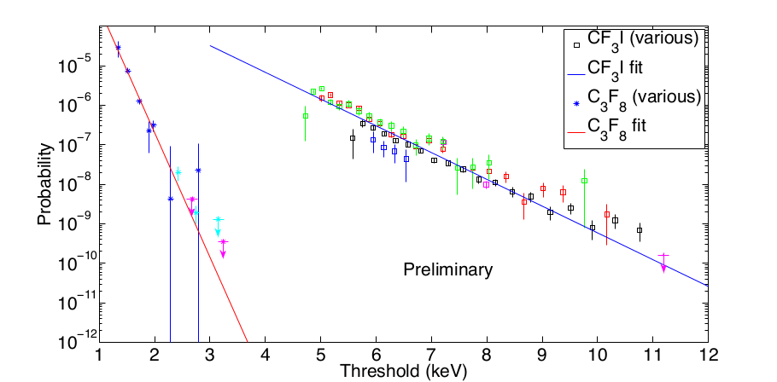
Threshold detector:
We can choose superheat parameters (T, P) so that the bubble chamber is blind to electronic recoils (10⁻¹⁰ rejection or better)
Threshold attainable with 10⁻¹⁰ gamma rejection is:
~3 keV with C₃F₈
~ 11 keV with CF₃I
CF₃I
C₃F₈
Excellent electron/gamma rejection has been demonstrated.
C₃F₈ can reach lower thresholds than CF₃I for same rejection.
A lower threshold extends the sensitivity to lower mass WIMPs.

Slide 31
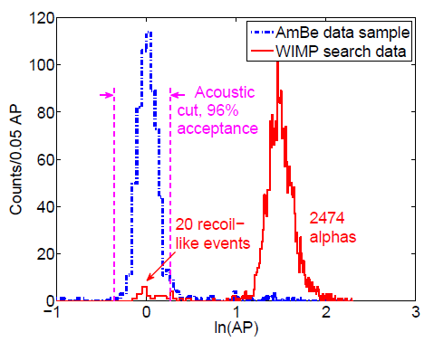
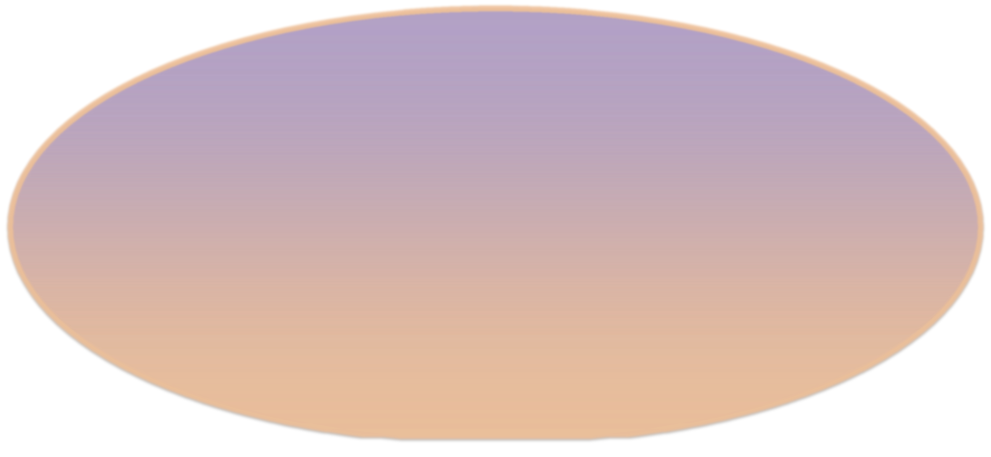
Alpha Acoustic Discrimination
Discovery by PICASSO of acoustic discrimination against alphas (Aubin et al., New J. Phys.10:103017, 2008)
  Nuclear recoils deposit their energy over tens of nanometers.
  Alphas deposit their energy over tens of microns.
In bubble chambers alphas are several times louder due to the expansion rate difference.
Observable bubble ~mm
~40 μm
~50 nm
Daughter heavy nucleus
(~100 keV)
Helium nucleus
(~5 MeV)

Slide 32
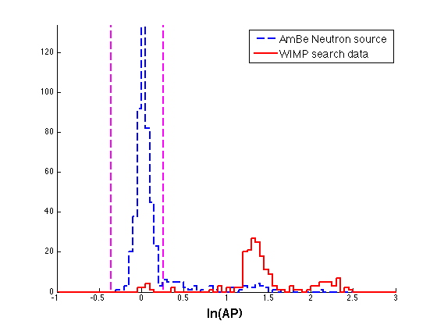
PICO-2L Analysis:
Acoustic discrimination
Acoustic cut
94%
acceptance
3 keV threshold
No multiple bubble events in the low background data
Two distinct alpha peaks, clearly separated from nuclear recoils
Timing of events in high AP peaks consistent with radon chain alphas, and indicate that the higher energy ²¹⁴Po alphas are significantly louder (a new effect not seen in CF₃I)
“Clean” alpha triplets
²²²Rn
α(5.6 MeV)
²¹⁸Po
α(6.1 MeV)
²¹⁴Po
α(7.9 MeV)
3 minutes
55 minutes

Slide 33
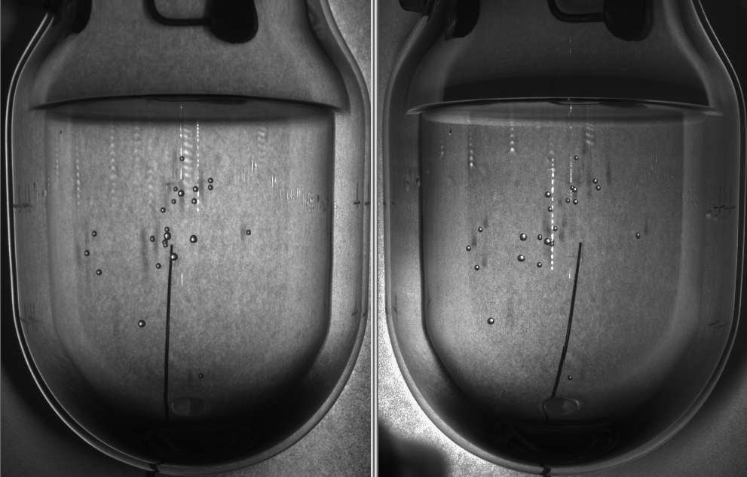
23 bubble AmBe neutron event
High multiplicity is a result of high bubble nucleation efficiency; 60% of neutron
calibration events in C₃F₈ are multiples.

Slide 34
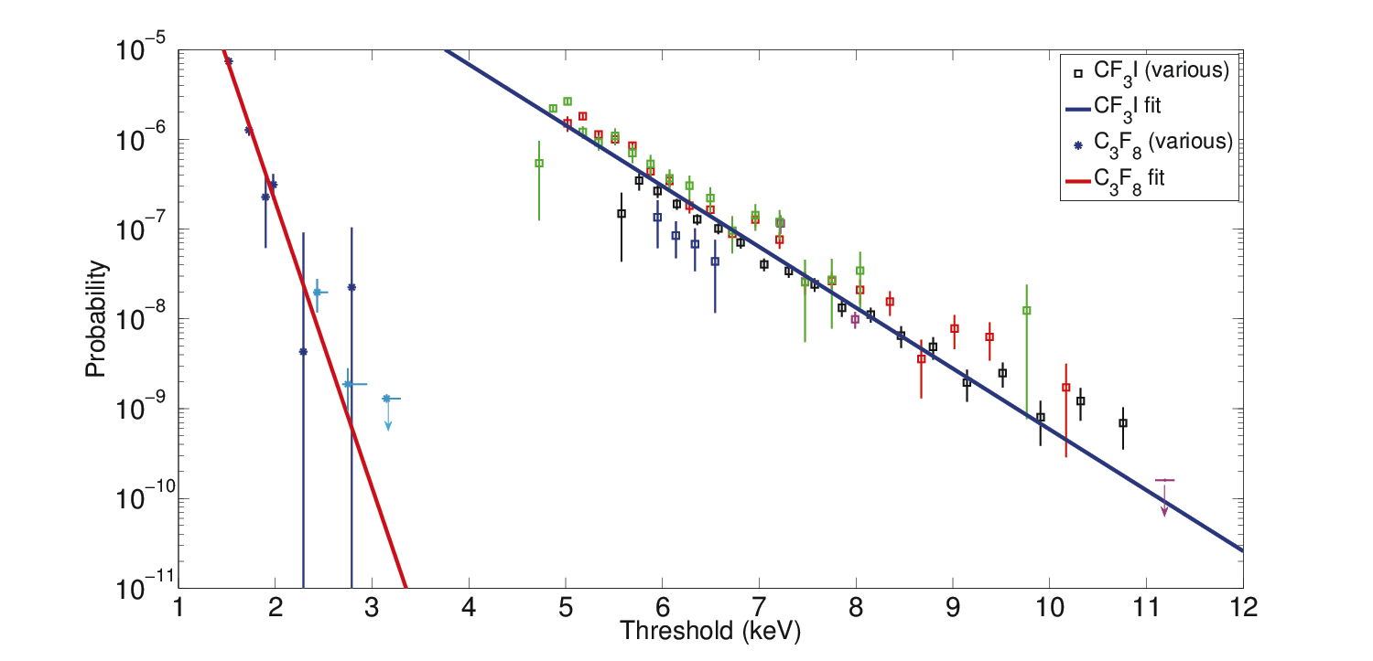
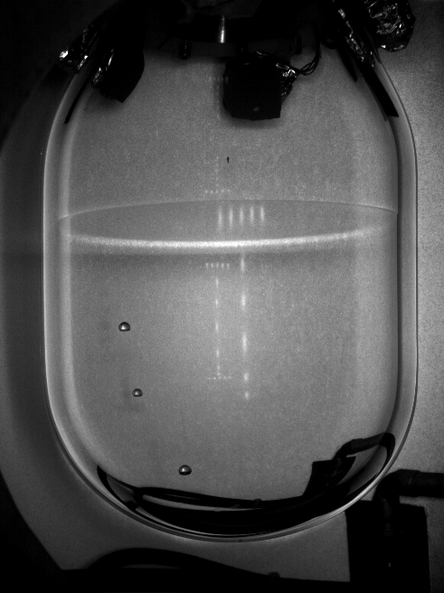
Background Rejection Summary
Gamma/Beta:
Select materials carefully
Operate detector above gamma threshold
Neutrons:
Go deep underground
Add local shielding (water tanks)
Select materials carefully
Use multiplicity
Bubbles per gamma interaction
Alpha-decay:
Purify all materials
Optimize piezo analysis
>99.3% Rejection
CF₃I

Slide 35
Results From PICO

Slide 36
Three new results
  PICO-60 (experiment formerly known as COUPP-60)
  preliminary DM results.
PICO-2L Run-1
  2015 DM result.
PICO-2L Run-2
  preliminary report from recently completed physics run.

Slide 37
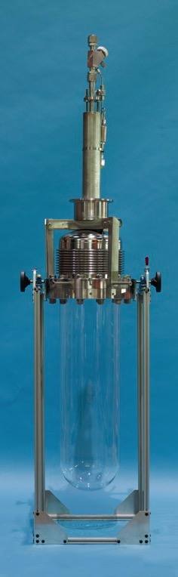
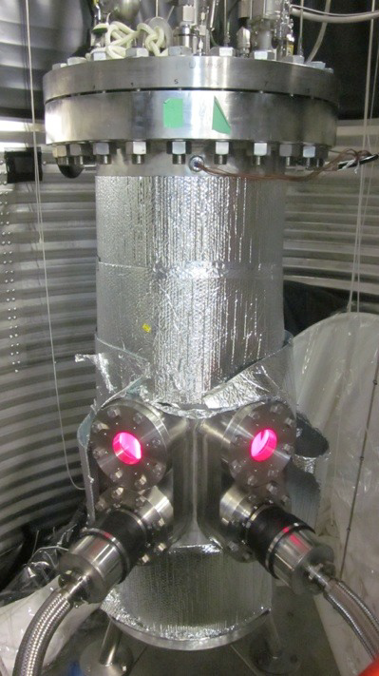
PICO-60
Filled with 36.8 kg of CF₃I.
PICO-60 Run-1: June 2013 to May 2014.
Run-2 with C₃F₈ target in 2016.

Slide 38
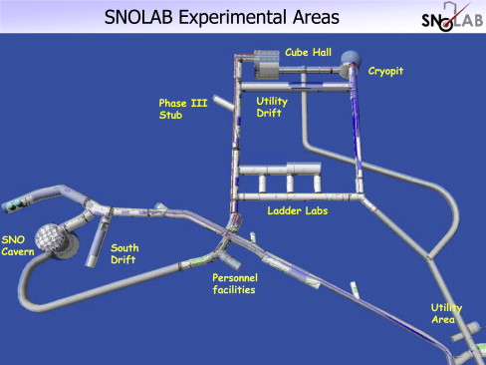
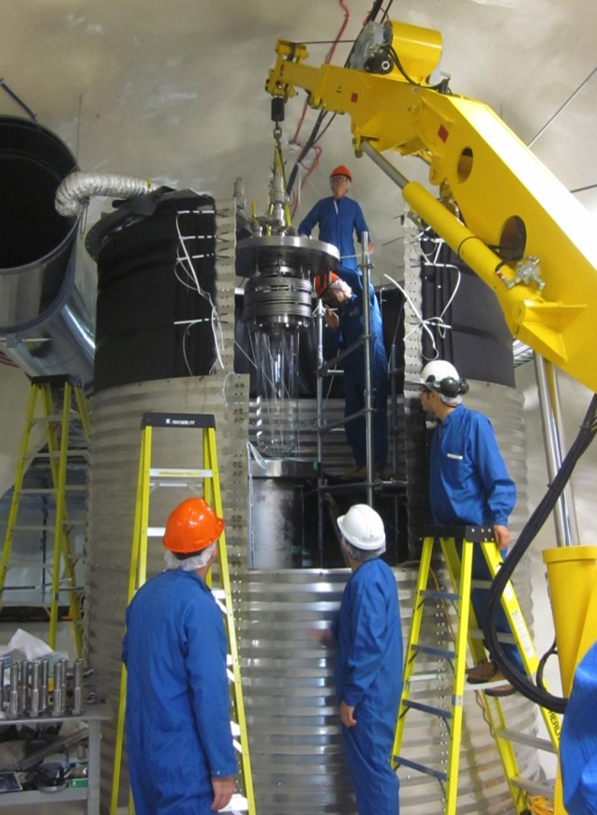
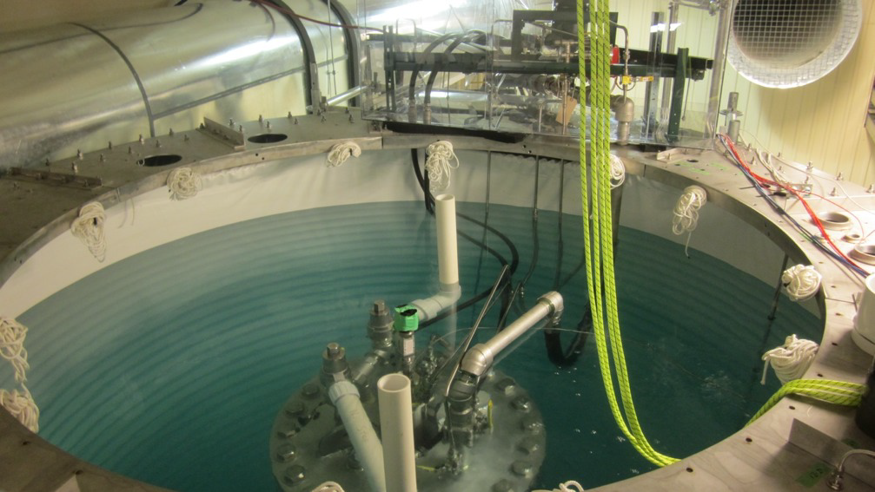
PICO-60 at SNOLAB

Slide 39
PICO-60 results
WIMP search data show ~2000 background events of unknown origin, with mean Acoustic Parameter (AP) slightly above nuclear recoil peak.

Slide 40
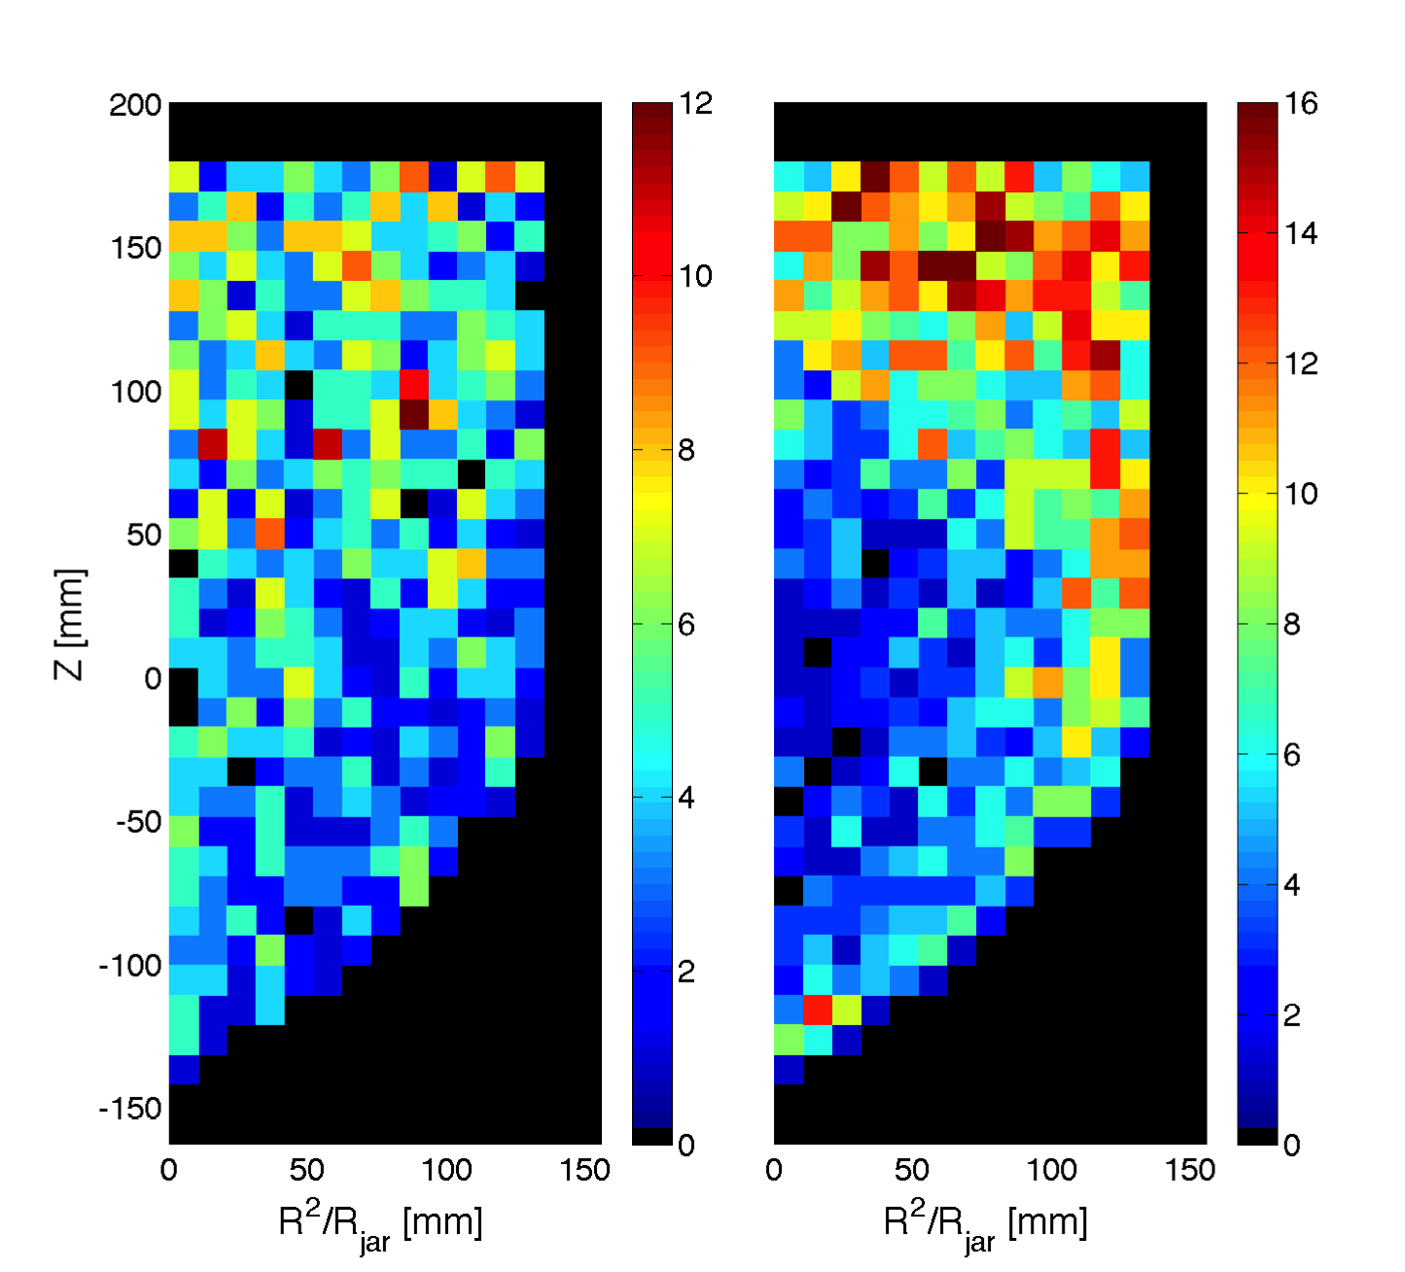
The unknown background
Alphas
Unknown background
The unknown background distributions are markedly different from alphas (and Dark Matter).

Slide 41
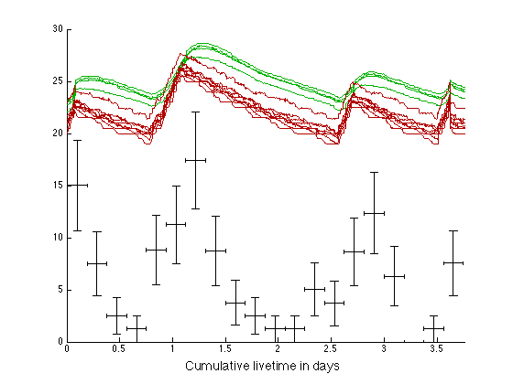
Some classes of events clearly correlated with the temperature of the water and glycol …. Correlation with pump, heaters, electrical noise, vibrations, convection…?
Temperature in Glycol (not to scale)
Temperature in Water (not to scale)
Mystery-Event rate
(not to scale)

Slide 42
Combined PICO-60 cuts
48.2% combined efficiency, and no surviving background events

Slide 43
PICO-60 preliminary limits
Statistical penalty for setting cuts on data is calculated with Monte Carlo (similar to Optimum Interval method: S. Yellin, Phys.Rev. D66 (2002) 032005)
We’re currently upgrading PICO-60 for a new run with C₃F₈ target.

Slide 44
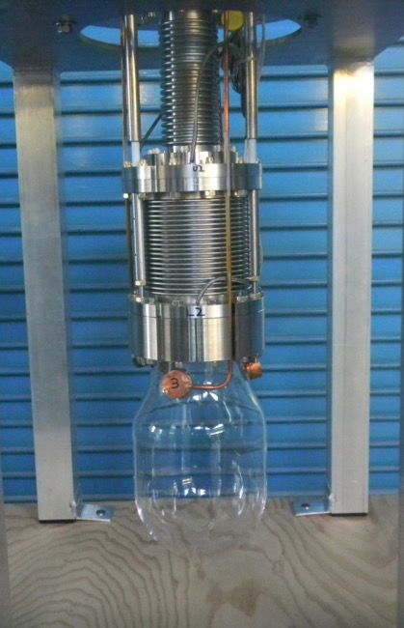
PICO-2L
Two liter active mass of C₃F₈.
Better fluorine sensitivity than CF₃I: (used by COUPP)
Twice the F density.
Lower threshold.
Improved efficiency.
More stable chemistry.
Inside water shield at SNOLAB.
Silica jar and double bellows attachment.

Slide 45
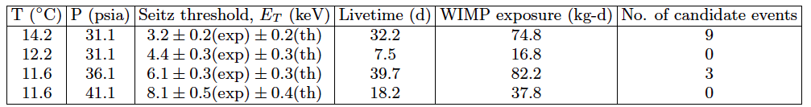
PICO-2L Run-1 results
Well above expected neutron background (<1 event at 3.2keV), and no multiple bubble events observed, so these are not neutron events.
There are timing correlations of events at 3.2keV with previous events, therefore not DM or neutrons.
We set limits by applying a timing cut with MC-derived statistical penalty, similar to PICO-60.

Slide 46
PICO-2L limits
C. Amole et al., Phys. Rev. Lett. 114, 231302 (2015)

Slide 47
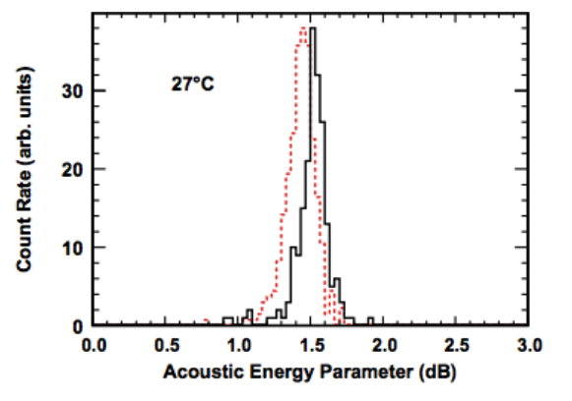
Background hypothesis
Partially contained alpha decays are slightly louder than nuclear recoil events in droplet detectors.
Similar effect expected in a monolithic bubble chamber for alpha decays originating in suspended particulate.
Program to test this hypothesis by assaying the DM chambers and reproducing the effect in small test chambers.
Neutron events
Partially contained alpha decays
Droplet detector: S. Archambault et al.; New J. Phys. 13(2011)043006

Slide 48
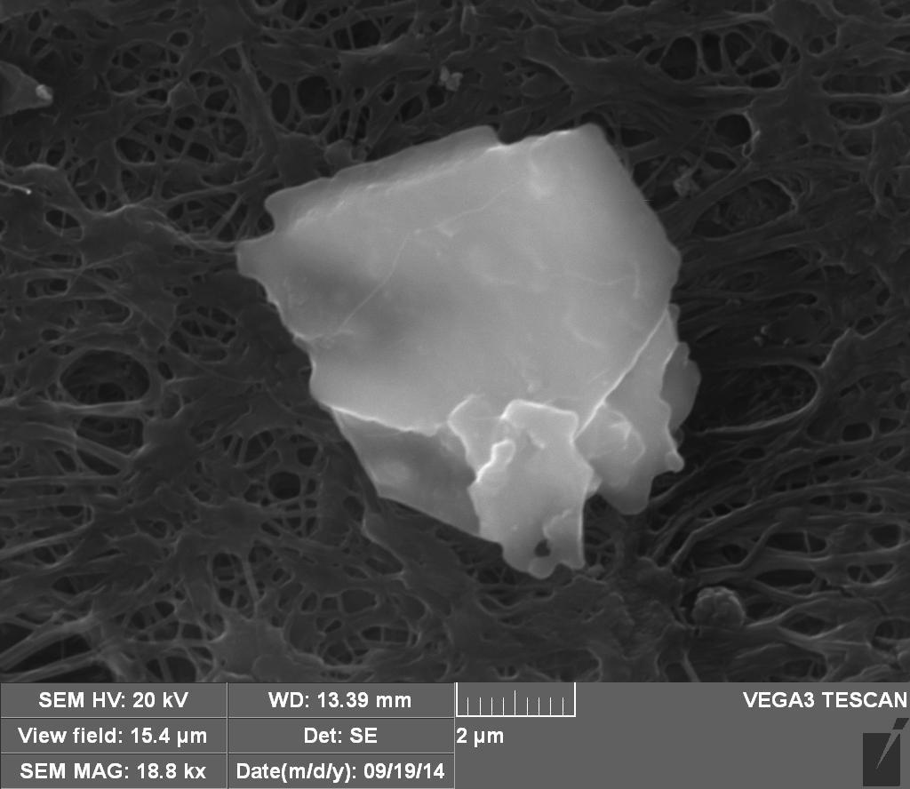
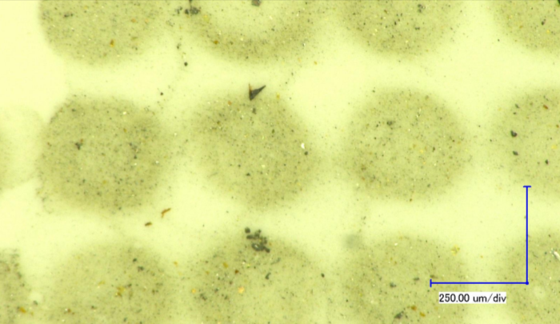
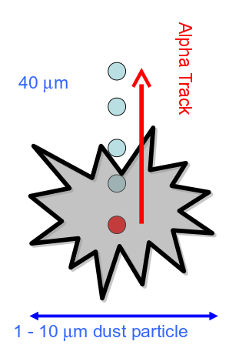
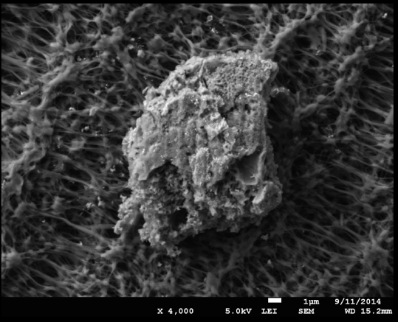
PICO-2L background forensics:
Filter sample from PICO-2L
Leading hypothesis - particulate contamination
ICPMS has found enough thorium to explain PICO-2L rate
XRF has identified many components chemically
Stainless steel
Quartz
Gold (from seal)
Silver (VCR parts?)
Anomalous background from degraded alpha tracks?

Slide 49
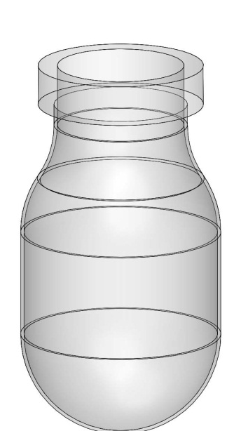
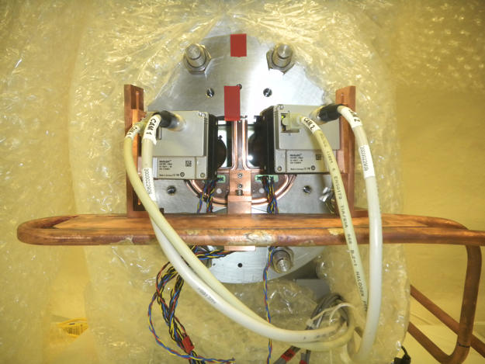
PICO-2L Run-2
Physics run June 12 – Sept 25 2015.
Natural quartz inner vessel flange replaced with low-radioactivity fused silica.
Assembled and filled with particular focus on minimizing particulate contamination.
Technical improvements to cooling and piezo-acoustic sensors (0% sensor failure in Run-2).
Bulk event rate consistent with expected neutron background.
flange
active camera cooling

Slide 50
PICO-2L Run-1 vs Run-2
Run-1 3.2keV data
32 live days
Est. neutron bkgd 0.9^{+0.2}_{-0.7} events
Run-2 3.2keV prelim. data
~63 live days
Est. neutron bkgd 1.5^{+0.3}_{-1.1} events

Slide 51
Next steps
PICO-60 with C₃F₈
C₃F₈ target fluid
New vessel with fused silica flange
Coated bellows to eliminated steel particulate
Active fluid recirculation with filtering
“Right-side-up” bubble chamber with no buffer fluid
Stable against convection currents
Simplified fluid handling/recirculation.
Wider range of possible target fluids

Slide 52
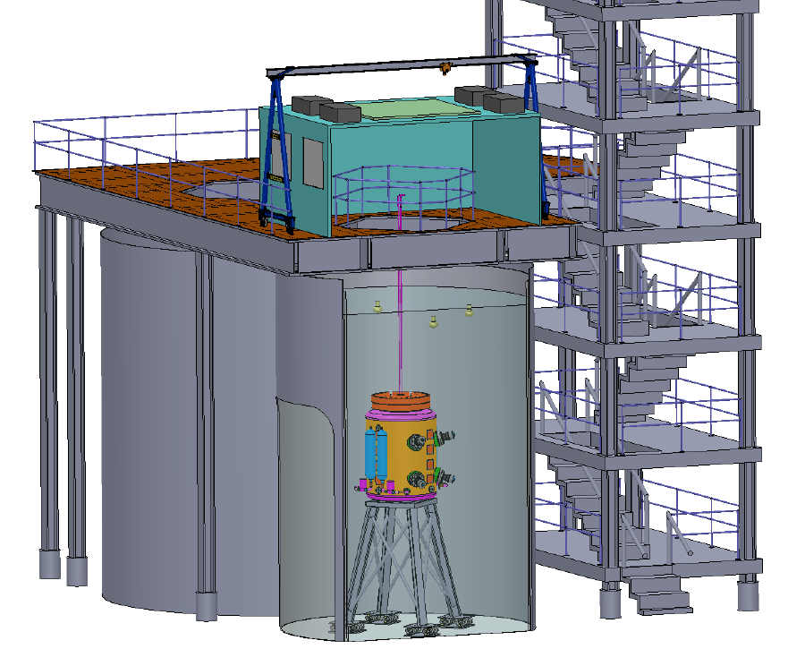

PICO-250L
Proposed 250-liter active volume bubble chamber.
Designed for CF₃I or C₃F₈ target.

Slide 53
Conclusions
PICO-2L and PICO-60 have produced world-leading limits on Spin-Dependent WIMP-proton interactions with different target fluids.
PICO-2L also has excellent Spin-Independent limits on low-mass (few GeV) WIMPs.
Both experiments observed a population of background events we believe is due to particulate contamination of the target fluids.
After efforts to reduce the background, Run-2 of PICO-2L now shows an a very low event rate consistent with neutron background.
PICO-60 is being prepared for a second run with similar improvements and C₃F₈ target fluid and this is in a water tank providing better neutron shielding.
The overall SNOLAB program is vibrant, with lots more new results imminent. Of particular note, in a few months DEAP should have a result that surpasses LUX.

