Slide 1

Recent Results from the Double Chooz Experiment for the Neutrino Mixing Angle Theta13
João dos Anjos
Observatório Nacional & CBPF - Rio de Janeiro
UTFSM, Valparaiso, 11 January, 2016

Slide 2
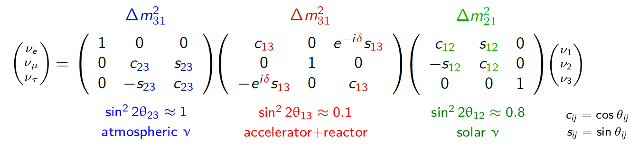
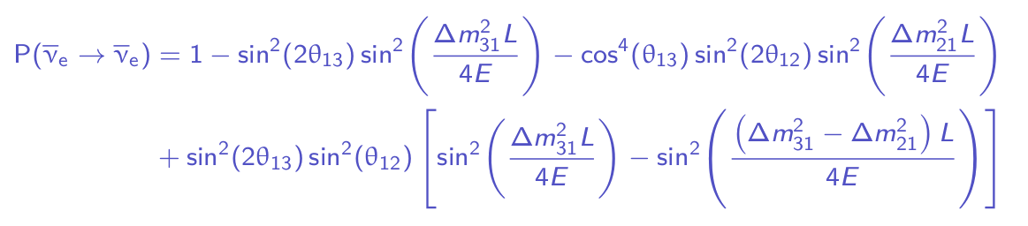
Neutrino Oscillations
A short reminder
Neutrino flavors are a superposition of mass eigenstates
Propagation of states leads to oscillation phenomenon

Slide 3
Neutrino Mixing Matrix
Experimental situation by 2010:
Atmospheric
Reactor and LBL
Solar
The parameters θ₂₃ and Δm²₂₃ determined using atmospheric neutrino data from Super-Kamiokande, K2K and Minos. (10% level)
Data from SNO, KamLAND and Super-Kamiokande used to determine θ₁₂ and Δm²₁₂ with 10 – 20% precision.
Only a limit for θ₁₃ by the reactor experiment CHOOZ (2003).
sin ² (2 θ₁₃ ) < 0.2

Slide 4
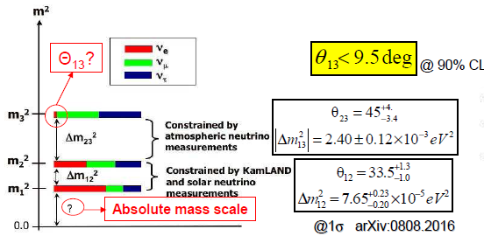
Neutrino Oscillations: open questions 2010
arxiv:0812.3161
  Size of θ₁₃
  CP violaton effects
  Mass hierarchy
  Absolute mass scale

Slide 5
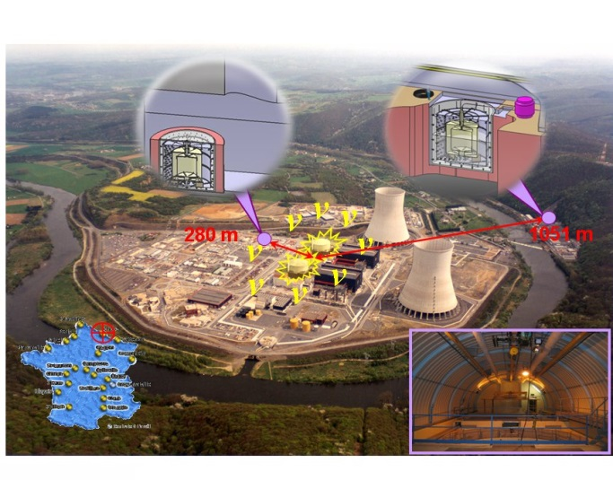

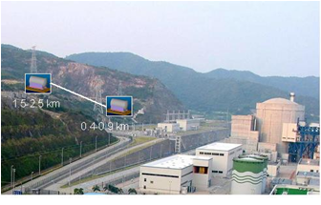
World Competition
in Reactor Neutrino Experiments
Experiments | Location | Thermal Power (GW) | Distances Near/Far (m) | Depth Near/Far (mwe) | Target Mass (tons) | sin²(2θ₁₃) 90% C.L.
Double-CHOOZ | France | 8.7 | 410/1050 | 115/300 | 8/8 | 0.03
RENO | Korea | 17.3 | 290/1380 | 120/450 | 16/16 | 0.02
Daya Bay | China | 17.4 | 360(500)/1985(1613) | 260/910 | 40X2/80 | 0.01
Double-CHOOZ
RENO
Daya Bay

Slide 6
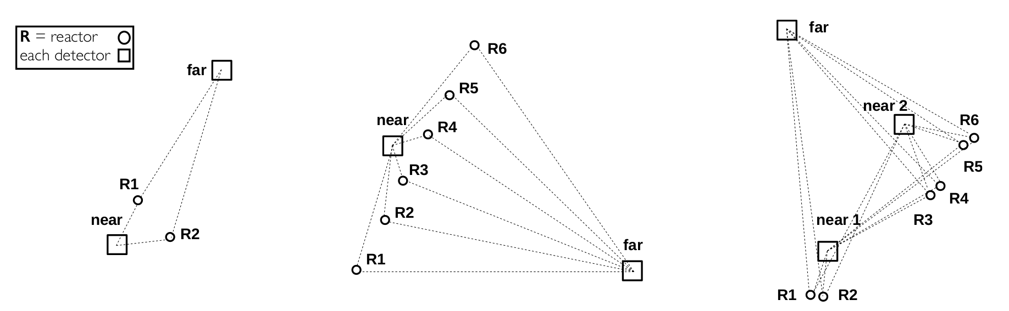
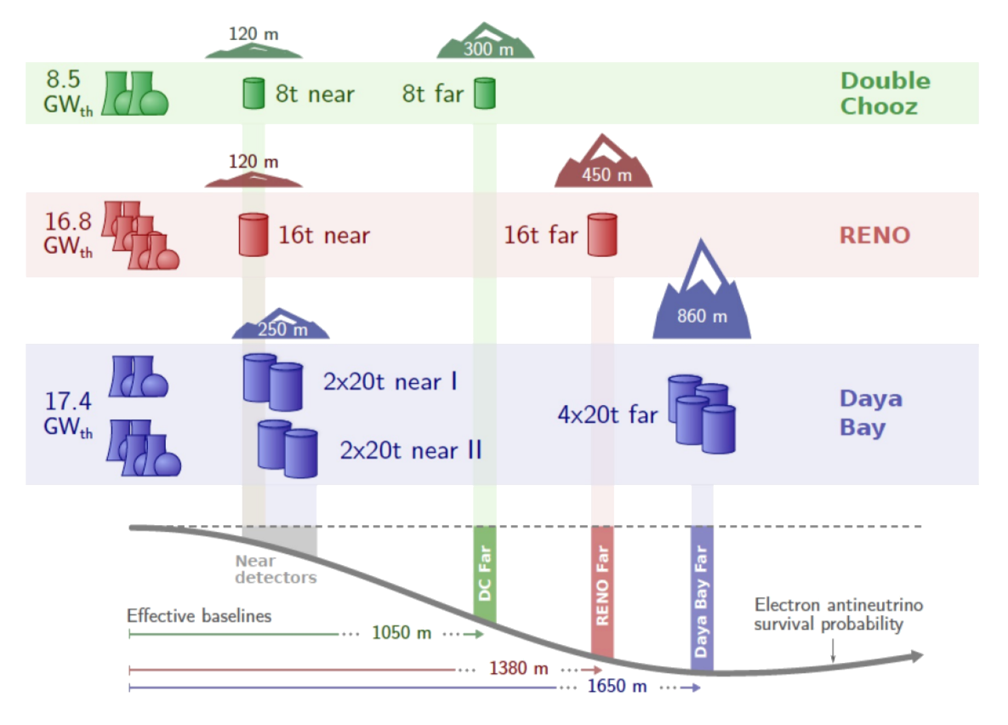
Experimental Geometries
Isoflux lines
Various baselines
Various baselines
Many detectors
A. Cabrera

Slide 7
Neutrino Oscillations
Reactor neutrino experiments predestined for measuring θ₁₃
Strongest man-made neutrino sources (good statistics)
Pure source of antineutrinos (no flavor contaminations)
Antineutrinos rather than neutrinos (no matter effects)
Tremendous effort: θ₁₃ from unknown to best known in a few years
Why are we interested in θ₁₃?
Measure CP violation in lepton sector (matter asymmetry in the universe)
Determine mass hierarchy (→ future experiments; understanding of ν mass)
Understand the structure of mixing matrix (guide development of new theories)

Slide 8
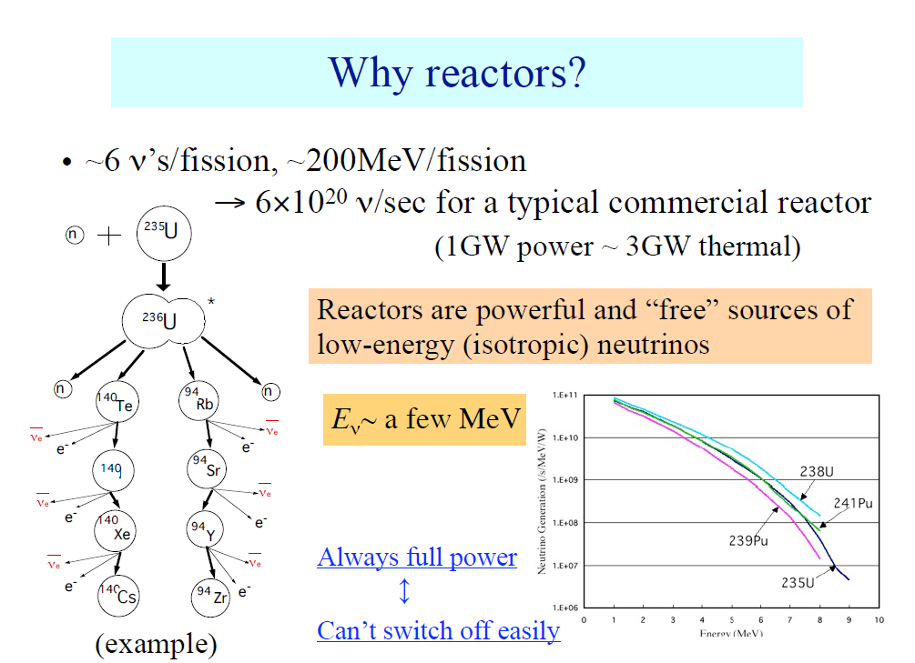

Slide 9
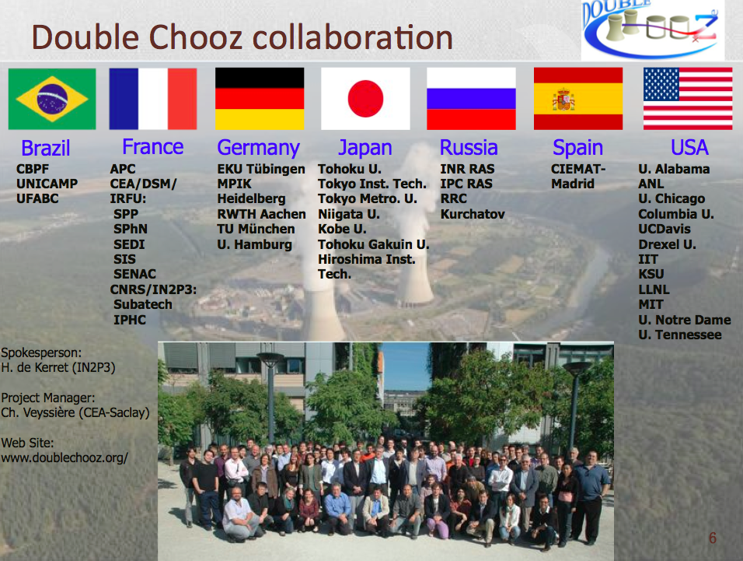

Slide 10
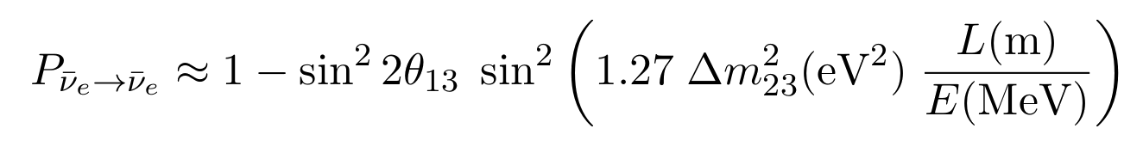
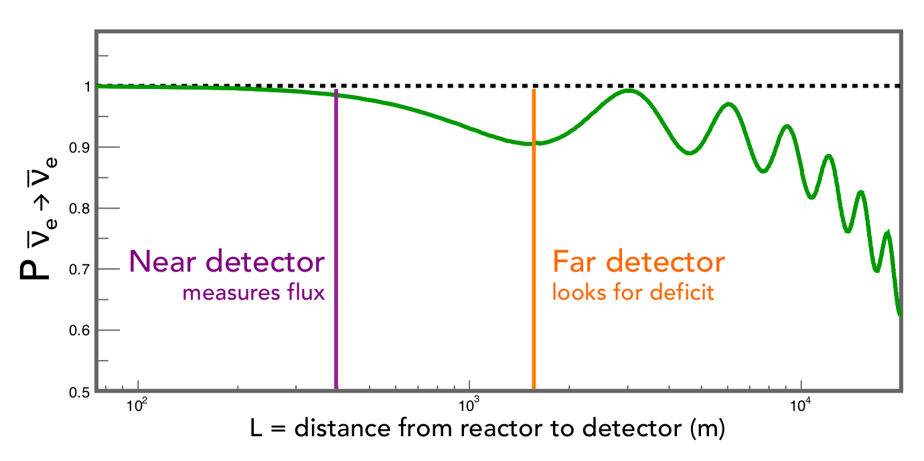
Experimental Concept
Short baseline: reduce parameter correlations
Two-detector-concept: reduction of systematics

Slide 11
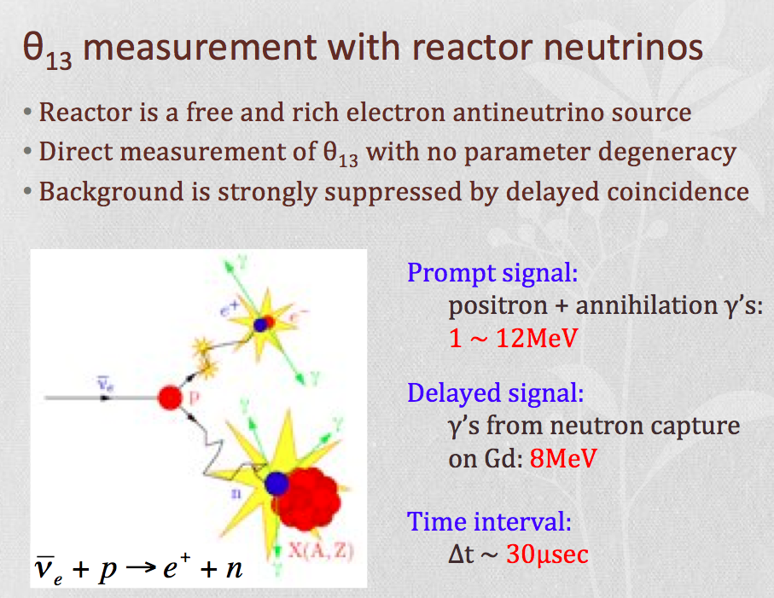

Slide 12
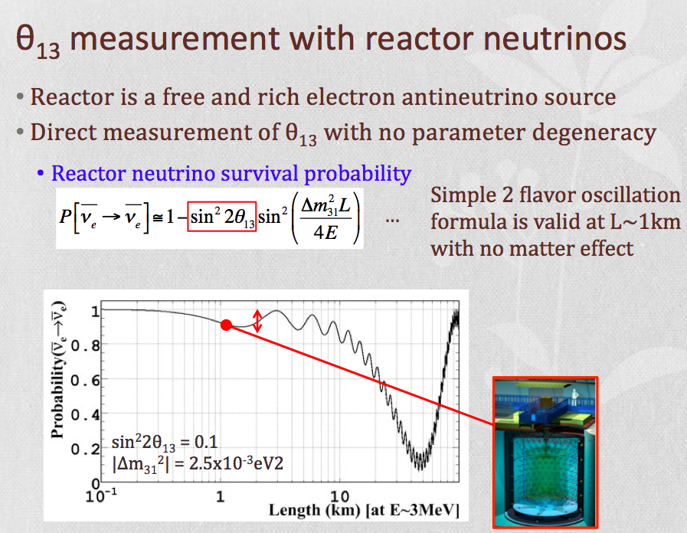

Slide 13
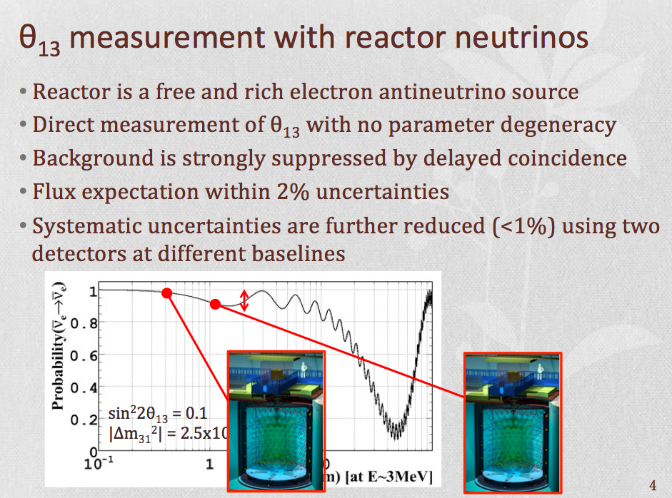

Slide 14
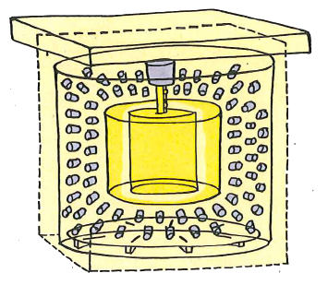
Generic Detector Design
„Standard“ multi-volume organic liquid scintillators detector design
Outer Veto
Plastic scintillator for muon detection + tracking
Neutrino Target
Gd-loaded LS for neutrino detection (n-Gd)
Gamma Catcher
Unloaded LS for γ containment (E-scale)
Buffer Volume
Mineral oil to shield inner volumes; PMTs
Inner Veto
Rejection of muons and external radioactivity
Passive Shielding
Overburden + shielding
Spirou #3849, 2012

Slide 15
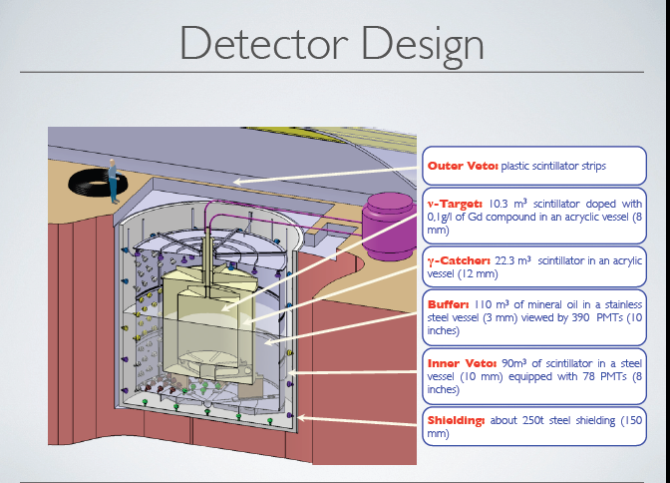

Slide 16
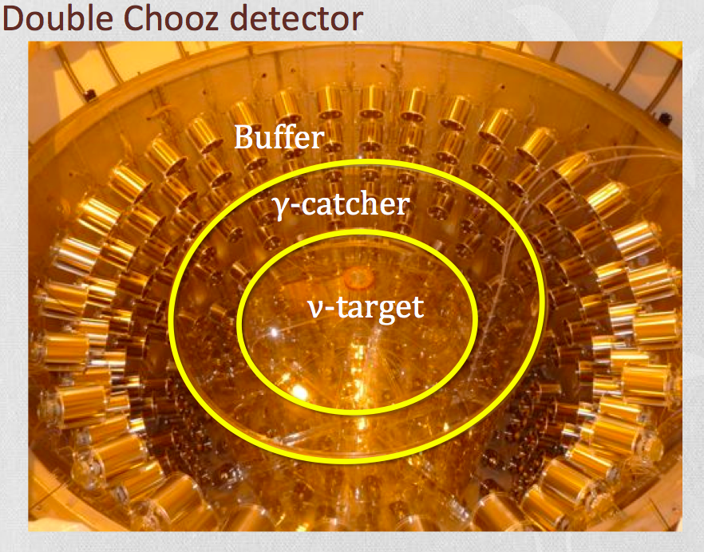

Slide 17
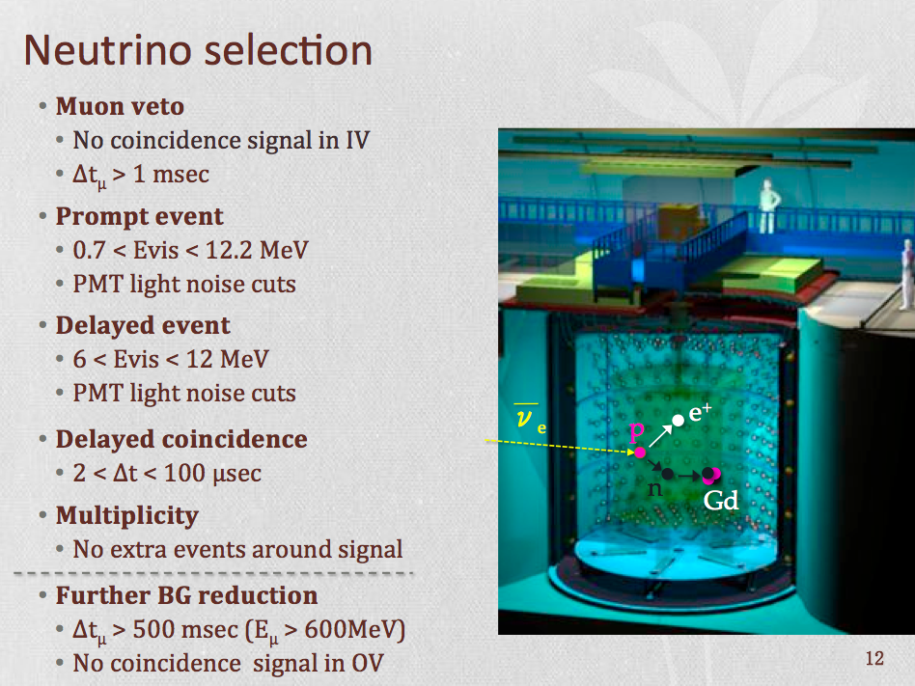

Slide 18
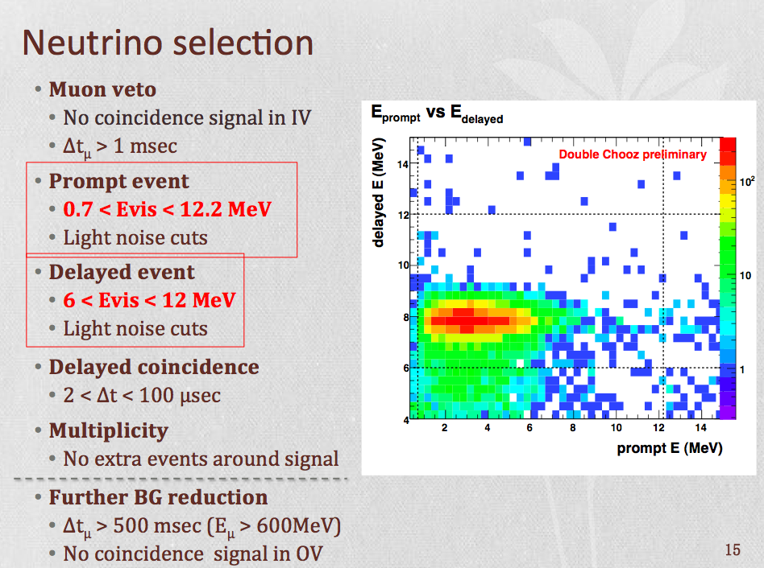

Slide 19
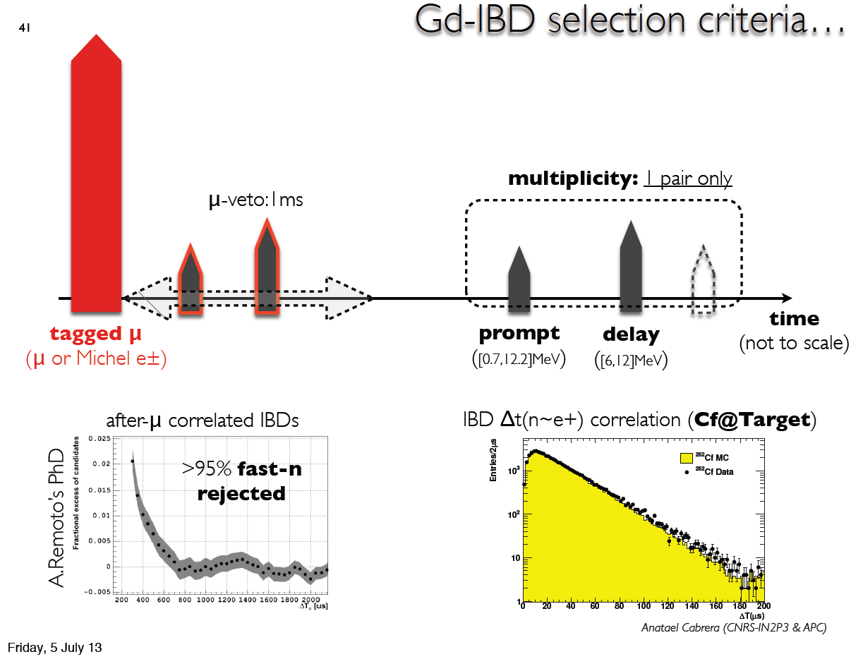

Slide 20
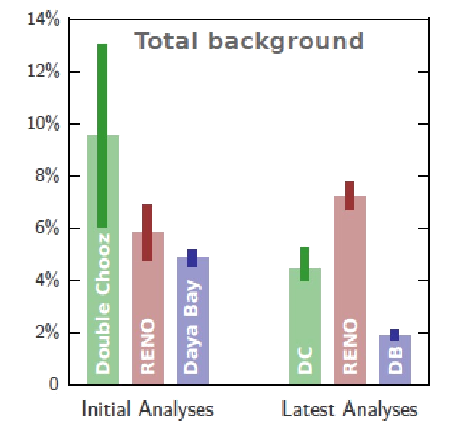
Background Contributions
Accidentals: negligible for n-Gd, still important for n-H
Correlated (stopping-µ, fast n): µ-induced, reduced with increasing overburden
Cosmogenic β-n emitters (⁹Li, ⁸He): concern to all experiments
All experiments significantly improved their BG understanding
New methods developed to reject BG
@ Far Detector sites, n-Gd analyses

Slide 21
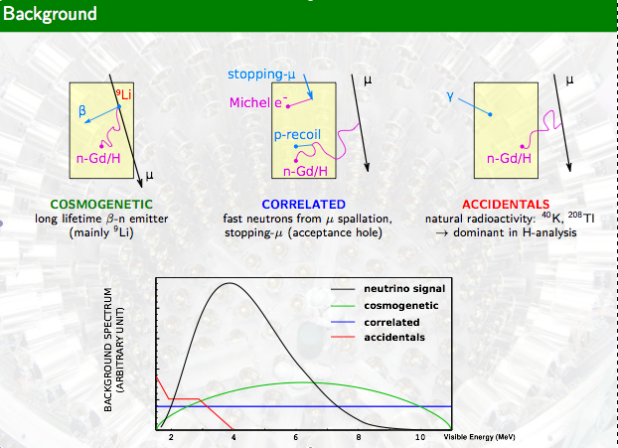

Slide 22
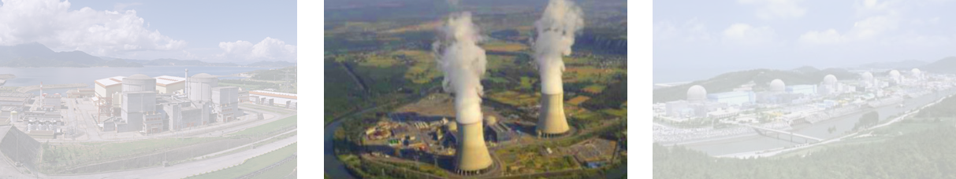
New θ13 Results
Daya Bay Double Chooz RENO

Slide 23
New Analysis started around 2013
2 new ideas:
Neutron Capture on Hidrogen
Look for IBD interactions in the Gamma-Catcher volume (22.3 tons), twice the target volume (10.3 tons) looking at neutron capture in hidrogen.
Theta13 via a reactor rate modulation analysis
Look for antineutrino disappearance as a function of the reactor power fitting the observed IBD rate as a function of the predicted rate, which depends on the reactor power.
Good Background constraint thanks to two reactor OFF periods
Background model independent fit (no constraints on B)
This method is independent of the reactor ν_{e} flux energy distribution, a fact that became important after the observation of unexpected distortions of the reactor flux at about 6MeV ν_{e} energy
_
_

Slide 24
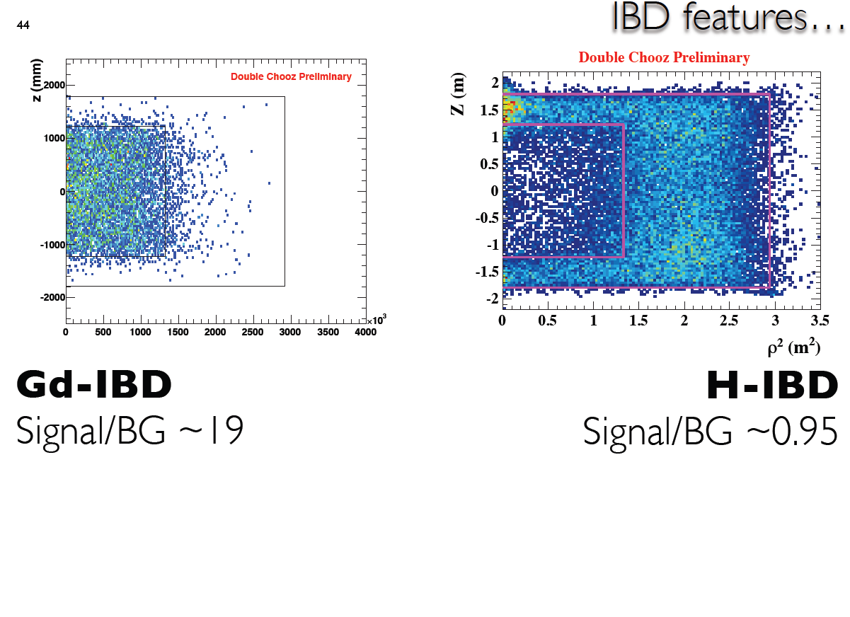
Neutron capture from IBD in Gd or in H
(First n-H paper)

Slide 25
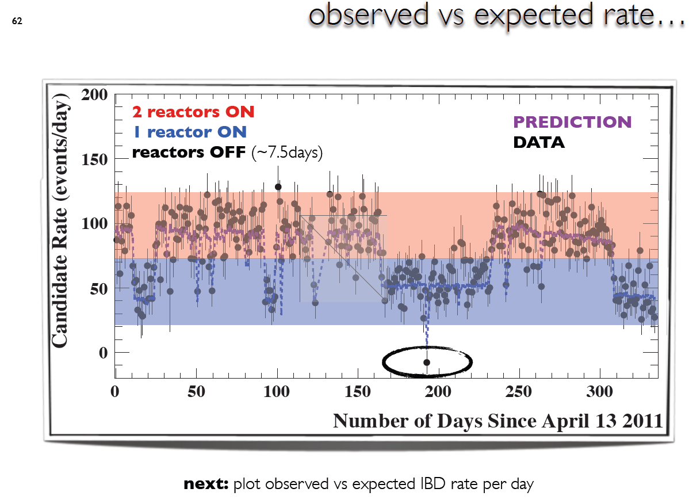

Slide 26
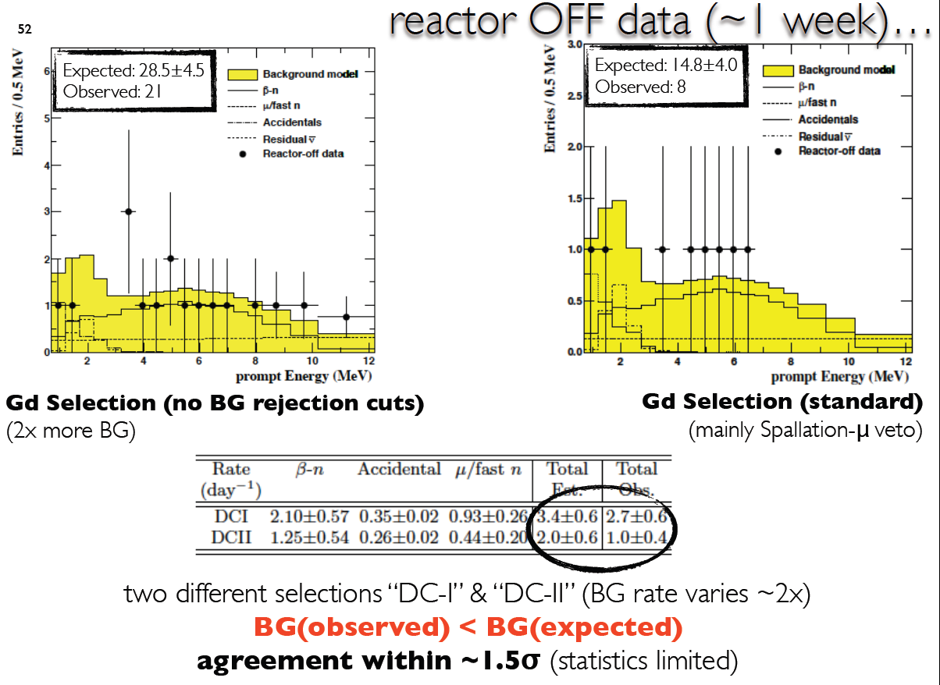
Background

Slide 27
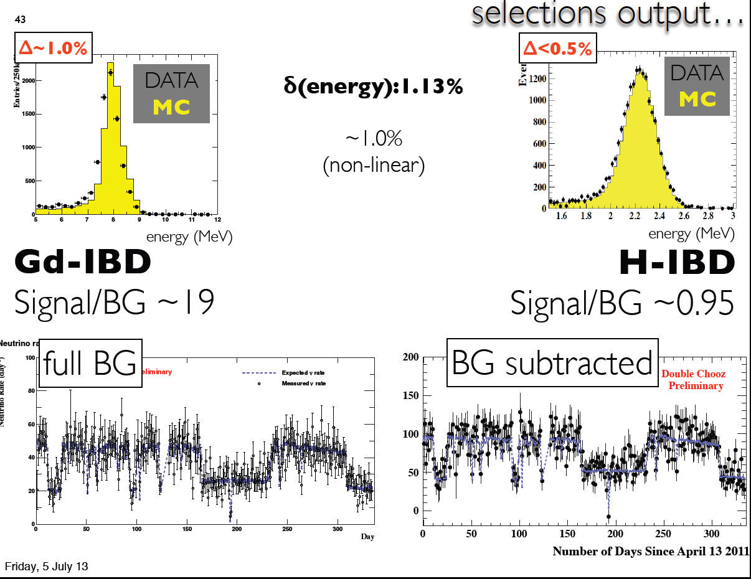

Slide 28
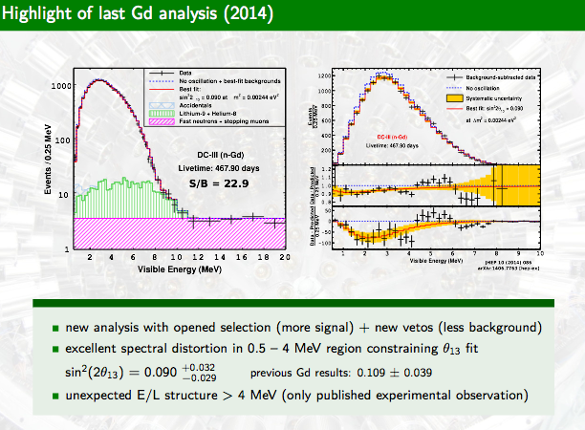

Slide 29
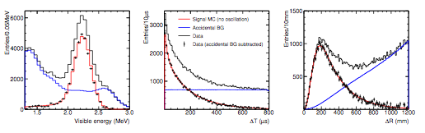
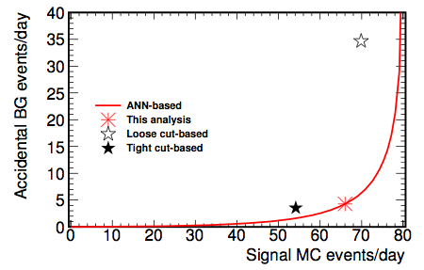
Double Chooz θ13 new Results
New n-H analysis
Multiple Variable analysis instead of cut based approach:
Input: delayed energy, time and space correlation
Maximise signal/background for unprecedented accidental reduction
Multivariate BG rejection ANN (artificial neural network based)
T. Lasserre, TAUP 2015

Slide 30
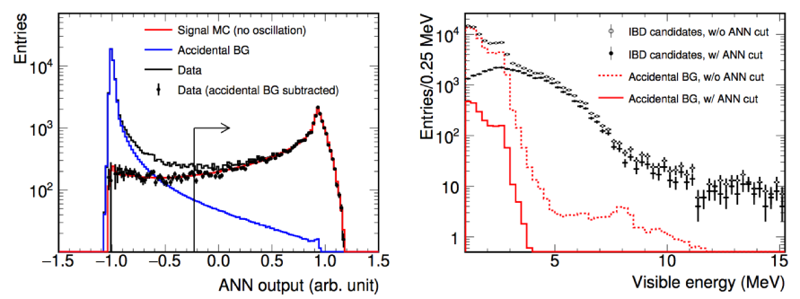
Double Chooz θ13 Results
n-H analysis
Improvements over last nH result:
Significantly larger data set (~240 days → ~460 days)
Multivariate BG rejection ANN (artificial neural network based)
Multiplicity Pulse Shape veto against FN (Fast Neutrons)
T. Lasserre, TAUP 2015

Slide 31
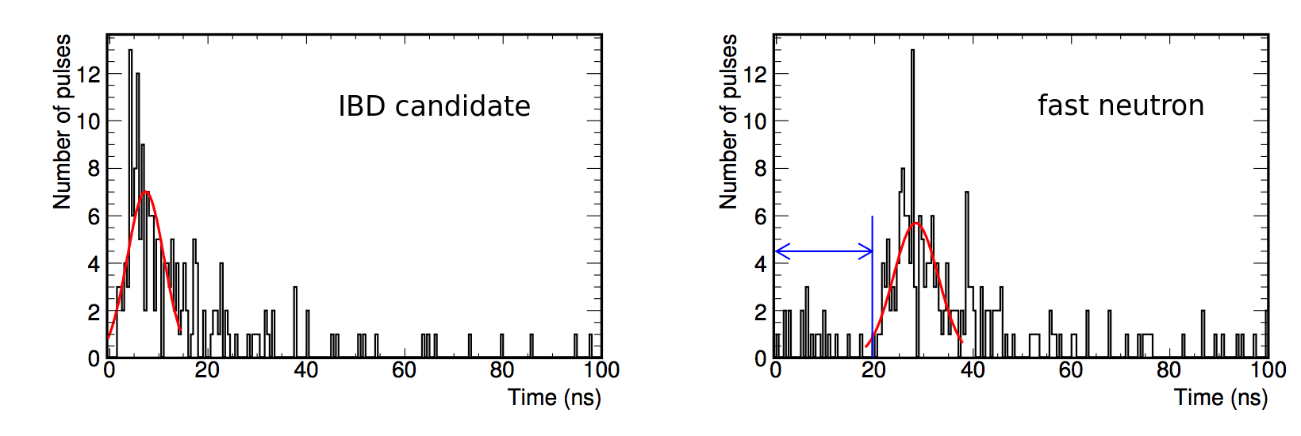
Double Chooz θ13 Results
n-H analysis
Improvements over last nH result:
Significantly larger data set (~240 days → ~460 days)
Multivariate BG rejection (ANN-based)
Multiplicity Pulse Shape (MPS) veto against Fast Neutrons - FN
T. Lasserre, TAUP 2015

Slide 32

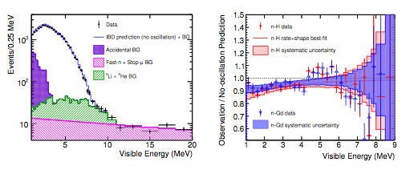
Double Chooz θ13 new Results
n-HIII analysis (Rate + Shape)
⇒ S/BG ratio improved by factor of ~20!
Rate+shape analysis: sin² 2 θ13 = 0.124
+0.030
-0.039
~
J. Castano, WIN 2015

Slide 33
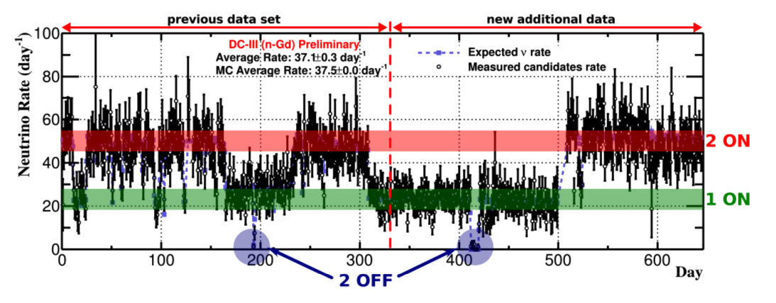
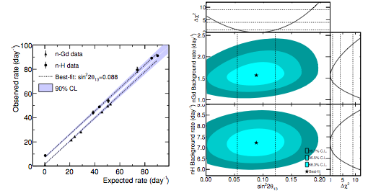
Double Chooz θ13 Results
Reactor-Rate-Modulation
Compares IBD rates for different reactor powers
Measurement of θ₁₃ and BG rate at the same time
Independent of neutrino energy distribution
BG model independent measurement or using BG model to increase precision
Combined Gd-III + H-III fit:
sin² 2 θ13 = 0.088 ± 0.033
BG rate = 7.27 ± 0.49 d⁻¹
T. Lasserre, TAUP 2015

Slide 34
Double Chooz θ13 new Results
n-H analysis results - Reactor Rate Modulation:
Measurement based in 462.72 live days data at FD
Novel techniques developed to reduce background
Accidental coincidences supressed by factor > 10
Improvements demonstrate capacity of precise measurements of reactor antineutrinos without Gadolinium loading.
Fit to event rate as a function of reactor power (RRM)
n-H analysis result sin² 2 θ13 = 0.095 ( stat+syst)
Reactor Rate Modulation combined fit:
n-H + n-Gd result sin² 2 θ13 = 0.088 ± 0.33 (stat+syst)
+0.038
-0.039

Slide 35
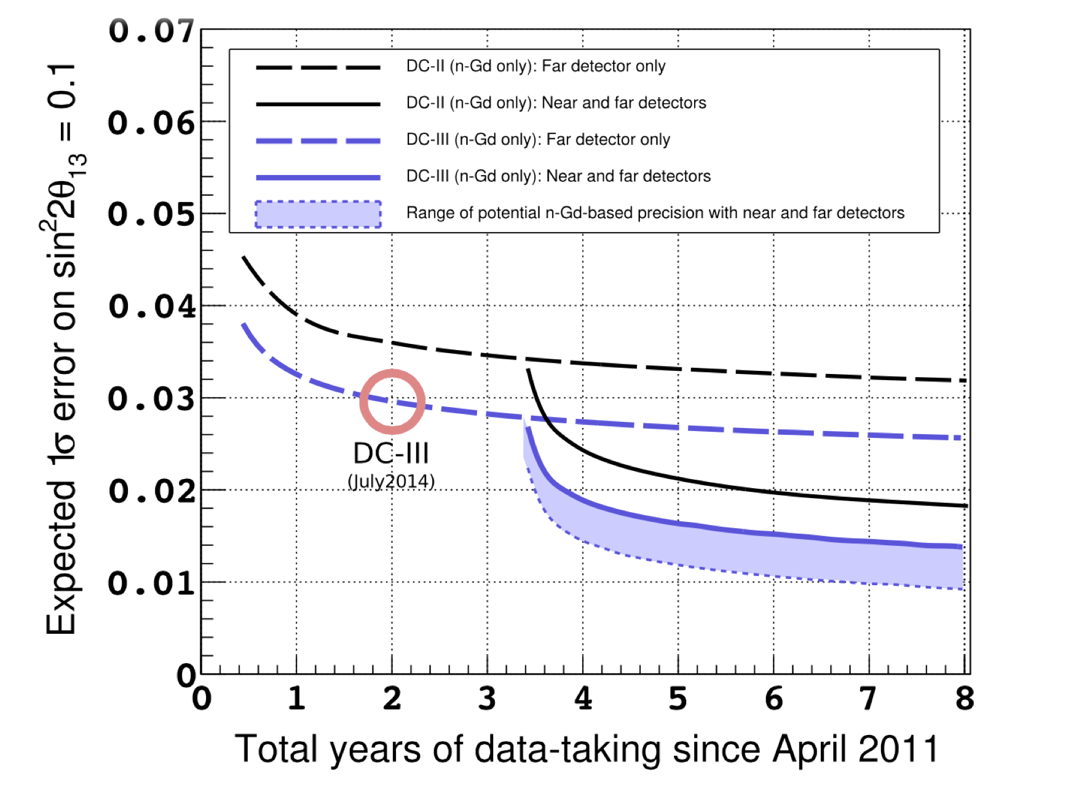
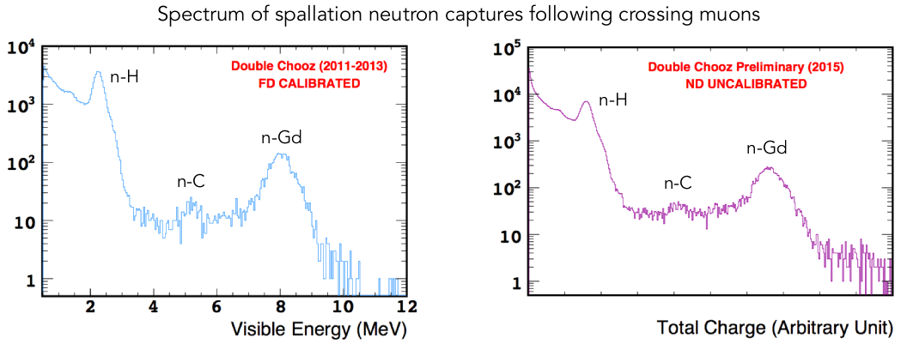
Double Chooz θ13 outlook
2-detector phase
Near detector completed
Taking data since January 2015
Prospect to lower 1σ-uncertainty to below 10% in 3 years.
~
J. Castano, WIN 2015

Slide 36
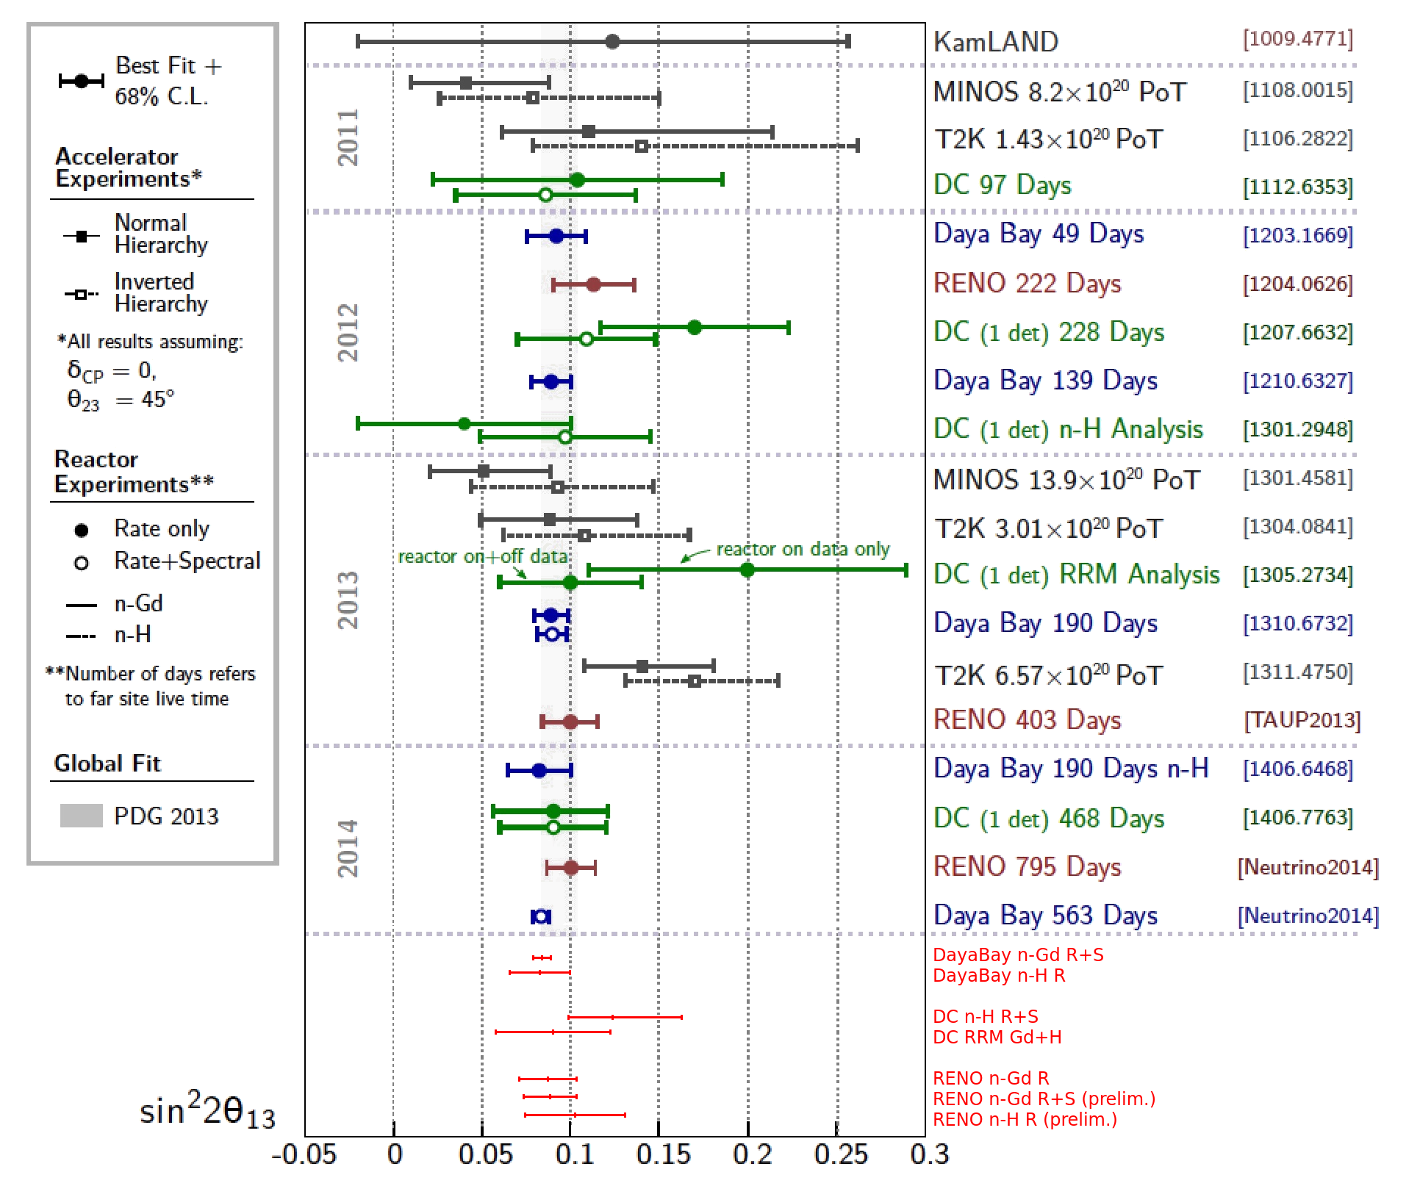
θ13 Summary

Slide 37
Thank you for your attention!

Slide 38
New Results Beyond θ13

Slide 39
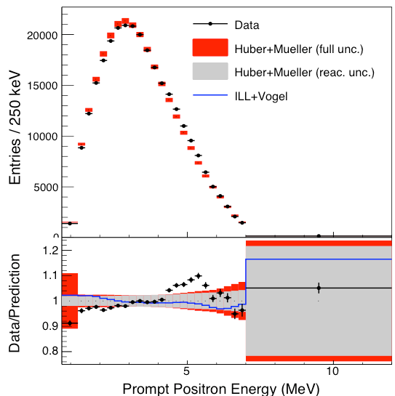
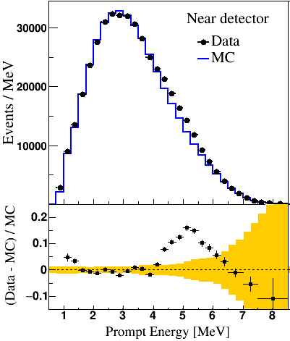
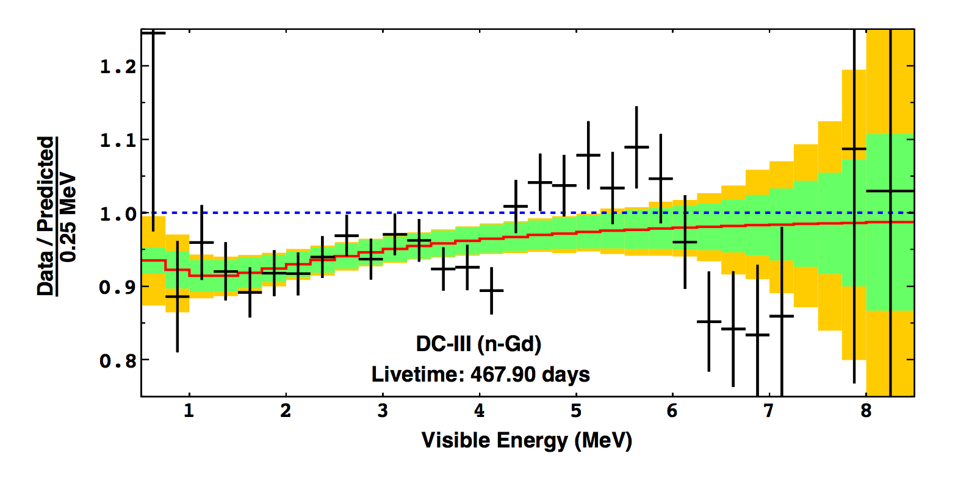
Spectral Distortion
„5 MeV bump“ observed in all three experiments (in ND and FD)
Events have IBD characteristics
Correlation with reactor power
→ consistent with feature in PWR neutrino spectra
Appears in Gd and H analyses alike
Measurement of θ₁₃ is not affected!
Daya Bay ND
RENO ND
Double Chooz FD

Slide 40
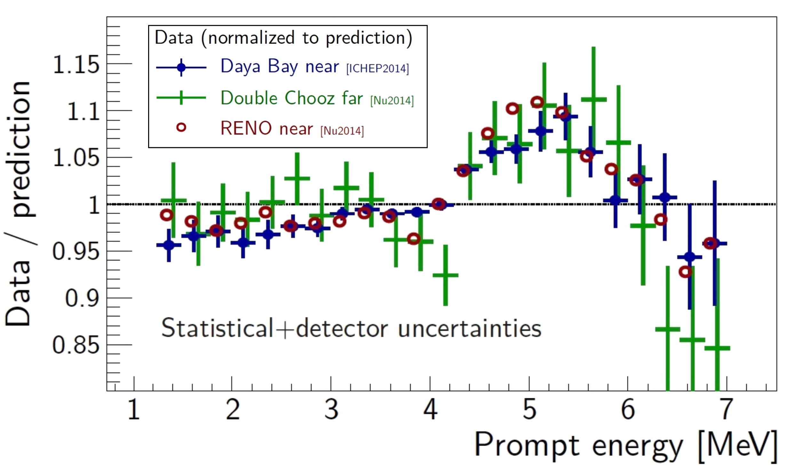
Spectral Distortion
Possible SM explanations are available [e.g. PR D 92, 033015 (2015)]
Non-fission contributions
Forbidden transitions
U-238 fission daughters
PWR neutron spectrum
Possible error in original measurement at ILL
Need for new reactor neutrino experiments with different reactor types

Slide 41
Conclusions
Improved results for θ₁₃ (all compatible)
Daya Bay: sin² 2θ₁₃ = 0.084 ± 0.005 (n-Gd R+S), also |Δm²ee| = (2.42 ± 0.11)·10⁻³ eV²
Double Chooz: sin² 2θ₁₃ = 0.088 ± 0.033 (RRM Gd+H)
RENO: sin² 2θ₁₃ = 0.087 ± 0.016 (n-Gd R)
Further improvements expected
General improvements in data analysis and understanding of BG
DC will start 2-detector phase
RENO is preparing R+S analysis and n-H analysis
Physics beyond θ₁₃
Discovery of spectral distortion by all three experiments
No sterile neutrinos found in 0.001 eV² < Δm²₄₁ < 0.1 eV² by DB
Broad physics program possible

Slide 42
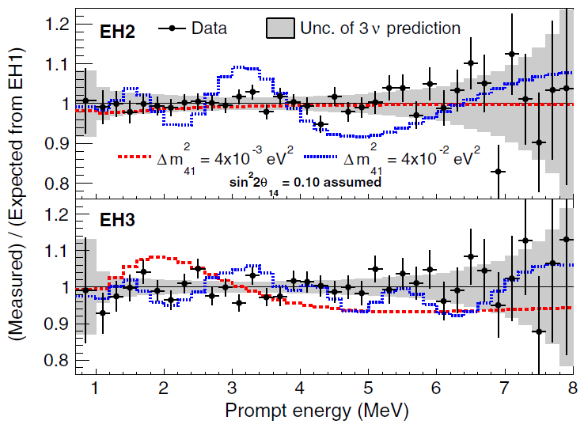
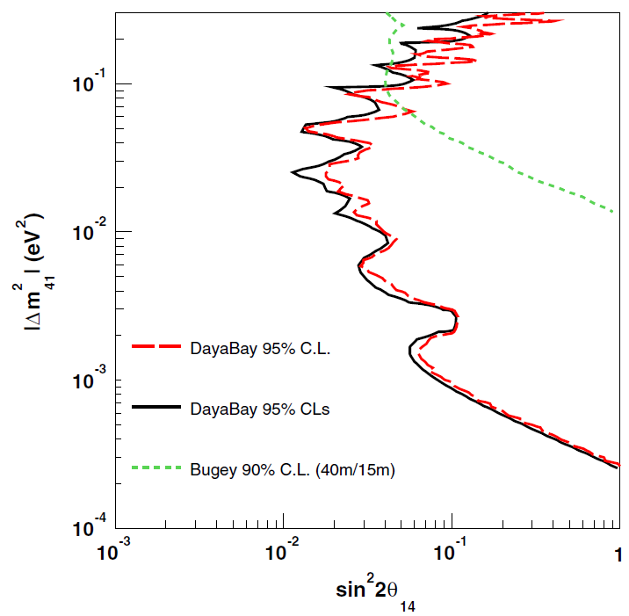
Sterile Neutrino Results
⇒ Talk by C. Giunti later this session
Search for light sterile νs performed by DB
Relative measurements at various baselines (350, 500, 1600m)
No signal observed, consistent with standard 3 oscillation
Most stringent limit for
0.001 eV² < Δm²₄₁ < 0.1 eV²
PRL 113, 141802 (2014)

Slide 43
Further Studies
Other physics results and development of analysis methods
of general interest
Background studies [1210.3748]
Test of Lorentz violation [1209.5810]
o-Positronium detection [1407.6913]
Muon reconstruction [1405.6227, 1407.0275]
Supernova neutrinos ?
Nonstandard interactions
Neutrino directionality
Pulse shape analyses
...

Slide 44
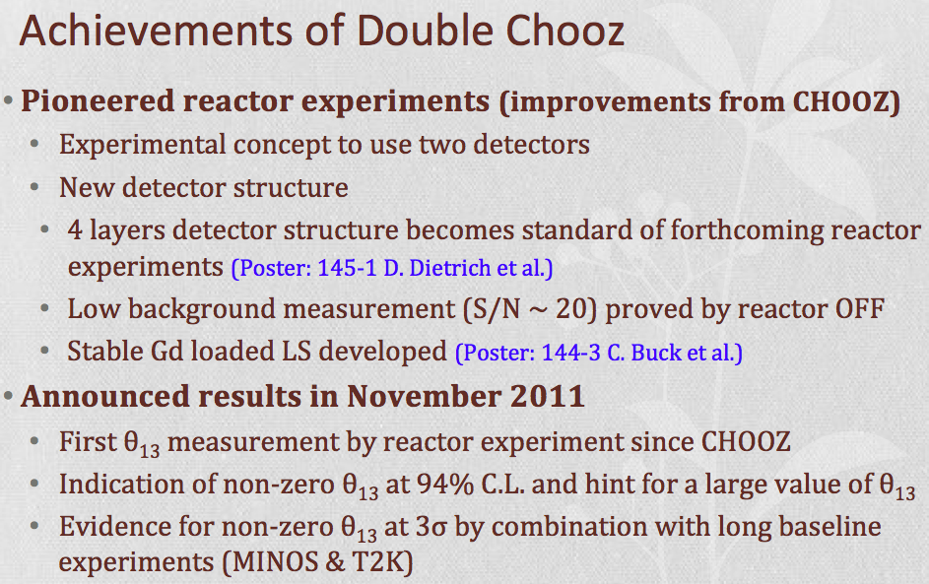

Slide 45


Slide 46
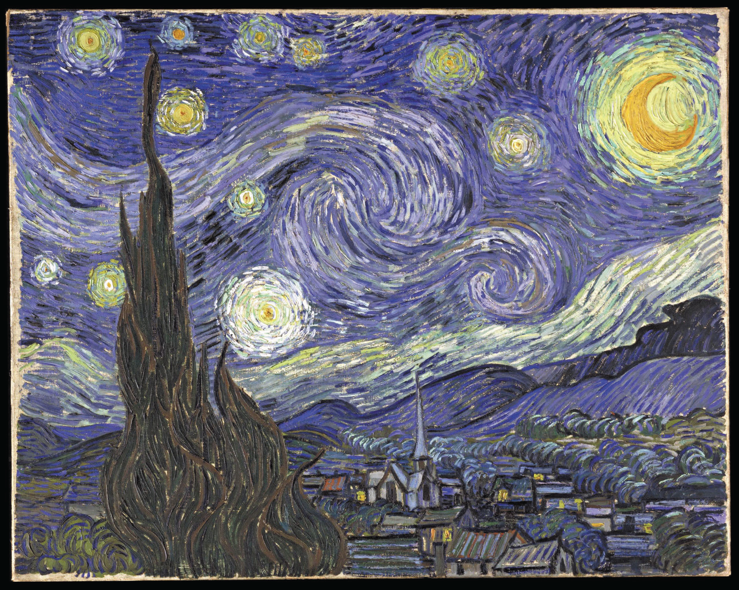
THANK YOU
Neutrino Oscillations:
Unveiling the last mixing angle
João dos Anjos
UTFSM, Valparaiso, Chile
11 January 2016

