Slide 1
Mejoras a la tecnología CHEX y su implementación a nivel nacional e internacional
Project Researcher: Christian Romero
Project Engineer: Tomás Gómez

Slide 2
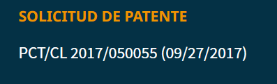
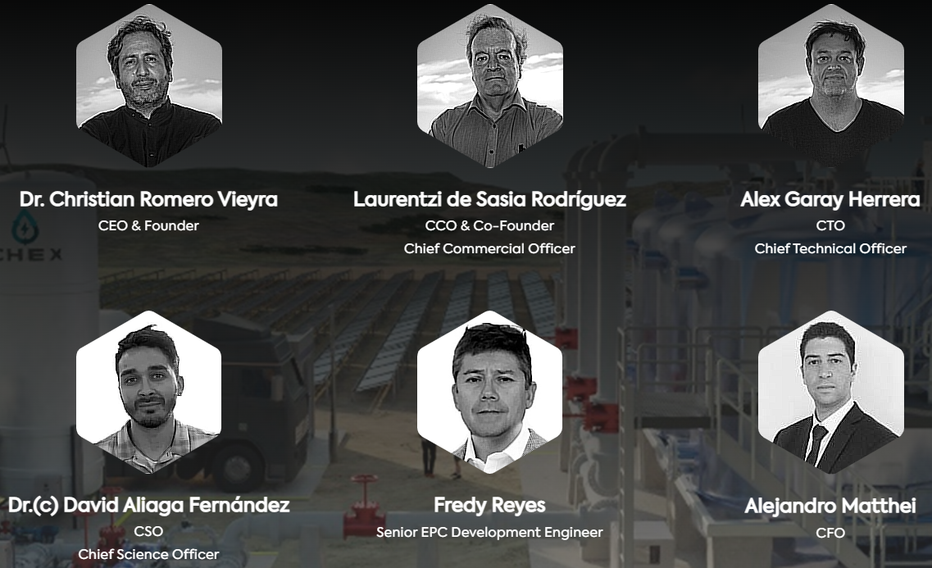
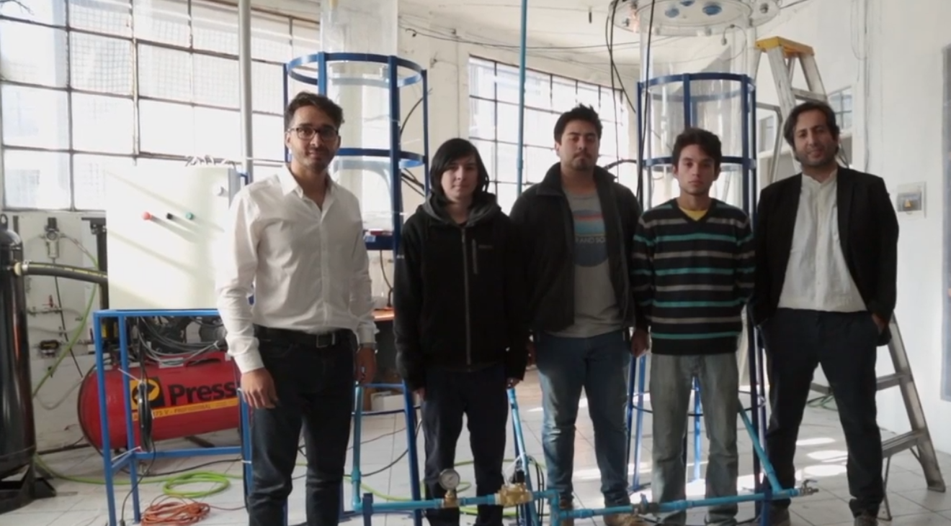
2017
2018
2019
2020
2021
2022
Creación de CheX SPA
Finalista MBRIF Dubái
Inversión privada inicial
Primera patente otorgada, Chile
Patentamiento en territorios específicos
Licenciamiento CheX SPA-USM
Creación Prototipo CCTVAL

Slide 3

What is CHEX?

Slide 4
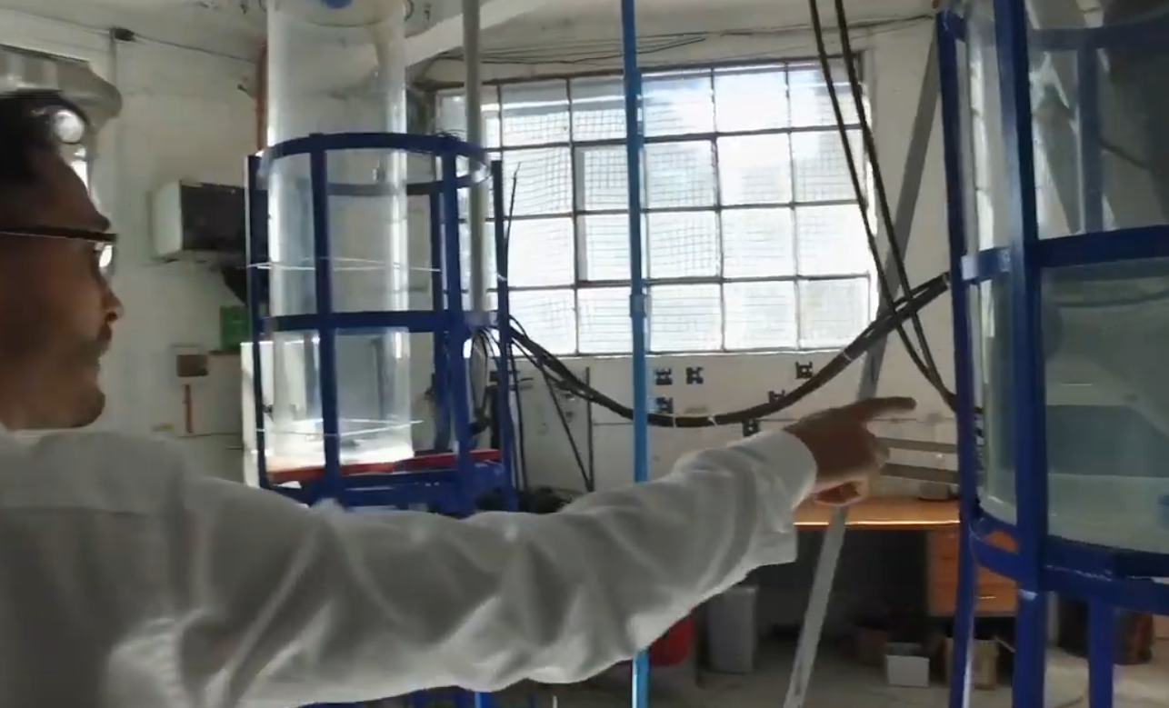
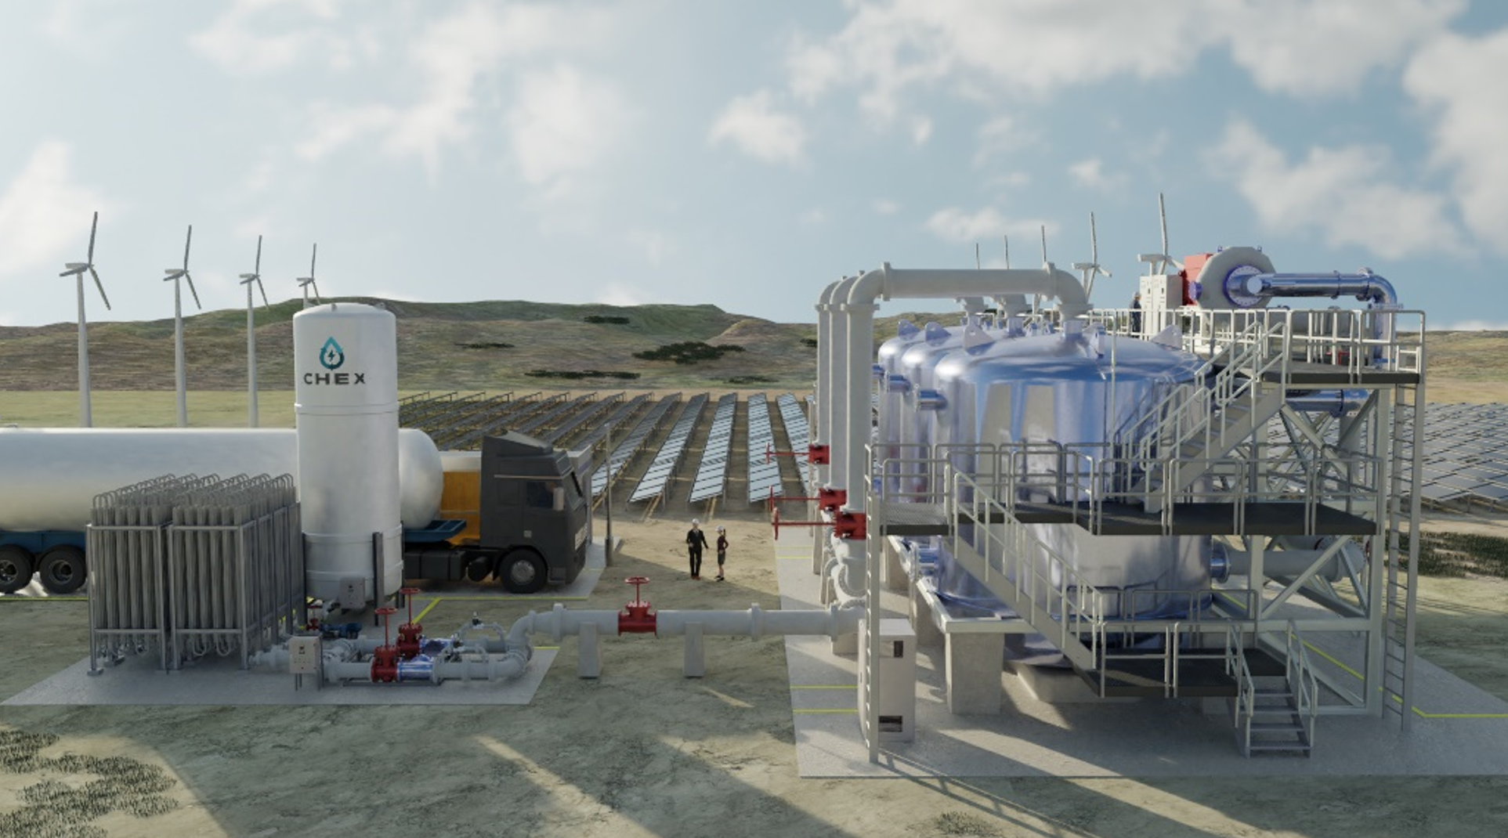
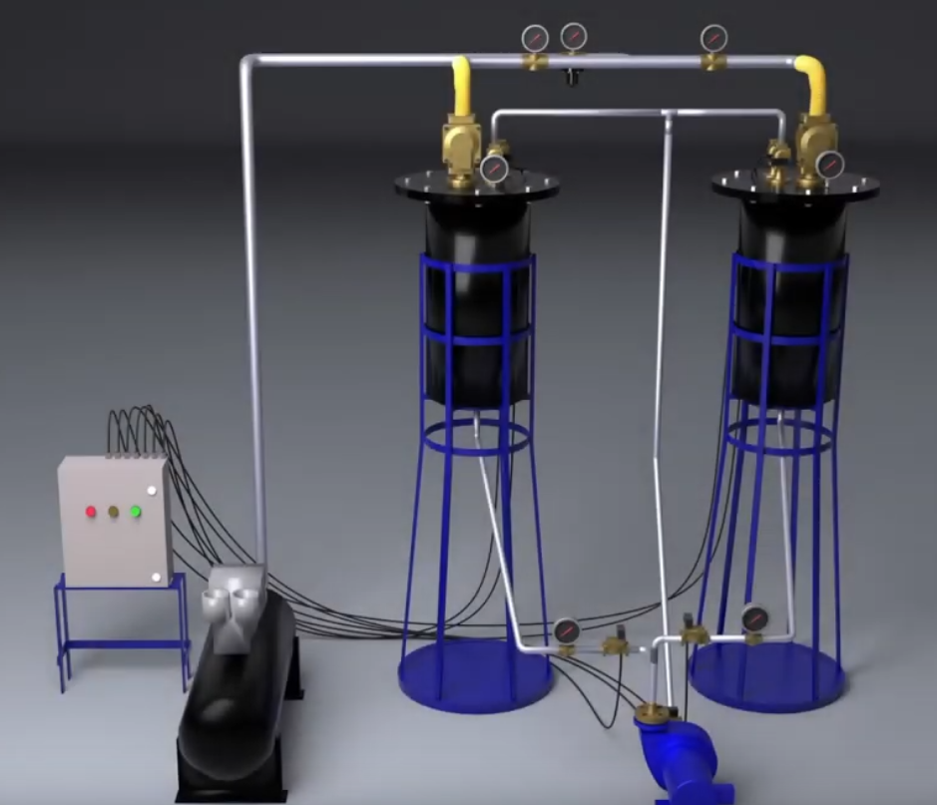
From “proof of concept” to Industrial prototype

Slide 5
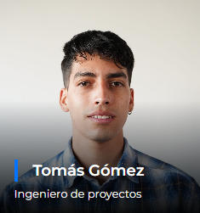
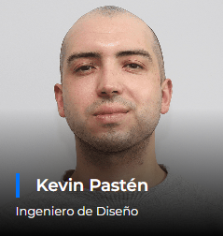
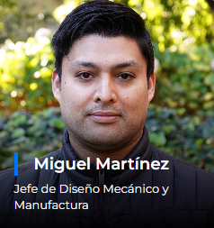
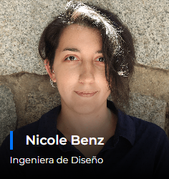
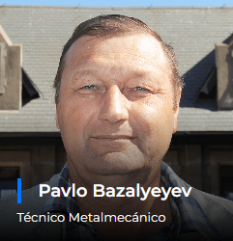
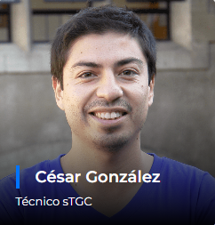
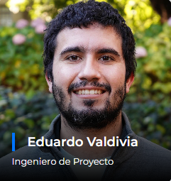
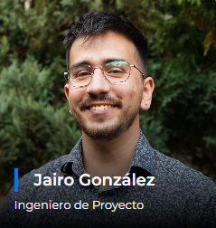
Collaborators from CCTVal

Slide 6




Integrated project

Slide 7
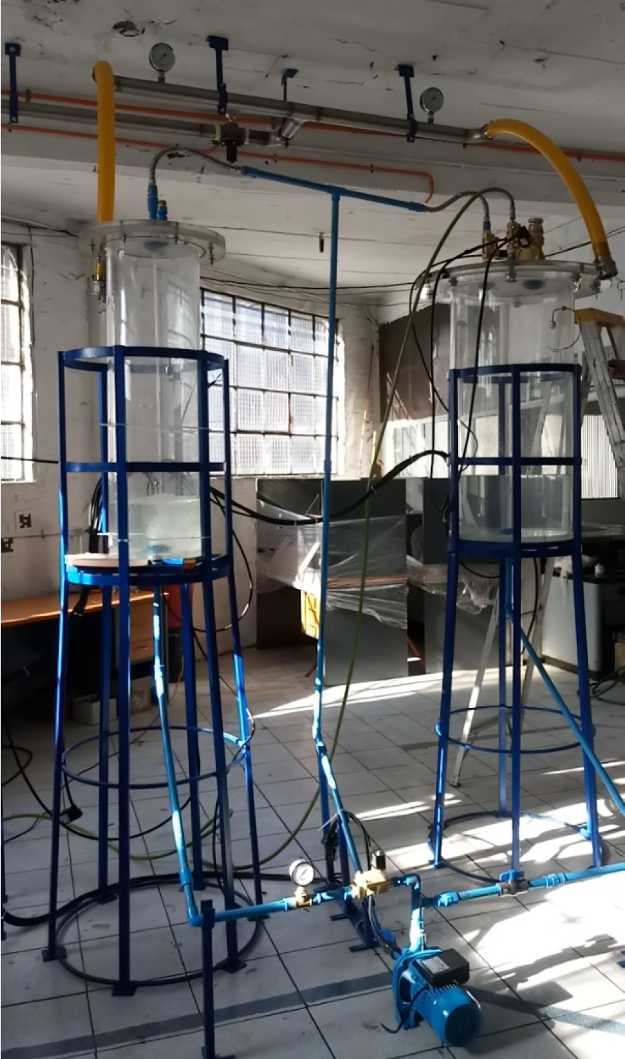
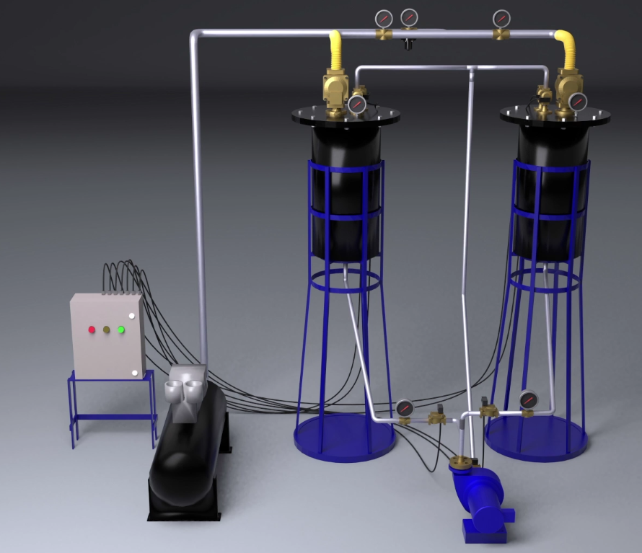
First laboratory prototype

Slide 8
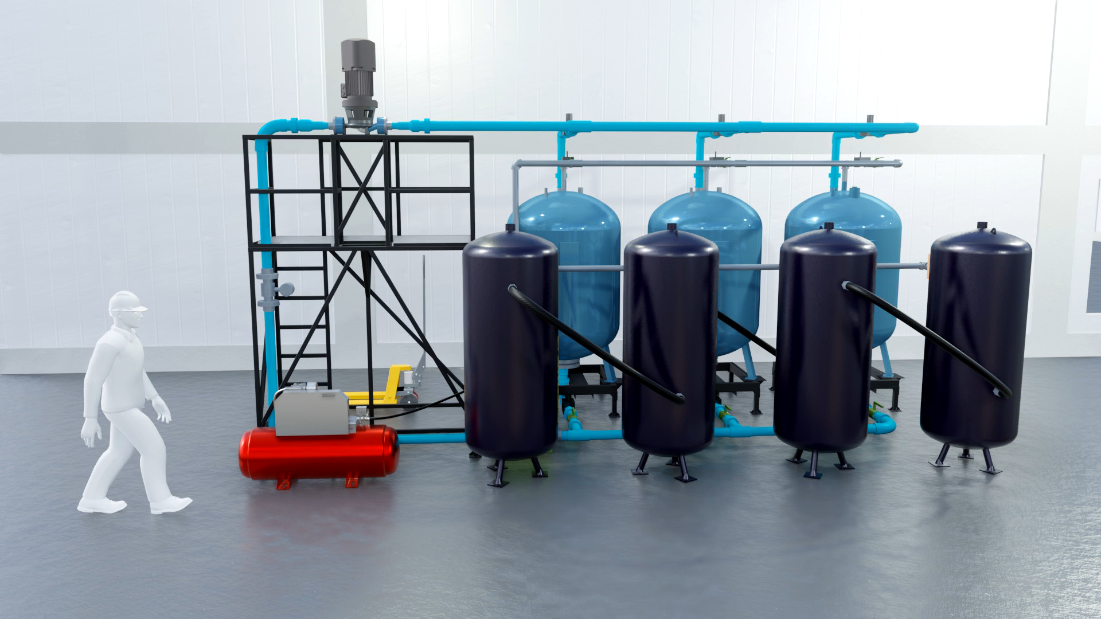
Industrial Prototype

Slide 9
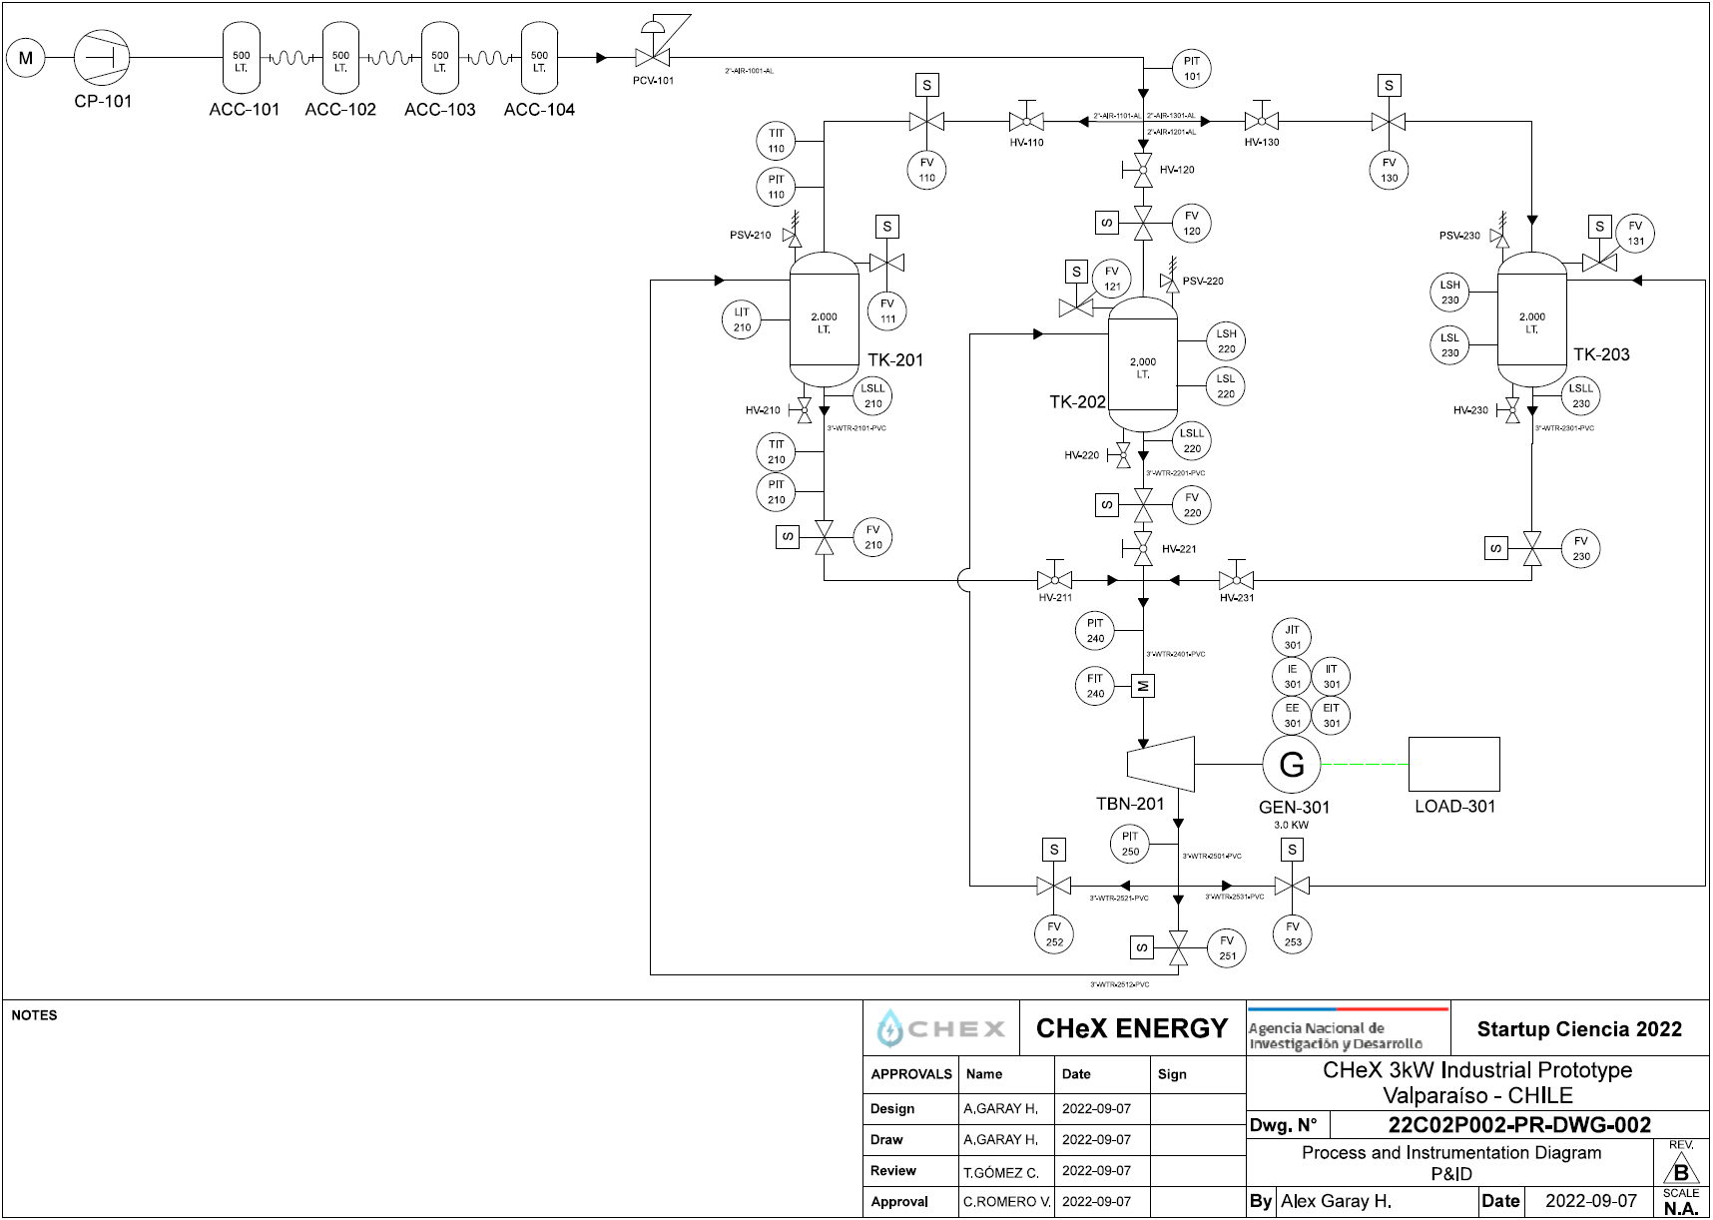
Required equipment
Air compressor
Air compressed accumulator
Pressure regulator valve
Safety relief valves
Water tanks
Turbine
Water and air lines
Electro valves for water and air system
PLC control board

Slide 10
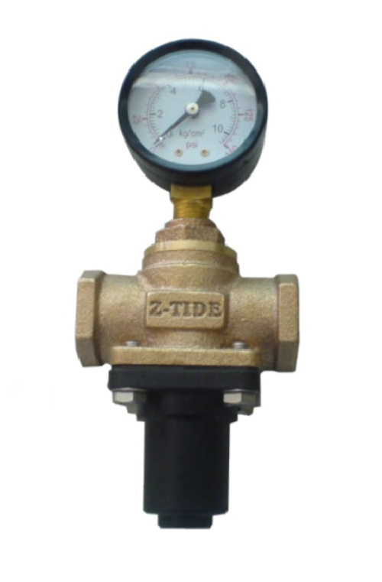
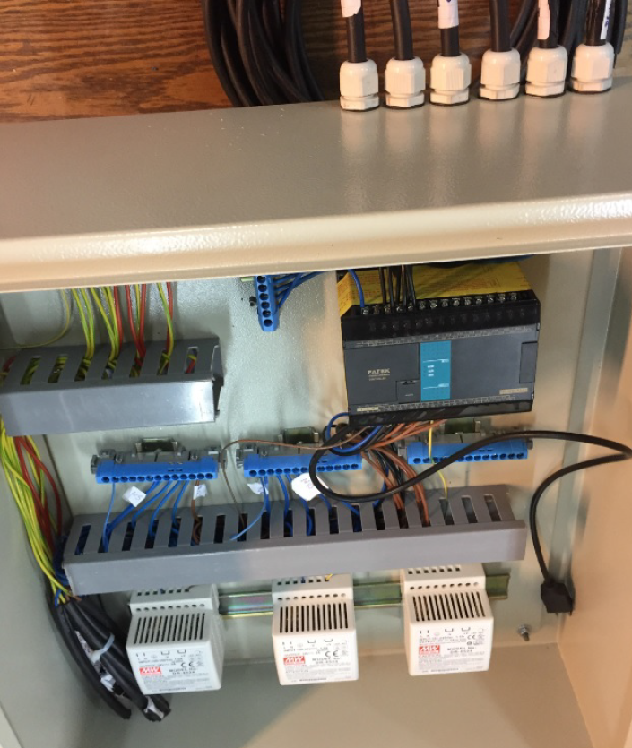
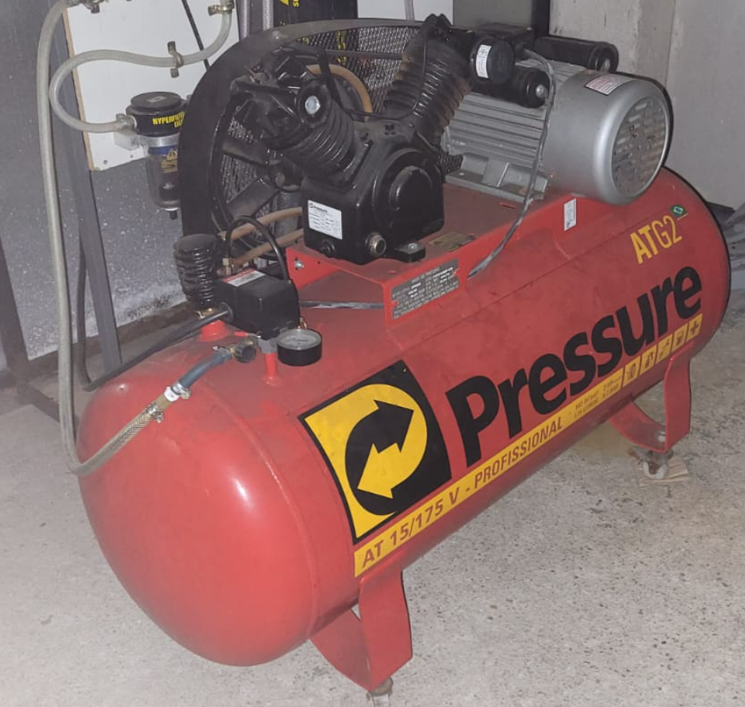
Reused equipment
Air compressor
Air pressure reducing valve
PLC control board

Slide 11
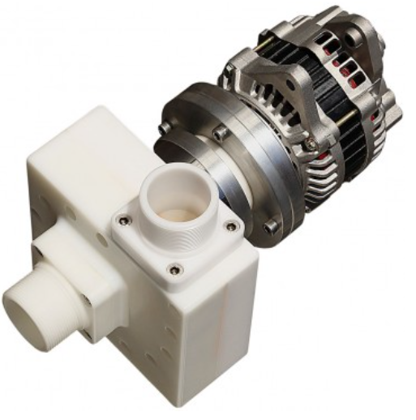
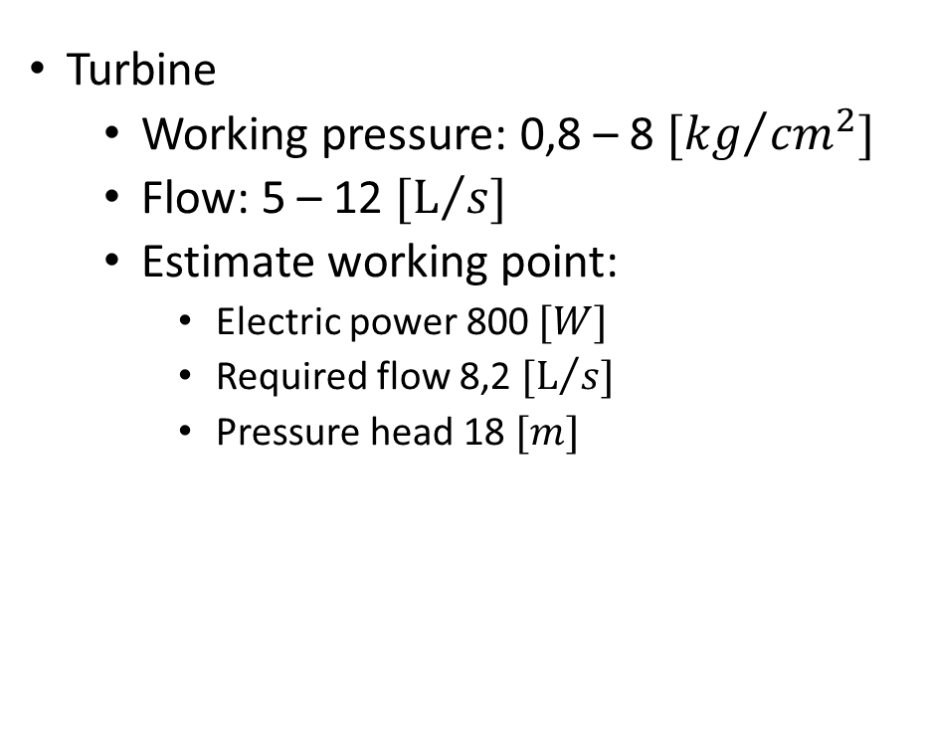
First equipment purchased
Turbine
  Working pressure: 0,8 – 8 ${[kg}/{{cm}^{2}]}$
  Flow: 5 – 12 $[L/s]$
  Estimate working point:
    Electric power 800 $[W]$
    Required flow 8,2 $[L/s]$
    Pressure head 18 $[m]$

Slide 12
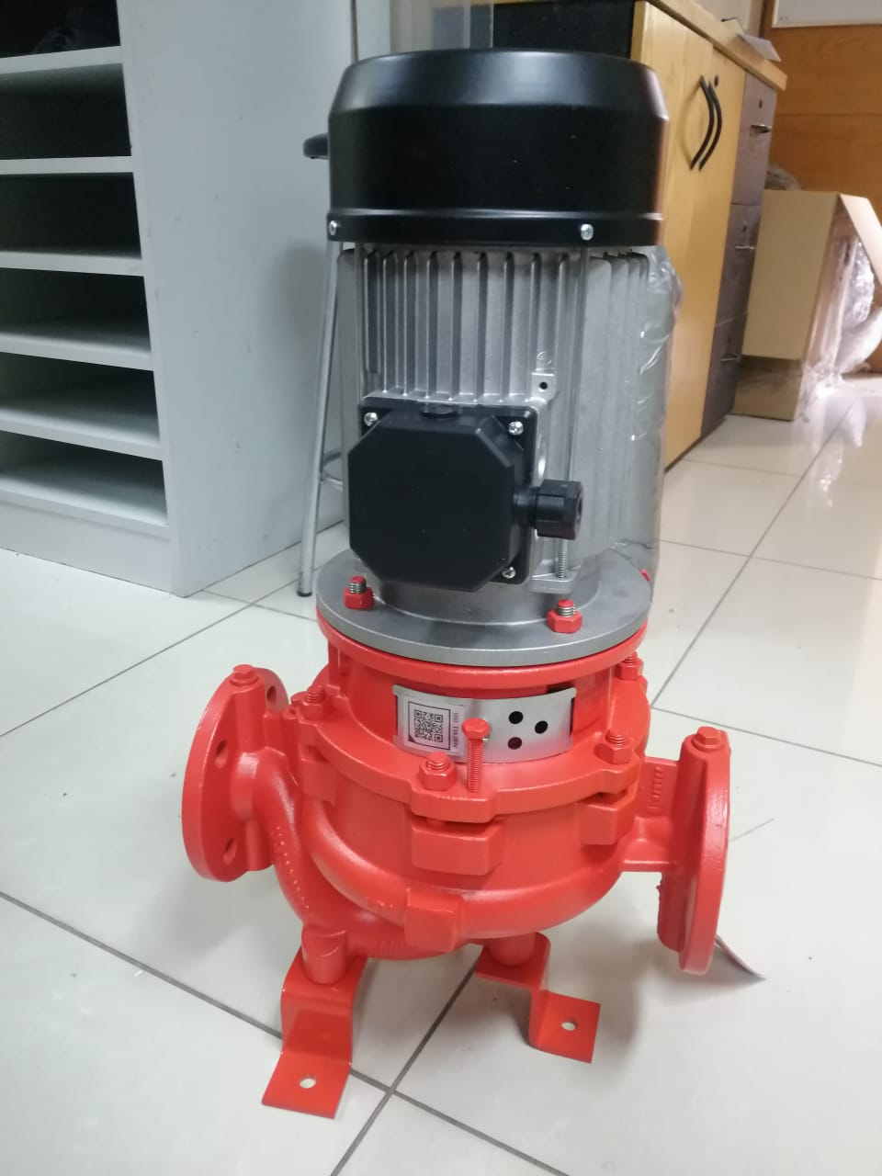
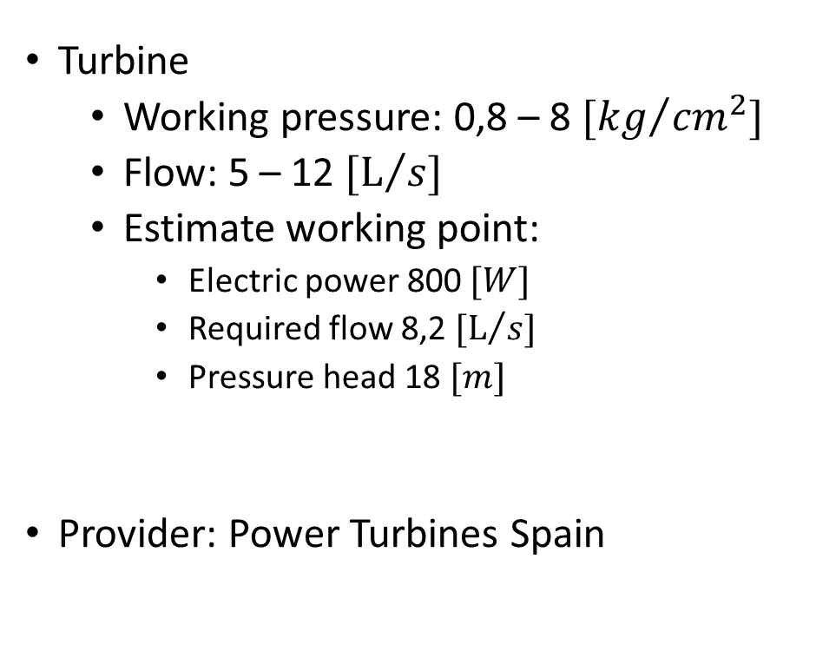
First equipment purchased
Turbine
  Working pressure: 0,8 – 8 ${[kg}/{{cm}^{2}]}$
  Flow: 5 – 12 $[L/s]$
  Estimate working point:
    Electric power 800 $[W]$
    Required flow 8,2 $[L/s]$
    Pressure head 18 $[m]$
Provider: Power Turbines Spain

Slide 13
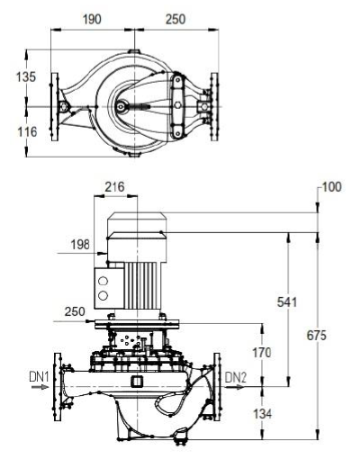
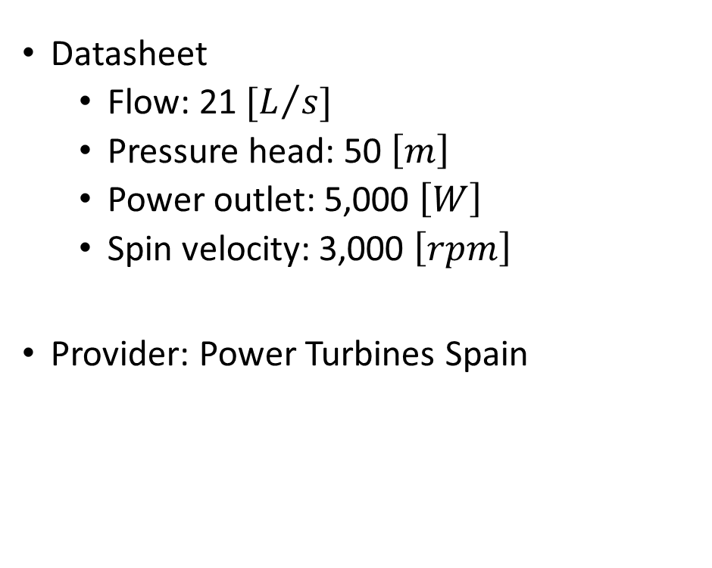
Line 050-B Turbine
Datasheet
  Flow: 21 $[L/s]$
  Pressure head: 50 $\left[m\right]$
  Power outlet: 5,000 $\left[W\right]$
  Spin velocity: 3,000 $\left[rpm\right]$
Provider: Power Turbines Spain

Slide 14
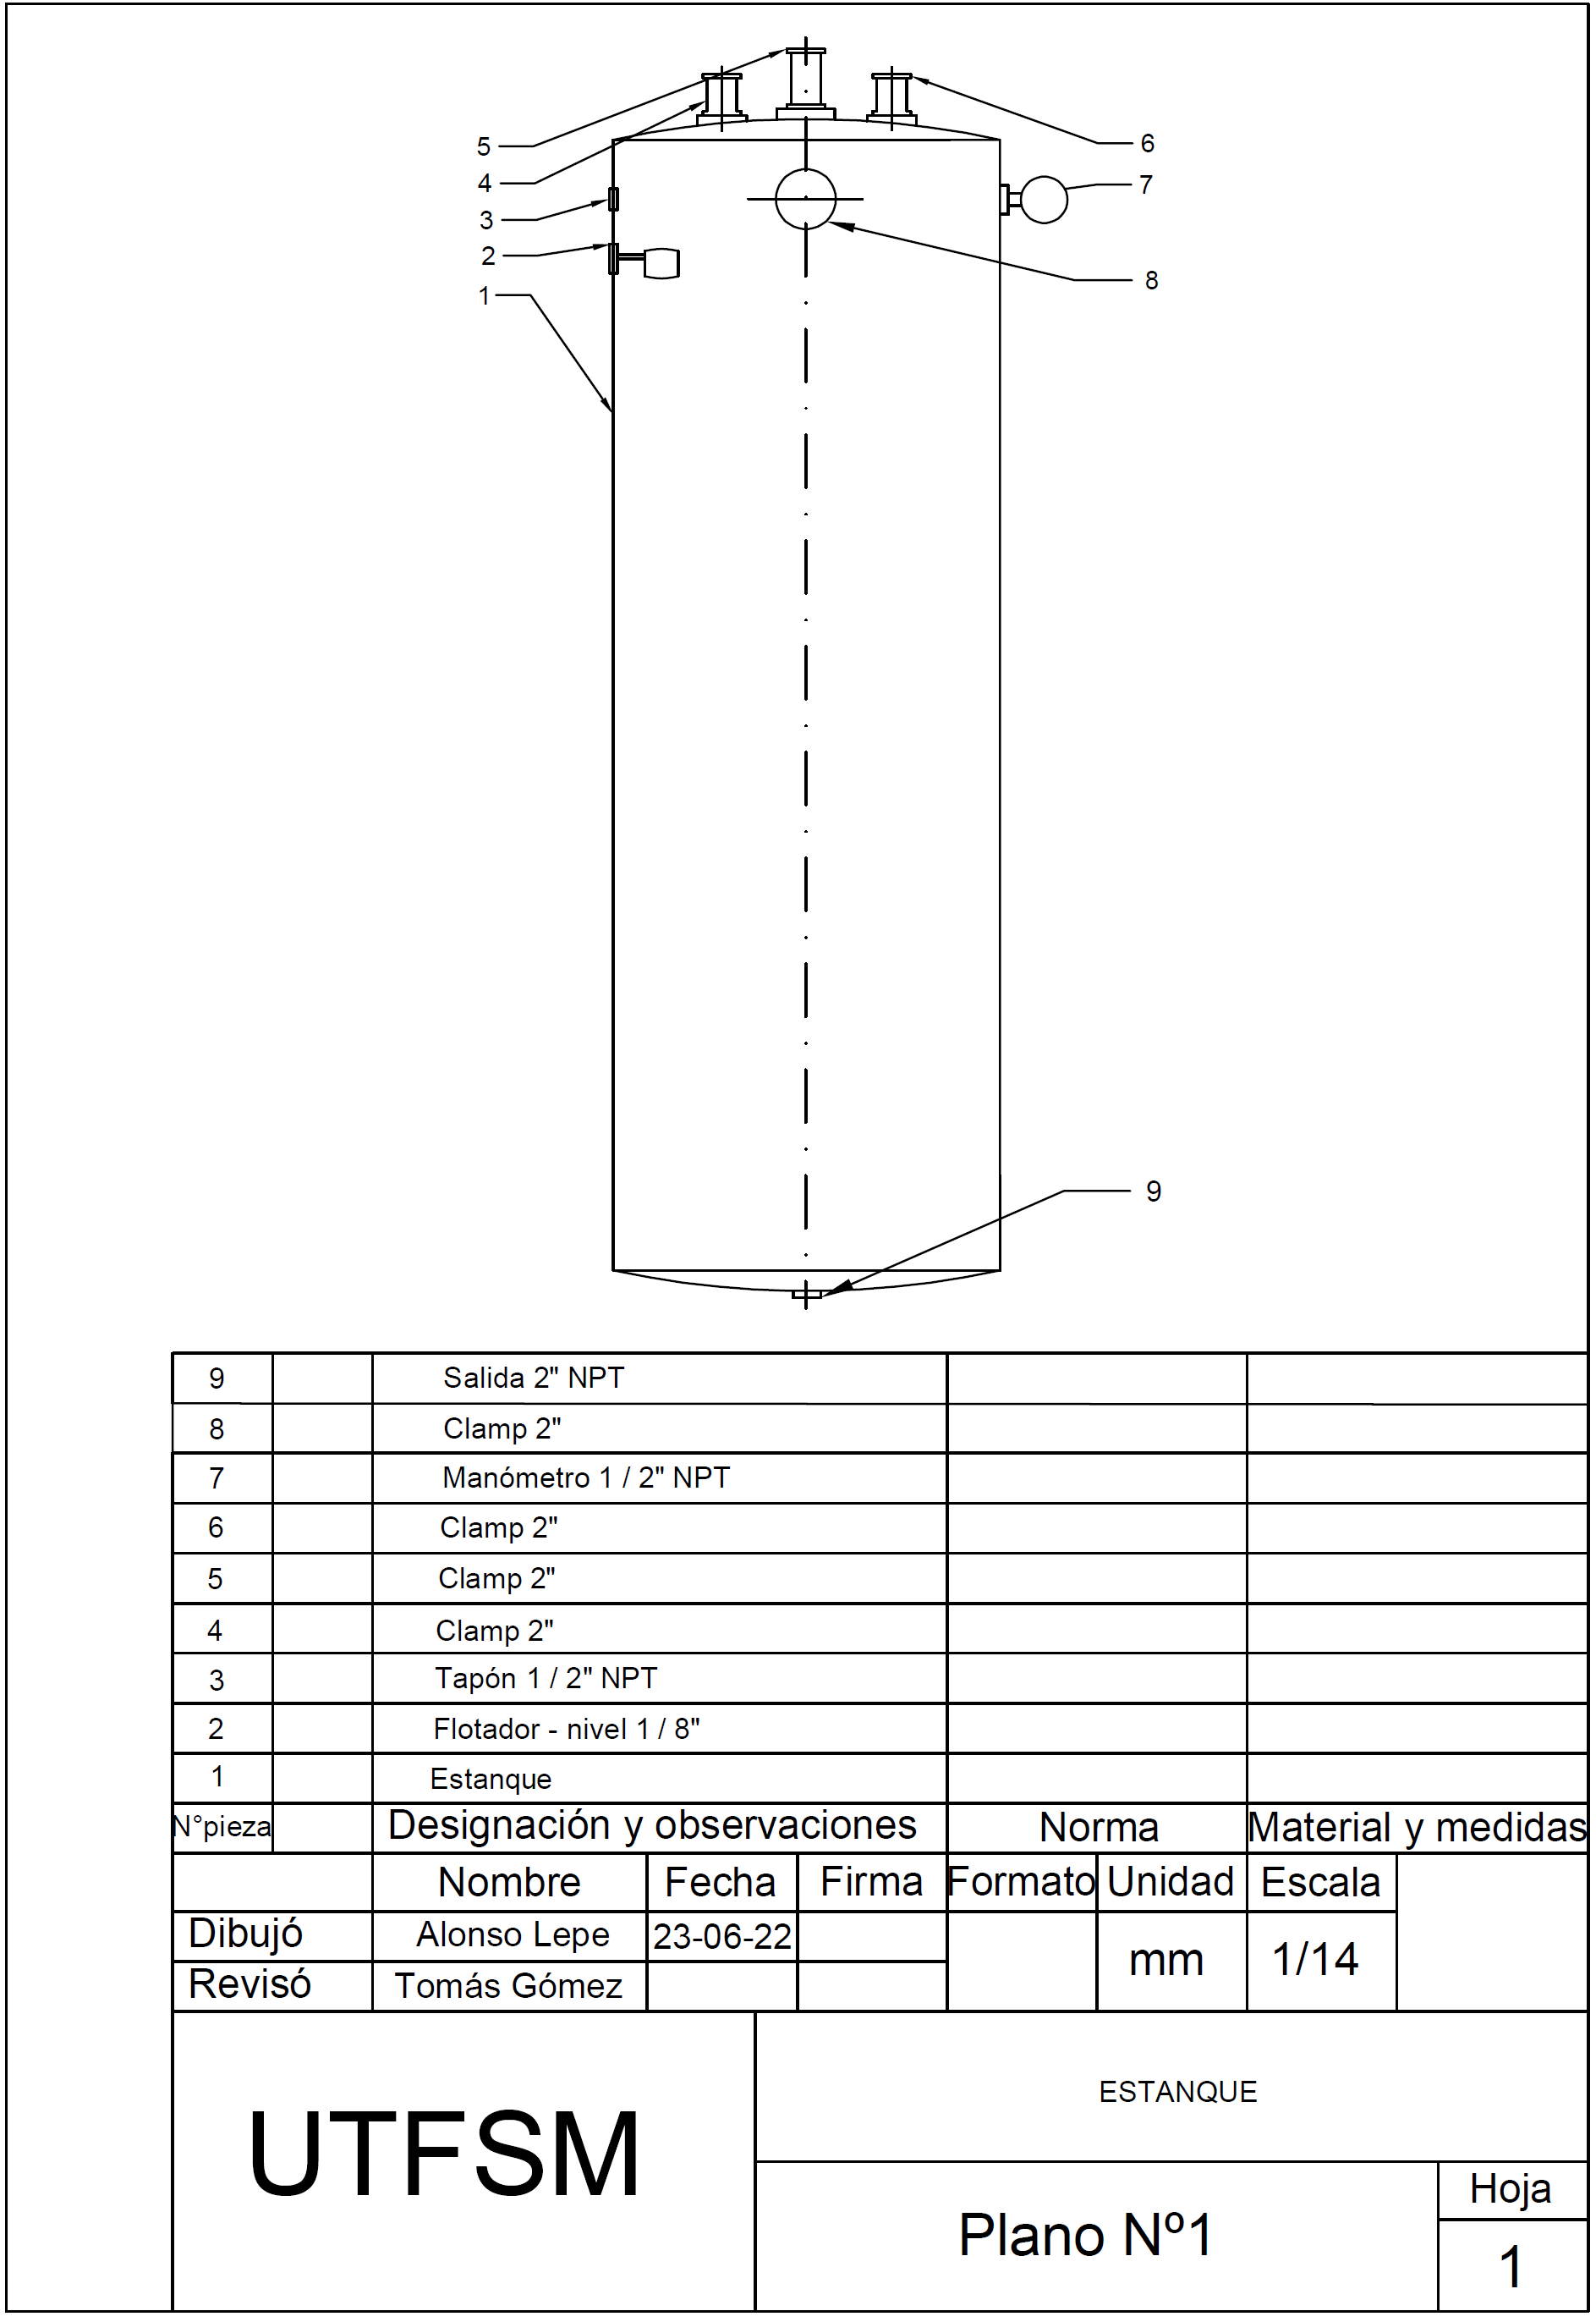
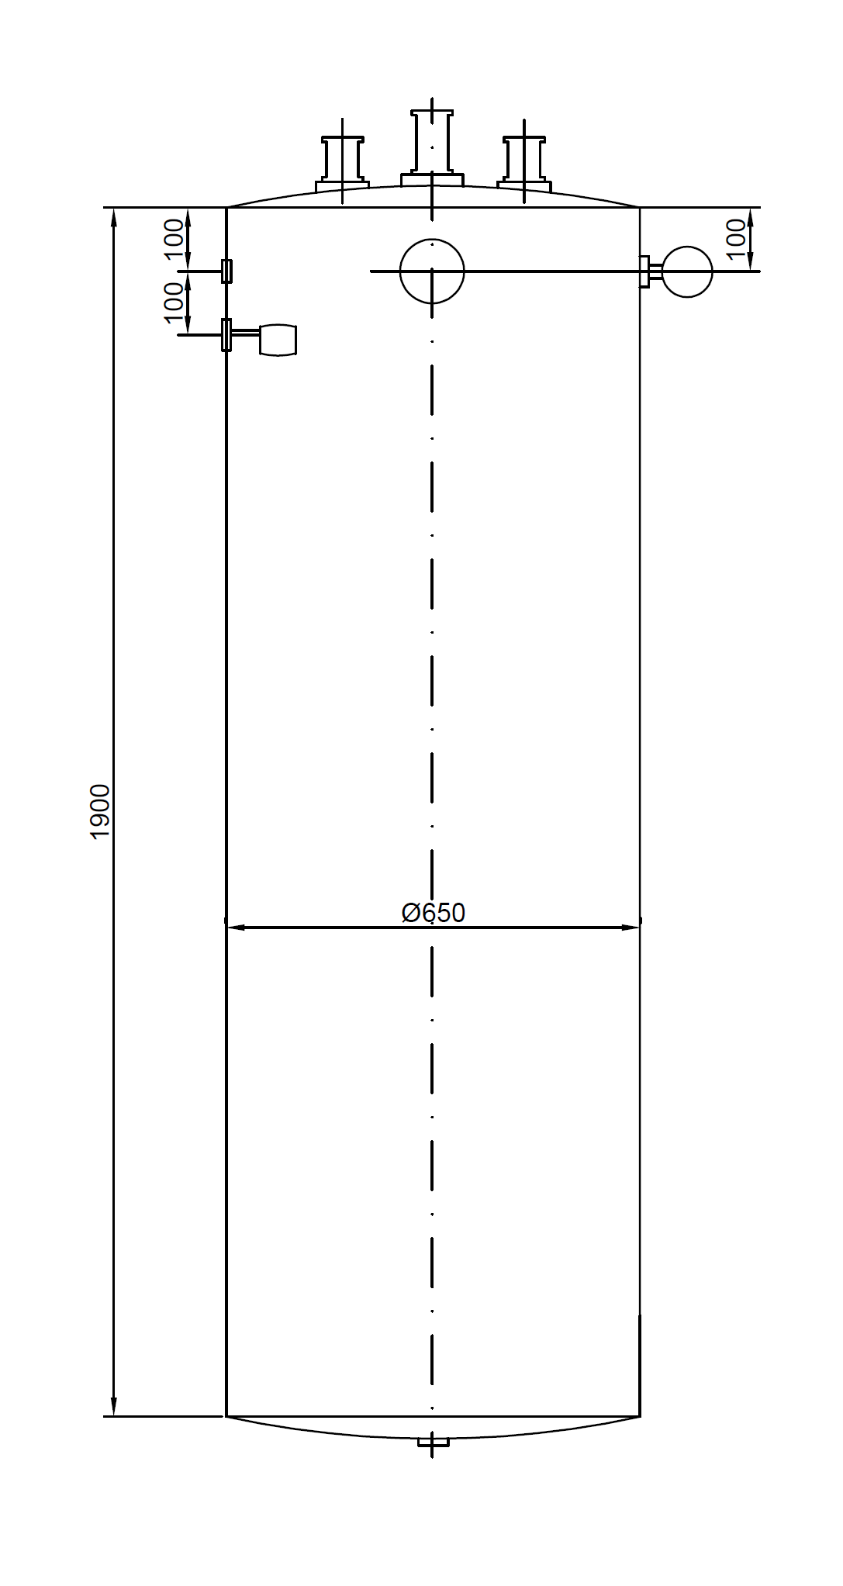
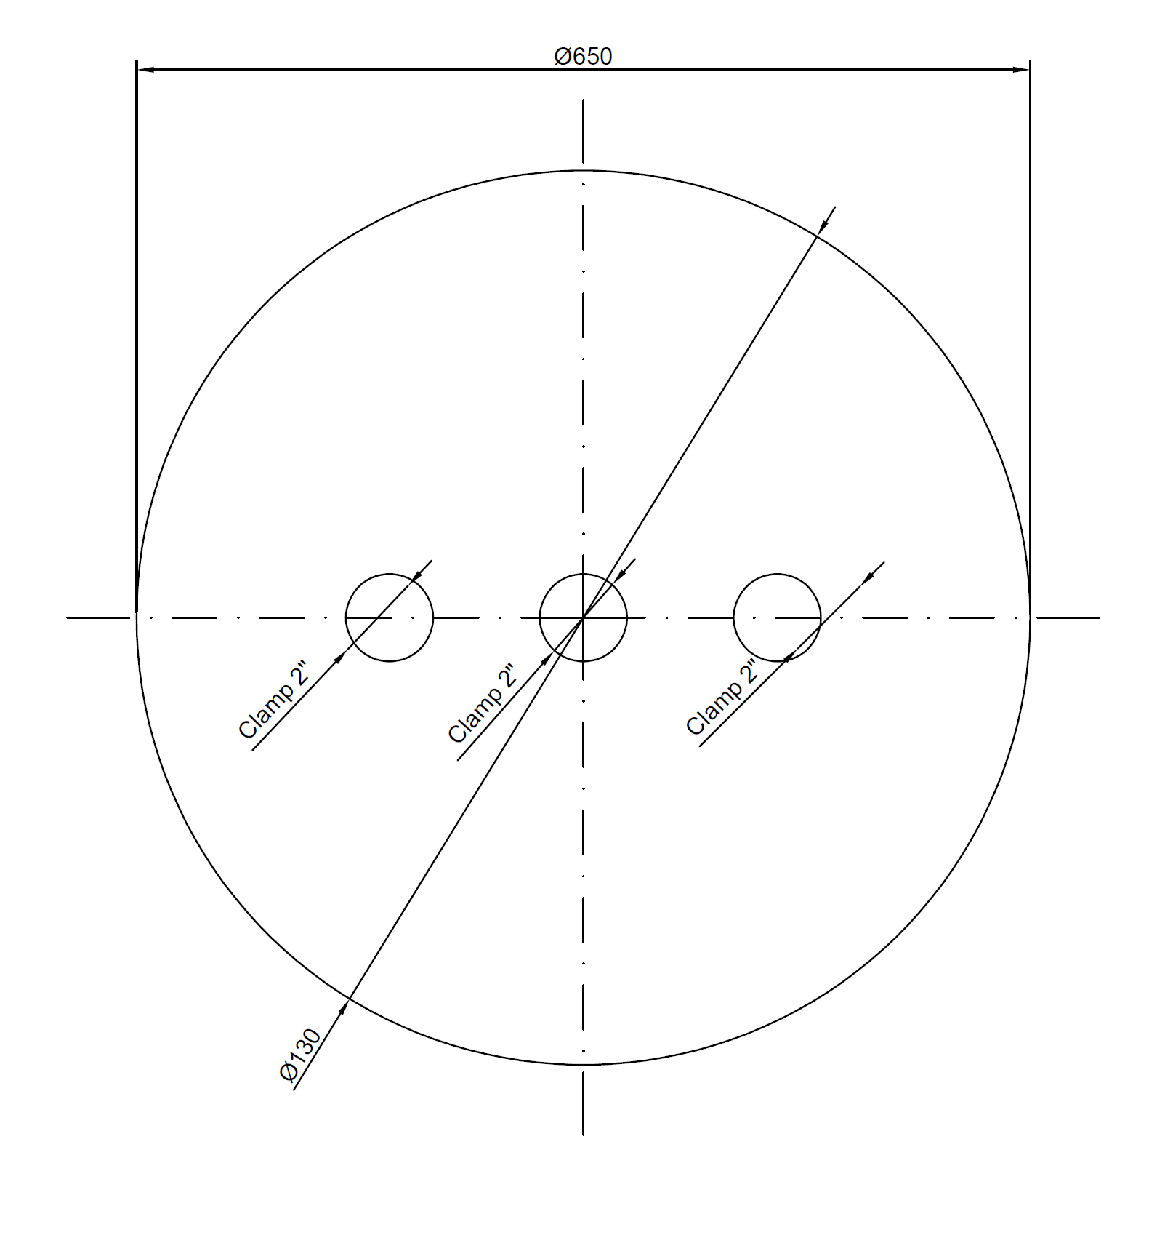
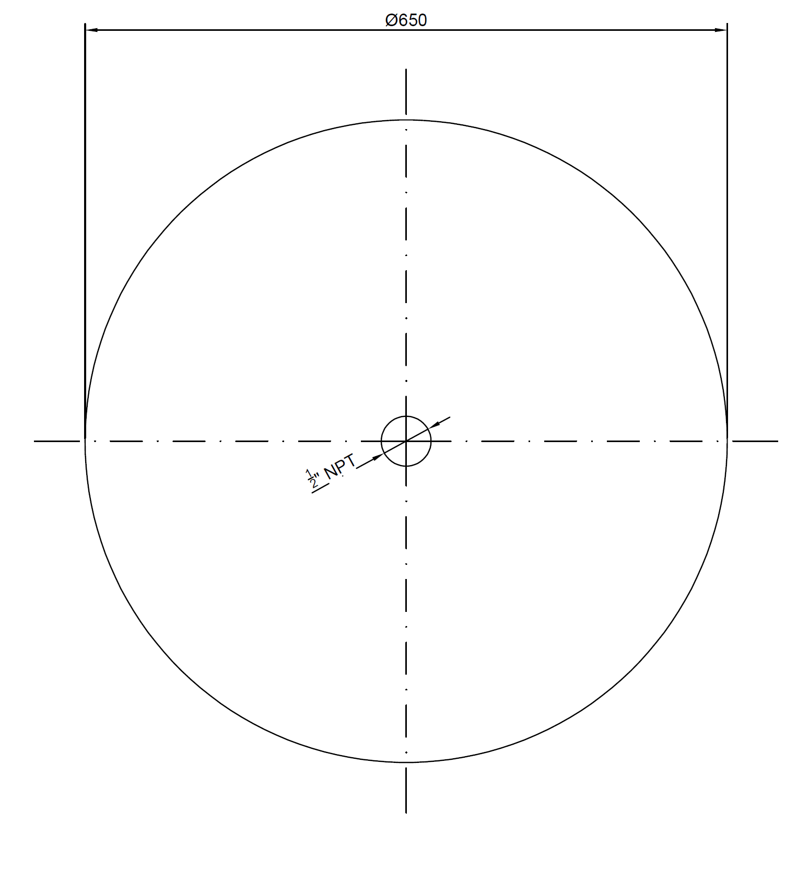
Initial water tank design
Top and bottom view of the tank
Approx volume 630 liters total
Installation of vortex breaker at the bottom of the tank
Tank dimensions
Frontal view of the tank

Slide 15
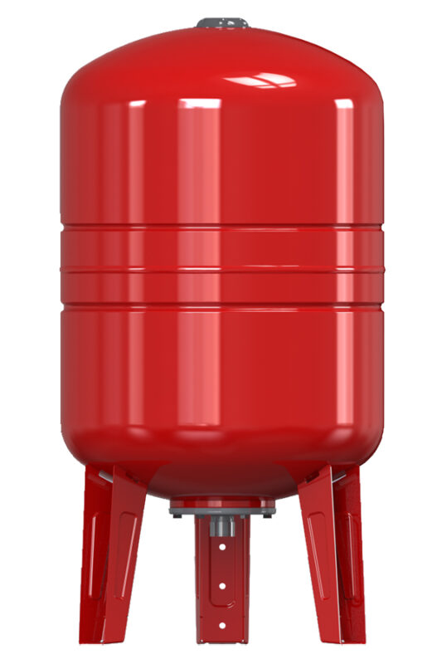
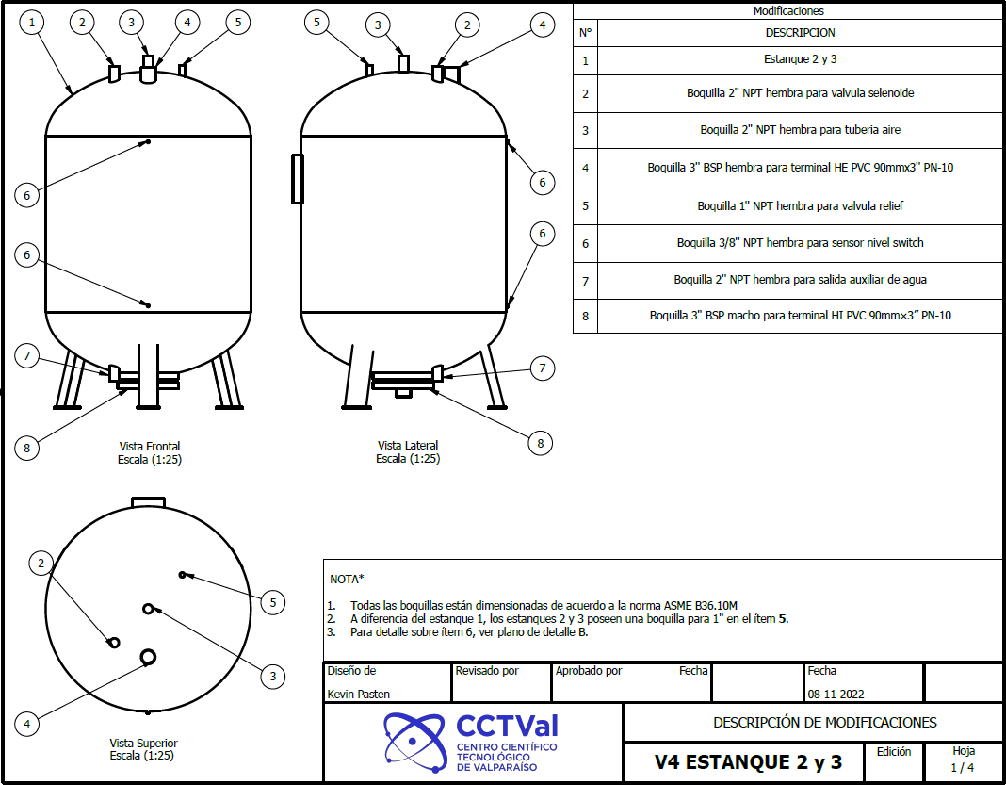
Final water tank design
Hidropack Varem Maxivarem 2,000 $\left[L\right]$ modified at a local shop

Slide 16
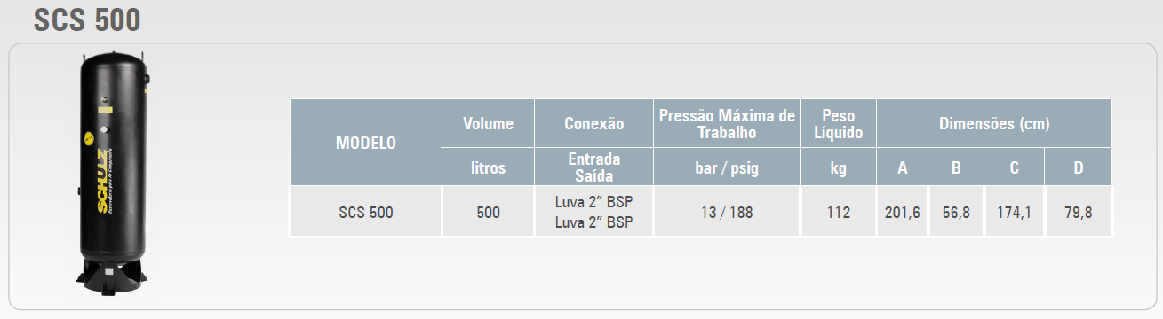
Compressed air accumulator
We selected four of these accumulators to achieve a total of 2,000 $[L]$ of compressed air for recommendation of the provider hence it’s cheaper and easy to access. So, we had to interlock one each other.

Slide 17
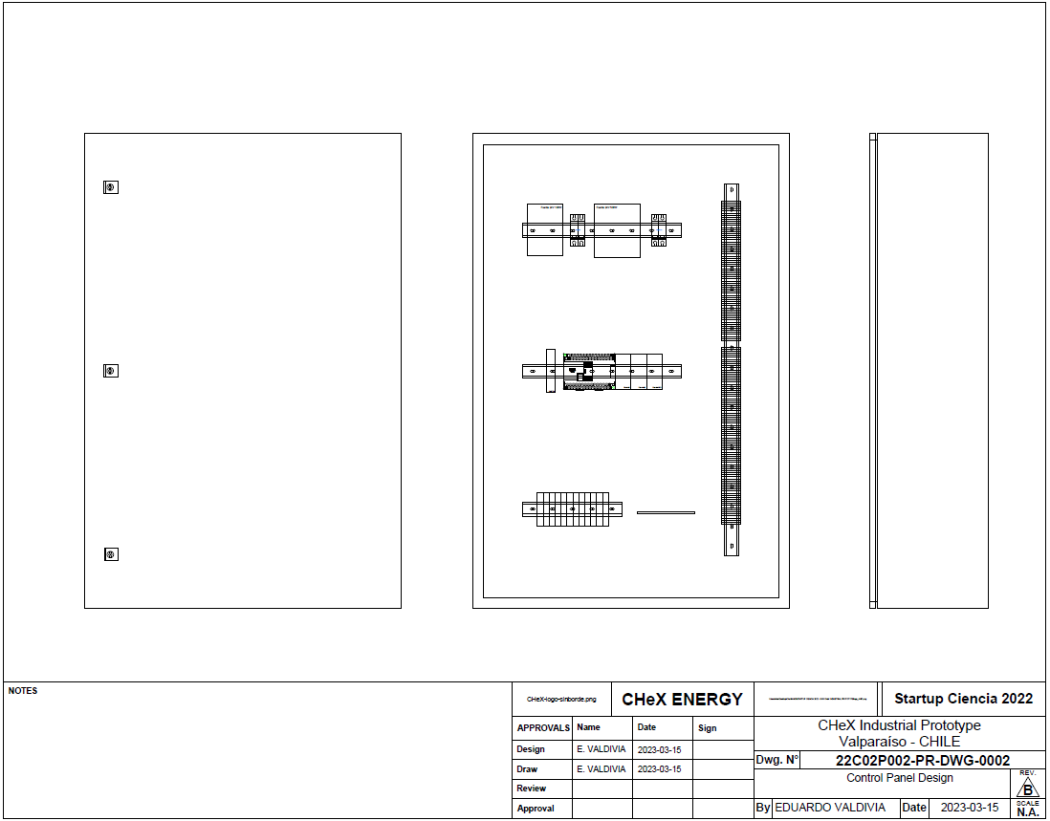
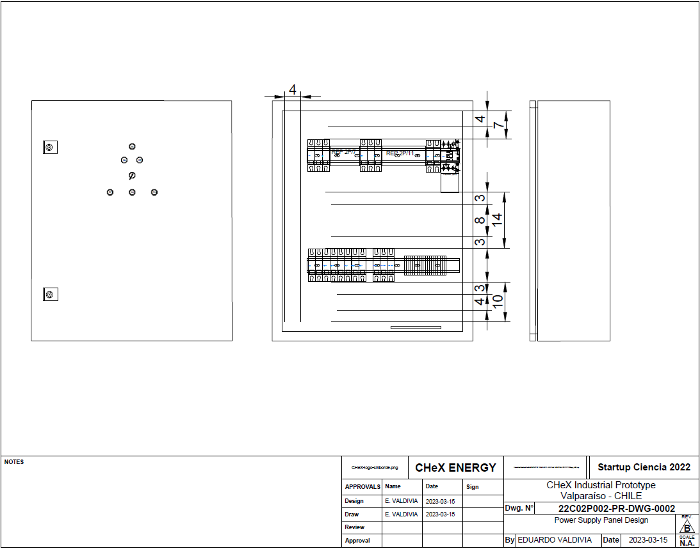
PLC and control system

Slide 18
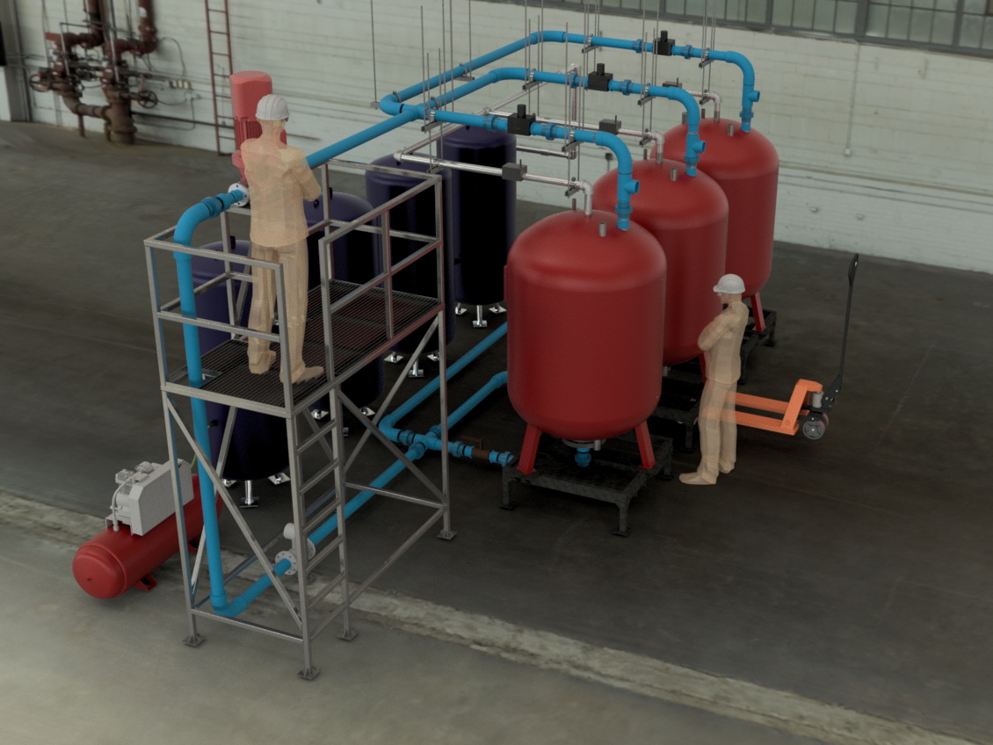
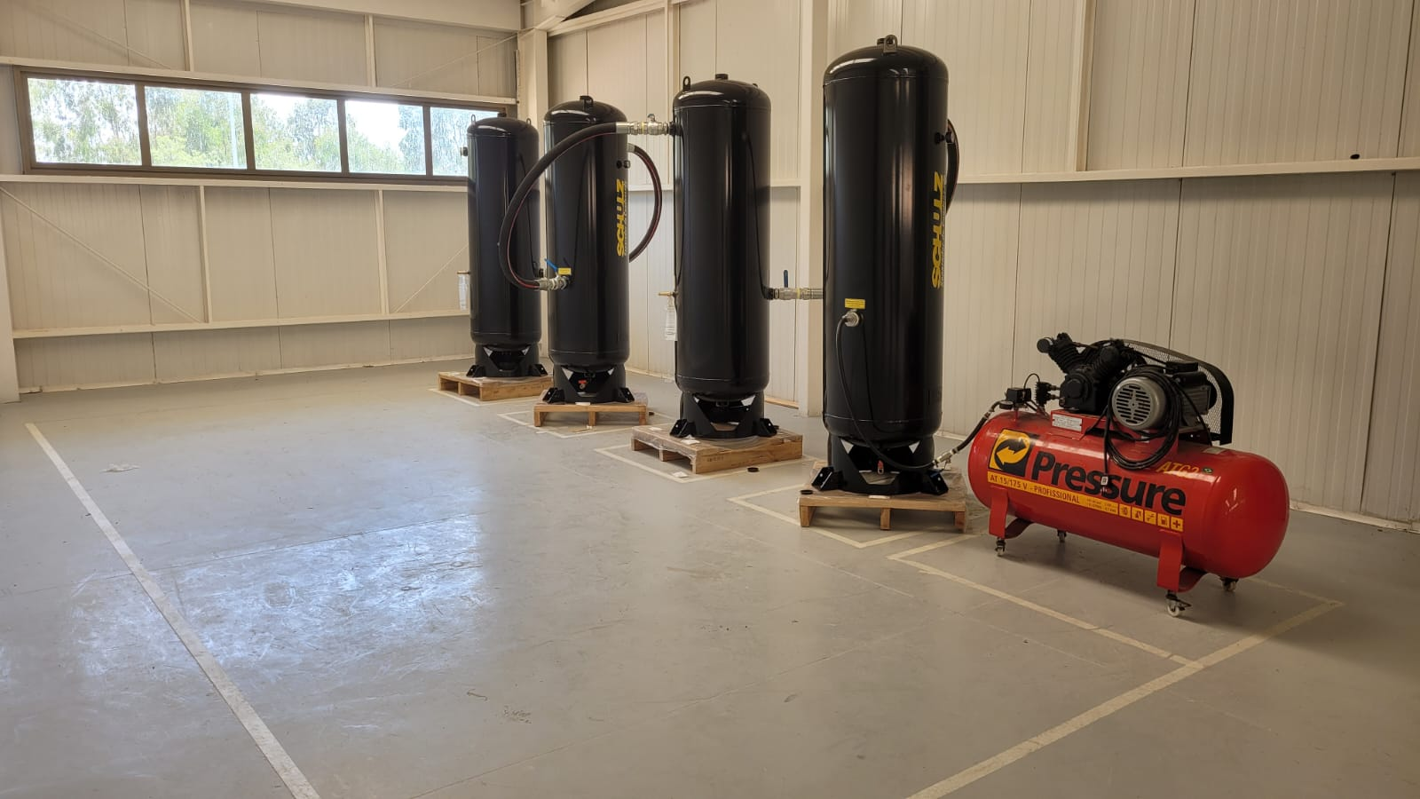
Current Results

Slide 19
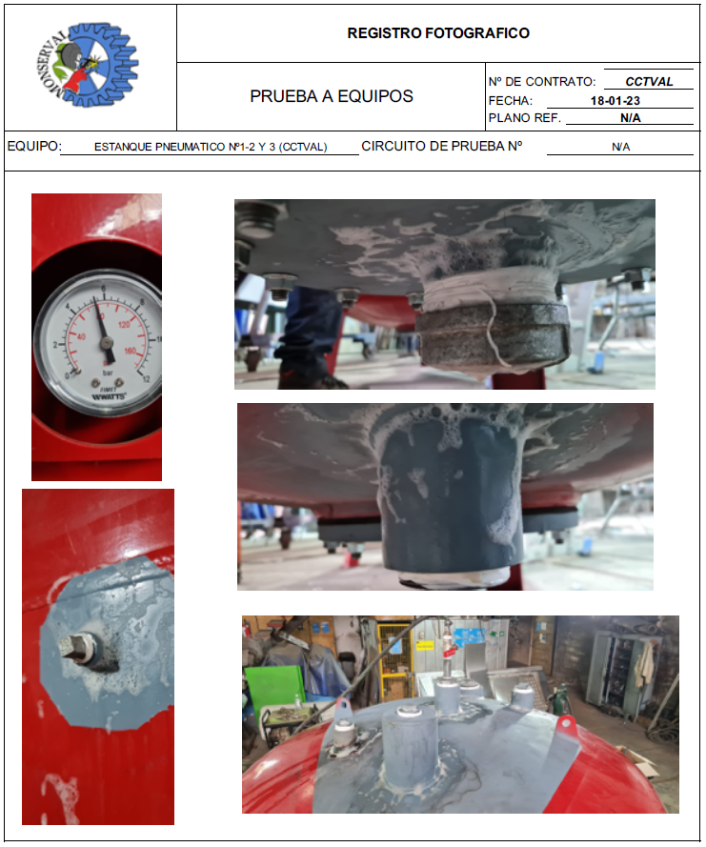
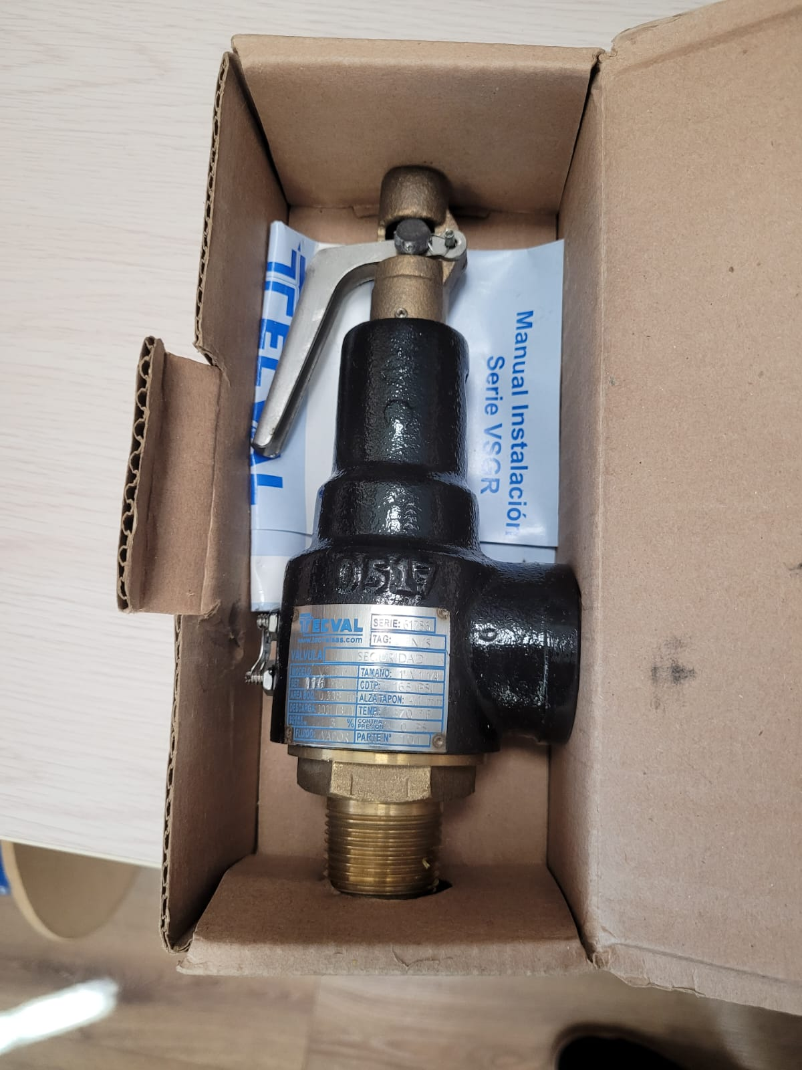
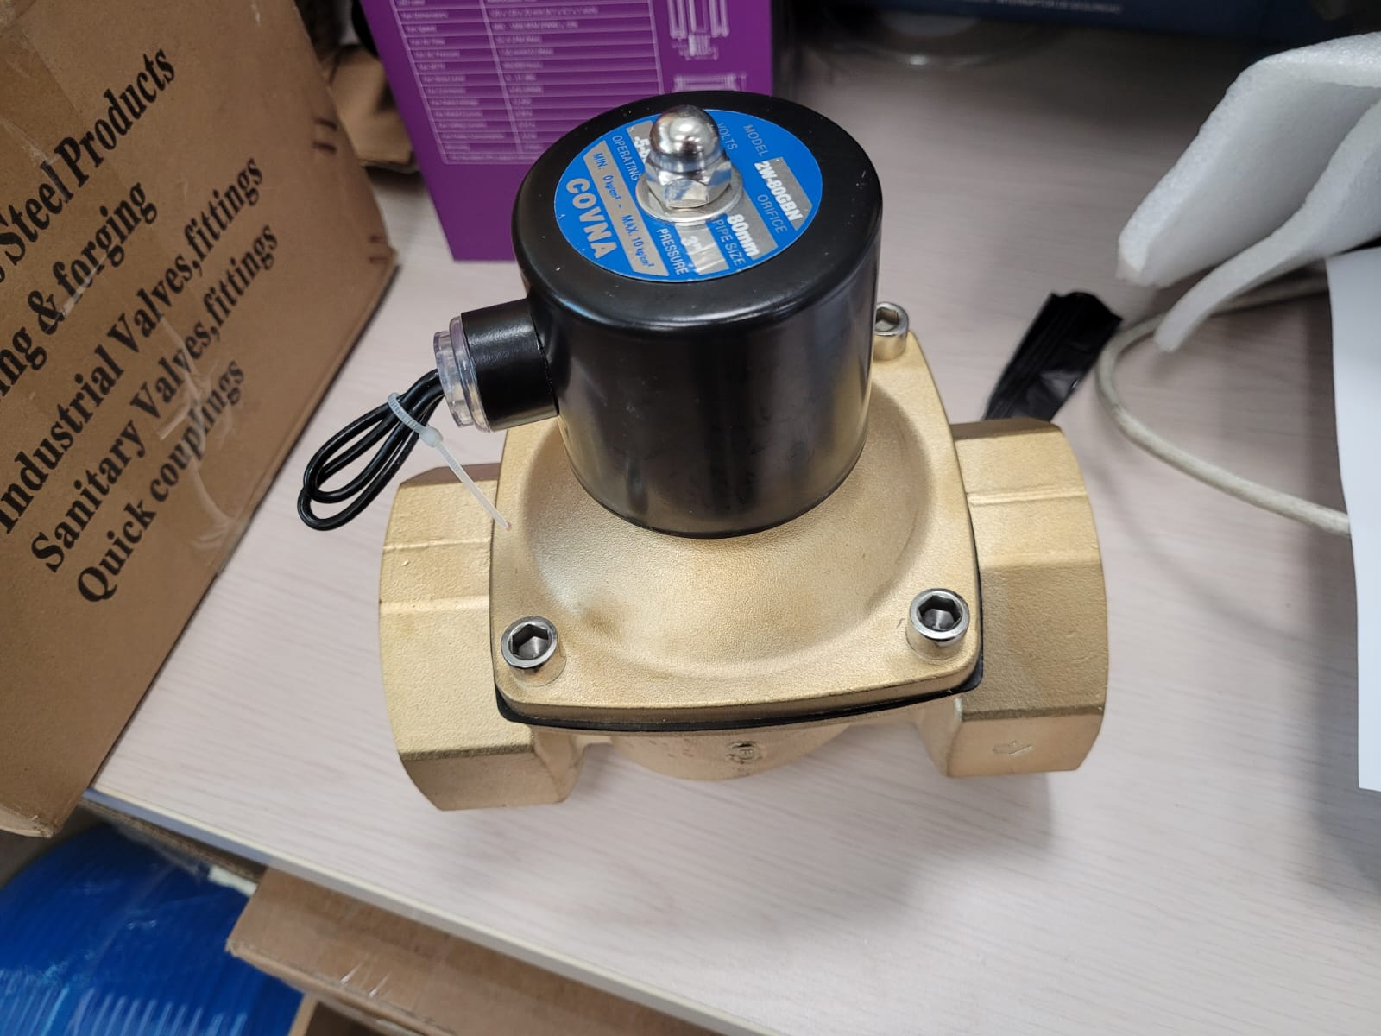
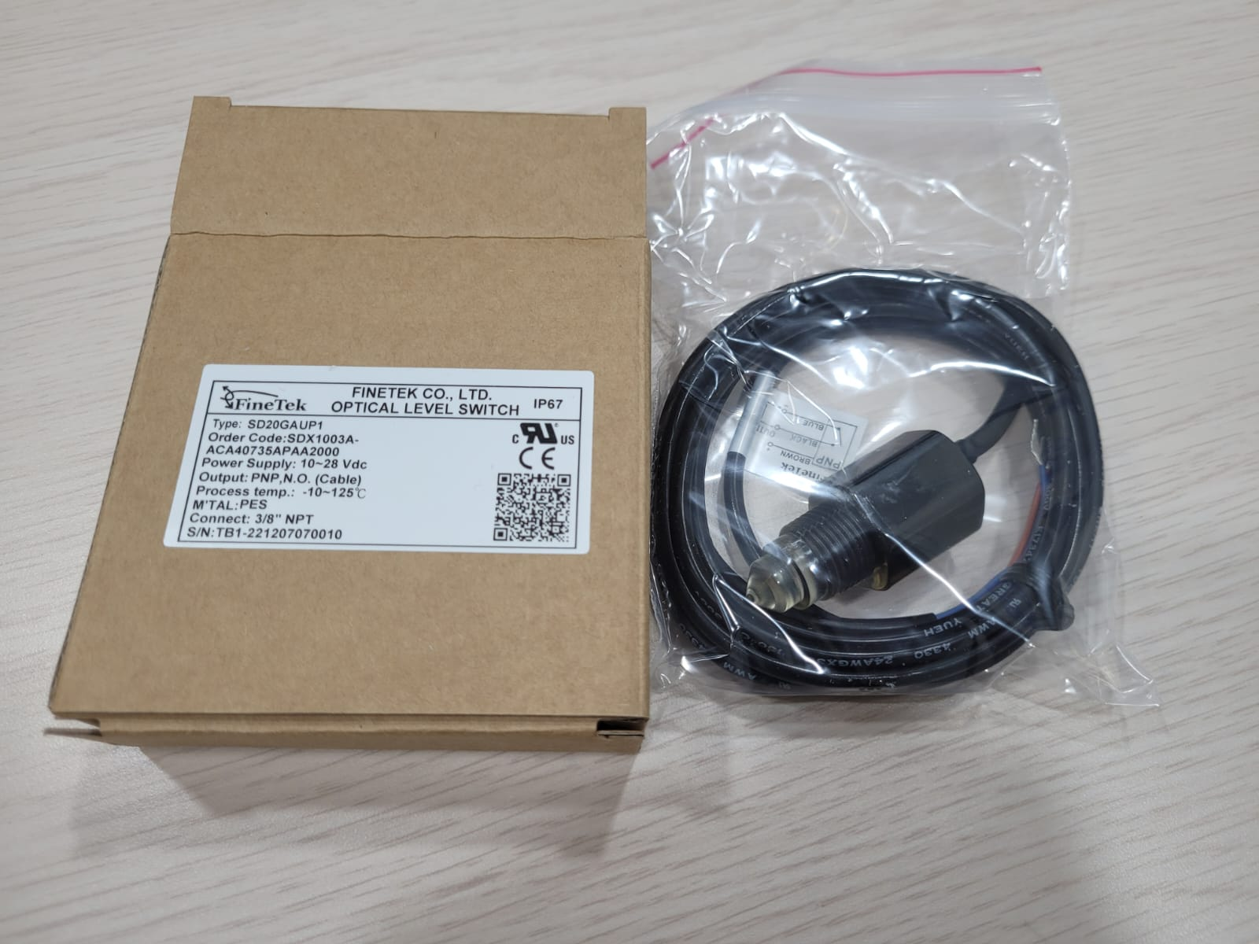
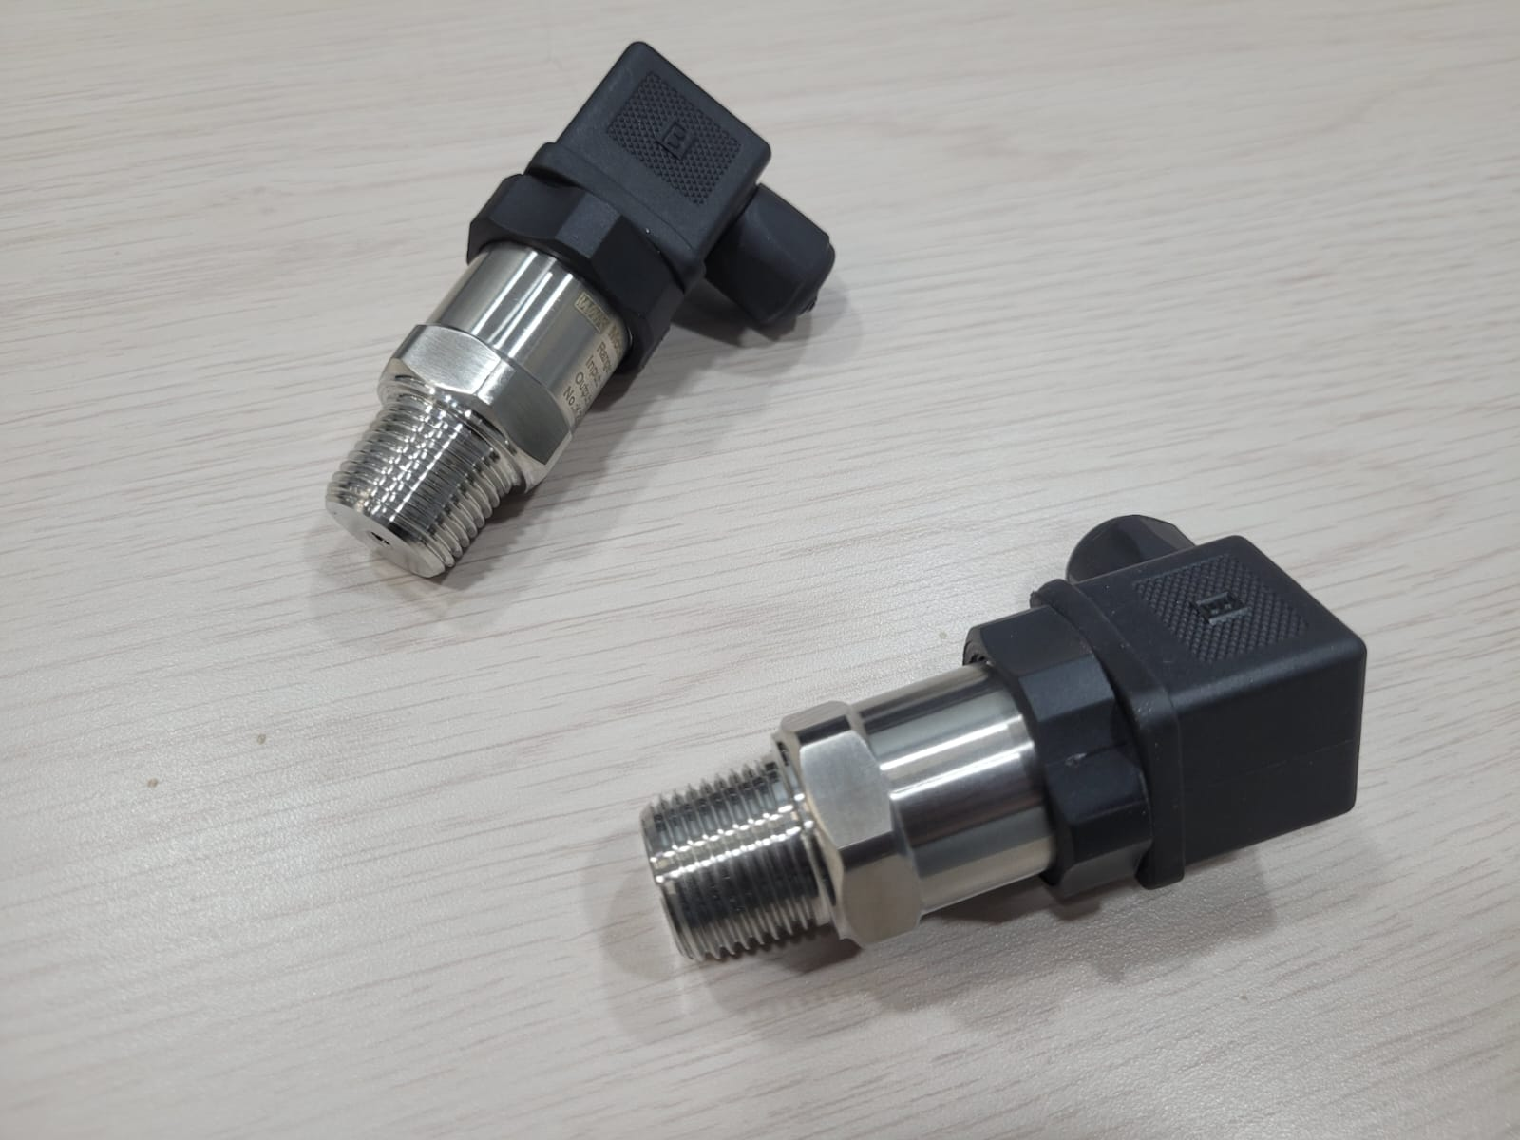
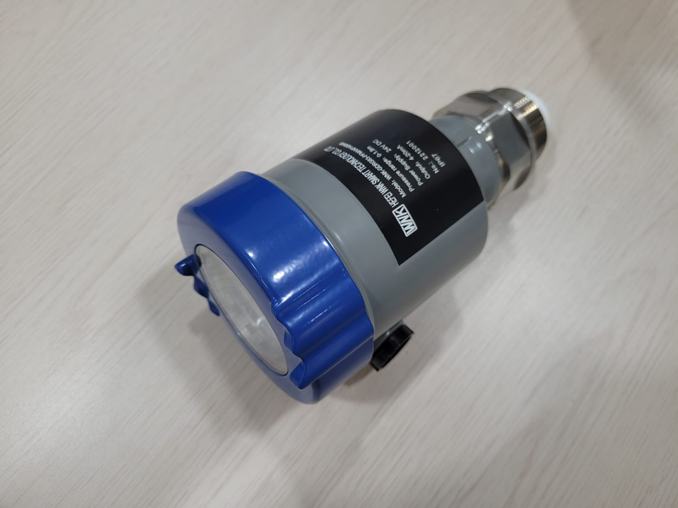
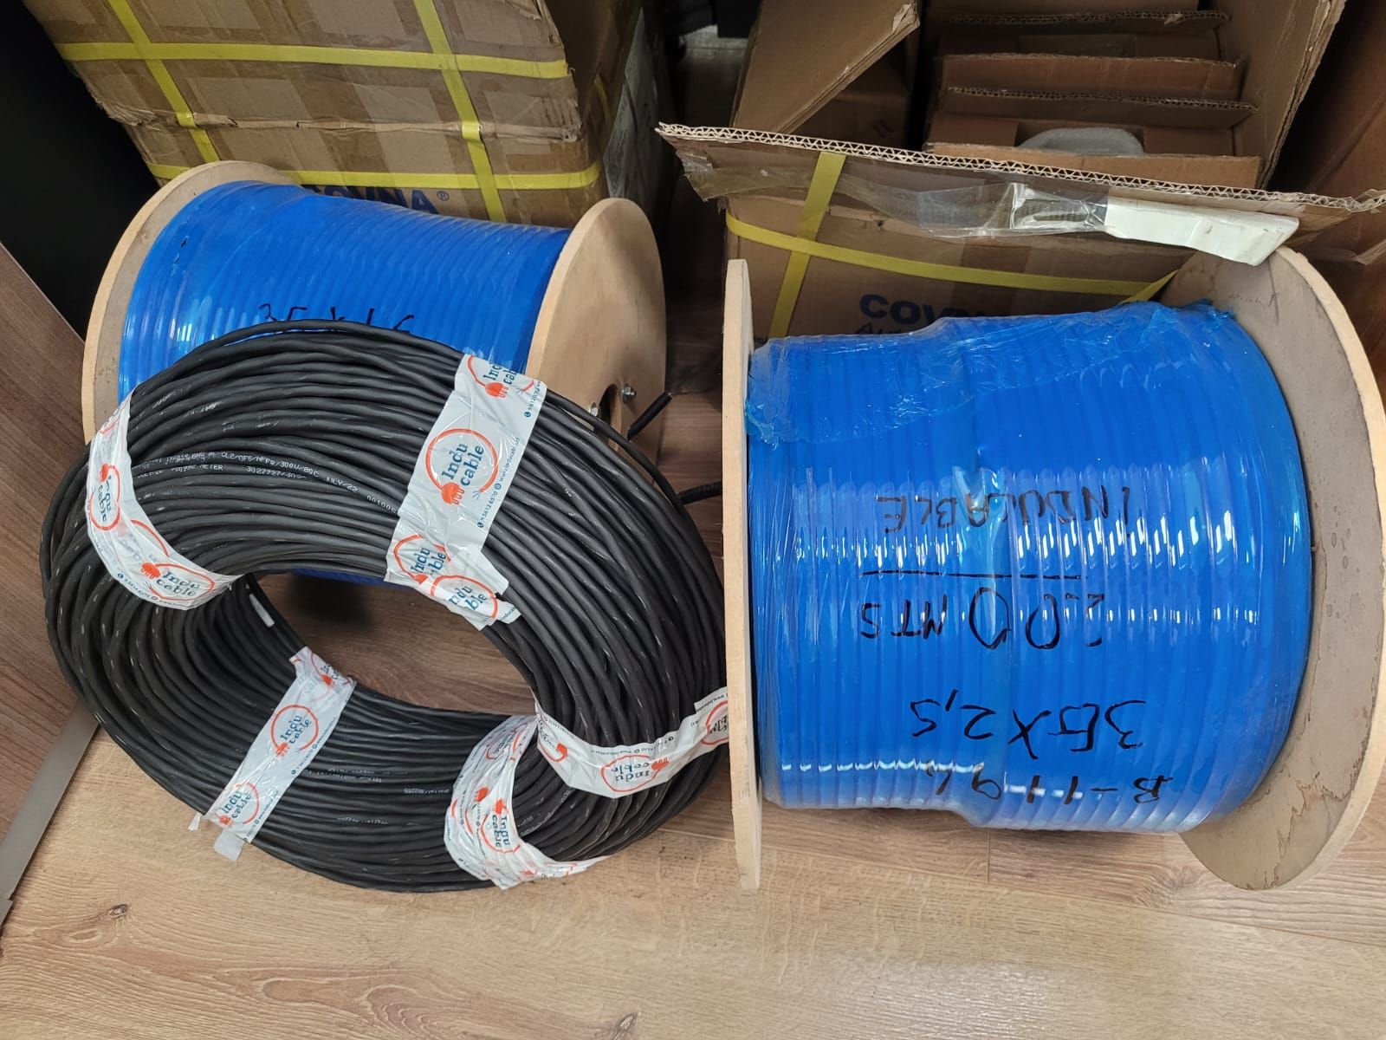
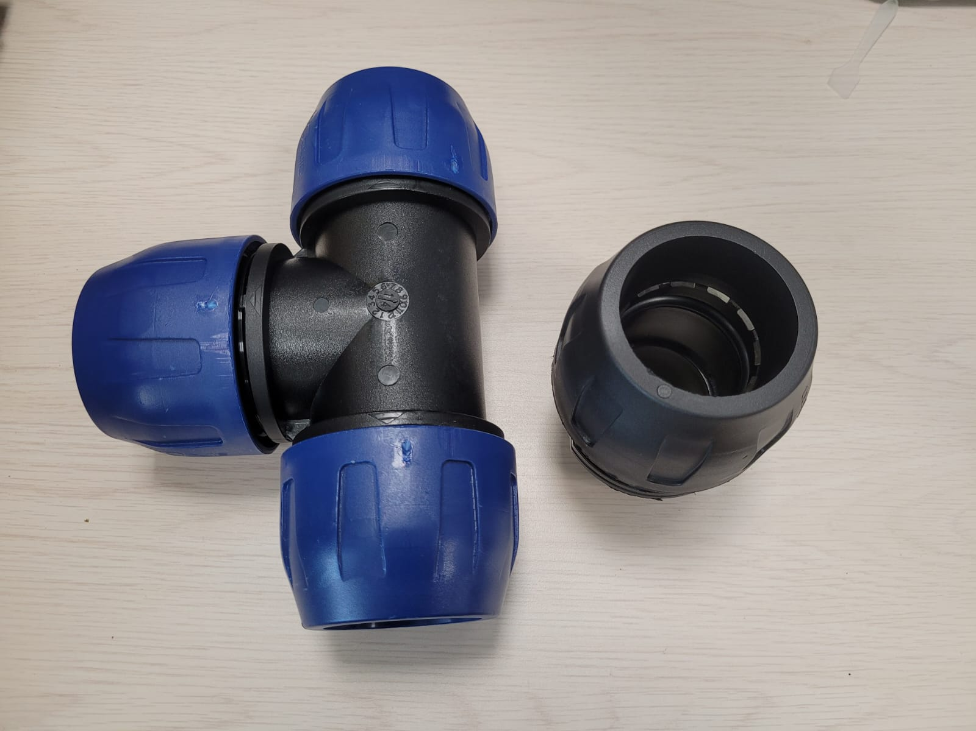
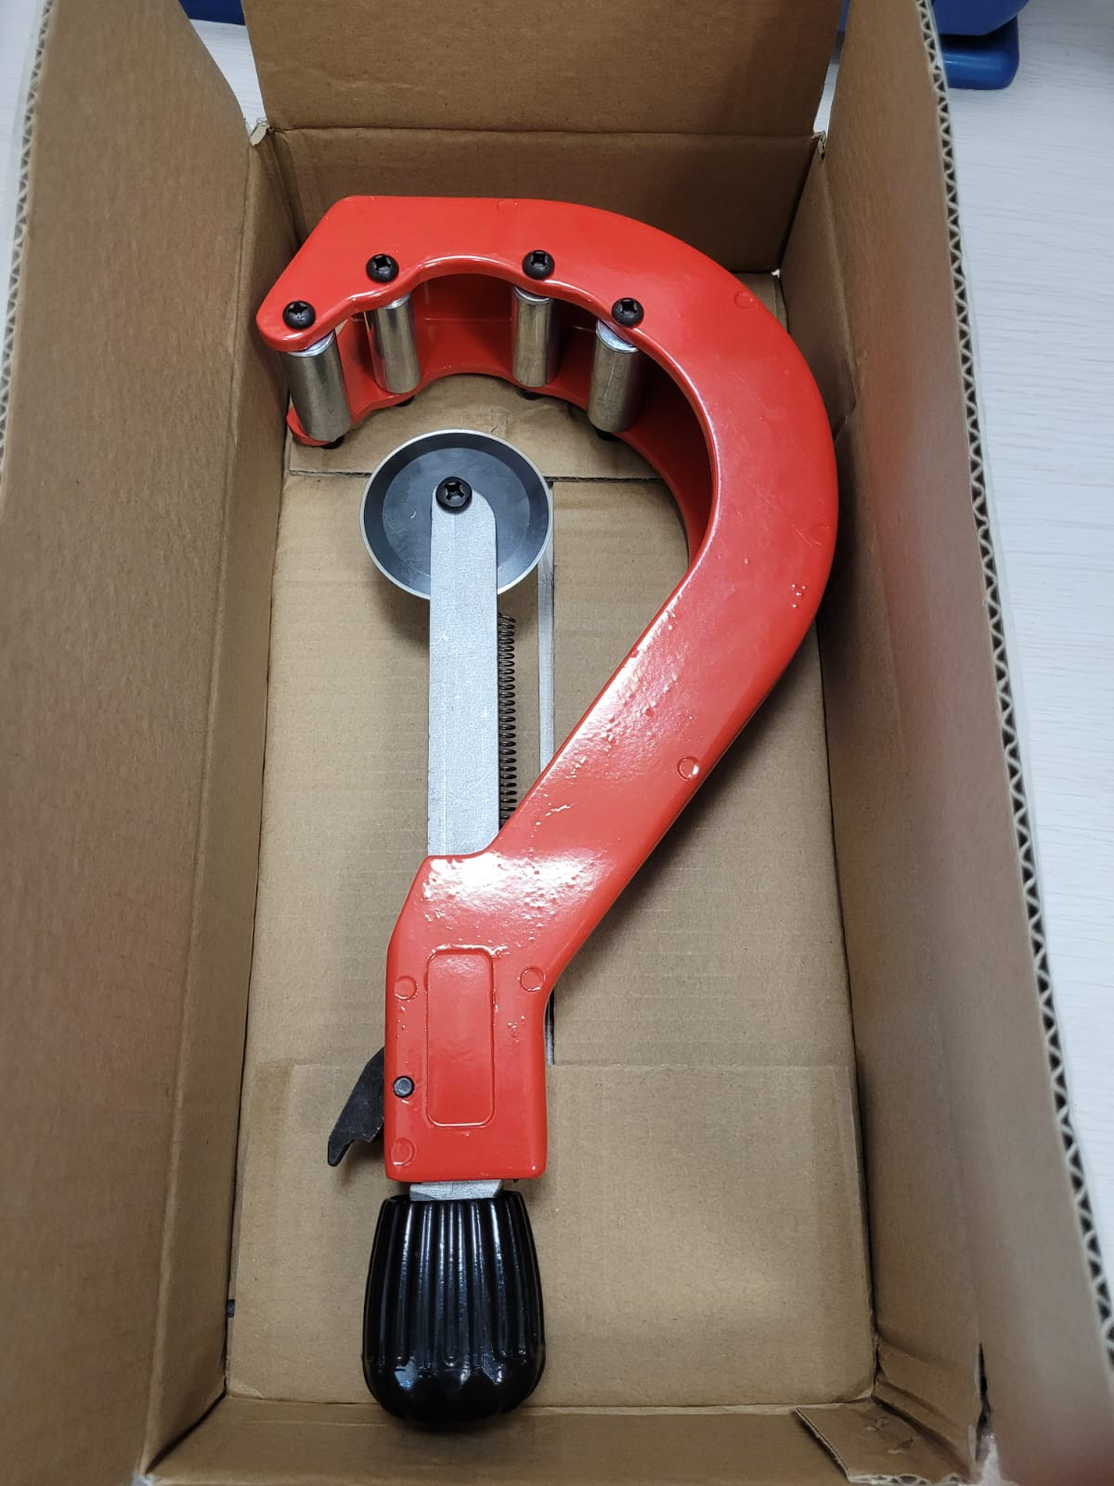
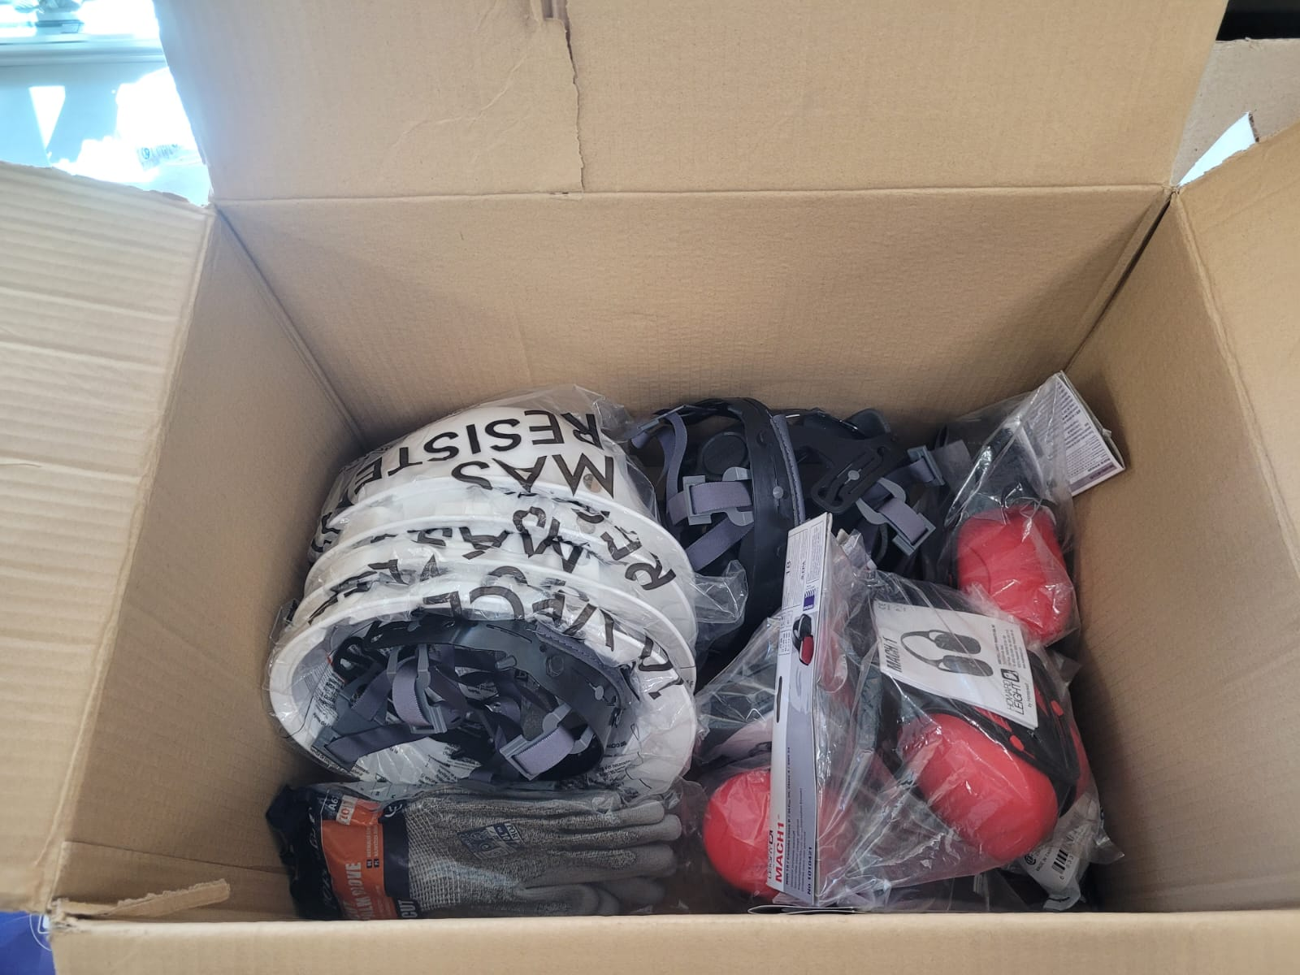
Current Results

Slide 20

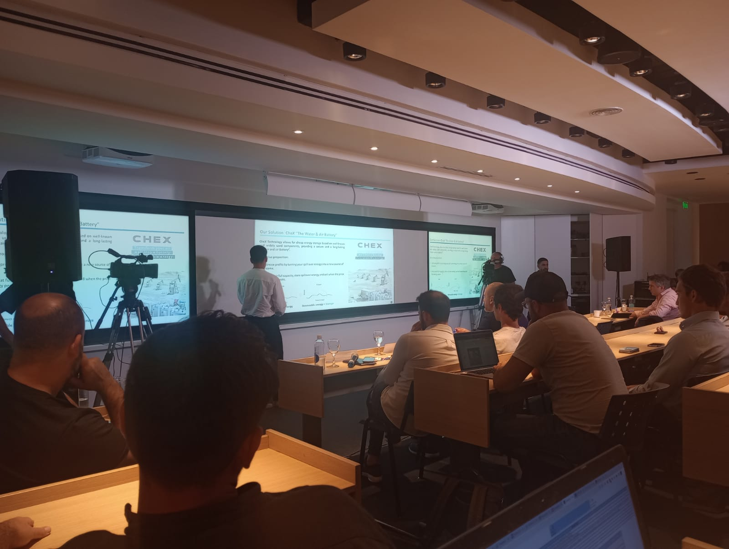
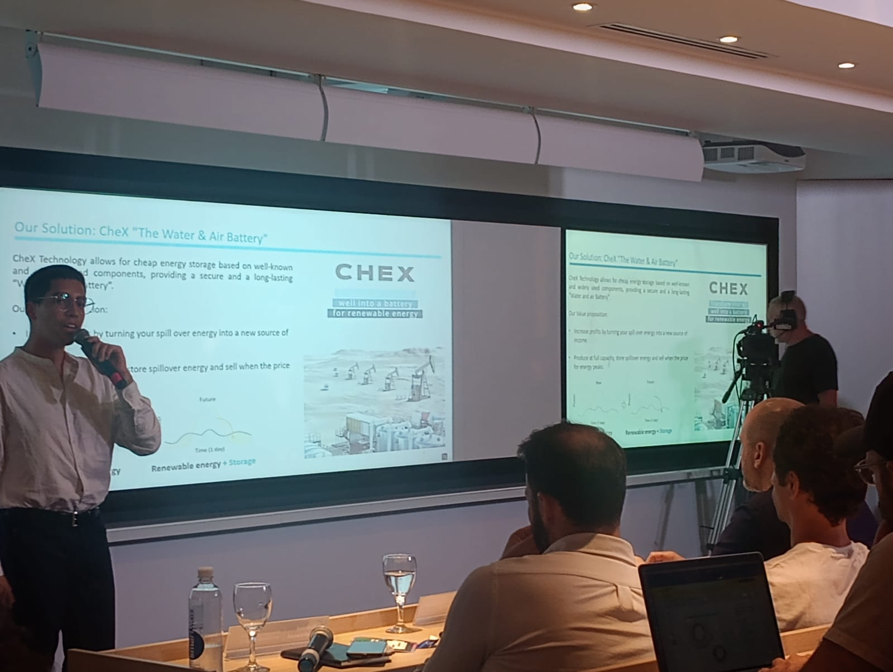
Current Results
Finalist of 200 startups
4 days in to make it

Slide 21



Current Results
Selected in the Renewables Energy & Green Hydrogen bootcamp by EDP which took place in Houston, Texas

Slide 22
Budget
Basically, the budget approved is for operational expenses to purchase the last items in need
Also, the ones need to mount the whole plant
Status | Amount | Human resources |  | Operational expenses
 |  | A2 | A3 | B1 | D2
Approved | $8,100,000 | $0 | $0 | $8,000,000 | $100,000

Slide 23
Gantt chart
Detail | Month 1 | Month 2 | Month 3 | Month 4 | Month 5 | Month 6 | Month 7 | Month 8 | Month 9 | Month 10
Improved details
Tests and upgrades
International outreach
National outreach
Project completion
Improved details: Adjust the final details already design and finish installation in Z warehouse
Tests and upgrades: New tests in order to improve the final touches of installation and compare to tests that took place in 2022
International outreach: Travel to conferences, seminaries, technology fairs or capital raising abroad to show our solution to the world. With three destinies in particular, Europe (EU), middle east and north África (MENA) and Asia hopefully China
National outreach: Travel inside Chile to the same scope with emphasis in ProChile, Chile Foundation, HUB’s in Santiago and this region
Project completion: Generate a final report with the most relevant results of the prototype

Slide 24
Av. General Bari 699, Valparaíso, Chile.
www.cctval.cl

Slide 25

Projected time development

Slide 26
Projected time development
Compras con retraso de 7 meses
Tomás comenzó recién hace 3 meses

Slide 27
Conclusions
Delay on
Delay on Project development
Be
Project will be executed finished in 2023
Reach
Development will reach target of TRL-7

