Slide 1
Double target system for CLAS12 experiment
Presentación Seminario de Proyectos Internos CCTVal 2023
Milan Ungerer Muñoz

Slide 2
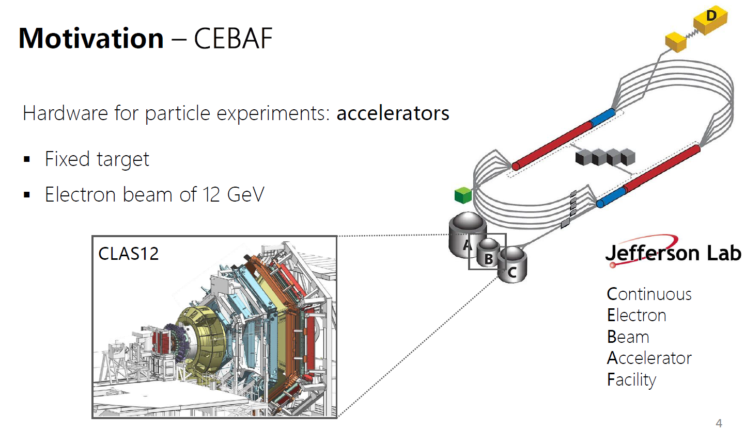
Hardware for particle physics experiments
Double target system for particle physics experiment in Jefferson Lab
The experiment already have time scheduled for 2024
Great technical challenges

Slide 3
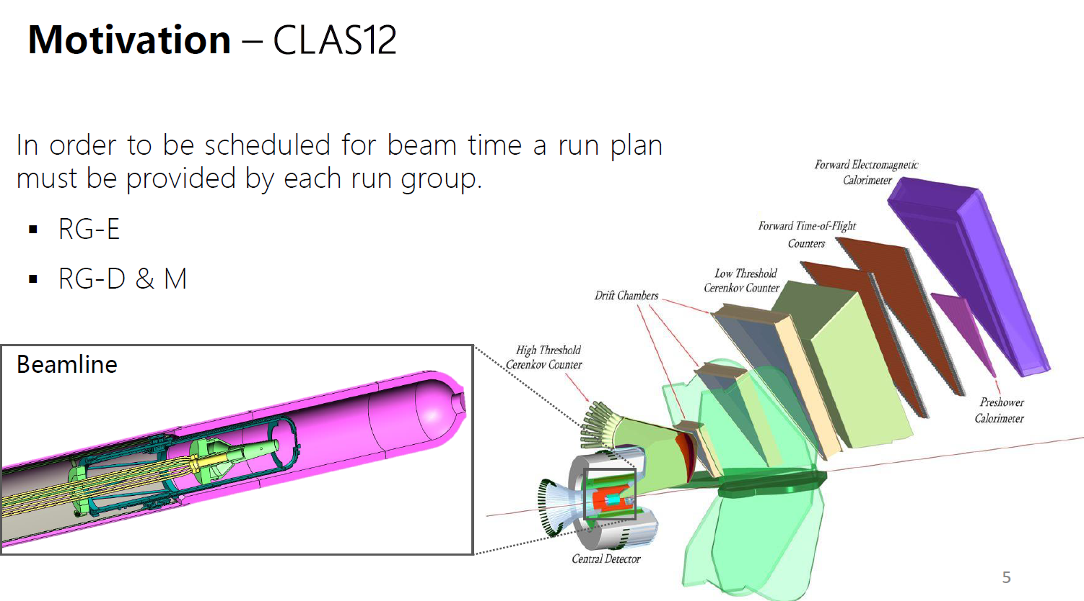
Extreme environmental conditions for the hardware
High vacuum
High magnetic field
Extreme temperatures
Ionizing radiation
Limited space for installation

Slide 4
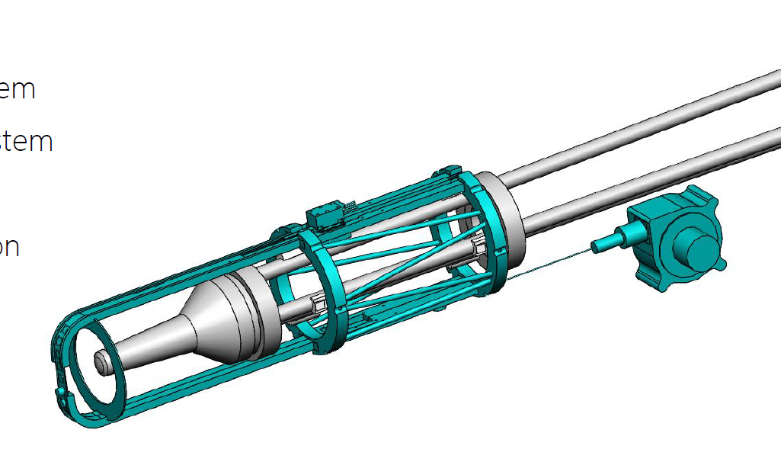
Double target system
Movement control system
Solid targets
Support structure

Slide 5
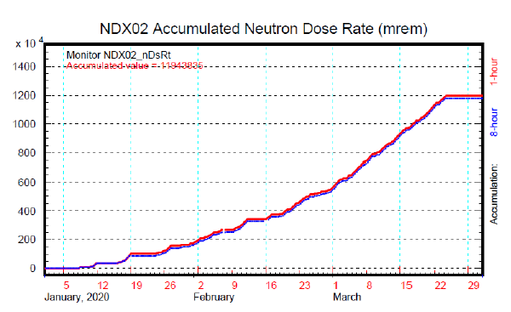

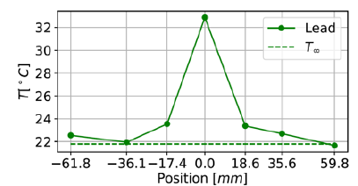
Tests of the double target system into extreme conditions
Radiation hardness test
Operation in vacuum test
High temperature test
Low temperature test
Repetitiveness and precision test
Comissioning

Slide 6
Plan de trabajo anual
 | 2023 |  |  |  |  |  |  |  |  |  |  |  | 2024
 | January | February | March | April | May | June | July | August | September | October | November | December | January | February | March | April | May | June | July | August | September | October | November | December
Comissioning preparation
Comissioning
Definitive equipment preparation
Experiment and data acquisition
Comissioning preparation | March |  |  |  | April |  |  |  | May
 | 1 | 2 | 3 | 4 | 1 | 2 | 3 | 4 | 1 | 2 | 3 | 4
Design
Test preparation
Manufacturing and programming.
Official tests
Contingencies

Slide 7
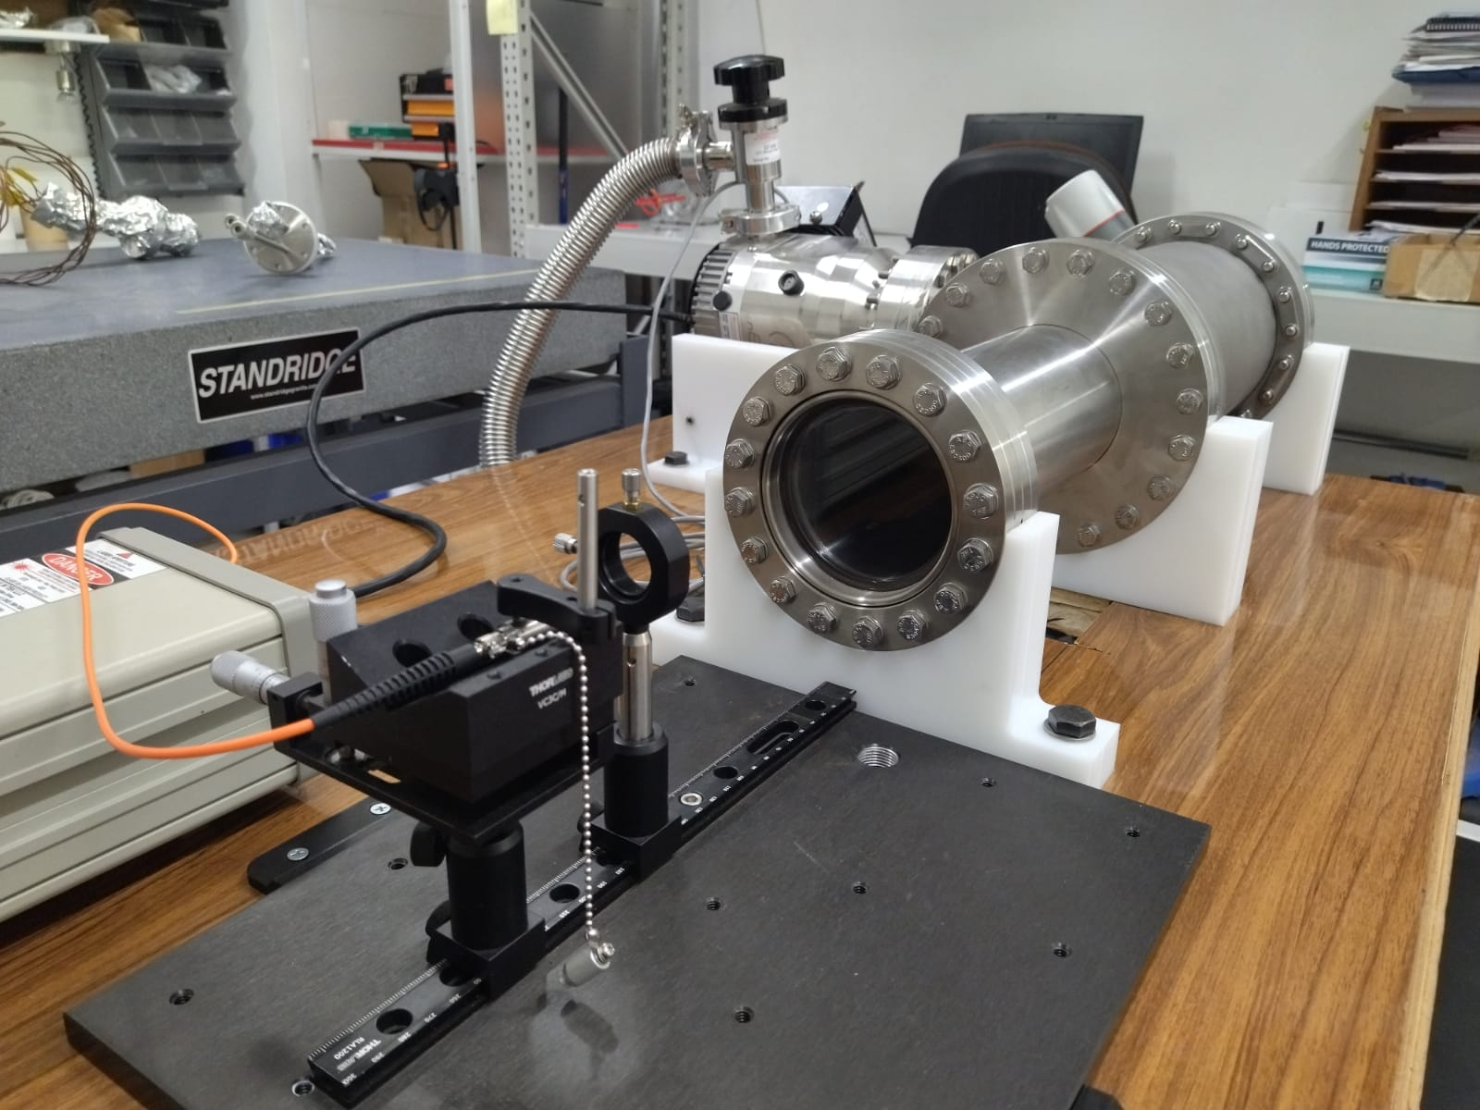
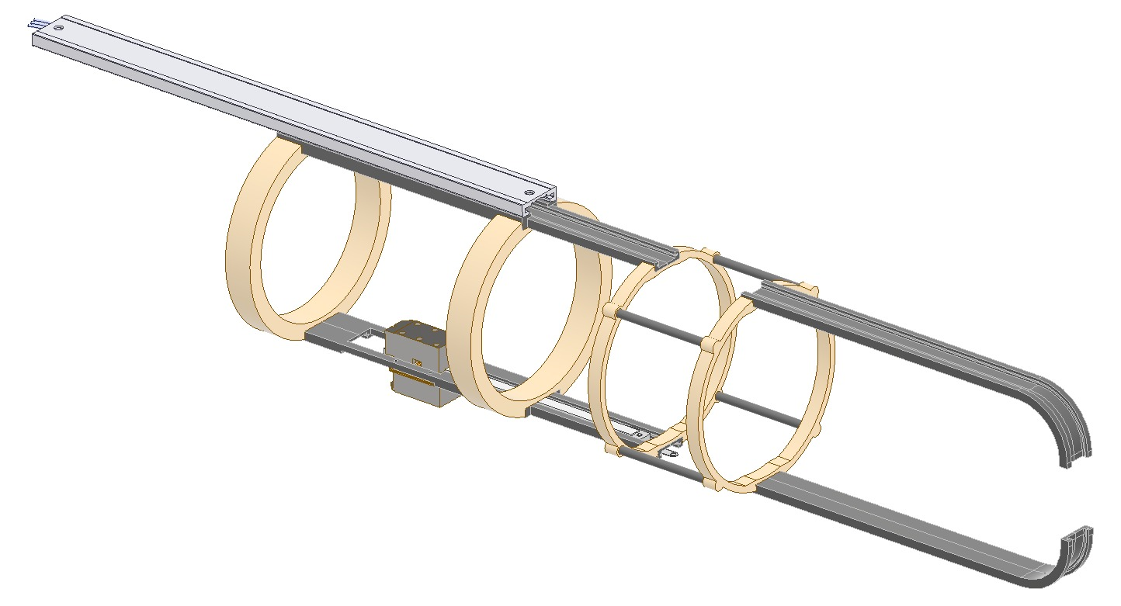
Comissioning preparation
Spatial restrictions
Repetitiveness and precision test
Low temperature test
*Courtesy of Alonso Lepe

Slide 8
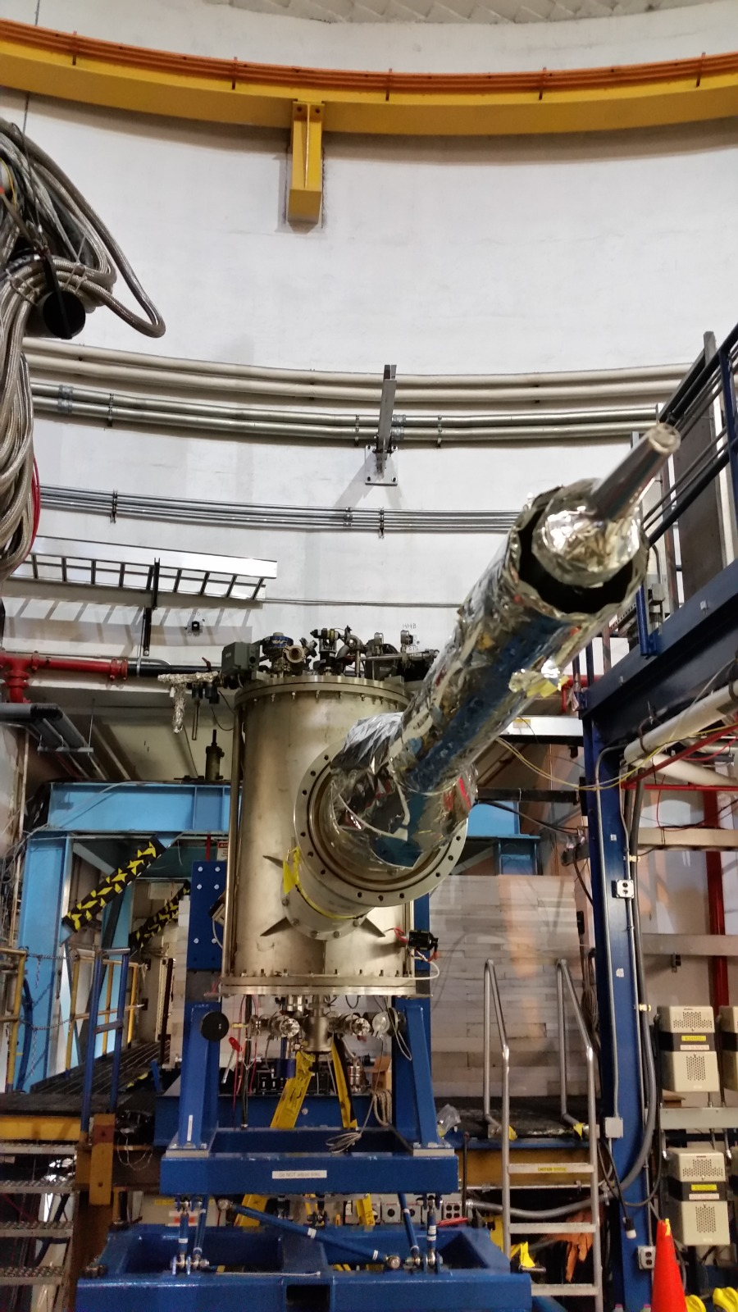
Comissioning and next steps
Test the setup under real conditions
Improvements
Definitive equipment fabrication
Installation, experiment and data acquisition

Slide 9
Work team
Researchers | Design and manufacturing | Digital transformation | Physics
Hayk Hakobyan | Alonso Lepe | Jairo González | Esteban Molina
Will Brooks | Miguel Martinez | Eduardo Valdivia | Bruno Benkel
Taisiya Mineeva |  | Vicente Saona | Milan Ungerer
*And in addition, all the team that supports every specific task that we require

Slide 10
Indicadores
Obtener publicación ISI (1)
Participación en conferencias internacionales (4)
Participación en conferencias nacionales (2)
Estudiantes de pre y postgrado trabajando en el proyecto (1)
Colaboración de trabajo con otra institución (1)
Acuerdos oficiales de colaboración con instituciones internacionales (1)

Slide 11
Final considerations
Formidable technical challenges that require substantial engineering development
Multidisciplinary work (electronic, mechanical, and physics)
We have a tight schedule to prepare the system for commissioning (June)
Potential applications of the acquired knowledge (e.g. aerospace).
Approved budget for 2023: $13.100.000

Slide 12
General Bari 699, Valparaíso, Chile.
www.cctval.cl

