Slide 1
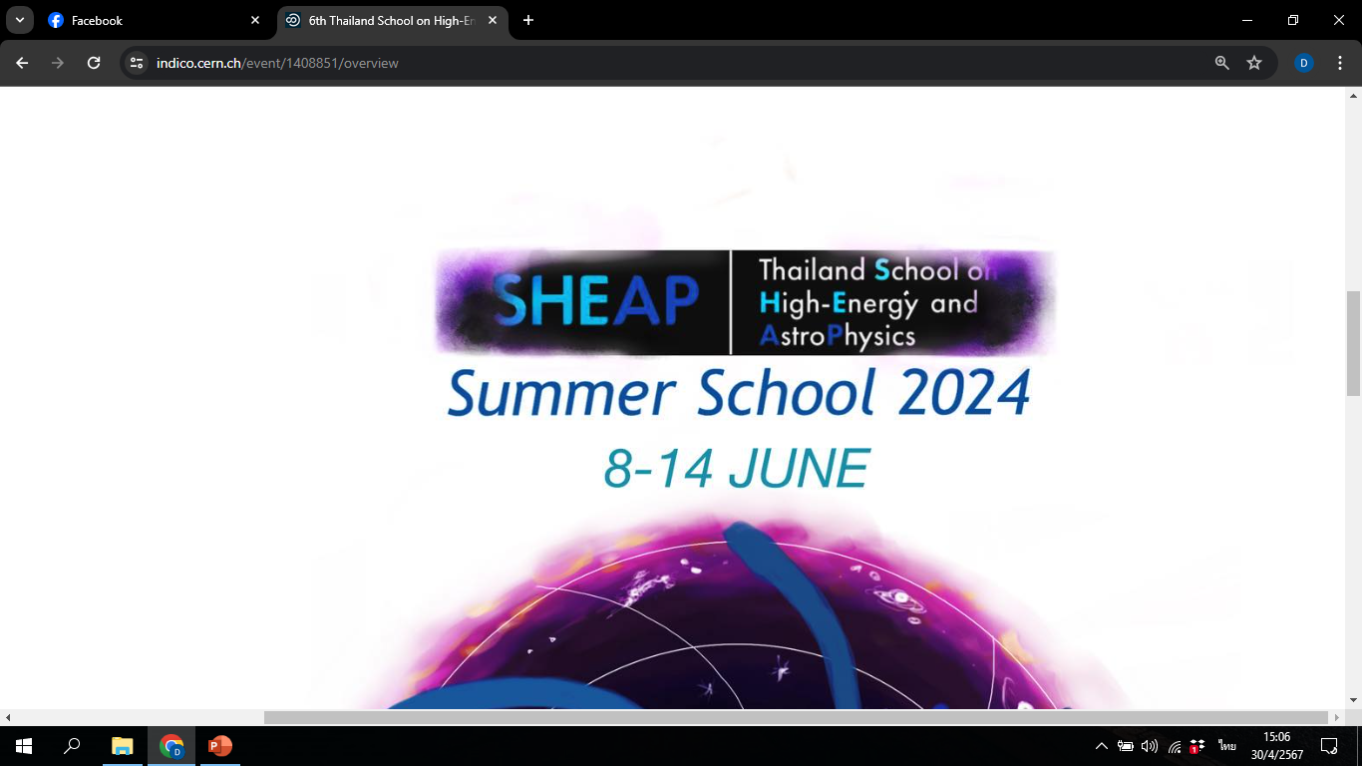
Classical Fields in Curved Spacetime
(สนามดั้งเดิมในกาลอวกาศโค้ง)
11 June 2024
Dr. Patharadanai Nuchino (Day)
Department of Physics, Faculty of Science, Ramkhamhaeng University

Slide 2
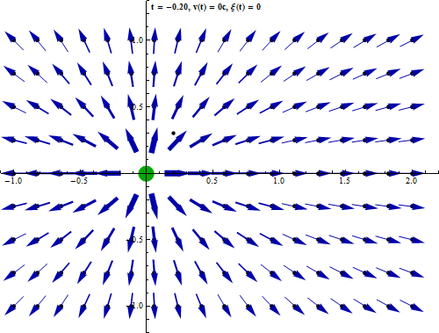
Outline
1. What is Field?
2. What is Classical Field?
3. Dynamics of Classical Field
4. What are Classical Fields in Curved Spacetime?

Slide 3
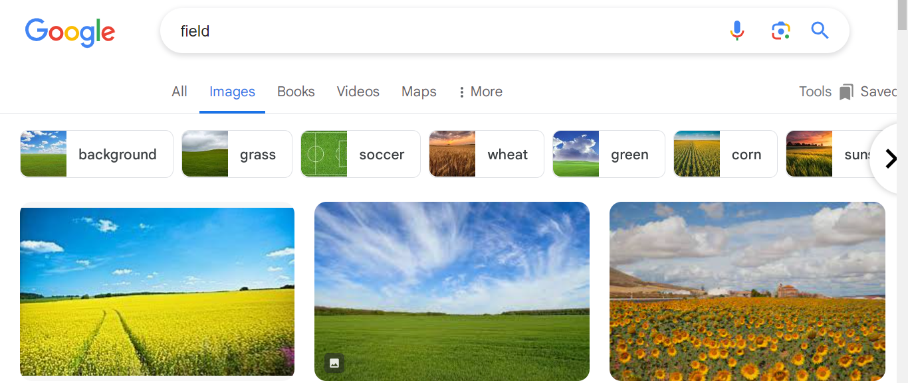
1. What is Field?
meaning depends on contexts

Slide 4
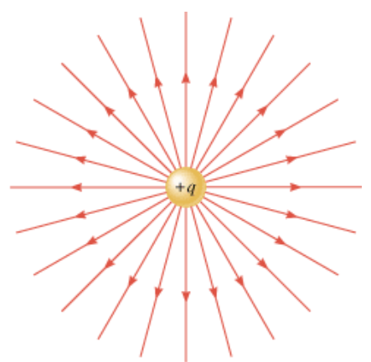
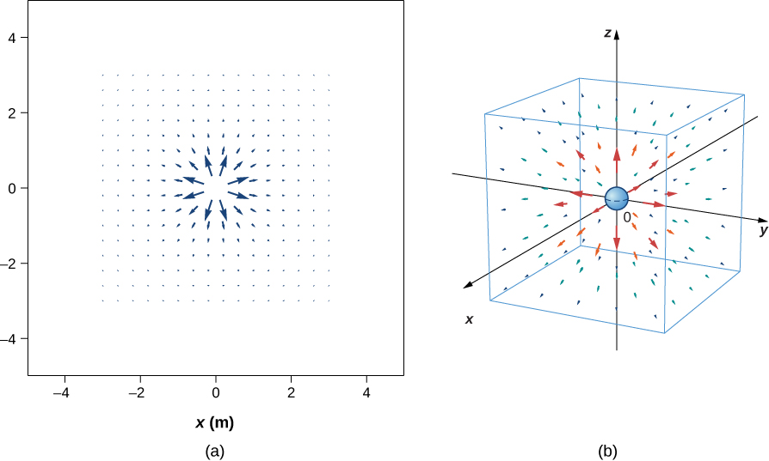





1. What is Field (in Physics)?
In physics, a field is a region of space which has a value for some physical quantity assigned to each point of the region.
Electric field
ex.
$$×$$
$$\vec{r}$$
$$\vec{E}(\vec{r})$$
$$\vec{E}=\frac{kq}{r^{2}}\hat{r}$$
vector field
$$k=9×10^{9} N∙m^{}/C^{2}$$

Slide 5
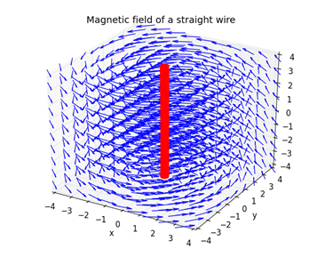
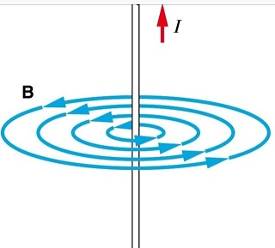



1. What is Field (in Physics)?
In physics, a field is a region of space which has a value for some physical quantity assigned to each point of the region.
Magnetic field
ex.
$$\vec{d}$$
$$B=k_{m}\frac{I}{d}$$
vector field
$$k_{m}=2×10^{−7} N/A^{2}$$

Slide 6
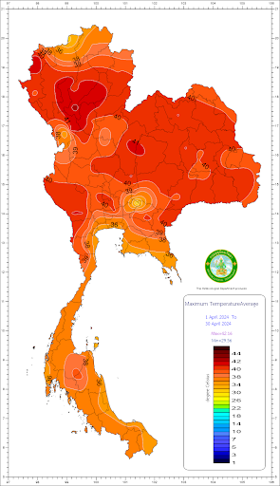
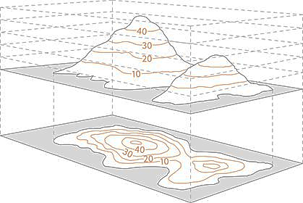

1. What is Field (in Physics)?
In physics, a field is a region of space which has a value for some physical quantity assigned to each point of the region.
temperature map
ex.
mountain height
ex.
scalar field
scalar field
$$h=h\left(x,y,z\right)$$

Slide 7

2. What is Classical Field?
In physics, a field is a region of space which has a value for some physical quantity assigned to each point of the region.
spacetime pos.
rep. of spacetime
vector field: $\left\{t,x,y,z\right\}→$ vector quantity at each point
(spin 1)
Bosonic field
(integer spin)
scalar field: $\left\{t,x,y,z\right\}→$ scalar quantity at each point
(spin 0)
tensor field: $\left\{t,x,y,z\right\}→$ tensor quantity at each point
(spin 2)
spacetime metric tensor $g_{μν}(x)$
ex.
Fermionic field
(half-integer spin)
spinor field: $\left\{t,x,y,z\right\}→$ spinor quantity at each point
(spin 1/2)
vector-spinor field: $\left\{t,x,y,z\right\}→$ vector-spinor quantity at each point
(spin 3/2)
We call these fields that are not quantized as “Classical fields”

Slide 8
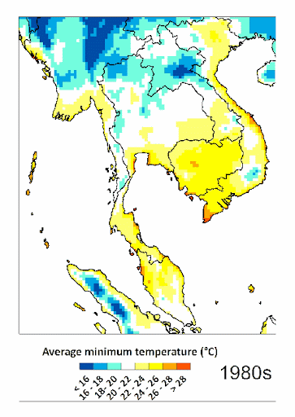
2. What is Classical Field?
Why should we care Classical Field?
1. It can be used to describe wave-like physical phenomena such as sound and light, or other continuous phenomena such as fluid flow.
Fields can have dynamics
They have energy
and momentum
Their dynamics can be described by Lagrangian formulation

Slide 9
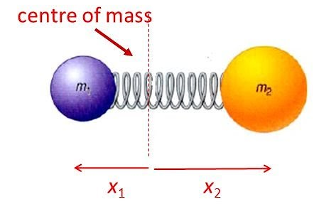




2. What is Classical Field?
Why should we care Classical Field?
2. It is impossible to construct relativistic interactions in a many-body system (due to no-go theorem [2]).
Boost in x-direction
$$F_{1}^{′}≠F_{1}$$
$$F_{2}^{′}≠F_{2}$$
$$F_{1}=k(x_{2}−x_{1}−l_{0})$$
$$F_{2}=−k(x_{2}−x_{1}−l_{0})$$
If special relativity is imposed, we need an extension of the many-particle systems, such classical fields, to incorporate interactions.

Slide 10
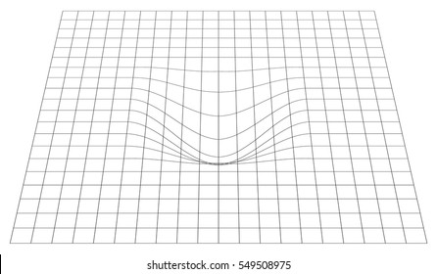
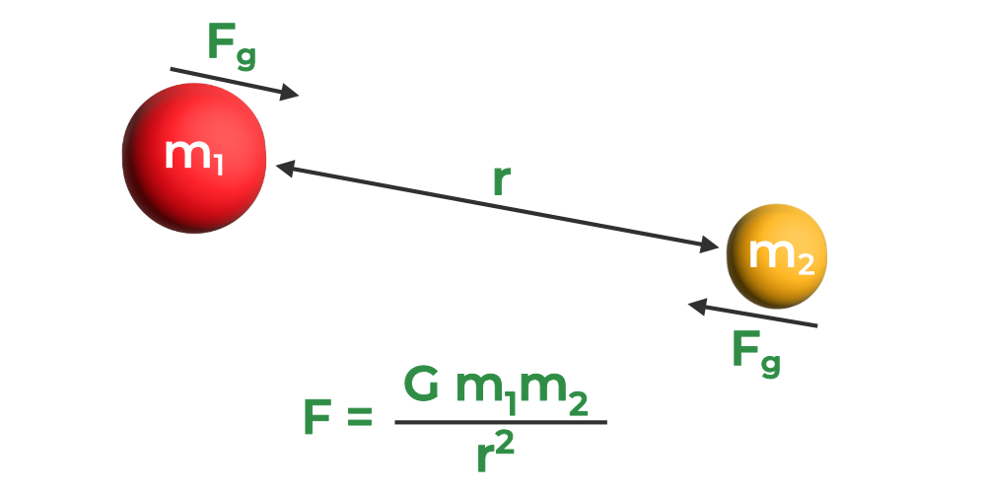
2. What is Classical Field?
Why should we care Classical Field?
Ans: We want (relativistic) classical fields for describing relativistic interactions between matters (and also spacetime curvature)
field 1
interaction
field 2
non-Lorentz invariant
Lorentz invariant

Slide 11
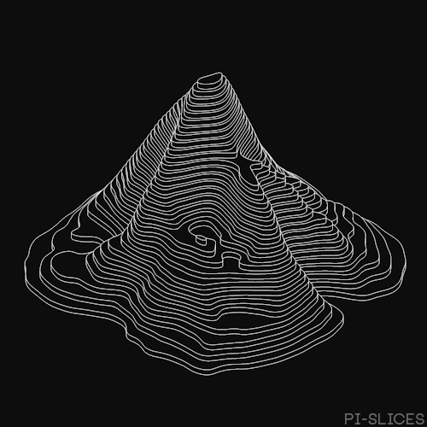
3. Dynamics of Classical Field
Fields can have dynamics
create
Dynamic of fields
Waves

Slide 12
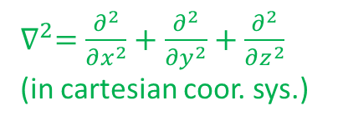


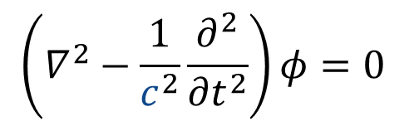
3. Dynamics of Classical Field
create
Dynamic of fields
Waves
Thus, the simplest dynamic of classical fields can be described by wave equation
$∇^{2}=\frac{∂^{2}}{∂x^{2}}+\frac{∂^{2}}{∂y^{2}}+\frac{∂^{2}}{∂z^{2}}$
(in cartesian coor. sys.)
$∇^{2}φ=\frac{1}{v^{2}}\frac{∂^{2}φ}{{∂t}^{2}}$.
Laplacian op.
$v$ is the wave speed
This equation is non-relativistic (non-Lorentz covariant)!!!
To obtain relativistic wave equation, space & time derivatives should be written unified as $∂_{μ}=\left\{\frac{1}{c}\frac{∂}{∂t},\frac{∂}{∂x},\frac{∂}{∂y},\frac{∂}{∂z}\right\}$. Thus, the wave speed $v$ should equal to the speed of light $c$
$$\left(∇^{2}−\frac{1}{c^{2}}\frac{∂^{2}}{{∂t}^{2}}\right)φ=0$$
$$□φ=η^{μν}∂_{μ}∂_{ν}φ=0$$
d’ Alembert op.

Slide 13


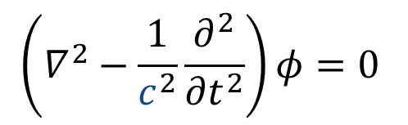


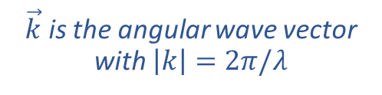




3. Dynamics of Classical Field
To obtain relativistic wave equation, space & time derivatives should be written unified as $∂_{μ}=\left\{\frac{1}{c}\frac{∂}{∂t},\frac{∂}{∂x},\frac{∂}{∂y},\frac{∂}{∂z}\right\}$. Thus, the wave speed $v$ should equal to the speed of light $c$
$$\left(∇^{2}−\frac{1}{c^{2}}\frac{∂^{2}}{{∂t}^{2}}\right)φ=0$$
$$□φ=η^{μν}∂_{μ}∂_{ν}φ=0$$
This has a complete set of plane wave solutions of the form
$\vec{k}$ is the angular wave vector with $\left|k\right|=2π/λ$
$$φ\left(t,x,y,z\right)=φ_{0}e^{i\left(\vec{k}∙\vec{r}−ωt\right)}$$
$\vec{r}$ is the position vector
$ω$ is the angular frequency
Substituting this solution into the wave equation yields the dispersion relation
$$E=ℏω$$
$$ω^{2}−k^{2}c^{2}=0$$
$$E^{2}−p^{2}c^{2}=0$$
$$p=ℏk$$
This is reminiscent of the energy-momentum relationship for massless particles

Slide 14

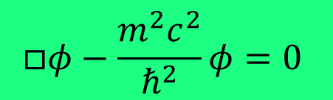


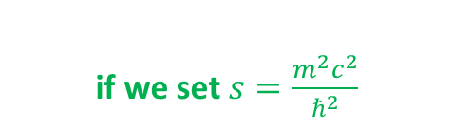







3. Dynamics of Classical Field
We can modify the wave equation while preserving Lorentz covariance by
introducing a Lorentz scalar $s$.
$$□φ=s$$
This is the wave equation with a source term
(it does not in general have plane wave solutions)
$$□φ=η^{μν}∂_{μ}∂_{ν}φ=0$$
$$□φ=sφ$$
This form has plane wave solutions
iff $s$ is independent of time and space
Substituting the plane wave solution into the second form yields the dispersion relation
if we set $s=\frac{m^{2}c^{2}}{ℏ^{2}}$
$$E=ℏω$$
This is the energy-momentum relationship for massive particles
$$ω^{2}−k^{2}c^{2}=sc^{2}$$
$$E^{2}−p^{2}c^{2}=m^{2}c^{4}$$
$$p=ℏk$$
This is called Klein-Gordon eq., relativistic field equation (field’s eq. of motion) of a real scalar field $φ$ with mass $m$
$$□φ−\frac{m^{2}c^{2}}{ℏ^{2}}φ=0$$
$$c=ℏ=1$$
$$□φ−m^{2}φ=0$$
in SI unit
in natural unit

Slide 15

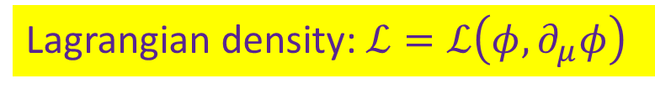

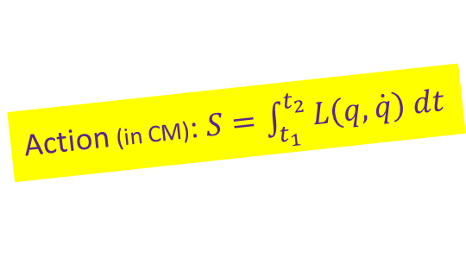



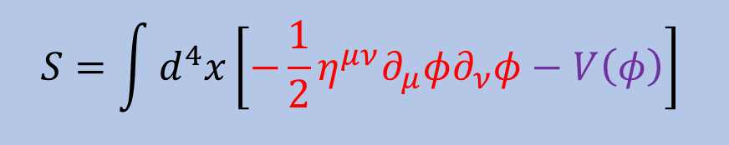
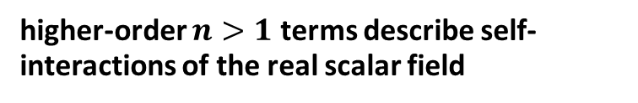
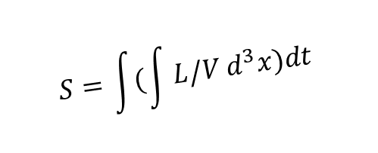
3. Dynamics of Classical Field
We can modify the wave equation while preserving Lorentz covariance by
introducing a Lorentz scalar $s$.
$$□φ=s$$
This is the wave equation with a source term
(it does not in general have plane wave solutions)
$$□φ=η^{μν}∂_{μ}∂_{ν}φ=0$$
$$□φ=m^{2}φ$$
Klein-Gordon equation describing a real free scalar field $φ$ with mass $m$
$$□φ=sφ^{n}$$
higher-order $n>1$ terms describe self-interactions of the real scalar field
The most general form of scalar field equation can be derived from the action
kinetic term
potential term: any functions of $φ$
recall
$$S=\int{d^{4}x}\left[−\frac{1}{2}η^{μν}∂_{μ}φ∂_{ν}φ−V\left(φ\right)\right]$$
Action (in CM): $S=\int_{t_{1}}^{t_{2}}{L\left(q,\dot{q}\right) dt}$
$$S=\int{(\int{L/V}d^{3}x})dt$$
Lagrangian density: $ℒ=ℒ\left(φ,∂_{μ}φ\right)$
$$d^{4}x$$

Slide 16


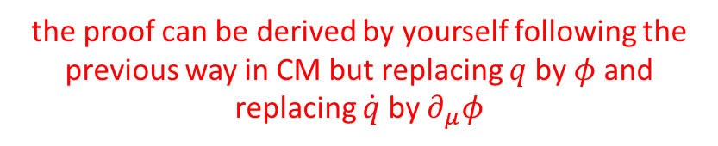
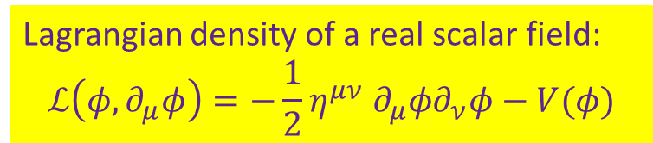
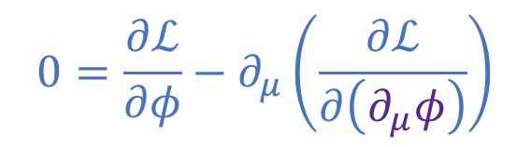



3. Dynamics of Classical Field
The most general form of scalar field equation can be derived from the action
$$S=\int{d^{4}x}ℒ\left(φ,∂_{μ}φ\right)$$
Their dynamics can be described by Lagrangian formulation
The least action principle ($δS=0$)
the proof can be derived by yourself following the previous way in CM but replacing $q$ by $φ$ and replacing $\dot{q}$ by $∂_{μ}φ$
The Euler-Lagrange field equation
(Field equation = Equation of motions)
$$0=\frac{∂ℒ}{∂φ}−∂_{μ}\left(\frac{∂ℒ}{∂\left(∂_{μ}φ\right)}\right)$$
Note: apart from real scalar fields, this form of Euler-Lagrange equation can be applied for every relativistic classical fields
(like F=ma for classical field)
Gen. (real) scalar field equation
Klein-Gordon equation
Lagrangian density of a real scalar field:
$$ℒ\left(φ,∂_{μ}φ\right)=−\frac{1}{2}η^{μν} ∂_{μ}φ∂_{ν}φ−V(φ)$$
$$□φ=\frac{dV}{dφ}$$
for
$V=\frac{1}{2}m^{2}φ^{2}$
$$□φ=m^{2}φ$$

Slide 17
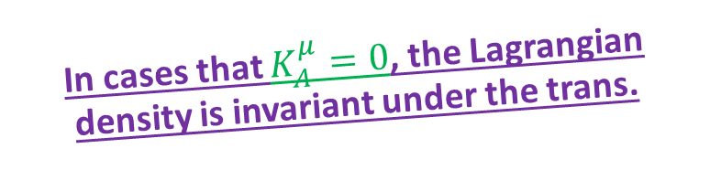
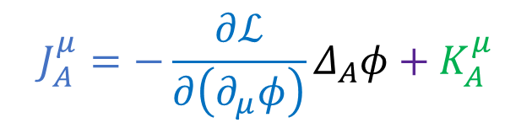


3. Dynamics of Classical Field
As in CM, Lagrangian formulation also gives conserved quantities through the symmetry of the Lagrangian densities (besides the Euler-Lagrange field equations)
For general infinitesimal trans. $φ→φ^{′}=φ+ε^{A}Δ_{A}φ$
If the theory has a symmetry under this trans., then the action is invariant,
$$δS/δε^{A}=0$$
and the variation of the Lagrangian density is an explicit total derivative, i.e.
In cases that $K_{A}^{μ}=0$, the Lagrangian density is invariant under the trans.
$$ℒ→ℒ^{′}=ℒ+ε^{A}∂_{μ}K_{A}^{μ}$$
The quantity called Noether current
$$J_{A}^{μ}=−\frac{∂ℒ}{∂\left(∂_{μ}φ\right)}Δ_{A}φ+K_{A}^{μ}$$
is a conserved current, by which we mean that $∂_{μ}J_{A}^{μ}=0$for all solutions of the field equations

Slide 18
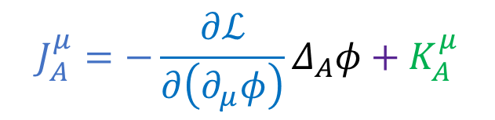

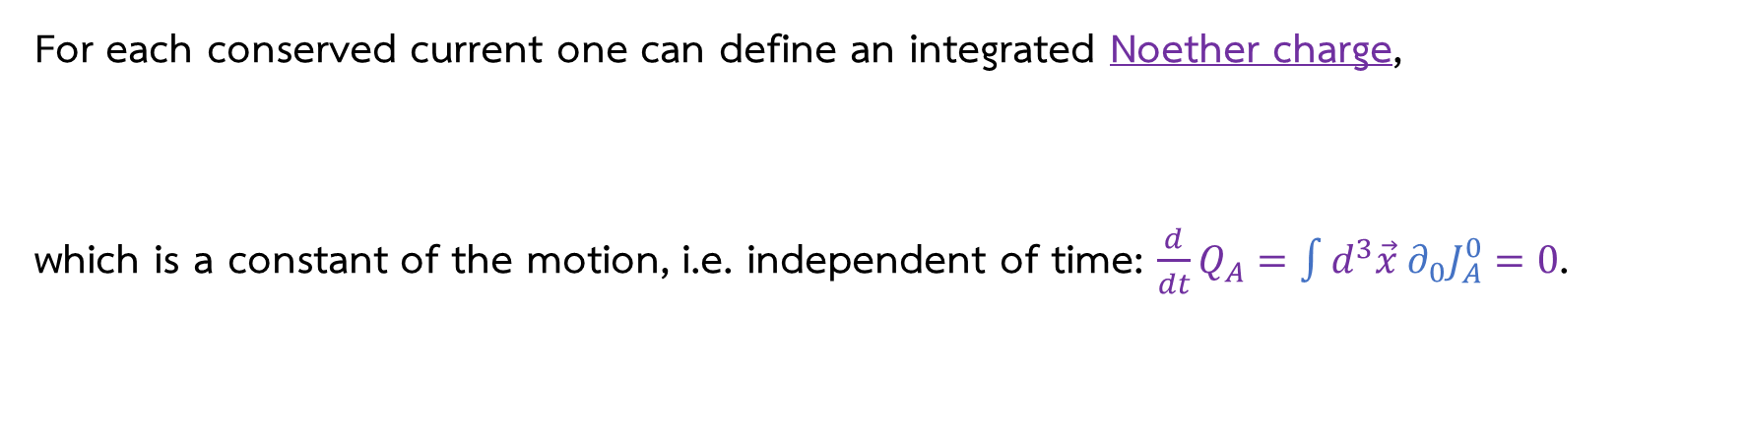
3. Dynamics of Classical Field
The quantity called Noether current
$$J_{A}^{μ}=−\frac{∂ℒ}{∂\left(∂_{μ}φ\right)}Δ_{A}φ+K_{A}^{μ}$$
is a conserved current, by which we mean that $∂_{μ}J_{A}^{μ}=0$for all solutions of the field equations
For each conserved current one can define an integrated Noether charge,
which is a constant of the motion, i.e. independent of time: $\frac{d}{dt}Q_{A}=\int{d^{3}\vec{x} ∂_{0}J_{A}^{0}}=0$.
$$Q_{A}=\int{d^{3}\vec{x} J_{A}^{0}}$$

Slide 19

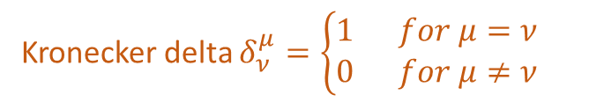

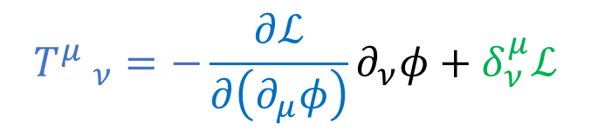



3. Dynamics of Classical Field
a small constant 4-vector
$$ε^{A}=a^{μ}$$
Ex1. spacetime translation: $x^{μ}→{x′}^{μ}=x^{μ}+a^{μ}$
$$Δ_{A}φ=∂_{μ}φ$$
Taylor’s theorem
under whish the scalar field transforms as $φ→φ′(x+a)=φ(x)+a^{μ}∂_{μ}φ$
and also $∂_{μ}φ→∂_{μ}φ′(x+a)=∂_{μ}φ(x)+a^{ν}∂_{μ}∂_{ν}φ$
Thus, the Lagrangian density transforms as $ℒ→ℒ′=ℒ+a^{μ}∂_{μ}ℒ$
comparing with
$$ℒ→ℒ^{′}=ℒ+ε^{A}∂_{μ}K_{A}^{μ}$$
$$K_{A}^{μ}=δ_{ν}^{μ}ℒ$$
with $ε^{A}=a^{ν}$
Kronecker delta $δ_{ν}^{μ}=\left\{\begin{aligned}1 for μ=ν \\ 0 for μ≠ν\end{aligned}\right.$
With all these, we find the Noether current
$${T^{μ} }_{ν}=−\frac{∂ℒ}{∂\left(∂_{μ}φ\right)}∂_{ν}φ+δ_{ν}^{μ}ℒ$$
which is called energy-momentum (or stress-energy) tensor

Slide 20
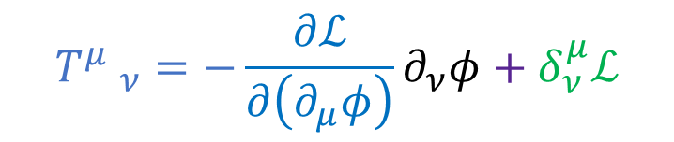
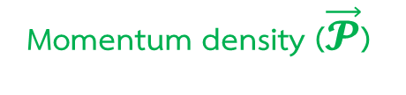



3. Dynamics of Classical Field
With all these, we find the Noether current
$${T^{μ} }_{ν}=−\frac{∂ℒ}{∂\left(∂_{μ}φ\right)}∂_{ν}φ+δ_{ν}^{μ}ℒ$$
which is called energy-momentum (or stress-energy) tensor
$$p_{μ}=\int{d^{3}\vec{x} {T^{0} }_{μ}}$$
Noether charge = momentum 4-vector
Energy
3D Momentum
$$E=p_{0}=\int{d^{3}\vec{x} {T^{0} }_{0}}$$
$$\vec{P}=p_{i}=\int{d^{3}\vec{x} {T^{0} }_{i}}$$
They have energy
and momentum
Energy density (𝓾)
Momentum density ($\vec{𝓟}$)

Slide 21
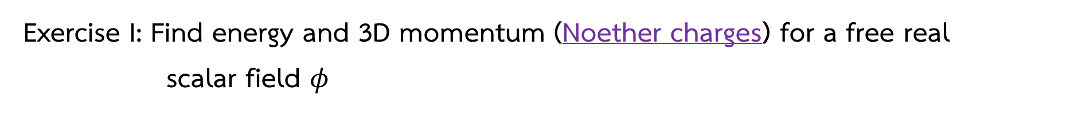
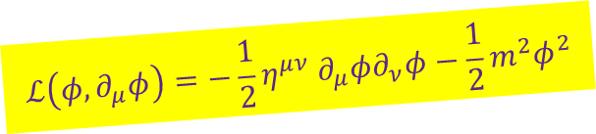
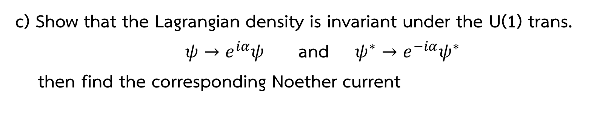
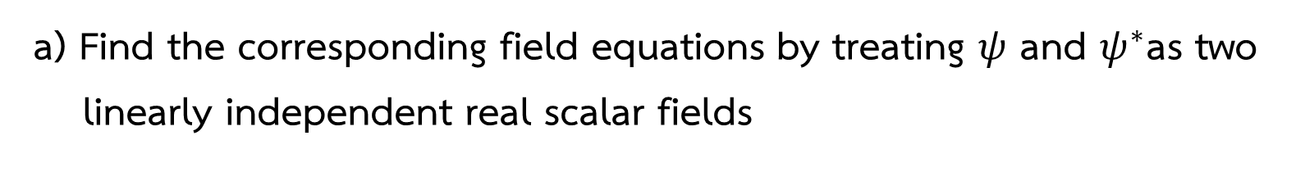

NOW YOUR TURN
Exercise I: Find energy and 3D momentum (Noether charges) for a free real
scalar field $φ$
$$ℒ\left(φ,∂_{μ}φ\right)=−\frac{1}{2}η^{μν} ∂_{μ}φ∂_{ν}φ−\frac{1}{2}m^{2}φ^{2}$$
Exercise II: Consider a complex scalar field $ψ$ with Lagrangian density
$ℒ\left(ψ,ψ^{∗},∂_{μ}ψ,∂_{μ}ψ^{∗}\right)=−\frac{1}{2}η^{μν} ∂_{μ}ψ^{∗}∂_{ν}ψ−\frac{1}{2}m^{2}ψ^{∗}ψ$
a) Find the corresponding field equations by treating $ψ$ and $ψ^{∗}$as two linearly independent real scalar fields
b) Find the corresponding energy and 3D momentum
c) Show that the Lagrangian density is invariant under the U(1) trans.
$ψ→e^{iα}ψ$ and $ψ^{∗}→e^{−iα}ψ^{∗}$
then find the corresponding Noether current

Slide 22








3. Dynamics of Classical Field
For vector fields, we consider electromagnetic fields as an example
They have energy density
Their dynamics are described by Maxwell’s Eqs.
$$𝓾=\frac{1}{2}ε_{0}E_{0}^{2}=\frac{1}{2μ_{0}}B_{0}^{2}$$
charge density
$\vec{∇}∙\vec{E}=\frac{ρ}{ε_{0}}$
$\vec{∇}∙\vec{B}=0$
$\vec{∇}×\vec{E}=−\frac{∂\vec{B}}{∂t}$
$\vec{∇}×\vec{B}=μ_{0}\vec{j}+\frac{1}{c^{2}}\frac{∂\vec{E}}{∂t}$
Vacuum permittivity
They have momentum density
current density
$$\vec{𝓟}=ε_{0}\left(\vec{E}×\vec{B}\right)$$
speed of light
$$c={\left(μ_{0}ε_{0}\right)}^{−1/2}$$
Vacuum permeability
No magnetic monopole

Slide 23









3. Dynamics of Classical Field
Maxwell’s eqs. unify electric & magnetic field
Maxwell’s Eqs.
✓relativistic
Electromagnetic wave eqs
$\vec{∇}∙\vec{E}=\frac{ρ}{ε_{0}}$
$\vec{∇}∙\vec{B}=0$
$\vec{∇}×\vec{E}=−\frac{∂\vec{B}}{∂t}$
$\vec{∇}×\vec{B}=μ_{0}\vec{j}+\frac{1}{c^{2}}\frac{∂\vec{E}}{∂t}$
$$∇^{2}\vec{E}=μ_{0}ε_{0}\frac{∂^{2}\vec{E}}{∂t^{2}}$$
$$∇^{2}\vec{B}=μ_{0}ε_{0}\frac{∂^{2}\vec{B}}{∂t^{2}}$$
How??
Exercise III
and
Hint: For instance vector $\vec{V}$, $\vec{∇}×\left(\vec{∇}×\vec{V}\right)=\vec{∇}\left(\vec{∇}∙\vec{V}\right)−∇^{2}\vec{V}$
Two field Eqs.
$□^{2}\frac{φ}{c}=−μ_{0}cρ$
$□^{2}\vec{A}=−μ_{0}\vec{j}$
d’ Alembert op.
For instance vector $\vec{V}$, $\vec{∇}∙\left(\vec{∇}×\vec{V}\right)=0$, we can write
$$□=\left(∇^{2}−\frac{1}{c^{2}}\frac{∂^{2}}{{∂t}^{2}}\right)$$
$$\vec{E}=−\vec{∇}φ−\frac{∂\vec{A}}{∂t}$$
$$\vec{B}=\vec{∇}×\vec{A}$$
as well as
For simplicity, we will write these eqs in terms of
4-vector potential: $A_{μ}=\{\frac{φ}{c},\vec{A}\}$

Slide 24









3. Dynamics of Classical Field
We can unify electric & magnetic field by introducing 4-vector potential
Two field Eqs.
$$A^{μ}=\{\frac{φ}{c},\vec{A}\}$$
$□^{2}\frac{φ}{c}=−μ_{0}cρ$
$□^{2}\vec{A}=−μ_{0}\vec{j}$
One field Eq.
$$∂_{ν}F^{μν}=μ_{0}J^{μ}$$
$$J^{μ}=\{cρ,\vec{j}\}$$
$$A^{μ}=\{\frac{φ}{c},\vec{A}\}$$
$$\vec{E}=−\vec{∇}φ−\frac{∂\vec{A}}{∂t}$$
Bianchi Identity
$$\vec{B}=\vec{∇}×\vec{A}$$
as well as
$$∂_{μ}F_{νρ}+∂_{ν}F_{ρμ}+∂_{ρ}F_{μν}=0$$
With the field strength tensor
satisfy by def.
$$F_{μν}=∂_{μ}A_{ν}−∂_{ν}A_{μ}$$

Slide 25







3. Dynamics of Classical Field
This field equation can be derived by Lagrangian formulation
The Euler-Lagrange field equation
Lagrangian density:
$$ℒ\left(A_{μ},∂_{ν}A_{μ}\right)=−\frac{1}{4μ_{0}}F_{μν}F^{μν}−J^{μ}A_{μ}$$
One field Eq.
Exercise IV
$$∂_{ν}F^{μν}=μ_{0}J^{μ}$$
$$0=\frac{∂ℒ}{∂A_{μ}}−∂_{ν}\left(\frac{∂ℒ}{∂\left(∂_{ν}A_{μ}\right)}\right)$$
Hint: $\frac{∂\left(∂_{α}A_{β}\right)}{∂\left(∂_{ν}A_{μ}\right)}=δ_{α}^{ν}δ_{Β}^{μ}$
In vacuum (no source term)
The Euler-Lagrange field equation
Lagrangian density:
$$ℒ\left(A_{μ},∂_{ν}A_{μ}\right)=−\frac{1}{4μ_{0}}F_{μν}F^{μν}$$
One field Eq.
$$∂_{ν}F^{μν}=0$$
$$0=\frac{∂ℒ}{∂A_{μ}}−∂_{ν}\left(\frac{∂ℒ}{∂\left(∂_{ν}A_{μ}\right)}\right)$$

Slide 26






3. Dynamics of Classical Field
In vacuum (no source term)
The Euler-Lagrange field equation
Lagrangian density:
$$ℒ\left(A_{μ},∂_{ν}A_{μ}\right)=−\frac{1}{4μ_{0}}F_{μν}F^{μν}$$
One field Eq.
$$∂_{ν}F^{μν}=0$$
$$0=\frac{∂ℒ}{∂A_{μ}}−∂_{ν}\left(\frac{∂ℒ}{∂\left(∂_{ν}A_{μ}\right)}\right)$$
spacetime translation
The energy-momentum (or stress-energy) tensor
$${T^{μ} }_{ν}=−\frac{∂ℒ}{∂\left(∂_{μ}A_{ρ}\right)}∂_{ν}A_{ρ}+δ_{ν}^{μ}ℒ=\frac{1}{μ_{0}}\left(F^{μσ}F_{νσ}−\frac{1}{4}δ_{ν}^{μ}F_{ρσ}F^{ρσ}\right)$$
How??
Exercise V
Energy density
Momentum density
$$\text{𝓾}={T^{0} }_{0}=\frac{1}{2}ε_{0}E_{0}^{2}=\frac{1}{2μ_{0}}B_{0}^{2}$$
$$\vec{𝓟}={T^{0} }_{i}=ε_{0}{\left(\vec{E}×\vec{B}\right)}_{i}$$

Slide 27







4. What are Classical Fields in Curved Spacetime?
Everything we have considered so far is classical field in flat spacetime
Dynamics of classical fields in curved spacetime can be achieved through
the minimal coupling process.
This can be done by changing the following components in the action
flat spacetime metric $η_{μν}=diag(−,+,+,+)$
curved spacetime metric
$$g_{μν}\left(x\right)$$
flat volume element
$d^{4}x=\sqrt{\left|η\right|}$ $d^{4}x$
curved volume element
$\sqrt{\left|g\right|}$ $d^{4}x$
$$g=\det{g_{μν}}$$
spacetime derivative $∂_{μ}$
covariant derivative
$$∇_{μ}=∂_{μ}+Γ_{μ}$$
Christoffel symbols

Slide 28








4. What are Classical Fields in Curved Spacetime?
For example, a real scalar field theory
curved spacetime
action
flat spacetime
$$S=\int{\sqrt{\left|g\right|}d^{4}x}\left[−\frac{1}{2}g^{μν}∇_{μ}φ∇_{ν}φ−V\left(φ\right)\right]$$
action
$$S=\int{d^{4}x}\left[−\frac{1}{2}η^{μν}∂_{μ}φ∂_{ν}φ−V\left(φ\right)\right]$$
$$=\int{\sqrt{\left|g\right|}d^{4}x}\left[−\frac{1}{2}g^{μν}∂_{μ}φ∂_{ν}φ−V\left(φ\right)\right]$$
field equation
field equation
since $∇_{μ}φ=∂_{μ}φ$
$$□φ=η^{μν}∂_{μ}∂_{ν}φ=\frac{dV}{dφ}$$
$$□φ=g^{μν}∇_{μ}∂_{ν}φ=\frac{dV}{dφ}$$
Energy-momentum tensor
Energy-momentum tensor
$$T_{μν}=∂_{μ}φ∂_{ν}φ−\frac{1}{2}η_{μν}\left(∂_{ρ}φ∂^{ρ}φ+2V\right)$$
$$T_{μν}=∂_{μ}φ∂_{ν}φ−\frac{1}{2}g_{μν}\left(∂_{ρ}φ∂^{ρ}φ+2V\right)$$

Slide 29







4. What are Classical Fields in Curved Spacetime?
For example, a vector (EM) field theory
curved spacetime
action
flat spacetime
$$S=\int{\sqrt{\left|g\right|}d^{4}x}\left[−\frac{1}{4}F_{μν}F^{μν}\right]$$
action
$$S=\int{d^{4}x}\left[−\frac{1}{4}F_{μν}F^{μν}\right]$$
where $F_{μν}=∇_{μ}A_{ν}−∇_{ν}A_{μ}=∂_{μ}A_{ν}−∂_{ν}A_{μ}$
field equation
field equation
$$∂_{ν}F^{μν}=0$$
$$∇_{ν}F^{μν}=0$$
Energy-momentum tensor
Energy-momentum tensor
$$T_{μν}=η^{ρσ}F_{μρ}F_{νσ}−\frac{1}{4}η_{μν}F_{ρσ}F^{ρσ}$$
$$T_{μν}=g^{ρσ}F_{μρ}F_{νσ}−\frac{1}{4}g_{μν}F_{ρσ}F^{ρσ}$$

Slide 30









4. What are Classical Fields in Curved Spacetime?
The energy-momentum tensor $T_{μν}$ plays an important role being a source of the spacetime curvature in GR as shown in Einstein’s field eq.: $R_{μν}−\frac{1}{2}g_{μν}R=8πGT_{μν}$
Apart from the spacetime translation, the energy-momentum tensor $T_{μν}$ can also be obtained by vary the action w.r.t. the metric tensor
field 1
flat spacetime
curved spacetime
$$T^{μν}=−\frac{2}{\sqrt{\left|η\right|}}\frac{δS}{δη_{μν}}$$
$$T^{μν}=−\frac{2}{\sqrt{\left|g\right|}}\frac{δS}{δg_{μν}}$$
interaction
The action of Einstein’s field equation
$$S=S_{gravity}+S_{Matter}$$
$$δ/δg_{μν}$$
$$δ/δg_{μν}$$
$$R_{μν}−\frac{1}{2}g_{μν}R$$
$$\sim T_{μν}$$

Slide 31
















Further topics (Spinor field)
Lagrangian density
Field equation
vector field ex. EM field $A_{μ}\left(x\right)$
$$ℒ=−\frac{1}{4}F_{μν}F^{μν}$$
$$∇_{ν}F^{μν}=0$$
Bosonic field
(integer spin)
(spin 1)
scalar field ex. real scalar field $φ\left(x\right)$
$$ℒ=−\frac{1}{2} η^{μν}∂_{μ}φ∂_{ν}φ−\frac{1}{2}m^{2}φ^{2}$$
Klein-Gordon eq.
$$□φ−m^{2}φ=0$$
(spin 0)
tensor field ex. metric tensor $g_{μν}\left(x\right)$
$$R_{μν}−\frac{1}{2}g_{μν}R=0$$
$$ℒ=R$$
(spin 2)
Dirac conjugate, i.e., 4x1 complex matrix
Dirac eq.
^2
spinor field ex. Dirac spinor
$$χ_{α}\left(x\right)=\left(\begin{matrix}\begin{matrix}χ_{1}\left(x\right) \\ χ_{2}\left(x\right)\end{matrix} \\ \begin{matrix}χ_{3}\left(x\right) \\ χ_{4}\left(x\right)\end{matrix}\end{matrix}\right)$$
$${{\left(γ^{μ}\right)}_{α}}^{β}∂_{μ}χ_{β}−mχ_{α}=0$$
Fermionic field
(half-integer spin)
$$δS/δ\overline{χ}$$
(spin 1/2)
$$ℒ={\overline{χ}}^{β}{{\left(γ^{μ}\right)}_{β}}^{α}∂_{μ}χ_{α}−m{\overline{χ}}^{α}χ_{α}$$
ex. electron
4x1 complex matrix
$${{\left(γ^{μ}\right)}_{β}}^{α}∂_{μ}{\overline{χ}}^{β}−m{\overline{χ}}^{α}=0$$
$$δS/δχ$$
gamma matrix, i.e., 4x4 complex matrix satisfying Clifford algebra
$\left\{γ^{μ},γ^{ν}\right\}=γ^{μ}γ^{ν}$+ $γ^{ν}γ^{μ}=2η^{μν}$
ex. positron
vector-spinor field ex. gravitino $Ψ_{μ}^{α}\left(x\right)$ in supergravity see [3]
(spin 3/2)

Slide 32










Further topics (Gauge theory)
What about interactions between classical fields?
The action of Einstein’s field equation
$$S=S_{gravity}+S_{Matter}$$
$$δ/δg_{μν}$$
$$δ/δg_{μν}$$
Adding the actions of free different fields cannot describe their interaction!!
$$R_{μν}−\frac{1}{2}g_{μν}R$$
$$\sim T_{μν}$$
$$S=S_{φ}+S_{A_{μ}}$$
field 1
In this case, interaction terms is hidden in $S_{Matter}$ terms via the minimal coupling
$$∂_{μ}→∇_{μ}$$
$$+S_{int.}$$
We need interaction terms
field 1
ex. complex scalar field $φ\left(x\right)$
field 2
ex. EM field $A_{μ}\left(x\right)$
interaction
interaction
Gauge symmetry is the key to interactions between classical fields

Slide 33


Further topics (Gauge theory)
$ψ→e^{iα}ψ$ and $ψ^{∗}→e^{−iα}ψ^{∗}$
For example, the U(1) trans. in Exercise II
This corresponds to shifting the phase of the field around an imaginary circles.
If the U(1) trans. is local, i.e., $α=α\left(x\right)$
the action isn’t invariant.
We have to do minimal coupling the theory with EM field (U(1) gauge field)
in order to make the action invariant under the local U(1) transformation.
electric charge
$$∂_{μ}→D_{μ}=∂_{μ}−iqA_{μ}$$

Slide 34



Further topics (Gauge theory)
Etc.
U(1) gauge theory
SU(2) gauge theory
SU(3) gauge theory
“Electroweak”

Slide 35








Further topics (QFT)
Lagrangian density in terms of classical fields
$$ℒ=ℒ\left(φ_{i}, ∂_{μ}φ_{i}\right)$$
Legendre trans.
Hamiltonian density written in terms of classical fields and momentum density
$$ℋ=ℋ\left(φ_{i}, π_{i}\right)$$
momentum density
Quantum Field Theory
Nowadays particle physics
$$π_{i}=\frac{∂ℒ}{∂φ_{i}}$$
2nd Quantization
seen as a particle
operate by ${\hat{φ}}_{i}\left(\vec{x},t\right)$
U(1) x SU(2) x SU(3)
Empty space is full of particle/antiparticle creation & anihilation

Slide 36
References
[1] J. FRANKLIN, “Classical Field Theory,” Cambridge Univ. Press, United Kingdom (2017), ISBN 9781316995419. (English textbook)
[2] J. Polonyi, “Lecture Notes on Classical Field Theory,” available [online] at https://wigner.hu/~polonyi.janos/cft.pdf (English lecture note)
[3] D. Z. Freedman and A. Van Proeyen, `“ Supergravity,” Cambridge Univ. Press, 2012,
ISBN 978-1-139-36806-3, 978-0-521-19401-3 doi:10.1017/CBO9781139026833.
(English textbook)

