Slide 1
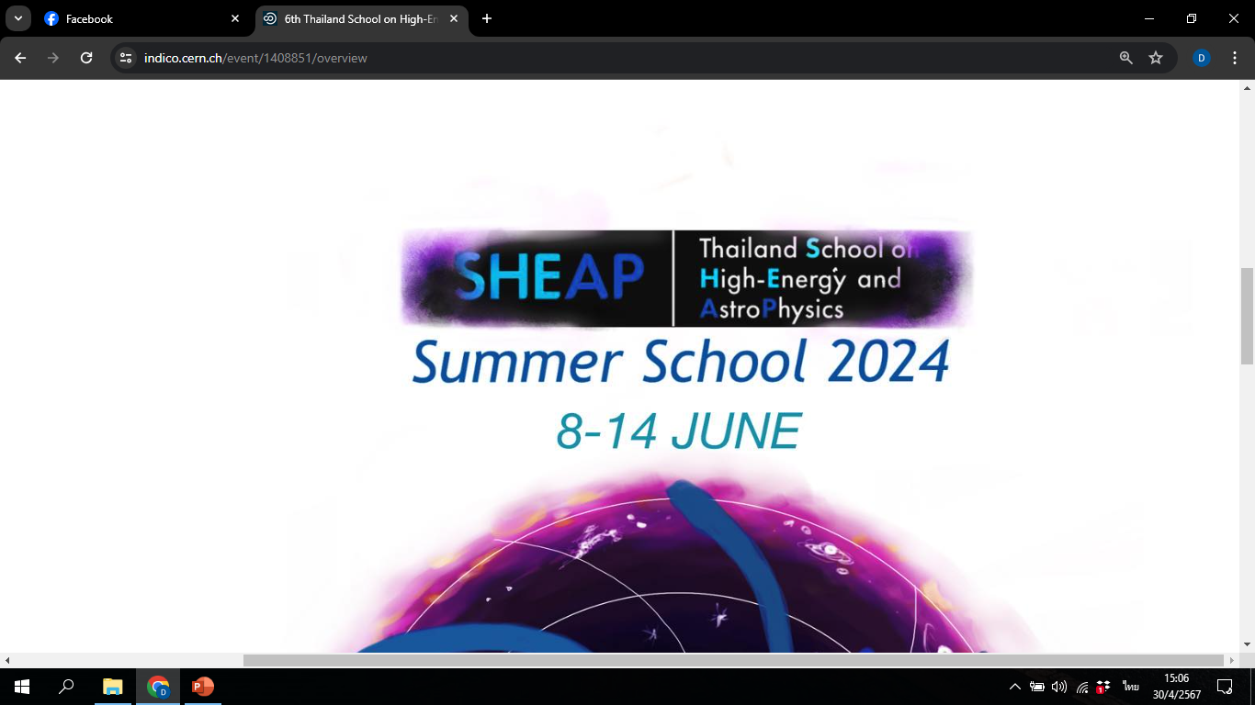
Least Action Principle
(หลักการแอคชันน้อยสุด)
10 June 2024
Dr. Patharadanai Nuchino (Day)
Department of Physics, Faculty of Science, Ramkhamhaeng University

Slide 2

Outline
1. Review of Newtonian Mechanics
2. Lagrangian formulation
Advanced Mechanics
(Classical Mechanics)
3. Euler-Lagrange equation
4. Conserved quantities and Noether theorem

Slide 3
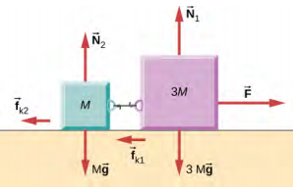
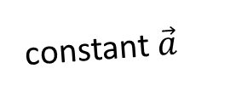

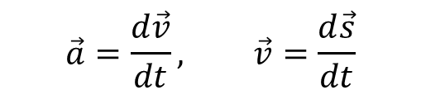

1. Review of Newtonian Mechanics
In high school physics, we have concerned about the relation between force and motion
Apply force
Create acceleration
Make motion
Kinematics
Newton’s law of motion
$$\vec{a}=\frac{d\vec{v}}{dt}, \vec{v}=\frac{d\vec{s}}{dt}$$
$$Σ\vec{F}=m\vec{a}$$
constant $\vec{a}$
${\vec{v}}_{f}={\vec{v}}_{i}+\vec{a}t$
${\left|{\vec{v}}_{f}\right|}^{2}={\left|{\vec{v}}_{i}\right|}^{2}+2\vec{a}∙\vec{s}$
$\vec{s}={\vec{v}}_{i}t+\frac{1}{2}\vec{a}t^{2}$
$\vec{s}=\left(\frac{{\vec{v}}_{i}+{\vec{v}}_{f}}{2}\right)t$
With these vector equations, we can describe EVERY SINGLE (simple) motion in textbooks

Slide 4
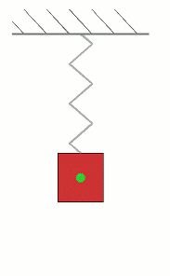
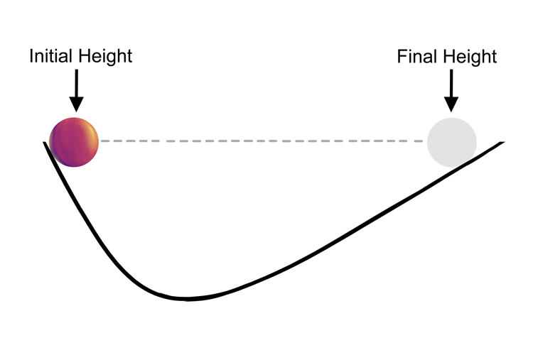
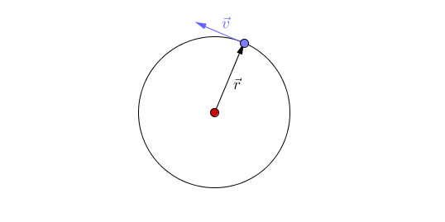
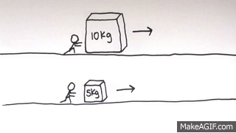
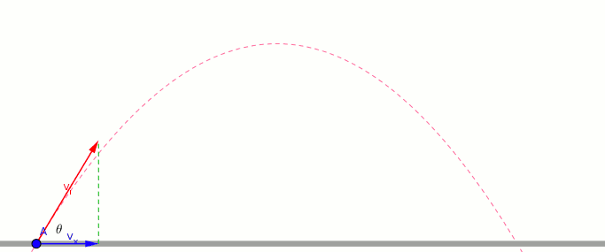
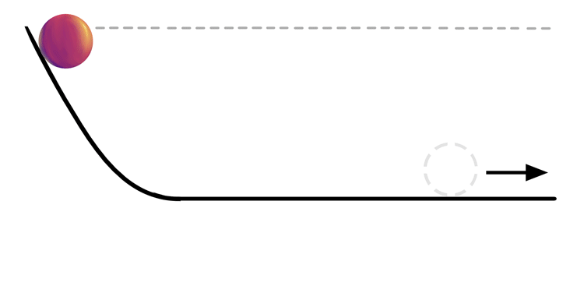
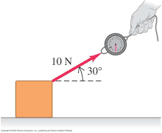
1. Review of Newtonian Mechanics
With these vector equations, we can describe EVERY SINGLE (simple) motion in textbooks
What about these?

Slide 5
1. Review of Newtonian Mechanics
Dealing with curved trajectory makes vector equations
(Newton’s law of motion & Kinematics) complicated!!
Instead, we find other more comfortable ways describing these motions!
Potential Energy
Conservation of Energy
Kinetic Energy
work
Period
However, we cannot fully describe actual paths of motion using these quantities!!
Constant quantities characterize the motion
Frequency

Slide 6
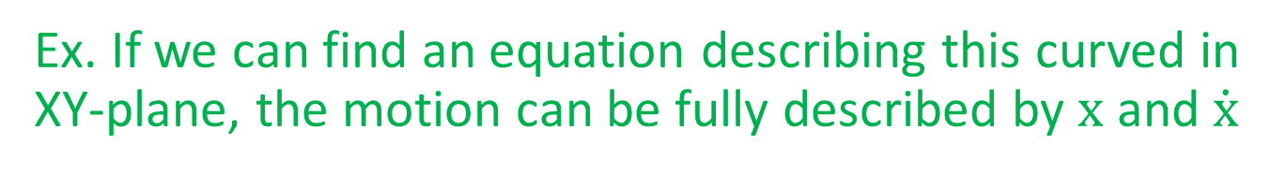
2. Lagrangian formulation
y
Scalar quantities/ scalar equations can fully describe motion picture if we can find constraint of the motion.
f(x,y)=0
Ex. If we can find an equation describing this curved in XY-plane, the motion can be fully described by $x$ and $\dot{x}$
x
We call least coordinates that can fully describe the motion (ex. $x$) as
generalized coordinates (gen. coor.) denoted by $q$
and call their time derivative (ex.$\dot{x}=\frac{dx}{dt}$ ) as
generalized velocities (gen. vel.) denoted by $\dot{q}$
# of gen. coor. = 3(# of particles) – # of constraints

Slide 7
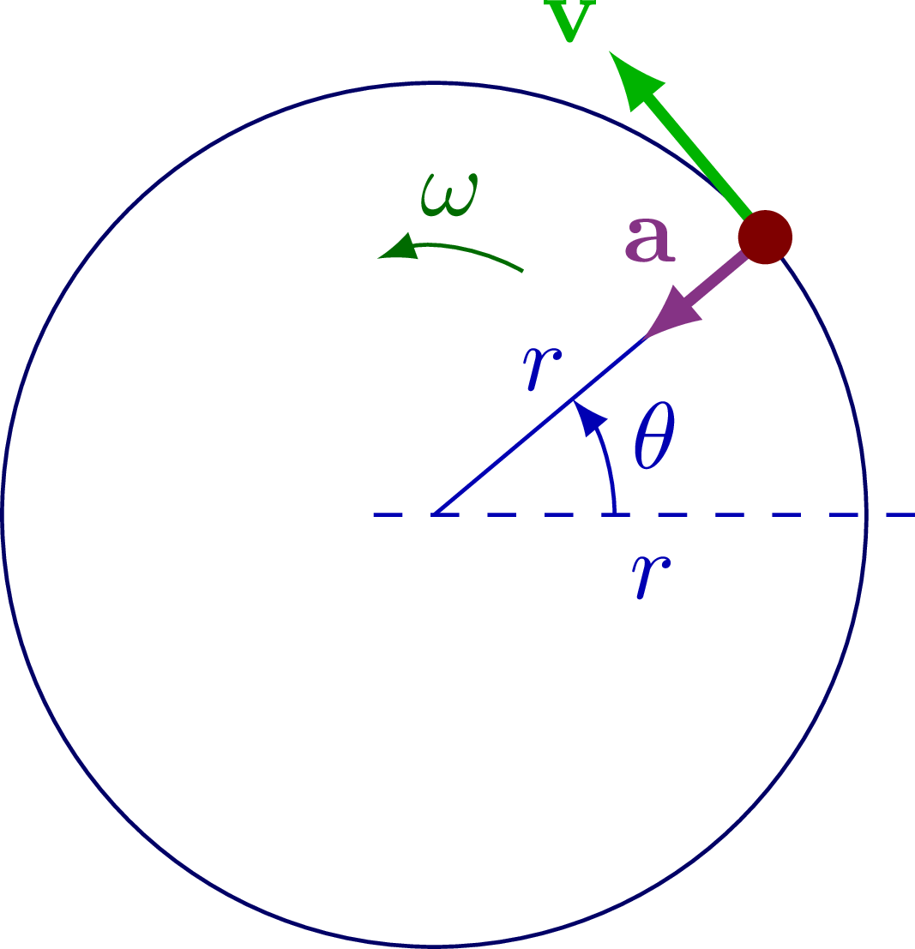

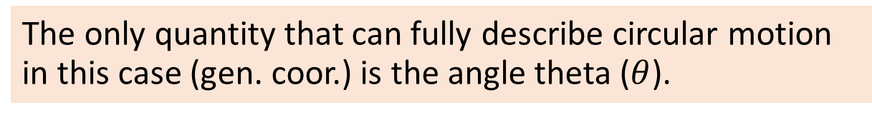

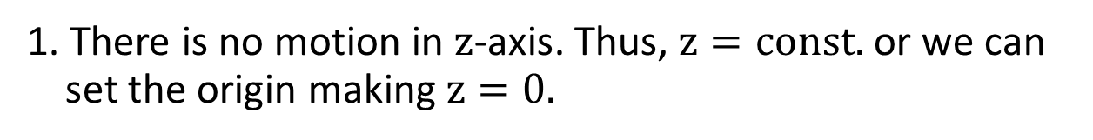
2. Lagrangian formulation
y
Note: gen. coor. don’t need to be x, y, z.
They can be any quantities fully describing the motion!!
Ex1. circular motion of one particle on XY plane
x
We find 2 constraints for this motion in cartesian coor. sys.
1. There is no motion in $z$-axis. Thus, $z=const.$ or we can set the origin making $z=0.$
2. Circular motion on XY plane satisfy the circle equation
In axial/spherical coor. sys. there are also two constraints
$z=0$ or $θ=π/2$
$r=const.$
making gen. coor. to be
$θ$ in axial coor. sys.
and $φ$ in axial coor. sys.
$$x^{2}+y^{2}−r^{2}=0$$
Therefore, the numbers of gen. coor. in this case is
# of gen. coor. = 3(1) – 2 = 1
The only quantity that can fully describe circular motion in this case (gen. coor.) is the angle theta ($θ$).

Slide 8
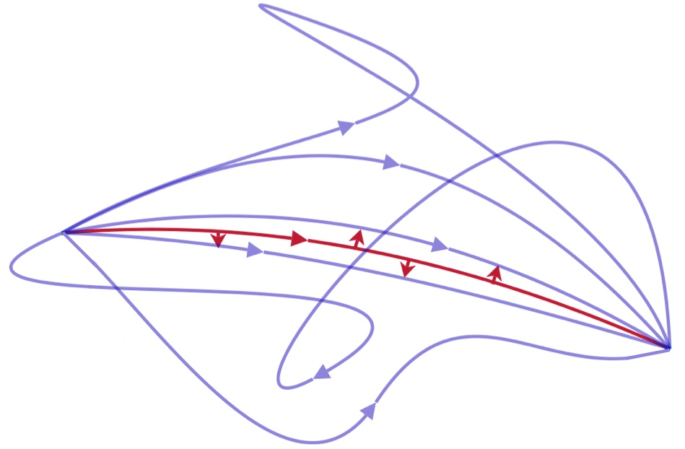
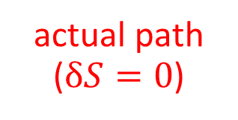
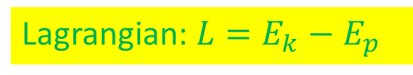


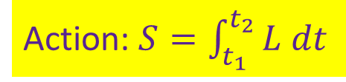

2. Lagrangian formulation
The least action principle
In any physical system, the path an object actually takes minimizes
the time integral of the difference between kinetic energy and potential energy.
Lagrangian: $L=E_{k}−E_{p}$
Action: $S=\int_{t_{1}}^{t_{2}}{L dt}$
actual path ($δS=0$)
Equations of motion
$$\left(q_{2},t_{2}\right)$$
final
imaginary path ($δS≠0$)
$$\left(q_{1},t_{1}\right)$$
initial
variation

Slide 9
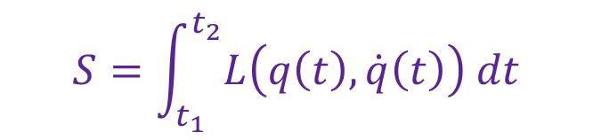
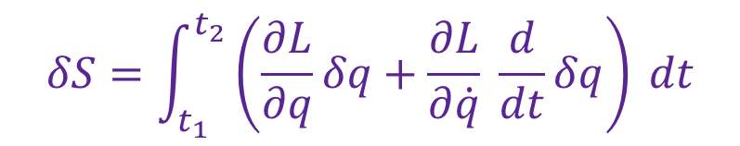
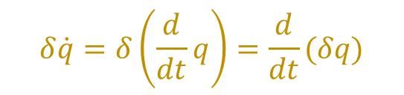

2. Lagrangian formulation
The key to obtain equations of motion is we need to write the Lagrangian in terms of gen. coor. and gen. velo., which are functions of time.
$$S=\int_{t_{1}}^{t_{2}}{L\left(q\left(t\right),\dot{q}\left(t\right)\right) dt}$$
Then do the variation $q\left(t\right)→q^{′}\left(t\right)=q\left(t\right)+δq(t)$ making the action vary as
$$δS=\int_{t_{1}}^{t_{2}}{δL\left(q\left(t\right),\dot{q}\left(t\right)\right) dt}=\int_{t_{1}}^{t_{2}}{\left(\frac{∂L}{∂q}δq+\frac{∂L}{∂\dot{q}}δ\dot{q}\right) dt}$$
However, the variation and time derivation are independent from each other so that
$$δ\dot{q}=δ\left(\frac{d}{dt}q\right)=\frac{d}{dt}(δq)$$
The variation then takes the form
$$δS=\int_{t_{1}}^{t_{2}}{\left(\frac{∂L}{∂q}δq+\frac{∂L}{∂\dot{q}} \frac{d}{dt}δq\right) dt}$$

Slide 10






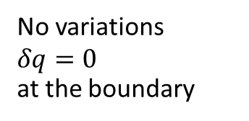
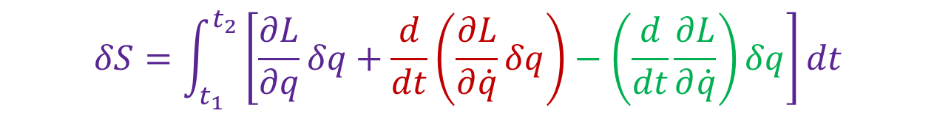

3. Euler-Lagrange equation
Since $\frac{d}{dt}\left(\frac{∂L}{∂\dot{q}}δq\right)=\left(\frac{d}{dt}\frac{∂L}{∂\dot{q}}\right)δq+\frac{∂L}{∂\dot{q}}\frac{d}{dt}δq$, substituting in the variation
$$δS=\int_{t_{1}}^{t_{2}}{\left[\frac{∂L}{∂q}δq+\frac{d}{dt}\left(\frac{∂L}{∂\dot{q}}δq\right)−\left(\frac{d}{dt}\frac{∂L}{∂\dot{q}}\right)δq\right]dt}$$
The second (red) term is the total derivation becoming the boundary terms
$$0$$
No variations
$δq=0$
at the boundary
$$δS=\int_{t_{1}}^{t_{2}}{\left[\frac{∂L}{∂q}−\frac{d}{dt}\frac{∂L}{∂\dot{q}}\right]δq dt+{\left[\frac{∂L}{∂\dot{q}}δq\right]}_{t_{1}}^{t_{2}}}$$
The least action principle
$$0$$
The Euler-Lagrange equation
$$\left(q_{2},t_{2}\right)$$
(Equation of motions)
$$0=\frac{∂L}{∂q}−\frac{d}{dt}\frac{∂L}{∂\dot{q}}$$
initial
final
$$δS=\int_{t_{1}}^{t_{2}}{\left(\frac{∂L}{∂q}δq+\frac{∂L}{∂\dot{q}} \frac{d}{dt}δq\right) dt}$$
$$q\left(t\right)$$
solve
$$\left(q_{1},t_{1}\right)$$
(like F=ma in scalar form)
differential equations

Slide 11


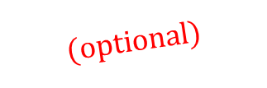



3. Euler-Lagrange equation
In conclusion, Lagrangian formulation gives rise to the path an object actually takes in the following steps
$$\left\{q_{1}, q_{2}, …, q_{n}\right\}$$
1. Determine general coordinates
2. Write out the Lagrangian in terms of the generalized coordinates and generalized velocities
$$L=L\left(q_{i},{\dot{q}}_{i}\right)$$
$$0=\frac{∂L}{∂q_{i}}−\frac{d}{dt}\frac{∂L}{∂{\dot{q}}_{i}}$$
3. Write out the Euler-Lagrange equations for each gen. coor.
$$get$$
Equations of motion
$$(optional)$$
4. Solve the equations of motion giving rise to the solution of gen. coor. as functions of time showing the actual path.
$$q_{i}=q_{i}\left(t\right)$$

Slide 12


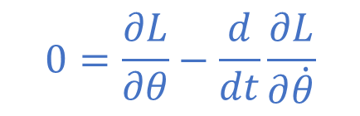



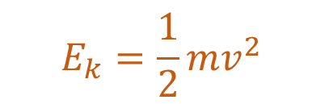

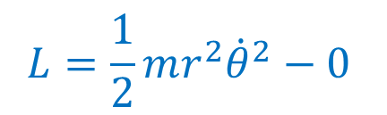
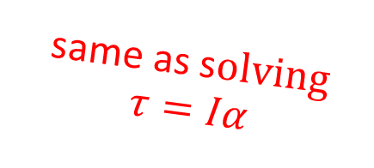
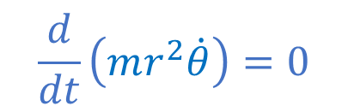
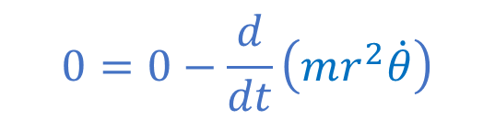

3. Euler-Lagrange equation
y
Ex1. circular motion of one particle on XY plane
1. There is one gen. coor., i.e., $θ$.
2. The Lagrangian in terms of the gen. coor. and gen. velo. is
x
$$L=\frac{1}{2}mr^{2}{\dot{θ}}^{2}−0$$
$$ω=\dot{θ}$$
$$E_{k}=\frac{1}{2}mv^{2}$$
$$=\frac{1}{2}mω^{2}r^{2}$$
$$=\frac{1}{2}mr^{2}{\dot{θ}}^{2},$$
Since the kinetic energy is
while the potential energy is zero.
$$v=ωr$$
$$0=\frac{∂L}{∂θ}−\frac{d}{dt}\frac{∂L}{∂\dot{θ}}$$
$$0=0−\frac{d}{dt}\left(mr^{2}\dot{θ}\right)$$
3. The Euler-Lagrange equation is given by
$$\frac{d}{dt}\left(mr^{2}\dot{θ}\right)=0$$
or
which is nothing but the conservation of angular momentum
(angular momentum)
same as s$olving$
$$τ=Iα$$
4. Solve the Euler-Lagrange equation giving rise to
for $b$ and $c$ being constants
(angular newton’s law)
$$\dot{θ}=b/mr^{2}$$
and
$$θ\left(t\right)=(b/mr^{2})t+c$$

Slide 13
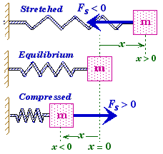
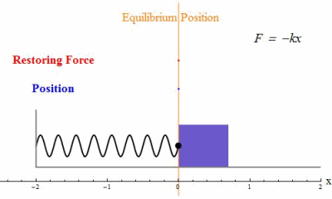
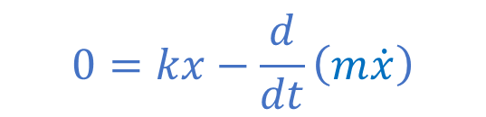


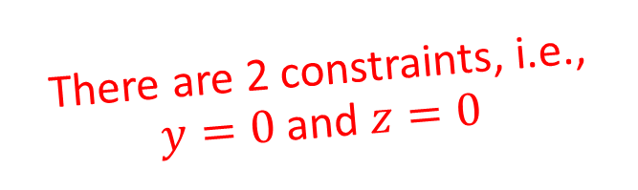


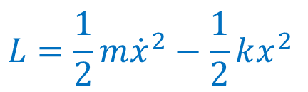
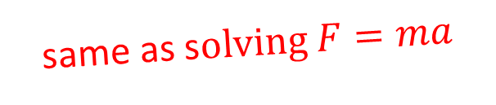



3. Euler-Lagrange equation
There are 2 constraints, i.e.,
$y=0$ and $z=0$
Ex2. Simple harmonic motion
1. There is one gen. coor., i.e., $x$.
2. The Lagrangian in terms of the gen. coor. and gen. velo. is
$$L=\frac{1}{2}m{\dot{x}}^{2}−\frac{1}{2}kx^{2}$$
$$E_{k}=\frac{1}{2}mv^{2}=\frac{1}{2}m{\dot{x}}^{2}$$
Since the kinetic energy is
$$v=dx/dt$$
$$E_{p}=\frac{1}{2}kx^{2}.$$
while the potential energy is
$$0=kx−\frac{d}{dt}\left(m\dot{x}\right)$$
3. The Euler-Lagrange equation is given by
or
$$kx=m\ddot{x}$$
same as s$olving F=ma$
4. Solve the Euler-Lagrange equation giving rise to
$$x\left(t\right)=a\sin{ωt}+b\cos{ωt}$$
with $ω=\sqrt{k/m}$
$a$ and $b$ being constants

Slide 14
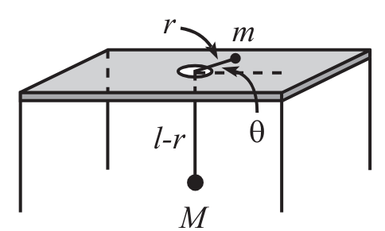


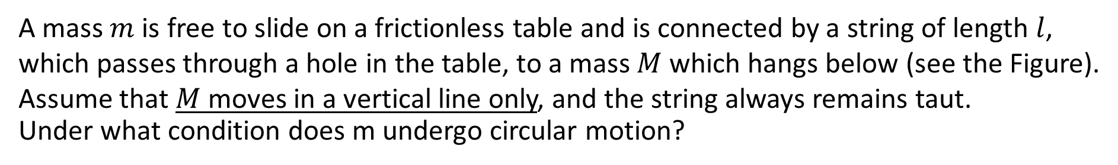

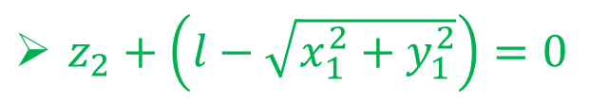






3. Euler-Lagrange equation
Ex3. Spinning on the table
A mass $m$ is free to slide on a frictionless table and is connected by a string of length $l$,
which passes through a hole in the table, to a mass $M$ which hangs below (see the Figure).
Assume that $M$ moves in a vertical line only, and the string always remains taut.
Under what condition does m undergo circular motion?
STEP 1: Determine gen. coor.
z
y
$$\left(x_{1},y_{1},z_{1}\right)$$
How many constraints we have from this setting?
x
$z_{1}=0$
$x_{2}=0$
$y_{2}=0$
$x_{1}^{2}+y_{1}^{2}=r^{2}$
$z_{2}+\left(l−\sqrt{x_{1}^{2}+y_{1}^{2}}\right)=0$
$$\left(x_{2},y_{2},z_{2}\right)$$
$z_{2}=−\left(l−r\right)$
$l$ is a constant
There are 4 constraint
# of gen. coor. = 3(2) – 4 = 2
We choose $r$ and $θ$ to be generalized coor.

Slide 15



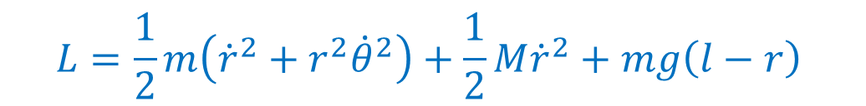













3. Euler-Lagrange equation
STEP 2: Write the Lagrangian in terms of the gen. coor. and gen. velo. is
Ex3. Spinning on the table
z
$$x_{1}=r\cos{θ}$$
The total kinetic energy is
$$\left(x_{1},y_{1},z_{1}\right)$$
$$y_{1}=r\sin{θ}$$
y
$$x_{1}^{2}+y_{1}^{2}=r^{2}$$
$$0$$
$$0$$
$$0$$
$${\dot{r}}^{2}$$
$$E_{k}=\frac{1}{2}m\left({\dot{x}}_{1}^{2}+{\dot{y}}_{1}^{2}+{\dot{z}}_{1}^{2}\right)+\frac{1}{2}M\left({\dot{x}}_{2}^{2}+{\dot{y}}_{2}^{2}+{\dot{z}}_{2}^{2}\right)$$
x
$${\dot{r}}^{2}+r^{2}{\dot{θ}}^{2}$$
$$z_{1}=0$$
$$x_{2}=0$$
$$y_{2}=0$$
$$z_{2}=−\left(l−r\right)$$
$$=\frac{1}{2}m\left({\dot{r}}^{2}+r^{2}{\dot{θ}}^{2}\right)+\frac{1}{2}M{\dot{r}}^{2}$$
$$\left(x_{2},y_{2},z_{2}\right)$$
The total potential energy is
$$E_{p}=−Mg\left(l−r\right)$$
$$L=\frac{1}{2}m\left({\dot{r}}^{2}+r^{2}{\dot{θ}}^{2}\right)+\frac{1}{2}M{\dot{r}}^{2}+mg\left(l−r\right)$$
The Lagrangian is

Slide 16
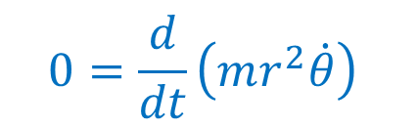
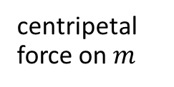











3. Euler-Lagrange equation
STEP 3: Write the Euler-Lagrange equations for each gen. coor.
Ex3. Spinning on the table
z
The Lagrangian is
$$\left(x_{1},y_{1},z_{1}\right)$$
$$L=\frac{1}{2}m\left({\dot{r}}^{2}+r^{2}{\dot{θ}}^{2}\right)+\frac{1}{2}M{\dot{r}}^{2}+mg\left(l−r\right)$$
y
x
1) $0=\frac{∂L}{∂θ}−\frac{d}{dt}\frac{∂L}{∂\dot{θ}}$
$$0=\frac{d}{dt}\left(mr^{2}\dot{θ}\right)$$
the conservation of angular momentum (as in Ex1)
$$\left(x_{2},y_{2},z_{2}\right)$$
2) $0=\frac{∂L}{∂r}−\frac{d}{dt}\frac{∂L}{∂\dot{r}}$
$$\left(M+m\right)\ddot{r}=mr{\dot{θ}}^{2}−Mg$$
acceleration in $r$ direction
centripetal force on $m$
gravitational force on $M$
Under what condition does m undergo circular motion?
ans.
$$=\frac{b^{2}}{mr_{0}^{3}}$$
($r=const.=r_{0}→\dot{r}=0→\ddot{r}=0$)
$$Mg=mr_{0}{\dot{θ}}^{2}$$
for $b$ being a constant (angular momentum)
Since $\dot{θ}=b/mr^{2}$ from the first eq. of motion

Slide 17



Exercise I: Moving frictionless plane
A block of mass $m$ is held motionless on a frictionless plane of mass $M$ and angle of inclination $θ$ (see the Figure). The plane rests on a frictionless horizontal surface. The block is released. What is the horizontal acceleration of the plane?
NOW YOUR TURN
a) Use the Lagrangian method
b) Use the Newton’s law $ΣF=ma$
(You will have a greater appreciation for the Lagrangian method.)

Slide 18










3. Euler-Lagrange equation
Apart from finding equation of motion, we can use the Euler-Lagrange eq. in order to find any minimal quantities.
Ex4. Shortest distance in a plane
Show that the shortest path between two points in a plane is a straight line.
Pythagoras
Distance: $s=\int_{(x_{1},z_{1})}^{(x_{2},z_{2})}{ds}$
$$ds=\sqrt{dx^{2}+dz^{2}}$$
$$\left(x_{2},z_{2}\right)$$
$$=\int_{x_{1}}^{x_{2}}{\sqrt{1+z^{′2}} dx}$$
$$z=z\left(x\right)$$
Now we treat $L=\sqrt{1+z^{′2}}$, then the Euler-Lagrange eq. $0=\frac{∂L}{∂z}−\frac{d}{dx}\frac{∂L}{∂z^{′}}$ will be the condition making $s$ shortest!
$$dz=\frac{dz}{dx}dx=z^{′}dx$$
$$\left(x_{1},z_{1}\right)$$
ans.
$$z\left(x\right)=Ax+B$$

Slide 19



Exercise II: The Brachistochrone
A bead is released from rest at the origin and slides down a frictionless wire that
connects the origin to a given point, as shown in Figure. You wish to shape the wire
so that the bead reaches the endpoint in the shortest possible time. Let the desired
curve be described by the function y(x), with downward taken to be positive.
Show that y(x) satisfies
1+y’² = B/y
where B is a constant. Then show that x and y may be written as
x = a(θ − sin θ), y = a(1 − cos θ).
This is the parametrization of a cycloid, which is the path taken by a point on the rim of a rolling wheel.
$$\left(x_{0},y_{0}\right)$$
Hint: The total time is $T=\int_{0}^{x_{0}}{\frac{ds}{v}}$ where the speed $v$ can be found as a function of $y$ via the conservation of energy

Slide 20




4. Conserved quantities and Noether’s theorem
Noether's Theorem
For each symmetry of the Lagrangian, there is a conserved quantity.
(one of the most beautiful and useful theorems in physics)
a function of $q_{i}$
Under the change of coordinates $q_{i}→q_{i}+εK_{i}$
a small number
$$\frac{dL}{dε}=0$$
The Lagrangian has a symmetry under this transformation iff
The quantity
$$P\left(q,\dot{q}\right)=\sum_{i}{\frac{∂L}{∂{\dot{q}}_{i}}K_{i}}$$
the proof can be seen in any ref.
does not change with time.
It is given the generic name of conserved momentum.
But it need not have the units of linear momentum.

Slide 21











4. Conserved quantities and Noether’s theorem
Ex4. space translations
Consider a thrown ball. We have $L =\left(\frac{m}{2}\right)\left({\dot{x}}^{2}+{\dot{y}}^{2}+{\dot{z}}^{2}\right)−mgz$ that is invariant under translations in $x$, that is, $x→x+ε_{x}$; and also under translations in $y$, that
is, $y→y+ε_{y}$. Find conserved quantity for each translation.
$$1$$
$$0$$
$$0$$
$x$-translation: $K_{x}=1$, while $K_{y}=0$ and $K_{z}=0$
$P_{1}\left(q,\dot{q}\right)=\frac{∂L}{∂\dot{x}}K_{x}+\frac{∂L}{∂\dot{y}}K_{y}$+ $\frac{∂L}{∂\dot{z}}K_{z}$
$$=m\dot{x}$$
linear momentum in x-direction
$$0$$
$$1$$
$$0$$
$y$-translation: $K_{x}=0$, while $K_{y}=1$ and $K_{z}=0$
$P_{2}\left(q,\dot{q}\right)=\frac{∂L}{∂\dot{x}}K_{x}+\frac{∂L}{∂\dot{y}}K_{y}$+ $\frac{∂L}{∂\dot{z}}K_{z}$
$$=m\dot{y}$$
linear momentum in y-direction
Note: This Lagrangian is not invariant under $z$-translation
linear momentum in z-direction is not conserved!!

Slide 22



Exercise III: Space rotation
Consider a thrown ball. We have $L =\left(\frac{m}{2}\right)\left({\dot{x}}^{2}+{\dot{y}}^{2}+{\dot{z}}^{2}\right)−mgz$ (as in Ex4).
a) Show that the Lagrangian is invariant under space rotation around z axis. Relations between x and y coordinates before and after the rotation is given by
$$x→x^{′}=x\cos{θ}+y\sin{θ} \\ y→y^{′}=y\cos{θ}−x\sin{θ}$$
top view
b) Find the conserved quantity for this transformation
Hint: $\cos{θ}≈1$ and $\sin{θ}≈θ$ for small $θ$.

Slide 23





Conclusion
Lagrangian formulation gives us an analytic way to describe actual paths of motion
The least action principle ($δS=0$)
The Euler-Lagrange equation
(Equation of motions)
$$0=\frac{∂L}{∂q}−\frac{d}{dt}\frac{∂L}{∂\dot{q}}$$
Lagrangian in terms of gen. coor. and gen. velo.
$$L=L\left(q_{i}, {\dot{q}}_{i}\right)=E_{k}−E_{p}$$
(like F=ma in scalar form)
differential equations
The quantity
$$P\left(q,\dot{q}\right)=\sum_{i}{\frac{∂L}{∂{\dot{q}}_{i}}K_{i}}$$
Noether's Theorem
($dL/dε=0$)
does not change with time.
conserved momentum (Noether charge)

Slide 24








Further topics
Lagrangian in terms of gen. coor. and gen. velo.
$$L=L\left(q_{i}, {\dot{q}}_{i}\right)=E_{k}−E_{p}$$
Hamiltonian quantity written in terms of gen. coor. and gen. momentum
$$H=H\left(q_{i}, p_{i}\right)=E_{k}+E_{p}$$
Legendre trans.
generalized momentum
Quantization
+ Lorentz symmetry
$$p_{i}=\frac{∂L}{∂{\dot{q}}_{i}}$$
Quantum mechanics
Lagrangian density in terms of classical fields
$$ℒ=ℒ\left(φ_{i}, ∂_{μ}φ_{i}\right)$$
Legendre trans.
Hamiltonian density written in terms of classical fields and momentum density
$$ℋ=ℋ\left(φ_{i}, π_{i}\right)$$
see you tomorrow
momentum density
Quantum Field Theory
$$π_{i}=\frac{∂ℒ}{∂φ_{i}}$$
2nd Quantization

Slide 25
References
[1] H. Goldstein, C. Poole and J. Safko, “Classical Mechanics” 3rd edition, 2002, Addison Wesley. (English textbook known as the holy bible of classical mechanics)
[2] P. Wongjun, “Classical Mechanics1”, available [online] at https://indico.cern.ch/event/888750/contributions/4438214/attachments/2275745/3870490/Classical-Mech1.pdf (Thai lecture note)
[3] D. Morin, “The Lagrangian Method”, available [online] at https://scholar.harvard.edu/files/david-morin/files/cmchap6.pdf (English lecture note)

