Slide 1
Introduction to
Particle Accelerators
T. Pulampong

Slide 2
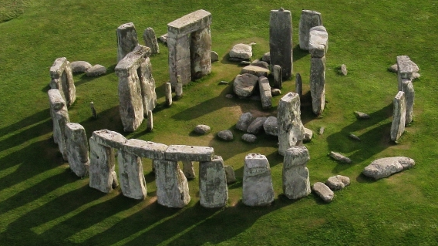
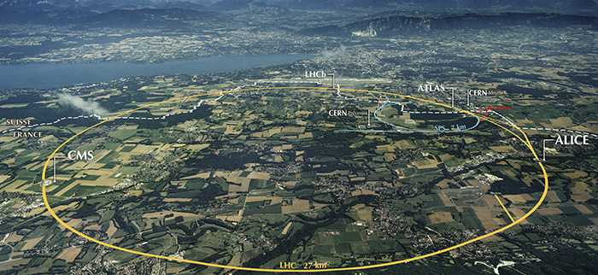
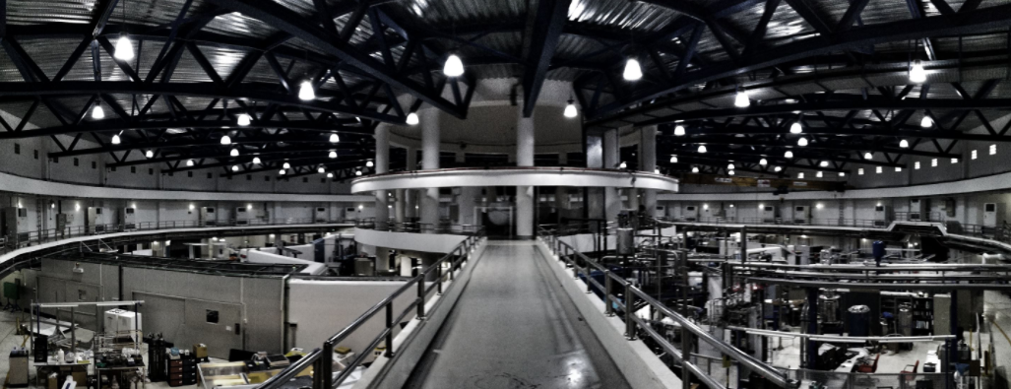
Outline
History of particle accelerators
Particle acceleration
Synchrotron
Beam dynamics
Large Hadron Collider (LHC)
Synchrotron in Thailand

Slide 3
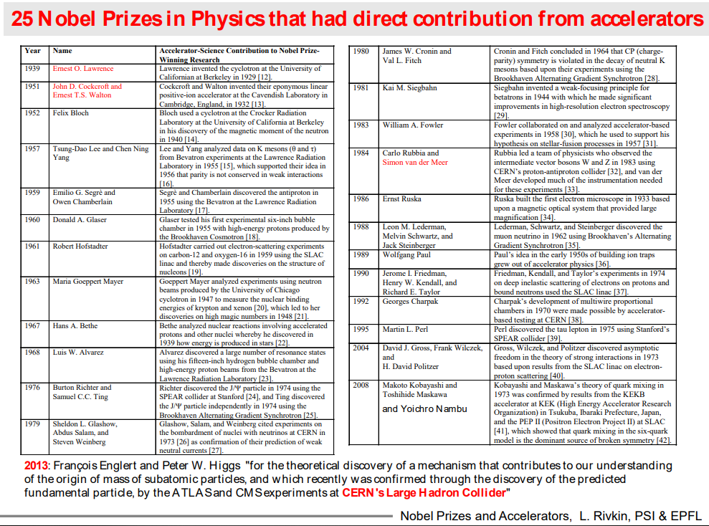
Particle Accelerators : the true engine of discoveries

Slide 4
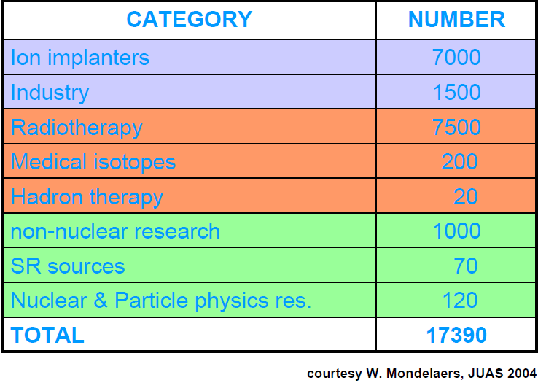
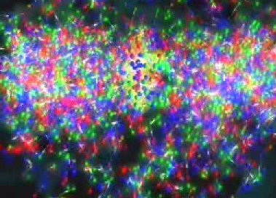
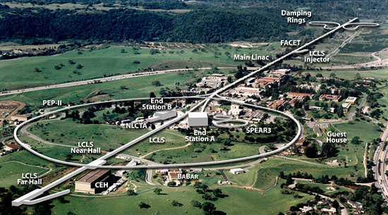
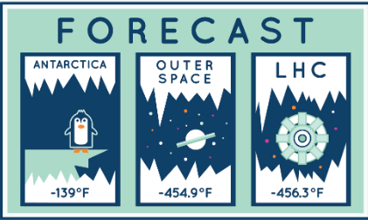
Particle Accelerators ???
5 things you might not know about particle accelerators
There are more than 30,000 accelerators in operation around the world.
One of the longest modern buildings in the world was built for a particle accelerator.
Particle accelerators are the closest things we have to time machines, according to Stephen Hawking.
The highest temperature recorded by a manmade device was achieved in a particle accelerator.
The inside of the Large Hadron Collider is colder than outer space.
Quark-Gluon
plasma
ALICE: A Large Ion Collider Experiment at CERN
on August, 2012 in the ranges of 5.5 trillion (5.5×10¹²) kelvin
>3 km long
https://www.symmetrymagazine.org/article/april-2014/ten-things-you-might-not-know-about-particle-accelerators

Slide 5
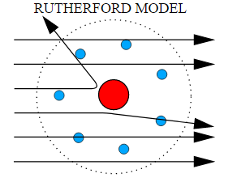
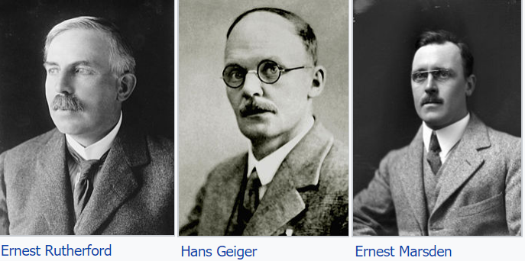
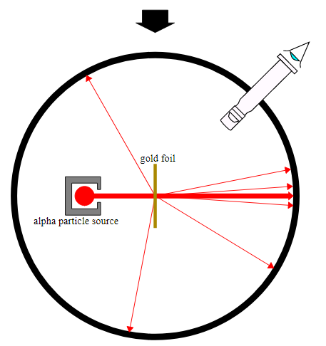
The need of Particle accelerators
The experiments were performed between 1908 and 1913 by Hans Geiger and Ernest Marsden under the direction of Ernest Rutherford
Trigger was pulled on high energy accelerator racing!

Slide 6

History of particle accelerators
Particle as a probe
de Brogile, 1923 Wavelength of particle with momentum p
Resolution is inversely proportional to p.
Particles production
Einstein 1905
Massive particle need higher c.m. energy.

Slide 7
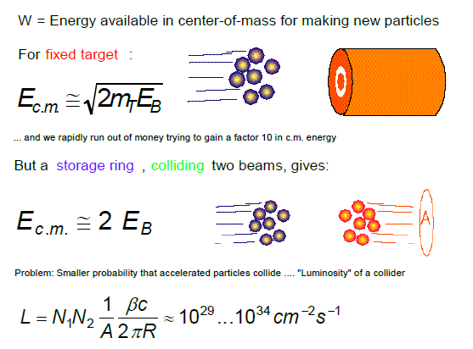

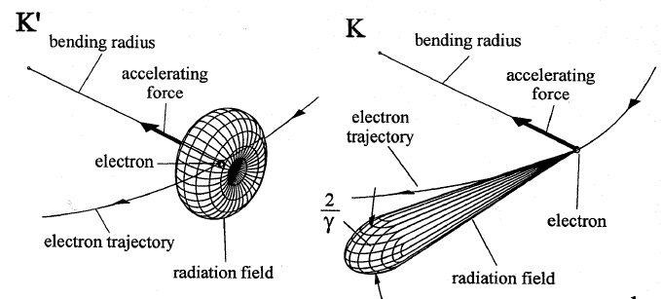

E for particle physics / photon application
High energy physics
Light source
Photon energy
The higher energy the better!!!
Circular machine

Slide 8
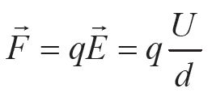
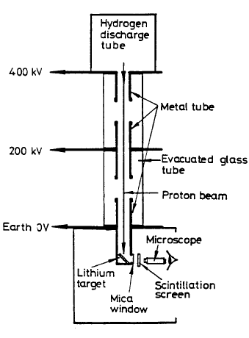
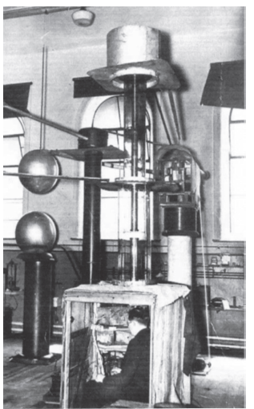
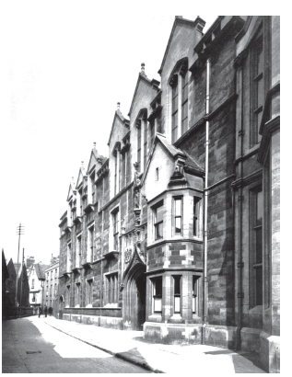
How to Accelerate particle
Cockroft &Walton
Voltage multiplying column
Walton

Slide 9
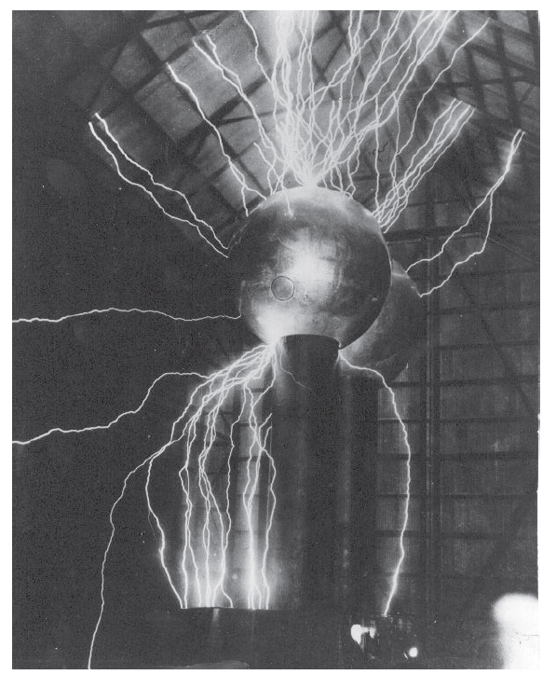
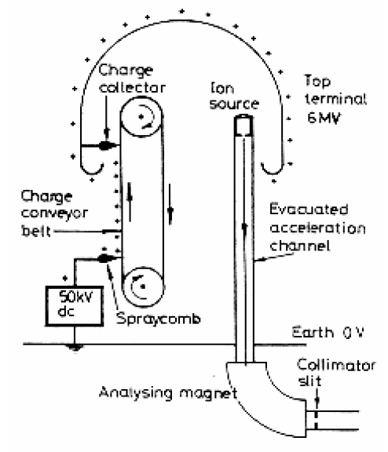
Van de Graaff
Robert Van de Graaff
Accumulate charge
via mechanical transportation
Discharge problem
MIT’s Round Hill experiment station
Require clean and smooth sphere surface

Slide 10
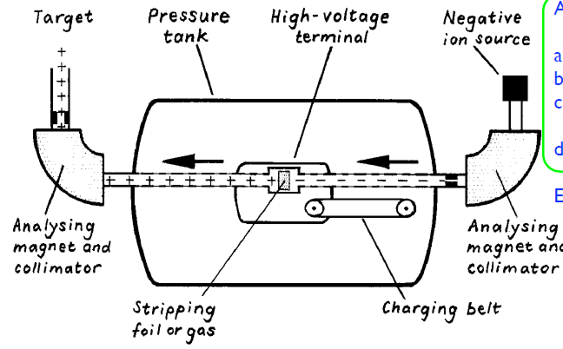
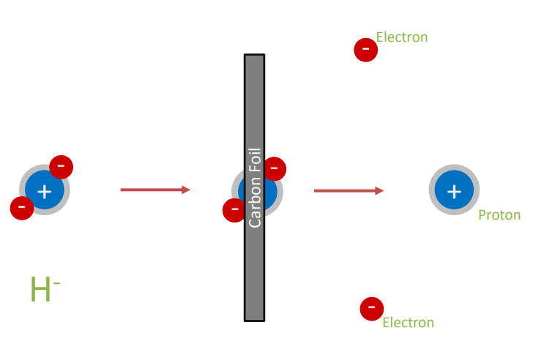
Tandem
Van der Graaff parts
-Modification of Van der Graaf with double energy.
-Stripping foil for charge changing.
-Compact machine

Slide 11
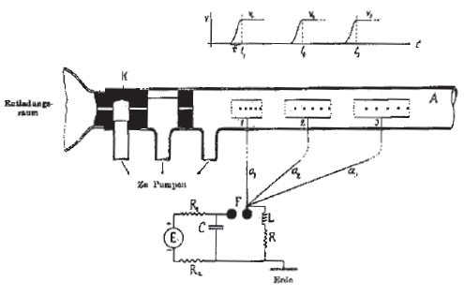
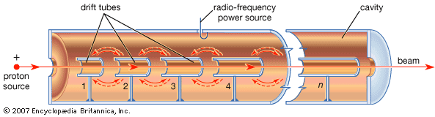
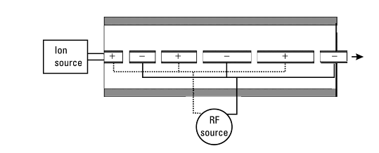
RF Acceleration (time-varying field)
Rolf Wideroe AC voltage to the drift tube between two grounded electrodes. The beam experienced an accelerating voltage in both gaps.
This is not possible using electrostatic voltages
Ising’s original paper of 1924
-Drift tube length vary according to the velocity of particle and the frequency of a source.
-For higher beam energy the drift tube becomes too long.
-Field loss problem at high RF freq.

Slide 12
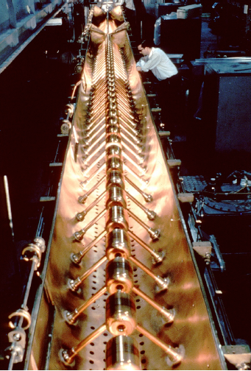
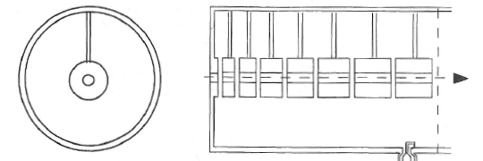
Alvaretz structure
E field can be generated in resonant cavity.
Low loss for high RF frequency.

Slide 13
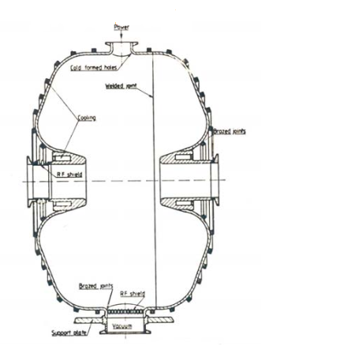
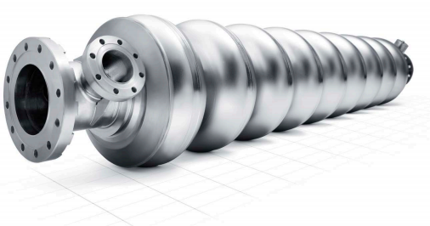
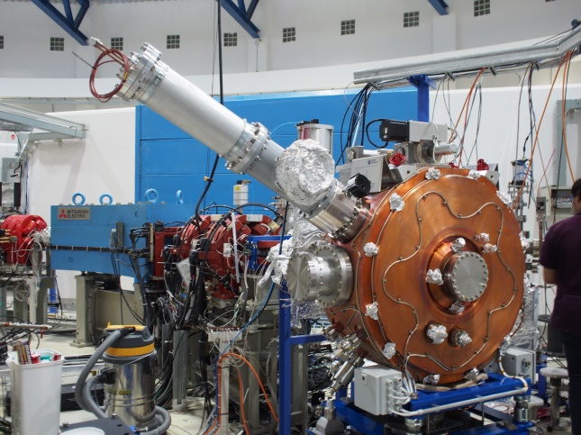
RF for acceleration (RF CAVITY)
Single gap
Proper RF oscillation mode
E field on longitudinal axis
Need synchronization
Accelerating structure
SLRI normal conducting RF cavity

Slide 14
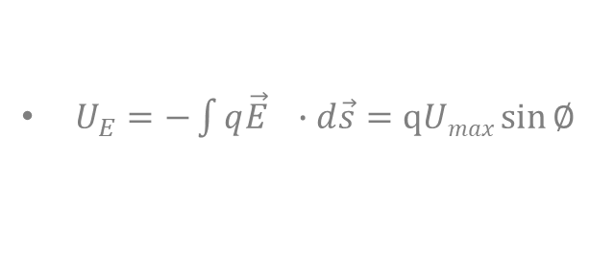
Energy gain
$U_{E}=−\int{q\vec{E} ∙d\vec{s}}=qUmax\sin{∅}$
Phase focusing
Arrive later
Arrive early
Synchronous phase

Slide 15
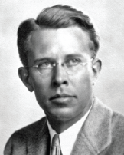

Gain Control: Lorentz Force
$$\vec{F}=q\vec{E}+q(\vec{v}×\vec{B})=\frac{d\vec{P}}{dt}=m\vec{a}$$
In the presence of E-field, a charged particle will experience a force in the direction of E-field.
In the presence of B-field, a charged particle will experience a force in the perpendicular direction of B-field.
electron

Slide 16
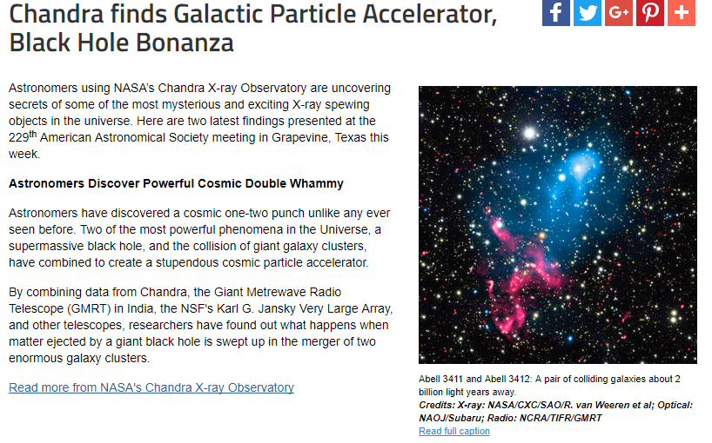
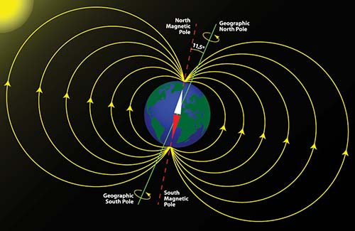
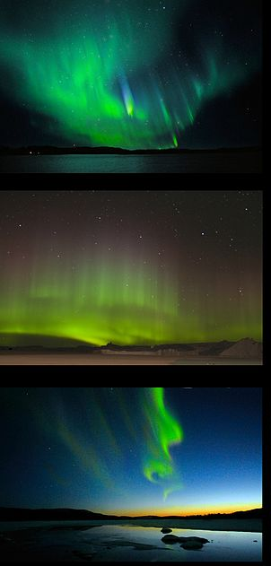
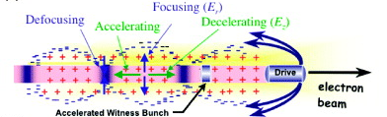
Particle acceleration in Nature
Natural particle control
Plasma wake field

Slide 17
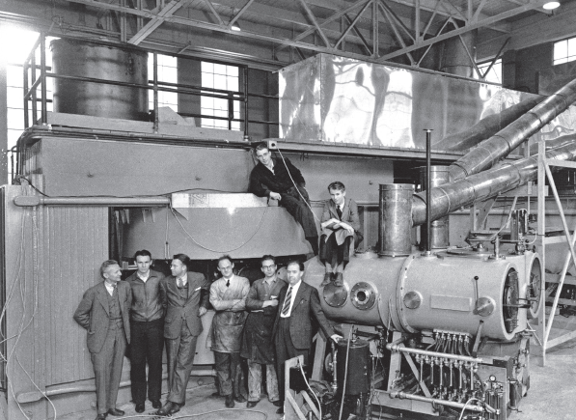
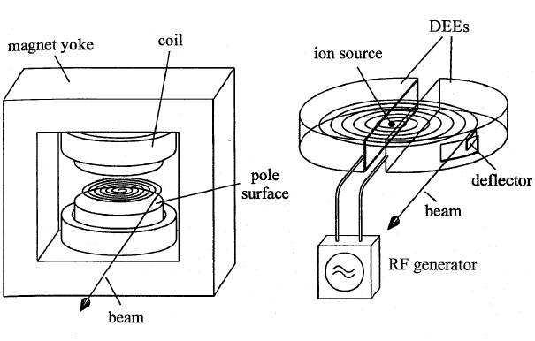
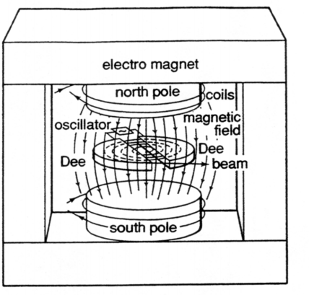
Cyclotron
Simple circular accelerator
Constant revolution frequency
Gain more energy every time
between the gap
Lawrence
https://www.youtube.com/watch?v=m2jp0klZHEE&t=26s

Slide 18
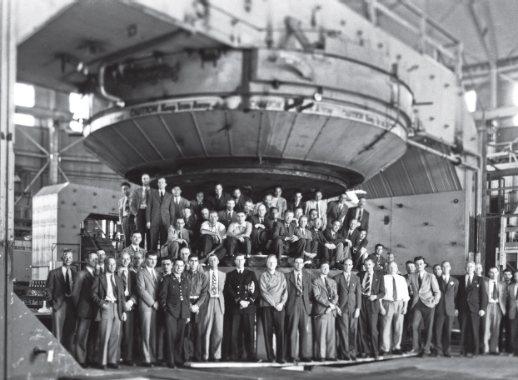
Cyclotron
Fix B field
-> massive machine for higher beam energy
Too big and
Very heavy machine

Slide 19
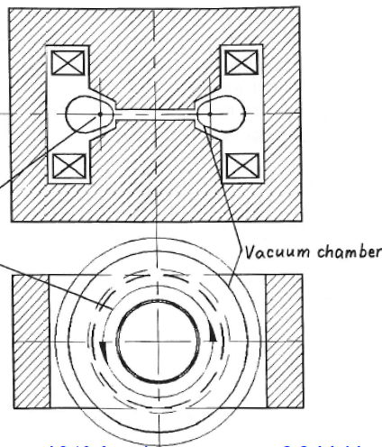
Betatron
Varying B flux -> E field
Commercial Betatron
Bigger size for
higher beam energy

Slide 20
SyncHrotron

Slide 21
Synchrotron
RF cavity
Dipole
Fix the particle trajectory path
-control local bend
-Vary Dipole field
- Synchronize with increasing beam energy
High beam energy requires strong Dipole field
Circular machine

Slide 22
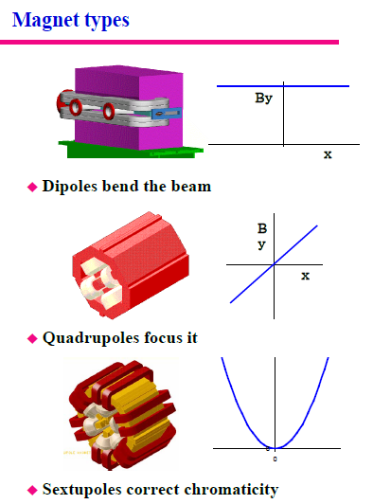
Magnets for Synchrotron
Used in Booster and Storage ring
To control & correct the electron beam
Main electric power consumption of the facility

Slide 23
Dipole
Keep the beam in circular machine
Iron Pole saturation
Iron
B field ←→ energy

Slide 24
Quadrupole
Focusing magnet

Slide 25
Sextupole
For chromaticity correction

Slide 26
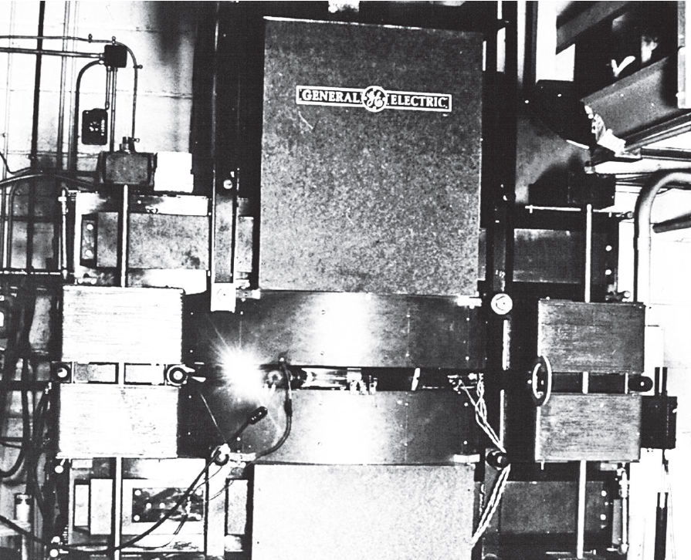
The first observed synchrotron light
At the General Electric
300 MeV electron synchrotron
Glass vacuum tube

Slide 27
Beam dynamics

Slide 28
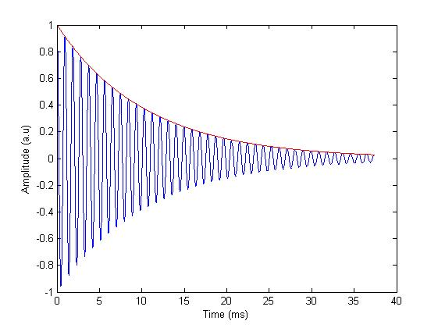
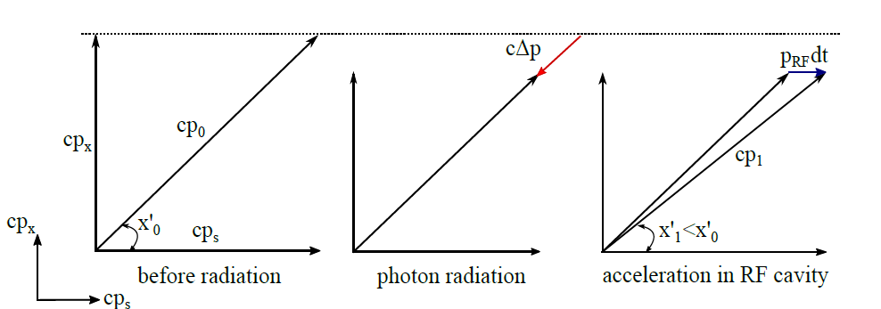
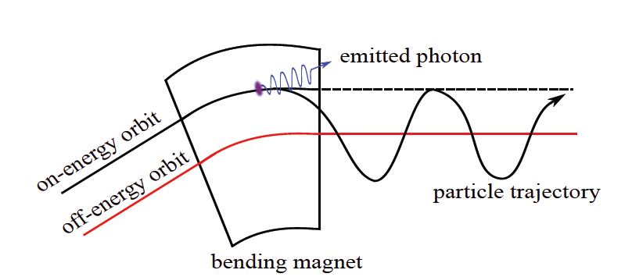


Equilibrium Beam (electron case)
Radiation damping
-lost p in all direction
-gain p in longitudinal
-total -> transverse damping
Quantum excitation
-sudden change of energy
-oscillate around an off-energy orbit
Dispersion function

Slide 29
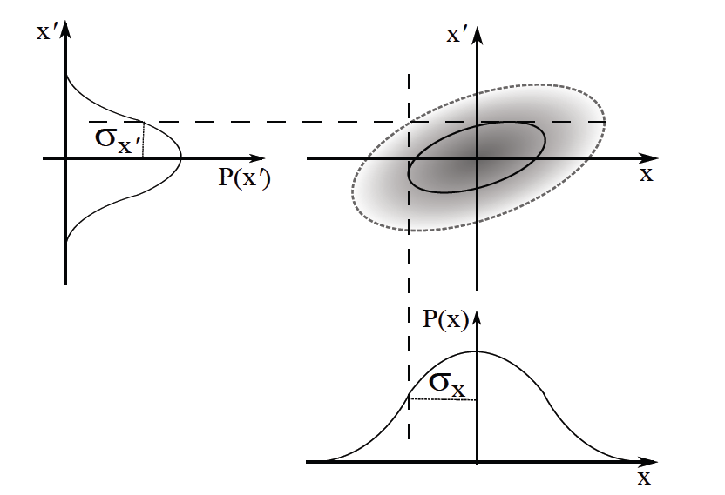

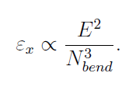

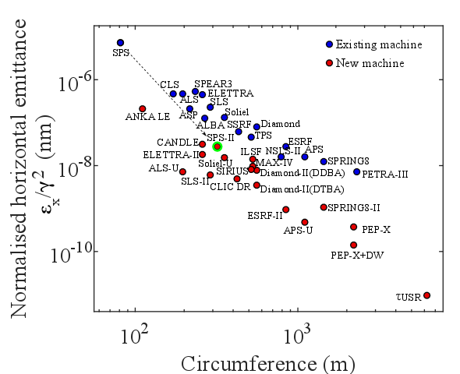
Beam Emittance
ε
Phase space
:Area in phase space ellipse
Horizontal natural beam emittance

Slide 30


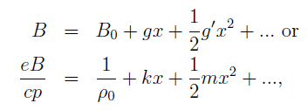


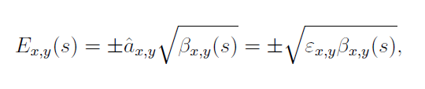

Twiss functions
Ideal orbit (curvature)
Hill’s equation
Deviate from ideal orbit
Beta function
Phase advance
Beam envelope
Beam emittance

Slide 31





Betatron tune
Betatron tune: number of oscillation per ring
Resonance diagram
Resonance condition
Resonance
Operation tune point has to be away from these lines

Slide 32



Siam photon source twiss functions
Storage ring floor coordinate
Optic functions
Operating tunes
DBA unit cell : 2 dipoles per arc

Slide 33


Chromaticity & correction
Focusing error (aberration) <- energy dependent
Quadrupole
Sextupole
Head-tail instability

Slide 34
Chromaticity & correction
Quadrupole
Sextupole

Slide 35



Dynamic & Momentum aperture
DA: Maximum stable area
Phase space
MA: Maximum allowed momentum
Beam injection

Slide 36







Beam Lifetime
Quantum lifetime
Negligible when a/σ >6
Gas lifetime
Touschek lifetime
Physical aperture
Lost rate fn.
Direct deflection
Lost energy
Elastic collision within the bunch
P transfer from transverse to longitudinal
Momentum acceptance
Relativistic gamma boost
c

Slide 37
Large hadron collider
Largest accelerator on earth

Slide 38
Largh Hadron Collider (LHC)
27 km ring circumference
~4.3 bn CHF

Slide 39

CERN accelerators complex
50 k tons of normal magnets
50 k tons of superconducting magnets
1232 Dipoles

Slide 40


Proton source
Duoplasmatron
H₂

Slide 41

LHC dipole
85% of arc
Total 1232 dipoles
Length: 14.3 m each
B: 8.3 T

Slide 42



Conductors
X5 more expensive
Thin filament -> stability
Need stabilizer : pure Cu
Dipole
Quadrupole
Sextupole
https://indico.cern.ch/event/716193/attachments/1677796/2694319/Schoerling_SummerStudents_PARTI.pdf

Slide 43
Siam photon source
Largest accelerator in ASEAN

Slide 44

Siam Photon Source
SPS (Organized by SLRI) is the sole light source in Thailand and the largest in South East Asia
Refurbished SORTEC machine
Please visit: http://www.slri.or.th

Slide 45


Synchrotron Machine
Siam Photon Source (SPS)
https://www.youtube.com/watch?v=l4NSF-gkKCU

Slide 46


Electron gun
Energy gain = q*V [eV]

Slide 47


Bunching system

Slide 48

Linac
Linear accelerator
Part of pre-injector
Underground
2 separated Linac structures
40 MeV after Linac

Slide 49

Booster
No space for beamline
Underground
43 m Circumference
Boost energy up from 40MeV to 1.2 GeV
Within 0.7 second

Slide 50


Storage ring
Decay mode operation
Inject electron twice per day : ~8:00 A.M. & P.M.

Slide 51

SPS Basic parameters

Slide 52




What is synchrotron radiation?
Electromagnetic radiation is emitted by accelerated charged particles
synchrotron radiation sources are bending magnets undulators and wigglers

Slide 53

Wave & object
synchrotron
sources
Radio
Microwave
Infrared
UV
Soft
X-rays
Hard
X-rays
Gamma rays
particle
Size
(m)
objects
Building
Animal
Bacteria
protein
atom
nucleus
quark
virus
molecule

Slide 54


Brightness

Slide 55

synchrotron radiation (relativistic)
Synchrotron radiation is electromagnetic radiation emitted when charged particles are radially accelerated (move on a curved path).
At low electron velocity (non-relativistic case) the radiation is emitted in a non-directional pattern
When the electron velocity approaches the velocity of light, the emission pattern is folded sharply forward. Also the radiated power goes up dramatically

Slide 56


Energy loss due to synchrotron radiation
Time in the dipoles → loss energy
Energy loss per turn
Need to be compensated by the RF cavity
Electron Vs Proton ?

Slide 57


Sources
Strong bend , incoherent
Weak bend , coherent
See radiation 2d

Slide 58

Sources & Spectrum
undulator
Wiggler
Bending

Slide 59
Photon science, Applications
photo-emission
(electrons)
diffraction
scattering
absorption
from the synchrotron
to the detector
fluorescence
Notes:
Specificity to different elements

Slide 60
OTHER subsystem
-Control system → operate, safety interlock …
-Vacuum → able to store beam (ultra high vacuum (UHV) 10⁻⁹ Torr)
-Power supply → operate magnets
-Radiation Safety (shielding)
…

Slide 61


Conclusions
There are many accelerators in everyday life.
Accelerator appear to be a fundamental tool for discoveries (many Nobel prize).
Accelerator physics is very broad and fun.
High energy physics and Photon science is part of accelerator applications.
Synchrotron radiation is unique and has many applications.
New great machines are coming in the near future …

Slide 62

Further reading
Engine of discovery (A. Sessler, E. Wilson)
The physics of particle accelerators (K. Wille)
CERN CAS, CERN summer school
USPAS
…

Slide 63

Thank you

Slide 65


Photon energy & electron energy
Dipole source
Increasing e- energy
Separate two halves of the the integral of the spectrum

Slide 66




Beam coupling κ
Natural vertical beam emittance is ~ 1e-12 mm mrad
coupling
Vertical Dispersion generated by misaligned sextupole, tilted dipole and quadrupole
Need Skew quadrupole (additional wiring in sextupole)

Slide 67


Ramping Vs. Full Energy injection
SLRI case
Ramping mode
Previously
1.0 GeV
1.2 GeV
Full energy mode
Since May 2018
Quicker,
More stable
- Magnet
- BL heat load

Slide 68




Accelerator as Light source
High Flux
High Brightness
High Coherence
(Transverse)
Effective size, divergence
Submicron stability
Orbit control < 10% or the beam size

Slide 69

Dipole source
Photon spectrum
Total radiated power

Slide 70



Undulator, wiggler

Slide 71


3rd generation storage ring light sources
1992 ESRF, France (EU) 6 GeV
ALS, US 1.5-1.9 GeV
1993 TLS, Taiwan 1.5 GeV
1994 ELETTRA, Italy 2.4 GeV
PLS, Korea 2 GeV
MAX II, Sweden 1.5 GeV
1996 APS, US 7 GeV
LNLS, Brazil 1.35 GeV
1997 Spring-8, Japan 8 GeV
1998 BESSY II, Germany 1.9 GeV
2000 ANKA, Germany 2.5 GeV
SLS, Switzerland 2.4 GeV
2004 SPEAR3, US 3 GeV
CLS, Canada 2.9 GeV
2006: SOLEIL, France 2.8 GeV
DIAMOND, UK 3 GeV
ASP, Australia 3 GeV
MAX III, Sweden 700 MeV
Indus-II, India 2.5 GeV
2008 SSRF, China 3.4 GeV
2009 PETRA-III, D 6 GeV
2011 ALBA, E 3 GeV
2016 MAX-IV, Sweden 3 GeV
ESRF
SSRF

Slide 72

Top up operation
Continuous electron filling with a set current limit.
DLS machine status last week
What’s the difference between full energy injection and top-up?
Fast orbit feedback, tune feedback ...
Transparent injection (closed bump) small perturbation
Sufficient radiation protection

Slide 73
Generation of synchrotron machine
1st generation light sources: machine built for High Energy Physics or other purposes used parasitically for synchrotron radiation
2nd generation light sources: purpose built synchrotron light sources, SRS at Daresbury was the first dedicated machine (1981 – 2008)
3rd generation light sources: optimised for high brilliance with low emittance and Insertion Devices; ESRF, Diamond, …
4th generation light sources: photoinjectors LINAC based Free Electron Laser sources; FLASH (DESY), LCLS (SLAC), …

Slide 74


Worldwide users
SLRI

