Slide 1

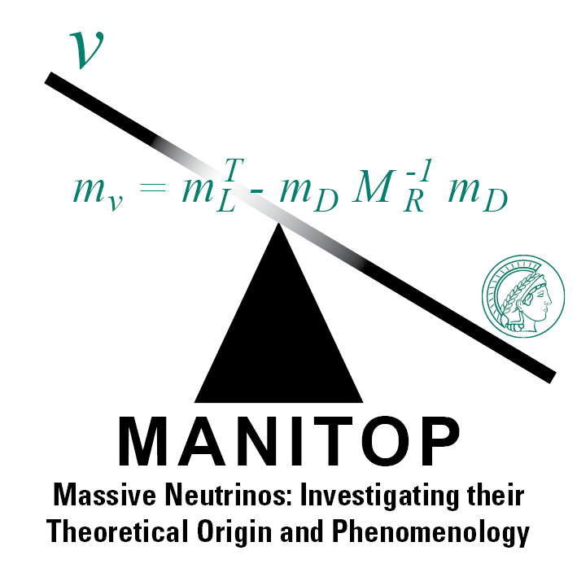
Neutrinos and recent observations at the Dark Matter experiments
Based on: arXiv: 2006.12887 (PLB 809, 135782, (2020))
arXiv: 2008.10279
Amir Khan
MPIK, Heidelberg,
November 17, 2020
Particle Physics on the Plains, Theoretical Seminar Series,
University of Kansas
1

Slide 2
Motivations
Direct Dark Matter Direction
Experiments
&
The challenge from the low energy astrophysical neutrinos, solar in particular!!
Plus point! they provide good opportunity
to understand neutrinos at very low energy!!
Amir Khan, MPIK
Nov 17, 2020
1/33

Slide 3
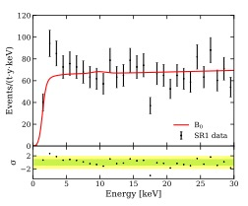
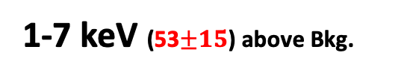
Electron recoil excess in DM Experiments
1-7 keV (53$±15$) above Bkg.
Threshold∼1 keV
LNGS
(Gran Sasso, Italy)
XENON1T
CJPL
(Sichuan, China)
(1-7 keV)
(1-7 keV)
~ 20 above Bkg.
PandaX-II
DAMA
Amir Khan, MPIK
Nov 17, 2020
2/33

Slide 4
Borexino: A solar neutrino experiment
The lowest electron recoil energy in neutrino physics to-date
Threshold of ∼170 keV
Amir Khan, MPIK
Nov 17, 2020
3/33

Slide 5
Neutrino vs Dark Matter Experiments
arXiv:1202.6073v3
Amir Khan, MPIK
Nov 17, 2020
4/33

Slide 6
Outline
  What XENON1T and PandaX-II observed?
  How the observation was interpreted?
  What is neutrino NSI interpretations?
  Focus on neutrino EM interactions and new light mediators
  Inverse recoil energy enhancement game!
  Outlook n Summary?
2
Amir Khan, MPIK
Nov 17, 2020
5/33

Slide 7
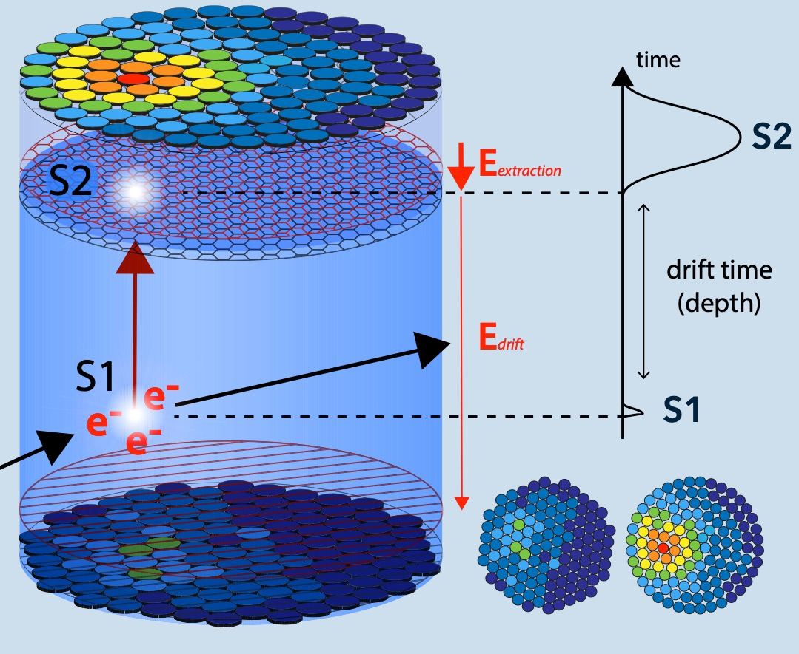
How does a TPC work?
A Time Projection Chamber (TPC)
Reconstructed Energy
Electroluminescence
Gaseous Xe
(Ionized charge)
Liquid Xe
(Scintillation)
(PMTs)
E. Shockley for XENON
Amir Khan, MPIK
Nov 17, 2020
6/33

Slide 8
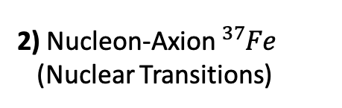
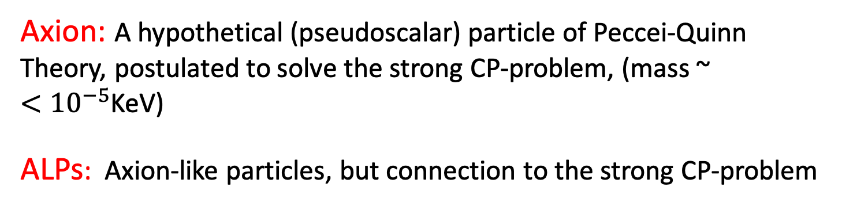
  XENON Results: Solar Axions
Axion: A hypothetical (pseudoscalar) particle of Peccei-Quinn Theory, postulated to solve the strong CP-problem, (mass ~ ${<10}^{−5}$KeV)
ALPs: Axion-like particles, but connection to the strong CP-problem
1) ABC model
Atomic axio-recombination, axio- Bremsstrahlung in electron-Ion, Compton scattering
2) Nucleon-Axion ${}_{ }^{37}{Fe}$
(Nuclear Transitions)
3) Photon-Axion Interactions
(Classical)
(Classical)
Only loop
Amir Khan, MPIK
Nov 17, 2020
7/33

Slide 9
  Axions production in SUN
E. Shockley for XENON
Amir Khan, MPIK
Nov 17, 2020
8/33

Slide 10
  Expected Axions signal in the detector
(Axion-Electron
cross section)
Amir Khan, MPIK
Nov 17, 2020
9/33

Slide 11
  Neutrino Magnetic Moment
Nu-e cross section
Expected Rate
E. Shockley for XENON
Amir Khan, MPIK
Nov 17, 2020
10/33

Slide 12
  XENON & PandaX-II Results: Solar Axions
XENON1T
PandaX-II
3-dim fit (ABC vs Primakoff)
arXiv:2008.06485v2
E. Shockley for XENON
Amir Khan, MPIK
Nov 17, 2020
11/33

Slide 13
  XENON Results: Solar Axions
XENON1T
$g_{ae}<3.8×{10}^{−12}$ , $g_{ae}g_{an}<4.8×{10}^{−18}, {g_{ae}g}_{aγ}<4.8×{10}^{−22}, \text{(}\text{Excludes} g_{ae}=0 or g_{ae}g_{an}=g_{aγ}=0 at 3.6 σ)$
3-dim fit (ABC vs Nuclear)
3-dim fit (Primakoff vs Nuclear)
E. Shockley for XENON
Amir Khan, MPIK
Nov 17, 2020
12/33

Slide 14
  XENON & PandaX-II Results: Neutrino Magnetic Moment
XENON1T
PandaX-II
Amir Khan, MPIK
Nov 17, 2020
13/33

Slide 15
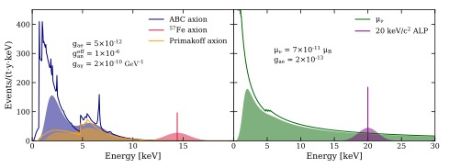
  Dark Matter Vs. Neutrino at XENON1T
The sensitivity of the solar neutrinos (with non-zero NNM) are comparable to the all possible DM candidates!!
Neutrinos
Dark Matter
Amir Khan, MPIK
Nov 17, 2020
14/33

Slide 16
  What's further for neutrino with this data?
  If the excess is not due to background!
  What other nonstandard neutrino interactions can be constrained with this data?
  All the relevant Electromagnetic properties
  All type general light interactions based with the general Lorentz structure (Vector, Axial-vector, Scalar and Pseudoscalar)
Amir Khan, MPIK
Nov 17, 2020
15/33

Slide 17
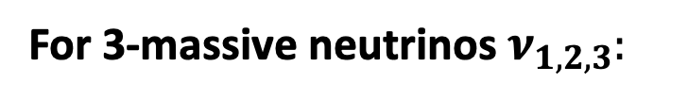

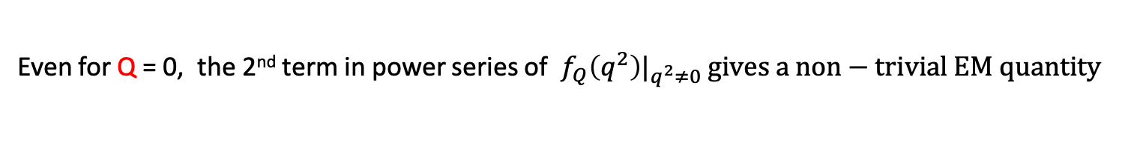

The$ν$EM Interaction (Minimal extended SM with 3$ν_{R}$)
For 3-massive neutrinos $ν_{1,2,3}:$
Lorentz and EM gauge invariant
$ν$EM vertex function:
Electric
Charge
Anapole
Moment
Magnetic
Dipole Moment
Electric
Dipole
Moment
(Only if P and CP)
4 EM form factors:
Even for Q = 0, the 2nd term in power series of $f_{Q}\left(q^{2}\right)|_{q^{2}≠0} gives a non−trivial EM quantity$
The $ν$ charge radius:
Fujikawa & Shrock, PRL45 963, (1980)
Giunti & Studenikin, 1403.6344
Vogel&Engel, PRD39 3378, (1989)
Amir Khan, MPIK
Nov 17, 2020
16/33

Slide 18
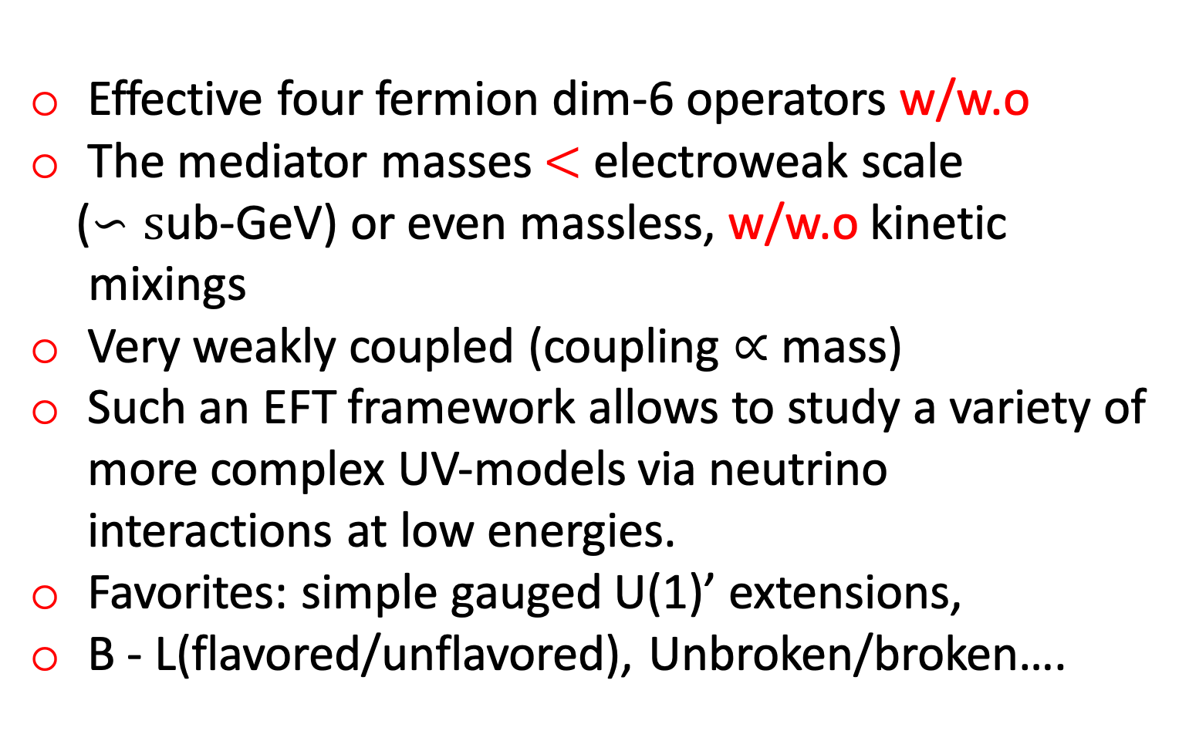
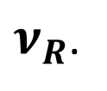
  Light Mediators: A simple phenomenological model
Effective four fermion dim-6 operators w/w.o
The mediator masses $<$ electroweak scale
($∽s$ub-GeV) or even massless, w/w.o kinetic
mixings
Very weakly coupled (coupling $∝$ mass)
Such an EFT framework allows to study a variety of more complex UV-models via neutrino interactions at low energies.
Favorites: simple gauged U(1)’ extensions,
B - L(flavored/unflavored), Unbroken/broken….
$ν_{R}$.
Amir Khan, MPIK
Nov 17, 2020
17/33

Slide 19
  Light mediators: interactions terms
(Scalar)
(Pseudoscalar)
(Vector)
(Axial Vector)
Amir Khan, MPIK
Nov 17, 2020
18/33

Slide 20
  Cross section and the eight new interactions
Cross section:
+ +
(NC)
(CC)
 | Electromagnetic Interactions | New Light Mediators
LL, RR
LR, RL
Amir Khan, MPIK
Nov 17, 2020
19/33

Slide 21
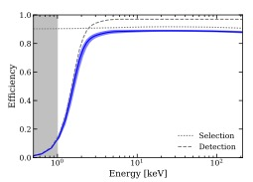
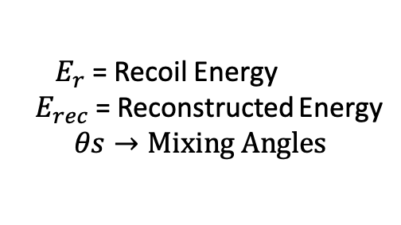

  Expected energy spectrum
cf. for details: 2006.12887
$N_{e}$ = Exposure: 0.65 ton-year (XENON1T), 100.7 ton-day (PandaX-II)
G($E_{rec},E_{r}$) = Gaussian smearing function with resolution power:
(Survival probability)
(Conversion probability)
${ E}_{r}$ = Recoil Energy
${ E}_{rec}$ = Reconstructed Energy
$$θs→Mixing Angles$$
$$ε(E_{rec})$$
Amir Khan, MPIK
Nov 17, 2020
20/33

Slide 22
  Spectral Fit with EM parameters (XENON1T)
Amir Khan, MPIK
Nov 17, 2020
21/33

Slide 23
  Spectral Fit with light mediators (XENON1T)
Amir Khan, MPIK
Nov 17, 2020
22/33

Slide 24
  Spectral Fit with light mediators (PandaX-II)
Non-linear model fitting with the fixing masses and fitted coupling constants
For V, A, and S, same best fit value, while for P 1 order of magnitude larger value.
Amir Khan, MPIK
Nov 17, 2020
23/33

Slide 25
  Chi-square and fitting (Constraining parameters)
XENON:
PandaX:
Amir Khan, MPIK
Nov 17, 2020
24/33

Slide 26
  Light mediators (XENON1T)
Amir Khan, MPIK
Nov 17, 2020
25/33

Slide 27
  Light mediators (PandaX-II)
Amir Khan, MPIK
Nov 17, 2020
26/33

Slide 28

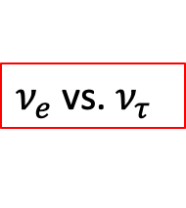
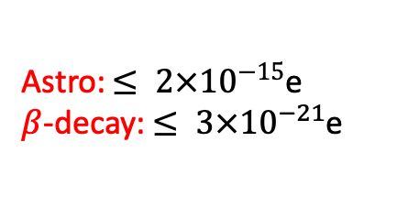
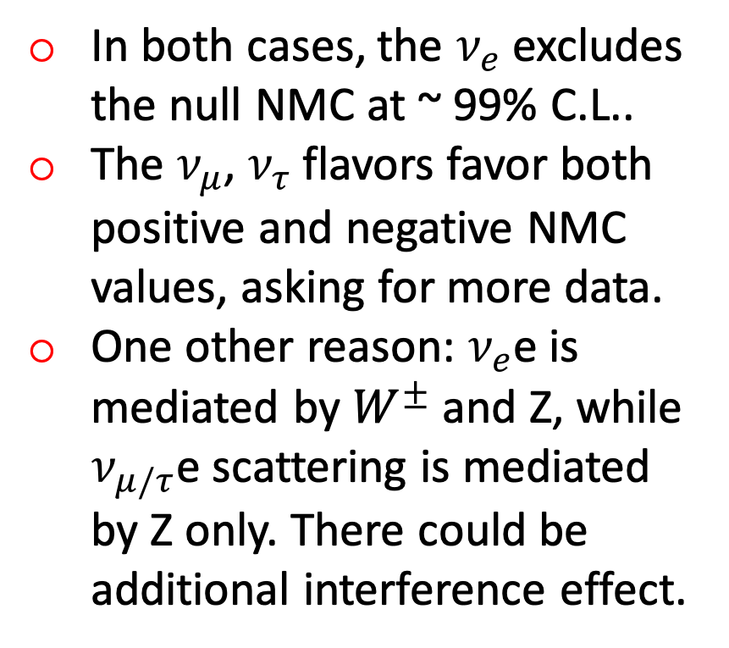
  Two parameter fit for Millicharge neutrinos
In both cases, the $ν_{e}$ excludes the null NMC at ~ 99% C.L..
The $ν_{μ}$, $ν_{τ}$ flavors favor both positive and negative NMC values, asking for more data.
One other reason: $ν_{e}$e is mediated by $W^{±}$ and Z, while $ν_{μ/τ}$e scattering is mediated by Z only. There could be additional interference effect.
$ν_{e}$ vs. $ν_{μ}$
$ν_{e}$ vs.${ ν}_{τ}$
Astro: $≤ {2×10}^{−15}$e
$β$-decay: $≤ {3×10}^{−21}$e
Amir Khan, MPIK
Nov 17, 2020
27/33

Slide 29
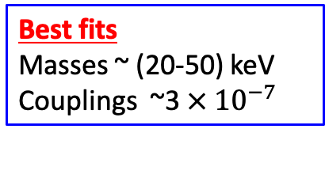
  Two parameter fit for vector and scalar mediators
XENON1T
Rule out
Gemma & Borexino!
Best fits
Masses ~ (20-50) keV
Couplings ~3$× {10}^{−7}$
XENON1T
Gemma & Borexino,
Survive!
C´eline Bœhm et al, 2006.11250
28/33

Slide 30

Bounds $ν$-EM after XENON1T
Amir Khan, MPIK
Nov 17, 2020
29/33

Slide 31
  Final Constraints on light mediators (masses =10 keV)
XENON1T
PandaX-II
Amir Khan, MPIK
Nov 17, 2020
30/33

Slide 32
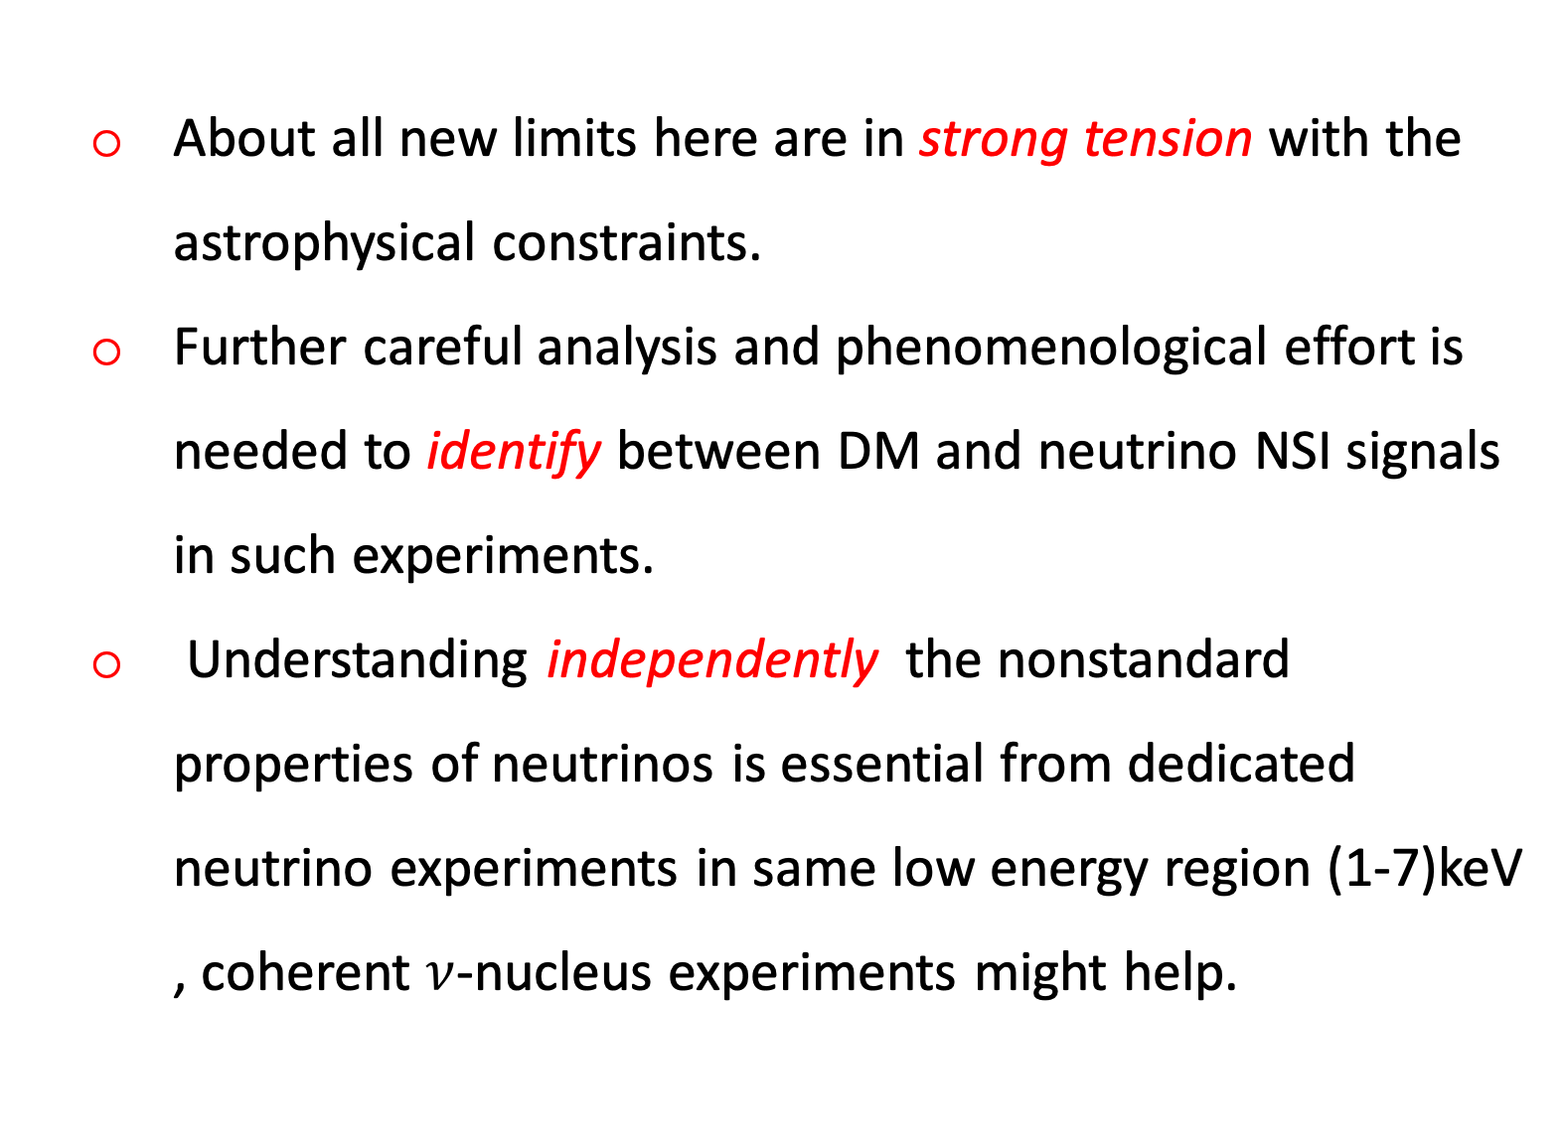
Outlook and Summary
  About all new limits here are in strong tension with the astrophysical constraints.
  Further careful analysis and phenomenological effort is needed to identify between DM and neutrino NSI signals in such experiments.
  Understanding independently the nonstandard properties of neutrinos is essential from dedicated neutrino experiments in same low energy region (1-7)keV , coherent $ν$-nucleus experiments might help.
Amir Khan, MPIK
Nov 17, 2020
31/33

Slide 33
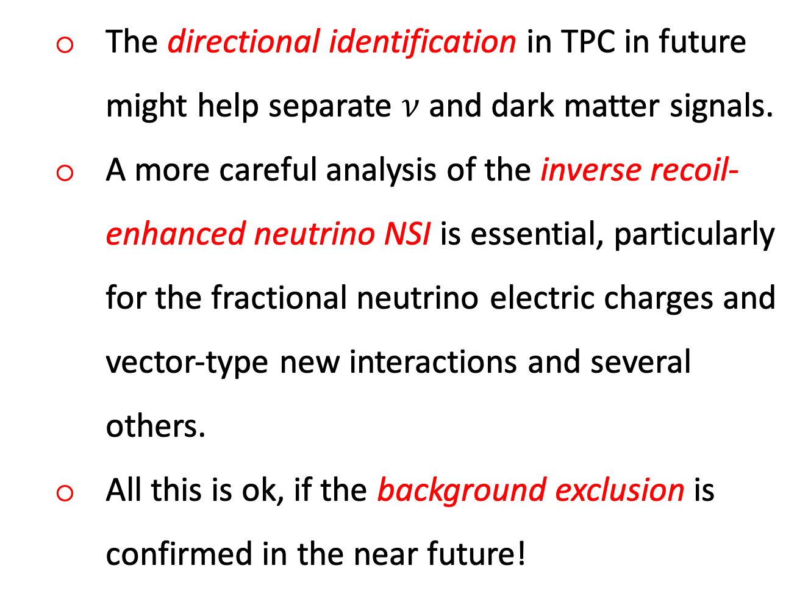
Outlook and Summary
  The directional identification in TPC in future might help separate $ν$ and dark matter signals.
  A more careful analysis of the inverse recoil- enhanced neutrino NSI is essential, particularly for the fractional neutrino electric charges and vector-type new interactions and several others.
  All this is ok, if the background exclusion is confirmed in the near future!
Amir Khan, MPIK
Nov 17, 2020
32/33

Slide 34
Thank You All!
24
Amir Khan, MPIK
Nov 17, 2020
33/33

