Slide 1
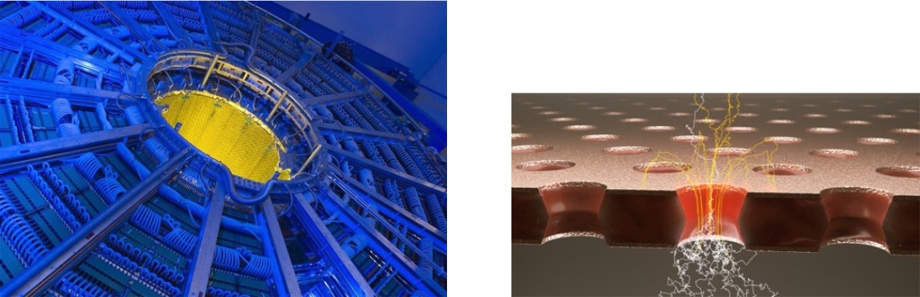
Particle Observation
Suwat Tangwancharoen
Kachanon Nirunpong

Slide 2
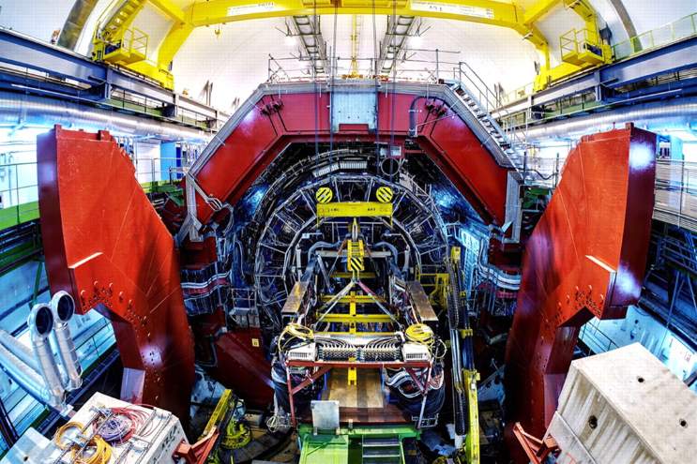
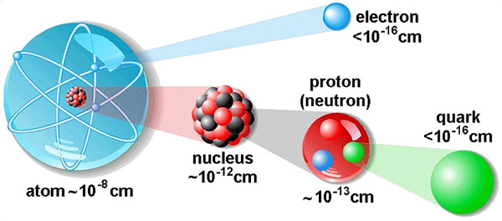

Slide 3
Cloud chamber
Observe
Invented by Charles Thomson Rees Wilson.
A vapor of water or alcohol is placed in the chamber and allows to reach a saturation state.
Chamber is adiabatically cooled or expand, resulting in supersaturation of the air inside.
Disruption will cause the vapor to condense.
Source
Piston

Slide 4
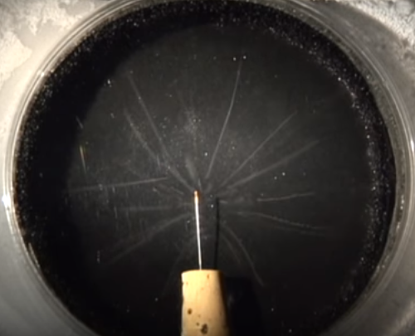
https://www.youtube.com/watch?v=pewTySxfTQk

Slide 5
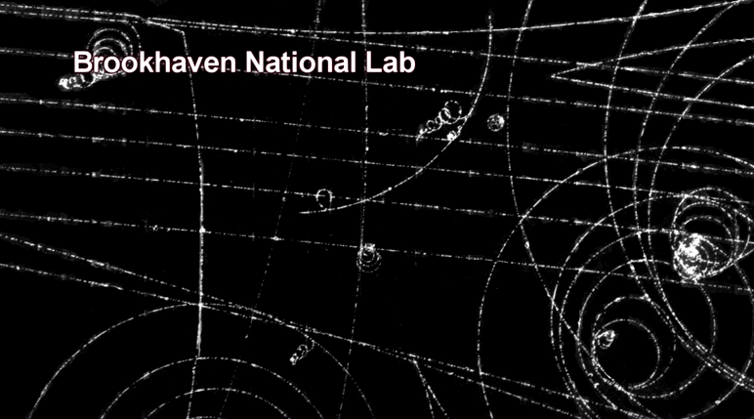
Picture from cloud chamber
https://www.youtube.com/watch?v=wAsceiIMY2I

Slide 6
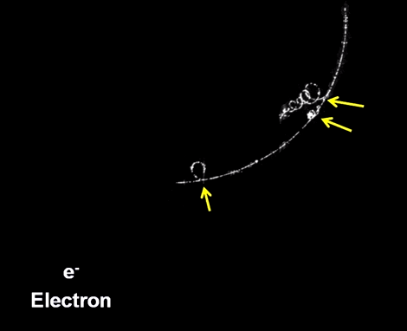
Picture from cloud chamber

Slide 7
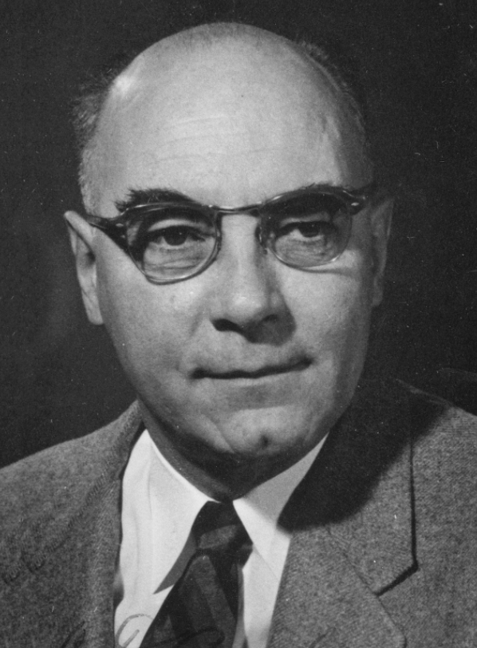
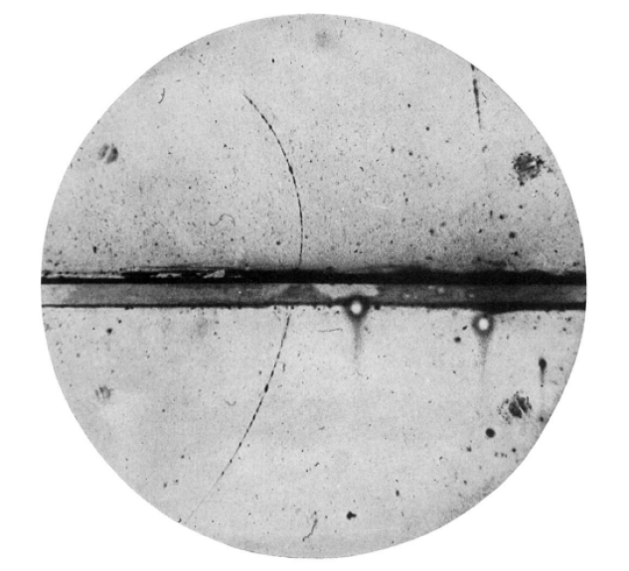
Discovery of positron (1932)
Carl Anderson discovered a particle that has a positive charge but has the mass of a free electron by using a cloud chamber under a magnetic field.
Positron track

Slide 8
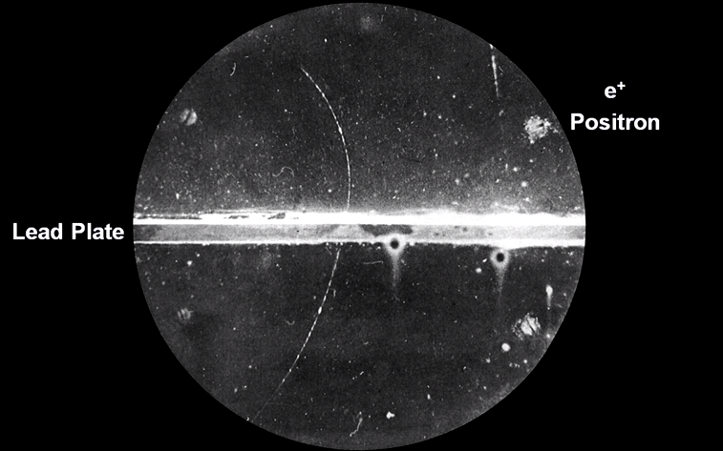
From Cern

Slide 9
Bubble chamber
In 1952, Donald Glaser improved the performance of the cloud chamber by replacing the vapor with liquid.
Liquid inside is slightly below the boiling point.
The pressure is reduced below the vapor pressure of the liquid.
Disruptions cause the liquid to boil.
Camera
Particle
B
Liquid
Piston

Slide 10
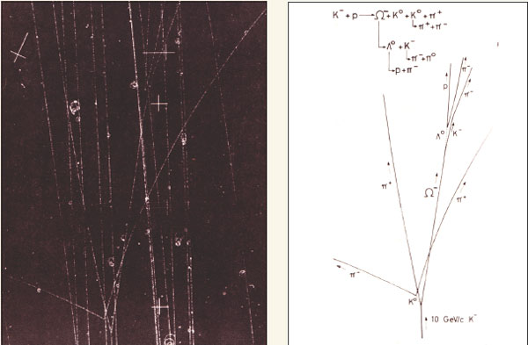
http://cerncourier.com/cws/article/cern/36308, Physics Letters (Vol. 19, pp. 152–154, 1 October 1965)

Slide 11
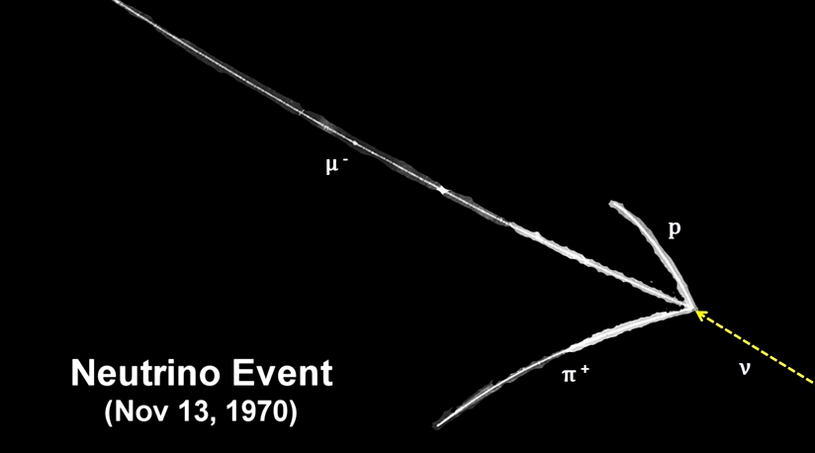
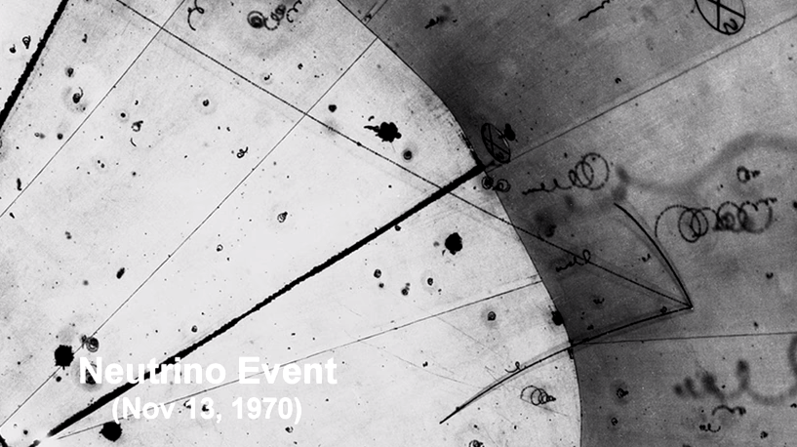

Slide 12
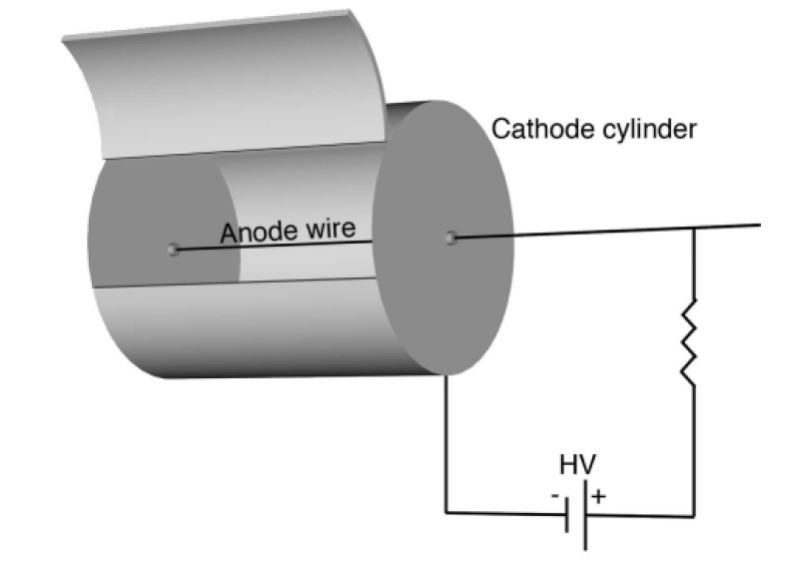
Multiwire proportinal chamber (MWPC)

Slide 13
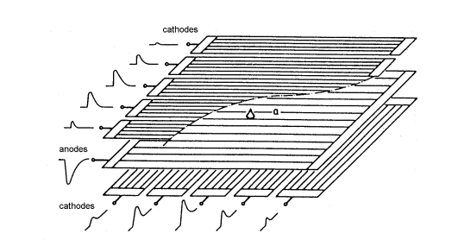
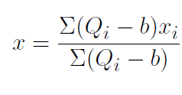
Multiwire proportinal chamber (MWPC)
Cathode
Anode
Cathode
Avalanche
The centroid of the signals can be obtained by
Particle track
Nuclear Instruments and Methods, Volume 143, Issue 1, 1977, Pages 29-39

Slide 14
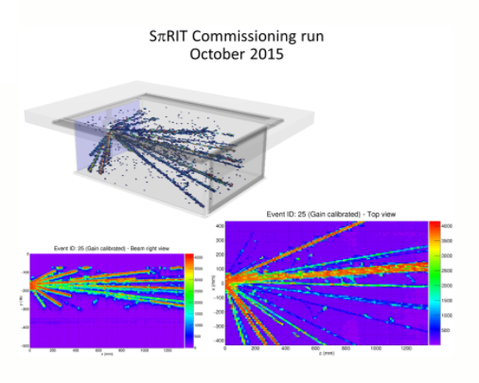
Time Projection Chamber (TPC)

Slide 15
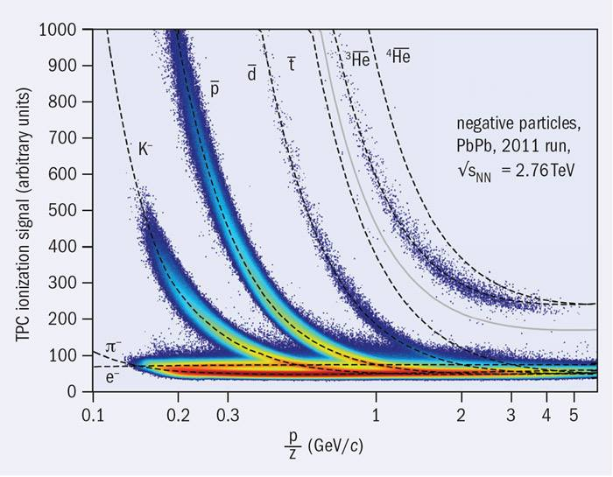

Slide 16

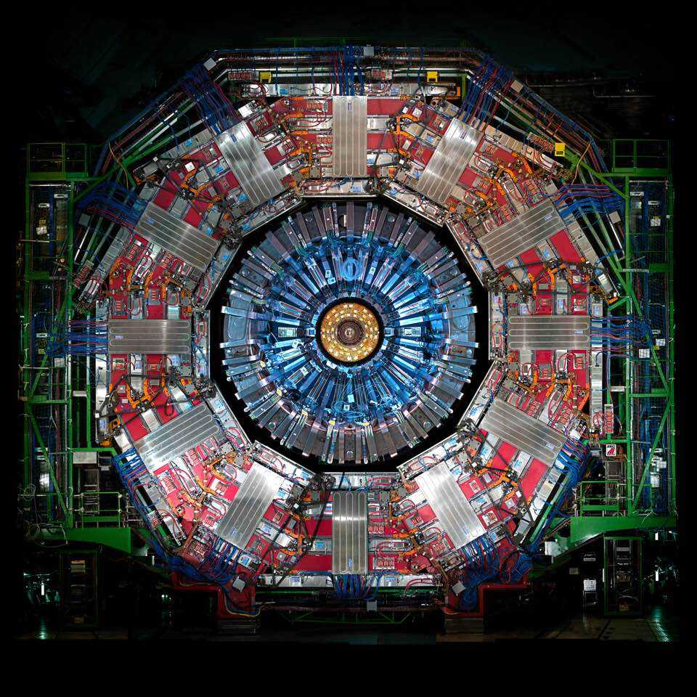

Slide 17
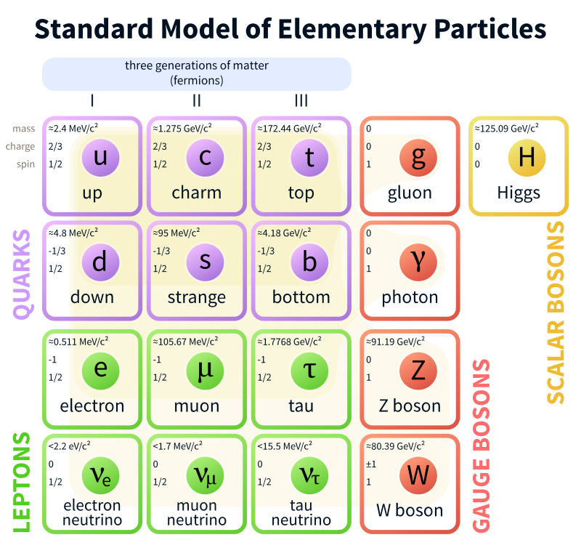
Here is what we have.

Slide 18
How do we detect them, identify them, and measure their properties?
Charge, mass, momentum, energy, etc.

Slide 19
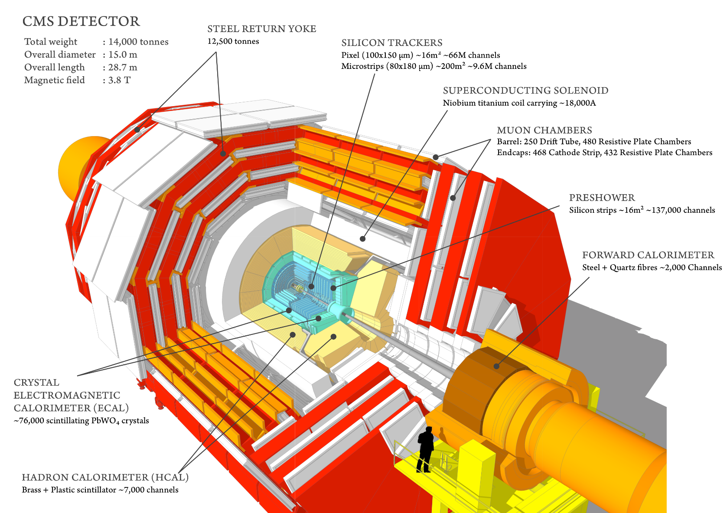
The Layer Architecture
Notes:
Barrel + Endcap

Slide 20
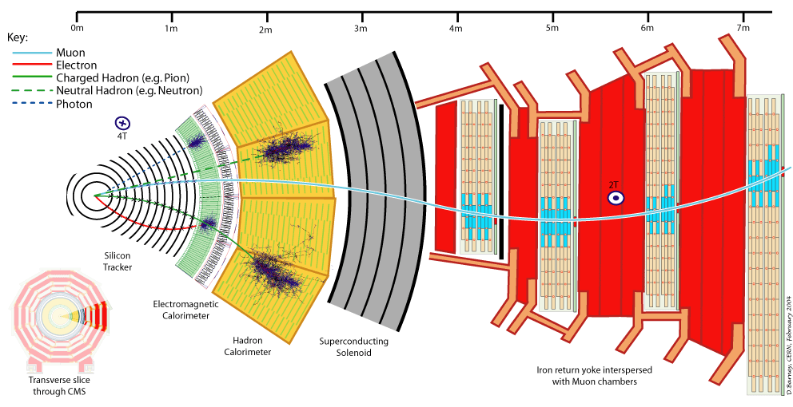
The Layer Architecture

Slide 21
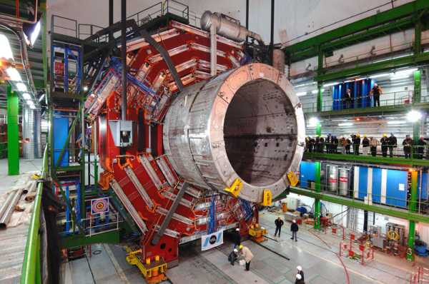
Superconducting Magnet
Magnetic field
  helps identifying the charge of particles
  allows the measurement of the momentum of particles

Slide 22
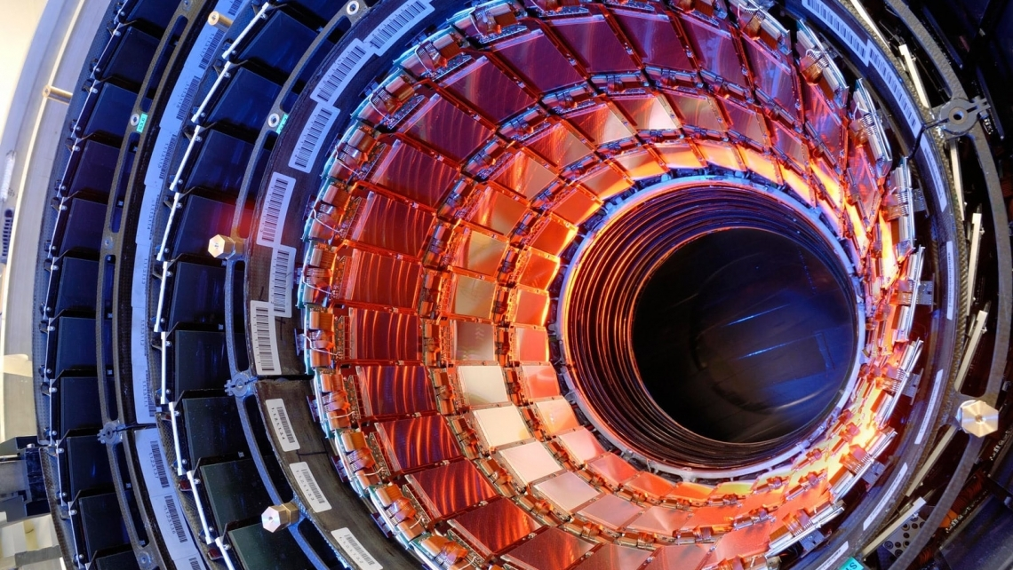
Tracking System
  detection of hits and reconstruction of track of charged particles
  placed closest to the colliding point
  high radiation resistance
  high accuracy but low disturbance
  use silicon technology

Slide 23
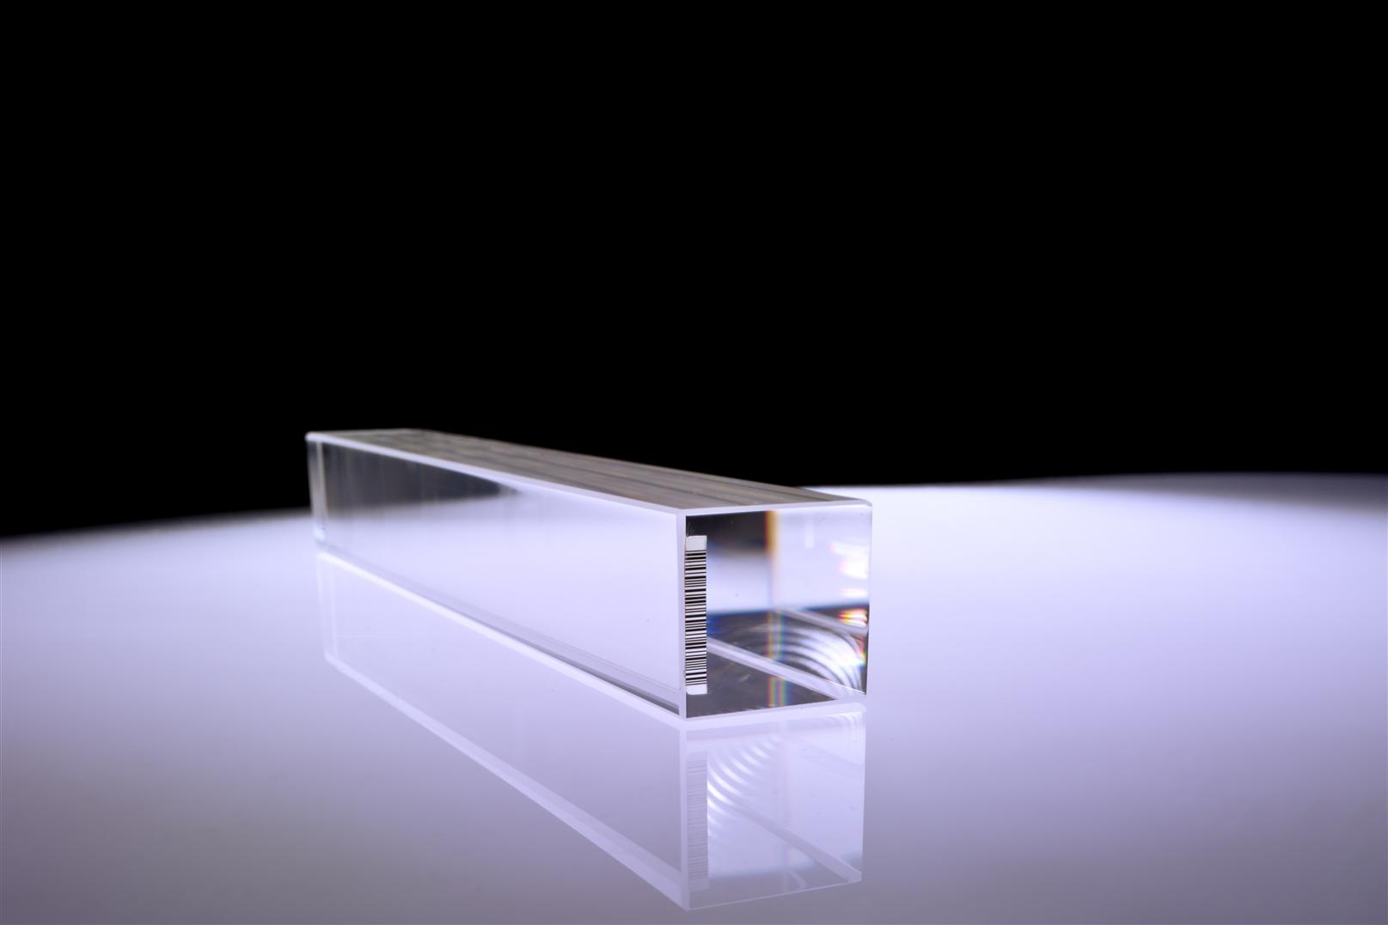
Electromagnetic Calorimeter
  Measure the energy and position of electrons and photons
  Scintillation: when electrons or photons are stopped in material, they produce light.
  Photodetectors amplify and convert the light signal to electrical signal.
  The signal is then transported away
  for analysis by optical fibres.
Notes:
Explain “scintillation”

Slide 24
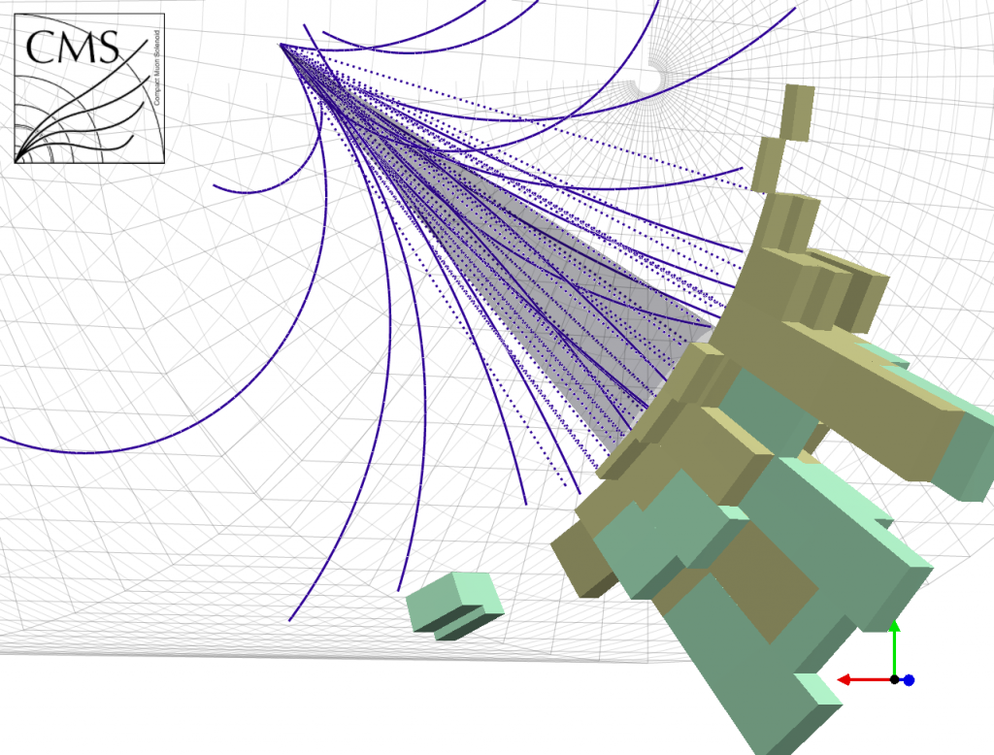
Hadronic Calorimeter
  Measure the energy and position of hadrons.
  Quark are always seen as jets of particles.
  Sophisticated jet algorithms are required.
  Dense material is required to stop hadronic jets.
  Scintillation and photodetectors can be a mean to measure energy.
Notes:
Explain “hadronisation”

Slide 25
Muon Detector
  Muons are not very interacting. It can penetrate several metres of iron, so they are not stopped in ECAL.
  Ionisation of gas can be used as a mean to detect mouns.

