Slide 1



Memorization and Prediction Capability of the Interacting Phase Oscillators
Chanin Kumpeerakij
Chula Intelligent and Complex Systems Lab, Department of Physics, Faculty of Science, Chulalongkorn University, Thailand
23 June 2022
In Collaboration with:
Dr. Thiparat Chotibut, CHICS, CU
Dr. Vudtiwat Ngampruetikorn, The Graduate Center, CUNY
Notes:
Hello everyoneMy name is Chanin Kumpeerakij. I'm a graduate student from Chula Intelligent and Complex Systems, Chulalongkorn University. I'm so excited today to share with you some of the recent research that my supervisors and I have been studying about the computational capability of interacting phase oscillators system through the lens of an information-theoretic framework.

Slide 2
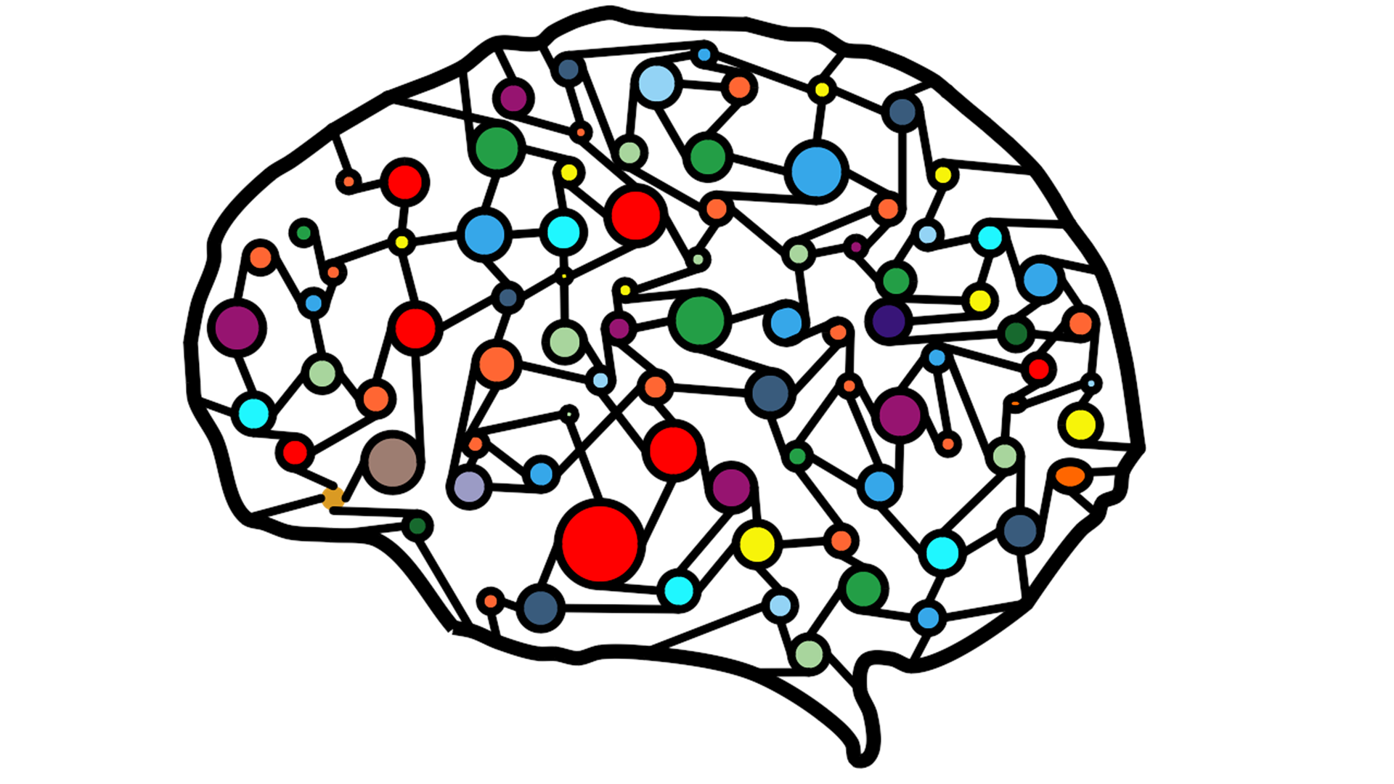
Nonlinear Dynamical Systems
Well-constructed nonlinear dynamical systems benefit model the complex temporal data, like recurrent neural network.
Tuning parameters to achieve the best model remains a challenge.
Emergence of a large system’s behavior is complicated.
Notes:
Well-constructed nonlinear dynamical system provides us with useful methods to model the temporal data, like a recurrent neural network. So, we can predict the dynamic of natural phenomena with this framework. However, tuning parameters to achieve the best performance model remains challenging because each parameter setup can affect the system's behaviors, and the behavior emerges from the interaction of microscopic elements.The point is that it isn't easy to understand the emergence behavior of a large system because of the number of units and parameter configuration.
So, in this project, I simplified the system into two interacting phase oscillators and then studied the effect of each parameter on the memory and predictive capability.

Slide 3
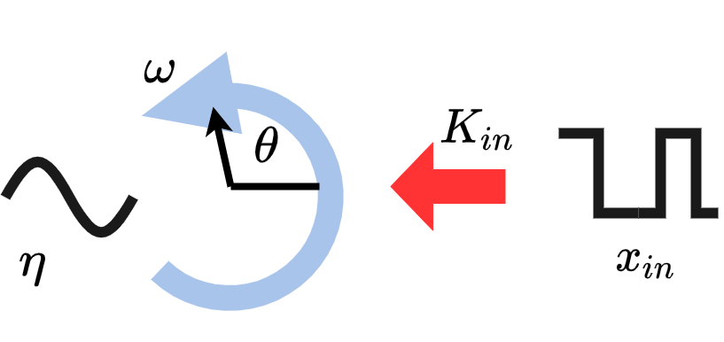

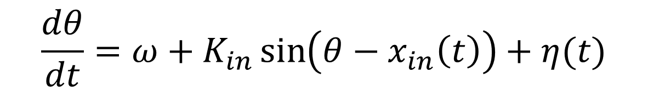
Interacting Phase oscillators system: $1$ oscillator
$$\frac{dθ}{dt}=ω+K_{in}\sin\left(θ−x_{in}\left(t\right)\right)+η(t)$$
$$\left\langle η\left(t\right)η(t^{′})\right\rangle =2Dδ(t−t^{′})$$
Notes:
First, I would like to introduce the main element of the system that we consider. If there is one oscillator in the system, there will be no interaction with others. The oscillator will run the phase, theta, with its own natural frequency, omega. Next, I add noise into the system to replicate the situation in nature, eta, which is the gaussian white noise. The last part is the external input term with sinusoidal nonlinearity, where the system encodes the external signal by coupling the signal with strength, K(in).So, each oscillator will affect by three elements. Natural frequency, noise, and external input.

Slide 4
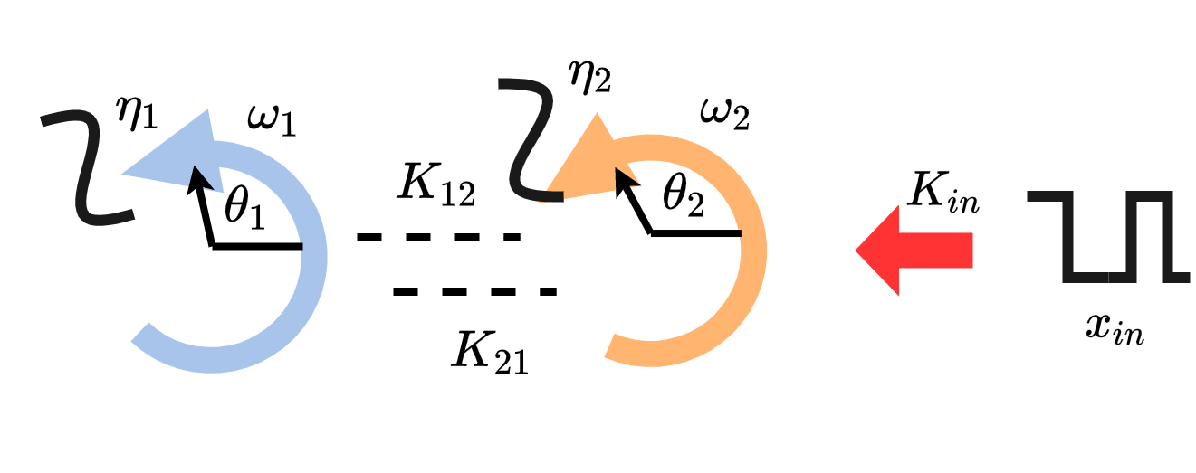

Interacting Phase oscillators system: $2$ oscillators
$$\frac{dθ_{1}}{dt}=ω_{1}+K_{in}\sin\left(θ_{1}−x_{in}\left(t\right)\right)+η_{1}\left(t\right)+\frac{K}{2}sin⁡(θ_{2}−θ_{1})$$
$$\frac{dθ_{2}}{dt}=ω_{2}+K_{in}\sin\left(θ_{2}−x_{in}\left(t\right)\right)+η_{2}\left(t\right)+\frac{K}{2}sin⁡(θ_{1}−θ_{2})$$
$$ω_{i}∈\{1,−1\}$$
$$K_{12}=K_{21}=K/2$$
Notes:
When I have two oscillators in the system, I will consider the interaction between oscillators. As a result, there will be an extra term that couples with another oscillator by connection strength, K. This term also applies sinusoidal nonlinearity.
So now, I studied the effect of natural frequency, noise, input coupling strength, and coupled strength.
Also, I specified that natural frequency is drawn from set 1 and -1, and mean coupled strength.

Slide 5





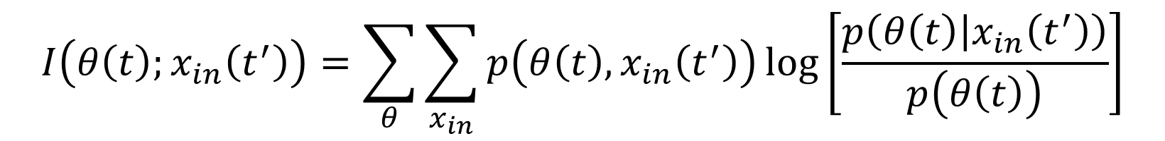


Memory & Predictive Capability Quantification
$$Δt=t^{′}−t$$
Memory
Predictive Capability
$$t′$$
$$Δt<0$$
$$t$$
$$Δt>0$$
$$t′$$
$$I\left(θ\left(t\right);x_{in}\left(t^{′}\right)\right)=\sum_{θ}{\sum_{x_{in}}{p\left(θ\left(t\right),x_{in}\left(t^{′}\right)\right)\log\left[\frac{p\left(θ\left(t\right) | x_{in}\left(t^{′}\right)\right)}{p\left(θ\left(t\right)\right)}\right]}}$$
Notes:
Now, I know the parameters that I need to study with. So, how do I quantify the memory and predictive capability to measure the system's performance?
Mutual information is metric that indicates the reduction in uncertainty about one variable given knowledge of another or how much information one variable could give about another.
So, I use mutual information to measure how much information the oscillators could tell about the input.
I measure mutual information between oscillators' response at time t and input at time t' to show the correlation over time. As a result, I can quantify the memory as mutual information that delta t is negative because it indicates the information that oscillators know about input in the past. In contrast, I quantified the predictive capability when delta t is positive because it shows the maximum information that oscillators could tell about the future.
Consequently, the memory and predictive capability can represent the system's performance.

Slide 6
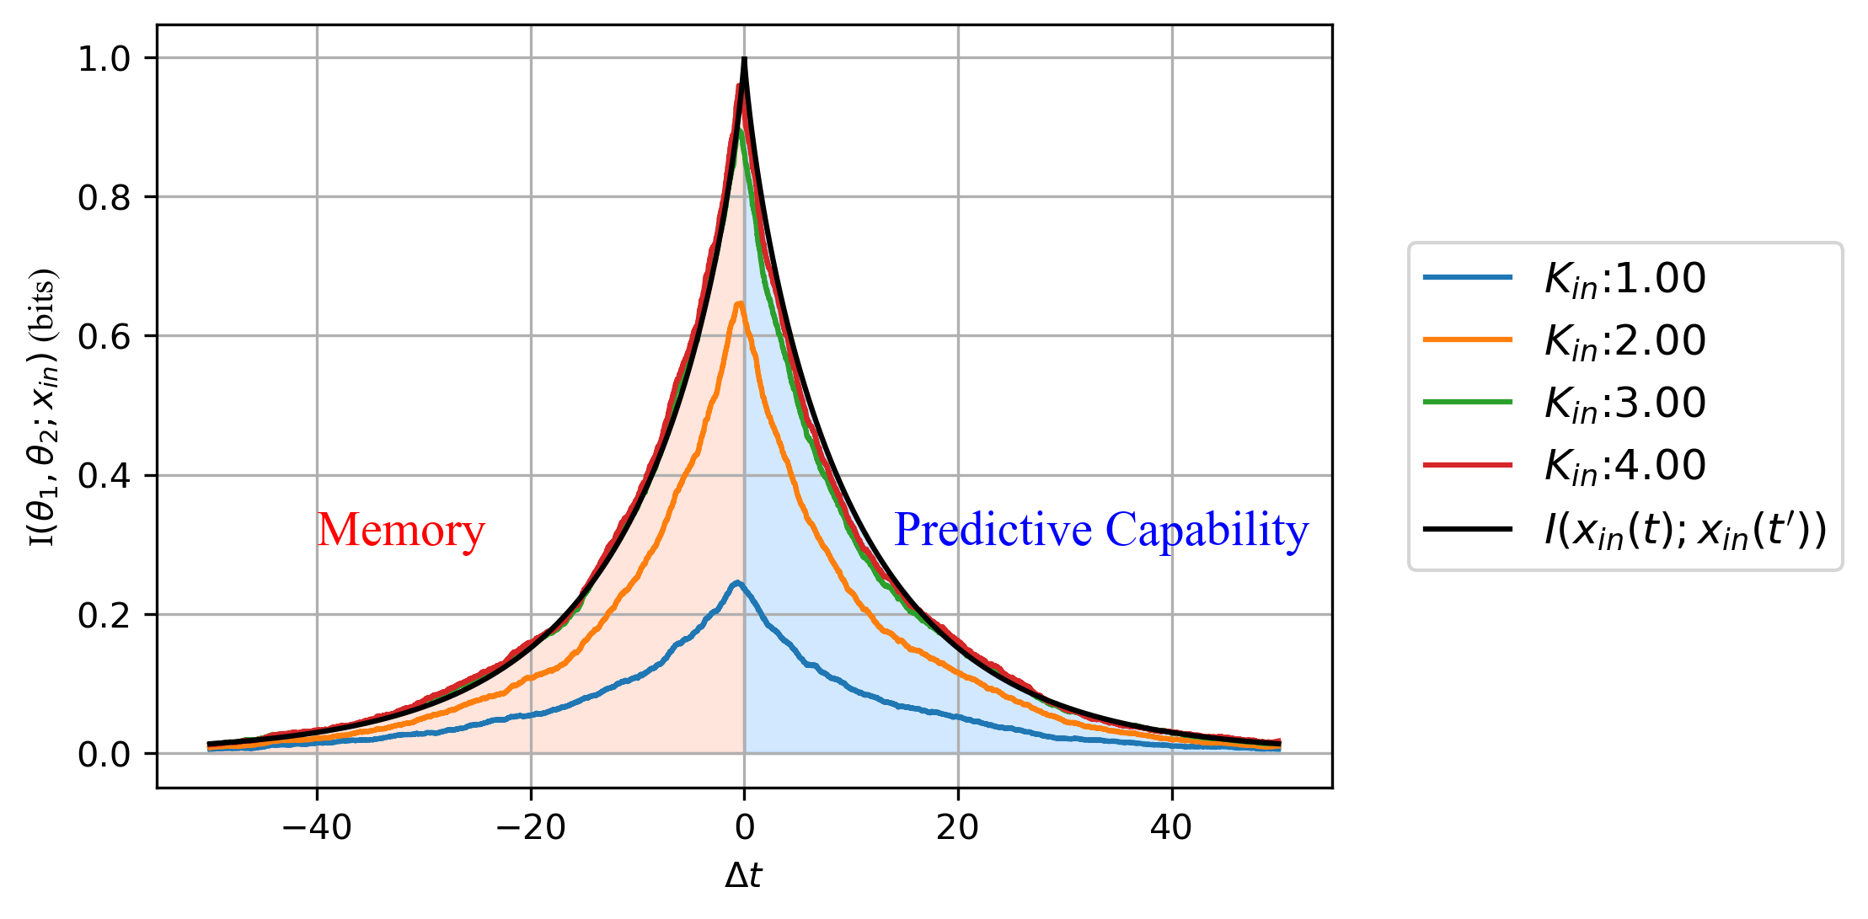


$$K=0$$
$$Δt=t′−t$$
$x_{in}$ Binary state is drawn from Poisson process with relaxation time 50
Notes:
Now, I will show the result of the investigation of each parameter. First, I consider the system without interaction and compare different input strengths with input-input mutual information because the oscillators could not know more than the input knows itself.The results show in the figure. The vertical axis is the mutual information between two oscillators' responses and input. The horizontal axis is the time difference between responses and input. At delta t =0, the input-input mutual information maximizes at one bit because we use the binary state signal.As you can see, the mutual information decreases while delta t increases both negative and positive because it is too long to hold the memory or make a prediction. Another interesting point is there is a time delay of a peak because the system encodes previous input successfully. So, it makes sense that oscillators have information about the past more than the future or current input.About the memory and predictive capability, they both increase while the input strength increases. As a result, I use this advantage to demonstrate both performances in the following results.

Slide 7
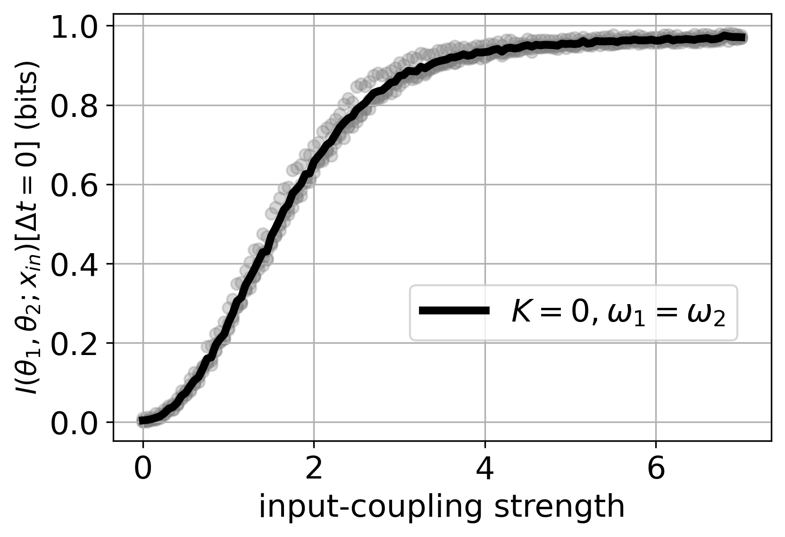
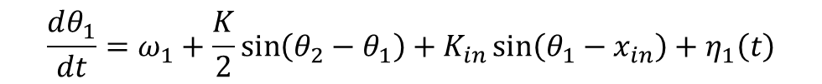

Effect of Input strength on encoded information
Notes:
Okay, we are still on the experiment without interaction between oscillators.I focus only on the effect of input strength.
So, I kept increasing the input strength. The vertical axis is the mutual information between oscillators' responses and inputs at the same time. The horizontal axis is the input strength.
As you can see, there is no information about the input in weak input strength because the system's dominated by noise and encode noise instead.
In contrast, equal time mutual information converges into one bit at strong input strength because the system is dominated by input and behaves like input.

Slide 8
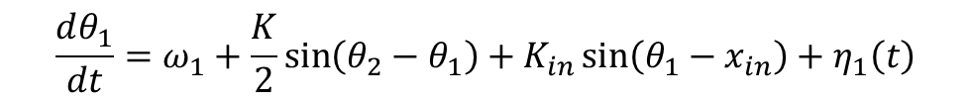
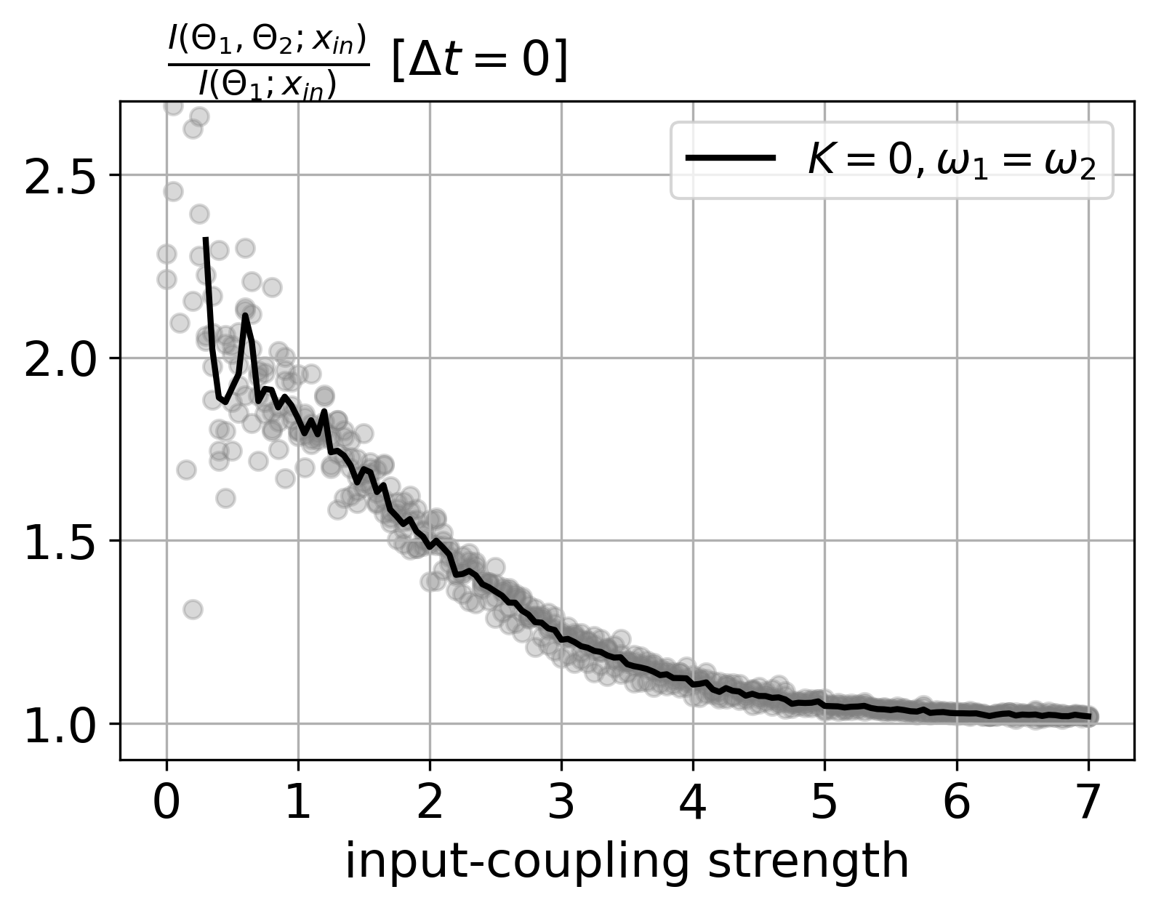
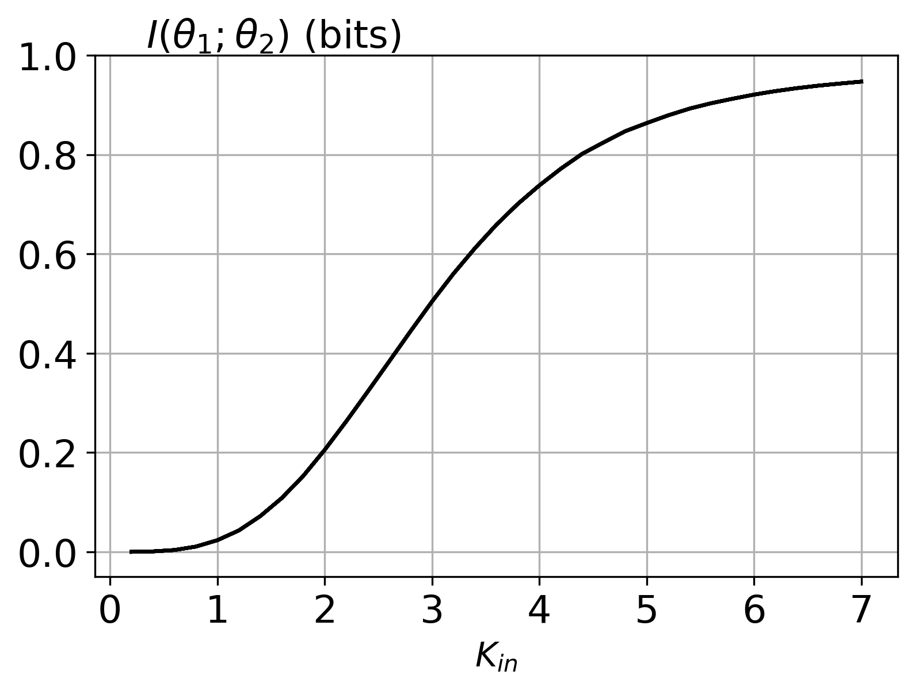
Notes:
Furthermore, I determine how oscillators use the state space to encode the system. So, I compare the mutual information estimated by two and one oscillators' responses to show how much information can increase while using a different number of oscillators to encode.
In this figure, the vertical axis is the proportion of mutual information from two and one oscillators. The horizontal axis is input strength.
As you can see, the proportion is highest in the noise-dominated regime because both oscillators act differently from each other. So, increasing the number of oscillators helps encode different parts. As a result, information increases because there is increasing in state-space.
You can see it in the next plot. This plot demonstrates how similarly both oscillators act while input strength increases. The vertical axis is the mutual information between oscillators.
Consequently, this plot reveals that both oscillators act incoherently because even if we know the state of one oscillator, we rarely know another.
In contrast, the proportion tells that both oscillators act as same as one oscillator because it acts like input instead. The trend of mutual information between oscillators also shows the convergence into one bit.
The input strength is a parameter that shows how strong the system encodes the input. If it's too strong, we will not know the performance except the replication of input. If it's too weak, noise will take place, and we will know nothing about the input.

Slide 9
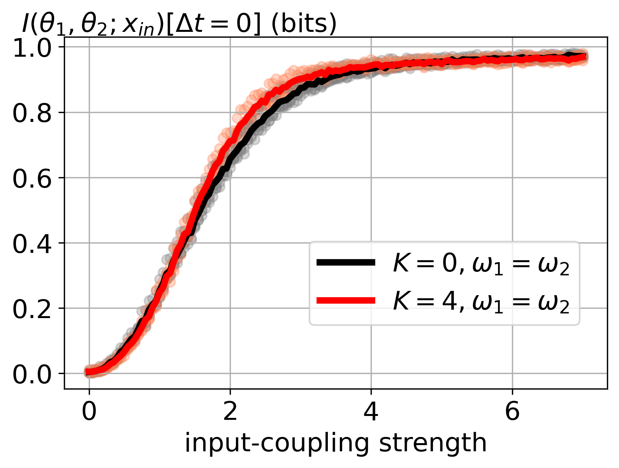
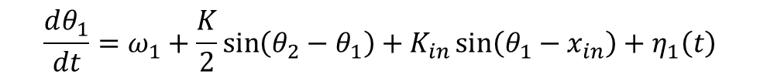
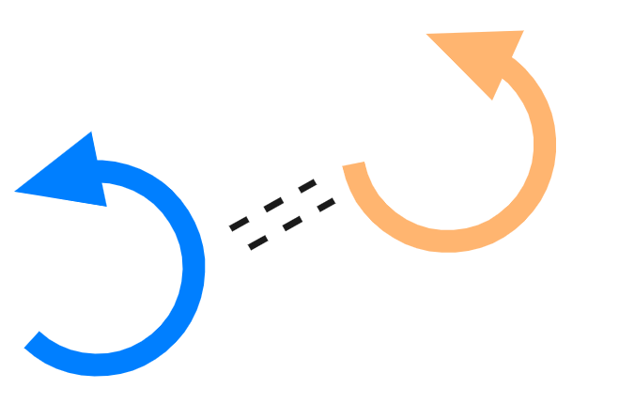
Effect of Interaction on encoded information
Notes:
Next, we will consider the system with interaction.
In this result, I illustrate the same axis but compare the performance of two different systems. The Red line is the result of the system with interaction.
There is no significant difference in both extreme limits but a system with interaction can encode information more than the system without interaction in the middle of the line.
Intuitively, the interaction between oscillators reduces the noise effect because it helps the system increase the encoded information in low input strength.

Slide 10
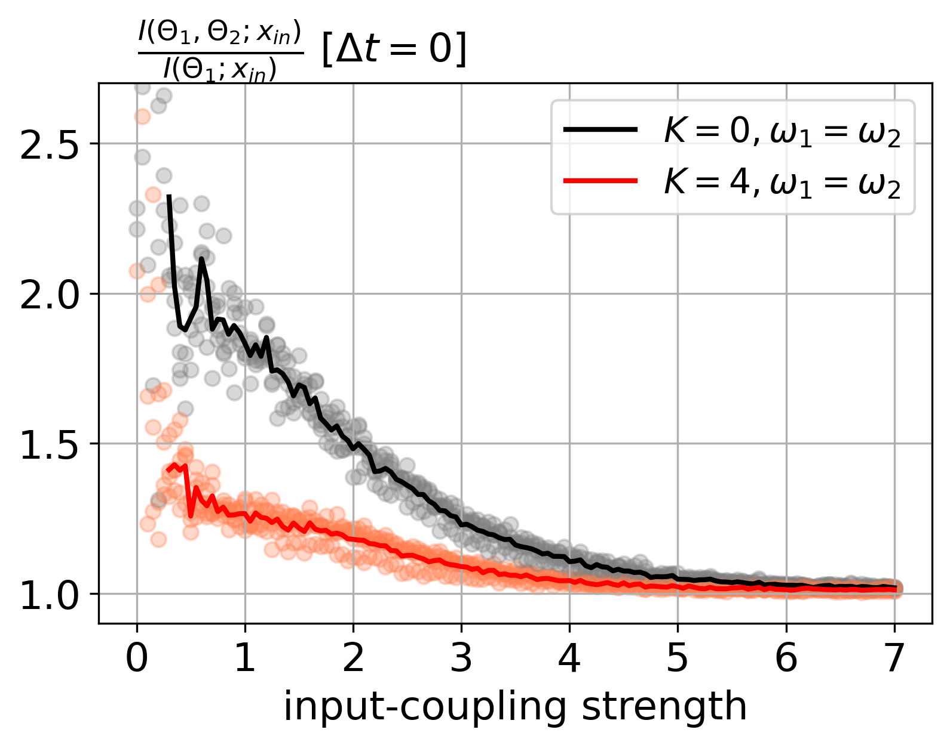
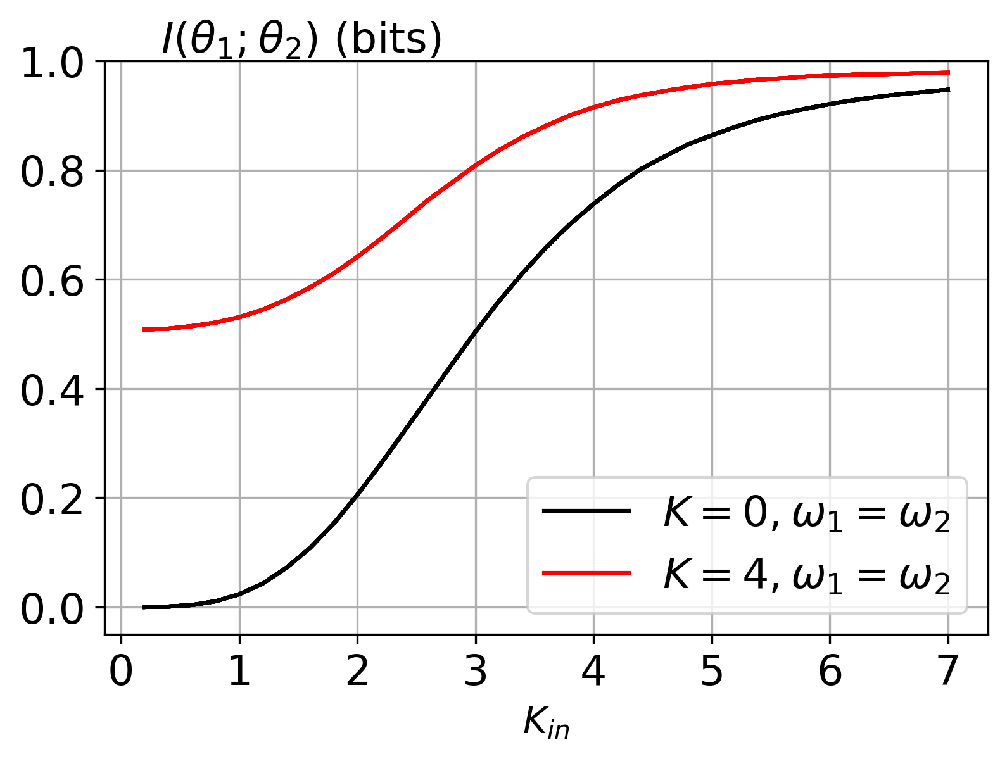
Notes:
If we look at the proportion, we can see that proportion for the system with interaction decreases because the interaction helps oscillators share information and behave similarly to each other.
The mutual information between oscillators also shows that oscillators know each other even in the noise-dominated regime. Also, the system can encode more information, and then both oscillators act like the input signal because of sharing information. You can see that mutual information close to one bit even more.
So, the interaction helps to increase the signal-to-noise ratio. It affects the system to be more redundant.

Slide 11
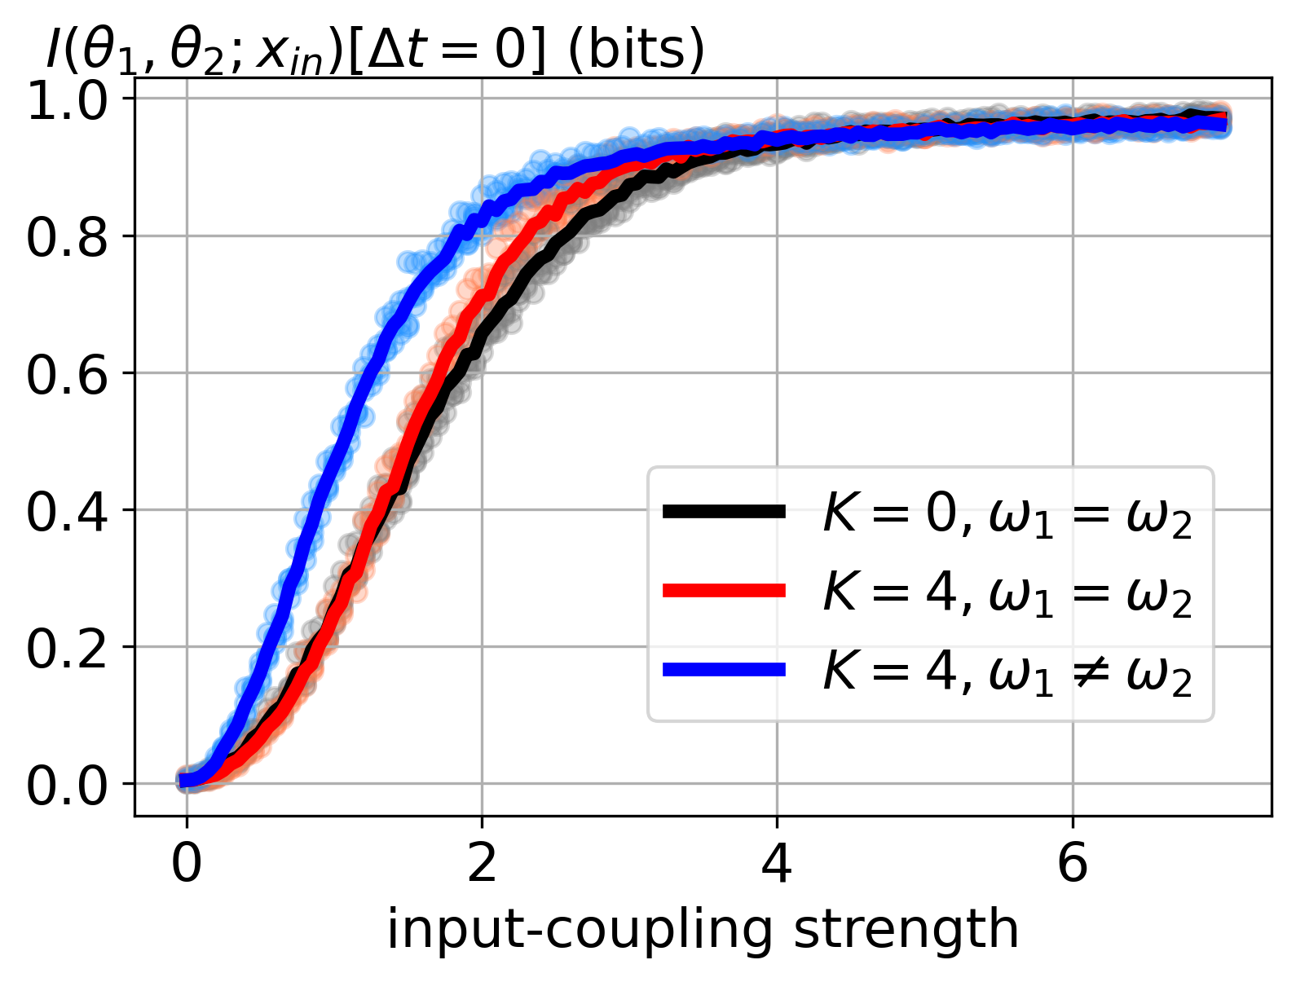
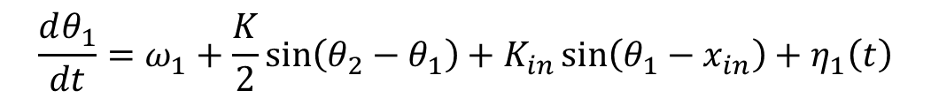
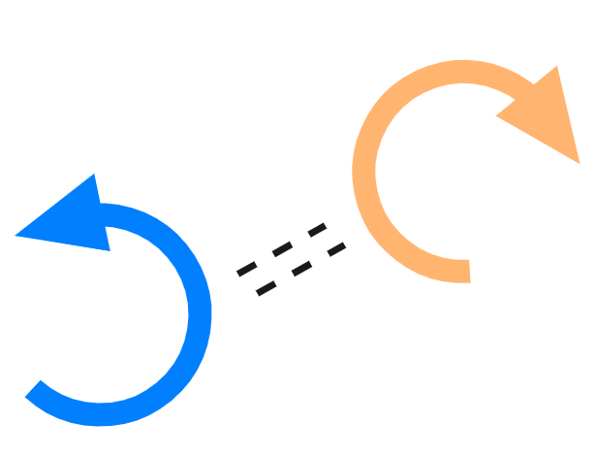

Effect of $ω$ configuration on encoded information
$$ω_{i}∈\{1,−1\}$$
Notes:
The last topic that I investigate is natural frequency configuration.
Natural frequency is the characteristic speed of each oscillator. So, I ask what will happen when both oscillators have different speeds? The heterogeneity of the system helps increase the encoded information or not?
This is the result. The blue line is the equal time mutual information from the system with different natural frequencies. As you can see, the encoded information in the noise-dominated regime increases significantly. This means the heterogeneity of the system help increases the signal-to-noise ratio.

Slide 12
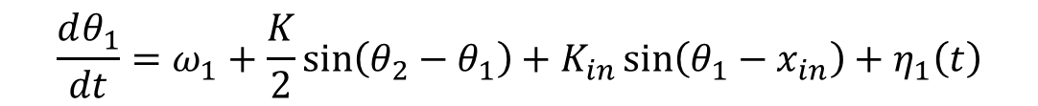
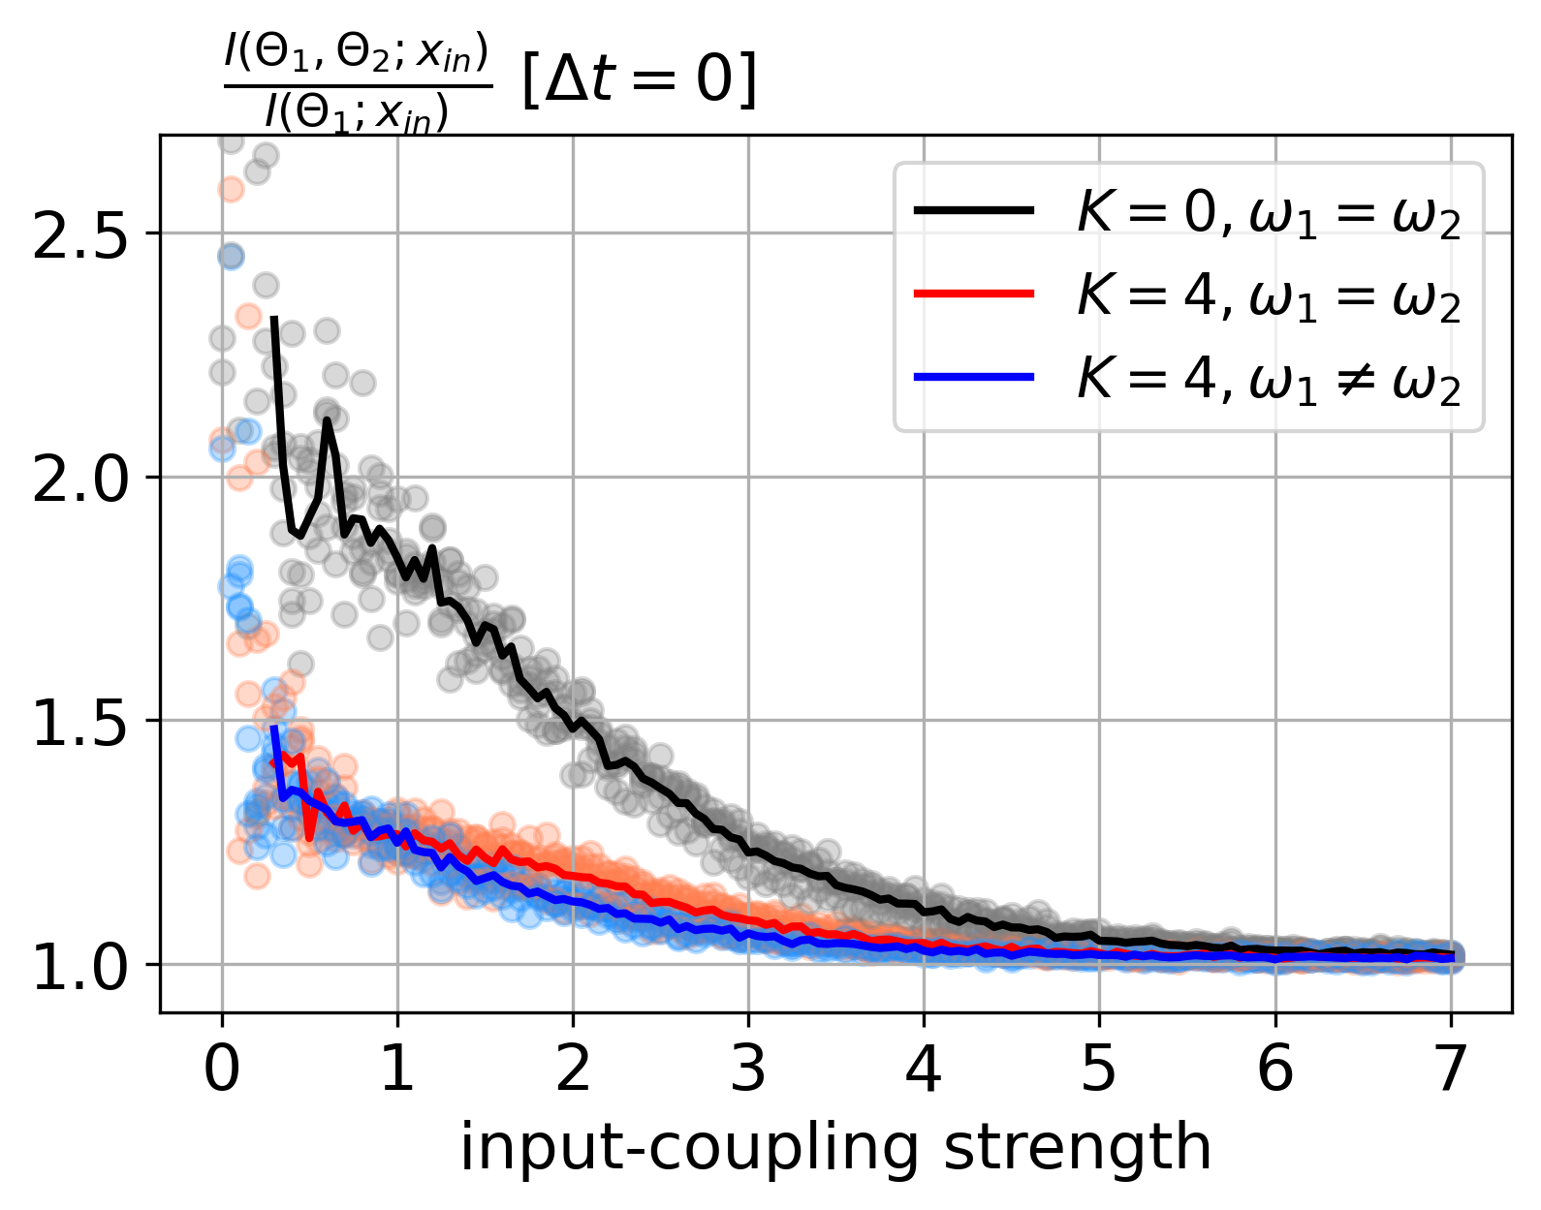
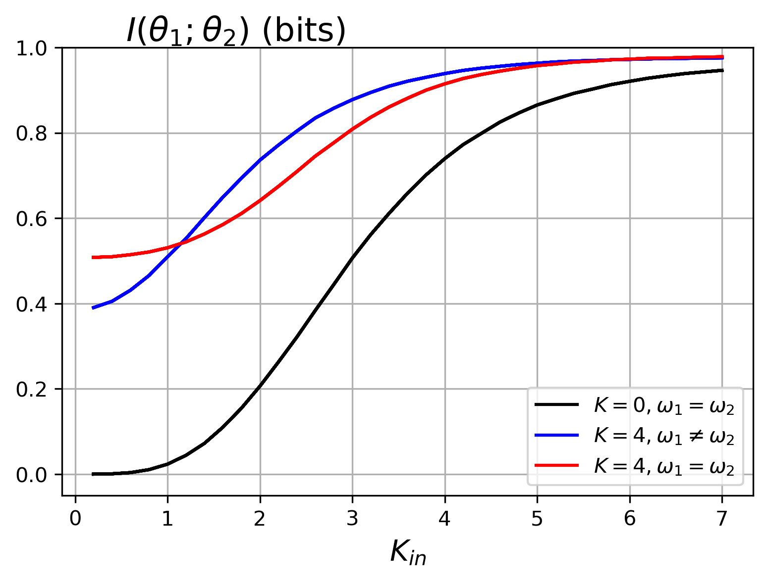
Notes:
Next, the proportion shows that the system with different natural frequencies is similar to the system with the same natural frequencies. However, the proportion in the middle seems less than the system with the same natural frequencies.
So, I look at the mutual information between oscillators in this system. The result shows that the oscillators behave differently in a noise-dominated regime because of the heterogeneity. However, increasing a little input strength causes the system to respond to the input signal effectively.

Slide 13
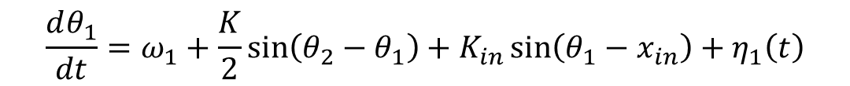
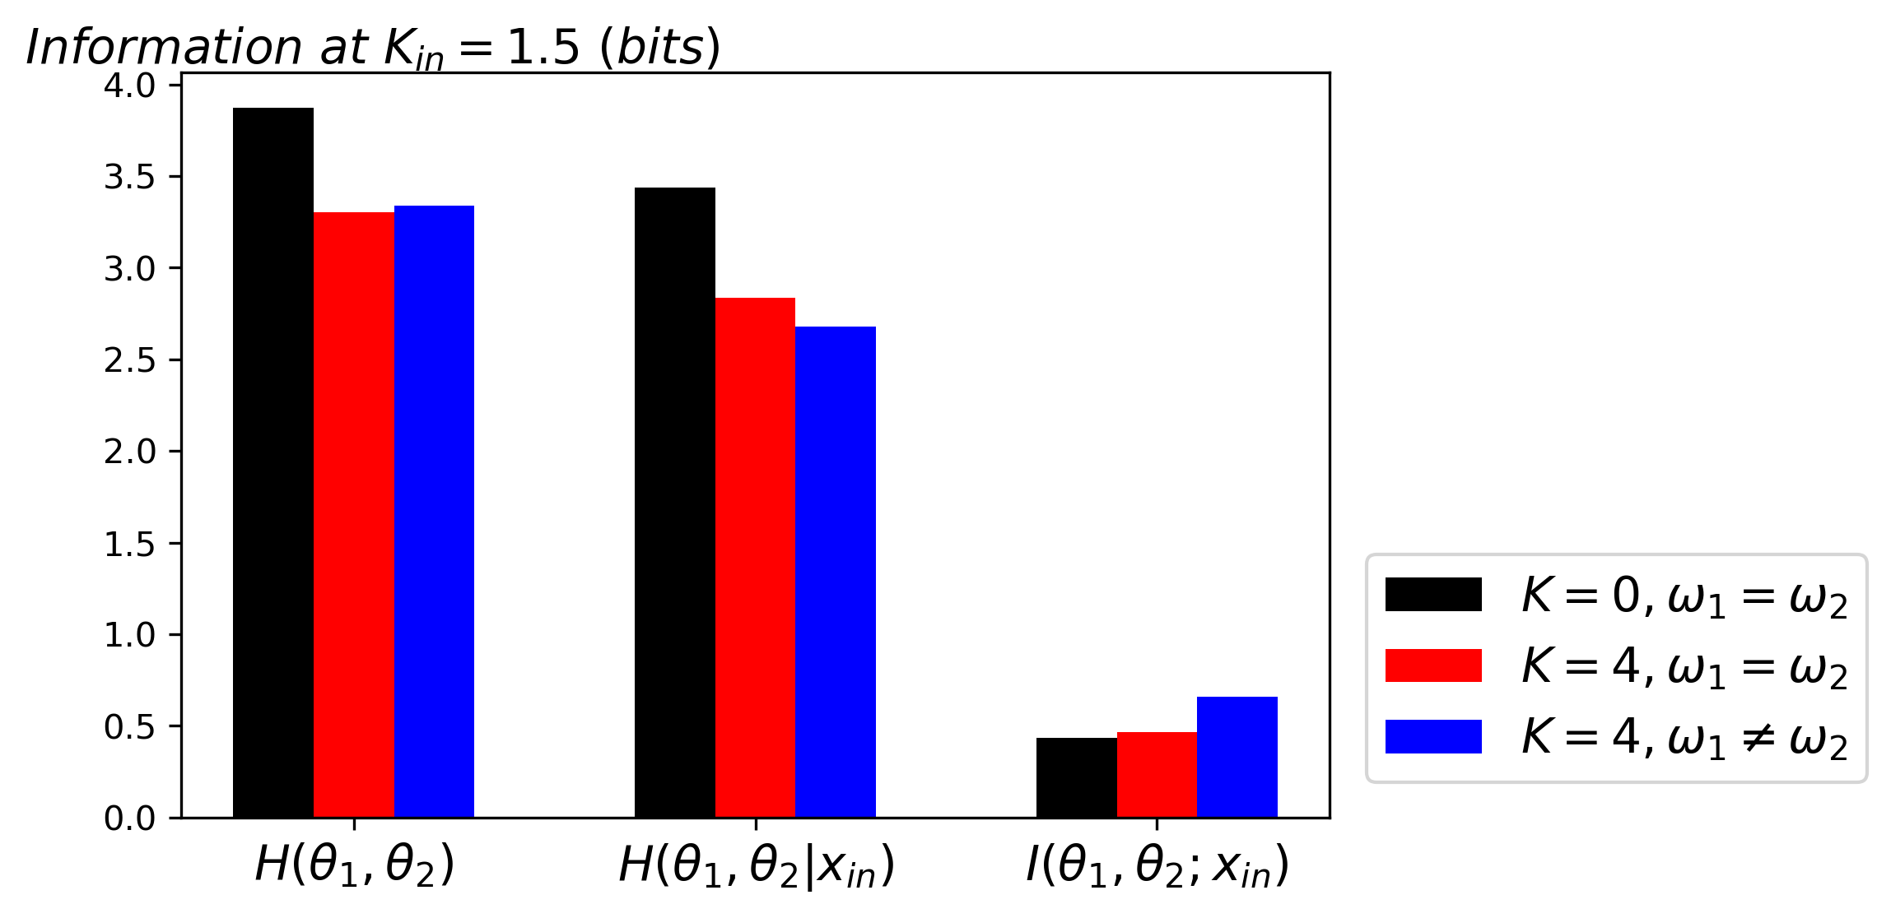

Noise entropy
$$I\left(θ;x_{in}\right)=H\left(θ\right)−H(θ|x_{in})$$
Notes:
Furthermore, I also investigate mutual information in an alternative form.
The mutual information can be written in the system and noise entropy. The system entropy is the uncertainty of the system, while noise entropy is the uncertainty given the knowledge about the input. The difference between two quantities shows the uncertainty reduction given the input knowledge.
I pick the result from the input strength equal to 1.5 and show the information ratio on the vertical axis. Comparison between three setups represents in different color, black is the system without interaction, red is the system with interaction but same natural frequency, and blue is the system with interaction , same natural frequency.
As you can see, the system with interaction decreases the entropy of the system or reduces the uncertainty compared with a system without interaction.Next, the noise entropy decreases significantly while the heterogeneity of the system increases. As a result, the system with interaction and different natural frequencies can encode information the most.
All results show that the interaction and heterogeneity of the system help increase information by reducing the noise effect.

Slide 14
Summary
Input strength play main role to encode input
Interaction helps reduce the noise
Heterogeneity helps the system respond effectively
Notes:
In conclusion, this project is the first step to understanding the encoding efficiency of an interacting dynamical system by learning the performance of interacting phase oscillators.
As a result, there are three major parameters that affect the system's performance.
The input strength plays a key role in encoding the input. if it is too strong, the system will act as input. If it is too weak, the noise will dominate the system.
The interaction helps increase signal-to-noise ratio by sharing information and making the system to be redundant.
The last investigation is the natural frequency configuration.
This scheme helps the system respond to input effectively by increasing the system's heterogeneity.
Even though this is the first step of the investigation, this project provides a systematic approach to understanding the large system more clearly.

Slide 15
Reference
Acebrón, J. A., Bonilla, L. L., Vicente, C. J. P., Ritort, F., and Spigler, R. 2005.The kuramoto model: A simple paradigm for synchronization phenomena.77.1 (2005): 137–185.
MacKay, D. J. C. 2002. Information Theory, Inference Learning Algorithms.Cambridge University Press.
Palmer, S. E., Marre, O., Berry, M. J., and Bialek, W. 2015. Predictive information in a sensory population. Proceedings of the National Academy of Sciences of the United States of America 112 (6 2015): 6908–6913.
Strogatz, S. H. 2018. Nonlinear Dynamics and Chaos. CRC Press. ISBN 9780429961113. doi: 10.1201/9780429492563.

