Slide 1

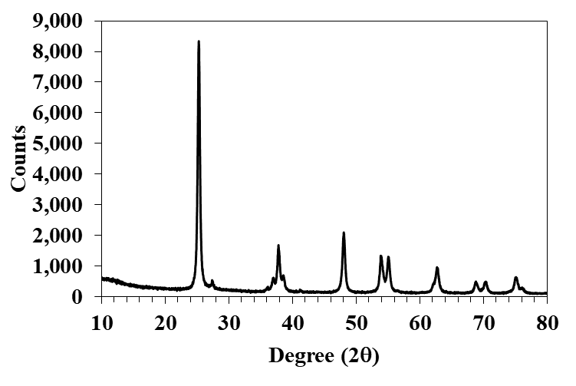
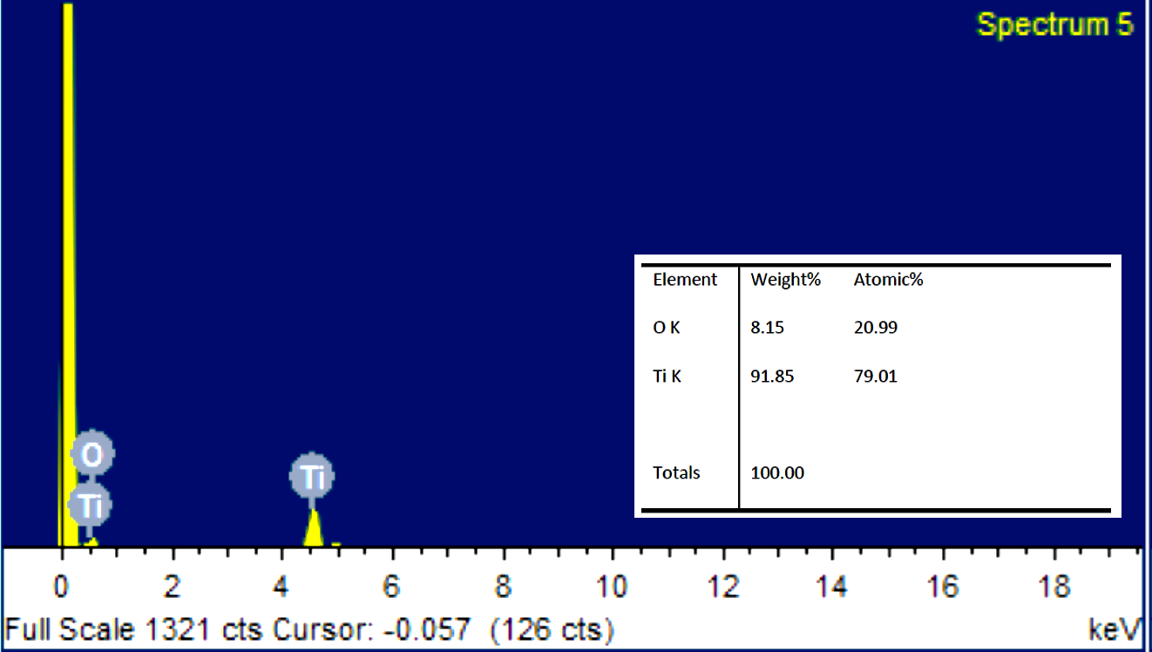
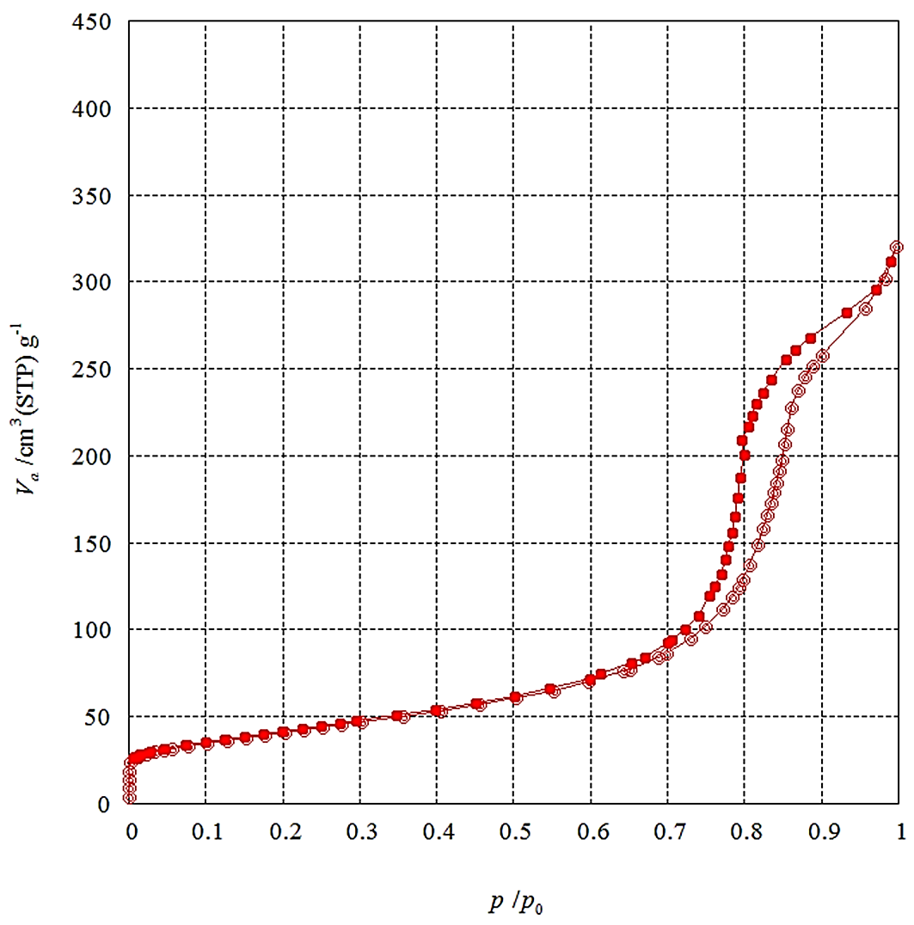
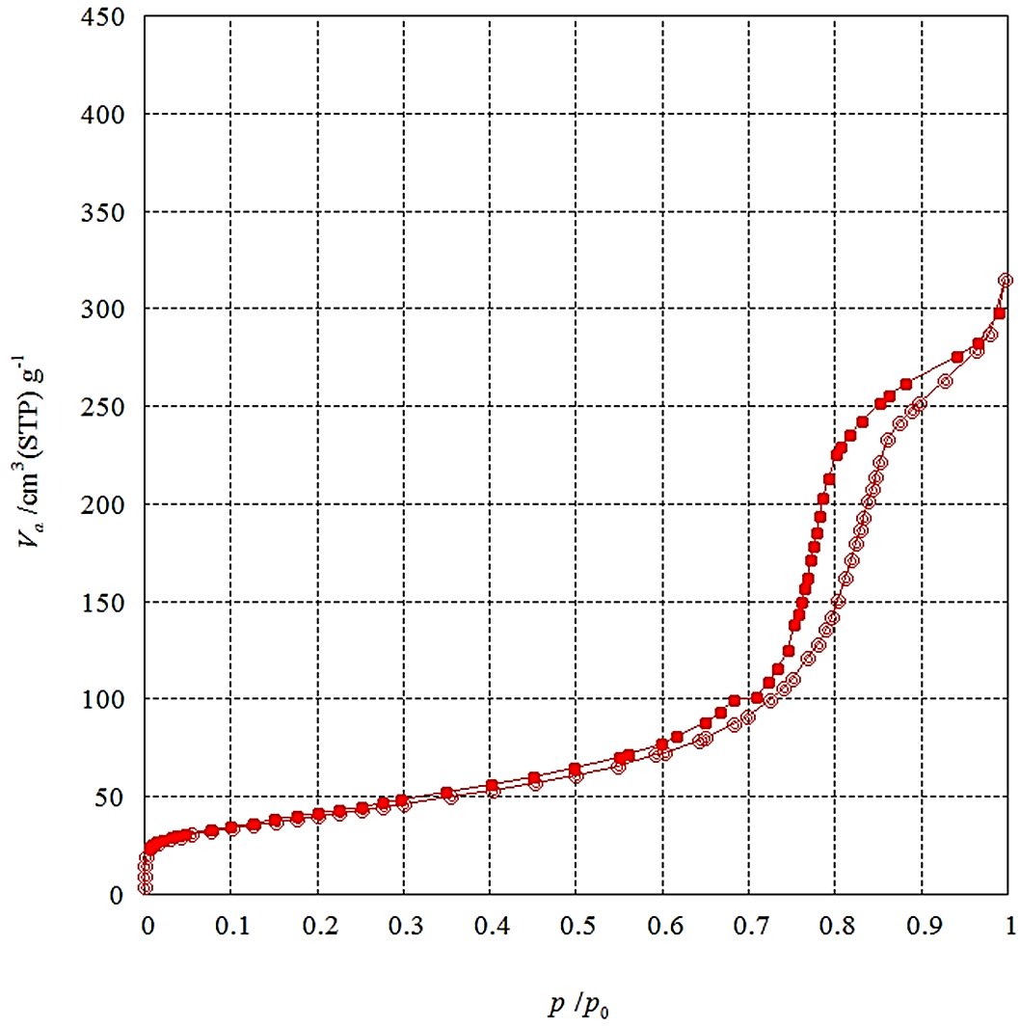
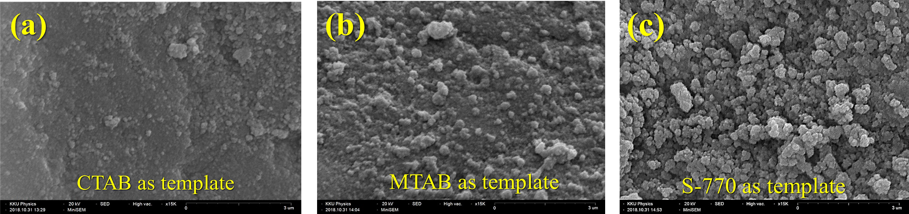
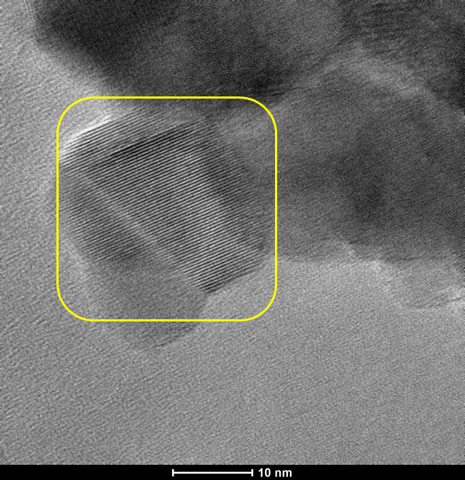
TiO₂ porous nanoparticles synthesized by co-condensation method
using different templates
Artit Hutem, Chanyalack Kumsee, Wirachai Meesuk, Chalad Yuenyao*
Department of Physics, Faculty of Science and Technology, Phetchabun Rajabhat University,
83 M.11 Sadiang sub-district, Muang, Phetchabun 67000, Thailand
*Corresponding author: chalady_2012@hotmail.com
ABSTRACT
The objective of this research is to investigate the synthesis of porous single-phase nano-titanium using titanium (IV) isopropoxide (TTIP) as a precursor and three types of surfactant as structure directing agent or template; CTAB, MTAB and Sugar Ester S770. Co-condensation method combined with bi-phasic condition is utilized for the synthesis. The formation of titanium nanoparticles occurs at about 65 ºC under atmospheric pressure and the basic environment. To obtain a single-phase nano-titanium, the as-synthesized titanium dioxide (TiO₂) are dried and calcined at 80 and 550 °C, respectively. Calcined particles are then analyzed and tested with various analytical techniques. Surface area and pore volume were analyzed by BET technique while the size and distribution of porosity were analyzed by BJH method with nitrogen (N₂) adsorption-desorption isotherm. Morphology and internal nanostructure of particles were analyzed through the SEM and TEM techniques. UV-vis and XRD techniques were employed to determine the light absorption property and crystallinity of the obtained particles, respectively,while water contact measurement was employed to evaluate the hydrophilic properties of synthesized particles. Results showed the successful synthesis of TiO₂ nanoparticles with highly porous surfaces area.
Keywords: Synthesis, Monodisperse, Mesoporous, TiO₂, Nanoparticles.
MATERIALS AND EXPERIMENTS
Titanium (IV) isopropoxide (TTIP, C₁₂H₂₈O₄Ti, MW:284.22 g/mol) with purity of 97.0 % was supplied by Sigma-Aldrich. Ryoto Sugar Ester S-770 manufactured by Mitsubishi-Kagaku Foods Corporation, was supported from Caltech Corp., Ltd. Cetyl-trimethyl ammoniumbromide (CTAB, C₁₉H₄₂BrN, MW:364.45 g/mol) was purchased from Merck KGaA, EMD Millipore Corporation. Cyclohexane (CHX, C₆H₁₂, MW:84.16 g/mol) with purity of 99.5% and Ethanol (AR. Grade, C₂H₅OH, MW:46.07 g/mol) was supplied by ACI Labscan and Myristyrimethyl ammonium bromide (MTAB, C₁₇H₃₈BrN, MW:336.39 g/mol) with 98.0 % purity was supplied by Sigma-Aldrich. Deionized water (DI-water, 18.2 MΩ) was produced by a Sartorius (H20PRO-DI-T Model).
For the synthesis of titanium dioxide (TiO₂) nanoparticles by using CTAB as template, 4.0 g CTAB was dissolved in 80 ml DI-water at 60 °C under stirring. After the solution was stirred about 10 min, 8 g CHX was added to create a second phase. TTIP for 6 g was then slowly added into the solution and continue mild stirring for 24 h. Afterwards, TiO₂ nanoparticles were collected by centrifugation at 6,000 rpm for 15 min, washed with pure water and ethanol for three times, and then dried at 80 °C for 4 h. Finally, CTAB and other organic components were removed by calcination at 550 °C for 5 h to obtain the pure TiO₂ nanoparticles. Preparation of TiO₂ by using MTAB and S770 as template were conducted by the same procedure. In this study, prepared particles were characterized by various analytical techniques. Scanning electron microscopy (SEM) and transmission electron microscopy (TEM) were employed to evaluate the morphological structures while UV/VS spectrophotometry (190-250 nm) was utilized to analyzed the light absorption properties of TiO₂ nanoparticles. Crystallinity and porous properties of nanoparticles were determined by x-ray diffraction spectroscopy (XRD) and N₂ adsorption-desorption isotherm combined with BET and BJH techniques, respectively.
Figure 3 X-ray diffraction pattern (left) and EDS spectrum of TiO₂ porous nanoparticles using CTAB as template.
Figure 3 shows the XRD pattern and EDS spectrum of the synthesized particles. XRD pattern shows the strong diffraction peaks at about 25°, 37°, 38°, 39°, 48°, 54°, 55°, 63°, 69°, 70°, 75° and 76° indicating the single phase (anatase) TiO₂ nanoparticles. EDS spectrum confirms the purity of the obtained TiO₂.
TiO₂/CTAB
TiO₂/MTAB
Figure 4 N₂ adsorption-desorption isotherm (left) and EDS spectrum of TiO₂ porous nanoparticles using CTAB as template.
N₂ adsorption-desorption isotherm as shown in figure 4 clearly show the gas adsorption and desorption behavior of particles indicating the meso and micro-porous on the TiO₂ synthesized by using CTAB and MTAB as directing agent. Combination of N₂-isotherm with BET and BJH techniques revealed the porous properties of TiO₂. Specific surface area, pore volume and pore size distribution are TiO₂/CTAB and TiO₂/MTAB are 145.16 m²/g, 0.4813 m³/g, 13.89 nm and 144.31 m²/g, 0.4693 m³/g, 10.39 nm, respectively. UV/VIS absorption testing results showed that the light with wavelength of about 190-290 nm are absorbed by TiO₂/CTAB, TiO₂/MTAB and TiO₂/S770.
Figure 1 SEM-micrograph shows morphological structure of TiO₂ synthesized by using (a) CTAB, (b) MTAB and (c) S-770 as template.
CONCLUSIONS
According to the experimental results as mention above, meso and micro-porous anatase-TiO₂ nanoparticles with high specific surface area and uniform particle size distribution were completely synthesized by co-condensation method using CTAB, MTAB and S-770 as template.
ACKNOWLEDGMENTS
This research work was financially supported by the Science Research and Innovation Fund (budget year of 2020), Thailand Science Research and Innovation (TSRI). We would like to thank to the Science Center and Department of Physics, Faculty of Science and Technology for infrastructure support.
Figure 1 TEM-micrograph shows morphological nanostructures of TiO₂ synthesized by using CTAB as template.
EXPERIMENTAL RESULTS
SEM and TEM-micrographs as shown in figure 1 and 2 disclose the morphological structures of TiO₂. Comparison of particle size of TiO₂ synthesized using CTAB, MTAB and S-770 as template showed that smallest particles are obtained when CTAB is used as template. While the particle size distribution of TiO₂ is the same in all templates. TEM-micrograph with high magnifying power clearly shows the crystal planes and confirm that the produced particles are porous particles.
REFERENCES
Wang, J., Sugawara-Narutaki, A., Shimojima, A. and Okubo, T. (2012). Biphasic synthesis of colloidal mesoporous silica nanoparticles using primary amine catalysts. 385. 41-47.
Leshuk, T., Linley, S., Baxter, G. and Gu, F. (2012). Mesoporous hollow sphere titanium dioxide photocatalysts through hydrothermal silica etching. ACS Applied Materials & Interfaces. 4. 6062-6070.

