Slide 1

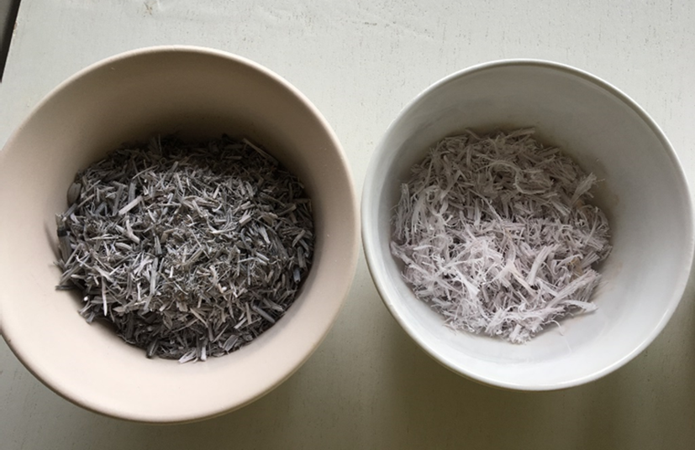
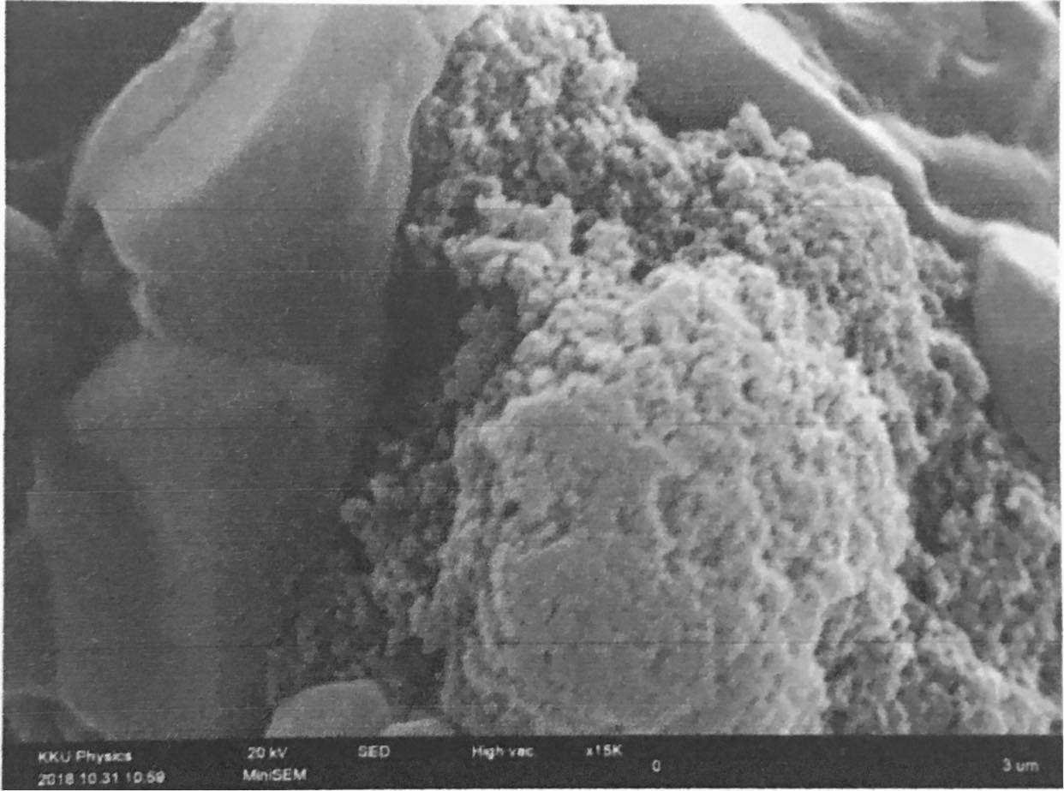
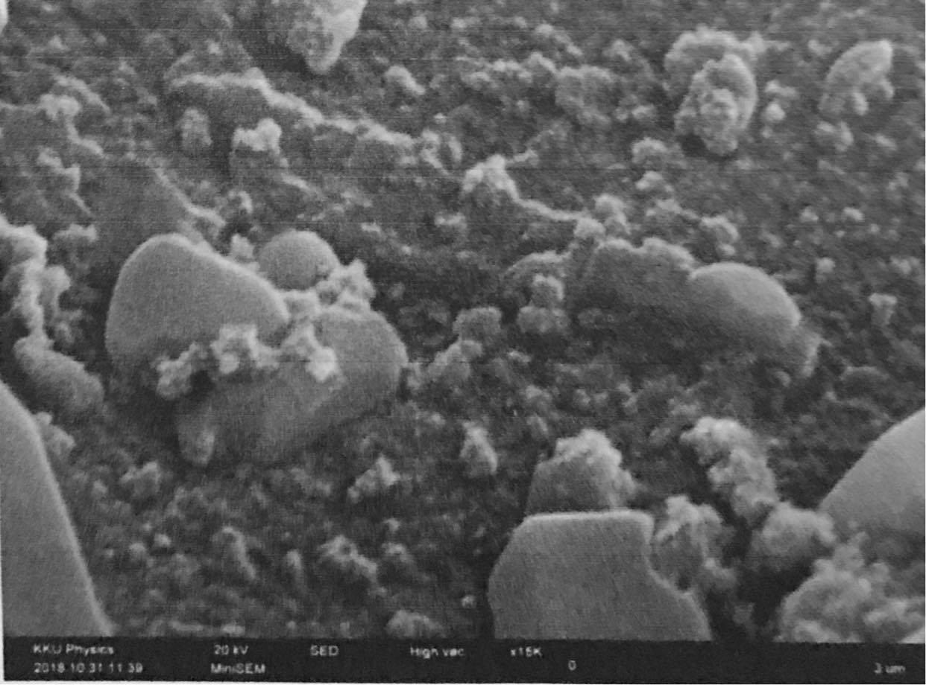
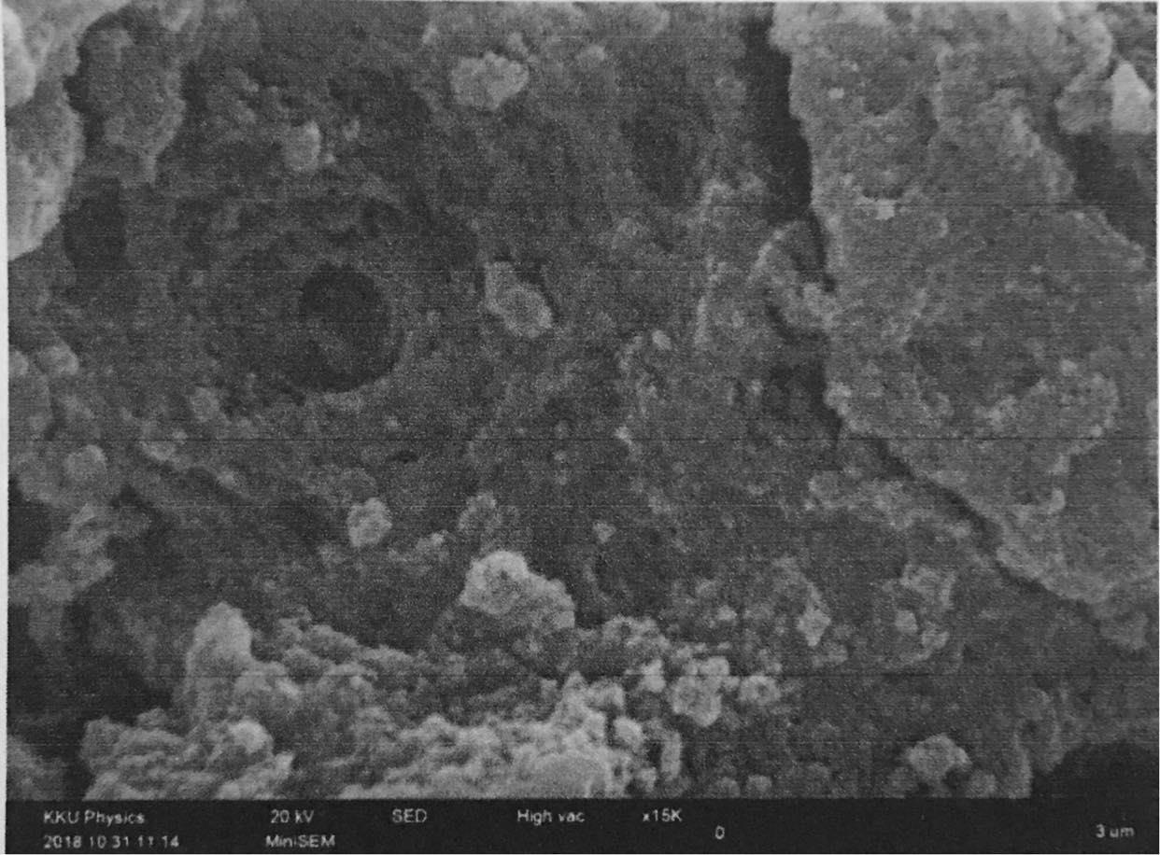
Facile synthesis of high purity silica xerogel from rice straw
Oranut Yosma, Chalad Yuenyao
Department of Physics, Faculty of Science and Technology, Phetchabun Rajabhat University,
83 M. 11 Saraburi-Lom Sak Road, Sadiang Sub-district, Muang, Phetchabun 67000, Thailand
*Corresponding author: chalady_2012@hotmail.com
ABSTRACT
(a)
(b)
This research aims to synthesize a silica xerogels from rice straw that is a residue biomass generating from agriculture. Purity and morphological structure of synthesized silica xerogel are also studied. The first step of the synthesis is the preparation of sodium silicate from rice straw ash that is then used as silica source. To prepare a silica source, pretreated rice straw was burnt at 700 °C for 2 h to obtain a rice straw ash. After that resulted rice straw ash is washed with 1.0 M HCl aqueous solution, reacted with 2.0 M NaOH at 80 °C for 1 h and filtrated two times by a no.41 filter paper and ion exchange resin, respectively. The obtained sodium silicate is then mixed with 1.0 M HCl under stirring for 6 h to produce the nano-silica. To increase the purity of nano-silica xerogels, as-synthesized silica was washed with deionized water for 3 times, dried in electric oven at 85 °C overnight and calcined at 500 °C for 5 h. Scanning electron microscopy (SEM) and % whiteness are employed to evaluate the morphology and purity of particles. Experimental results showed that nano-silica with purity up to 99.0 wt% was completely synthesized. Different morphological structure of silica synthesized under pH of 7, 8 and 9 were obtained.
Keywords: Rice straw ash; Nano-silica; Xerogel; Biomass; Whiteness..
Figure 1. Color of rice straw ash from rice straw, (a) un-washed and (b) washed, by 0.1 M HCl.
(a)
(b)
(c)
Figure 2. SEM micrograph of silica xerogels synthesized at (a) pH 7, (b) pH 8 and (c) pH 9.
Particle sizes of produced gel is varied from nanometers to micrometers. Silica xerogel which is prepared at pH 7 more amorphous than silica prepared at pH of 8 and 9. Silica prepared at pH 9 are almost all particles. It can be said that when pH is increased the resulting silica xerogel has a lower amorphousness. Additionally, SEM micrograph confirmed that particle size of silica xerogels smaller than 0.3 μm and the particle size distribution is fairly uniform. In this research, the synthesized silica was also subjected to color measuring to estimate the purity. Generally, if the color of the synthesized material has a high percentage of white this implies that the material is high purity [3]. From the color measuring as shown in table 1 found that the % whiteness of silica xerogel is quite a lot; 76.69, 81.25 and 79.69 for silica xerogel synthesized at pH of 7, 8 and 9, respectively. Comparing the silica xerogels prepared at pH 7, 8 and 9, found silica xerogel which prepared at pH 8 have higher % whiteness than the xerogel prepared at pH 7 and 9. It can be said that silica xerogels prepared in this research. relatively high purity.
MATERIALS AND EXPERIMENTS
Hydrochloric acid (HCl, 37%) and sodium hydroxide in the pellet forms (NaOH, 98.0 % purity) were purchased from RCI LabScan and Sigma-Aldrich, respectively. Ashless filter papers no. 41 (Whatman™) were supplied from GE Healthcare Life Sciences.
In this research, rice straw was divided into two groups. The first group was just washed by tap water and RO-water, respectively while the second group of rice straw was washed by pure water for three times and 0.1 M HCl at 80 °C for 1 h, respectively. After treated with HCl, 2nd group of rice straw was washed again for three times with pure water before drying at 90 °C for 15 h in electric oven. To obtain a rice straw ash (RSA), pretreated rice straw was then burnt at 700 °C for 2 h.
To prepare sodium silicate or silica source from RSA, 20 g of RSA was treated with 100 ml of 1.0 M HCl and reacted with 60 ml of 2.0 M NaOH at 80 °C for 1 h. Resultant mixture was filtrated by ashless filter papers (No.41) and filtrated again with strong acid ion exchange resin. Sodium silicate was tritrated with 1.0 M HCl to adjust a pH to 7, 8 and 9. After the adjusted pH mixtures were placed at room temperature for 18 h, phase of mixture change from liquid form to gel form. Gel was then washed with pure water for 3 times and dried at 85 °C for 12 h, respectively. These processes can increase the purity of produced-gel from biomass residue [1,2].
Morphological structure and purity in term of % whiteness of synthesized silica particles were characterized by SEM and spectrophotometer, respectively.
Table 1 % whiteness of silica xerogels measured by ColorFlex EZ.
Name of substance | L* (% whiteness)
Silica Xerogel ph 7 | 76.69
Silica Xerogel ph 8 | 81.25
Silica Xerogel ph 9 | 79.69
CONCLUSIONS
RSA prepared from acid treated rice straw is whiter than RSA prepared from untreated rice straw. Generally if the color of the ashes from the straw is very white, it means that straw ash contains a lot of silica. Amorphous silica was completely synthesized in this research. Amorphousness of produced silica xerogels decrease with increase of pH level. Percent whiteness of produced gels is quite high and it can conclude that silica xerogels synthesized in this research relatively high purity.
ACKNOWLEDGMENTS
This work was financially supported by the revenue budget fund of Phetchabun Rajabhat University (PCRU) . We would like to thank to the Science Center and Department of Physics, Faculty of Science and Technology PCRU for chemicals, scientific instruments and infrastructure support.
EXPERIMENTAL RESULTS
REFERENCES
Figure 1 illustrates the difference of rice straw ash obtained from rice straw. It was showed that the color of ash influenced from the pretreatment process of rice straw. The color of ash from rice straw washed with 0.1 M HCl is quite white. The study of SEM micrograph of silica xerogel that is synthesized from sodium silicate preparing from RSA by controlling the level of pH at 7, 8 and 9 as shown in figure 2 found that silica xerogels have the characteristics of a mixture of gel and particles or amorphous.
1. Samsudin, A., Heru, S., Sugeng, W., Agus, P., Ratna, B. (2009). A facile method for production of high-purity silica xerogels from bagasse ash. Advanced Powder Technology, 20,468-472.
2. Rohani Adu, B., Rosiyah, Y., Sang Neon, G. (2016). Production of High Purity Amorphous Silica from Rice Husk. Procedia Chemistry,19,189-195.
3. Kongkajun, N., Thongruang, R., Saisin, N. and Kaewngeun, S. (2013). Characterization of high purity silica from rice husk by acid treatment. Science and Technology Journal, 2, 159-166.

