Slide 1
Fluid Density and Impact Cavity Formation
C. Lin, A. Michelin, D. Siriwanna, and P. Tanalikhit

Slide 2



Who are we?

Slide 3
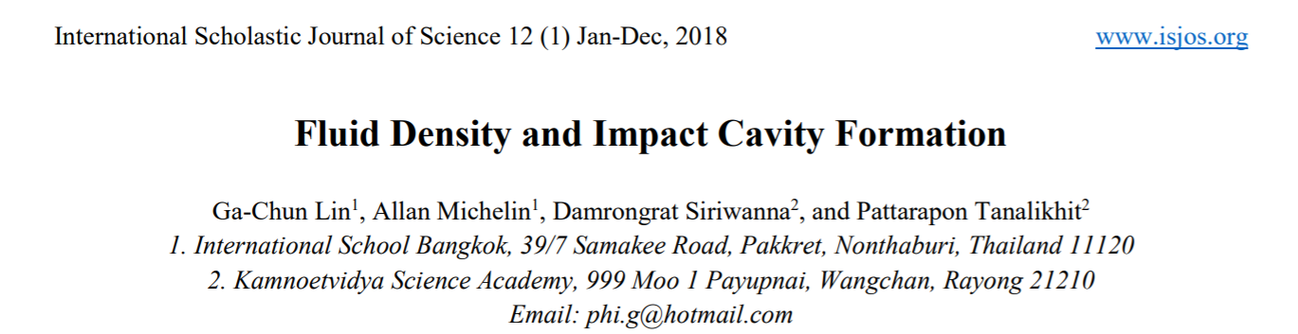
Who are we?

Slide 4
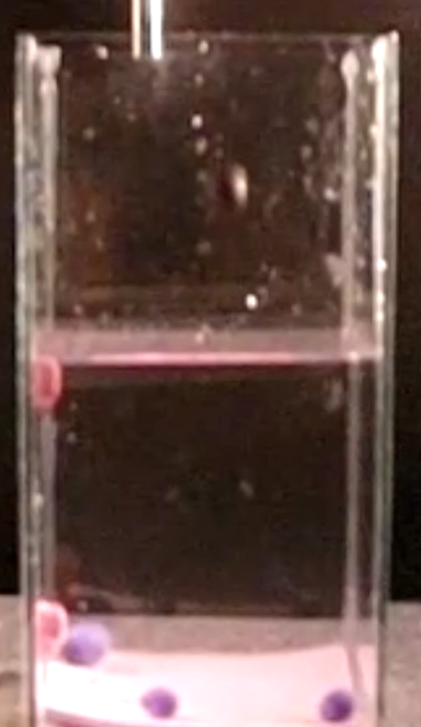
Research Question
What happens to the cavity volume when the fluid density increases?

Slide 5
Outline
Introduction
Methodology
Result & Analyze
Discussion & Conclusion

Slide 6
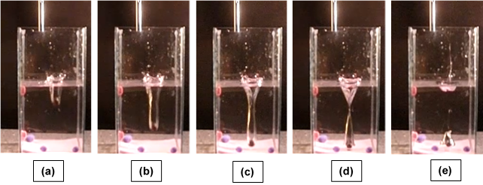
Initial Observation

Slide 7
Physics Principle
Cavity Formation
Zinc Chloride
(ZnCl)
Variability
Increasing Density
(Mass and Fluid Pressure)
Cavity Diameter
Related to the velocity

Slide 8
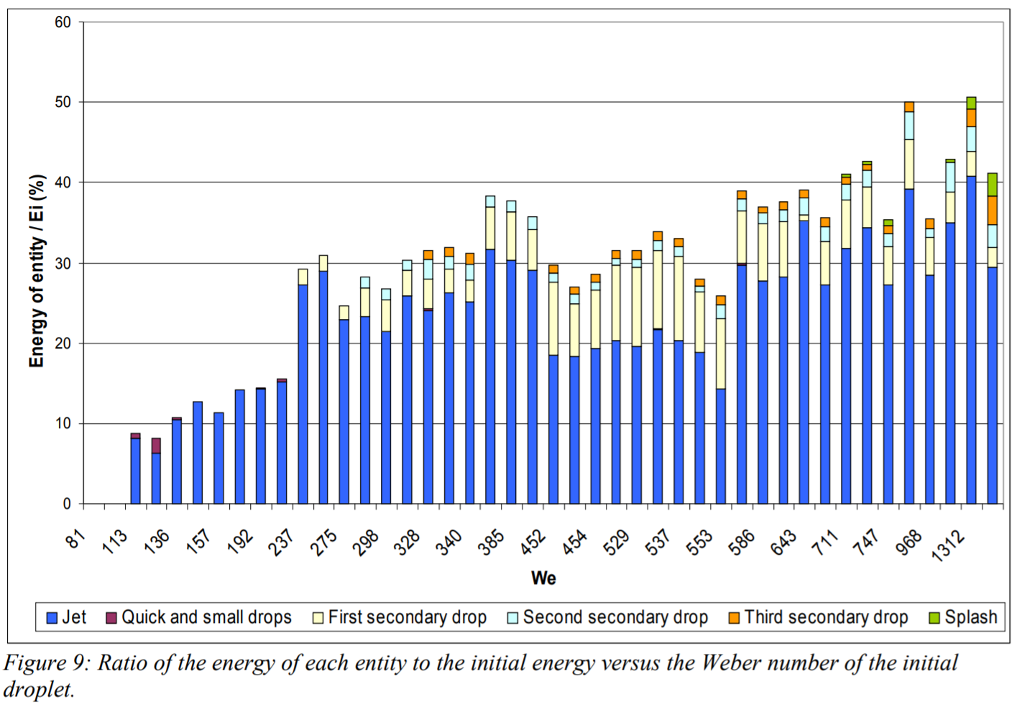
Physics Principle: Cavity Formation
Reference: Sylvain Raynal, 2009.

Slide 9
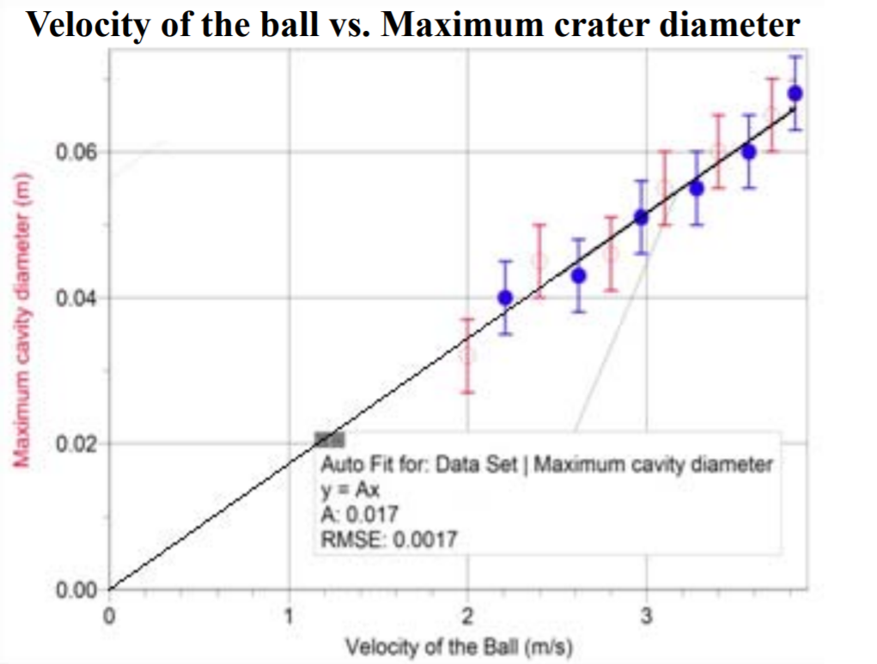
Physics Principle: Cavity Diameter
Reference: P. Chaikulngamdee and et al., 2009.

Slide 10
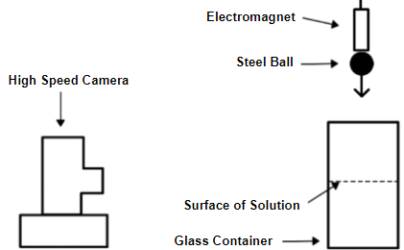
Methodology

Slide 11
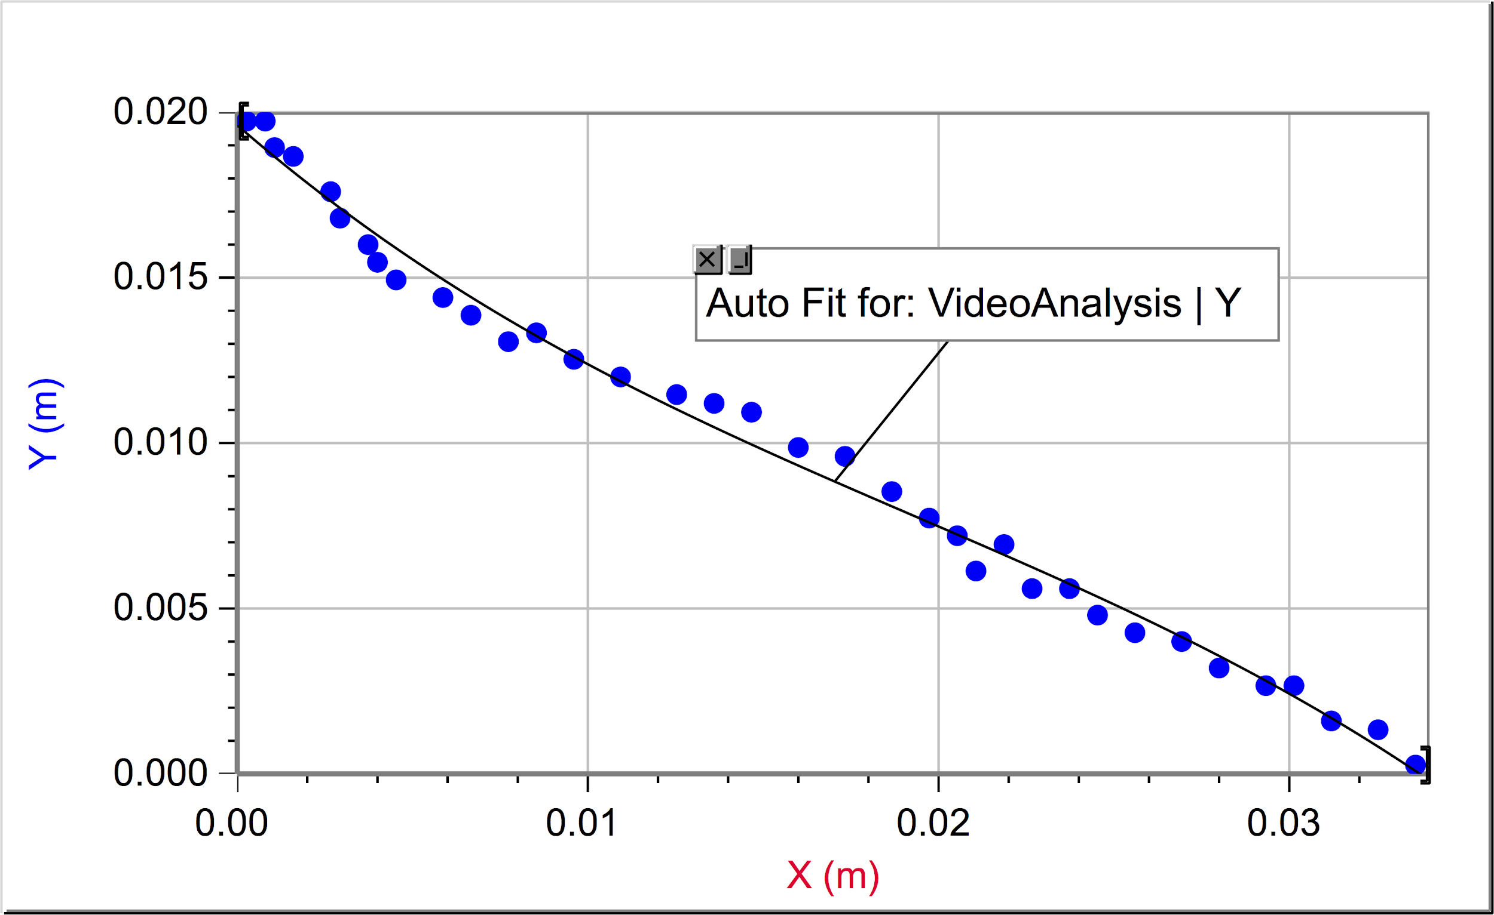
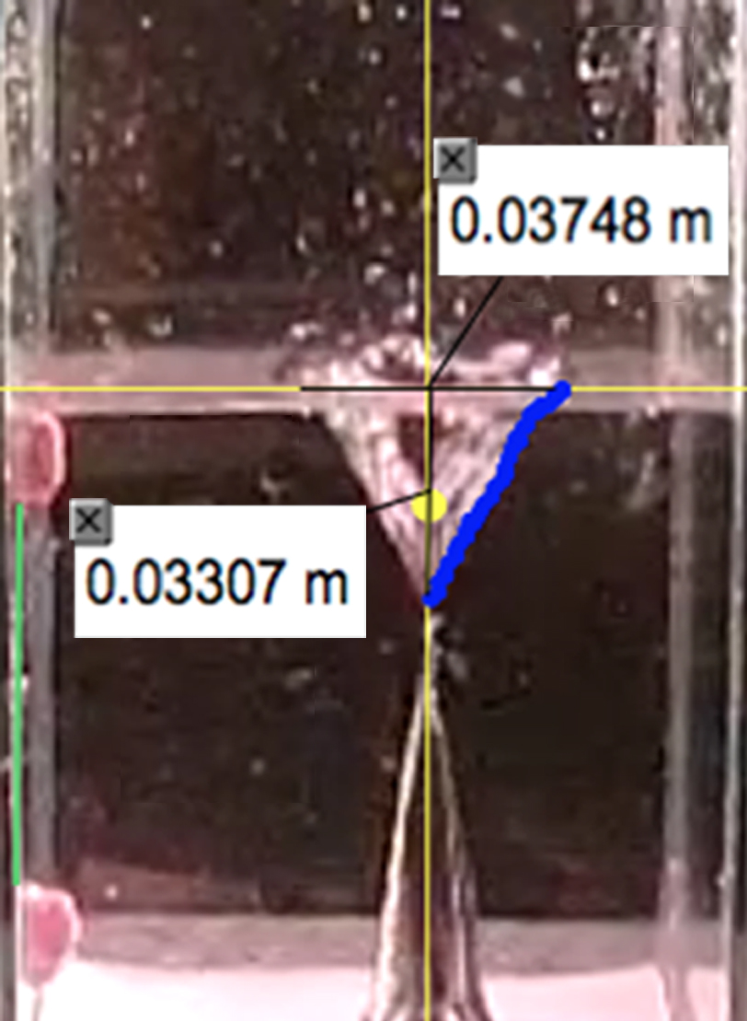
Methodology
11

Slide 12
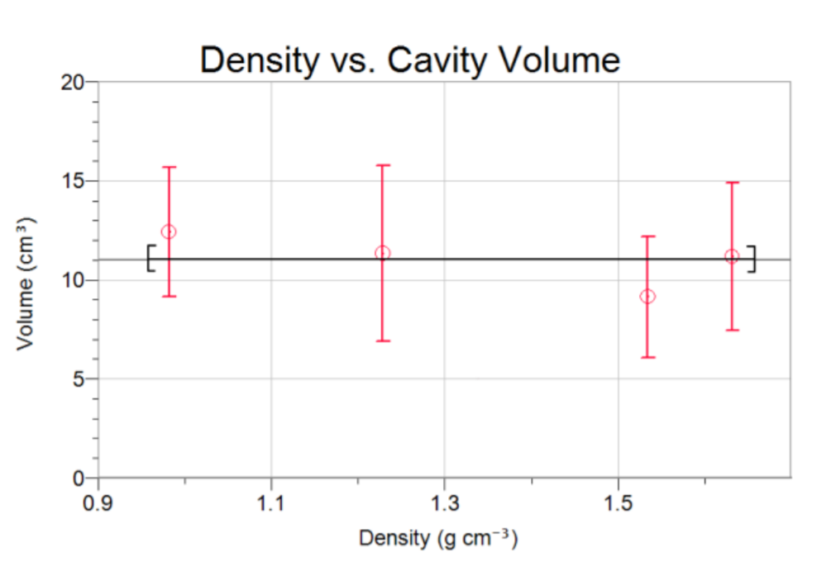
Result & Analyze

Slide 13
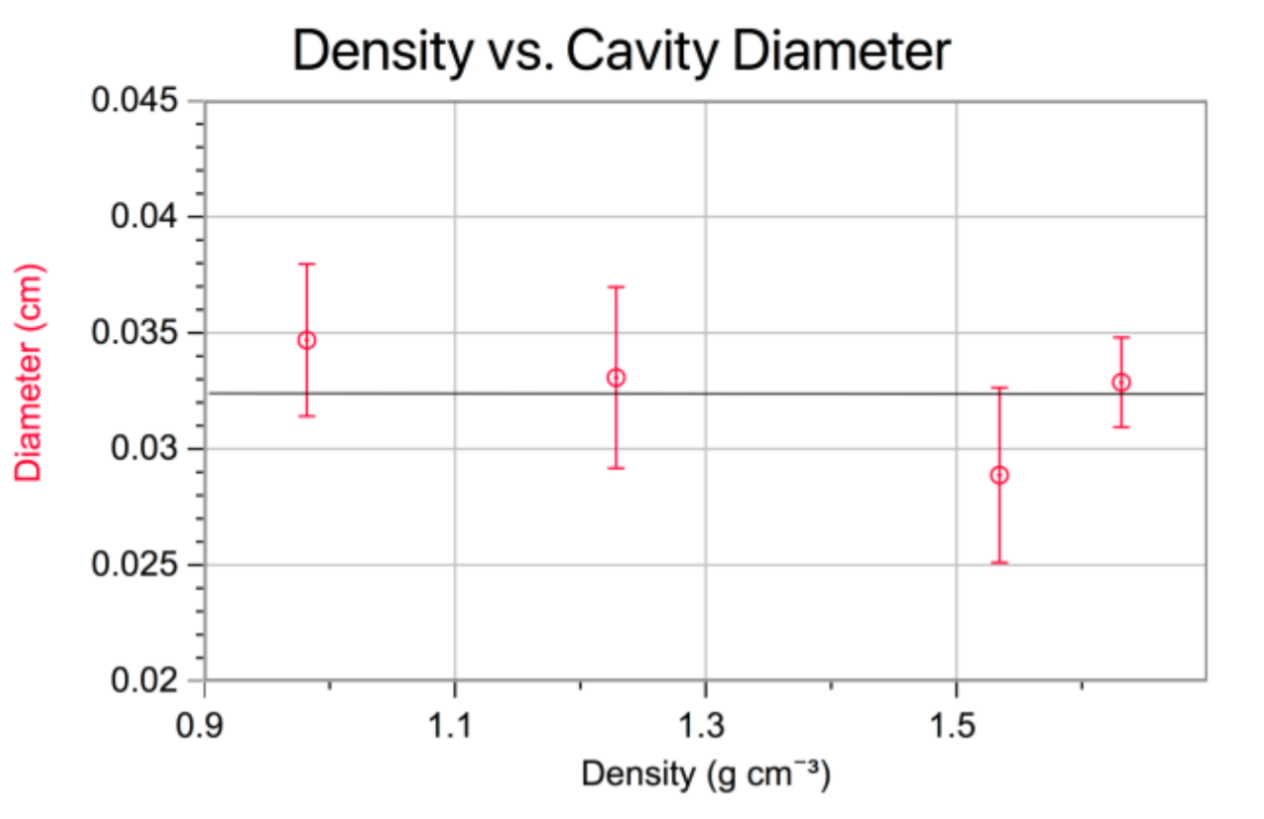
Result & Analyze

Slide 14
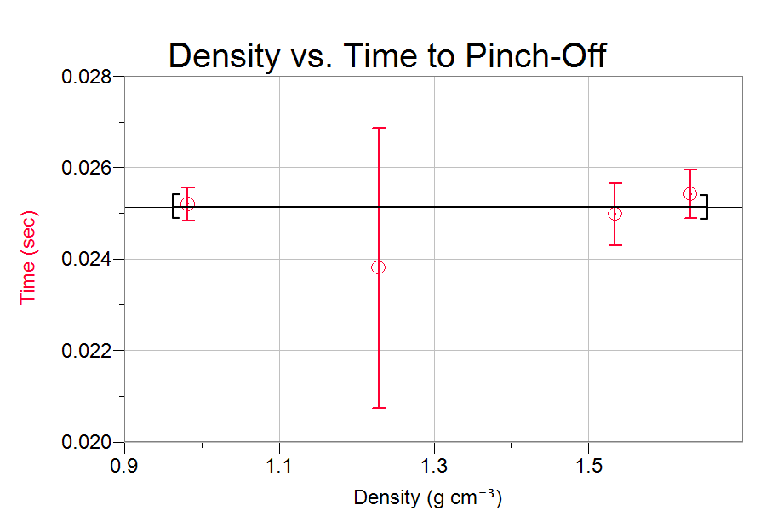
Result & Analyze

Slide 15
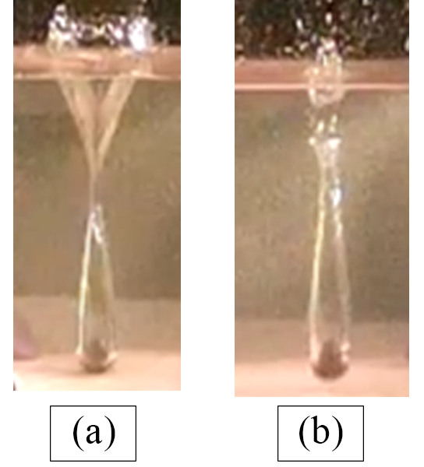
Result & Analyze
The cavity formation for liquid density 1.63 g·cm⁻³ (a) is clearly different from the cavity formation for 1.45 g·cm⁻³ (b).

Slide 16
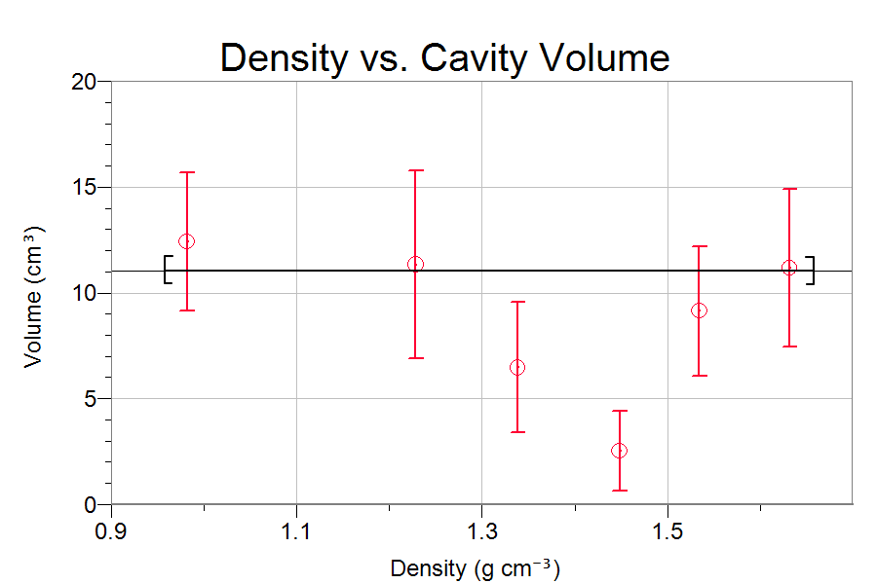
Discussion
^{Causes of Error}
^{- Turbulence}
^{- Viscosity}
^{- Surface Tension}

Slide 17
Conclusion
Cavity volume, cavity diameter and pinch off time is constant as the density increasing.

Slide 18
What we have gained?
18
^{- Scientific method}
^{- Related knowledge}
^{- Publishing process}

Slide 19
19
Acknowledgement

Slide 20
?
Question & Answer

