Slide 1
Paddle Angle and Ball Spin

Slide 2
Outline
Introduction
Research Question
Methodology
Results
Conclusion

Slide 3

Research at ISB
Notes:
https://www.isb.ac.th/learning-isb/academic-programs/high-school/international-baccalaureate

Slide 4
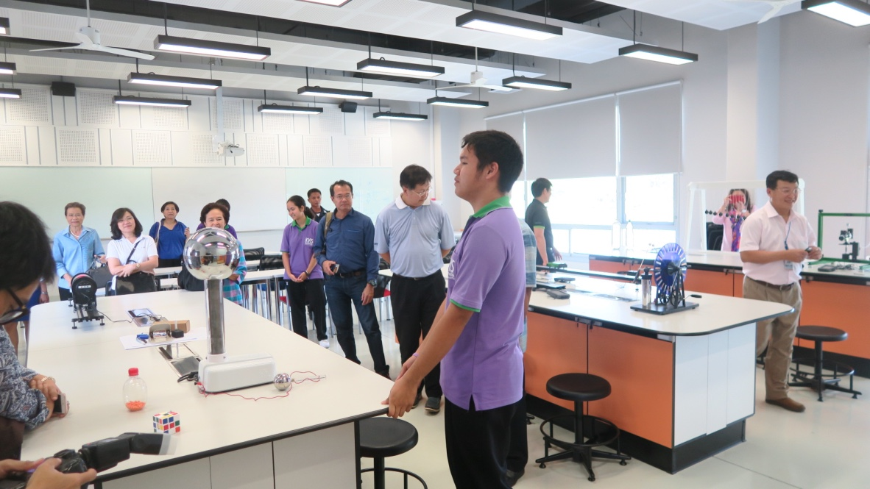

Research at KVIS
Notes:
https://en.wikipedia.org/wiki/Kamnoetvidya_Science_Academy

Slide 5
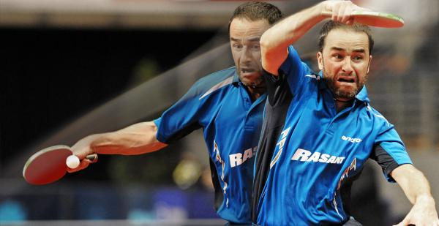
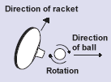
Table tennis
Top spin ball

Slide 6

Research Question
How does the impact angle of the ball affect the angular velocity of a table tennis ball?

Slide 7
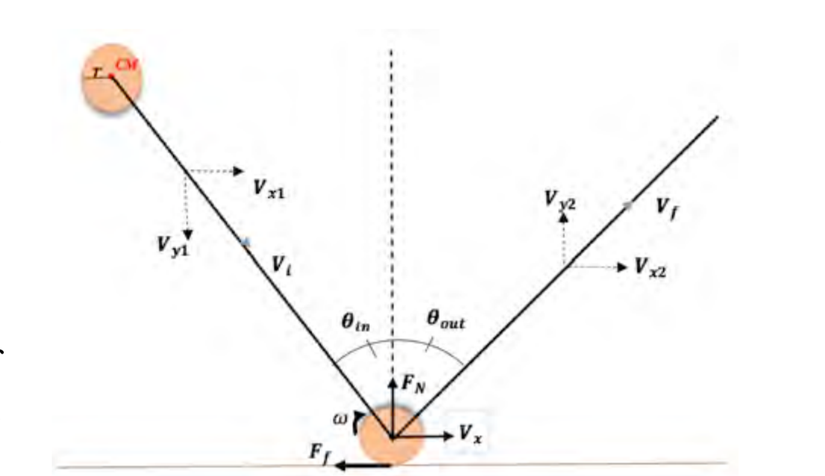
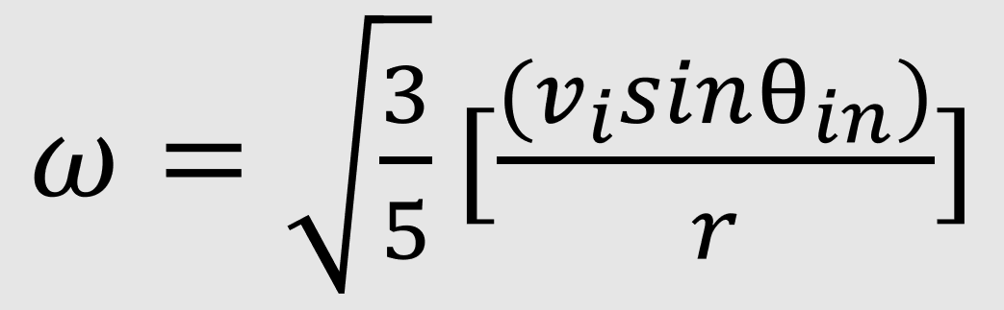
Prior Research
Spin Rate of a Racquetball Due To Angular Impact
Illouz, Dolev. (2014). Spin Rate of a Racquetball Due To Angular Impact. International School of Bangkok Journal of Physics

Slide 8
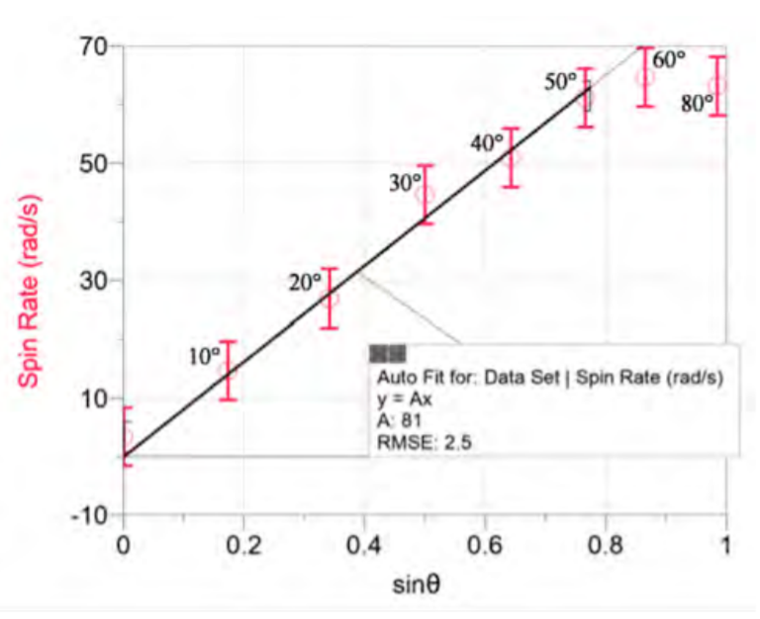
Prior Research
Spin Rate of a Racquetball Due To Angular Impact
Illouz, Dolev. (2014). Spin Rate of a Racquetball Due To Angular Impact. International School of Bangkok Journal of Physics

Slide 9
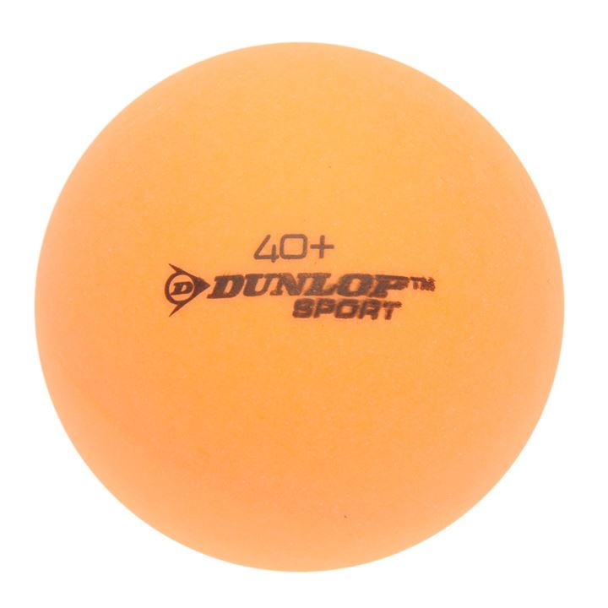

Predicted model
Experimental parameters
-Incoming velocity = 2.96 m/s
-Radius of the ball = 0.0200 m
$ω=113sinθ_{in}$⁡
Illouz, Dolev. (2014). Spin Rate of a Racquetball Due To Angular Impact. International School of Bangkok Journal of Physics

Slide 10
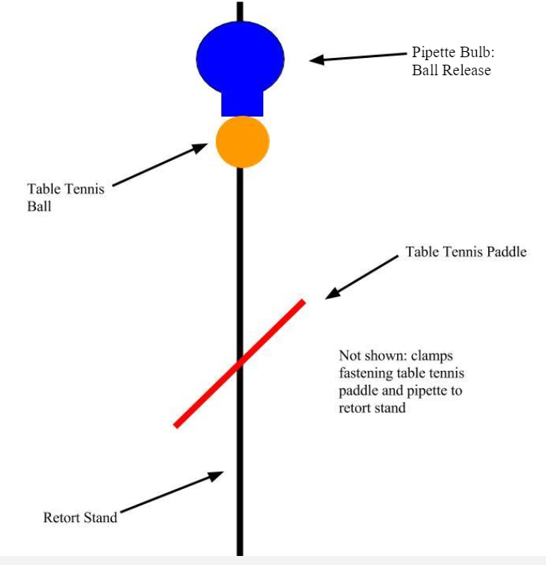
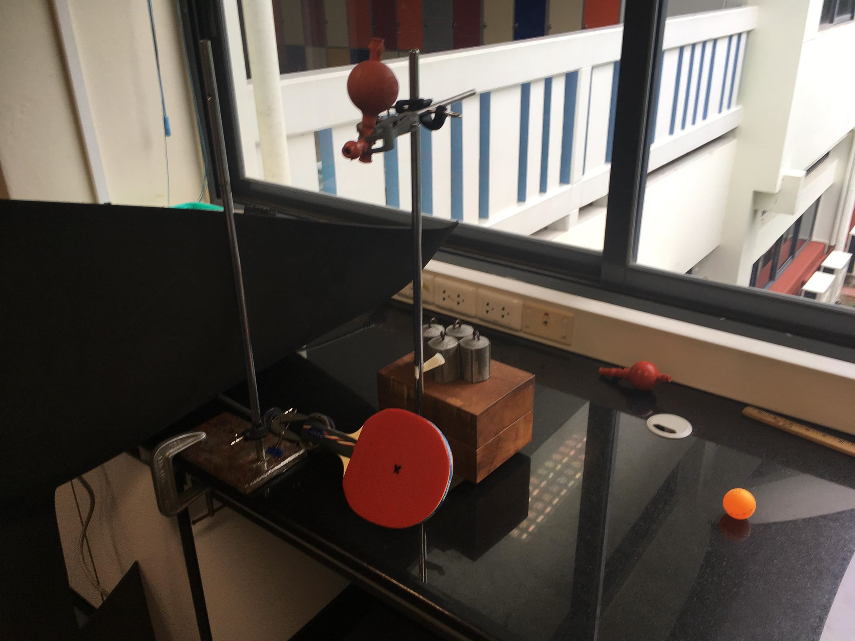

Methodology
Apparatus
⁡Ɵ
$\text{Ɵ}$_{in}
$\text{Ɵ}$_{in}

Slide 11
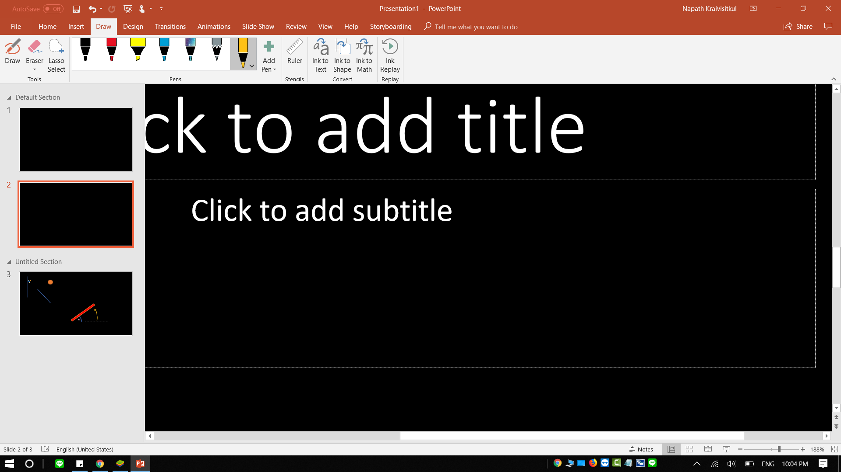
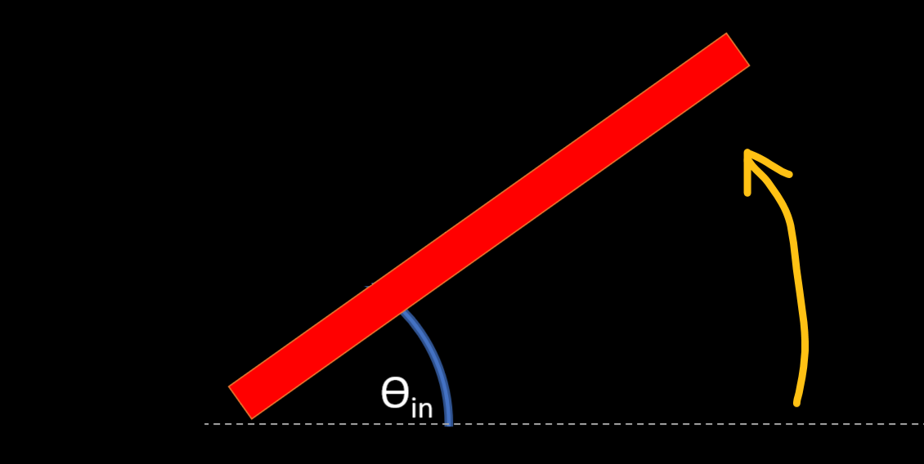
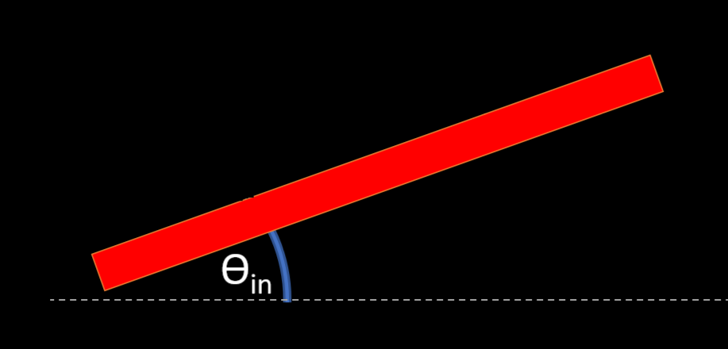
Methodology
Procedure

Slide 12
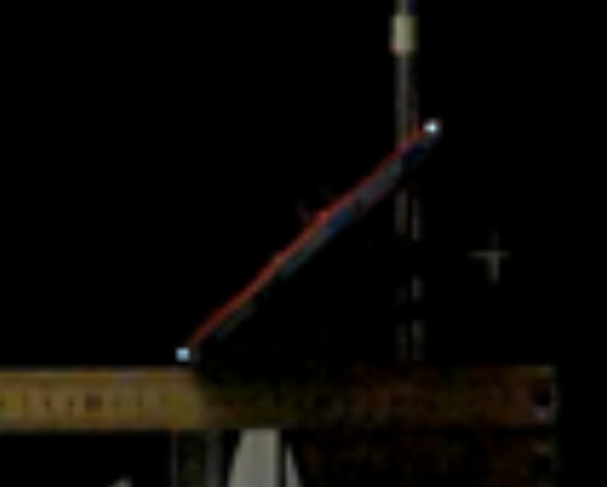
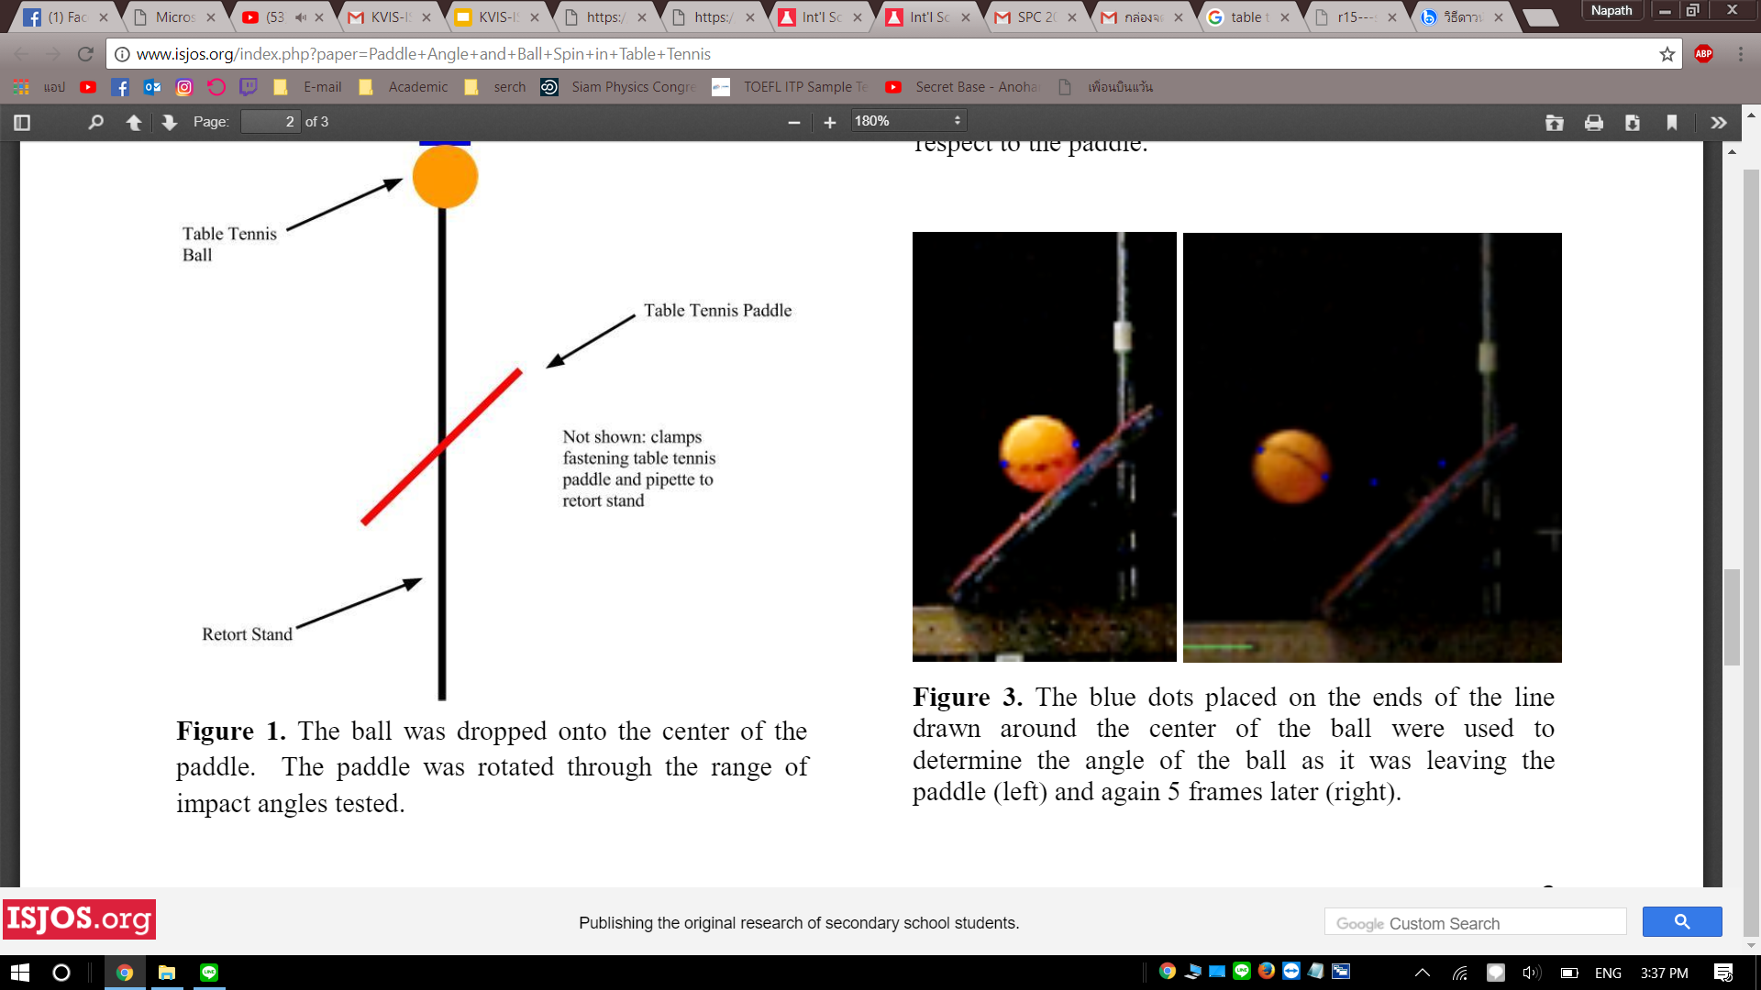
Analysis
Angle of the paddle
Finding angular velocity

Slide 13
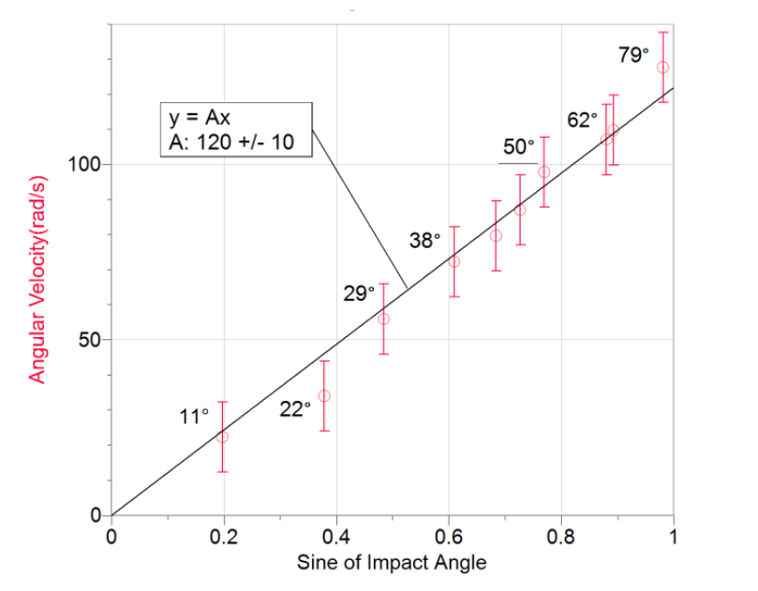


Results
Predicted model
$$ω=113sinθ_{in}$$
Experimental model
$ω=(120±10)sinθ_{in}$⁡
Notes:
120 sin theta

Slide 14
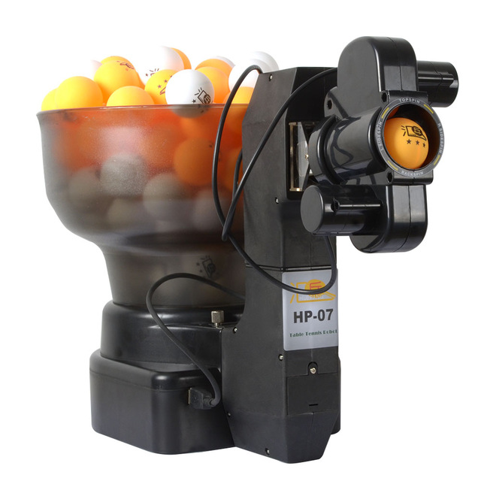
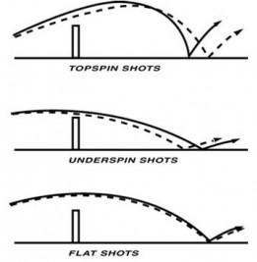
Further Improvements
Use ball shooter to imitate real play
Depict trajectory of top spin shots

Slide 15

Conclusion
The angular velocity is directly proportional to sine of the impact angle according to the theoretical model
The slippling effect is not observed
Experimental model
$ω=(120±10) sinθ_{in}$⁡

Slide 16
ISB x KVIS
Benefits

Slide 17
Questions?

Slide 18

Derivation

