Slide 1





HETEROGENEOUS SUZUKI CROSS-COUPLING REACTION IN WATER CATALYZED BY
PALLADIUM NANOPARTICLES SUPPORTED
ON INDIVIDUAL CALCIUM CARBONATE PLATES DERIVED FROM MUSSEL SHELL
Presented by
Miss Sukumaporn Chotnitikornkun
Advisor: Assoc. Prof. Dr. Sumrit Wacharasindhu
Co-advisor: Prof. Dr. Mongkol Sukwattanasinitt
Department of Chemistry, Faculty of Science, Chulalongkorn University
NanoThailand 2016
Notes:
-Good afternoon everyone, My name is Sukumaporn Chotnitikornkun, I’m Master degree student in Department of Chemistry, Faculty of Science at Chulalongkorn university.
-Today I’m going to talk about my work in the topic of “Heterogeneous Suzuki cross-coupling reaction in water catalyzed by palladium nanoparticles supported on individual calcium carbonate plates derived from mussel shell”.

Slide 2
Introduction
Suzuki cross-coupling reaction
Synthesis of biaryl compound from aryl halide and aryl boronic acid
Homogeneous Pd catalyst
External ligand
Organic solvent
High temperature
develop
Heterogeneous Pd catalyst
No External ligand
Aqueous solvent
low temperature
Easy product isolation
Simple recycling catalyst
Reduced toxic organic waste
Notes:
First, let me introduce you about Suzuki cross-coupling reaction.
The Suzuki cross-coupling reaction is the palladium-catalyzed reaction between aryl halide and aryl boronic acid to form C-C bond in biaryl compound. And this reaction required Pd (0) as catalyst, base and temperature as shown the scheme.
However, weak point of most this reaction is the use of homogeneous Pd catalyst Such as Pd(OAc)2 that need external ligand and organic solvent at high temperature.
So the use of heterogeneous Pd catalyst without external ligand in aqueous solvent at low temperature is interesting because of easy product isolation, simple recycling catalyst and reduced toxic organic waste.

Slide 3
Introduction
Literature reviews
Published year | Heterogeneous Pd catalyst | Cross-coupling reaction | Characteristic of catalyst
In 2002 | Pd/C |  | X Pyrophoric
In 2007 | Pd/CaCO₃ |  | Non-pyrophoric CaCO₃ is a common substance found in nature
In 2010 | Pd/SP |  | Non-pyrophoric CaCO₃ from shell waste
Suzuki reaction
J. Org. Chem. 2002, 67, 2721-2722.
Stille reaction
Tetrahedron Lett. 2007, 48, 7671-7674.
Heck reaction
Appl. Organometal. Chem. 2010, 24, 631-635.
Notes:
From advantages of heterogeneous Pd catalyst, There are many research about using heterogeneous Pd catalyst to develop cross-coupling reaction.
For example, In 2002, reported the use of palladium on C in Suzuki rxn between 4-iodophenol and phenylboronic acid.
In 2007, reported the use of palladium on CaCO3 in Stille rxn between iodobenzene and tributylphenyltin.
and In 2010, reported the use of palladium on Shell particle in Heck rxn between iodobenzene and butylacrylate.
All results show that these catalysts have effective catalytic activity and reusability.
However, Pd on C can ignite in air so the use of CaCO3 and shell particle can fix this problem and both of them are available in nature.

Slide 4
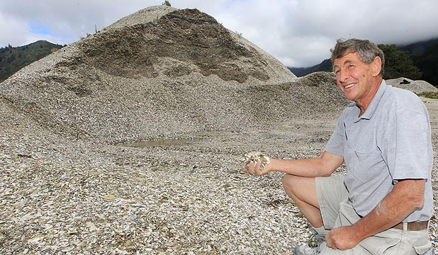
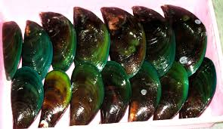
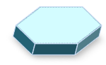
Introduction
Waste green mussel shells
Produced 70,000 tons/year
Accumulation at coastal areas
Damage of natural landscape
Sanitation problem
http://www.fao.org/fishery/species/2691/en.
How to add value to waste shells
Using for preparation of catalyst
Metal
CaCO₃
Solid support
Metal catalyst
High surface area
Notes:
Furthermore Nowaday, fishery industry produced a lot of waste from green mussel shells around 70000 tons/year in south east asia. Which is difficult to handle leading to many problem such as accumulation at coastal areas, damage of natural landscape and sanitation problem.
So How to add value to these waste shells.
The possible way is the use of green mussel shell as solid support for preparing catalyst because the mussel shell consist of high surface area calcium carbonate plates.

Slide 5
Objectives
Chemical treatment
Pd
ICCP
Individual calcium carbonate plates
Pd/ICCP catalyst or
Palladium on
Individual calcium carbonate plates
Asian green mussel shell
No external ligand, low temperature
In aqueous solution
Pd/ICCP catalyst
Notes:
Therefore, We would like to prepare the individual calcium carbonate plates from waste Asian green mussel shell supported palladium catalyst (or Pd/ICCP) by chemical treatment and investigate catalytic activity by using Suzuki reaction between aryl halide and arylboronic acid at low temperature without external ligand in aqueous solution, which have not been done before.

Slide 6
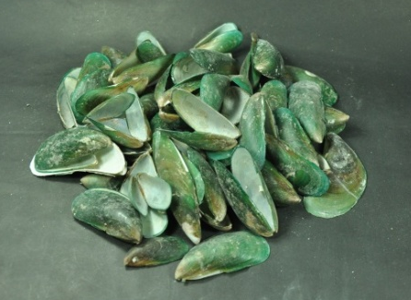
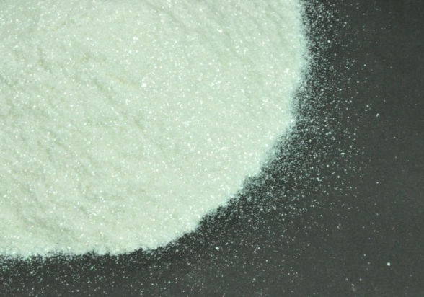
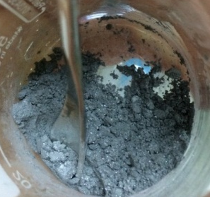
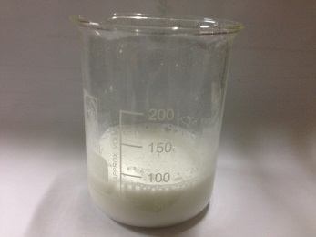
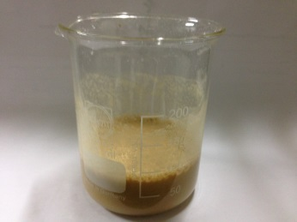
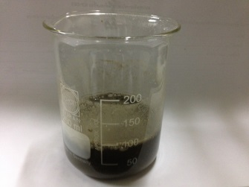
Results
Preparation of the individual calcium carbonate plates supported palladium catalyst (Pd/ICCP) by impregnation-reduction method
Ultrasonic
generator
bake 300 ºC
Immerse in
1) Wash
for 2 h
30 %wt. H₂O₂
2) Dry
Virgin shells
Thermal-treated
shells
individual calcium carbonate plates (ICCPs)
Add
water
Add H₂PdCl₄
_{and stir}
Add NaBH₄
_{and stir}
1) Wash
2) Dry
Individual calcium carbobate plate
supported palladium
(Pd/ICCP)
individual calcium
carbonate plates (ICCPs)
We received individual calcium carbonate plates from Sensor research unit.
Notes:
First, we prepared the individual calcium carbonate plates supported palladium catalyst (or Pd/ICCP) by impregnation-reduction method as show on the slide.
Individual calcium carbonate plates was obtained from sensor research unit.
First, we add ICCP and water into the beaker, then add dihydrogentetrachloropalladate(II) solution and stir until color of solution change from brown to colorless, after that reduce Pd with sodium borohydride, then wash and dry it. Finally we obtain Pd on individual calcium carbonates plates in black solid as show in the picture.

Slide 7
Results
Investigating morphology of the heterogeneous Pd/ICCP catalyst by using Scanning electron microscope technique
SEM
EDX
ICCP size is around 3 micrometer.
Pd/ICCP catalyst
Notes:
Next, we investigate morphology of the heterogeneous Pd/ICCP catalyst by using Scanning electron microscope technique.
Picture on the left hand side is SEM image, It shows morphology of the catalyst which is around 3 micrometer individual plate.
Picture on the right hand side, we obtained from EDX technique. It shows total dispersion of the palladium catalyst on shell particles, As you can see white,red and green dot in the picture.

Slide 8
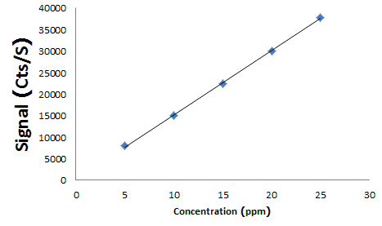
Results
Investigating amount of palladium on shell particle by using inductively coupled plasma optical emission spectroscopy (ICP-OES)
Add
Aquaregia
6 mL
Stir
100 Cº
24 hr
Make
volume
To 25 mL
Run
ICP-OES
Pd/ICCP 8 mg
Catalyst | Expected Palladium Content [%wt] | Exact Palladium Content [%wt]ª
Pd/ICCP | 7.0 | 6.1 ± 0.2
ªPercentage of exact palladium weight was determined by ICP-OES analysis.
Notes:
Furthermore, we investigate amount of palladium on shell particle by using inductively coupled plasma optical emission spectroscopy.
Amount of palladium on shell particles is about 6.1% by weight. Which are a little bit lower than expected palladium content, It’s probably due to binding ability between palladium and surface of shell particle.

Slide 9
Results
Optimization condition
1. Screening type of base
Following of the reaction by %conversion from ¹H-NMR
Entry | Type of base | Conversion[%]
1 | KOAc | 18
2 | piperidine | 88
3 | TEA | 94
4 | DIPA | 100
5 | Cs₂CO₃ | 100
6 | Na₂CO₃ | 100
7 | K₂CO₃ | 100
Reaction condition: 4-iodoanisole (0.43 mmol), phenylboronic acid (0.645 mmol), Pd catalysts (0.0086 mmol), bases (1.29 mmol), in solvents (6.0 mL).
Notes:
To investigate catalytic activity of the catalyst, we optimize reaction condition of Suzuki cross-coupling reaction between 4-iodoanisole and phenylboronic acid which follow the reaction by %conversion from H-NMR. Firstly, we screen 7 types of base which have been widely used in Suzuki reaction. The best result is obtained in 100% conversion when we used DIPA, Cs2CO3, Na2CO3 or K2CO3 as base.

Slide 10
Results
Optimization condition
2. Screening type of solvent
Following of the reaction by %conversion from ¹H-NMR
Entry | Type of solvent | Conversion[%]
1 | DMF | 0
2 | DMSO | 7
3 | Toluene | 51
4 | EtOH | 98
5 | H₂O | 36
6 | DMF:H₂O (3:1) | 94
7 | EtOH:H₂O (3:2) | 100
8 | H₂O, CTAB | 100
CTAB was added as phase transfer agent.
solvation of organic reagents
Reaction condition: 4-iodoanisole (0.43 mmol), phenylboronic acid (0.645 mmol), Pd catalysts (0.0086 mmol), bases (1.29 mmol), in solvents (6.0 mL).
Notes:
Secondly, we screen 8 types of solvent as show in the table. The best result is obtained in 100% conversion when we used the mixed solvent of EtOH and water. It’s probably due to increasing solubility between base and reactants. Moreover, when we add cetyltrimethylammonium bromide or CTAB in water as solvent system, the excellent conversion is obtained in 100%. Because CTAB was used as a phase transfer agent to promote in bringing organic reagents into aqueous solution.

Slide 11
Results
Optimization condition
Condition | Base | Solvent | Conversion [%]
A | K₂CO₃ | EtOH:H₂O (3 : 2) | 100
B | K₂CO₃ | H₂O, CTAB | 100
Optimum conditions
Notes:
Finally, we choose two optimum conditions to study the Suzuki reactions at 40 degree Celsius for 12 hours. Condition A is the use of K2CO3 as base in mixed solvent of ETOH:H2O in volume ratio 3:2 and Condition B is the use of K2CO3 as base in water and CTAB as solvent.
because K₂CO₃ is low-priced and the use of water as solvent can reduce toxic organic wastes.

Slide 12
Results
Substrate compatibility of aryl iodide
%Isolated yield
Without remaining starting materials
Reaction condition: aryl iodide (1.0 mmol), phenylboronic acid (1.5 mmol), Pd /ICCP catalysts ( 2 mol% ), bases (3.0 mmol), in solvents (10.0 mL), 40 ºC, 12 h.
Notes:
To investigate the substrate scope of this reaction, we used phenylboronic acid to couple with derivative of aryl iodide under the optimum condition A or B.
The results show that aryl iodide with neutral, electron donating and electron withdrawing groups underwent successful cross-coupling reactions without remaining of starting materials and then we isolate these compounds which are obtained more than 80% in every condition. as show on the slide

Slide 13
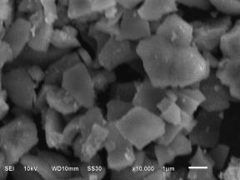
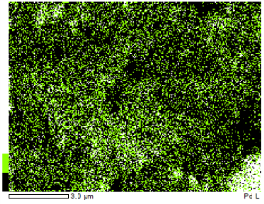
Conclusions
ICP-OES
Palladium content 6.1%wt
Novel heterogeneous
Pd/ICCP catalyst
3 micrometer Individual plate
SEM
EDX
Aqueous media
Low temperature
Pd/ICCP catalyst
Notes:
In conclusions, we have successfully prepared a novel heterogeneous Pd/ICCP catalyst and characterized by ICP-OES, SEM and EDX techniques
Which found 6.1% by weight of Palladium content with 3 micrometer individual plate.
And the prepared Pd/ICCP catalyst can catalyze effectively the Suzuki cross-coupling reactions conducted in aqueous media at low temperatures that giving coupling product more than 80%.

Slide 14
Future works
Expanding scope of the Suzuki reaction
Aryl bromide
Arylboronic acid
Pd/ICCP catalyst
studying reusability of palladium catalyst
Reusability of catalyst
Notes:
In the future work, we focus on expanding the scope of the Suzuki reaction both variation of aryl bromide and arylboronic acid, as well as studying reusability of palladium catalyst.

Slide 15


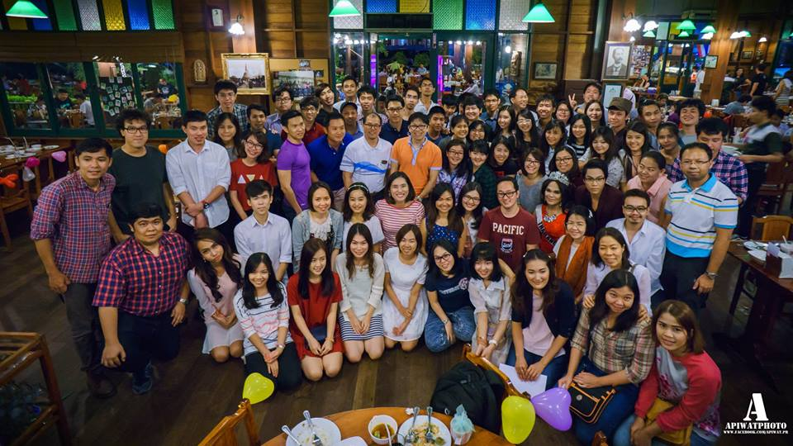



Acknowledgement
Assoc. Prof. Dr. Sumrit Wacharasindhu
Prof. Dr. Mongkol Sukwattanasinitt
NanoThailand 2016
72nd Birthday Anniversary of His Majesty the King’s Scholarship
Notes:
Finally, I would like to thank you very much to my thesis advisor associate professor Sumrit Wacharasindhu and my-co advisor professor Mongkol Sukwattanasinitt for valuable advice and kindness throughout this research.
Thank you Chulalongkorn University, Thank you Nanothailand conference.
Thank you MAPs group, And all of you, thank you for your kind attention.

Slide 16
THANK YOU

Slide 17
Q&A

