Slide 1

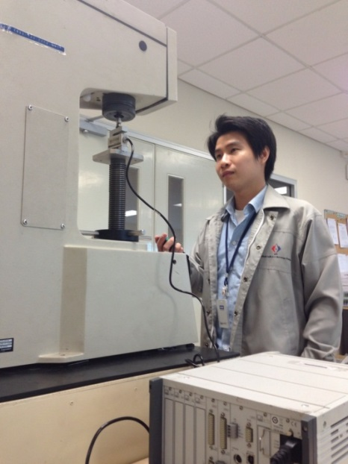

The prototype of high stiffness load cell for Rockwell hardness testing machine calibration according to ISO 6508-2:2015
M Pakkratoke¹ and T Sanponpute²
^{1, 2} National Institute of Metrology (Thailand), 3/4-5 Moo 3, Klong 5, Klong Luang, Pathumthani, Thailand 12120 email: ¹montree@nimt.or.th, ²tassanai@nimt.or.th
“I AM NIMT”

Slide 2

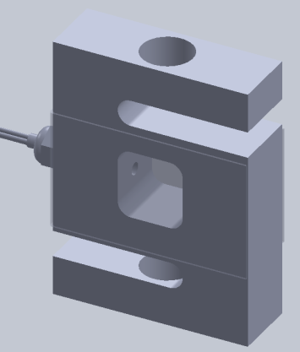
Outline
“I AM NIMT”
Introduction to the verification of hardness machine
Force verification of hardness testing machine
Conceptual design of High Stiffness Load Cell
Experiment results
Conclusion

Slide 3
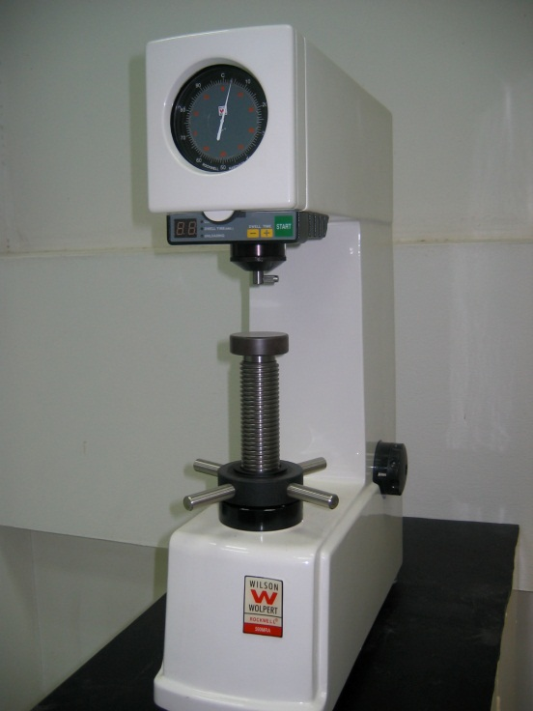
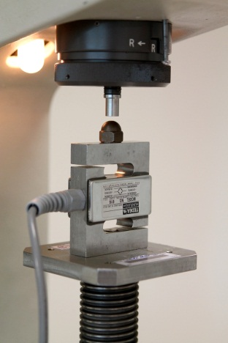

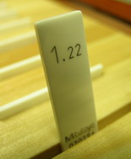
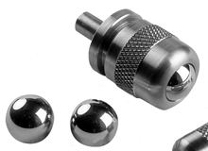
1. Introduction to direct verification of Rockwell hardness testing machine
1. Verification of the test force
2. Verification of the testing cycle
3. Verification of the depth measuring device
4. Verification of the indenter shape
Hardness Machine
Test Force
Time
Depth
Indenter shape
“I AM NIMT”

Slide 4
Operation of hardness testing machine
“I AM NIMT”
Rockwell hardness
Calibration position
Bearing
Weight
Calibration position

Slide 5
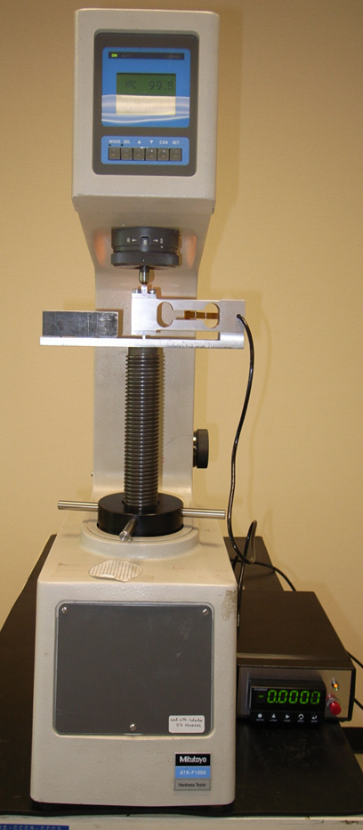
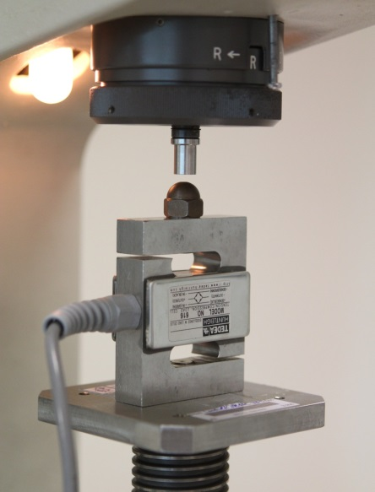
2. Force verification
“I AM NIMT”
Each test force shall be measured.
Shall be done at not less than three position of the plunger movement during test.
Three readings shall be taken for each force at each position of the plunger.
The preliminary test force, F₀ shall be measured before application and after removal of the additional test force, F₁.

Slide 6
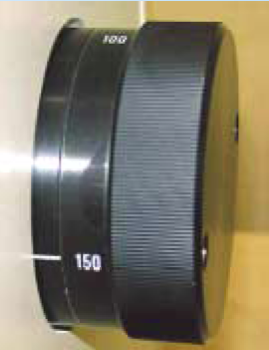
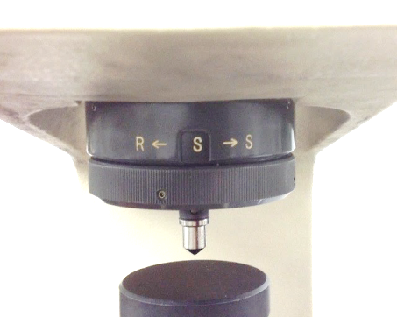
Test force of Rockwell hardness testing machine
Rockwell hardness scale | Preliminary Test force, F₀ (kgf) | Total test force, F (kgf)
15N, 15T | 3 | 15
30N, 30T |  | 30
45N, 45T |  | 45
A, F, H | 10 | 60
B, D, E |  | 100
C, G, K |  | 150
Preliminary Test force, F₀
Total test force, F
Calibration position of Rockwell A
Hardness | Position
HRA | (µm/HR )
85 | -30/-15
60 | -80/-40
30 | -140/-70
Notes:
Depth =-2*(100-HR)

Slide 7
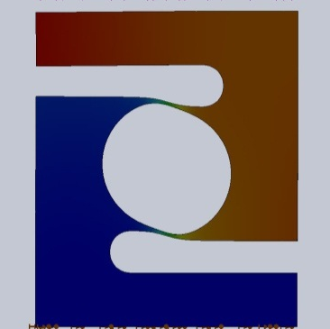
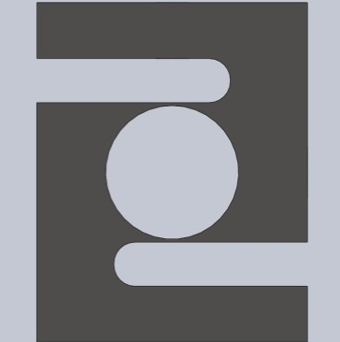
Calibration position changes due to load cell deformation
“I AM NIMT”
Bearing
The calibration position must be compensated!
Load cell deforms
Weight
Calibration position
Position after applied F₁
(HR)
55
Reference position
(HR)
100
Deforms of load cell
( HR ) | ( µm )
100-55 = 45 | 45×2=90
Commercial load cell usually deforms more than 200 µm at capacity

Slide 8
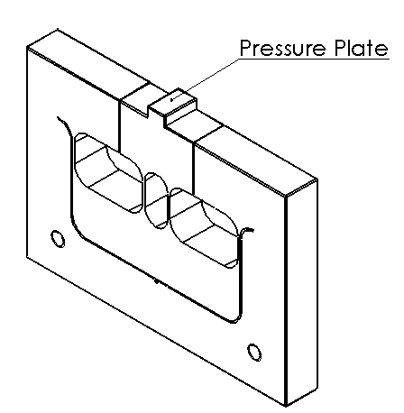
3. Conceptual design
“I AM NIMT”
Capacity of load cell over 150 kgf
Deform less than 20 μm
Compact size, suit for hardness machine

Slide 9
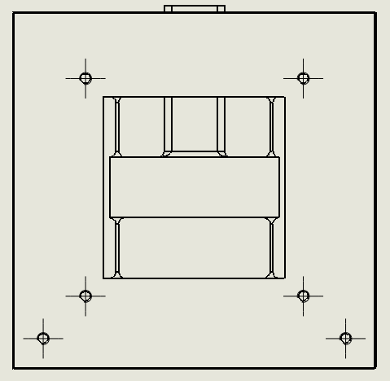
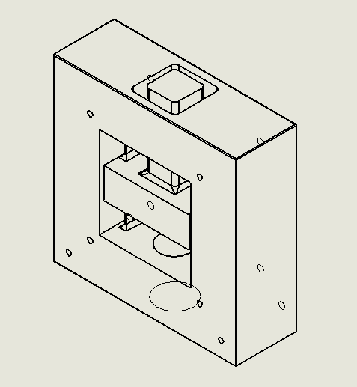
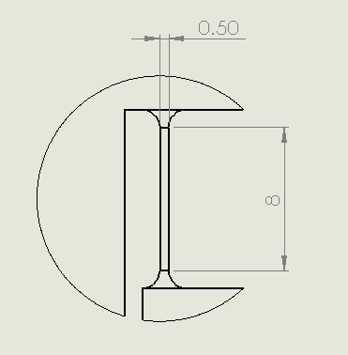
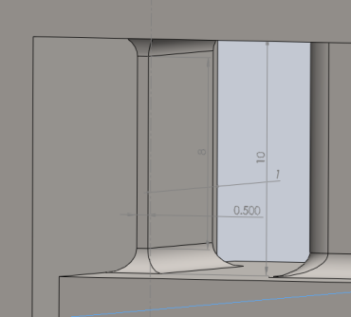
Design of HSL
“I AM NIMT”
A
C
B
D
4 sensing body =300 kgf

Slide 10
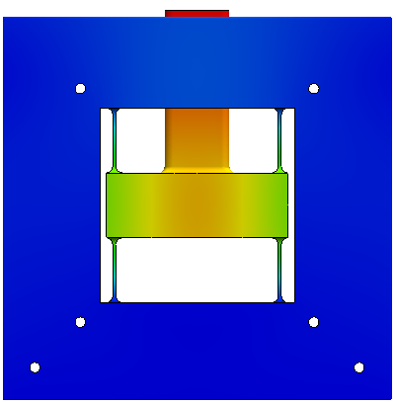
4. Experiment results
“I AM NIMT”
150 kgf applied force
PA
PC
FEA simulation results
PB
PD
Parameters | PA | PB | PC | PD
Stress (GPa) | 117.5 | 127.4 | 116.7 | 127.9
Strain (×10⁻⁶ strain) | 458.0 | 501.3 | 457.9 | 498.7
Yield strength = 350 GPa

Slide 11
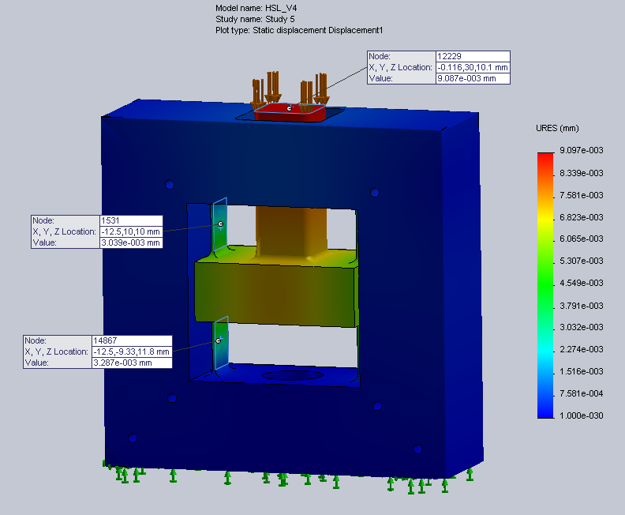
Displacement simulation results
“I AM NIMT”
G
D
C
E
B
F
A
Parameters | A | B | C | D | E | F | G
Deformed (µm) | 0.95 | 6.56 | 6.68 | 6.16 | 8.0 | 8.0 | 9.25
Calculate (μm) | - | - | - | - | - | - | 5.00
Weakness of pressure plate

Slide 12
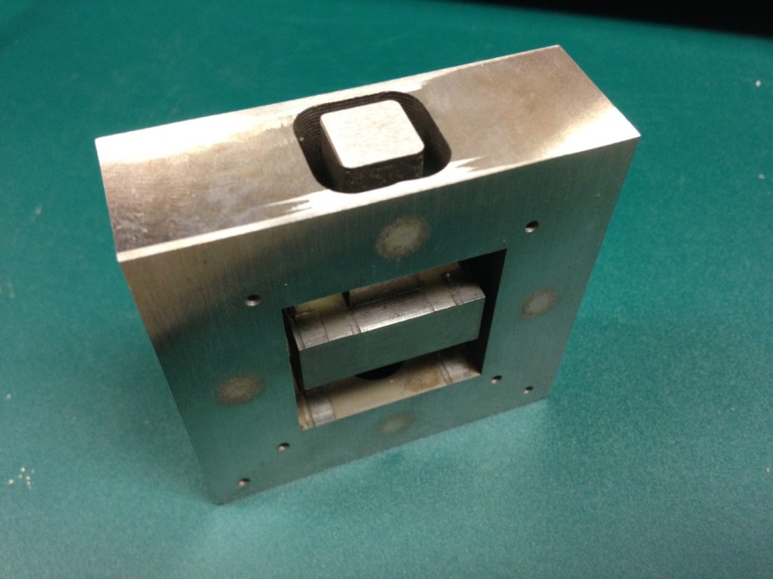
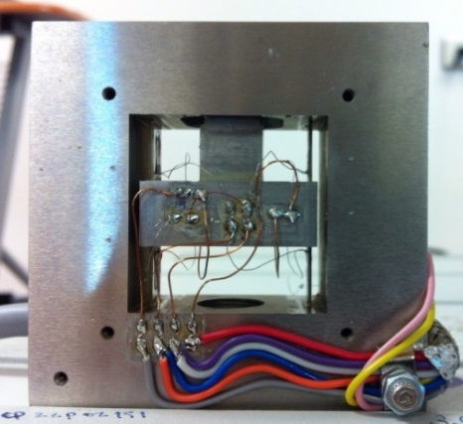
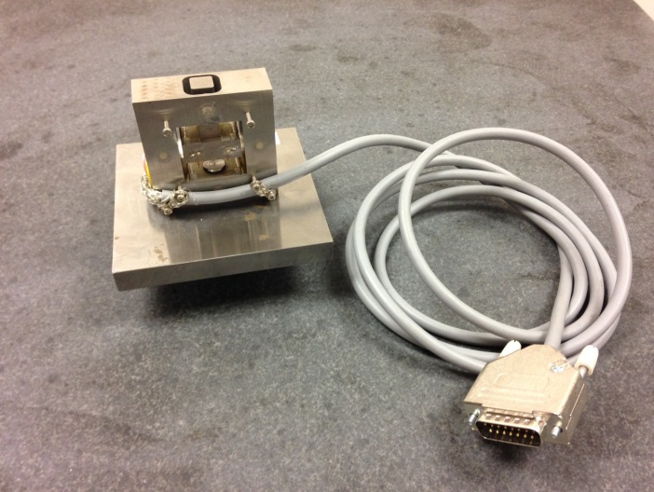
Fabricated HSL
“I AM NIMT”
Dimension size of a fabricated is slightly different from design.

Slide 13
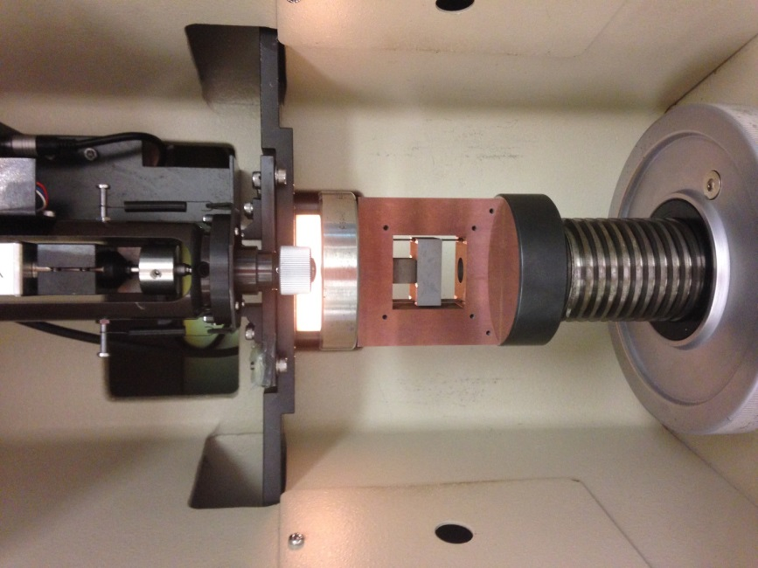
Deformation experiment results
“I AM NIMT”
Test force (kgf) | HSL experiment results (µm) | Simulation results (µm)
15 | 2.4 | 0.9
30 | 4.4 | 1.8
45 | 5.9 | 2.8
60 | 5.6 | 3.7
100 | 8.5 | 6.2
150 | 12.1 | 9.2
The deformation experiment results are only 2 µm larger than FEA results.

Slide 14

Conclusion
The 150 kgf high stiffness load cell was designed and constructed.
The deformation under 150 kgf is lower than 10 µm.
The strain under 150 kgf is 542.57×10⁻⁶ m/m.
FEA and experiments gave the consistent results within 5 µm displacement length and 50×10⁻⁶ m/m strain.
Future work
Weakness of pressure plate.
Load cell calibration and classification.

