Slide 1
Probing the quantum nature of gravity using a Bose-Einstein condensate
Phys. Rev. D 110 (2024) 026014 arXiv:2410:05184 [hep-th]
Soham Sen
Supervisor: Prof. Sunandan Gangopadhyay
Department of Astrophysics and High Energy Physics
S. N. Bose National Centre for Basic Sciences

Slide 2
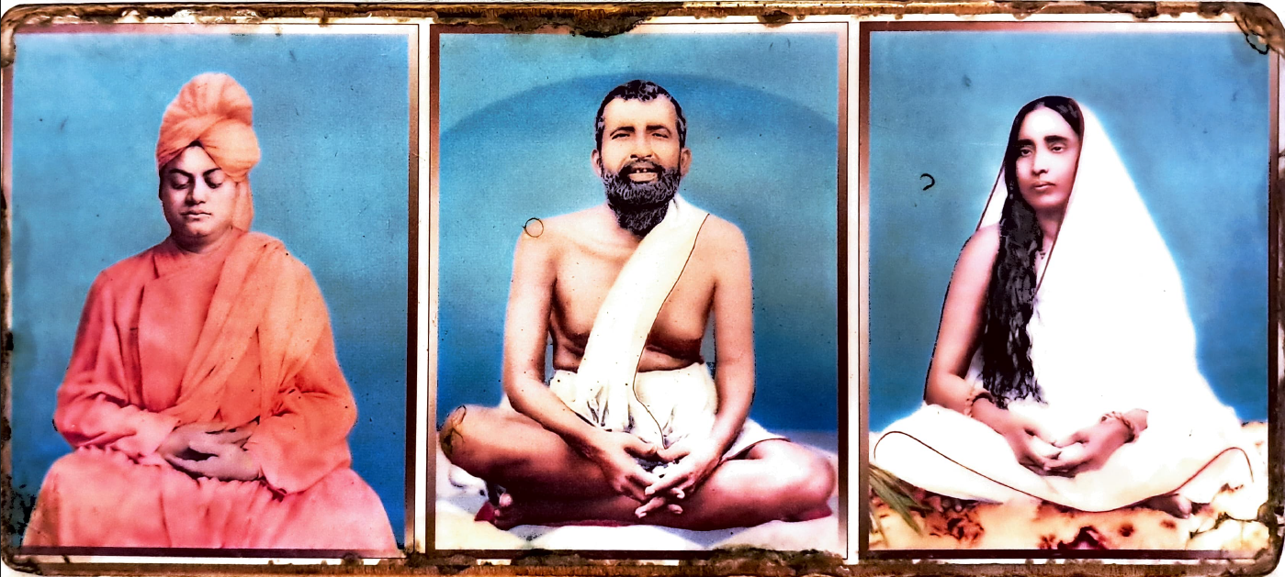
ওঁ
ঠাকুর মা
সত্য মঙ্গল প্রেমময় তুমি ধ্রুবজ্যোতি তুমি অন্ধকারে

Slide 3
Plan of the talk
Introduction
Background model of the analysis
Graviton induced noise in the BEC
Quantum metrology and the noise of graviton
  Cramér-Rao bound and the quantum Fisher information
  Modified covariance matrix for a Bose-Einstein condensate
  Quantum gravitational Fisher information (QGFI)
Bose-Einstein condensate as a graviton detector
Conclusion

Slide 4
Plan of the talk
Some important references
Acknowledgement
Decoherence due to the emission of Bremsstrahlung
Schematic flow chart of an experimental model
An experimental proposal!
Additional Slides

Slide 5
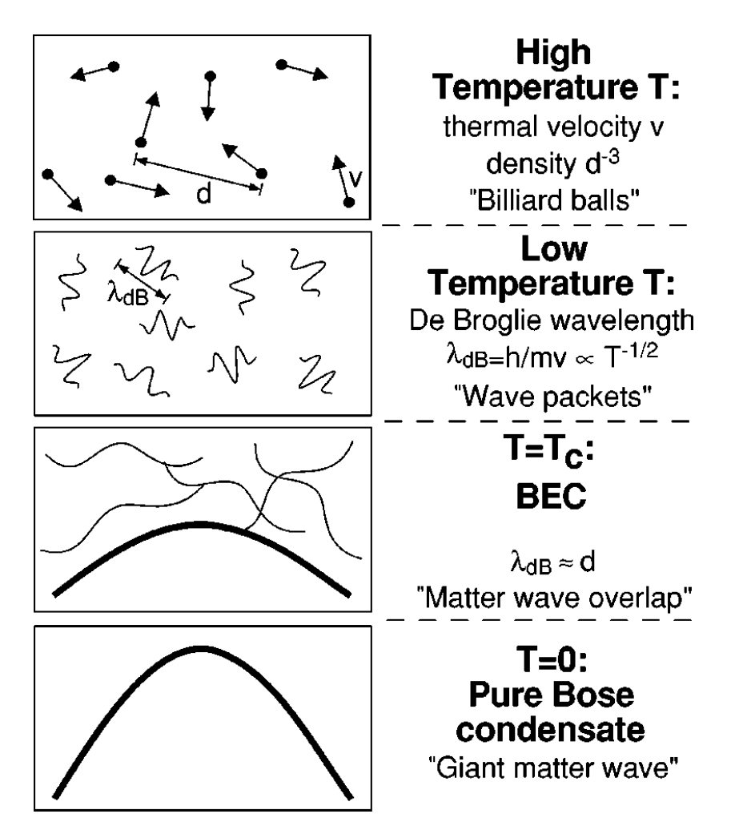
Introduction
The derivation of Planck’s radiation law by Satyendra Nath Bose in 1924 (Z. Phys. 26 (1924) 178) led to the introduction of the Bose statistics.
Albert Einstein in the years 1924 and 1925 extended this idea to matter systems which led to the idea of a Bose gas governed by Bose statistics (Quantentheorie des einatomigen idealen Gases, Sitzungsber. Preuss. Akad. Wiss. Phys. Math. Kl. 10 (1924) 261).
Einstein proposed that if the temperature is lowered below a critical value, then all the bosons occupy the ground state energy of the system where the matter waves corresponding to each atom start superposing with each other.
This new state of matter is termed as the Bose-Einstein condensate (BEC).

Slide 6
Introduction
The diagrammatical representation of a BEC in the previous slide is taken from the Nobel lecture: When atoms behaves as waves: Bose-Einstein condensation and the atom laser, Wolfgang Ketterle, Rev. Mod. Phys. 74 (2022) 1131.
Recently there has been a series of theoretical endeavours to use Bose-Einstein condensate as a gravitational wave detector like C. Sabín et. Al. in New. J. Phys. 16 (2014) 085003 and later by M. P. G. Robbins et. Al. (J. Cosmo. Astropart. Phys. 07 (2019) 032).
They found that a BEC can work as a gravity wave detector provided the inherent phonon modes are highly squeezed.
In this work, we investigated whether a Bose-Einstein condensate based detector is better at picking up quantum gravity signatures than detecting classical gravitational waves.
Finally, we have proposed an experimental model for a BEC based graviton detector.

Slide 7
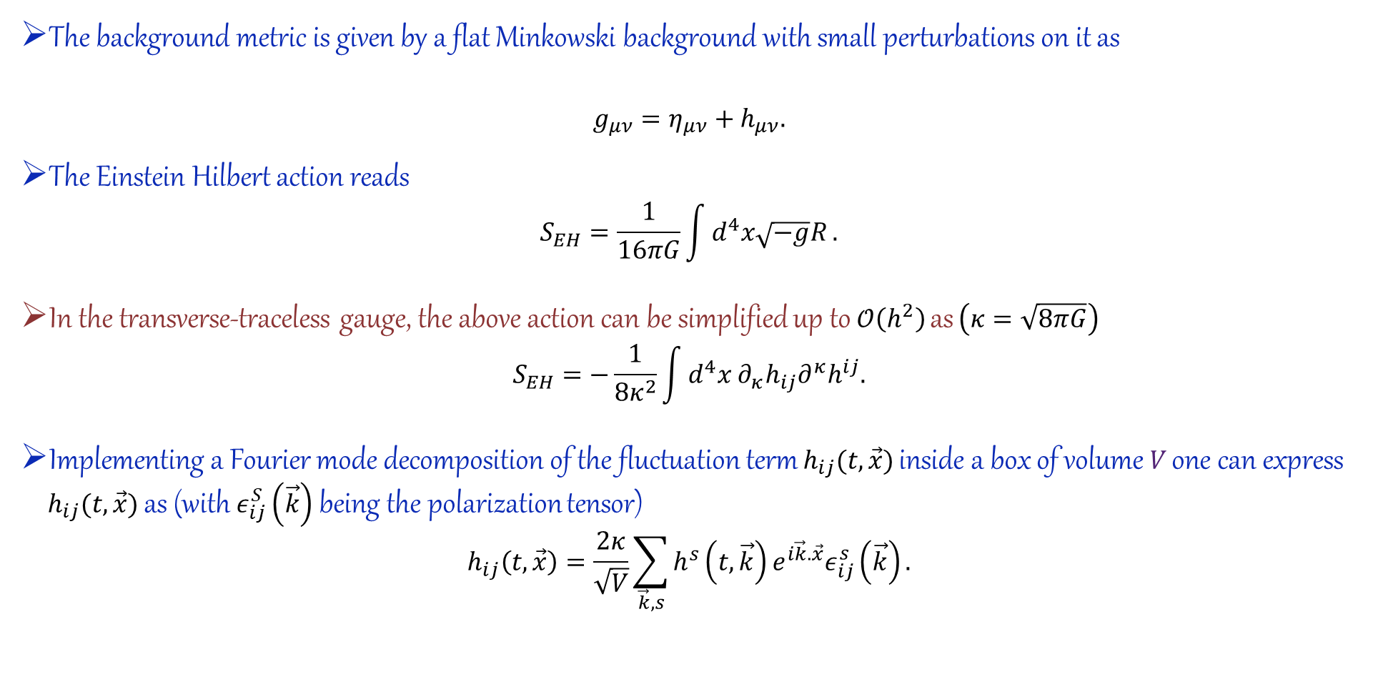
Background model of the analysis
The background metric is given by a flat Minkowski background with small perturbations on it as
$$g_{μν}=η_{μν}+h_{μν}.$$
The Einstein Hilbert action reads
$$S_{EH}=\frac{1}{16πG}\int{d^{4}x\sqrt{−g}R}.$$
In the transverse-traceless gauge, the above action can be simplified up to $𝒪\left(h^{2}\right)$ as $\left(κ=\sqrt{8πG}\right)$
$$S_{EH}=−\frac{1}{8κ^{2}}\int{d^{4}x ∂_{κ}h_{ij}∂^{κ}h^{ij}.}$$
Implementing a Fourier mode decomposition of the fluctuation term $h_{ij}(t,\vec{x})$ inside a box of volume $V$ one can express $h_{ij}(t,\vec{x})$ as (with $ε_{ij}^{S}\left(\vec{k}\right)$ being the polarization tensor)
$$h_{ij}\left(t,\vec{x}\right)=\frac{2κ}{\sqrt{V}}\sum_{\vec{k},s}{h^{s}\left(t,\vec{k}\right)}e^{i\vec{k}.\vec{x}}ε_{ij}^{s}\left(\vec{k}\right).$$

Slide 8
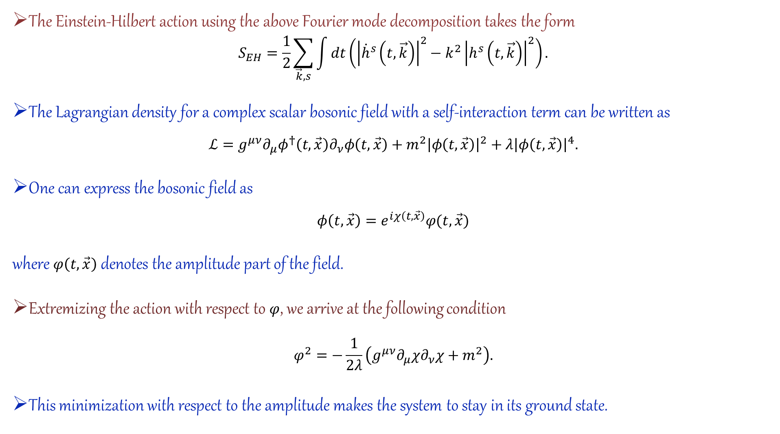
The Einstein-Hilbert action using the above Fourier mode decomposition takes the form
$$S_{EH}=\frac{1}{2}\sum_{\vec{k},s}{\int{dt\left({\left|{\dot{h}}^{s}\left(t,\vec{k}\right)\right|}^{2}−k^{2}{\left|h^{s}\left(t,\vec{k}\right)\right|}^{2}\right)}}.$$
The Lagrangian density for a complex scalar bosonic field with a self-interaction term can be written as
$$ℒ=g^{μν}∂_{μ}φ^{†}\left(t,\vec{x}\right)∂_{ν}φ\left(t,\vec{x}\right)+m^{2}{\left|φ\left(t,\vec{x}\right)\right|}^{2}+λ{\left|φ\left(t,\vec{x}\right)\right|}^{4}.$$
One can express the bosonic field as
$$φ\left(t,\vec{x}\right)=e^{iχ\left(t,\vec{x}\right)}φ(t,\vec{x})$$
where $φ\left(t,\vec{x}\right)$ denotes the amplitude part of the field.
Extremizing the action with respect to $φ$, we arrive at the following condition
$$φ^{2}=−\frac{1}{2λ}\left(g^{μν}∂_{μ}χ∂_{ν}χ+m^{2}\right).$$
This minimization with respect to the amplitude makes the system to stay in its ground state.

Slide 9
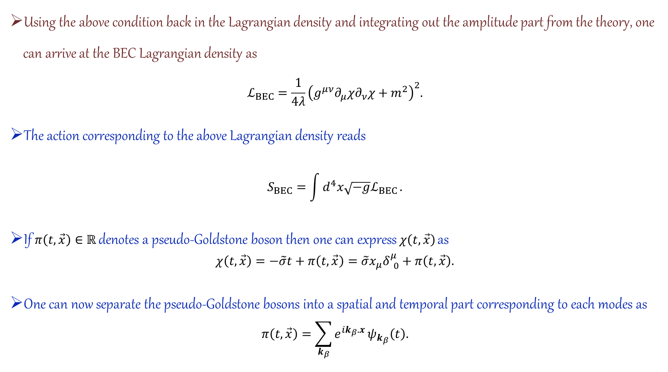
Using the above condition back in the Lagrangian density and integrating out the amplitude part from the theory, one can arrive at the BEC Lagrangian density as
$$ℒ_{BEC}=\frac{1}{4λ}{\left(g^{μν}∂_{μ}χ∂_{ν}χ+m^{2}\right)}^{2}.$$
The action corresponding to the above Lagrangian density reads
$$S_{BEC}=\int{d^{4}x\sqrt{−g}ℒ_{BEC}}.$$
If $π\left(t,\vec{x}\right)∈ℝ$ denotes a pseudo-Goldstone boson then one can express $χ\left(t,\vec{x}\right)$ as
$$χ\left(t,\vec{x}\right)=−\tilde{σ}t+π\left(t,\vec{x}\right)=\tilde{σ}x_{μ}δ_{ 0}^{μ}+π\left(t,\vec{x}\right).$$
One can now separate the pseudo-Goldstone bosons into a spatial and temporal part corresponding to each modes as
$$π\left(t,\vec{x}\right)=\sum_{k_{β}}{e^{ik_{β}.x}}ψ_{k_{β}}\left(t\right).$$

Slide 10
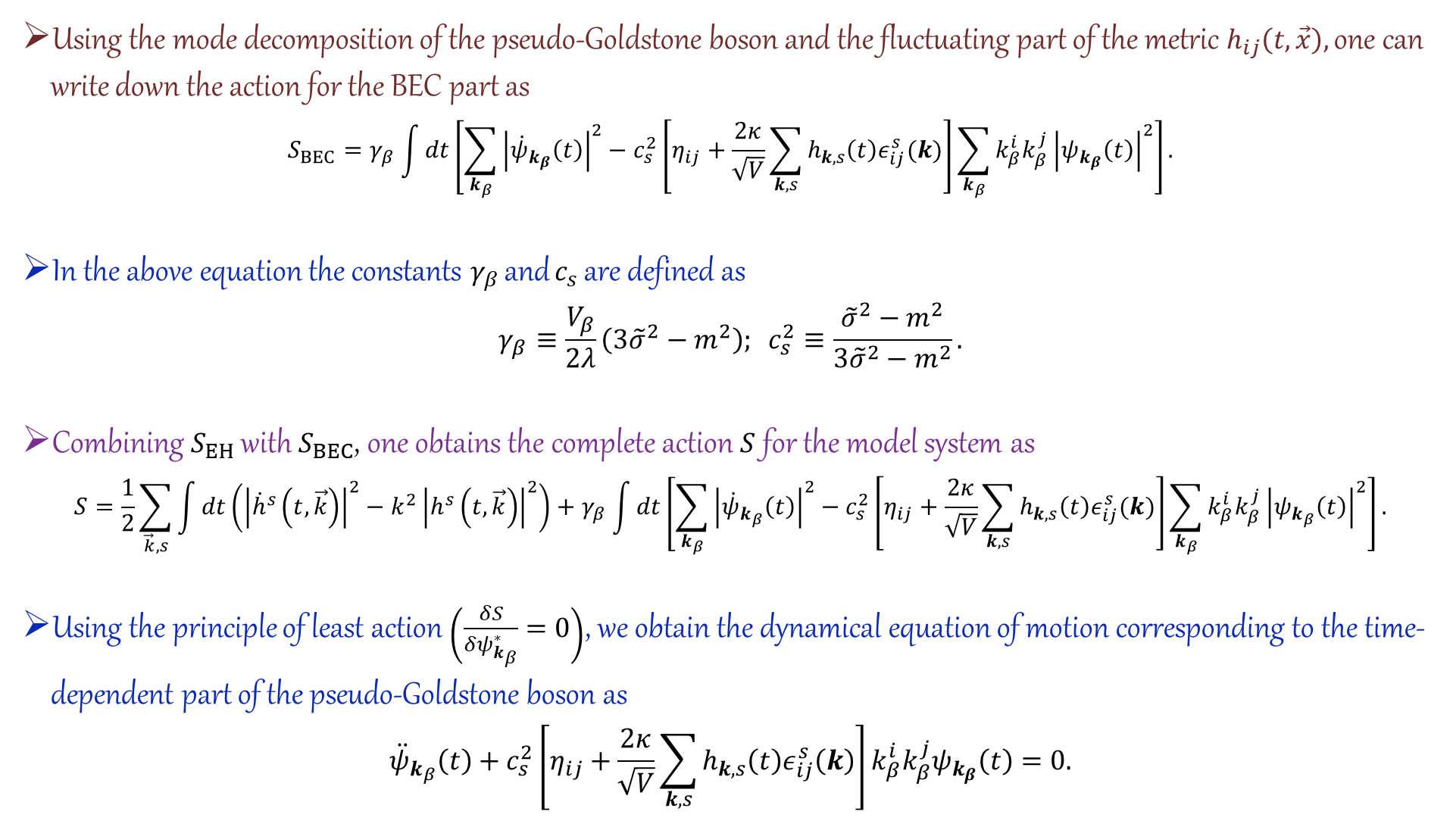
Using the mode decomposition of the pseudo-Goldstone boson and the fluctuating part of the metric $h_{ij}\left(t,\vec{x}\right),$ one can write down the action for the BEC part as
$$S_{BEC}=γ_{β}\int{dt\left[\sum_{k_{β}}{{\left|{\dot{ψ}}_{k_{β}}\left(t\right)\right|}^{2}}−c_{s}^{2}\left[η_{ij}+\frac{2κ}{\sqrt{V}}\sum_{k,s}{h_{k,s}\left(t\right)ε_{ij}^{s}(k)}\right]\sum_{k_{β}}{k_{β}^{i}k_{β}^{j}}{\left|ψ_{k_{β}}\left(t\right)\right|}^{2}\right]}.$$
In the above equation the constants $γ_{β}$ and $c_{s}$ are defined as
$$γ_{β}≡\frac{V_{β}}{2λ}\left(3{\tilde{σ}}^{2}−m^{2}\right); c_{s}^{2}≡\frac{{\tilde{σ}}^{2}−m^{2}}{3{\tilde{σ}}^{2}−m^{2}}.$$
Combining $S_{EH}$ with $S_{BEC}$, one obtains the complete action $S$ for the model system as
$$S=\frac{1}{2}\sum_{\vec{k},s}{\int{dt\left({\left|{\dot{h}}^{s}\left(t,\vec{k}\right)\right|}^{2}−k^{2}{\left|h^{s}\left(t,\vec{k}\right)\right|}^{2}\right)}}+γ_{β}\int{dt\left[\sum_{k_{β}}{{\left|{\dot{ψ}}_{k_{β}}\left(t\right)\right|}^{2}}−c_{s}^{2}\left[η_{ij}+\frac{2κ}{\sqrt{V}}\sum_{k,s}{h_{k,s}\left(t\right)ε_{ij}^{s}(k)}\right]\sum_{k_{β}}{k_{β}^{i}k_{β}^{j}}{\left|ψ_{k_{β}}\left(t\right)\right|}^{2}\right]}.$$
Using the principle of least action $\left(\frac{δS}{δψ_{k_{β}}^{∗}}=0\right)$, we obtain the dynamical equation of motion corresponding to the time-dependent part of the pseudo-Goldstone boson as
$${\ddot{ψ}}_{k_{β}}\left(t\right)+c_{s}^{2}\left[η_{ij}+\frac{2κ}{\sqrt{V}}\sum_{k,s}{h_{k,s}\left(t\right)ε_{ij}^{s}\left(k\right)}\right]k_{β}^{i}k_{β}^{j}ψ_{k_{β}}\left(t\right)=0.$$

Slide 11

Similarly the other equation of motion is obtained as (extremizing with respect to $h_{k,s}^{∗}$)
$${\ddot{h}}_{k,s}\left(t\right)+k^{2}h_{k,s}\left(t\right)=−\frac{4γ_{β}κc_{s}^{2}}{\sqrt{V}}{ε_{ij}^{s}}^{∗}\left(k\right)\sum_{k_{β}}{k_{β}^{i}k_{β}^{j}{\left|ψ_{k_{β}}\left(t\right)\right|}^{2}}.$$
Up to this point the BEC as well as the gravitational wave is treated classically.
Our next aim is to quantize the gravitational fluctuations to investigate the effect of gravitons on the BEC.

Slide 12
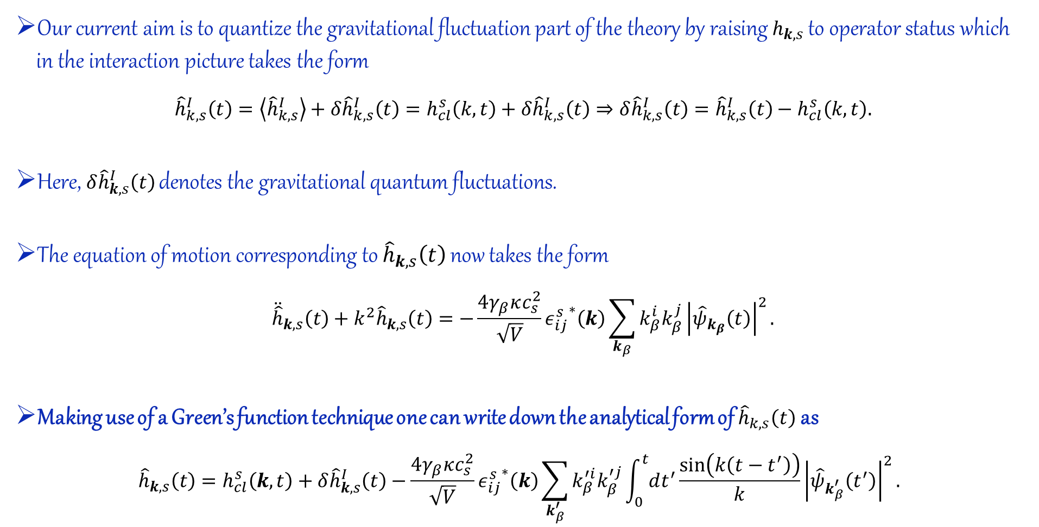
Graviton induced noise in the BEC
Our current aim is to quantize the gravitational fluctuation part of the theory by raising $h_{k,s}$ to operator status which in the interaction picture takes the form
$${\hat{h}}_{k,s}^{I}\left(t\right)=\left\langle {\hat{h}}_{k,s}^{I}\right\rangle +δ{\hat{h}}_{k,s}^{I}\left(t\right)=h_{cl}^{s}\left(k,t\right)+δ{\hat{h}}_{k,s}^{I}\left(t\right)⇒δ{\hat{h}}_{k,s}^{I}\left(t\right)={\hat{h}}_{k,s}^{I}\left(t\right)−h_{cl}^{s}\left(k,t\right).$$
Here, $δ{\hat{h}}_{k,s}^{I}\left(t\right)$ denotes the gravitational quantum fluctuations.
The equation of motion corresponding to ${\hat{h}}_{k,s}\left(t\right)$ now takes the form
$${\ddot{\hat{h}}}_{k,s}\left(t\right)+k^{2}{\hat{h}}_{k,s}\left(t\right)=−\frac{4γ_{β}κc_{s}^{2}}{\sqrt{V}}{ε_{ij}^{s}}^{∗}\left(k\right)\sum_{k_{β}}{k_{β}^{i}k_{β}^{j}{\left|{\hat{ψ}}_{k_{β}}\left(t\right)\right|}^{2}}.$$
Making use of a Green’s function technique one can write down the analytical form of ${\hat{h}}_{k,s}\left(t\right)$ as
$${\hat{h}}_{k,s}\left(t\right)=h_{cl}^{s}\left(k,t\right)+δ{\hat{h}}_{k,s}^{I}\left(t\right)−\frac{4γ_{β}κc_{s}^{2}}{\sqrt{V}}{ε_{ij}^{s}}^{∗}\left(k\right)\sum_{k_{β}^{′}}{k_{β}^{′i}k_{β}^{′j}}\int_{0}^{t}{dt^{′}}\frac{\sin\left(k\left(t−t^{′}\right)\right)}{k}{\left|{\hat{ψ}}_{k_{β}^{′}}\left(t^{′}\right)\right|}^{2}.$$

Slide 13
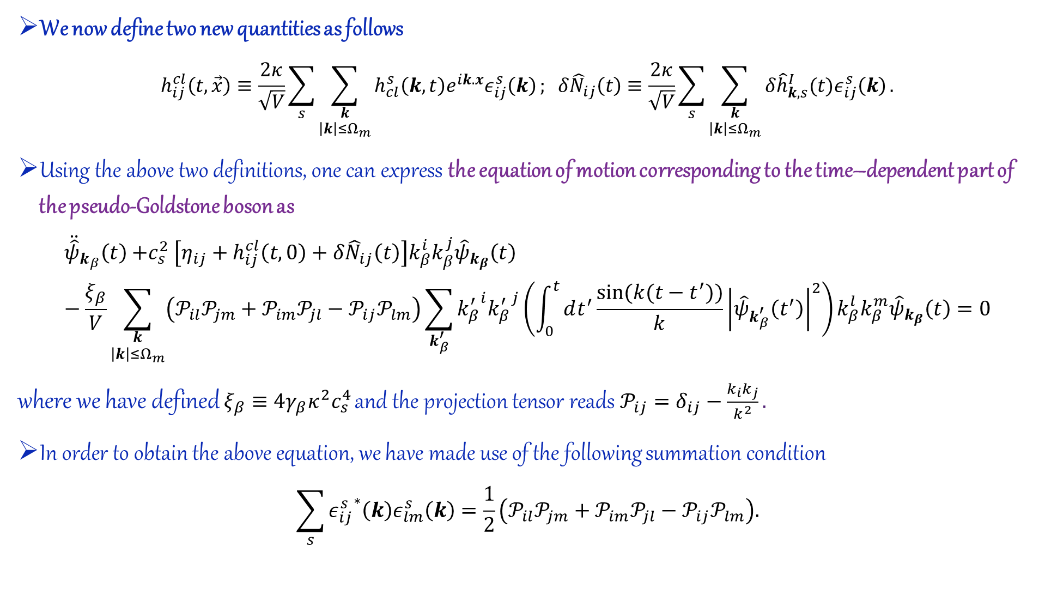
We now define two new quantities as follows
$$h_{ij}^{cl}\left(t,\vec{x}\right)≡\frac{2κ}{\sqrt{V}}\sum_{s}{\sum_{\begin{aligned}k \\ \left|k\right|≤Ω_{m}\end{aligned}}{h_{cl}^{s}\left(k,t\right)e^{ik.x}ε_{ij}^{s}\left(k\right)}}; δ{\hat{N}}_{ij}\left(t\right)≡\frac{2κ}{\sqrt{V}}\sum_{s}{\sum_{\begin{aligned}k \\ \left|k\right|≤Ω_{m}\end{aligned}}{δ{\hat{h}}_{k,s}^{I}(t)ε_{ij}^{s}\left(k\right)}}.$$
Using the above two definitions, one can express the equation of motion corresponding to the time–dependent part of the pseudo-Goldstone boson as
$${\ddot{\hat{ψ}}}_{k_{β}}\left(t\right){+c}_{s}^{2}\left[η_{ij}+h_{ij}^{cl}\left(t,0\right)+δ{\hat{N}}_{ij}\left(t\right)\right]k_{β}^{i}k_{β}^{j}{\hat{ψ}}_{k_{β}}\left(t\right)−\frac{ξ_{β}}{V}\sum_{\begin{aligned}k \\ \left|k\right|≤Ω_{m}\end{aligned}}{\left(𝒫_{il}𝒫_{jm}+𝒫_{im}𝒫_{jl}−𝒫_{ij}𝒫_{lm}\right)}\sum_{k_{β}^{′}}{{k_{β}^{′}}^{i}{k_{β}^{′}}^{j}}\left(\int_{0}^{t}{dt^{′}\frac{\sin{(k(t−t^{′}))}}{k}}{\left|{\hat{ψ}}_{k_{β}^{′}}\left(t^{′}\right)\right|}^{2}\right)k_{β}^{l}k_{β}^{m}{\hat{ψ}}_{k_{β}}\left(t\right)=0$$
where we have defined${ ξ_{β}≡4γ_{β}κ}^{2}c_{s}^{4}$ and the projection tensor reads $𝒫_{ij}=δ_{ij}−\frac{k_{i}k_{j}}{k^{2}}.$
In order to obtain the above equation, we have made use of the following summation condition
$$\sum_{s}{{ε_{ij}^{s}}^{∗}\left(k\right)ε_{lm}^{s}\left(k\right)=\frac{1}{2}}\left(𝒫_{il}𝒫_{jm}+𝒫_{im}𝒫_{jl}−𝒫_{ij}𝒫_{lm}\right).$$

Slide 14
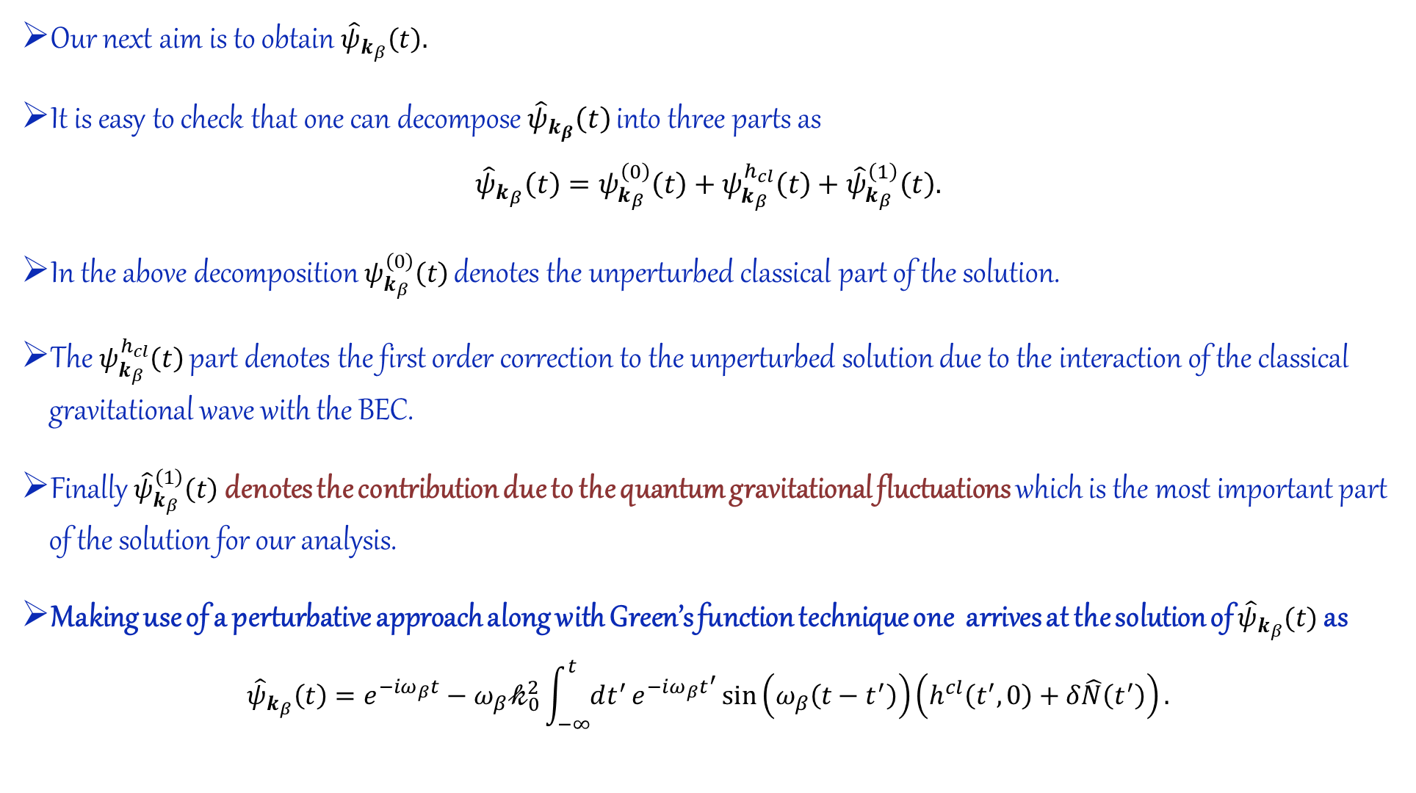
Our next aim is to obtain ${\hat{ψ}}_{k_{β}}\left(t\right).$
It is easy to check that one can decompose ${\hat{ψ}}_{k_{β}}\left(t\right)$ into three parts as
$${\hat{ψ}}_{k_{β}}\left(t\right)=ψ_{k_{β}}^{\left(0\right)}\left(t\right)+ψ_{k_{β}}^{h_{cl}}\left(t\right)+{\hat{ψ}}_{k_{β}}^{\left(1\right)}\left(t\right).$$
In the above decomposition $ψ_{k_{β}}^{\left(0\right)}\left(t\right)$ denotes the unperturbed classical part of the solution.
The $ψ_{k_{β}}^{h_{cl}}\left(t\right)$ part denotes the first order correction to the unperturbed solution due to the interaction of the classical gravitational wave with the BEC.
Finally ${\hat{ψ}}_{k_{β}}^{\left(1\right)}\left(t\right)$ denotes the contribution due to the quantum gravitational fluctuations which is the most important part of the solution for our analysis.
Making use of a perturbative approach along with Green’s function technique one arrives at the solution of ${\hat{ψ}}_{k_{β}}(t)$ as
$${\hat{ψ}}_{k_{β}}\left(t\right)=e^{−iω_{β}t}−{ω_{β}𝓀}_{0}^{2}\int_{−∞}^{t}{dt^{′}}e^{−iω_{β}t^{′}}\sin\left(ω_{β}\left(t−t^{′}\right)\right)\left(h^{cl}\left(t^{′},0\right)+δ\hat{N}\left(t^{′}\right)\right).$$

Slide 15
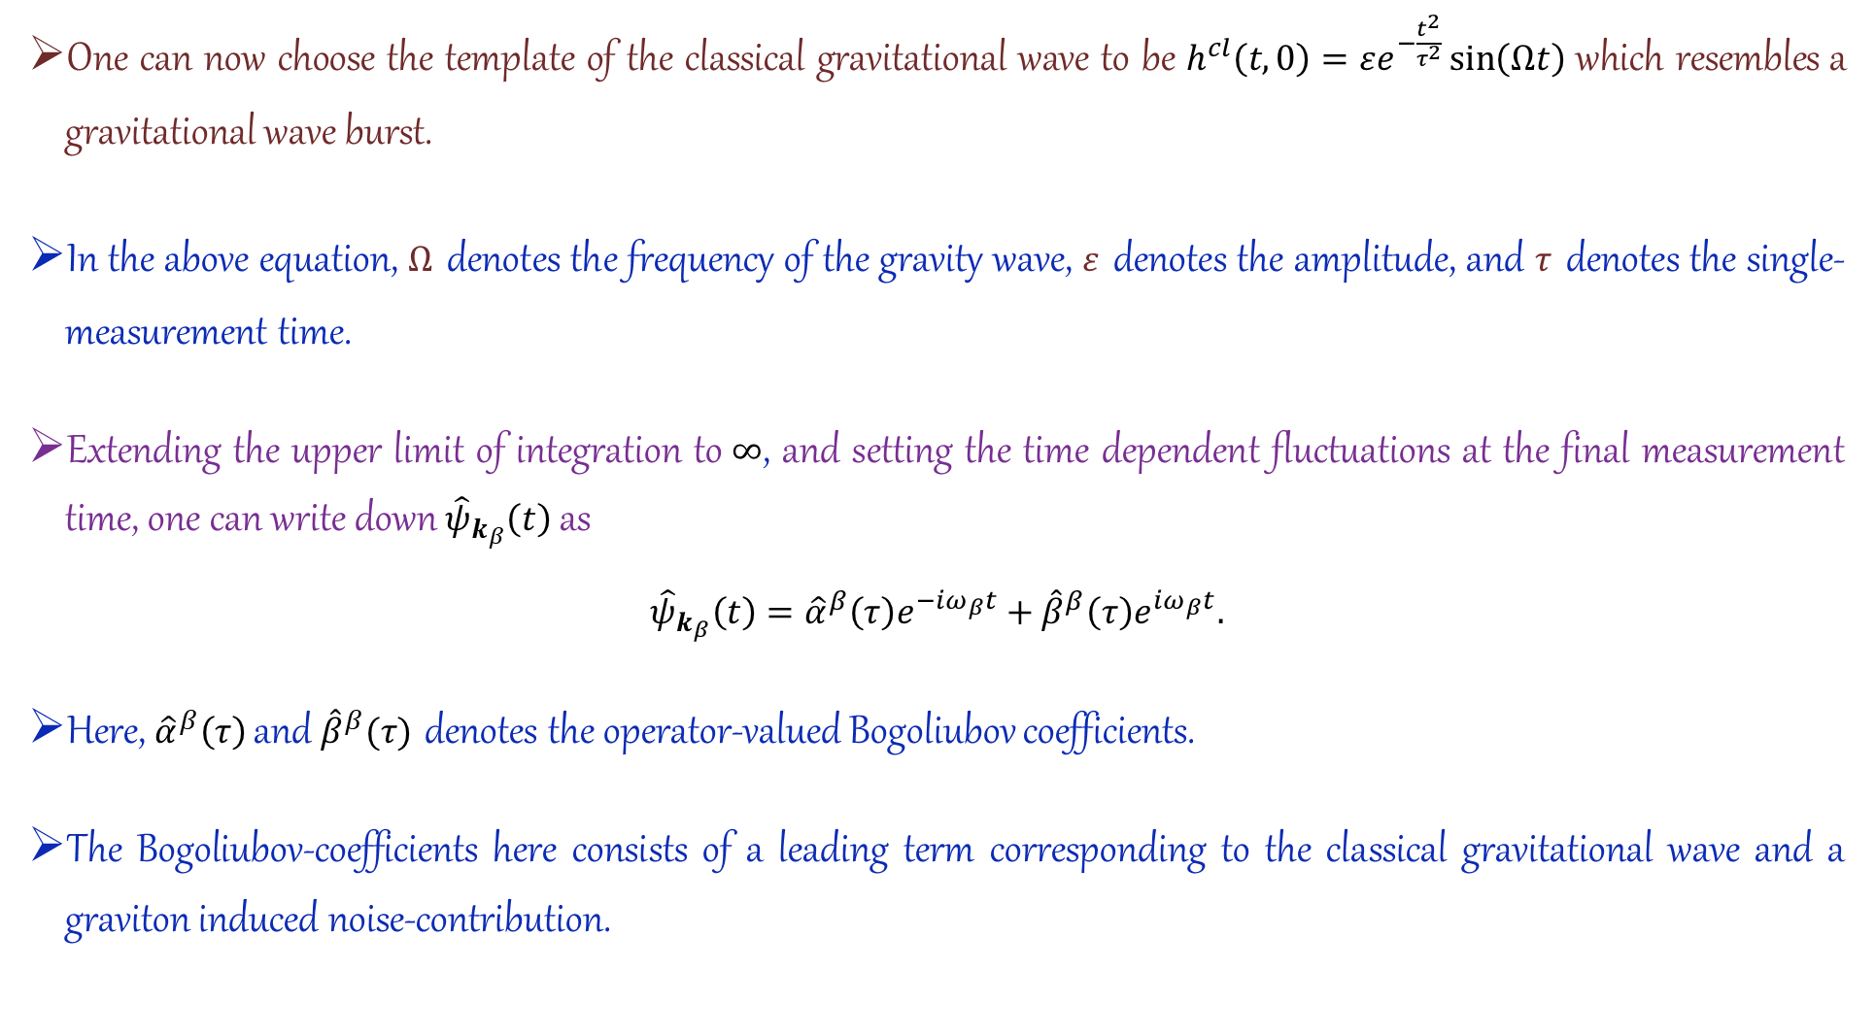
One can now choose the template of the classical gravitational wave to be $h^{cl}\left(t,0\right)=εe^{−\frac{t^{2}}{τ^{2}}}\sin\left(Ωt\right)$ which resembles a gravitational wave burst.
In the above equation, $Ω$ denotes the frequency of the gravity wave, $ε$ denotes the amplitude, and $τ$ denotes the single-measurement time.
Extending the upper limit of integration to $∞$, and setting the time dependent fluctuations at the final measurement time, one can write down ${\hat{ψ}}_{k_{β}}\left(t\right)$as
$${\hat{ψ}}_{k_{β}}\left(t\right)={\hat{α}}^{β}\left(τ\right)e^{−iω_{β}t}+{\hat{β}}^{β}\left(τ\right)e^{iω_{β}t}.$$
Here, ${\hat{α}}^{β}\left(τ\right)$ and ${\hat{β}}^{β}(τ)$ denotes the operator-valued Bogoliubov coefficients.
The Bogoliubov-coefficients here consists of a leading term corresponding to the classical gravitational wave and a graviton induced noise-contribution.

Slide 16
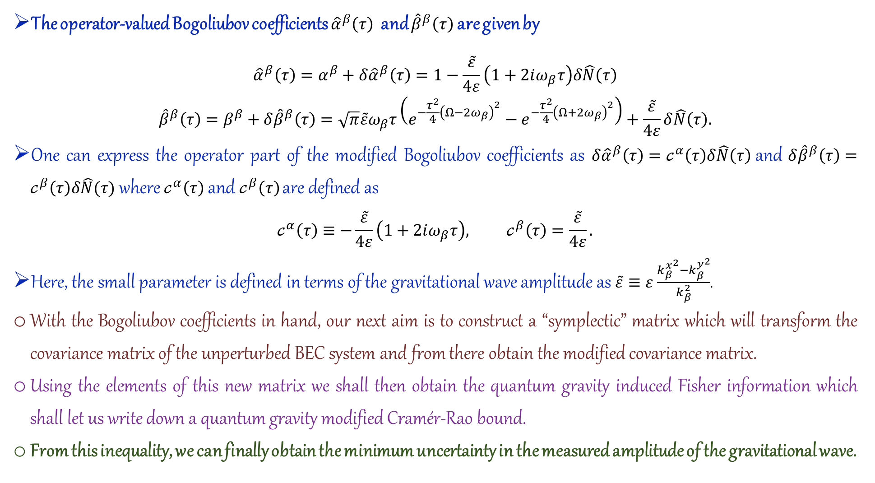
The operator-valued Bogoliubov coefficients ${\hat{α}}^{β}\left(τ\right)$ and ${\hat{β}}^{β}\left(τ\right)$ are given by
$$\begin{matrix}{\hat{α}}^{β}\left(τ\right)=α^{β}+δ{\hat{α}}^{β}\left(τ\right)=1−\frac{\tilde{ε}}{4ε}\left(1+2iω_{β}τ\right)δ\hat{N}\left(τ\right) \\ {\hat{β}}^{β}\left(τ\right)=β^{β}+δ{\hat{β}}^{β}\left(τ\right)=\sqrt{π}\tilde{ε}ω_{β}τ\left(e^{−\frac{τ^{2}}{4}{\left(Ω−2ω_{β}\right)}^{2}}−e^{−\frac{τ^{2}}{4}{\left(Ω+2ω_{β}\right)}^{2}}\right)+\frac{\tilde{ε}}{4ε}δ\hat{N}\left(τ\right).\end{matrix}$$
One can express the operator part of the modified Bogoliubov coefficients as $δ{\hat{α}}^{β}\left(τ\right)=𝒸^{α}\left(τ\right)δ\hat{N}\left(τ\right)$ and $δ{\hat{β}}^{β}\left(τ\right)=𝒸^{β}\left(τ\right)δ\hat{N}(τ)$ where $𝒸^{α}\left(τ\right)$ and $𝒸^{β}\left(τ\right)$ are defined as
$$𝒸^{α}\left(τ\right)≡−\frac{\tilde{ε}}{4ε}\left(1+2iω_{β}τ\right), 𝒸^{β}\left(τ\right)=\frac{\tilde{ε}}{4ε}.$$
Here, the small parameter is defined in terms of the gravitational wave amplitude as $\tilde{ε}≡ε$ $\frac{{k_{β}^{x}}^{2}−{k_{β}^{y}}^{2}}{k_{β}^{2}}$.
With the Bogoliubov coefficients in hand, our next aim is to construct a “symplectic” matrix which will transform the covariance matrix of the unperturbed BEC system and from there obtain the modified covariance matrix.
Using the elements of this new matrix we shall then obtain the quantum gravity induced Fisher information which shall let us write down a quantum gravity modified Cramér-Rao bound.
From this inequality, we can finally obtain the minimum uncertainty in the measured amplitude of the gravitational wave.

Slide 17
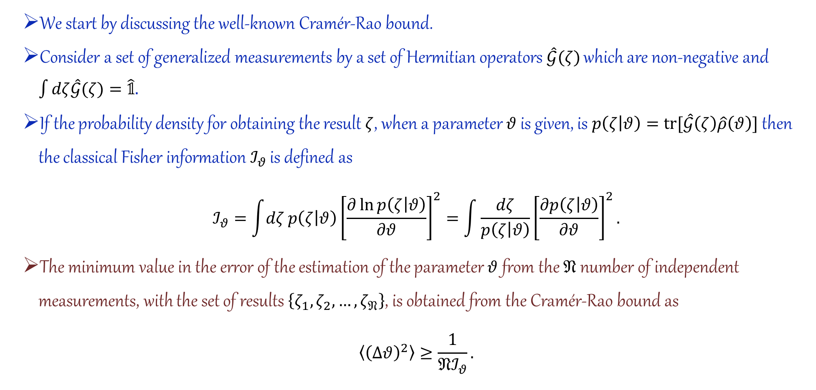
Quantum metrology and the noise of gravitons
Cramér-Rao bound and the quantum Fisher information
We start by discussing the well-known Cramér-Rao bound.
Consider a set of generalized measurements by a set of Hermitian operators $\hat{𝒢}(ζ)$ which are non-negative and $\int{dζ\hat{𝒢}(ζ)}=\hat{𝟙}.$
If the probability density for obtaining the result $ζ$, when a parameter $θ$ is given, is $p\left(ζ | θ\right)=tr[\hat{𝒢}\left(ζ\right)\hat{ρ}\left(θ\right)]$then the classical Fisher information $ℐ_{θ}$ is defined as
$$ℐ_{θ}=\int{dζ}p\left(ζ | θ\right){\left[\frac{∂\ln{p\left(ζ | θ\right)}}{∂θ}\right]}^{2}=\int{\frac{dζ}{p\left(ζ | θ\right)}}{\left[\frac{∂p\left(ζ | θ\right)}{∂θ}\right]}^{2}.$$
The minimum value in the error of the estimation of the parameter $θ$ from the $𝔑$ number of independent measurements, with the set of results $\left\{ζ_{1},ζ_{2},…,ζ_{𝔑}\right\}$, is obtained from the Cramér-Rao bound as
$$\left\langle {\left(Δθ\right)}^{2}\right\rangle ≥\frac{1}{𝔑ℐ_{θ}}.$$

Slide 18
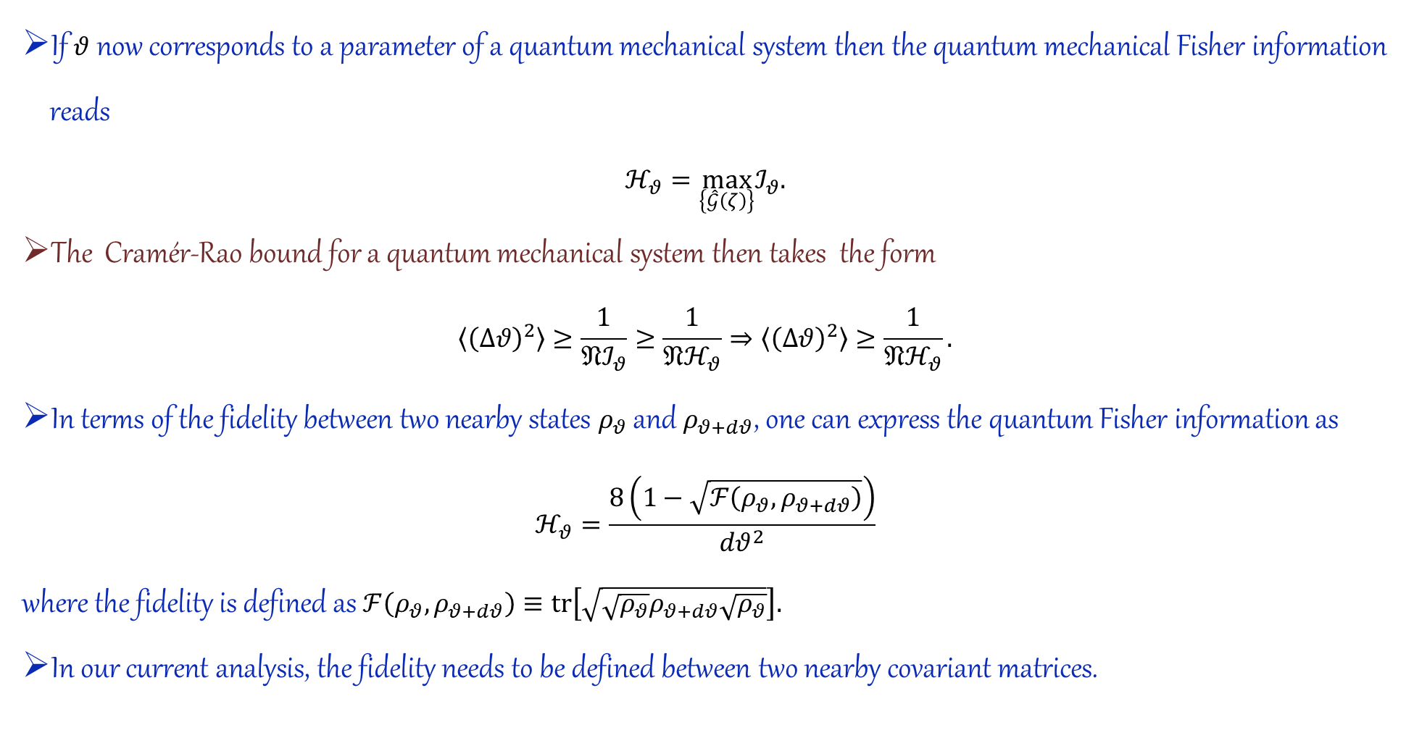
If $θ$ now corresponds to a parameter of a quantum mechanical system then the quantum mechanical Fisher information reads
$$ℋ_{θ}=\max_{\left\{\hat{𝒢}\left(ζ\right)\right\}}ℐ_{θ}.$$
The Cramér-Rao bound for a quantum mechanical system then takes the form
$$\left\langle {\left(Δθ\right)}^{2}\right\rangle ≥\frac{1}{𝔑ℐ_{θ}}≥\frac{1}{𝔑ℋ_{θ}}⇒\left\langle {\left(Δθ\right)}^{2}\right\rangle ≥\frac{1}{𝔑ℋ_{θ}}.$$
In terms of the fidelity between two nearby states $ρ_{θ}$ and $ρ_{θ+dθ}$, one can express the quantum Fisher information as
$$ℋ_{θ}=\frac{8\left(1−\sqrt{ℱ\left(ρ_{θ},ρ_{θ+dθ}\right)}\right)}{dθ^{2}}$$
where the fidelity is defined as $ℱ\left(ρ_{θ},ρ_{θ+dθ}\right)≡tr\left[\sqrt{\sqrt{ρ_{θ}}ρ_{θ+dθ}\sqrt{ρ_{θ}}}\right].$
In our current analysis, the fidelity needs to be defined between two nearby covariant matrices.

Slide 19
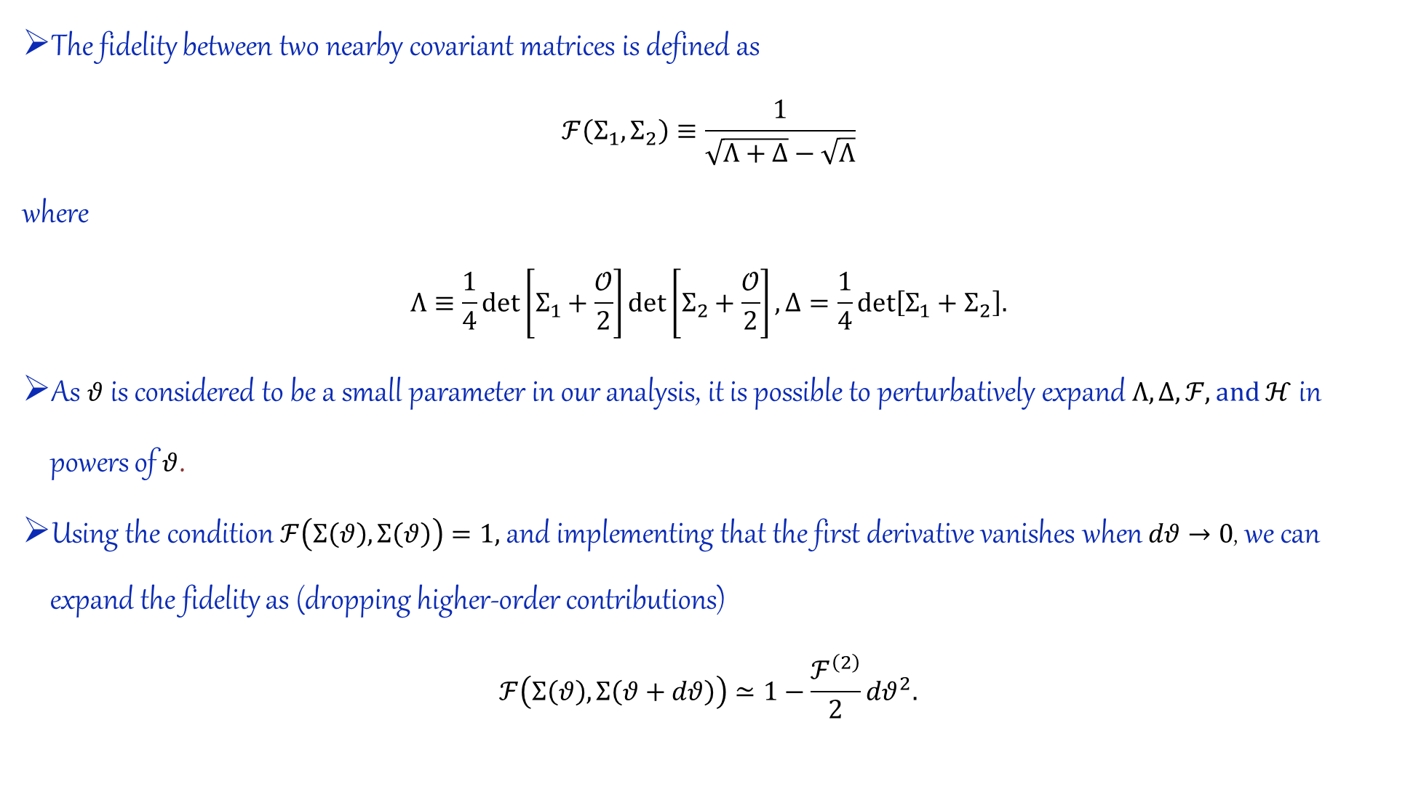
The fidelity between two nearby covariant matrices is defined as
$$ℱ\left(Σ_{1},Σ_{2}\right)≡\frac{1}{\sqrt{Λ+Δ}−\sqrt{Λ}}$$
where
$$Λ≡\frac{1}{4}det\left[Σ_{1}+\frac{𝒪}{2}\right]det\left[Σ_{2}+\frac{𝒪}{2}\right], Δ=\frac{1}{4}det\left[Σ_{1}+Σ_{2}\right].$$
As $θ$ is considered to be a small parameter in our analysis, it is possible to perturbatively expand $Λ, Δ, ℱ, and ℋ$ in powers of $θ$.
Using the condition $ℱ\left(Σ\left(θ\right),Σ\left(θ\right)\right)=1,$ and implementing that the first derivative vanishes when $dθ→0$, we can expand the fidelity as (dropping higher-order contributions)
$$ℱ\left(Σ\left(θ\right),Σ\left(θ+dθ\right)\right)≃1−\frac{ℱ^{\left(2\right)}}{2}dθ^{2}.$$

Slide 20
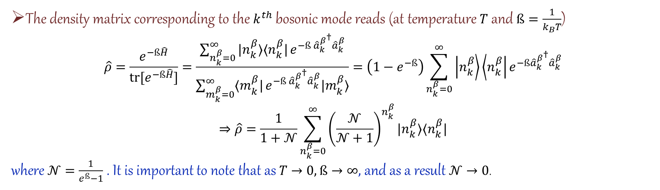

Here, for a squeezed state with vanishing displacement, $ℱ^{\left(2\right)}$ takes the form
$$ℱ^{\left(2\right)}=𝒞^{\left(2\right)}=\frac{1}{2}\left(Σ_{11}^{\left(0\right)}Σ_{22}^{\left(2\right)}+Σ_{11}^{\left(2\right)}Σ_{22}^{\left(0\right)}−2Σ_{12}^{\left(0\right)}Σ_{12}^{\left(2\right)}\right)+\frac{1}{8}\left(Σ_{11}^{\left(1\right)}Σ_{22}^{\left(1\right)}−2Σ_{12}^{\left(1\right)}Σ_{12}^{\left(1\right)}\right).$$
Then the corresponding quantum Fisher information is obtained as
$$ℋ_{θ}=4𝒞^{\left(2\right)}.$$
Modified covariance matrix for a Bose-Einstein condensate
The density matrix corresponding to the $k^{th}$ bosonic mode reads (at temperature $T$ and $ß=\frac{1}{k_{B}T}$)
$$\hat{ρ}=\frac{e^{−ß\hat{H}}}{tr[e^{−ß\hat{H}}]}=\frac{\sum_{n_{k}^{β}=0}^{∞}{|n_{k}^{β}⟩⟨n_{k}^{β}|}e^{−ß {{\hat{a}}_{k}^{β}}^{†}{\hat{a}}_{k}^{β}}}{\sum_{m_{k}^{β}=0}^{∞}{⟨m_{k}^{β}|}e^{−ß {{\hat{a}}_{k}^{β}}^{†}{\hat{a}}_{k}^{β}}|m_{k}^{β}⟩}=\left(1−e^{−ß}\right)\sum_{n_{k}^{β}=0}^{∞}{\left|n_{k}^{β}\right\rangle \left\langle n_{k}^{β}\right|}e^{−ß{{\hat{a}}_{k}^{β}}^{†}{\hat{a}}_{k}^{β}}$$
$$⇒\hat{ρ}=\frac{1}{1+𝒩}\sum_{n_{k}^{β}=0}^{∞}{{\left(\frac{𝒩}{𝒩+1}\right)}^{n_{k}^{β}}|n_{k}^{β}⟩⟨n_{k}^{β}|}$$
where $𝒩=\frac{1}{e^{ß}−1}$ . It is important to note that as $T→0,$ $ß→∞,$ and as a result $𝒩→0$.

Slide 21
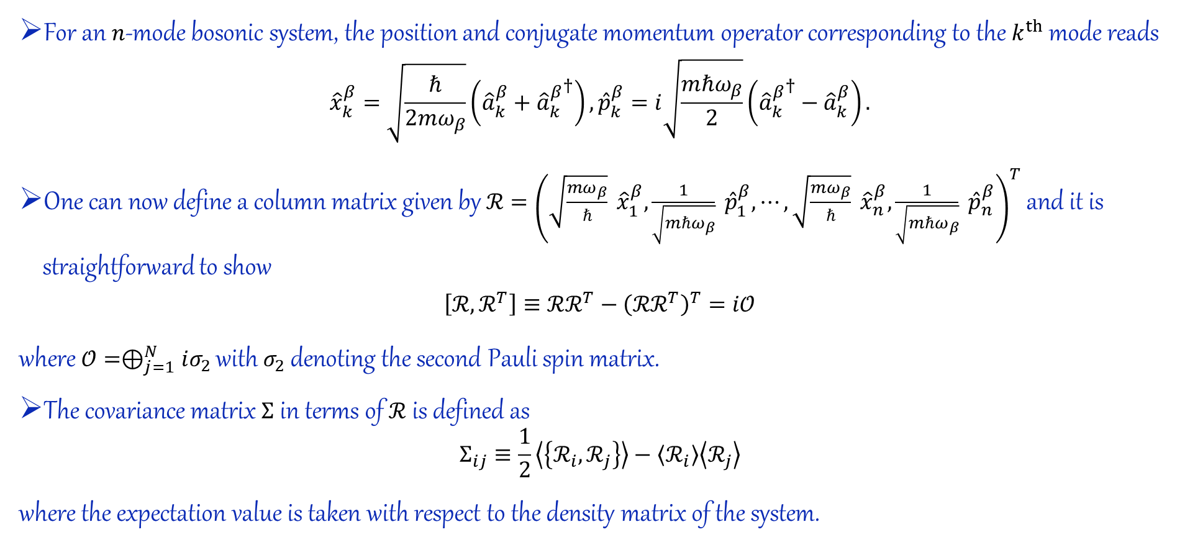
Covariance Matrix Calculation (Additional Slide)
Calculating the covariance matrix for a single mode of an $n$-mode bosonic system
For an $n$-mode bosonic system, the position and conjugate momentum operator corresponding to the $k^{th}$mode reads
$${\hat{x}}_{k}^{β}=\sqrt{\frac{ℏ}{2mω_{β}}}\left({\hat{a}}_{k}^{β}+{{\hat{a}}_{k}^{β}}^{†}\right), {\hat{p}}_{k}^{β}=i\sqrt{\frac{mℏω_{β}}{2}}\left({{\hat{a}}_{k}^{β}}^{†}−{\hat{a}}_{k}^{β}\right).$$
One can now define a column matrix given by $ℛ={\left(\sqrt{\frac{mω_{β}}{ℏ}} {\hat{x}}_{1}^{β},\frac{1}{\sqrt{mℏω_{β}}} {\hat{p}}_{1}^{β},⋯,\sqrt{\frac{mω_{β}}{ℏ}} {\hat{x}}_{n}^{β},\frac{1}{\sqrt{mℏω_{β}}} {\hat{p}}_{n}^{β}\right)}^{T}$ and it is straightforward to show
$$\left[ℛ,ℛ^{T}\right]≡ℛℛ^{T}−{\left(ℛℛ^{T}\right)}^{T}=i𝒪$$
where $𝒪=⊕_{j=1}^{N}iσ_{2}$ with $σ_{2}$ denoting the second Pauli spin matrix.
The covariance matrix $Σ$ in terms of $ℛ$ is defined as
$$Σ_{ij}≡\frac{1}{2}\left\langle \left\{ℛ_{i},ℛ_{j}\right\}\right\rangle −\left\langle ℛ_{i}\right\rangle \left\langle ℛ_{j}\right\rangle$$
where the expectation value is taken with respect to the density matrix of the system.

Slide 22
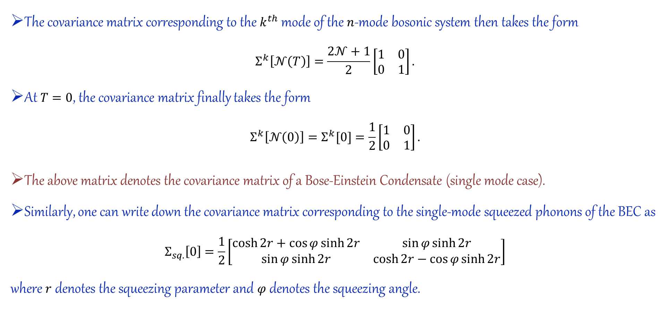
Quantum metrology and the noise of gravitons
The covariance matrix corresponding to the $k^{th}$ mode of the $n$-mode bosonic system then takes the form
$$Σ^{k}\left[𝒩\left(T\right)\right]=\frac{2𝒩+1}{2}\left[\begin{matrix}1 & 0 \\ 0 & 1\end{matrix}\right].$$
At $T=0$, the covariance matrix finally takes the form
$$Σ^{k}\left[𝒩\left(0\right)\right]=Σ^{k}[0]=\frac{1}{2}\left[\begin{matrix}1 & 0 \\ 0 & 1\end{matrix}\right].$$
The above matrix denotes the covariance matrix of a Bose-Einstein Condensate (single mode case).
Similarly, one can write down the covariance matrix corresponding to the single-mode squeezed phonons of the BEC as
$$Σ_{sq.}\left[0\right]=\frac{1}{2}\left[\begin{matrix}\cosh{2r}+\cos{φ}\sinh{2r} & \sin{φ}\sinh{2r} \\ \sin{φ}\sinh{2r} & \cosh{2r}−\cos{φ}\sinh{2r}\end{matrix}\right]$$
where $r$ denotes the squeezing parameter and $φ$ denotes the squeezing angle.

Slide 23
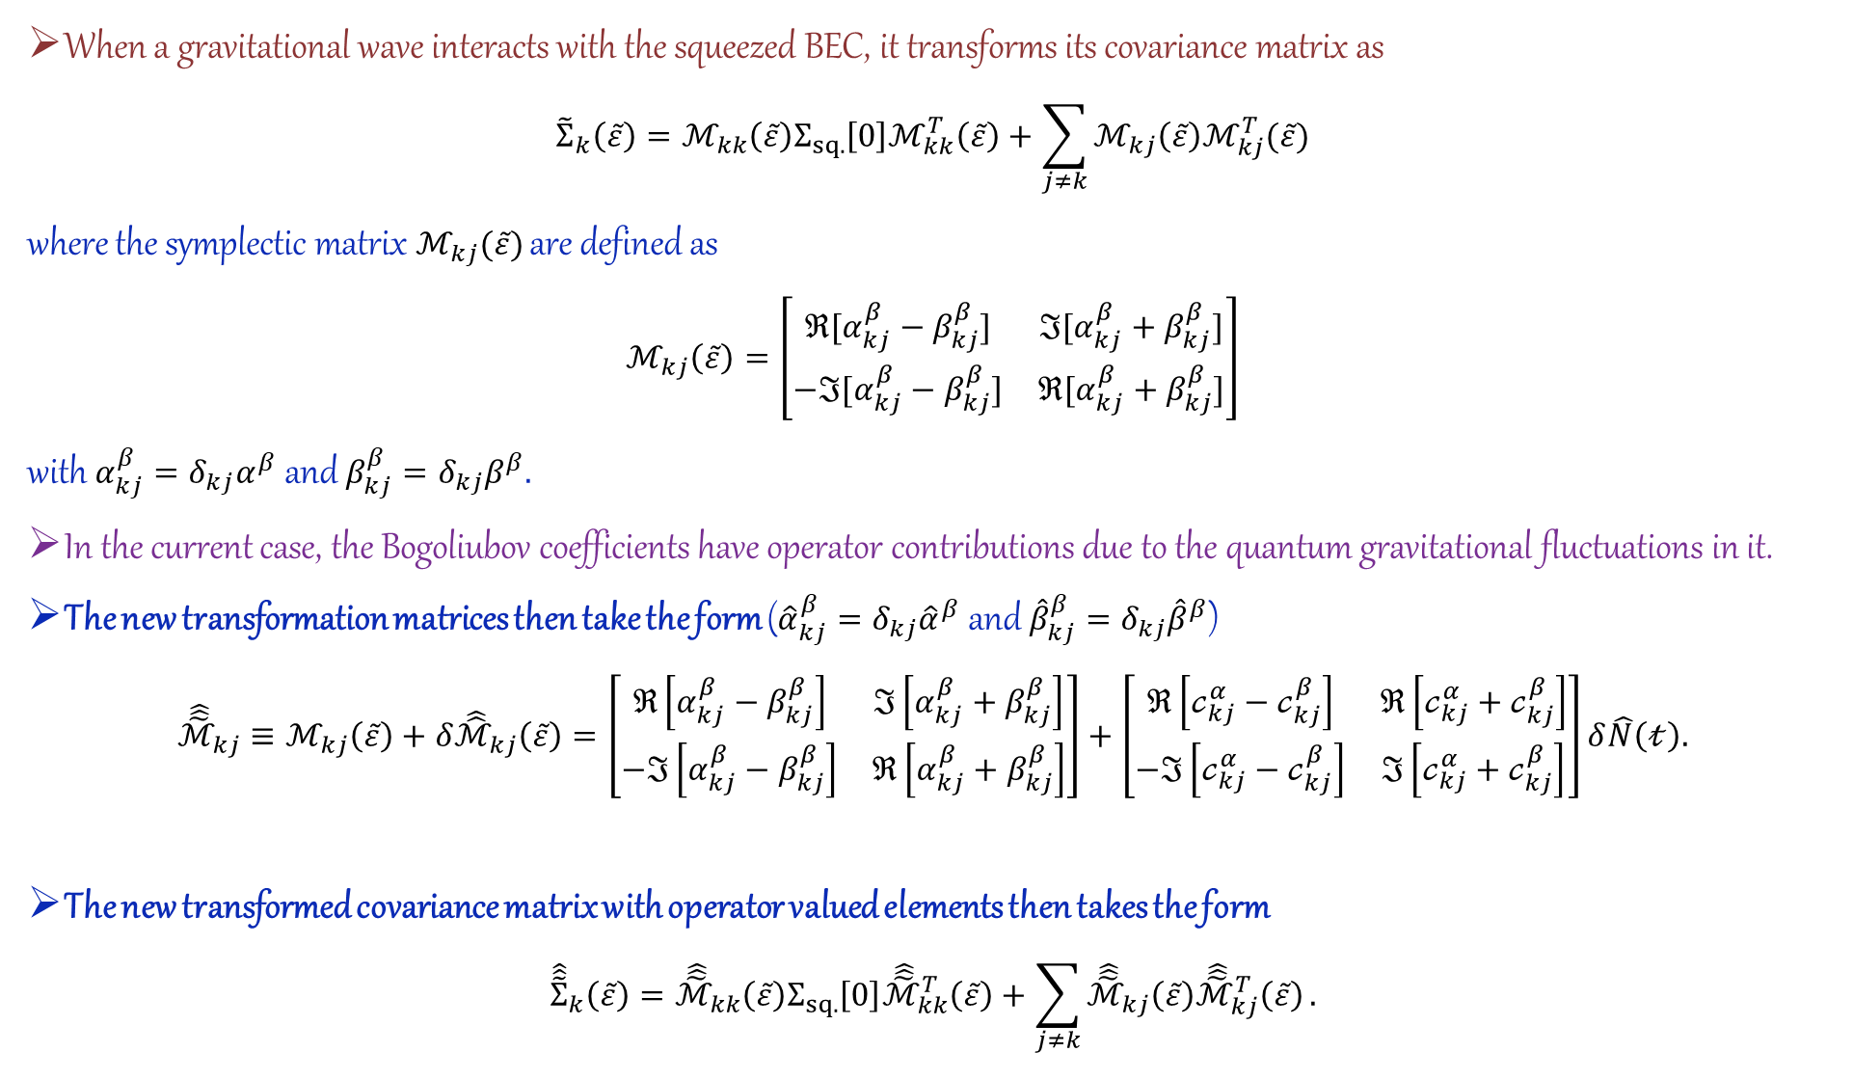
When a gravitational wave interacts with the squeezed BEC, it transforms its covariance matrix as
$${\tilde{Σ}}_{k}\left(\tilde{ε}\right)=ℳ_{kk}\left(\tilde{ε}\right)Σ_{sq.}\left[0\right]ℳ_{kk}^{T}\left(\tilde{ε}\right)+\sum_{j≠k}{ℳ_{kj}\left(\tilde{ε}\right)ℳ_{kj}^{T}(\tilde{ε})}$$
where the symplectic matrix $ℳ_{kj}(\tilde{ε})$ are defined as
$$ℳ_{kj}\left(\tilde{ε}\right)=\left[\begin{matrix}ℜ[α_{kj}^{β}−β_{kj}^{β}] & ℑ[α_{kj}^{β}+β_{kj}^{β}] \\ −ℑ[α_{kj}^{β}−β_{kj}^{β}] & ℜ[α_{kj}^{β}+β_{kj}^{β}]\end{matrix}\right]$$
with $α_{kj}^{β}=δ_{kj}α^{β}$ and $β_{kj}^{β}=δ_{kj}β^{β}.$
In the current case, the Bogoliubov coefficients have operator contributions due to the quantum gravitational fluctuations in it.
The new transformation matrices then take the form (${\hat{α}}_{kj}^{β}=δ_{kj}{\hat{α}}^{β}$ and ${\hat{β}}_{kj}^{β}=δ_{kj}{\hat{β}}^{β}$)
$${\hat{\hat{\tilde{ℳ}}}}_{kj}≡ℳ_{kj}\left(\tilde{ε}\right)+δ{\hat{\hat{ℳ}}}_{kj}\left(\tilde{ε}\right)=\left[\begin{matrix}ℜ\left[α_{kj}^{β}−β_{kj}^{β}\right] & ℑ\left[α_{kj}^{β}+β_{kj}^{β}\right] \\ −ℑ\left[α_{kj}^{β}−β_{kj}^{β}\right] & ℜ\left[α_{kj}^{β}+β_{kj}^{β}\right]\end{matrix}\right]+\left[\begin{matrix}ℜ\left[𝒸_{kj}^{α}−𝒸_{kj}^{β }\right] & ℜ\left[𝒸_{kj}^{α}+𝒸_{kj}^{β }\right] \\ −ℑ\left[𝒸_{kj}^{α}−𝒸_{kj}^{β }\right] & ℑ\left[𝒸_{kj}^{α}+𝒸_{kj}^{β }\right]\end{matrix}\right]δ\hat{N}\left(𝓉\right).$$
The new transformed covariance matrix with operator valued elements then takes the form
$${\hat{\hat{\tilde{Σ}}}}_{k}\left(\tilde{ε}\right)={\hat{\hat{\tilde{ℳ}}}}_{kk}\left(\tilde{ε}\right)Σ_{sq.}\left[0\right]{\hat{\hat{\tilde{ℳ}}}}_{kk}^{T}\left(\tilde{ε}\right)+\sum_{j≠k}{{\hat{\hat{\tilde{ℳ}}}}_{kj}\left(\tilde{ε}\right){\hat{\hat{\tilde{ℳ}}}}_{kj}^{T}\left(\tilde{ε}\right)}.$$

Slide 24
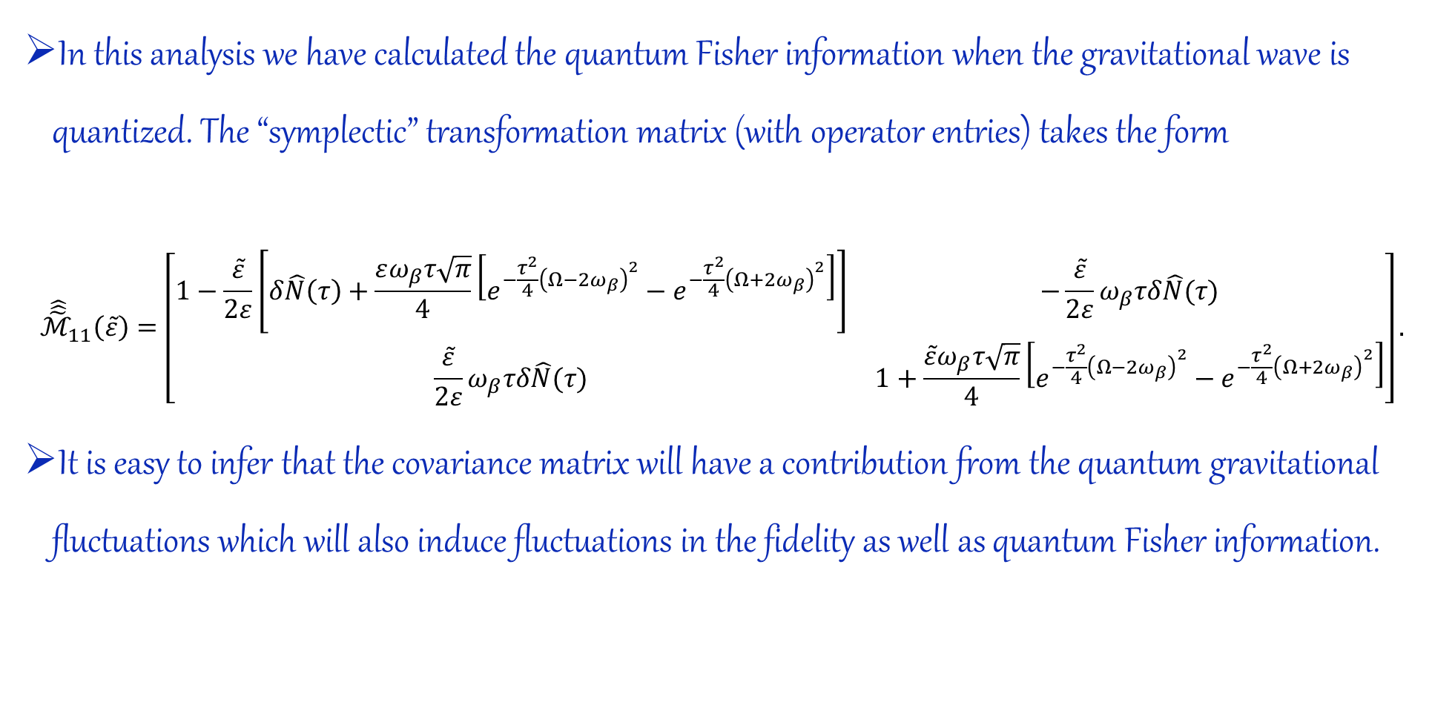
“Symplectic matrix” constructed using operator-valued Bogoliubov coefficients
In this analysis we have calculated the quantum Fisher information when the gravitational wave is quantized. The “symplectic” transformation matrix (with operator entries) takes the form
$${\hat{\hat{\tilde{ℳ}}}}_{11}\left(\tilde{ε}\right)=\left[\begin{matrix}1−\frac{\tilde{ε}}{2ε}\left[δ\hat{N}\left(τ\right)+\frac{εω_{β}τ\sqrt{π}}{4}\left[e^{−\frac{τ^{2}}{4}{\left(Ω−2ω_{β}\right)}^{2}}−e^{−\frac{τ^{2}}{4}{\left(Ω+2ω_{β}\right)}^{2}}\right]\right] & −\frac{\tilde{ε}}{2ε}ω_{β}τδ\hat{N}(τ) \\ \frac{\tilde{ε}}{2ε}ω_{β}τδ\hat{N}(τ) & 1+\frac{\tilde{ε}ω_{β}τ\sqrt{π}}{4}\left[e^{−\frac{τ^{2}}{4}{\left(Ω−2ω_{β}\right)}^{2}}−e^{−\frac{τ^{2}}{4}{\left(Ω+2ω_{β}\right)}^{2}}\right]\end{matrix}\right].$$
It is easy to infer that the covariance matrix will have a contribution from the quantum gravitational fluctuations which will also induce fluctuations in the fidelity as well as quantum Fisher information.

Slide 25
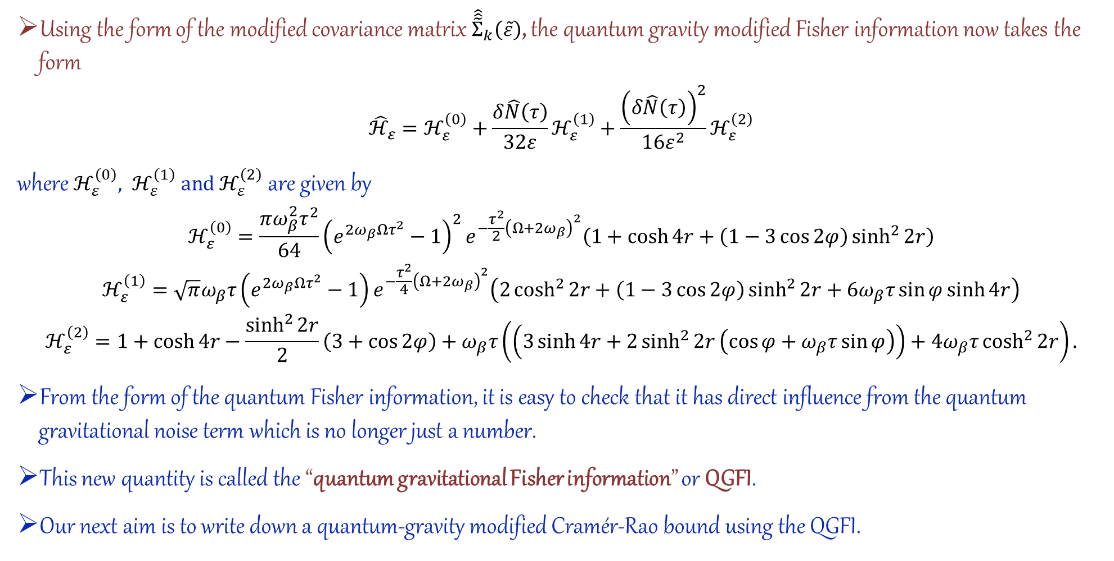
Quantum gravitational Fisher information (QGFI)
Using the form of the modified covariance matrix ${\hat{\hat{\tilde{Σ}}}}_{k}\left(\tilde{ε}\right)$, the quantum gravity modified Fisher information now takes the form
$${\hat{ℋ}}_{ε}=ℋ_{ε}^{\left(0\right)}+\frac{δ\hat{N}\left(τ\right)}{32ε}ℋ_{ε}^{\left(1\right)}+\frac{{\left(δ\hat{N}\left(τ\right)\right)}^{2}}{16ε^{2}}ℋ_{ε}^{\left(2\right)}$$
where $ℋ_{ε}^{\left(0\right)}, ℋ_{ε}^{\left(1\right)} and ℋ_{ε}^{\left(2\right)}$ are given by
$$\begin{matrix}ℋ_{ε}^{\left(0\right)}=\frac{πω_{β}^{2}τ^{2}}{64}{\left(e^{2ω_{β}Ωτ^{2}}−1\right)}^{2}e^{−\frac{τ^{2}}{2}{\left(Ω+2ω_{β}\right)}^{2}}\left(1+\cosh{4r}+\left(1−3\cos{2φ}\right)\sinh^{2}{2r}\right) \\ ℋ_{ε}^{\left(1\right)}=\sqrt{π}ω_{β}τ\left(e^{2ω_{β}Ωτ^{2}}−1\right)e^{−\frac{τ^{2}}{4}{\left(Ω+2ω_{β}\right)}^{2}}\left(2\cosh^{2}{2r}+\left(1−3\cos{2φ}\right)\sinh^{2}{2r}+6ω_{β}τ\sin{φ}\sinh{4r}\right) \\ ℋ_{ε}^{\left(2\right)}=1+\cosh{4r}−\frac{\sinh^{2}{2r}}{2}\left(3+\cos{2φ}\right)+ω_{β}τ\left(\left(3\sinh{4r}+2\sinh^{2}{2r}\left(\cos{φ}+ω_{β}τ\sin{φ}\right)\right)+4ω_{β}τ\cosh^{2}{2r}\right).\end{matrix}$$
From the form of the quantum Fisher information, it is easy to check that it has direct influence from the quantum gravitational noise term which is no longer just a number.
This new quantity is called the “quantum gravitational Fisher information” or QGFI.
Our next aim is to write down a quantum-gravity modified Cramér-Rao bound using the QGFI.

Slide 26
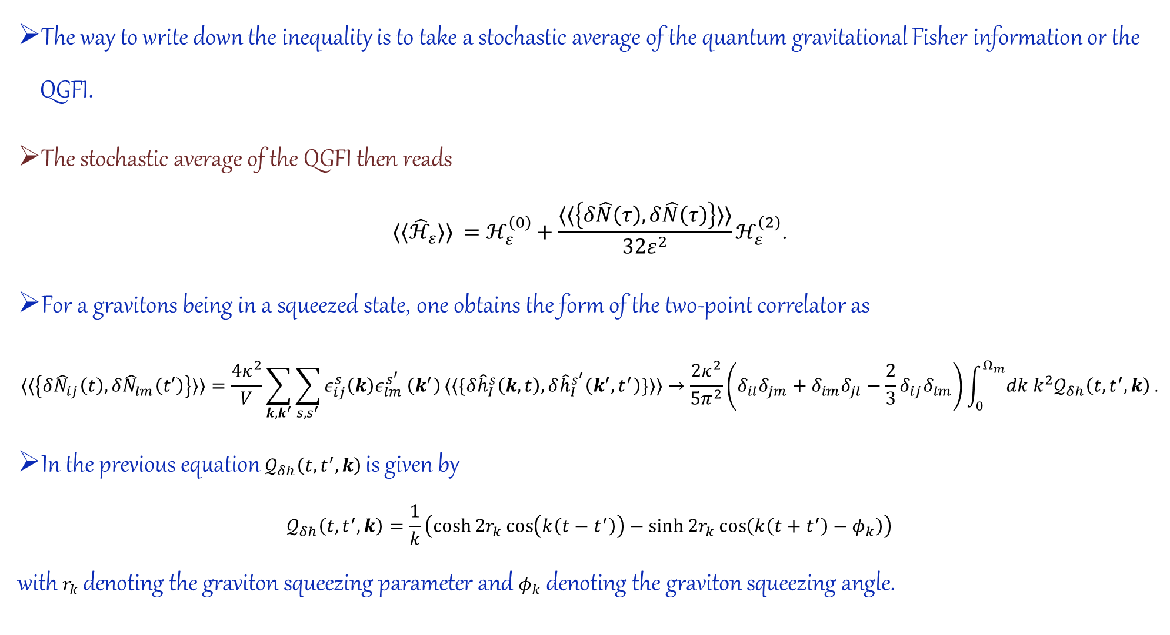
The way to write down the inequality is to take a stochastic average of the quantum gravitational Fisher information or the QGFI.
The stochastic average of the QGFI then reads
$$⟨⟨{\hat{ℋ}}_{ε}⟩⟩ =ℋ_{ε}^{\left(0\right)}+\frac{⟨⟨\left\{δ\hat{N}\left(τ\right),δ\hat{N}\left(τ\right)\right\}⟩⟩}{32ε^{2}}ℋ_{ε}^{\left(2\right)}\text{.}$$
For a gravitons being in a squeezed state, one obtains the form of the two-point correlator as
$$⟨⟨\left\{δ{\hat{N}}_{ij}\left(t\right),δ{\hat{N}}_{lm}\left(t′\right)\right\}⟩⟩=\frac{4κ^{2}}{V}\sum_{k,k^{′}}{\sum_{s,s^{′}}{ε_{ij}^{s}\left(k\right)ε_{lm}^{s^{′}}}\left(k^{′}\right)}⟨⟨\{δ{\hat{h}}_{I}^{s}\left(k,t\right),δ{\hat{h}}_{I}^{s^{′}}\left(k^{′},t^{′}\right)\}⟩⟩→\frac{2κ^{2}}{5π^{2}}\left(δ_{il}δ_{jm}+δ_{im}δ_{jl}−\frac{2}{3}δ_{ij}δ_{lm}\right)\int_{0}^{Ω_{m}}{dk k^{2}𝒬_{δh}\left(t,t^{′},k\right)}\text{.}$$
In the previous equation $𝒬_{δh}\left(t,t^{′},k\right)$ is given by
$$𝒬_{δh}\left(t,t^{′},k\right)=\frac{1}{k}\left(\cosh{2r_{k}}\cos\left(k\left(t−t^{′}\right)\right)−\sinh{2r_{k}}\cos\left(k\left(t+t^{′}\right)−φ_{k}\right)\right)$$
with $r_{k}$ denoting the graviton squeezing parameter and $φ_{k}$denoting the graviton squeezing angle.

Slide 27
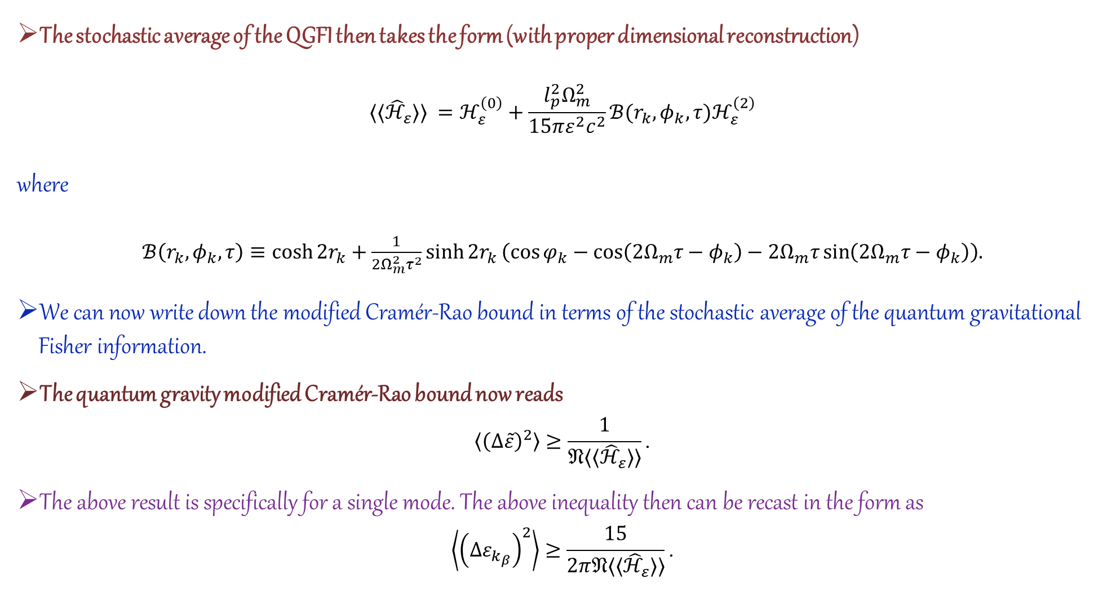
The stochastic average of the QGFI then takes the form (with proper dimensional reconstruction)
$$⟨⟨{\hat{ℋ}}_{ε}⟩⟩ =ℋ_{ε}^{\left(0\right)}+\frac{l_{p}^{2}Ω_{m}^{2}}{15πε^{2}c^{2}}ℬ(r_{k},φ_{k},τ)ℋ_{ε}^{\left(2\right)}$$
where
$ℬ\left(r_{k},φ_{k},τ\right)≡\cosh{2r_{k}}+\frac{1}{2Ω_{m}^{2}τ^{2}}\sinh{2r_{k}}\left(\cos{φ_{k}}−\cos\left(2Ω_{m}τ−φ_{k}\right)−2Ω_{m}τ\sin\left(2Ω_{m}τ−φ_{k}\right)\right).$
We can now write down the modified Cramér-Rao bound in terms of the stochastic average of the quantum gravitational Fisher information.
The quantum gravity modified Cramér-Rao bound now reads
$$\left\langle {\left(Δ\tilde{ε}\right)}^{2}\right\rangle ≥\frac{1}{𝔑⟨⟨{\hat{ℋ}}_{ε}⟩⟩}\text{.}$$
The above result is specifically for a single mode. The above inequality then can be recast in the form as
$$\left\langle {\left(Δε_{k_{β}}\right)}^{2}\right\rangle ≥\frac{15}{2π𝔑⟨⟨{\hat{ℋ}}_{ε}⟩⟩}\text{.}$$

Slide 28
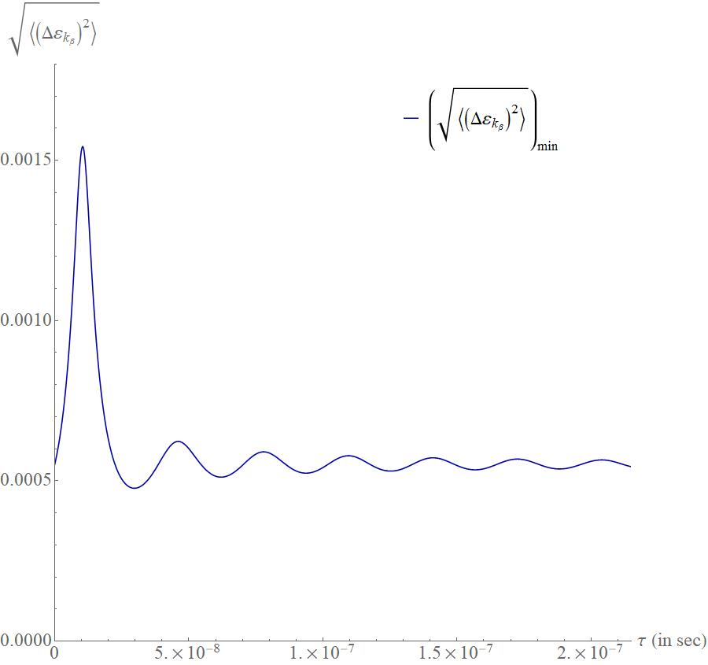


We start by plotting the minimum value of the standard deviation in the measured amplitude of gravitational wave with parameter values $r=0.82, φ=\frac{π}{2}, r_{k}=42, φ_{k}=\frac{π}{2}, Ω=100 Hz, and ω_{β}=50 Hz.$
Even if $τ→0$, we observe that
$$\lim_{τ→0}{⟨⟨{\hat{ℋ}}_{ε}⟩⟩}=\frac{l_{p}^{2}Ω_{m}^{2}}{15πε^{2}c^{2}}\cosh^{2}{2r}\left(\cosh{2r_{k}}−\sin{φ_{k}}\sinh{2r_{k}}\right).$$
Hence, although the contribution from the unperturbed part vanishes, the quantum gravitation contribution survives.

Slide 29
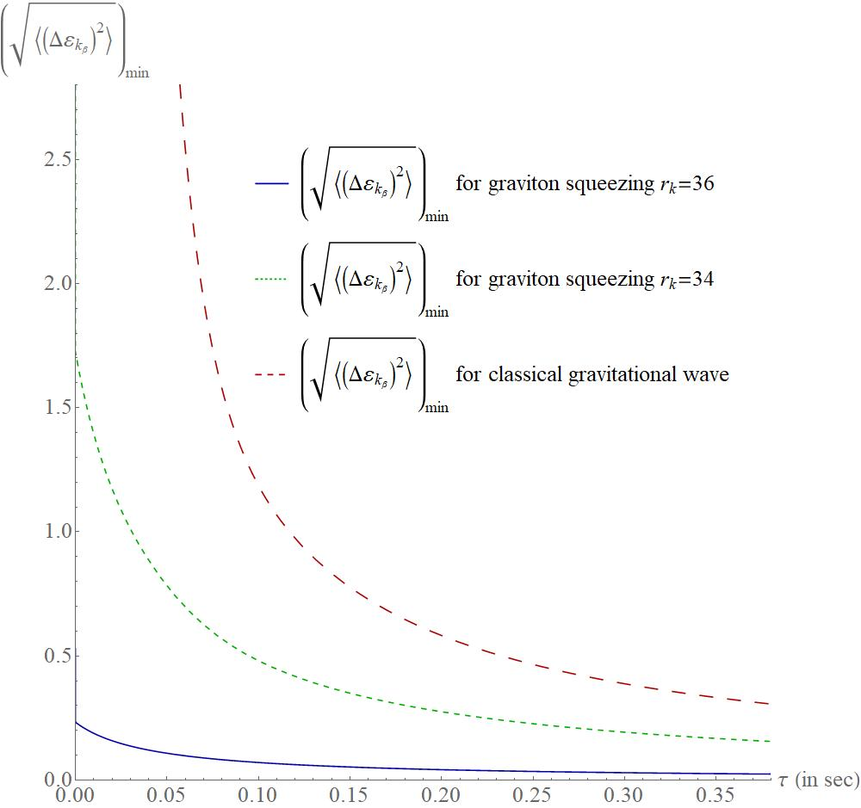
We shall now compare the results from the gravitation-induced scenario with the classical gravitational wave case. We observe that if the measurement time is very small a BEC can not detect an incoming classical gravitational wave.

Slide 30
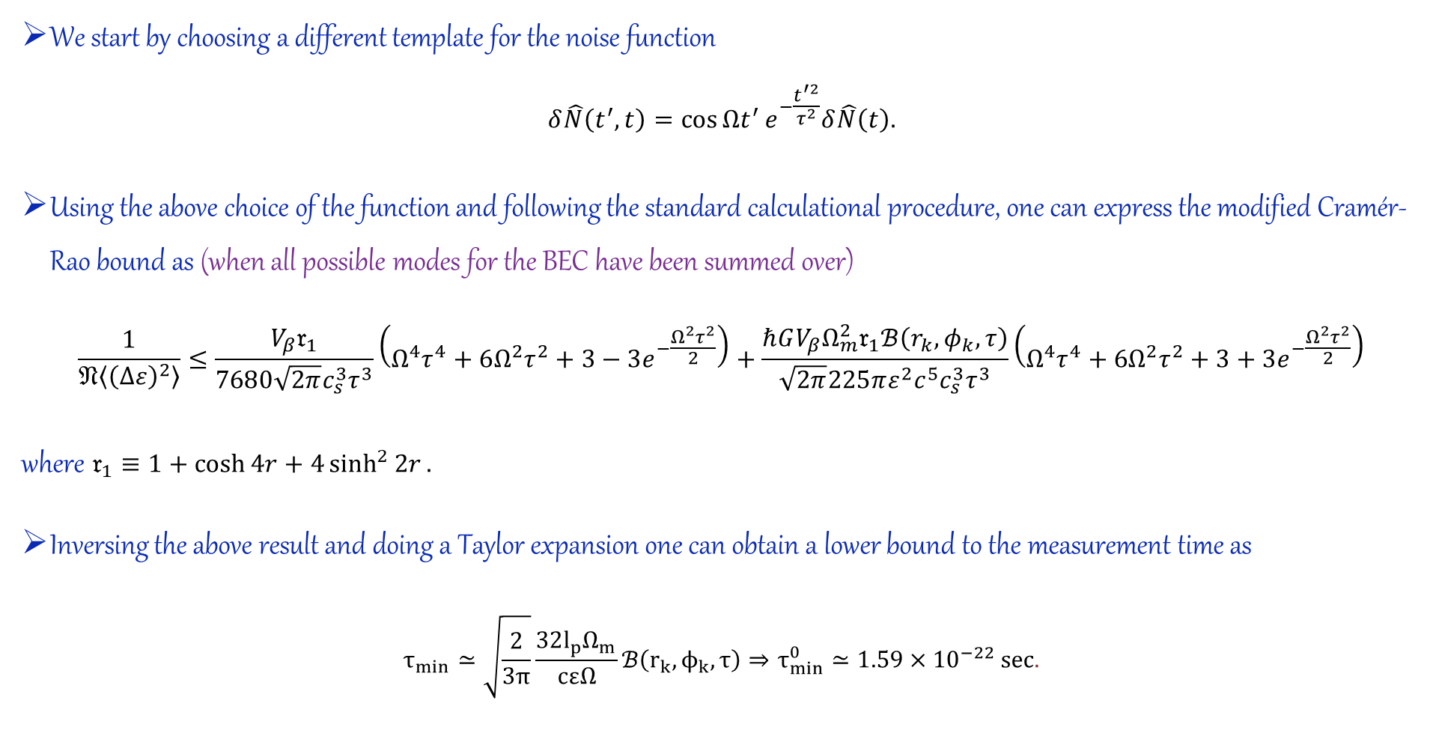
Bose-Einstein condensate as a graviton detector
We start by choosing a different template for the noise function
$$δ\hat{N}\left(t^{′},t\right)=\cos{Ωt^{′}}e^{−\frac{t^{′2}}{τ^{2}}}δ\hat{N}\left(t\right).$$
Using the above choice of the function and following the standard calculational procedure, one can express the modified Cramér-Rao bound as (when all possible modes for the BEC have been summed over)
$$\frac{1}{𝔑\left\langle {\left(Δε\right)}^{2}\right\rangle }≤\frac{V_{β}𝔯_{1}}{7680\sqrt{2π}c_{s}^{3}τ^{3}}\left(Ω^{4}τ^{4}+6Ω^{2}τ^{2}+3−3e^{−\frac{Ω^{2}τ^{2}}{2}}\right)+\frac{ℏGV_{β}Ω_{m}^{2}𝔯_{1}ℬ\left(r_{k},φ_{k},τ\right)}{\sqrt{2π}225πε^{2}c^{5}c_{s}^{3}τ^{3}}\left(Ω^{4}τ^{4}+6Ω^{2}τ^{2}+3+3e^{−\frac{Ω^{2}τ^{2}}{2}}\right)$$
where $𝔯_{1}≡1+\cosh{4r}+4\sinh^{2}{2r}.$
Inversing the above result and doing a Taylor expansion one can obtain a lower bound to the measurement time as
$$τ_{min}≃\sqrt{\frac{2}{3π}}\frac{32l_{p}Ω_{m}}{cεΩ}ℬ\left(r_{k},ϕ_{k},τ\right)⇒τ_{min}^{0}≃1.59×{10}^{−22} sec.$$

Slide 31
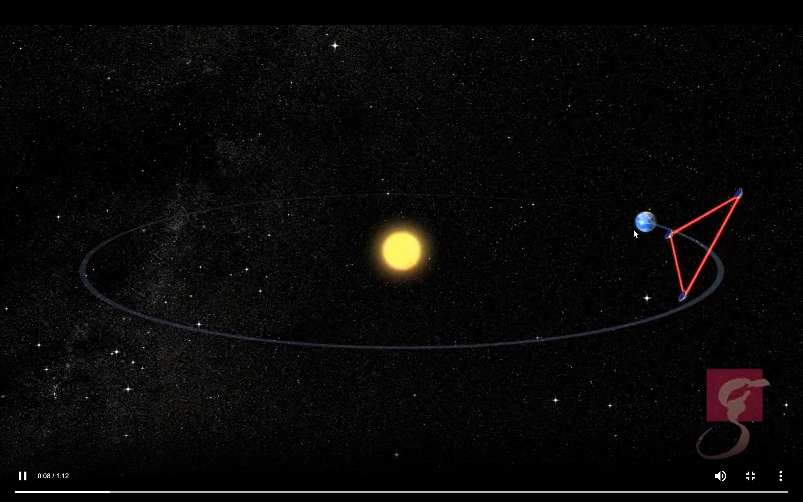
Bose-Einstein condensate as a graviton detector
The LISA or “Laser Interferometer Space Antenna” is a new proposed space-based gravitational wave observatory.
Here one can see the proposed trajectory of LISA (Credit: AEI/Milde marketing; Video taken from NASA-ESA LISA website)

Slide 32
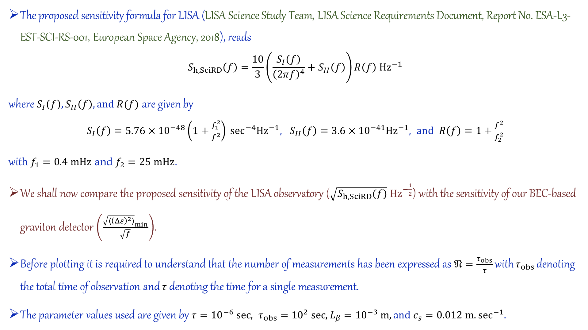
The proposed sensitivity formula for LISA (LISA Science Study Team, LISA Science Requirements Document, Report No. ESA-L3-EST-SCI-RS-001, European Space Agency, 2018), reads
$$S_{h,SciRD}\left(f\right)=\frac{10}{3}\left(\frac{S_{I}\left(f\right)}{{\left(2πf\right)}^{4}}+S_{II}\left(f\right)\right)R\left(f\right) {Hz}^{−1}$$
where $S_{I}\left(f\right), S_{II}\left(f\right), and R(f)$ are given by
$S_{I}\left(f\right)=5.76×{10}^{−48}\left(1+\frac{f_{1}^{2}}{f^{2}}\right) \sec^{−4}{Hz}^{−1}, S_{II}\left(f\right)=3.6×{10}^{−41}{Hz}^{−1}, and R\left(f\right)=1+\frac{f^{2}}{f_{2}^{2}}$
with $f_{1}=0.4 mHz$ and $f_{2}=25 mHz$.
We shall now compare the proposed sensitivity of the LISA observatory ($\sqrt{S_{h,SciRD}(f)} Hz^{−\frac{1}{2}}$) with the sensitivity of our BEC-based graviton detector $\left(\frac{{\sqrt{\left\langle {\left(Δε\right)}^{2}\right\rangle }}_{min}}{\sqrt{f}}\right)$.
Before plotting it is required to understand that the number of measurements has been expressed as $𝔑=\frac{τ_{obs}}{τ}$ with $τ_{obs}$ denoting the total time of observation and $τ$ denoting the time for a single measurement.
The parameter values used are given by $τ={10}^{−6} sec, τ_{obs}={10}^{2} sec, L_{β}={10}^{−3} m, and c_{s}=0.012 m.\sec^{−1}.$

Slide 33
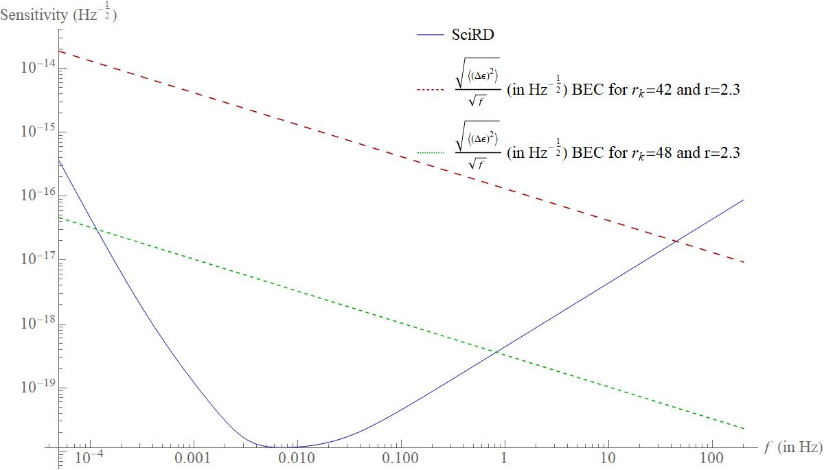
At first we plot the case of the proposed SciRD data with the BEC sensitivity formula for gravitons with different initial squeezing parameter.

Slide 34
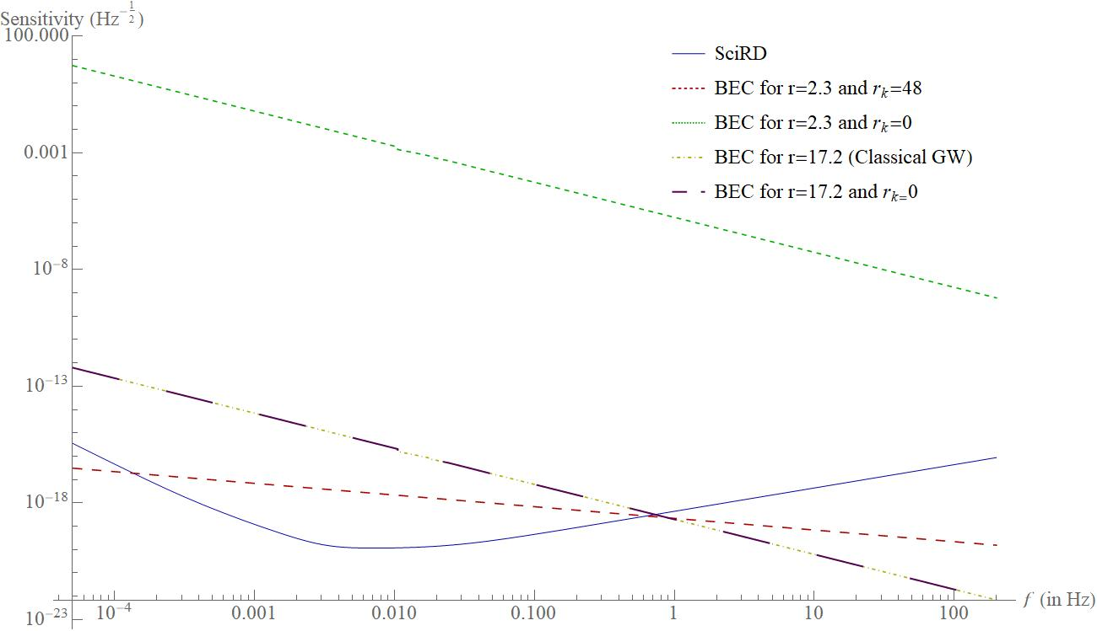
We now compare the case when the graviton has initial squeezing versus when the graviton has no inherent initial squeezing.

Slide 35
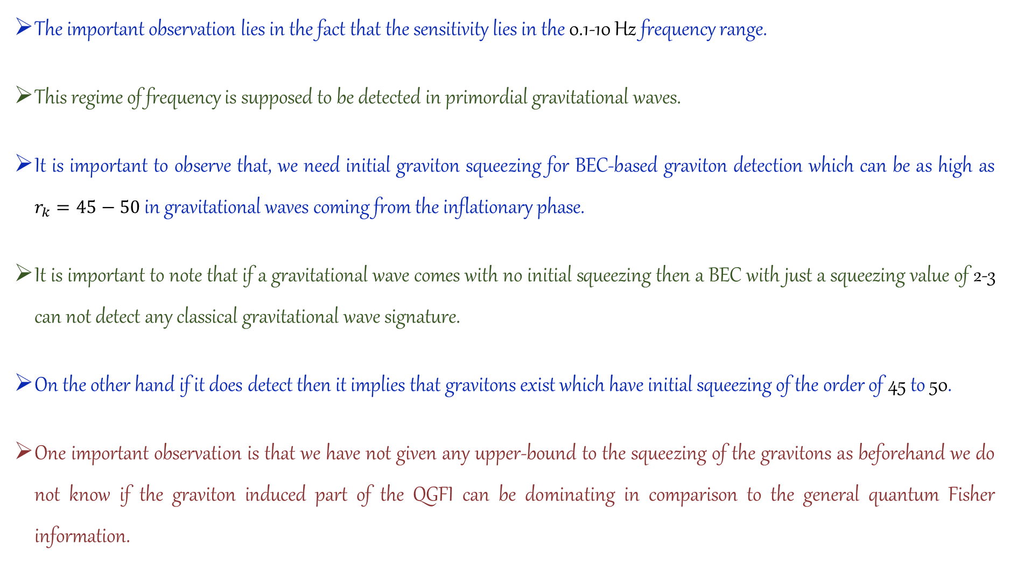
The important observation lies in the fact that the sensitivity lies in the 0.1-10 Hz frequency range.
This regime of frequency is supposed to be detected in primordial gravitational waves.
It is important to observe that, we need initial graviton squeezing for BEC-based graviton detection which can be as high as $r_{k}=45−50$ in gravitational waves coming from the inflationary phase.
It is important to note that if a gravitational wave comes with no initial squeezing then a BEC with just a squeezing value of 2-3 can not detect any classical gravitational wave signature.
On the other hand if it does detect then it implies that gravitons exist which have initial squeezing of the order of 45 to 50.
One important observation is that we have not given any upper-bound to the squeezing of the gravitons as beforehand we do not know if the graviton induced part of the QGFI can be dominating in comparison to the general quantum Fisher information.

Slide 36
Conclusion
We investigate the BEC-gravitational wave interaction model when the gravitational wave is quantized.
We observe that the time-dependent part of the pseudo-Goldstone bosons follows a Langevin-like stochastic differential equation of motion.
The Bogoliubov coefficients also become dependent on the noise operator which results in a covariance matrix of a BEC with each of the elements having an operator dependence.
The noise induced by gravitons on the BEC finally results in a modified quantum Fisher information which we term as the “quantum gravitational Fisher information” or QGFI.
Taking the expectation value of the QGFI one can write down a modified Cramér-Rao bound.

Slide 37
Conclusion
We observe that even for a very small single-measurement time, it is possible to detect graviton signatures in the BEC provided that the resonance condition is satisfied.
Finally using the proposed sensitivity formula for the upcoming LISA observatory we show that the BEC can be one of the best candidates for the indirect detection of gravitons in highly squeezed primordial gravitational waves.
We have then investigated the decoherence scenario for the BEC-graviton system where the time-dependent part of the Goldstone bosons are quantized. We observe that entanglement is generated between the BEC part of the system and the graviton part and it decays eventually with time as a result of the emission of Bremsstrahlung.
We also propose a new BEC based graviton detector that may be able to pick up signatures of gravitons in a matter of decades.

Slide 38
ওঁ
ঠাকুর মা
সত্য মঙ্গল প্রেমময় তুমি ধ্রুবজ্যোতি তুমি অন্ধকারে
Acknowledgement
I thank my supervisor Prof. Sunandan Gangopadhyay for his continuous support, granting of freedom of research, and his efforts.

Slide 39
Some important references on BEC and BEC based GW detectors
S. N. Bose, Plancks Gesetz und Lichtquantenhypothese, Z. Phys. 26 (1924) 178.
A. Einstein, Quantentheorie des einatomigen idealen Gases, Sitzungsber. Preuss. Akad. Wiss. Phys. Math. Kl. 10 (1924) 261.
M. P. G. Robbins, N. Affshordi, and R. B. Mann, Bose-Einstein condensates as gravitational wave detectors, J. Cosmo. Astropart. Phys. 07 (2019) 032.
M. Ahmadi, D. E. Bruschi, and I. Fuentes, Quantum metrology for relativistic quantum fields, Phys. Rev. D 89 (2014) 065028.
LISA Science Study Team, LISA Science Requirements Document, Report No. ESA-L3-EST-SCI-RS-001, European Space Agency, 2018.
S. Babak, M. Hewitson, and A. Petiteau, LISA sensitivity and SNR Calculations, Report No. LISA-LCST-SGS-TN001, arXiv:2108.01167[astro-ph.IM].

Slide 40
Some important references for BEC and BEC based GW detectors
S. T. Beliaev, Energy-spectrum of a non-ideal Bose gas, Sov. Phys. JETP 34 (1958) 299.
S Fagnocchi, S. Finazzi, S. Liberati, M. Kormos, and A. Trombettoni, Relativistic Bose–Einstein condensates: a new system for analogue models of gravity, New. J. Phys. 12 (2010) 095012.
M. Grether, M. de Llano, and G. A. Baker. Jr., Bose-Einstein Condensation in the Relativistic Ideal Bose Gas, Phys. Rev. Lett. 99 (2007) 200406.
K. B. Davis, M.-O. Mewes, M. R. Andrews, N. J. van Druten, D. S. Durfee, D. M. Kurn, and W. Ketterle, Bose-Einstein condensation in a gas of sodium atoms, Phys. Rev. Lett. 75, 3969 (1995).

Slide 41
References on which the presentation is based
S. Sen and S. Gangopadhyay, “Probing the quantum nature of gravity using a Bose-Einstein condensate”, Phys. Rev. D 110 (2024) 026014.
S. Sen and S. Gangopadhyay, “Quantum nature of gravity in a Bose-Einstein condensate”, arXiv:2410.05184 [hep-th].
S. Kanno, J. Soda, and J. Tokuda, Noise and decoherence induced by gravitons, Phys. Rev. D 103 (2021) 044017.
S. Kanno, J. Soda, and J. Tokuda, Indirect detection of gravitons through quantum entanglement, Phys. Rev. D 104 (2021) 083516.
M. Parikh, F. Wilczek, and G. Zahariade, Quantum mechanics of gravitational waves, Phys. Rev. Lett. 127 (2021) 081602.
M. Parikh, F. Wilczek, and G. Zahariade, Signatures of the quantization of gravity at gravitational wave detectors, Phys. Rev. D 104 (2021) 046021.
S. Sen and S. Gangopadhyay, “Minimal length scale corrections in the noise of gravitons”, Eur. Phys. J. C 83 (2023) 1044.
S. Sen and S. Gangopadhyay, “Uncertainty principle from the noise of gravitons”, Eur. Phys. J. C 84 (2024) 116.
Some important references on graviton induced noise

Slide 42
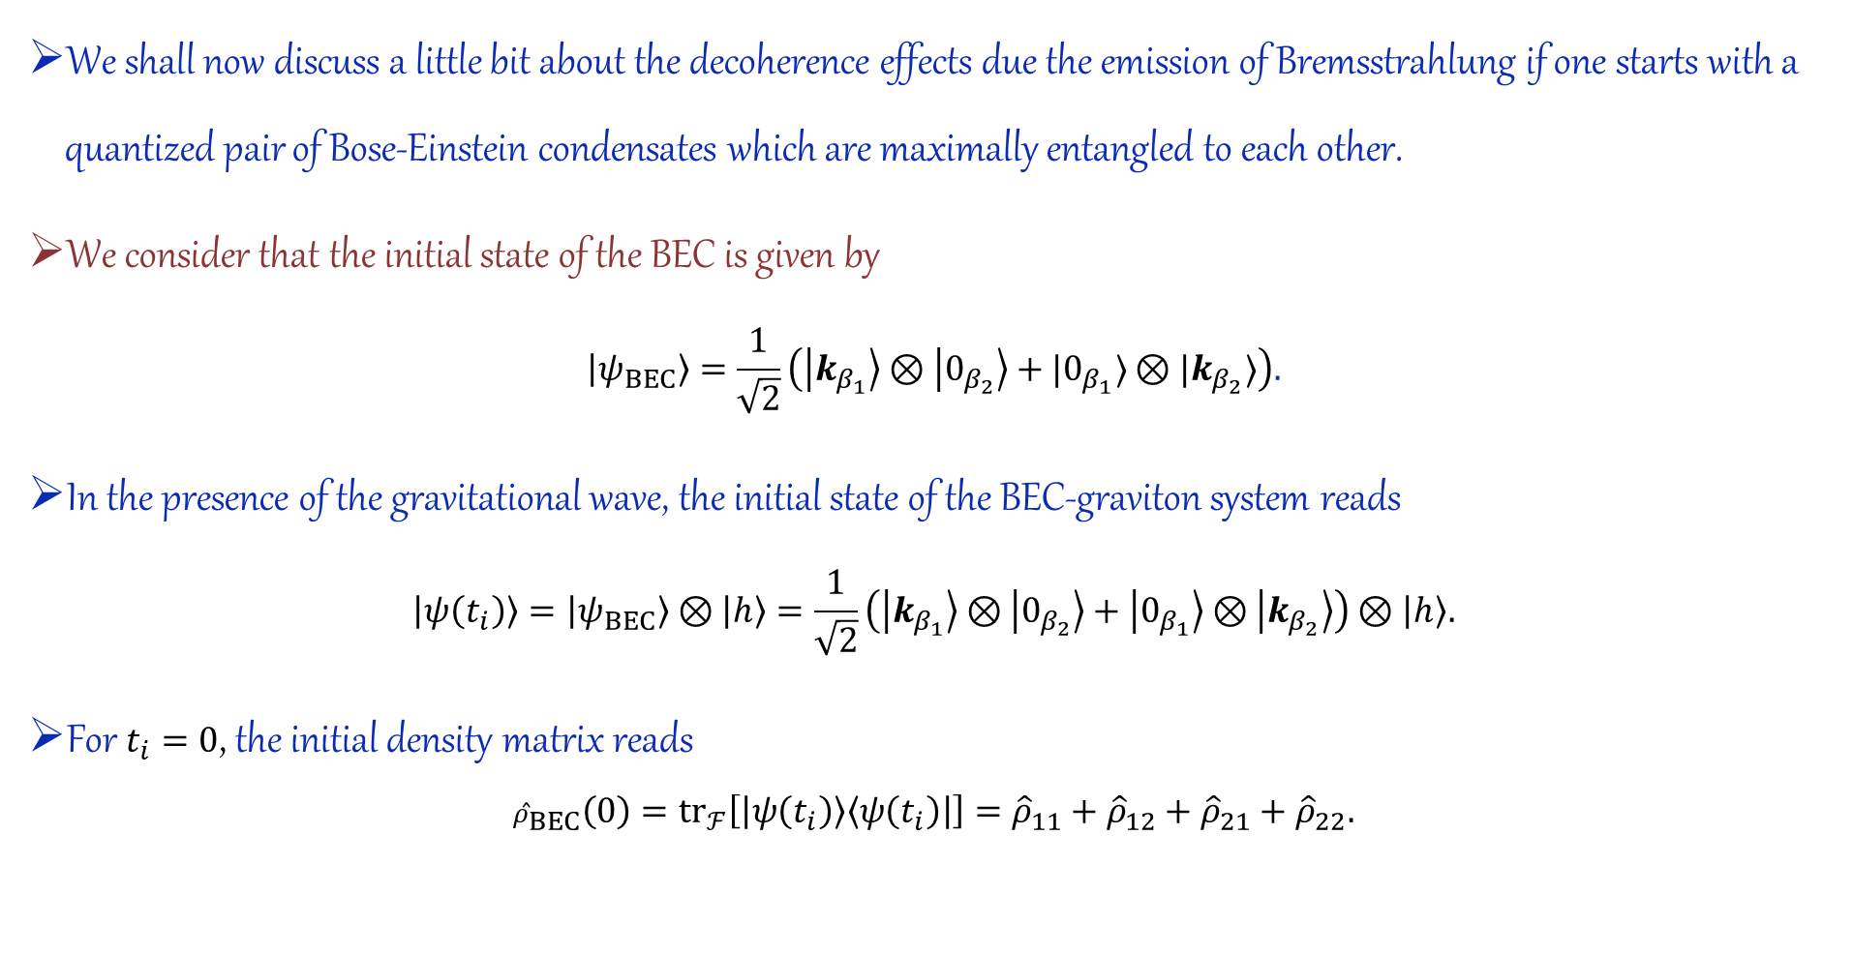
Part 2: Decoherence due to the emission of Bremsstrahlung
We shall now discuss a little bit about the decoherence effects due the emission of Bremsstrahlung if one starts with a quantized pair of Bose-Einstein condensates which are maximally entangled to each other.
We consider that the initial state of the BEC is given by
$$\left|ψ_{BEC}\right\rangle =\frac{1}{\sqrt{2}}\left(\left|k_{β_{1}}\right\rangle ⊗\left|0_{β_{2}}\right\rangle +|0_{β_{1}}⟩⊗|k_{β_{2}}⟩\right).$$
In the presence of the gravitational wave, the initial state of the BEC-graviton system reads
$$\left|ψ\left(t_{i}\right)\right\rangle =\left|ψ_{BEC}\right\rangle ⊗\left|h\right\rangle =\frac{1}{\sqrt{2}}\left(\left|k_{β_{1}}\right\rangle ⊗\left|0_{β_{2}}\right\rangle +\left|0_{β_{1}}\right\rangle ⊗\left|k_{β_{2}}\right\rangle \right)⊗\left|h\right\rangle .$$
For $t_{i}=0$, the initial density matrix reads
$${\hat{ρ}}_{BEC}\left(0\right)={tr}_{ℱ}\left[\left|ψ\left(t_{i}\right)\right\rangle \left\langle ψ\left(t_{i}\right)\right|\right]={\hat{ρ}}_{11}+{\hat{ρ}}_{12}+{\hat{ρ}}_{21}+{\hat{ρ}}_{22}.$$

Slide 43
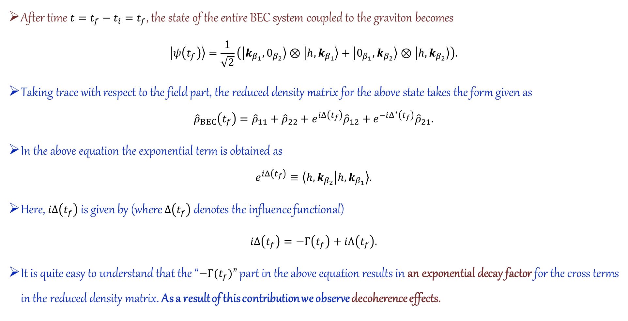
Part 2: Decoherence due to the emission of Bremsstrahlung
After time $t=t_{f}−t_{i}=t_{f}$, the state of the entire BEC system coupled to the graviton becomes
$$\left|ψ\left(t_{f}\right)\right\rangle =\frac{1}{\sqrt{2}}\left(\left|k_{β_{1}},0_{β_{2}}\right\rangle ⊗\left|h,k_{β_{1}}\right\rangle +\left|0_{β_{1}},k_{β_{2}}\right\rangle ⊗\left|h,k_{β_{2}}\right\rangle \right).$$
Taking trace with respect to the field part, the reduced density matrix for the above state takes the form given as
$${\hat{ρ}}_{BEC}\left(t_{f}\right)={\hat{ρ}}_{11}+{\hat{ρ}}_{22}+e^{iΔ\left(t_{f}\right)}{\hat{ρ}}_{12}+e^{−iΔ^{∗}\left(t_{f}\right)}{\hat{ρ}}_{21}.$$
In the above equation the exponential term is obtained as
$$e^{iΔ\left(t_{f}\right)}≡\left\langle h,k_{β_{2}} | h,k_{β_{1}}\right\rangle .$$
Here, $iΔ\left(t_{f}\right)$ is given by (where $Δ\left(t_{f}\right)$ denotes the influence functional)
$iΔ\left(t_{f}\right)=−Γ\left(t_{f}\right)+iΛ\left(t_{f}\right).$
It is quite easy to understand that the “$−Γ(t_{f})$” part in the above equation results in an exponential decay factor for the cross terms in the reduced density matrix. As a result of this contribution we observe decoherence effects.

Slide 44
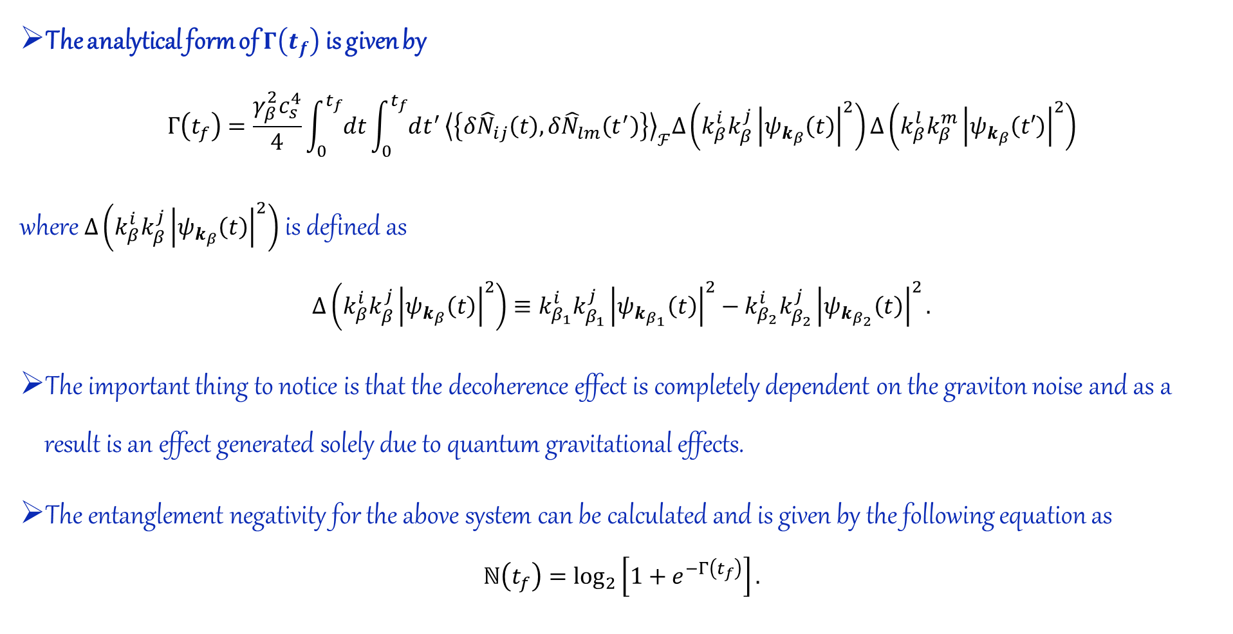
Part 2: Decoherence due to the emission of Bremsstrahlung
The analytical form of $Γ\left(t_{f}\right)$ is given by
$$Γ\left(t_{f}\right)=\frac{γ_{β}^{2}c_{s}^{4}}{4}\int_{0}^{t_{f}}{dt}\int_{0}^{t_{f}}{dt^{′}}{\left\langle \left\{δ{\hat{N}}_{ij}\left(t\right),δ{\hat{N}}_{lm}\left(t^{′}\right)\right\}\right\rangle }_{ℱ}Δ\left(k_{β}^{i}k_{β}^{j}{\left|ψ_{k_{β}}\left(t\right)\right|}^{2}\right)Δ\left(k_{β}^{l}k_{β}^{m}{\left|ψ_{k_{β}}\left(t′\right)\right|}^{2}\right)$$
where $Δ\left(k_{β}^{i}k_{β}^{j}{\left|ψ_{k_{β}}\left(t\right)\right|}^{2}\right)$ is defined as
$$Δ\left(k_{β}^{i}k_{β}^{j}{\left|ψ_{k_{β}}\left(t\right)\right|}^{2}\right)≡k_{β_{1}}^{i}k_{β_{1}}^{j}{\left|ψ_{k_{β_{1}}}\left(t\right)\right|}^{2}−k_{β_{2}}^{i}k_{β_{2}}^{j}{\left|ψ_{k_{β_{2}}}\left(t\right)\right|}^{2}.$$
The important thing to notice is that the decoherence effect is completely dependent on the graviton noise and as a result is an effect generated solely due to quantum gravitational effects.
The entanglement negativity for the above system can be calculated and is given by the following equation as
$$ℕ\left(t_{f}\right)=\log_{2}\left[1+e^{−Γ\left(t_{f}\right)}\right].$$

Slide 45
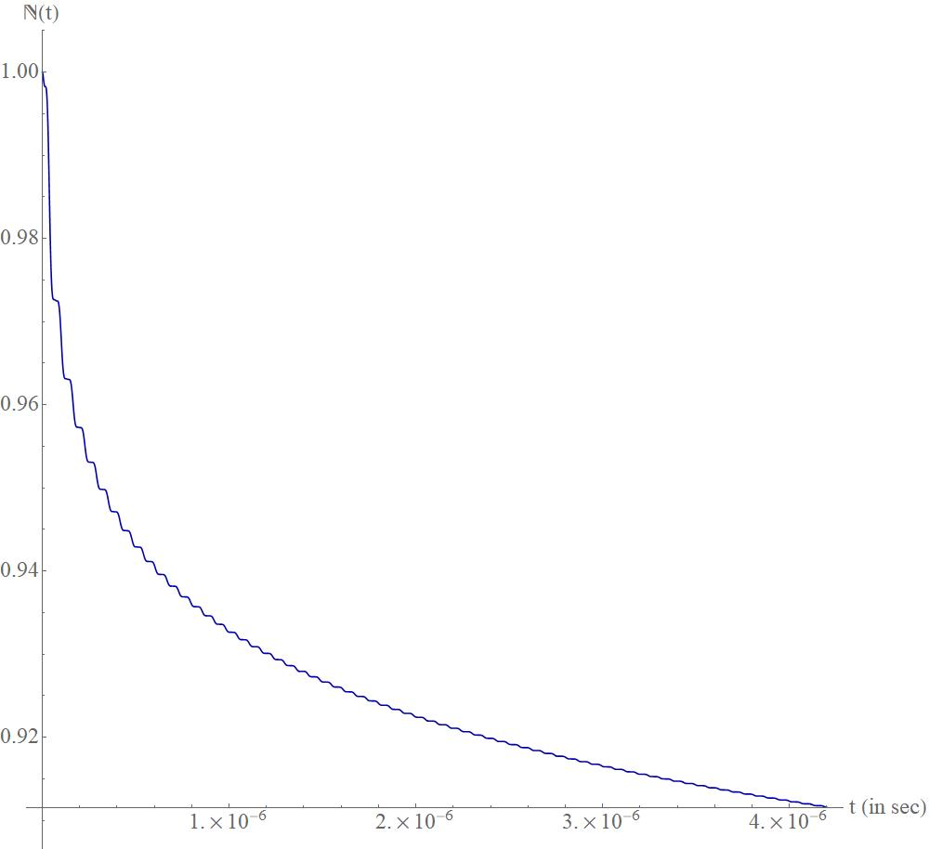

Part 2: Decoherence due to the emission of Bremsstrahlung
The logarithmic negativity of the system can be plotted against the final time of observation and one can observe a jittery decay pattern.
We observe that for a graviton with squeezing $r_{k}=42$, one observes a coherence loss of 10% after a time-interval of $2μS$.
With phonon squeezing $r_{ω}∼11.0$, one can observe a coherence loss of 10% after a time-interval of $2μS$, even for graviton squeezing as low as $r_{k}=20.0$.
In the next slide we shall show a schematic diagram for a BEC based graviton detector which uses atom interferometry for a graviton induced loss of coherence.

Slide 46
Schematic flow chart of an experimental model
Continuous generation of an ultra cold atom laser
Creation of a maximally entangled BEC state
Splitting the freely-falling atom-laser using a Raman beam splitter (RBS)
Splitting of the beam falling to the left using RBS
Splitting of the beam falling to the right using RBS
Making use of mirror pulses to create interference between the middle two beams
Decoding the interference pattern using a readout beam splitter
Creation of interference between the final two beams
Decoding the final interference pattern using a readout beam splitter

Slide 47
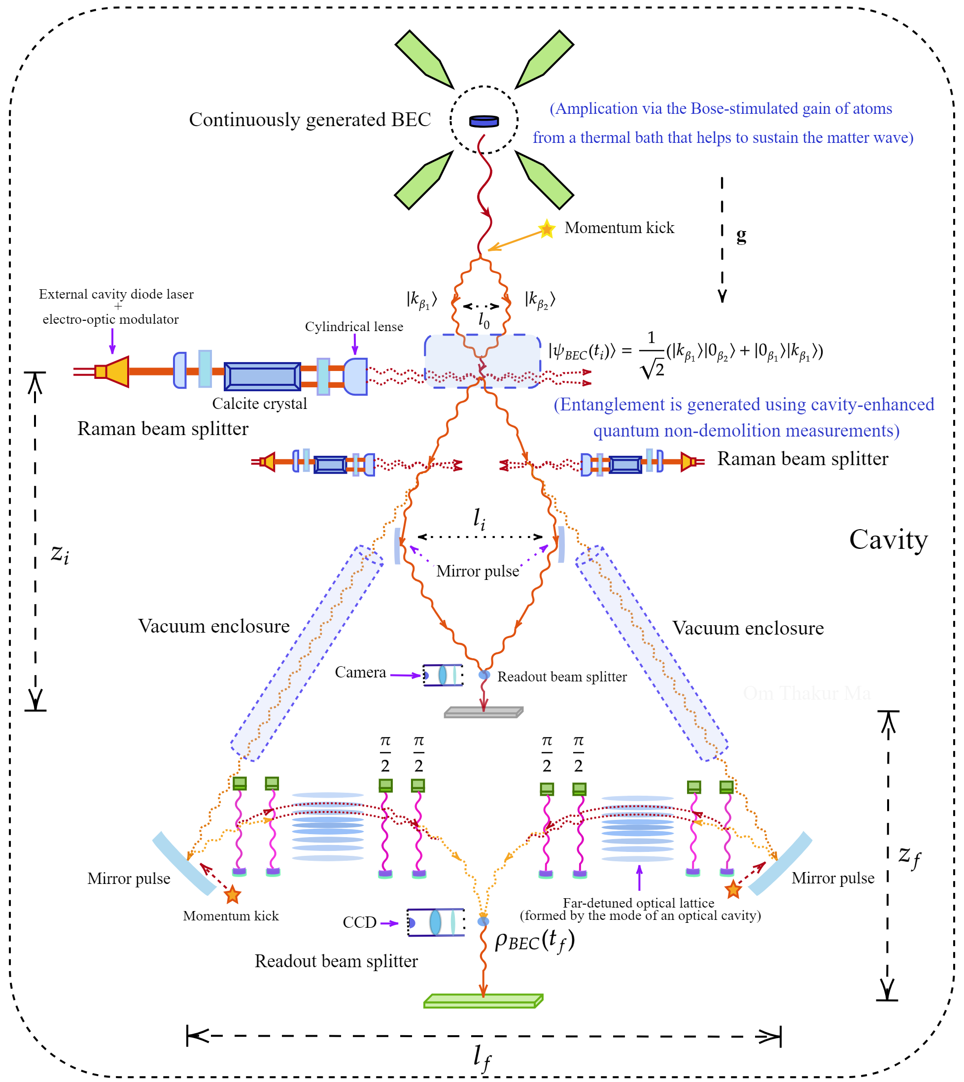
An experimental proposal!

Slide 48
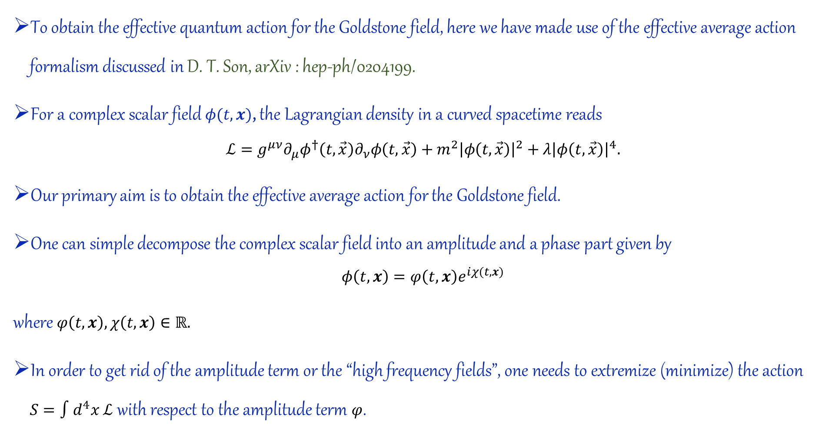
The relativistic BEC Lagrangian (Additional Slides)
To obtain the effective quantum action for the Goldstone field, here we have made use of the effective average action formalism discussed in D. T. Son, arXiv : hep-ph/0204199.
For a complex scalar field $φ(t,x)$, the Lagrangian density in a curved spacetime reads
$$ℒ=g^{μν}∂_{μ}φ^{†}\left(t,\vec{x}\right)∂_{ν}φ\left(t,\vec{x}\right)+m^{2}{\left|φ\left(t,\vec{x}\right)\right|}^{2}+λ{\left|φ\left(t,\vec{x}\right)\right|}^{4}.$$
Our primary aim is to obtain the effective average action for the Goldstone field.
One can simple decompose the complex scalar field into an amplitude and a phase part given by
$$φ\left(t,x\right)=φ\left(t,x\right)e^{iχ(t,x)}$$
where $φ\left(t,x\right),χ\left(t,x\right)∈ℝ.$
In order to get rid of the amplitude term or the “high frequency fields”, one needs to extremize (minimize) the action $S=∫d^{4}x ℒ$ with respect to the amplitude term $φ$.

Slide 49
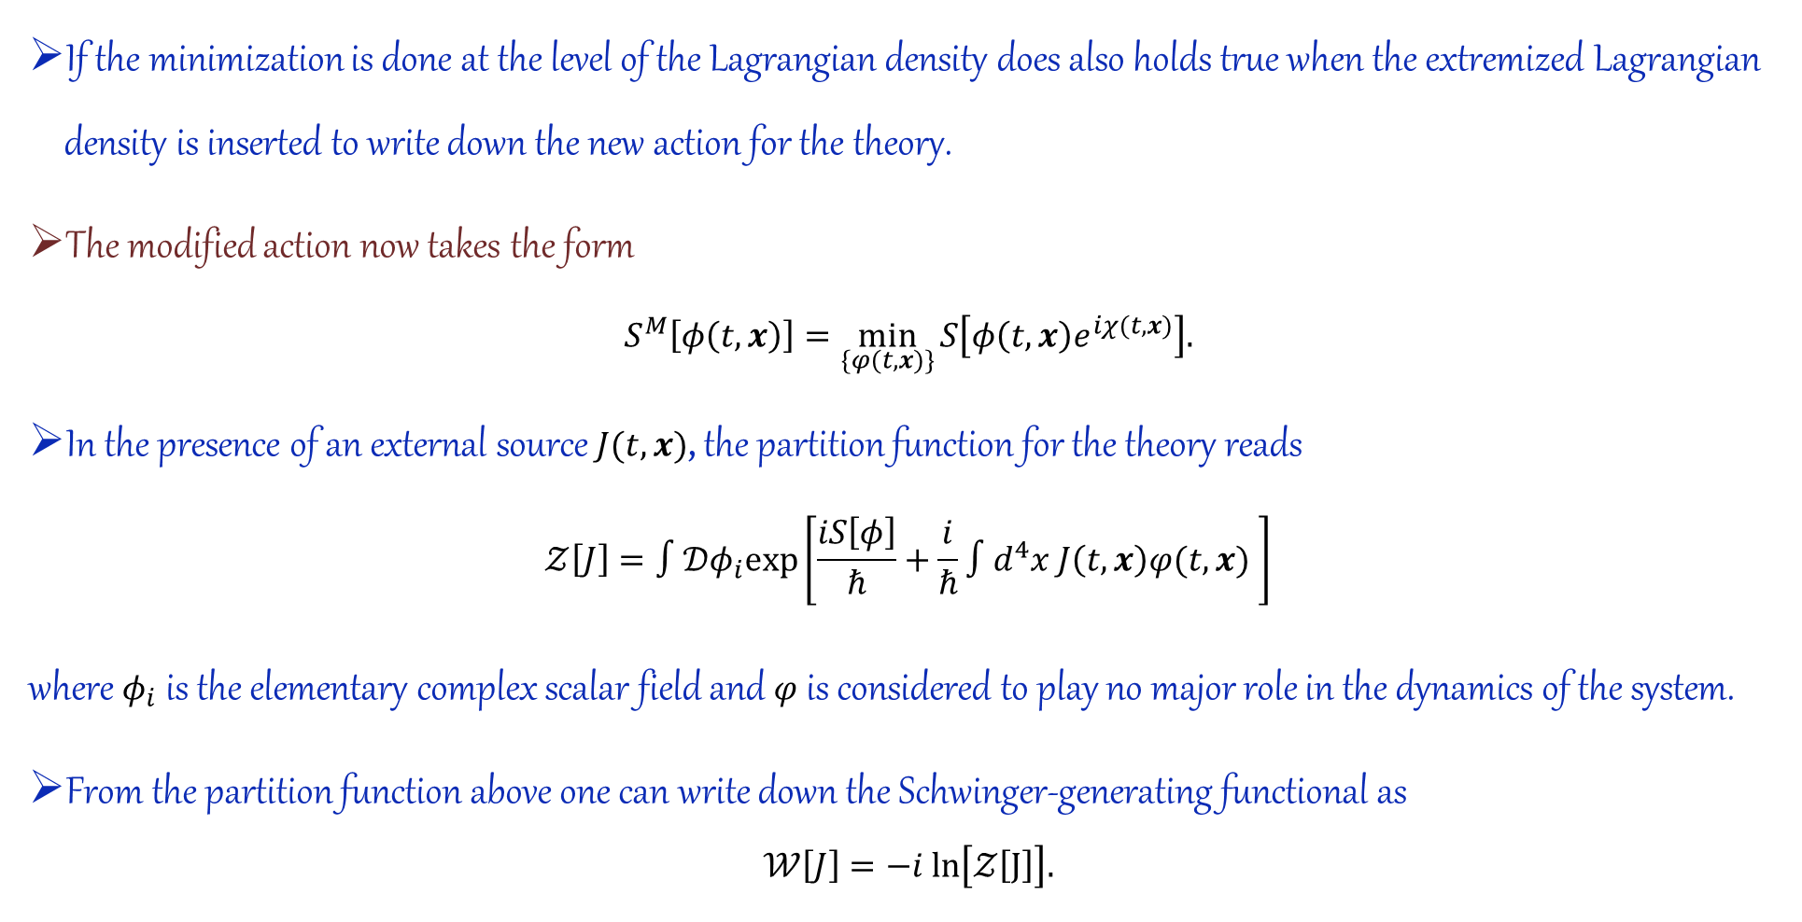
The relativistic BEC Lagrangian (Additional Slides)
If the minimization is done at the level of the Lagrangian density does also holds true when the extremized Lagrangian density is inserted to write down the new action for the theory.
The modified action now takes the form
$$S^{M}\left[φ\left(t,x\right)\right]=\min_{\{φ(t,x)\}}{S\left[φ\left(t,x\right)e^{iχ(t,x)}\right].}$$
In the presence of an external source $J(t,x)$, the partition function for the theory reads
$$𝒵\left[J\right]=∫𝒟φ_{i}exp\left[\frac{iS\left[φ\right]}{ℏ}+\frac{i}{ℏ}∫d^{4}x J\left(t,x\right)φ(t,x) \right]$$
where $φ_{i}$ is the elementary complex scalar field and $φ$ is considered to play no major role in the dynamics of the system.
From the partition function above one can write down the Schwinger-generating functional as
$$𝒲\left[J\right]=−i ln\left[𝒵\left[J\right]\right].$$

Slide 50
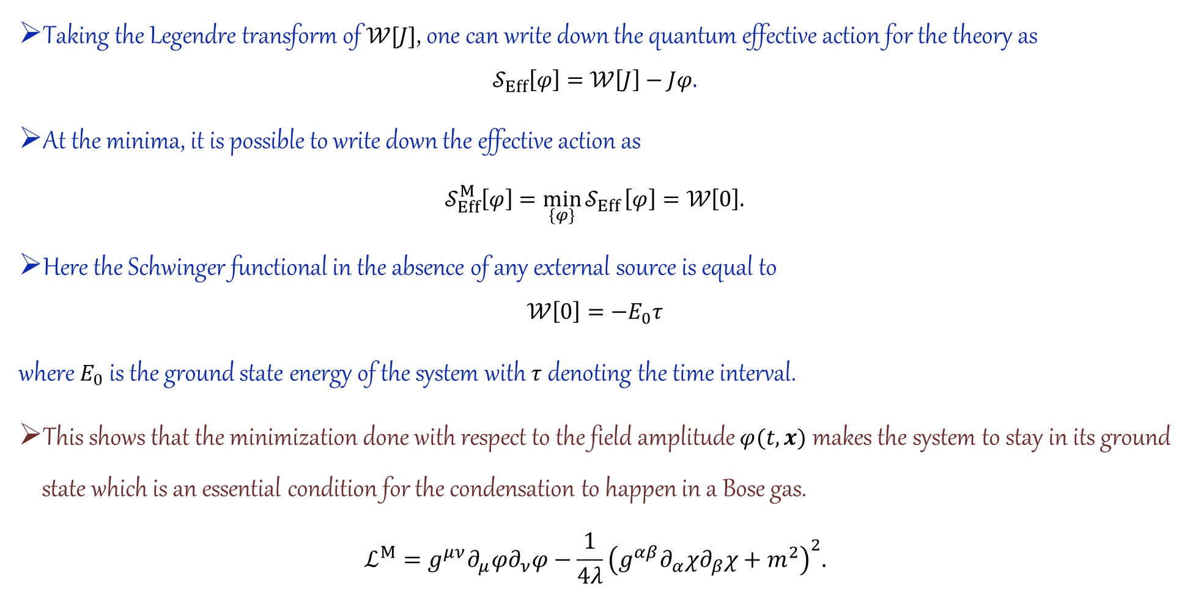
The relativistic BEC Lagrangian (Additional Slides)
Taking the Legendre transform of $𝒲[J]$, one can write down the quantum effective action for the theory as
$$𝒮_{Eff}\left[φ\right]=𝒲\left[J\right]−Jφ.$$
At the minima, it is possible to write down the effective action as
$$𝒮_{Eff}^{M}\left[φ\right]=\min_{\{φ\}}{𝒮_{Eff}}\left[φ\right]=𝒲\left[0\right].$$
Here the Schwinger functional in the absence of any external source is equal to
$$𝒲\left[0\right]=−E_{0}τ$$
where $E_{0}$ is the ground state energy of the system with $τ$ denoting the time interval.
This shows that the minimization done with respect to the field amplitude $φ(t,x)$ makes the system to stay in its ground state which is an essential condition for the condensation to happen in a Bose gas.
$$ℒ^{M}=g^{μν}∂_{μ}φ∂_{ν}φ−\frac{1}{4λ}{\left(g^{αβ}∂_{α}χ∂_{β}χ+m^{2}\right)}^{2}.$$

Slide 51
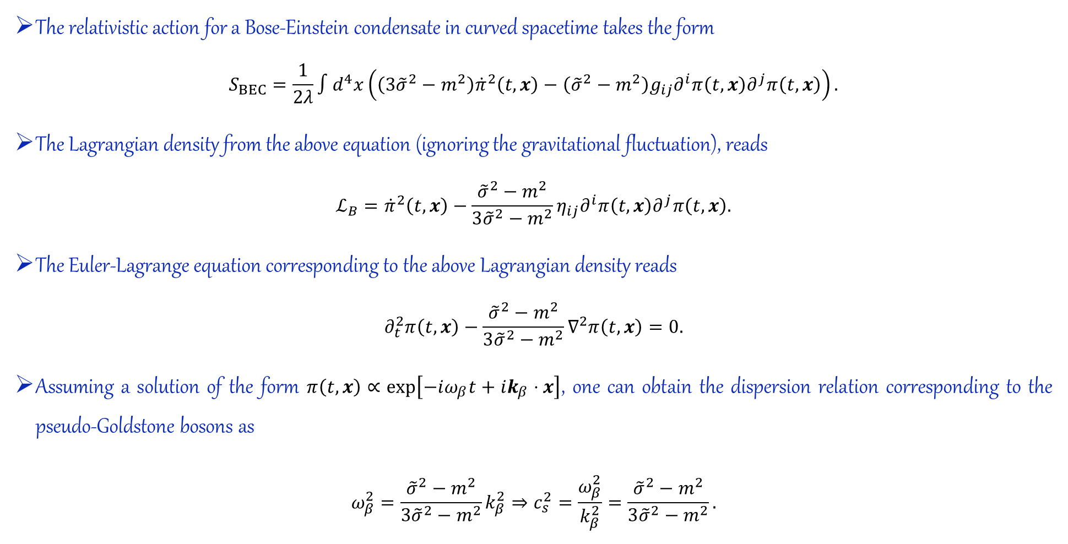
The relativistic dispersion relation (Additional Slides)
The relativistic action for a Bose-Einstein condensate in curved spacetime takes the form
$$S_{BEC}=\frac{1}{2λ}∫d^{4}x\left(\left(3{\tilde{σ}}^{2}−m^{2}\right){\dot{π}}^{2}\left(t,x\right)−\left({\tilde{σ}}^{2}−m^{2}\right)g_{ij}∂^{i}π\left(t,x\right)∂^{j}π\left(t,x\right)\right).$$
The Lagrangian density from the above equation (ignoring the gravitational fluctuation), reads
$$ℒ_{B}={\dot{π}}^{2}\left(t,x\right)−\frac{{\tilde{σ}}^{2}−m^{2}}{3{\tilde{σ}}^{2}−m^{2}}η_{ij}∂^{i}π\left(t,x\right)∂^{j}π\left(t,x\right).$$
The Euler-Lagrange equation corresponding to the above Lagrangian density reads
$$∂_{t}^{2}π\left(t,x\right)−\frac{{\tilde{σ}}^{2}−m^{2}}{3{\tilde{σ}}^{2}−m^{2}}∇^{2}π\left(t,x\right)=0.$$
Assuming a solution of the form $π\left(t,x\right)∝exp\left[−iω_{β}t+ik_{β}⋅x\right]$, one can obtain the dispersion relation corresponding to the pseudo-Goldstone bosons as
$$ω_{β}^{2}=\frac{{\tilde{σ}}^{2}−m^{2}}{3{\tilde{σ}}^{2}−m^{2}}k_{β}^{2}⇒c_{s}^{2}=\frac{ω_{β}^{2}}{k_{β}^{2}}=\frac{{\tilde{σ}}^{2}−m^{2}}{3{\tilde{σ}}^{2}−m^{2}}.$$

Slide 52
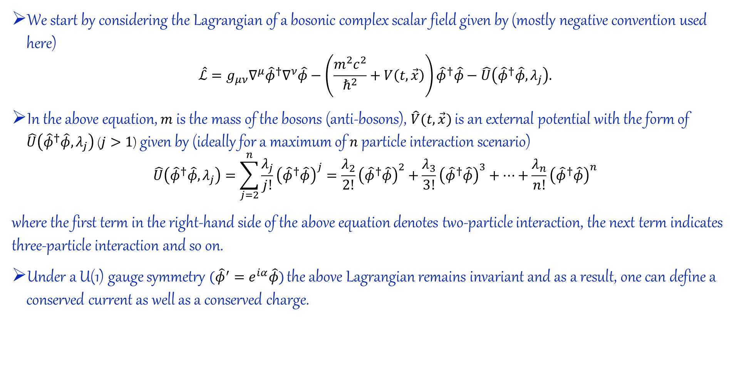
Obtaining the critical temperature for the BEC (Additional slides)
We start by considering the Lagrangian of a bosonic complex scalar field given by (mostly negative convention used here)
$$\hat{ℒ}=g_{μν}∇^{μ}{\hat{φ}}^{†}∇^{ν}\hat{φ}−\left(\frac{m^{2}c^{2}}{ℏ^{2}}+V\left(t,\vec{x}\right)\right){\hat{φ}}^{†}\hat{φ}−\hat{U}\left({\hat{φ}}^{†}\hat{φ},λ_{j}\right).$$
In the above equation, $m$ is the mass of the bosons (anti-bosons), $\hat{V}(t,\vec{x})$ is an external potential with the form of $\hat{U}\left({\hat{φ}}^{†}\hat{φ},λ_{j}\right)$ ($j>1$) given by (ideally for a maximum of $n$ particle interaction scenario)
$$\hat{U}\left({\hat{φ}}^{†}\hat{φ},λ_{j}\right)=\sum_{j=2}^{n}{\frac{λ_{j}}{j!}{\left({\hat{φ}}^{†}\hat{φ}\right)}^{j}}=\frac{λ_{2}}{2!}{\left({\hat{φ}}^{†}\hat{φ}\right)}^{2}+\frac{λ_{3}}{3!}{\left({\hat{φ}}^{†}\hat{φ}\right)}^{3}+⋯+\frac{λ_{n}}{n!}{\left({\hat{φ}}^{†}\hat{φ}\right)}^{n}$$
where the first term in the right-hand side of the above equation denotes two-particle interaction, the next term indicates three-particle interaction and so on.
Under a U(1) gauge symmetry $({\hat{φ}}^{′}=e^{iα}\hat{φ})$ the above Lagrangian remains invariant and as a result, one can define a conserved current as well as a conserved charge.

Slide 53
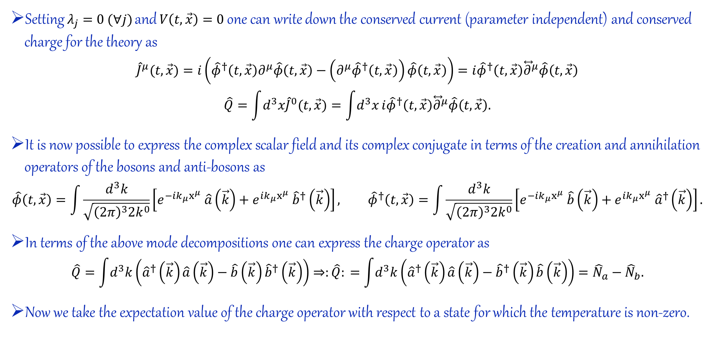
Obtaining the critical temperature for the BEC (Additional slides)
Setting $λ_{j}=0 (∀j)$ and $V\left(t,\vec{x}\right)=0$ one can write down the conserved current (parameter independent) and conserved charge for the theory as
$${\hat{J}}^{μ}(t,\vec{x})=i\left({\hat{φ}}^{†}\left(t,\vec{x}\right)∂^{μ}\hat{φ}\left(t,\vec{x}\right)−\left(∂^{μ}{\hat{φ}}^{†}\left(t,\vec{x}\right)\right)\hat{φ}\left(t,\vec{x}\right)\right)=i{\hat{φ}}^{†}\left(t,\vec{x}\right){\overset{⃡}{∂}}^{μ}\hat{φ}\left(t,\vec{x}\right)$$
$$\hat{Q}=\int{d^{3}x{\hat{J}}^{0}(t,\vec{x})}=\int{d^{3}x}i{\hat{φ}}^{†}\left(t,\vec{x}\right){\overset{⃡}{∂}}^{μ}\hat{φ}\left(t,\vec{x}\right).$$
It is now possible to express the complex scalar field and its complex conjugate in terms of the creation and annihilation operators of the bosons and anti-bosons as
$$\hat{φ}\left(t,\vec{x}\right)=\int{\frac{d^{3}k}{\sqrt{{\left(2π\right)}^{3}2k^{0}}}\left[e^{−ik_{μ}x^{μ}} \hat{a}\left(\vec{k}\right)+e^{ik_{μ}x^{μ}} {\hat{b}}^{†}\left(\vec{k}\right)\right]}, {\hat{φ}}^{†}\left(t,\vec{x}\right)=\int{\frac{d^{3}k}{\sqrt{{\left(2π\right)}^{3}2k^{0}}}\left[e^{−ik_{μ}x^{μ}} \hat{b}\left(\vec{k}\right)+e^{ik_{μ}x^{μ}} {\hat{a}}^{†}\left(\vec{k}\right)\right]}.$$
In terms of the above mode decompositions one can express the charge operator as
$$\hat{Q}=\int{d^{3}k}\left({\hat{a}}^{†}\left(\vec{k}\right)\hat{a}\left(\vec{k}\right)−\hat{b}\left(\vec{k}\right){\hat{b}}^{†}\left(\vec{k}\right)\right)⇒:\hat{Q}: =\int{d^{3}k}\left({\hat{a}}^{†}\left(\vec{k}\right)\hat{a}\left(\vec{k}\right)−{\hat{b}}^{†}\left(\vec{k}\right)\hat{b}\left(\vec{k}\right)\right)={\hat{N}}_{a}−{\hat{N}}_{b}.$$
Now we take the expectation value of the charge operator with respect to a state for which the temperature is non-zero.

Slide 54
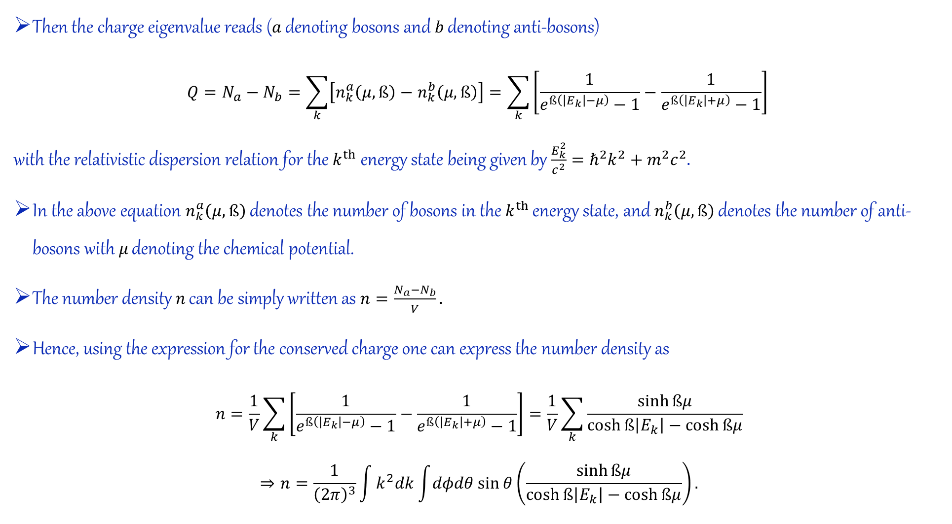
Then the charge eigenvalue reads ($a$ denoting bosons and $b$ denoting anti-bosons)
$$Q=N_{a}−N_{b}=\sum_{k}{\left[n_{k}^{a}\left(μ,ß\right)−n_{k}^{b}\left(μ,ß\right)\right]}=\sum_{k}{\left[\frac{1}{e^{ß\left(\left|E_{k}\right|−μ\right)}−1}−\frac{1}{e^{ß\left(\left|E_{k}\right|+μ\right)}−1}\right]}$$
with the relativistic dispersion relation for the $k^{th}$energy state being given by $\frac{E_{k}^{2}}{c^{2}}=ℏ^{2}k^{2}+m^{2}c^{2}.$
In the above equation $n_{k}^{a}\left(μ,ß\right)$ denotes the number of bosons in the $k^{th}$ energy state, and $n_{k}^{b}\left(μ,ß\right)$ denotes the number of anti-bosons with $μ$ denoting the chemical potential.
The number density $n$ can be simply written as $n=\frac{N_{a}−N_{b}}{V}.$
Hence, using the expression for the conserved charge one can express the number density as
$$n=\frac{1}{V}\sum_{k}{\left[\frac{1}{e^{ß\left(\left|E_{k}\right|−μ\right)}−1}−\frac{1}{e^{ß\left(\left|E_{k}\right|+μ\right)}−1}\right]}=\frac{1}{V}\sum_{k}{\frac{\sinh{ßμ}}{\cosh{ß\left|E_{k}\right|}−\cosh{ßμ}}}$$
$$⇒n=\frac{1}{{\left(2π\right)}^{3}}\int{k^{2}dk\int{dφdθ\sin{θ}}}\left(\frac{\sinh{ßμ}}{\cosh{ß\left|E_{k}\right|}−\cosh{ßμ}}\right).$$

Slide 55
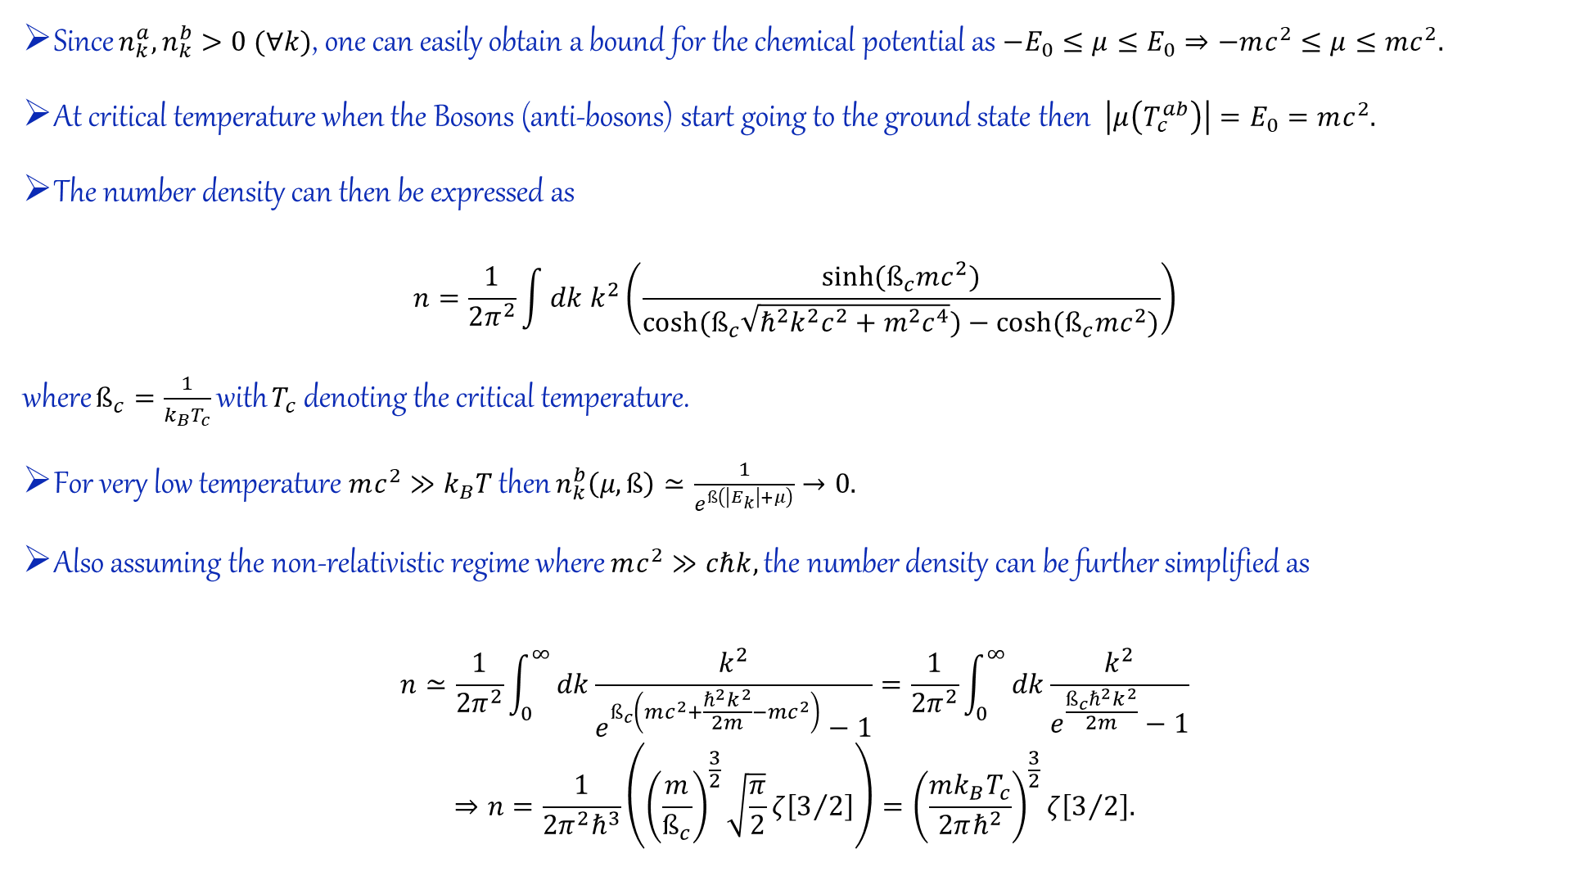
Since $n_{k}^{a},n_{k}^{b}>0 (∀k)$, one can easily obtain a bound for the chemical potential as $−E_{0}≤μ≤E_{0}⇒−mc^{2}≤μ≤mc^{2}.$
At critical temperature when the Bosons (anti-bosons) start going to the ground state then $\left|μ\left(T_{c}^{ab}\right)\right|=E_{0}=mc^{2}.$
The number density can then be expressed as
$$n=\frac{1}{2π^{2}}\int{dk k^{2}\left(\frac{\sinh{(ß_{c}mc^{2})}}{\cosh{(ß_{c}\sqrt{ℏ^{2}k^{2}c^{2}+m^{2}c^{4}})}−\cosh{(ß_{c}mc^{2})}}\right)}$$
where $ß_{c}=\frac{1}{k_{B}T_{c}}$ with $T_{c}$ denoting the critical temperature.
For very low temperature $mc^{2}≫k_{B}T$ then $n_{k}^{b}\left(μ,ß\right)≃\frac{1}{e^{ß\left(\left|E_{k}\right|+μ\right)}}→0.$
Also assuming the non-relativistic regime where $mc^{2}≫cℏk,$ the number density can be further simplified as
$$n≃\frac{1}{2π^{2}}\int_{0}^{∞}{dk\frac{k^{2}}{e^{ß_{c}\left(mc^{2}+\frac{ℏ^{2}k^{2}}{2m}−mc^{2}\right)}−1}}=\frac{1}{2π^{2}}\int_{0}^{∞}{dk\frac{k^{2}}{e^{\frac{ß_{c}ℏ^{2}k^{2}}{2m}}−1}}$$
$$⇒n=\frac{1}{2π^{2}ℏ^{3}}\left({\left(\frac{m}{ß_{c}}\right)}^{\frac{3}{2}}\sqrt{\frac{π}{2}}ζ\left[3/2\right]\right)={\left(\frac{mk_{B}T_{c}}{2πℏ^{2}}\right)}^{\frac{3}{2}}ζ\left[3/2\right].$$

Slide 56
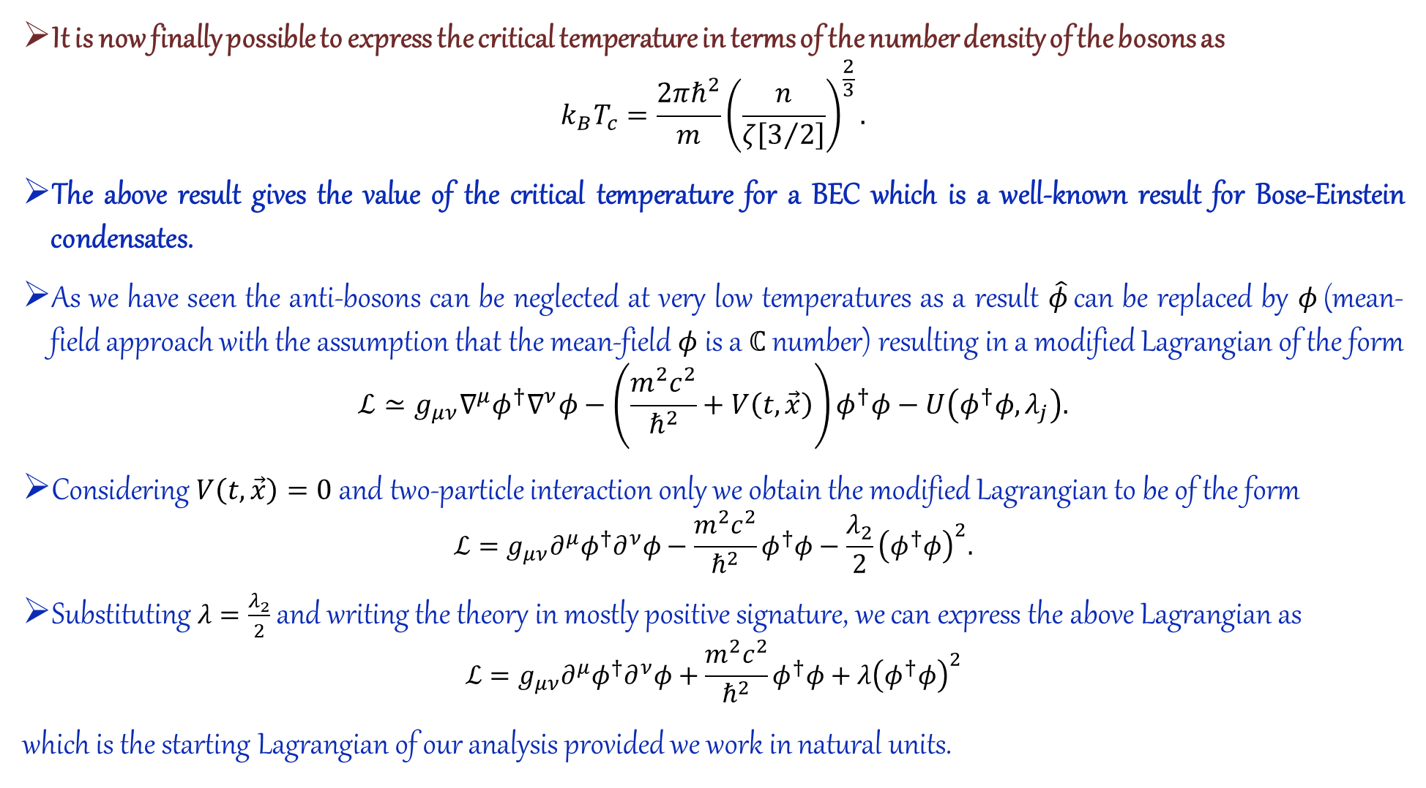
It is now finally possible to express the critical temperature in terms of the number density of the bosons as
$$k_{B}T_{c}=\frac{2πℏ^{2}}{m}{\left(\frac{n}{ζ\left[3/2\right]}\right)}^{\frac{2}{3}}.$$
The above result gives the value of the critical temperature for a BEC which is a well-known result for Bose-Einstein condensates.
As we have seen the anti-bosons can be neglected at very low temperatures as a result $\hat{φ}$ can be replaced by $φ$ (mean-field approach with the assumption that the mean-field $φ$ is a $ℂ$ number) resulting in a modified Lagrangian of the form
$$ℒ≃g_{μν}∇^{μ}φ^{†}∇^{ν}φ−\left(\frac{m^{2}c^{2}}{ℏ^{2}}+V\left(t,\vec{x}\right)\right)φ^{†}φ−U\left(φ^{†}φ,λ_{j}\right).$$
Considering $V\left(t,\vec{x}\right)=0$ and two-particle interaction only we obtain the modified Lagrangian to be of the form
$$ℒ=g_{μν}∂^{μ}φ^{†}∂^{ν}φ−\frac{m^{2}c^{2}}{ℏ^{2}}φ^{†}φ−\frac{λ_{2}}{2}{\left(φ^{†}φ\right)}^{2}.$$
Substituting $λ=\frac{λ_{2}}{2}$ and writing the theory in mostly positive signature, we can express the above Lagrangian as
$$ℒ=g_{μν}∂^{μ}φ^{†}∂^{ν}φ+\frac{m^{2}c^{2}}{ℏ^{2}}φ^{†}φ+λ{\left(φ^{†}φ\right)}^{2}$$
which is the starting Lagrangian of our analysis provided we work in natural units.

Slide 57
Thank you
Om
Thakur Ma

