Slide 1
The granularity of emergent gravity:
case study of 2D string theory
Gautam Mandal, TIFR
“Black Hole Information in Holography and String Theory”
IISc, Bangalore, 9 February, 2025
w/ Ajay Mohan https://arxiv.org/abs/2406.07629 (JHEP 2025)
w/ Adwait Gaikwad, Ajay Mohan (in progress)
w/ Nemani Suryanarayana (in progress)
w/ Rushikesh Suroshe, Sanjaye Ramgoolam (in progress)
Earlier: with
Avinash Dhar, Anirvan Sengupta, Nemani Suryanarayana, Spenta Wadia.

Slide 2
1. Motivation
It has now been over 3 decades of holography:
c=1 matrix model <-> 2D string theory (1990)
BFSS matrix theory <-> M theory (1996)
N=4 super Yang Mills <-> AdS(5) string theory (1997)
….
Good time to ask what we have learned about emergent gravity
A difficult conceptual issue about general relativity (including higher curvature corrections) has been that of infinities:
      (a) Singularity of classical solutions
      (b) Divergence in the quantum theory
“To handle (a,b) a different description must be used at short distances.” We find for 2D string theory that the description, emerging from c=1 matrix model, is in terms of a granular geometry.

Slide 3





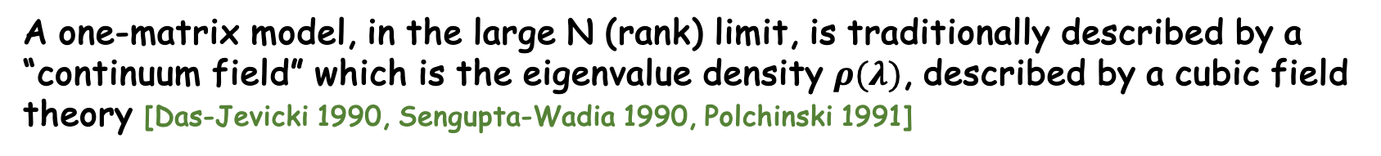

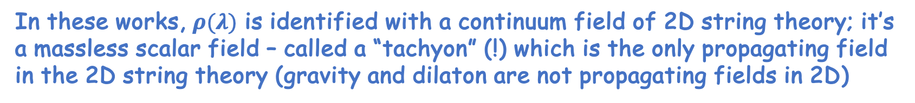
In more detail:
A one-matrix model, in the large N (rank) limit, is traditionally described by a “continuum field” which is the eigenvalue density $ρ(λ)$, described by a cubic field theory [Das-Jevicki 1990, Sengupta-Wadia 1990, Polchinski 1991]
In these works, $ρ(λ)$ is identified with a continuum field of 2D string theory; it’s a massless scalar field – called a “tachyon” (!) which is the only propagating field in the 2D string theory (gravity and dilaton are not propagating fields in 2D)
Tree amplitude ${\left\langle ρρρρ \right\rangle }_{tree}$
[GM-Sengupta-Wadia 1991, Moore 1991, Polchinski 1991]
=
=
$ρ(λ)$ theory
$c=1$ matrix model
$2D$ string theory

Slide 4


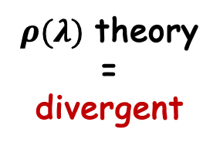
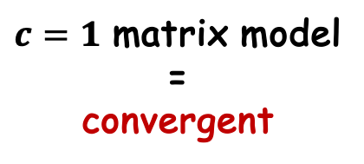
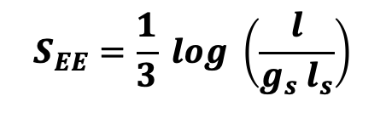
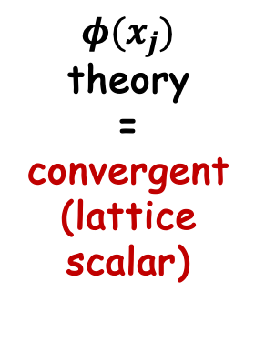
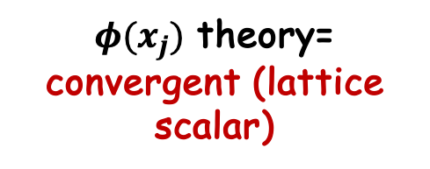
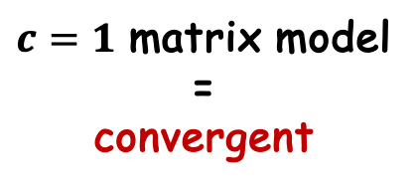
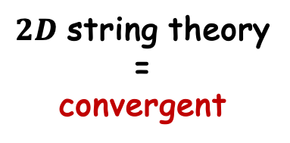
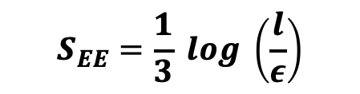
2. Summary of results
Loop amplitude [GM-Sengupta-Wadia 1991, Moore-Plessar-Ramgoolam 1991, Yin et al 2019, Gaikwad-GM-Mohan 2025]
=
=
=
$φ(x_{j})$ theory
=
convergent (lattice scalar)
$ρ(λ)$ theory
=
divergent
(cf. graviton loop)
$c=1$ matrix model
=
convergent
$2D$ string theory
=
convergent
??
Entanglement entropy [Das 1995, Hartnoll-Mazenc 2015, GM-Mohan 2024, Gaikwad-GM-Mohan 2025]
??
$$S_{EE}=\frac{1}{3} log \left(\frac{l}{ε}\right)$$
=
$$S_{EE}=\frac{1}{3} log \left(\frac{l}{g_{s} l_{s}}\right)$$
=
$φ(x_{j})$ theory=
convergent (lattice scalar)
$c=1$ matrix model
=
convergent
$ρ(λ)$ theory
=
divergent
$2D$ string theory

Slide 5
Plan for the talk:
1. Introduction and Motivation
2. Results
3. Matrix QM= fermion QM
Computation of expectation values and EE (fermion theory and $ρ(λ)$ effective theory)
4. Exact bosonization of Matrix QM (any N)
5. c=1 Matrix model
6. Conclusions

Slide 6
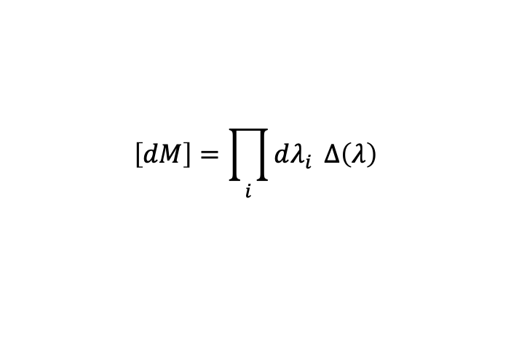
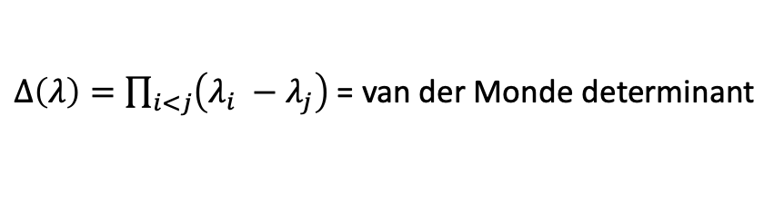
3. Matrix Quantum Mechanics
Consider computing the following vev:
$$\left[dM\right]=\prod_{i}{dλ_{i}} Δ\left(λ\right)$$
$Δ\left(λ\right)=\prod_{i<j}{\left(λ_{i} −λ_{j}\right) }$= van der Monde determinant
For $V=\frac{1}{2} ω^{2} λ^{2} , χ_{n}\left(λ\right)=H_{n}\left(\sqrt{ω} λ\right)\exp\left(−\frac{ω λ^{2}}{2}\right), ε_{n}=\left(n+\frac{1}{2}\right)ω$
Is there a “continuum” description which reproduces this?

Slide 7

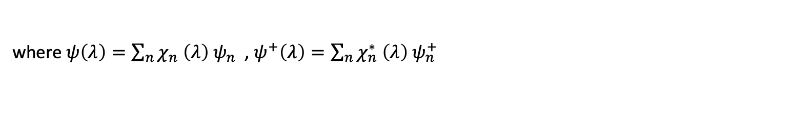
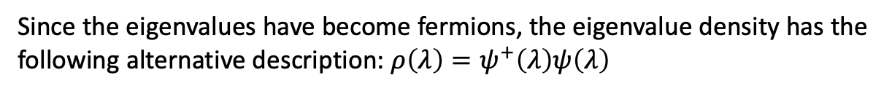
Let us try the eigenvalue density description. $ρ\left(λ\right)=\frac{1}{N}\sum_{i}{δ\left(λ−λ_{i}\right), \prod_{i}{dλ_{i}→[Dρ]}}$
Since the eigenvalues have become fermions, the eigenvalue density has the following alternative description: $ρ\left(λ\right)=ψ^{+}\left(λ\right)ψ\left(λ\right)$
where $ψ\left(λ\right)=\sum_{n}{χ_{n} \left(λ\right) ψ_{n} }$, $ψ^{+}\left(λ\right)=\sum_{n}{χ_{n}^{∗} \left(λ\right) ψ_{n}^{+} }$
Das-Jevicki 1990, Sengupta-Wadia 1990 wrote the following density representation (collective variable) of the matrix path integral
Saddle point solution:
For harmonic oscillator potential $V=\frac{1}{2} ω^{2} λ^{2}$ we find that $ε_{F}=N ω$
which reproduces the leading term of the exact result. How about the sub-leading O(1/N²) correction?

Slide 8

The sub-leading term is given by looking at fluctuations around the saddle point:
The loop integral involves a coincident propagator, and is divergent; this gives
Recall that the exact result is
Once again, we do not get the correct result since the change of variable from
{ $λ_{i }\left(t\right), i=1,2,…,N$ } to { $ρ\left(λ,t\right), λ∈R$ } is not exact except in the $N→∞$ limit.
We will resolve the problem below by finding an Exact transformation of variables from the eigenvalues to a lattice boson field where the lattice contains precisely N points.
Similar statements hold for the two point function $⟨ρρ⟩$

Slide 9
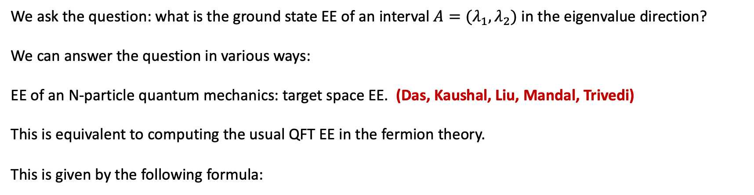
3.1 Entanglement Entropy
Before describing the new boson, let us mention another important calculation, that of entanglement entropy (EE), which also shows a problem with the eigenvalue density representation:
We ask the question: what is the ground state EE of an interval $A=(λ_{1}, λ_{2})$ in the eigenvalue direction?
We can answer the question in various ways:
EE of an N-particle quantum mechanics: target space EE. (Das, Kaushal, Liu, Mandal, Trivedi)
This is equivalent to computing the usual QFT EE in the fermion theory.
This is given by the following formula:

Slide 10



Entanglement Entropy (fermionic formulation)
……. (1a)
Note that: this is obviously finite for finite N, we will find that it is also finite in the double scaling limit for c=1!
(In the c=1/2D string theory context computed and emphasized by Das 1995; later refined by Hartnoll-Mazenc 2015)
In case of free fermions (box potential), the above evaluates to the formula well-known from the statistical mechanics literature :
$S_{A}=\frac{1}{3}\log{(\frac{λ_{2}−λ_{1}}{ε})}, ε=\frac{L}{N}$ …..(2)
For fermions in an external potential $V(λ)$ [Das-Hampton-Liu 2022]
$S_{A}=\frac{1}{3}\log{(p_{F}(λ_{0}})\frac{λ_{2} −λ_{1}}{ℏ})$ …..(2a)
Here, we have assumed that $V(λ)$ varies slowly inside the interval A. More sophisticated formulae exist.
[LeCroix-Majumdar-Schehr]
Can we get these formulae from the density theory (collective variable theory)?

Slide 11
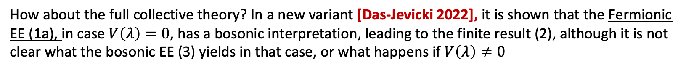
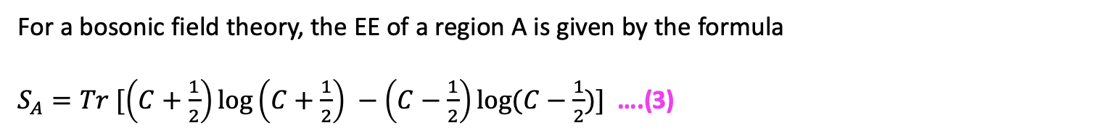


Entanglement Entropy (density boson formulation)
For a bosonic field theory, the EE of a region A is given by the formula
$S_{A}=Tr [\left(C+\frac{1}{2}\right)\log\left(C+\frac{1}{2}\right) −\left(C−\frac{1}{2}\right)\log{(C−\frac{1}{2})] }$ ….(3)
where $C^{2}=X.P, X=\left\langle φ_{x} φ_{y}\right\rangle , P=\left\langle Π_{x} Π_{y}\right\rangle , x,y∈A$
If we consider the collective variable theory for $V\left(λ\right)=0,$ and restrict to quadratic fluctuations, we get a massless relativistic scalar field, for which eq. (3) gives the well-known result (Holzhey-Wilczek, Calabrese-Cardy)
$S_{A}=\frac{1}{3}\log{(\frac{λ_{2}−λ_{1}}{ε})}, ε=$ short-distance ultraviolet cut-off …..(3a)
Note that this result is divergent. It agrees with eq.(2) IF we choose $ε=\frac{L}{N}$ !
We will find that eq.(2), as well as eq. (2a) can indeed be reproduced in terms of a lattice boson, with the above lattice spacing.
How about the full collective theory? In a new variant [Das-Jevicki 2022], it is shown that the Fermionic EE (1a), in case $V\left(λ\right)=0$, has a bosonic interpretation, leading to the finite result (2), although it is not clear what the bosonic EE (3) yields in that case, or what happens if $V\left(λ\right)≠0$

Slide 12
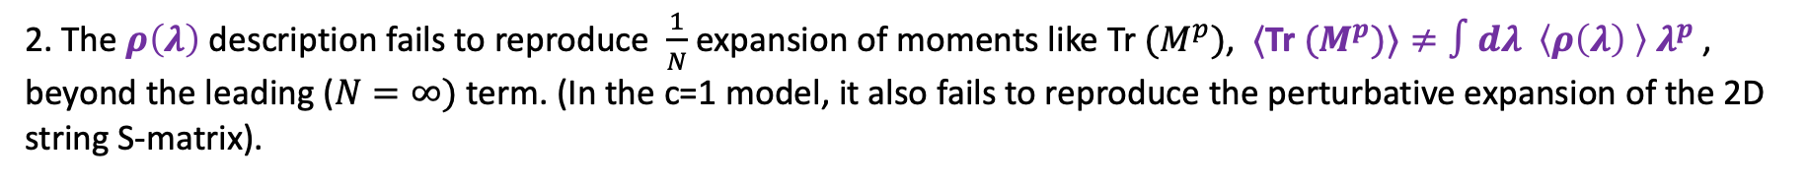

Summary so far….
1. A continuum description of matrix models in terms of an eigenvalue density $ρ\left(λ\right)$ is inconsistent with trace identities, which prevents an exact change of variables from the matrix degrees of freedom to $ρ\left(λ\right)$.
2. The $ρ\left(λ\right)$ description fails to reproduce $\frac{1}{N}$expansion of moments like Tr $(M^{p})$, $⟨$Tr ${(M}^{p})⟩≠∫dλ \left\langle ρ\left(λ\right) \right\rangle λ^{p}$, beyond the leading ($N=∞)$ term. (In the c=1 model, it also fails to reproduce the perturbative expansion of the 2D string S-matrix).
3. In case of matrix quantum mechanics, the eigenvalue density description does not reproduce the leading large $N$ expression for the entanglement entropy $S_{A}=\frac{1}{3}\log\left({(x}_{2}−x_{1}\right)p_{F}(x)/ℏ)$ which is nonperturbative in $N$.
$$N/L$$
Coming attractions….
4. We will discuss an exact bosonization of matrix quantum mechanics (equivalently, an exact bosonization of 1D non-relativistic fermi gas), valid for any $N$, which incorporates the trace identities.
5. The boson field lives on a lattice of $N$ points (granular geometry), which are in one-to-one correspondence with the $N$ eigenvalues.
6. This new bosonization solves the abovementioned problems, including that of the perturbative 2D string S-matrix.

Slide 13


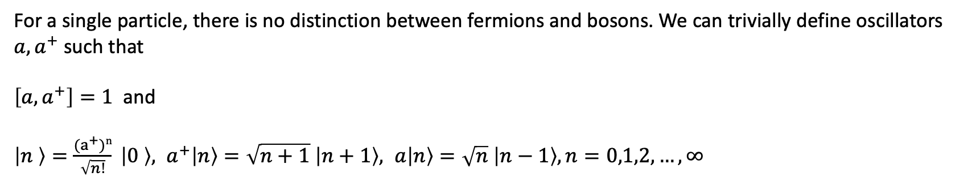

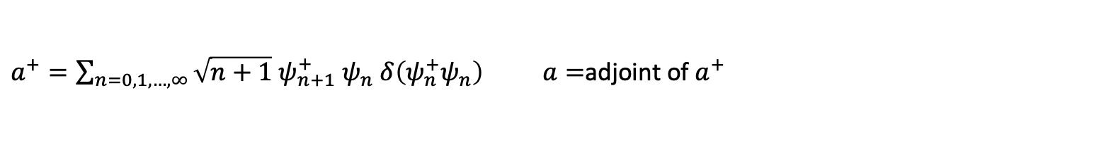

4. Exact bosonization of Matrix QM (non-relativistic fermion)
We would like to find a bosonic description of matrix QM which resolves the problems with the eigenvalue density description. The main point that we would like to ensure is that the degrees of freedom on the bosonic side match with those of the matrix QM.
The way we achieve this is by finding an exact finite N bosonization of non-relativistic fermions (equiv. to MQM)
[Dhar-GM-Suryanarayana].
$$a$$
1-particle Hilbert space H = Span{$\left|n \right\rangle , n=0,1,…, ∞$} where $\left|n \right\rangle =ψ_{n}^{+}|0 ⟩$
For a single particle, there is no distinction between fermions and bosons. We can trivially define oscillators $a, a^{+}$ such that
$\left[a, a^{+}\right]=1$ and
$\left|n \right\rangle =\frac{{(a}^{+})n}{\sqrt{n!}} \left|0 \right\rangle , a^{+}\left|n\right\rangle =\sqrt{n+1} \left|n+1\right\rangle , a\left|n\right\rangle =\sqrt{n} \left|n−1\right\rangle , n=0,1,2,…, ∞$
$a^{+}$
$a^{+}=\sum_{n=0,1,…, ∞}{\sqrt{n+1} ψ_{n+1}^{+} ψ_{n} δ\left(ψ_{n}^{+}ψ_{n}\right) a=}$adjoint of $a^{+}$

Slide 14
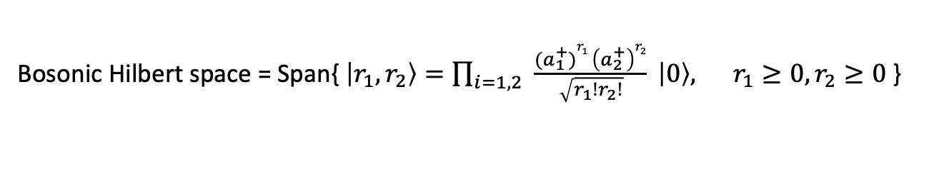


Hilbert space= H $∧$ H = Span{$\left|f_{1}, f_{2} \right\rangle , 0≤f_{1}<f_{2}<∞$}
Bosonic Hilbert space = Span{ $\left|r_{1}, r_{2}\right\rangle =\prod_{i=1,2}{ \frac{{(a}_{1}^{+})r_{1} \left(a_{2}^{+}\right)r_{2}}{\sqrt{r_{1}!r_{2}!}}} \left|0\right\rangle , r_{1}≥0, r_{2}≥0$}
These definitions imply $\left|r_{1}, r_{2} \right\rangle =\left|f_{1}, f_{2} \right\rangle ,$ where
$$r_{2}=f_{1}, r_{1}=f_{2} −f_{1} −1$$

Slide 15
Exact Heisenberg algebra
Finite number of bosonic oscillators (=> Finite UV cut-off)
…….. (4)

Slide 16


Demystifying the correspondence
We wish to understand how, e.g. $σ_{2}^{+} \left|0,1 \right\rangle =|1,2 〉, σ_{1}^{+} \left|0,1\right\rangle =\left|0,2 \right\rangle .$ Note $\left|0,1\right\rangle =|F_{0}⟩$= filled Fermi sea
Suppose that the 1-particle fermion wavefunctions are harmonic oscillator eigenfunctions: then
$σ_{2}^{+}$ is an operator which creates a hole at depth 2. The Berezin representation of such an operator is a Schur polynomial corresponding to the representation (YT of height 2)
$$\left|0,1\right\rangle$$
$$\left|1,2\right\rangle$$
Hole at depth 2
History: Holes = giant gravitons.
Hole at depth 1

Slide 17
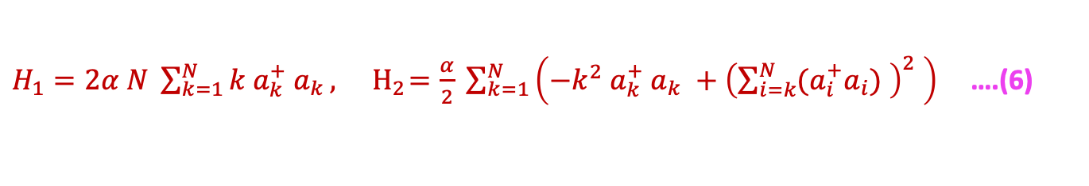
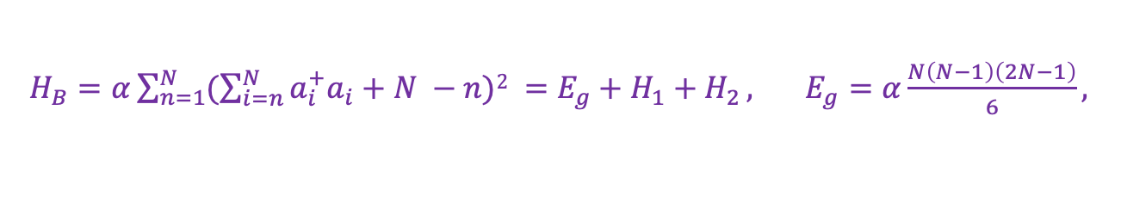
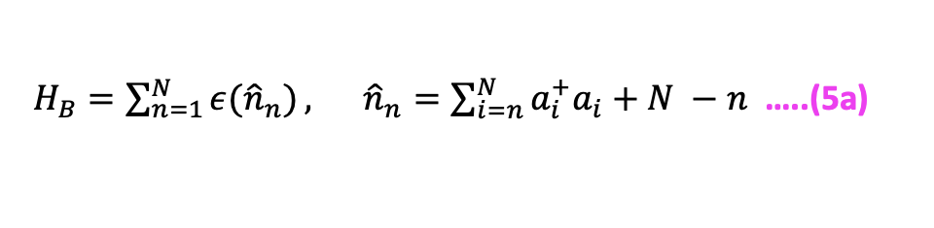
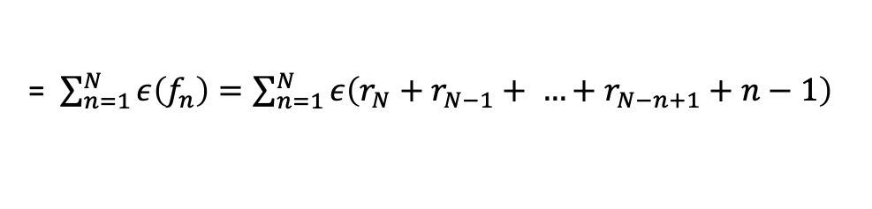
Bosonized Hamiltonian:
$$f_{1}=r_{N}, f_{2}=r_{N}+r_{N−1}+1, …, f_{n}=r_{N}+r_{N−1}+ …+r_{N−n+1}+n−1$$
Hence, energy of the fermionic state $|f_{1},f_{2},…, f_{N} ⟩$ is
= $\sum_{n=1}^{N}{ε\left(f_{n}\right)=\sum_{n=1}^{N}{ε\left(r_{N}+r_{N−1}+ …+r_{N−n+1}+n−1\right) }}$
……..(5)
What bosonic Hamiltonian, acting on $|f_{1},f_{2},…, f_{N} ⟩$ = $|r_{1},r_{2},…, r_{N} ⟩$ , produces the result (5)?
$H_{B}=\sum_{n=1}^{N}{ε({\hat{n}}_{n})}, {\hat{n}}_{n}=\sum_{i=n}^{N}{a_{i}^{+}a_{i}+N −n}$ …..(5a)
Thus, e.g., for fermions in a box, where $ε\left(f_{n}\right)=α f_{n}^{2}, α=\frac{ℏ^{2}π^{2}}{L^{2}}$, we get
$H_{B}=α\sum_{n=1}^{N}{(\sum_{i=n}^{N}{a_{i}^{+}a_{i}+N −n)2 }=E_{g}+H_{1}+H_{2}}, E_{g}=α\frac{N\left(N−1\right)\left(2N−1\right)}{6},$
$H_{1}=2α N \sum_{k=1}^{N}{k a_{k}^{+} a_{k}}, { H}_{2}=\frac{α}{2} \sum_{k=1}^{N}{\left(−k^{2} a_{k}^{+} a_{k} +{\left(\sum_{i=k}^{N}{{(a}_{i}^{+}a_{i})} \right)}^{2} \right) }$….(6)

Slide 18

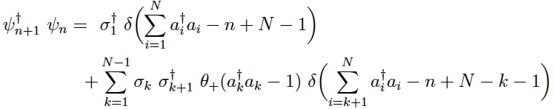
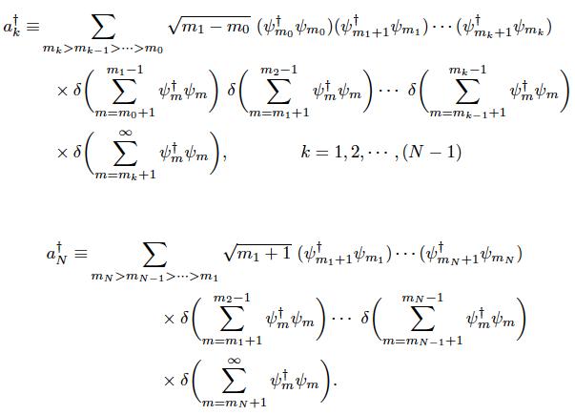
The Bose-Fermi mapping is EXACT !
In the fixed fermion number sector, physical excitations are fermion bilinears $ψ_{m}^{+}ψ_{n}$. ALL such bilinears can be written exactly in terms of the $N$ pairs of bosonic oscillators $a_{m}^{+}, a_{n}$ and vice versa:

Slide 19




Applications of the exact bosonization
GM-Mohan 2024
+ work in progress
1. Calculation of moments $I_{p}$
Finite number of fermions N
2. Entanglement entropy
1.
E.g., for fermions in harmonic oscillator potential
In terms of the bosons, the exact transcription on the previous page gives
Finite number of bosonic modes N (uv-finite)
$$∞$$
In particular,
Collective field theory has infinite no. of modes
Thus, our bosonic theory reproduces the fermionic moment exactly (not a surprise).

Slide 20
For entanglement entropy, the question is slightly more involved.
The issue is as follows.
Consider a spatial region A in the fermionic theory.
We have so far found an oscillator bosonization of the fermion theory.
Of course, the Fermionic EE for the region A will have a (complicated) translation in terms of the bosonic Hilbert space.
The important question is, does the fermionic EE correspond to the EE of a certain “region” of a real space bosonic formulation of the above exact bosonization?
This is what we do next: to invent a real space version of the bosonic theory.
We will find that indeed the fermionic EE in a region A becomes the bosonic EE in a corresponding spatial region of the bosonic theory.

Slide 21
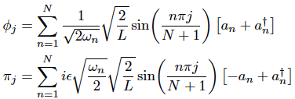
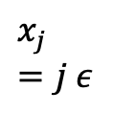
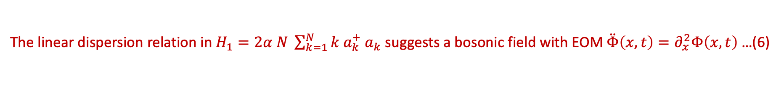
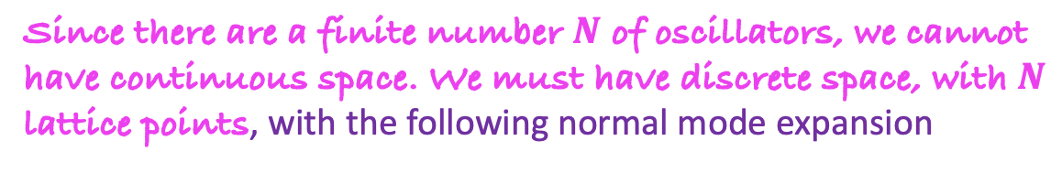
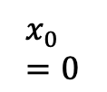
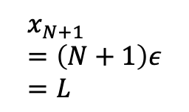
Introducing the real space: lattice boson
GM-Mohan 2024
Inventing local fields from the oscillators by introducing “space”: first consider fermions in a box.
The linear dispersion relation in $H_{1}=2α N \sum_{k=1}^{N}{k a_{k}^{+} a_{k}}$ suggests a bosonic field with EOM $\ddot{Φ}\left(x,t\right)=∂_{x}^{2}Φ\left(x,t\right)$…(6)
Since there are a finite number $N$ of oscillators, we cannot have continuous space. We must have discrete space, with $N$ lattice points, with the following normal mode expansion
$$x_{0}=0$$
$$x_{j}=j ε$$
$$x_{N+1}=\left(N+1\right)ε=L$$
Note that $\left[φ_{j}, π_{l}\right]=i δ_{jl}$ → EXACT HEISENBERG ALGEBRA
The Heisenberg algebra does not require specifying $ω_{n}$, but if we consider the lattice version of the EOM (6) , namely
we get

Slide 22

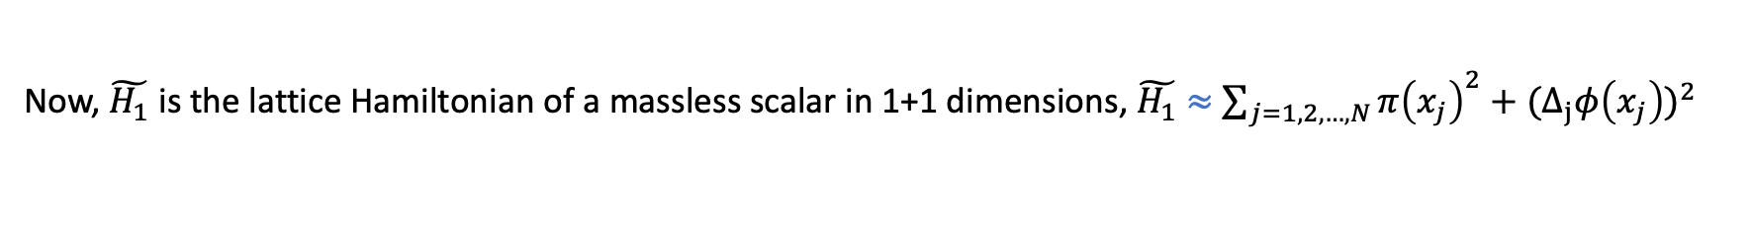
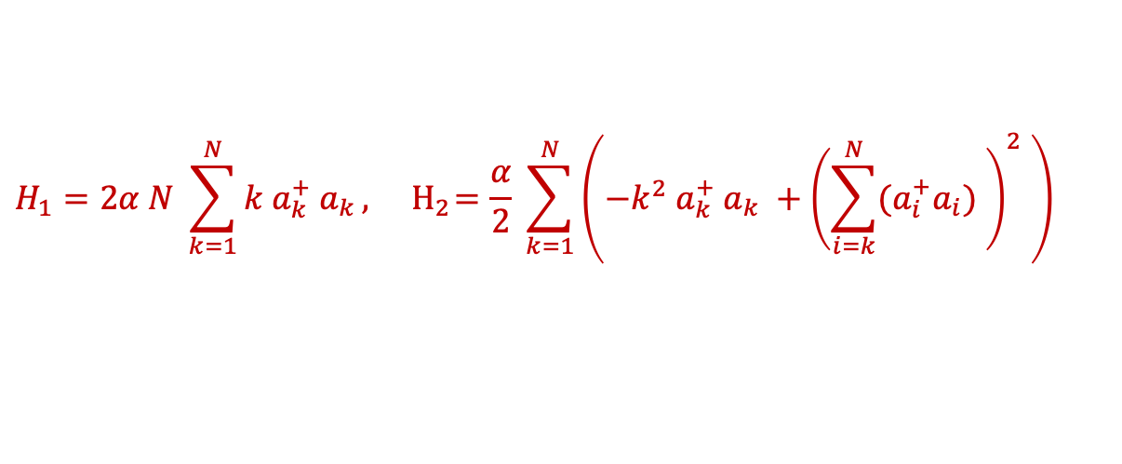
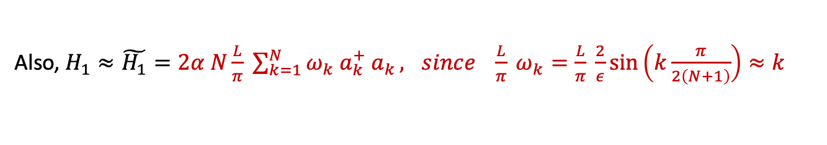

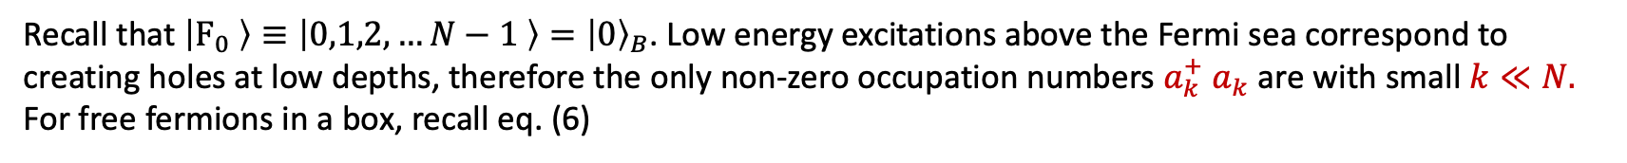

Low energies $≈$ massless scalar
Recall that $\left|F_{0} \right\rangle ≡\left|0,1,2,…N−1 \right\rangle ={\left|0\right\rangle }_{B}$. Low energy excitations above the Fermi sea correspond to creating holes at low depths, therefore the only non-zero occupation numbers $a_{k}^{+} a_{k}$ are with small $k≪N.$
For free fermions in a box, recall eq. (6)
$$H_{1}=2α N \sum_{k=1}^{N}{k a_{k}^{+} a_{k}}, { H}_{2}=\frac{α}{2} \sum_{k=1}^{N}{\left(−k^{2} a_{k}^{+} a_{k} +{\left(\sum_{i=k}^{N}{{(a}_{i}^{+}a_{i})} \right)}^{2} \right) }$$
Under the above conditions
$$H_{2}≪H_{1}$$
Also, $H_{1}≈\tilde{H_{1}}=2α N\frac{L}{π} \sum_{k=1}^{N}{ω_{k} a_{k}^{+} a_{k}}, since \frac{L}{π} ω_{k}=\frac{L}{π} \frac{2}{ε}\sin\left(k\frac{π}{2\left(N+1\right)}\right)≈k$
Now, $\tilde{H_{1}}$ is the lattice Hamiltonian of a massless scalar in 1+1 dimensions, $\tilde{H_{1}}$ $≈$ $\sum_{j=1,2,…,N}{π{\left(x_{j}\right)}^{2}+(Δ_{j}φ{\left(x_{j}\right))}^{2}}$
Note that the ground state of $\tilde{H_{1}}$, namely ${\left|0\right\rangle }_{B}$, is identical to that of the full bosonic Hamiltonian $H$. (both are given by the state ${\left|0\right\rangle }_{B}$ which is annihilated by the $a_{k}$). Hence EE for the ground state of $H$ should be that of the relativistic scalar:
$S_{A}=\frac{1}{3}\log{\frac{l}{ε}}$, where $ε$is the lattice cut-off.
[Holzhey-Wilczek, Calabrese-Cardy, Peschel, …]
We verify this explicitly below. But before that …..

Slide 23
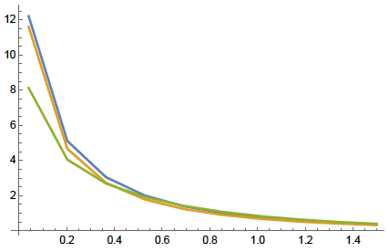

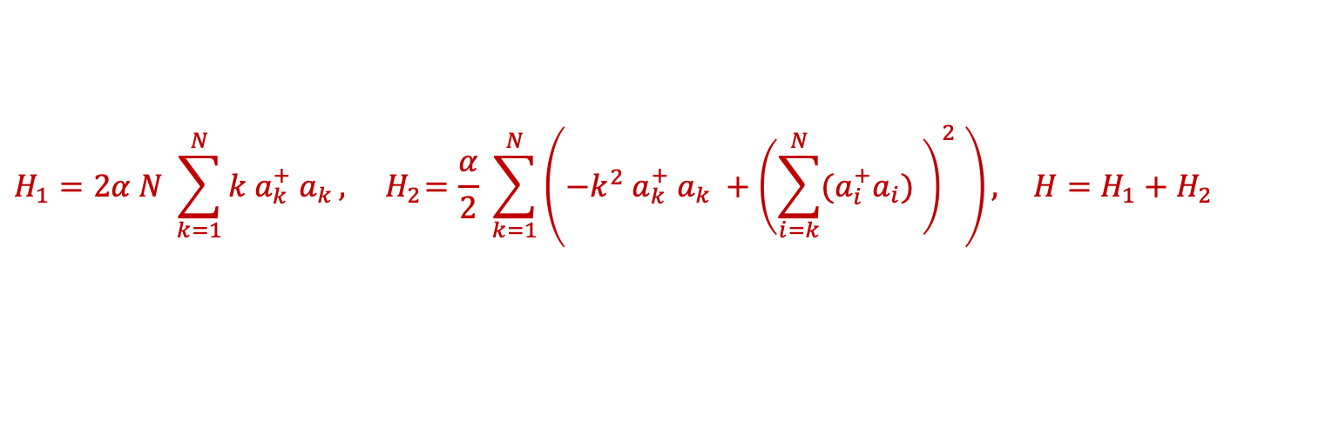

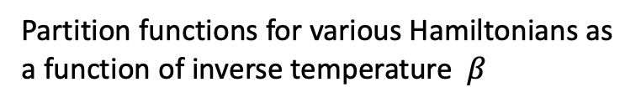
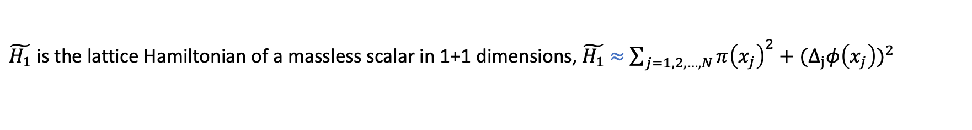

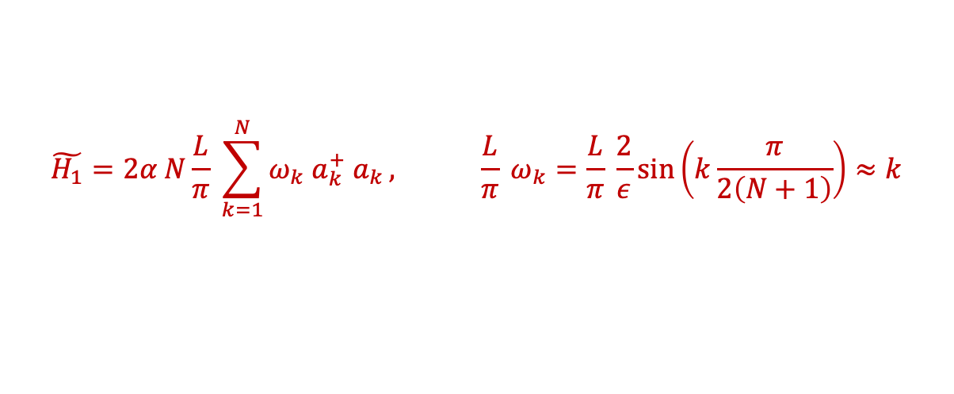

Low temperature partition function
$$H_{1}=2α N \sum_{k=1}^{N}{k a_{k}^{+} a_{k}}, { H}_{2}=\frac{α}{2} \sum_{k=1}^{N}{\left(−k^{2} a_{k}^{+} a_{k} +{\left(\sum_{i=k}^{N}{{(a}_{i}^{+}a_{i})} \right)}^{2} \right), } H=H_{1}+H_{2}$$
$$\tilde{H_{1}}=2α N\frac{L}{π} \sum_{k=1}^{N}{ω_{k} a_{k}^{+} a_{k}}, \frac{L}{π} ω_{k}=\frac{L}{π} \frac{2}{ε}\sin\left(k\frac{π}{2\left(N+1\right)}\right)≈k$$
$\tilde{H_{1}}$ is the lattice Hamiltonian of a massless scalar in 1+1 dimensions, $\tilde{H_{1}}$ $≈$ $\sum_{j=1,2,…,N}{π{\left(x_{j}\right)}^{2}+(Δ_{j}φ{\left(x_{j}\right))}^{2}}$
$\tilde{H_{1}}$ (= relativistic boson on a lattice)
$H_{1}$(= low energy form of H)
Partition functions for various Hamiltonians as a function of inverse temperature $β$
$$H (=Fermionic Hamiltonian)$$
$$β$$

Slide 24
Entanglement entropy: lattice boson
This PRECISELY reproduces the fermionic result! We thus have a bosonic description reproducing the (finite) EE.
The matching of the real spaces (box $→$ box) is a surprise, since the bosonic field $φ\left(x_{j}\right)$is rather non-local in terms of the fermion field $ψ(x)$ or the fermion bilinear $ψ^{+}(x)$ $ψ(y)$. The reason it works is that at low energies, the relation becomes approximately local.

Slide 25
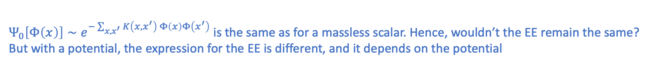
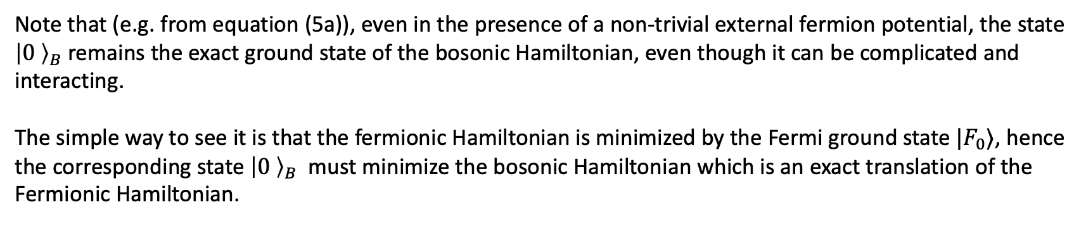
Bosonic EE for fermions in a non-trivial external potential
Note that (e.g. from equation (5a)), even in the presence of a non-trivial external fermion potential, the state ${\left|0 \right\rangle }_{B}$ remains the exact ground state of the bosonic Hamiltonian, even though it can be complicated and interacting.
The simple way to see it is that the fermionic Hamiltonian is minimized by the Fermi ground state $|F_{0}⟩$, hence the corresponding state ${\left|0 \right\rangle }_{B}$ must minimize the bosonic Hamiltonian which is an exact translation of the Fermionic Hamiltonian.
THIS SEEMS TO LEAD TO A PUZZLE!!
$Ψ_{0}\left[Φ\left(x\right)\right]∼e^{−\sum_{x,x^{′}}{K\left(x,x^{′}\right) Φ\left(x\right)Φ\left(x^{′}\right)}}$ is the same as for a massless scalar. Hence, wouldn’t the EE remain the same?
But with a potential, the expression for the EE is different, and it depends on the potential
$S\left(λ_{1}, λ_{2}\right)=\frac{1}{3}\log\left(\frac{{(λ_{2} −λ_{1}) p}_{F}\left(λ_{0}\right)}{ℏ} \right) , p_{F}\left(λ\right)=\sqrt{2\left(ε_{F} −V\left(λ\right)\right)}$,
If the ground state is the same, how does the dependence on the potential $V\left(λ\right)$ come about???

Slide 26
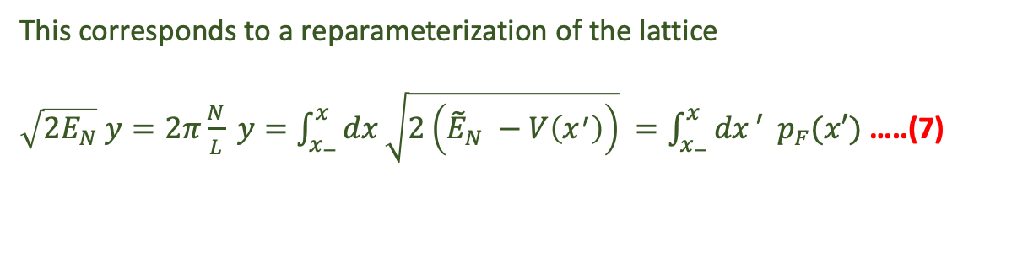






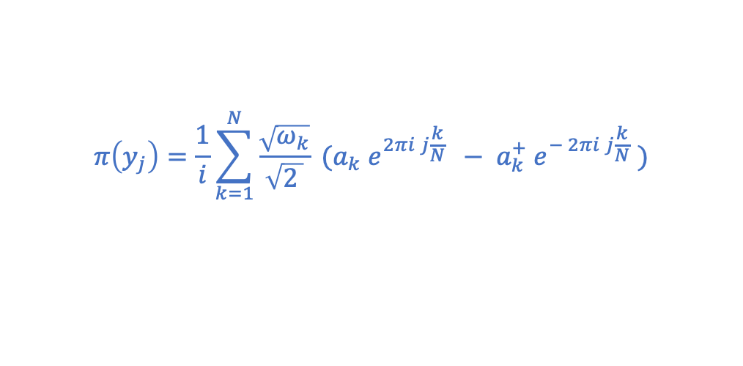

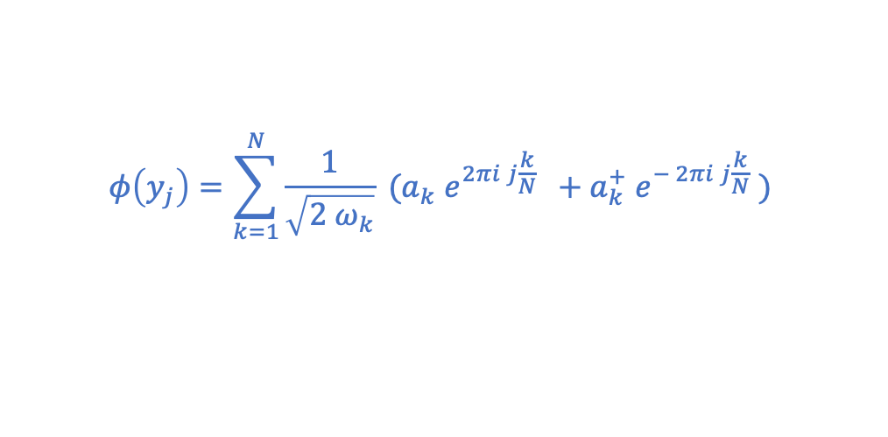





Solution: let the potential determine the geometry of the lattice
The existence of a non-zero potential introduces inhomogeneity of space.
$$y_{0}=0$$
$$y_{j}=j ε$$
$$y_{N+1}=\left(N+1\right)ε=L$$
This corresponds to a reparameterization of the lattice
$\sqrt{2E_{N}} y=2π\frac{N}{L} y=\int_{x_{−}}^{x}{dx}\sqrt{2\left({\tilde{E}}_{N} −V\left(x^{′}\right)\right)} =\int_{x_{−}}^{x}{dx}′{ p}_{F}(x′)$ …..(7)
$$y=0$$
$$y=L$$
$$φ\left(y_{j}\right)=\sum_{k=1}^{N}{\frac{1}{\sqrt{2 ω_{k}}} (a_{k} e^{2πi j\frac{k}{N} } +a_{k}^{+} e^{− 2πi j\frac{k}{N}}} )$$
$$x_{0}=x_{−}$$
$$x_{j}=x(y_{j})$$
$$x_{N+1}=x_{+}$$
$$x_{−}$$
$$x_{+}$$
The conjugate field is defined by
$$π\left(y_{j}\right)=\frac{1}{i}\sum_{k=1}^{N}{\frac{\sqrt{ω_{k}}}{\sqrt{2 }} (a_{k} e^{2πi j\frac{k}{N} } − a_{k}^{+} e^{− 2πi j\frac{k}{N}}} )$$
$$\tilde{φ}\left(x_{j}\right)=φ\left(y_{j}\right), \tilde{π}\left(x_{j}\right)=π\left(y_{j}\right)$$
so that $\left[{φ(x}_{j}), {π(y}_{l})\right]=i δ_{jl}$ → EXACT HEISENBERG ALGEBRA
The EE is clearly $S\left[y_{1},y_{2}\right]=\frac{1}{3}\log\left(\frac{\left(y_{2}−y_{1}\right)N}{L}\right)=\frac{1}{3}\log\left(\left(x_{2}−x_{1}\right) p_{F}(x_{0})\right)$ reproducing the fermion EE of [Das et al]!
(we have assumed $p_{F}(x)$ to be a slowly varying function of $x$ in the interval $\left(x_{1} , x_{2}\right)$)

Slide 27
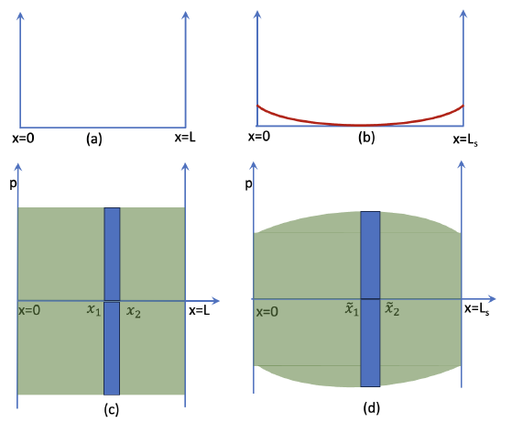
Justification for the coordinate transformation:
The ground state is semi-classically described by a fluid droplet occupying a certain region R, bounded by the Fermi surface.
One can make a canonical transformation of the single-fermion phase space; the fluid droplet changes its shape (without changing the area). The boundary of the new droplet can be interpreted as the Fermi surface of a new Hamiltonian.
One can ask: what is the canonical transformation needed to go from the free particle (in a box) Hamiltonian
$h=\frac{p^{2}}{2}$ to $h^{′}=\frac{p^{2}}{2}+V\left(λ\right)$ ?
Such a transformation can be found. When restricted on the Fermi surface, the canonical transformation projects onto a transformation of the x-coordinate. The coordinate transformation precisely turns out to be (7).

Slide 28
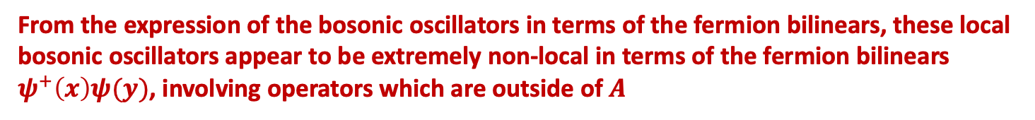
Why does fermionic real space map to the bosonic real space (albeit latticized)?
Locality
The EE of the bosonic theory for an interval $A$ corresponds to an operator algebra of the bosonic fields $φ\left(x\right), π\left(x\right)$, where $x∈A$.
From the expression of the bosonic oscillators in terms of the fermion bilinears, these local bosonic oscillators appear to be extremely non-local in terms of the fermion bilinears $ψ^{+}\left(x\right)ψ(y)$, involving operators which are outside of $A$
Why does the bosonic EE match with the fermionic EE then?
It can be shown that on low energy bosonic states (fermionic states near Fermi surface), the relation is approximately local.

Slide 29







5. C=1 matrix model
GM-Mohan 2024, Gaikwad-GM-Mohan 2025
$$=\frac{1}{3}\log{[2\frac{\left(λ_{2} −λ_{1}\right)p_{F}\left(λ\right)}{ℏ}]}$$
Entanglement entropy $S_{A}$
where $p_{F}(λ)=\sqrt{2\left(ε_{F} −V\left(λ\right)\right)}$
$$λ=0$$
$$λ=1$$
$$λ=2$$
Dual to 2D string:
As we saw above, this result can be obtained from the fermionic formulation as well as from the exact lattice boson described above.
$$Ψ^{+}\left(λ,t\right)Ψ\left(λ,t\right)=ρ\left(λ,t\right)$$
Density fluctuations near the Fermi surface map to close string tachyon

Slide 30









Double scaled c=1 matrix model
$$ε_{c}=\frac{1}{4}$$
$$ε_{F}$$
“Single scaling”
$$→0$$
“Double scaling”
$$λ=0$$
$$λ=2$$
$$λ=1$$
→ Taking fermi level near the top
$V\left(λ\right)=\frac{1}{4} −\frac{{\left(λ −1\right)}^{2}}{2}+\frac{{\left(λ−1\right)}^{4}}{4}=\frac{1}{4}−\frac{{\tilde{λ}}^{2}}{2βN}+\frac{{\tilde{λ}}^{4}}{4 {\left(βN\right)}^{2}}$
Also, zoom near the maximum $λ=1$
$$ε_{F}−ε_{c}=ε_{F}−\frac{1}{4}=−\frac{μ}{βN}$$
$p_{F}(λ)=\sqrt{2\left(ε_{F} −V\left(λ\right)\right)}=\sqrt{2(−\frac{μ}{βN}−\frac{{\tilde{λ}}^{2}}{2βN}+\frac{{\tilde{λ}}^{4}}{4 {\left(βN\right)}^{2}})}∼1/\sqrt{N}$
$$λ_{2} −λ_{1}={(\tilde{λ}}_{2} −{\tilde{λ}}_{1})/\sqrt{βN}∼1/\sqrt{N}$$
$$\frac{1}{ℏ}∼N$$

Slide 31


Entanglement entropy $S_{A}$
$$\tilde{λ}=\sqrt{2μ} cosh⁡( \frac{x}{l_{s}} )$$
… (8)
The EE in eq. (8) was originally derived by Das (1995) and Hartnoll-Mazenc (2015) using the fermion theory.
As we see, we have derived this here using the exact lattice boson theory.
(Note that in collective field theory, the EE is expected to be divergent in any order of perturbation theory).
Below, we will discuss the relation of this bosonic field with D0 branes. But, before that, we discuss how our lattice boson correctly captures loop corrections to 2D string S-matrix elements.

Slide 32

Exact boson for double scaled c=1
$$φ\left(y_{j}\right)=\sum_{k=1}^{N}{\frac{1}{\sqrt{2 ω_{k}}} (a_{k} e^{2πi j\frac{k}{N} } +a_{k}^{+} e^{− 2πi j\frac{k}{N}}} )$$
turns to →
where
where the limit $N→∞$ has already been taken
From the above, we get
which gives
Thus, in the double scaled boson theory, the lattice spacing remains finite, even though $N=∞$
This explains the reason for finiteness of various quantities.

Slide 33

S- matrix of 2D string theory
c=1 Matrix model (= Fermion field theory) gives
$$S\left(1→1\right)=S_{0}+g_{s}^{2} S_{1}, S_{0}=ω, { S}_{1}=\frac{1}{24} \left(i ω^{2}+2 i ω^{4}−ω^{5}\right)+O\left(g_{s}^{4}\right)$$
Sengupta-Wadia 1990, GM-Sengupta-Wadia 1991, Moore-Plessar-Ramgoolam 1991
Tachyon scattering
off the wall
${ S}_{1}$ corresponds to a 1-loop contribution in the string theory. This has been exactly reproduced by a torus world sheet calculation by Yin et al 2018.
$$\left\langle 0\right|ρ\left(1\right)ρ\left(2\right)|0⟩$$
In collective field theory, given by the cubic action,
the above one-loop term corresponds to the following diagram
In (GM-Sengupta-Wadia 1991) it was shown to be quadratically divergent. The divergence could be removed by a counter-term, but the remaining finite expression differed from ${ S}_{1}$ above. (see also Gaikwad-GM-Mohan 2025)
Result: In our new bosonic formulation, the above $S\left(1→1\right)$ is exactly reproduced!

Slide 34





(McGreevy-Verlinde, Klebanov-Maldacena-Seiberg, Berenstein, Gaiotto-Itzhaki-Rastelli)
$M_{ij}\left(t\right)≡T_{ij}\left(t\right)=$open string tachyon field on N D0 branes = dual to 2D closed string in a linear dilaton background
$V\left(M\right)=−\frac{1}{2α^{′} } M^{2}$is reinterpreted as $V\left(T\right)=−\frac{1}{2α^{′} } T^{2}$ which is part of the spacetime tachyon potential, with mass$2=−\frac{1}{α^{′}}$
Eigenvalues of the matrix $M$, namely $λ_{i}\left(t\right)$, represent open string tachyon field on the $i$-th D0 brane.
${\text{Classical} \text{solution}\text{ (}\text{with} l_{s}=\sqrt{α^{′} } \text{):} λ}_{i}\left(t\right)=\sqrt{μ}\sin\left(π{\tilde{λ}}_{0}\right)cosh\left(\frac{t}{l_{s}}\right)$ …(9)
$$λ_{i,0}<\sqrt{μ}$$
$$λ_{i,0}=\sqrt{μ}$$
This is the rolling tachyon solution on an unstable D brane (Sen)
$$λ_{i,0}>\sqrt{μ}$$
In this rolling tachyon background, string world-sheet action becomes (in $l_{s}=1$ units)
$$S_{ws}=∫d^{2}ξ ∂X^{μ}∂ X_{μ} +{\tilde{λ}}_{0} ∫dσ cosh⁡(t\left(σ\right))$$
$V\left(λ,t\right)$= vertex operator related to the ground ring element $O_{1,2}+O_{2,1}$
Such a boundary deformation to a CFT corresponds to a boundary state $\left| Bd \right\rangle$
Closed string field $∫dλ Ψ^{+}\left(λ\right) λ Ψ\left(λ\right)$, generated by the D0 brane, is $\left\langle Bd \right|V\left(λ, t\right)\left| Bd \right\rangle =\sqrt{μ}\sin\left(π{\tilde{λ}}_{0}\right)\cosh\left(t\right)$ (same as (9))
Eigenvalue above the fermi surface (particle): ${\tilde{λ}}_{0}$ = real, hence at $t=0,λ_{i}≤\sqrt{μ}$ (see the blue dot)
Eigenvalue below the fermi surface (hole): ${\tilde{λ}}_{0}=\frac{1}{2}+i \tilde{\tilde{λ_{0}}} ,\tilde{\tilde{λ_{0}}} =$real, hence at $t=0,λ_{i}≥\sqrt{μ}$ (see the black dot)

Slide 35



$$r_{1}=4, r_{2}=0, …→{ {(a}_{1}^{+})4 ⇒ f}_{1}=0, f_{2}=1, …, f_{5}=4, f_{6}=9$$
particle at height 4
$$λ_{i,0}<\sqrt{μ}$$
$$λ_{i,0}=\sqrt{μ}$$
$$λ_{i,0}>\sqrt{μ}$$
hole at depth 4
$$r_{4}=1, r_{1}=0, …, r_{6}=0→{ a_{4}^{+}⇒ f}_{1}=0, f_{2}=1,f_{3}=5, .. f_{6}=8$$

Slide 36




Lattice boson for unitary matrix model
GM-Ramgoolam-Suroshe, in progress
Unitary matrix model:
$∫DU O(U)=∫\prod_{i=1,…,N}{d^{2}u_{i} exp⁡[−\sum_{k=1,…,N}{\frac{\overline{u_{k}} u_{k}}{k} ] O(u_{i}, \overline{u_{i}} }})$
This can be rigorously shown for operators which are not “too large”, i.e. when
$O=\prod_{i=1,…,N}{u_{i}^{P_{i}} {\overline{u_{i}}}^{Q_{i}}}$ with $\sum_{j}{j P_{j}≤N, }$ $\sum_{j}{j Q_{j}≤N, }$
The above equation can be rewritten in terms of a lattice field:
$$χ\left(θ_{j}\right)=\sum_{n=1,..,N}{\frac{u_{n}}{\sqrt{n}} exp\left(i n θ_{j}\right)=\sum_{n=1,…,N}{\frac{u_{n}}{\sqrt{n}} exp\left(i 2π n\frac{j}{N}\right),} θ_{j}=2π\frac{j}{N}}$$
$∫DU O(U)=∫\prod_{j=1,…,N}{dχ\left(θ_{j}\right) d\overline{χ(θ_{j})} exp⁡[−\sum_{j=1,…,N}{ χ\left(θ_{j}\right)\overline{χ(θ_{j})}] O(χ(θ_{j}), \overline{χ(θ_{j})} }})$

Slide 37
CONCLUSIONS
We pointed out subtleties with a continuum description of large N limit of matrix QM (in particular c=1)
For matrix QM, a continuum description in terms of the eigenvalue density (the collective variable) gives divergent answers for (a) moments and (b) entanglement entropy, whereas they are finite in the matrix QM.
We found an exact lattice bosonization of matrix QM. It resolves the two problems mentioned above.
It appears that the exact boson field $φ(x)$ is a second quantized field describing multiple D0 branes! It is perhaps natural that such a field theory comes with a cut-off $g_{s}l_{s}$.
What is the lesson for higher dimensions? E.g. for N=4 SYM ←→ AdS gravity, … ?

Slide 38
Thank you!

