Slide 1

JT gravity in deSitter Space and Its Extensions
Sandip Trivedi
Tata Institute of Fundamental Research

Slide 2
Based On:
1) Kanhu K. Nanda, Sunil Sake, ST
``JT Gravity in dS Space and The Problem of Time”, JHEP 02 (2024) 145
2) Indranil Dey, Kanhu K. Nanda, Akashdeep Roy, Sunil Sake, ST,
``JT Gravity in dS Space and Its Extensions”, hep-th/2501.03148.

Slide 3
Several Additional References
In particular:
M. Henneaux, Phys. Rev. Lett. 54 (Mar, 1985) 959–962.
J. Maldacena, G. J. Turiaci and Z. Yang, JHEP 01 (2021) 139
L. V. Iliesiu, J. Kruthoff, G. J. Turiaci and H. Verlinde, SciPost Phys. 9 (2020) 023, [2004.07242].
J.Cotler, K. Jensen, JHEP12 (2021),089; 2401.01925
E. Alonso-Monsalve, D. Harlow and P. Jefferson, hep-th/2409.12943.
J. Held and H. Maxfield, hep-th/2410.14824.

Slide 4
Recent Paper
A note on Centaur geometry -- probing IR de Sitter spacetime holography;
Norihiro Iizuka and Sunil Sake
arXiv:2501.02614

Slide 5
Outline :
Introduction and Motivation
Classical Solutions
Canonical Quantisation
Additional Topics:
  Extensions of JT Theory
  Path Integral Understanding
  Matrix Theory as a Hologram
Conclusions

Slide 6
Motivation and Introduction
Jackiw-Teitleboim Theory is a very simple theory of 2 dimensional gravity.
With No Propagating degrees of Freedom.
Why Study It?
In the deSitter Context…

Slide 7
Motivation:
Many Conceptual Questions in Quantum Cosmology:
Meaning and interpretation of Wave function
Observers and Observables ?
Problem of Time:
  Physical Clock Must Arise Internal to the System.
  Hilbert Space Must be constructed at instances of physical time.

Slide 8
Motivation
These conceptual questions are present in 2 dimensions as well and not directly connected with UV divergence in higher dimensions
Hopefully what is learnt can also be of relevance in more realistic higher dimensional theories of Gravity.

Slide 9
Motivation
Holography:
What we learn could also shed some light how dS/CFT works in general.

Slide 10
JT deSitter gravity:
: Dilaton
: Dimensionless
: Only Scale, >0.
Set = 2
: GH Boundary term

Slide 11
can be set to 1 by rescaling
Note: The classical limit corresponds to
While corresponds to

Slide 12
In addition a topological term:
JT Gravity Can be obtained by dimensional reduction of a near extremal black hole in de Sitter space.
Higher dim. entropy
(Dilaton: Radius of internal space)

Slide 13
Dilaton: Physical Clock
The idea will be explore is that the dilaton plays the role of the physical clock.
This is similar to what happens in inflation (where the inflaton, also a scalar, plays this role).

Slide 14
Range of Dilaton
In dimensionally reduced case there is a minimum value for
We analyse the 2 dim quantum theory without imposing any restriction, and find that it allows for the range

Slide 15
Classical Solutions:
Global deSitter
Spatial slices are compact
Dilaton
A: constant

Slide 16
Global deSitter:
Other Solutions :

Slide 17
Classical Solutions
Bounce Solutions
Spatial sections are compact
Dilaton
Two parameters worth of solutions
(two dimensional phase space).

Slide 18
: Orbifolds of Black Hole Solutions
F
BH
Cosmological
horizons
Black hole
horizons
P
WH

Slide 19
F
P
Orbifold Singularity, analogue of big bang/big crunch.
Contracting universe encounters the singularity.
Expanding Universe emerges from singularity.

Slide 20
Expanding, Contracting Branches and Black Hole White Hole Branches.

Slide 21
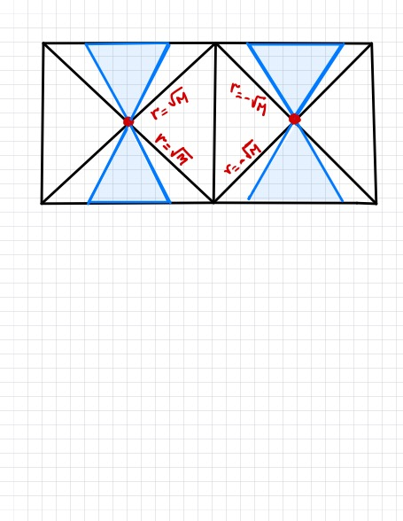

Slide 22
: Bounce Branch
: Big Bang/Big Crunch Branch
Two parameters worth of solutions, M, A. Two dimensional phase space.
However there is one more set of solutions
E. Alonso-Monsalve, D. Harlow and P. Jefferson, hep-th/2409.12943.
J. Held and H. Maxfield, hep-th/2410.14824.

Slide 23
Resulting spacetimes cannot be foliated by space-like hypersurfaces with constant dilaton.

Slide 24
Our discussion will only apply to the bounce and big bang/big crunch branches.

Slide 25
The parameter M corresponds to a conserved quantity
We will loosely refer to this parameter as the ``Mass”.
It will play an important role in the following analysis

Slide 26
Path Integral
The wave function of the Hartle Hawking State can be calculated using the path integral Exactly.
After analytic continuation from ,
i.e. anti-deSitter space with two time like directions.
(Maldacena, Turiaci, Yang; Cotler, Jensen, Moitra, Sake, SPT;…
Stanford, Witten, )

Slide 27
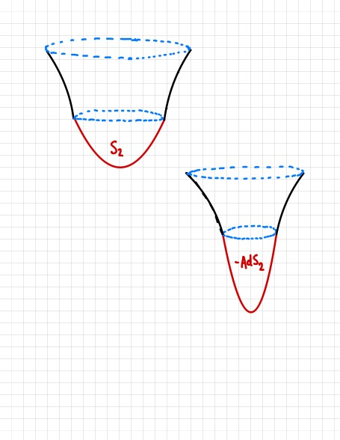
This exact result will guide us in carrying out the canonical quantisation.

Slide 28
Hartle Hawking State

Slide 29
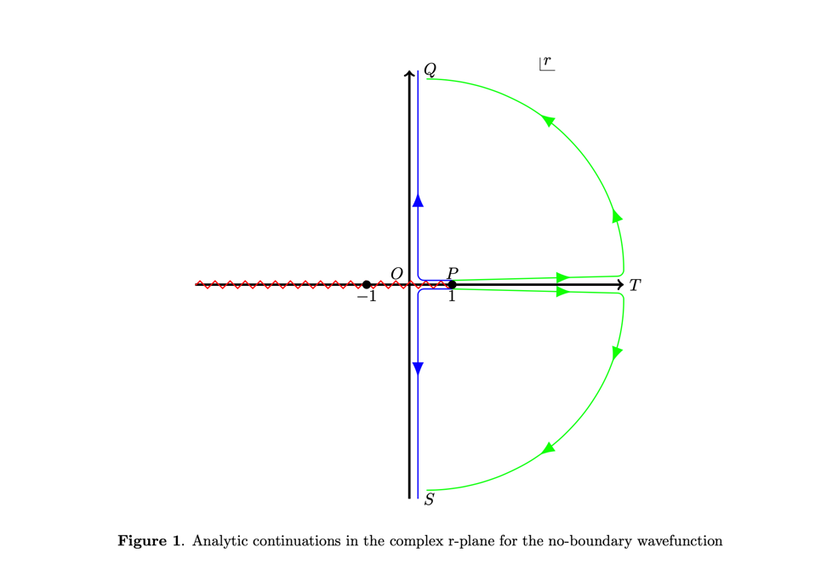

Slide 30
Canonical Quantisation:
(Standard ADM Quantisation)
Work in ADM gauge
Set

Slide 31
In this gauge:

Slide 32
Hamiltonian and Momentum Constraints
Equations of Motion of and
Classically the Constraints Close

Slide 33
Quantum Theory:
Physical states satisfy the conditions
: Functional of ,

Slide 34
Quantum Theory:
However the constraints have ordering ambiguities in the Quantum Theory.
Also UV divergences
( involves two functional derivatives, which acting on give type singularities.)

Slide 35
We will choose hypersurfaces along which the dilaton is constant.
E.g.,
Using the spatial reparametisation invariance only other variable the wave function can depend on is, the length of the spatial slice.

Slide 37
The wave function then becomes a simple function of : ,
The Hamiltonian constraint leads to the Wheeler De Witt (WdW) equation.
However the WdW equation suffers from ambiguities (due to being ill-defined).

Slide 38
E.g. in Mini-superspace approximation we get
Instead the Hartle-Hawking wave function satisfies the equation
Subdominant in the WKB limit

Slide 39
The extra term can be understood as arising from an appropriate ordering prescription.
Taking this guidance from the Path Integral we will take the Wheeler- DeWitt equation to be:

Slide 40
Solutions of Wheeler DeWitt Equation:
Expanding Branch
Contracting Branch
Coefficient Functions

Slide 41
There are an infinite number of solutions.
One for each value of M in the expanding and contracting branches.

Slide 42
The parameter M corresponds to the Mass parameter we saw in the classical solutions
In Quantum Theory eigenvalue of the operator

Slide 43
But we are not done yet.
To obtain a Hilbert Space we need to define a norm (more generally inner product).
We will construct a Hilbert Space at constant values of .
So the Dilaton will play the role of the physical clock.

Slide 44
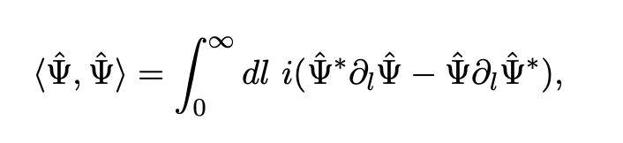
Since the WdW equation is akin to a Klein Gordon equation the natural norm:
Wheeler deWitt equation

Slide 45
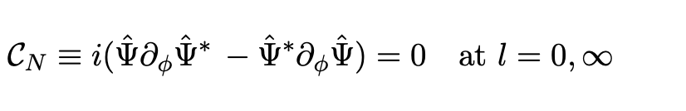
Norm Conservation:
Imposes condition
The condition at is in particular quite restrictive.

Slide 46
Norm Conservation Condition can be met by imposing suitable boundary conditions at .
(Analysis is best caried out in another basis, called the ``Rindler Basis”)

Slide 47
Bottom line:
Boundary condition cuts down the number of states by half.
Number of states which remain are still infinite.

Slide 48
It is convenient to expand the wave functions in the ``Rindler Basis”
Defining :
Solutions:
No leakage of probability:

Slide 49
``Norm”
= 2
Not positive definite.

Slide 50
Running time back, the expanding universe goes through the singularity and emerges in the far past as a contracting one

Slide 51
Range of Dilaton
In dimensionally reduced case there is a minimum value for
So far we have not considered what the range of is in the 2 dim quantum theory.

Slide 52
Making vanish at leaves no non-trivial solutions.
Wave function can be analytically continued at

Slide 53
Now the wave function have non-zero components in all four regions

Slide 54
Note that is a ``highly” quantum region
Corresponding to
The fact that the wave function can be extending smoothly across
is a non-trivial result in the quantum theory.

Slide 55
Other norms can also be defined.
Using the idea of group invariants.
(can be adapted to the discussion here as well).
One can also use a different clock to define physical time.
For example the extrinsic curvature of a hypersurface,
J. Held and H. Maxfield, hep-th/2410.14824.

Slide 56
Comments on Covariant Phase Space Quantisation
Classical Solutions have two parameters, M,A
Two dimensional phase space.
Asymptotically

Slide 57
Solutions of WDW equation depend on two variables
This might seem confusing at first.
Until one realizes that one variable, the dilaton, is playing the role of time.
E.g for a particle
Wave function

Slide 58
Asymptotic form of the wave function
(Analogous to )

Slide 59
Path Integral Understanding of other states
There is a limited understanding based on the path integral for some of the other states.
Basic idea: Deform the JT theory, so that the corrections become unimportant when
HH state in the deformed theory gives rise to other states in the JT theory asymptotically.

Slide 60
Can be checked in some examples.
This is an example of mapping different states in dS to different theories.
Chakraborty, Chakravarty, Godet, Paul, Raju, JHEP 12 (2023) 120, JHEP 01 (2024) 132

Slide 61
Asymptotic behaviour of HH state

Slide 62
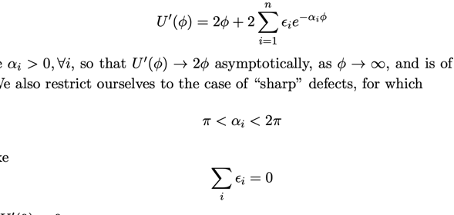
E.g.:
The Path Integral can be done exactly.
Witten, Proc. Royal Soc. A 476 (2020) 20200582.
L. Eberhardt and G. J. Turiaci, arXiv:2304.14948 (2023)
HH State
Correction

Slide 63
More generally one can consider deforming the theory by saying adding additional polynomial terms in the dilaton potential and doing the integral
by taking derivatives with respect to the coupling constants.
This brings down integrated operators in the path integral.

Slide 65
An interesting open question is whether this gives rise to all the states?
Probably not.
Maybe all states where the coefficient function asymptotically grows like that for the HH state of the JT theory

Slide 66
Extensions of JT Theory
This idea of deforming the JT theory can be explored in canonical quantisation as well.
And in fact taken quite far.

Slide 67
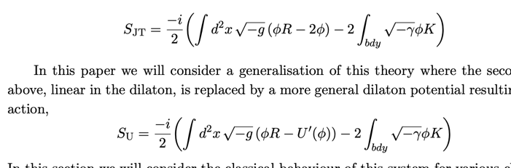
Extensions of the JT Model

Slide 68
Some Classical Solutions (locally )

Slide 69
Useful to think of the solutions in terms of a particle’s dynamics
PE
Energy

Slide 70
Big Bang/Big Crunch

Slide 71
Slow Roll Inflation

Slide 72
Singularity

Slide 73
Singularity

Slide 74
Interestingly, the canonical quantisation can be carried out for a large class of potentials , by extending the procedure followed for JT theory.
(For branches which allow for a foliation along constant slices.)

Slide 75
What about the ordering ambiguities in the Wheeler DeWitt equation?
We take the following form

Slide 76
Evidence
Ordering ambiguity arises from this term which is independent of U

Slide 77
Additional Evidence:
Path integral can be done exactly with addition of exponential corrections to potential.
The form we take leads to a WdW equation that is satisfied by the HH wave function in all these cases (sharp defects and blunt defects)

Slide 78
Solutions:
Expanding branch
Contracting Branch
Can construct a Hilbert space on constant slice. Etc.

Slide 79
States in the deformed theory can be also interpreted as states in JT theory, asymptotically.
Away from asymptotic limit the behaviour can be different.
A large class of two dimensional cosmologies which can be canonically quantized are obtained in this way.

Slide 80
Slow Roll case
For sufficiently large we take a Gaussian wave packet. Then subsequent evolution keeps it of this form, so that the Classical approximation continues to be good and we get a slowly ``relaxing” deSitter cosmology

Slide 81
Singularity
Length as

Slide 82
Making vanish at leaves no non-trivial solutions.
Wave function can be analytically continued at

Slide 83
Comments on Holography
Now let us return to JT theory

Slide 84
Holography
Boundary Hologram
Boundary Hologram
Forward/Past Regions of Big Bang/Big Crunch branch

Slide 85
Hartle Hawking State, in the expanding branch, can be expressed as a Trace
Matrix
In the Double Scaled Matrix Model, studied by Saad, Shenker, Stanford
(In asymptotic region )

Slide 86
Other States in The Hologram
Other states can be expressed as a Generalized Trace in the Matrix Model.
Expanding Branch, asymptotically
Different functions correspond to different states.

Slide 87
Similarly for the contracting branch.
Trace in the Double Scaled Matrix Theory

Slide 88
One-to-one map between solutions in bulk, in expanding branch, and states in the Matrix Theory.
Leads to a norm and Hilbert space for the bulk states, namely the norm and Hilbert space in the Matrix theory.

Slide 89
Matrix Model density of states
Manifestly positive definite.
(Hilbert Space is different from what we got by canonical quantisation on constant dilaton slices.
States which were thrown out due to norm conservation are included here.)

Slide 90
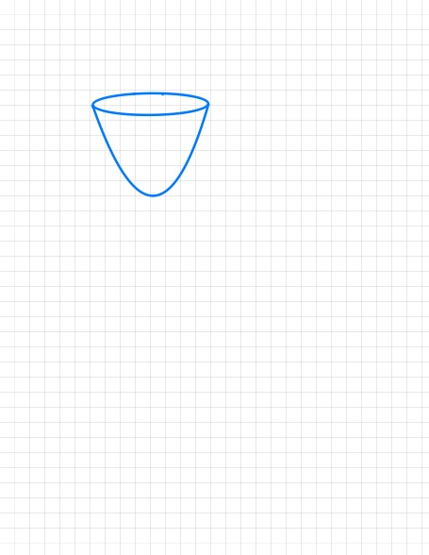
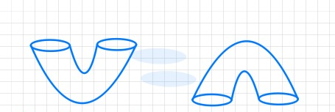
Matrix Theory computes Topology changing processes for the Hartle Hawking state.
These allow a single of multiple universes to be ``born” from nothing.
Nothing to One
One to Nothing
Nothing to Two
Two to Nothing
Matrix Theory results agree with the Path Integral (Maldacena, Turiaci, Yang)

Slide 91
To understand the holographic correspondence better:
Additional checks are needed, beyond single universe sector.
Better Path Integral understanding for general states will help.

Slide 92
Norm of the HH state:
The HH wave function is given by
Diverges at the turning point.
The Klein Gordon norm also diverges.

Slide 93
Matrix Theory Norm
In this norm for the HH state
This is badly divergent.

Slide 94
Path Integral Norm
Computed by carrying out the sphere partition function.
This too is divergent

Slide 95
Finite Rank and deSitter Entropy
JT theory is dual to the double scaled limit of Matrix theory, with rank
Now suppose JT theory can be modified so that the bulk theory is dual to a matrix theory at large but finite rank.
(Or dual to SYK model with finite but large number of flavours N)

Slide 96
Finite Rank and deSitter Entropy
If after the modification the identification between bulk states and in the matrix theory continues to be valid
Number of states in Matrix Theory L
Number of states in dS
Finite
(Similar comments would apply to SYK at large but finite N)

Slide 97
Finite Rank and deSitter Entropy
Factor of order unity
in JT –coefficient of
the topological term-
Corresponds to higher dim entropy.
L=Number of states in Matrix Theory
Suggesting that entropy of deSitter space can be accounted for in a hologram at

Slide 98
E.g., For SYK model
Order unity
``Ground state” entropy

Slide 99
Finite Rank and deSitter Entropy
Topology counting Parameter in Matrix Theory
=
Number of States
At finite
Topology counting parameter
in JT/Bulk
=
Higher dimensional Entropy
Suggesting that entropy of deSitter space can be accounted for by a hologram at

Slide 100
The comments on Holography are very preliminary
In the finite rank case corrections would set in when
These will need to be understood as corrections in JT theory.

Slide 101
Conclusions
Canonical quantisation revealed an infinite number of physical states.
Suggests that states other than the Hartle Hawking state should be given further attention in Cosmology.
Better Path Integral understanding of these states would be helpful

Slide 102
Conclusions
Holographic correspondence needs to be better understood.
Including the possibility of accounting for deSitter entropy.
Need to go beyond 2 dimensions

Slide 103
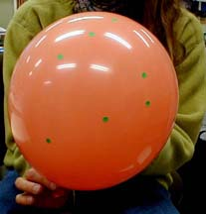

Several Directions For the Future
Perhaps Time Will Tell!
ありがとう ございます
ధన్యవాదాలు
ଧନ୍ୟବାଦ
ধন্যবাদ
धन्यवाद
Thank You
780 living languages
Khublai

Slide 104
Holography
Hartle Hawking State (Expanding Branch)
Density of states of Double Scaled Matrix Model with Energy E=M.

Slide 105
Perhaps not surprising since the HH state wave function can be obtained by analytic continuation from

Slide 106
What about other states?
(Similarly for contracting branch)

Slide 107
Finite Rank and deSitter Entropy
Canonically quantising JT theory in the single universe sector suppresses topology change,
Topology counting parameter
in JT, which corresponds
to higher dim entropy.

Slide 108
Finite Rank and deSitter Entropy
In JT theory there is a topology counting Parameter , which corresponds to higher dimensional entropy.
Working in the Single Universe sector corresponds to taking
Perhaps not surprisingly then we found an infinite number of states.

Slide 109
有り難うございます。
Thank you!
धन्यवाद
ধন্যবাদ
ధన్యవాదాలు
ਧੰਨਵਾਦ
Npeze
நன்றி
Thank You
Khublai
ধন্যবাদ
Kadinche
આભાર

Slide 110
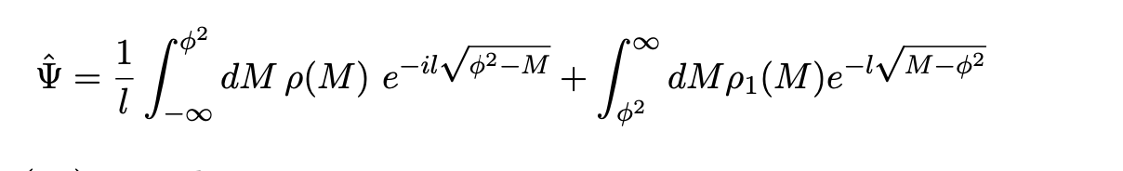
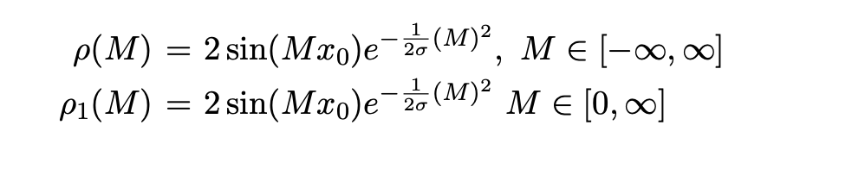
Example: Gaussian Wave packet
Two parameters,
Take

Slide 111
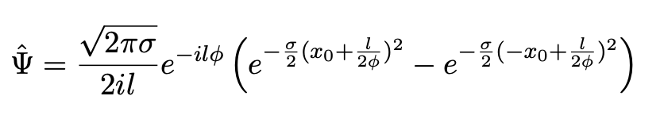
Gaussian Wave Packet
For sufficiently late time,
Wave function takes form

Slide 112
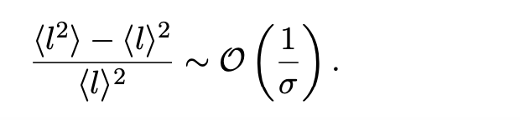
If we have a ``sharp peak”
Purely expanding universe.
(momentum has the correct sign).
Similarly

Slide 113
Agrees with the classical solutions (at late time) we had found earlier.
(More general wave packets can also be constructed which depend on two parameters, corresponding to , in the classical solutions).

Slide 114
Interestingly, Hartle Hawking state is not well behaved.
Norm diverges.
Diverges at

Slide 115
Note:
It might be premature to drop states which are not normalisable.
Once matter is added some observables could be well defined.
e.g., correlations of the matter fields at fixed values of l,
Matter

Slide 116
Concluding Comments And Summary
The number of allowed physical states is infinite. Even after imposing various conditions: a finite norm, finite expectation values, good classical limit.
The Hartle Hawking state (and related Vilenkin state) have received a lot of attention, but there are many other states, in some ways better behaved.

Slide 117
Concluding Comments And Summary
Understanding these states from the path integral perspective will be worthwhile.
Could potentially be of interest for the real world.
(U. Moitra, S. Sake, S.P.T JHEP 06 (2022) 138)

Slide 118
Concluding Comments And Summary:
The coefficient function (and ) give the amplitude for various values of the momentum P.
But unlike the AdS case can be complex.
This suggests the hologram of dS has some key new features.

Slide 119
Concluding Comments And Summary:
In some cases a conserved norm only arises at late times,
(determined by )
For earlier times, one does not have a conserved norm and conventional (Hamiltonian) quantum mechanics

Slide 120
Occurs for solutions where we sum over Orbifolds of Black Hole Geometries. Suggests some leakage of probability for near the orbifold region.

Slide 121
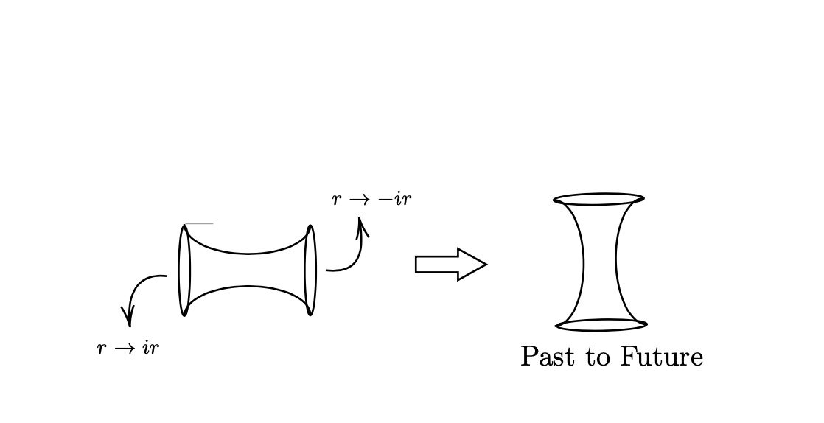
Amplitude for tunneling from a contracting orbifold geometry in far past to far future is non-vanishing
(Moitra, Sake, SPT)

Slide 122
Resulting matter power spectrum has deviations, from the Bunch Davies vacuum, for correlations at large wave lengths.

Slide 123
In other cases the norm is not conserved even at late times, to a small extent.
Suggests a breakdown of conventional quantum mechanics even at late times.

Slide 124
Concluding Remarks And Summary
In yet other cases the behaviour is perfectly well defined (with conserved norm etc) all the way till and even beyond for
Behaviour in the presence of matter needs to be studied (in semiclassical approximation matter back reaction is finite).
Quantisation with matter may not be too hard.
(for geometries of non-orbifold type)

Slide 125
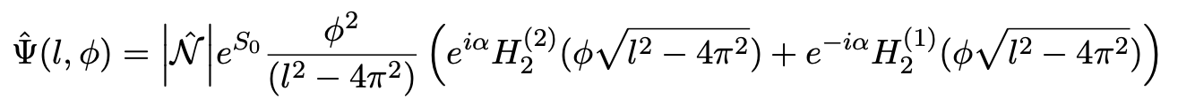
Interestingly, Hartle Hawking state is not well behaved.
Norm diverges.
Contracting Branch
Expanding Branch

Slide 126
Path Integral gives (Moitra, Sake, SPT):
Near turning point gives rise to divergence
(unless )
(See also: G. Fanaras and A. Vilenkin)

Slide 127
Summary:
We canonically quantized JT gravity in dS space and found all the gauge invariant states. (Henneaux)
There are an infinite number of such states
With dilaton as the physical clock, we constructed a space of physical states, defined their norm and expectation values for operators on these states.

Slide 128
Summary
Imposing various conditions, like a finite norm, finite expectation values, good classical limit, cut down the number of states, but still left many allowed ones.
The Hartle Hawking state (and related Vilenkin state) have received a lot of attention, but there are many other states, in some ways much better behaved.

Slide 129
Some, but not all, states have a norm which is conserved and finite.
Some, but not all, have a good classical limit.
Even after imposing all these requirements we found there were an infinite number of solutions.
The Hartle Hawking (and related Vilenkin) states have received a lot of attention. But there are many others, in some ways even better defined,

Slide 130
Going forward:
Understand the extra states we have found using path integral method. What replaces the no-boundary proposal?
Add matter
Consider inflation.

Slide 131
Additional states could have interesting departures in CMB spectrum.
One example (shown in Moitra, Sake SPT), using path integral methods, gives spectrum with deviations at longer wave lengths (small l)

Slide 132
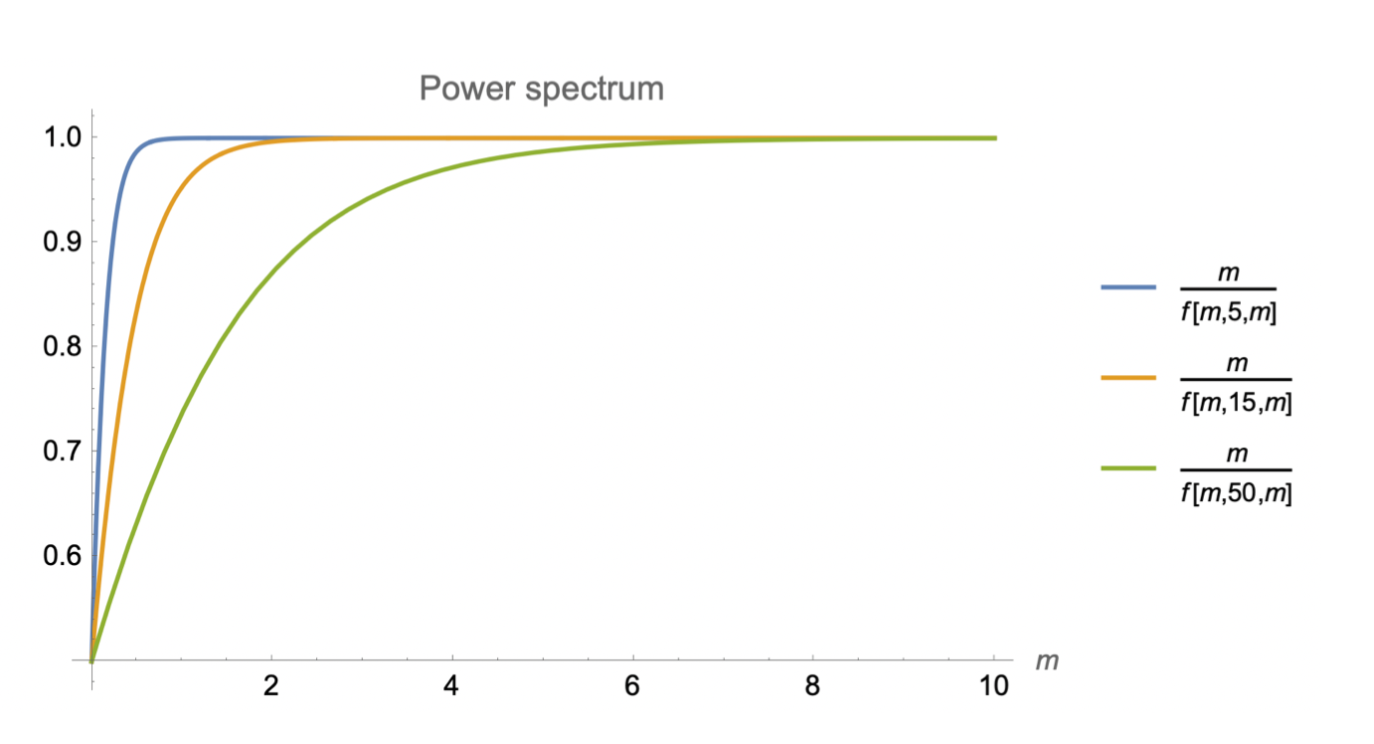

Slide 133
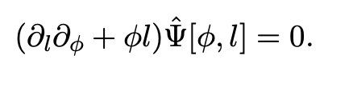
Note that the solutions we have obtained turn out to be closely related to those of a Klein Gordon equation for a massive field:
(Equation is First order in )

Slide 134
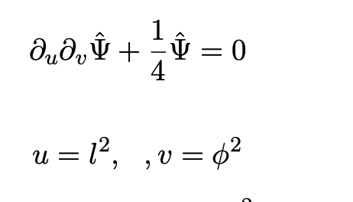
Klein Gordon Equation:
Klein Gordon equation for field of mass ¼.
Hyperbolic equation. Infinite number of solutions

Slide 135
, are null directions.

Slide 136
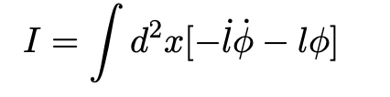
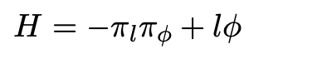
Minisuperspace approximation
Independent of x and only dependent on t.

Slide 137
Minisuperspace approximation
Independent of x and only dependent on t.

Slide 138
Hamiltonian constraint (also referred to as Wheeler Dewitt constraint) leads to :
(Note, , not, )
(Illiesiu, Kruthoff, Turiaci, Verlinde; Maldacena)

Slide 139
Similar to what we got above.
Not identical due to the ordering ambiguities.

Slide 140
Covariant Phase Space:
The phase space corresponding to the classical solutions
Is two dimensional.
The symplectic form in phase space
can be worked out. (Crnkovic, Witten)

Slide 141
Setting,
We get:
An eigenstate of M, with eigenvalue, -M, is then

Slide 142
In the asymptotic dS limit
They come close.
Away from this limit it would be nice to understand the connection between the two ways of quantisation better.

Slide 143
Using the relation (from the classical solutions) that
We find that
Which is quite different from what we got earlier.

