Slide 1
Status of FoCal Electronics activities at VECC
J. Saini, VECC, Kolkata

Slide 2
Electronics requirements for FoCal
High dynamic range for calorimetric requirement
Precision timing measurements
High speed backend elinks
Harsh radiation environment
Self triggered system
CMS HGCROC-3 ASIC is chosen to be the readout ASIC as it meets all the requirement of the ASIC

Slide 3
Present status
Delivery of ASIC to still awaited from the collaboration
FEE board design is taken from the collaboration and ordering procedure is started
  As design is yet not released to the manufacturer, still the design is open for customization.

Slide 4
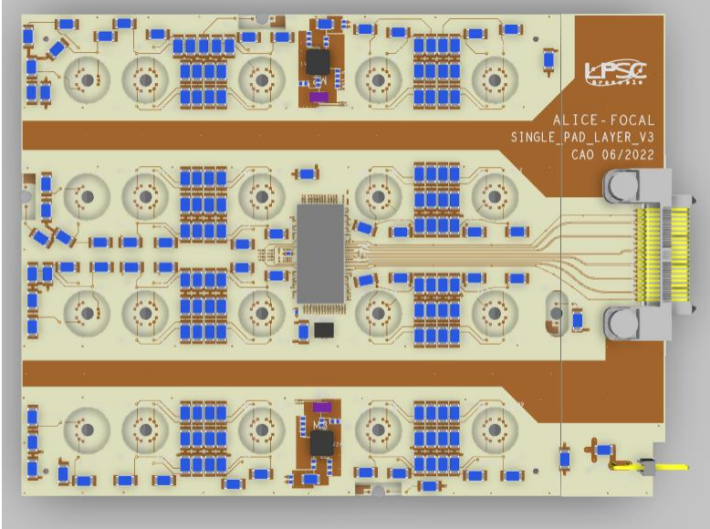
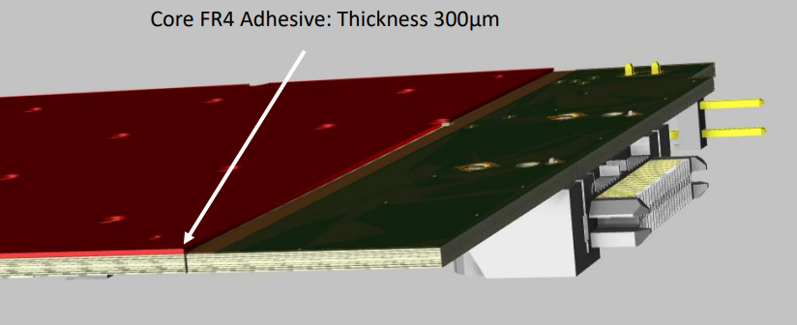
HGCROC FEE board layout for FoCal
Bottom View
Top View
Design received from FoCal collaboration

Slide 5
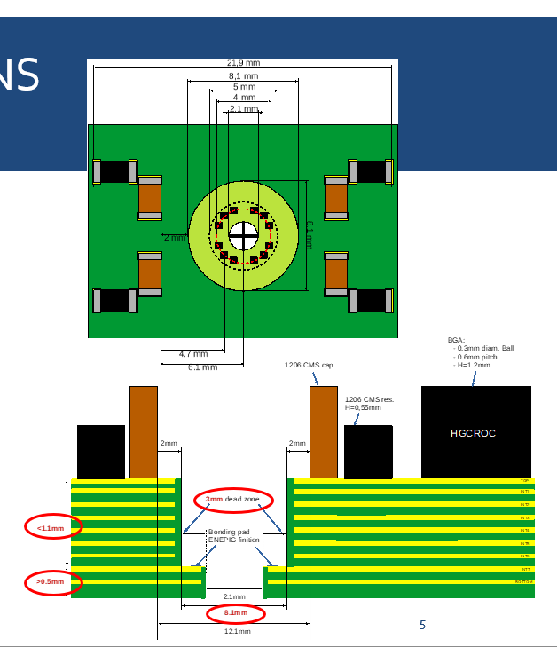
Salient Features of the board:
Total Thickness with CORE FR4 (mm): 1.6 mm
Total Thickness without CORE FR4 (mm): 1.32 mm
Minimum Vias Laser: Regular Pad ( cu) 0.30 mm / hole 0.12 mm
Depth controlled drilling with ENIG finish
Design received from FoCal collaboration

Slide 6
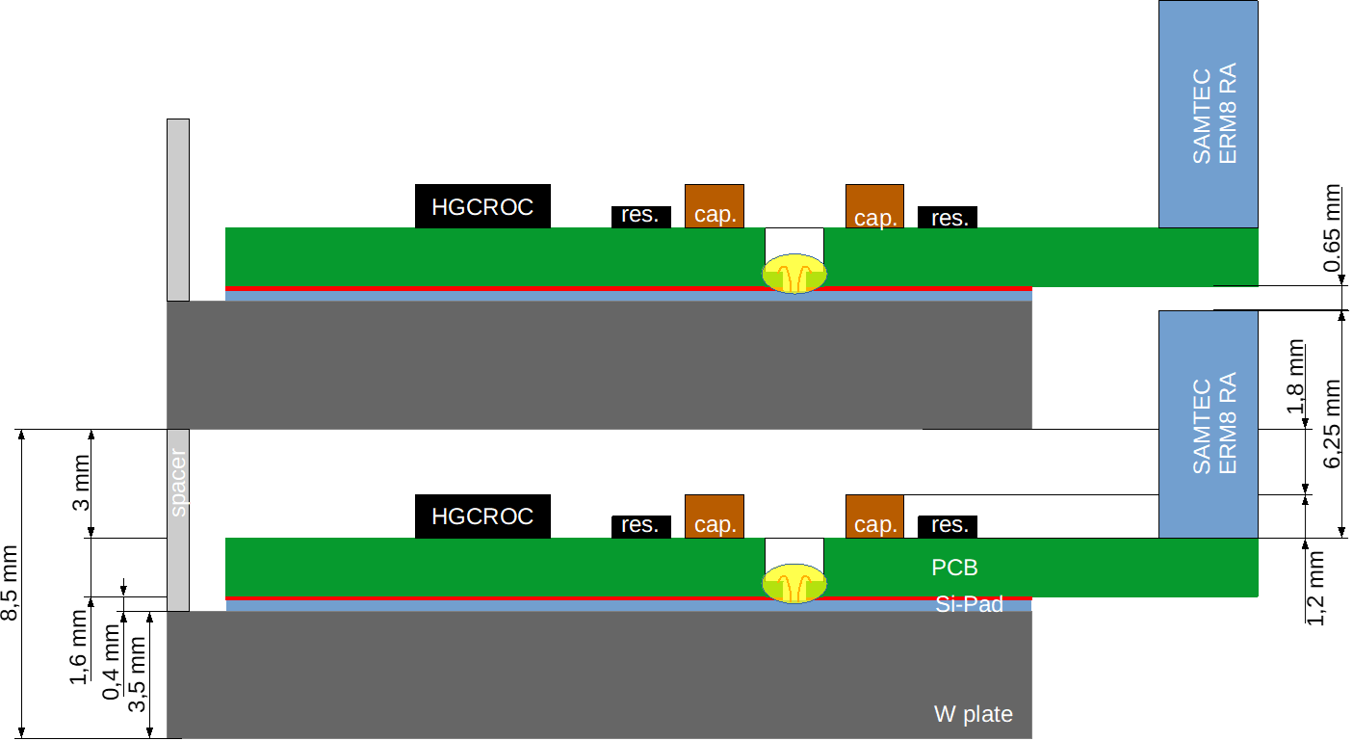
Proposed layer stack-up of the silicon Tungsten layer in FoCal
Design received from FoCal collaboration

Slide 7
Digital backend test bench planned at VECC
DAQ workstation
KCU FPGA based backen board
Electronics and Detector assembly
Interface board

Slide 8
Status of backend component ordering
Interface board is already ordered
KCU board is already purchased at VECC and is available in VECC.

Slide 9
Thanks

